Slide 1


Events in Paris
JOMAIN Mathieu
JUN, 10th | PARIS
DAFT MAY2022

Slide 2


Business case
Domain
Entertainment – public events in Paris
Find out what you can do in Paris during your free time
Problem
Clean, organize and systemize data about events
Insights we want to get:
What kind of events are the most orgnanised?
Where?
At what cost?

Slide 3
Plan
Business case investigation
Acquire data
Data exploration
Clean the data
Data visualization using plots & crosstabs
Choosing type of database and create ERD
Create database and table
Import data in SQL
Create queries

Slide 4
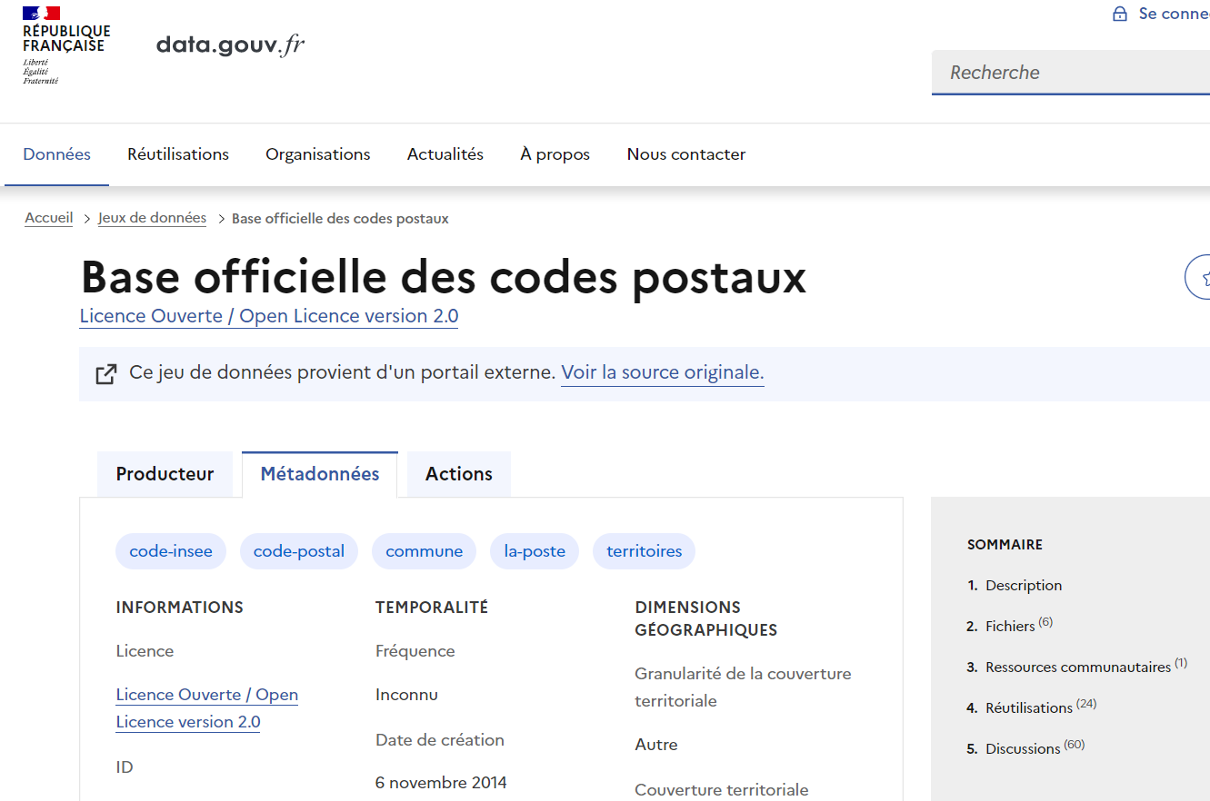
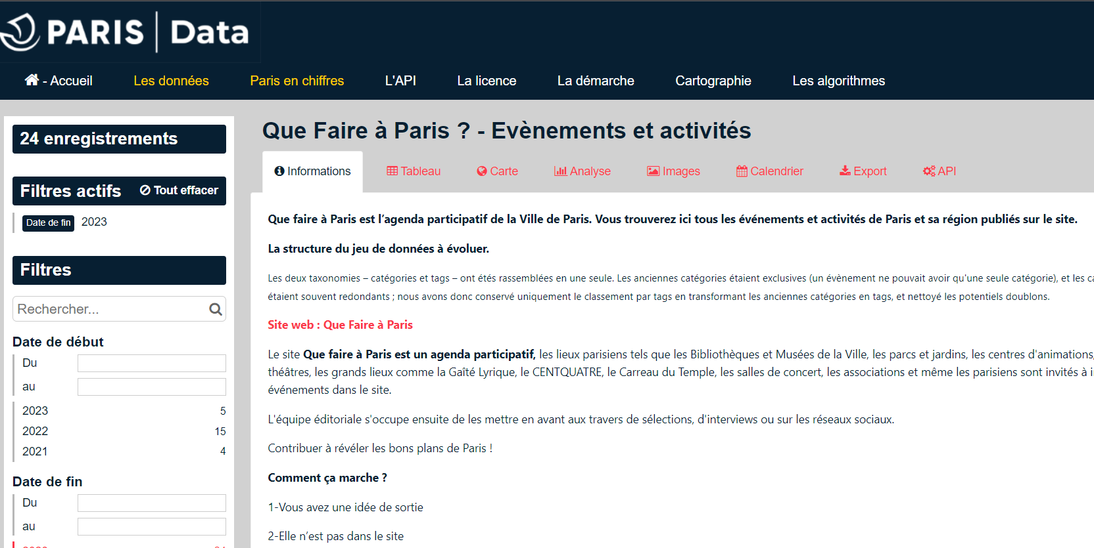
About data
Data source: Open Data Paris + Data Gouv
List of events in Paris
Column to define the kind of events, location, informations about organisator…
Initial size: 1752 x 39

Slide 5
About data
Paris events metadata
Column name | Explanation
ID | Basically an unique integer number for each event
URL | Website link where we can find information about the event
Titre / chapeau | Name and some information about the event and what it is about
Date debut / fin | Starting and ending date of the event
Occurences | At first list of dates of the event, then turned into the number of occurences
Mots cles | Keyword to indicate the nature / related field of the event
Nom / adresse du lieu | Name of the place and adress
Postal code / ville | Postal code and city of the adress
Access PMR / mal voyant / mal entendant | If the location suits people with different disabilities needs
URL / telephone / email de contact / facebook | Website link, phone number, email address and facebook page of the organisator
Type de prix | Field to know if the event as either a paid or a free entrance

Slide 6
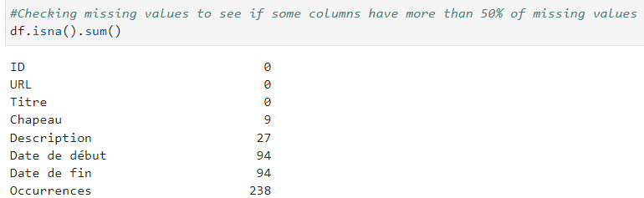
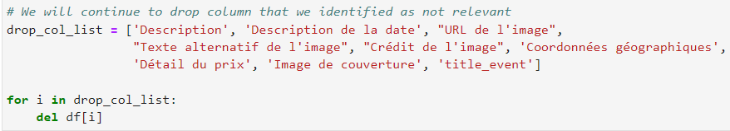
Data cleaning & data prep
Data exploration: understand the data
Dropping irrelevant columns / columns with too many missing values
Notes:
Format cleaning: case / special caracters for text columns, changing some format (date)

Slide 7
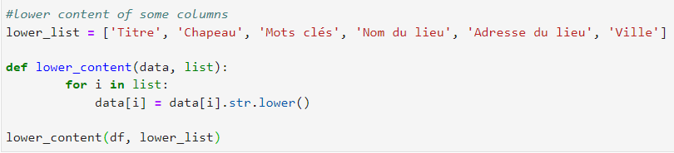
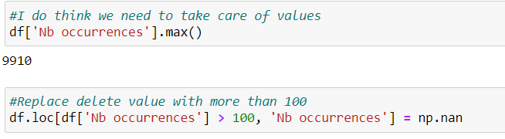
Data cleaning & data prep
Format cleaning (case, special caracters…)
Taking care of outliers
Notes:
Format cleaning: case / special caracters for text columns, changing some format (date)

Slide 8
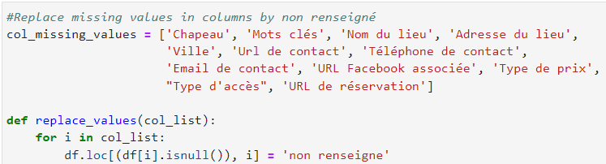
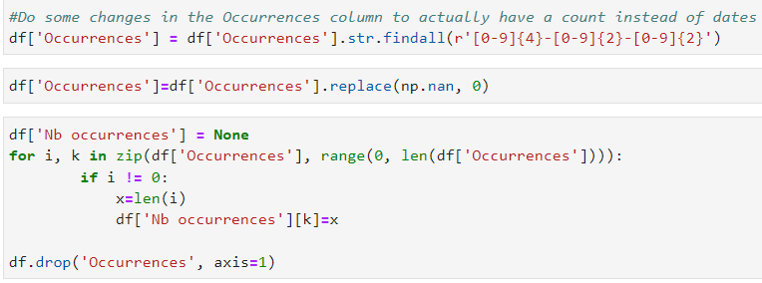
Data cleaning & data prep
Filling missing values
Cleaning columns with too many informations
Notes:
Format cleaning: case / special caracters for text columns, changing some format (date)

Slide 9
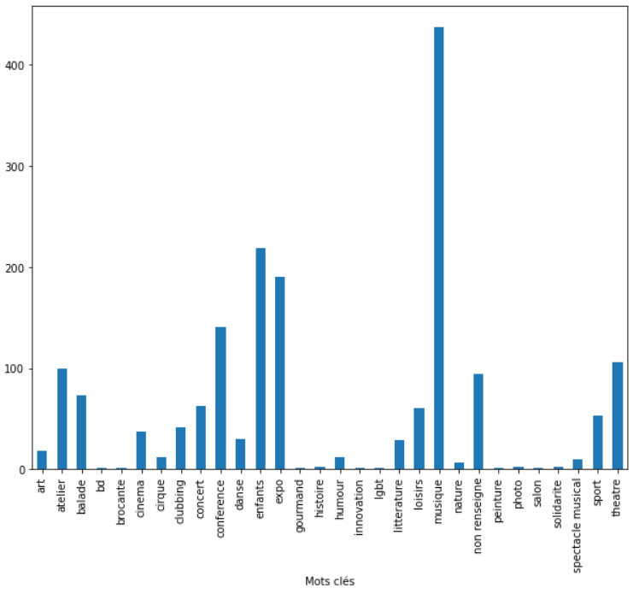
EDA
Distribution of events by keywords:
Show how much events are available in the data according to each key word
We can see that some type of events are way more numerous than others

Slide 10
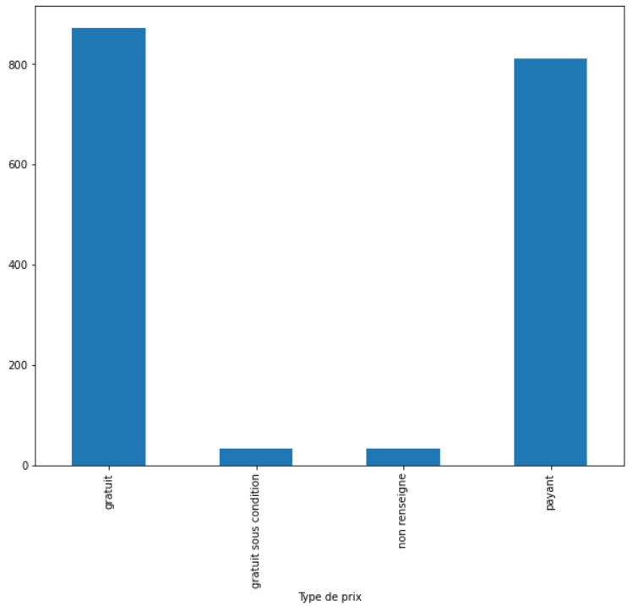
EDA
Distribution of price type:
Show the difference in number between free entrance and paid entrance events
We can see that the distribution is more or less even

Slide 11
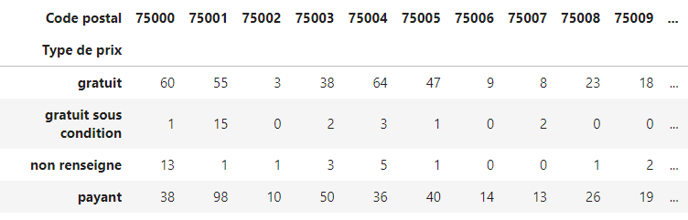
EDA
Crosstab between postal code and price type:
Show how much paid and free entrance events take place in each district of Paris

Slide 12
Choose a data base
Existing database types:
Centralized database
Distributed database
Relational database
Object-oriented database
Needs for the project:
Be able to write queries
Be able to create relationships between tables
Relational database such as SQL is the most suitable
Notes:
Centralized: stores data at a centralized database system + access from different locations + authentication process
Distributed: distributed among different database systems + database systems are connected via communication links
Relational: based on the relational data model + which stores data in the form of a table (row +column) + uses SQL for storing, manipulating
Object-oriented: uses the object-based data model approach for storing data
Why SQL: ability to store the data collected + ability to create queries and retrieve information + ability to create relations or not

Slide 13
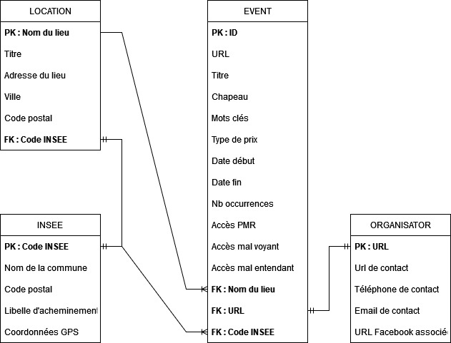
ERD
After conducting the data exploration
Finding out which elements could be intersting to show
Elaborate a first draft of the ER
Defining relationships between tables with Primary and Foreign keys
Notes:
Elaborate tables that have different types of information
Then create a way to put everything in relation

Slide 14
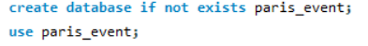
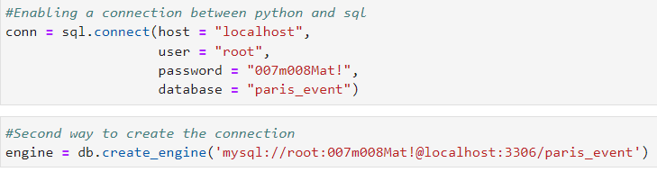
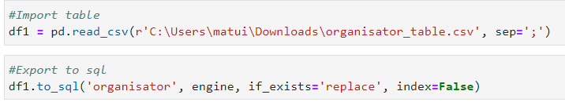
Database creation & insertion
Create database in SQL
Create tables from dataframe in python
Export data from python to SQL
Step 1:
Step 2:
Step 3:
Notes:
Talk about how to create it in SQL even if I didnt do it that way:
Import way
And coding way

Slide 15
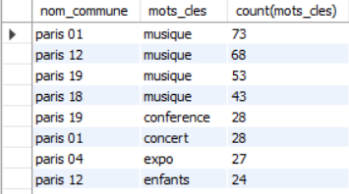
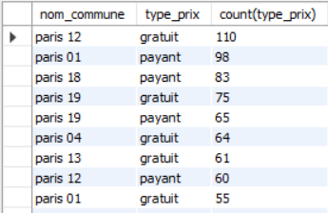
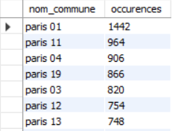
Conclusions
We’ve seen the general process to build a database from scratch
Insights:
2: Number of events by keyword in each location
3: Sum of occurrences of every unique event by location
1: Number of type of price for each location
Notes:
Process: acquire, explore, clean, analyse, clean again + create database and tables
Paris district 1 is a very nice location for entertainment

Slide 16
Events in Paris
JOMAIN Mathieu
Questions?

