Slide 1


Project 5: Streamlit
Ferdi – Edgar - Mathieu
JUN, 17th | PARIS
DAFT MAY2022

Slide 2


Plan
Dataset
Challenges
Process
Learnings & Improvments
Comparison initial – final data

Slide 3
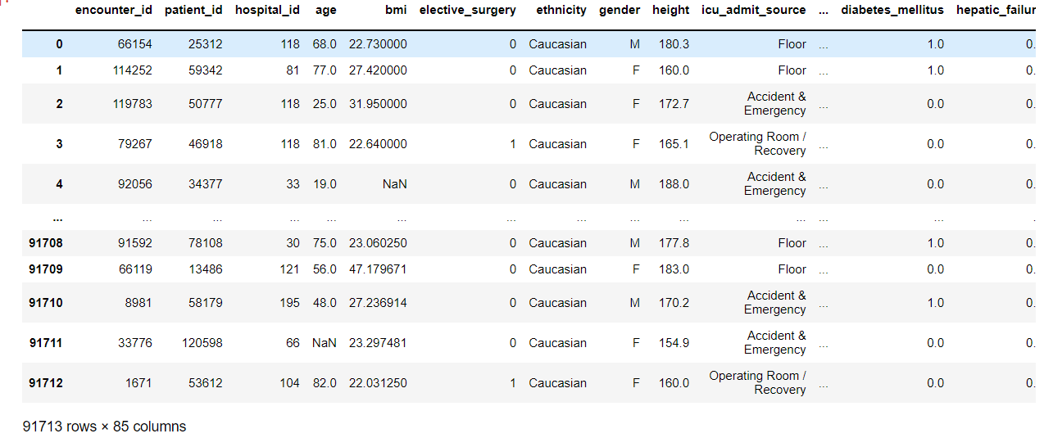
Dataset
Patient survival data
Information about distribution of population (gender, age…)
Diseases indicators
Death column

Slide 4
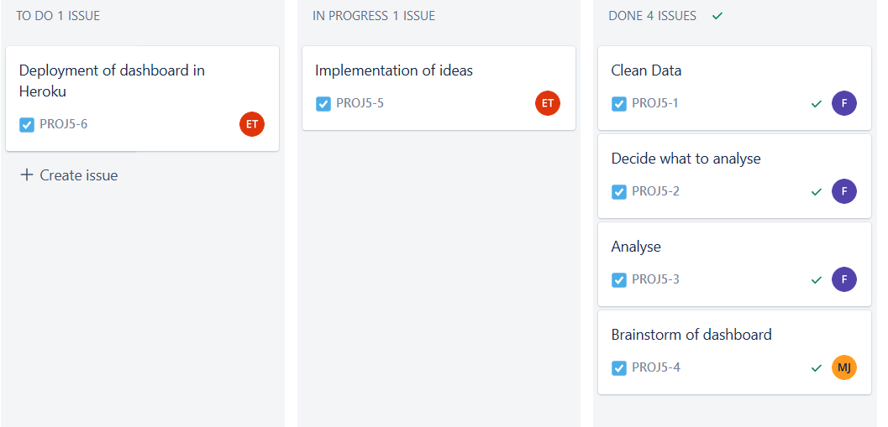
Challenges
Project planning with Kanban board
Data examination and cleaning
Creating a dashboard on streamlit

Slide 5
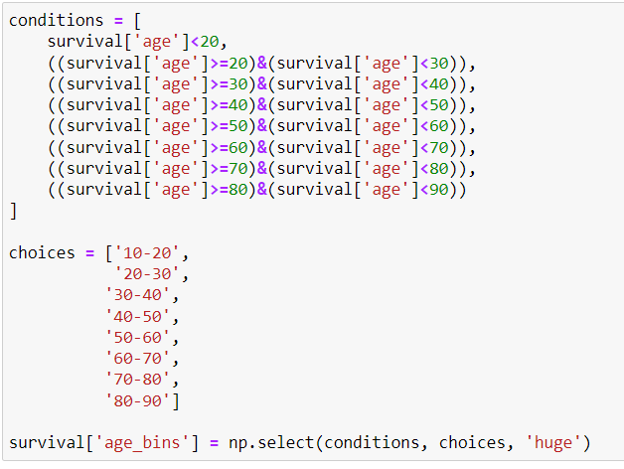
Process
Data exploration & cleaning
Finding out key elements
Making plot & crosstabs
Creation of a dashboard using streamlit
Uploading dashboard on Heroku

Slide 6
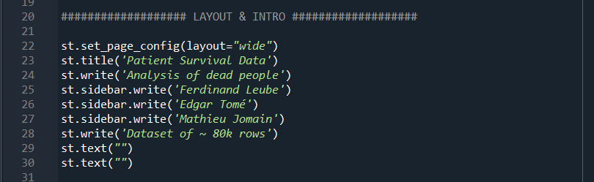
Learnings and Improvments
Getting used to project planification with Kanban boards
Understanding streamlit, widgets…
Being faster in data exploration & cleaning
Understanding pertinent information more quickly

Slide 7
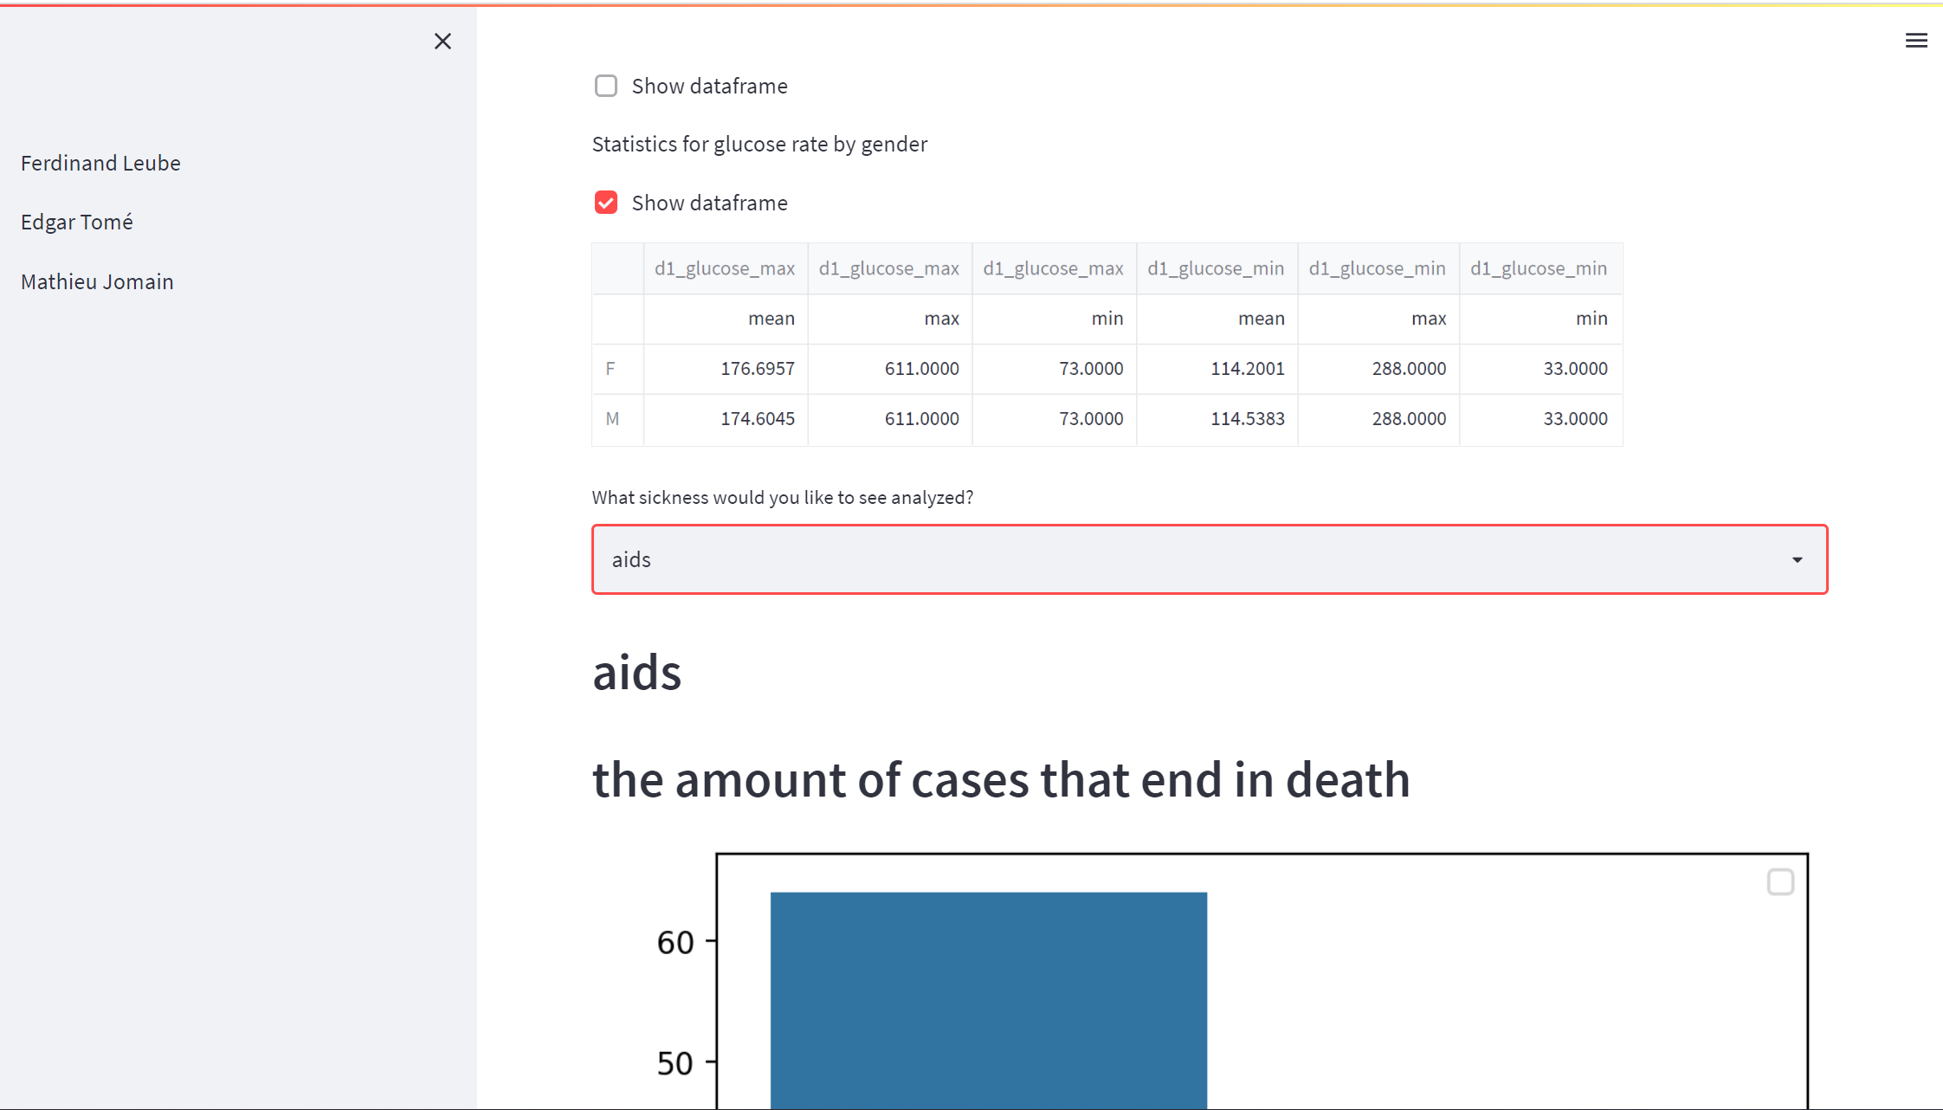
Demo

Slide 8
Project 5: Streamlit
Ferdi – Edgar - Mathieu
Questions?

