Slide 1


Project 6: Tableau Dashboard
Mathieu
JUN, 20th | PARIS
DAFT MAY2022

Slide 2


Plan
Dataset
Challenges
Process

Slide 3
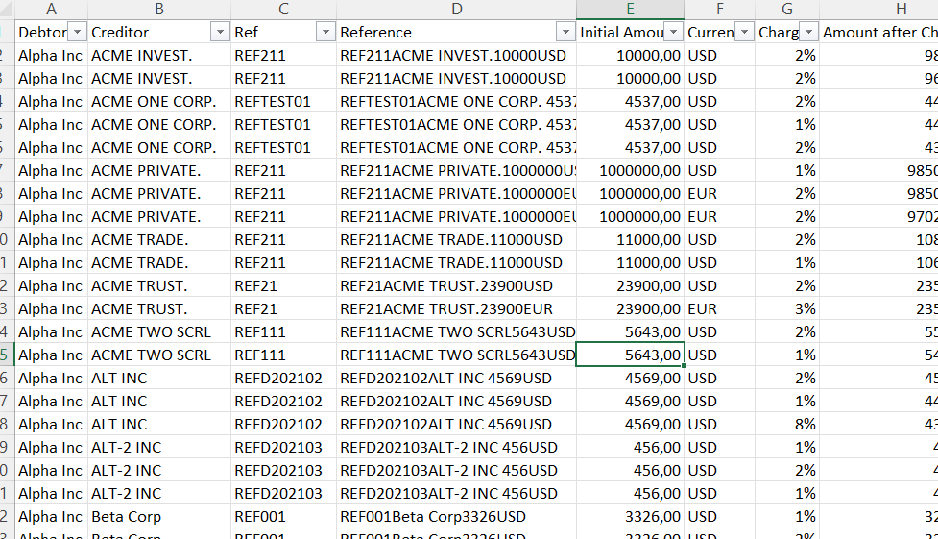
Dataset
Bank transfer data
Information about transfers (bank, amount, date…)
Status of the transfer
Need to create columns with more information

Slide 4
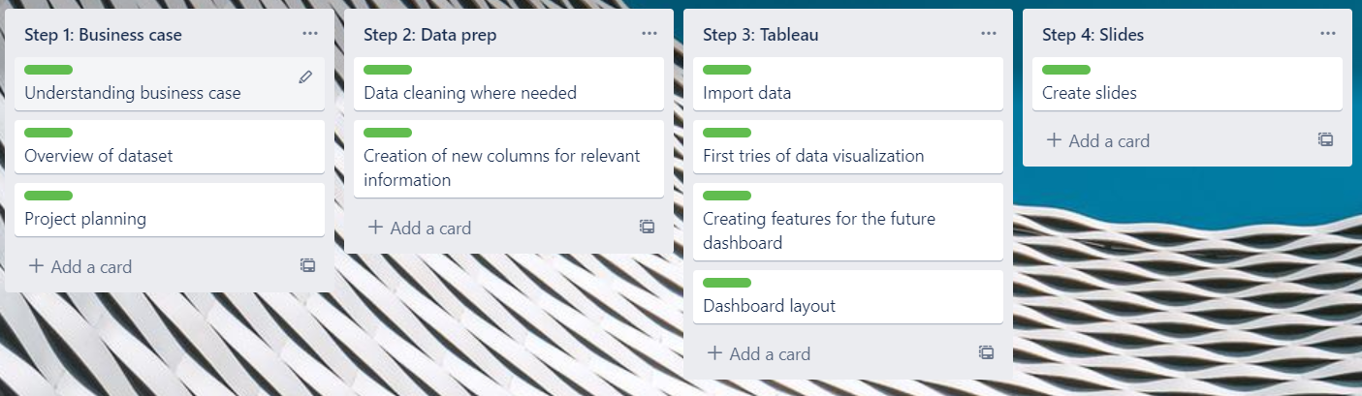
Challenges
Project planning with Kanban board
Data examination and cleaning
Creating a dashboard on tableau

Slide 5
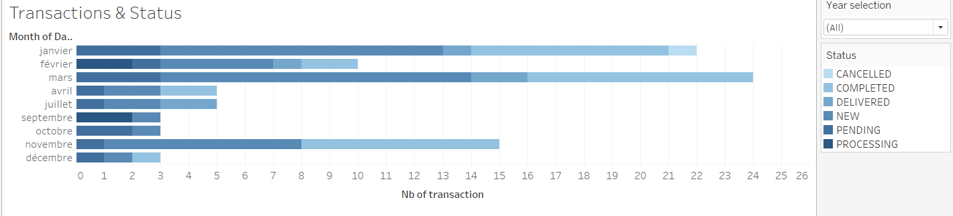
Process
Data exploration & cleaning
Adding columns such as country
Creating first visualization on tableau
Creation of a dashboard using tableau

Slide 6
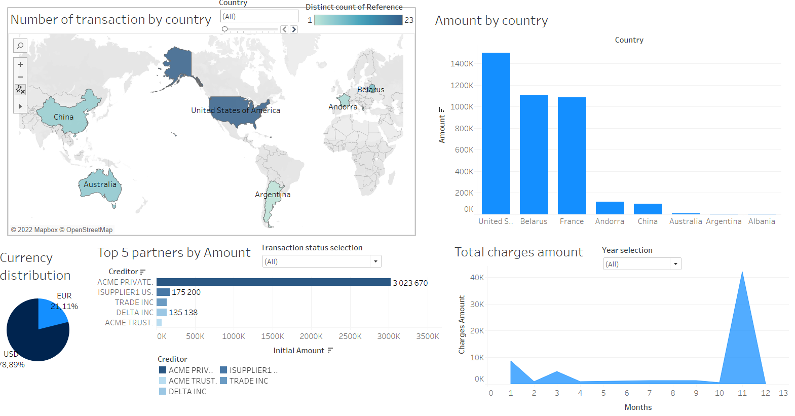
Demo

Slide 7
Project 6: Tableau Dashboard
Mathieu
Questions?

