Slide 1


Project 7: Supervised ML
Mathieu
JUL, 5th | PARIS
DAFT MAY2022

Slide 2


Plan
Business case
Challenges
Dataset
Process

Slide 3
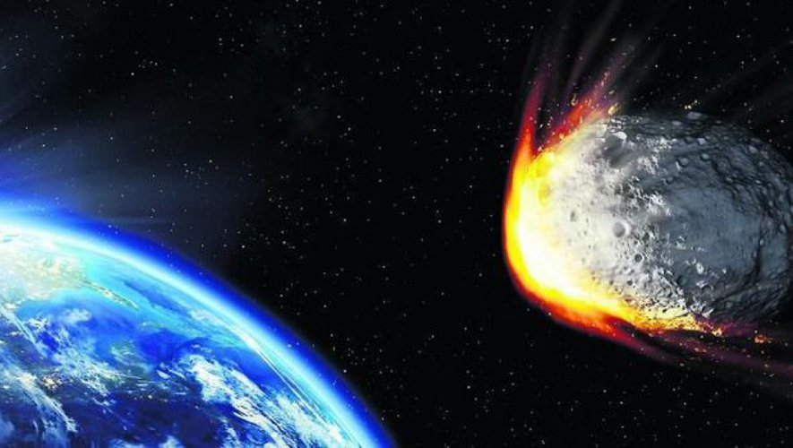
Business case
Apply ML on asteroids observations
Now if the asteroids is likely to hit Earth

Slide 4
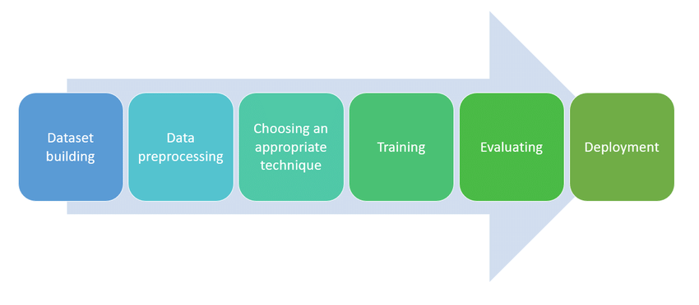
Challenges
Data examination and cleaning
Hyperparameters tuning
ML model pipeline
Defining best model

Slide 5
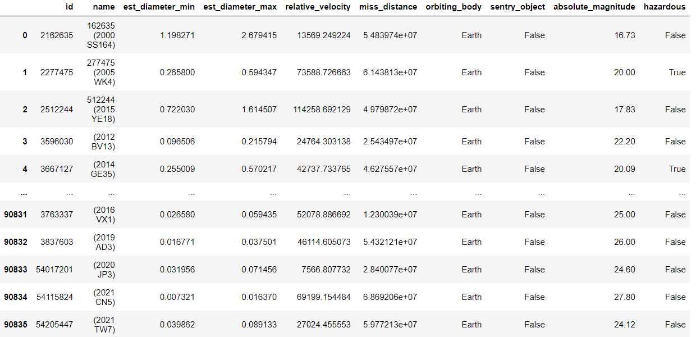
Dataset
Asteroids observations
Information about size, velocity

Slide 6
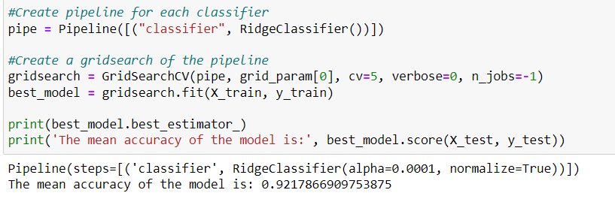
Process
Data exploration & cleaning
Sampling the dataset
Create pipeline to define hyperparameters
Create pipeline to define best model
Apply best model
Results
Pipeline for hyperparameters
Notes:
Cleaning: dropping some irrelevant columns, deleting duplicate rows on id (replace each row by mean), encoding hazardous

Slide 7
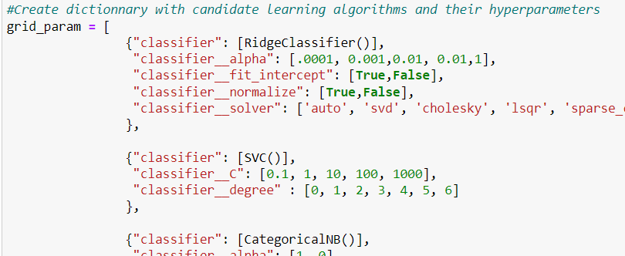
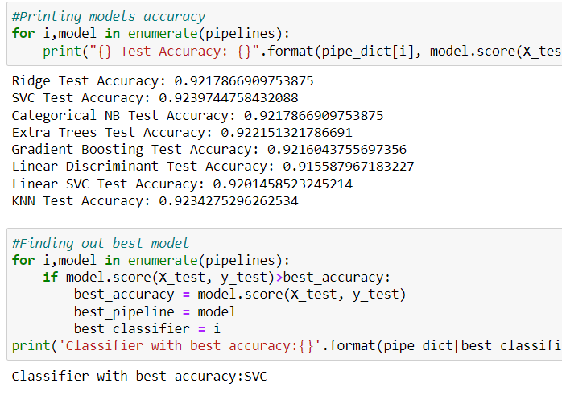
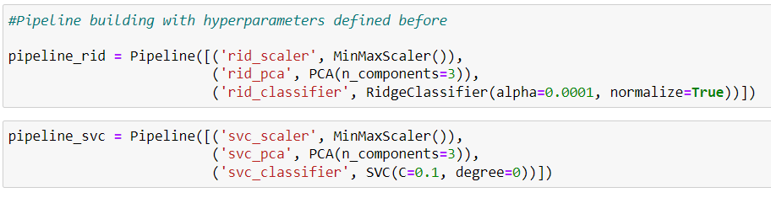
Process – In depth pipeline
Notes:
Grid param is for hyper param
Then create pipeline for model using param
Then printing score and defining best model

Slide 8
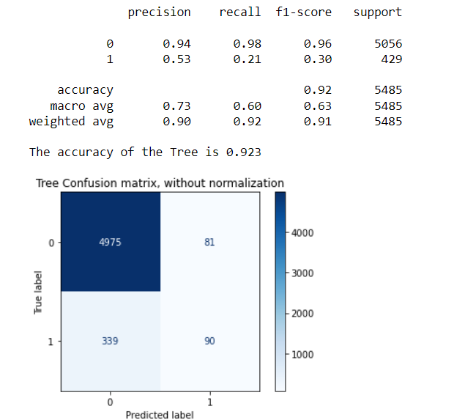
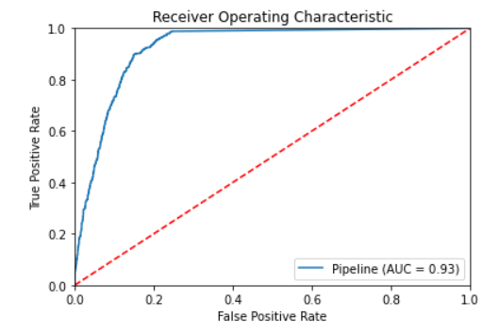
Results

Slide 9
Project 7: Supervised ML
Mathieu
Questions?

