Slide 1




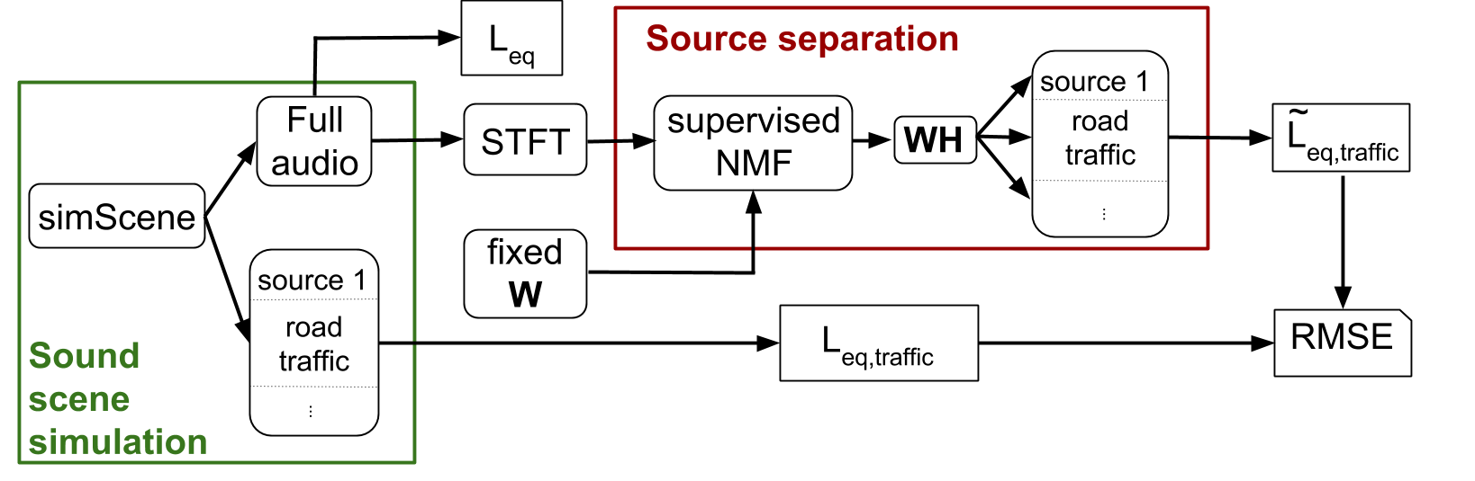
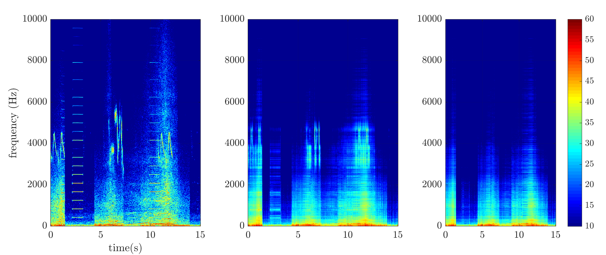
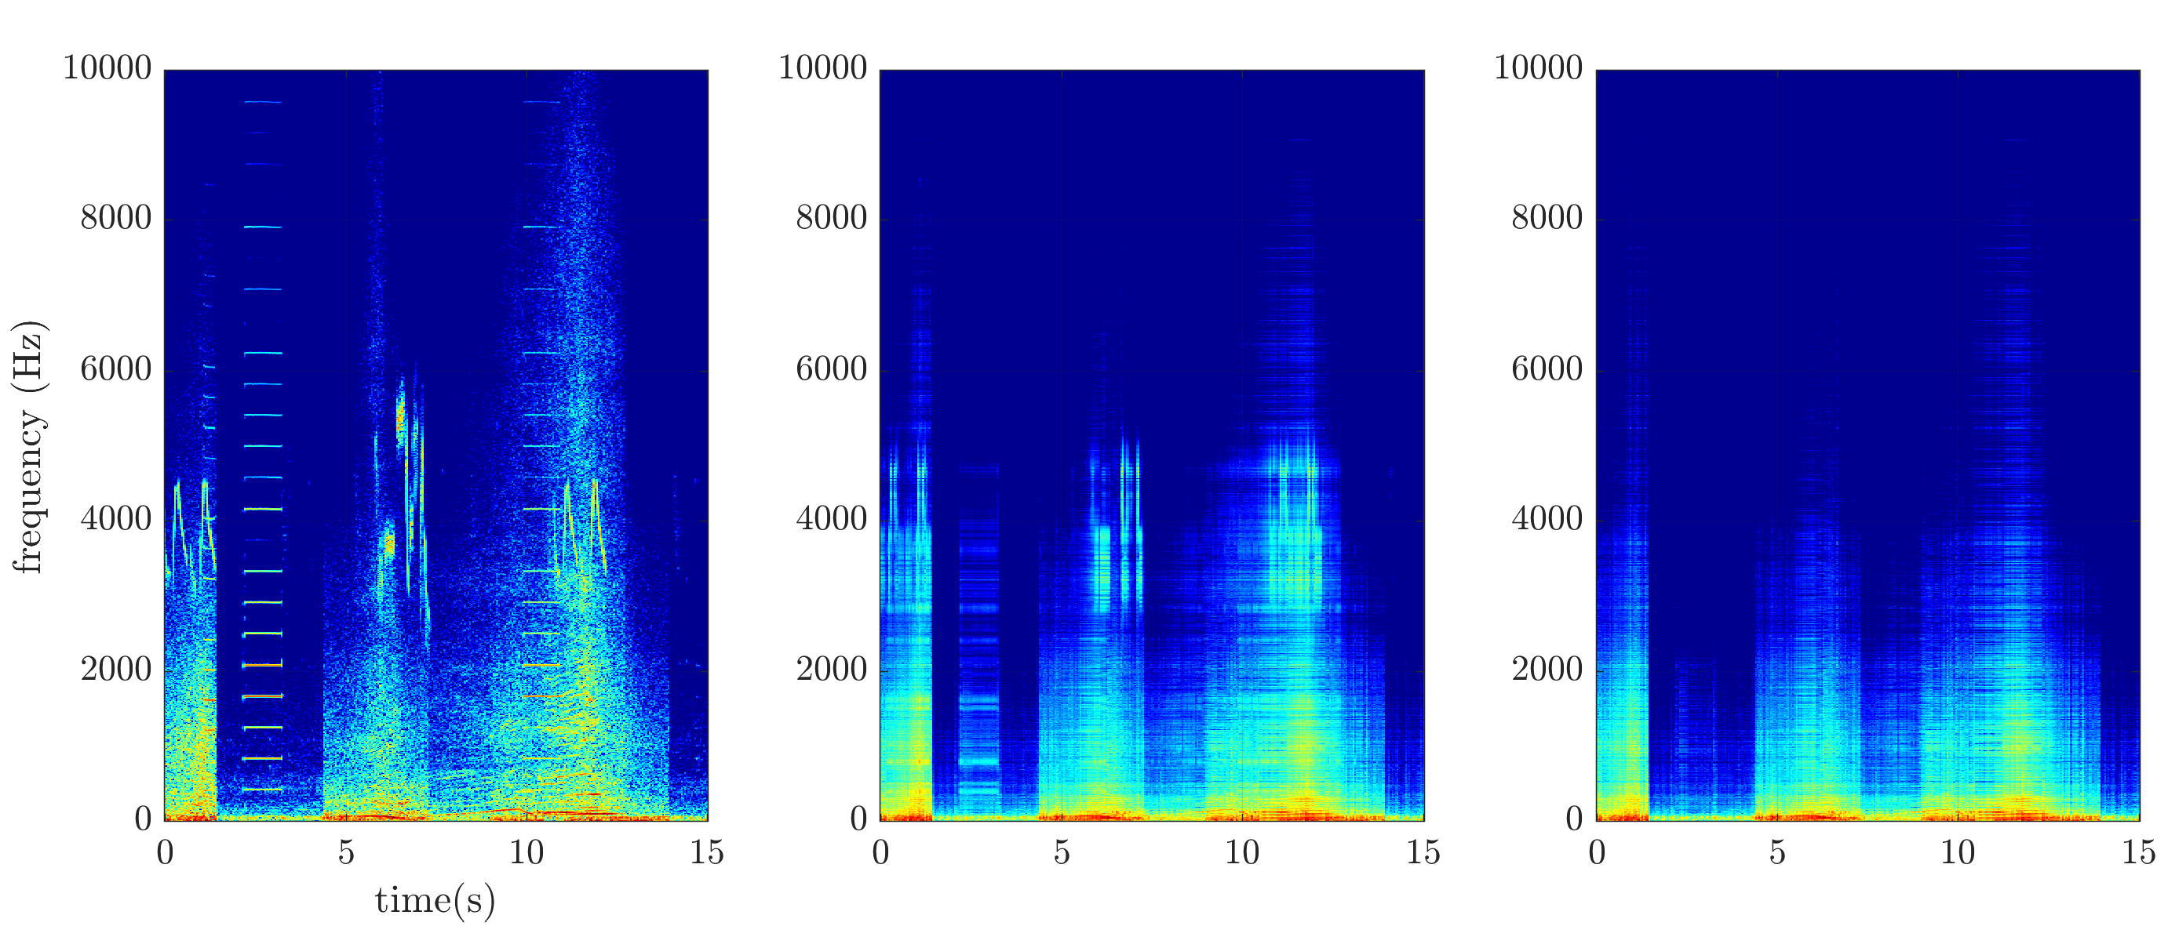
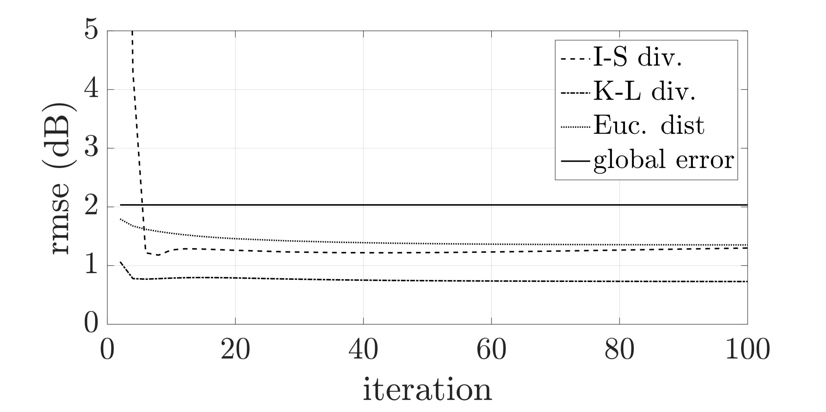
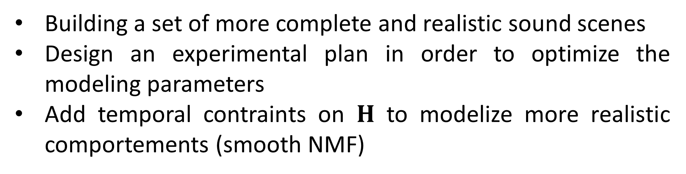

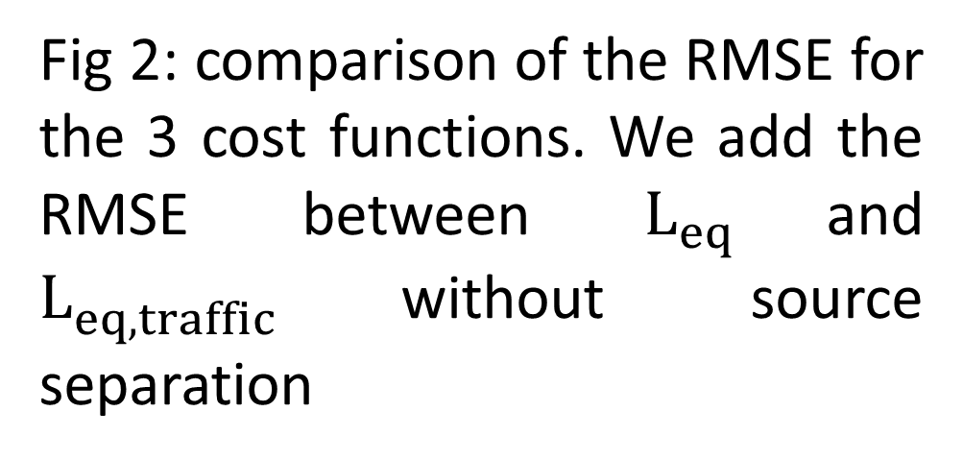
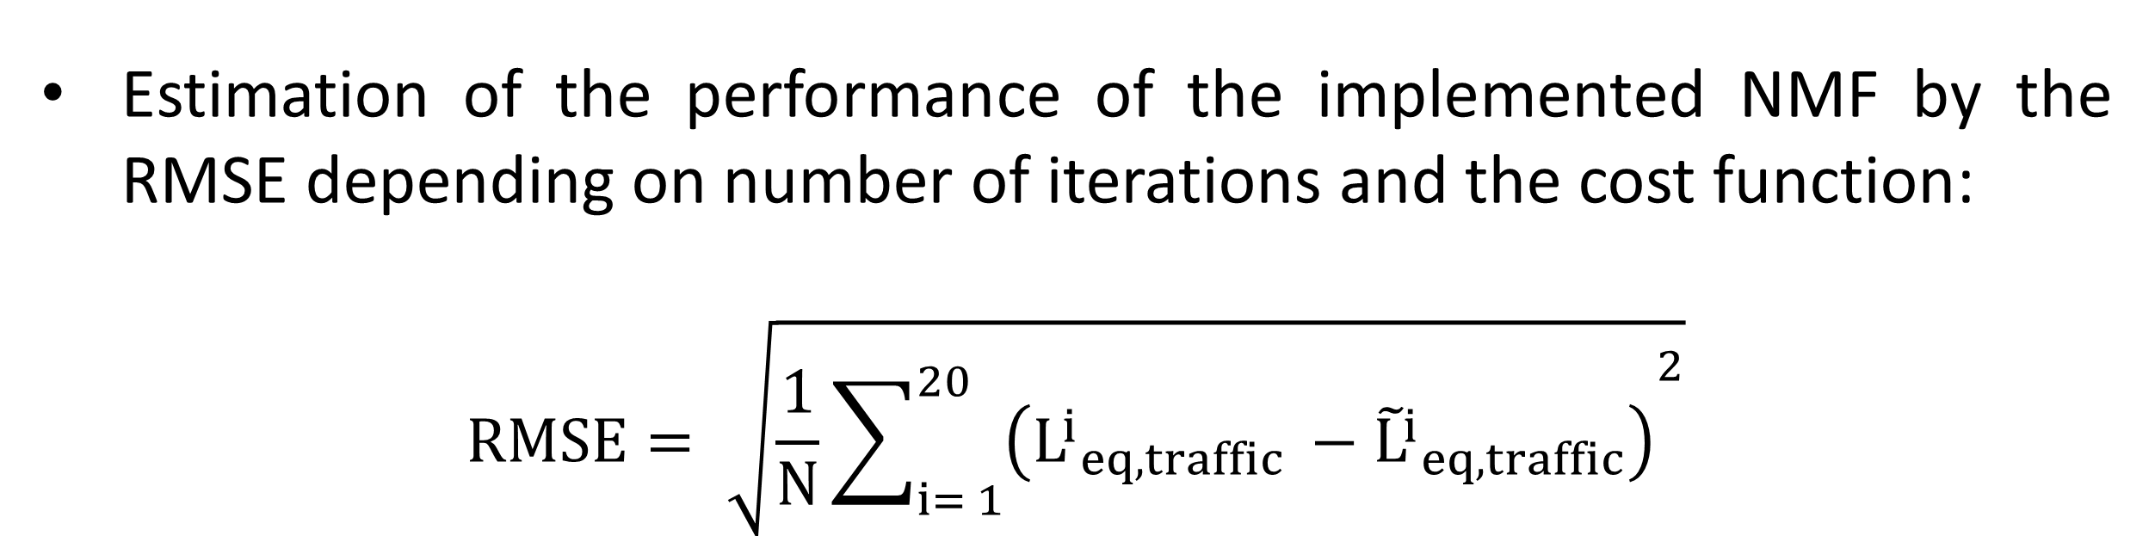
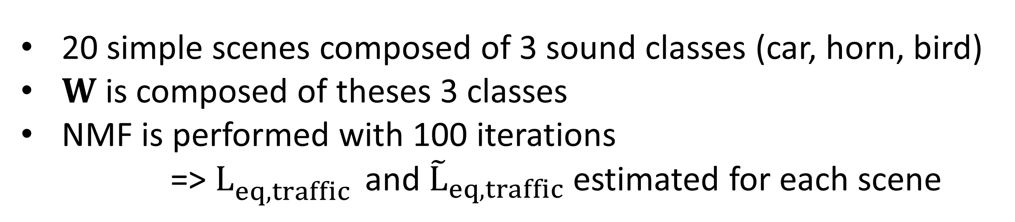
Estimating traffic noise levels using acoustic monitoring: a preliminary study Jean-Rémy Gloaguen¹, Arnaud Can¹, Matthieu Lagrange², Jean-François Petiot² ¹ Ifsttar-LAE, route de Bouaye-CS4, 44344 Bouguenais,FR ² IRCCyN, UMR CNRS 6597, École Centrale de Nantes, 1 rue de la Noë, 44321 Nantes, FR jean-remy.gloaguen@ifsttar.fr, +33 (0)2 40 84 56 19
Introduction
Approach: Usual methods for urban sound environments separation do not deal with overlapping sounds
The NMF seems to suit urban sound mixture requirements but it is used yet only for audio or musical applications
Context: European Directive 2002/49/EC imposes to cities over 100 000 inhabitants to realize road traffic noise maps
Aim to improve road traffic simulated noise maps by means of with acoustic measurements
=> Need for a method that separates road traffic from the other existing sound sources within measurements
=> Adapt and test the NMF on a set of simulated urban sound mixtures
Method
Source separation
Supervised Non-negative Matrix Factorization:
$$V≈ WH$$
$V_{F×N}∈R^{+}$, the audio spectrogram of the sound mixture,
$W_{F×K}∈R^{+},$ fixed dictionary composed of a set of $K$audio spectra of urban sound sources
$H_{K×N}∈R^{+},$ the feature matrix standing for the temporal variation of the spectrum found iteratively by the minimisation of the cost function
$$\text{min} D(V|\left|WH\right) w.r.t. W>0, H>0$$
3 tested cost functions :
The Euclidian distance (Euc. Dist)
The Kullback-Leibler divergence (K-L div)
The Itakura –Saïto divergence (I-S div)
$W$ is composed of 3 classes (car, bird, horn)
$H$ is updated with the maximisation-minimisation algorithm^{b}
Sound scene simulation
Simulation of a set of sound scenes with the simSceneª software:
Realization of sound mixtures from a database of isolated sounds
Control of the event/backgroud ratio
Control of the time of presence of each sound source
It gives as output:
A complete audio file with all the mixed sound sources and an audio file for each sound class,
=> Creation of specific urban sound environments (animated or quiet streets, parks…)
ªM. Rossignol & al., simScene: a web-based acoustic scenes simulator, 1st Web Audio Conference, 2015
^{b}C. Févotte & J. Idier, Algorithms for nonnegative matrix factorization with the β–divergence, Neural Computation, vol 23, no 9, 2011
Experiment and first results
20 simple scenes composed of 3 sound classes (car, horn, bird)
$W$ is composed of theses 3 classes
NMF is performed with 100 iterations
=> $L_{eq,traffic }^{}$ and ${\tilde{L}}_{eq,traffic}$ estimated for each scene
Estimation of the performance of the implemented NMF by the RMSE depending on number of iterations and the cost function:
$$RMSE= \sqrt{\frac{1}{N}{\sum_{i= 1}^{20}{\left({L^{i}}_{eq,traffic }^{}−{{\tilde{L}}^{i}}_{eq,traffic}\right)}}^{2}}$$
Fig 2: comparison of the RMSE for the 3 cost functions. We add the RMSE between $L_{eq }^{}$and $L_{eq,traffic }^{}$without source separation
Fig 1: on the left the spectrogram of a scene created with simScene, in the middle the estimated spectrogram after 100 iterations, on the right the road traffic spectrogram estimated after source separation
Conclusion and investigations
First results for the road traffic source separation in an sound urban context within simple simulated sound scene
Low RMSE values and improvement of the estimated road traffic sound levels show the interest of the NMF in that context
The K-L divergence seems the most promising approach
Future works:
Building a set of more complete and realistic sound scenes
Design an experimental plan in order to optimize the modeling parameters
Add temporal contraints on $H$ to modelize more realistic comportements (smooth NMF)
Detection and Classification of Acoustic Scenes and Events 2016
3 September 2016, Budapest, Hungary

