Slide 1
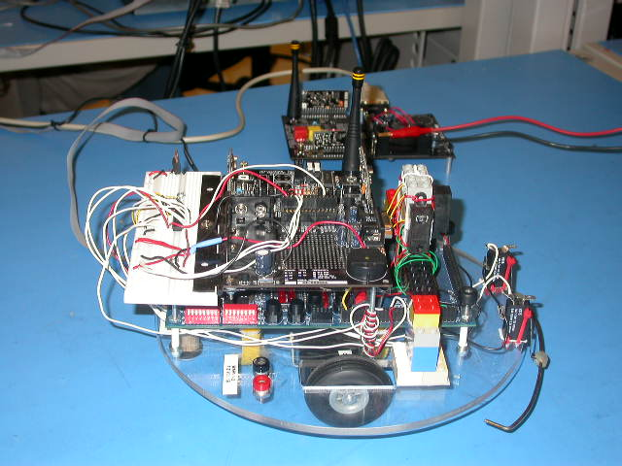
CEG 4392 : Maze Solving Robot
Presented by:
Dominic Bergeron George Daoud
Bruno Daoust Erick Duschesneau
Martin Hurtubise Mathieu Mallet

Slide 2
Presentation Overview

Slide 3
Presentation Overview
Product Overview
Features
Specifications
YARE Demo
Where to buy

Slide 4
Product Overview

Slide 5
Product Overview
YARE is the name of our maze solving robot. The four letter name is an acronym for “Yare Automaton for Revealing Exits”.
YARE provides the greatest degree of autonomous behaviour and functionality achieved by our engineering team to navigate through a maze and locate nearest exit.

Slide 6
Product Overview
In autonomous mode, YARE follows the right wall of the maze and finds its way through the nearest accessible exit.
Using a PC, the client software and the wireless network interface, YARE acknowledges manual commands and is able to go through the maze using the shortest possible path.

Slide 7
Features
Robot

Slide 9
Features: Robot
Three-way wall detection
Distance compensation
Collision detection/avoidance
Data acquisition and analysis system
Wireless communication
Autonomous navigation mode
Slave navigation mode

Slide 10
Three-way wall detection
YARE detects nearby walls using infrared (IR) sensors.
YARE contains three sets of IR sensors positioned at the front, left and right of the robot.
Each of these sensors is used to measure the distance between the robot and the closest wall.

Slide 11
Distance compensation
The right IR sensor is used to monitor distance between the robot and the right wall.
To prevent the robot from deviating from its current path, a distance compensation algorithm was implemented to keep the robot as parallel as possible to the right wall and at a constant distance.

Slide 12
Collision detection/avoidance
The front sensor is used to monitor the distance between the robot and an incoming obstacle (or front wall).
It can also be used to avoid front collisions.
If avoidance is not possible because the obstacle is not detected, the frontal collision will trigger the bumper switch and the robot will stop and go into slave mode, awaiting commands.

Slide 13
Data acquisition and analysis system
Data is acquired internally (time, wheel speed, wheel direction) and externally (IR sensors, bumper switch).
Only the data acquired from external sensors is analysed by the robot.
This data is crucial when the robot is in autonomous navigation mode.

Slide 14
Wireless communication
The data acquired is transformed into several 10-bit RS232 serial packets and sent to the base station.
To maintain synchronization, the packet is synchronized at a serial-compatible bit rate.
In addition to the serial start and stop bits, an extra information bit is present in each packet to efficiently identify the start byte.
The data and its checksum are sent three times.

Slide 15
Autonomous navigation mode
In this mode, YARE analyses data from the right and front IR and follows the right wall while avoiding collisions.
If a possible path is discovered at the right side of the robot, YARE will turn 90 degrees right and follow that path.
If a front wall is detected and no right path is discovered, YARE will turn 90 degrees left and follow that path.

Slide 16
Slave navigation mode
In slave mode, YARE awaits for instructions:
  “follow right wall”
  “clear”
  “turn 90 degrees to the right”
  “find right wall”
  “turn 90 degrees to the left”
  “follow left wall”
  “find left wall”
  “find front wall”
  “switch to autonomous mode”

Slide 17
Features
Client software

Slide 18
Features: Client software
Cross-platform compatible
Robot progress displayed in real-time
Ability to send manual commands to robot
Ability to load/save maze data
Ability to transform IR data samples into a straight wall
Implementation of A* shortest path algorithm
Communicates path to the robot

Slide 19
Cross-platform compatible
The JAVA language was chosen to create YARE’s client software.
Cross-platform compatibility is achieved using JAVA to provide flexibility and meet user demands.

Slide 20
Robot progress displayed in real-time
The interface allows real-time display of the robot’s progress.
Wall information captured from IR sensors and the robot’s current path are displayed on screen.
The GUI interface allows the user to choose which information (sensor and/or path) will be displayed.

Slide 21
Ability to send manual commands to robot
Through the GUI interface, the user can conveniently send manual commands to YARE, when he awaits in slave mode.
The robot can be manually re-set to autonomous mode through the same interface.

Slide 22
Ability to load/save maze data
Maze information captured during a session can be saved into a file.
The maze data file can be re-loaded at any time and allow YARE to receive shortest path instructions for any recorded maze.

Slide 23
Ability to transform IR data samples into a straight wall
To analyse the maze data, the client software transforms IR data samples into straight line by means of an interpolation.
These straight lines are used in the A* shortest path algorithm.

Slide 24
Implementation of A* shortest path algorithm
The A* algorithm can be explained as follows:
  The start point is the robot’s starting point. This point becomes the first element of the closed list.
  Then, all reachable points from the last element of the closed list (in the first case the starting point) are found and added to the open list.
  The point with the minimum F value is found from the open list and added to the closed list.
  The process is repeated until the end point is reached.
  Some backtracking is done to find the optimal path.

Slide 25
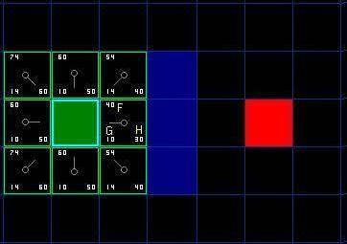

Slide 26
Implementation of A* shortest path algorithm
The A* algorithm can be explained as follows:
  The start point is the robot’s starting point. This point becomes the first element of the closed list.
  Then, all reachable points from the last element of the closed list (in the first case the starting point) are found and added to the open list.
  The point with the minimum F value is found from the open list and added to the closed list.
  The process is repeated until the end point is reached.
  Some backtracking is done to find the optimal path.

Slide 27
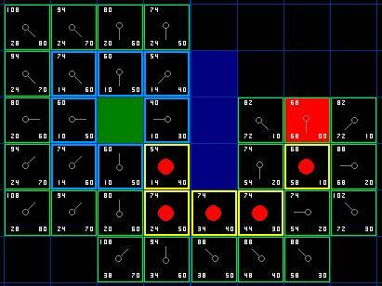

Slide 28
Implementation of A* shortest path algorithm
The A* algorithm can be explained as follows:
  The start point is the robot’s starting point. This point becomes the first element of the closed list.
  Then, all reachable points from the last element of the closed list (in the first case the starting point) are found and added to the open list.
  The point with the minimum F value is found from the open list and added to the closed list.
  The process is repeated until the end point is reached.
  Some backtracking is done to find the optimal path.

Slide 29
Communicates path to the robot
Manual commands and shortest path instructions are sent directly to YARE wirelessly.
The shortest path found using our A* algorithm implementation is first transformed into a series of manual instructions.

Slide 30
Communicates path to the robot
These commands are assembled and sent into several 10-bit RS232 serial packets to the robot.
Synchronization is set at a serial-compatible bit-rate and each packet contains an information bit needed to identify the start byte.
Since these instructions are most crucial, the data and its checksum is sent five times.

Slide 31
Specifications

Slide 32
YARE Demo

Slide 33
YARE Demo
For those interested, a live demonstration of YARE’s capabilities will be shown at the University of Ottawa.
When? December 1st 2003, 7:10pm.
Where? SITE 2061

Slide 34
Where to buy

Slide 35
Where to buy
This product is currently not for sale or rent.
Contact the University of Ottawa, School of Information Technology and Engineering for more information.

