Slide 1


AI-enhanced Track Finding for Recoil Ions with ALERT and CLAS12 at Jefferson Lab
Mathieu Ouillon (Mississippi State University)

Slide 2
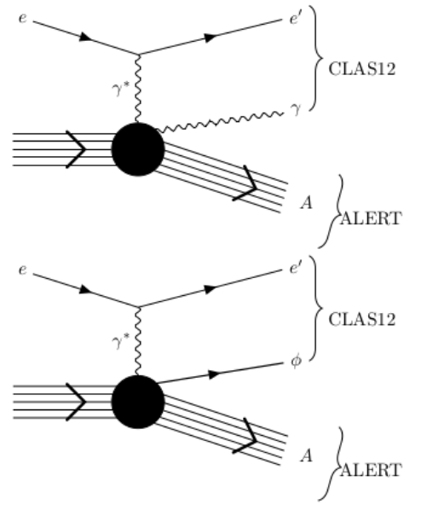
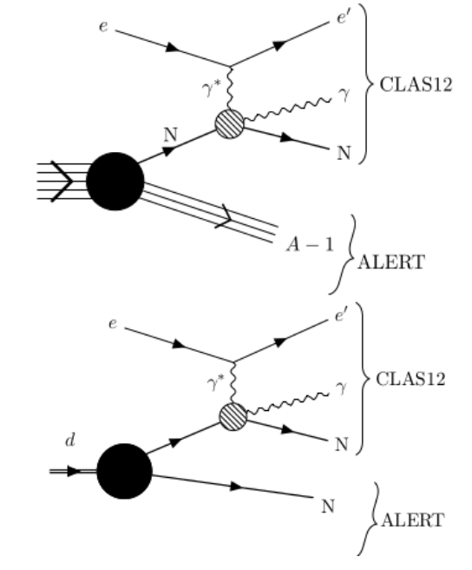
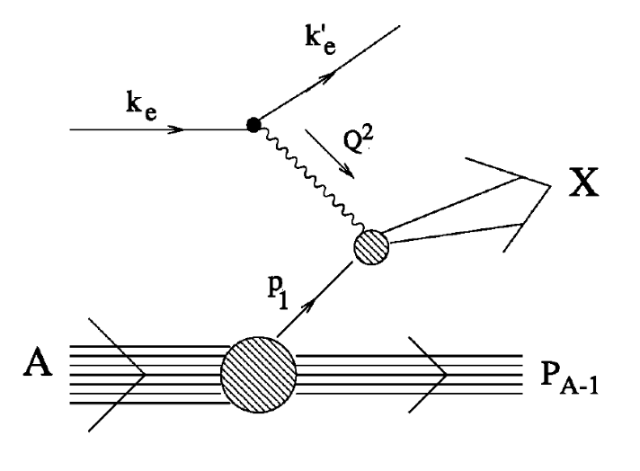
ALERT Physics Program
Comprehensive studies QCD in nuclei and associated medium modifications
Coherent DVCS on ⁴He
DIS on ⁴He and ²H
Incoherent DVCS on ⁴He (²H)
Explore the partonic structure of ⁴He with Generalized Parton Distributions
Test the Final State Interactions and rescaling model
Explore the 3-D structure of modified nucleons in light ions ²H,³H, and ³He (¹H or neutron)

Slide 3
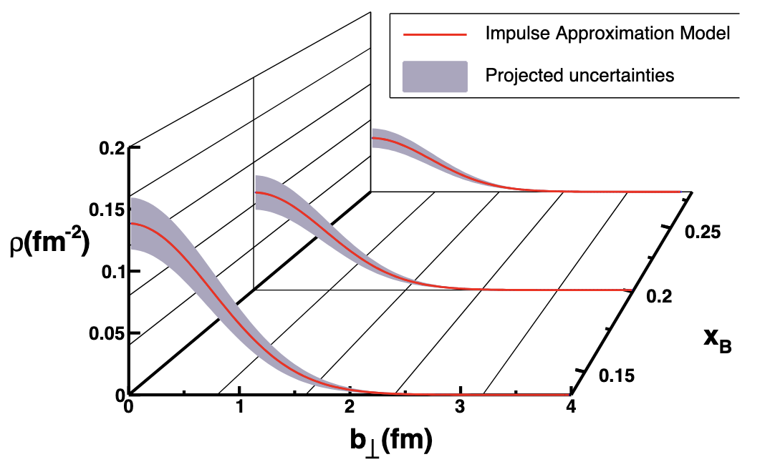
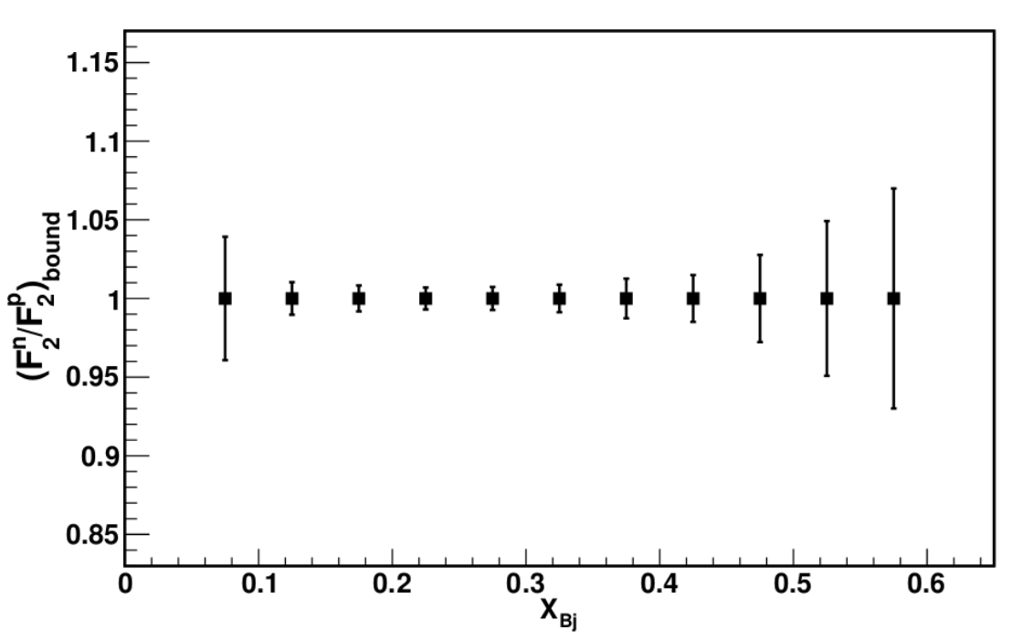
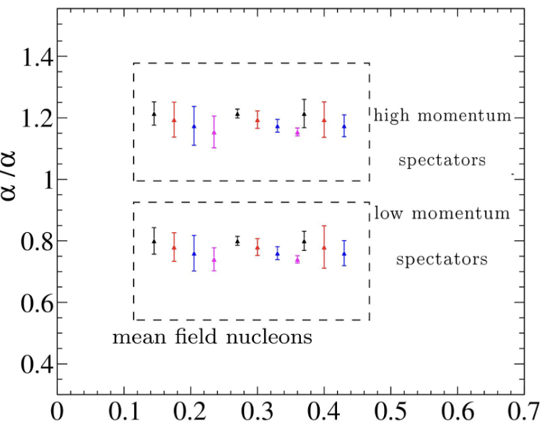
ALERT Physics Program
Comprehensive studies QCD in nuclei and associated medium modifications
Coherent Process on ⁴He
DIS on ⁴He and ²H: Tagged EMC effect
Incoherent Process on ⁴He and ²H
Extract quark and gluon GPDs in a dense nucleus; in this case, GPD H is obtained for both quarks and gluons in ⁴He
Measure the F₂ structure function of a weakly bound nucleon in ⁴He and compare it to the ²H case. Control FSIs with tagged fragments
Extract quarks GPDs for bound nucleons and thus understand the effect of FSIs

Slide 4
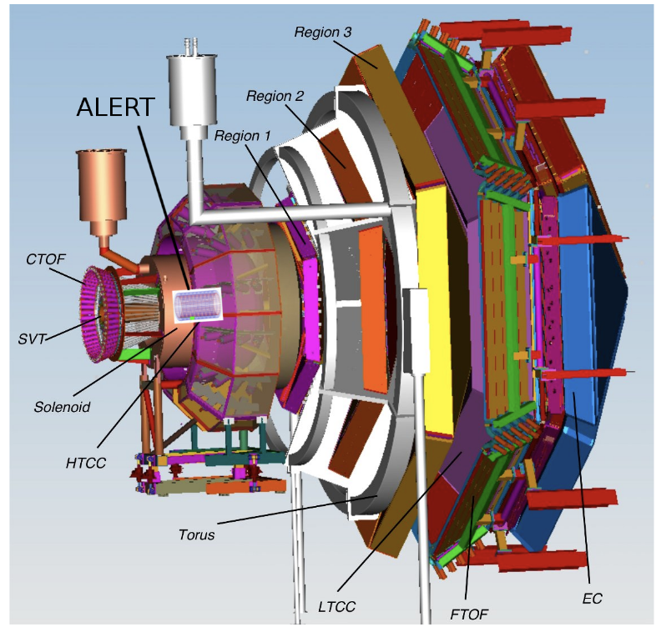
ALERT Experiment Setup
The ALERT experiment will take place in Hall B at Jefferson Lab
CLAS12: detect scattered electrons and forward scattered hadrons
ALERT: detect recoil spectators or coherently scattered nucleus
ALERT Goals:
Aim to identify light ions: p, ²H, ³H, ³He, and ⁴He
Detect the lowest momentum possible, down to 70 MeV/c for proton
Handle high CLAS12 rates and luminosities (10³⁵ cm²s⁻¹)

Slide 5
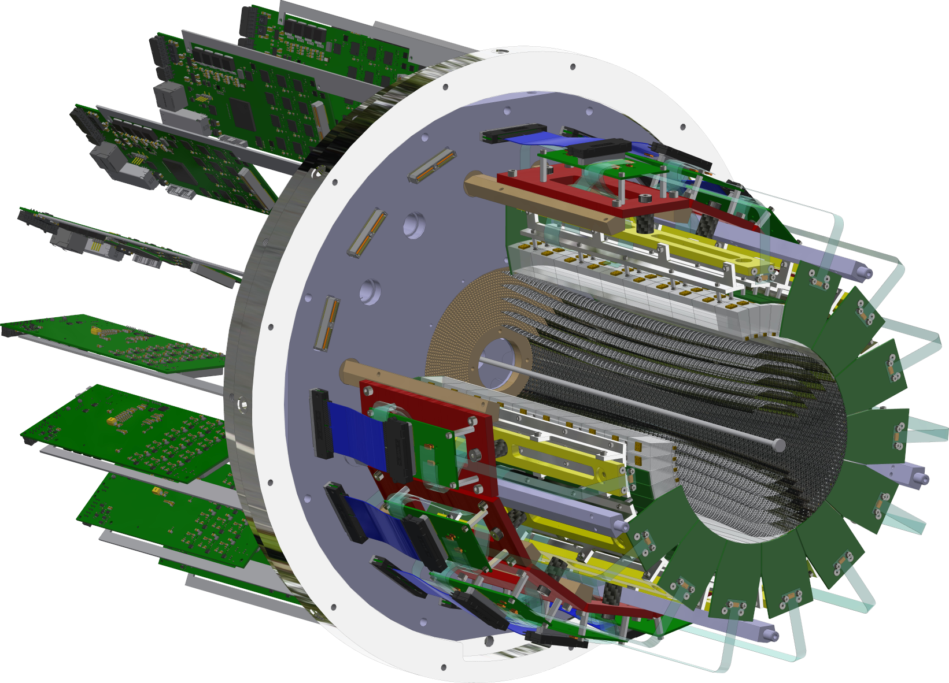
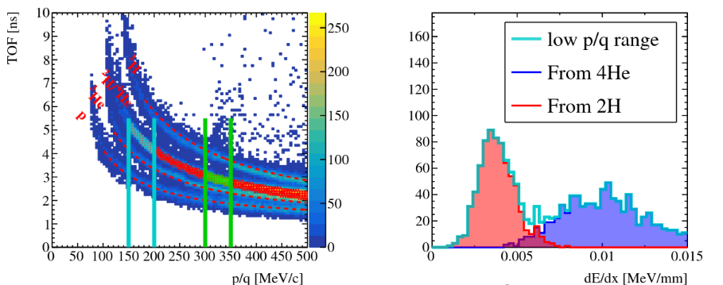
ALERT Experiment Setup
ALERT have two sub-detectors: A Hyperbolic Drift Chamber (AHDC) and A Time of Flight (ATOF)
ATOF
Time of flight: used for Particle IDentification
Small barrel of segmented scintillators
The TOF measurement is degenerate for ²H and ⁴He, but dE/dx can distinguish the two nuclei bands
AHDC
Aluminum wire: 2 mm apart
20-degree stereo angle (hyperbolic shape)
5 superlayers, each composed of 2 layers
576 signal wires (6 ground wires of each signal)

Slide 6
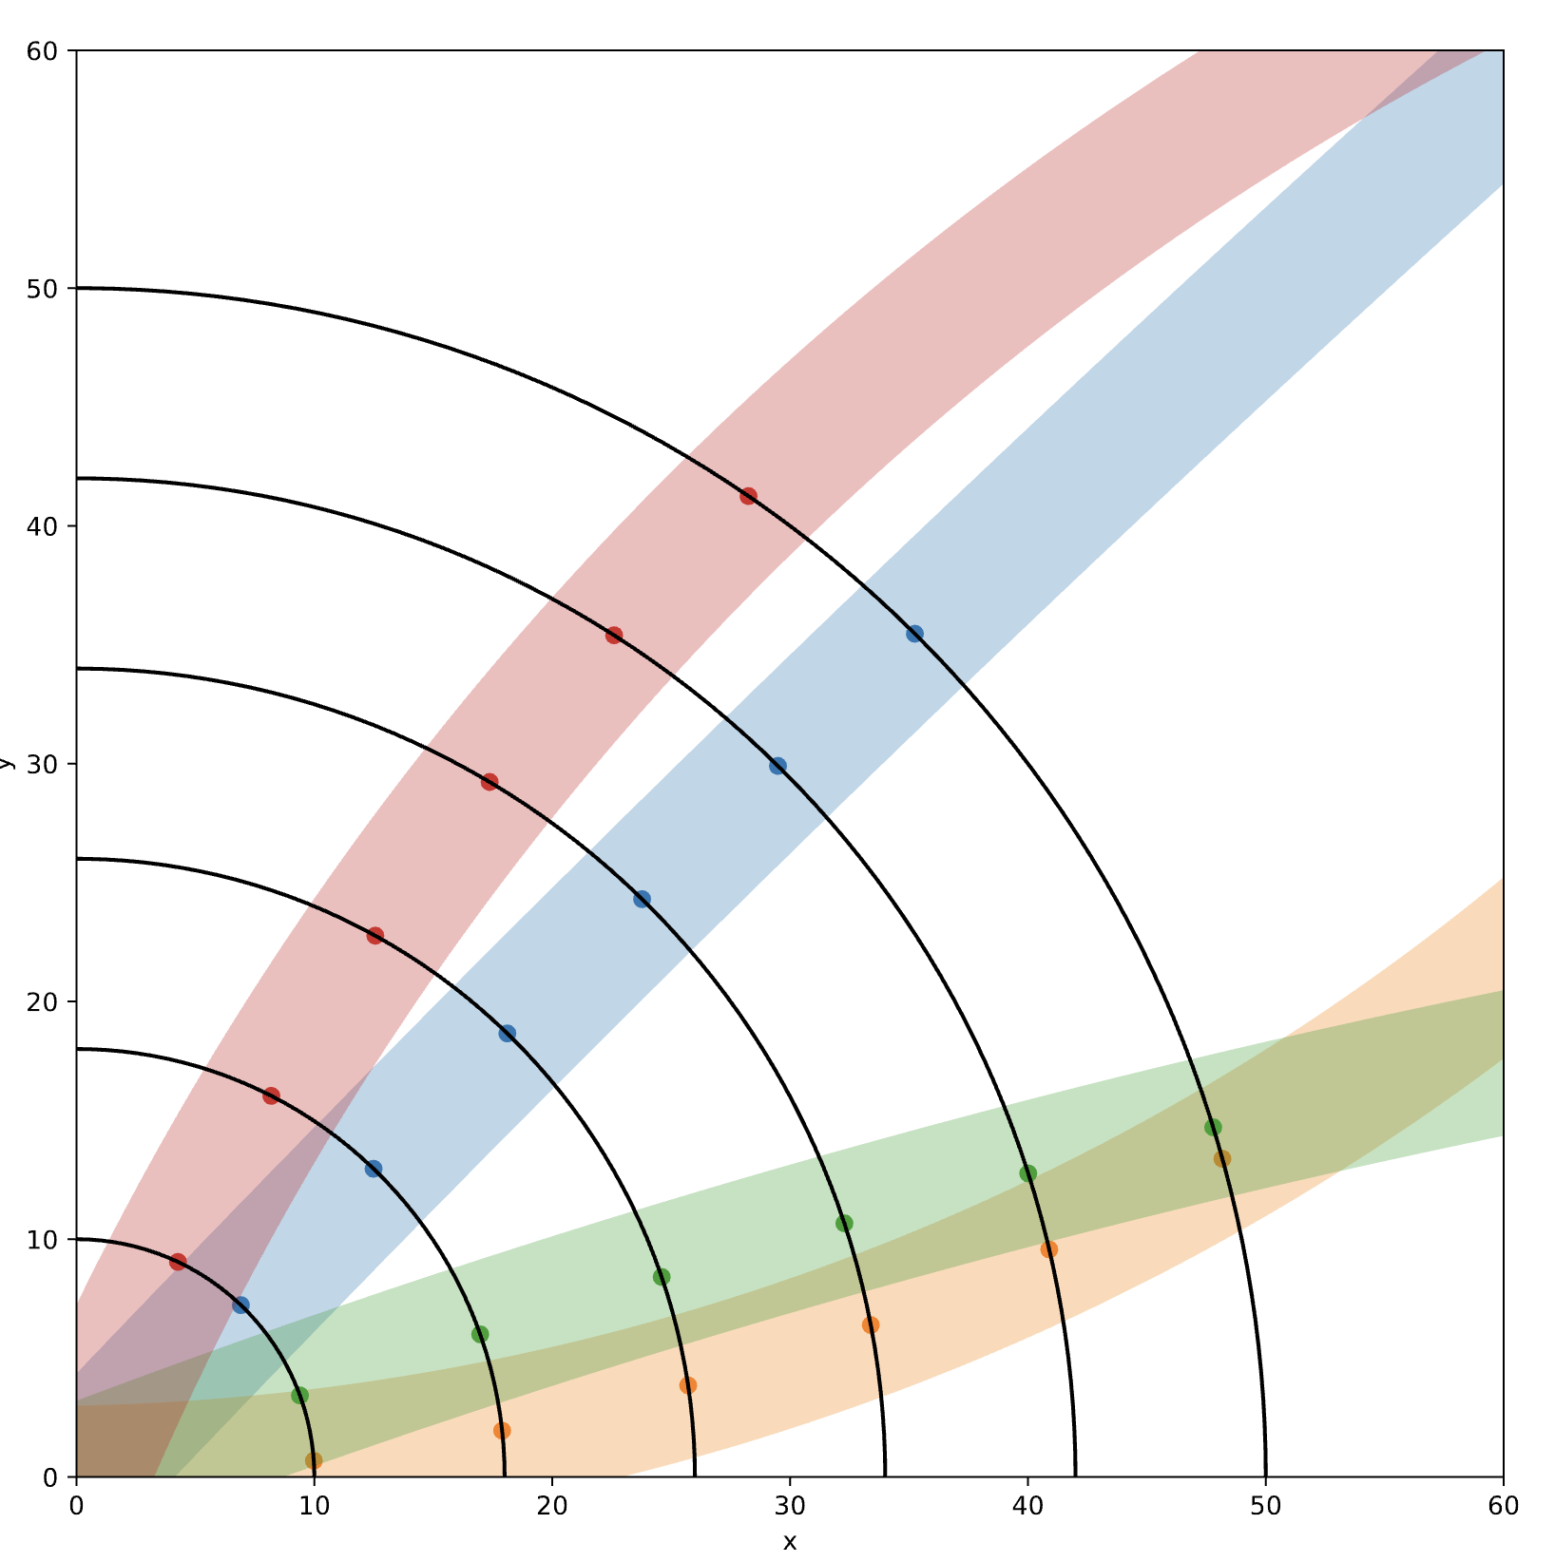
Track Finding
Aim to reconstruct the momentum and trajectory of (charged) particles
Two stages of track reconstruction:
Track finding: Identifying which hits came from the same charged particle
Track fitting: Fitting hits to a single track to extract track parameters (momentum and position)
Different algorithms:
Hough transform
Combinatorial Kalman Filter
Artificial Intelligence models (MLP, GNN…)

Slide 7
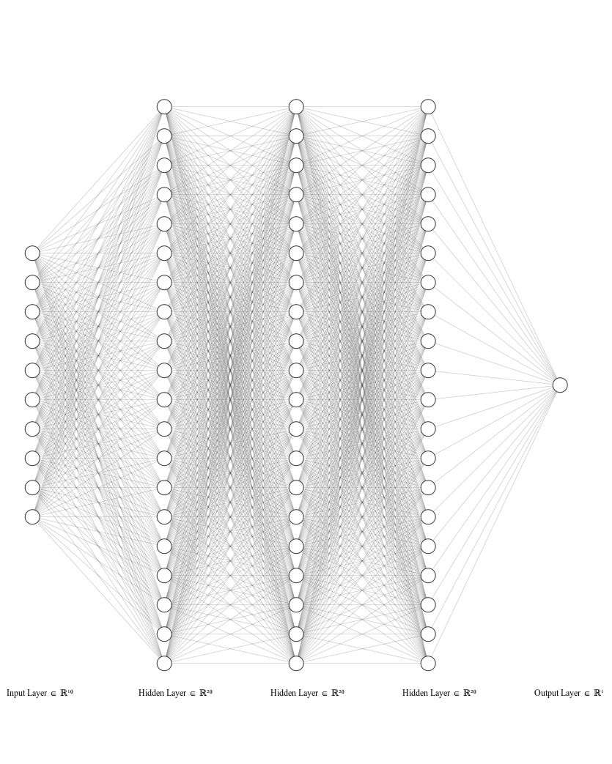
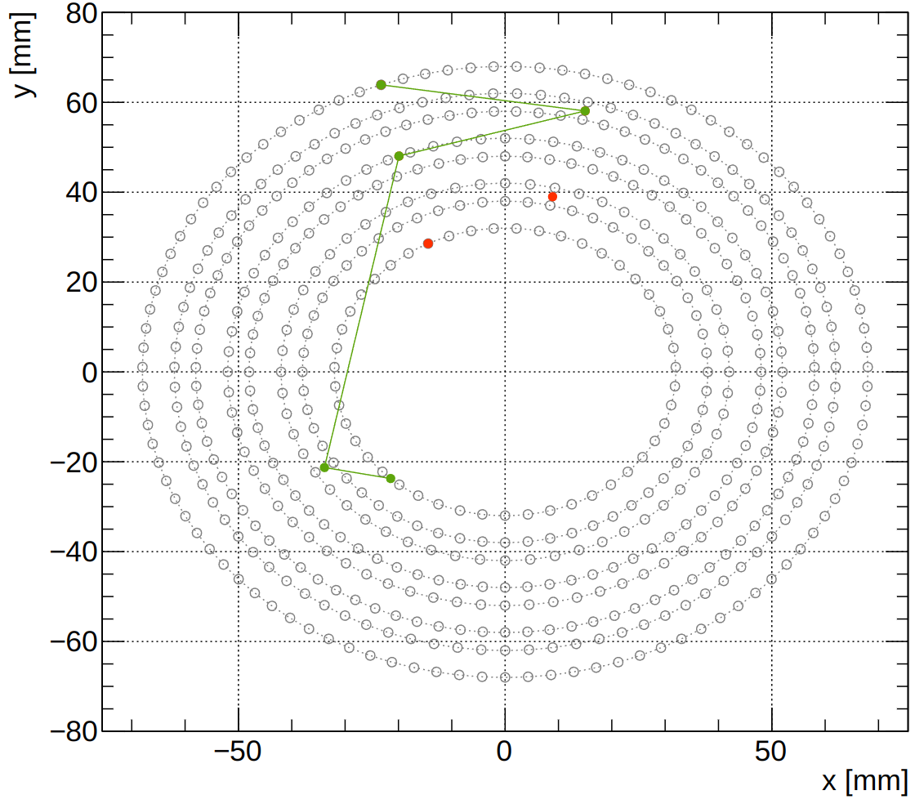
AI-assisted Model and Training
Model: MultiLayer Perceptron, 10 inputs, 1/3/5 hidden layer (20/100 neurons), 1 output
Inputs: x and y position of the five super-preclusters
Good and bad tracks for the training:
Good tracks: GEANT4 simulation (proton with p ∈ [70, 250] MeV/c, φ ∈ [0, 360]°, θ ∈ [60, 120]° and Vz ∈ [-15, 15] cm)
False tracks: Interchanging randomly up to two super-preclusters with another event
Output: Number between 0 and 1, with 0/1 means bad/good track
Bad track

Slide 8
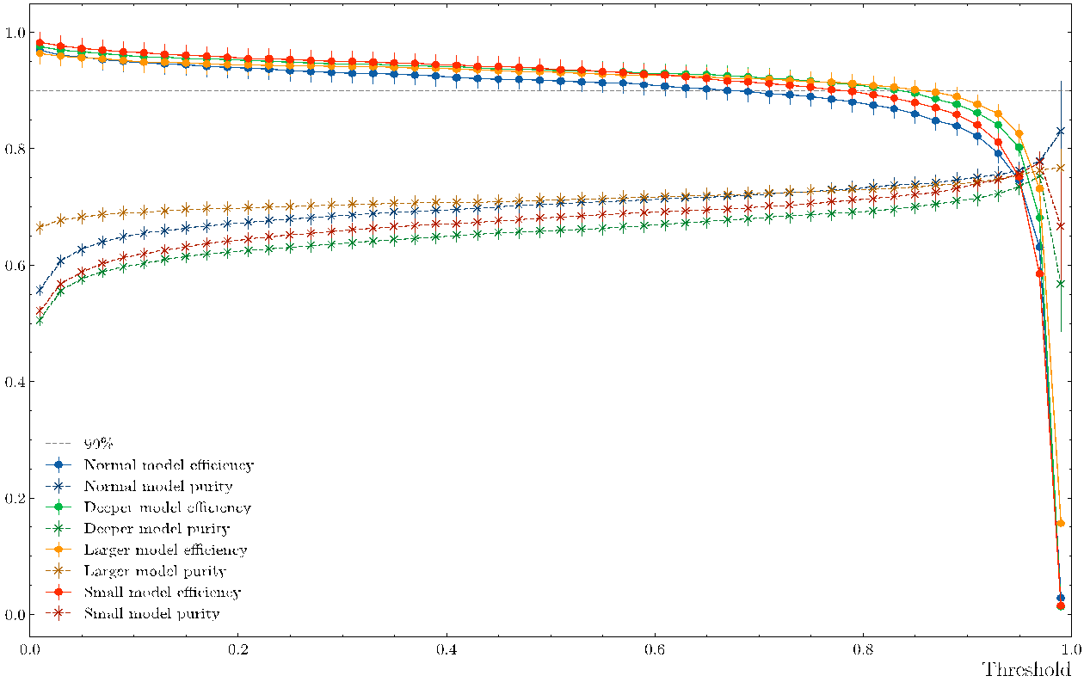
Efficiency and Purity vs. Threshold
Threshold: if output above/lower than the threshold ⇒ good/bad tracks
To evaluate the model:
Efficiency: Number of good tracks classified as good normalized by number of events.
Purity: Number of good tracks classified as good normalized by number of tracks (good or bad) classified as good.
Events need to have at least one track candidate.
Set the threshold to 0.2 to have a higher efficiency
Blue: model with 20 neurons in 3 hidden layers
Orange: model with 100 neurons in 3 hidden layers
Green: model with 20 neurons in 5 hidden layers
Red: model with 20 neurons in 1 hidden layer

Slide 9
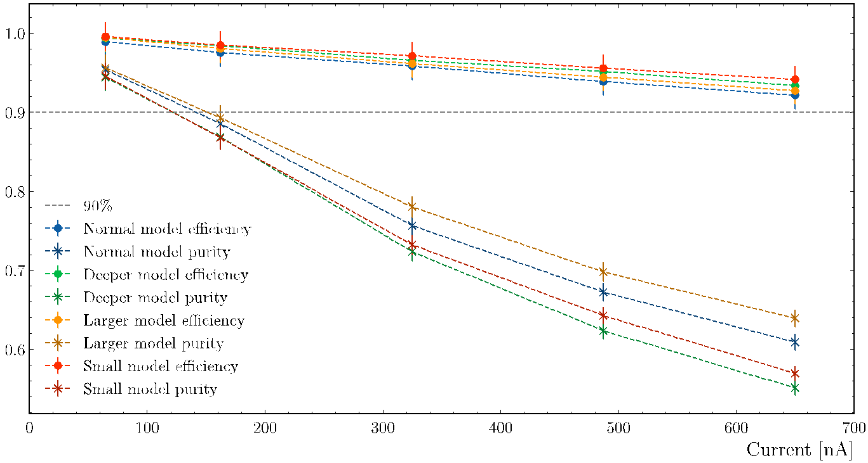
Efficiency and Purity vs. Current
Efficiency is always higher than 90% and the purity is between 55% and 95%
Blue: model with 20 neurons in 3 hidden layers
Orange: model with 100 neurons in 3 hidden layers
Green: model with 20 neurons in 5 hidden layers
Red: model with 20 neurons in 1 hidden layer

Slide 10
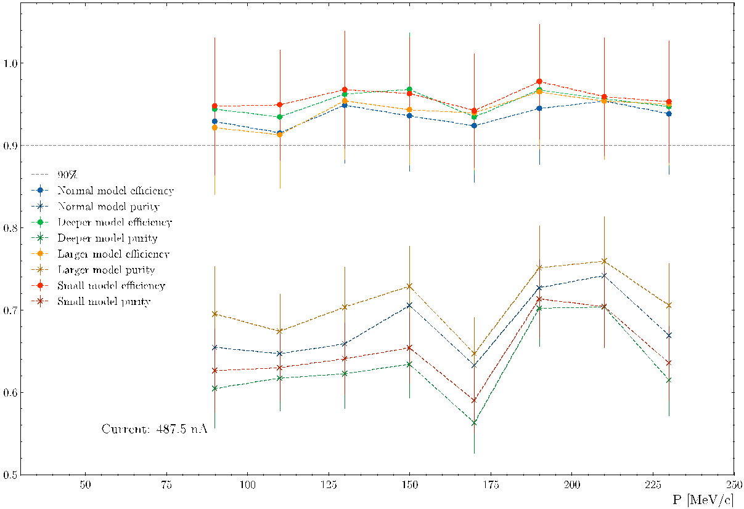
Efficiency and Purity vs. Momentum
Background is generated with current I = 487.5 nA
Constant efficiency and purity across the momentum range
Blue: model with 20 neurons in 3 hidden layers
Orange: model with 100 neurons in 3 hidden layers
Green: model with 20 neurons in 5 hidden layers
Red: model with 20 neurons in 1 hidden layer

Slide 11
Summary and Outlook
ALERT physics program will explore:
Coherent processes on ⁴He ⇒ its partonic structure
Tagged DIS on ⁴He and ²H ⇒ EMC effect in more detail with spectator information
Tagged incoherent DVCS on ⁴He and ²H ⇒ structure of the bound nucleons.
We have developed an AI-assisted MLP for track finding:
Evaluated the model's efficiency and purity as a function of momentum, threshold, and current
Compared efficiency of conventional and AI-assisted algorithms
Efficiency is always higher than 90%
Future work:
Check the efficiency and purity of real data using elastic scattering
Improve the model with other information as input (energy deposited and angle between hits)
Thanks
This work is supported in part by the U.S. DOE award #: DE-FG02-07ER41528

