Slide 1



A(I)LERT Track Finding
Mathieu Ouillon (Mississippi State University)
CLAS Collaboration (November 12th, 2024)

Slide 2
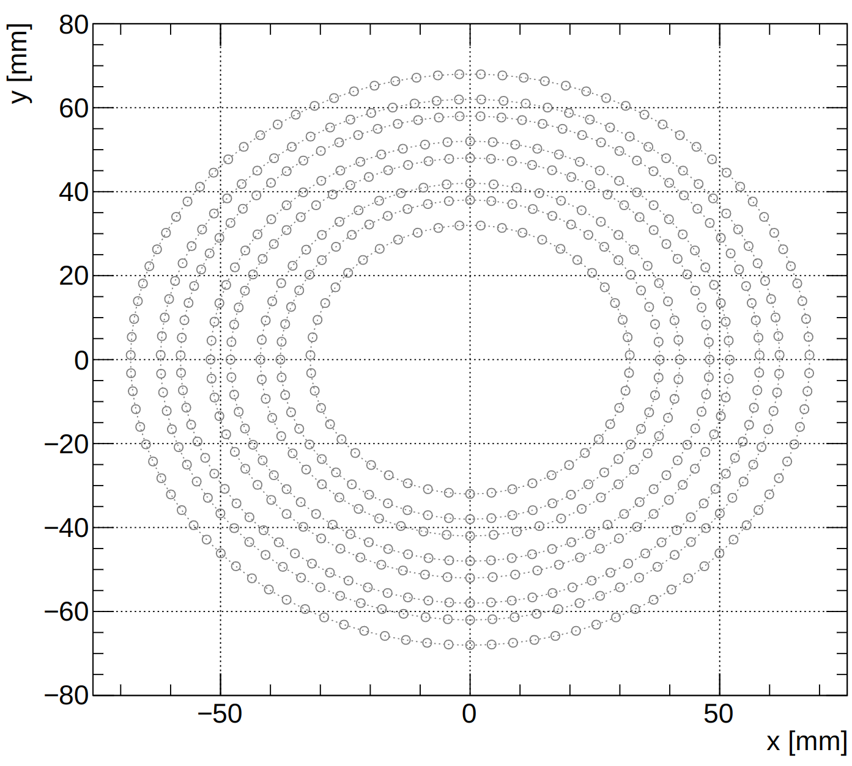
The ALERT Detector
ALERT comprises two sub-detectors: A Hyperbolic Drift Chamber (AHDC) and A Time of Flight (ATOF).
Focus on the AHDC used for track finding and fitting.
The AHDC is composed of:
5 superlayers with 2 layers each except for the first and last one.
Each layer has a given number of cells.
A cell is 6 field wires and 1 signal wire.
A stereo angle of 20° between each superlayer.
AHDC is composed of 576 signal wires distributed:
47, 56, 57, 72, 87, 99 for each superlayer.
Layer in each superlayer has the same amount of signal wires.
SL1
SL2
SL3
SL4
SL5

Slide 3
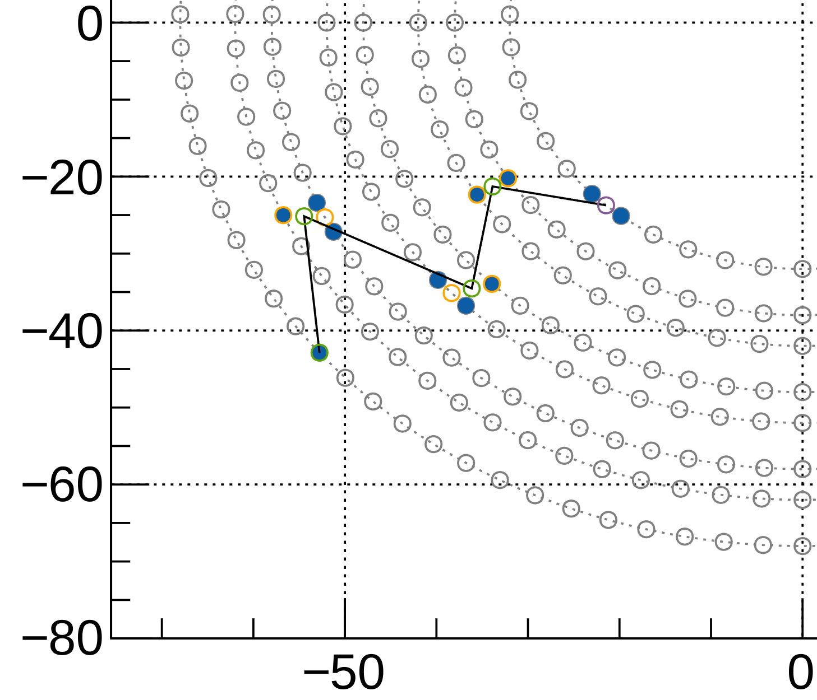
Clustering
The first step before the model is clustering. Goal: reduce the combinatorics to find track.
Test differents clustering:
Raw hits in blue.
Merge hits that on the same layer and 1 wire away together into precluster (orange circle).​
Merge precluster that are on the same superlayer and 8mm away into super-precluster (green circle)​.
End up with 5 super-preclusters.
Look for a track with 5 super-clusters.
Test the AI model with preclusters and super-preclusters.
y [mm]
x [mm]

Slide 4
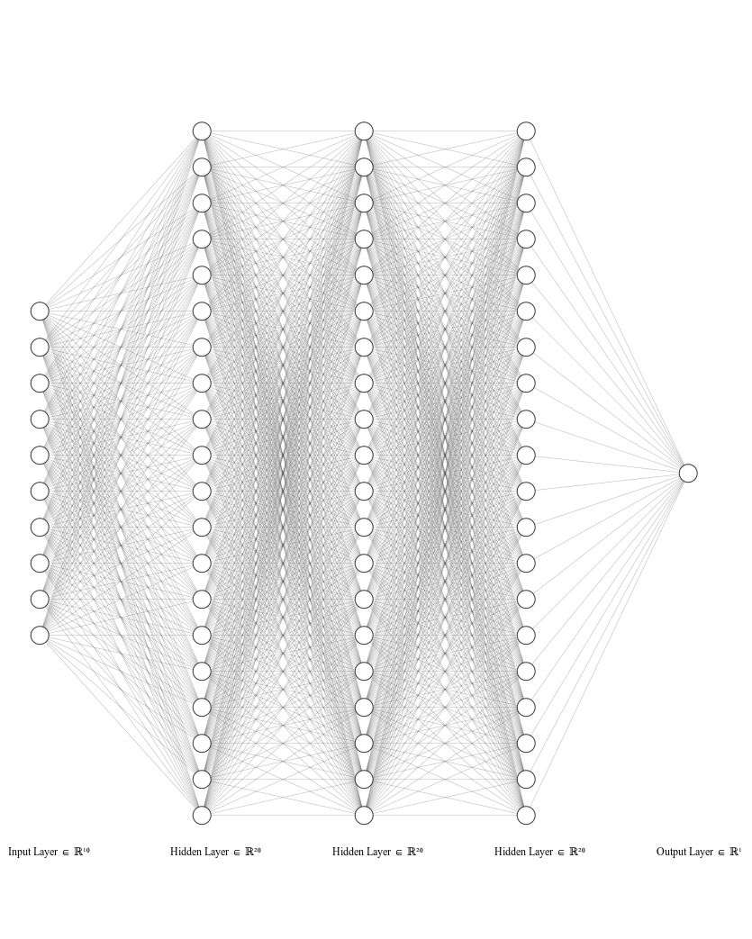
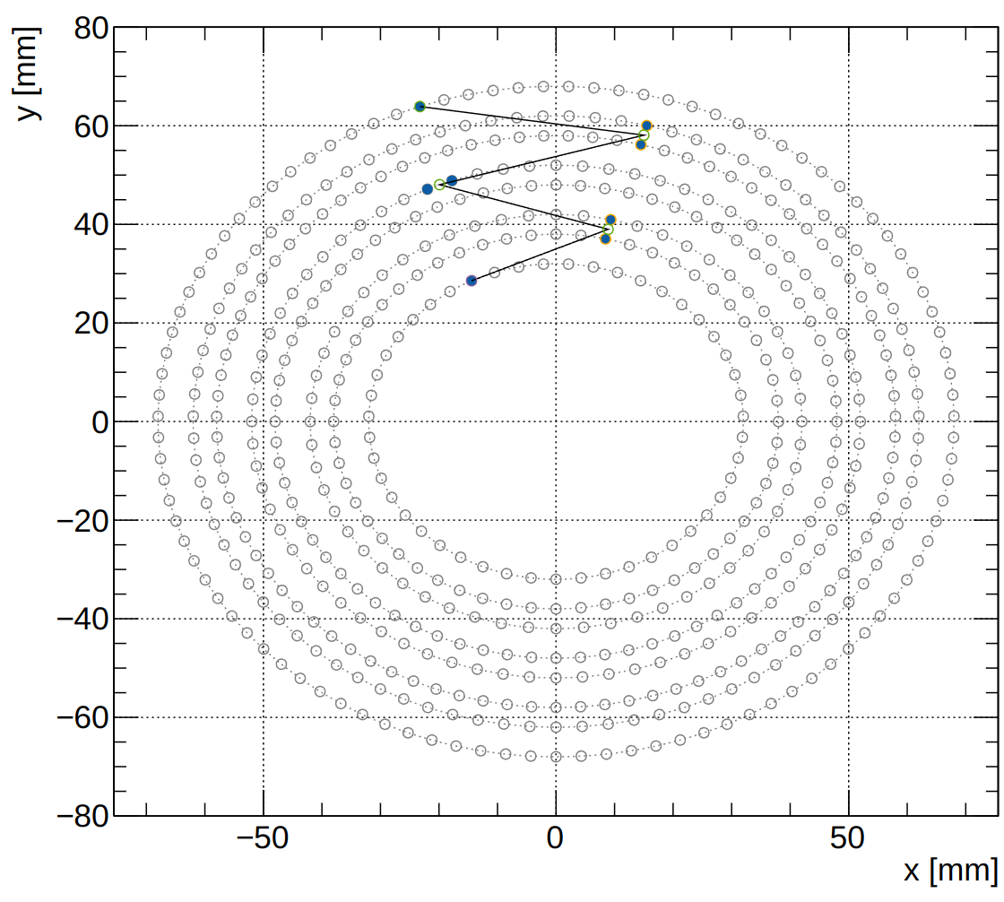
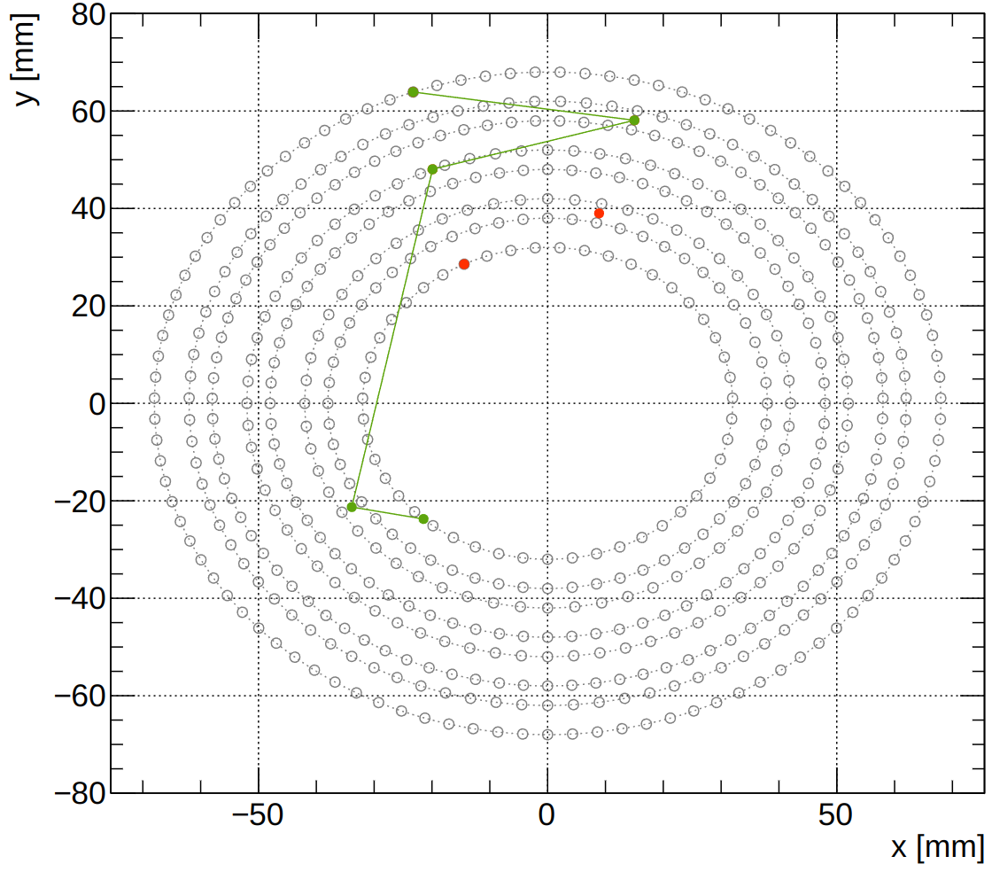
Model: MLP
The input for the model is 5 combinations for x and y which represent the super-preclusters.
Good tracks are generated by GEMC:
proton with p ∈ [60, 250] MeV/c, φ ∈ [0, 360]°, θ ∈ [60, 120]° and vz ∈ [-15, 15] cm.
False tracks: interchanging randomly up to two super-precluster, with a adjacent event.
Model: MLP 10 inputs, 3/5 hidden layer (20/100), 1 output.
Output of the model: Probability 1-good track or 0-bad track
Good track
Bad track

Slide 5
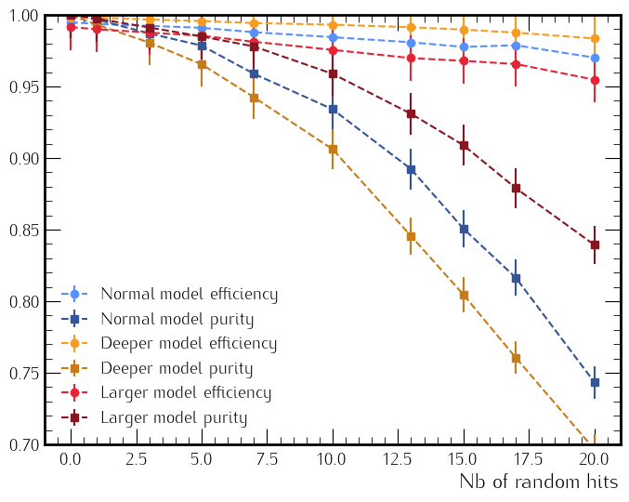
Efficiency and purity as a function of occupancy
Efficiency: Number of good tracks classified as good / number of event.
Purity: Number of good tracks classified as good / number of tracks (good or bad) classified as good.
To compute the efficiency/purity: Add some random hits in the drift chamber and generate all possible tracks per event.
Expect around 15 random hits per events (5% occupancy).
Blue line/dot: model with 20 neurons in the 3 hidden layers
Red line/dot: model with 100 neurons in the 3 hidden layers
Orange line/dot: model with 20 neurons in the 5 hidden layers

Slide 6
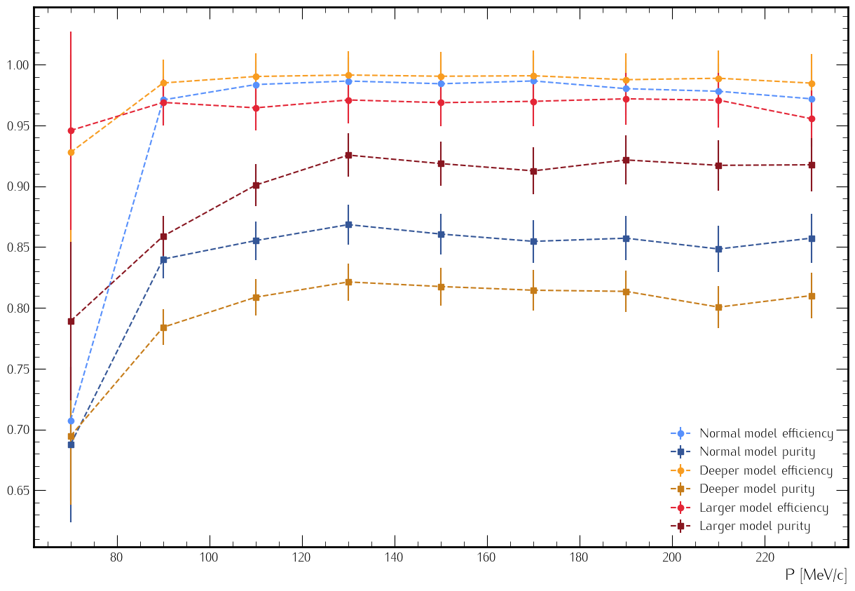
Efficiency and purity as function of momentum
Can also compute the efficiency as function of the momentum of the proton:
Using event with 1 track + 15 random hits
proton with p ∈ [60, 250] MeV/c, φ ∈ [0, 360]°, θ ∈ [60, 120]° and vz ∈ [-15, 15] cm
Efficiency and purity almost constant for the range of momentum.
Blue line/dot: model with 20 neurons in the 3 hidden layers
Red line/dot: model with 100 neurons in the 3 hidden layers
Orange line/dot: model with 20 neurons in the 5 hidden layers

Slide 7
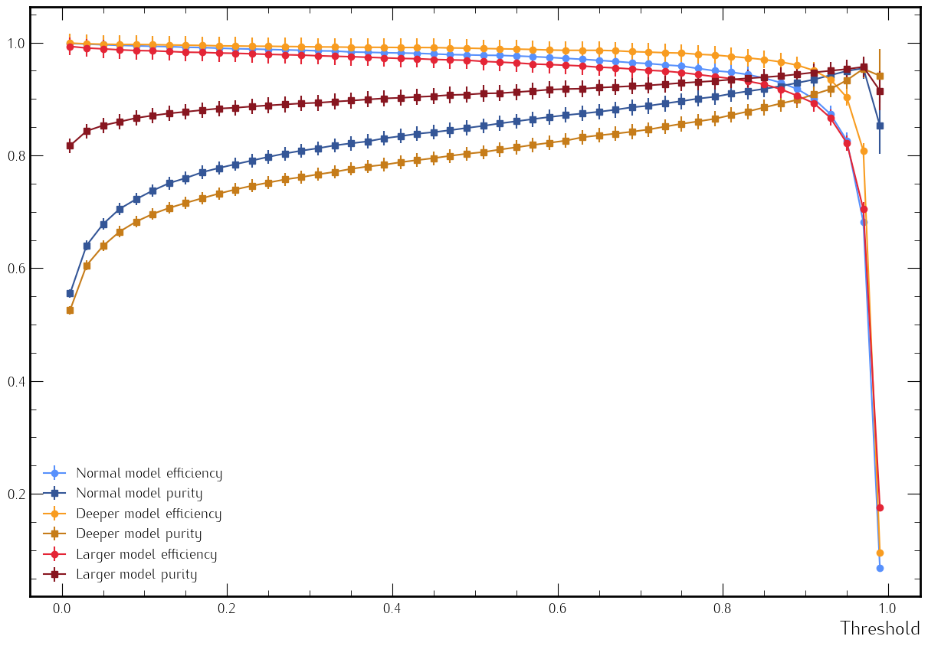
Efficiency and purity as function of threshold
Can look at the efficiency as function of the threshold.
Threshold: value above what the we consider the output of the model 1 and below 0.
Want high efficiency and purity, but not possible.
Prefer high efficiency to high purity.
Blue line/dot: model with 20 neurons in the 3 hidden layers
Red line/dot: model with 100 neurons in the 3 hidden layers
Orange line/dot: model with 20 neurons in the 5 hidden layers

Slide 8
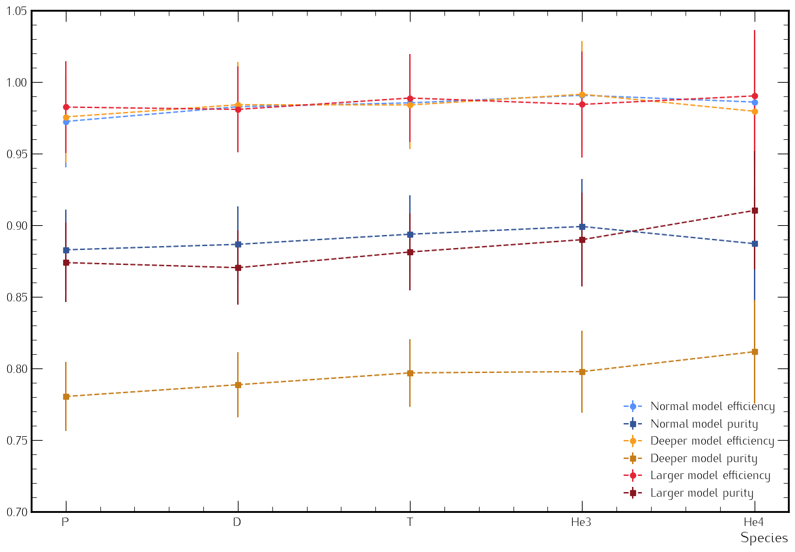
Efficiency and purity as function of species
Can look at the efficiency as function of the particle.
Train the model with tracks from proton, deuterium, tritium, helium 3 and helium 4.
Constant for all species. Purity of the deeper model is lower.
Blue line/dot: model with 20 neurons in the 3 hidden layers
Red line/dot: model with 100 neurons in the 3 hidden layers
Orange line/dot: model with 20 neurons in the 5 hidden layers

Slide 9
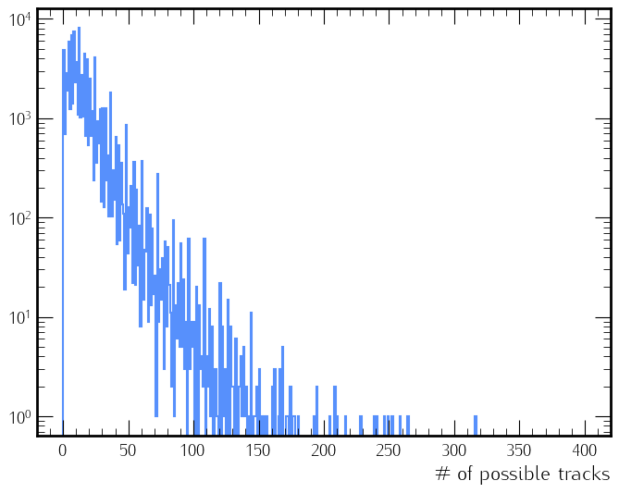
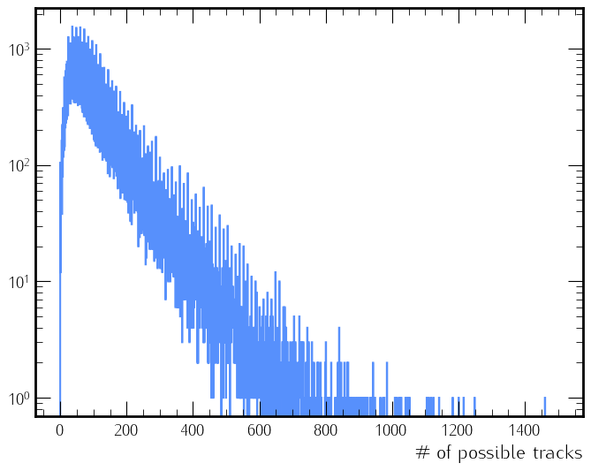
Inference time and number of possible tracks
For the normal model, the inference time is around 15µs ↦ 60KHz.
For a typical event, with 1 proton track and 15 random hits:
Mean of 16 possible tracks but can have up to 300 possible tracks for some events
For a busy event with 3 proton tracks and 15 random hits:
Mean of 100 possible tracks but can have up to 1500 possible tracks for some events (need a threshold)
1 proton
3 proton

Slide 10
Summary and Outlook
Develop an MLP for track finding for ALERT
New clustering to reduce the number of possible tracks
Evaluated the model's efficiency and purity as a function of a number of random hits added.
Evaluated the model's efficiency and purity as a function of momentum / threshold
Evaluated the model's efficiency and purity for differents particles
Remaining tasks:
Compare AI to conventional track finding
Use luminosity simulation to have a more realistic occupancy.
Implementation in COATJAVA using Deep Java Library
Already started, can load the pytorch model in Java and predict output
Same prediction between pytorch and DJL
Develop an AI for PID using MLP and a classifier with 5 classes.
Work done by Uditha Weerasinghe and me.

