Slide 1



Update on RG-D Experiments:
Calibration and Analysis Status
Mathieu Ouillon (Mississippi State University)
CLAS Collaboration (November 13th, 2024)

Slide 2
Run Group D​
RG-D is composed of two experiments:
Study of Color Transparency (CT) in Exclusive Vector Meson Electroproduction off Nuclei (E12-06-106)​:
Spokespeople: W. Armstrong¹ , L. El Fassi³ , K. Hafidi¹ , M. Holtrop⁴ and B. Mustapha^{1​}
Nuclear Transverse Momentum Distributions (nTMDs) in CLAS12 (E12-06-106A)​:
Spokespeople: R. Dupré² , L. El Fassi³ , Zein-Eddine Meziani¹ , and Holly Szumila-Vance​⁵
¹: Argonne National Lab (ANL), ²: IJCLAB, Orsay, France ³: Mississippi State U. (MSSate), ⁴: University of New-Hampshire (UNH), ⁵: Jefferson Lab

Slide 3
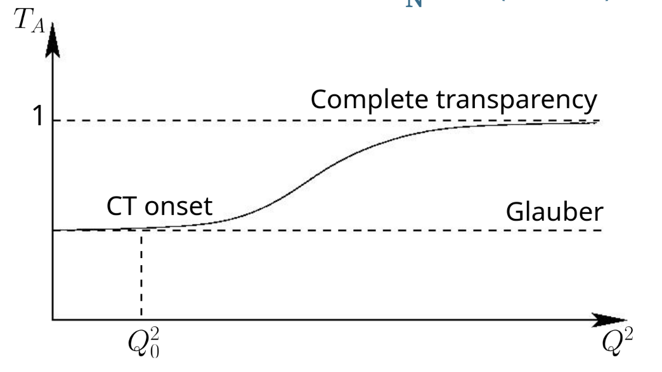
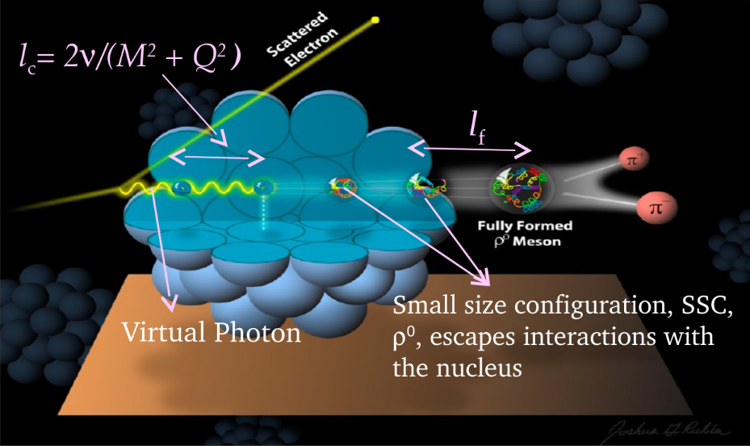
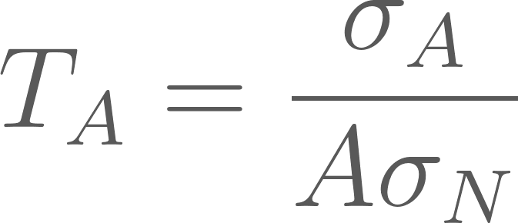
RG-D: CT Experiment​
E12-06-106, CT - the experimental signature of CT is the rise of the nuclear transparency, T_{A} as a function of Q²: ​
T_{A} is defined as the ratio of the cross section per nucleon on a bound nucleon to that on a free nucleon
σ_{A} − nuclei cross section
σ_{N} − free nucleon cross section
Coherence length, l_{c}: the lifetime of the qq-bar pair
Formation time, l_{f}: the time evolution of small size configurations (SSC) to an on-shell ρ⁰ meson​​
Virtual photon
Small size configuration (SSC),​ ρ⁰, is the nuclear cross section​ escapes interactions with the nucleus​

Slide 4
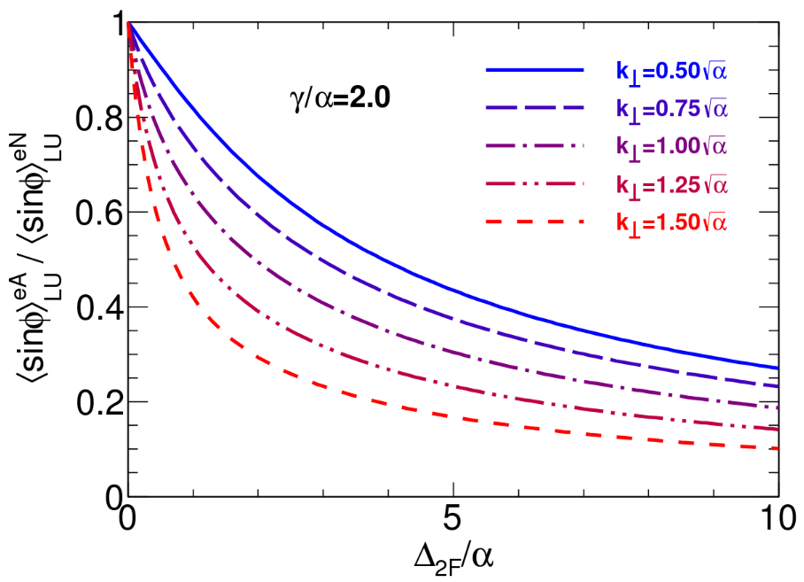
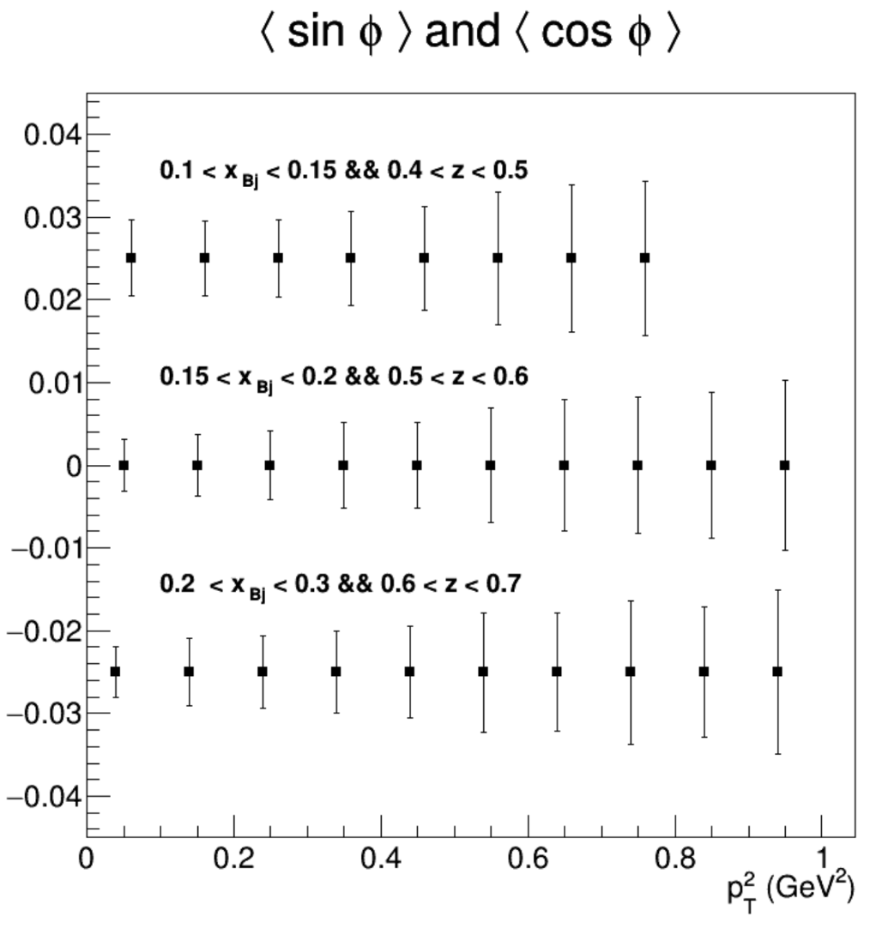
RG-D: Nuclear TMDs
E12-06-106A: nTMDs study uses the same CT running conditions except the beam polarization, and aims to explore​:
Fragmentation functions in nuclei​
Nuclear asymmetries at the partonic level​
Missing part of nuclear effects description​
Goal:
Measure the cos and sin modulations for p²_{T}
Mesure multiplicity ratios
For both charged pions and kaons
Accesses transport coefficient at parton level
Ratio of sin asymmetries nuclei to nucleon
Projected statistical error bars for sin and cos moments

Slide 5
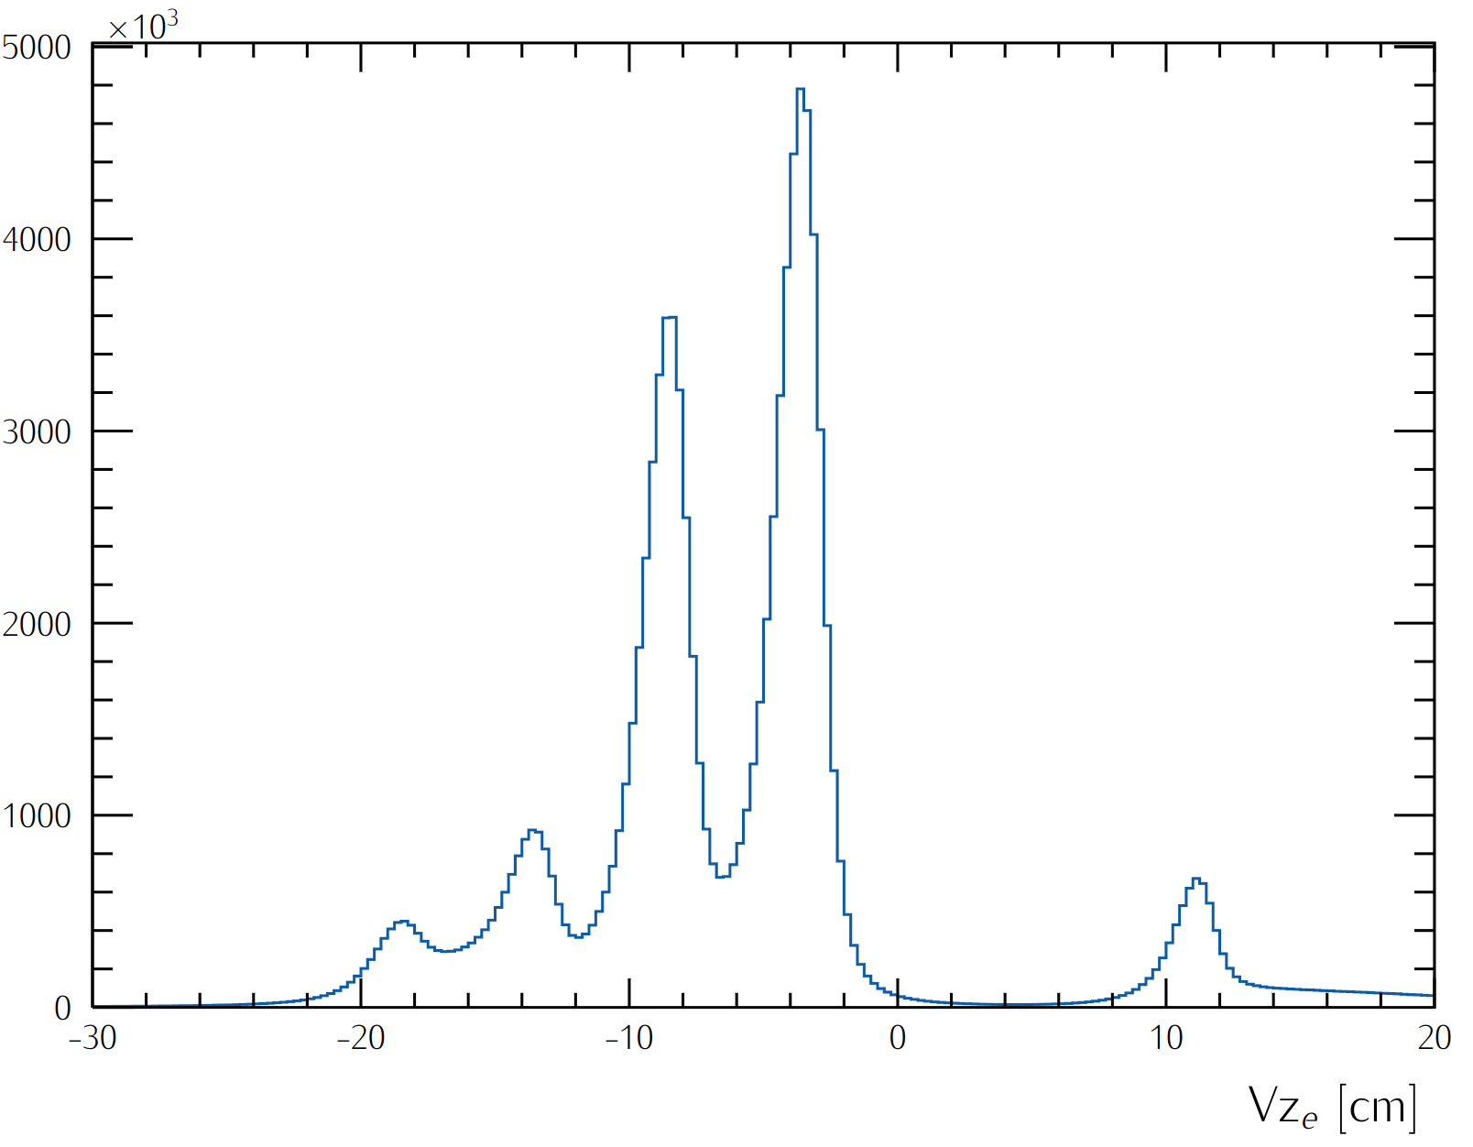
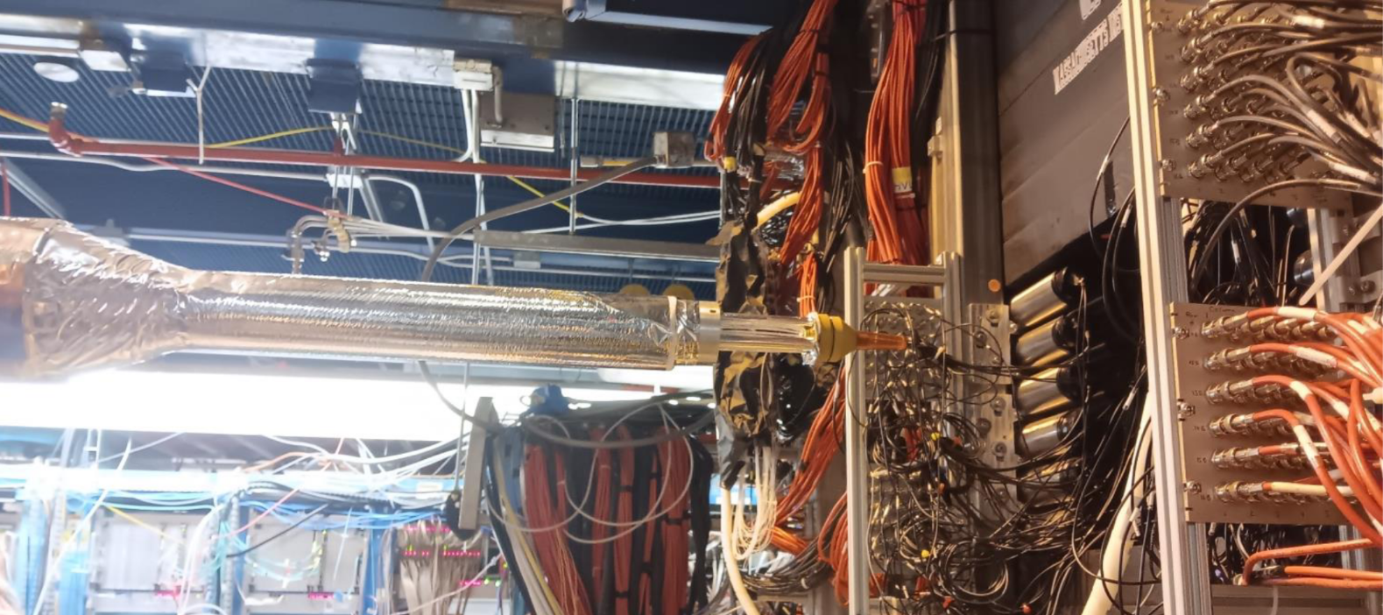
RG-D Run Configuration
RG-D experiments ran with:
10.54 GeV polarized beam with I= 5–175 nA for luminosity scans and production
Standard CLAS12 configuration with FT-OFF and three layers of FMT
Three target configurations, LD2, CxC, and CuSn, used with Inbending and Outbending torus magnet setup
New cryogenic LD2 and the nuclear-foil flag assembly centered at -5 cm for each configuration
Main run hiccups:
Faraday Cup vacuum contamination
Moller cone sagging
Sn target
Cu target
LD2 exit window
Scattering chamber entrance
LD2 entrance window

Slide 6
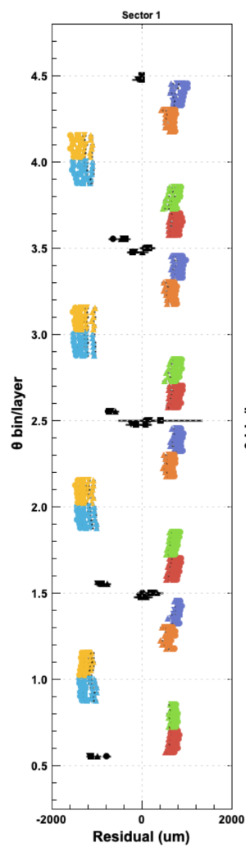
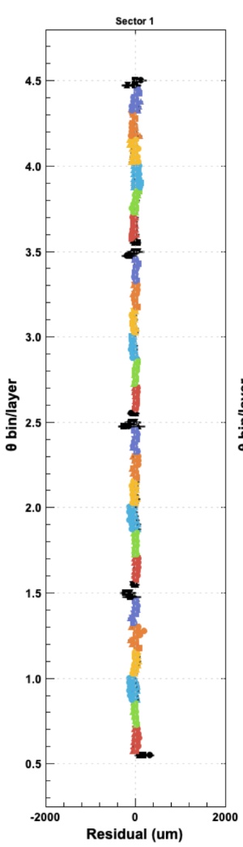
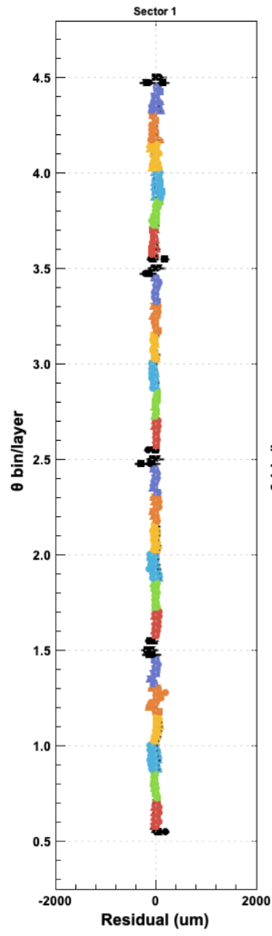
RG-D Status: DC Alignment
Alignment:
DC alignment using zero-field run is completed
Plots show tracks:
Fit residuals (colored points) and vertex residuals (black symbols) vs. θ bin.
Different symbols (circle, square, triangle, etc.) represent different φ bins
Colors denote different superlayers
Y-axis represents θ bins
Nominal geometry
First+Second alignment
Final alignment
Thanks to R. De Vita and M. Maynes

Slide 7
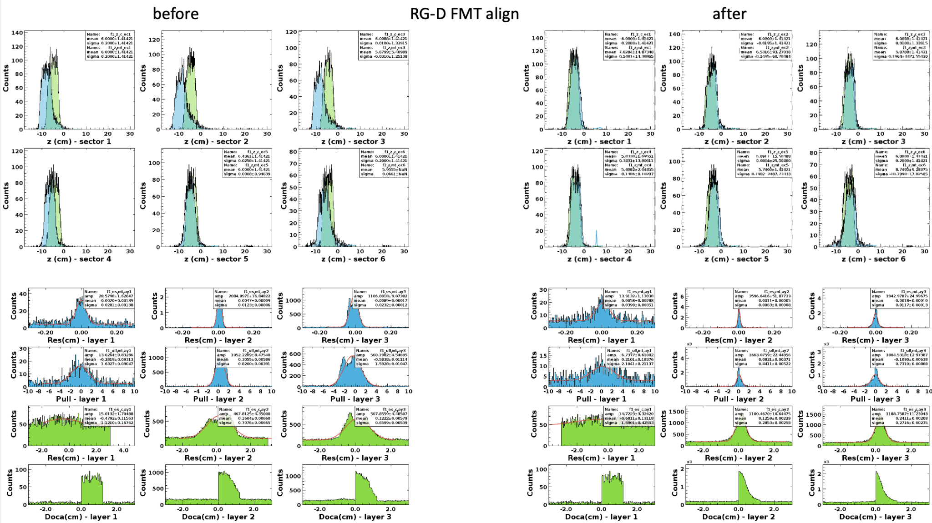
RG-D Status: FMT Alignment
The final FMT alignment constants were extracted using the zero-field and cosmic runs, and uploaded for layers 2 and 3 (layer 1 disk was not functional in RG-D).
Thanks to Y. Gotra

Slide 8
RG-D Status: Calibration Summary
Beam offsets: transverse X and Y positions for FD and CD were calibrated and CVT z-offset was adjusted
RF calibration is done
FTOF and CTOF calibrations are almost finalized depending on the to-be-produced timelines after the latest iterations
RICH: time calibration is finalized
LTCC: calibration of the per-sector number of photoelectrons is completed
ECal: time residual offsets were updated for IB and OB datasets (awaits timelines check)
CND calibration is almost finalized depending on the to-be-produced timelines after the latest iterations
HTCC and DC calibrations are in progress
Thanks to the CalCom group support

Slide 9
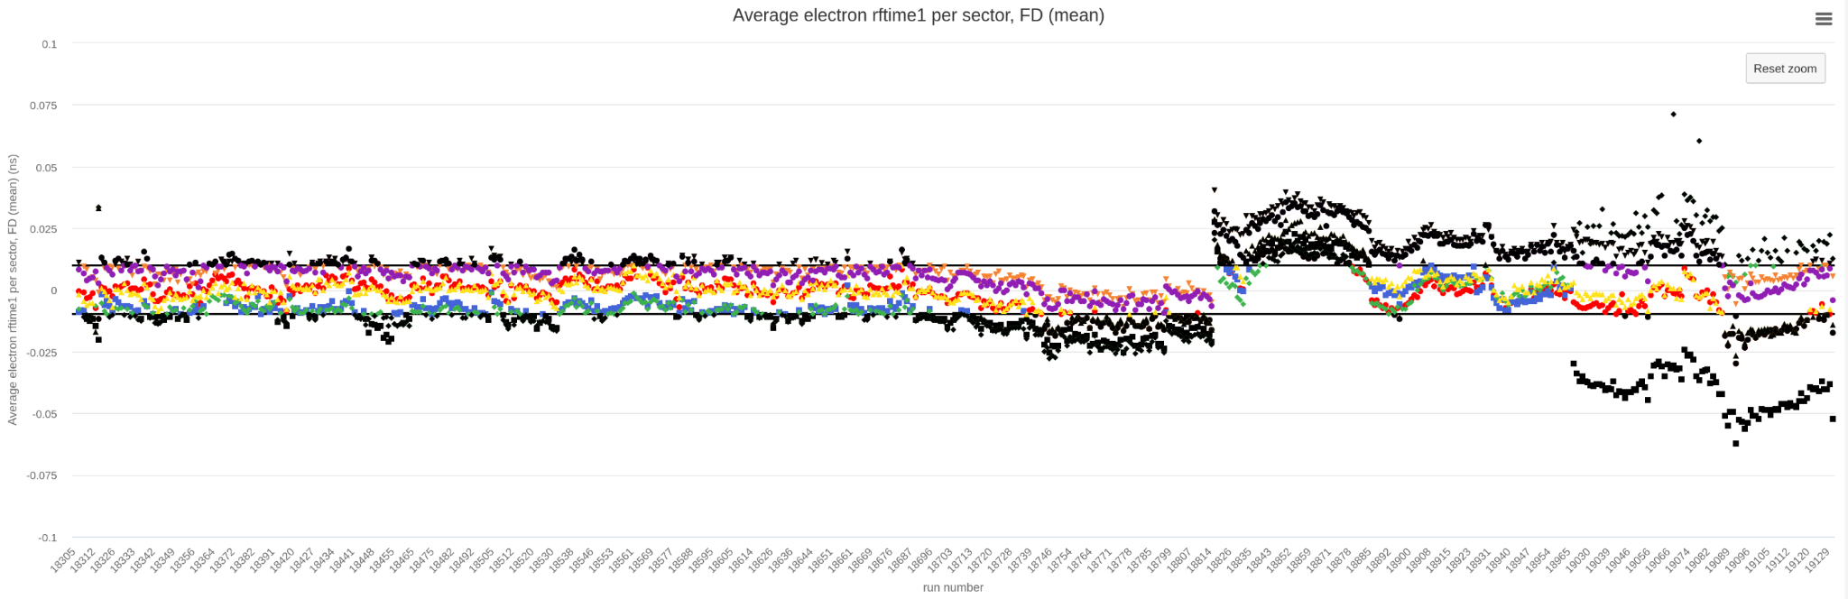
Data Processing Summary
Timelines monitoring:
The first three timelines for RG-D datasets were done online
September 4th: Pass0v4 was processed after the final DC alignment, beam offsets, and CVT z-offset adjustment
Timelines are available here
For more details, please visit the RG-D analysis wikipage

Slide 10
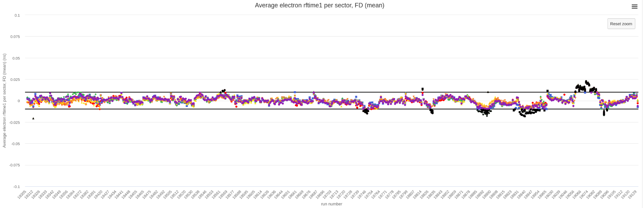
Data Processing Summary
Timelines monitoring:
October 14th: Pass0v5: Pass0v4 conditions + first-round of FTOF and CTOF, and partial ECal energy calibrations
Timelines are available here
For more details, please visit the RG-D analysis wikipage

Slide 11
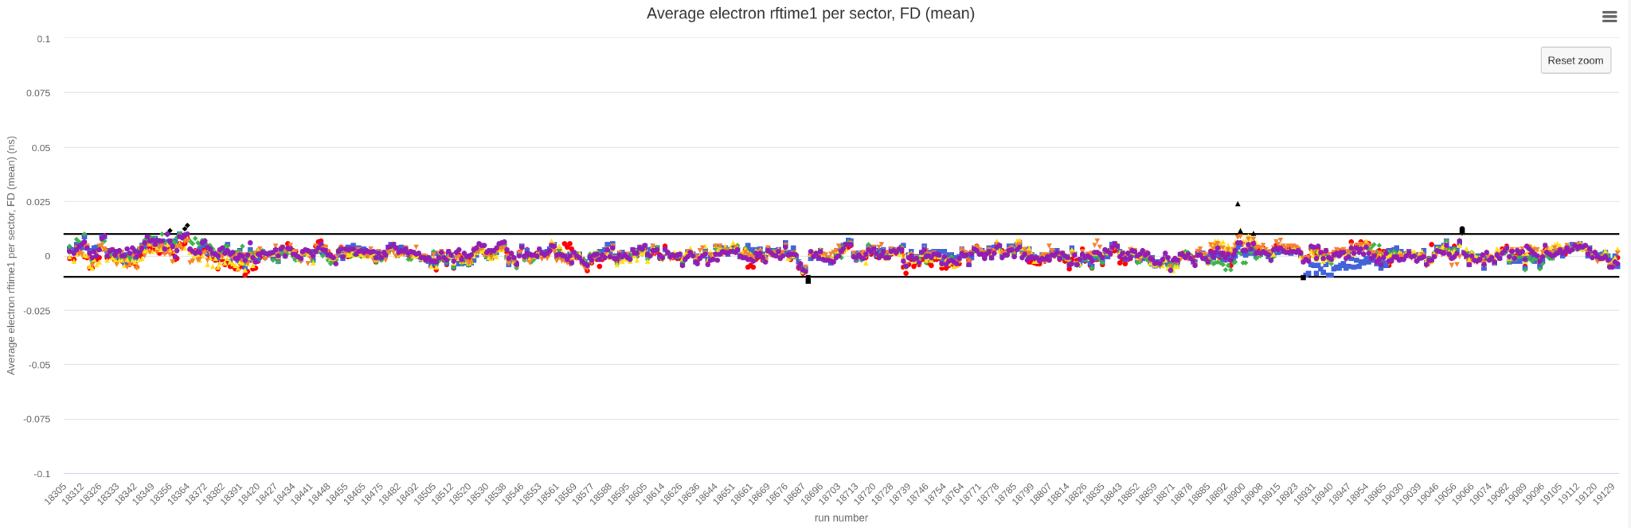
Data Processing Summary
Timelines monitoring:
October 23th: Pass0v6: Pass0v5 conditions + first round of RF calibration
Timelines are available here
For more details, please visit the RG-D analysis wikipage

Slide 12
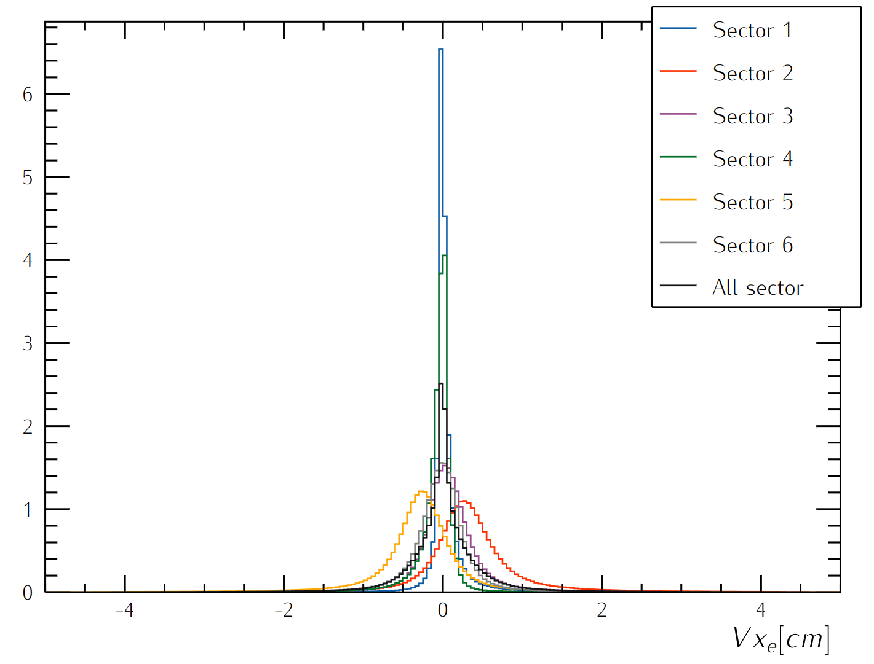
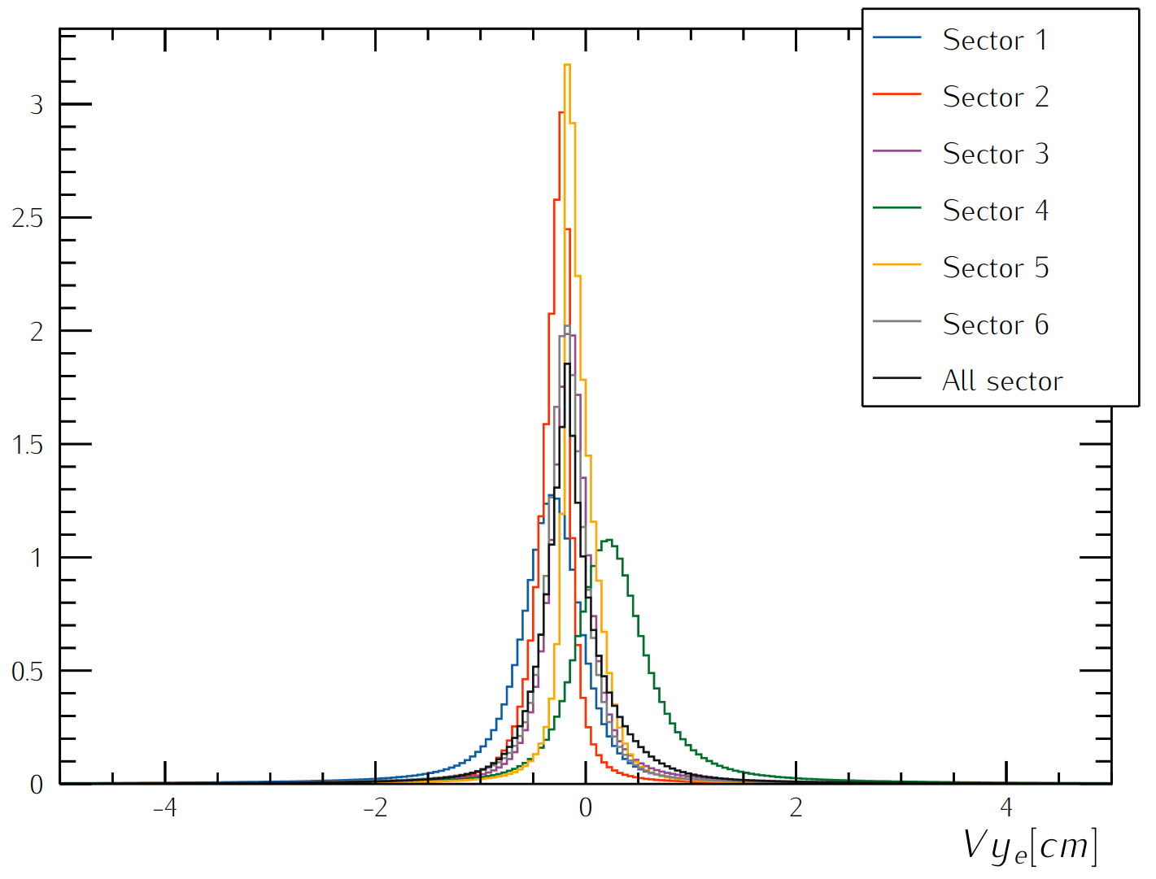
RG-D Vertex Studies
Goal:
Check whether all sectors are well aligned in Vx, Vy and Vz distributions
Could sector-independent cuts on Vx, Vy and Vz be applied?
Reduce the contamination for the target configuration with two different foils, Cu and Sn

Slide 13
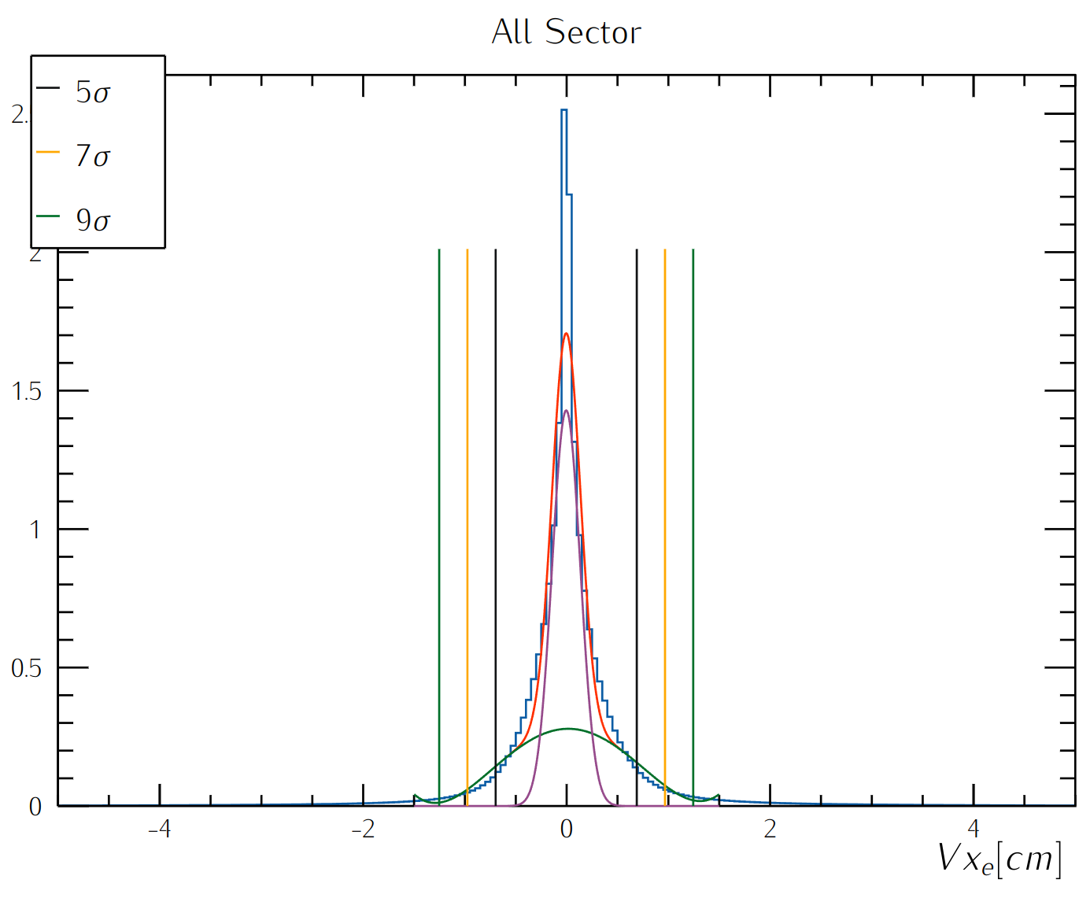
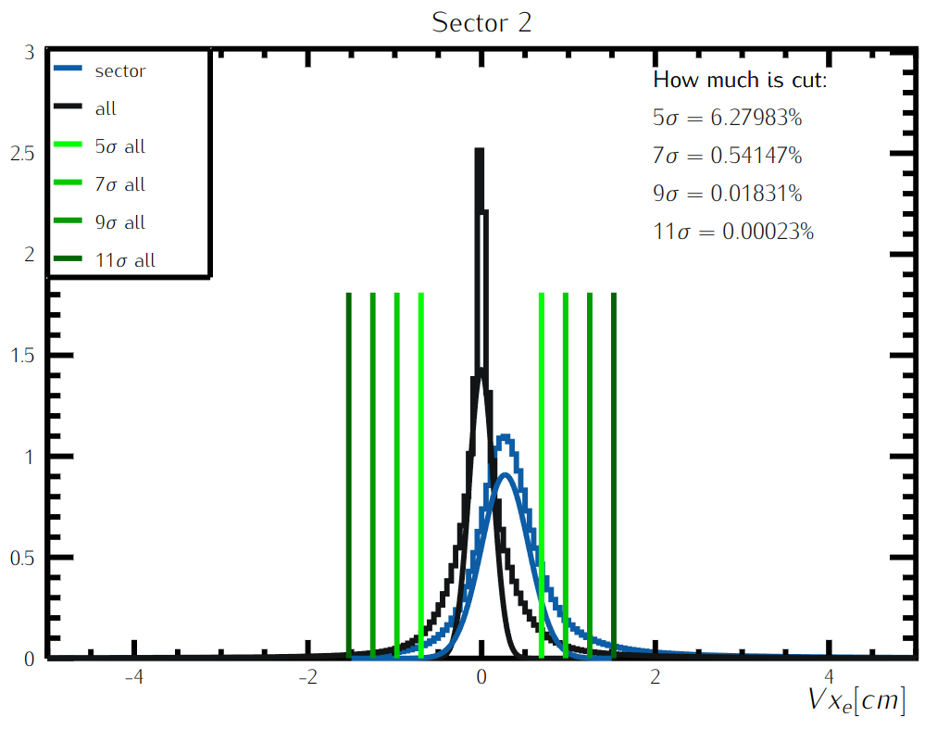
RG-D Vertex Studies: Transverse Components
Get rid of sector-dependent cuts for Vx

Slide 14
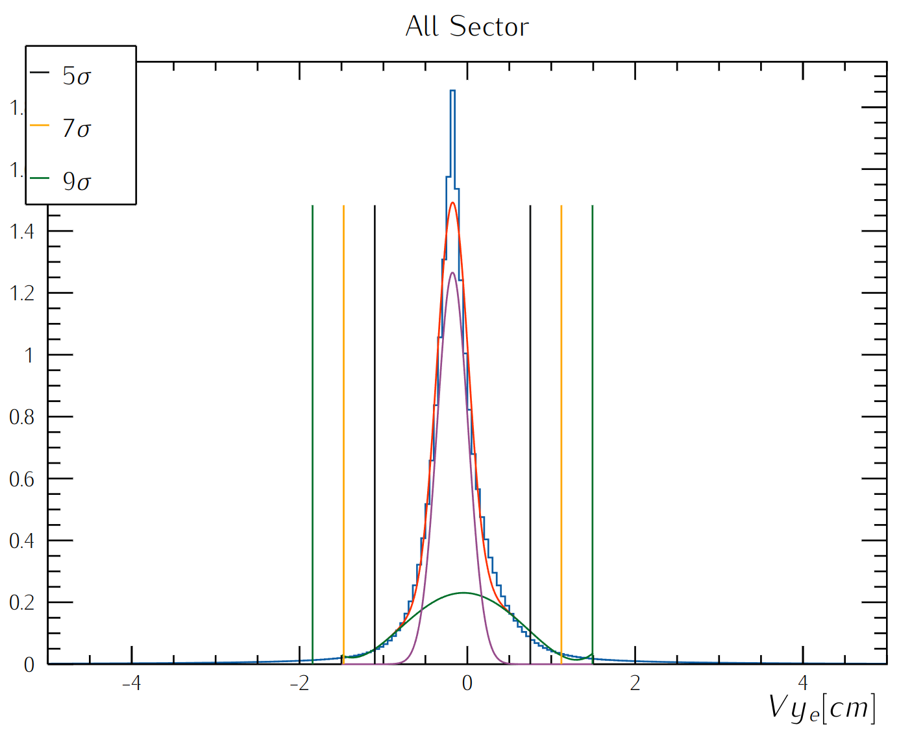
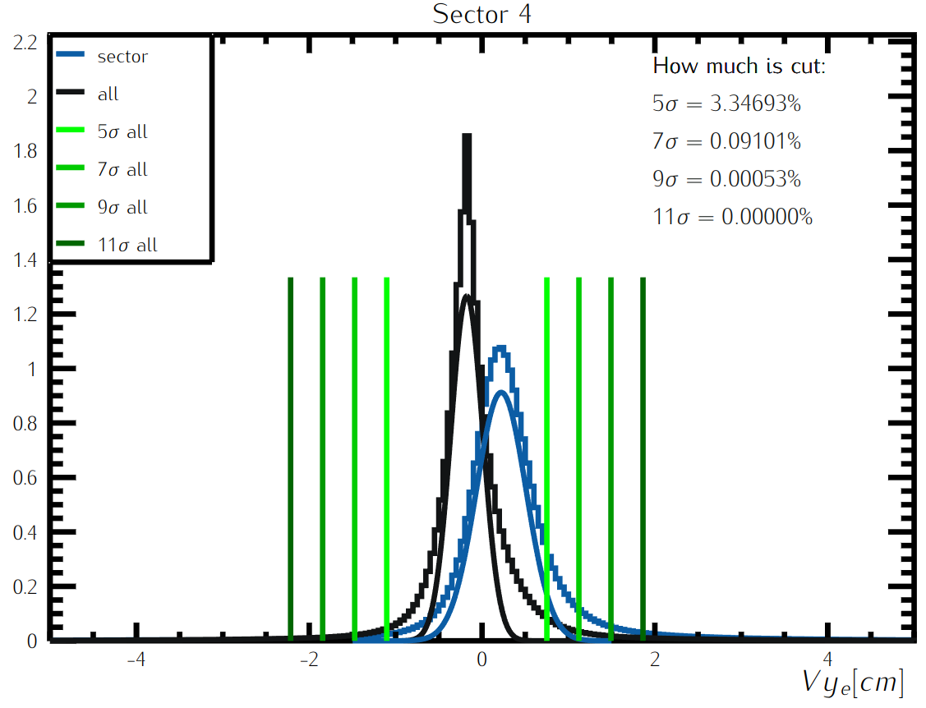
RG-D Vertex Studies: Transverse Components
Get rid of sector-dependent cuts for Vy

Slide 15
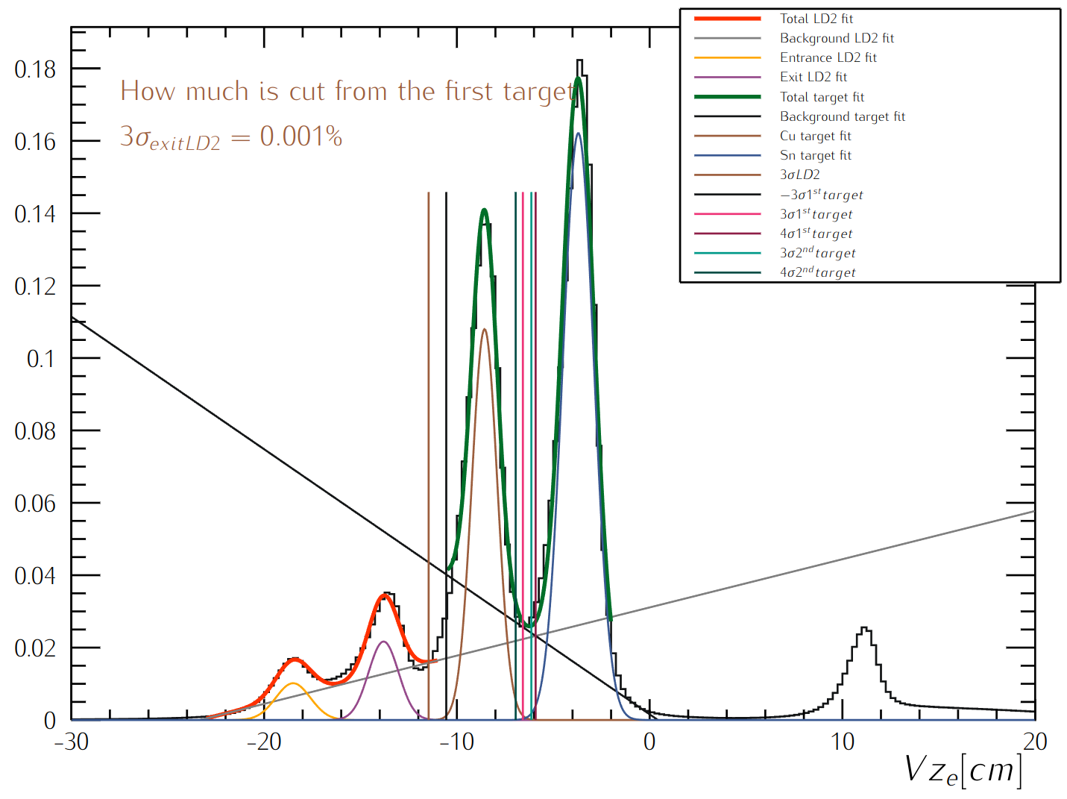
RG-D Vertex Studies: z-Vertex
Fits:
Fit the empty LD2 cell and nuclear-foil regions with double gaussians and first-order polynomial
Separate the two different foils, Cu and Sn from each other
Same study is performed for carbon
Similar study is underway for hadrons
Target | z-Vertex (cm)
LD2 | [-20, 5]
C | [-10.784, 5]
Cu | [-11.463, -6.576]
Sn | [-6.137, 5]
Empty LD2 cell
Nuclear-foil

Slide 16
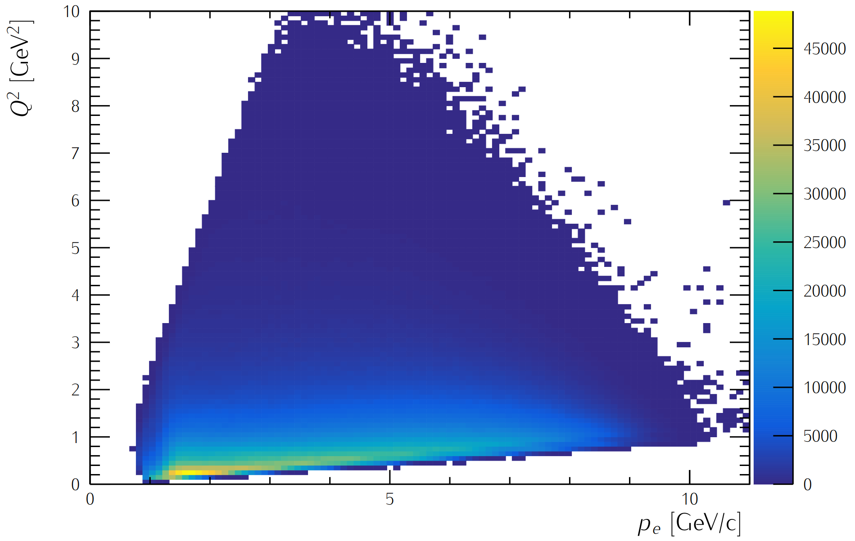
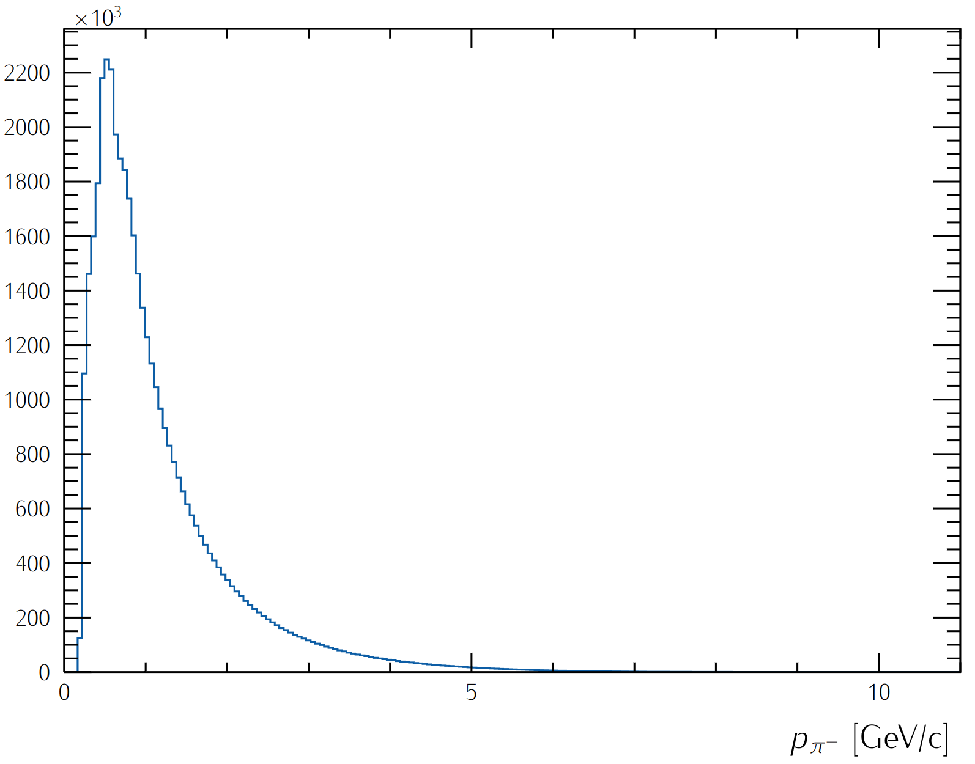
RG-D Analysis Study: Particle IDentification
Electron:
PID= 11
Status< 0
-5 < chi2pid < 5
Charged pions, π±:
PID (+/-) = (+/-) 211
-10 < chi2pid < 10

Slide 17
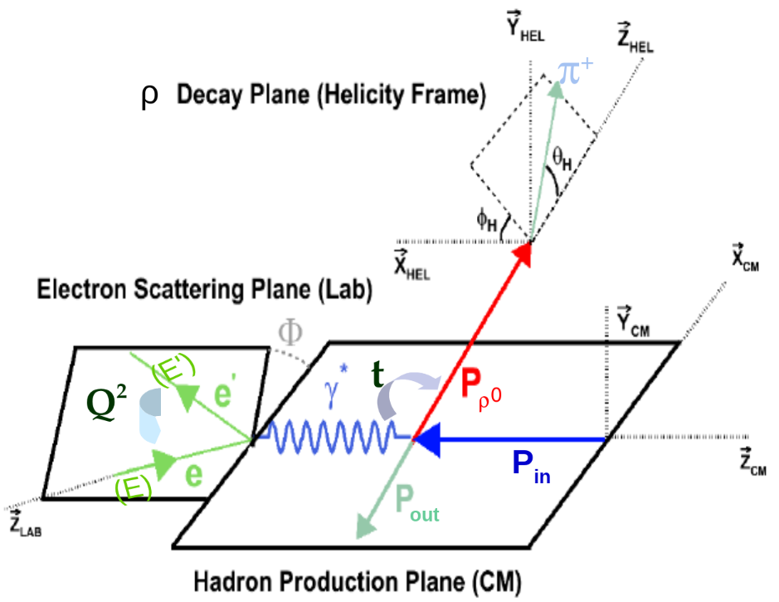
RG-D CT Study: Kinematical Cuts
ν= E - E’: virtual photon(γ*) energy in the Lab frame,
Q²= -(P_{e}- P_{e’})²= 4EE’sin²(θ/2): photon virtuality,
t= (P_{γ*} - P_{γ})²: momentum transfer square,
W²= (P_{in} + P_{γ*})²= -Q² + M_{p}² + 2M_{p}ν: invariant mass squared in (γ*, p) center of mass (CM).
Kinematical cuts:
W> 2 GeV ↦ avoid resonance region
z_{h}= E_{h}/ν > 0.9 ↦ select elastic channel
-t > 0.1 GeV² ↦ exclude coherent production
-t < 0.5 GeV² ↦ select diffractive process

Slide 18
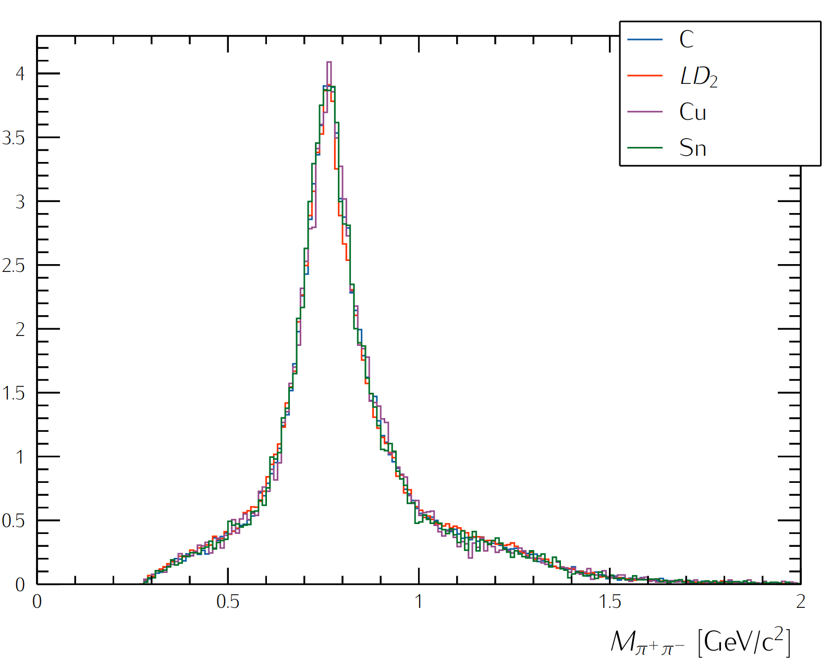
CT Study: Two-pion Invariant Mass

Slide 19
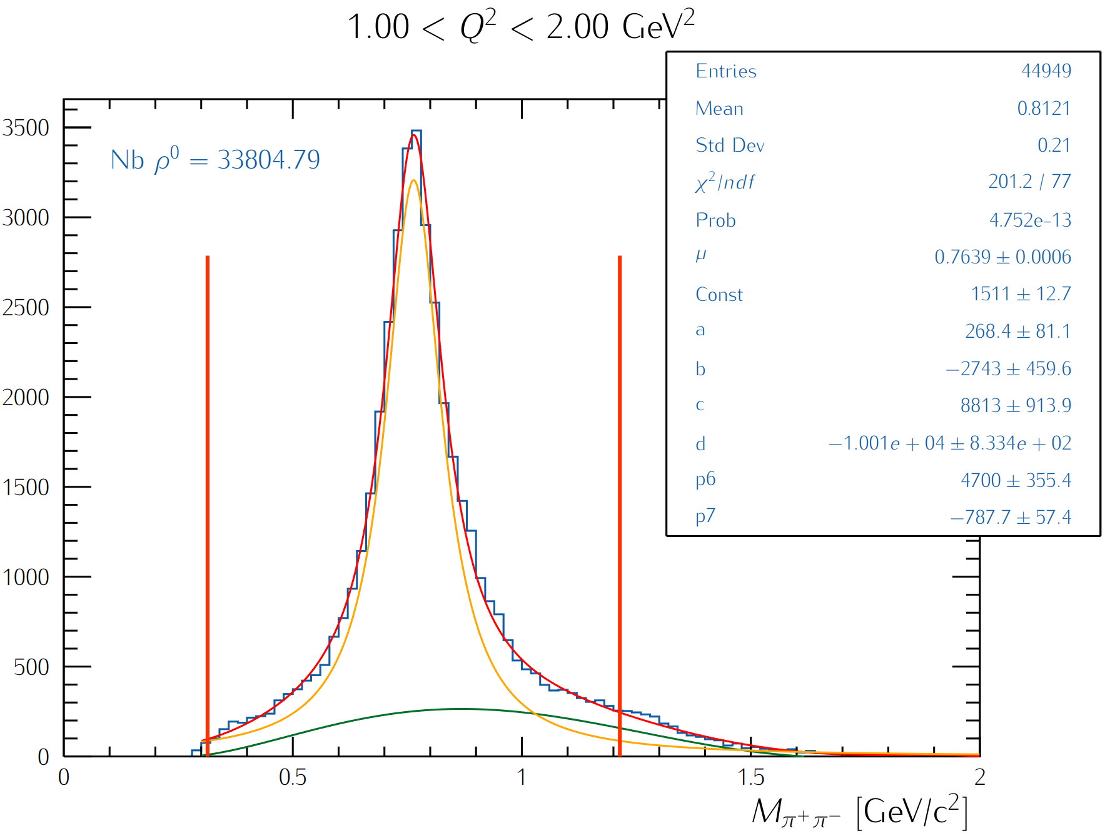
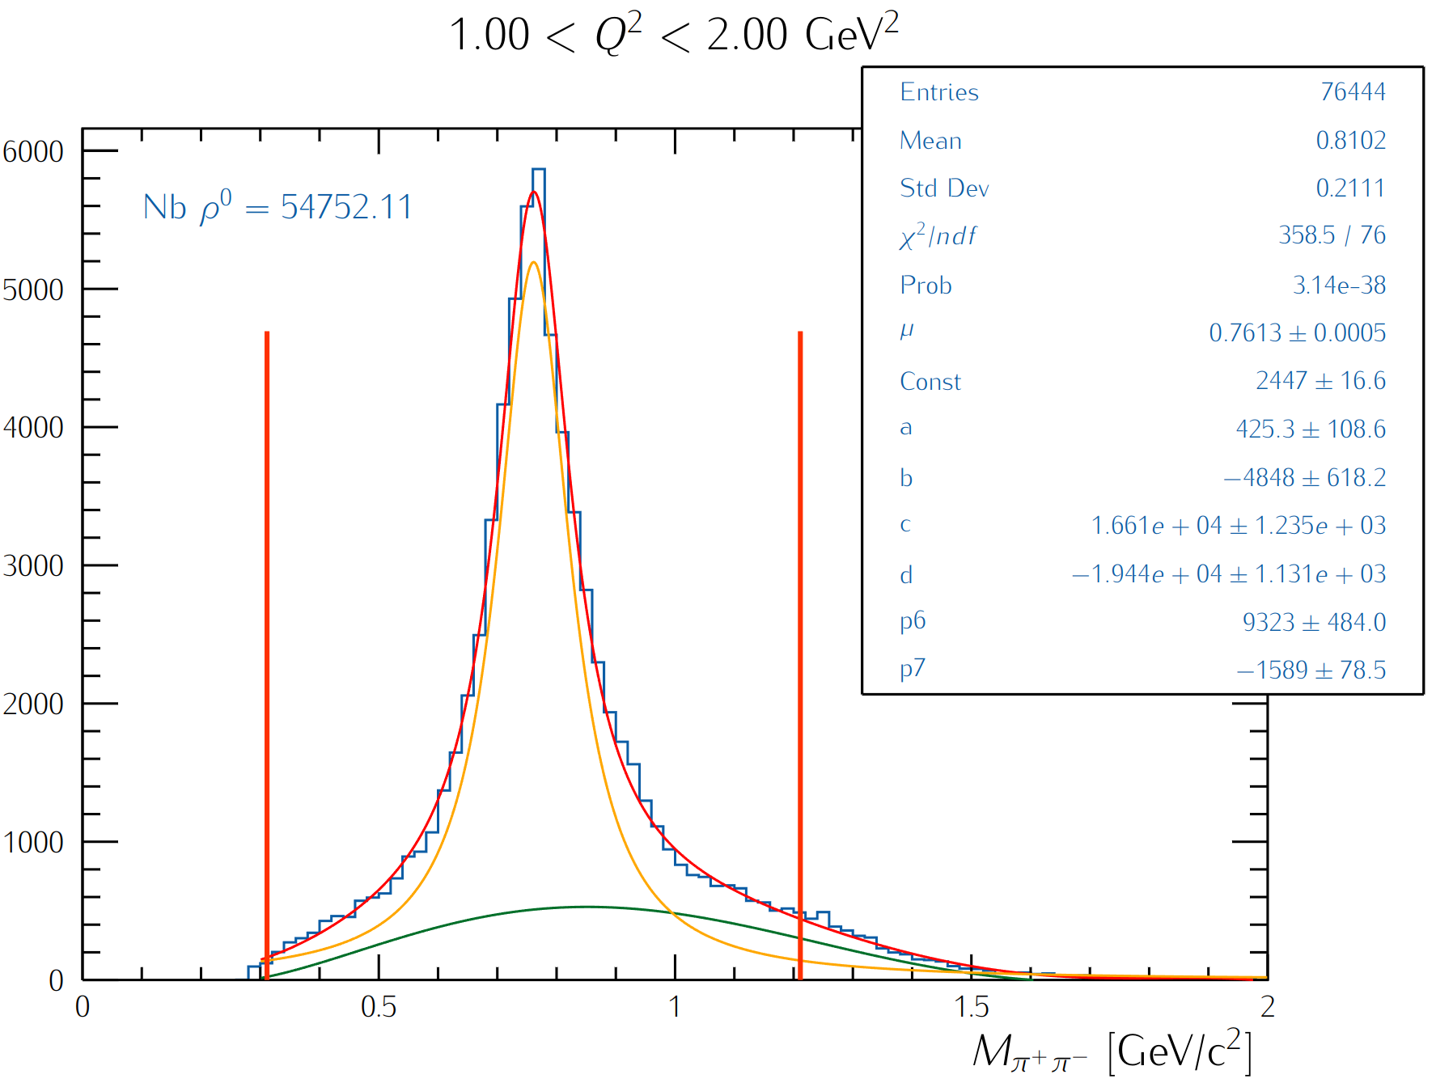
CT Study: Two-pion Invariant Mass
Fit the invariant mass shapes for the two-oppositely charged pions with a Breit-Wigner and three-order polynomial function (the latter will be replaced with the simulated background shape)
Extract ρ⁰ yield by integrating the background-subtracted BW within a 3σ range
Carbon data
LD2 data

Slide 20
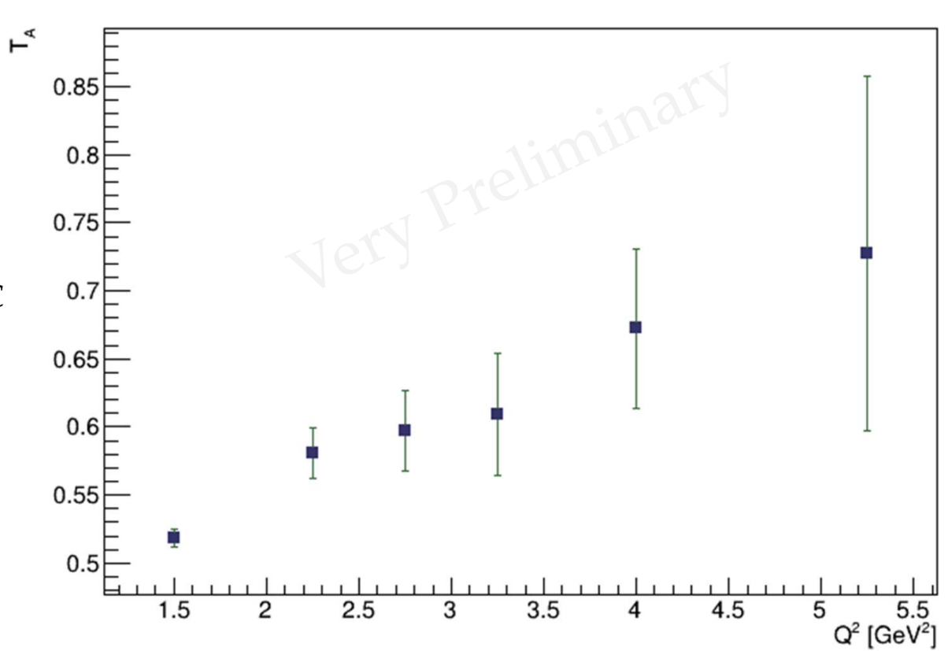
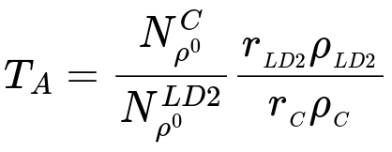
RG-D Color Transparency Study
Extract the nuclear transparency:
r_{LD2}= 5 cm: LD2 thickness
r_{CxC} = 0.4 cm: is CxC thickness
ρ_{LD2}= 0.164 g/cm³: LD2 density
ρ_{C}= 2.2g/cm³ : carbon density
Ongoing analysis by M. Maynes

Slide 21
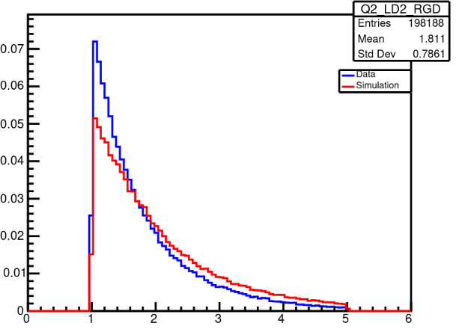
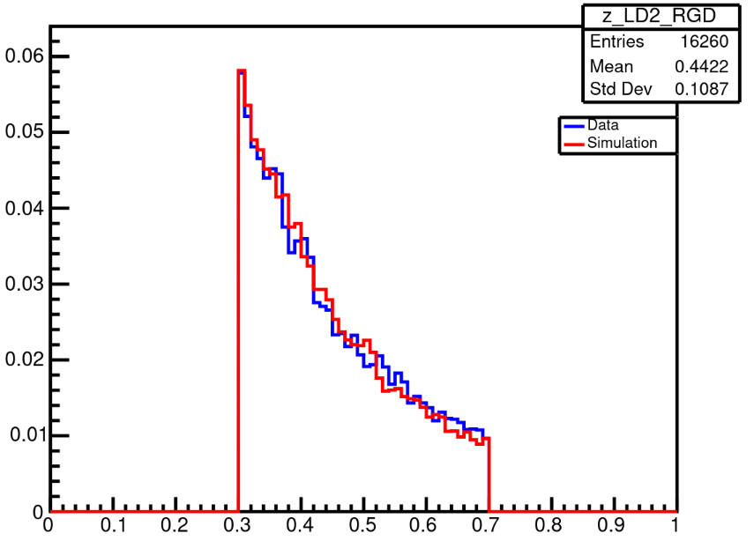
RG-D nTMDs Studies: Positively-charged Pion
Ongoing simulation efforts: preliminary results
Simulations are produced using modified version of Pythia
Comparing experimental data to simulation
Analysis by D. Matamoros
LD2
LD2
Q² [GeV²]
z_{h}
Parallel nTMDs analysis for charged pions by S. Shrestha

Slide 22
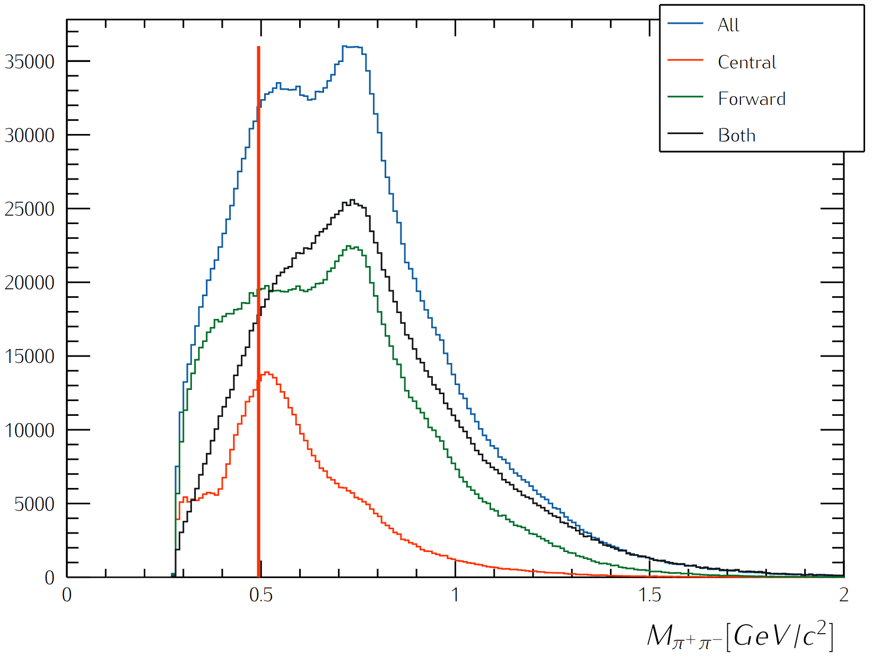
RG-D nTMDs Studies: K-short Channel
First look at the K⁰ channel to extract multiplicity ratios and azimuthal asymmetries:
In-progress studies to improve the two-pion invariant mass reconstruction in the mass region of interest
Kinematical cuts:
W> 2 GeV
Q²>1 GeV²
z_{h}< 0.7
|ΔVz| < 3 cm
by M. Ouillon

Slide 23
Summary and Outlook
Calibration is progressing as planned within the three-month timeframe:
RF, LTCC, and RICH calibrations are completed
DC and HTCC calibrations are underway
FTOF, CTOF, ECal, and CND are almost done depending on the to-be-produced timelines
New AI network will be trained after finalizing the DC calibration
Developing analysis tools for CT and nTMDs studies to
improve vertex cuts and corrections, if needed, due to any observed angular dependencies
implement fiducial cuts
perform background merging
use the ρ⁰ event generator for its two-pion invariant mass background subtraction
extract the CT signal for Cu and Sn in addition to C
improve the K⁰ identification method and extract its preliminary asymmetry results
obtain the preliminary asymmetry results for charged pions nTMDs studies

Slide 24
Backup

Slide 25
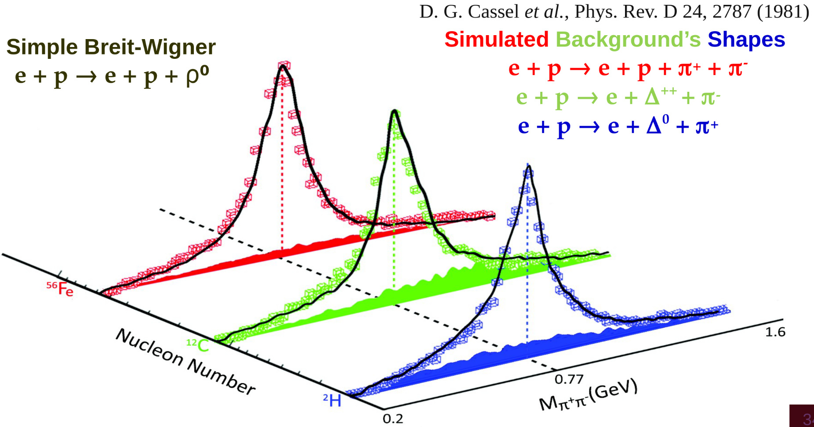
CT Study: Two-pion Invariant Mass
Our event generator incorporates the measured cross sections by Cassel et al. for the electroproduction of ρ⁰ and the three main background processes

