Slide 1



Update on RG-D Experiments:
Calibration and Analysis Status
Mathieu Ouillon (Mississippi State University)
CLAS Collaboration (5 March, 2025)

Slide 2
Run Group D​
RG-D is composed of two experiments:
Study of Color Transparency (CT) in Exclusive Vector Meson Electroproduction off Nuclei (E12-06-106)​:
Spokespeople: W. Armstrong¹ , L. El Fassi³ , K. Hafidi¹ , M. Holtrop⁴, and B. Mustapha^{1​}
Nuclear Transverse Momentum Distributions (nTMDs) in CLAS12 (E12-06-106A)​:
Spokespeople: R. Dupré² , L. El Fassi³ , Zein-Eddine Meziani¹ , and Holly Szumila-Vance​⁵
¹: Argonne National Lab, ²: IJCLAB, Orsay, France ³: Mississippi State U., ⁴: University of New-Hampshire, ⁵: Jefferson Lab

Slide 3
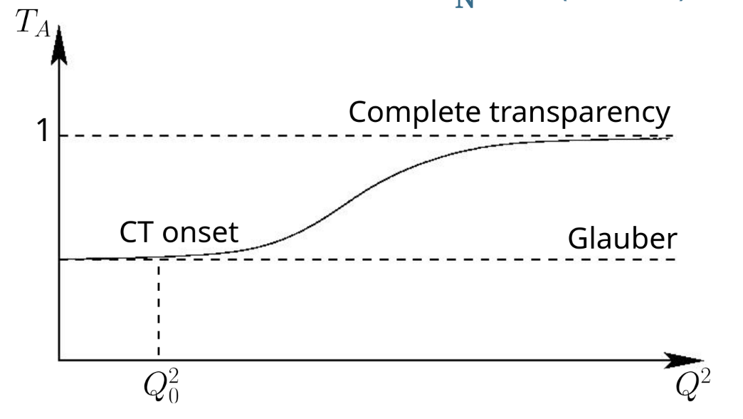
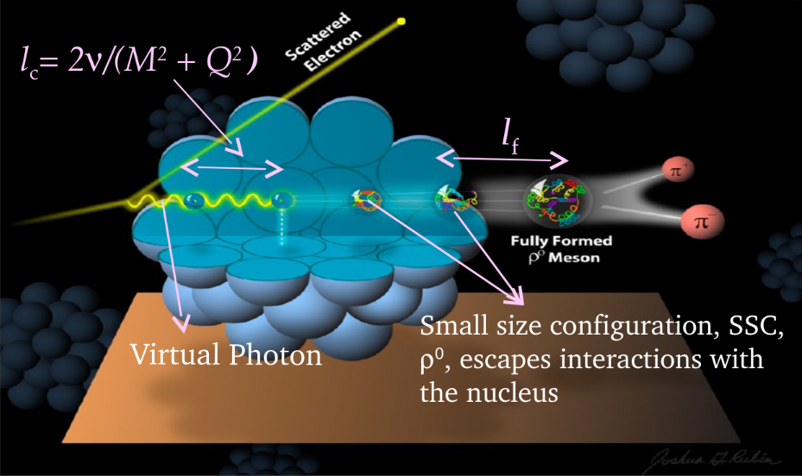
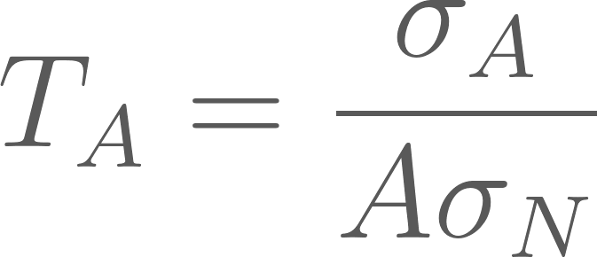
RG-D: CT Experiment​
E12-06-106, CT - the experimental signature of CT is the rise of the nuclear transparency, T_{A} as a function of Q²: ​
T_{A} is defined as the ratio of the cross section per nucleon on a bound nucleon to that on a free nucleon
σ_{A} − nuclei cross section
σ_{N} − free nucleon cross section
Coherence length, l_{c}: the lifetime of the qq-bar pair
Formation time, l_{f}: the time evolution of small size configurations (SSC) to an on-shell ρ⁰ meson​​
Virtual photon
Small size configuration (SSC),​ ρ⁰, is the nuclear cross section​ escapes interactions with the nucleus​

Slide 4
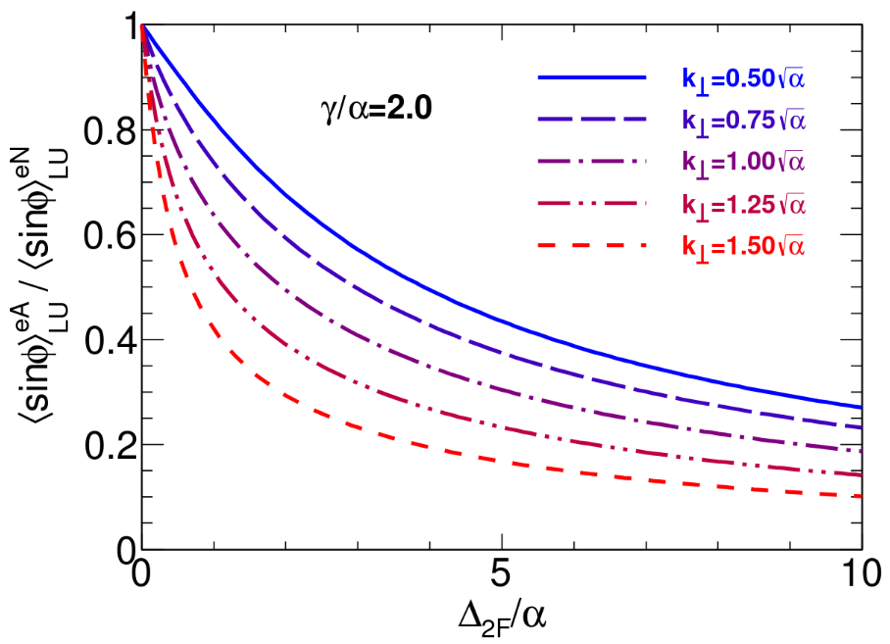
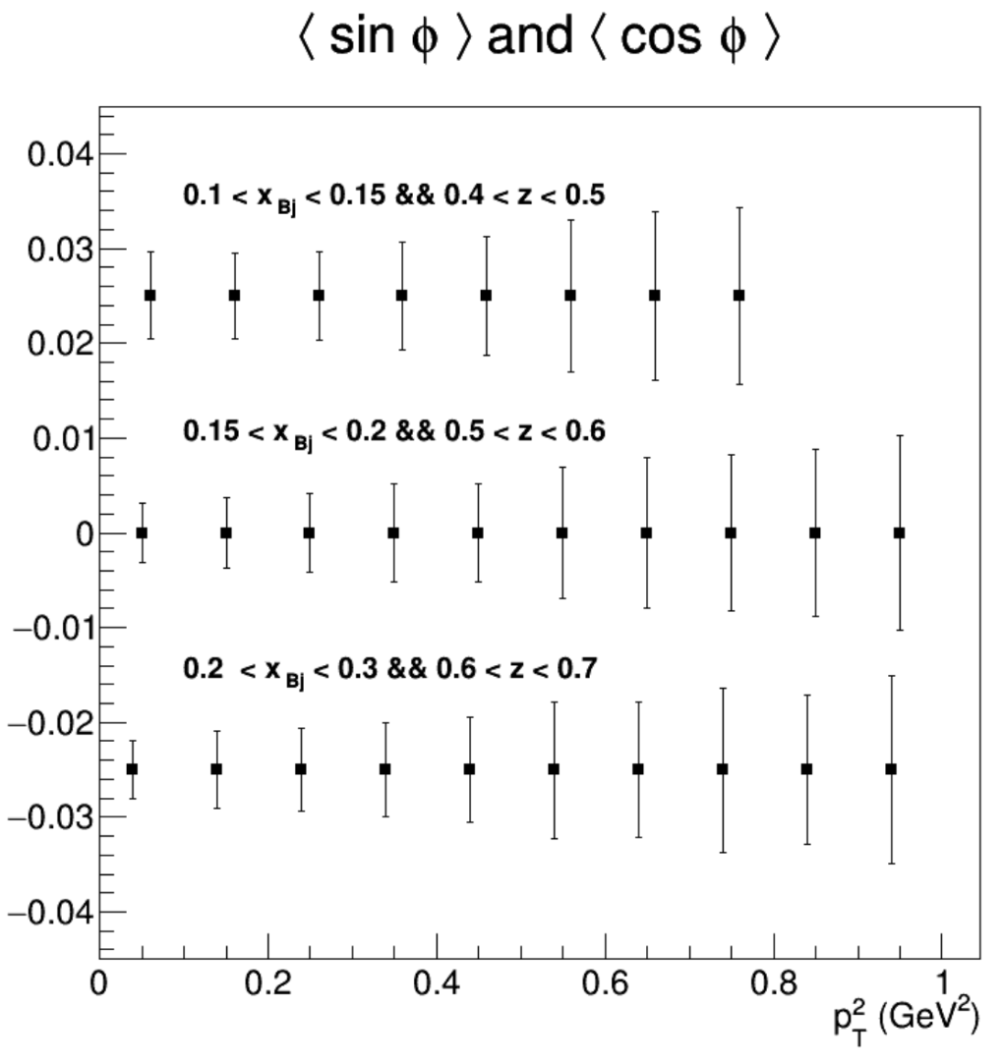
RG-D: Nuclear TMDs
E12-06-106A: nTMDs study uses the same CT running conditions except the beam polarization, and aims to explore​:
Fragmentation functions in nuclei​
Nuclear asymmetries at the partonic level​
Missing part of nuclear effects description​
Goal:
Measure the cos and sin modulations for p²_{T}
Mesure multiplicity ratios
For both charged pions and kaons
Accesses transport coefficient at parton level
Ratio of sin asymmetries nuclei to nucleon
Projected statistical error bars for sin and cos moments

Slide 5
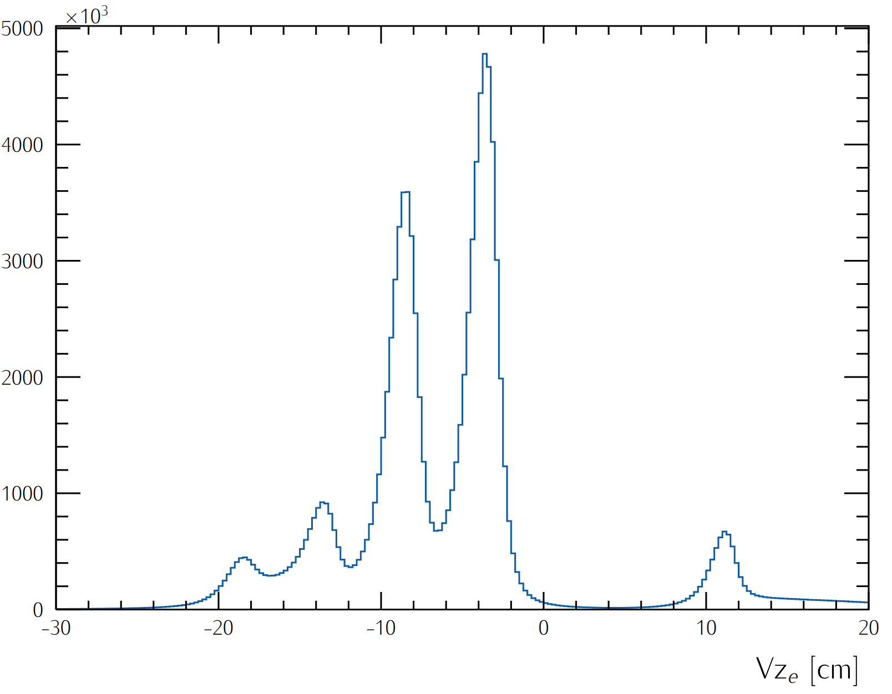
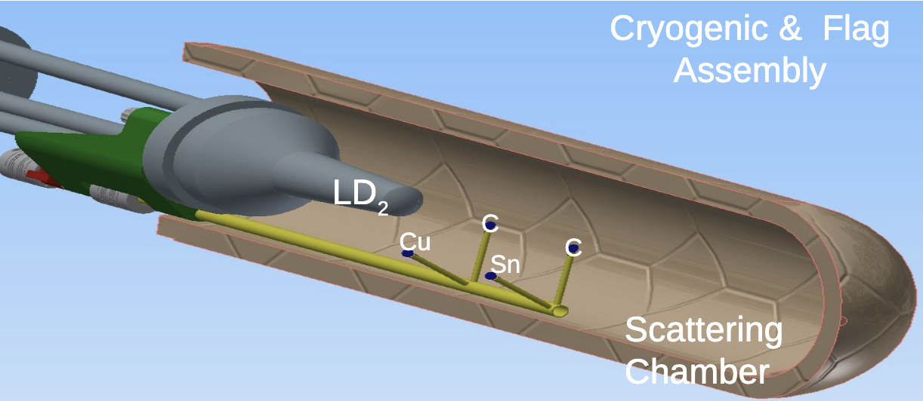
RG-D Run Configuration
RG-D experiments collected data in the fall of 2023 with
10.54 GeV polarized beam energy and I= 5–175 nA for luminosity scans and production
Standard CLAS12 configuration with FT-OFF and three layers of FMT
Three target configurations, LD2, CxC, and CuSn, deployed with InBending and OutBending torus polarity
New cryogenic LD2 and the nuclear-foil flag assembly centered at -5 cm for each configuration
Main run hiccups:
Faraday Cup vacuum contamination
Moller cone sagging
Sn target
Cu target
LD2 exit window
Scattering Chamber exit window
LD2 entrance window

Slide 6
RG-D Status: Calibration Summary
The calibration of most subsystems LTCC, FTOF, ECal, HTCC, RICH, and CND is done
DC: T0 and T2D calibrations are in an advanced stage and expected to converge soon, depending on the to-be-produced timelines after the latest iteration
Minor fine-tuning occurred since November’s report for
CTOF: Some parameters such as attenuation length, effective velocity, gain balance, and time offsets were re-calibrated for unstable run ranges
HTCC: Performed a 4 ns time adjustment for a few unstable runs and sectors
ECal: Performed a second iteration for the time resolution and time-walk correction to reduce the observed gain offsets for IB and OB datasets
Thanks to CalCom Experts for their support

Slide 7
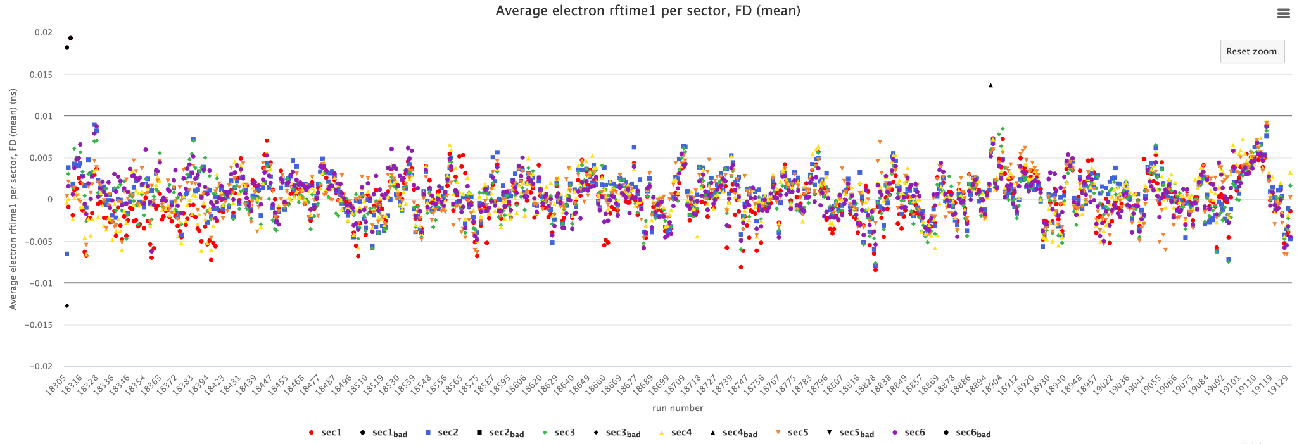
Data Processing Summary
Timelines monitoring:
November 18th, 2024: Pass0v7 was processed after a new iteration of RF, FTOF, ECal, LTCC, CTOF, CND, and HTCC calibration
Timelines are available here
For more details, please visit the RG-D analysis wikipage

Slide 8
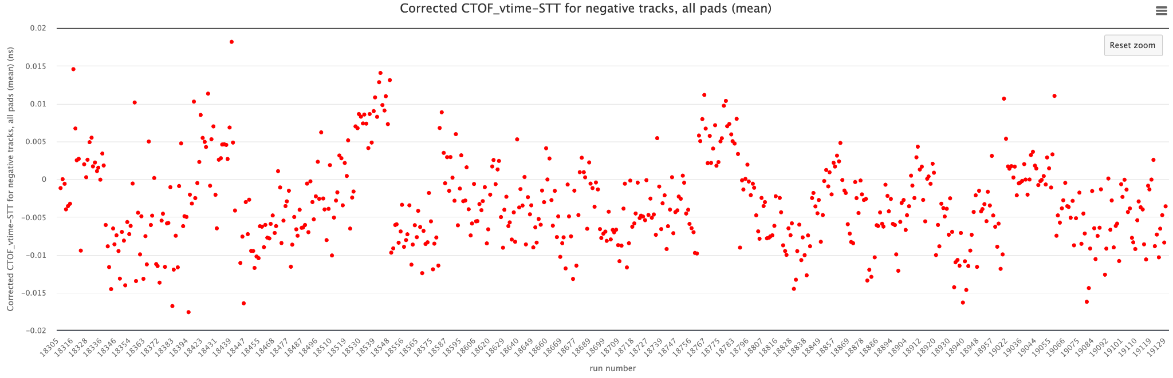
Data Processing Summary
Timelines monitoring:
January 24th, 2025; Pass0v8: Processed with same Pass0v7 conditions + cross-check of reconstructed CND and CVT vertex difference (zdiff), second iteration of the ECal time resolution and time walk correction, fine-tuning of CTOF parameters along with HTCC 4 ns time adjustment for some unstable runs.
Timelines are available here

Slide 9
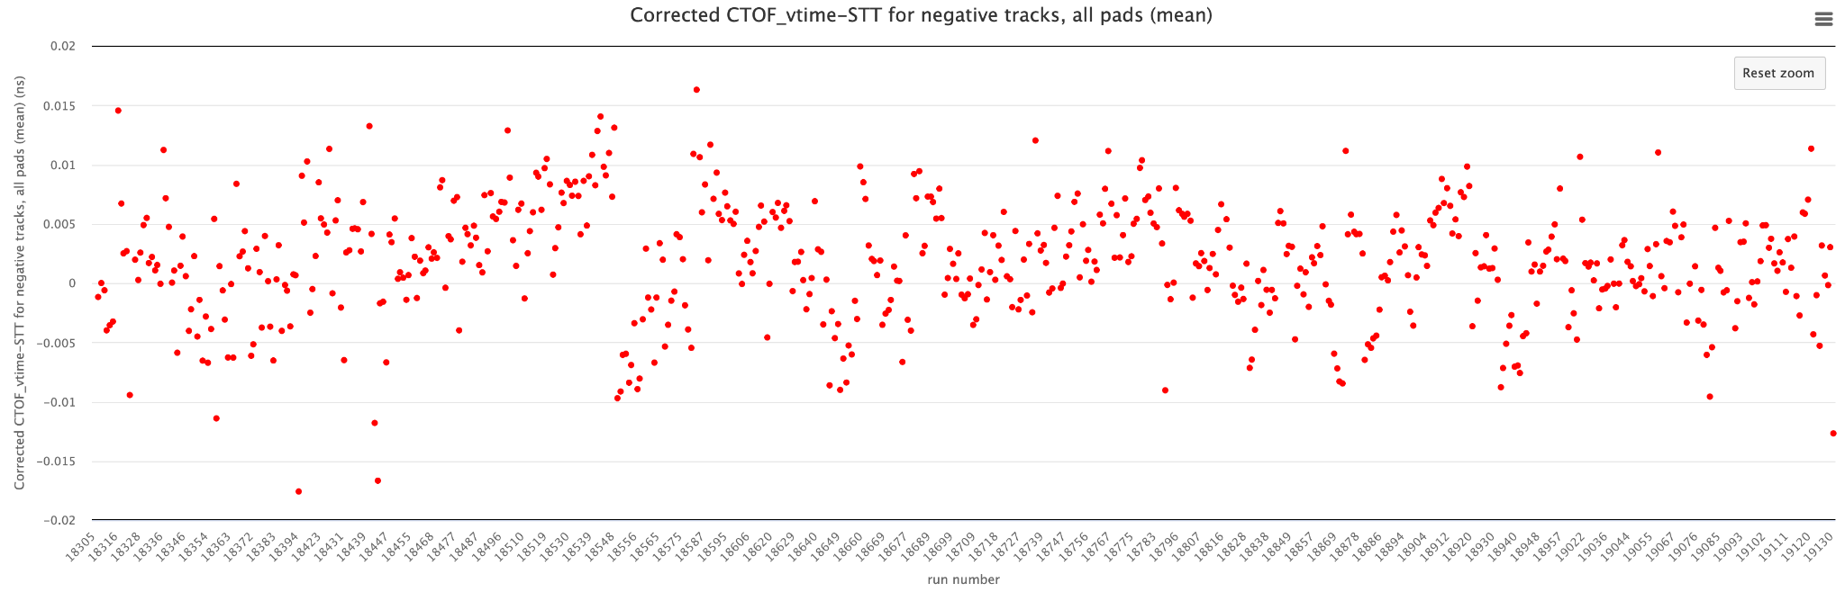
Data Processing Summary
Timelines monitoring:
February 01st, 2025; Pass0v9: Processed with same Pass0v8 conditions + CD vertex cut to restore the selection zone of good tracks that was affected after updating the CCDB with the actual RG-D solid target material/geometry (ongoing work to find a robust solution for this issue)
Timelines are available here

Slide 10
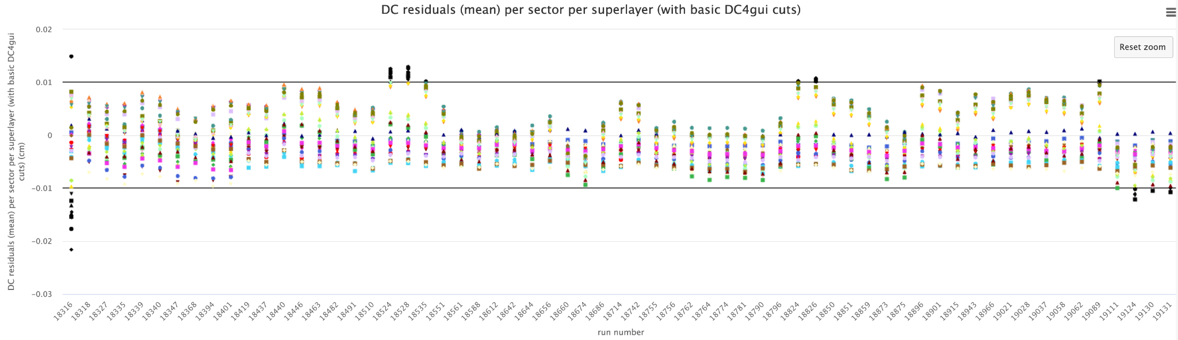
Data Processing Summary
Timelines monitoring:
February 14th, 2025; Pass0v9_dc: DC mini-timelines produced with same Pass0v9 conditions to check the quality of the newly extracted T2D and pressure calibration constants
Timelines are available here
Mean

Slide 11
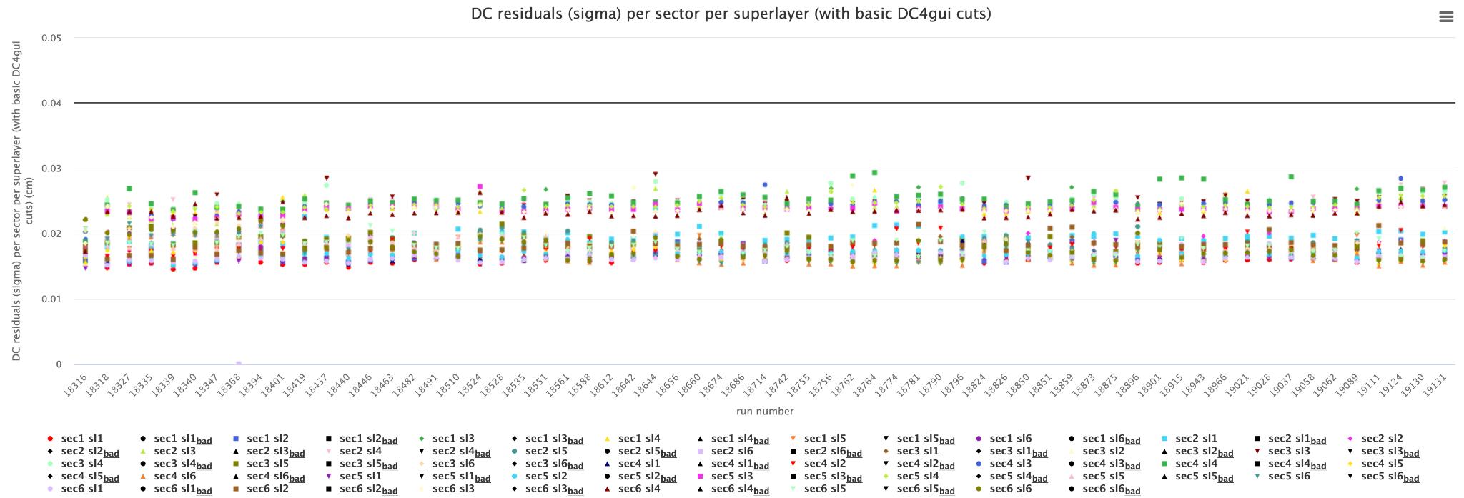
Data Processing Summary
Timelines monitoring:
February 14th, 2025; Pass0v9_dc: DC mini-timelines produced with same Pass0v9 conditions to check the quality of the extracted T2D and pressure calibration constants
Timelines are available here
Sigma

Slide 12
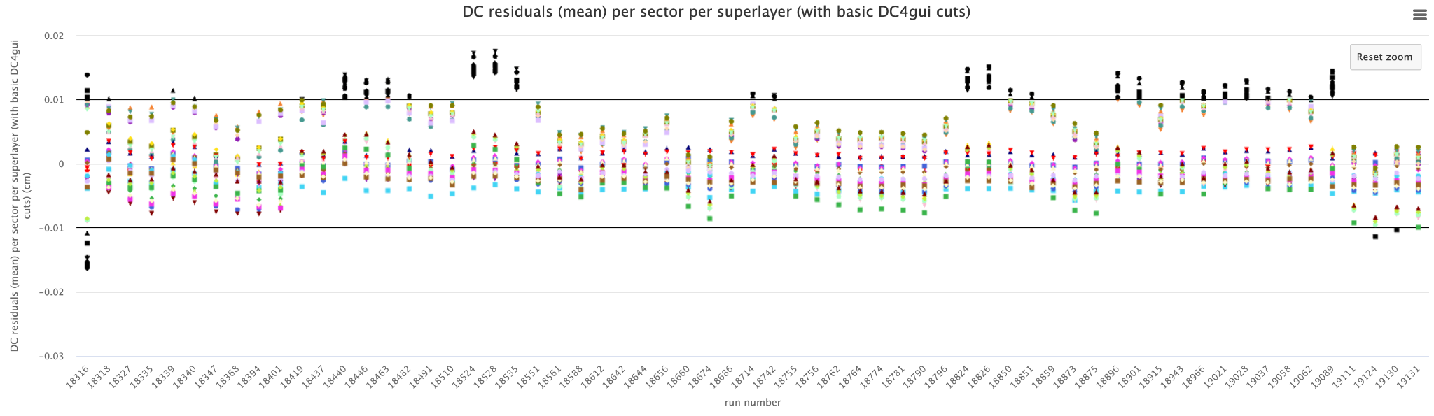
Data Processing Summary
Timelines monitoring:
February 25th, 2025; Pass0v9_dcv2: DC mini-timelines produced with same Pass0v9 conditions to check the quality of the T0/T00 correction adjustment
Timelines are available here
Mean

Slide 13
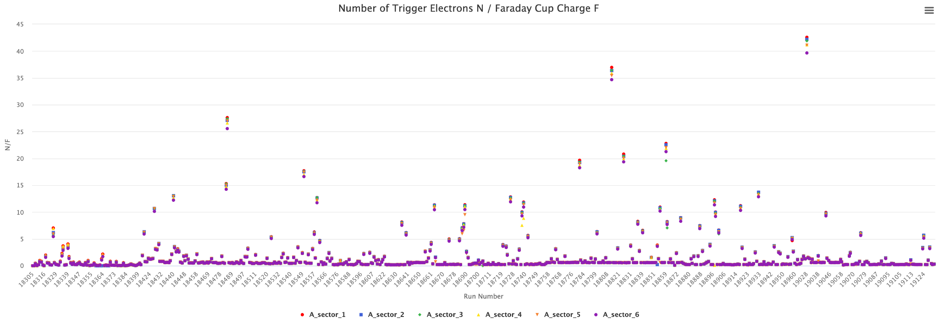
Data Processing Summary
Ongoing cross-check of the high-level physics QA timeline
More changes are needed to accommodate RG-D data suffering from the FCup vacuum contamination issue
Outliers are expected to diminish once full runs are processed since the normalization is done with the accumulated gated per-run beam-charge (current timelines has only 20 files per run)

Slide 14
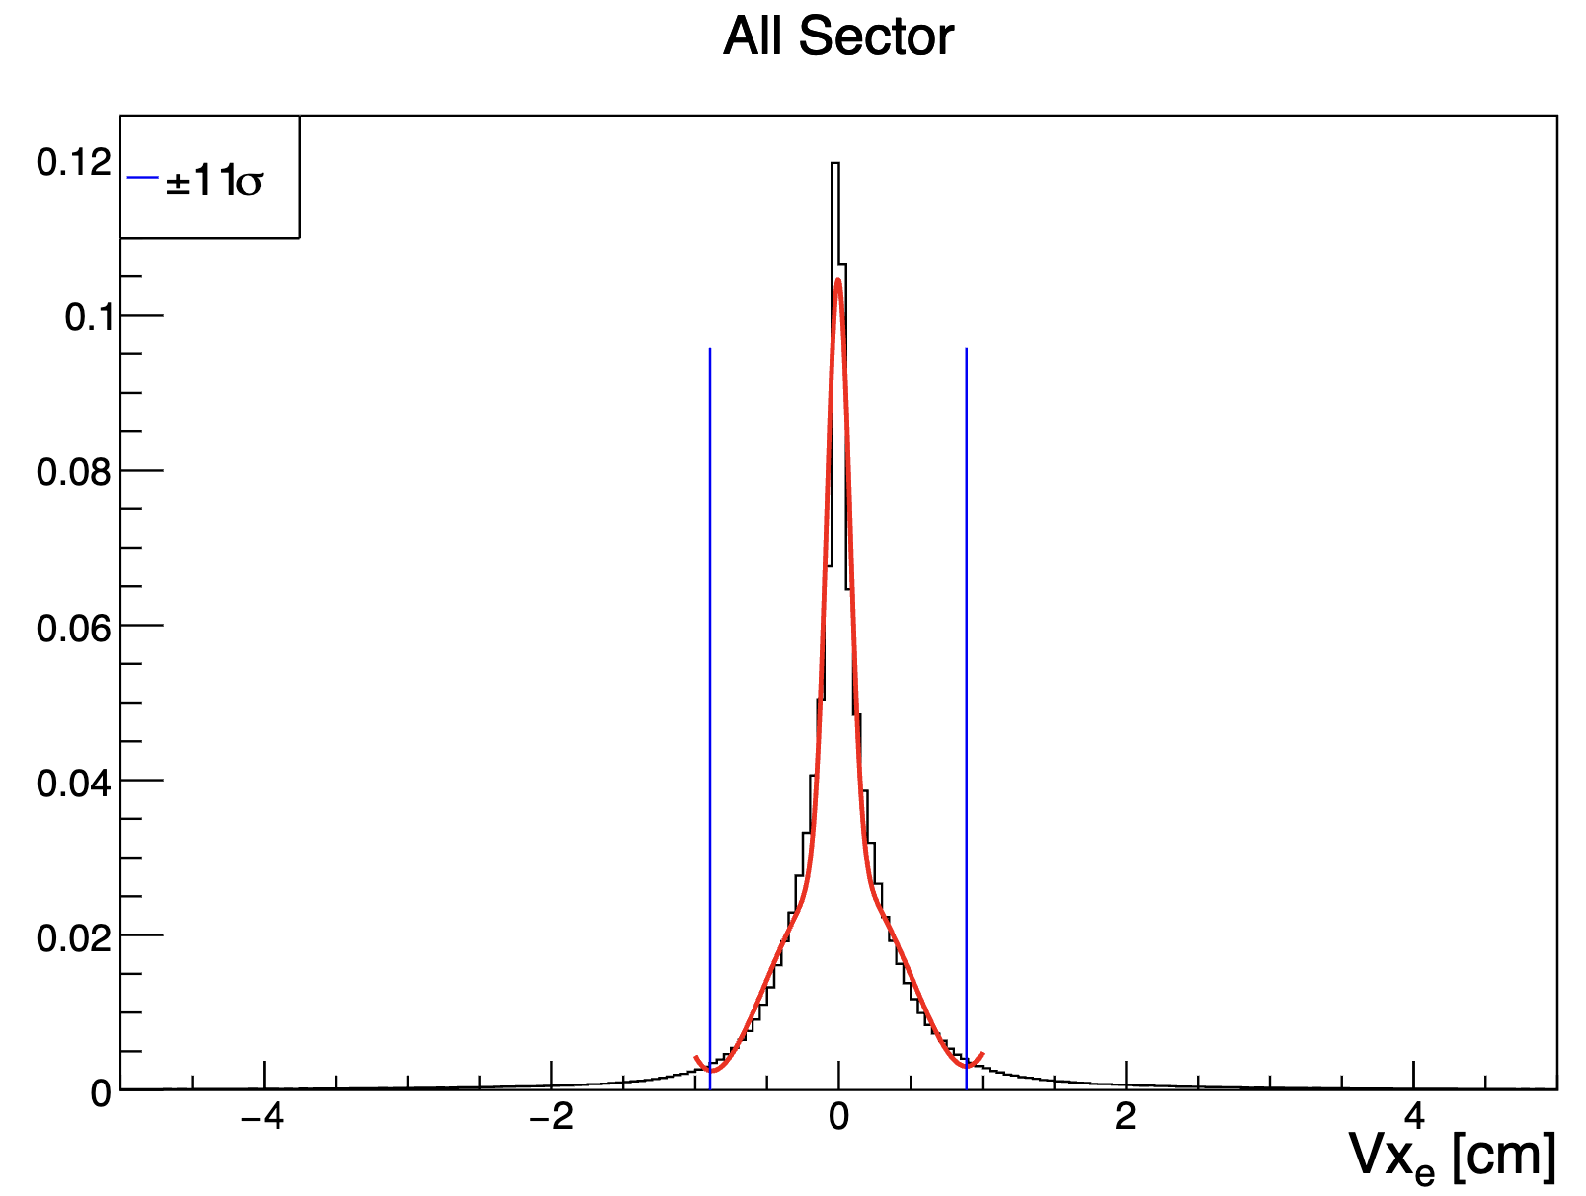
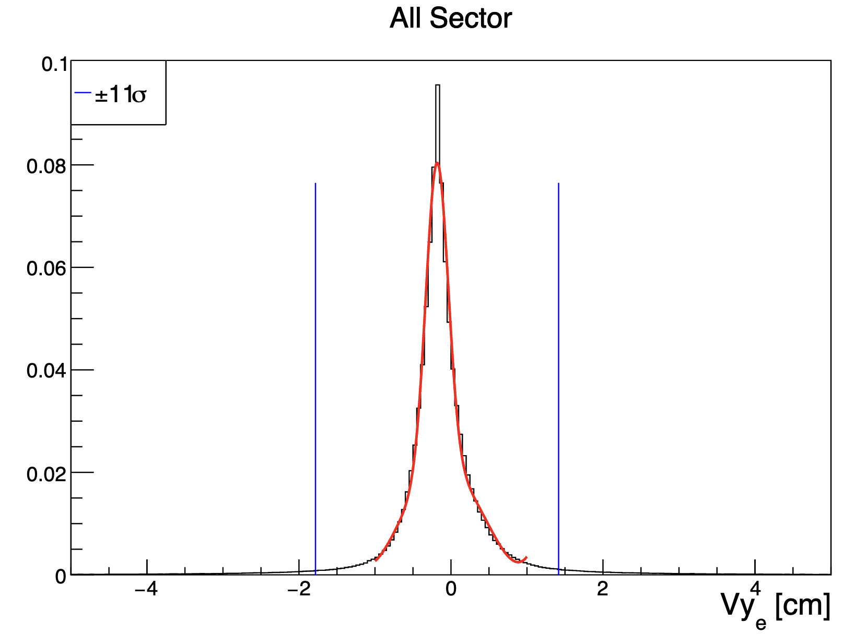
RG-D Vertex Studies
The study aimed to
Separate solid-foil peaks from the empty LD2 cell and scattering chamber exit windows
Reduce the contamination for the target configuration with two different foils, Cu and Sn
Check the effect of Vx and Vy cuts on Vz distributions:
Fit sector-independent Vx and Vy with a Gaussian and a 4th-order polynomial function

Slide 15
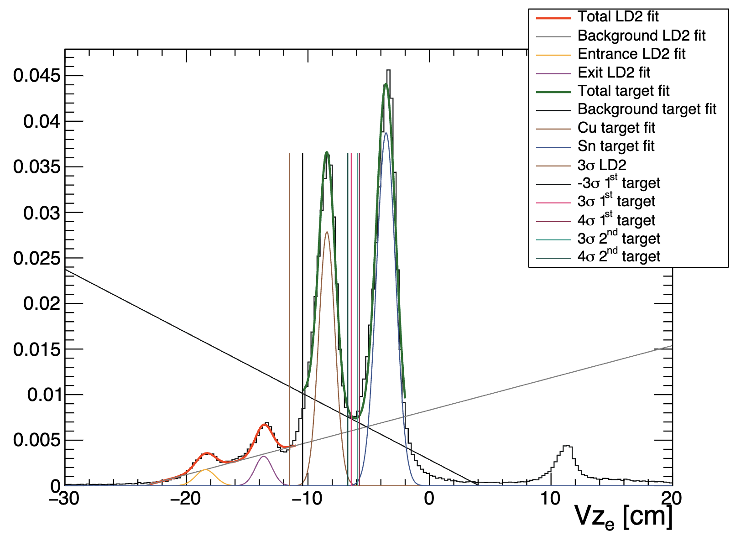
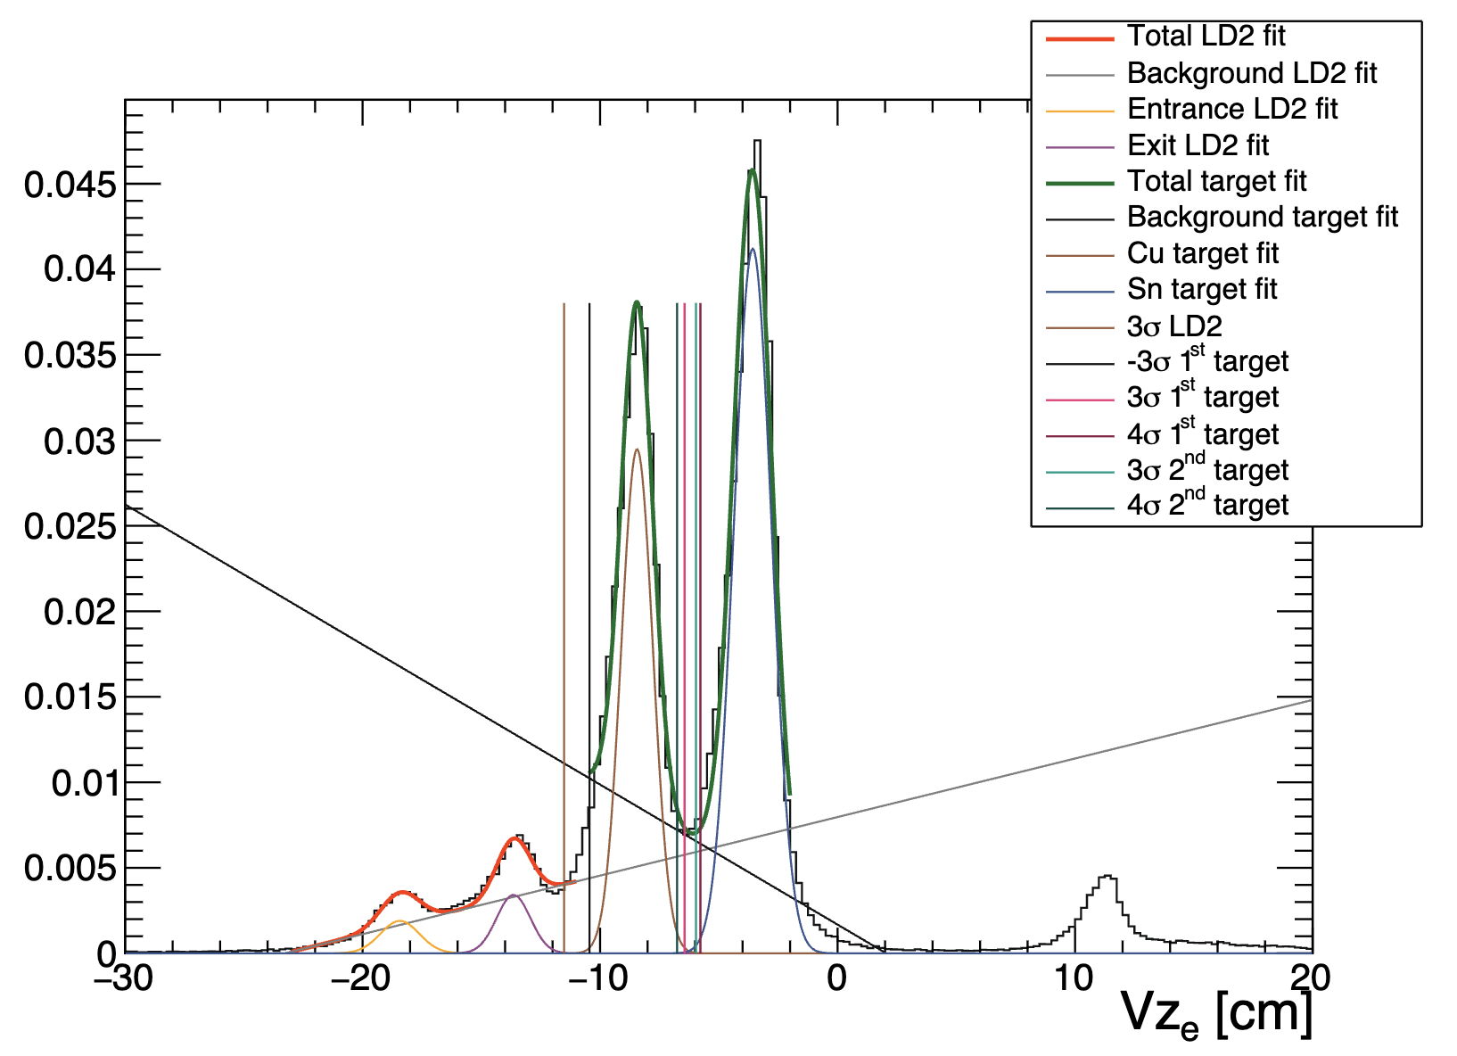
RG-D Vertex Studies
The study aimed to
Separate solid-foil peaks from the empty LD2 cell and scattering chamber exit windows
Reduce the contamination for the target configuration with two different foils, Cu and Sn
Check the effect of Vx and Vy cuts on Vz distributions:
No noticeable effects of Vx and Vy cuts on Vz fit parameters; thus, eliminated!
μ₁:-8.44 cm μ₂:-3.57 cm
𝜎₁:0.66 cm 𝜎₂:0.78 cm
μ₁:-8.44 cm μ₂:-3.57 cm
𝜎₁:0.66 cm 𝜎₂:0.79 cm
Without Vx and Vy cuts
With Vx and Vy cuts

Slide 16
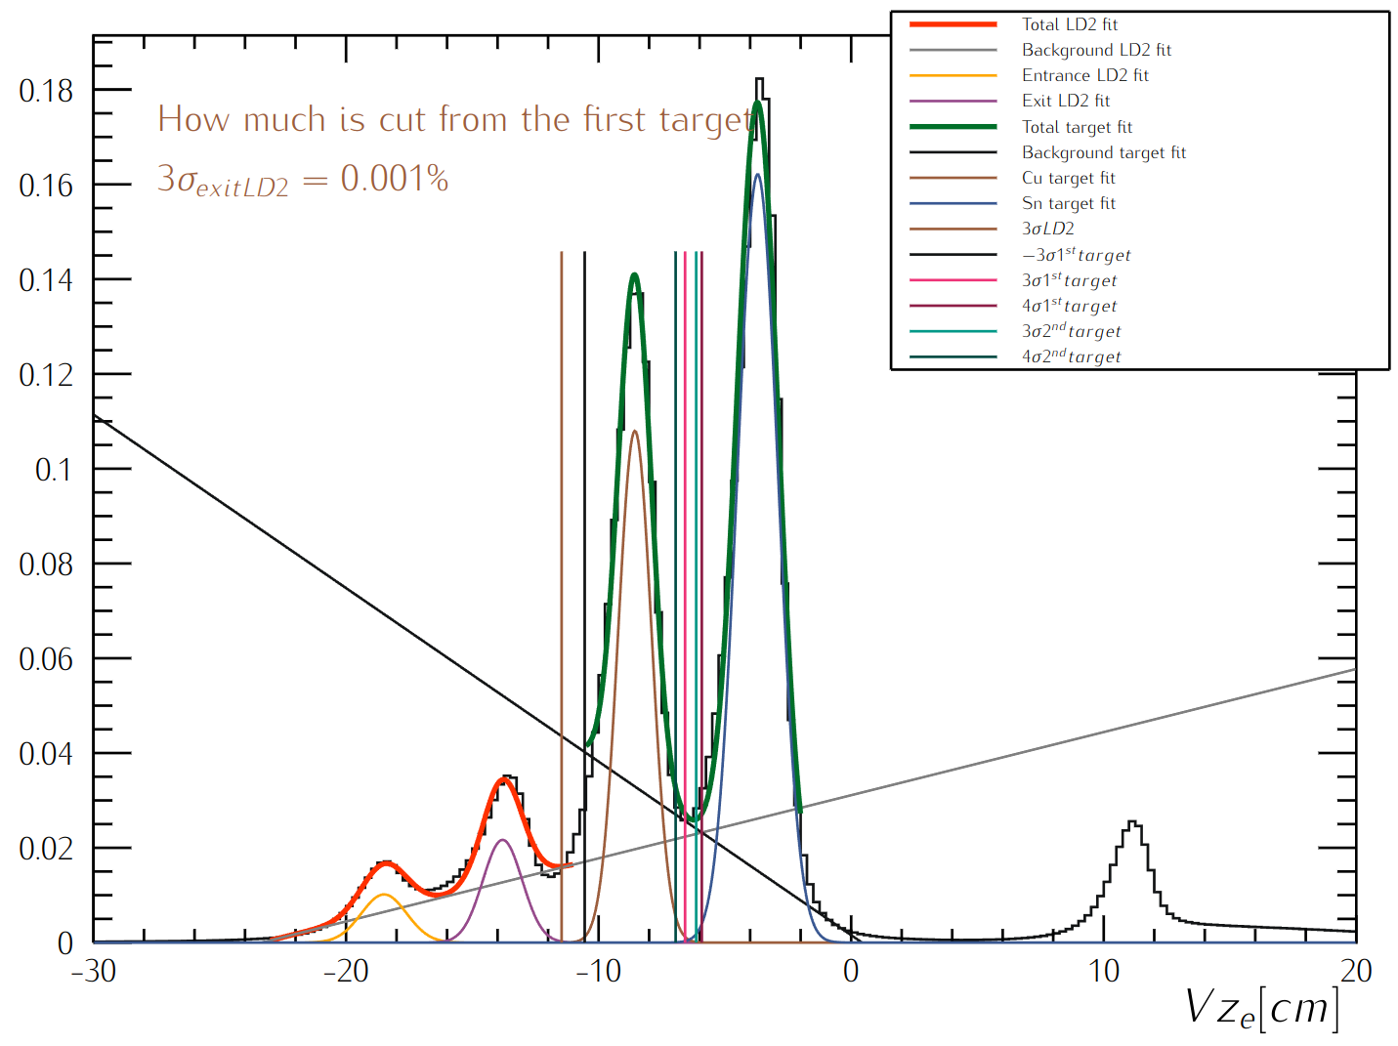
RG-D Vertex Studies
Empty LD2 cell
Nuclear-foil

Slide 17
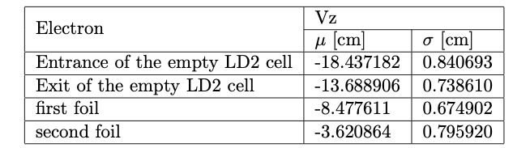
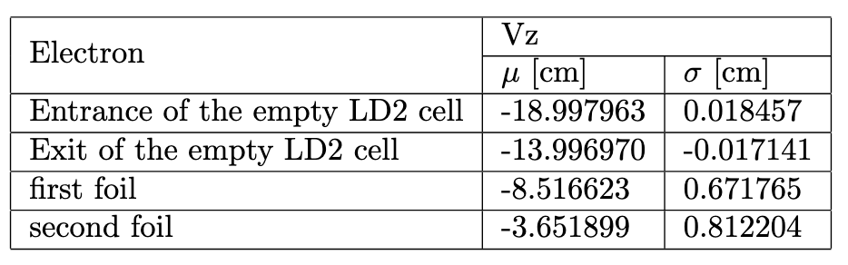
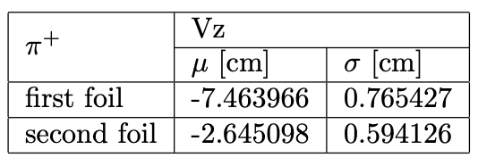
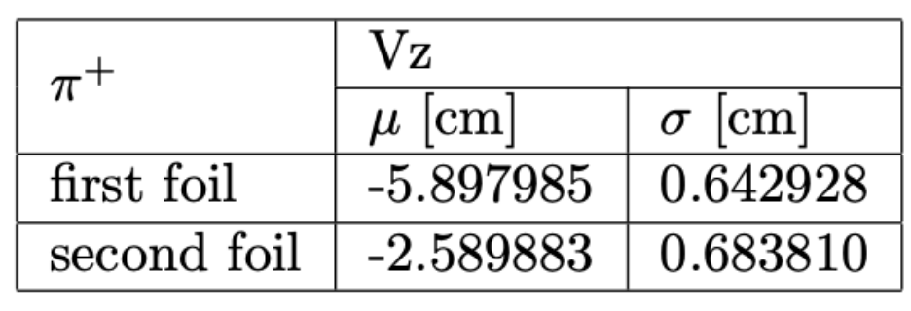
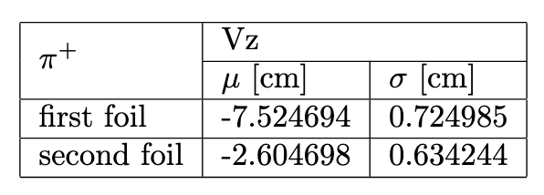
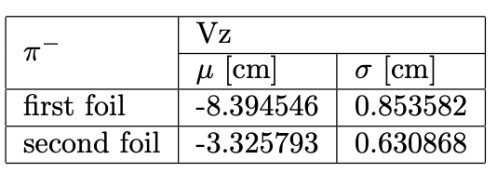
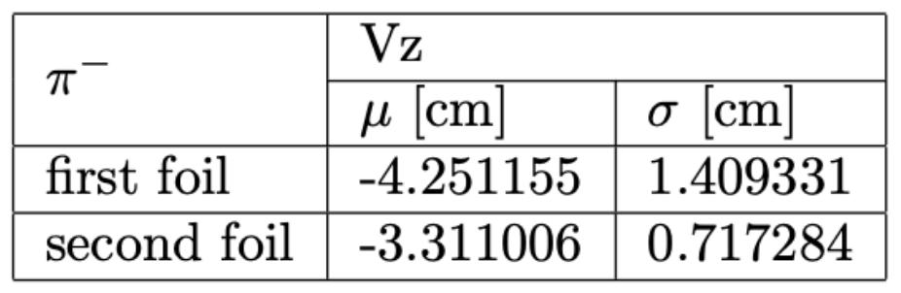
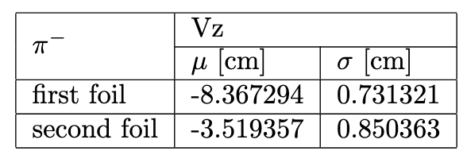
RG-D Vertex Studies
Established Vz cuts for electrons and charged pions and various solid foils
Upstream (Cu) and Downstream (Sn) foils
Carbon

Slide 18
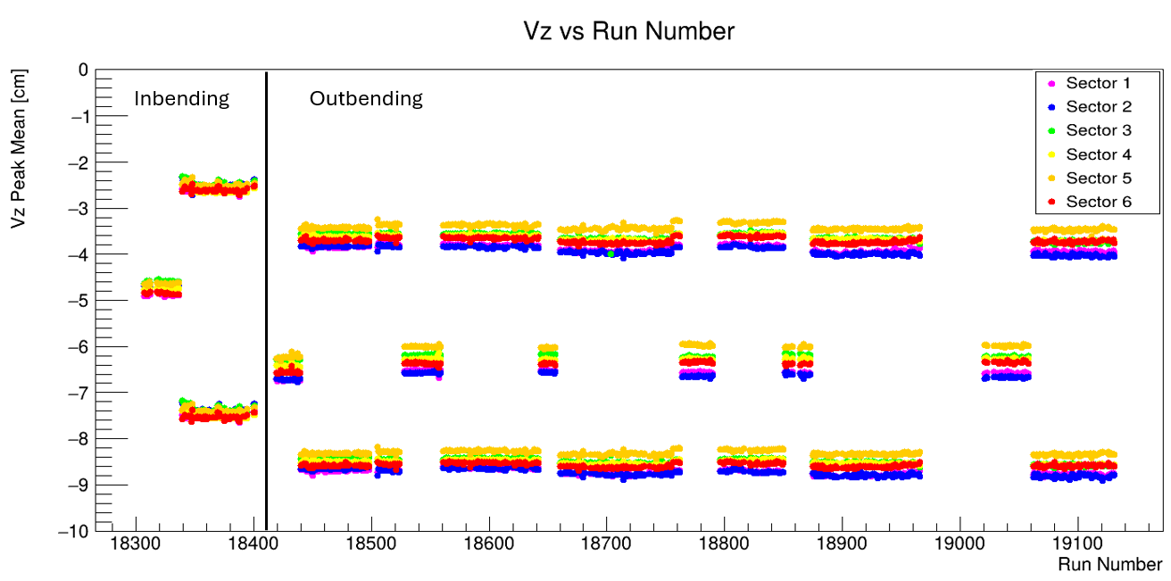
RG-D Vertex Studies
Extracted Vz timeline in which a global 1 cm shift is observed between IB and OB datasets!?
Plot credit of M. Maynes

Slide 19
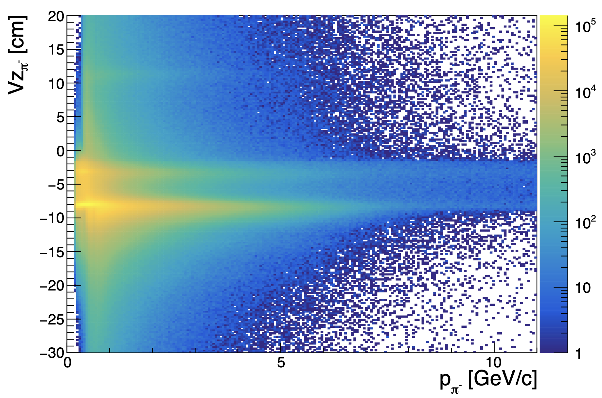
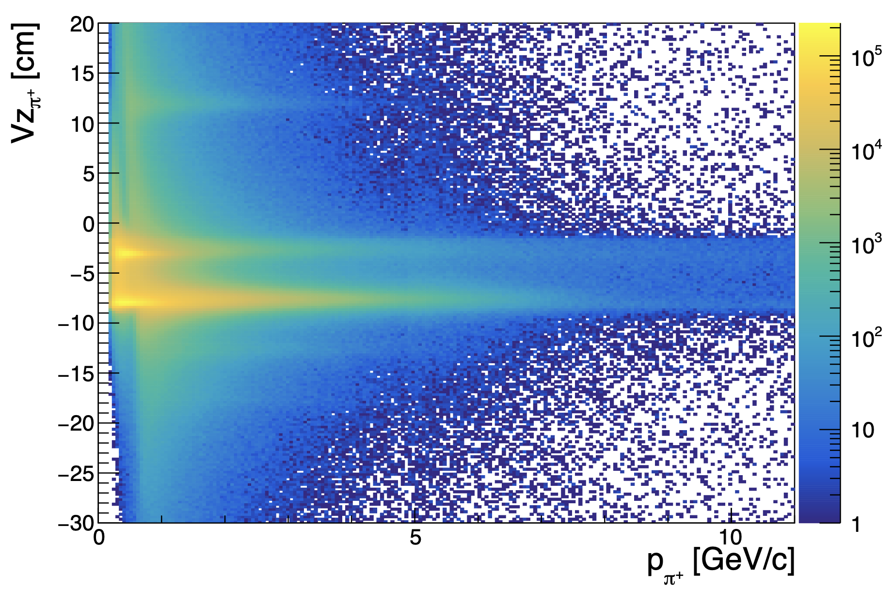
RG-D Analysis Study: Particle IDentification
Electron:
PID = 11
Status < 0
-5 < chi2pid < 5
Vz cuts depending on the target
Charged pions, π±:
PID (+/-) = (+/-) 211
-10 < chi2pid < 10
Vz cuts depending on the target

Slide 20
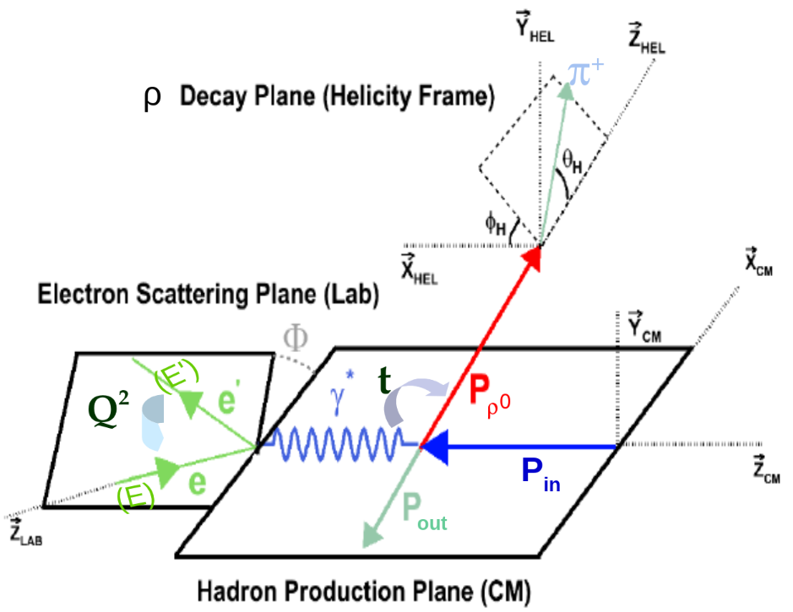
RG-D CT Study: Kinematical Cuts
ν= E - E’: virtual photon(γ*) energy in the Lab frame,
Q²= -(P_{e}- P_{e’})²= 4EE’sin²(θ/2): photon virtuality,
t= (P_{γ*} - P_{γ})²: momentum transfer square,
W²= (P_{in} + P_{γ*})²= -Q² + M_{p}² + 2M_{p}ν: invariant mass squared in (γ*, p) center of mass (CM)
Kinematical cuts:
W> 2 GeV ↦ avoid resonance region
z_{h}= E_{h}/ν > 0.9 ↦ select elastic channel
-t > 0.1 GeV² ↦ exclude coherent production
-t < 0.5 GeV² ↦ select diffractive process

Slide 21
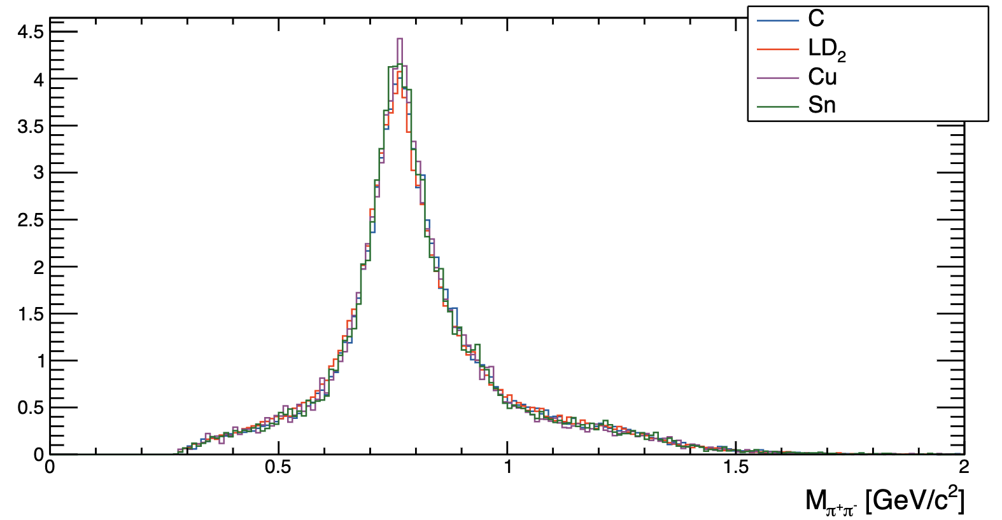
CT Study: Two-pion Invariant Mass

Slide 22
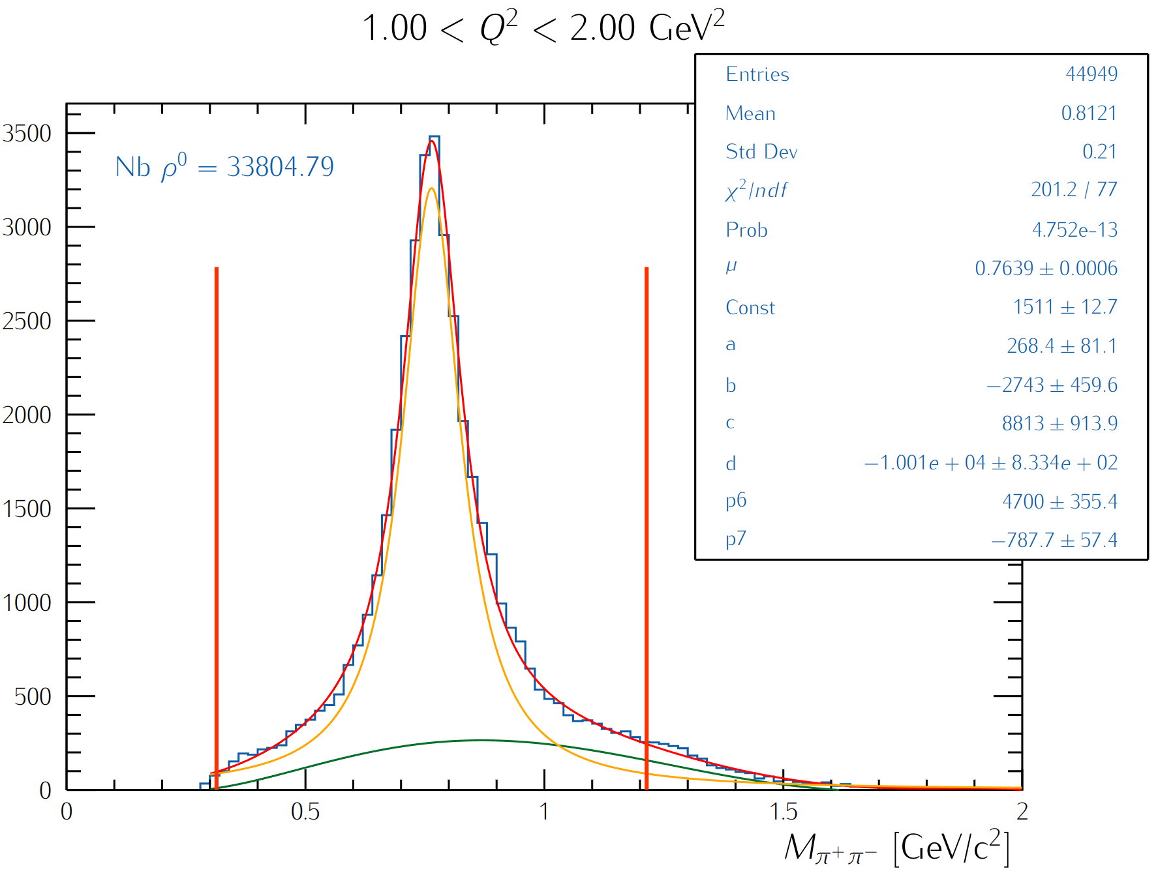
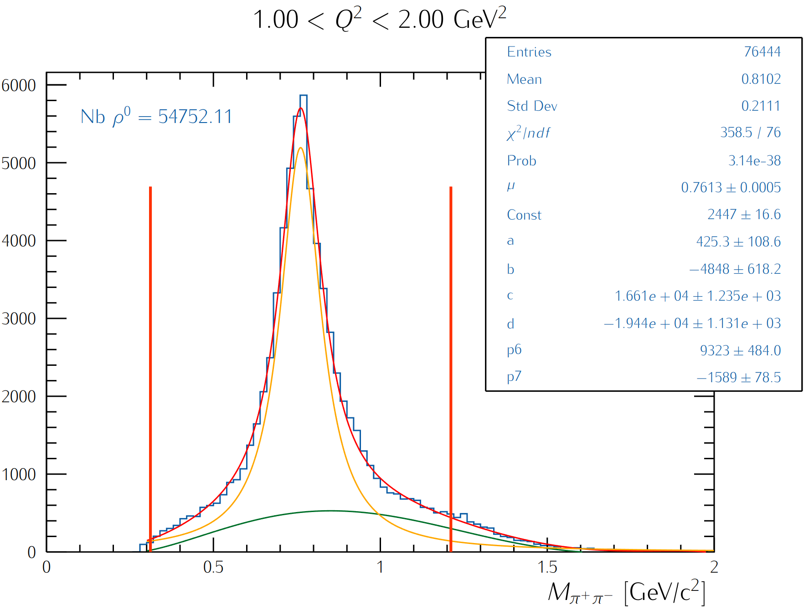
CT Study: Yield Extraction
Fit oppositely charged pions invariant mass with a Breit-Wigner and 3rd-order polynomial function (the latter will be replaced with the simulated background shape)
Extract ρ⁰ yield by integrating the background-subtracted BW within a 3σ range
Solid target: Carbon
Liquid target: LD2

Slide 23
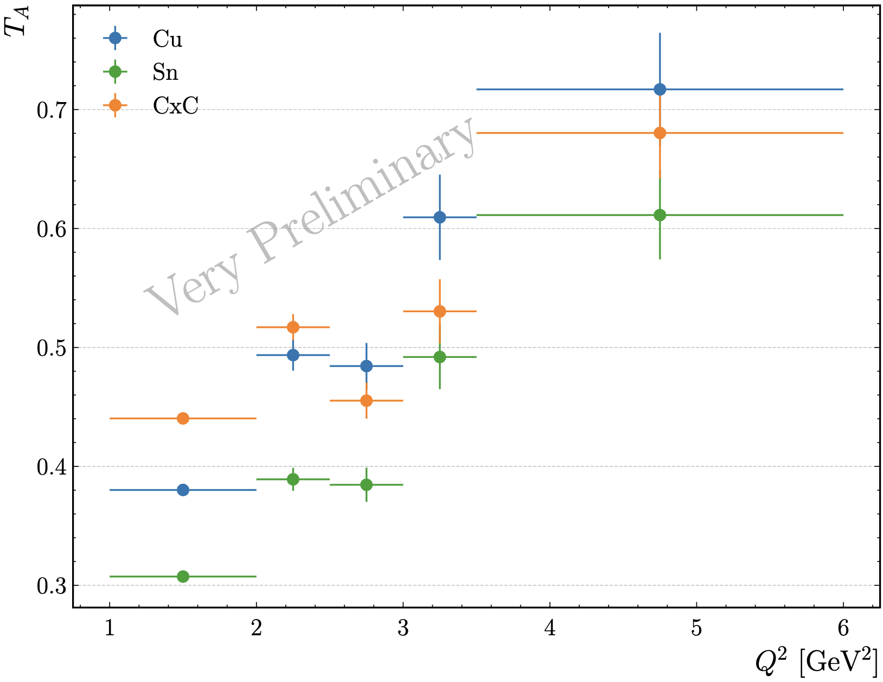
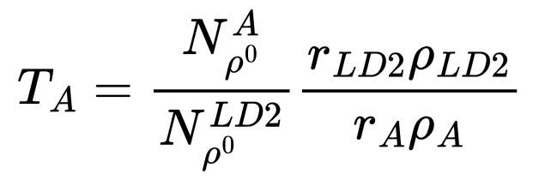
CT Study: Very Preliminary Nuclear Transparency
Extract (raw) nuclear transparency as
r_{LD2}= 5 cm: LD2 thickness
r_{CxC} = 0.4 cm: CxC thickness
r_{Cu}= 93 μm: Copper thickness
r_{Sn} = 171 μm: Tin thickness
ρ_{LD2}= 0.164 g/cm³: LD2 density
ρ_{C}= 2.2g/cm³ : Carbon density
ρ_{Cu}= 8.96 g/cm³: Copper density
ρ_{Sn}= 7.31g/cm³ : Tin density
Ongoing analysis by M. Maynes

Slide 24
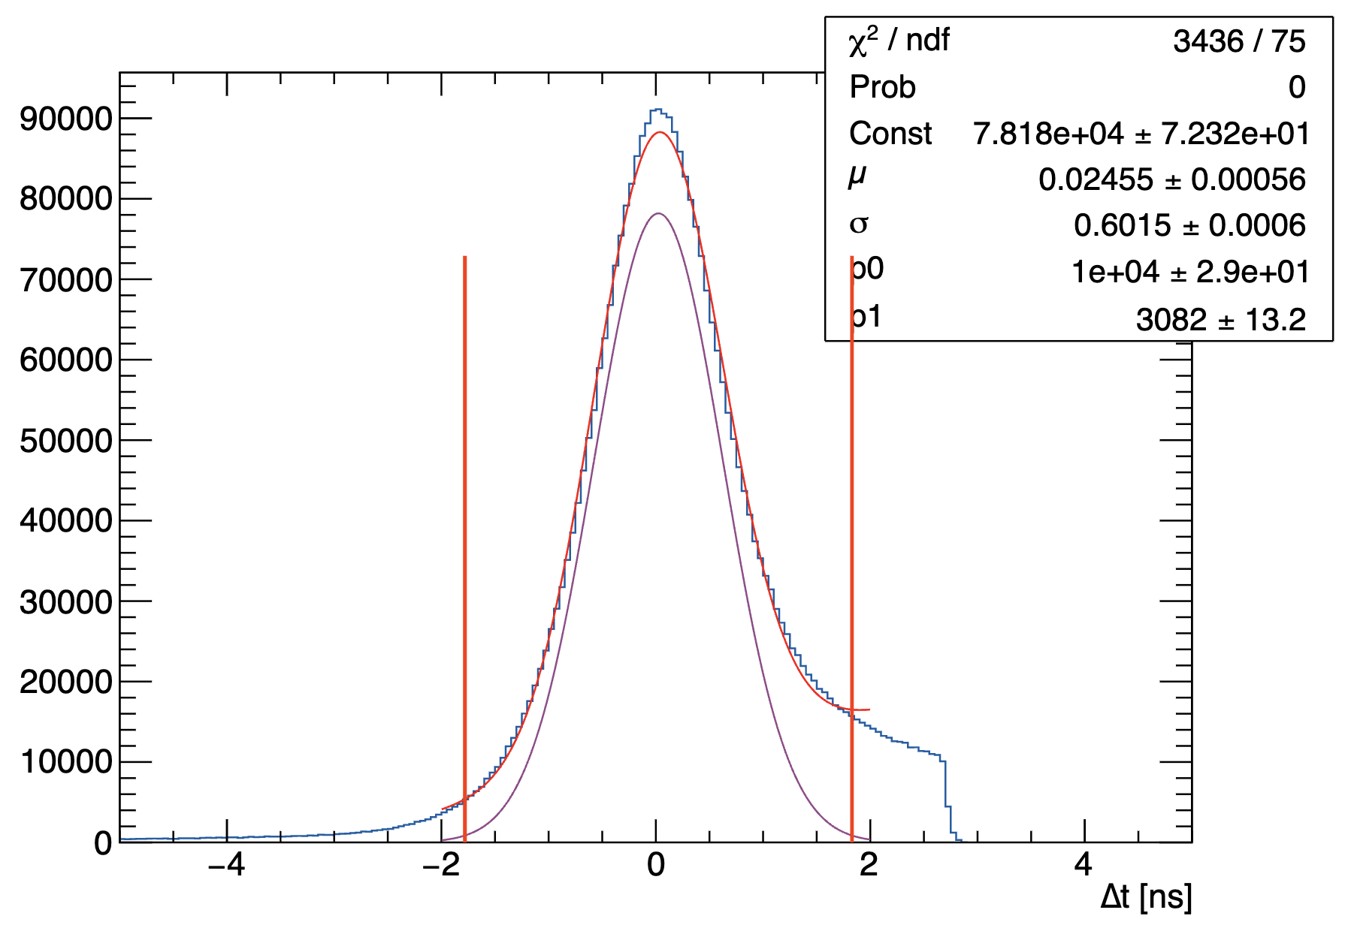
RG-D nTMDs Studies: π⁰ analysis
First look at the π⁰ channel to extract multiplicity ratios and azimuthal asymmetries:
In-progress efforts to employ the event mixing technique to subtract the background underneath the two photon mass peak
Electron cuts:
pid = 11
status < 0
-11 < Vz < 5 cm (for LD2)
Photon cuts:
pid = 22
E > 0.2 GeV
-1.67 < Δt = (t_{EC} − t_{start} − l_{EC} /30) < 1.55 ns
θ_{eɣ}> 8 deg → reduce radiative photon

Slide 25
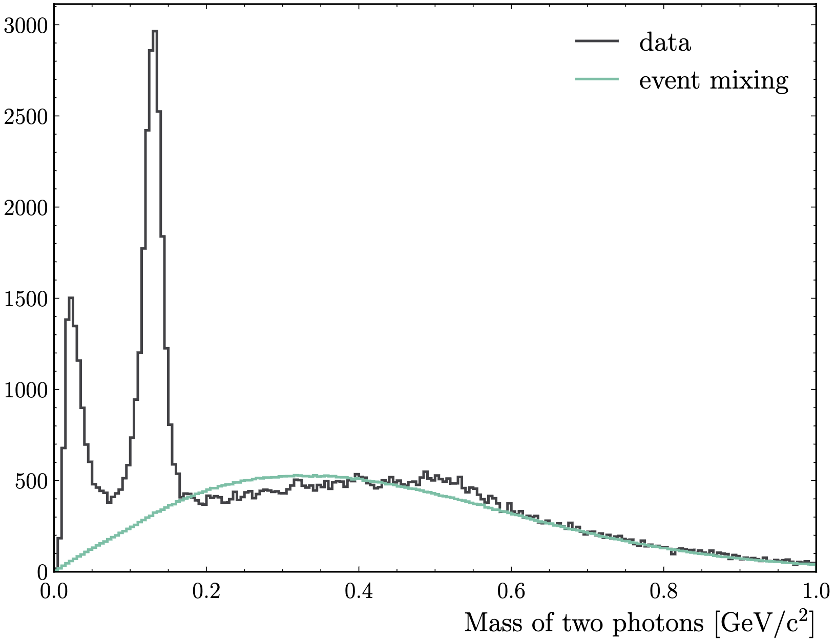
RG-D nTMDs Studies: π⁰ analysis
First look at the π⁰ channel to extract multiplicity ratios and azimuthal asymmetries:
In-progress efforts to employ the event mixing technique to subtract the background underneath the two photon mass peak
Kinematical cuts:
W > 2 GeV ↦ avoid resonance region
Q² >1 GeV² and 0.3< z_{h}< 0.7 ↦ region in which the TMDs factorization holds

Slide 26
Summary and Outlook
RG-D preparation for the Pass1 cooking review entails
Finalizing the DC calibration and checking its quality with Pass0 timelines, while all other subsystems calibration is done
Retrain the RG-D AI network after completing the DC calibration
Complete adapting the high-level physics QA timeline to RG-D run conditions
Perform background merging for data and Monte-Carlo tracking efficiency comparison
Optimizing analysis tools for CT and nTMDs studies to
Improve Particle IDentification for all final-state particles
Fine-tune the vertex cuts and corrections once the full calibration is completed
Implement fiducial cuts
Deploy the ρ⁰ event generator for its two-pion invariant mass background subtraction and apply necessary corrections for the extraction of the preliminary CT results
Finalize the π⁰ event mixing background-subtraction and extract its preliminary asymmetry results
Obtain the preliminary asymmetry results for charged pions nTMDs studies

Slide 27
Backup

Slide 28
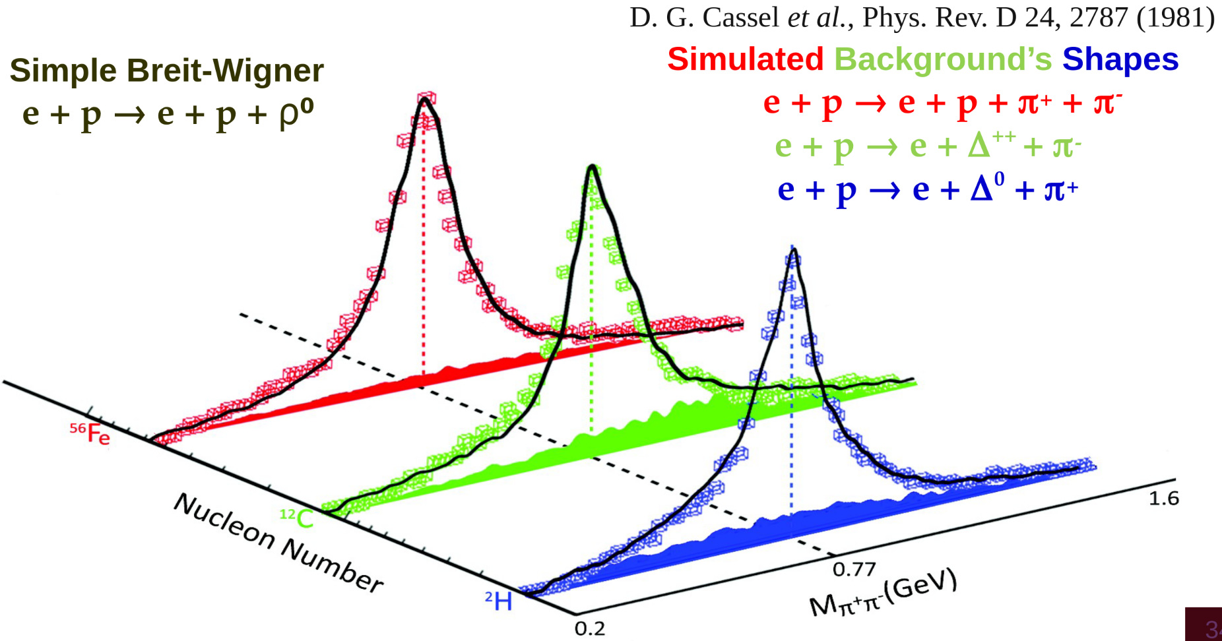
CT Study: Two-pion Invariant Mass
Our event generator incorporates the measured cross sections by Cassel et al. for the electroproduction of ρ⁰ and the three main background processes

Slide 29
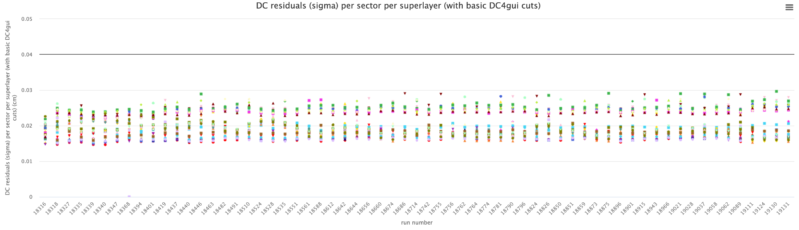
Data Processing Summary
Timelines monitoring:
February 25th, 2025: Pass0v9_dcv2: DC mini-timelines produced with same Pass0v9 conditions to check the quality of the T0 correction
Timelines are available here
sigma
For more details, please visit the RG-D analysis wikipage

Slide 30
RG-D Vertex Studies
Fits:
Fit the empty LD2 cell and solid-foil regions, CxC and CuSn. Use double gaussians and first-order polynomial function for both LD2 cell and solid foils
Separate the two different foils Cu and Sn peaks from each other
Same study is performed for hadrons, but the fit is performed with only one double gaussians and first order polynomial function since the empty LD2 cell had been already removed with the electron vertex cut
Empty LD2 cell
Nuclear-foil

Slide 31
RG-D nTMDs Studies: Charged Pions
Two parallel nTMDs analysis for charged pions by D. Matamoros and S. Shrestha
D. Matamoros will give a talk about his analysis about nTMDs on positively charged pion
S. Shrestha is currently working to understand the EB PID and compare it to offline PIDs based on \delta_T cuts

