Slide 1



Update on RG-D Experiments:
Calibration and Analysis Status
Mathieu Ouillon (Mississippi State University)
CLAS Collaboration (November 13th, 2024)

Slide 2
Run Group D​
RG-D is composed of two experiments:
Study of Color Transparency (CT) in Exclusive Vector Meson Electroproduction off Nuclei (E12-06-106)​:
Spokespeople: W. Armstrong¹ , L. El Fassi³ , K. Hafidi¹ , M. Holtrop⁴ and B. Mustapha^{1​}
Nuclear Transverse Momentum Distributions (nTMDs) in CLAS12 (E12-06-106A)​:
Spokespeople: R. Dupré² , L. El Fassi³ , Zein-Eddine Meziani¹ , and Holly Szumila-Vance​⁵
¹: Argonne National Lab (ANL), ²: IJCLAB, Orsay, France ³: Mississippi State U. (MSSate), ⁴: University of New-Hampshire (UNH), ⁵: Jefferson Lab

Slide 3
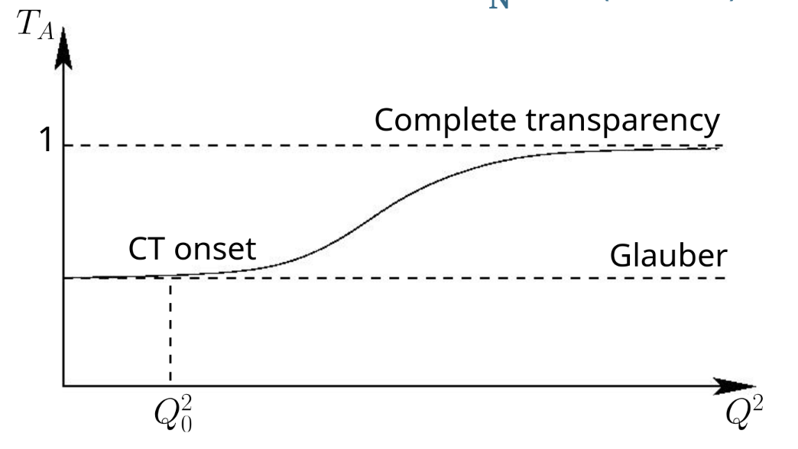
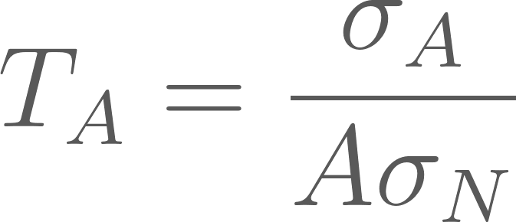
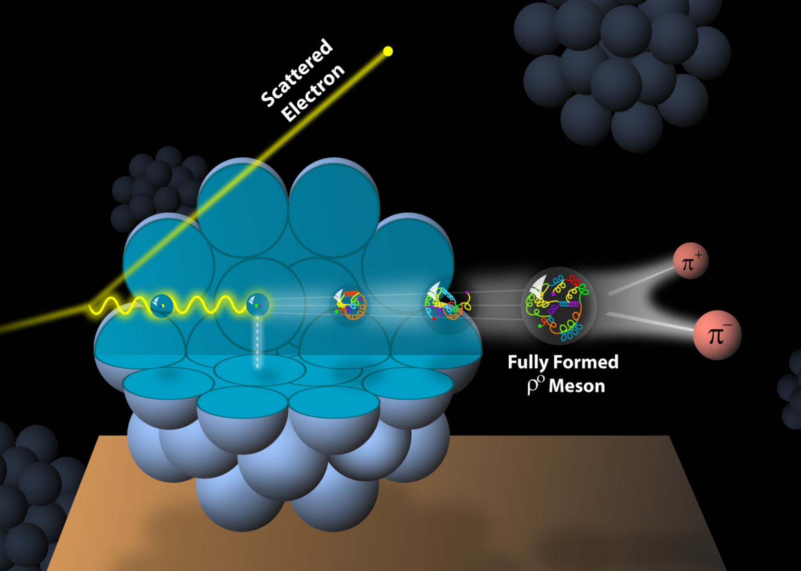
RG-D: CT Experiment​
E12-06-106, CT - the experimental signature of CT is the rise of the nuclear transparency, T_{A} as a function of Q²: ​
T_{A} is defined as the ratio of the cross section per nucleon on a bound nucleon to that on a free nucleon
σ_{A} − nuclei cross section
σ_{N} − free nucleon cross section
l_{c} coherence length - the lifetime of the qq-bar pair
l_{f} formation time - the time evolution of Small Size Configurations (SSC) to an on-shell ρ⁰ meson​​
Virtual photon
Small size configuration (SSC),​ ρ⁰, is the nuclear cross section​ escapes interactions with the nucleus​

Slide 4
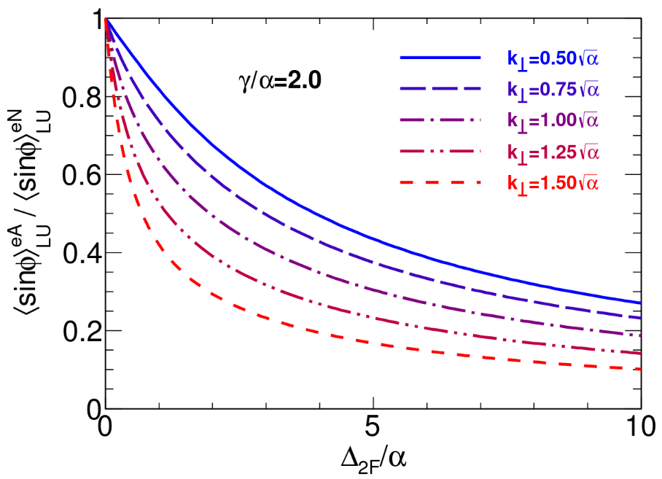
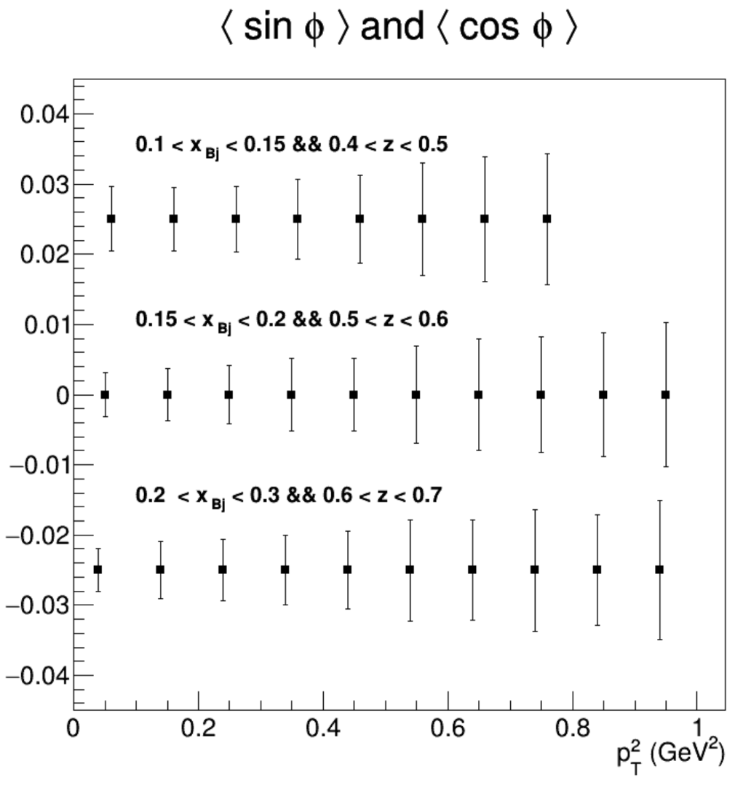
RG-D: Nuclear TMDs
E12-06-106A: Nuclear TMDs study uses the same CT running conditions except the beam polarization, and aims to explore​:
Fragmentation functions in nuclei​
Nuclear asymmetries at the partonic level​
Missing part of nuclear effects description​
Goal:
Measure the cos and sin modulations for p²_{T}
Mesure multiplicity ratios
For both charged pions and kaons
Accesses transport coefficient at parton level
Ratio of sin asymmetries nuclei to nucleon
Projected statistical error bars for sin and cos moments

Slide 5
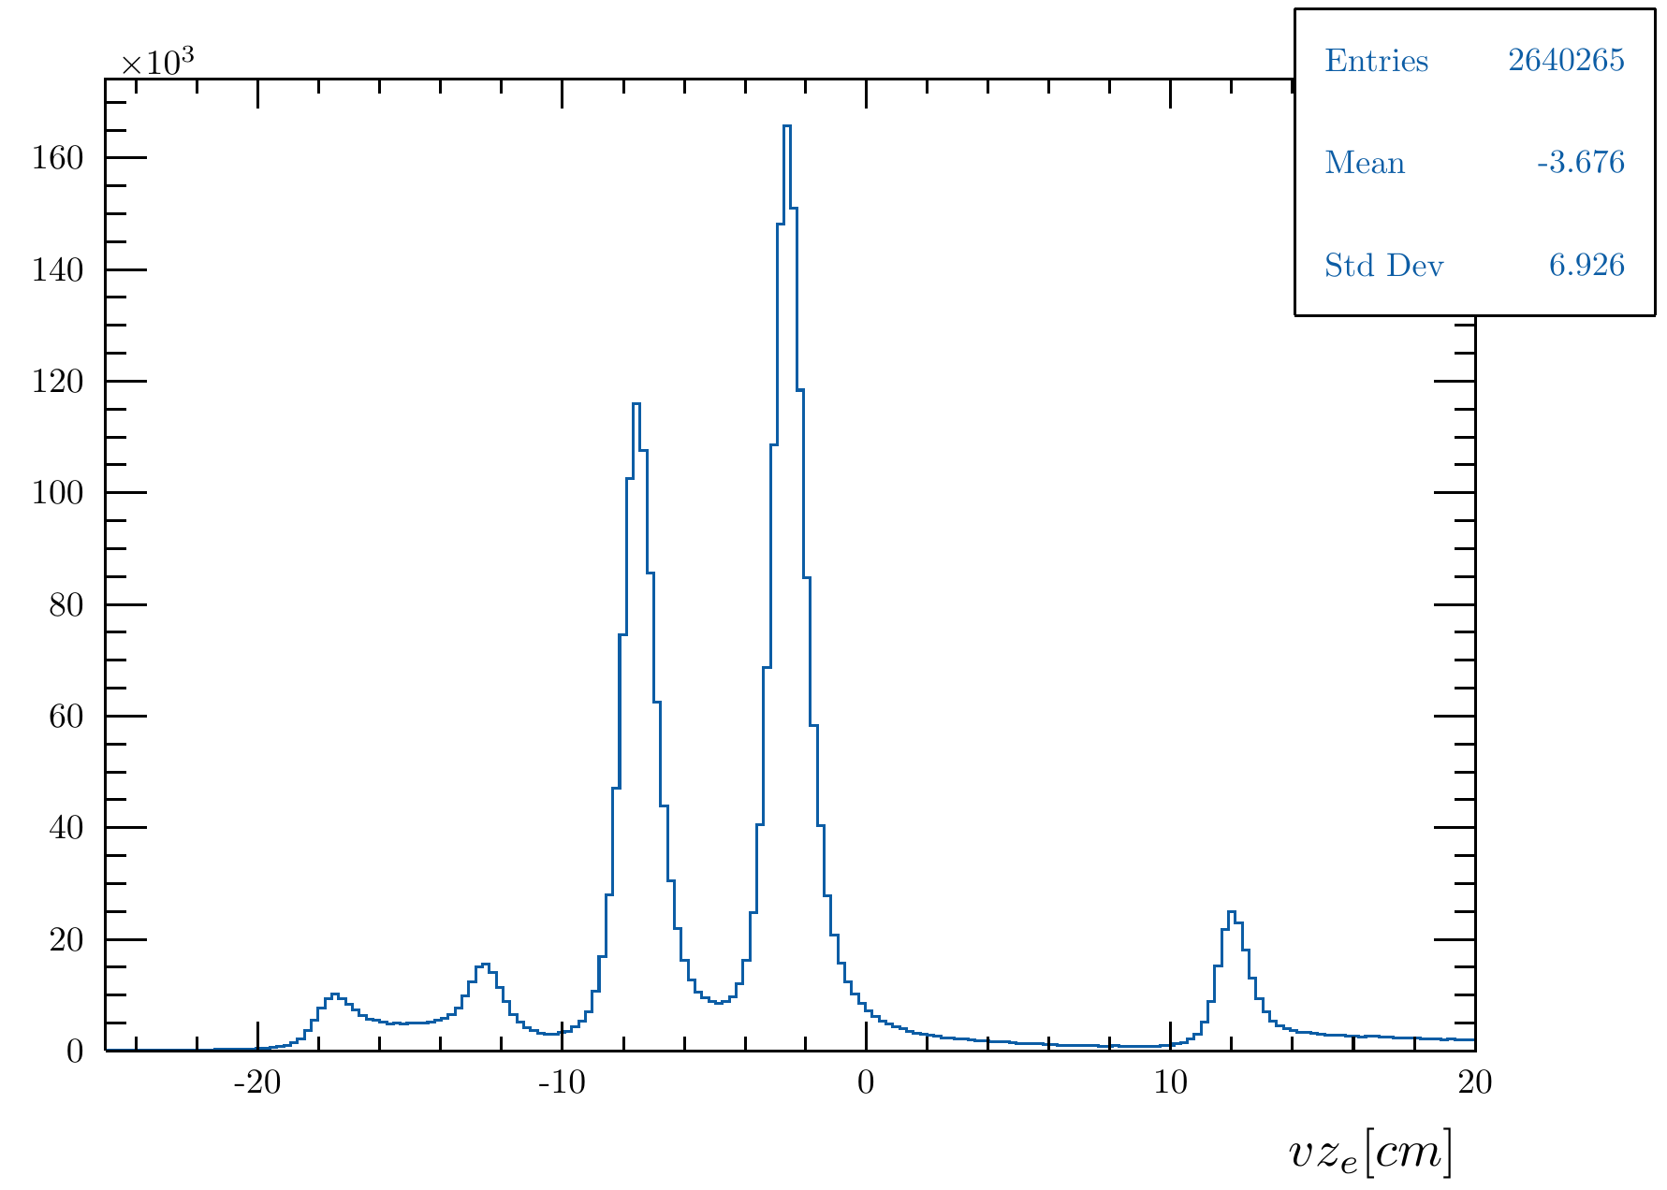
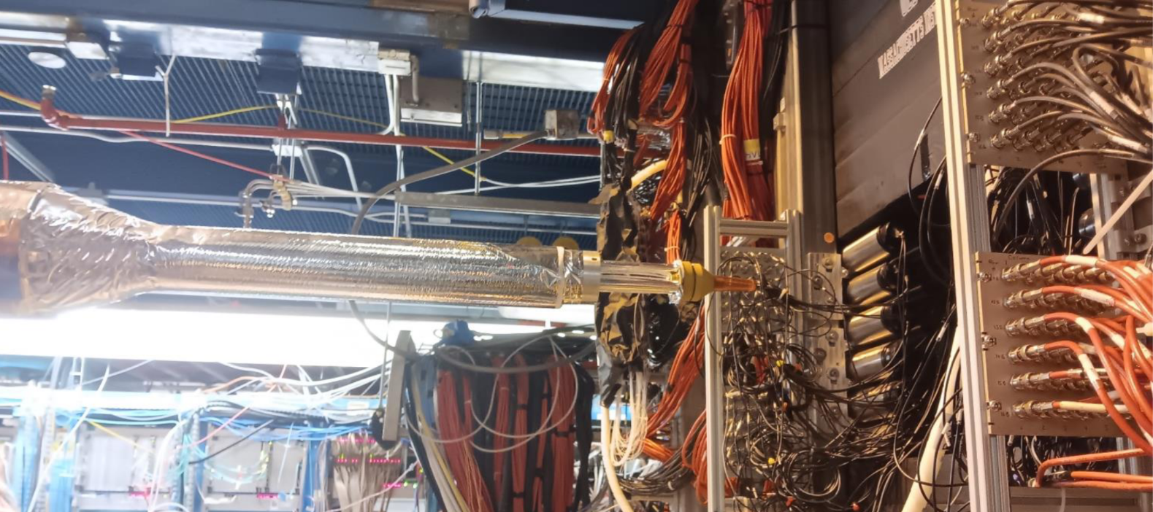
RG-D: Run configuration
RG-D experiments ran with:
10.54 GeV polarized beam with I= 5–175 nA for luminosity scans and production
Standard CLAS12 configuration with FT-OFF and three layers of FMT
Three target configurations, LD2, CxC, and CuSn, and Inbending and Outbending torus magnet setup
New cryogenic LD2 and the nuclear-foil flag assembly centered at -5 cm for each configuration
Main run hiccups:
Faraday Cup vacuum contamination
Moller cone sagging
Sn target
Cu target
LD2 exit window
Scattering chamber entrance
LD2 entrance window

Slide 6
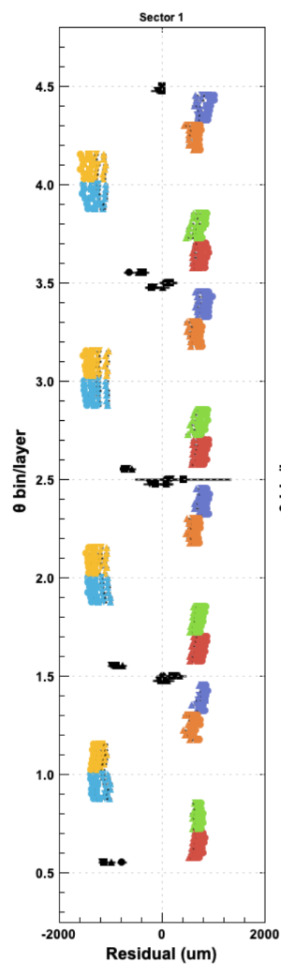
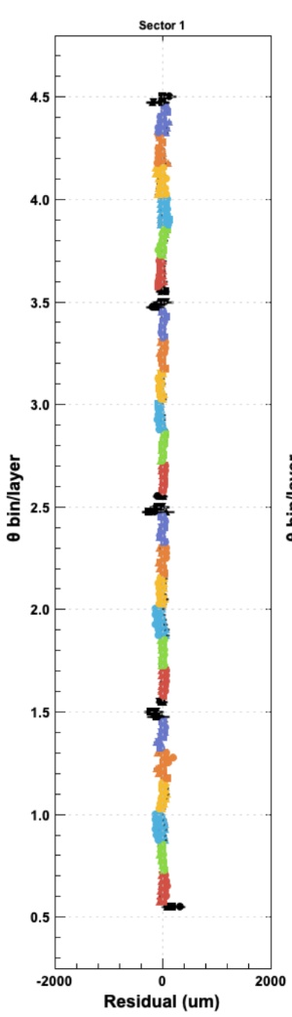
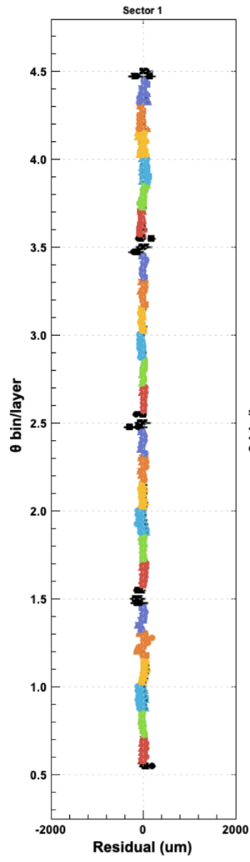
RG-D: Data Processing Summary
Alignment:
final DC (FMT) alignment using zero-field (and cosmic runs) run is completed
Plots show track:
Fit residuals (colored points) and vertex residuals (black symbols) vs. θ bin.
Different symbols (circle, square, triangle, etc.) represent different φ bins
Colors different superlayers
Y axis position the θ bin.
Nominal geometry
First+Second alignment
Final alignment
Thanks to R. De Vita and M. Maynes

Slide 7
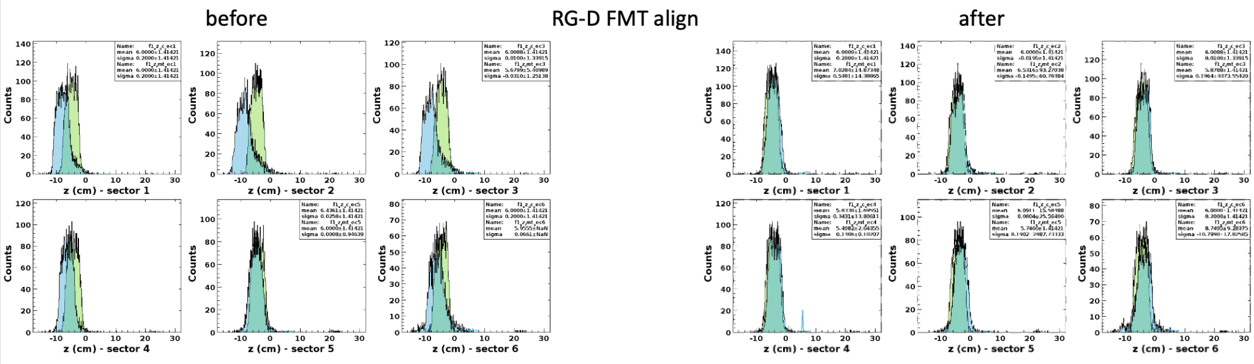
RG-D: Data Processing Summary
Alignment:
final DC (FMT) alignment using zero-field (and cosmic runs) run is completed
Final FMT alignment constants were extracted using the zero-filed and cosmic runs, and uploaded for layers 2 and 3 (layer 1 disk was not functional in RG-D).
Thanks to Y. Gotra

Slide 8
RG-D: Data Processing Summary
Alignment:
final DC (FMT) alignment using zero-field (and cosmic runs) run is completed
Calibration :
Beam offsets: transverse X and Y positions for FD and CD were calibrated and CVT z-offset was adjusted
RF calibration is done
FTOF and CTOF calibrations are almost finalized depending on the to-be-produced timelines after the latest iterations
RICH: time calibration is finalized
LTCC: per-sector number of photon electron signal was calibrated
ECal: time residual constants were updated for IB and OB datasets
CND calibration is almost finalized depending on the to-be-produced timelines after the latest iterations

Slide 9
RG-D: Data Processing Summary
Timelines monitoring:
The first three timelines for RG-D datasets were done online
September 4th: Pass0v4: final RG-D DC alignment, beam offsets, and CVT z-offset adjustment
Timelines are available here
October 14th: Pass0v5: Pass0v4 conditions + first-round of FTOF and CTOF, and partial ECal energy calibrations
Timelines are available here
October 23th: Pass0v6: Pass0v5 conditions + first round of RF calibration
Timelines are available here
For more details, please visit the RG-D analysis wikipage

Slide 10
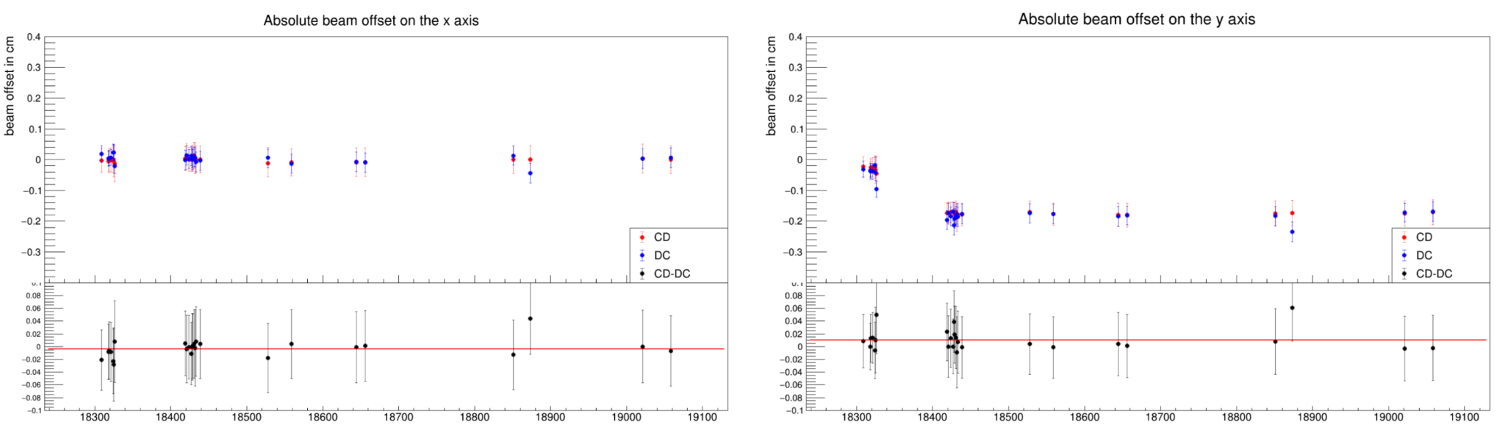
Beam Offsets Calibration
After the completion of DC and CVT alignment, the beam spot analysis was run by S. Polcher for LD2, C, and CuSn runs:
FD and CD beam spots are consistent with each other
Relative position of DC and CVT is already correct
x position is basically constant and consistent with 0 cm
Three run ranges with different y positions: -0.03, -0.09, and -0.18 cm
Beam spot analysis for LD2

Slide 11
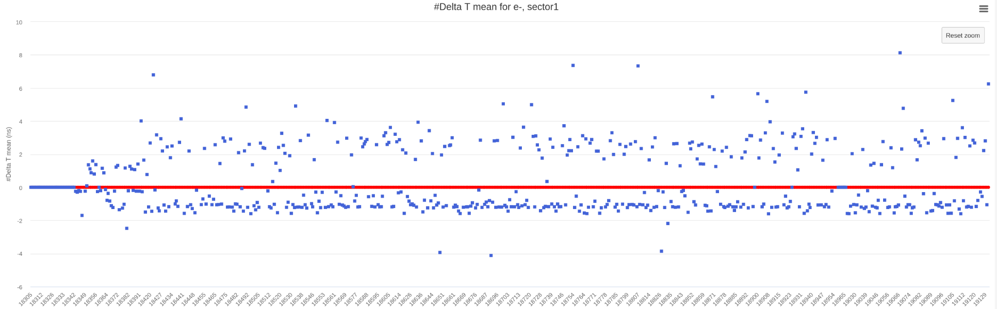
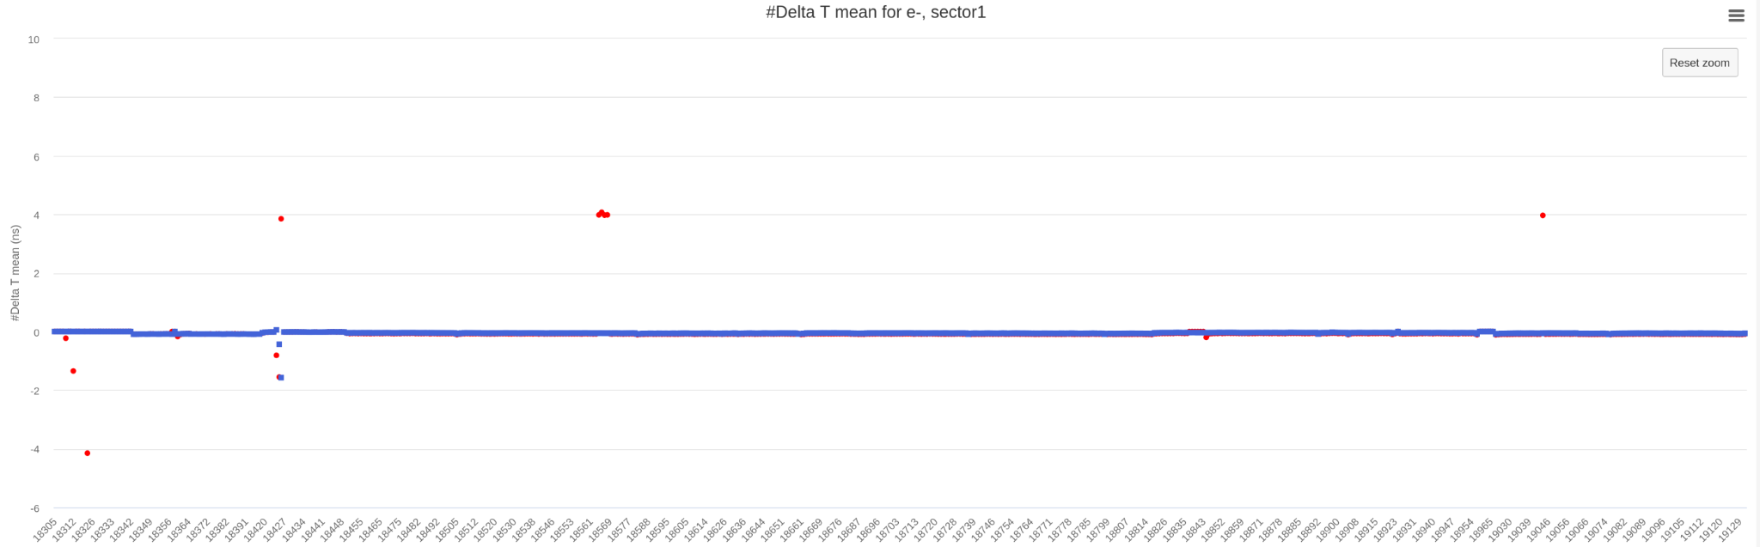
RICH: first calibration
Calibration done using the data of the pass0v4 cooking
Thanks to M. Mirazita
Pass0v4
Pass0v6

Slide 12
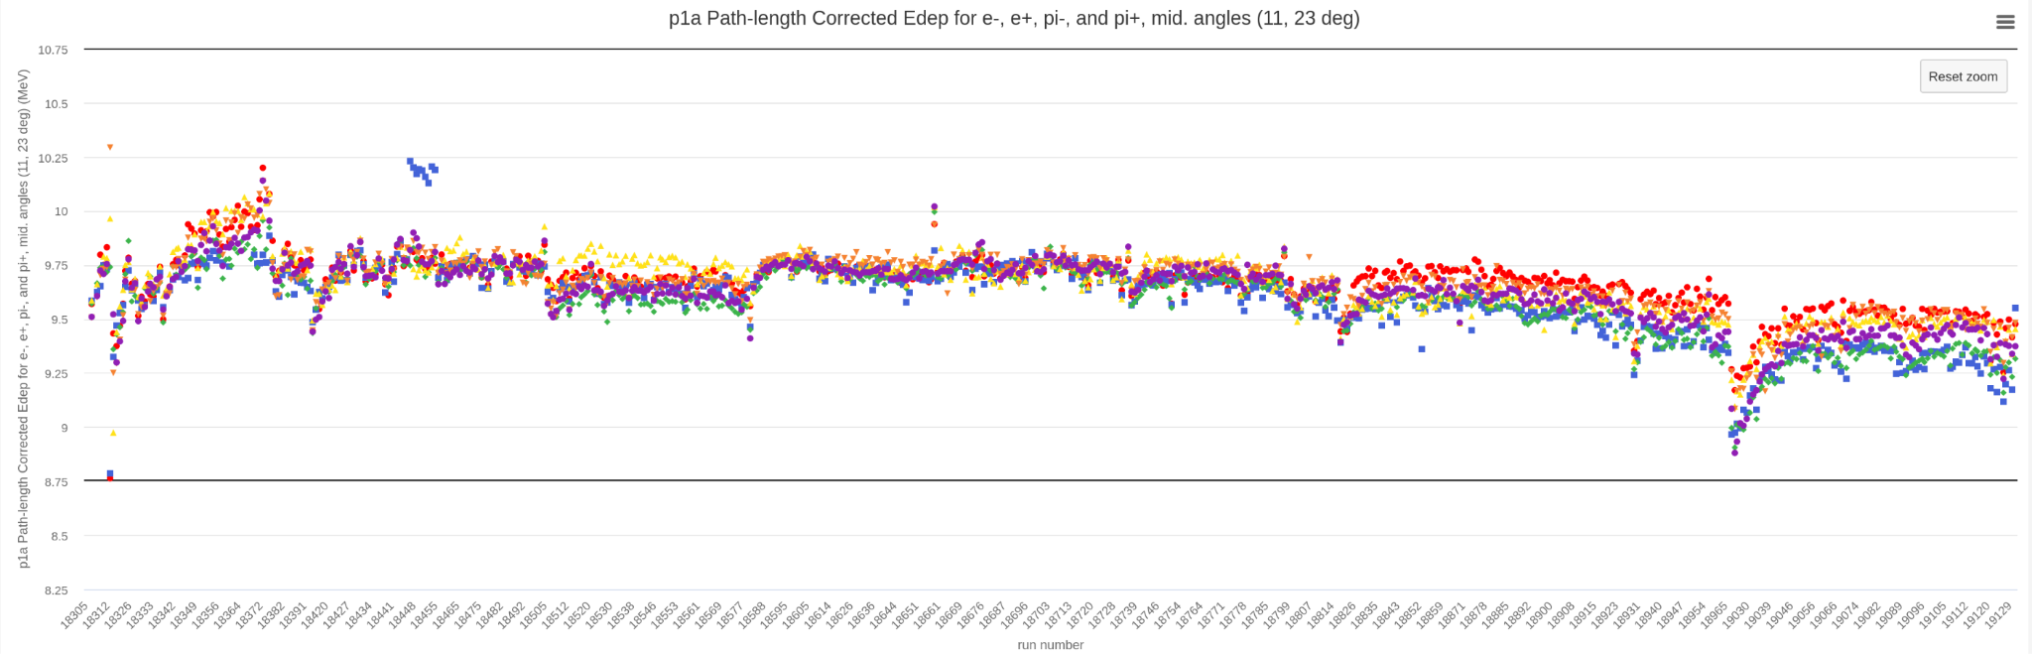
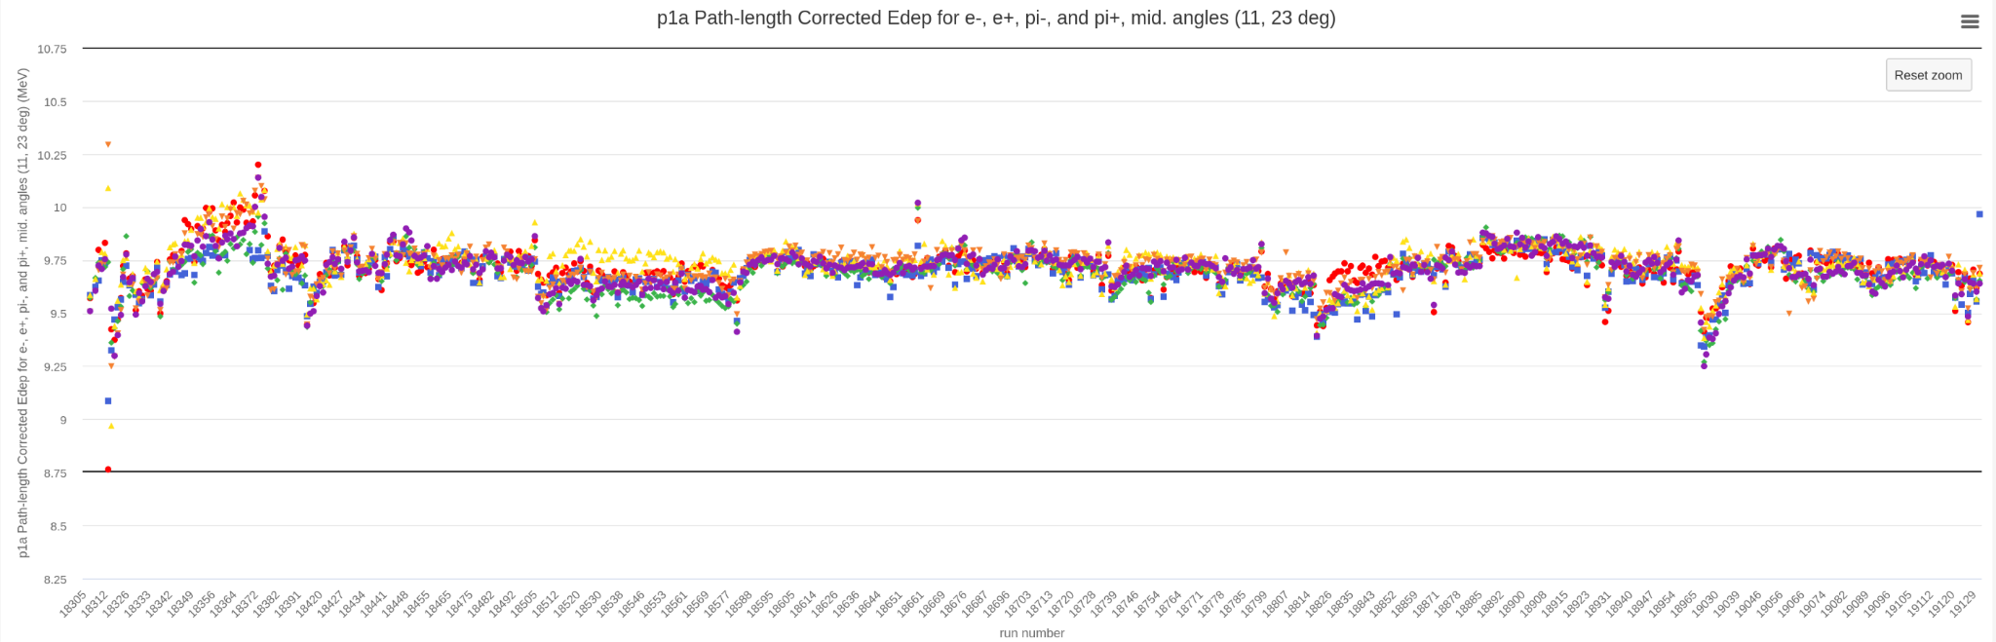
FTOF: first and second calibration rounds
Calibration using specific cooking calib_v8, calib_v9.
D. Carman calibrated the attenuation length, effective velocity, gain balance, time walk, time walk position, time offsets.
3 iterations of the FTOF calibration.
Thanks to D. Carman
Pass0v4
Pass0v6

Slide 13
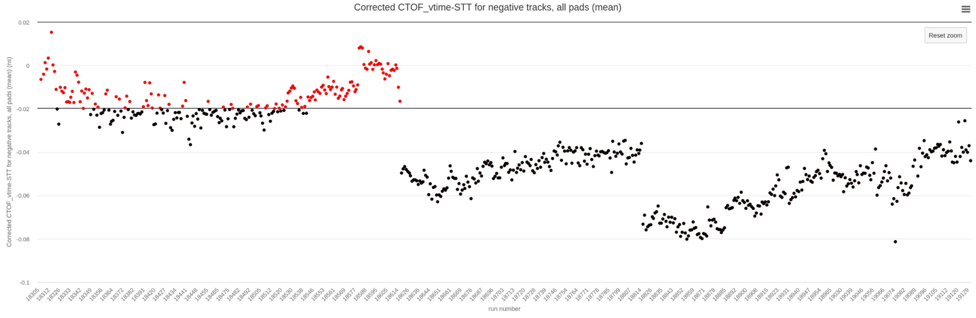
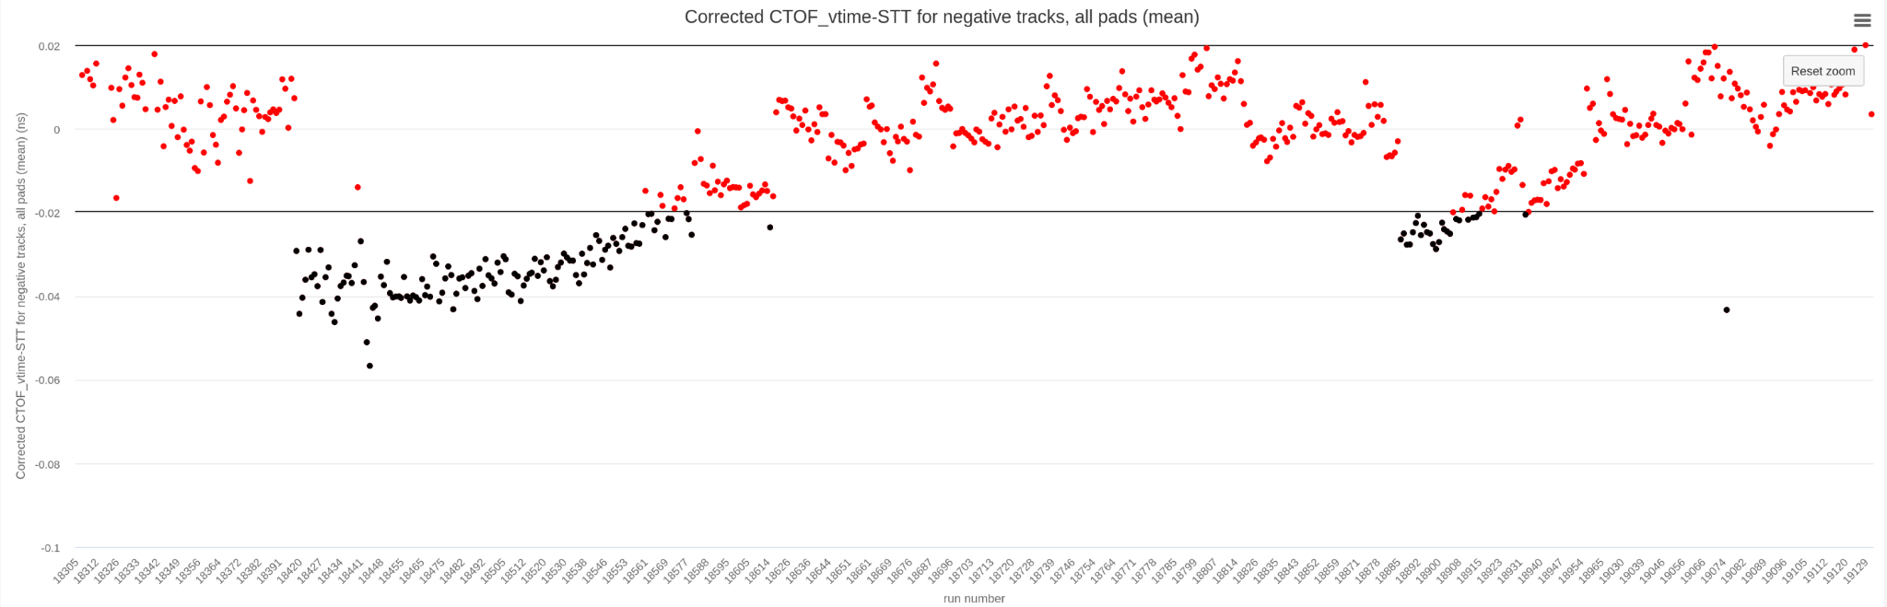
CTOF: calibration
Calibration using specific cooking calib_v8 and calib_v9.
2 iterations of the CTOF calibration.
Thanks to D. Carman
Pass0v4
Pass0v6

Slide 14
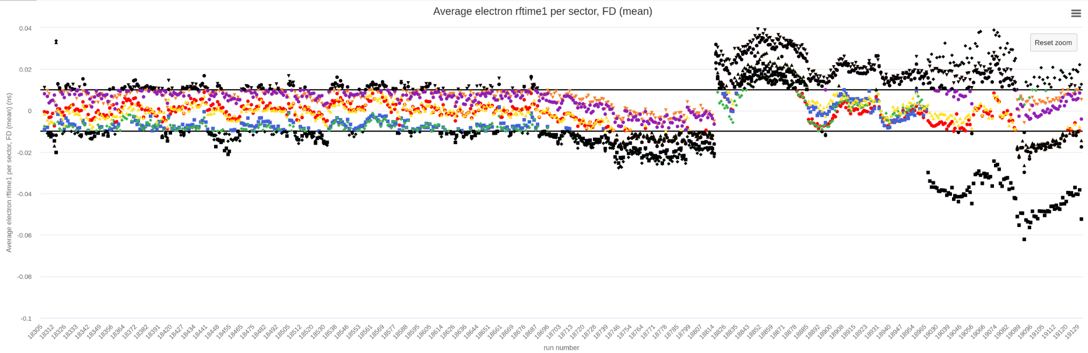
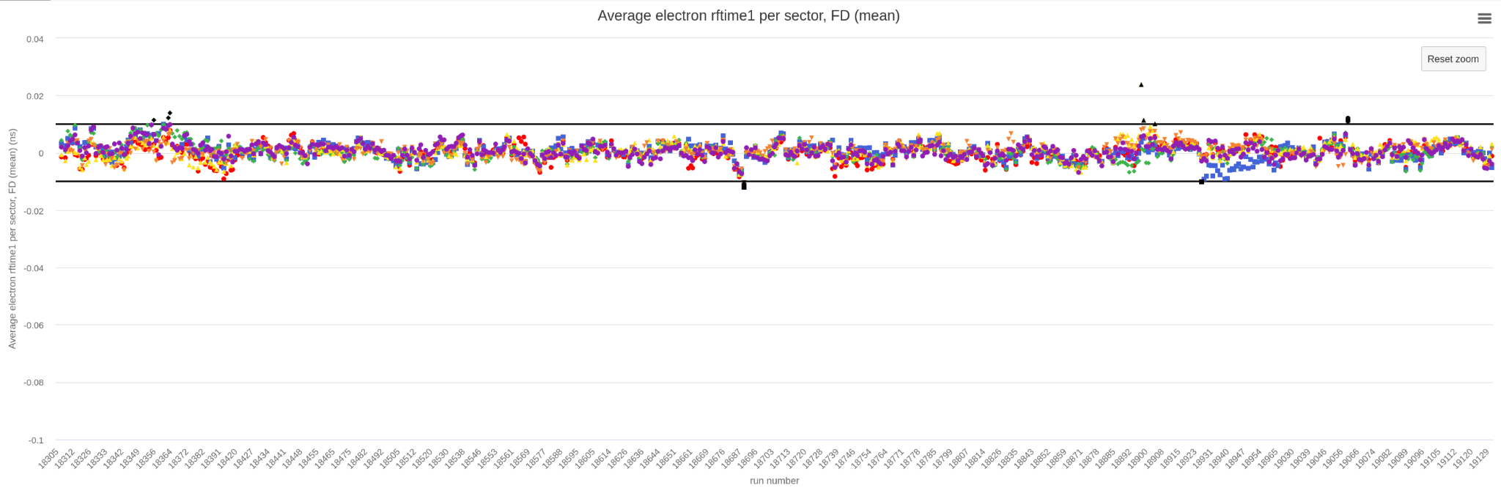
RF: calibration
RF offsets were updated based on Pass0v5 using a 5 ps threshold.
Using all runs and the rf train.
Thanks to R. De Vita
Pass0v4
Pass0v6

Slide 15
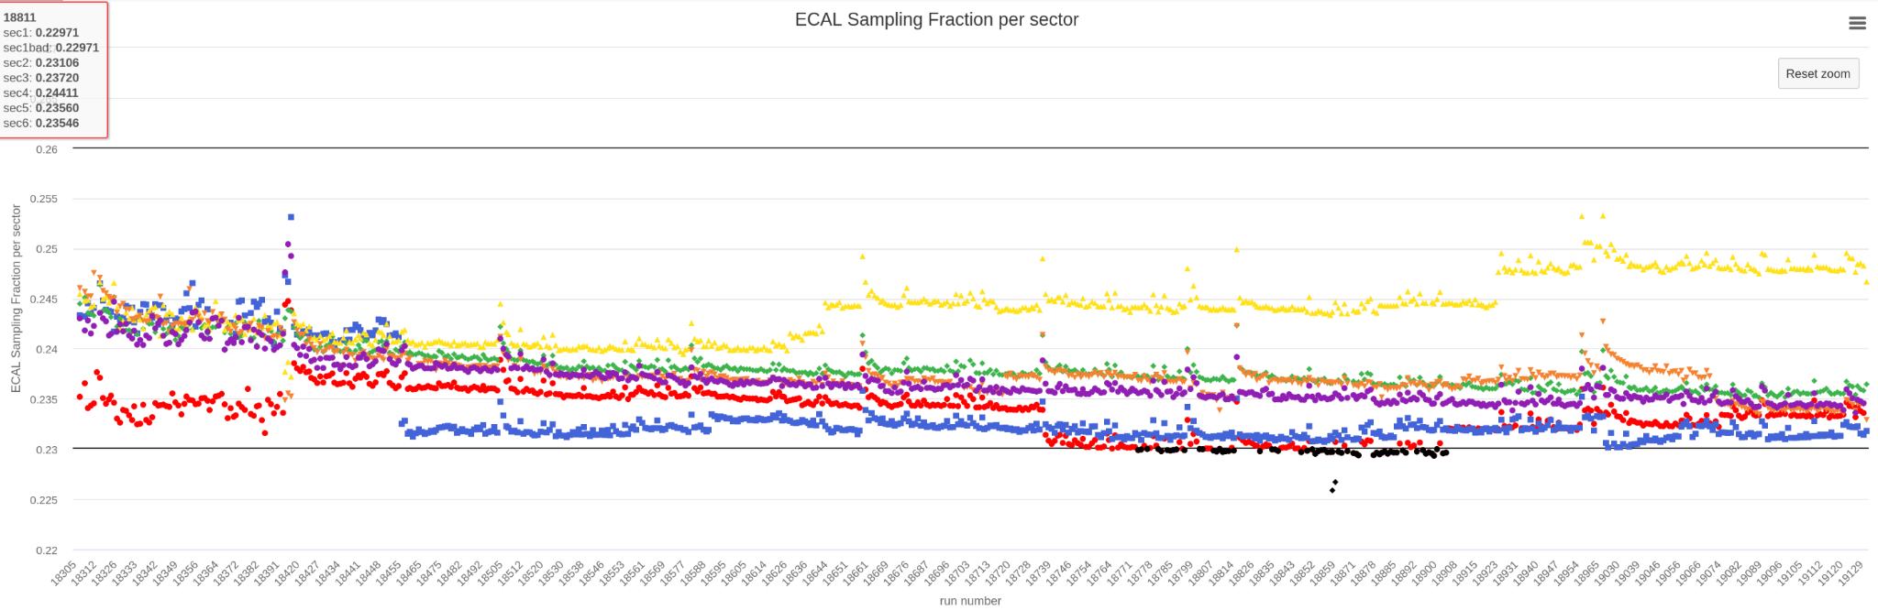
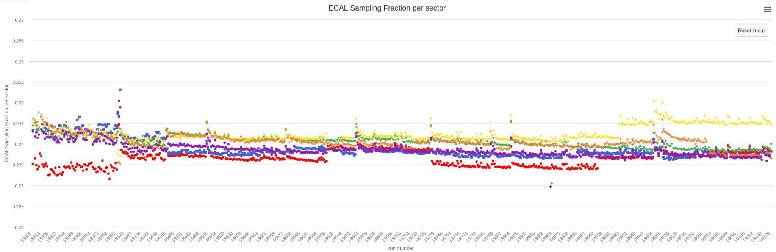
ECAL: calibration
First iteration of adjustments to timing residual offsets to compensate for probable time-walk.
First energy calibration attempt using LD2 runs processed in Pass0v4.
Thanks to C. Smith
Pass0v4
Pass0v6

Slide 16
Other calibration
LTCC calibration have been done with calib_v9 data, thanks to V. Mascagna.
Ongoing calibration:
DC with the new calibration suite.
HTCC
CND
Thanks to all the calibrators.

Slide 17
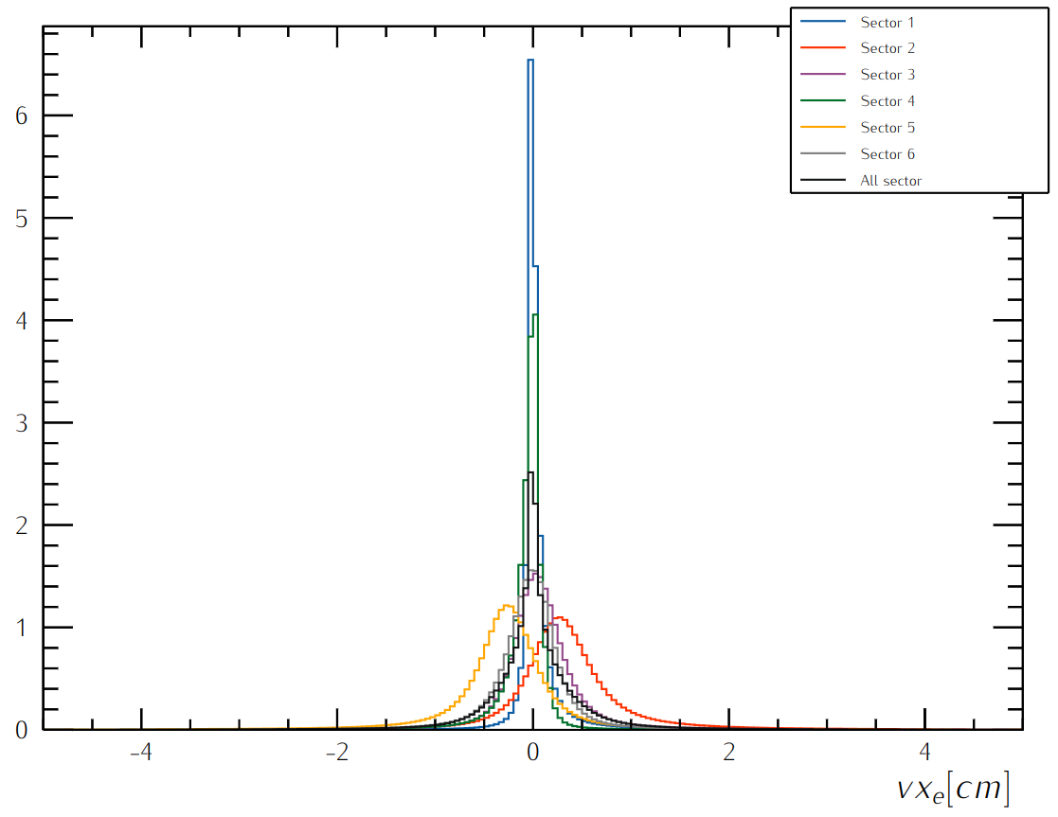
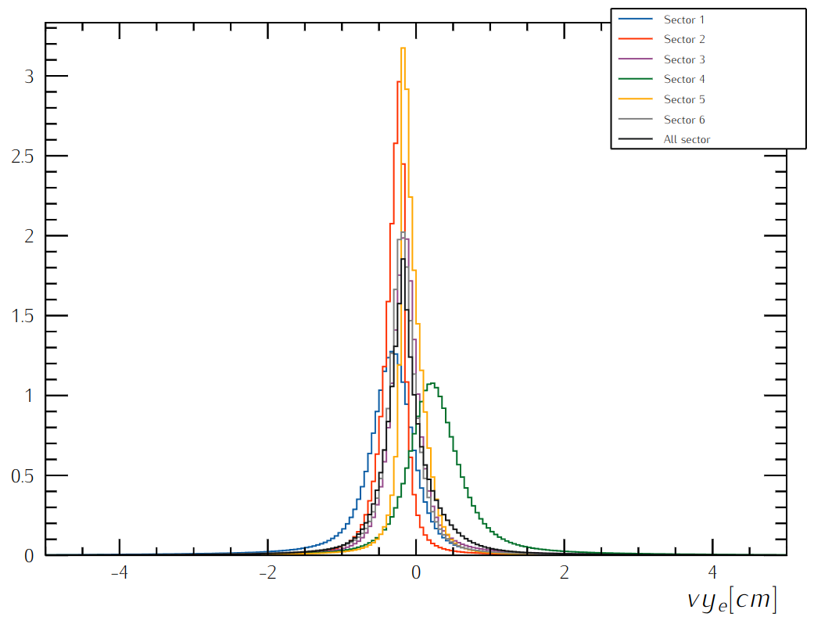
RG-D Vertex Studies
Goal:
Sectors are well aligned in Vx, vy and vz,
Could sector-independent cuts on vx, vy and vz be applied?
Reduce the contamination for the target configuration with two different foils, CuSn

Slide 18
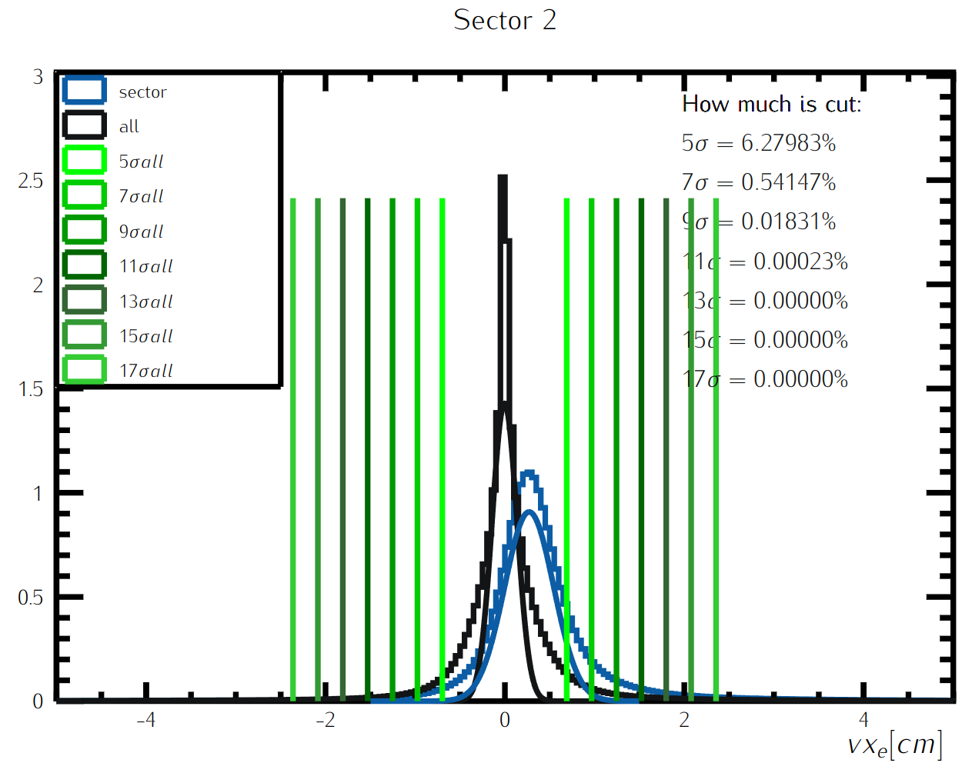
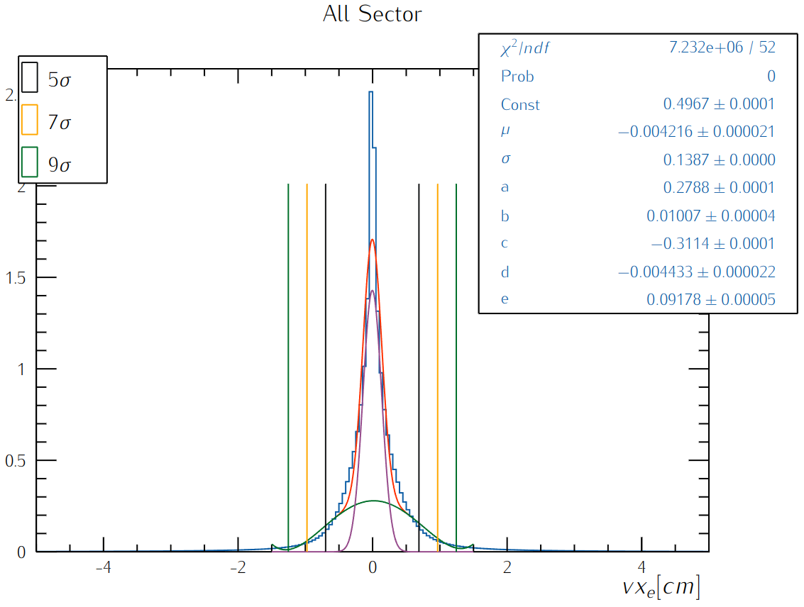
RG-D Vertex Studies: Transverse COmponents
Get rid of the sector-independent cuts

Slide 19
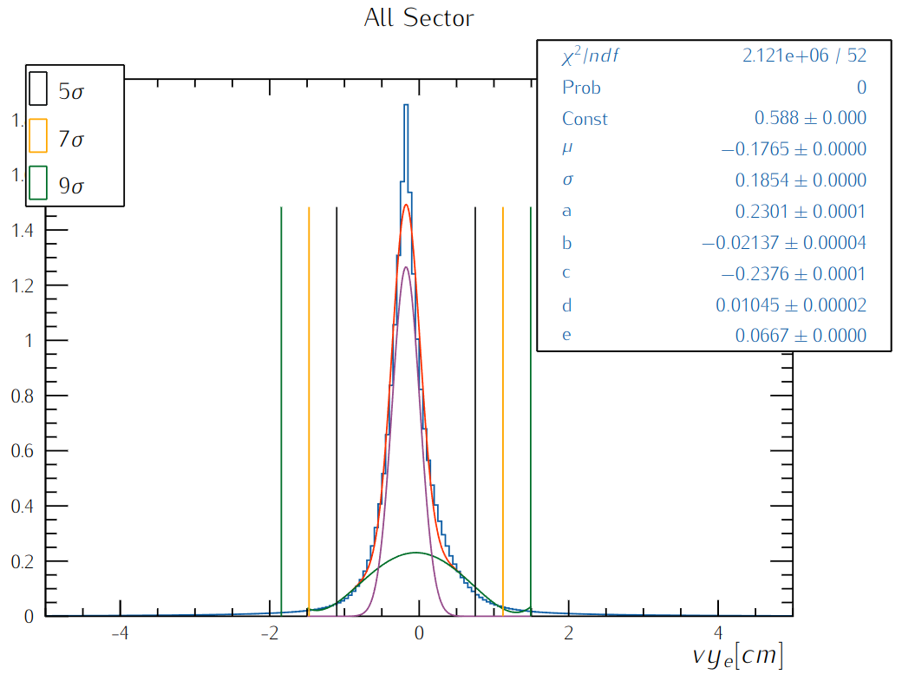
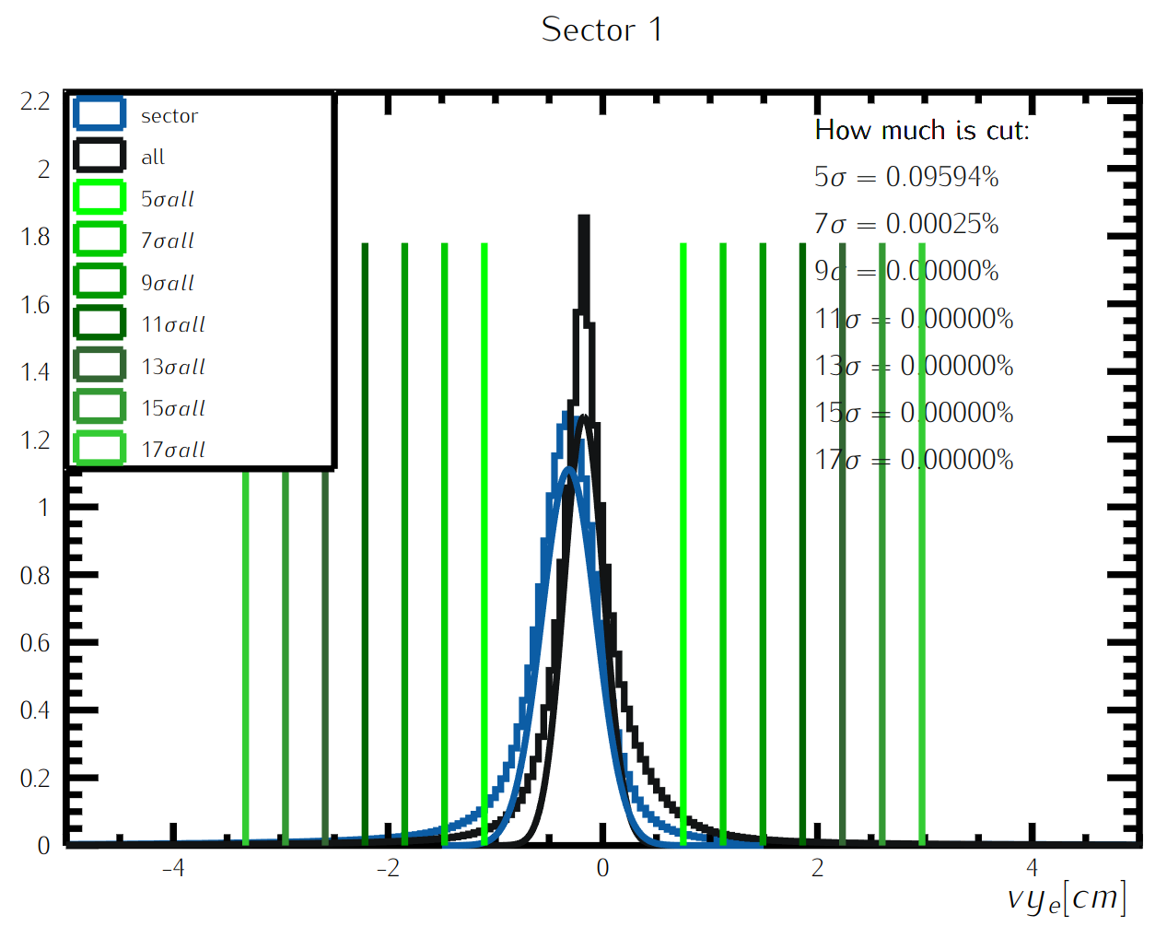
RGD studies: vertex study

Slide 20
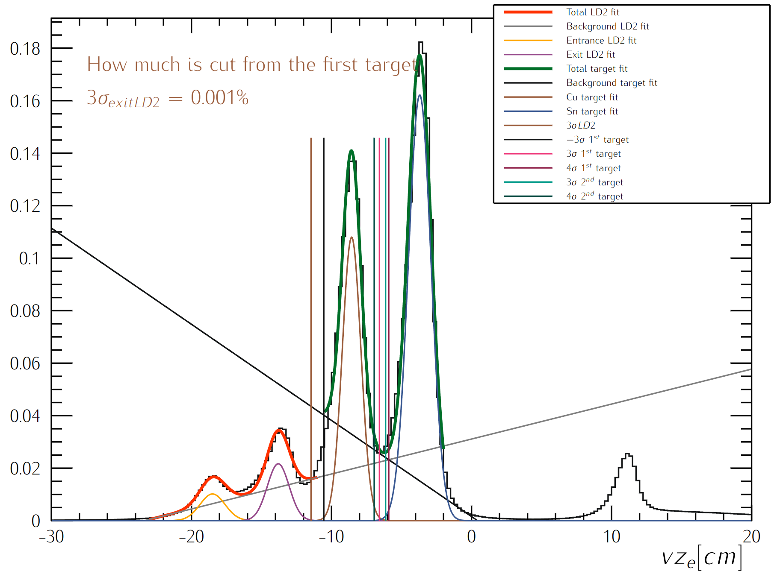
RG-D Vertex Studies: z-vertex
Fits:
Fit the empty LD2 cell and nuclear-foil regions with double gaussians and first-order polynomial
Same study on Carbon
Separate the two different foils, Cu and Sn from each other
Empty LD2 cell
Nuclear-foil

Slide 21
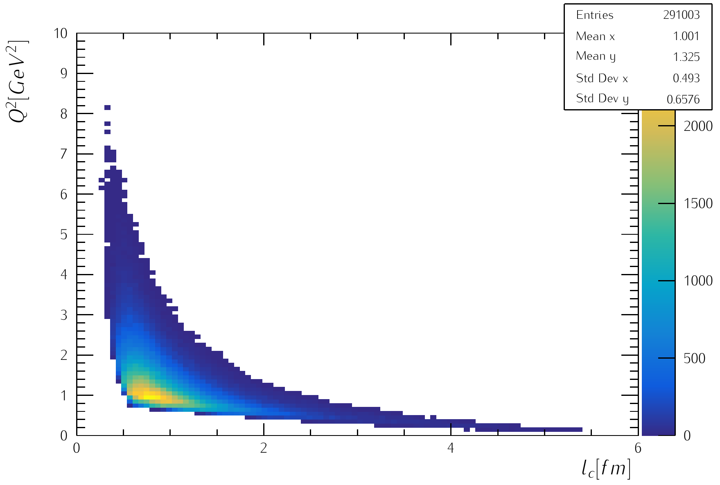
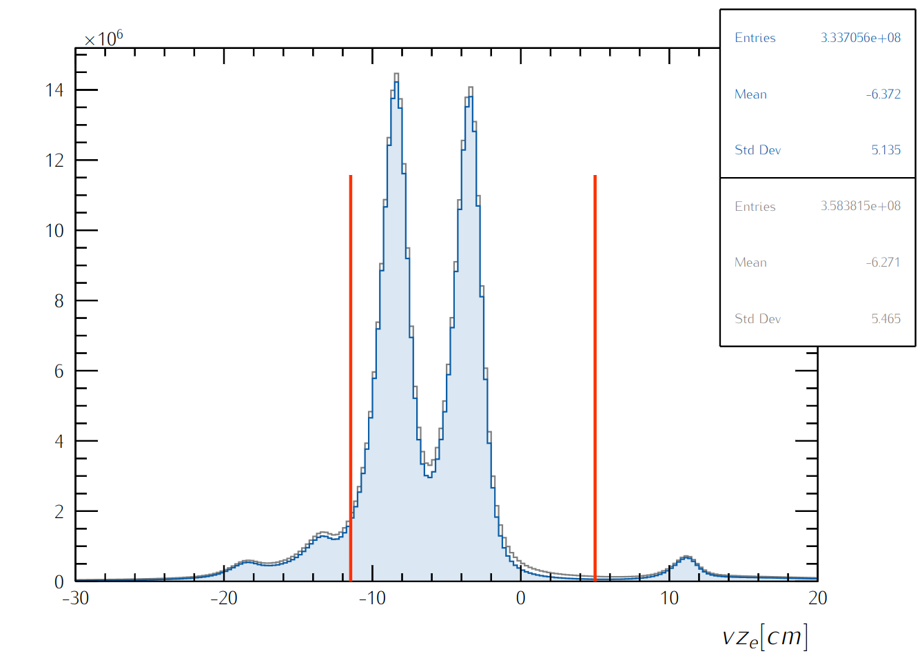
RG-D studies: Color Transparency
Extract nuclear transparency T_{A} as a function of Q²
Select event with 2 π that pass our cuts
Fit the invariant mass of the 2 π to extract the yield of ρ⁰
Compute the nuclear transparency
electron:
-5 < chi2pid < 5
-11.463 < vz < 5 cm for carbon
-20 < vz < 5 cm for LD2
π±:
-10 < chi2pid < 10
Select event:
W> 2 GeV
z_{h}> 0.9
0.1 < -t < 0.5

Slide 22
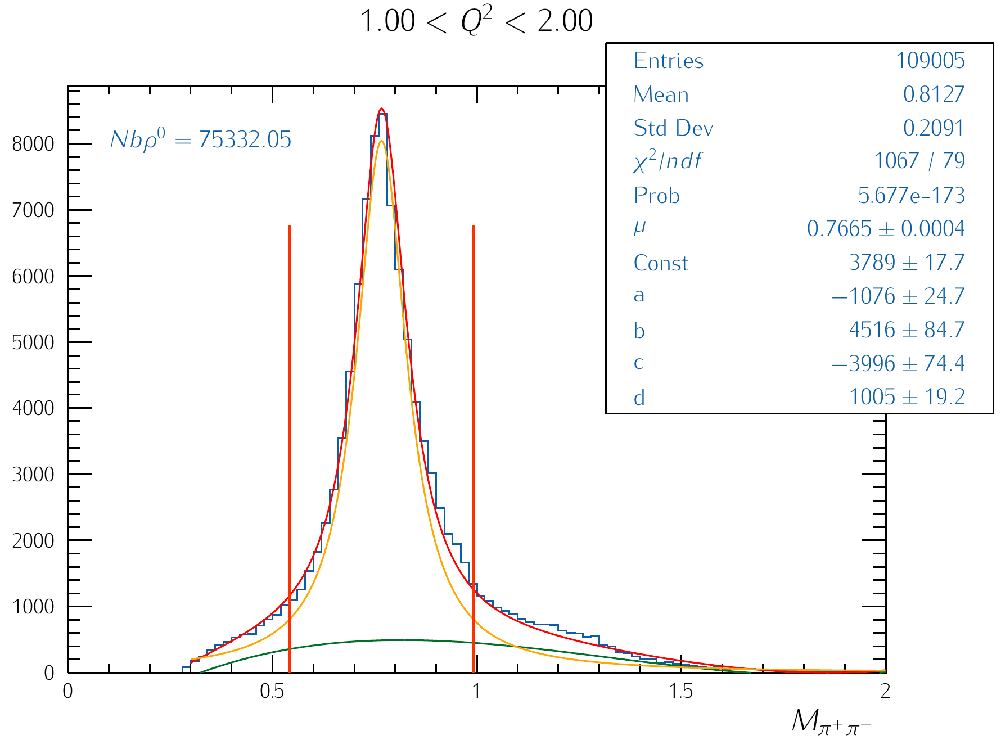
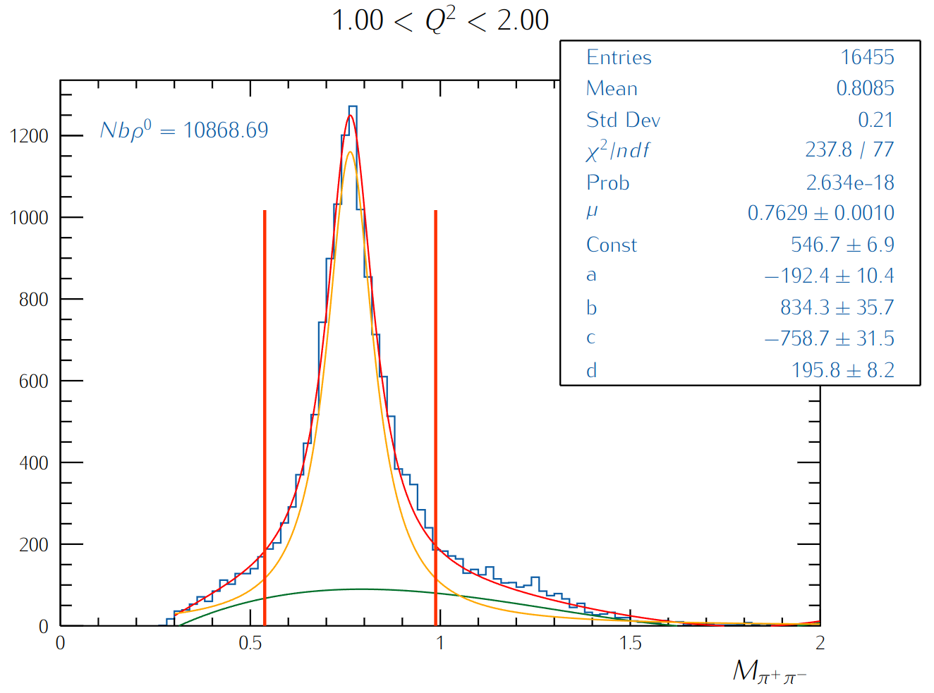
RGD studies: Color Transparency
Fit the invariant mass for the 2 π with a Breit-Wigner and temporarily with 3-order polynomial
Extract ρ⁰ yield by integrating the Breit-Wigner peak between μ ± 0.075, shown be the red lines.
Carbon data
LD2 data

Slide 23
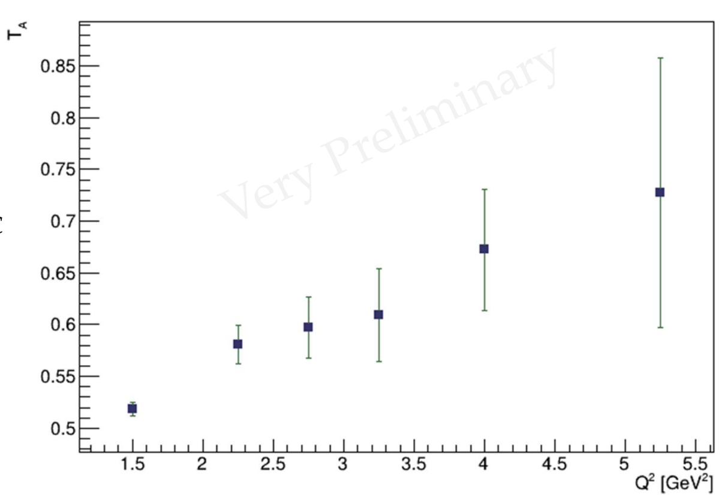
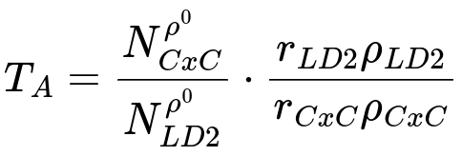
RG-D studies: Color Transparency
Extract the nuclear transparency:
r_{LD2}= 5 cm: LD2 thickness
r_{CxC} = 0.4 cm: is CxC thickness
ρ_{LD2}= 0.164 g/cm³: the density of target LD2
ρ_{CxC}= 2.2g/cm³ : the density of target CxC
Ongoing analysis by M. Maynes

Slide 24
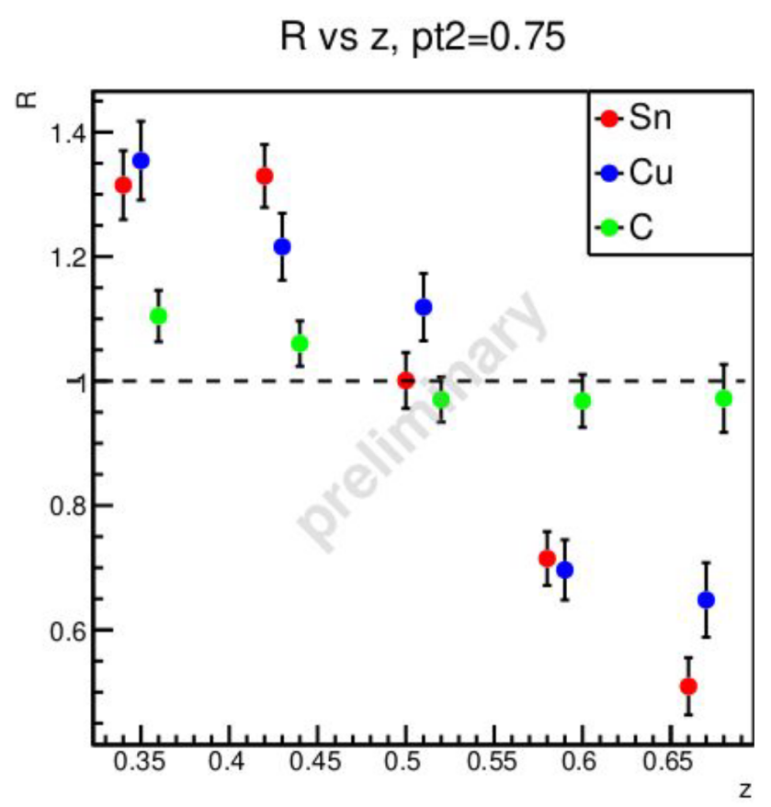
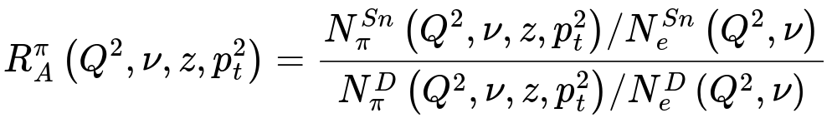
RG-D Studies: nTMDs observables
Development on nuclear TMD analysis: Ongoing analysis (Daniel Matamoros)
Pythia event generator with nuclear effects
Full GEMC simulation for production
Extract multiplicity ratio and cos(ϕ) for differents targets.
Cuts:
Q² > 1 GeV²
0.25 < y < 0.85
W > 2 GeV
0.3 < z < 0.7

Slide 25
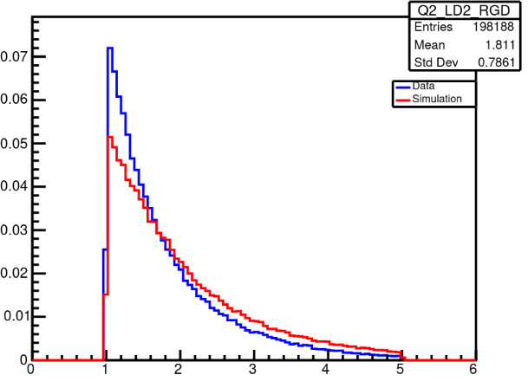
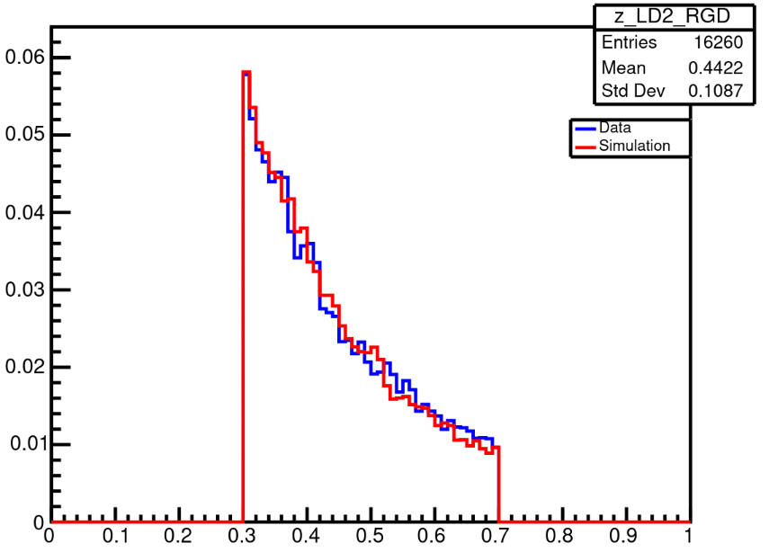
RG-D nTMDs Studies
Recent preliminary work:
Simulations are produced using modified version of Pythia with nuclear effects
Reconstruction was only run using conventional tracking
Comparing experimental data to simulation
LD2
LD2
Q² [GeV²]
z_{h}

Slide 26
Summary and Outlook
Calibration is progressing as planned within the three-month timeframe;
tttt
Developing analysis for color transparency and nuclear TMDs:
Separation of the empty LD2 target and the two targets to limit contamination
Extraction of the nuclear transparency as function of Q²
Simulation for TMD observables + comparison data and simulation

