Slide 1



AHDC AI Tracking
07/08/25
CLAS Collaboration Meeting (8-11 July, 2025)

Slide 2
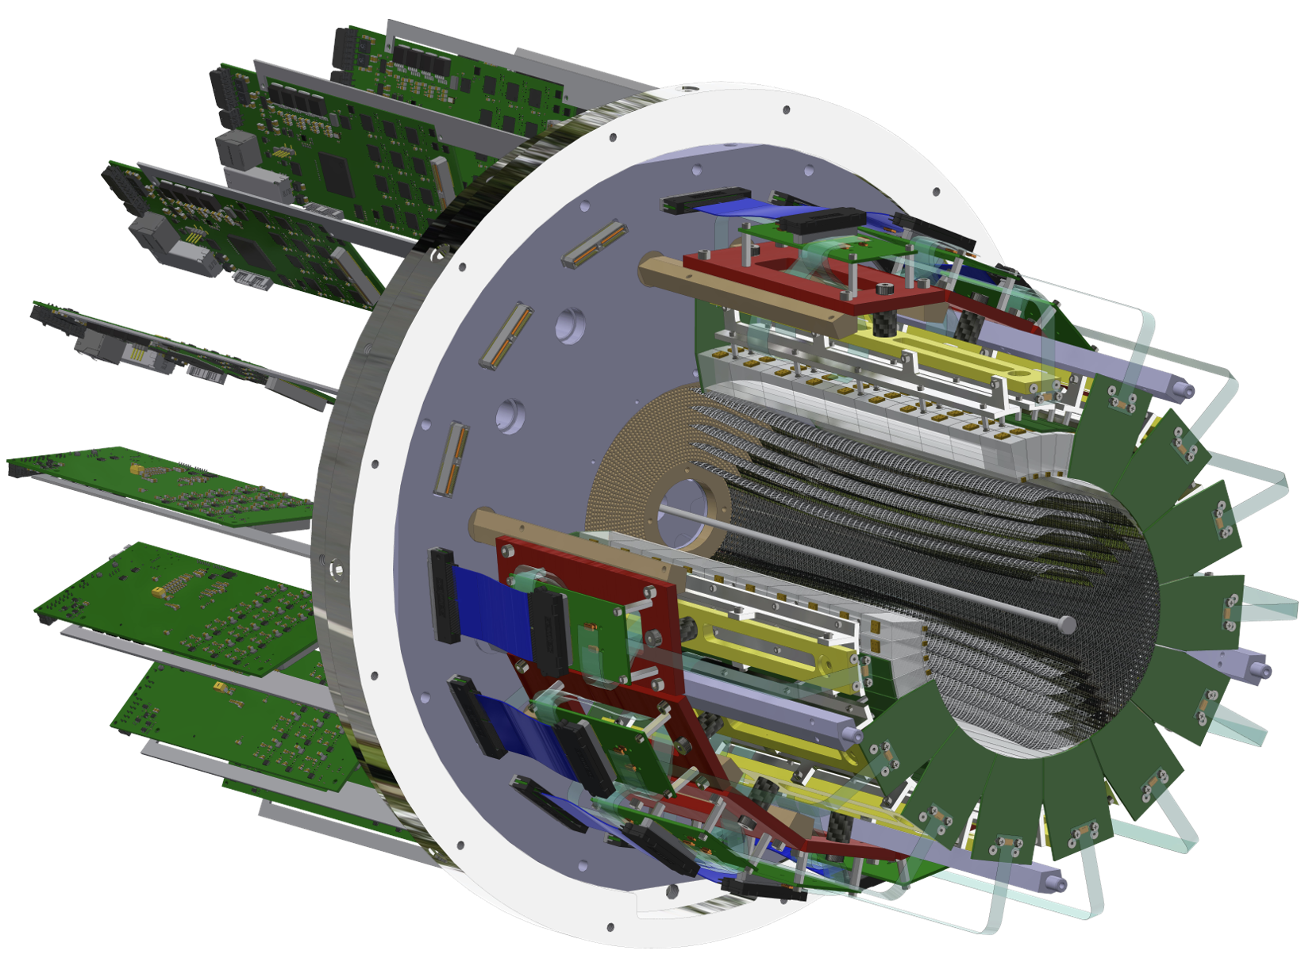
ALERT Experimental Setup
ALERT have two sub-detectors: A Hyperbolic Drift Chamber (AHDC) and A Time of Flight (ATOF)
ATOF
Time of flight: used for Particle IDentification
Small barrel of segmented scintillators
The TOF measurement is degenerate for ²H and ⁴He, but dE/dx can distinguish the two nuclei bands
AHDC
Aluminum wires: 2 mm apart
20-degree stereo angle (hyperbolic shape)
5 superlayers, each composed of 2 layers
576 signal wires (6 ground wires of each signal)

Slide 3
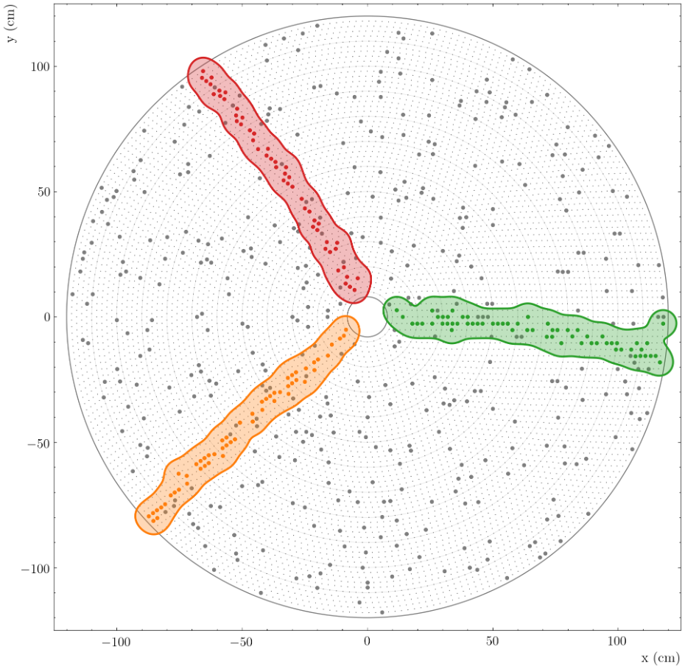
Track Finding
Track finding is a clustering problem:
Set of points (hits) ⇒ cluster in sets (tracks) originating from the same particle
Hits: particles deposit energy when interacting with the detector material
Tracks: reconstructed sequences of hits representing charged particle trajectories
Different algorithms:
Distance between hits + fit
Hough transform
Combinatorial Kalman Filter
Artificial Intelligence models (MLP, GNN…)

Slide 4
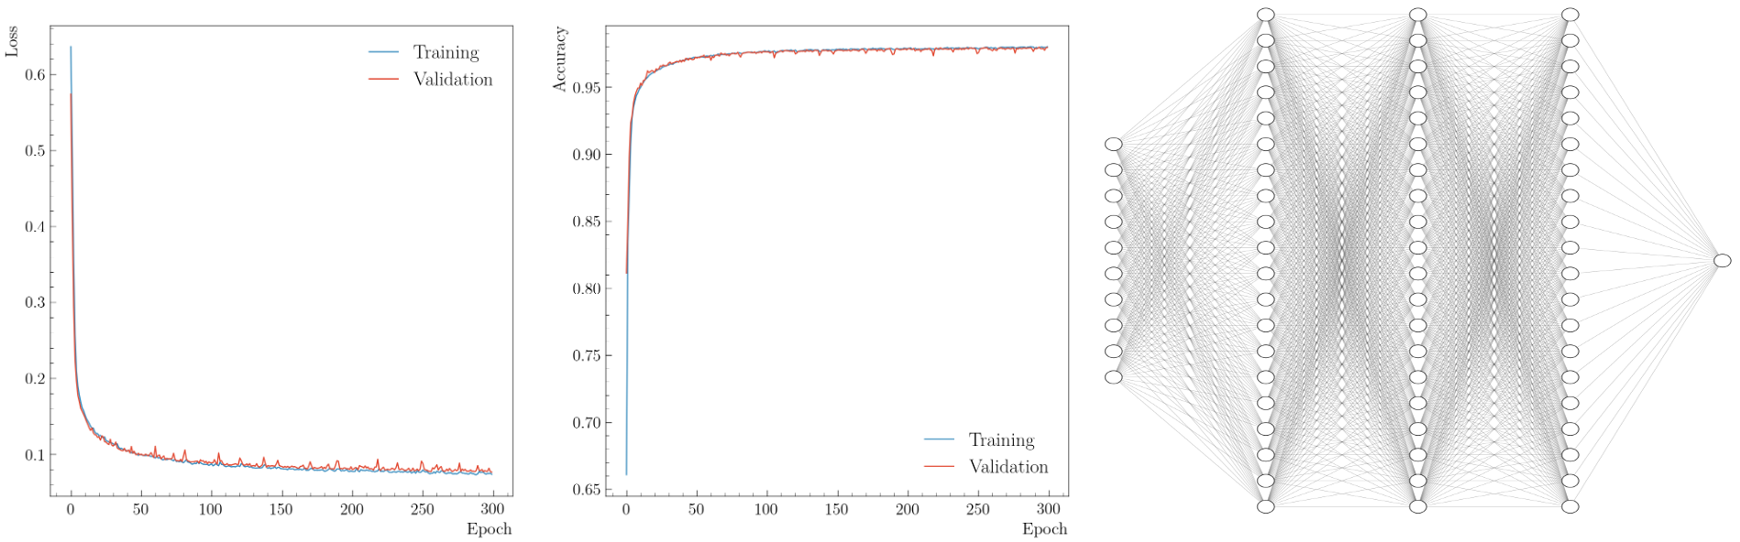
AI-assisted model: Description and Training
Model: MultiLayer Perceptron, 10 inputs, 1/3/5 hidden layer (15/20/100 neurons), 1 output
Inputs: x and y values of the five inter-clusters
For the training ⇒ Need good and bad tracks:
Good tracks: GEANT4 simulation (particle with p ∈ [0.07, 1.5] GeV/c, φ ∈ [0, 360]°, θ ∈ [30, 150]° , and Vz ∈ [-15, 15] cm)
False tracks: Interchanging randomly up to two inter-clusters with another event
Generate 5M events composed of all light nuclei (flat distribution for all variables)
Output: Number between 0 and 1, with 0/1 means bad/good track

Slide 5
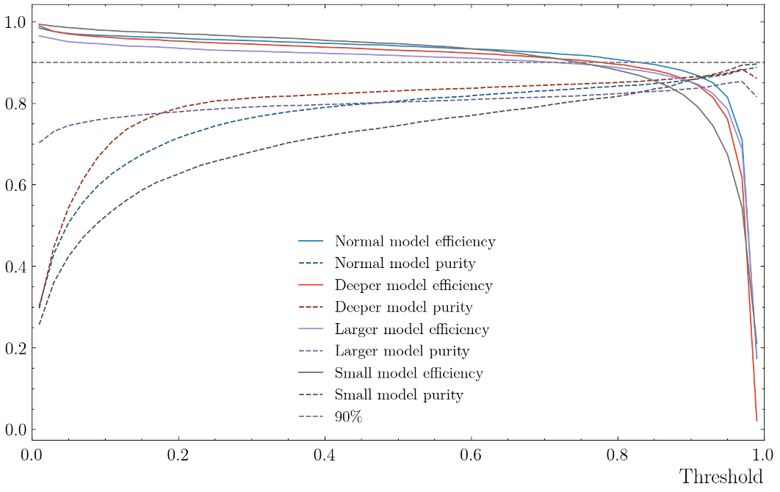
Simulation Validation: Efficiency and Purity vs. Threshold
Threshold: if output above/lower than the threshold ⇒ good/bad tracks
To evaluate the model:
Efficiency: Number of good tracks classified as good normalized by the number of events.
Purity: Number of good tracks classified as good normalized by the number of tracks (good or bad) classified as good.
Events need to have at least one track candidate.
Set the threshold to 0.2 to have a higher efficiency
Blue: model with 20 neurons in 3 hidden layers
Violet: model with 100 neurons in 3 hidden layers
Red: model with 20 neurons in 5 hidden layers
Gray: model with 15 neurons in 1 hidden layer

Slide 6
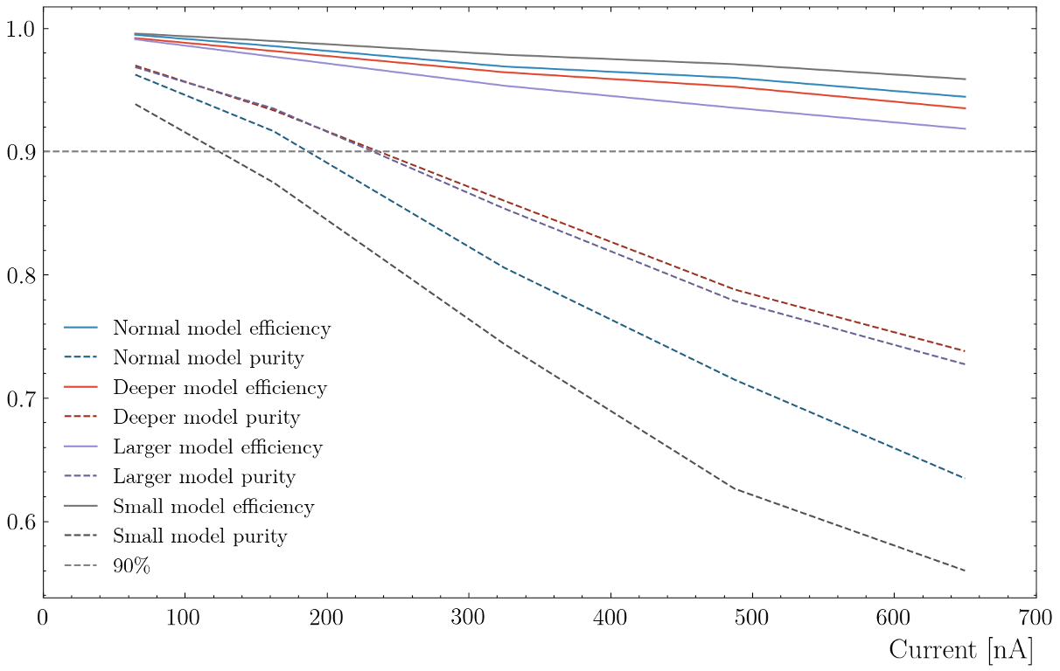
Simulation Validation: Efficiency and Purity vs. Current
Efficiency is always higher than 90% and the purity is between 55% and 95%
More current means more background
Efficiency: Number of good tracks classified as good normalized by the number of events.
Purity: Number of good tracks classified as good normalized by the number of tracks (good or bad) classified as good.
Events need to have at least one track candidate.
Threshold set to 0.2 to have a higher efficiency
Blue: model with 20 neurons in 3 hidden layers
Violet: model with 100 neurons in 3 hidden layers
Red: model with 20 neurons in 5 hidden layers
Gray: model with 15 neurons in 1 hidden layer

Slide 7
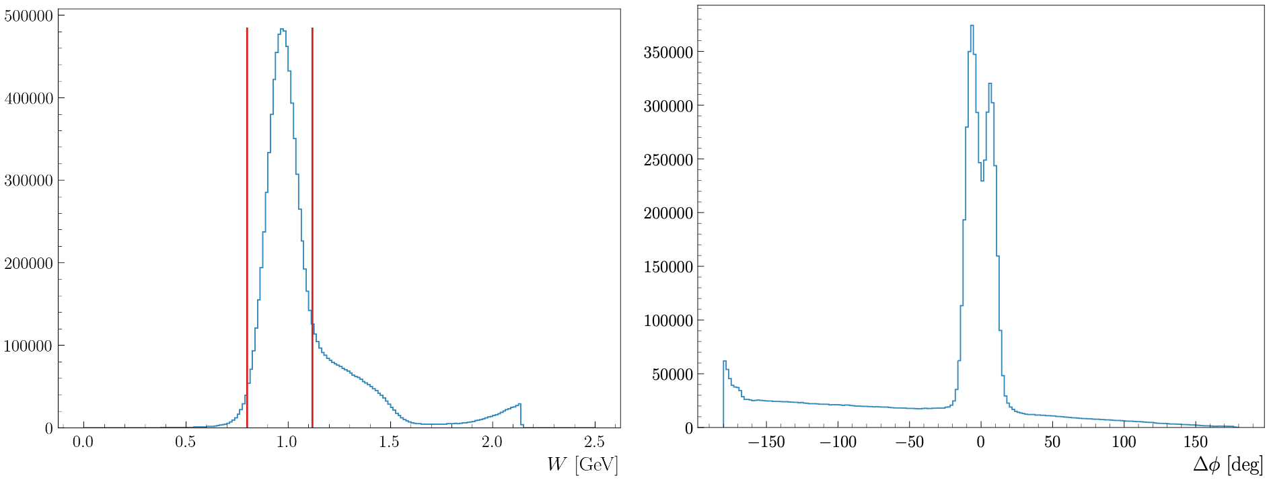
Validation with Proton data: Elastic Scattering
To evaluate the performance of the AI, use elastic scattering on proton
For the AHDC, want the low momentum proton ⇒ use electron at low θ
Compute Δϕ using electron and AHDC hits ⇒ shift in Δϕ approx. 20º

Slide 8
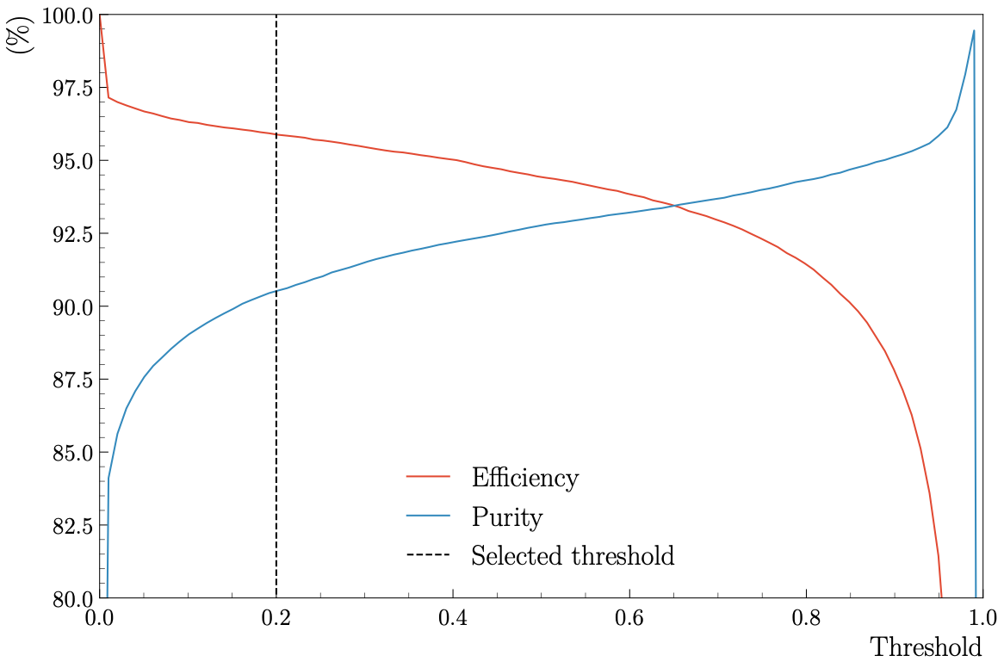
Validation on Proton Data: AI Efficiency and Purity
Efficiency and purity as a function of the threshold:
Threshold: if output above/lower than the threshold ⇒ good/bad tracks
Efficiency: Number of good tracks classified as good normalized by the number of events.
Purity: Number of good tracks classified as good normalized by the number of tracks (good or bad) classified as good.
We have an efficiency of 96%, and a purity of 90% at 0.2

Slide 9
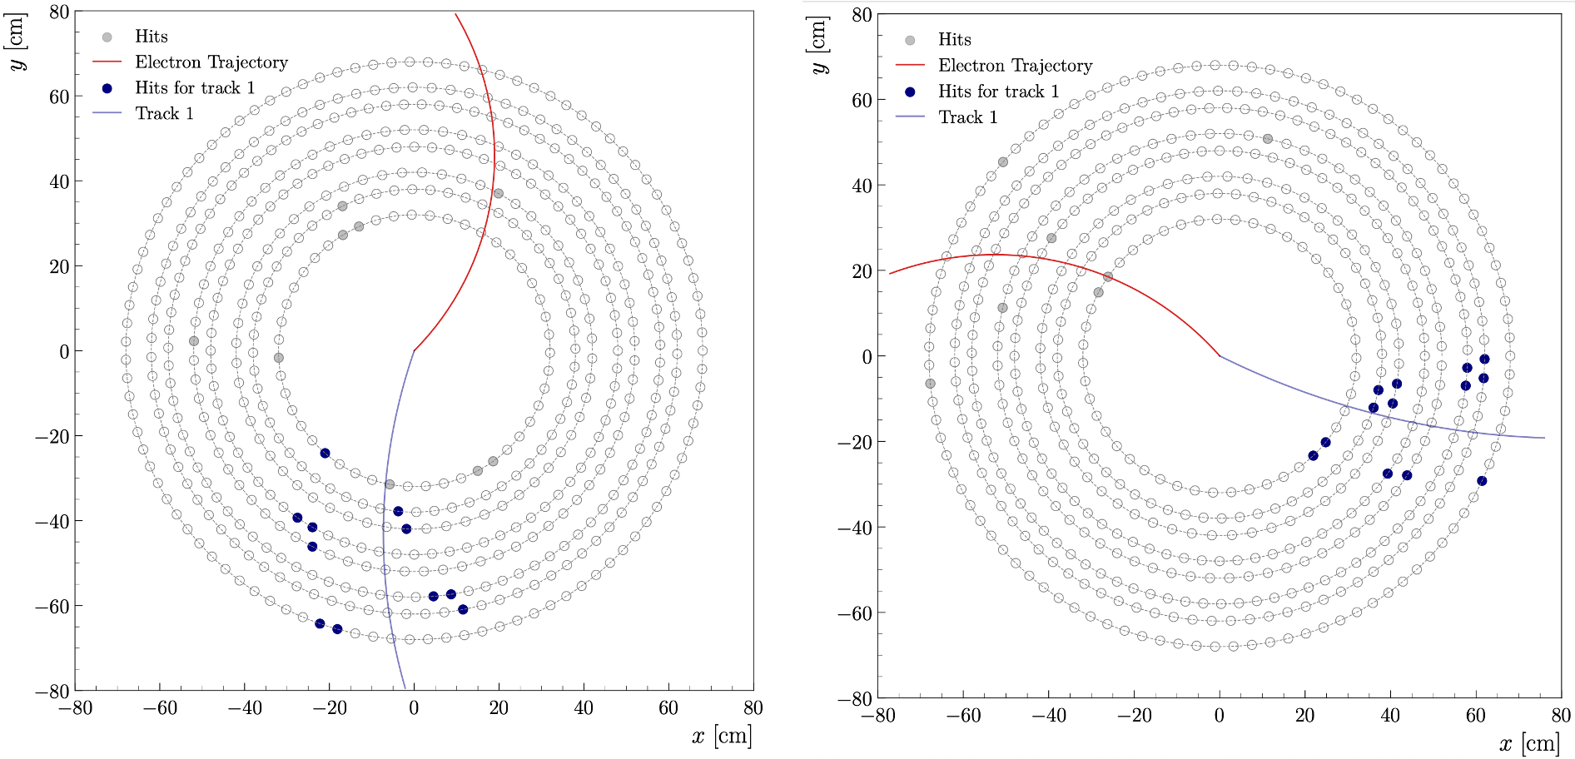
Validation with Proton data: Event Display

Slide 10
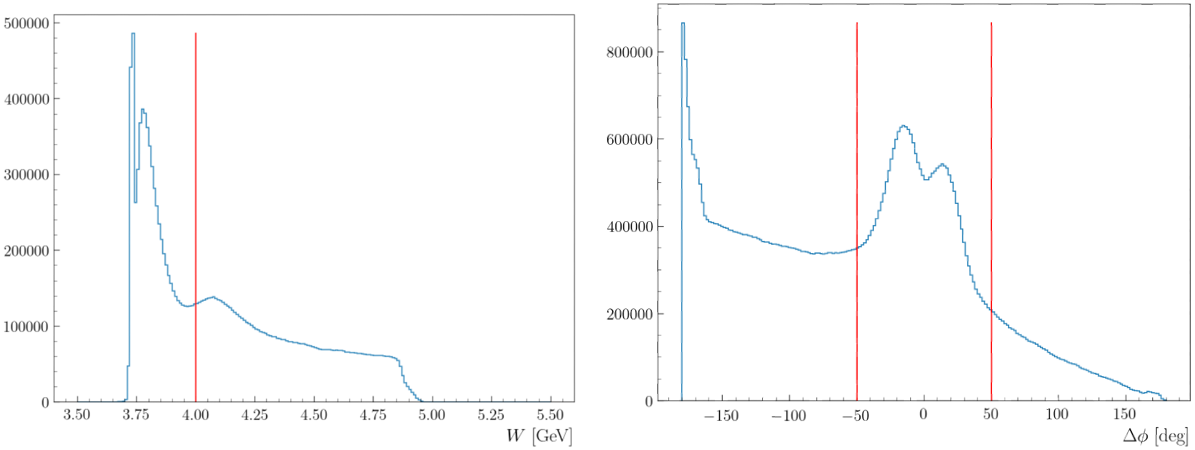
Validation with ⁴He Data: Elastic Scattering
To evaluate the performance of the AI, use elastic scattering on 4He
For the AHDC, want the low momentum ⁴He ⇒ use electron in FD
Compute Δϕ using electron and AHDC hits

Slide 11
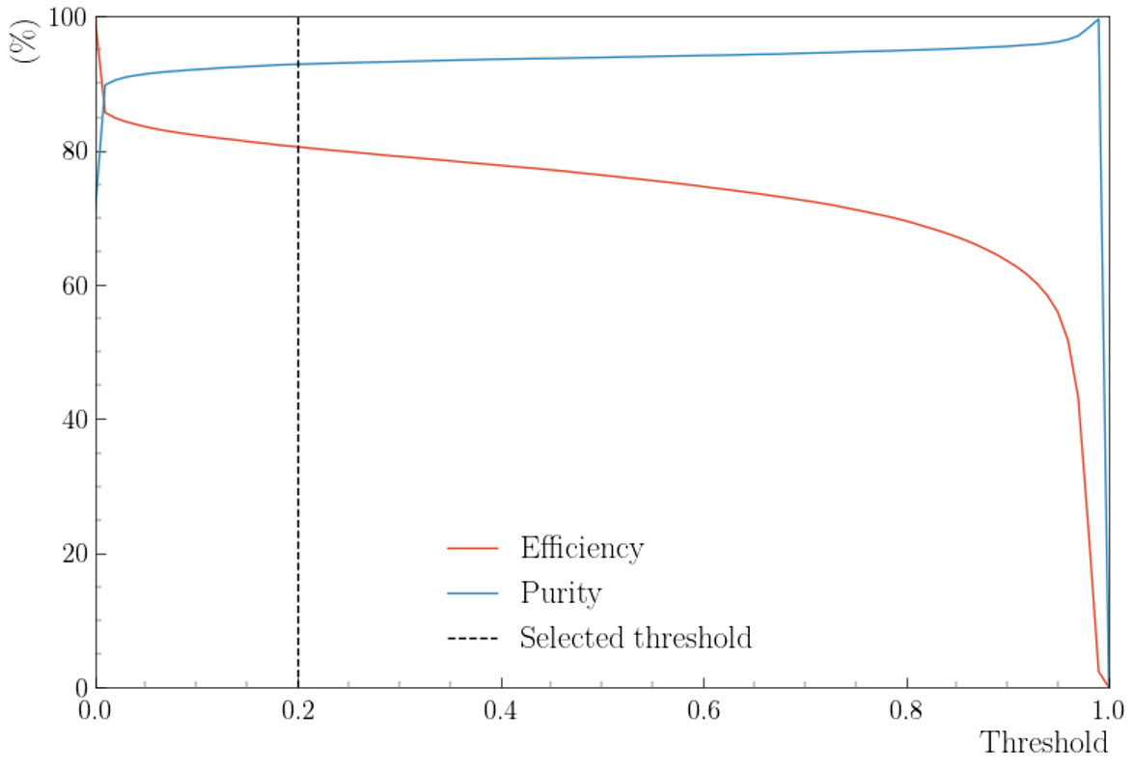
Validation with ⁴He data: AI Efficiency and Purity
Efficiency and purity as a function of the threshold:
Threshold: if output above/lower than the threshold ⇒ good/bad tracks
Efficiency: Number of good tracks classified as good normalized by the number of events.
Purity: Number of good tracks classified as good normalized by the number of tracks (good or bad) classified as good.
We have an efficiency of 81%, and a purity of 93% at 0.2

Slide 12
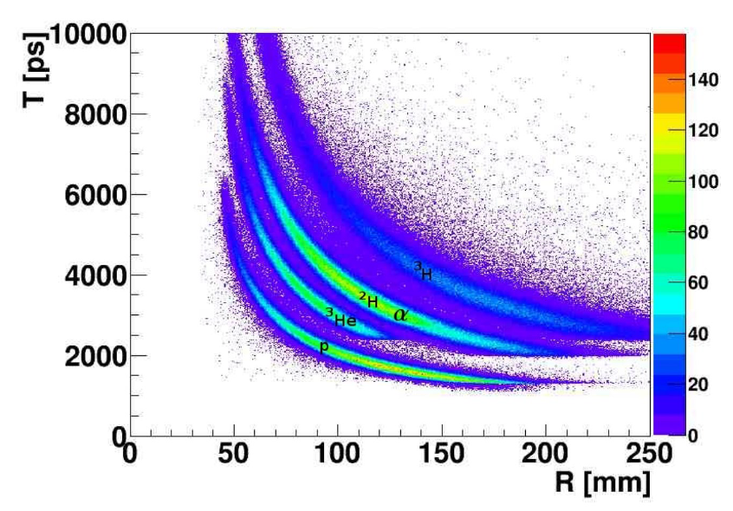
ALERT AI-Assisted PID
Ongoing efforts to deploy AI techniques to improve particle identification by a teammate Uditha Weerasinghe:
perfect task for machine learning
can learn non-trivial relations between different track parameters and PID
MultiLayer Perceptron model has been used to classify recoil nuclear-target fragments that are detected by ALERT
A set of 27 features to include:
momentum, energy deposited, inter-cluster position, AHDC residual, ATOF cluster position, time, and path length.
Main limitation: Quality of the classifier will depend on the MC sample

Slide 13
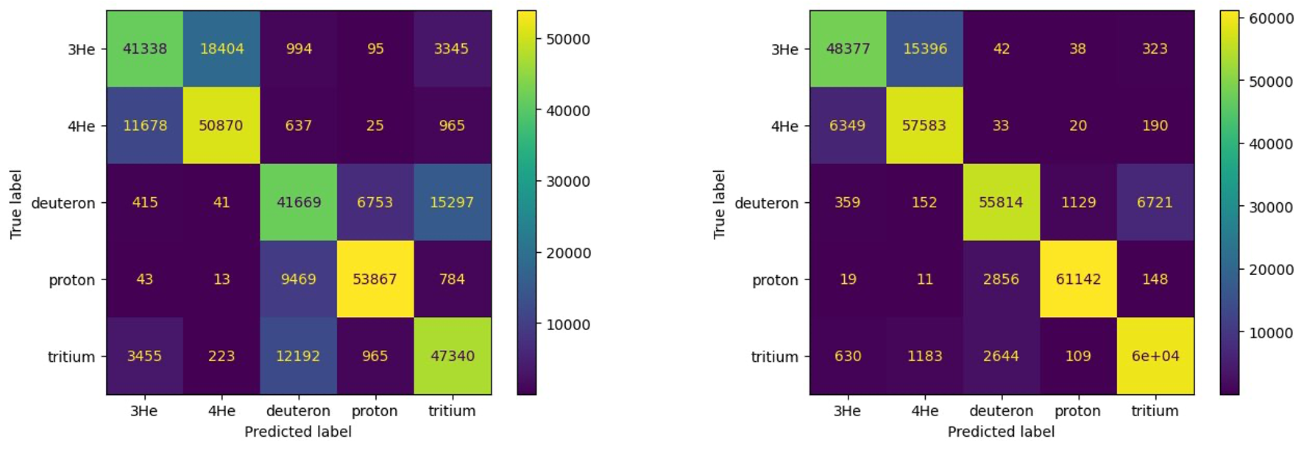
ALERT AI-Assisted PID
For reconstructed momentum
For generated momentum
Protons: 83.9 %
Deuterons: 64.9 %
Tritium: 73.7 %
Helium-3: 64.4%
Helium-4: 79.3%
Protons: 95.3 %
Deuterons: 87.0 %
Tritium: 92.9 %
Helium-3: 75.4%
Helium-4: 89.7%

Slide 14
Summary and Outlook
An MLP have been developed to improve track finding for ALERT:
Evaluated efficiency and purity as a function of momentum, threshold, and current for simulation
Evaluated efficiency and purity as a function of momentum and threshold for elastic data
Efficiency is always higher than 90% on proton and 80% on ⁴He
Worked on a classifier for the PID
Remaining works:
Matching hit in the ATOF with track in the AHDC using AI
Improve the performance of the PID classifier

Slide 15


