Slide 1



RG-D Experiments:
Status and Analysis Plans
07/10/25
CLAS Collaboration Meeting (8-11 July, 2025)

Slide 2
Run Group D
RG-D is comprised of two experiments:
Study of Color Transparency (CT) in Exclusive Vector Meson Electroproduction off Nuclei (E12-06-106)​:
Spokespeoples: W. Armstrong¹ , L. El Fassi⁴, K. Hafidi¹, M. Holtrop⁵, and B. Mustapha^{1​}
Nuclear Transverse Momentum Distributions (nTMDs) in CLAS12 (E12-06-106A)​:
Spokespeoples: R. Dupré³, L. El Fassi⁴, Zein-Eddine Meziani¹, and Holly Szumila-Vance​²
¹: Argonne National Lab, ²: Florida International U., ³: IJCLAB, Orsay, France, ⁴: Mississippi State U., ⁵: University of New-Hampshire

Slide 3
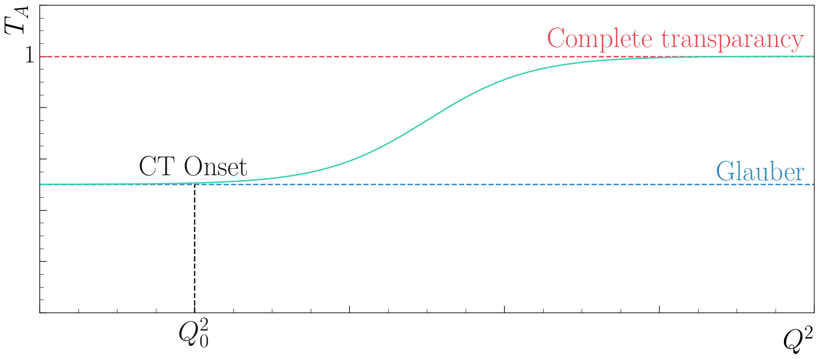
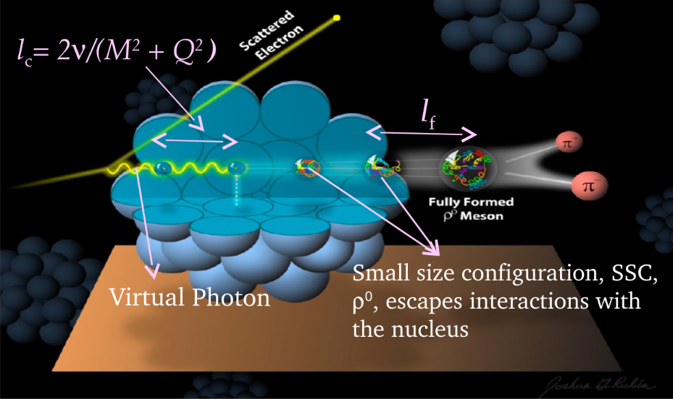
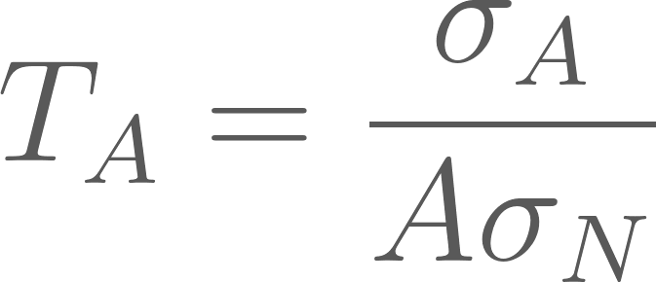
RG-D: CT Experiment​
Color Transparency: suppression of interactions of colorless SSC in nuclear medium
Experimental signature: rise of the nuclear transparency, T_{A}, as a function of Q², where
T_{A}: ratio of the cross section per nucleon on a bound nucleon to that on a free nucleon
σ_{A} − nuclei cross section
σ_{N} − free nucleon cross section
Objective:
Understanding evolution from small-size configurations into ordinary hadrons​
Validating the QCD factorization theorem
Coherence length, l_{c}: the lifetime of the qq-bar pair
Formation time, l_{f}: the time evolution of SSC to an on-shell ρ⁰ meson​​

Slide 4
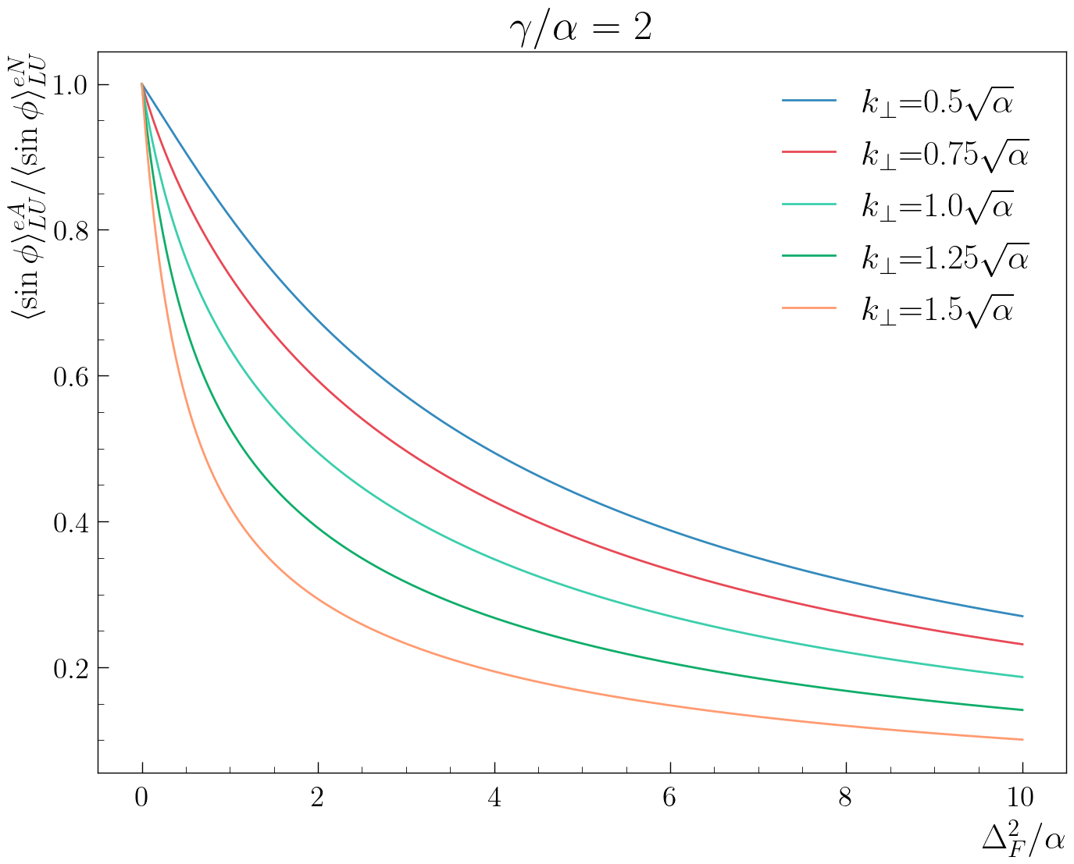
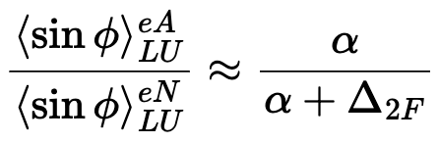
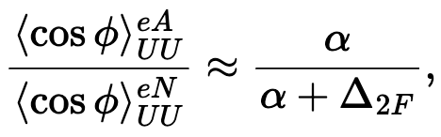
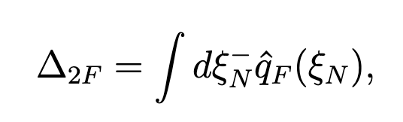
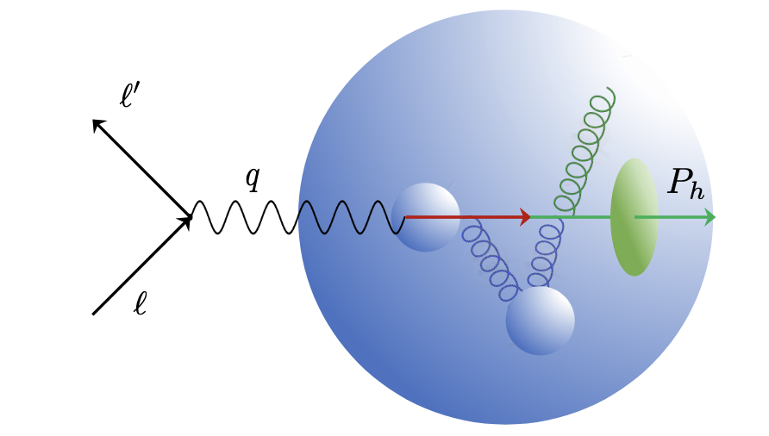
RG-D: Nuclear TMDs Study
nTMDs study uses the same CT running conditions except the beam polarization, and aims to study​:
Nuclear effects on SIDIS asymmetries
Transport coefficient of the nuclear matter
Therefore, it aims to measure
cos φ, sin φ, and cos(2φ)¹ moments for different hadrons as
where, and
Song, Y. et al. (2014) Physical Review D, 89 014005
and
q_{F}(ξ_{N}): quark transport parameter
¹ No predictions exist for this observable

Slide 5
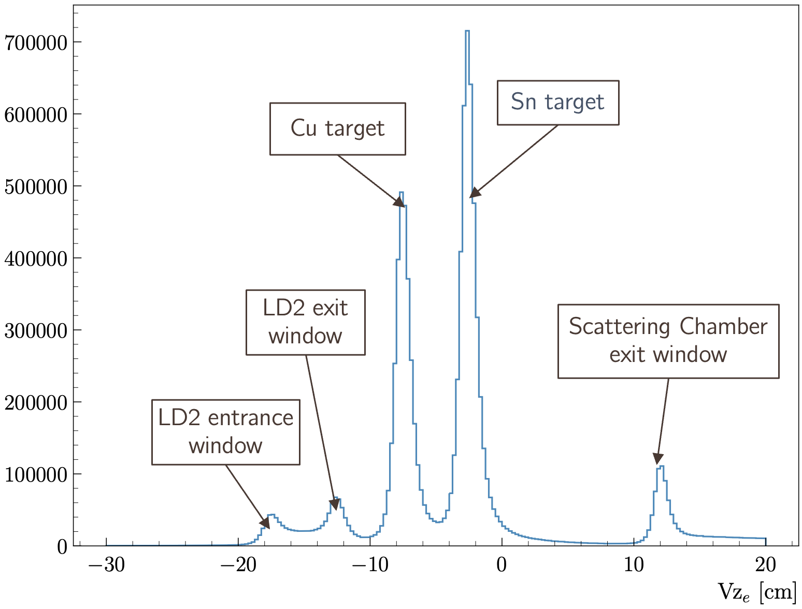
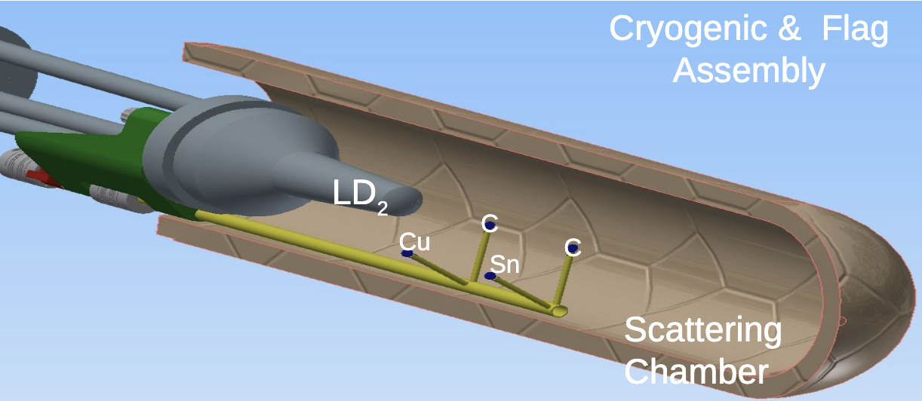
RG-D Run Configuration
RG-D experiments collected data in the fall of 2023 with
10.5 GeV polarized beam energy and 𝐼= 5–175 nA for luminosity scans and production
Standard CLAS12 configuration with FT-OFF and three layers of FMT
Three target-type, LD2, CxC, and CuSn, deployed with InBending and OutBending torus polarity
New cryogenic LD2 and the nuclear-foil flag assembly centered at -5 cm for each configuration
Main run hiccups:
Faraday Cup vacuum contamination
Moller cone sagging

Slide 6
RG-D Status: Calibration & Cooking Summary
Since March meeting update, RG-D fulfilled these milestones:
Completion of DC, the last piece of CLAS12 subsystems, calibration using the newest DCv2 suite
Training of three new AI-assisted networks and validating them on OB/IB LD2 and OB CuSn data
Sanity-check of the performance of the validated OB LD2 AI-assisted network on all RG-D datasets
Tracking efficiency and background merging studies based on simulation and real data comparison
Production of final Pass0 (v11) timelines and its associated high-level physics QA timeline with final calibration constants, adopted OB LD2 AI-assisted network, and denoising, as preparation for Pass1 cooking readiness review
RG-D successfully passed the Pass1 review on May 27th
Actual Pass1 cooking began on June 13th using the latest COATJAVA 13.0.0
RG-D is appreciably grateful to CalCom and Software Experts for their immense support

Slide 7
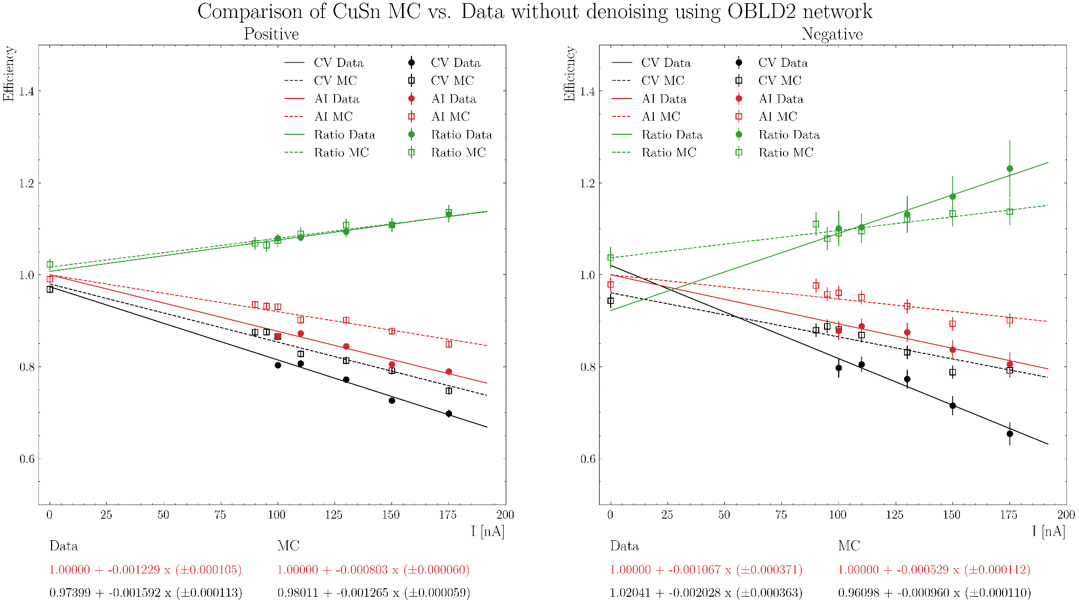
Tracking Efficiency & Background Merging Study
Solid/Dash line: Data/MC
Red: AI
Black: Conventional
Green: ratio AI/CV
Study DC efficiency vs. current for simulation and data:

Slide 8
Tracking Efficiency & Background Merging Study
Solid/Dash line: Data/MC
Red: AI
Black: Conventional
Green: ratio AI/CV
Study DC efficiency vs. current for simulation and data:
Bigger difference between MC and Data (approx. 20/52% for positive/negative) compared to the LD2 case; thus, Raffaella suggested to perform a similar study as a function of the DC occupancy to account for the two-target background, acceptance, etc.

Slide 9
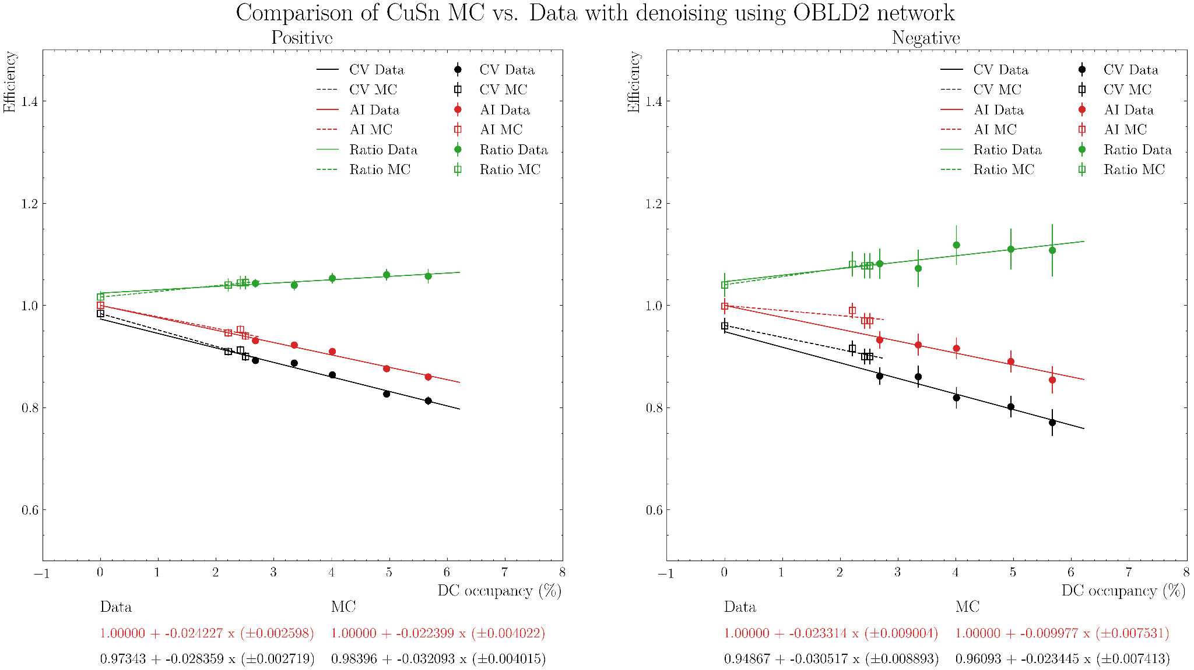
Tracking Efficiency & Background Merging Study
Study DC efficiency vs. DC occupancy for simulation and data:
Solid/Dash line: Data/MC
Red: AI
Black: Conventional
Green: ratio AI/CV

Slide 10
Tracking Efficiency & Background Merging Study
Study DC efficiency vs. DC occupancy for simulation and data:
Solid/Dash line: Data/MC
Red: AI
Black: Conventional
Green: ratio AI/CV
Less difference between MC and Data efficiency as a function of DC occupancy (approx. 8/43% for positive/negative) compared to beam current for the CuSn case!

Slide 11
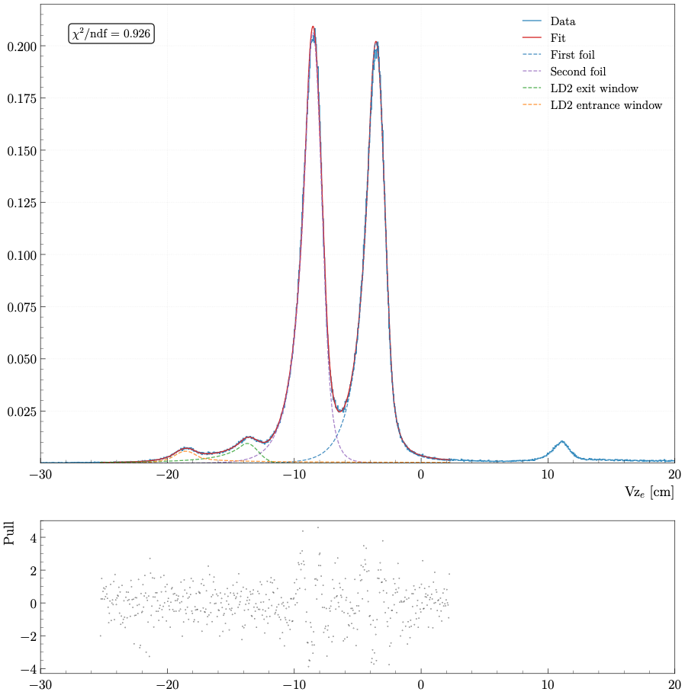
RG-D Refined Vz Cuts
The study aims to
Remove the beamline windows, empty LD2 cell windows for solid-foil runs in addition to the scattering chamber exit window for liquid and solid target runs
Fit with a four Double-Sided Crystal Ball function
Parameter | Before refinement | After refinement | Improvement (%)
σ_{Exit LD2} | 0.7691 | 0.7068 | 6.23
σ_{Entrance LD2} | 0.7799 | 0.7158 | 6.41
σ_{CxC1} | 1.1182 | 0.8586 | 25.96
σ_{CxC2} | 1.2309 | 0.9139 | 31.70

Slide 12
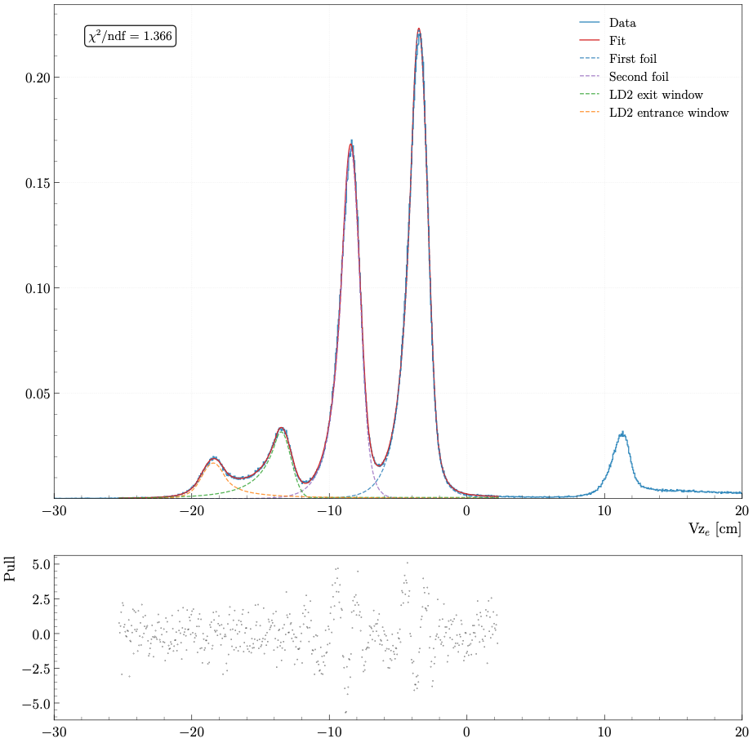
RG-D Refined Vz Cuts
The study aims to
Remove the beamline windows, empty LD2 cell windows for solid-foil runs in addition to the scattering chamber exit window for liquid and solid target runs
Separate the Cu and Sn solid-foil peaks prior to performing a proper contamination study
Fit with a four Double-Sided Crystal Ball function
Parameter | Before refinement | After refinement | Improvement (%)
σ_{Exit LD2} | 1.0045 | 0.8754 | 12.91
σ_{Entrance LD2} | 0.8162 | 0.7000 | 11.62
σ_{Cu} | 0.7625 | 0.6798 | 8.27
σ_{Sn} | 0.7439 | 0.6631 | 8.08

Slide 13
Electron Fiducial Cuts
Event builder Particle IDentification is used as a basis for all particle types, but some refinements are developed to improve electron ID
Raw electron cuts:
PID = 11, status< 0
2000≤ |status| < 4000: status represents the detector topology and is the sum of numbers associated to detector hits
|chi2pid| < 5: chi2pid is the number of σ_{SF} from the expected Sampling Fraction using the fit as function of deposited energy, E_{dep}, in ECal and PCal
Refinements:
Vz cut: select the target peak from where the scattered electron originated
Sampling Fraction vs. momentum: should be constant for electrons
V and W ECal views: defined at lengths that are multiples of 4.5 cm
DC fiducial cut using θ_{DC} vs. edge to remove edges of the three regions

Slide 14
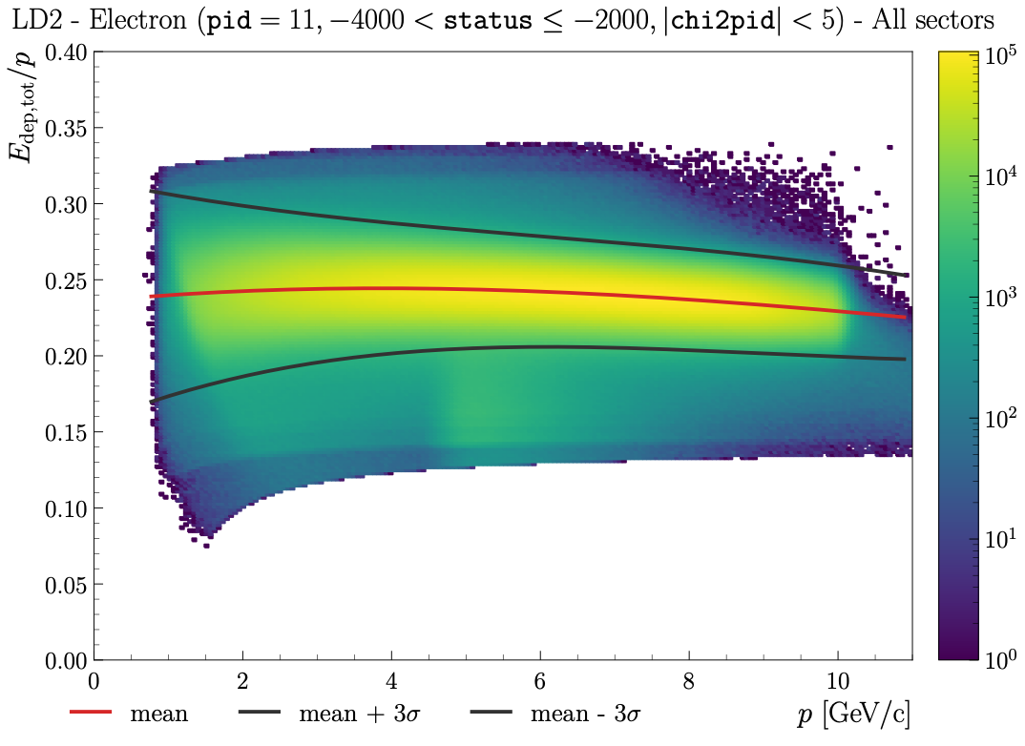
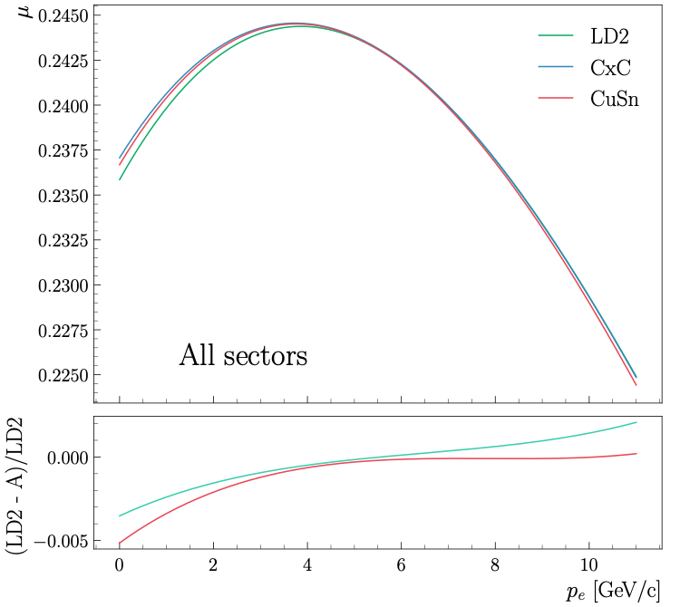
Electron FCs: SF vs. Momentum
Using a 3σ cut after performing a fit of sector-integrated SF for various momentum bins:
50 slices, fit with a Gaussian
Extract μ and σ, then deploy this function to select the desired band

Slide 15
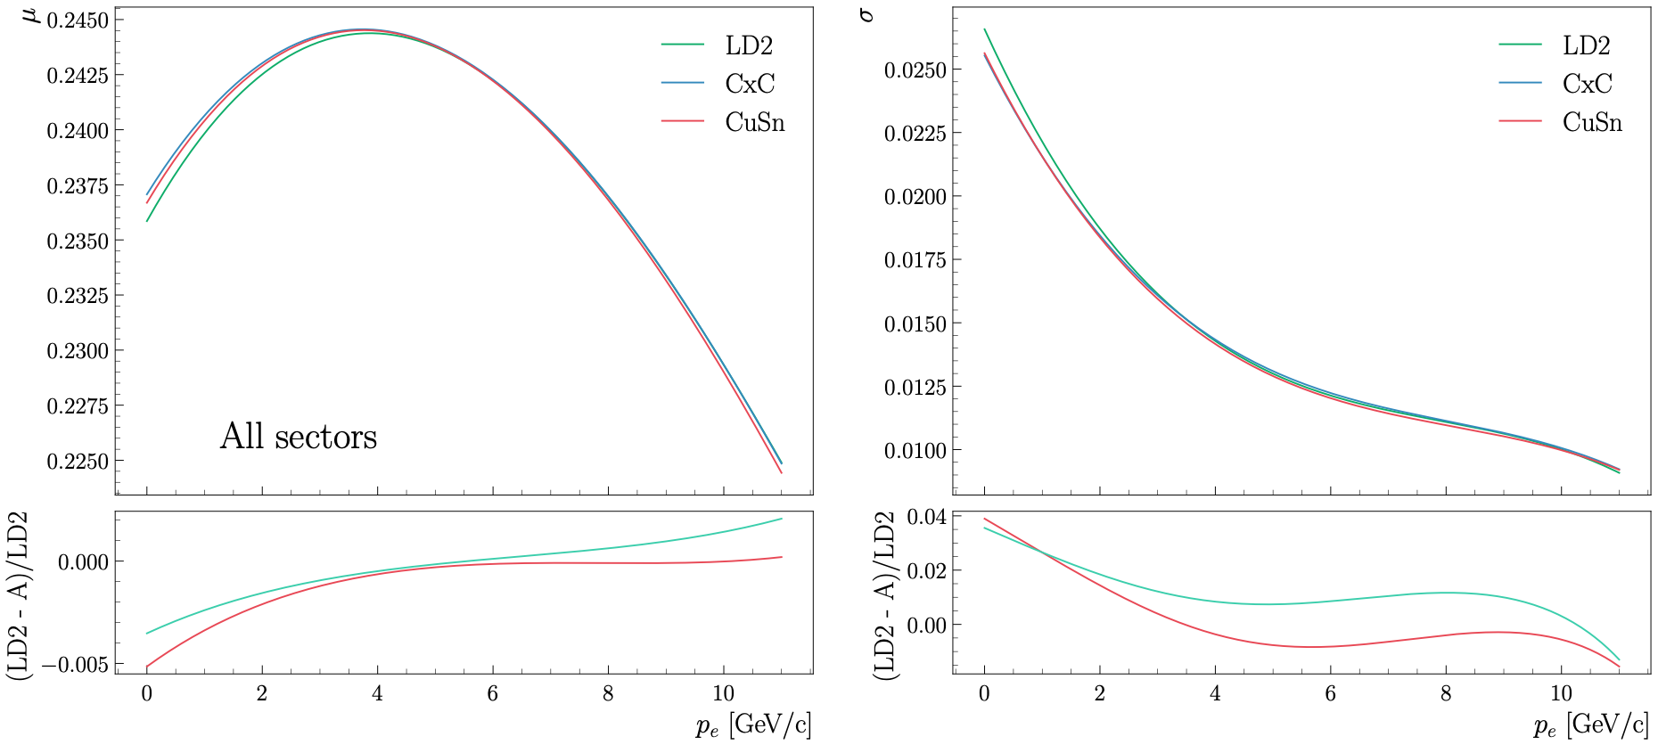
Electron FCs: SF vs. Momentum
Various targets comparison:

Slide 16
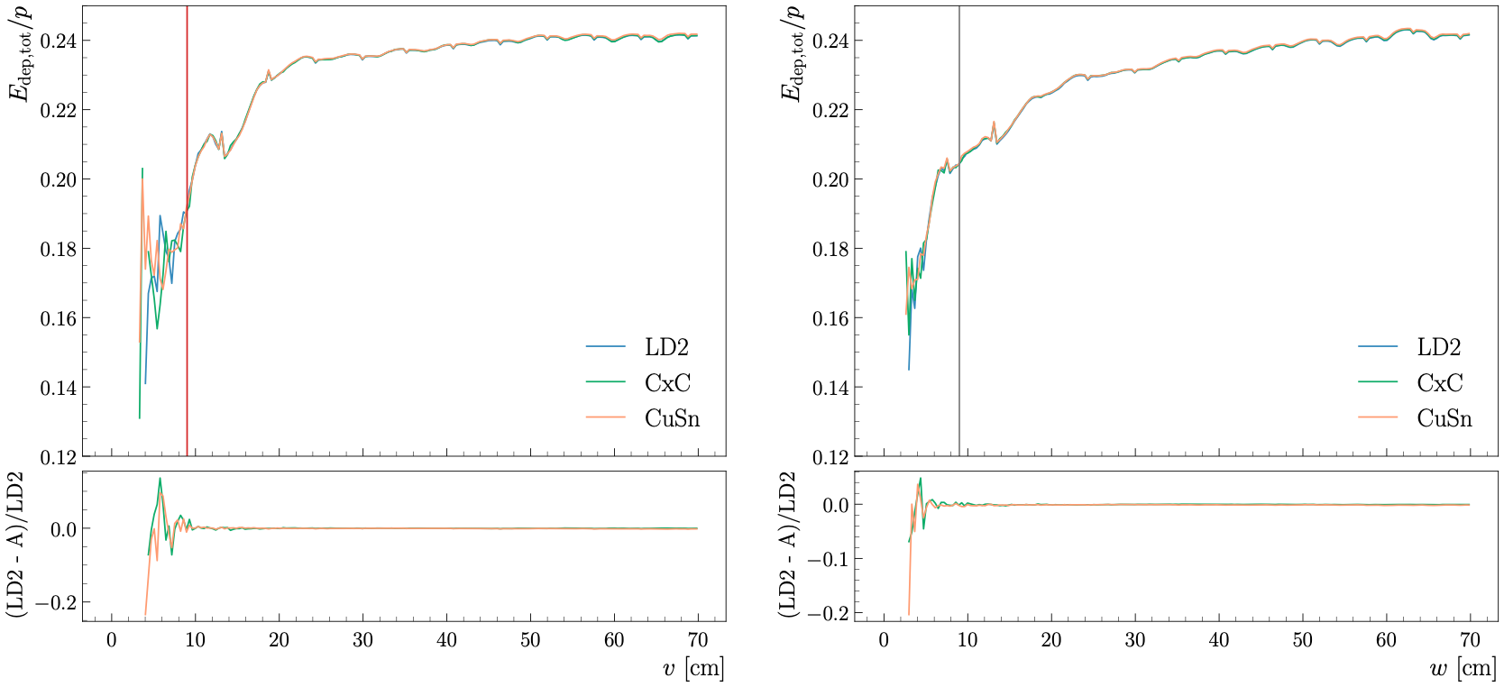
Electron FCs: ECal V and W Cuts
Use standard CLAS12 cuts for ECal: V, W> 9 cm; exclude 2 bars to minimize shower leakage!

Slide 17
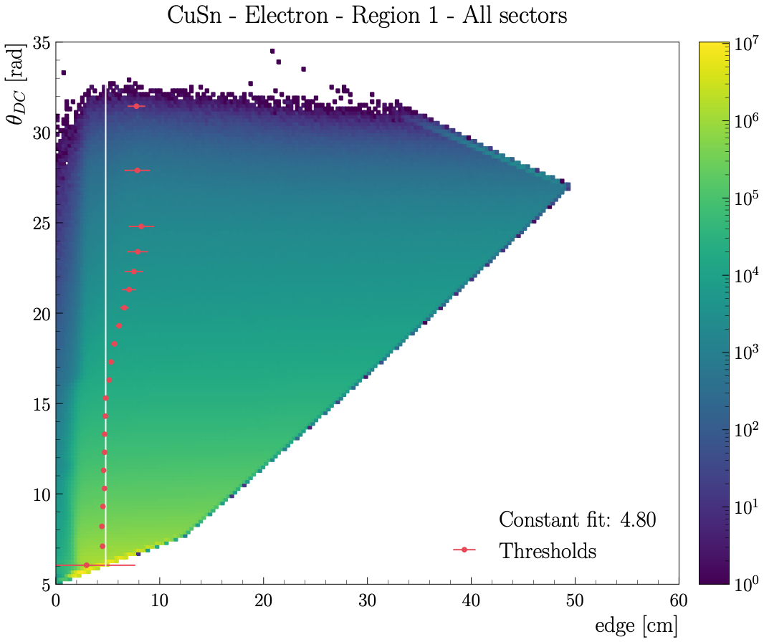
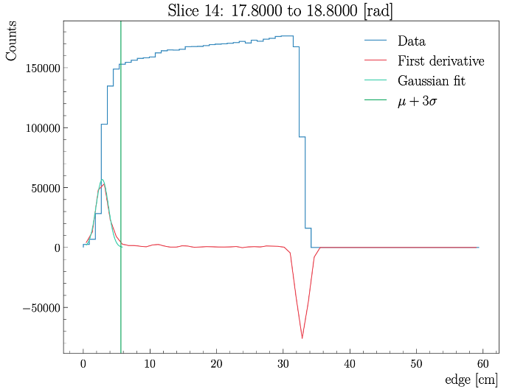
Electron FCs: θ_{DC} vs. Edge
Remove the DC edges for all regions and target types:
Slice the θ_{DC} vs. edge histogram
Fit the peak of the derivative with a Gaussian to obtain the threshold (μ+3σ)
Fit all thresholds with a constant

Slide 18
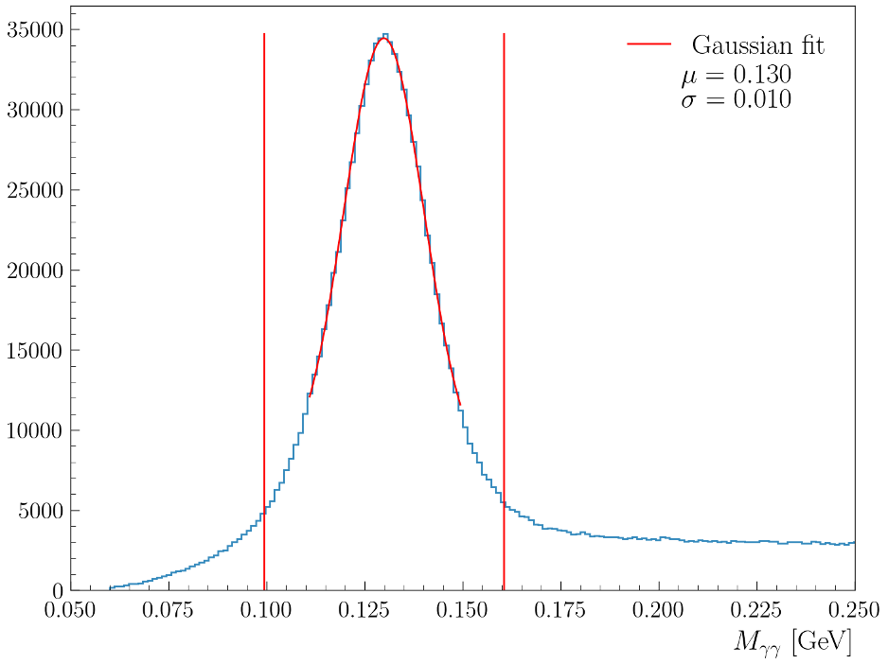
RG-D nTMDs Studies: π⁰ Analysis
First look at the π⁰ channel to extract multiplicity ratios and azimuthal asymmetries
Ongoing efforts to employ the event mixing technique to subtract the background underneath the two-photon mass peak
Electron cuts:
PID = 11, status< 0, 2000≤ |status|< 4000, |chi2pid|< 5, and Vz cut
Photon cuts:
PID= 22 and E> 0.2 GeV
AI-assisted cut developed by Gregory Matousek
μ ± 3σ to select the two-photon π⁰ peak
SIDIS cuts:
Q²> 1 GeV², W> 2 GeV, and y (= ν/E_{beam})< 0.85, where ν is the virtual photon energy

Slide 19
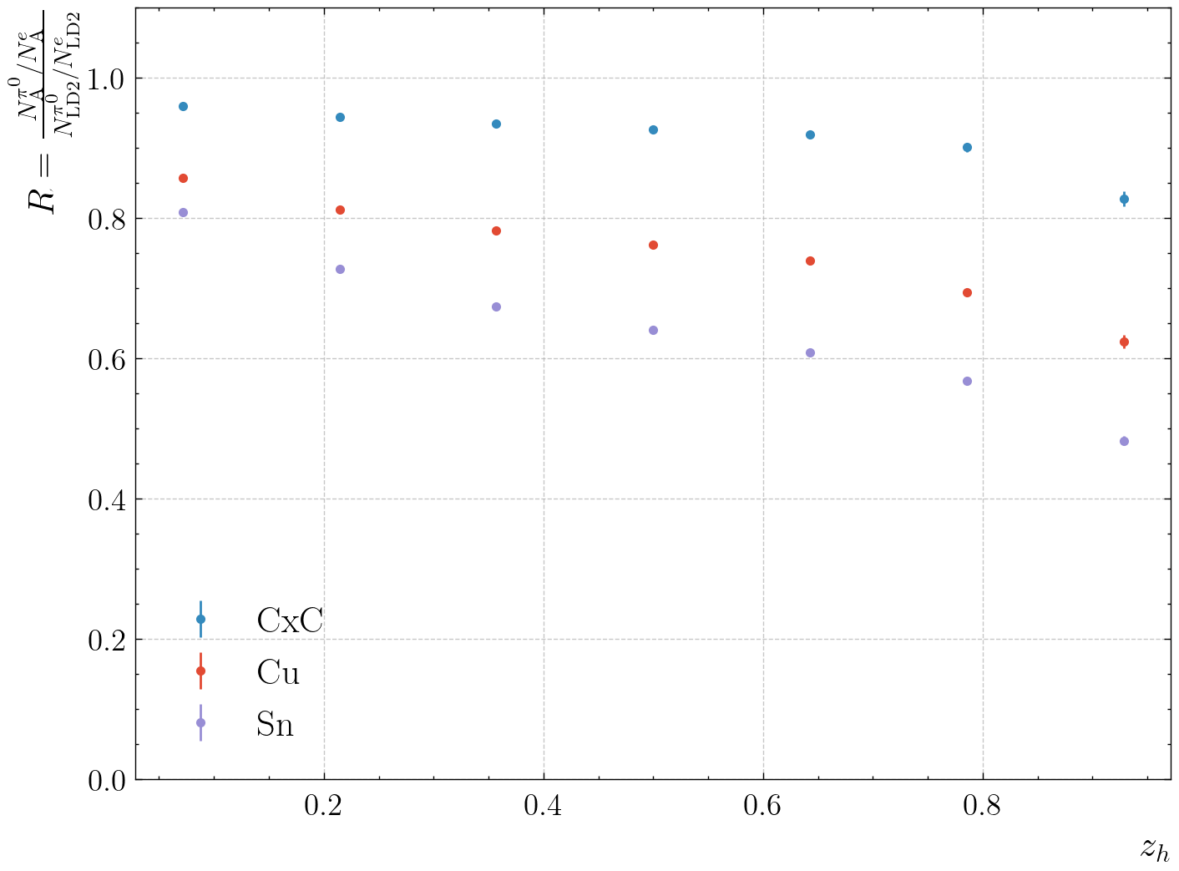
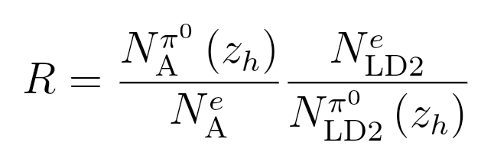
RG-D nTMDs Studies: π⁰ Analysis
First look at the π⁰ channel to extract multiplicity ratios and azimuthal asymmetries
As of now, extract 1-D multiplicity ratio as a function of z_{h}, defined as

Slide 20
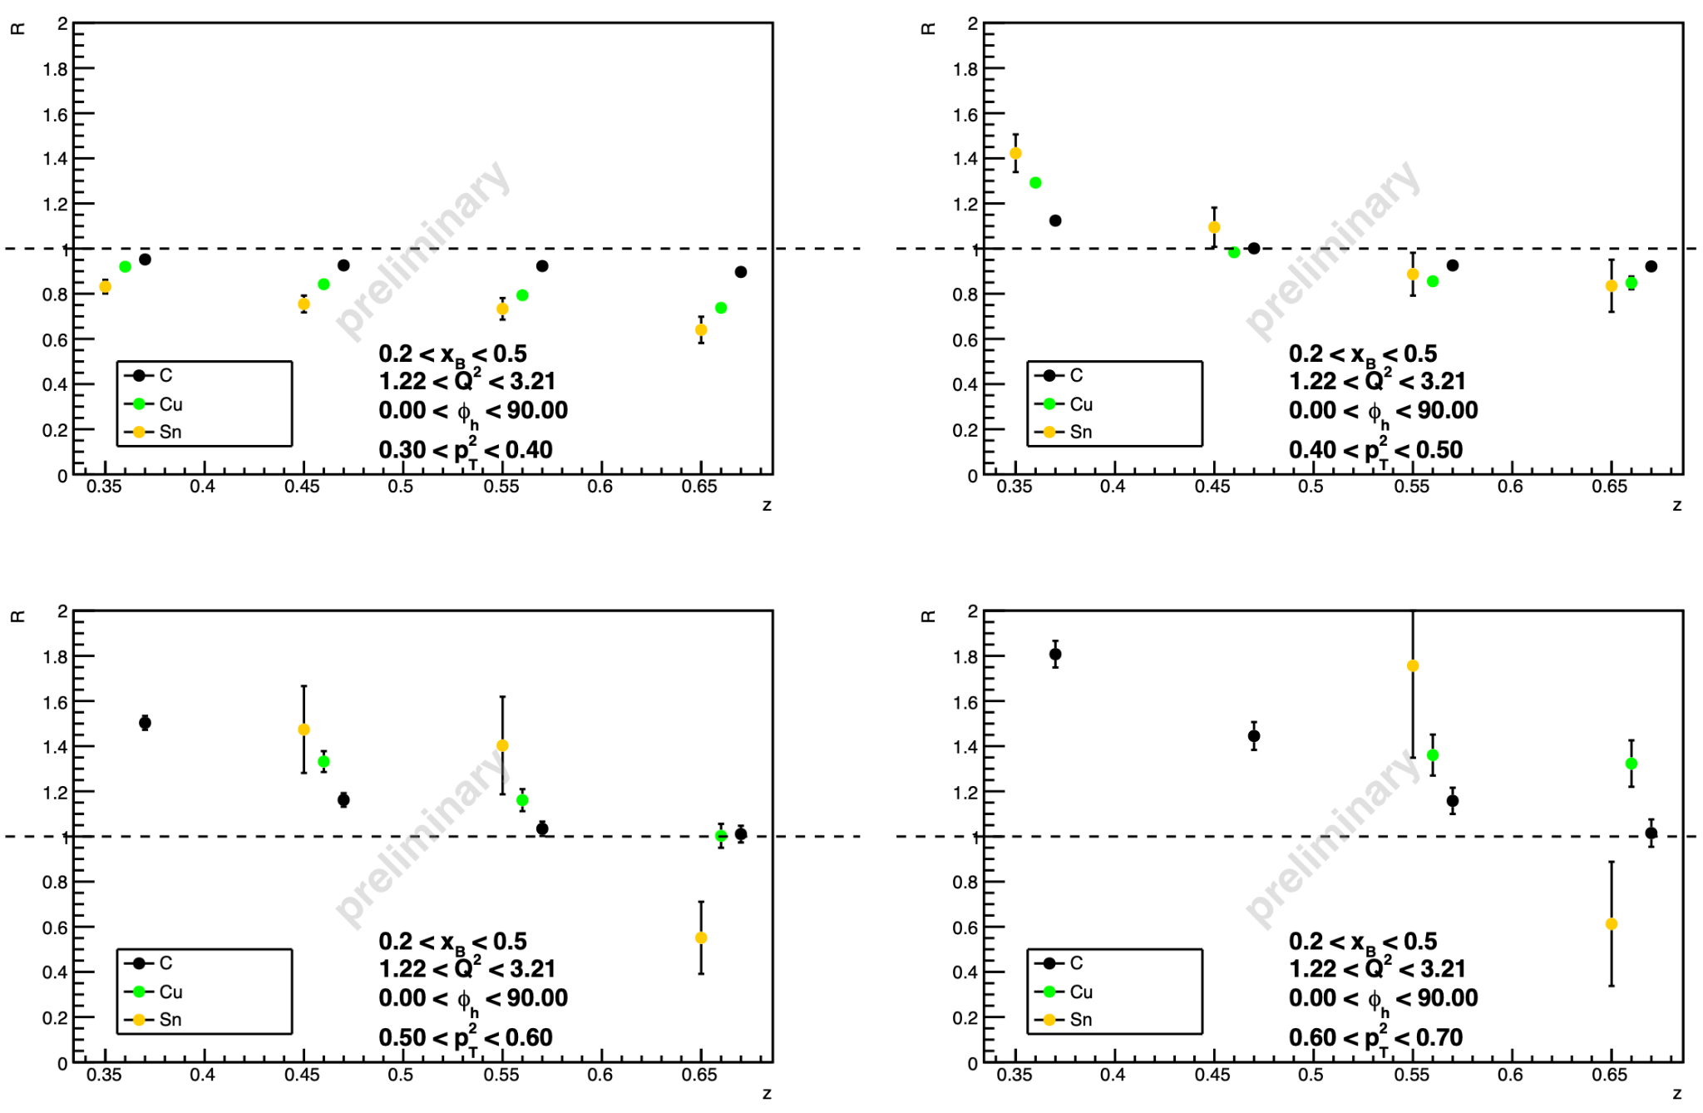
RG-D nTMDs Studies: π⁺ analysis
Pass0v11 preliminary results
Binning: Q², x_{B}, ϕ_{h} ,p_{T}², and z
Multiplicity Ratio results for one 1.2<Q²<3.2 and 0.2<x_{B}<0.5 bins by comparing the three nuclei
Expected behavior for preliminary results:
Nuclear hierarchy respected, suppression increases with nuclear mass
Increased suppression at higher z and lower p_{T}² could indicate absorption
Reversal of nuclear hierarchy at high p_{T}² suggests hadronization in the nuclear medium
Ongoing Unfolding
Ongoing analysis by D. Matamoros

Slide 21
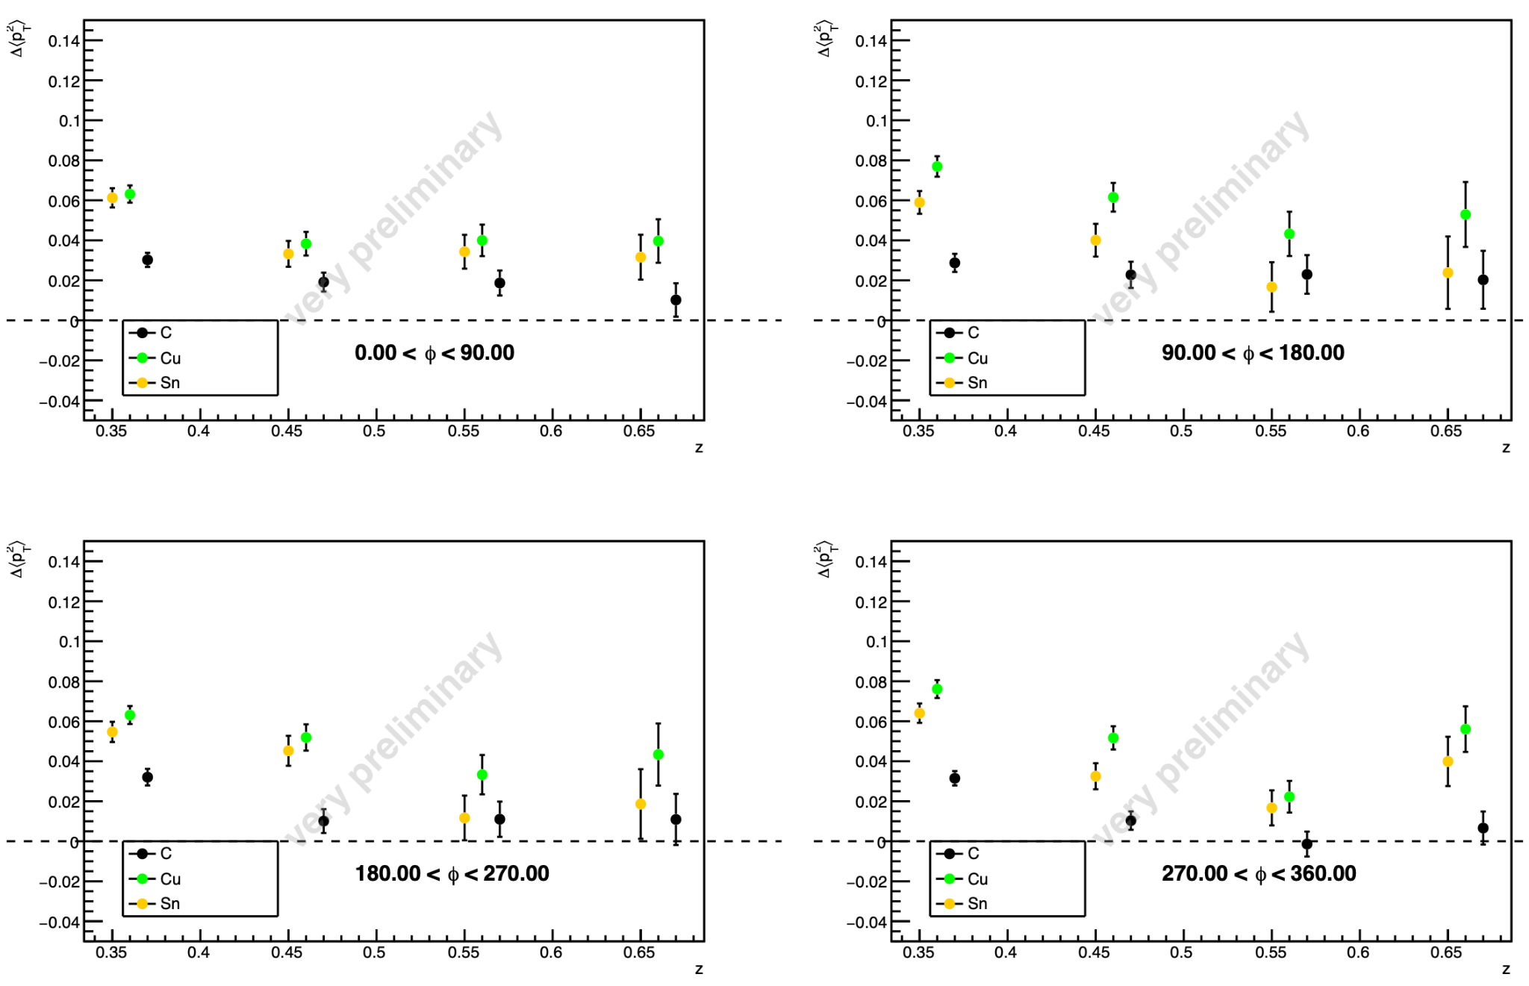
RG-D nTMDs Studies: π⁺ analysis
Transverse momentum broadening
Results for one 1.2<Q²<3.2 and 0.2<x_{B}< 0.5 bins by comparing the three nuclei:
Hierarchy between nuclei remains, coherent tendencies
Possible decrease with increasing z, could suggest hadron formation outside the nucleus
Inconclusive results, as corrections remain to be incorporated
Ongoing analysis by D. Matamoros

Slide 22
Summary and Outlook
RG-D has passed the Pass1 review, and the estimated 90-days Pass1 cooking began on June 13th
Optimizing analysis tools for CT and nTMDs studies to
improve PIDs and implement fiducial cuts for all final-state particles
correct for any solid-foil contamination associated with the CuSn target configuration
deploy the ρ⁰ event generator for its two-pion invariant mass background subtraction and apply necessary corrections to extraction the preliminary CT results
Finalize the π⁰ event mixing background-subtraction and extract its preliminary asymmetries
Obtain the preliminary asymmetry results for charged pions nTMDs studies

Slide 23


Slide 24
Back-up

