Slide 1


RG-D Experiments: Status and Analysis Plans
Mathieu Ouillon (Mississippi State University)
CLAS Collaboration (8-11 July 2025)

Slide 2
Run Group D
RG-D is composed of two experiments:
Study of Color Transparency (CT) in Exclusive Vector Meson Electro-production off Nuclei (E12-06-106)​:
Spokespeoples: W. Armstrong¹ , L. El Fassi³ , K. Hafidi¹ , M. Holtrop⁴, and B. Mustapha^{1​}
Nuclear Transverse Momentum Distributions (nTMDs) in CLAS12 (E12-06-106A)​:
Spokespeoples: R. Dupré² , L. El Fassi³ , Zein-Eddine Meziani¹ , and Holly Szumila-Vance​⁵
¹: Argonne National Lab, ²: IJCLAB, Orsay, France ³: Mississippi State U., ⁴: University of New-Hampshire, ⁵: Jefferson Lab

Slide 3
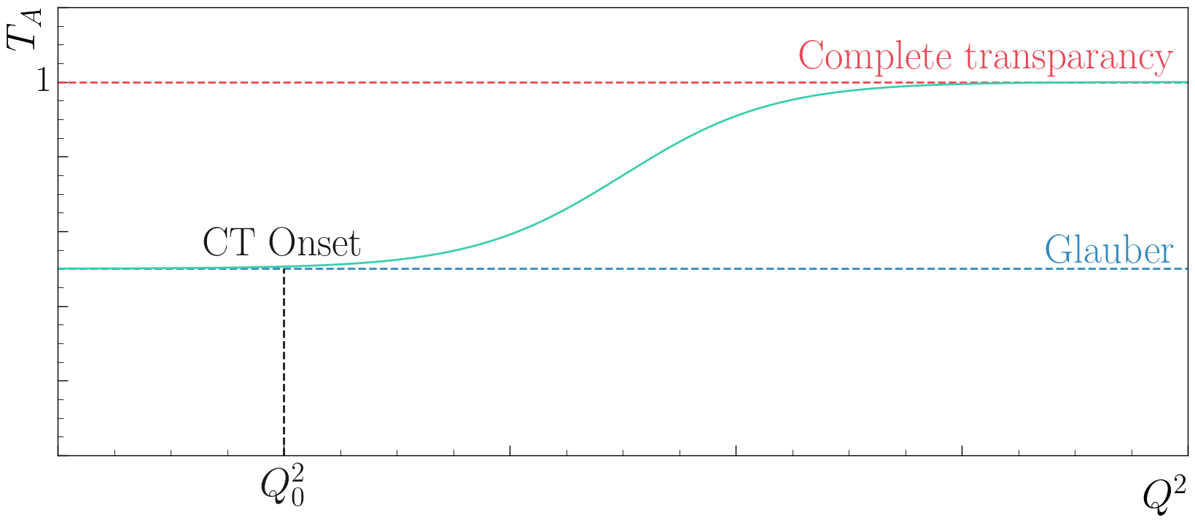
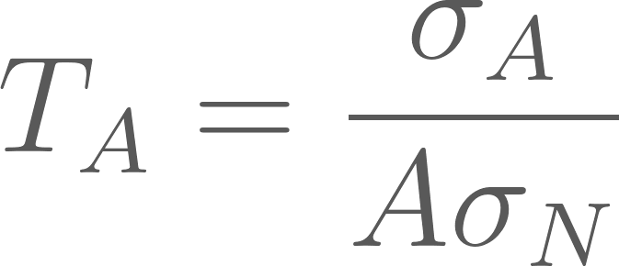
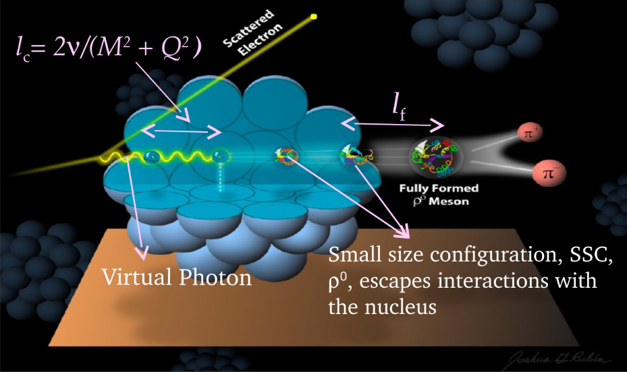
RG-D: CT Experiment​
E12-06-106, Color Transparency: suppression of interactions of the colorless small size configuration in the nuclear medium
Experimental signature: rise of the nuclear transparency, T_{A} as a function of Q²: ​
T_{A}: ratio of the cross section per nucleon on a bound nucleon to that on a free nucleon
σ_{A} − nuclei cross section
σ_{N} − free nucleon cross section
Objective: understanding the dynamical evolution from small-size configurations into ordinary hadrons, and validating the QCD factorization theorem
Coherence length, l_{c}: the lifetime of the qq-bar pair
Formation time, l_{f}: the time evolution of SSC to an on-shell ρ⁰ meson​​

Slide 4
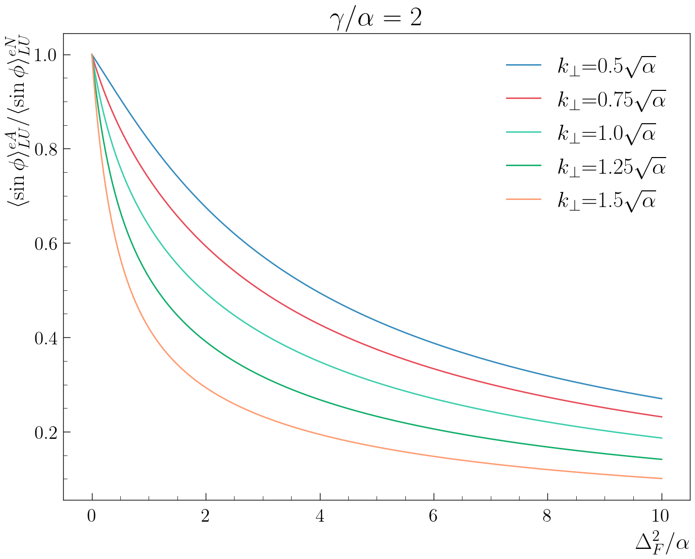
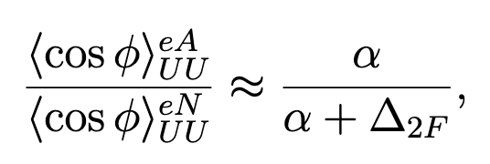
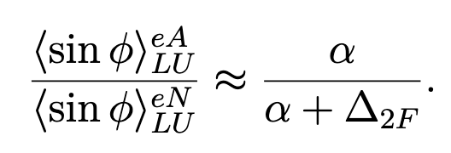
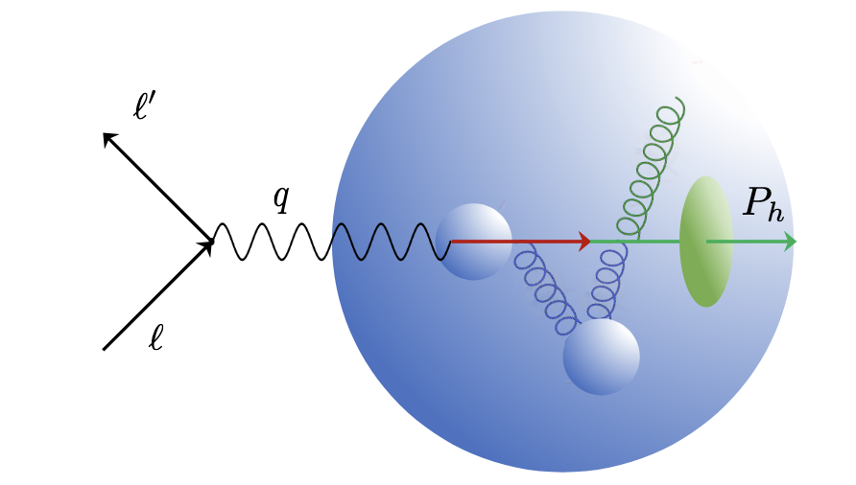
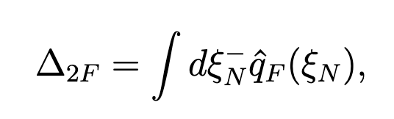
RG-D: Nuclear TMDs
E12-06-106A: nTMDs study uses the same CT running conditions except the beam polarization, and aims to study​:
Nuclear effect on SIDIS asymmetries
Transport coefficient of the nuclear matter
For that, measure:
cos φ, sin φ, cos(2φ)¹ moments for different hadrons:
Song, Y. et al. (2014) Physical Review D, 89 014005.
q_{F}(ξ_{N}): the quark transport parameter
¹ No predictions exist for this observable

Slide 5
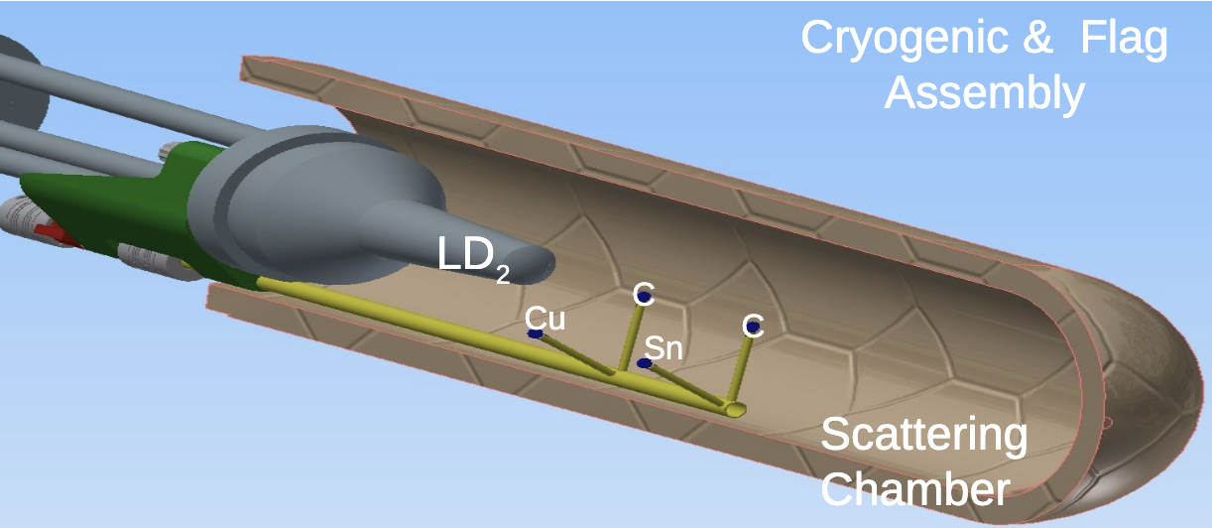
RG-D Run Configuration
RG-D experiments collected data in the fall of 2023 with
10.54 GeV polarized beam energy and 𝐼=5–175 nA for luminosity scans and production
Standard CLAS12 configuration with FT-OFF and three layers of FMT
Three target configurations, LD2, CxC, and CuSn, deployed with InBending and OutBending
New cryogenic LD2 and the nuclear-foil flag assembly centered at -5 cm for each configuration
Main run hiccups:
Faraday Cup vacuum contamination
Moller cone sagging
Sn target
Cu target
LD2 exit window
Scattering Chamber exit window
LD2 entrance window

Slide 6
RG-D Status: Calibration Summary
Since March, full calibration has been completed with the following points:
Completion of DC calibration using the new suite
Training of 3 new AIs and testing on OB/IB LD2 and OB CuSn data
Validation that the AI trained on OB LD2 data performs well on all targets
Completion and validation of background merging through MC/Data tracking efficiency comparison
The timelines (v11) have been produced, along with the high-level QA one
RG-D successfully passed Pass1 review on May 27th
Pass1 cooking initiated on June 13th using COATJAVA 13.0.0
Thanks to CalCom Experts for their support

Slide 7
Tracking efficiency: Different target
For inbending LD2 vs inbending CuSn as function of DC occupancy
Solid line: LD2
Dashed line: CuSn
Red: AI
Black: Conventional
Green: ratio AI/CV
Only a small difference between LD2 and CuSn

Slide 8
Tracking efficiency: MC vs Data
Monte Carlo vs Data, for LD2 target
Simulation well produce the data for LD2
Bigger difference for CuSn

Slide 9
Electron fiducial cuts
Event builder is used as a basis for all particles, and some refinements are developed to improve electron identification
Raw electron cuts:
pid = 11, status < 0
2000 ≤ |status| < 4000
|chi2pid| < 5
Refinements:
Sampling fraction vs momentum: should be constant for an electron
v and w for the calorimeter: defined at lengths that are multiples of 4.5cm
DC fiducial cut using θ_{DC} vs edge: remove the edges of each region
Vz cut: select an electron that comes from the target, and select which one

Slide 10
Electron fiducial cuts: Sampling fraction vs p
Based on a fit of the total sampling fraction in momentum slices, a mean ± 3σ band cut around the mean:
50 slices, fit with a Gaussian
Extract the μ and σ and fit with:

Slide 11
Electron fiducial cuts: Sampling fraction vs p
Comparison between different targets:

Slide 12
Electron fiducial cuts: Calorimeter v and w
Use standard CLAS12 cuts for the calorimeter: v, w > 9cm (2 bars)
Comparison between target: No difference

Slide 13
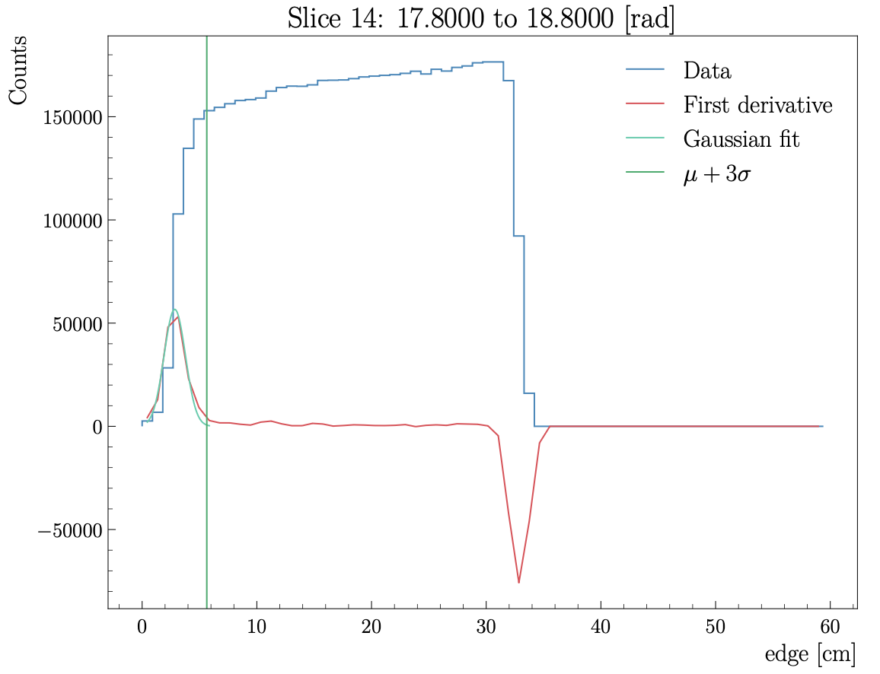
Electron fiducial cuts: θ_{DC} vs edge
Remove the edges of the DC
Slice the θ_{DC} vs edge histogram
Fit the peak of the derivative with a Gaussian and get threshold (μ+3σ)
Fit all thresholds with a constant
Do that for all regions and targets

Slide 14
Vz cuts: Impact of the other cuts
The study aimed to
Separate solid-foil peaks from the empty LD2 cell and scattering chamber exit windows
Fit with 4 Double-Sided Crystal Ball function
Parameter | Without | With | Improvement
σ_{Exit LD2} | 0.7691 | 0.7068 | 0.0623
σ_{Entrance LD2} | 0.7799 | 0.7158 | 0.0641
σ_{CxC1} | 1.1182 | 0.8586 | 0.2596
σ_{CxC2} | 1.2309 | 0.9139 | 0.3170

Slide 15
Vz cuts: Impact of the other cuts
The study aimed to
Separate the Cu and Sn foil
Separate solid-foil peaks from the empty LD2 cell and scattering chamber exit windows
Fit with 4 Double-Sided Crystal Ball function
Parameter | Without | With | Improvement
σ_{Exit LD2} | 1.0045 | 0.8754 | 0.1291
σ_{Entrance LD2} | 0.8162 | 0.7000 | 0.1162
σ_{Cu} | 0.7625 | 0.6798 | 0.0827
σ_{Sn} | 0.7439 | 0.6631 | 0.0808

Slide 16
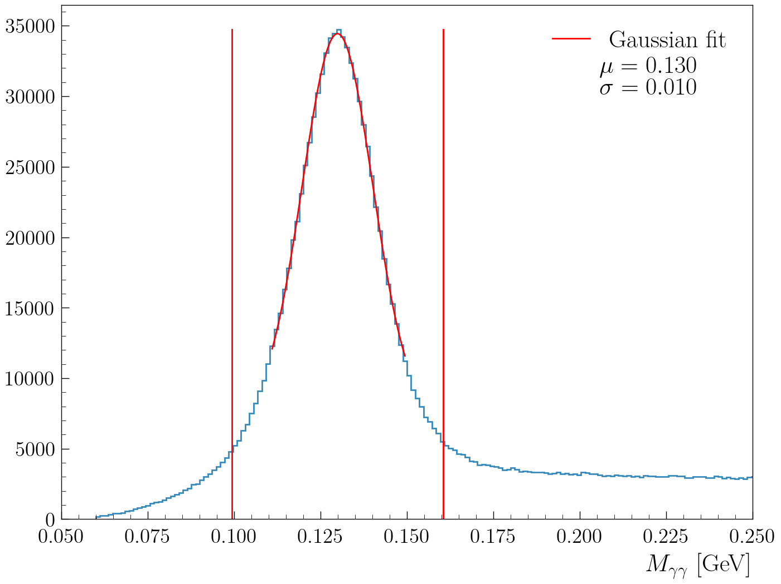
RG-D nTMDs Studies: π⁰ analysis
First look at the π⁰ channel to extract multiplicity ratios and azimuthal asymmetries:
In-progress efforts to employ the event mixing technique to subtract the background underneath the two-photon mass peak
Electron cuts:
pid = 11, status < 0, 2000 ≤ |status| < 4000, |chi2pid| < 5 and Vz cut
Photon cuts:
pid = 22 and E > 0.2 GeV
+ AI develop by Gregory Matousek
SIDIS cuts:
Q² > 1 GeV², W > 2 GeV μ ± 3σ on the two photon mass for the π⁰

Slide 17
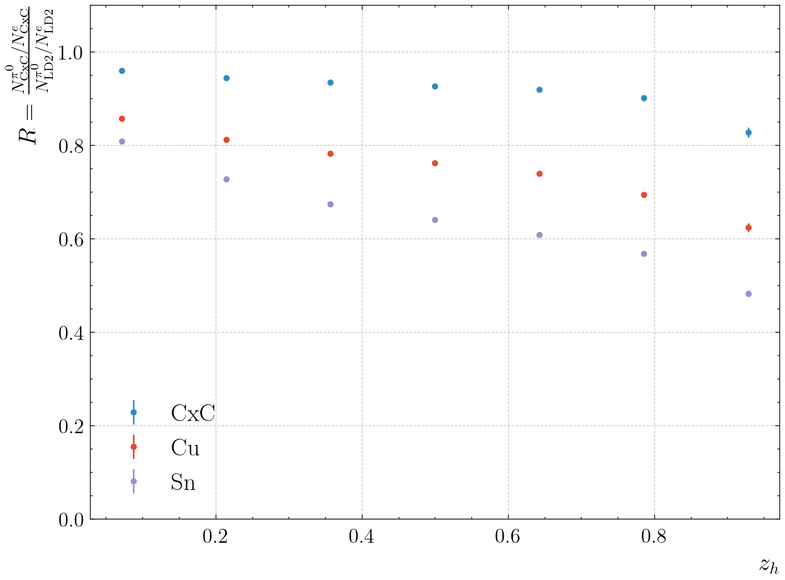
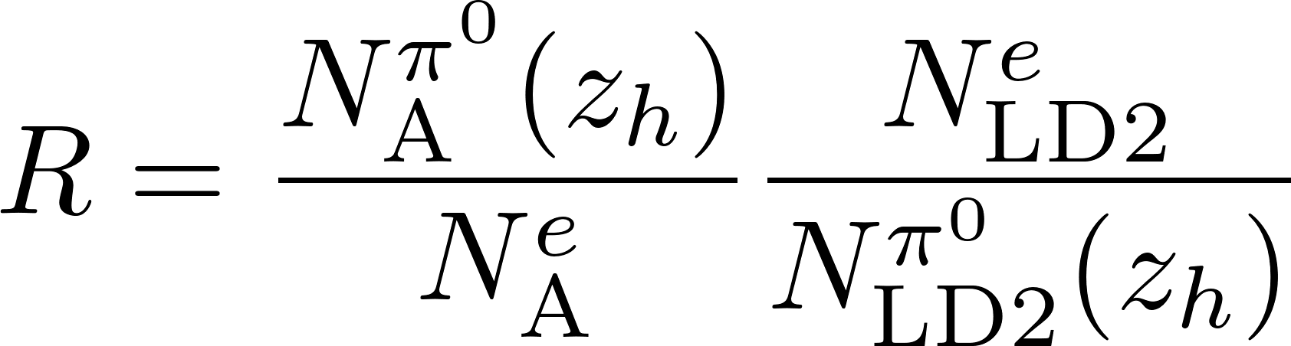
RG-D nTMDs Studies: π⁰ analysis
First look at the π⁰ channel to extract multiplicity ratios and azimuthal asymmetries:
1D multiplicity ratio: z_{h}
Statistical error only
SIDIS cut:
Q² > 1 GeV², W > 2 GeV and
μ ± 3σ on the two-photon mass
for the π⁰
Very preliminary

Slide 18
RG-D nTMDs Studies: π⁺ analysis
Ongoing analysis by D. Matamoros

Slide 19
RG-D nTMDs Studies: π⁺ analysis

Slide 20
Summary
RG-D has passed the Pass1 review, and the cooking has started.
Calibration is completed, thanks to all the CalCom experts
AI network trains on outbending LD2 work well on all targets
MC vs data efficiency studies show a small difference for LD2, larger for CuSn
Optimizing analysis tools for CT and nTMDs studies to
Improve Particle Identification and implement fiducial cuts for all final-state particles
Correct for contamination with the CuSn target.
Deploy the ρ⁰ event generator for its two-pion invariant mass background subtraction and apply necessary corrections for the extraction of the preliminary CT results
Finalize the π⁰ event mixing background-subtraction and extract its preliminary asymmetry results
Obtain the preliminary asymmetry results for charged pions nTMDs studies

Slide 21


Slide 22
Back-up

Slide 23
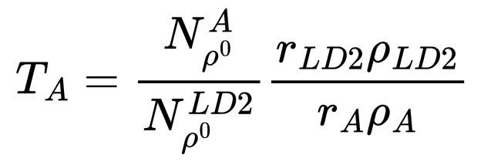
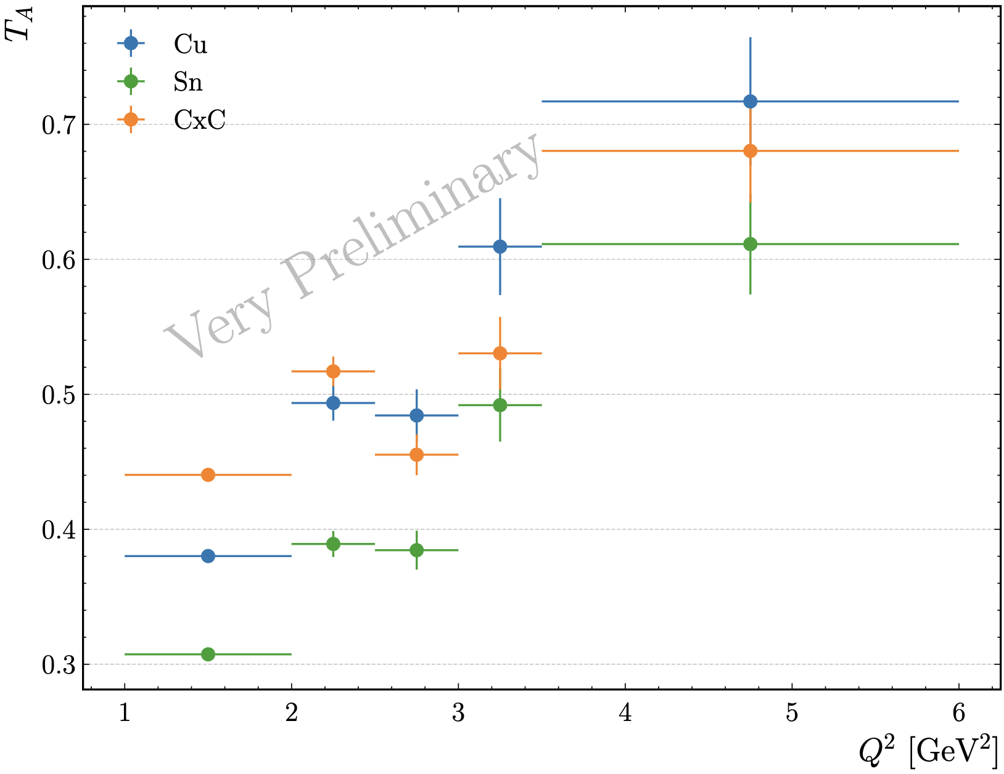
CT Study: Very Preliminary Nuclear Transparency
Extract (raw) nuclear transparency as
r_{LD2}= 5 cm: LD2 thickness
r_{CxC} = 0.4 cm: CxC thickness
r_{Cu}= 93 μm: Copper thickness
r_{Sn} = 171 μm: Tin thickness
ρ_{LD2}= 0.164 g/cm³: LD2 density
ρ_{C}= 2.2g/cm³ : Carbon density
ρ_{Cu}= 8.96 g/cm³: Copper density
ρ_{Sn}= 7.31g/cm³ : Tin density
Ongoing analysis by M. Maynes

Slide 24
Vz cuts: Impact of the other cuts
The study aimed to
Reduce the contamination for the target configuration with two different foils, Cu and Sn
Separate solid-foil peaks from the empty LD2 cell and scattering chamber exit windows
Fit with 4 Double-Sided Crystal Ball function
Before refinement cuts:
σ_{Exit LD2}: 0.7691 cm
σ_{Entrance LD2}: 0.7799 cm
σ_{CxC1}: 1.1182 cm
σ_{CxC2}: 1.2309 cm

