Slide 1


Machine Learning Approaches
for ALERT Track matching
Mathieu Ouillon (Mississippi State University)

Slide 2
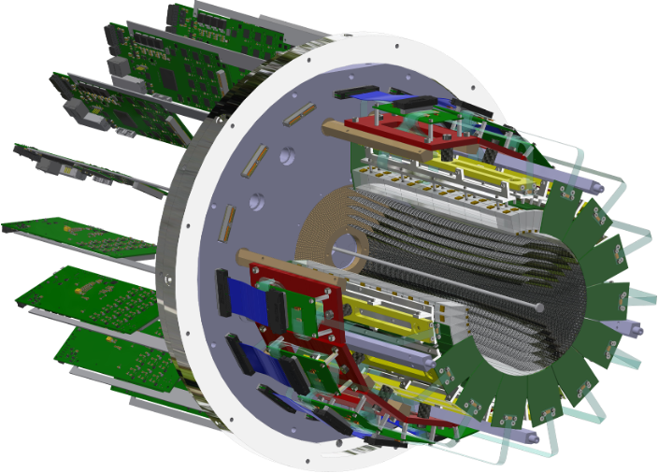
ALERT Experiment Setup
Introduction
Model & Train
Simulation
Data
Summary
1/14
ALERT is composed of two sub-detectors:
A Hyperbolic Drift Chamber (AHDC) and A Time of Flight (ATOF)
ATOF
Time of flight: used for Particle Identification
Small barrel of segmented scintillators
The TOF measurement is degenerate for ²H and ⁴He, but dE/dx can distinguish the two nuclei bands
AHDC
Aluminum wire: 2 mm apart
20-degree stereo angle (hyperbolic shape)
5 superlayers, each composed of 2 layers
576 signal wires (6 ground wires of each signal)

Slide 3
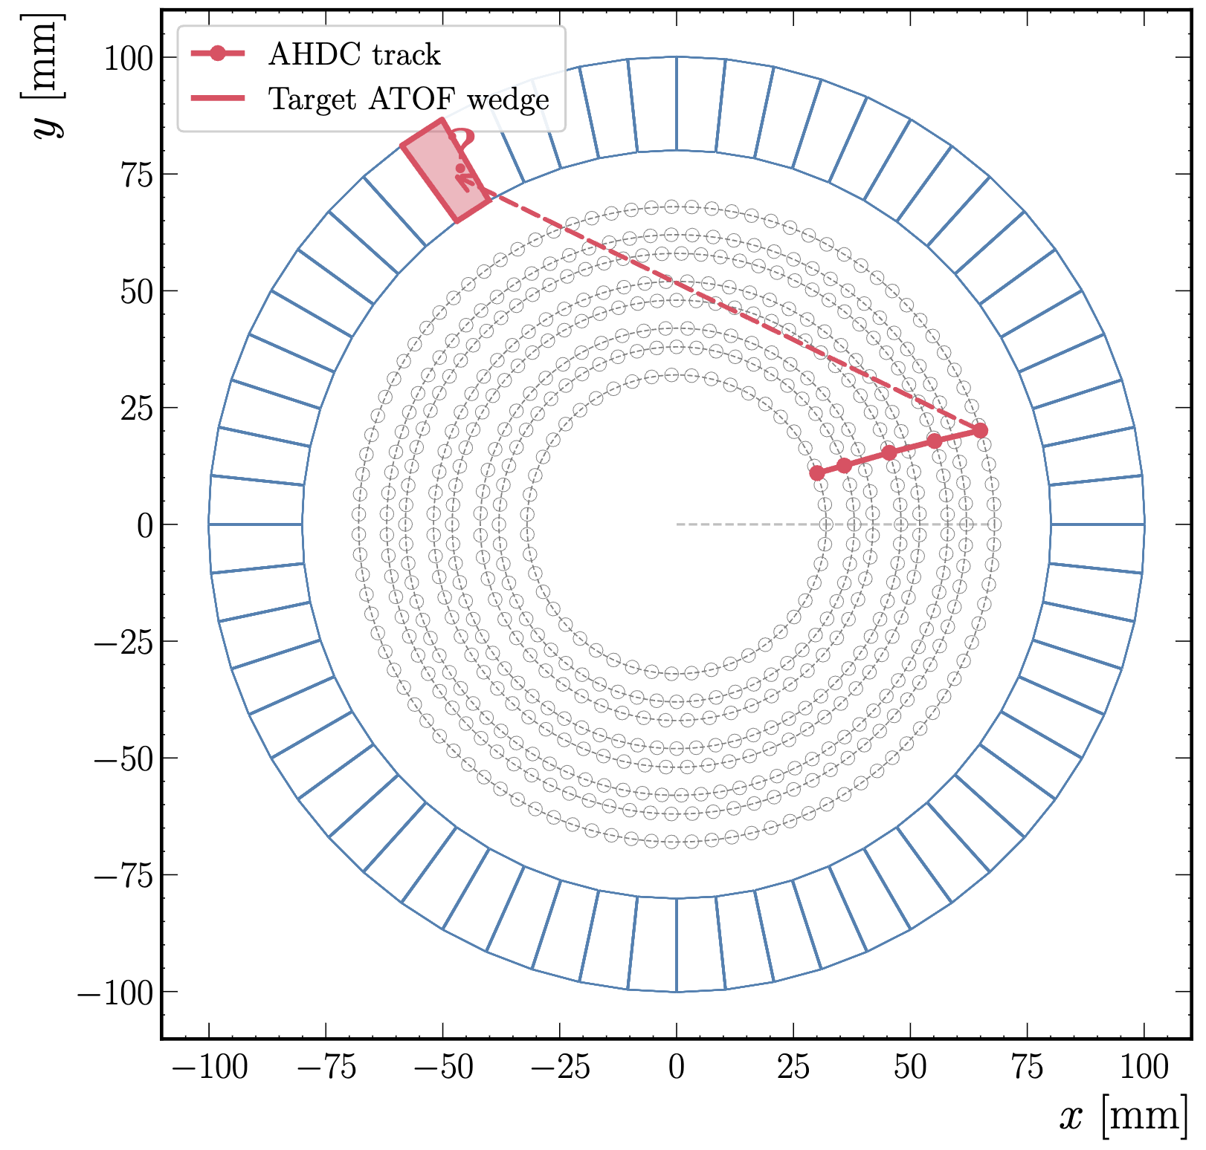
Introduction
Introduction
Model & Train
Simulation
Data
Summary
2/14
Problem:
Given a charged particle track reconstructed in the AHDC, predict which ATOF scintillator it will hit
ATOF Address = 3 labels:
Sector (0–14): azimuthal φ
Layer (0–3): quarter within sector
Wedge (0–9): longitudinal z slice
Total: 600 possible paddle IDs
Goal: with an AI, predict which wedge should be hit based on the inter-clusters:
Inputs: 5 of 2-D points (x, y)
Output: sector, layer, wedge

Slide 4
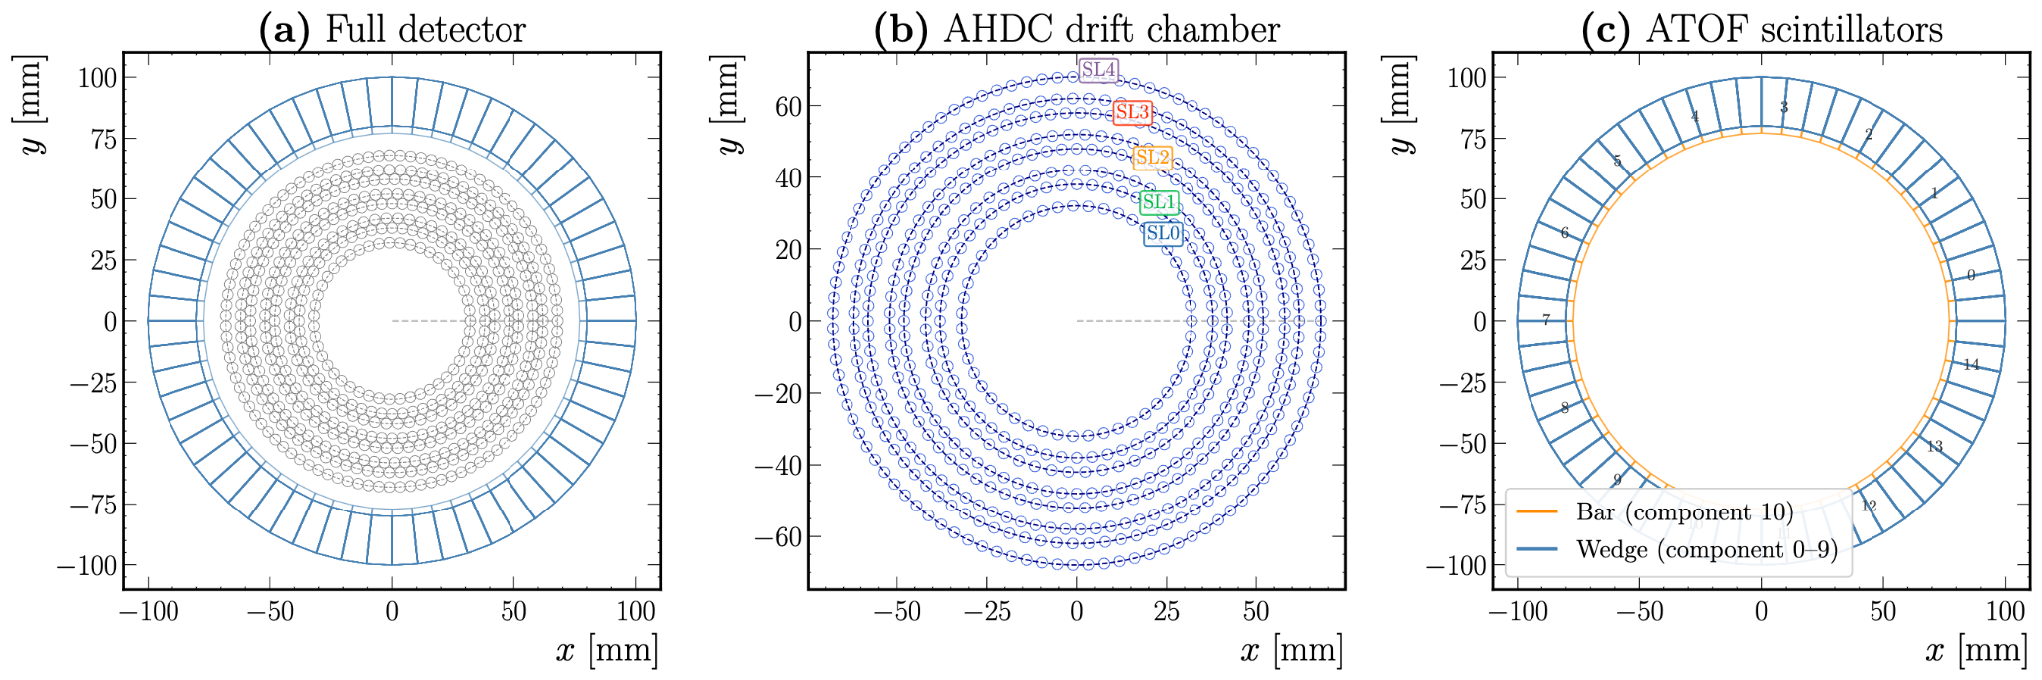
Detector Geometry
Introduction
Model & Train
Simulation
Data
Summary
3/14
Use information from the AHDC (one point per superlayer) to predict the wedge

Slide 5
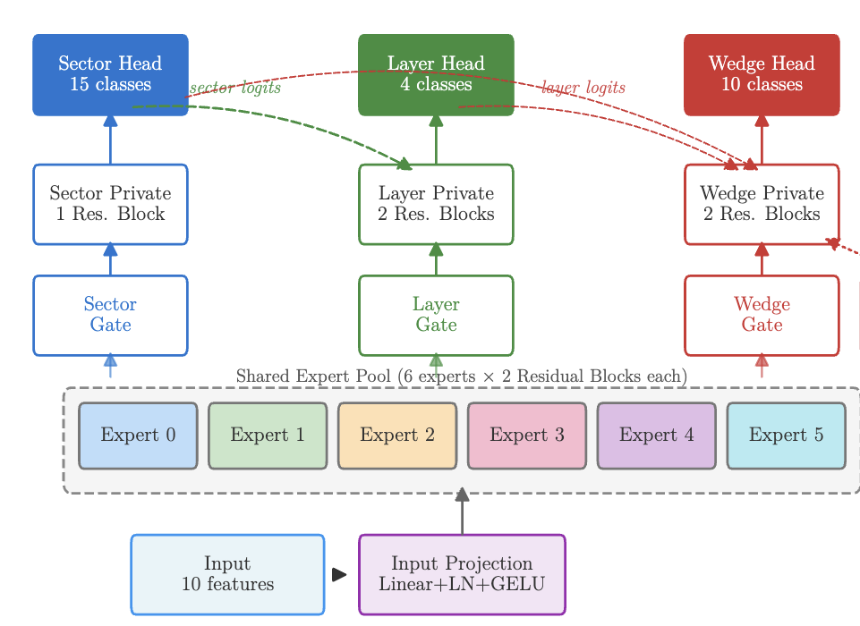
Model Architecture
Introduction
Model & Train
Simulation
Data
Summary
4/14
Shared experts
6 expert networks, each with 2 residual blocks (Linear+ LayerNorm+ReLU+Dropout)
Per-task gating
Each task learns a softmax weighting over all experts, enabling task specialization
Cascaded conditioning
Layer head receives sector logits, wedge head receives both sector and layer logits

Slide 6
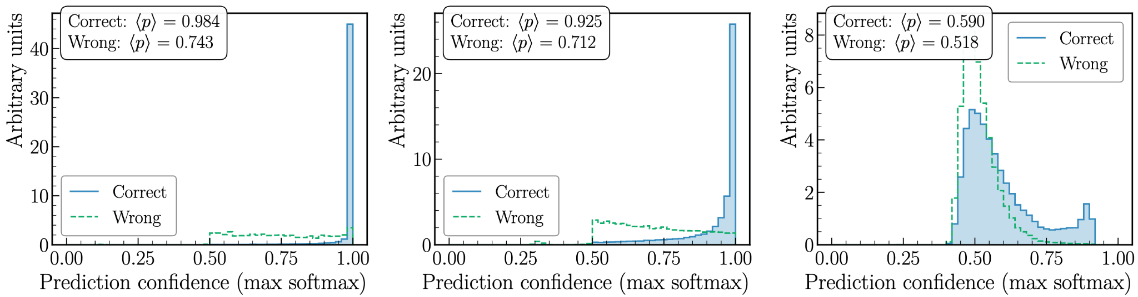
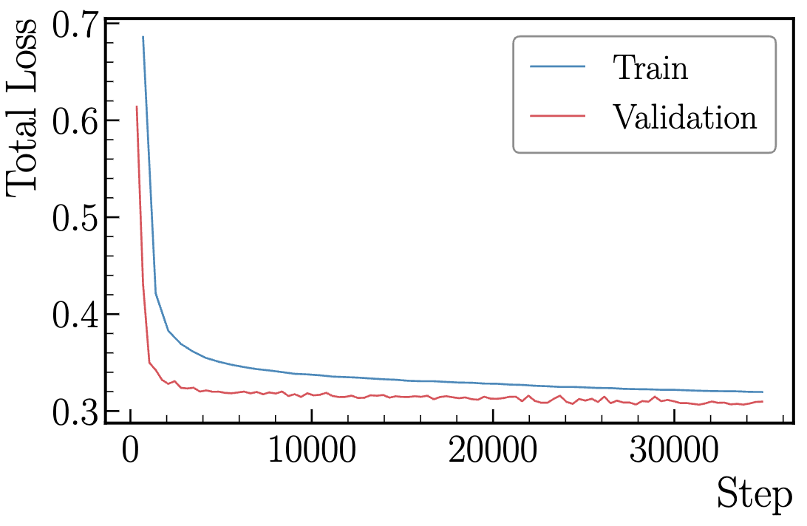
Training pipeline
Introduction
Model & Train
Simulation
Data
Summary
5/14
Data
From GEMC simulation
5M events with only ATOF hits
Split: 70/15/15 train/val/test
Batch size: 4096
Loss Function
Sector: Cross-Entropy
Layer: Cross-Entropy
Wedge: Focal loss (Ɣ=2.0)

Slide 7
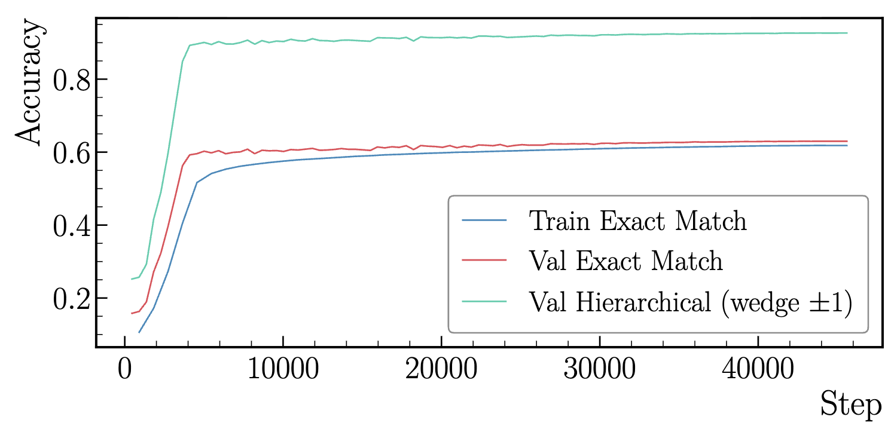
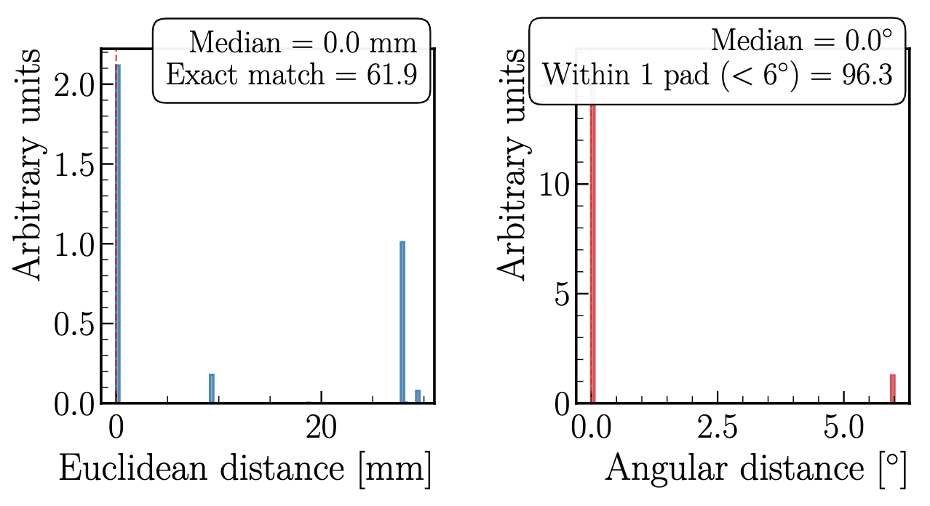
Evaluation on Simulation
Introduction
Model & Train
Simulation
Data
Summary
6/14
Monitor the accuracy: how often the model predicts the good sector, layer, and wedge
Accuracy off by one: how often the model predicts the correct sector, layer but the wedge is the correct one or off by one.
The distance: the x,y,z distance between the center of the predicted wedge and the correct one.

Slide 8
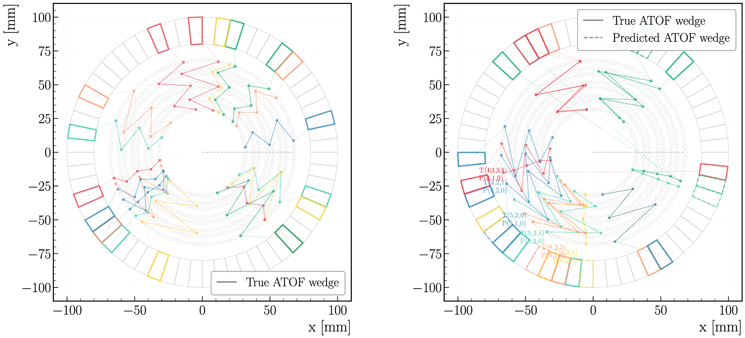
Evaluation on Simulation
Introduction
Model & Train
Simulation
Data
Summary
7/14
good predictions
bad predictions

Slide 9
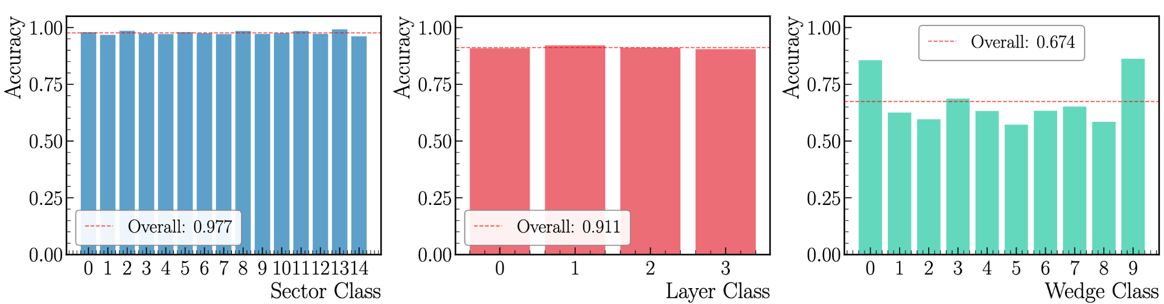
Evaluation on Simulation
Introduction
Model & Train
Simulation
Data
Summary
8/14
Accuracy per class (sector, layer and wedge)

Slide 10
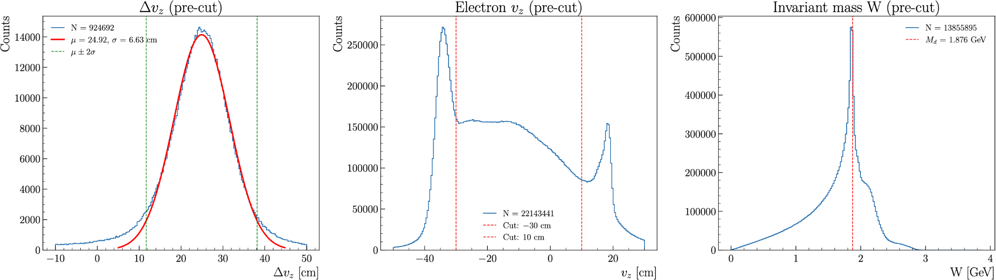
Evaluation on Real Data
Introduction
Model & Train
Simulation
Data
Summary
9/14
Deuterium elastic event (2.2 GeV run) selection

Slide 11
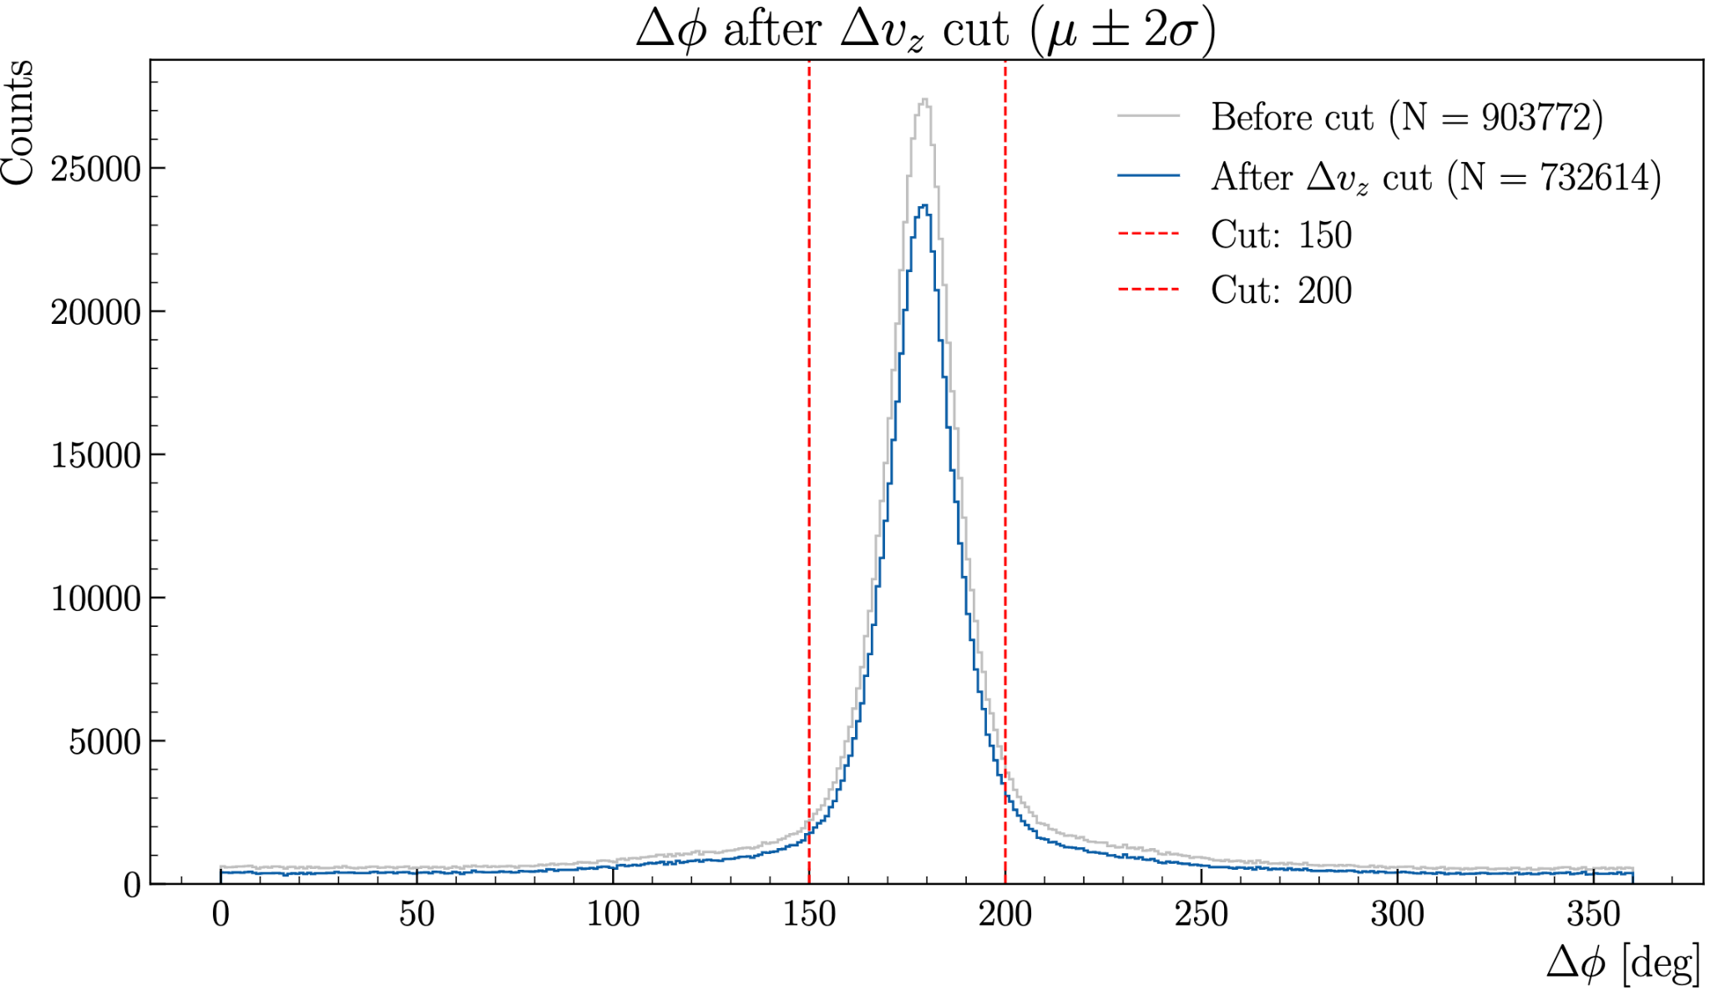
Evaluation on Real Data
Introduction
Model & Train
Simulation
Data
Summary
10/14
Estimate the wedge that should be hit based on the electron kinematics and use it as the truth

Slide 12


Evaluation on Real Data
Introduction
Model & Train
Simulation
Data
Summary
11/14
N_{true matchable}: Number of AHDC tracks that genuinely hit a specific ATOF sector
N_{correctly matched}: Number of those tracks where the predicted = true
This answers: "Of all tracks that should have been matched, what fraction did we correctly find?"
N_{candidates}: Number of tracks the model assigns to a given class, regardless of whether that assignment is correct or not.
This answers: "Of all tracks the model selected as matches, what fraction are genuine?"

Slide 13
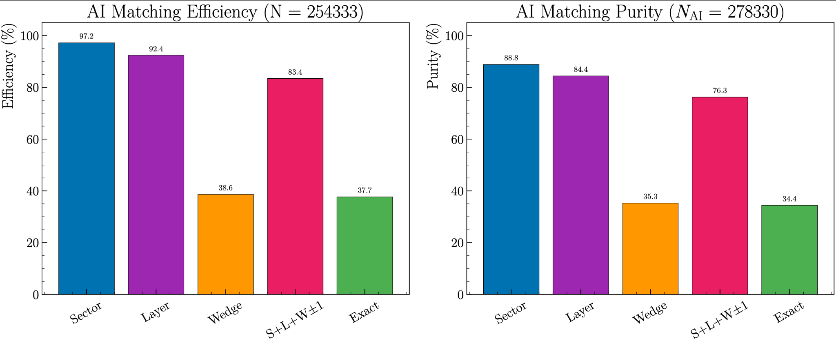
Evaluation on Real Data
Introduction
Model & Train
Simulation
Data
Summary
11/14

Slide 14
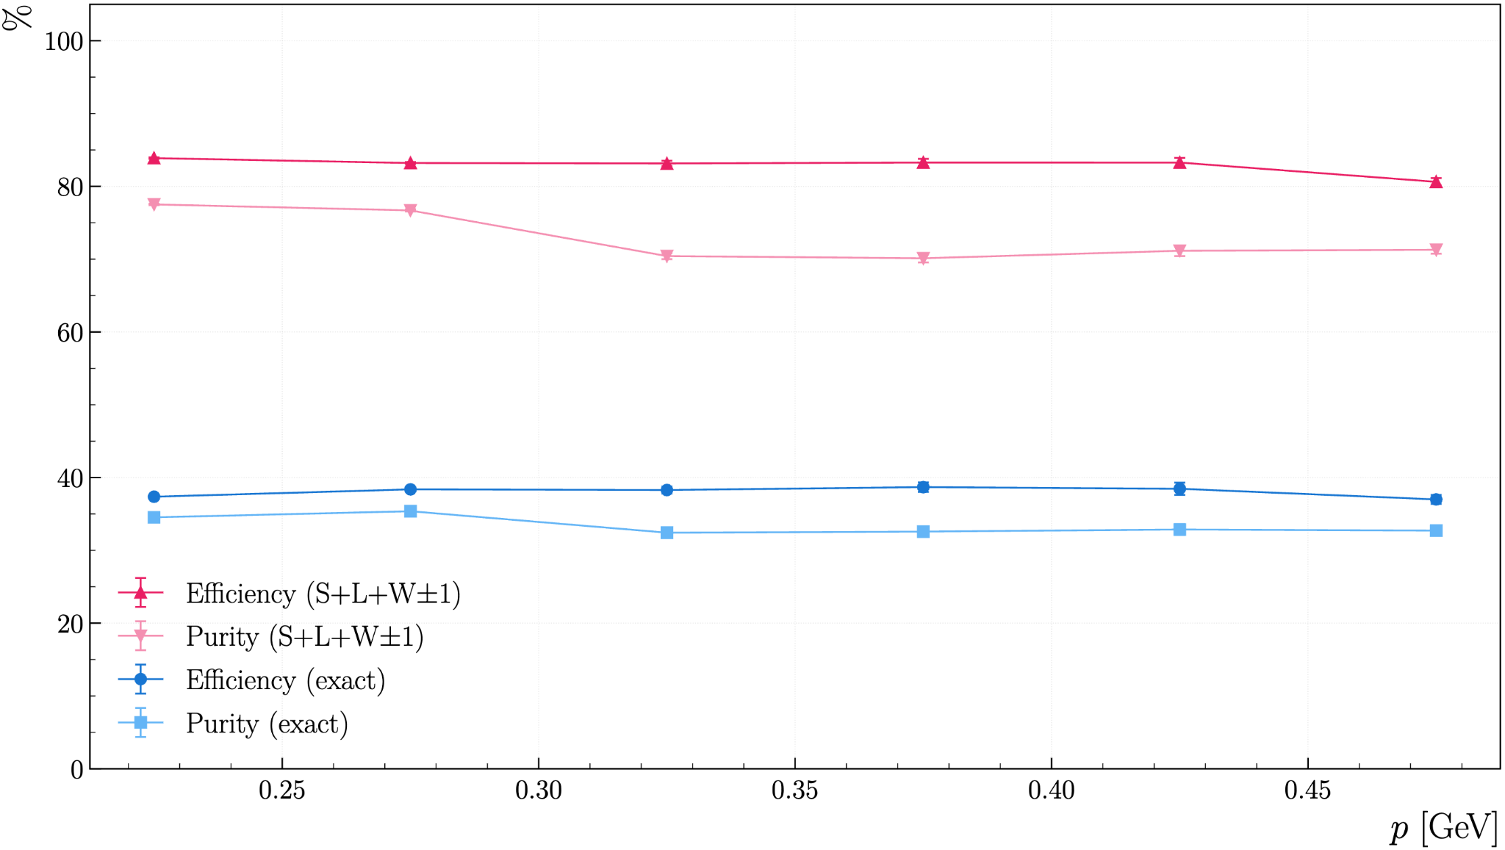
Evaluation on real data
Introduction
Model & Train
Simulation
Data
Summary
12/14

Slide 15
Summary and Outlook
Introduction
Model & Train
Simulation
Data
Summary
13/14
An AI-assisted MLP has been developed for track matching between AHDC and ATOF:
The network have been optimized and 3 heads to predict the sector, layer and wedge have been used
The AI is already implemented in COATJAVA and have been used in cooking
Evaluated the model's efficiency and purity as a function of momentum on simulation and data
Efficiency is always higher than 80% on data / 90% on simulation
Future work:
Retrain the track finding and track matching with the updated geometry

Slide 16
Backup slides
Introduction
Model & Train
Simulation
Data
Summary
14/14

Slide 17
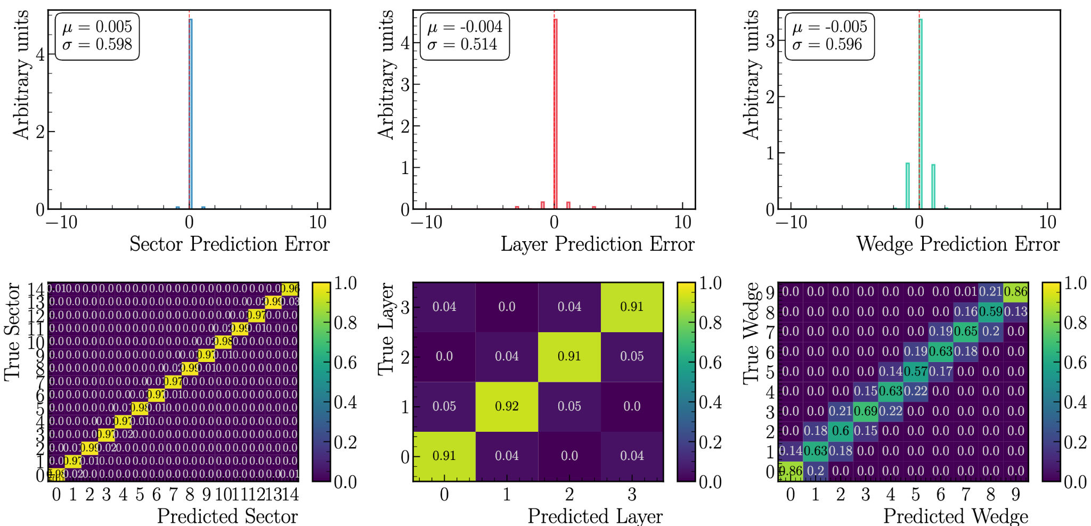
Evaluation on simulation
Introduction
Model & Train
Simulation
Data
Summary
Backup
Detail errors: good accuracy for sector and layer, wedge can be off by one

