Slide 1


RG-D Experiments: Status and Analysis Plans
Mathieu Ouillon (Mississippi State University)

Slide 2
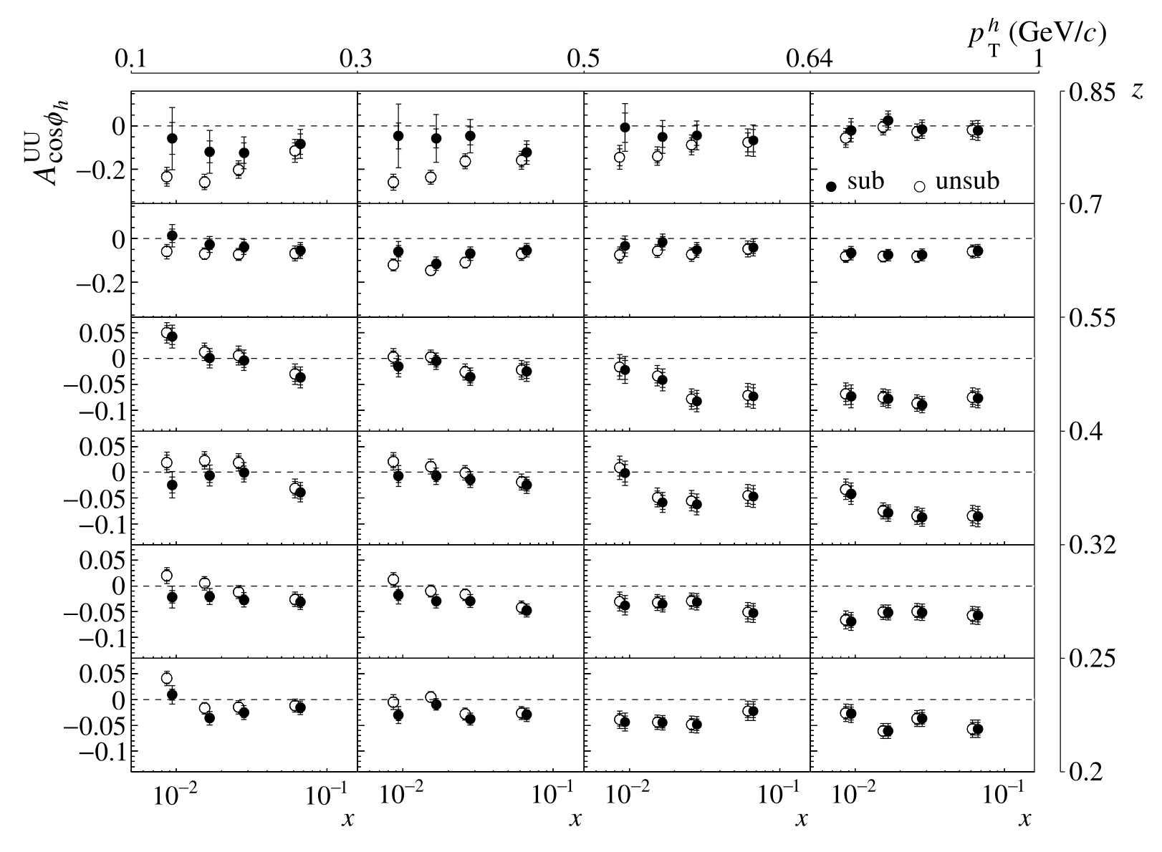
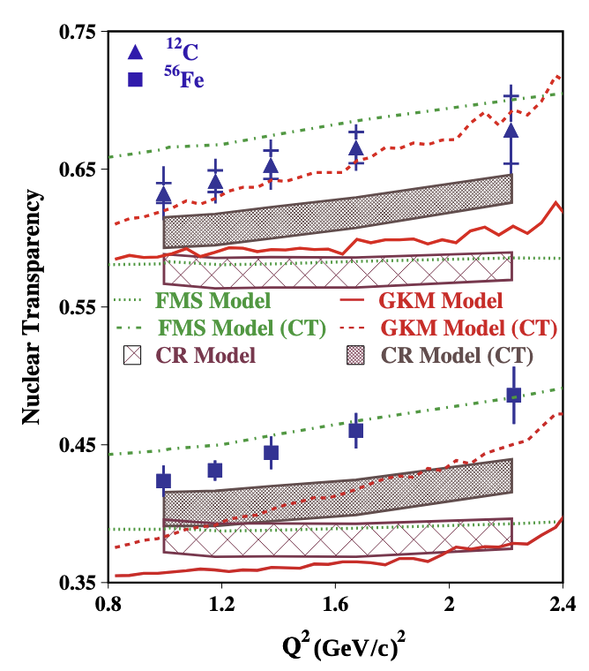
Run Group D
Introduction
PID
Analysis
Summary
1/20
¹: Argonne National Lab, ²: IJCLAB, Orsay, France
³: Mississippi State U., ⁴: University of New-Hampshire, ⁵: Florida International University
Run Group D is composed of two experiments:
Color Transparency (CT)
in Exclusive Vector Meson Electro-production off Nuclei E12-06-106
Spokespersons: W. Armstrong¹, L. El Fassi³,
K. Hafidi¹, M. Holtrop⁴, B. Mustapha¹
Nuclear TMDs (nTMDs)
in CLAS12 E12-06-106A
Spokespersons: R. Dupré², L. El Fassi³,
Z.-E. Meziani¹, H. Szumila-Vance⁵
The COMPASS Collaboration
arxiv.org:1912.10322
L. El Fassi, Physics 4, no. 3 (2022)
HERMES Collaboration arXiv:0704.3270

Slide 3
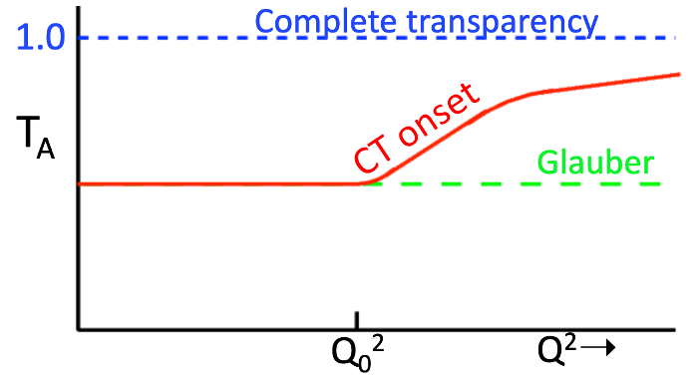
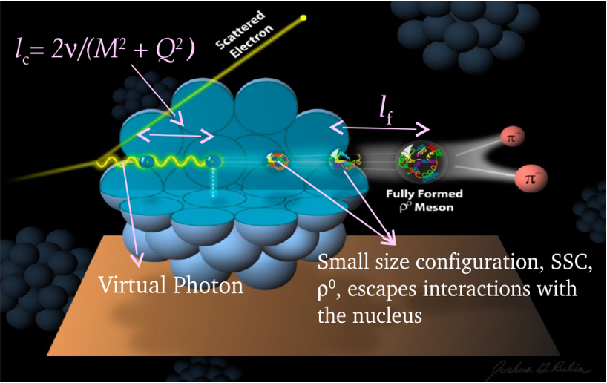
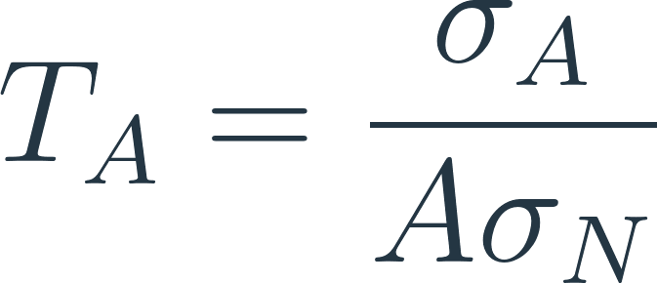
RG-D: CT Experiment
Introduction
PID
Analysis
Summary
2/20
E12-06-106: Color Transparency: suppression of interactions of colorless small size configuration in nuclear medium
Experimental signature: rise of the nuclear transparency, T_{A} as a function of Q²: ​
T_{A}: ratio of the cross section per nucleon on a bound nucleon to that on a free nucleon
σ_{A} − nuclei cross section
σ_{N} − free nucleon cross section
Objective: understanding the dynamical evolution from small-size configurations into ordinary hadrons, and validating the QCD factorization theorem
Coherence length, l_{c}: the lifetime of the qq-bar pair
Formation time, l_{f}: the time evolution of SSC to an on-shell ρ⁰ meson​​

Slide 4
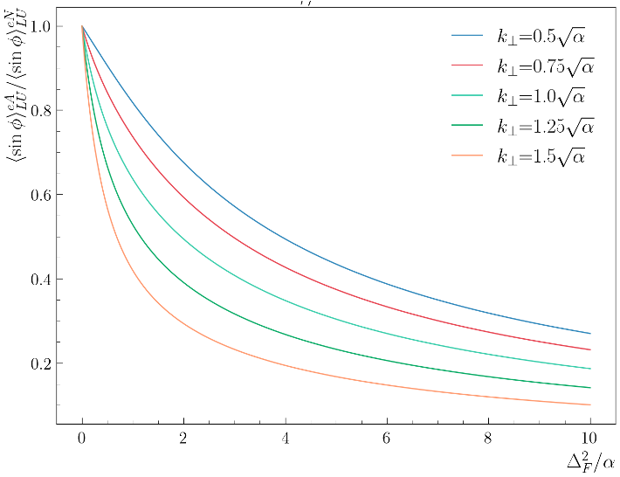
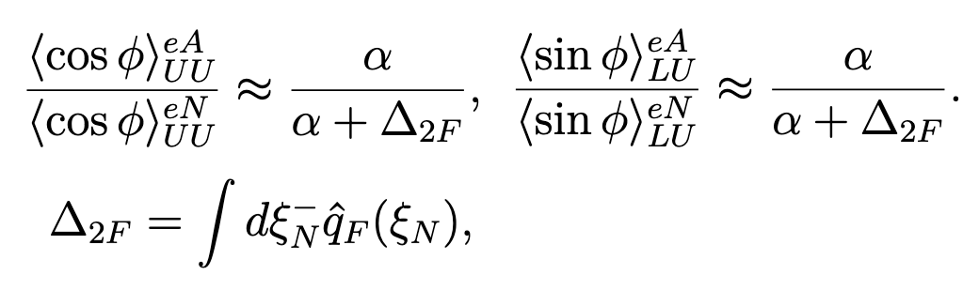
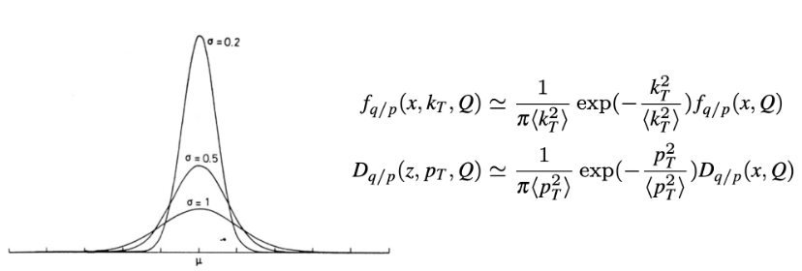
RG-D: Nuclear TMDs
Introduction
PID
Analysis
Summary
3/20
Song, Y. et al. (2014) Physical Review D, 89 014005.
E12-06-106A: nTMDs study uses the same CT running conditions except the beam polarization, and aims to study​:
Nuclear effect on SIDIS asymmetries
Transport coefficient of the nuclear matter
For that, measure different observables:
cos φ, sin φ, cos(2φ)¹ moments for different hadrons (π⁺,π⁻, and π⁰):
q_{F}(ξ_{N}): the quark transport parameter
¹ No predictions exist for this observable
The heavier the nucleus, the wider the TMD gaussian width (Nuclear Broadening)

Slide 5
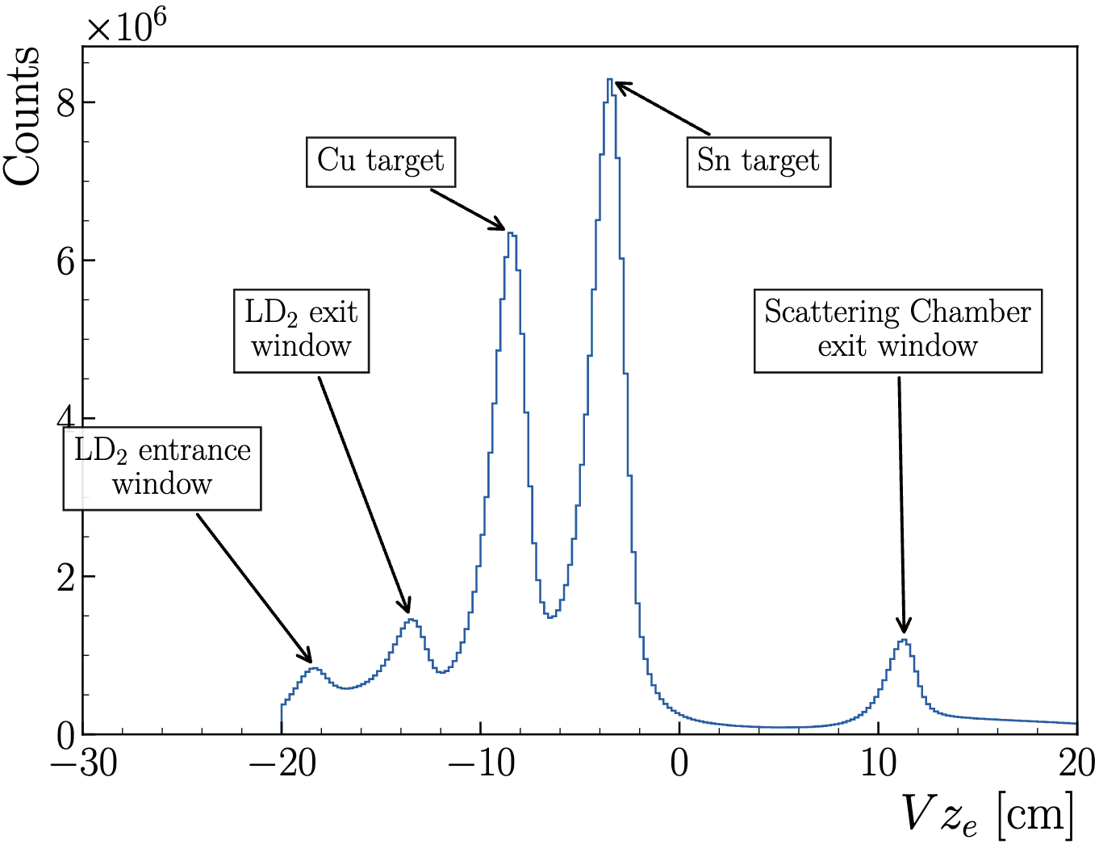
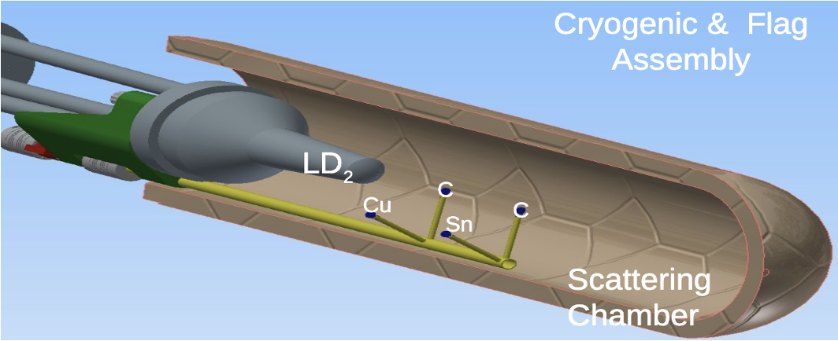
RG-D: Run Configuration
Introduction
PID
Analysis
Summary
4/20
RG-D experiments collected data in the fall of 2023 with
10.54 GeV polarized beam energy and 𝐼=5–175 nA for luminosity scans and production
Standard CLAS12 configuration with FT-OFF and three layers of FMT
Three target configurations, LD2, CxC, and CuSn, deployed with InBending and OutBending
New cryogenic LD2 and the nuclear-foil flag assembly centered at -5 cm for each configuration
Main run hiccups:
Faraday Cup vacuum contamination
Moller cone sagging

Slide 6
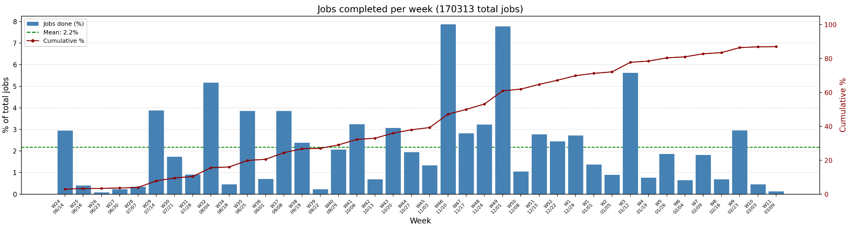
RG-D Status: Cooking Summary
Introduction
PID
Analysis
Summary
5/20
RG-D successfully passed Pass1 review on May 27th 2025
Pass1 cooking initiated on June 13th 2025 using COATJAVA 13.0.0
The cooking is at 87%:
Mainly due to the high usage of the farms, their recent downtime, and modification of the job scheduling and fair-share
Thanks to CalCom Experts for their support for calibration and cooking

Slide 7
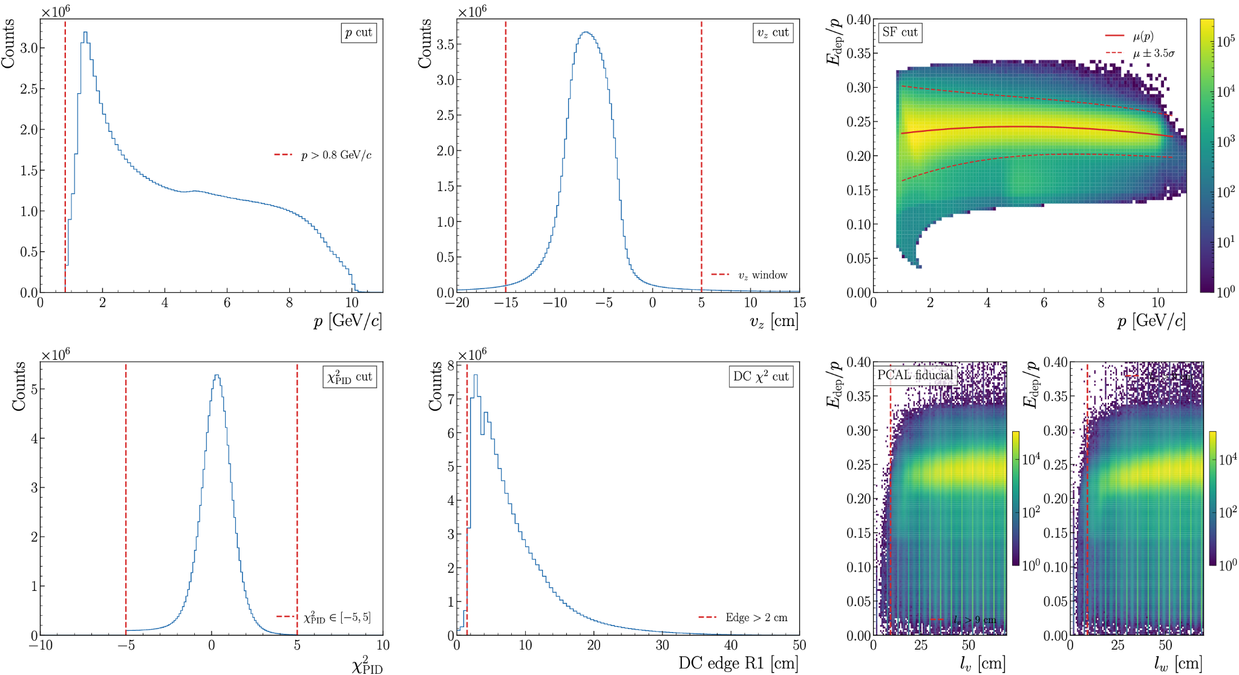
RG-D Particle IDentification: Electron
Introduction
PID
Analysis
Summary
6/20
Both refinement and fiducial cuts have been developed and optimized for RG-D:
pid = 11, status < 0
2000 ≤ |status| < 4000
|chi2pid| < 5

Slide 8
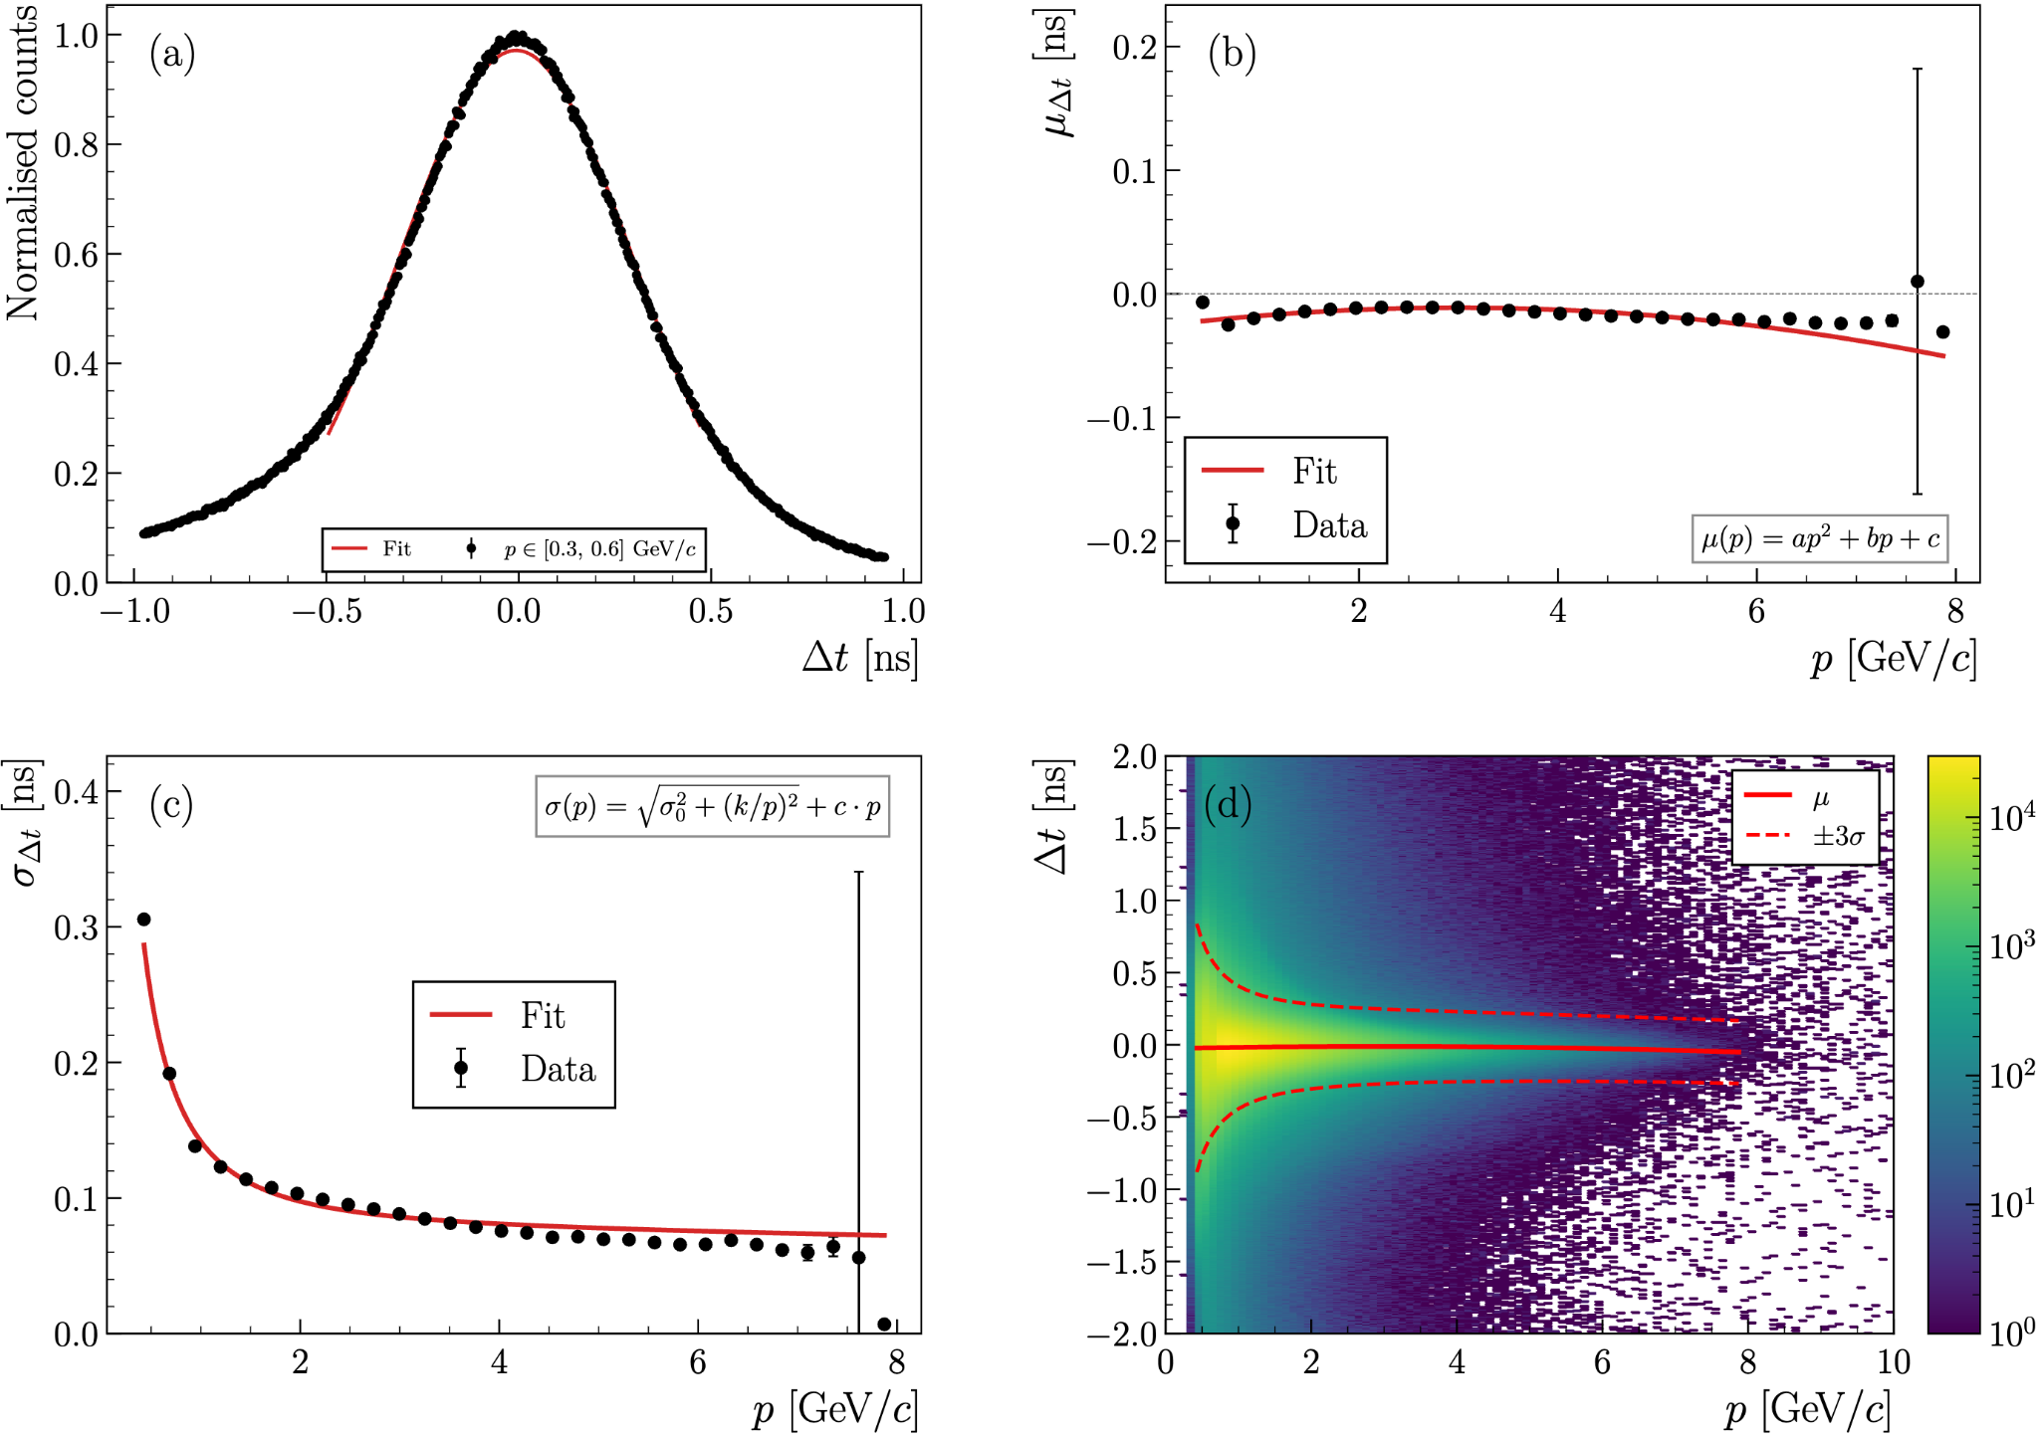
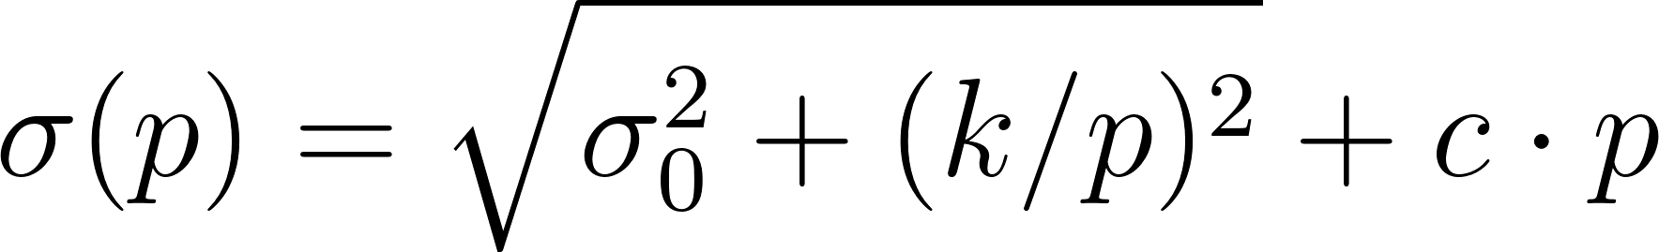
RG-D Particle IDentification: Pions
Introduction
PID
Analysis
Summary
7/20
The pion identification is very important for RG-D analyses (both CT and TMDs):
Develop refinement cuts: Δt vs p, and Vz
Slice Δt vs p in slices, fit each with Gaussian
Fit the mean of the Gaussian with 2rd order polynomial and σ with:
Use μ±3σ for the cut

Slide 9
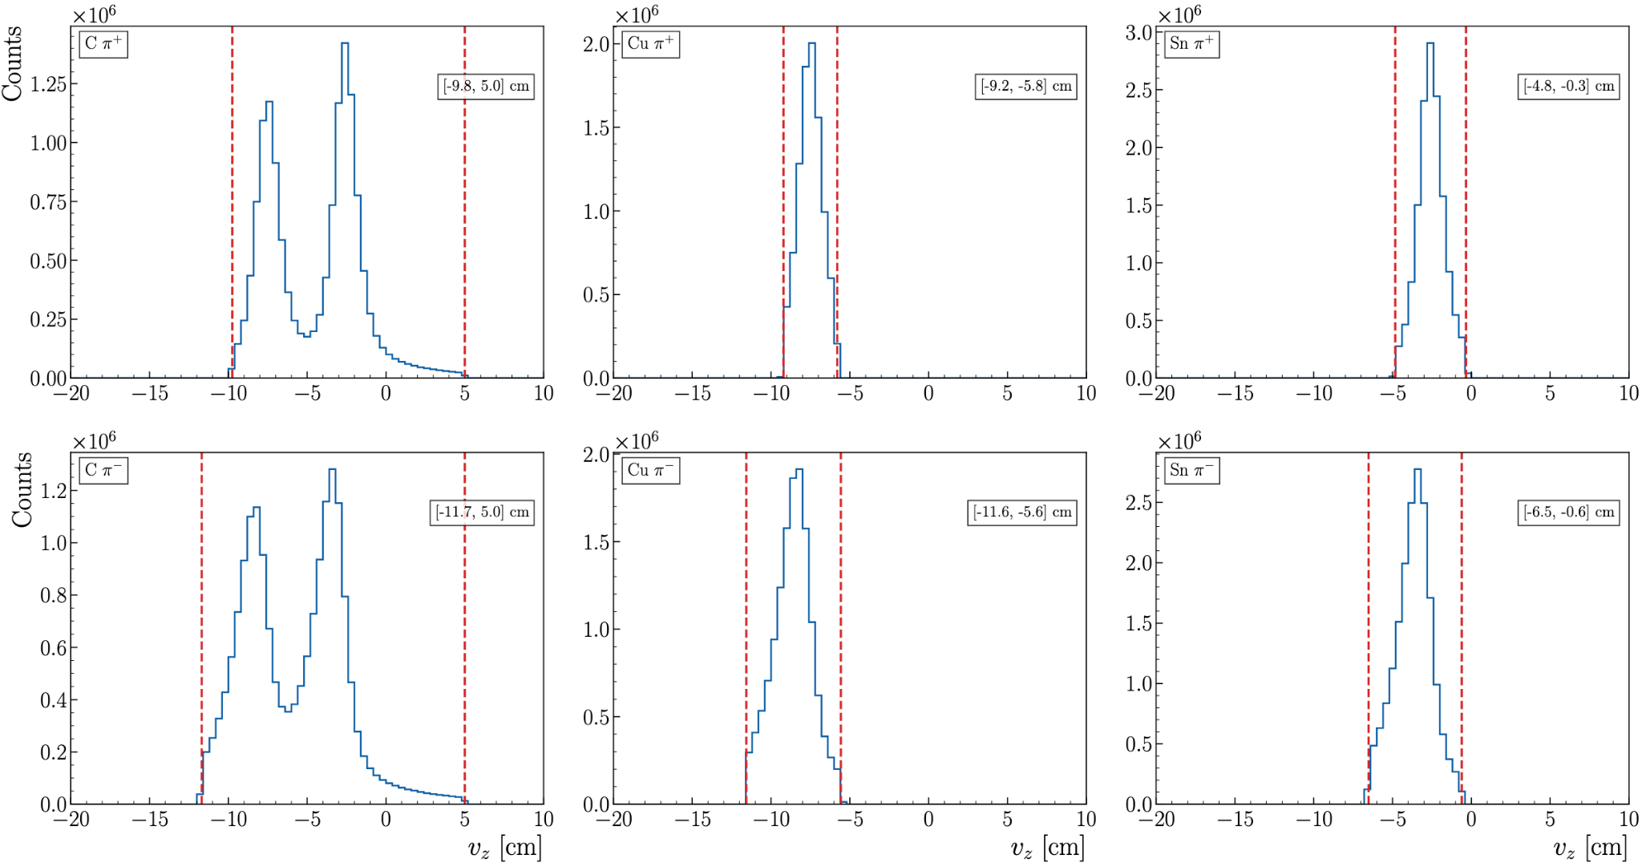
RG-D Particle IDentification: Pions
Introduction
PID
Analysis
Summary
8/20
The pion identification is very important for RG-D analyses (both CT and TMDs):
Develop refinement cuts: Δt vs p, and Vz based on Double sided Crystal Ball function

Slide 10
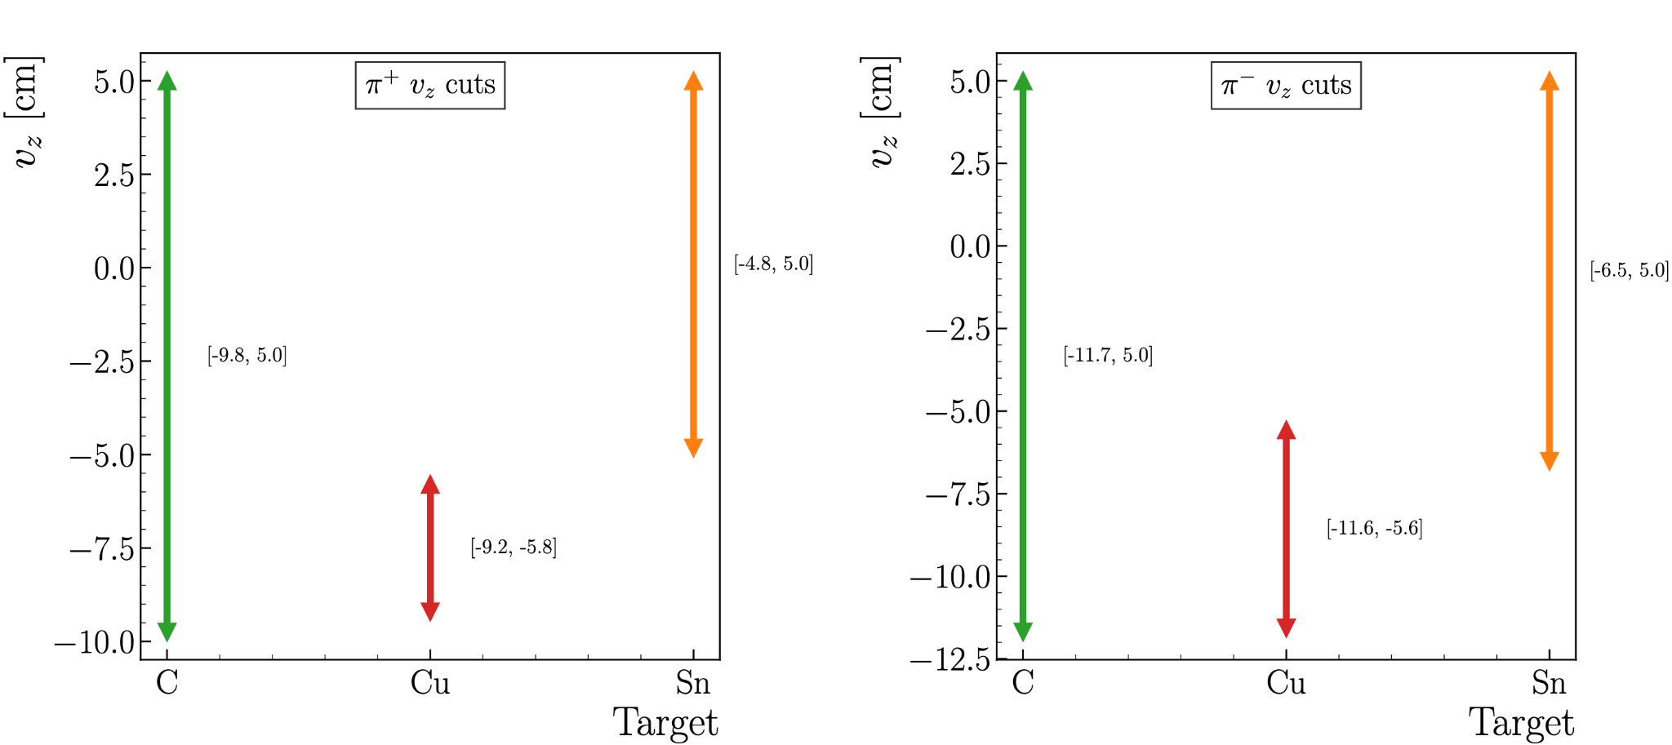
RG-D Particle IDentification: Pions
Introduction
PID
Analysis
Summary
9/20
The pion identification is very important for RG-D analyses (both CT and TMDs):
Develop refinement cuts: Δt vs p, and Vz based on Double sided Crystal Ball function

Slide 11
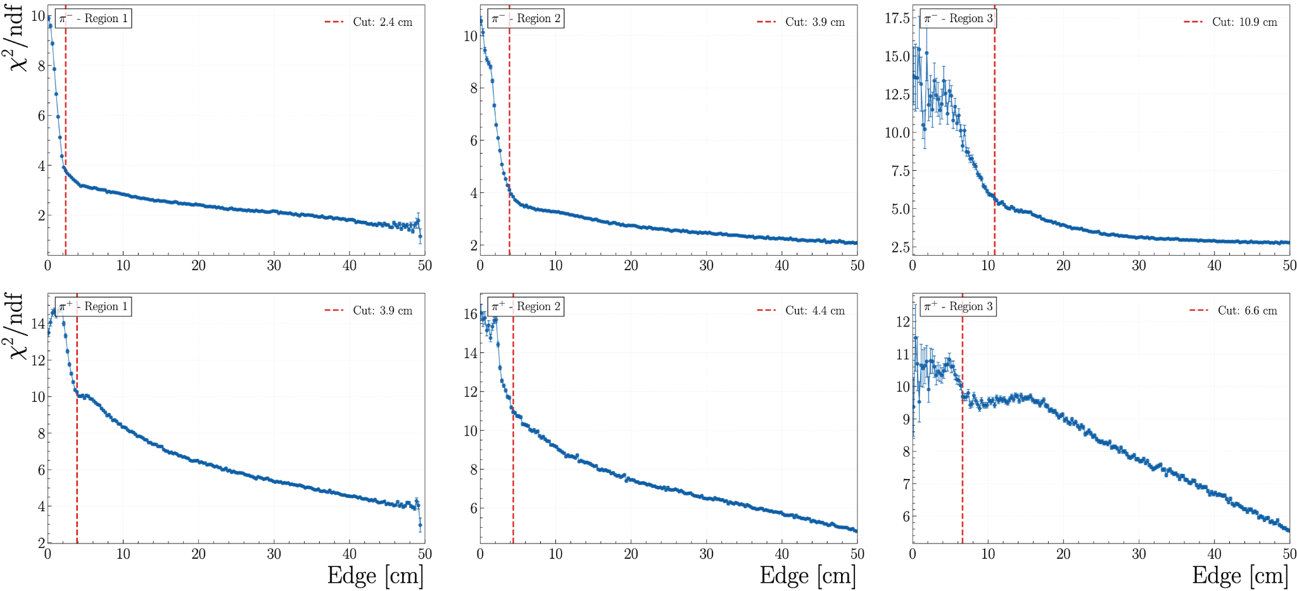
RG-D Particle IDentification: Pions
Introduction
PID
Analysis
Summary
10/20
The pion identification is very important for RG-D analyses (both CT and TMDs)
Develop also DC fiducial cuts following similar technique as for electrons
π⁻
π⁺

Slide 12
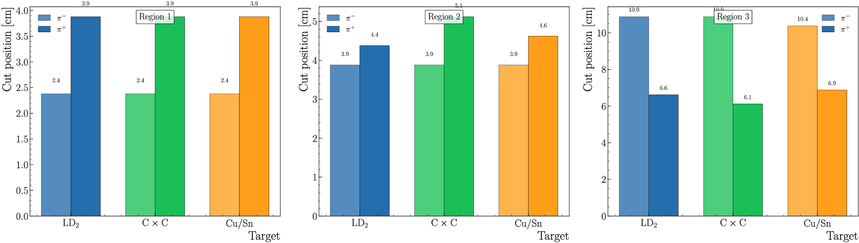
RG-D Particle IDentification: Pions
Introduction
PID
Analysis
Summary
11/20
The pion identification is very important for RG-D analyses (both CT and TMDs)
Develop also DC fiducial cuts following similar technique as for electrons

Slide 13
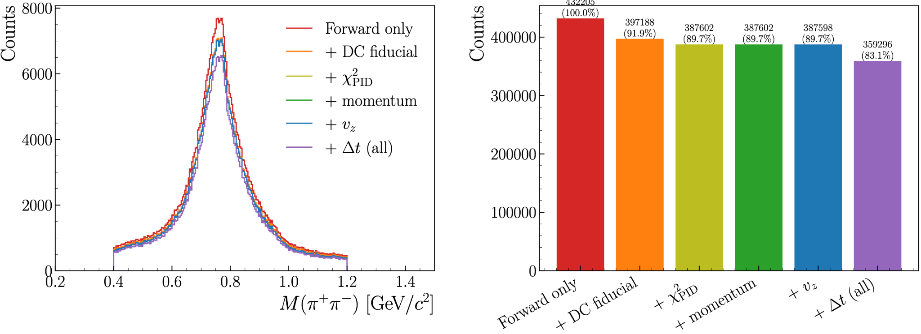
RG-D Particle IDentification: Pions
Introduction
PID
Analysis
Summary
12/20
The pion identification is very important for RG-D analyses (both CT and TMDs)
Look into the impact of the pions cuts on the invariant mass of the two pions

Slide 14
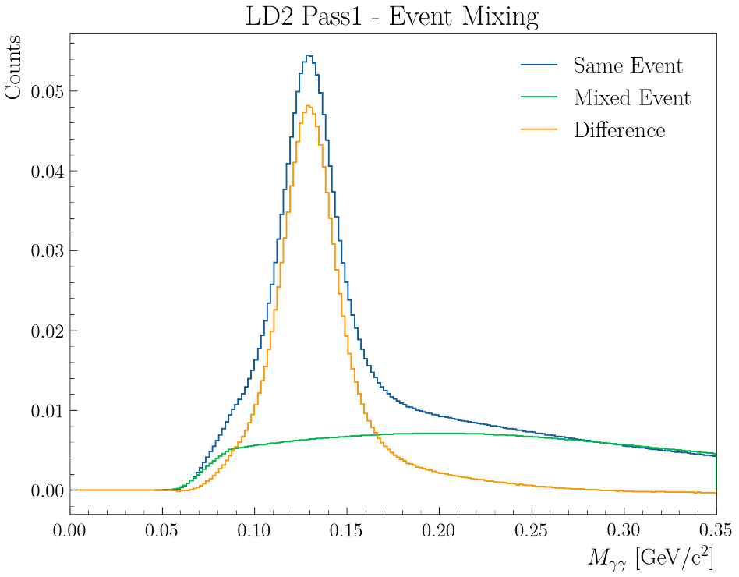
RG-D TMDs Studies: π⁰ analysis
Introduction
PID
Analysis
Summary
13/20
First look at the π⁰ channel to extract multiplicity ratios and azimuthal asymmetries:
In-progress efforts to employ the event mixing technique to subtract the background underneath the two-photon mass peak
Electron cuts: Standard RG-D cuts
Photon cuts: pid = 22 and E > 0.2 GeV
+ AI develop by Gregory Matousek

Slide 15
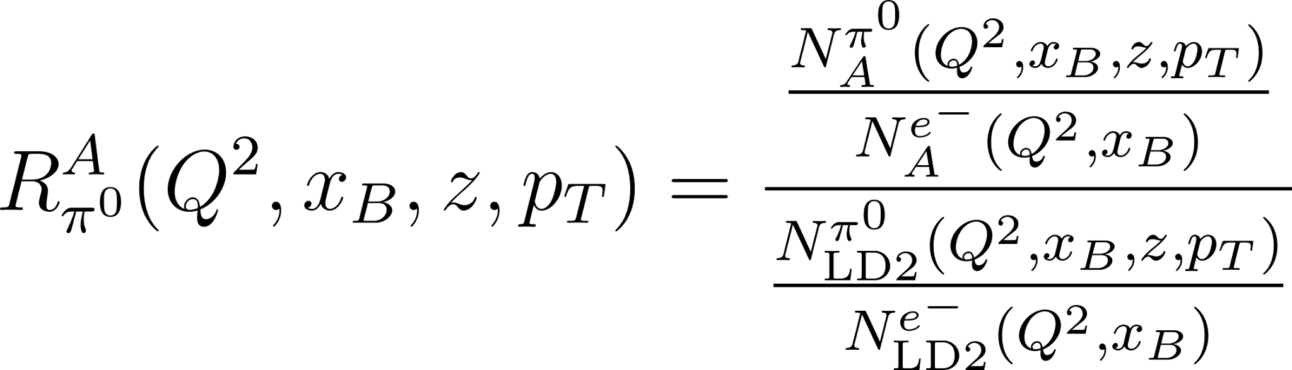
RG-D TMDs Studies: π⁰ analysis
Introduction
PID
Analysis
Summary
14/20
First look at the π⁰ channel to extract multiplicity ratios and azimuthal asymmetries:
Multidimensional binning:
Variable | Bins | Edges
Q² | 3 | [1.0, 1.33, 1.96, 10.98]
x_{B} | 3 | [0.06, 0.13, 0.21, 2.21]
z_{h} | 7 | [0.04, 0.13, 0.17, 0.21, 0.26, 0.33, 0.44, 1.0]
p_{T} | 3 | [0.00, 0.21, 0.36, 1.99]
SIDIS cut:
Q² > 1 GeV², W > 2 GeV, y < 0.85

Slide 16
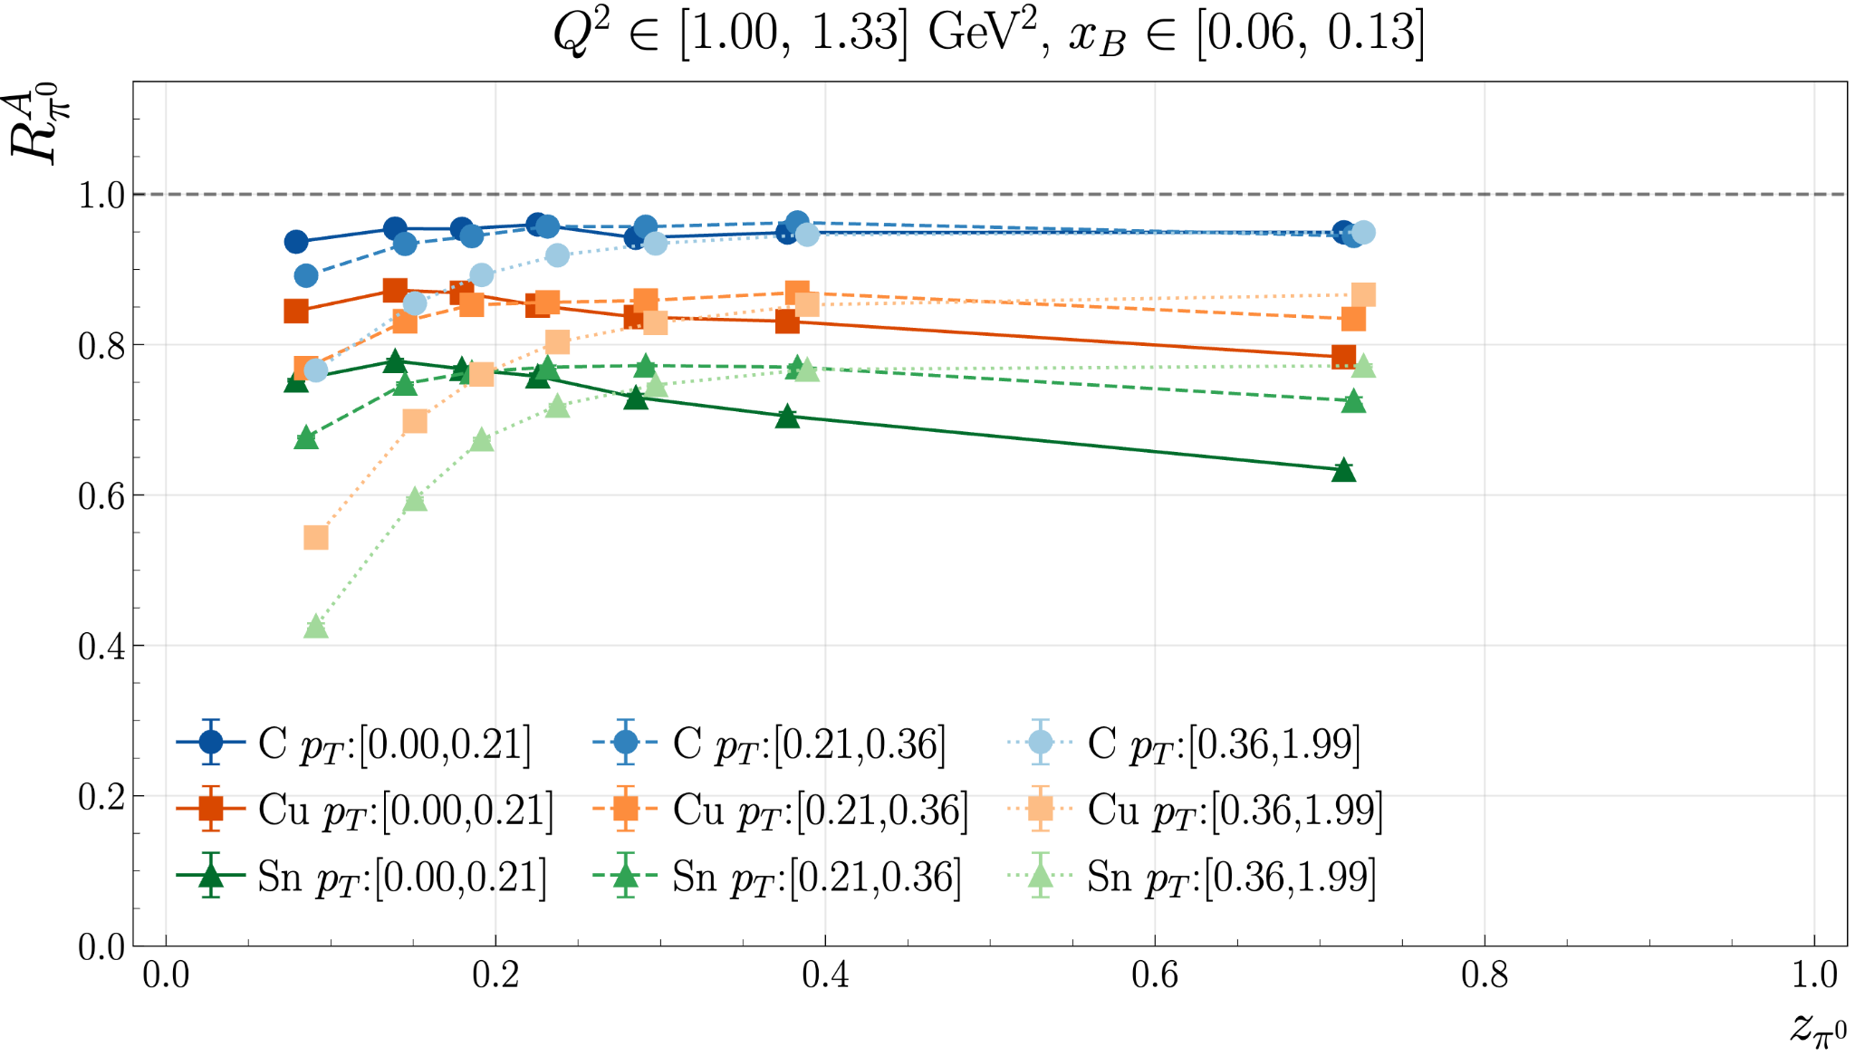
RG-D TMDs Studies: π⁰ analysis
Introduction
PID
Analysis
Summary
14/20

Slide 17
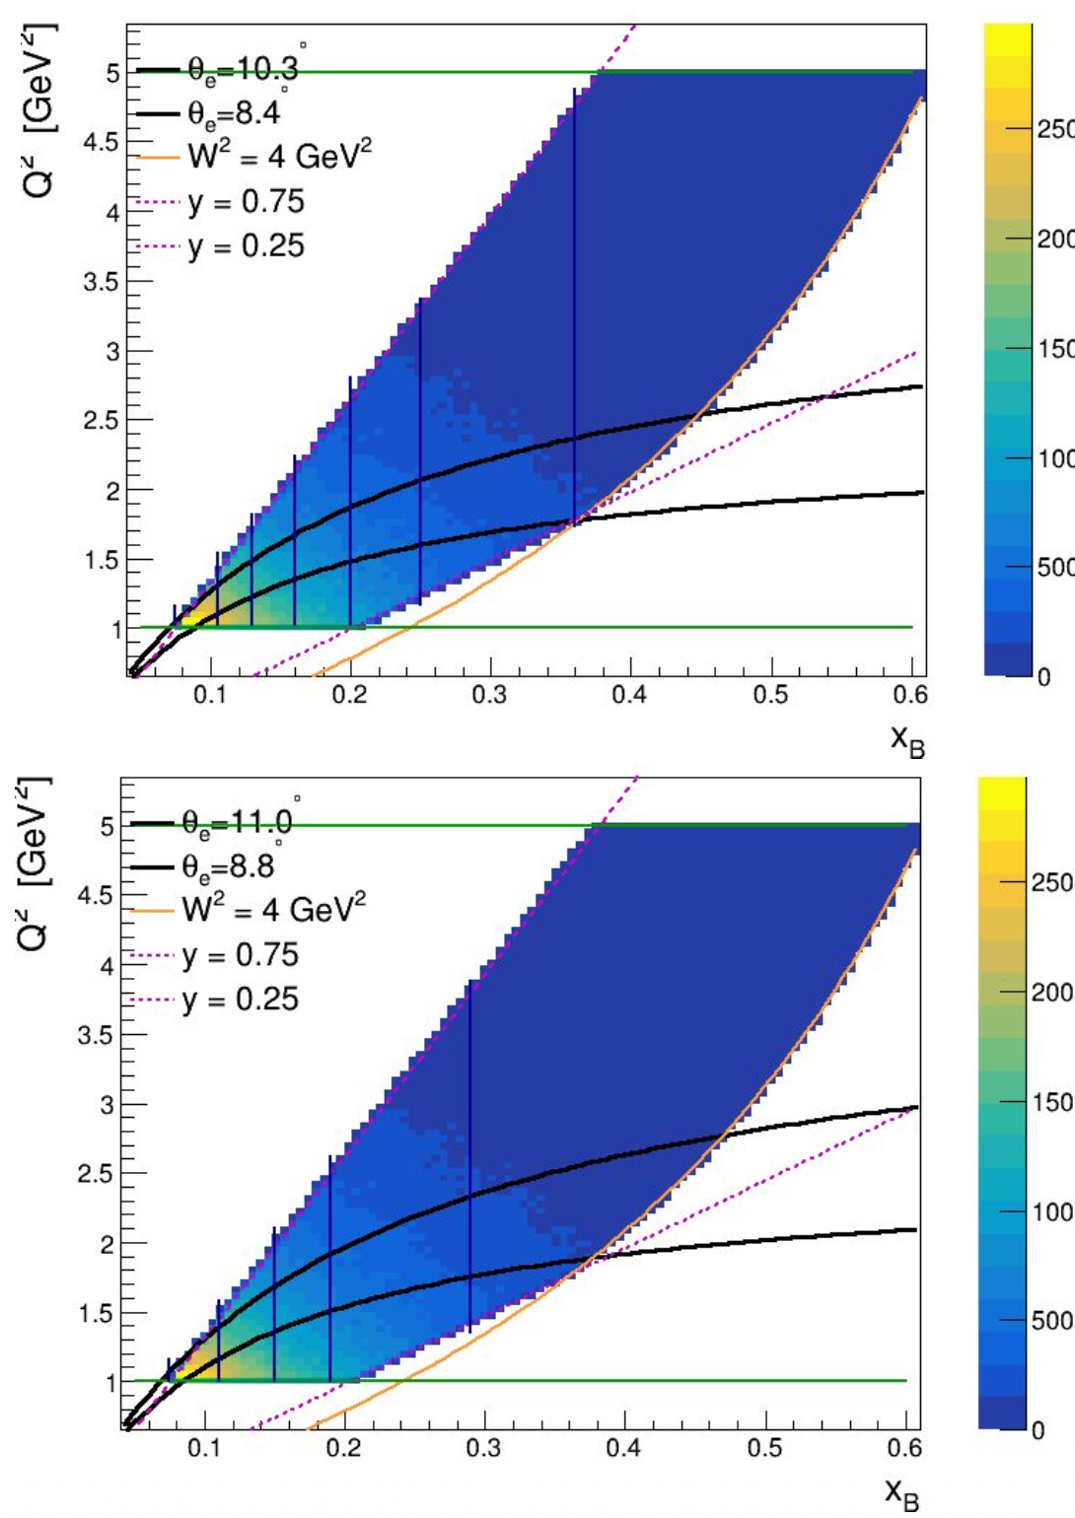
RG-D TMDs Studies: π⁺ analysis
Introduction
PID
Analysis
Summary
15/20
Motivation
SIDIS: Electron scattering off a target nucleus producing hadrons through virtual photon exchange. Nuclear effects influence SIDIS behavior in nuclear targets
Goal: compare nuclear targets to deuterium reference to study medium induced modifications
Main observables
Hadron multiplicity ratio
Transverse momentum broadening Δ⟨p_{T}²⟩
Azimuthal modulations over hadronic angle ϕ_{h}
Study in multi-dimensional bins (Q², xB, p_{T}², z) covering different kinematic ranges
21 two-dimensional bins in x_{B} and Q² kinematics
5x5 binning in hadron kinematics
Total bins: 525 across SIDIS kinematics
Ongoing analysis by D. Matamoros

Slide 18
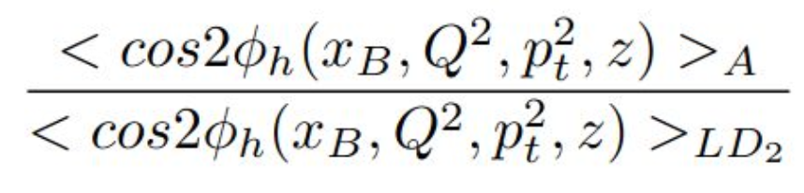
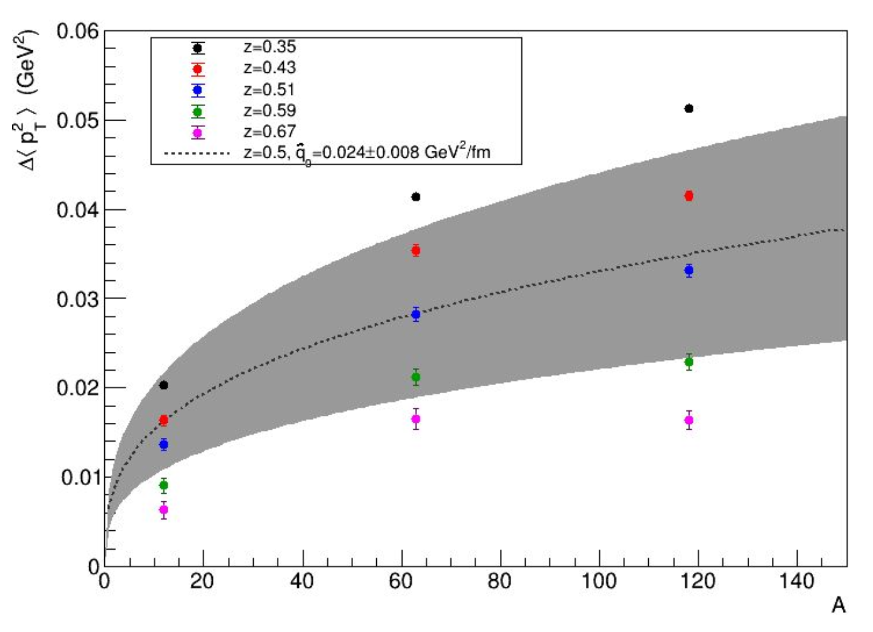
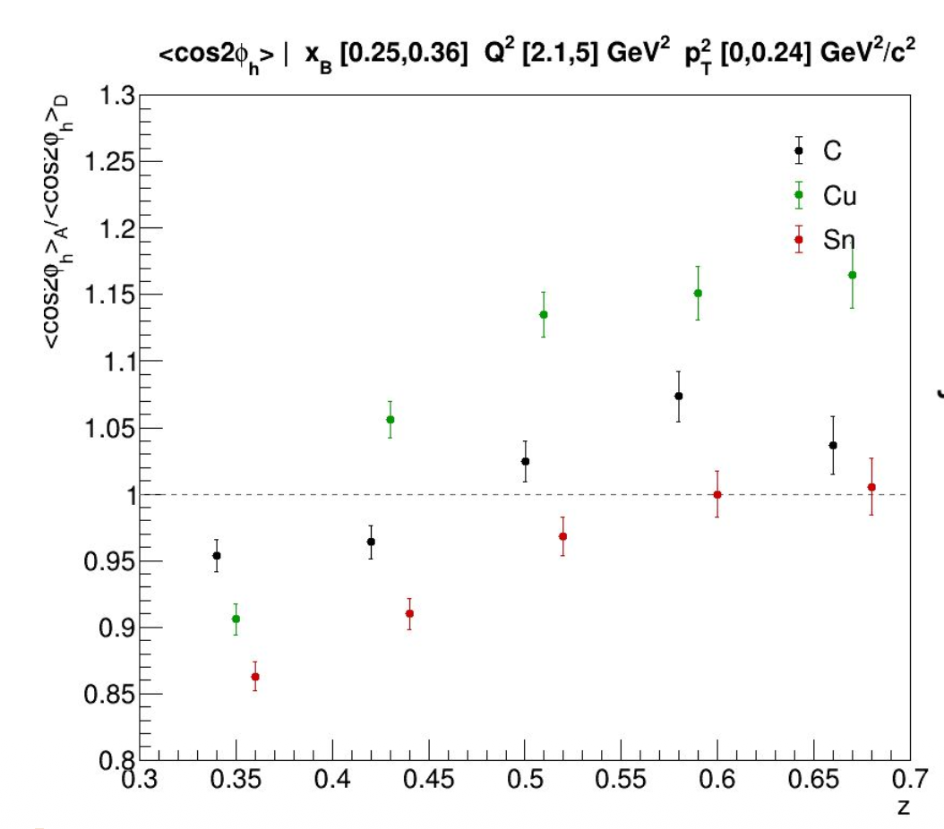
RG-D TMDs Studies: π⁺ analysis
Introduction
PID
Analysis
Summary
16/20
Ongoing analysis by D. Matamoros
Extract:
Nuclear Dependence of Transverse momentum Broadening
Azimuthal Modulation Ratio

Slide 19
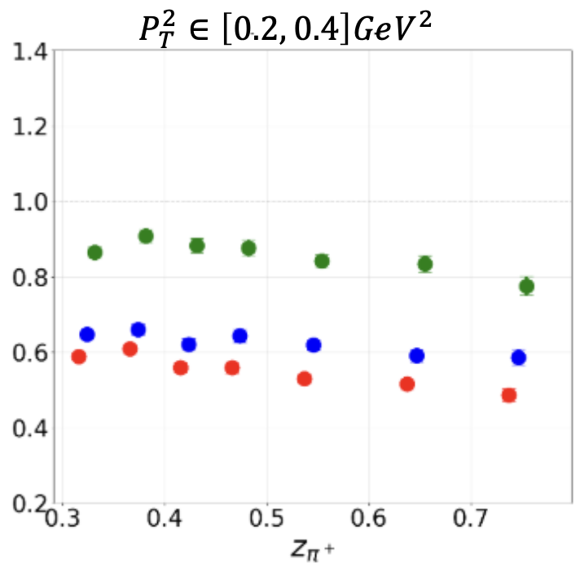
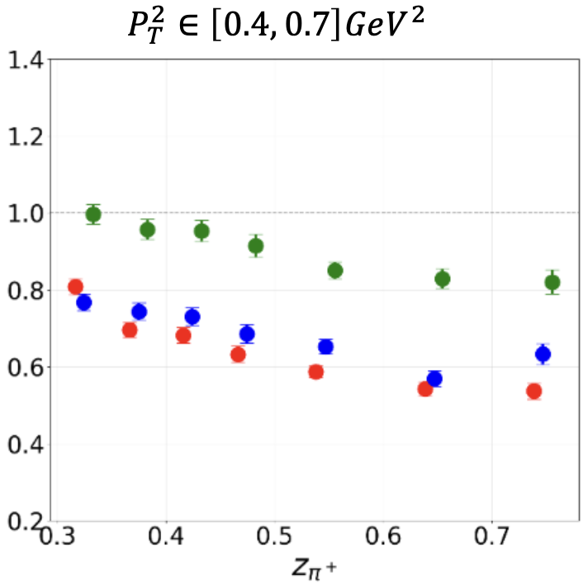
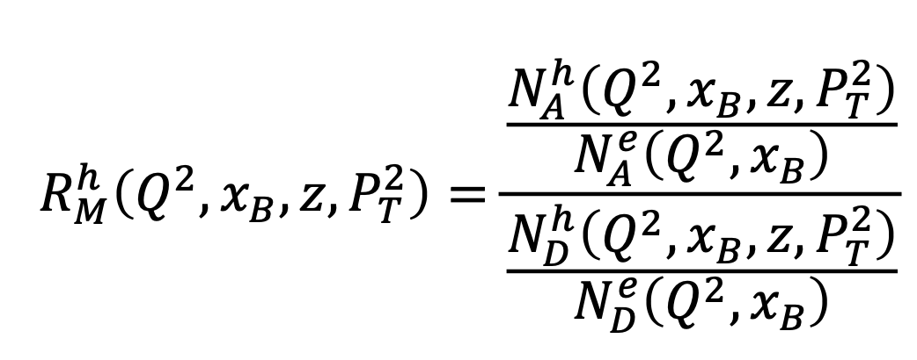
RG-D TMDs Studies: pions analysis
Introduction
PID
Analysis
Summary
17/20
Study multiplicity ratio, transverse momentum broadening and azimuthal moments for both negatively and positively charged pions:
Multidimensional binning in Q², x_{B}, z_{h} and p_{T}²
Ongoing analysis by S. Shrestha

Slide 20
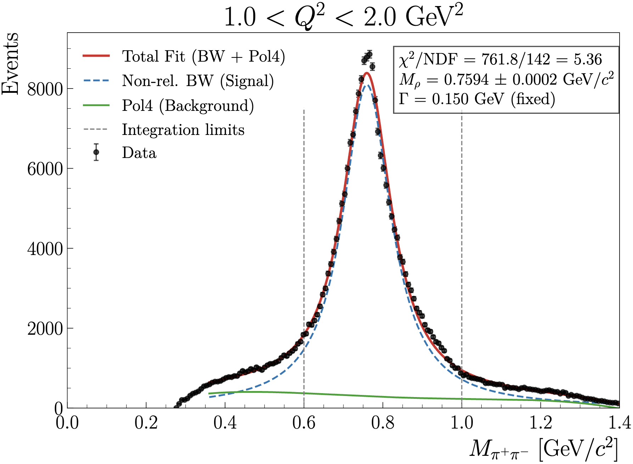
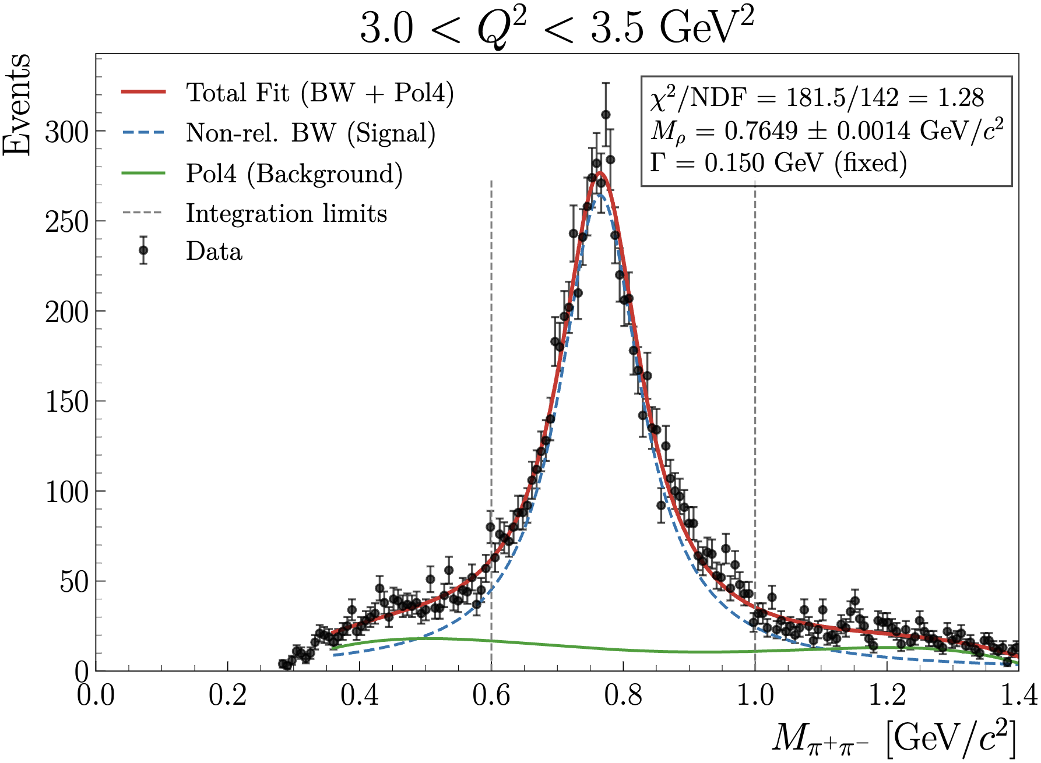
RG-D CT Study: Very Preliminary Nuclear Transparency
Introduction
PID
Analysis
Summary
18/20
Fit oppositely charged pions invariant mass with a Breit-Wigner and 3rd-order polynomial
Extract ρ⁰ yield by integrating the background-subtracted BW within a 3σ range using 10% of the Pass1 reconstruction data

Slide 21
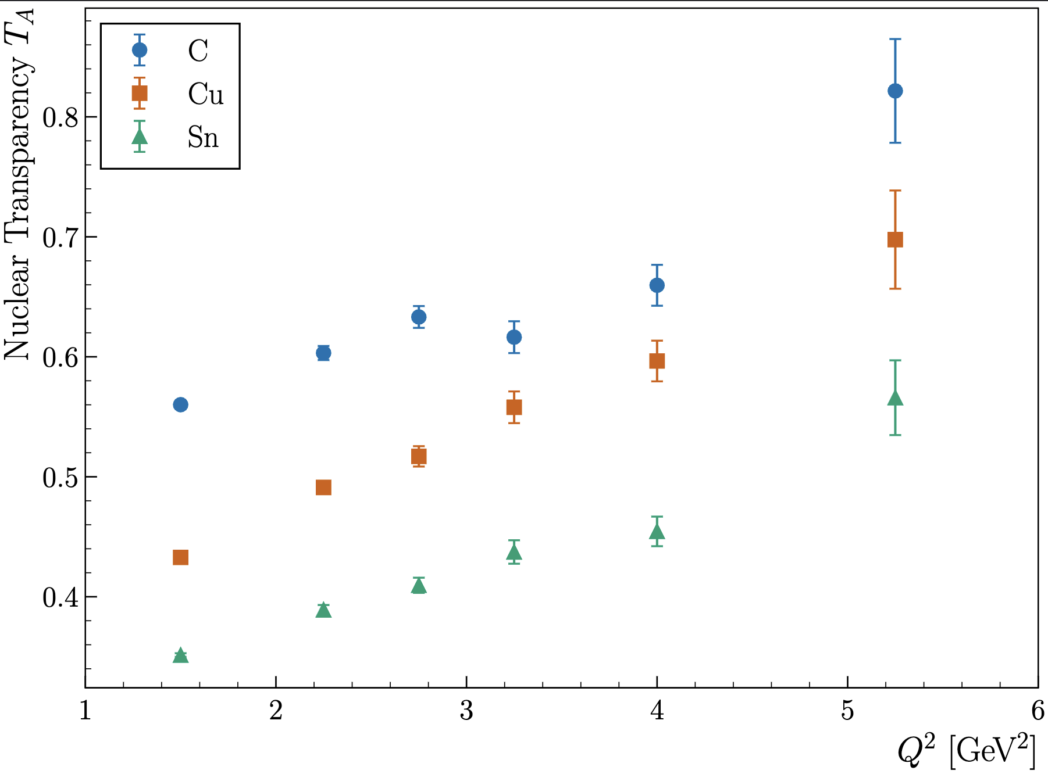
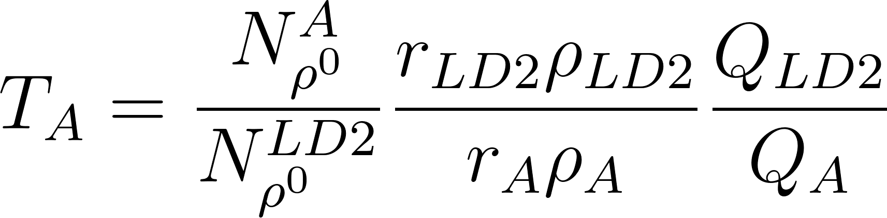
RG-D CT Study: Very Preliminary Nuclear Transparency
Introduction
PID
Analysis
Summary
19/20
Extract (raw) nuclear transparency as currently available Pass1 reconstructed data (around 10% of total)
r_{LD2}= 5 cm: LD2 thickness
r_{C} = 0.4 cm: CxC thickness
r_{Cu}= 93 μm: Copper thickness
r_{Sn} = 171 μm: Tin thickness
ρ_{LD2}= 0.164 g/cm³: LD2 density
ρ_{C}= 2.2 g/cm³: Carbon density
ρ_{Cu}= 8.96 g/cm³: Copper density
ρ_{Sn}= 7.31 g/cm³: Tin density

Slide 22
Summary and Outlook
Introduction
PID
Analysis
Summary
20/20
RG-D has passed the Pass1 review, and the cooking continue
Cooking will take three/four more months
Optimizing analysis tools for CT and nTMDs studies to
Study the hadron/electron contamination in pion sample
Correct for contamination with the CuSn target
Deploy the ρ⁰ event generator for the two-pion invariant mass background subtraction and apply necessary corrections for the extraction of the preliminary CT results
Implement radiative and acceptance correction for the nuclear transparency
Finalize the π⁰ event mixing background-subtraction and extract its preliminary asymmetry results
Obtain the preliminary asymmetry results for charged pions nTMDs studies

Slide 23
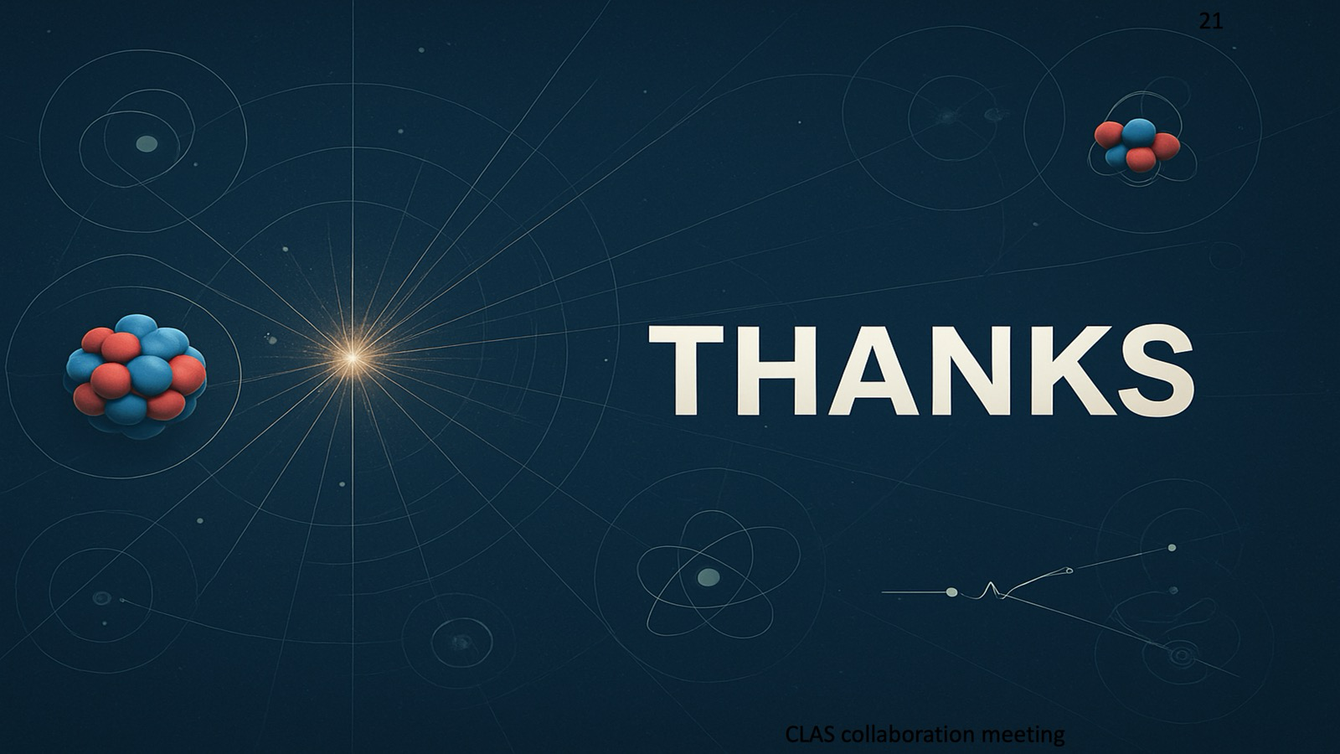

Slide 24
Backup slides
Introduction
PID
Analysis
Summary
Backup

Slide 25
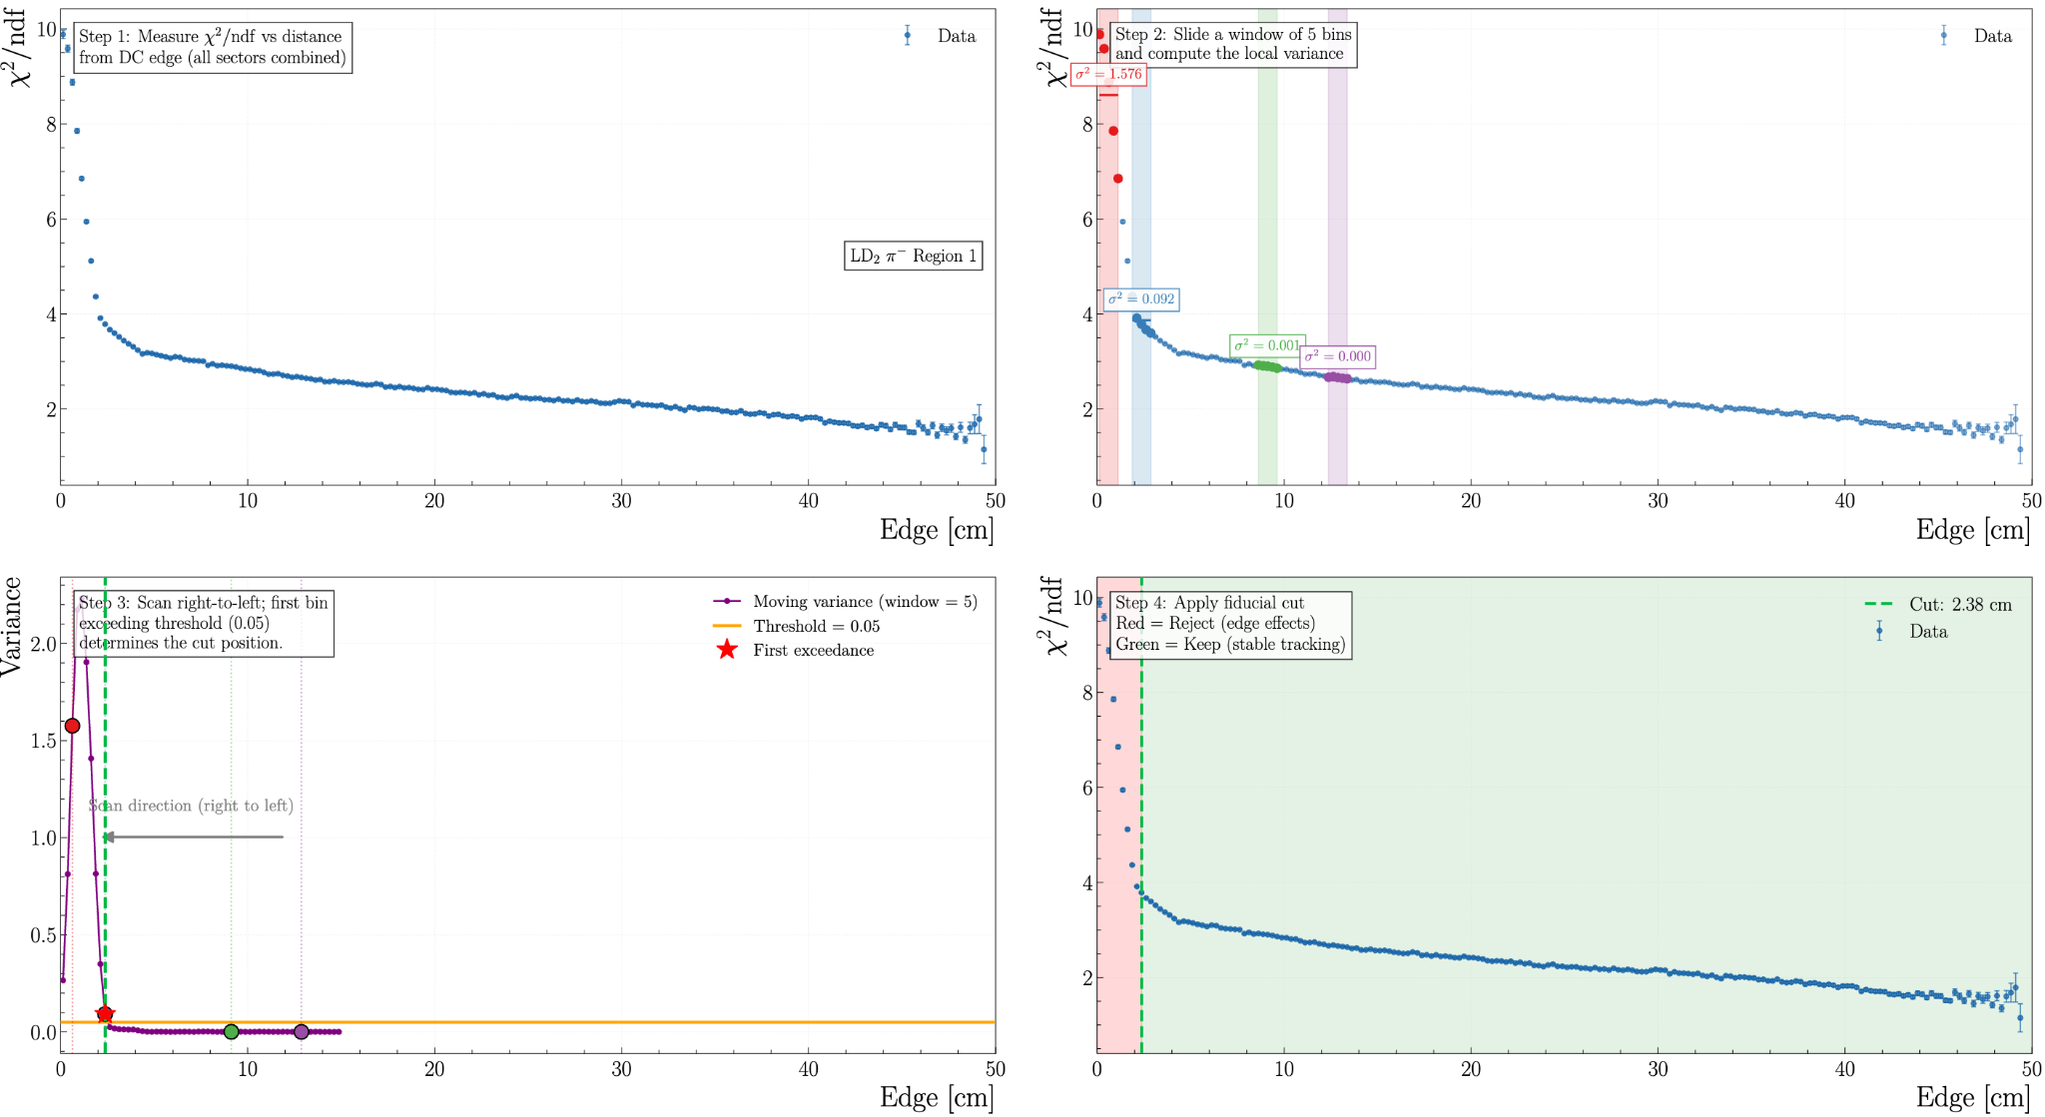
RG-D Particle IDentification: Pions Fiducial
Introduction
PID
Analysis
Summary
Backup
The goal is to remove tracks near the drift chamber edges where tracking quality degrades
profile the chi2/ndf of the track fit as a function of distance from the DC edge
Near the edge: chi2/ndf fluctuates due to poor tracking resolution
Far from the edge: chi2/ndf is stable (good tracking)
To find the transition between these two regimes automatically:
Compute a moving variance of the chi2/ndf profile using a sliding window of 5 bins
Scan from right to left (from the stable region toward the edge)
The first bin where the variance exceeds a threshold (0.05) marks the boundary — this is the cut position
Tracks closer to the edge than the cut position are rejected; tracks beyond are kept
The method is applied independently for each target, pion charge, and DC region (R1, R2, R3)

Slide 26
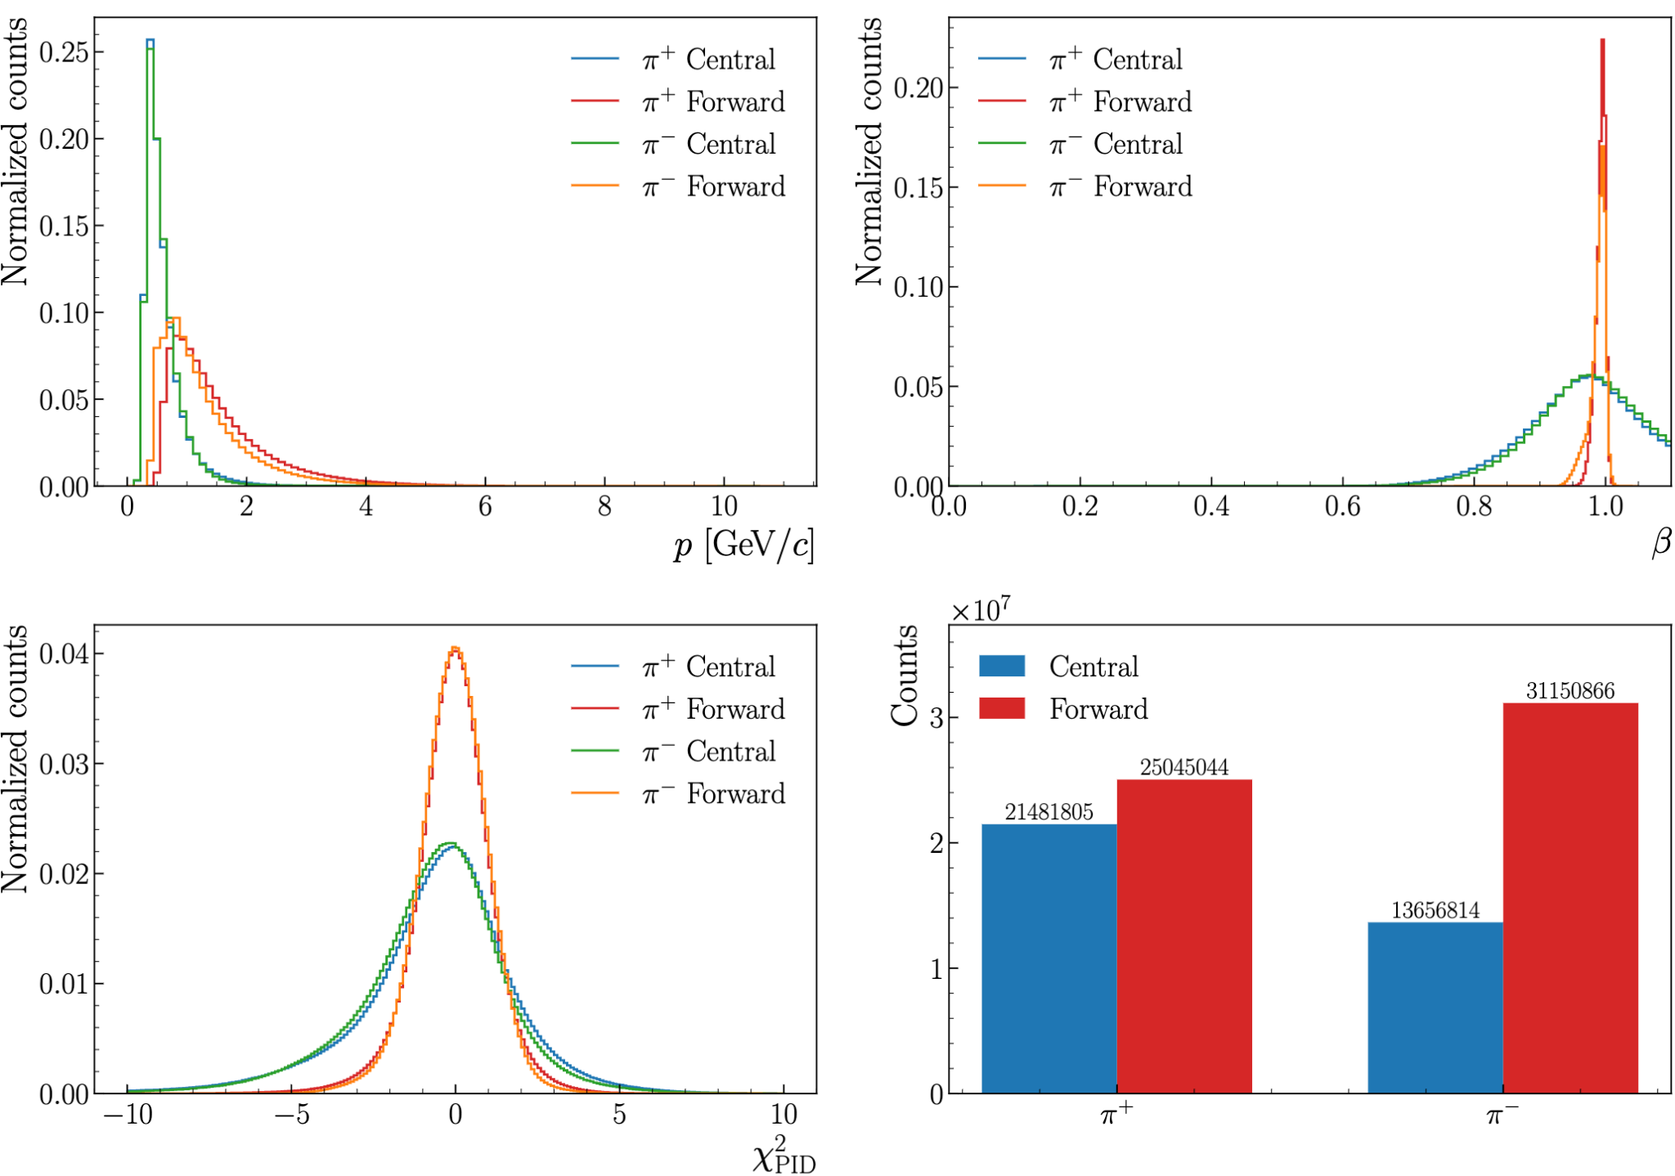
RG-D Particle IDentification: Pions
Introduction
PID
Analysis
Summary
Backup
The pion identification is very important for RG-D analyses (both CT and TMDs)
Also look into the pions detected in the central detector (CD)
π⁺: Central 46.2%, Forward 53.8%
π⁻: Central 30.5%, Forward 69.5%
Between a third and half of the statistic is in the central
Worse β and chi2pid in the central
The central pions don’t have any cuts

Slide 27
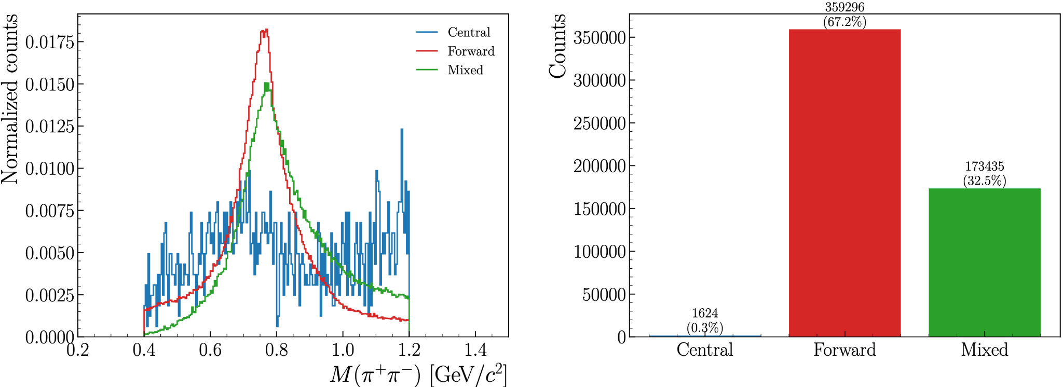
RG-D Particle IDentification: Pions
Introduction
PID
Analysis
Summary
Backup
The pion identification is very important for RG-D analyses (both CT and TMDs)
Also look into invariant mass for the pions detected in the central detector (CD)
After applying cuts: z_{h} > 0.9, 0.1 < -t < 0.5 GeV², l_{c}< 1 fm

Slide 28
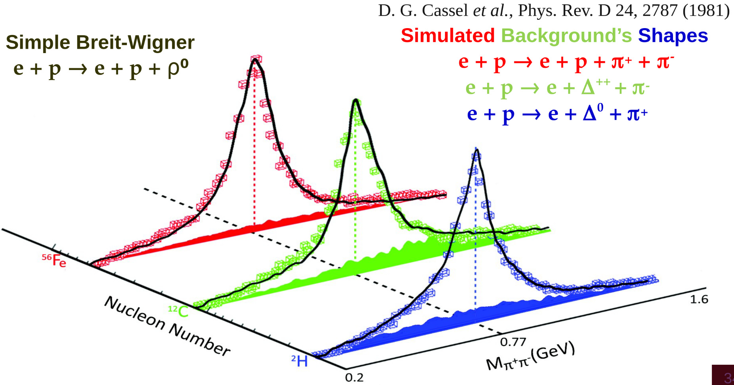
CT Study: Two-pion Invariant Mass
Introduction
PID
Analysis
Summary
Backup
Our event generator incorporates the measured cross sections by Cassel et al. for the electroproduction of ρ0 and the three main background processes

