Slide 1


Graph Neural Networks for Track Finding in ALERT
Mathieu Ouillon (Mississippi State University)

Slide 2
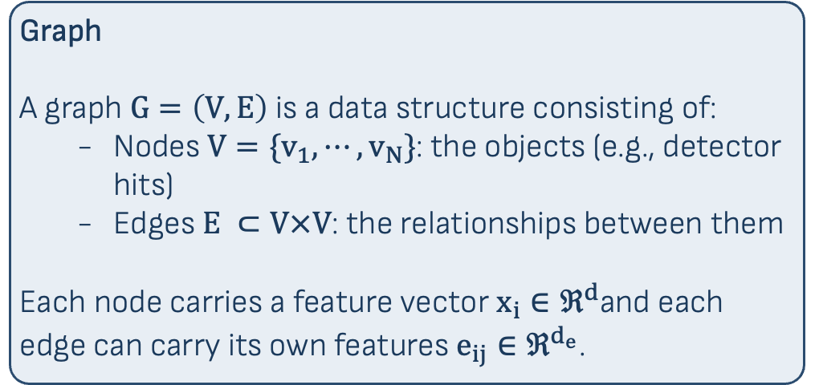
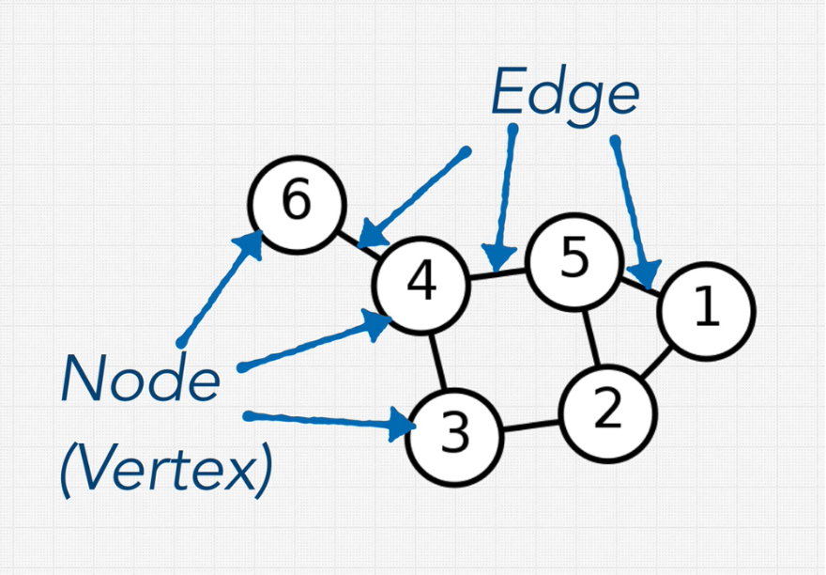
Introduction to Graph and Graph Neural Networks
Introduction
Training and Testing
Elastic Data
Summary
1/13
ALERT is designed to detect recoil nuclei
Accurate track finding is crucial for reconstructing particle trajectories and physics kinematics.
Traditional methods (like Multi-Layer Perceptrons, or CNN) struggle in high-multiplicity or noisy environments.
Goal: Implement and validate a Graph Neural Network (GNN) approach for robust track finding in ALERT.
Graphs naturally encode arbitrary pairwise relationships between hits.

Slide 3
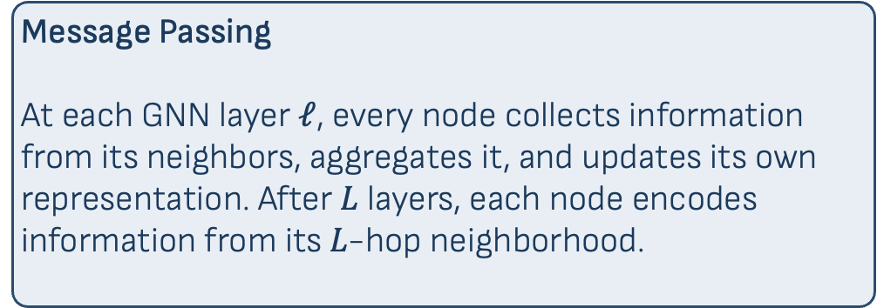
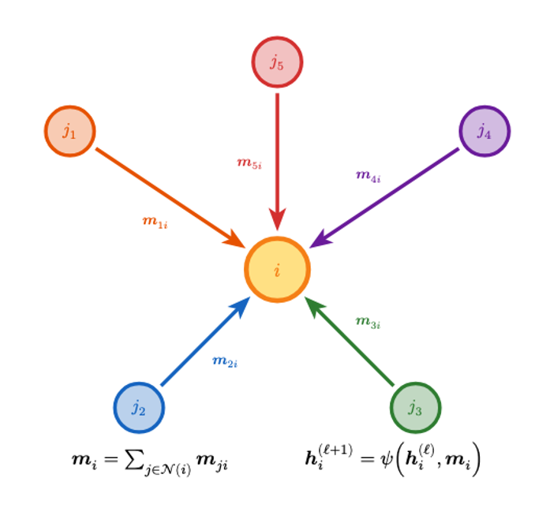
Message Passing: The Core of GNNs
Introduction
Training and Testing
Elastic Data
Summary
2/13
This allows the network to learn global track structures rather than just local pairwise features, making it highly robust against noise and overlapping tracks.

Slide 4
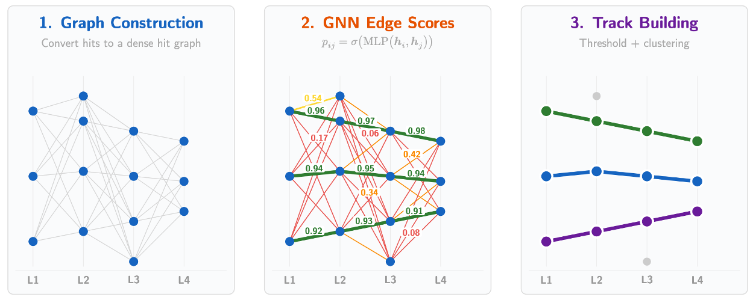
Edge Classification for Track Finding
Introduction
Training and Testing
Elastic Data
Summary
3/13
The GNN assigns a score e_{𝑖𝑗} ∈ [0, 1] to every edge, indicating the probability that hits 𝑖 and 𝑗 belong to the same particle track. High-scoring edges are kept; connected components in the surviving graph become track candidates.
The GNN transforms a dense candidate graph (left) into clean track candidates (right) by scoring each edge and keeping only the survivors.

Slide 5
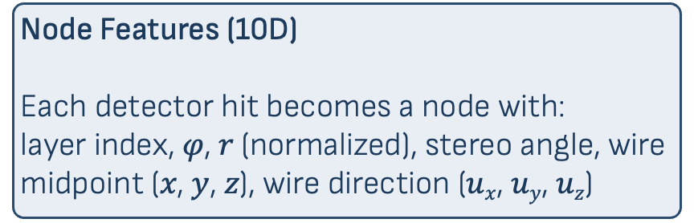
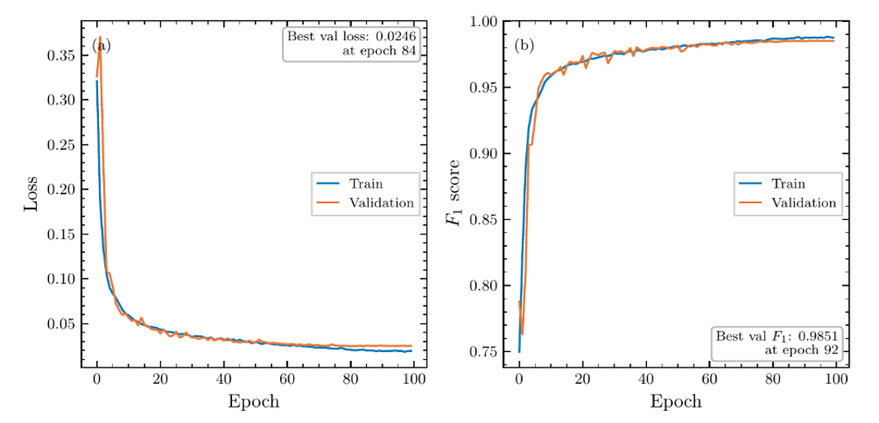
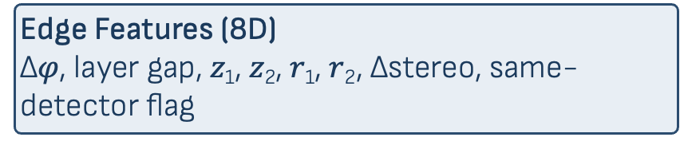
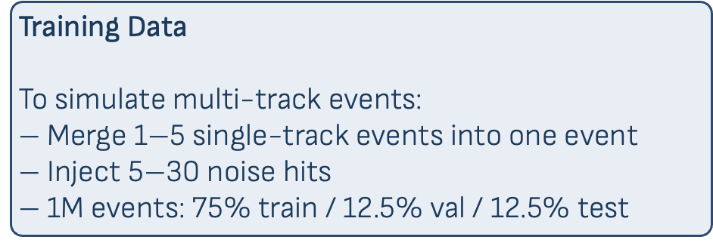
Graph Construction and Training
Introduction
Training and Testing
Elastic Data
Summary
4/13
Best validation F1 = 0.985 at epoch 92. Train and validation curves track closely: no overfitting.

Slide 6
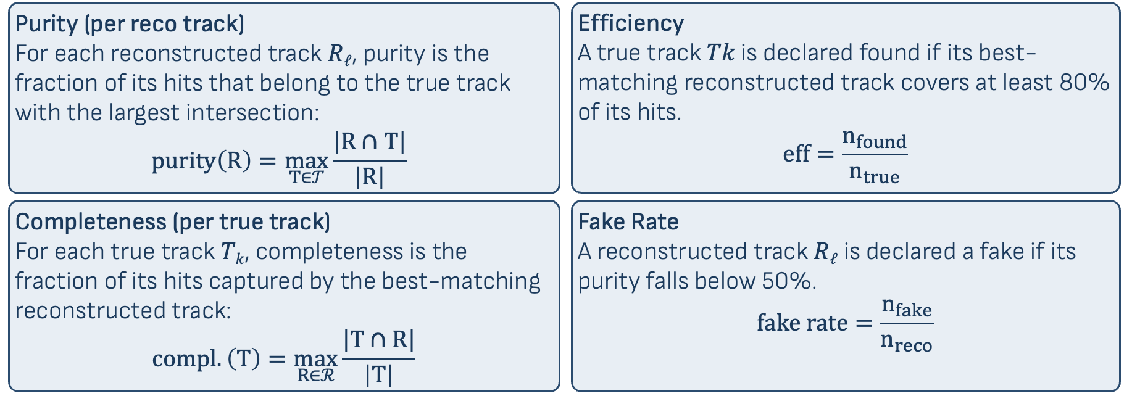
Track-Level Metric Definitions
Introduction
Training and Testing
Elastic Data
Summary
5/13
Let 𝒯 = {T₁, ..., T_{ntrue}} be true tracks (MC truth) and ℛ︀ = {R₁, ..., R_{nreco}} be reconstructed tracks (connected components from thresholded edge scores).
All metrics are defined in terms of hit-set overlaps |ℛ︀ ∩ 𝒯|.

Slide 7
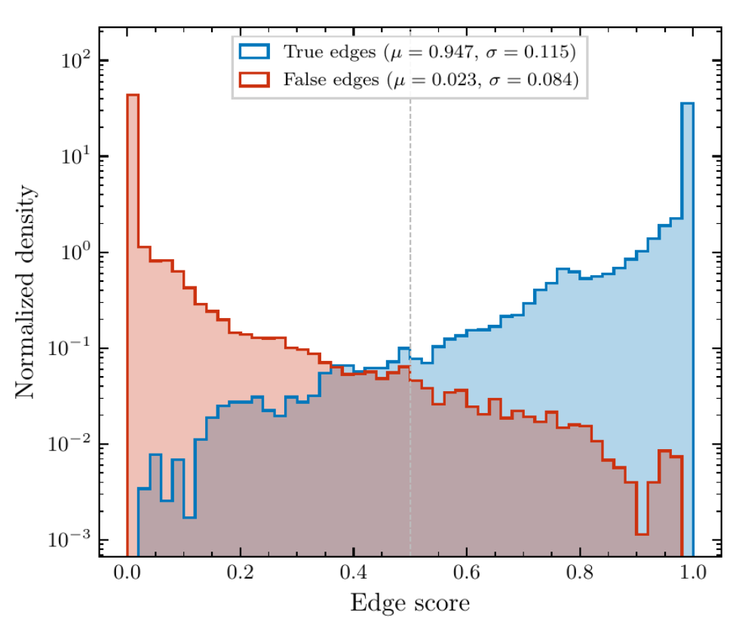
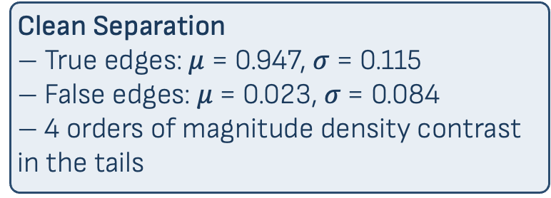
Edge Score Separation
Introduction
Training and Testing
Elastic Data
Summary
6/13
The small central overlap at scores 0.3–0.5 is where the classifier is genuinely uncertain: this is what drives the residual fake rate/contamination.

Slide 8
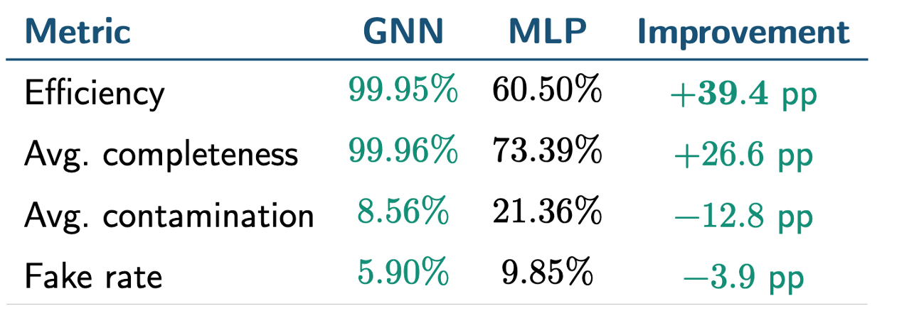
GNN vs MLP: Track-Level Performance
Introduction
Training and Testing
Elastic Data
Summary
7/13
N_{events} = 2823, N_{true} = 5704 true tracks.
GNN threshold = 0.1, MLP threshold = 0.2.
The GNN finds nearly every true track while producing fewer fake candidates than the MLP.

Slide 9
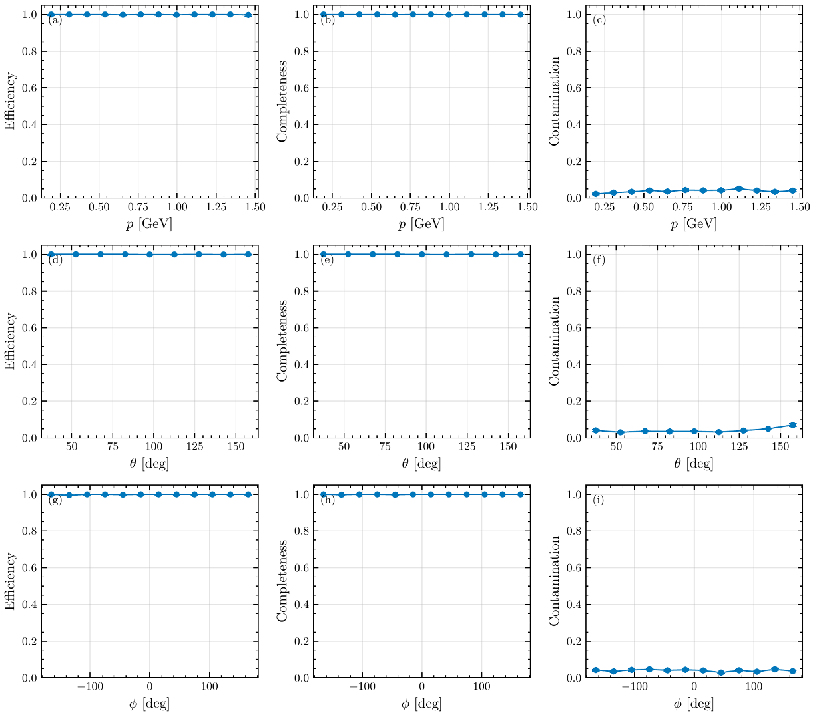
Kinematic Uniformity
Introduction
Training and Testing
Elastic Data
Summary
8/13
Efficiency, completeness, and contamination are flat across momentum 𝑝, polar angle 𝜃, and azimuth 𝜑

Slide 10
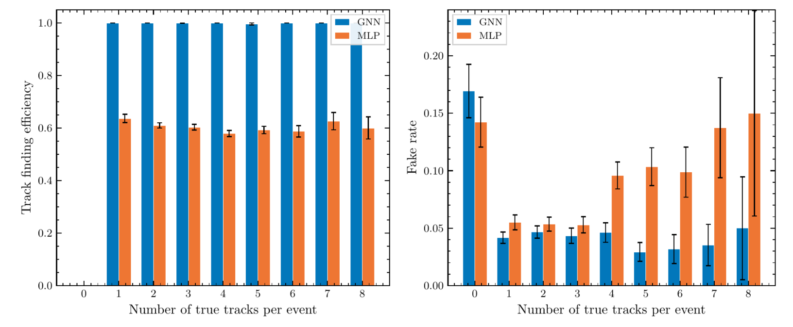
Robustness: Efficiency & Fake Rate vs Multiplicity
Introduction
Training and Testing
Elastic Data
Summary
9/13
GNN: flat at 100% efficiency from 1 to 8 tracks/event. MLP: stuck at ∼ 60% regardless.
GNN fake rate stays 3–5% while MLP climbs to 10–15% at high multiplicity.

Slide 11
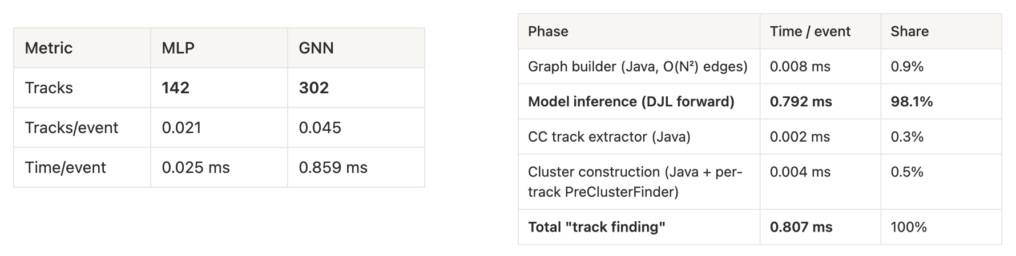
GNN vs MLP: Inference speed
Introduction
Training and Testing
Elastic Data
Summary
10/13
Compare the inference speed of GNN vs MLP in COATJAVA:
MLP is faster on small event, but GNN is still fast.
A full event take around ~500ms so GNN is 0.16%
Most of the time for the GNN is the model inference. I try smaller models but the efficiency on simulation was lower.

Slide 12
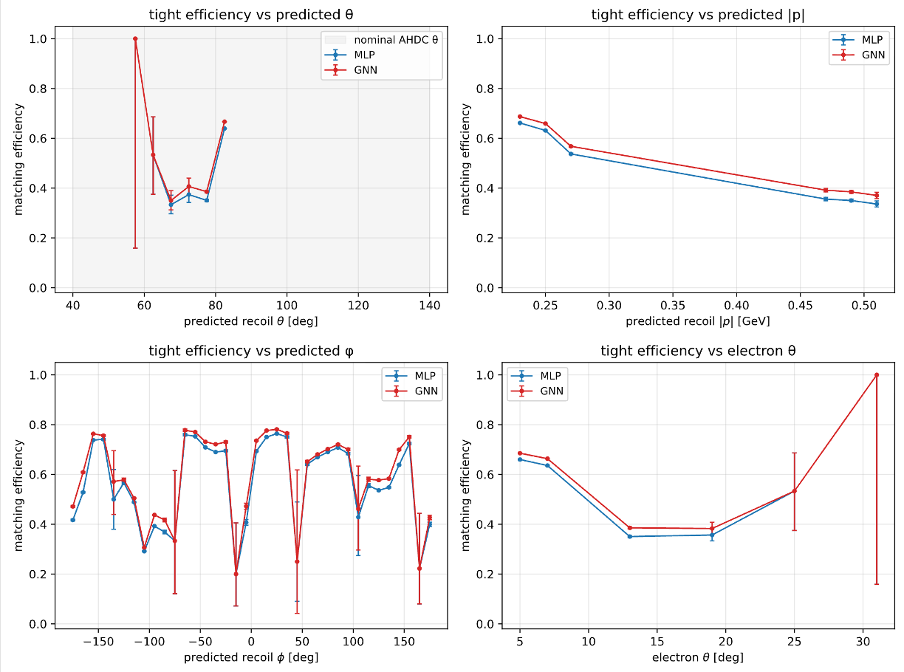
GNN vs MLP: Performance on elastic data
Introduction
Training and Testing
Elastic Data
Summary
11/13
Elastic scattering on deuterium, use polar angle of the electron to compute it momentum and the expected kinematics of the recoil.
Look at the kinematics of the track found by MLP and GNN:
- A track is match when both angular residuals are inside the matching windows
- GNN found more tracks that pass the Helix fitter than MLP
- With no specific phase space

Slide 13
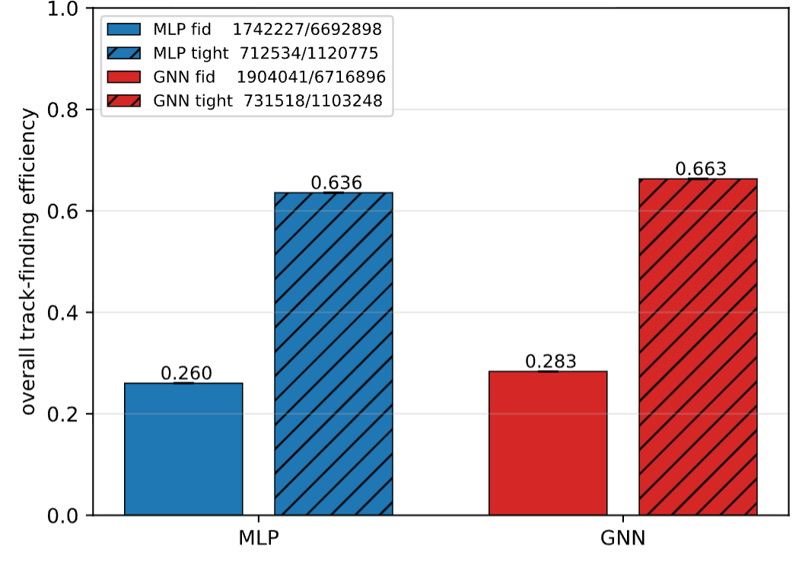
GNN vs MLP: Performance on elastic data
Introduction
Training and Testing
Elastic Data
Summary
12/13
GNN found a bit more tracks than MLP:
Mostly because elastic tracks are easy to find and are in a environment with low background
GNN will give better result in more noisy environment like 10.6 GeV runs

Slide 14
Summary and Outlook
Introduction
Training and Testing
Elastic Data
Summary
13/13
Test and implement a GNN for track finding in the ALERT detector:
Train in PyTorch a GNN using simulation
Hyperparameter optimization (Optuna)
Test it on both data and simulation, and compare it to previous method (MLP)
GNN find 99.9% of the tracks in simulation
GNN find 66% of the elastic tracks in data
GNN is slower than MLP, but it is not significantly (0.16% of a standard reconstruction time)
Have been implemented in COATJAVA with a yaml key to use it

