Slide 1


RG-D Experiments: Status and Analysis Plans
Mathieu Ouillon (Mississippi State University)

Slide 2
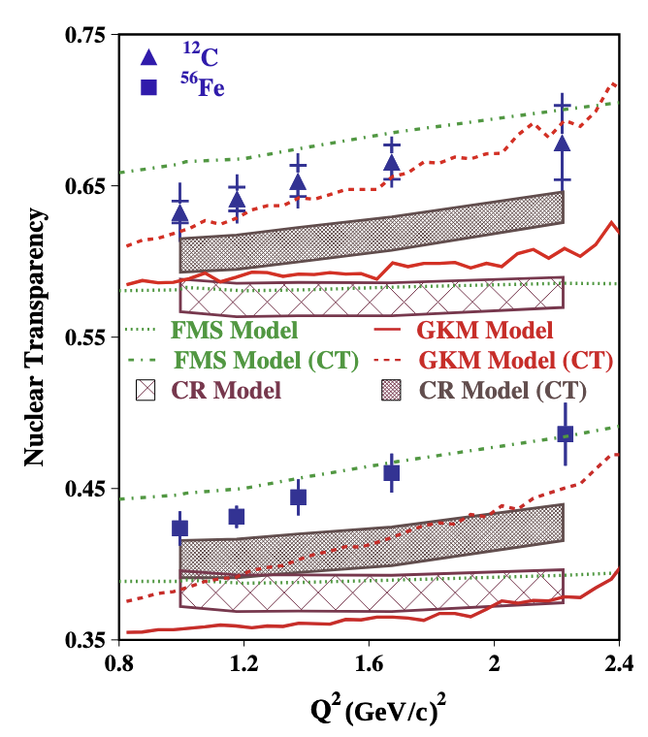
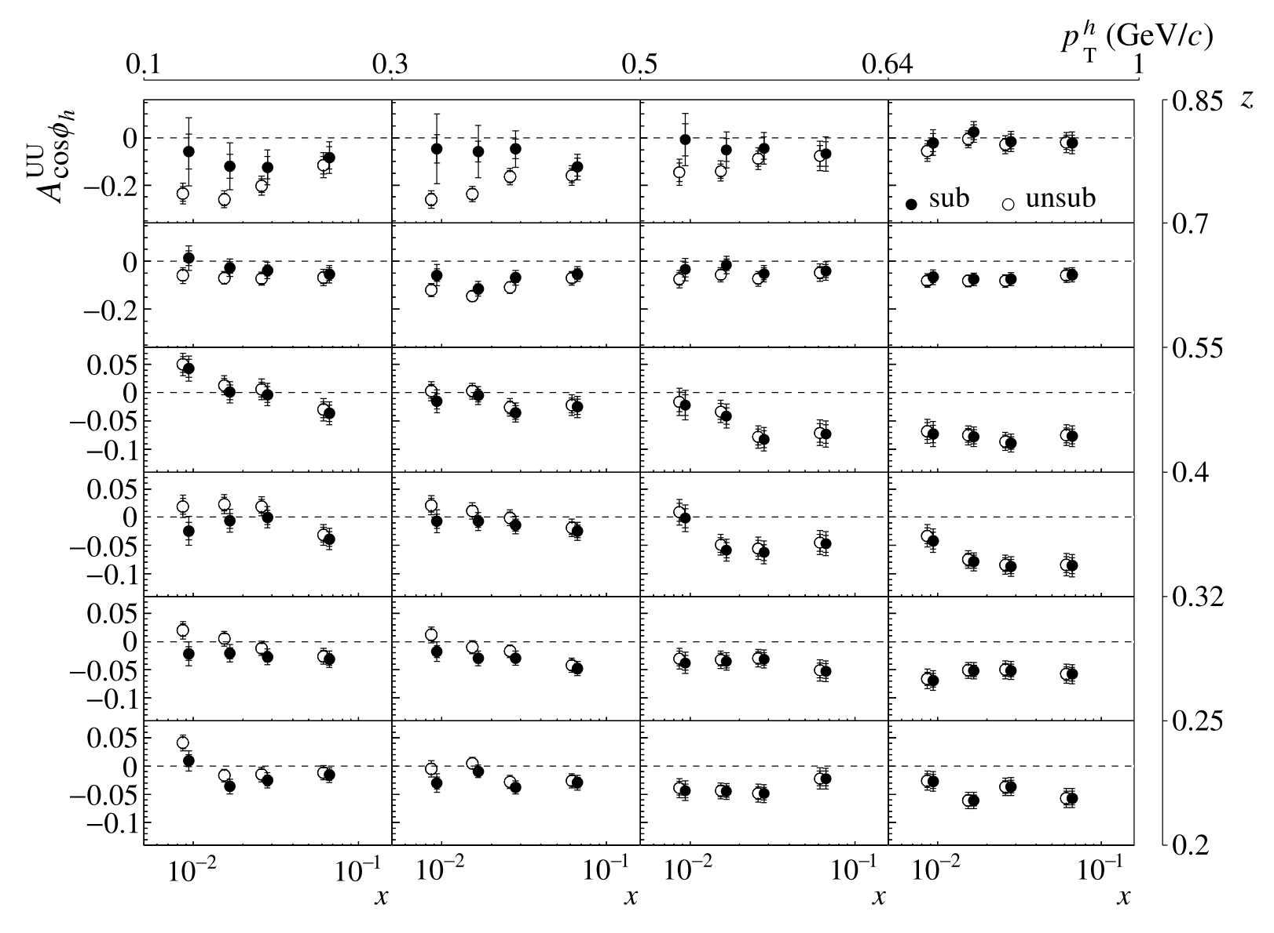
Run Group D
Introduction
Vertex Study
Analysis
Summary
1/23
¹: Argonne National Lab, ²: IJCLAB, Orsay, France
³: Mississippi State U., ⁴: University of New-Hampshire, ⁵: Florida International University
Run Group D is composed of two experiments:
Color Transparency (CT)
in Exclusive Vector Meson Electro-production off Nuclei E12-06-106
Spokespersons: W. Armstrong¹, L. El Fassi³,
K. Hafidi¹, M. Holtrop⁴, B. Mustapha¹
Nuclear TMDs (nTMDs)
in CLAS12 E12-06-106A
Spokespersons: R. Dupré², L. El Fassi³,
Z.-E. Meziani¹, H. Szumila-Vance⁵
The COMPASS Collaboration
arxiv.org:1912.10322
L. El Fassi, Physics 4, no. 3 (2022)

Slide 3
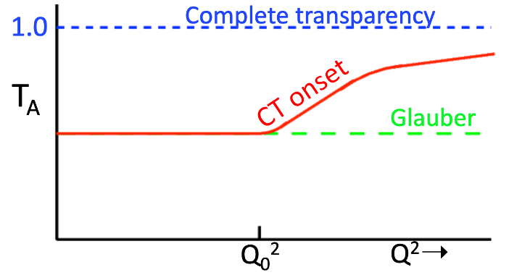
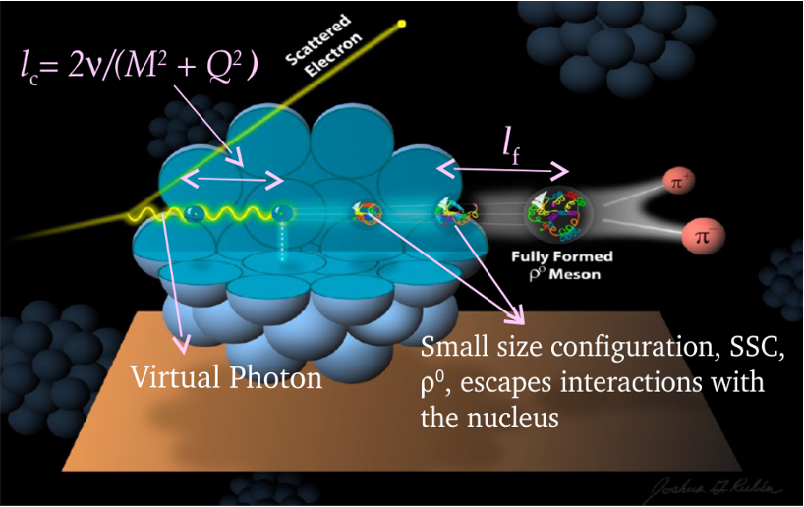
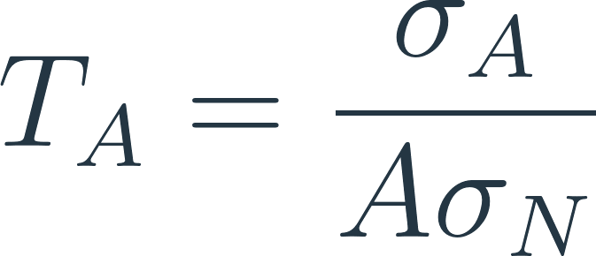
RG-D: CT Experiment
Introduction
Vertex Study
Analysis
Summary
2/23
E12-06-106: Color Transparency: suppression of interactions of colorless small size configuration in nuclear medium
Experimental signature: rise of the nuclear transparency, T_{A} as a function of Q²: ​
T_{A}: ratio of the cross section per nucleon on a bound nucleon to that on a free nucleon
σ_{A} − nuclei cross section
σ_{N} − free nucleon cross section
Objective: understanding the dynamical evolution from small-size configurations into ordinary hadrons, and validating the QCD factorization theorem
Coherence length, l_{c}: the lifetime of the qq-bar pair
Formation time, l_{f}: the time evolution of SSC to an on-shell ρ⁰ meson​​

Slide 4
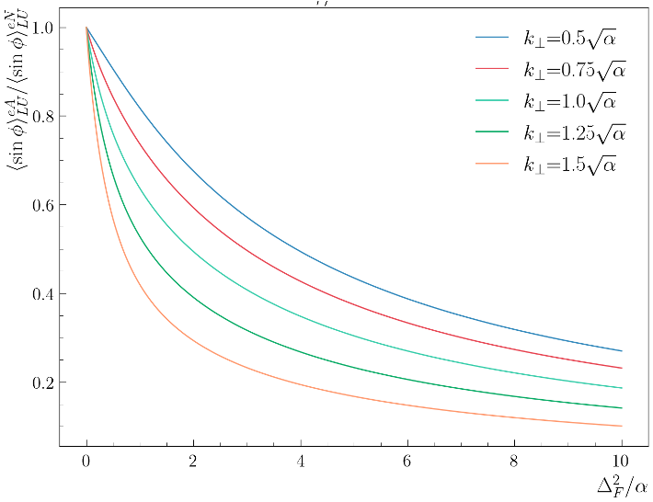
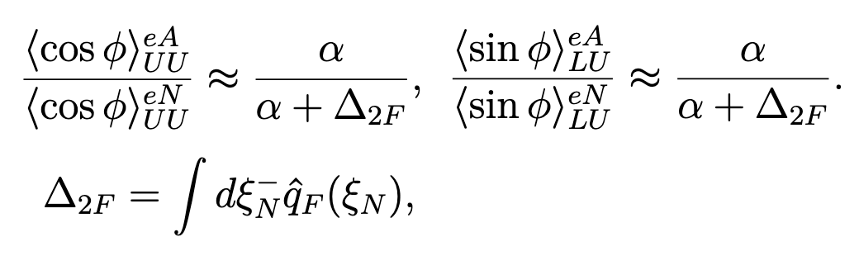
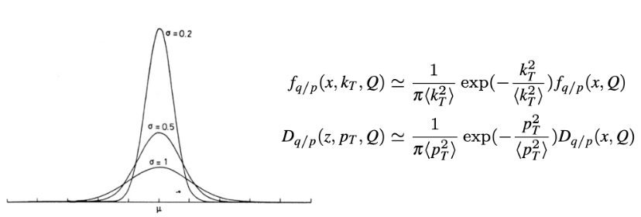
RG-D: Nuclear TMDs
Introduction
Vertex Study
Analysis
Summary
3/23
Song, Y. et al. (2014) Physical Review D, 89 014005.
E12-06-106A: nTMDs study uses the same CT running conditions except the beam polarization, and aims to study​:
Nuclear effect on SIDIS asymmetries
Transport coefficient of the nuclear matter
For that, measure different observables:
cos φ, sin φ, cos(2φ)¹ moments for different hadrons (π⁺,π⁻, and π⁰):
q_{F}(ξ_{N}): the quark transport parameter
¹ No predictions exist for this observable
The heavier the nucleus, the wider the TMD gaussian width (Nuclear Broadening)

Slide 5
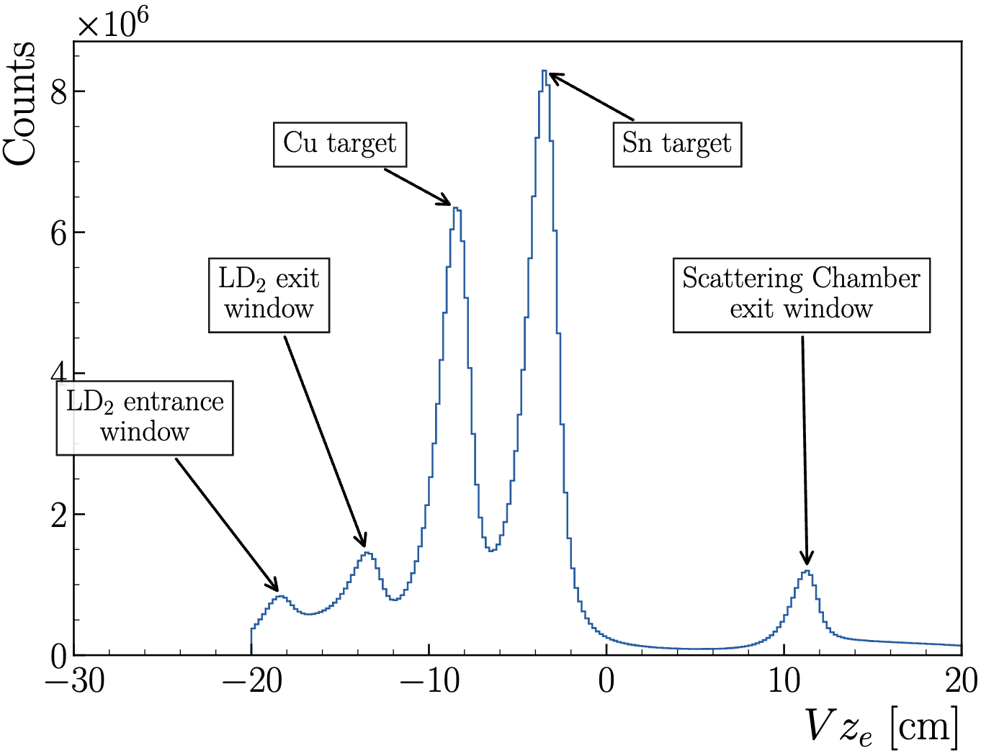
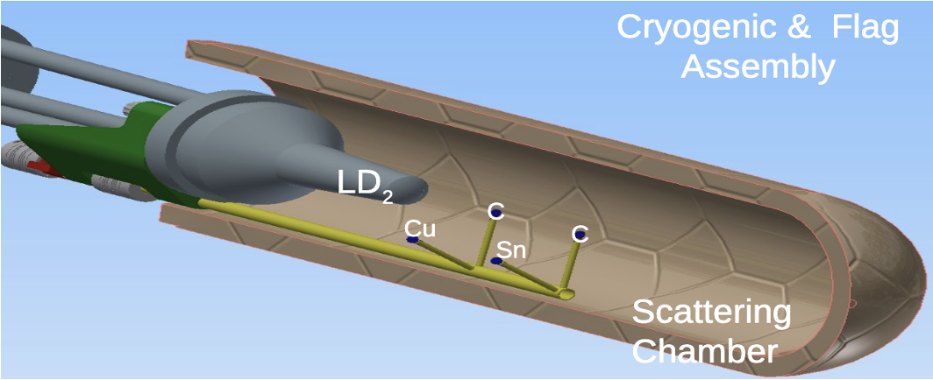
RG-D: Run Configuration
Introduction
Vertex Study
Analysis
Summary
4/23
RG-D experiments collected data in the fall of 2023 with
10.54 GeV polarized beam energy and 𝐼=5–175 nA for luminosity scans and production
Standard CLAS12 configuration with FT-OFF and three layers of FMT
Three target configurations, LD2, CxC, and CuSn, deployed with InBending and OutBending
New cryogenic LD2 and the nuclear-foil flag assembly centered at -5 cm for each configuration
Main run hiccups:
Faraday Cup vacuum contamination
Moller cone sagging

Slide 6
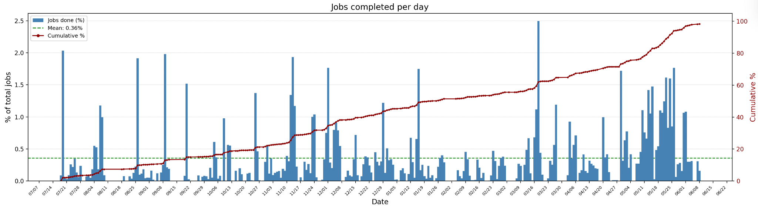
RG-D Status: Cooking Summary
Introduction
Vertex Study
Analysis
Summary
5/23
RG-D successfully passed Pass1 review on May 27th 2025
Pass1 cooking initiated on June 13th 2025 using COATJAVA 13.0.0
The cooking finished beginning of April:
Took 11M CPU-hours, for a total of 177,259 jobs
Thanks to CalCom Experts for their support for calibration and cooking

Slide 7
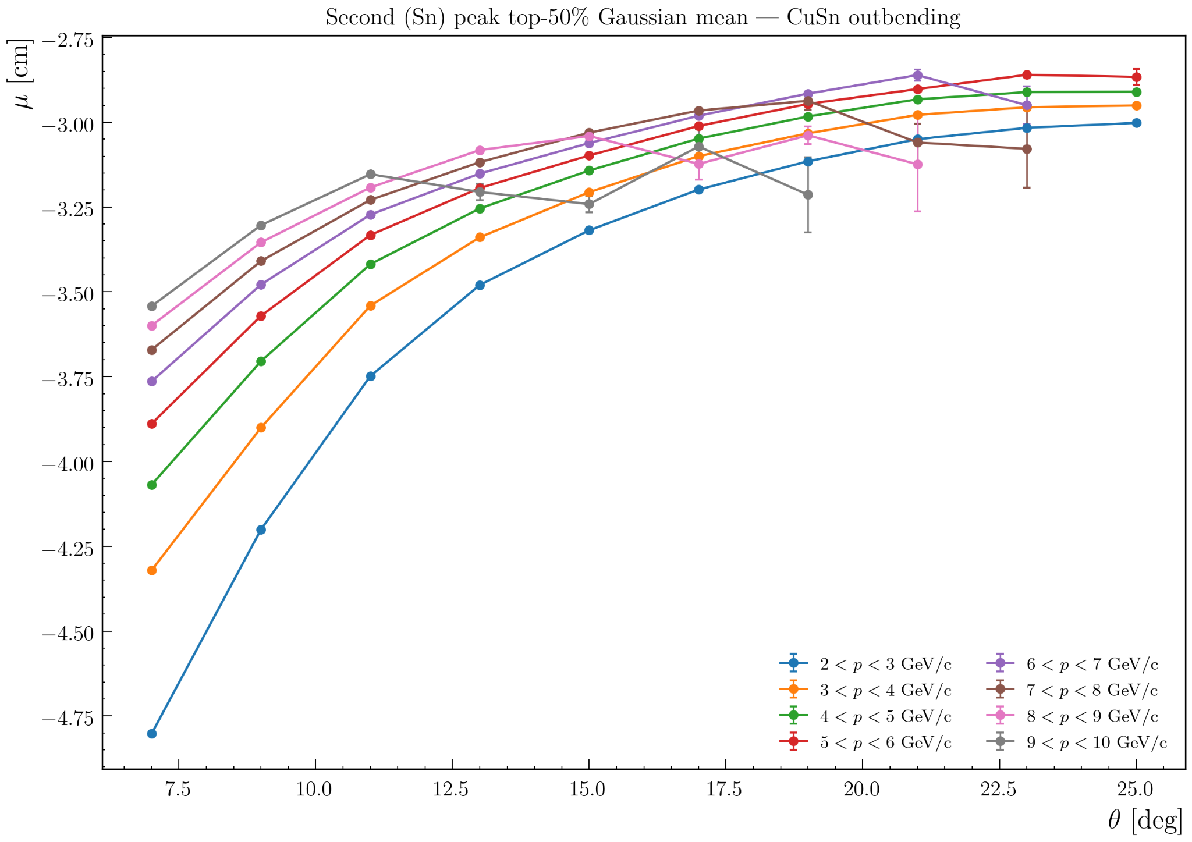
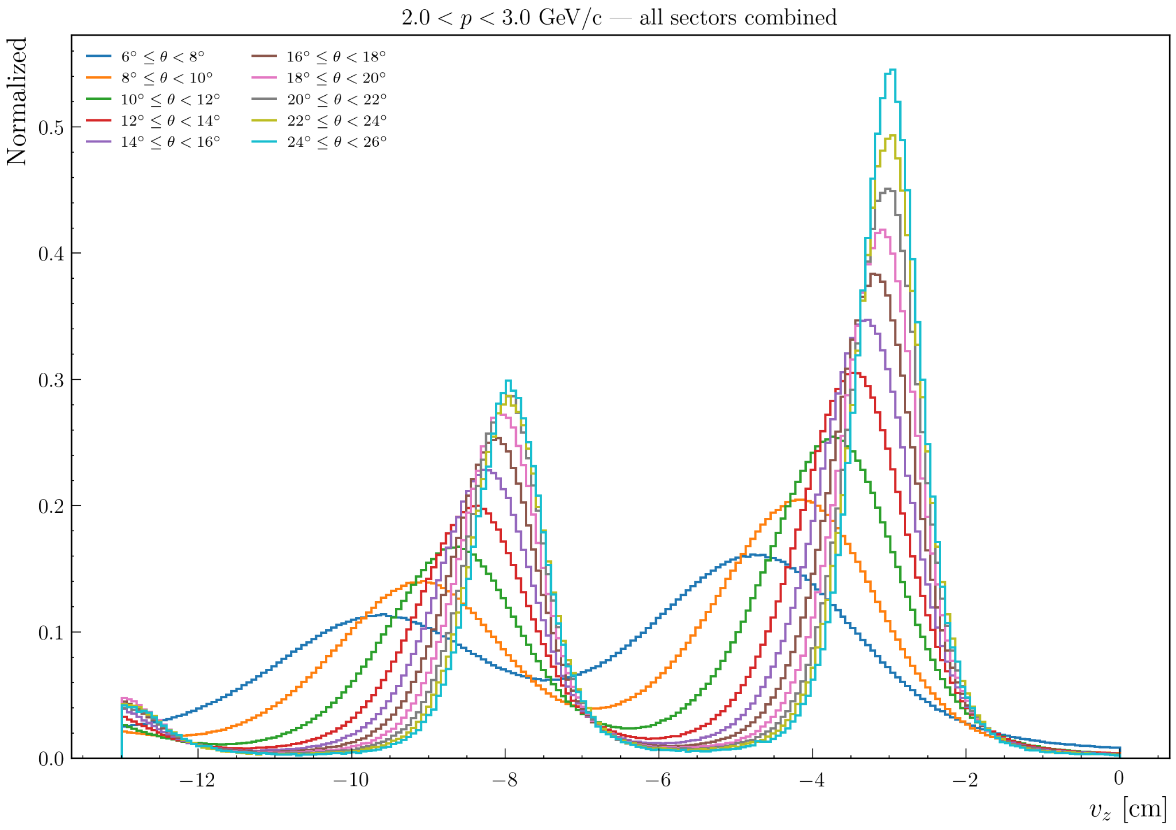
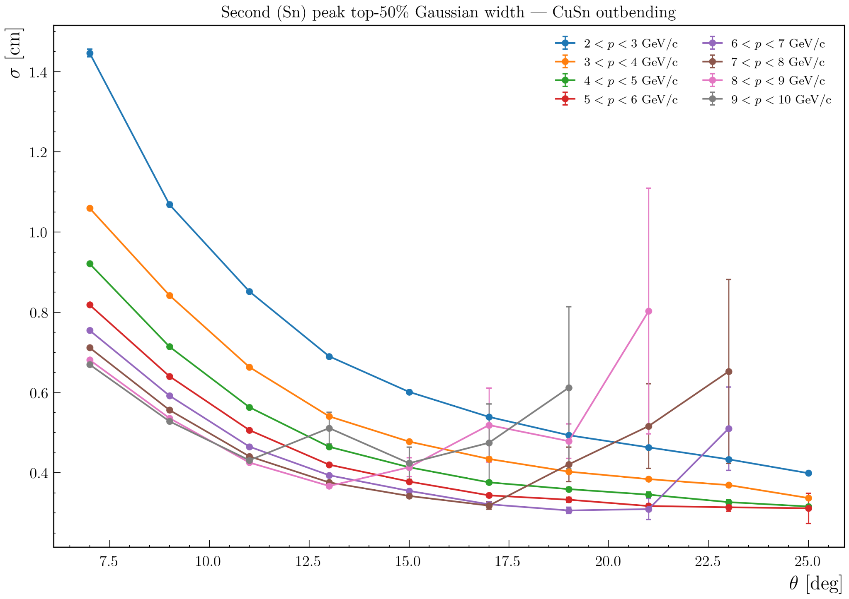
Electron Vertex Study
Introduction
Vertex Study
Analysis
Summary
6/23
With double foil targets: found that the electron Z vertex is shifted and wider as function of momentum, θ, φ, and sector.

Slide 8
Electron Vertex Study
Introduction
Vertex Study
Analysis
Summary
7/23
Found that the electron V_{z} peaks are shifted and broadened, and the effect depends on p, θ, φ, and sector.
Goal: derive a correction so that a single pair of V_{z} cut values works across all kinematics.
Binning: 6 sectors, p ⇒ 16 bins ∈ [2, 10] GeV/c, θ ⇒ 24 bins ∈ [6, 30]°, local-φ ⇒ 6 bins ⇒ 13,824 (s, p, θ, φ) bins
The distribution is stable across bins when θ > 15° and p > 5 GeV/C → reference region
Fit the distribution with a double Gaussian and extract μ₀ and σ₀
Tin: μ₀ = -2.92 cm
σ₀ = 0.37 cm
Copper: μ₀ = -7.86 cm
σ₀ = 0.38 cm

Slide 9
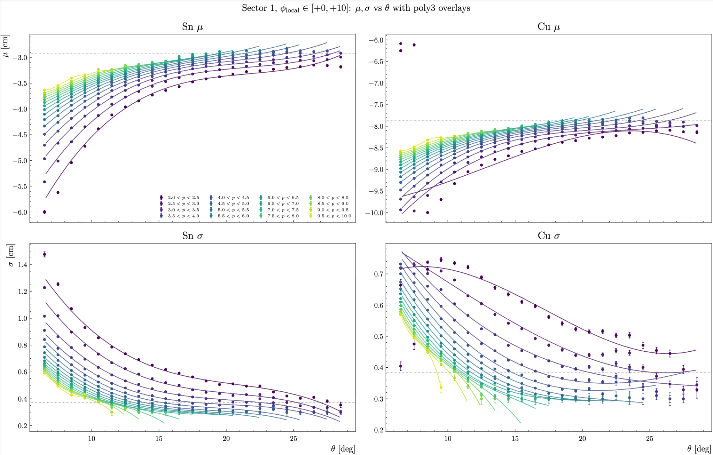
Electron Vertex Study
Introduction
Vertex Study
Analysis
Summary
8/23
For every (s, p, φ, θ) bin: Fit two peaks with Gaussians.
Give μ, σ with errors for both targets, per (sector, p, φ, θ).
Fit with third-order polynomial function the 24 θ-points of: μ_{Sn}(θ), σ_{Sn}(θ), μ_{Cu}(θ), σ_{Cu}(θ).

Slide 10
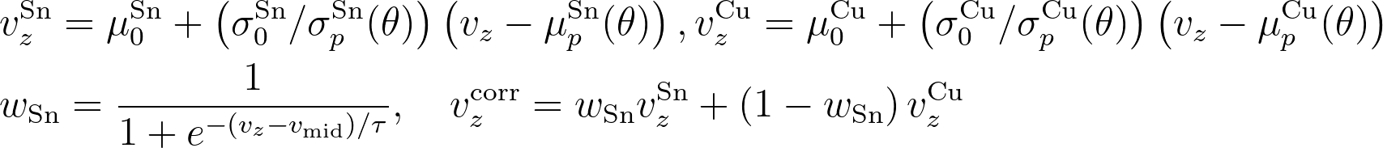
Electron Vertex Study
Introduction
Vertex Study
Analysis
Summary
9/23
The correction is:
Per-bin transform that shifts and rescales V_{z} to align each peak with the reference μ₀ and σ₀.
Each event shifts toward its nearest target; smooth handover.
μ_{p,} σ_{p} come from the third order polynomial function evaluated at the event’s (s, p, φ, θ)

Slide 11
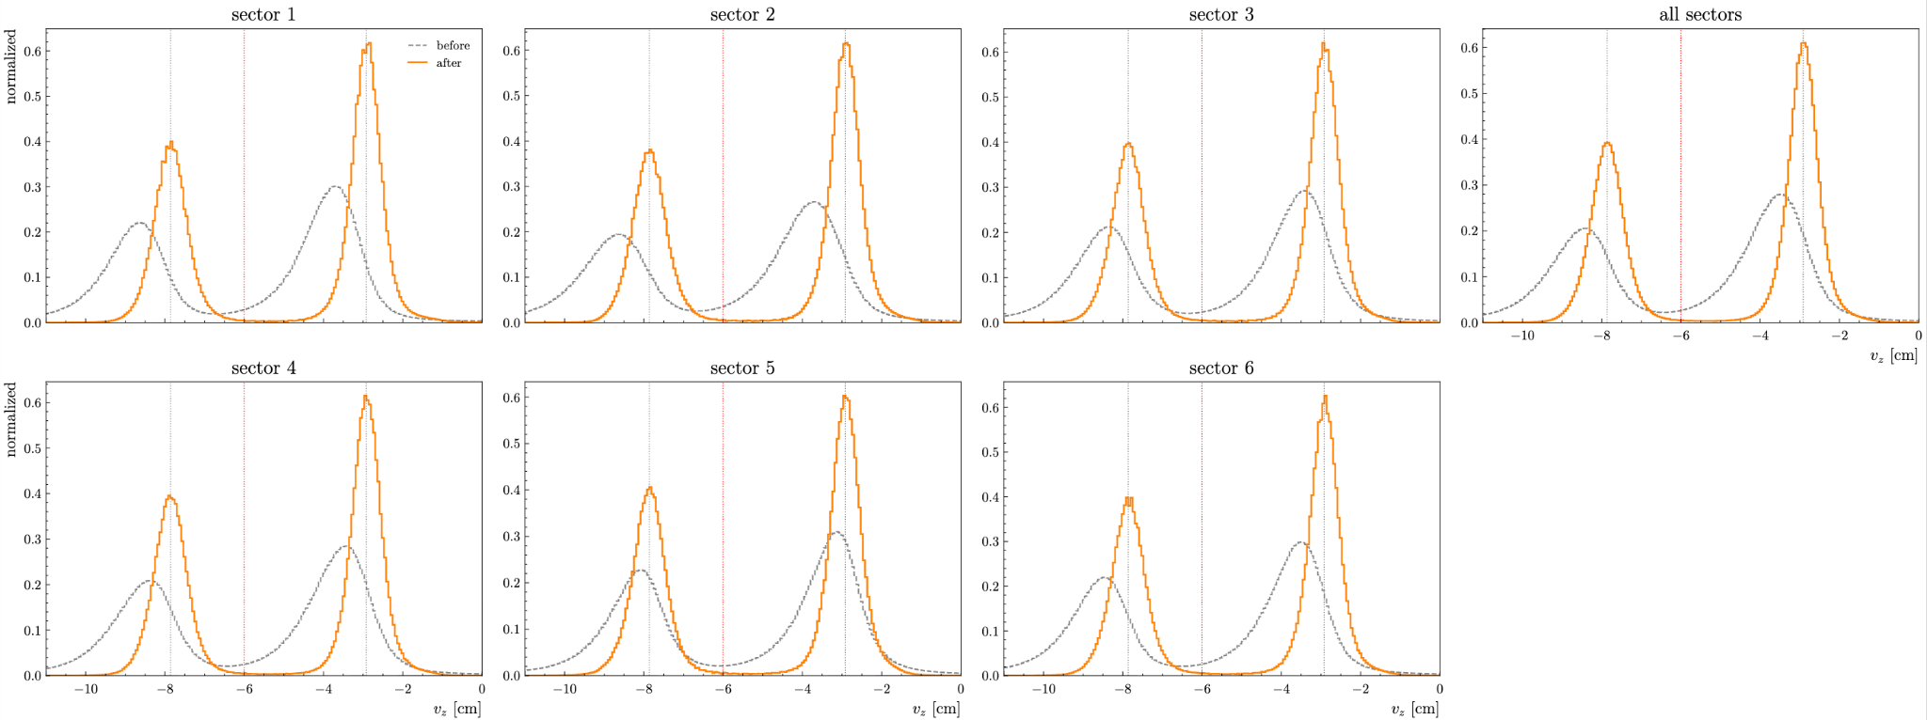
Electron Vertex Study
Introduction
Vertex Study
Analysis
Summary
10/23
Effect of the correction on outbending electron:

Slide 12
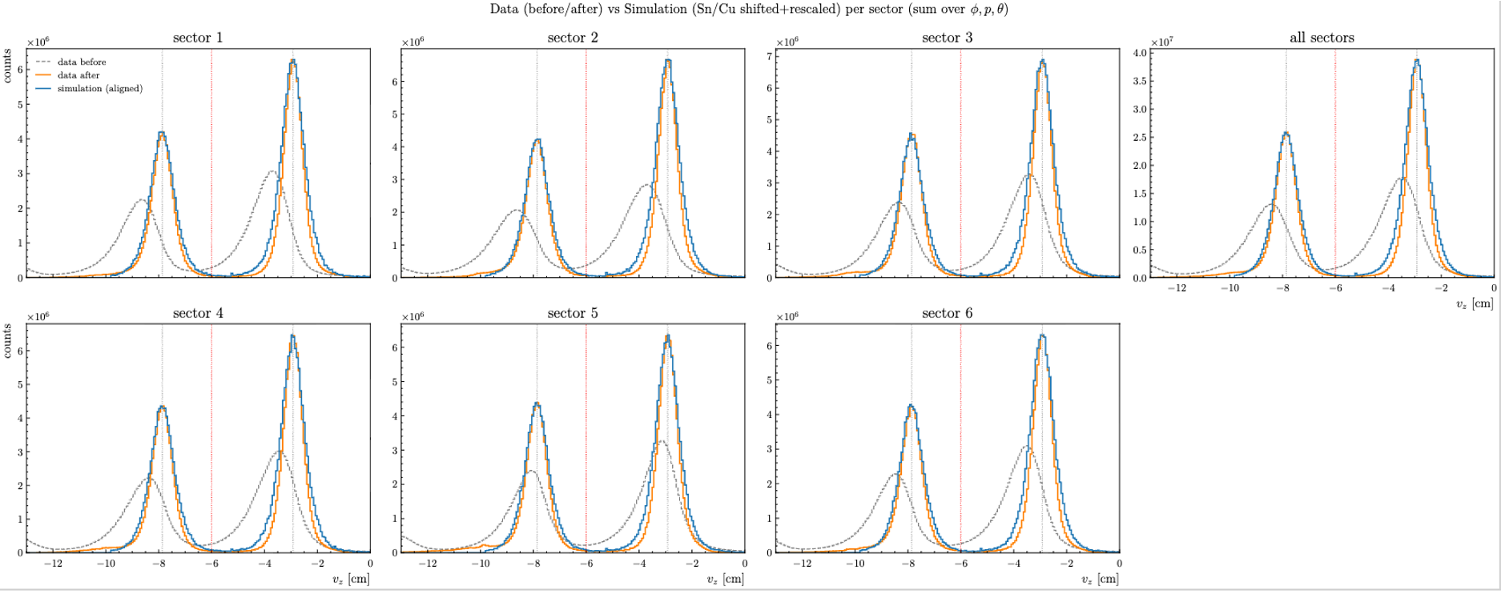
Electron Vertex Study
Introduction
Vertex Study
Analysis
Summary
11/23
Comparison of MC and data:

Slide 13
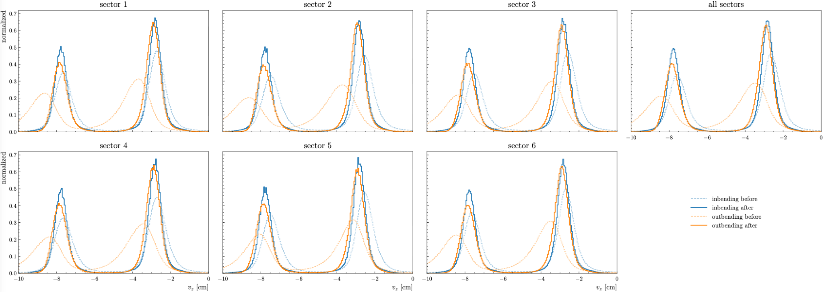
Electron Vertex Study
Introduction
Vertex Study
Analysis
Summary
12/23
Comparison of Inbending vs Outbending CuSn:

Slide 14
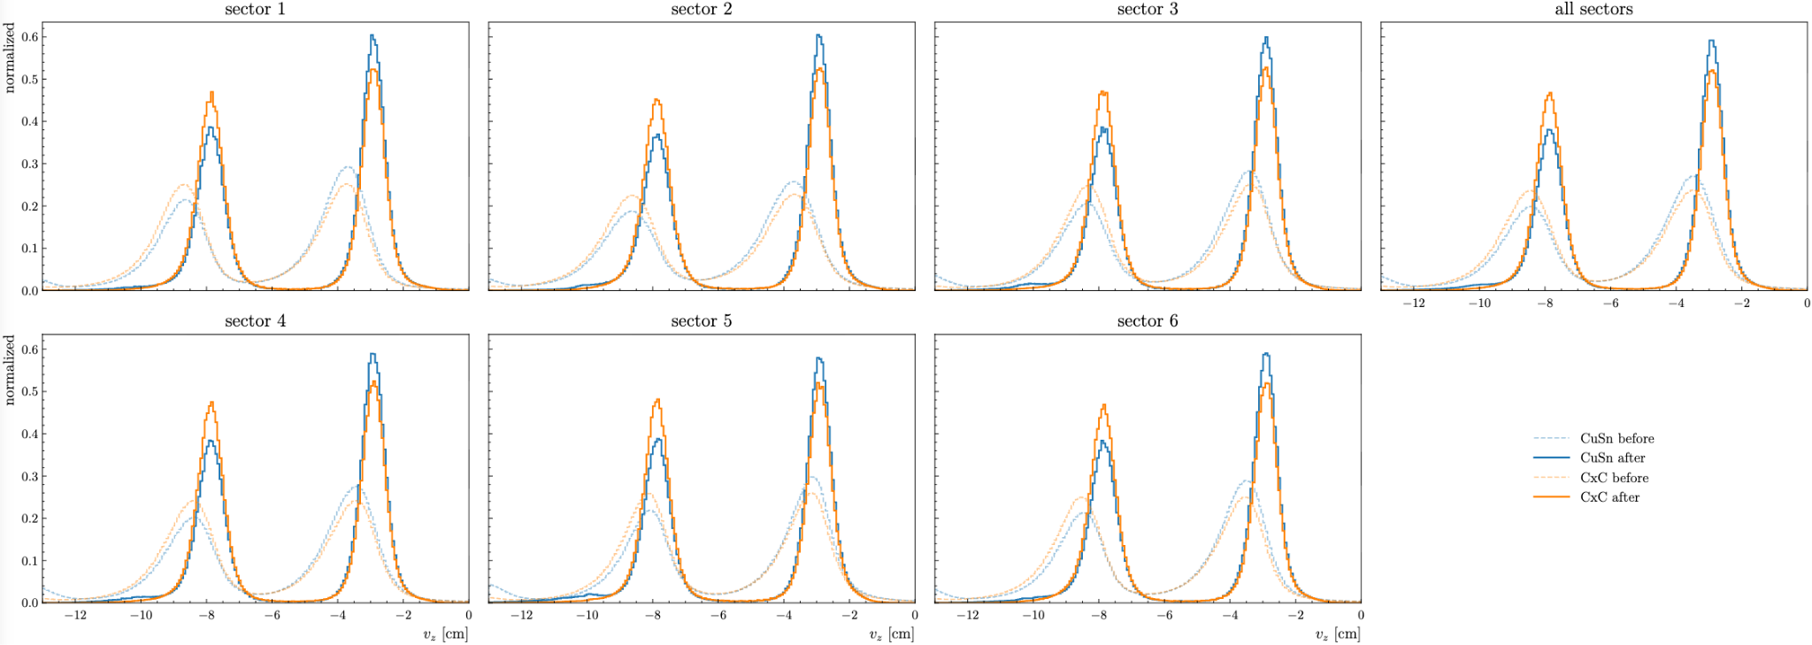
Electron Vertex Study
Introduction
Vertex Study
Analysis
Summary
13/23
Comparison of Carbon vs CuSn Outbending:

Slide 15
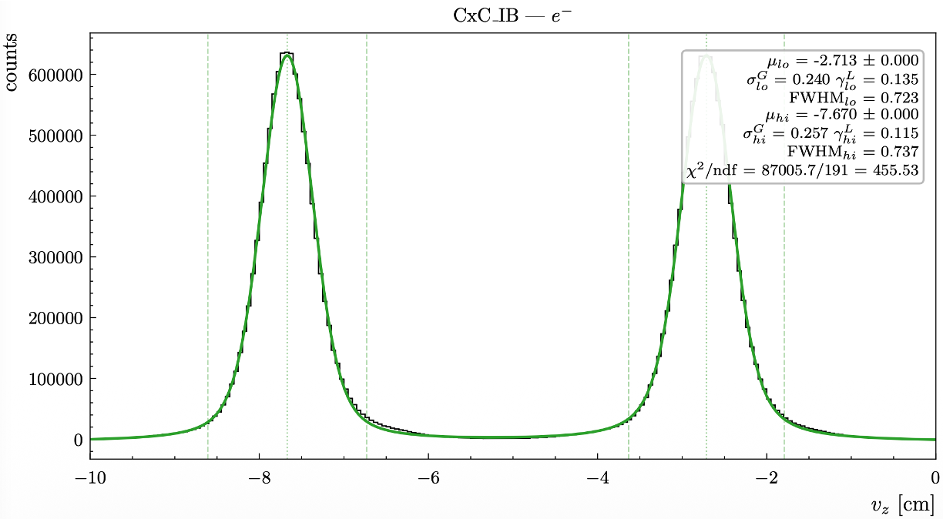
Electron Vertex Study
Introduction
Vertex Study
Analysis
Summary
14/23
After correction: fit the Vz distribution with simpler function (same for electron and pions):
Use 2 Voigt distributions as fit function

Slide 16
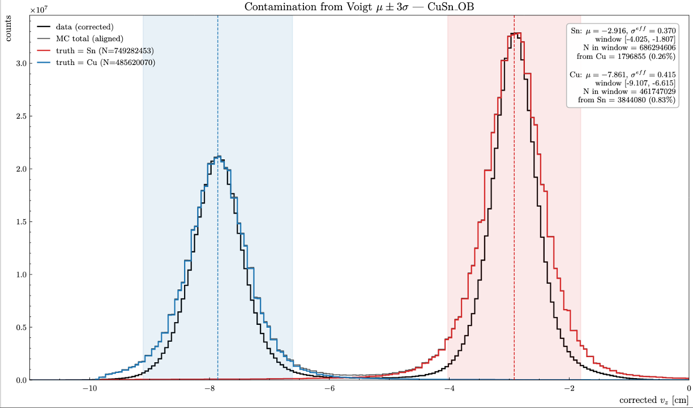
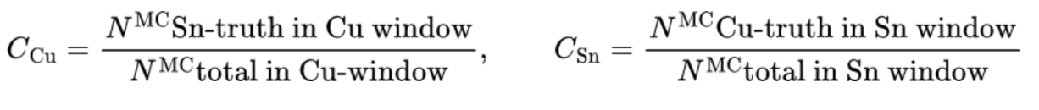
Electron Vertex Study
Introduction
Vertex Study
Analysis
Summary
15/23
We can use simulation to estimate the Cu contamination in the Sn target and Sn contamination in Cu target:
For each target peak we define a ±3σ window from its Voigt fit. Contamination is the fraction of counts in that window coming from the other target, estimated from truth-labelled MC integrated in the same window.

Slide 17
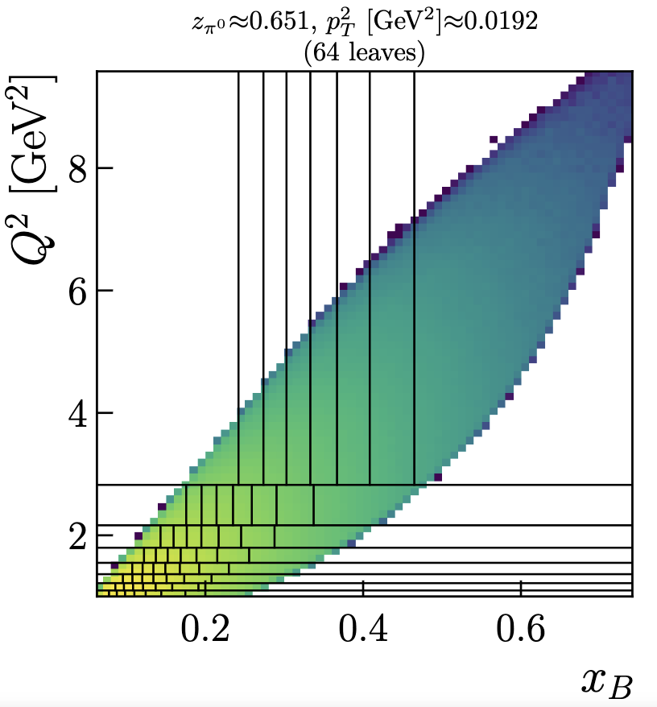
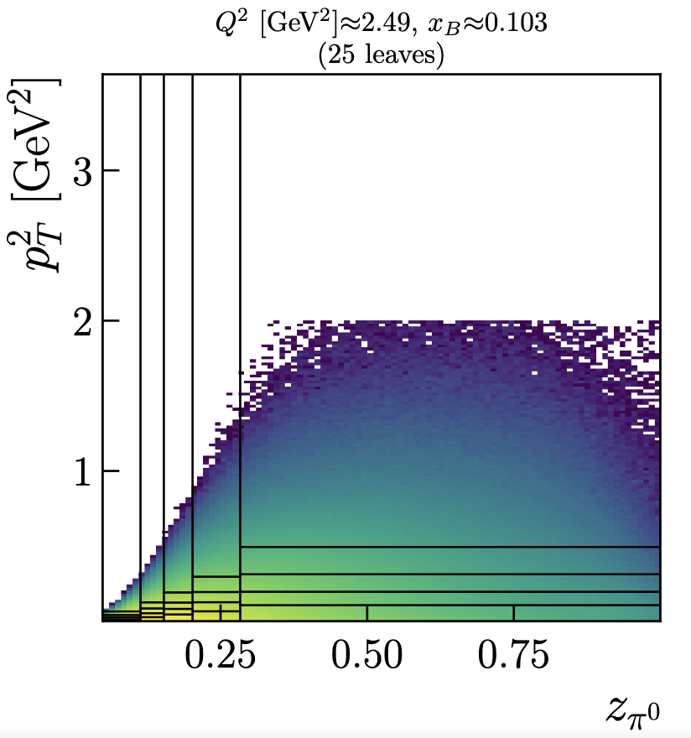
RG-D TMDs Studies: π⁰ analysis
Introduction
Vertex Study
Analysis
Summary
16/23
First look at the π⁰ channel to extract multiplicity ratios and azimuthal asymmetries:
Use 4D binning, with equal statistic (KD-Tree): 8 Q², 8 x_{B}, 5 z_{h} and 5 p_{T}² bins: 1600 bins
Different z_{h} and p_{T}² bins for each Q² and x_{B} bins

Slide 18

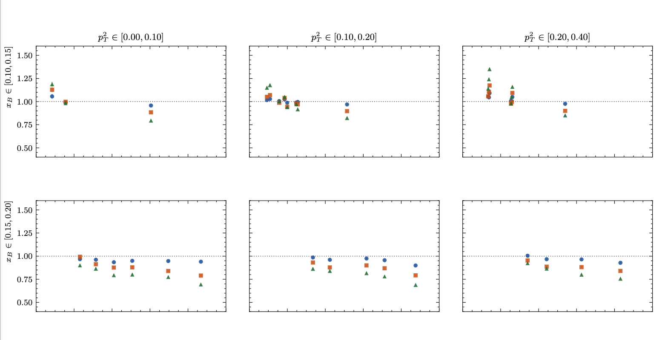
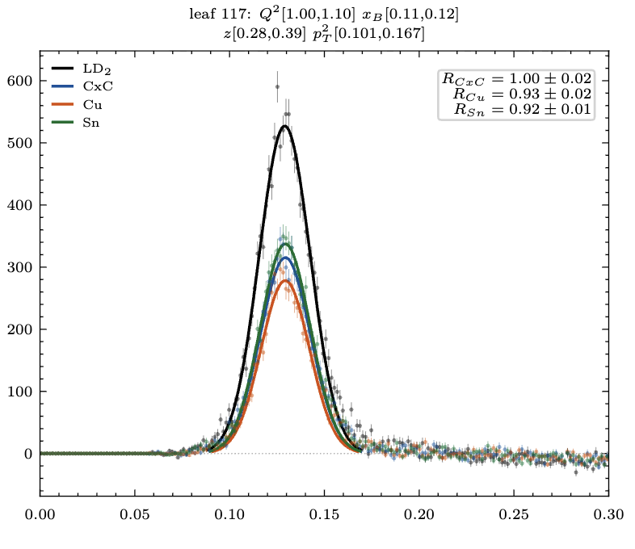
RG-D TMDs Studies: π⁰ analysis
Introduction
Vertex Study
Analysis
Summary
17/23
First look at the π⁰ channel to extract multiplicity ratios and azimuthal asymmetries:
Extract multiplicity ratio after the background subtraction using event mixing technique

Slide 19
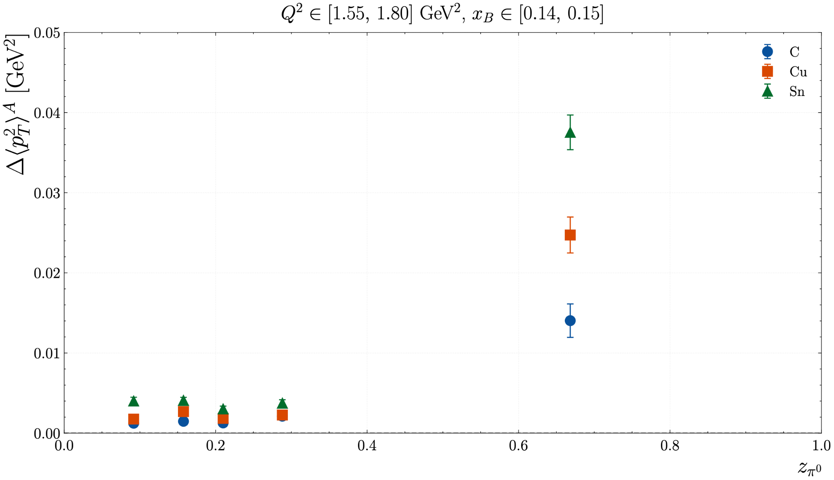
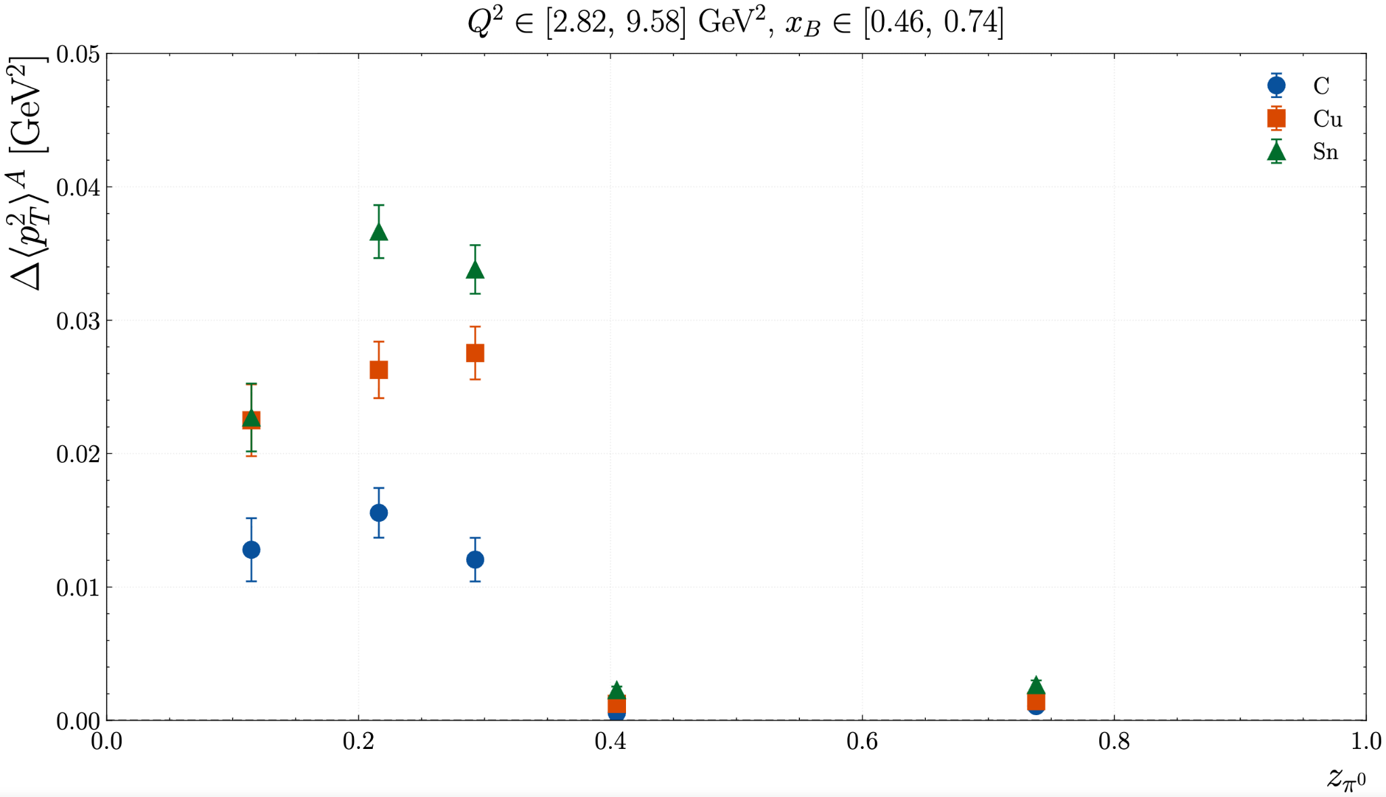
RG-D TMDs Studies: π⁰ analysis
Introduction
Vertex Study
Analysis
Summary
18/23
First look at the π⁰ channel to extract multiplicity ratios and azimuthal asymmetries:
Extract p_{T} broadening for 8 Q², 8 x_{B}, 5 z_{h}

Slide 20
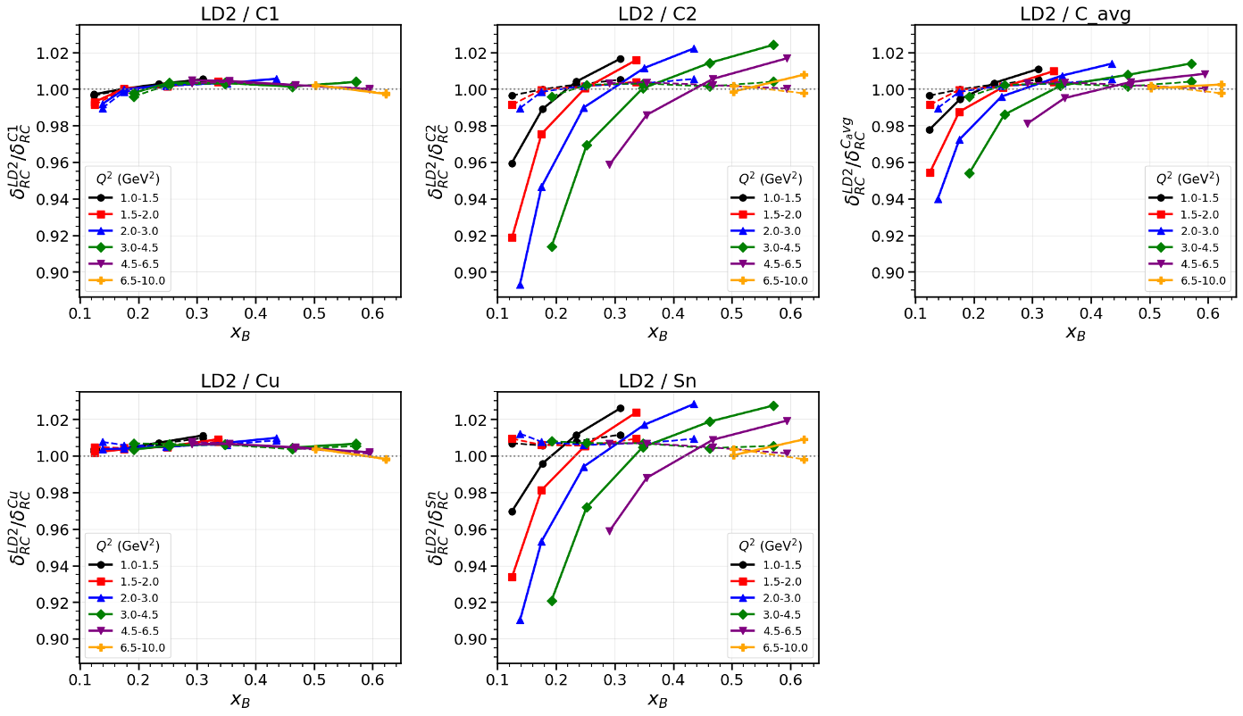
RG-D TMDs Studies: pions analysis
Introduction
Vertex Study
Analysis
Summary
19/23
Study multiplicity ratio, transverse momentum broadening and azimuthal moments for both negatively and positively charged pions:
Ratio of radiative-correction factors, 𝛿_{𝑅𝐶}^{𝐿𝐷2}/ 𝛿_{𝑅𝐶}^{𝐴}.
Dashed lines show internal-only corrections and solid lines show internal+external corrections.
Ongoing analysis by S. Shrestha

Slide 21
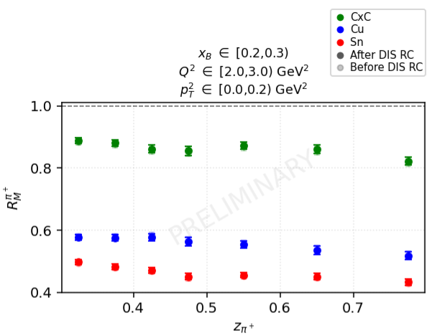
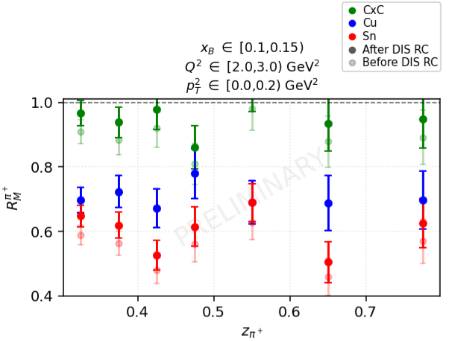
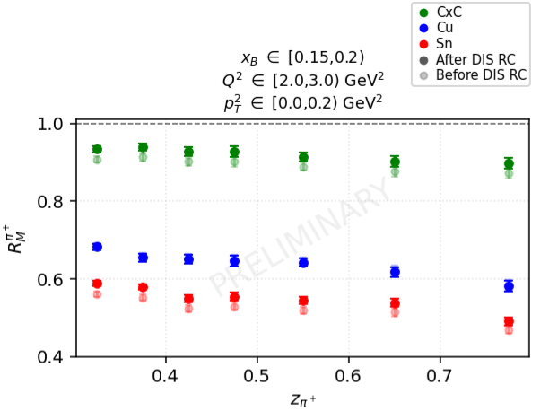
RG-D TMDs Studies: pions analysis
Introduction
Vertex Study
Analysis
Summary
20/23
Study multiplicity ratio, transverse momentum broadening and azimuthal moments for both negatively and positively charged pions:
𝜋⁺ multiplicity ratio 𝑅_{𝑀}^{𝜋+} ) versus 𝑧_{𝜋+} before and after applying the DIS radiative correction. Three x_{B} bins are shown at fixed Q² and p_{𝑇}².
Ongoing analysis by S. Shrestha

Slide 22
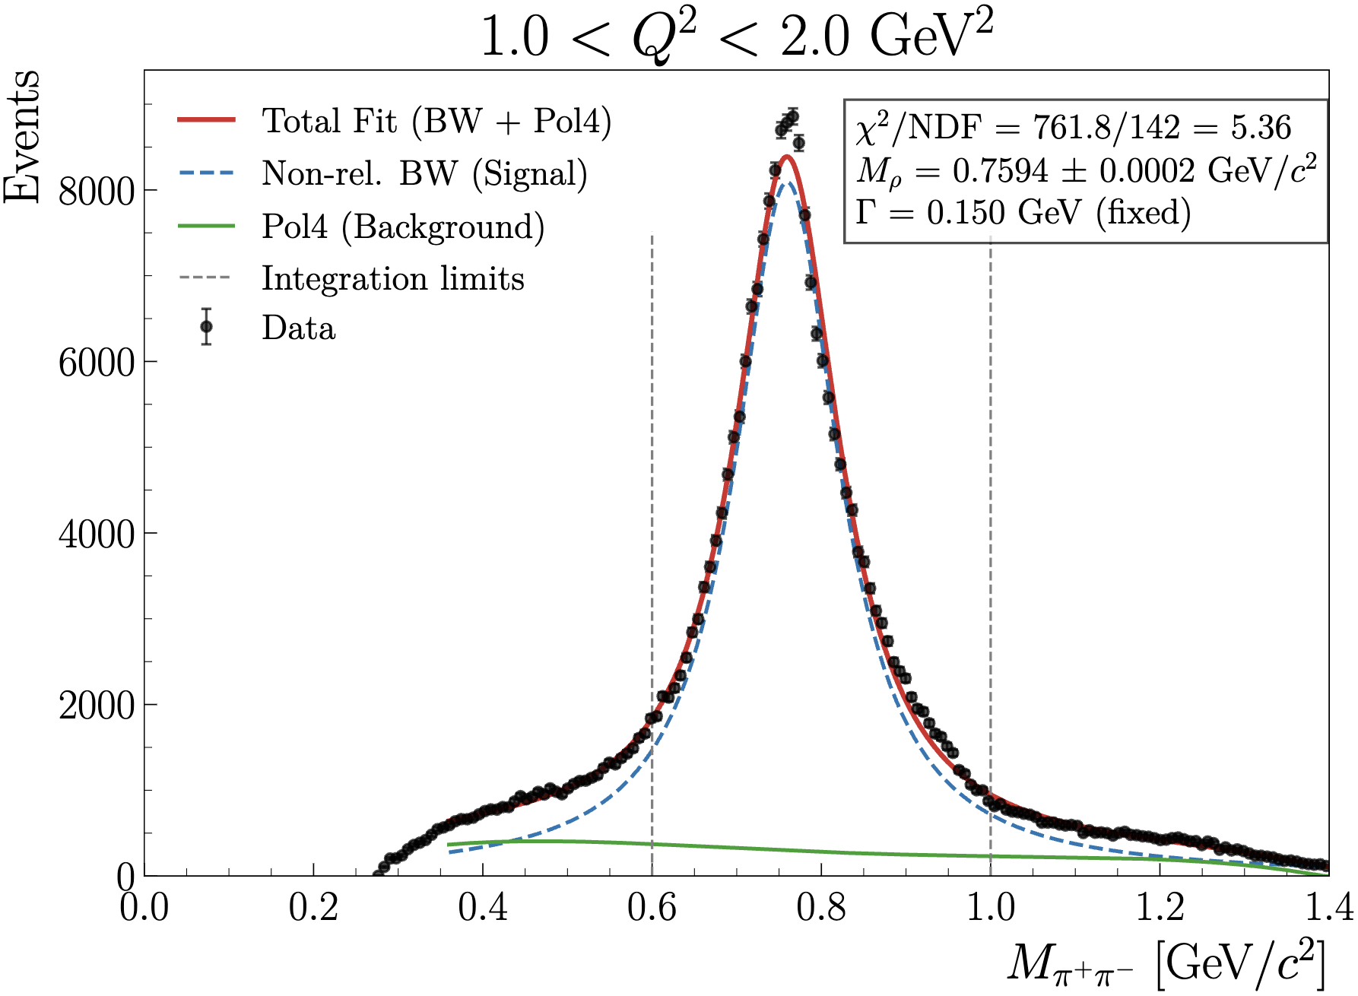
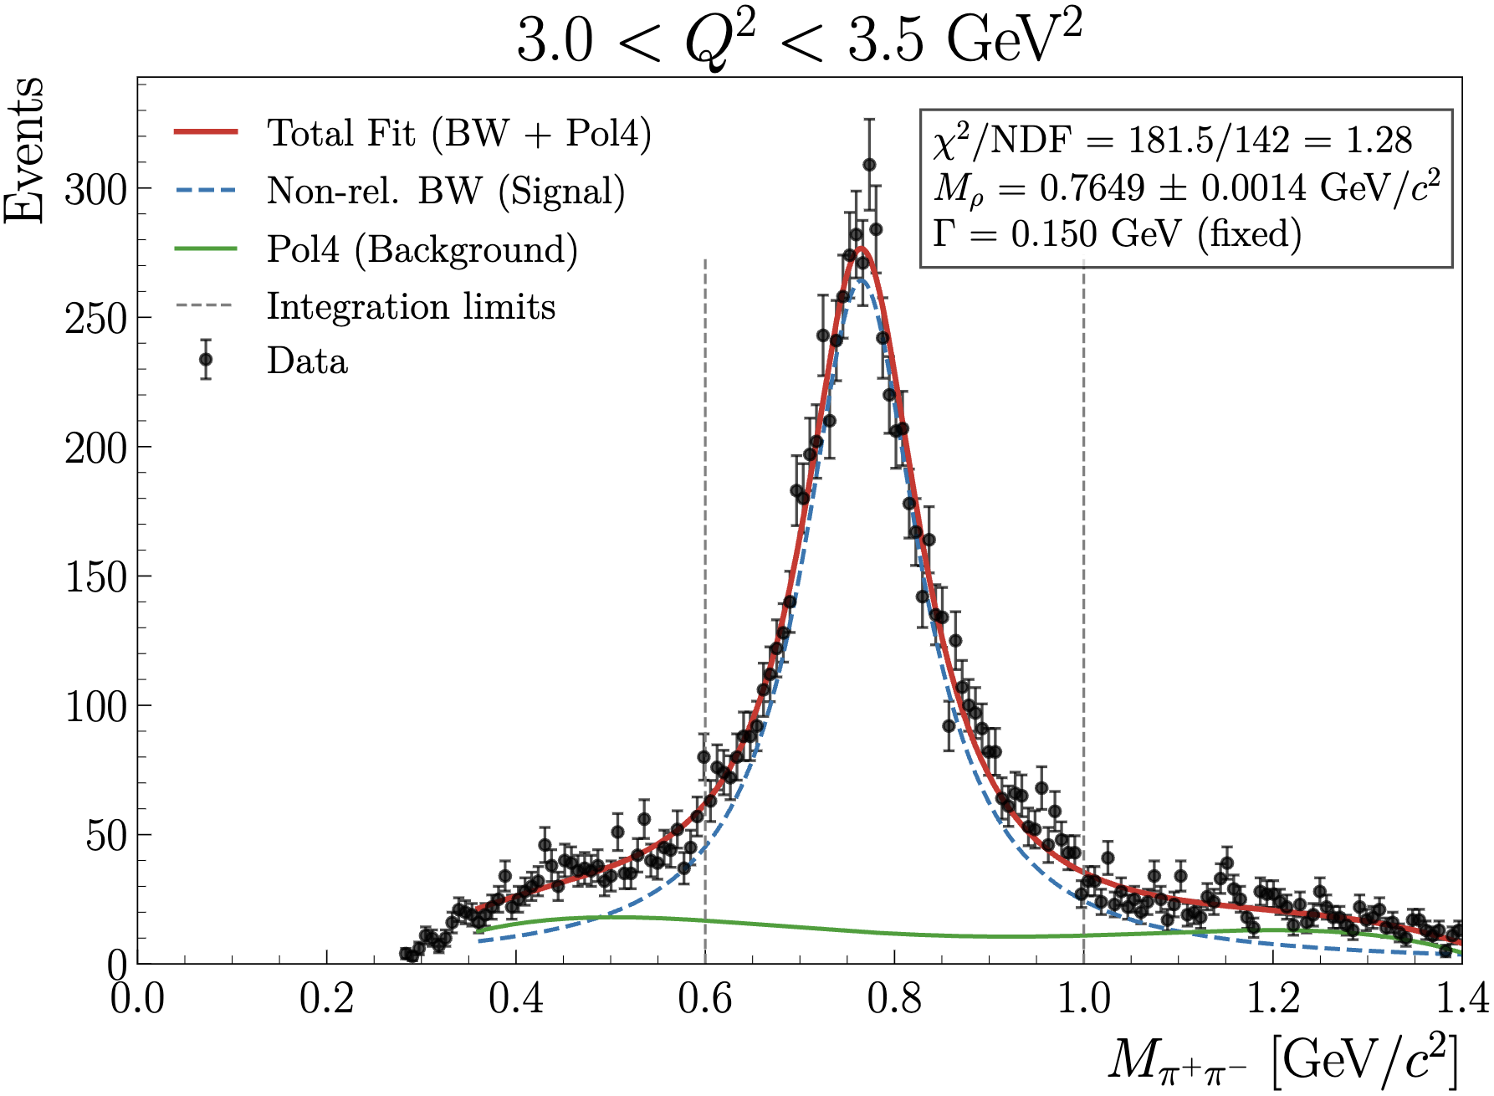
RG-D CT Study: Very Preliminary Nuclear Transparency
Introduction
Vertex Study
Analysis
Summary
21/23
Fit oppositely charged pions invariant mass with a Breit-Wigner and 3rd-order polynomial
Extract ρ⁰ yield by integrating the background-subtracted BW within a 3σ range using 10% of the Pass1 reconstruction data

Slide 23
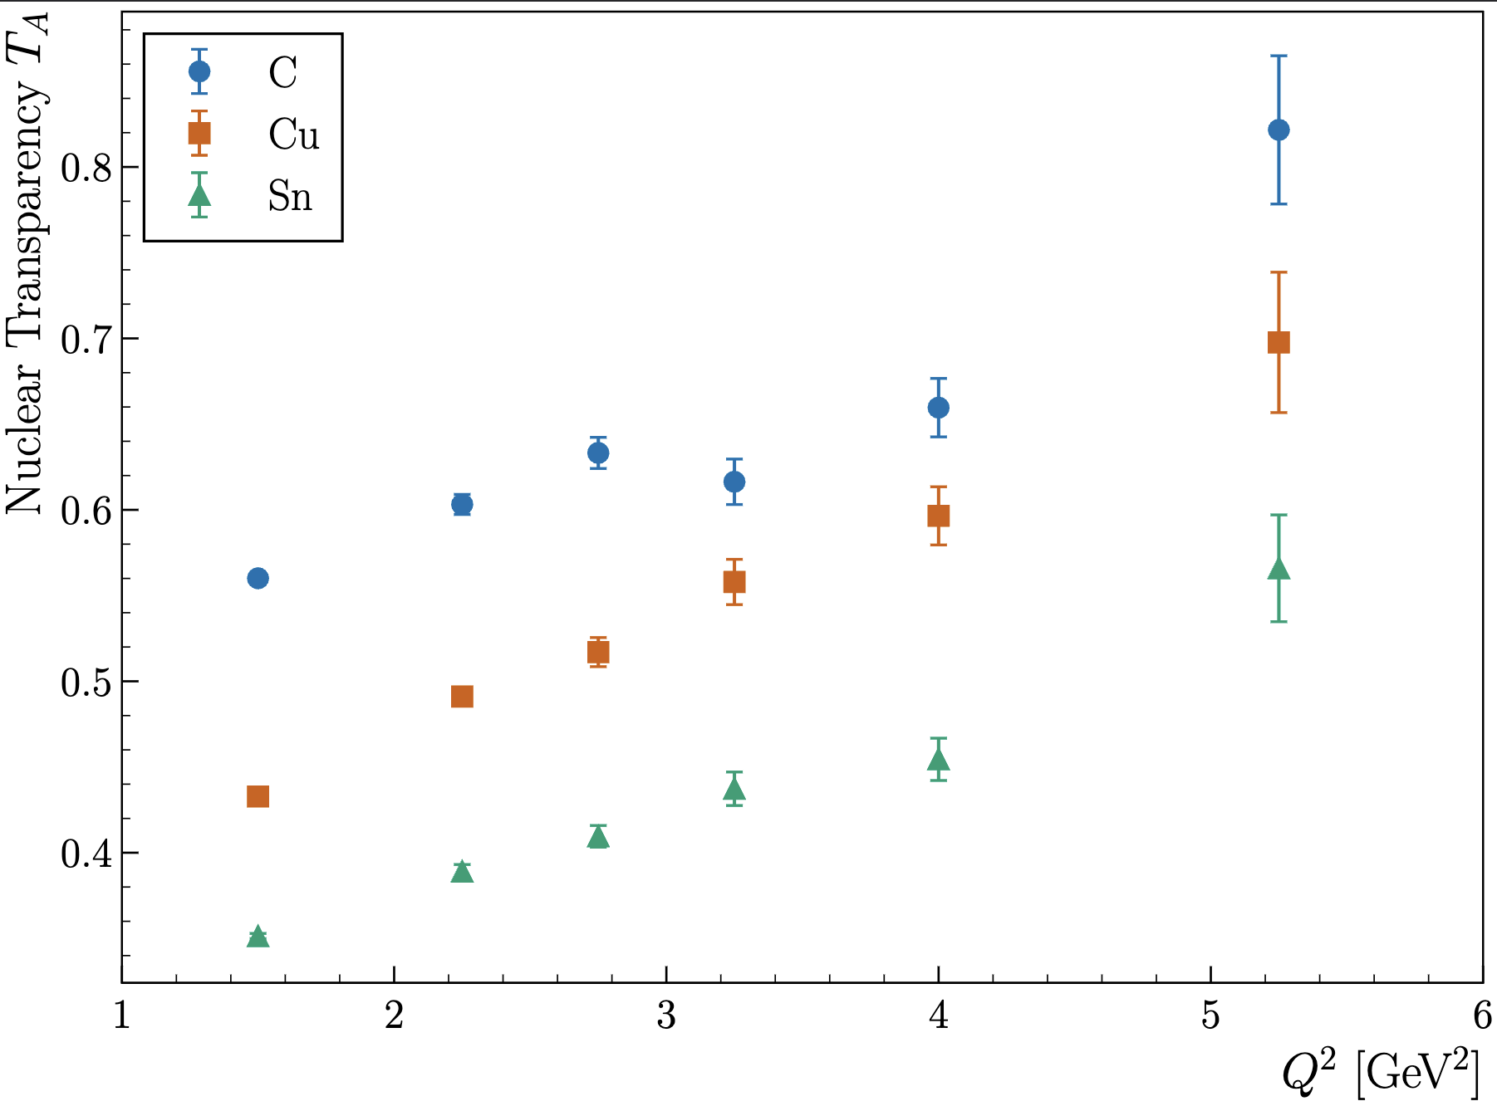
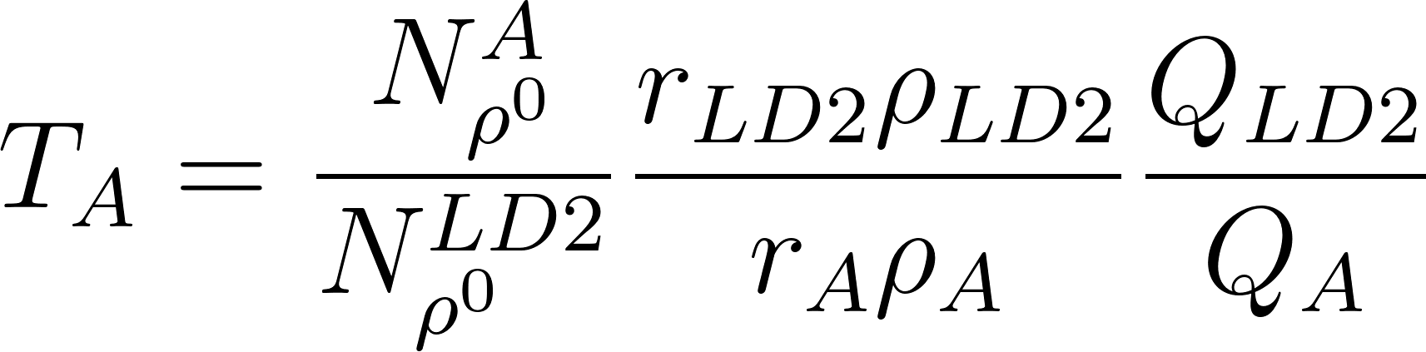
RG-D CT Study: Very Preliminary Nuclear Transparency
Introduction
Vertex Study
Analysis
Summary
22/23
Extract (raw) nuclear transparency as currently available Pass1 reconstructed data (around 10% of total)
r_{LD2}= 5 cm: LD2 thickness
r_{C} = 0.4 cm: CxC thickness
r_{Cu}= 93 μm: Copper thickness
r_{Sn} = 171 μm: Tin thickness
ρ_{LD2}= 0.164 g/cm³: LD2 density
ρ_{C}= 2.2 g/cm³: Carbon density
ρ_{Cu}= 8.96 g/cm³: Copper density
ρ_{Sn}= 7.31 g/cm³: Tin density

Slide 24
Summary and Outlook
Introduction
Vertex Study
Analysis
Summary
23/23
RG-D has passed the Pass1 review, and the cooking is done
Thanks to everyone who help us
Optimizing analysis tools for CT and nTMDs studies to
Study the hadron/electron contamination in pion sample
Continue to develop the correction contamination with the CuSn target
Deploy the ρ⁰ event generator for the two-pion invariant mass background subtraction and apply necessary corrections for the extraction of the preliminary CT results
Implement radiative and acceptance correction for the nuclear transparency
Extract azithumal asymmetry, multiplicity ratio and pT broadening results for π⁰
Obtain the preliminary asymmetry results for charged pions nTMDs studies

Slide 25
Backup slides
Introduction
Vertex Study
Analysis
Summary
Backup

Slide 26
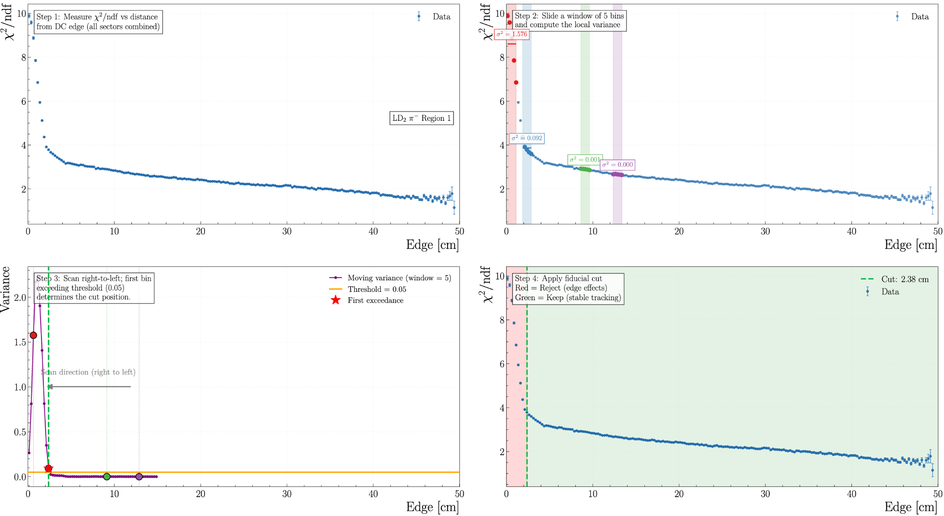
RG-D Particle IDentification: Pions Fiducial
Introduction
Vertex Study
Analysis
Summary
Backup
The goal is to remove tracks near the drift chamber edges where tracking quality degrades
profile the chi2/ndf of the track fit as a function of distance from the DC edge
Near the edge: chi2/ndf fluctuates due to poor tracking resolution
Far from the edge: chi2/ndf is stable (good tracking)
To find the transition between these two regimes automatically:
Compute a moving variance of the chi2/ndf profile using a sliding window of 5 bins
Scan from right to left (from the stable region toward the edge)
The first bin where the variance exceeds a threshold (0.05) marks the boundary — this is the cut position
Tracks closer to the edge than the cut position are rejected; tracks beyond are kept
The method is applied independently for each target, pion charge, and DC region (R1, R2, R3)

Slide 27
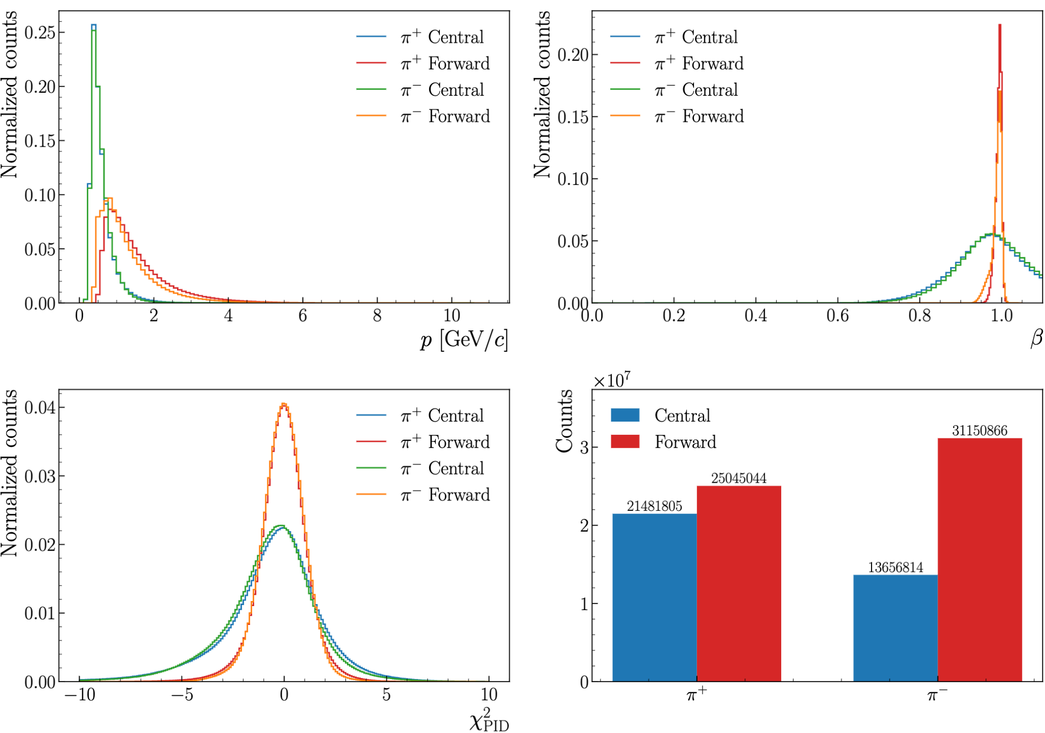
RG-D Particle IDentification: Pions
Introduction
Vertex Study
Analysis
Summary
Backup
The pion identification is very important for RG-D analyses (both CT and TMDs)
Also look into the pions detected in the central detector (CD)
π⁺: Central 46.2%, Forward 53.8%
π⁻: Central 30.5%, Forward 69.5%
Between a third and half of the statistic is in the central
Worse β and chi2pid in the central
The central pions don’t have any cuts

Slide 28
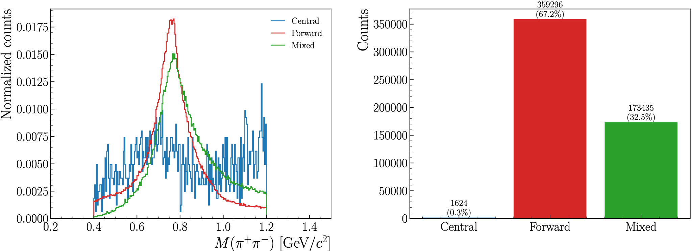
RG-D Particle IDentification: Pions
Introduction
Vertex Study
Analysis
Summary
Backup
The pion identification is very important for RG-D analyses (both CT and TMDs)
Also look into invariant mass for the pions detected in the central detector (CD)
After applying cuts: z_{h} > 0.9, 0.1 < -t < 0.5 GeV², l_{c}< 1 fm

Slide 29
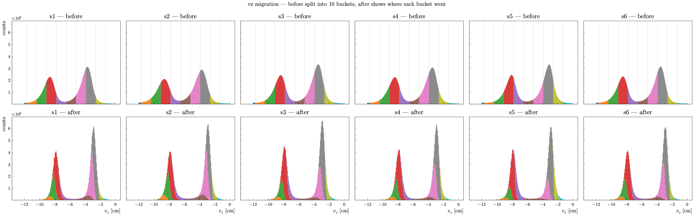
Electron Vertex Study
Introduction
Vertex Study
Analysis
Summary
Backup
Effect of the correction:

Slide 30
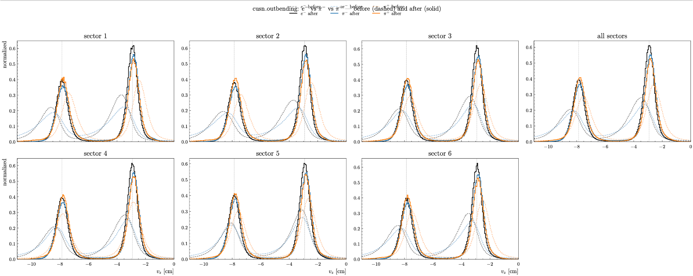
Electron Vertex Study
Introduction
Vertex Study
Analysis
Summary
Backup
Develop a similar correction for pions (CuSn Outbending):

Slide 31
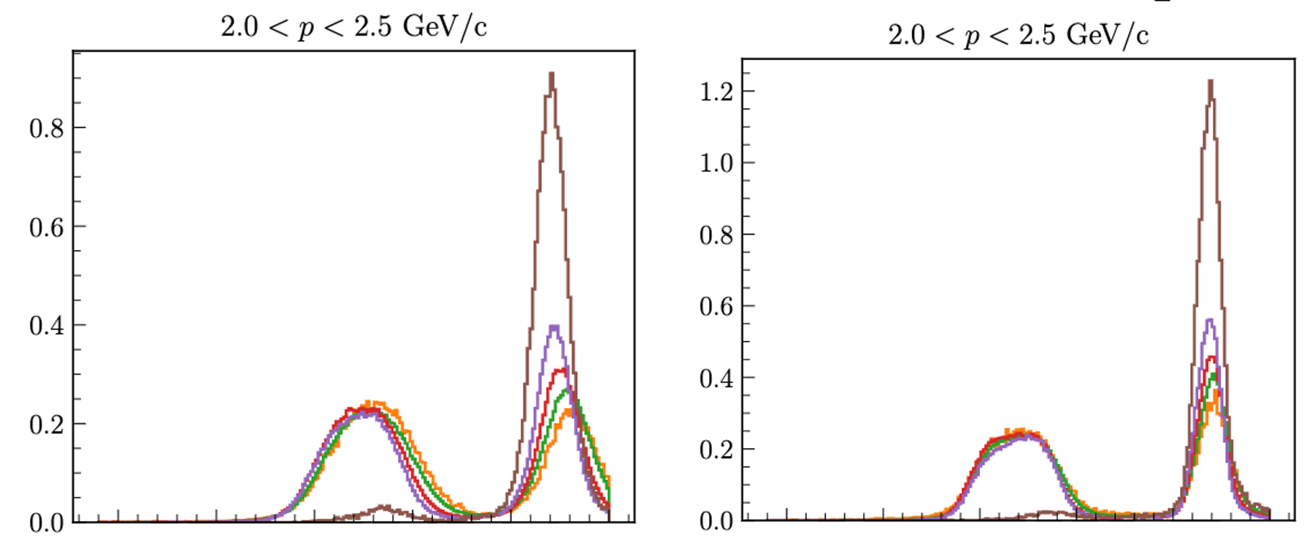
Electron Vertex Study
Introduction
Vertex Study
Analysis
Summary
Backup
Effect of the FMT on RG-E inbending dataset:

Slide 32
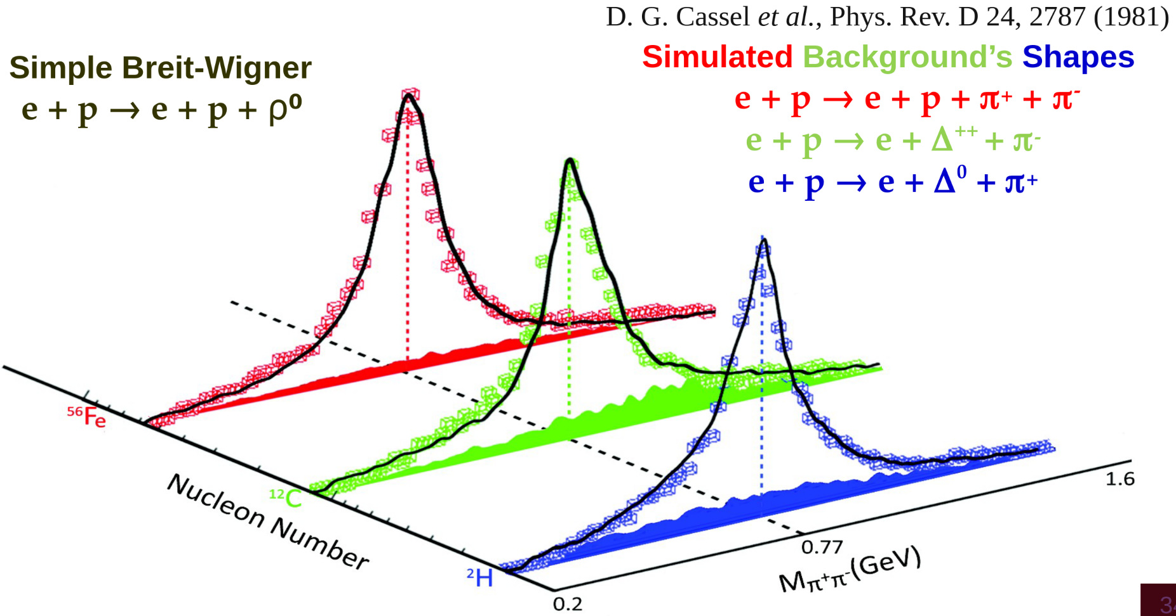
CT Study: Two-pion Invariant Mass
Introduction
Vertex Study
Analysis
Summary
Backup
Our event generator incorporates the measured cross sections by Cassel et al. for the electroproduction of ρ0 and the three main background processes

