Slide 1


Refinement of AI-assisted Track Reconstruction and Particle Identification for CLAS12 ALERT Experiment at Jefferson Lab
Fall Meeting of the APS Division of Nuclear Physics
Mathieu Ouillon (Mississippi State University)

Slide 2
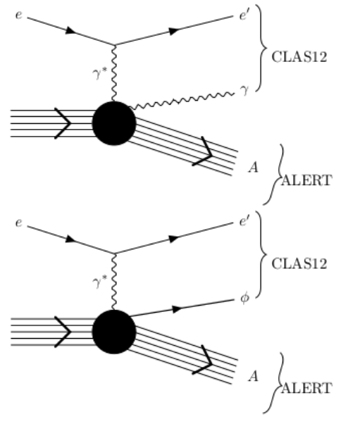
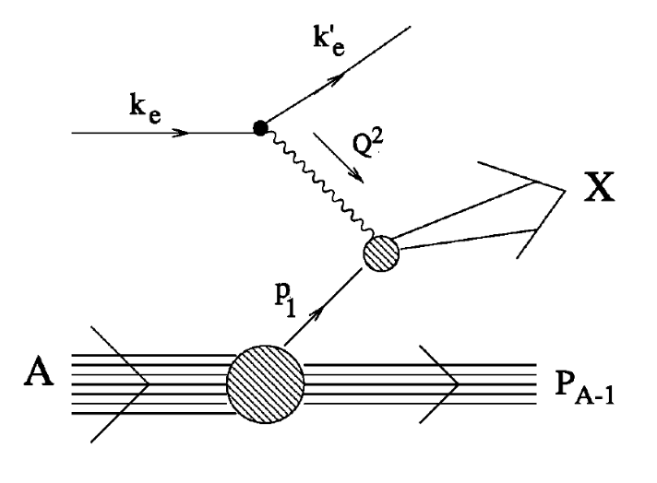
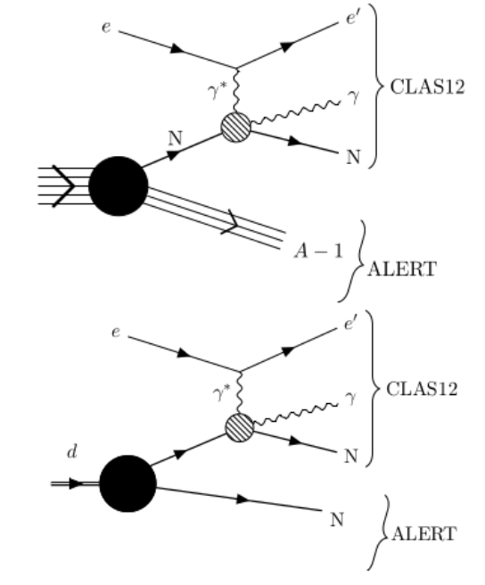
ALERT Physics Program
Comprehensive studies of QCD in nuclei and associated medium modifications
Coherent DVCS on ⁴He
DIS on ⁴He and ²H
Incoherent DVCS on ⁴He (²H)
Explore the partonic structure of ⁴He with Generalized Parton Distributions
Test the Final State Interactions and rescaling model
Explore the 3-D structure of modified nucleons in light ions ²H,³H, and ³He (¹H or neutron)

Slide 3
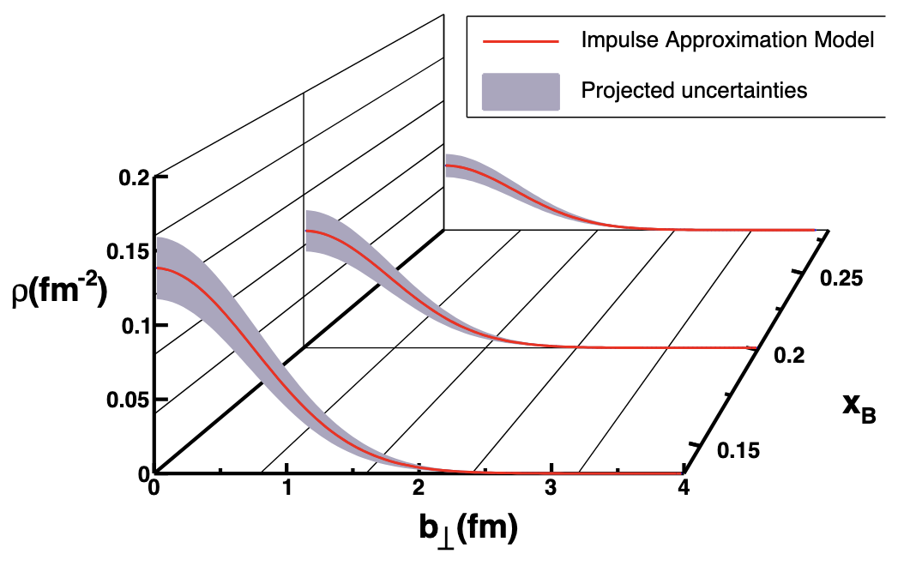
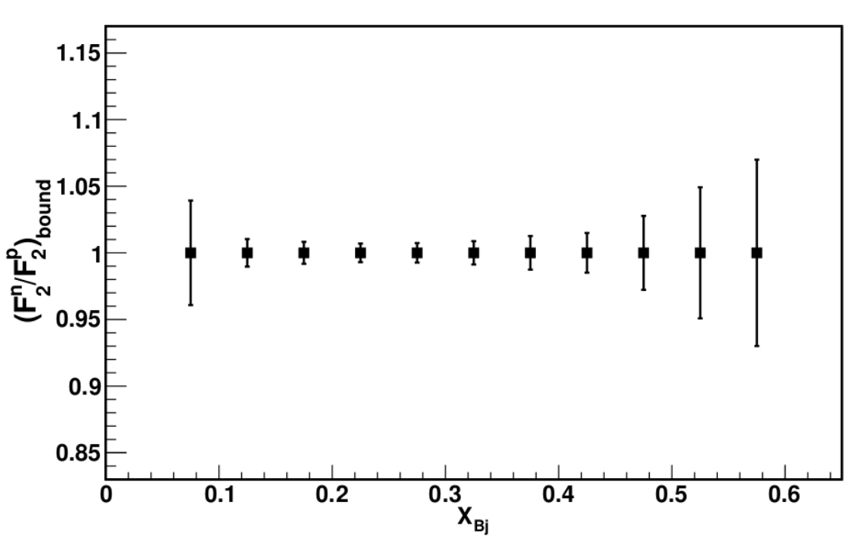
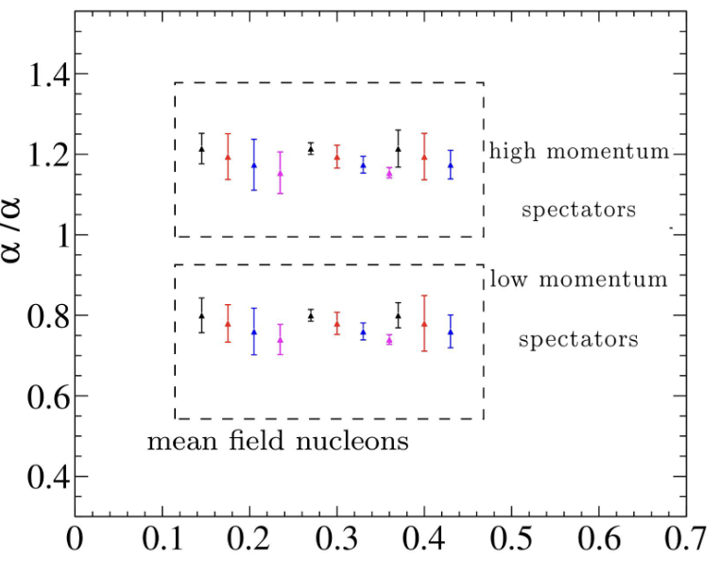
ALERT Physics Program
Comprehensive studies of QCD in nuclei and associated medium modifications
Coherent Process on ⁴He
Tagged EMC effect
Incoherent Process on ⁴He (²H)
Extract quark and gluon GPDs in a dense nucleus; in this case, GPD H is obtained for both quarks and gluons in ⁴He
Measure the F₂ structure function of a weakly bound nucleon in ⁴He and compare it to the ²H case. Control FSIs with tagged fragments
Extract quarks GPDs for bound nucleons and thus understand the effect of FSIs

Slide 4
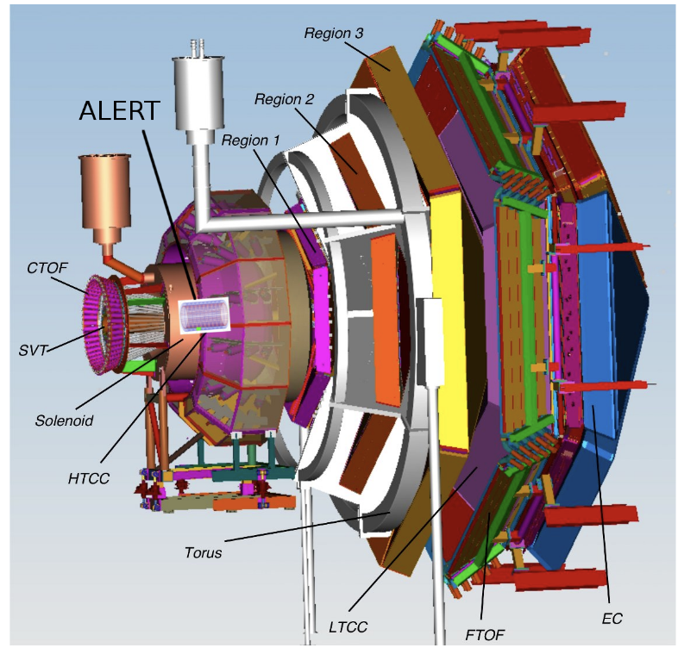
ALERT Experiment Setup
The ALERT experiment has taken place in Hall B at Jefferson Lab
CLAS12: detect scattered electrons and forward-scattered hadrons
ALERT: detect recoil spectators or coherently scattered nucleus
ALERT Goals:
Identifying light ions: p, ²H, ³H, ³He, and ⁴He
Detect the lowest momentum possible, down to 70 MeV/c for protons
Handle high CLAS12 rates and luminosities (10³⁵ cm²s⁻¹)

Slide 5
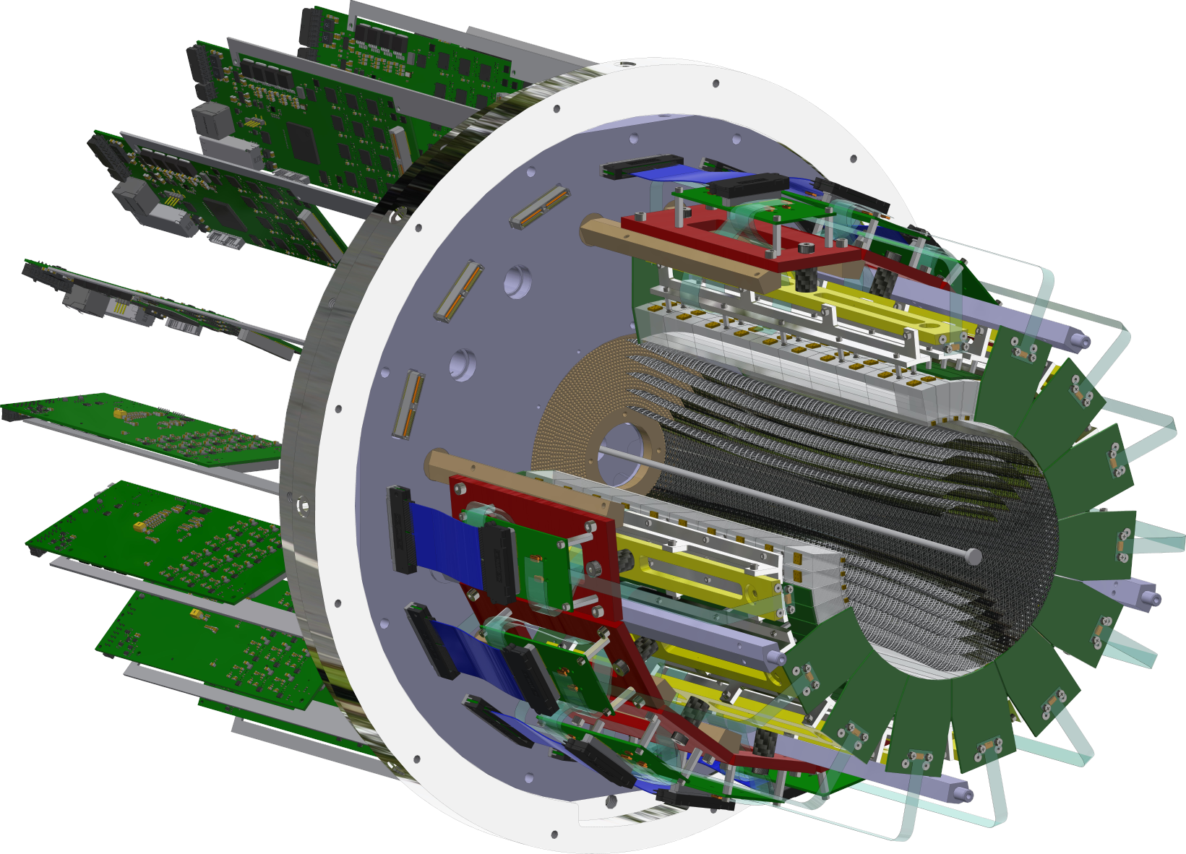
ALERT Experiment Setup
ALERT is composed of two sub-detectors:
A Hyperbolic Drift Chamber (AHDC) and A Time of Flight (ATOF)
ATOF
Time of flight: used for Particle Identification
Small barrel of segmented scintillators
The TOF measurement is degenerate for ²H and ⁴He, but dE/dx can distinguish the two nuclei bands
AHDC
Aluminum wire: 2 mm apart
20-degree stereo angle (hyperbolic shape)
5 superlayers, each composed of 2 layers
576 signal wires (6 ground wires of each signal)

Slide 6
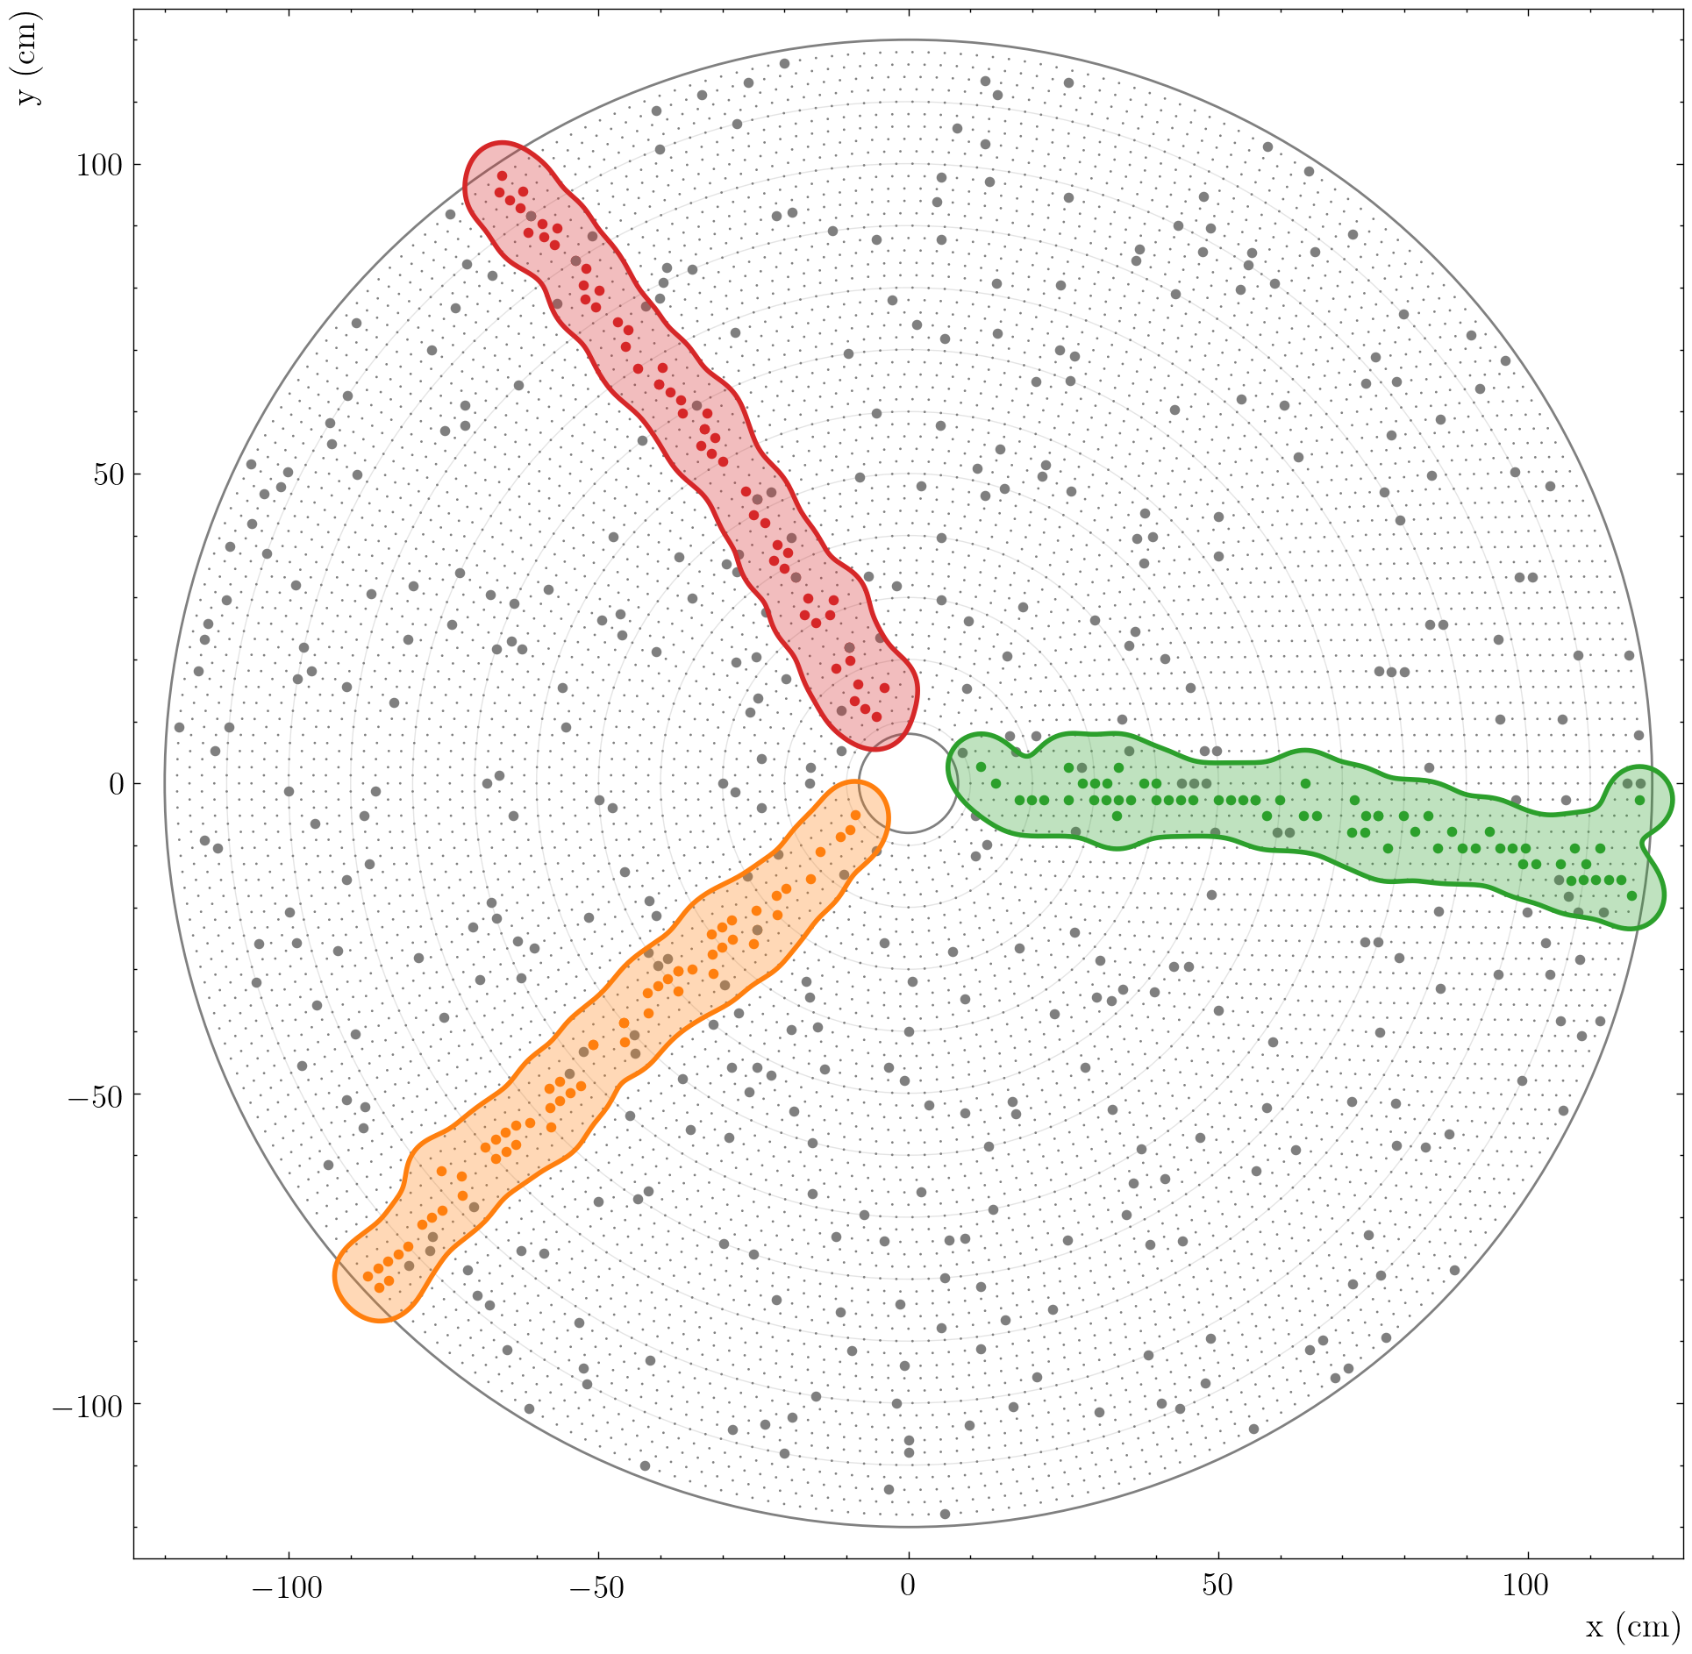
Track Finding
Two stages of track reconstruction:
Track finding: Identifying which hits came from the same charged particle
Track fitting: Fitting hits to a single track to extract track parameters (momentum and position)
Hits: particles deposit energy when interacting with the detector material
Tracks: reconstructed sequences of hits representing charged particle trajectories
Different algorithms:
Distance between hits + fit
Hough transform
Combinatorial Kalman Filter
Artificial Intelligence models (MLP, GNN…)

Slide 7
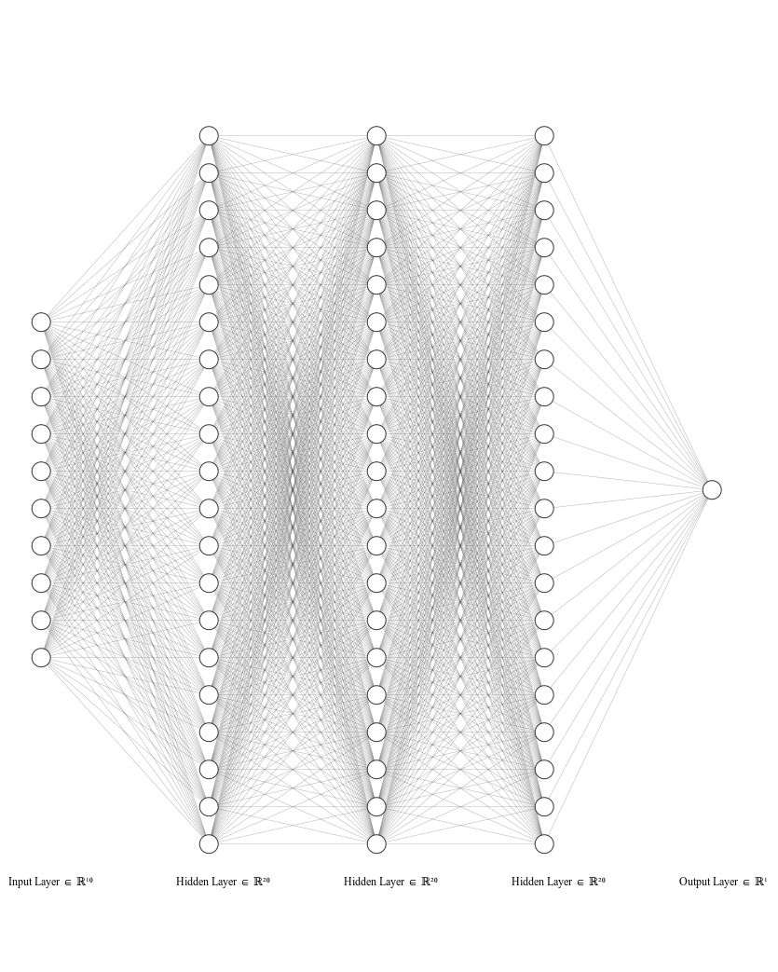
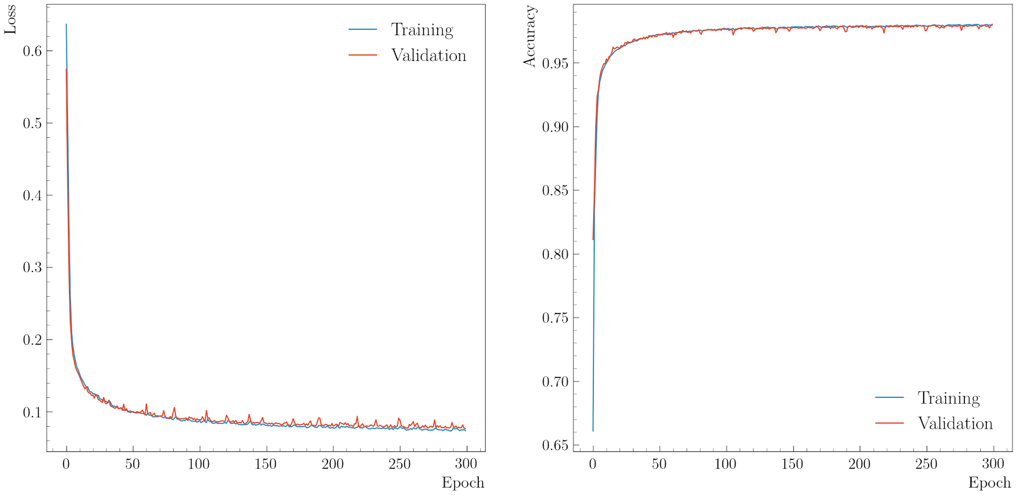
AI-assisted Model and Training
Model: MultiLayer Perceptron, 10 inputs, 1/3/5 hidden layer (15/20/100 neurons), 1 output
Inputs: x and y values of the five inter-clusters
For the training ⇒ Need good and bad tracks:
Good tracks: GEANT4 simulation (particle with p ∈ [0.07, 1.5] GeV/c, φ ∈ [0, 360]°, θ ∈ [30, 150]° , and Vz ∈ [-15, 15] cm)
False tracks: Interchanging randomly up to two inter-clusters with another event
Generate 5M events composed of all light nuclei (flat distribution for all variables)
Output: Number between 0 and 1, with 0/1 means bad/good track

Slide 8
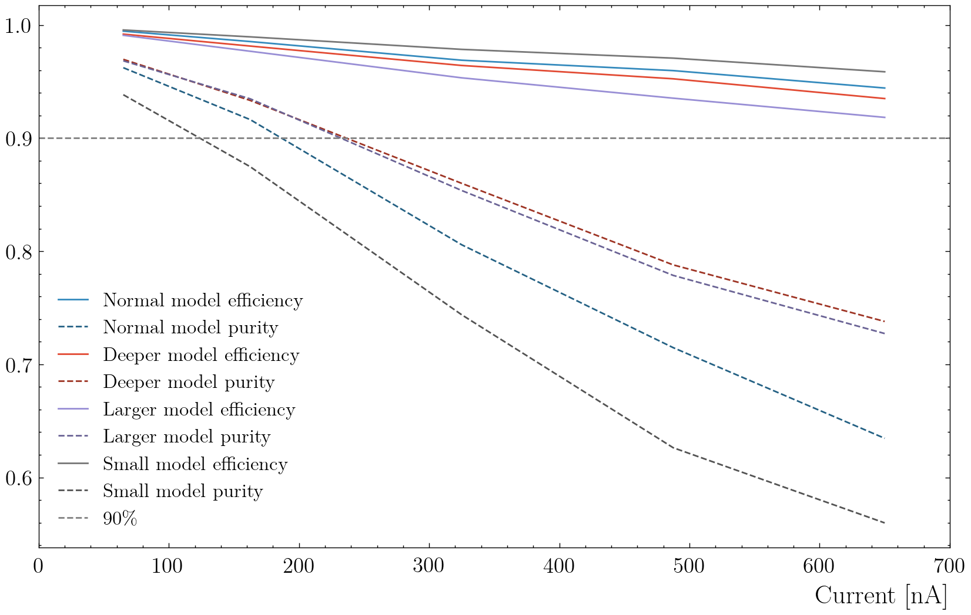
Evaluation: Efficiency and Purity vs. Background
Threshold: if output above/lower than the threshold ⇒ good/bad tracks
To evaluate the model:
Efficiency: Number of good tracks classified as good normalized by the number of events.
Purity: Number of good tracks classified as good normalized by the number of tracks (good or bad) classified as good.
Events need to have at least one track candidate.
Threshold (between good/bad tracks) set to 0.2 to have a higher efficiency
Blue: model with 20 neurons in 3 hidden layers
Violet: model with 100 neurons in 3 hidden layers
Red: model with 20 neurons in 5 hidden layers
Gray: model with 20 neurons in 1 hidden layer

Slide 9
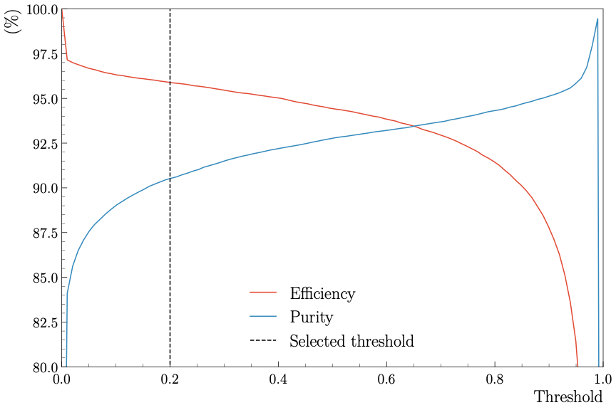
Evaluation: Efficiency and Purity vs. Threshold
To evaluate the performance of the AI on real data, use electron-proton elastic scattering
Selected by cut on hadronic mass W and the ϕ angle between the electron and the proton
Threshold: if output above/lower than the threshold ⇒ good/bad tracks
Efficiency: Number of good tracks classified as good normalized by the number of events.
Purity: Number of good tracks classified as good normalized by the number of tracks (good or bad) classified as good.
We have an efficiency of 96%, and a purity of 90% at 0.2

Slide 10
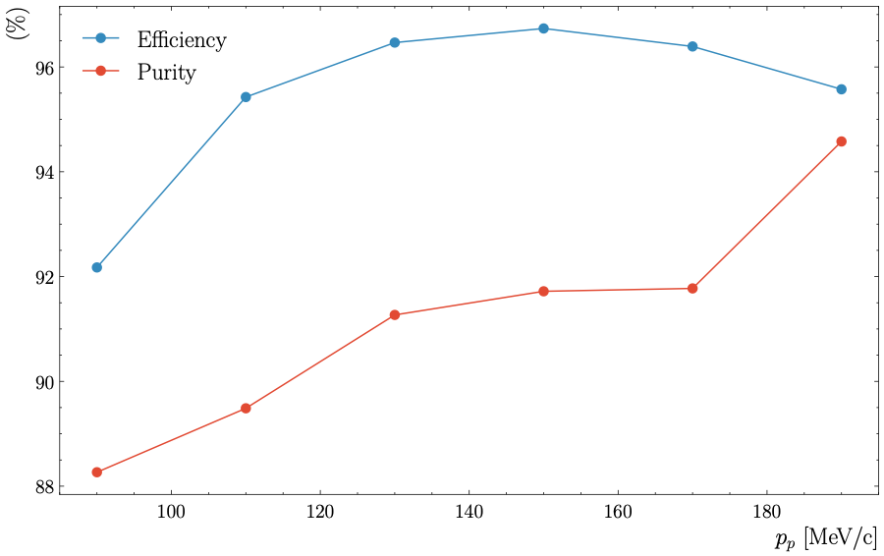
Evaluation: Efficiency and Purity vs. Momentum
To evaluate the performance of the AI on real data, use electron-proton elastic scattering
Selected by cut on hadronic mass W and the ϕ angle between electron and proton
Efficiency and purity as a function of the proton momentum:
Efficiency: Number of good tracks classified as good normalized by the number of events.
Purity: Number of good tracks classified as good normalized by the number of tracks (good or bad) classified as good.
Momentum is computed with θ_{e}
Both the efficiency and purity decrease when the momentum decreases

Slide 11
Summary and Outlook
ALERT physics program:
Tagged processes will provide insight into the origin of the EMC effect
Tagged DIS measurements will help differentiate between models
Tagged DVCS will bridge gap between partonic and nucleonic interpretations of the EMC ratio
We have developed an AI-assisted MLP for track finding:
Evaluated the model's efficiency and purity as a function of momentum, threshold, and current on simulation and data
Compared efficiency of conventional and AI-assisted algorithms
Efficiency is always higher than 90%
Future work:
Improve the model with other information as input (energy deposited and angle between hits)
Match hit in the ATOF with track in the AHDC using AI-assisted
Momentum prediction with AI-assisted
Thanks
This work is supported in part by the U.S. DOE award #: DE-FG02-07ER41528

