Slide 1


Overview of ALERT AI-assisted Track Reconstruction and Particle Identification Project
Mathieu Ouillon (Mississippi State University)

Slide 2
Outline
1. ALERT Physics Program
2. Previous JLab Experiments
3. ALERT Experimental setup
4. Track Reconstruction
5. Hits Clustering
6. AI-assisted Model
7. AI-assisted Model Evaluation
8. Conventional and AI comparison
9. Summary and outlook

Slide 3
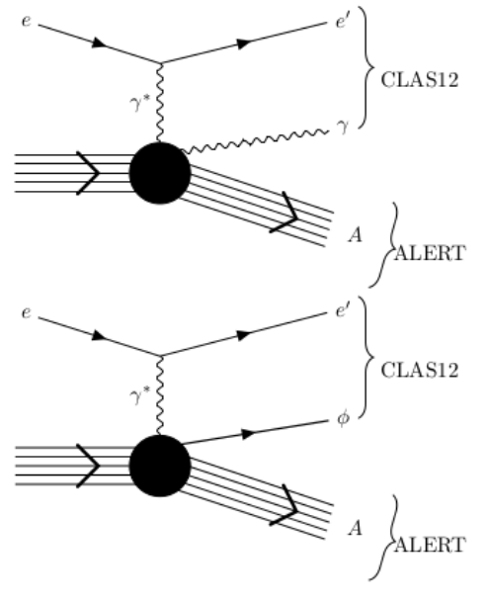
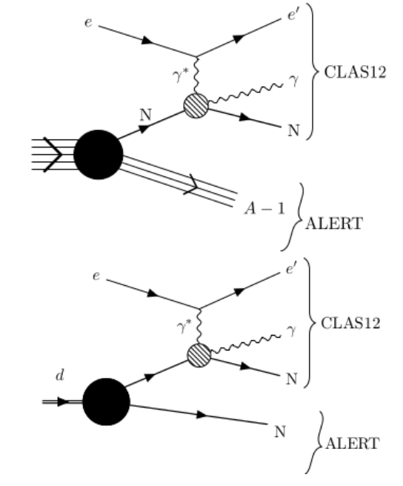
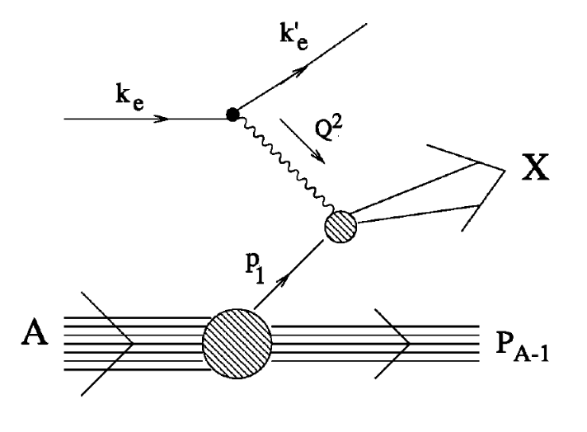
ALERT Physics Program
Comprehensive studies QCD in nuclei and associated medium modifications
Coherent DVCS on ⁴He
DIS on ⁴He and ²H
Incoherent DVCS on ⁴He (²H)
Explore the partonic structure of ⁴He with Generalized Parton Distributions
Test the Final State Interactions and rescaling model
Explore the 3-D structure of modified nucleons in light ions ²H,³H, and ³He (¹H or neutron)

Slide 4
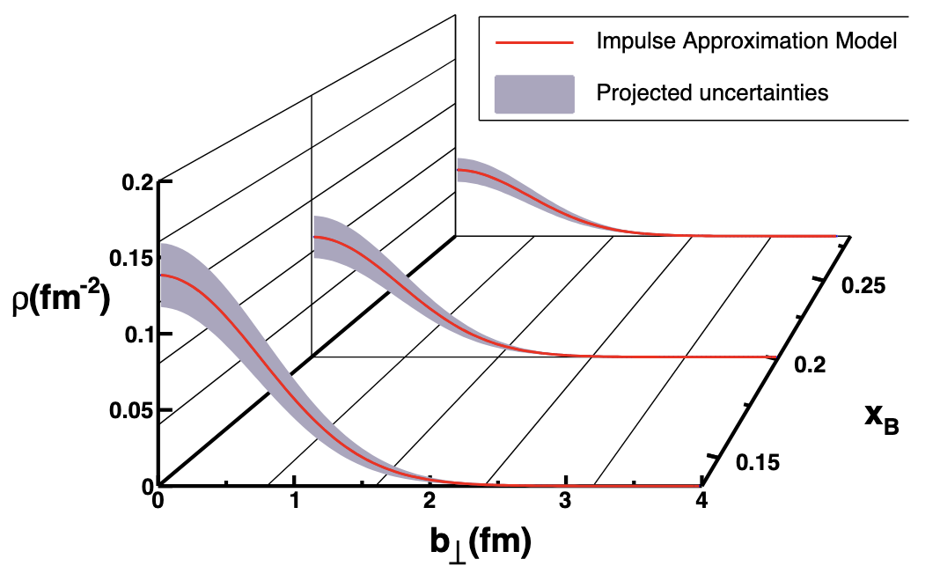
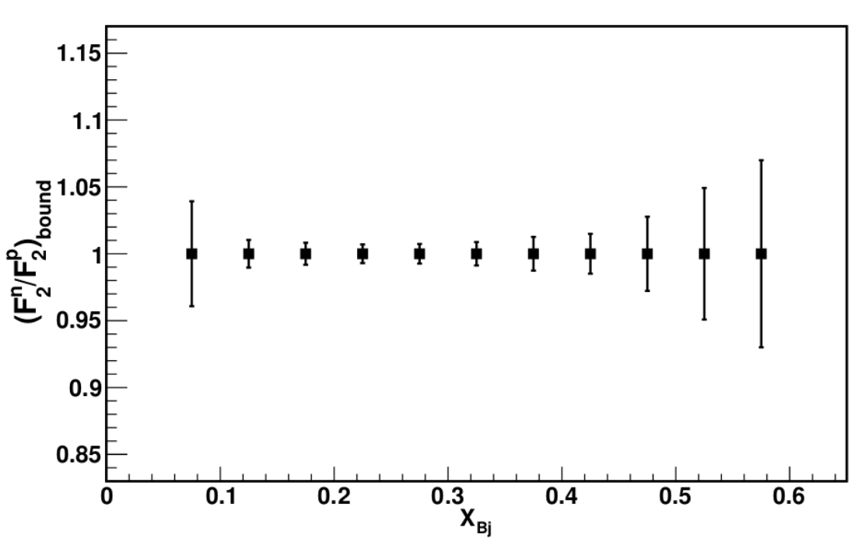
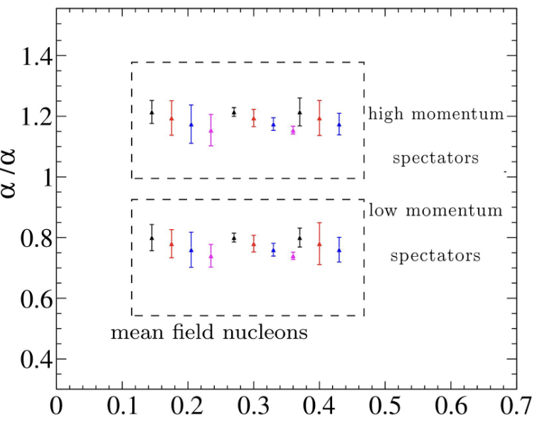
ALERT Physics Program
Comprehensive studies QCD in nuclei and associated medium modifications
Coherent Process on ⁴He
DIS on ⁴He and ²H: Tagged EMC effect
Incoherent Process on ⁴He and ²H
Extract quark and gluon GPDs in a dense nucleus; in this case, GPD H is obtained for both quarks and gluons in ⁴He
Measure the F₂ structure function of a weakly bound nucleon in ⁴He and compare it to the ²H case. Control FSIs with tagged fragments
Extract quarks GPDs for bound nucleons and thus understand the effect of FSIs

Slide 5
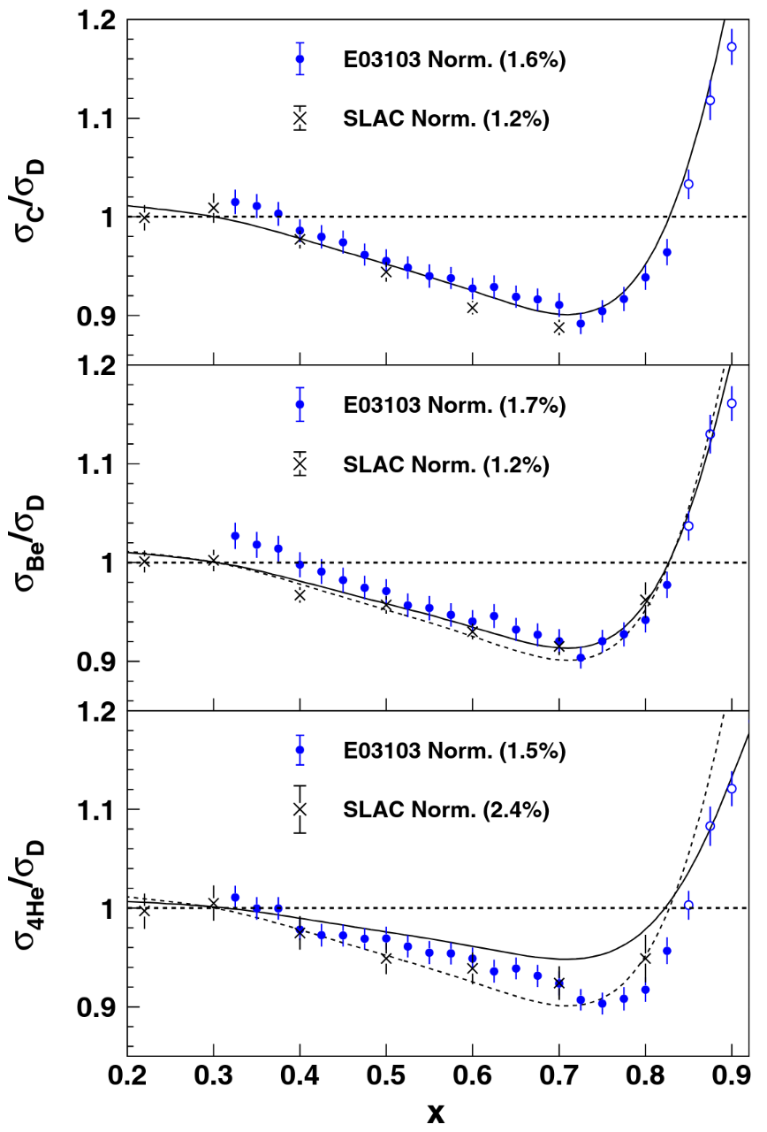
In-medium Structure and Effects
Modifications of bound nucleons properties and dynamics:
EMC effects at moderate Bjorken x, and shadowing at small x
Significant even for ⁴He
Many models for the EMC effect
The EMC effect remains a mystery
What is the origin of the EMC effect?
How is the nucleon modified in nuclear medium?
Nuclear modifications of DIS cross sections were probed by CERN, SLAC, and JLab experiments.
Clear explanations may arise from studying the nuclear modifications via other reactions, such as Deeply Virtual Compton Scattering and Deeply Virtual Meson Production…
What is the partonic structure of nuclei?
J. Seely et al. Phys.Rev.Lett. 103 (2009) 202301

Slide 6
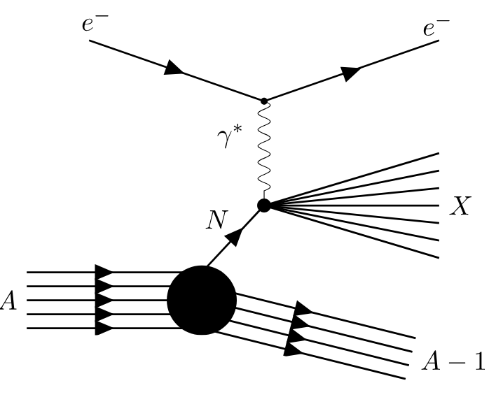
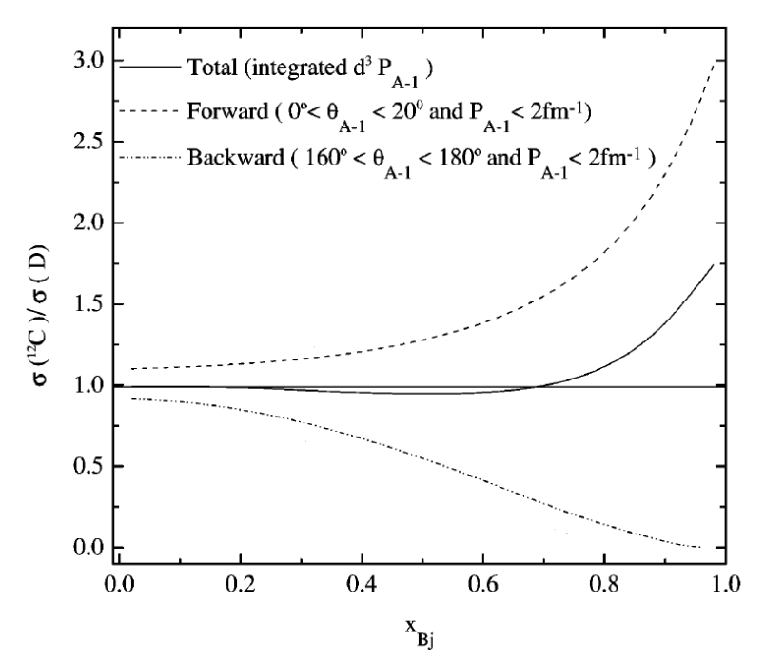
Tagged DIS and the EMC effect
Tagging ⇒ better understanding of the nuclear effects.
Tagging implies measuring the characteristics of the spectator part
Measurement with tagging ⇒ nuclear configuration selection via spectator kinematics:
On-shell extrapolation ⇒ access to free nucleon structure
Control initial state interactions
Control and constrain final state interactions
Study the EMC effect for backward and forward configuration to distinguish between models
Compare conventional models and alternative models:
Conventional: nuclear binding and Fermi motion
Alternative: modifications in quark confinement size or nucleon swelling

Slide 7
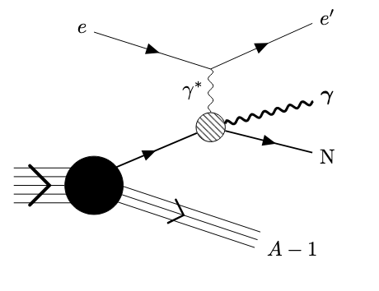
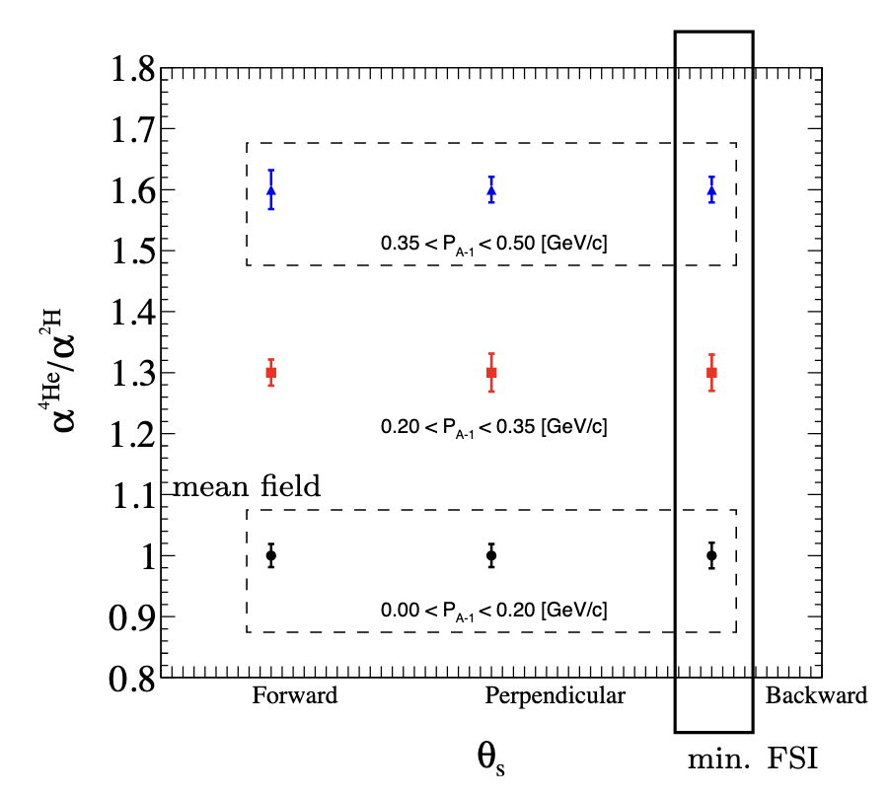
Spectator-Tagged DVCS
DVCS links the EMC effect and Short-Range Correlations (inelastic and quasi-elastic):
DVCS is used to study Generalized Partons Distributions
Forward limit: GPDs reduce to longitudinal parton distributions ⇒ may explain the EMC effect
Off-forward limit: GPDs reduce to form factors ⇒ describe quasi-elastic scattering off the nucleon
DVCS allows a partonic level interpretation and in-medium nucleon tomography
Tagged DVCS provides a way to quantify and control the nuclear effects
Identify struck nucleon via tagging ⇒ separate mean field nucleons (low momentum) from SRC (high momentum) nucleons

Slide 8
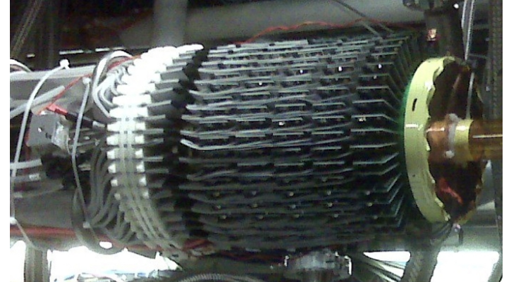
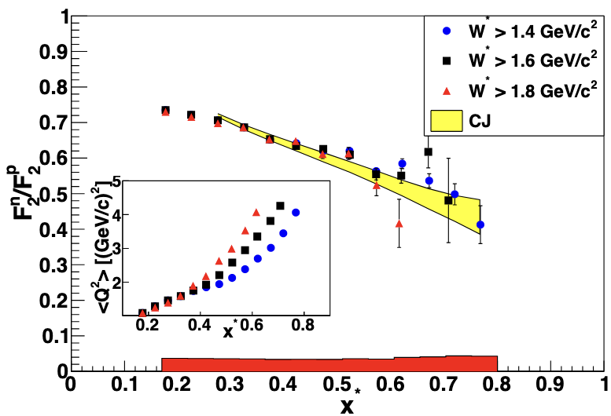
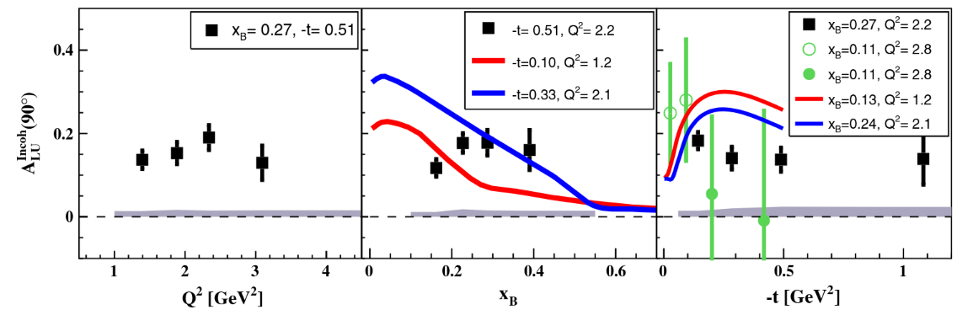
Previous Experiments at Jefferson Lab
Two previous 6 GeV CLAS experiments: EG6 and BONuS
Both use Radial Time Projection Chamber to detect the recoil fragment
Main limitations:
EG6: had long drift time and lacked full Particle IDentification capabilities (identified only ⁴He)
BONuS: had long drift time and only detect recoil proton
EG6 RTPC
BONuS
EG6
M. Hattawy et al., Phys. Rev. Lett. 119, (2017) 202004
M. Hattawy et al., Phys. Rev. Lett. 123, (2019) 032502
S. Tkachenko et al., Phys. Rev. C 89, (2014) 045206

Slide 9
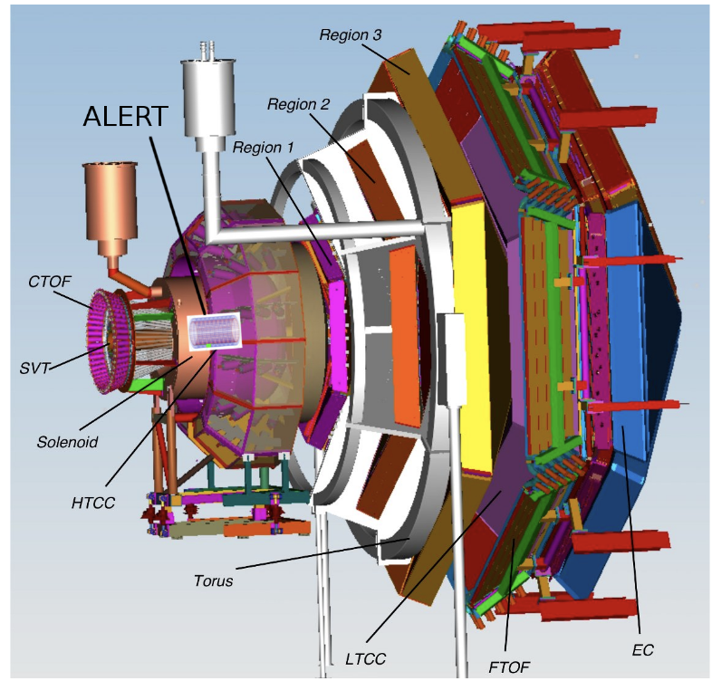
ALERT Experiment Setup
The ALERT experiment will take place in Hall B at Jefferson Lab
CLAS12: detect scattered electrons and forward scattered hadrons
ALERT: detect recoil spectators or coherently scattered nucleus
ALERT Goals:
Aim to identify light ions: p, ²H, ³H, ³He, and ⁴He
Detect the lowest momentum possible, down to 70 MeV/c for proton
Handle high CLAS12 rates and luminosities (10³⁵ cm²s⁻¹)

Slide 10
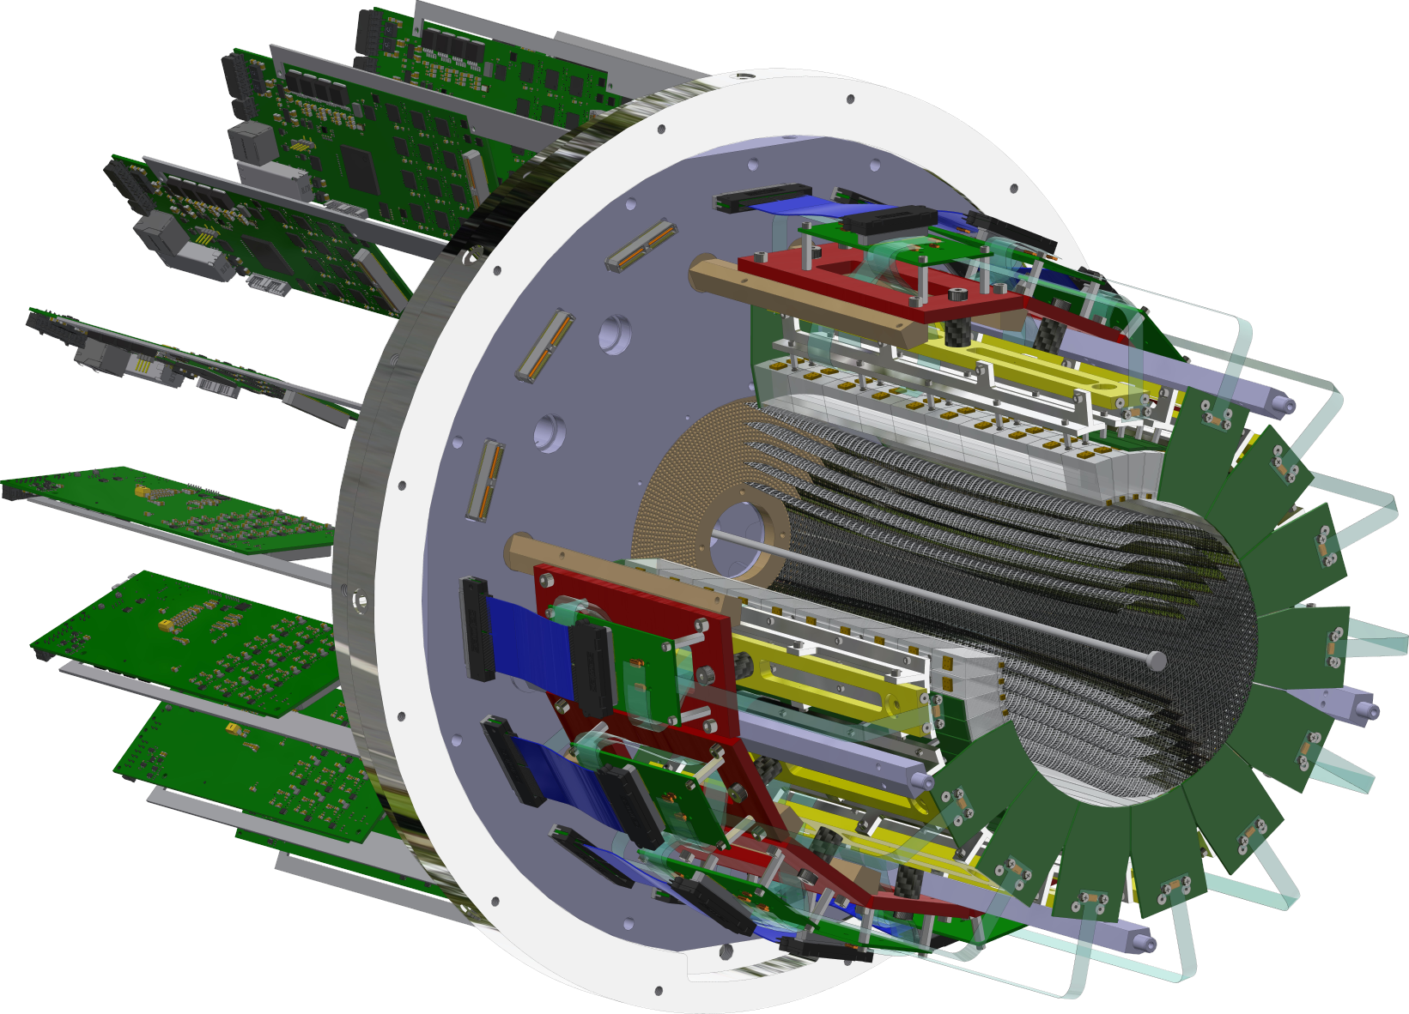
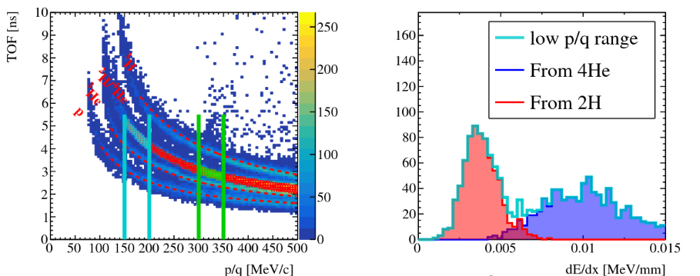
ALERT Experiment Setup
ALERT have two sub-detectors: A Hyperbolic Drift Chamber (AHDC) and A Time of Flight (ATOF)
ATOF
Time of flight: used for Particle IDentification
Small barrel of segmented scintillators
The TOF measurement is degenerate for ²H and ⁴He, but dE/dx can distinguish the two nuclei bands
AHDC
Aluminum wire: 2 mm apart
20-degree stereo angle (hyperbolic shape)
5 superlayers, each composed of 2 layers
576 signal wires (6 ground wires of each signal)

Slide 11
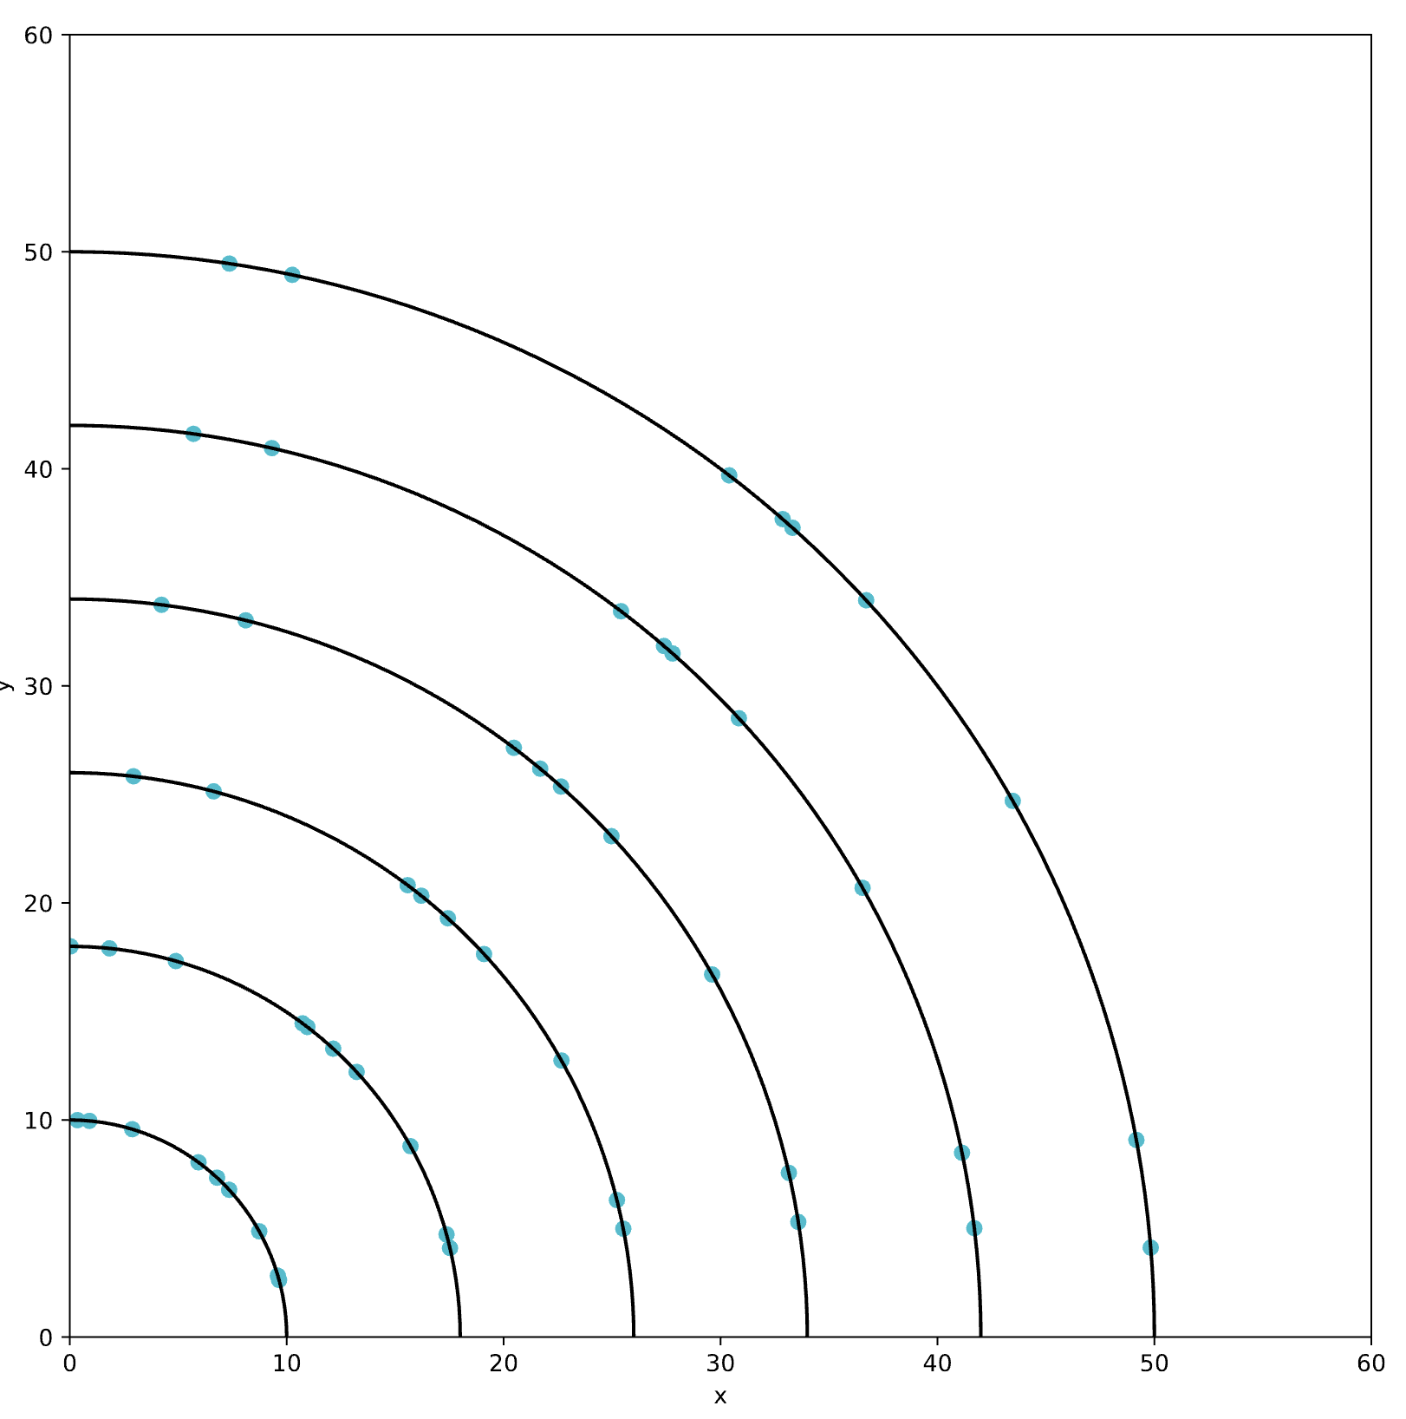
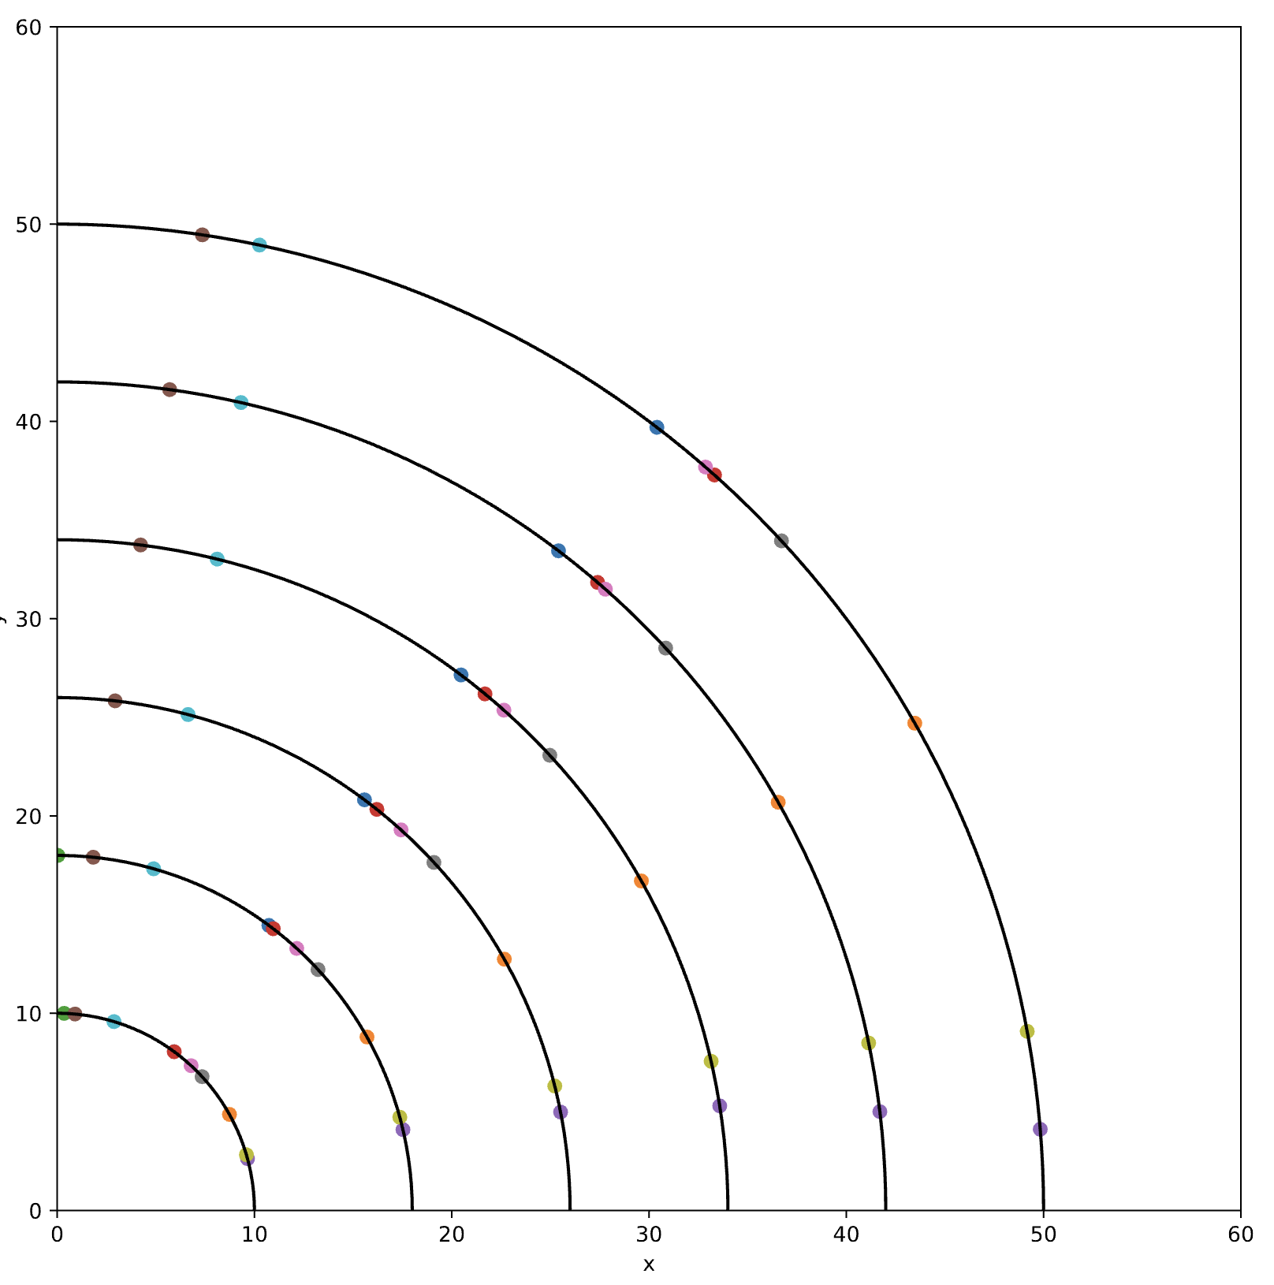
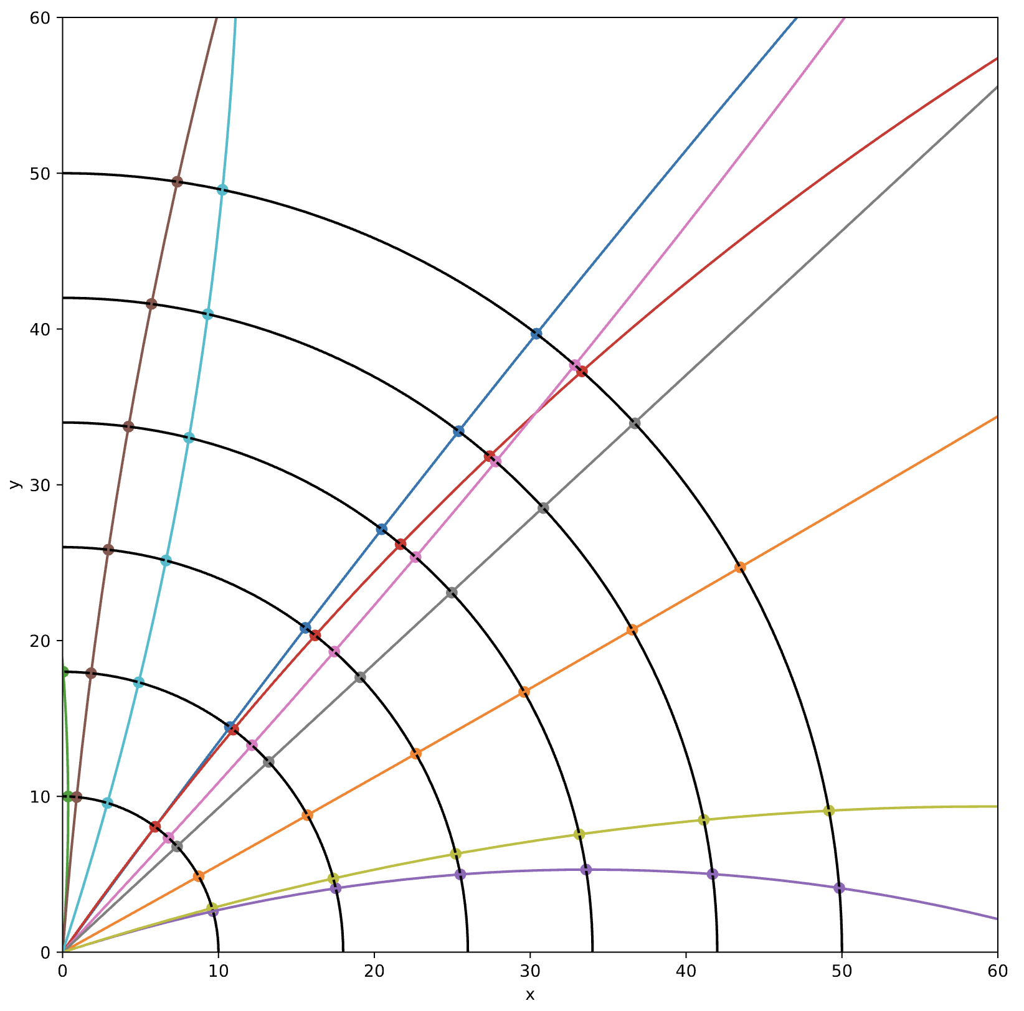
Track Reconstruction
Aim to reconstruct the momentum and trajectory of (charged) particles
Two stages of track reconstruction:
Track finding: Identifying which hits came from the same charged particle
Track fitting: Fitting hits to a single track to extract track parameters (momentum and position)
Measurements
Track finding
Track fitting

Slide 12
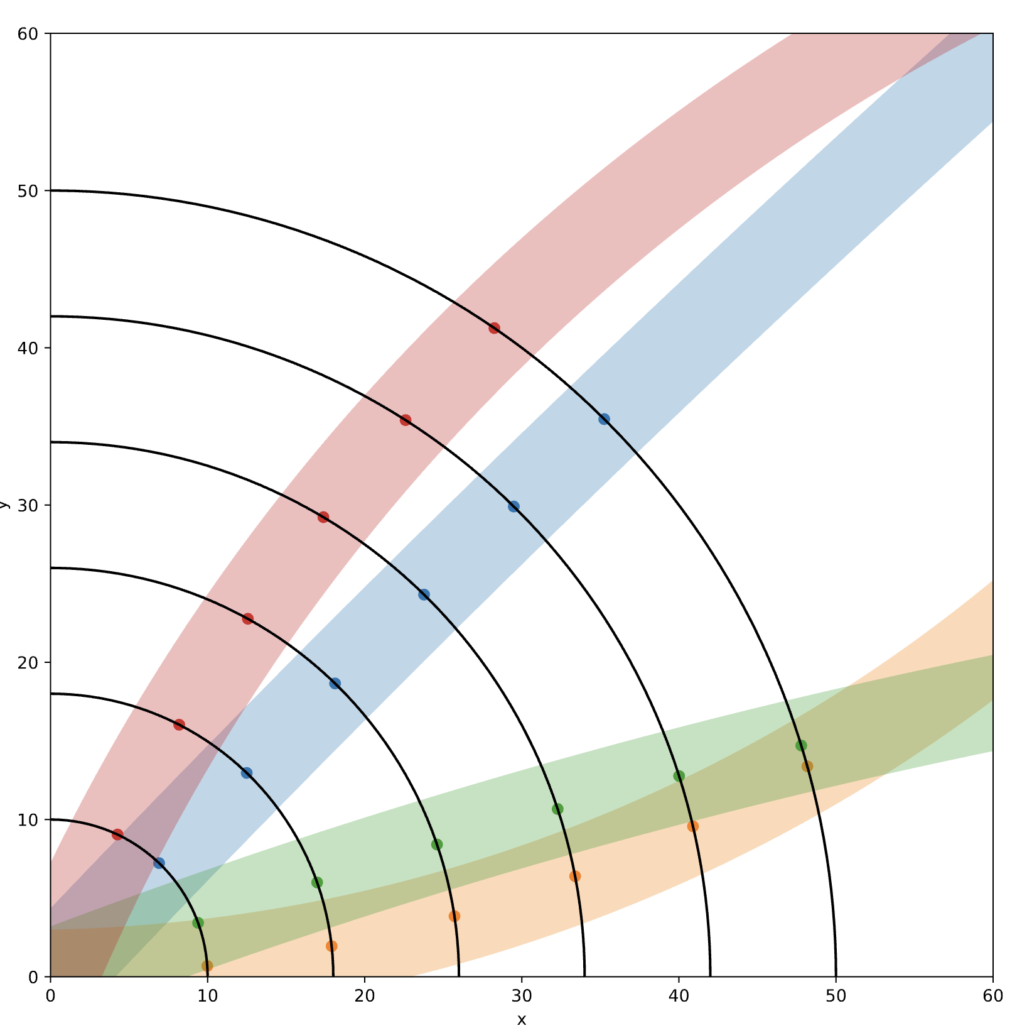
Track Finding
Track finding is a clustering problem:
Set of points (hits) ⇒ cluster in sets (tracks) originating from the same particle
Hits: particles deposit energy when interacting with the detector material
Tracks: reconstructed sequences of hits representing charged particle trajectories
Different algorithms:
Distance between hits + fit
Hough transform
Combinatorial Kalman Filter
Artificial Intelligence models (MLP, GNN…)

Slide 13
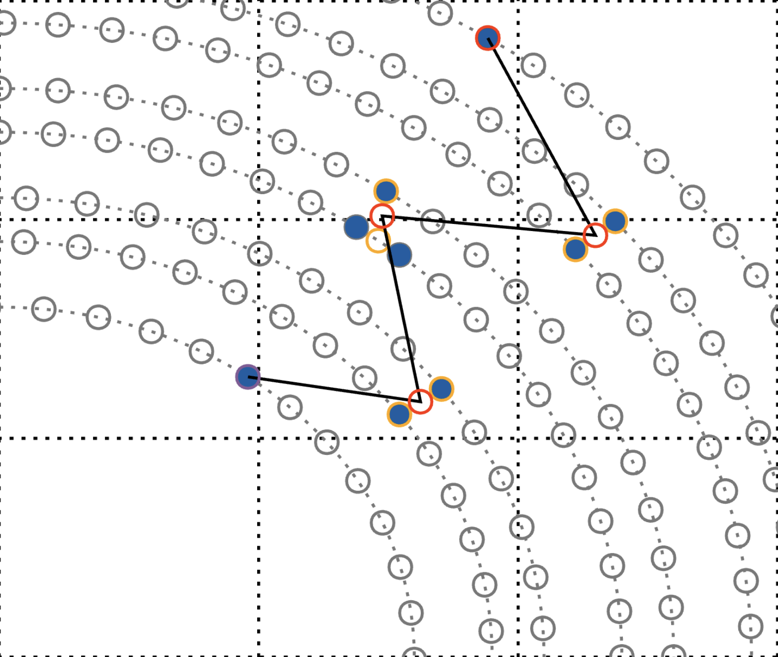
Clustering and Track Candidates
First step, find all track candidates:
Clustering ⇒ merging hits close in the x-y plane to reduce the combinatorial background
Merge hits on the same layer that are one wire apart into precluster
Merge precluster in the same superlayer that are less than 8mm apart into super-precluster
Generate all track candidates with 5 super-preclusters (one on each superlayer)
Generate around 40/100k track candidates per event with super-precluster/raw hits

Slide 14
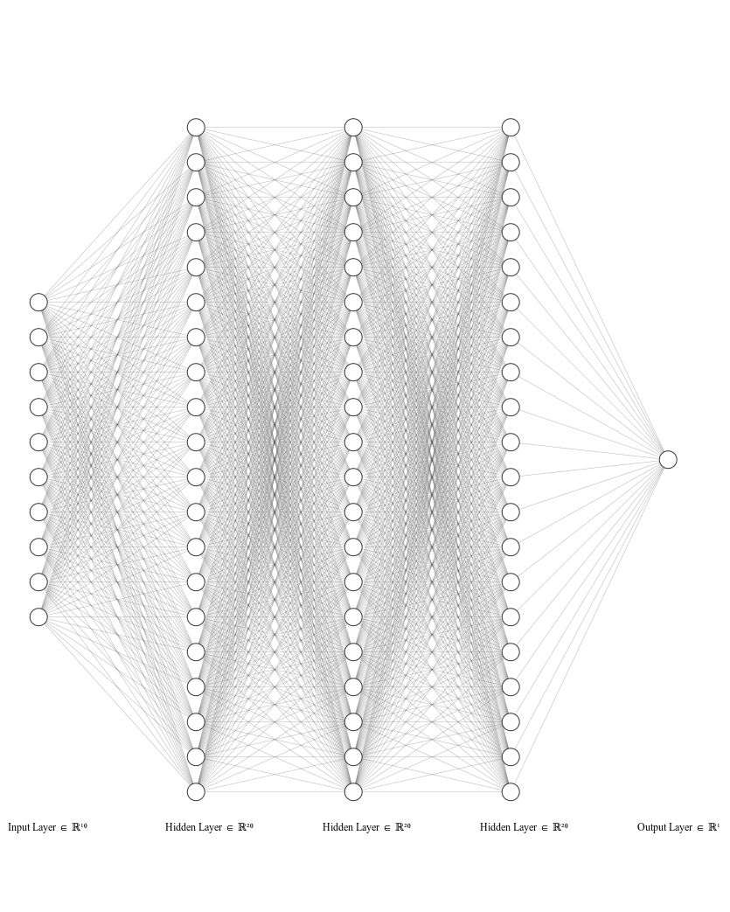
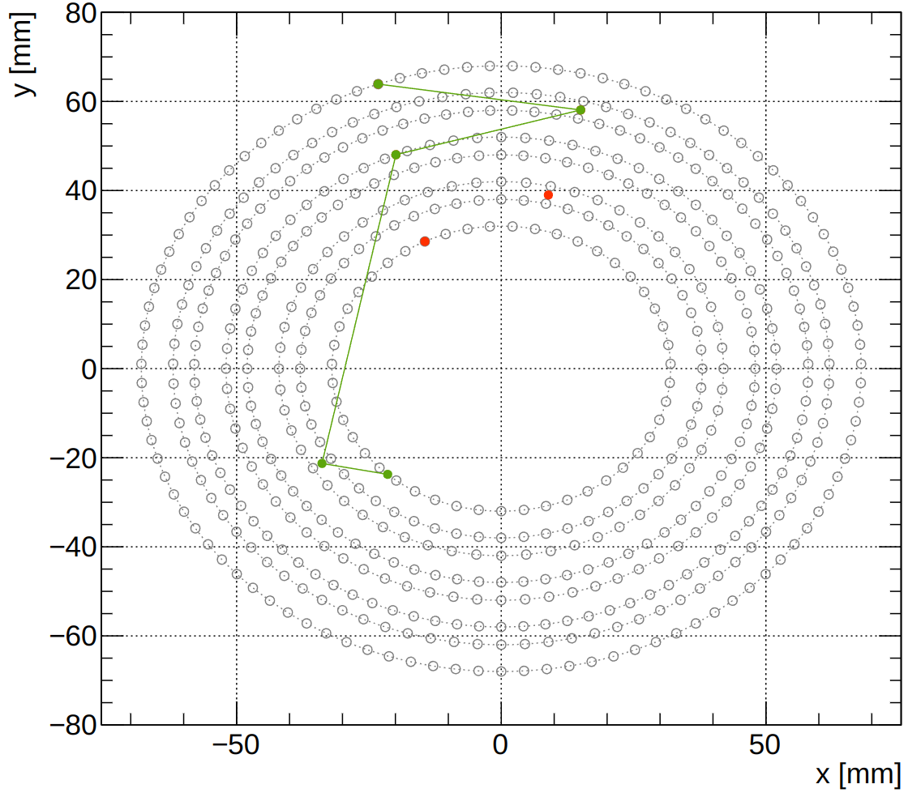
AI-assisted Model and Training
Model: MultiLayer Perceptron, 10 inputs, 1/3/5 hidden layer (20/100 neurons), 1 output
Inputs: x and y position of the five super-preclusters
Good and bad tracks for the training:
Good tracks: GEANT4 simulation (proton with p ∈ [70, 250] MeV/c, φ ∈ [0, 360]°, θ ∈ [60, 120]° and Vz ∈ [-15, 15] cm)
False tracks: Interchanging randomly up to two super-preclusters with another event
Output: Number between 0 and 1, with 0/1 means bad/good track
Bad track

Slide 15
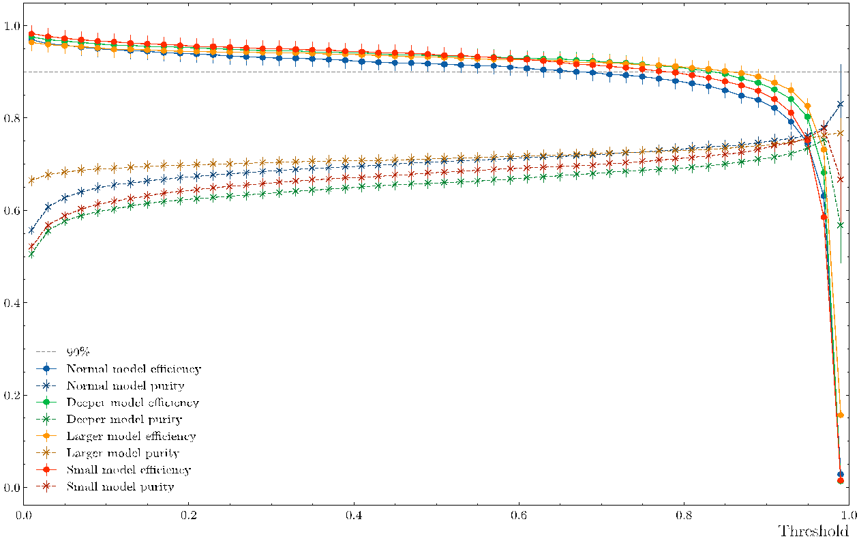
Efficiency and Purity vs. Threshold
Threshold: if output above/lower than the threshold ⇒ good/bad tracks
To evaluate the model:
Efficiency: Number of good tracks classified as good normalized by number of events.
Purity: Number of good tracks classified as good normalized by number of tracks (good or bad) classified as good.
Events need to have at least one track candidate.
Set the threshold to 0.2 to have a higher efficiency
Blue: model with 20 neurons in 3 hidden layers
Orange: model with 100 neurons in 3 hidden layers
Green: model with 20 neurons in 5 hidden layers
Red: model with 20 neurons in 1 hidden layer

Slide 16
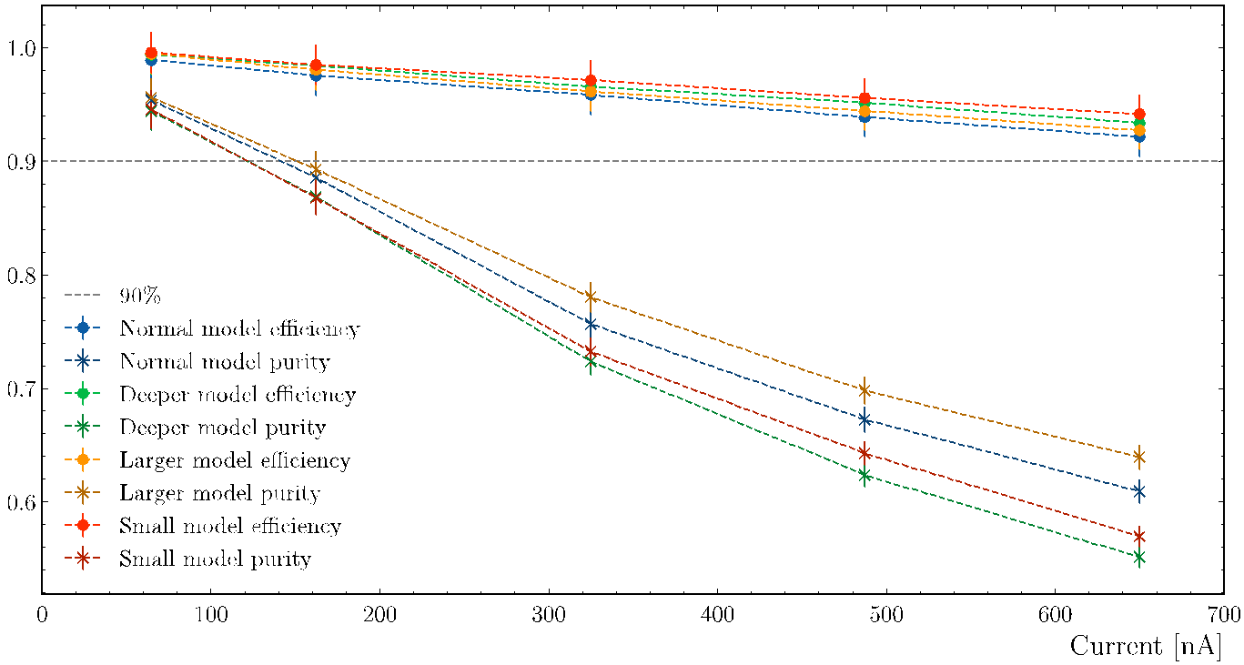
Efficiency and Purity vs. Current
Efficiency is always higher than 90% and the purity is between 55% and 95%
Blue: model with 20 neurons in 3 hidden layers
Orange: model with 100 neurons in 3 hidden layers
Green: model with 20 neurons in 5 hidden layers
Red: model with 20 neurons in 1 hidden layer

Slide 17
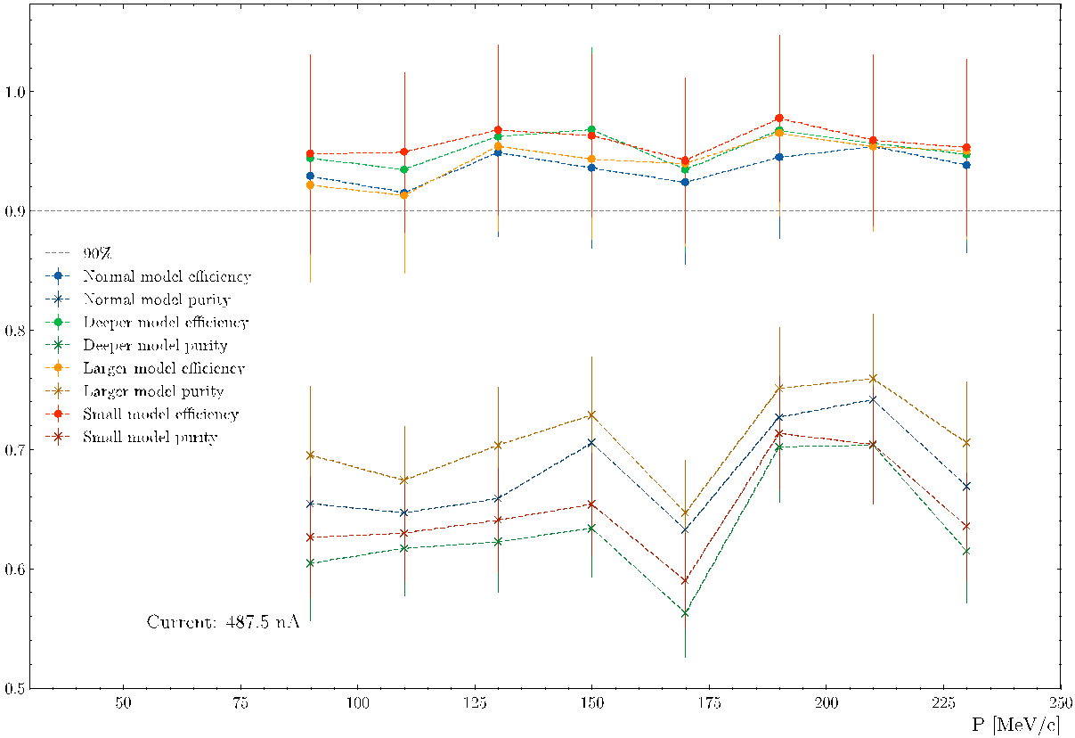
Efficiency and Purity vs. Momentum
Background is generated with current I = 487.5 nA
Constant efficiency and purity across the momentum range
Blue: model with 20 neurons in 3 hidden layers
Orange: model with 100 neurons in 3 hidden layers
Green: model with 20 neurons in 5 hidden layers
Red: model with 20 neurons in 1 hidden layer

Slide 18
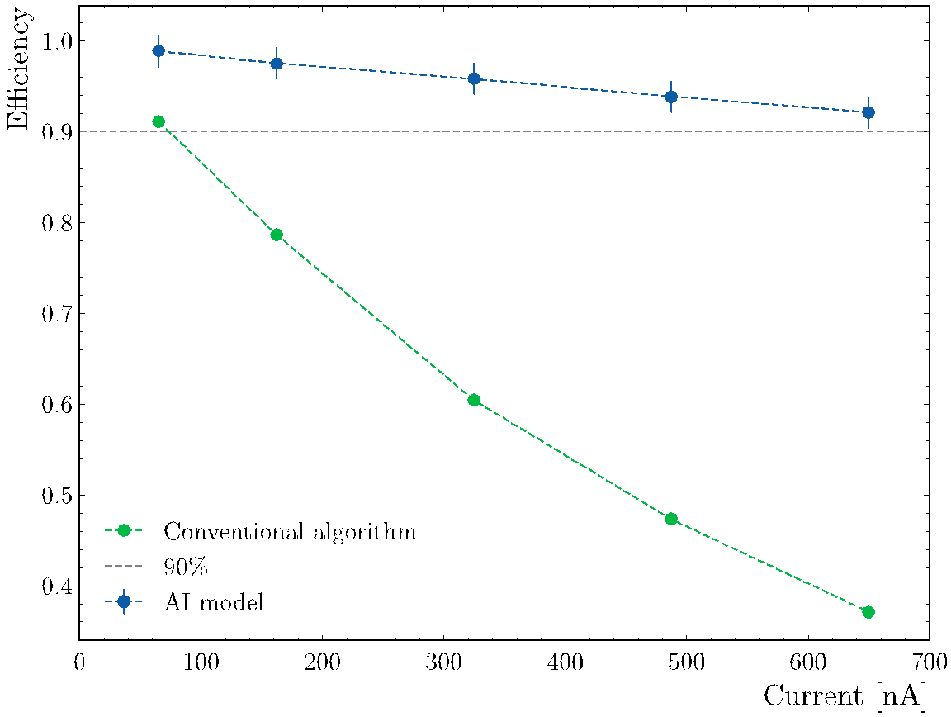
Conventional vs. AI-assisted Track Finding
Feed both algorithms with track candidates

Slide 19
Summary and Outlook
ALERT physics program:
Tagged processes will provide insight into the origin of the EMC effect
Tagged DIS measurements will help differentiate between models
Tagged DVCS will bridge the gap between partonic and nucleonic interpretations of the EMC ratio
Tagged measurements have better control on uncertainties associated with FSIs
We have developed an AI-assisted MLP for track finding:
Evaluated the model's efficiency and purity as a function of momentum, threshold, and current
Compared efficiency of conventional and AI-assisted algorithms
Efficiency is always higher than 90%
Future work:
Check the efficiency and purity of real data using elastic scattering
Improve the model with other information as input (energy deposited and angle between hits)
Thanks
This work is supported in part by the U.S. DOE award #: DE-FG02-07ER41528

