Slide 1



Study of Tagged Processes with ⁴He and ALERT at 22 GeV
Mathieu Ouillon
Mississippi State University
Science at the Luminosity Frontier: Jefferson Lab at 22 GeV
12 December, 2024

Slide 2
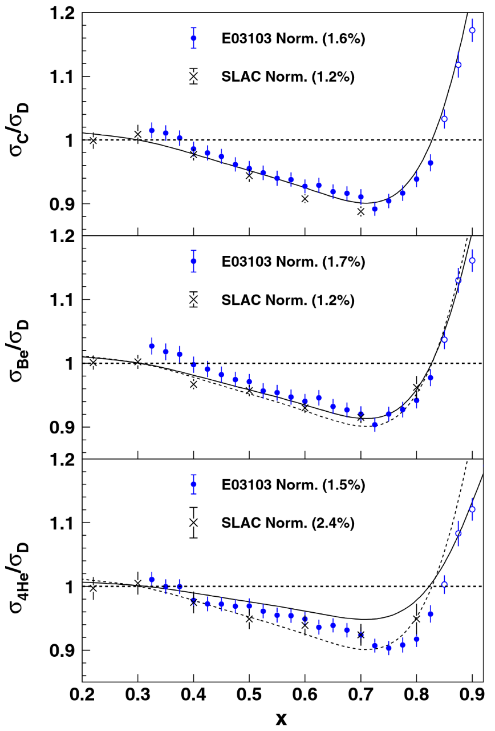
In-medium Structure and Effects
Modifications of bound nucleons properties and dynamics:
EMC effects at moderate Bjorken x, and shadowing at small x
Many models for the EMC effect
Significant even for ⁴He
The origin of the effect remains unclear
Nuclear modifications of DIS cross sections were probed by CERN, SLAC, and JLab experiments
Clear explanations may arise from studying the nuclear modifications via other reactions, such as Deeply Virtual Compton Scattering and Deeply Virtual Meson Production…
What is the partonic structure of nuclei?
J. Seely et al. Phys.Rev.Lett. 103 (2009) 202301

Slide 3
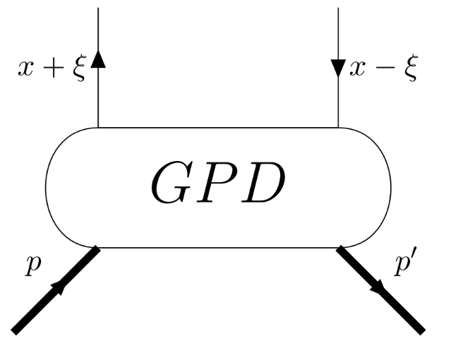
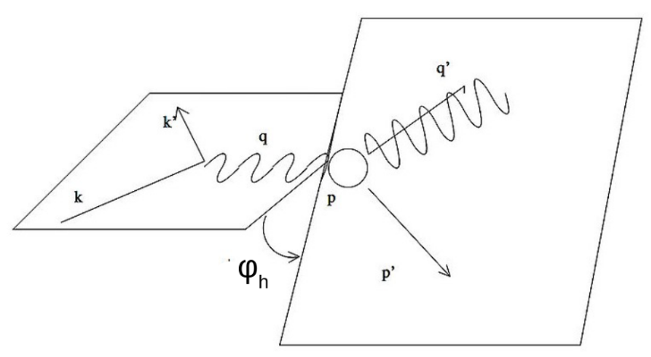

Generalized Parton Distributions
GPDs describe the nucleon structure in terms of longitudinal momentum and transverse position:
Three dimensions: x, ξ and t
Spin-0 → 2 GPDs, Spin-1/2 → 8 GPDs, Spin-1 → 18 GPDs
Accessible through exclusive processes such as DVCS, DVMP, Time-like Compton Scattering, Double DVCS…
Experimental efforts (JLab, HERA, CERN) mainly focused on proton, which triggered the need for neutron studies
x +/- ξ is the momentum fraction of the initial/final quark.
Leptonic plane
Hadronic plane

Slide 4
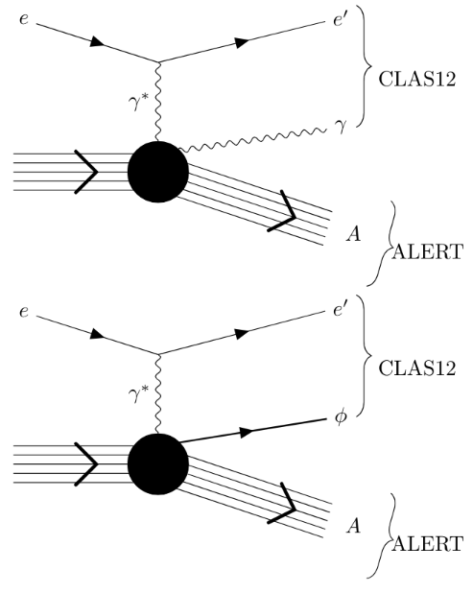
DVCS on ⁴He
Provides a straightforward access to GPDs
Advantages of using such a probe on ⁴He:
Only two GPDs for ⁴He: H (chiral-even) and H_{T} (chiral-odd)
Ensure model independent extraction for the coherent DVCS Beam Spin Asymmetries
A few body system that is theoretically well known
Realistic calculations are difficult, but possible
Ability to explore two tagged processes:
Coherent DVCS: access to non-nucleonic degrees of freedom
Incoherent DVCS: access to nucleonic modifications in the cold nuclear environment
But, would it be studied regardless of its
small cross section?
large energy gap between recoiled target fragments and outgoing forward particles (electron and photon)?

Slide 5
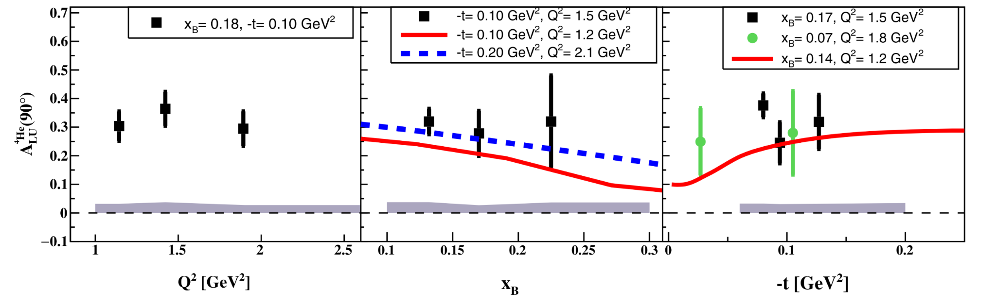
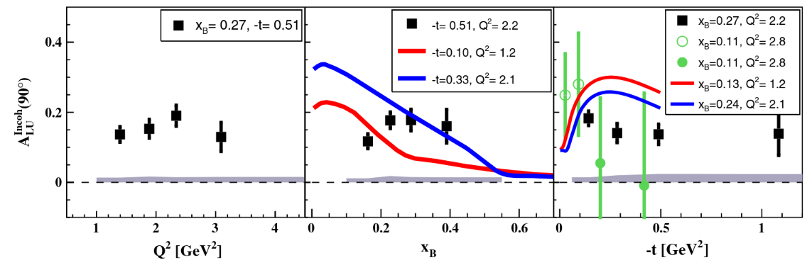
Previous 6 GeV Experiment with CLAS (EG-6 Experiment)
Results extracted for
First exclusive coherent DVCS on tagged ⁴He
Incoherent DVCS on ⁴He via spectator tagging of target fragments
Detected ⁴He using a Radial Time Projection Chamber for which
the response was slow
identified only ⁴He
rates were limited, and could not be part of the CLAS6 trigger
Coherent/Incoherent DVCS (top/bottom)
M. Hattawy et al., Phys. Rev. Lett. 119, (2017) 202004
M. Hattawy et al., Phys. Rev. Lett. 123, (2019) 032502

Slide 6
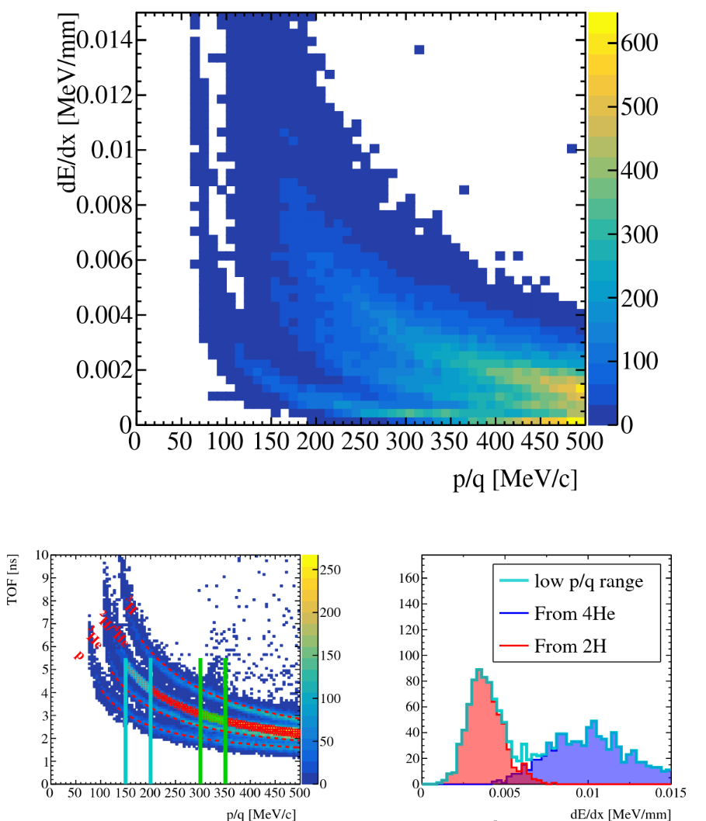
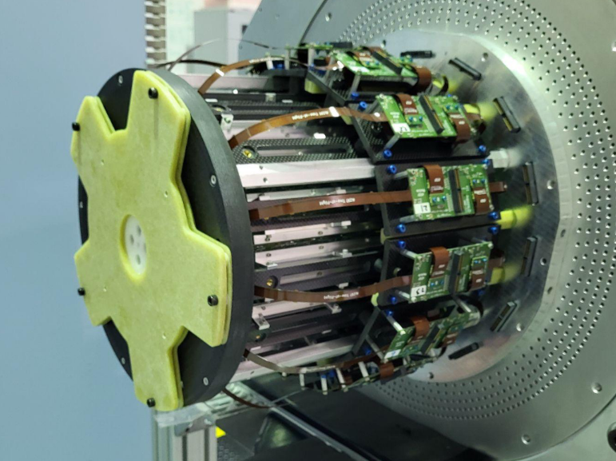
CLAS12 ALERT Experiment
Aim to identify light ions: H, ²H, ³H, ³He, and ⁴He
Detect the lowest momentum possible, down to 70 MeV/c
Handle high CLAS12 rates and luminosities
ALERT is composed of a hyperbolic drift chamber (AHDC) and a time of flight (ATOF);
The TOF measurement is degenerate for ²H and ⁴He, but dE/dx can distinguish the two nuclei bands

Slide 7
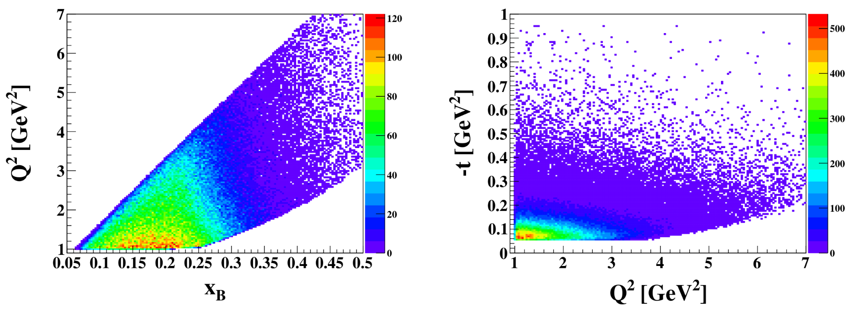
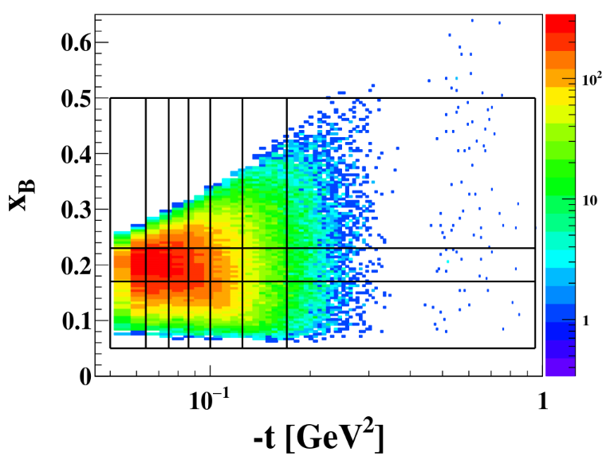
Coherent DVCS with CLAS12 ALERT
Proposed measurements of coherent DVCS on ⁴He aim to
extract BSA, A_{LU}
use a high luminosity: 20 PAC days at 1.5x10³⁴cm⁻²s⁻¹, and 10 PAC days at 0.75x10³⁴cm⁻²s⁻¹
utilize a 55-cm-long gaseous target
run with approximately 80% beam polarization
cover a phase space consisting of 7 bins in -t, 3 bins in x_{B}, and 12 bins in ɸ_{h}
detect scattered electron and a real photon with CLAS12, and ⁴He with ALERT
identify ⁴He with momenta in the range of 230< p< 400 MeV/c

Slide 8
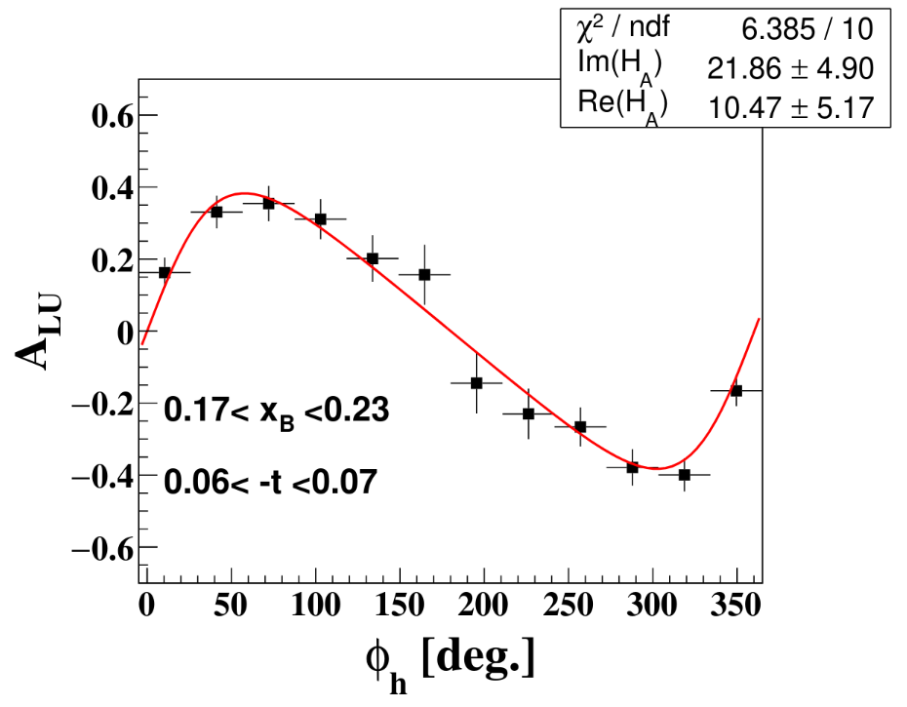
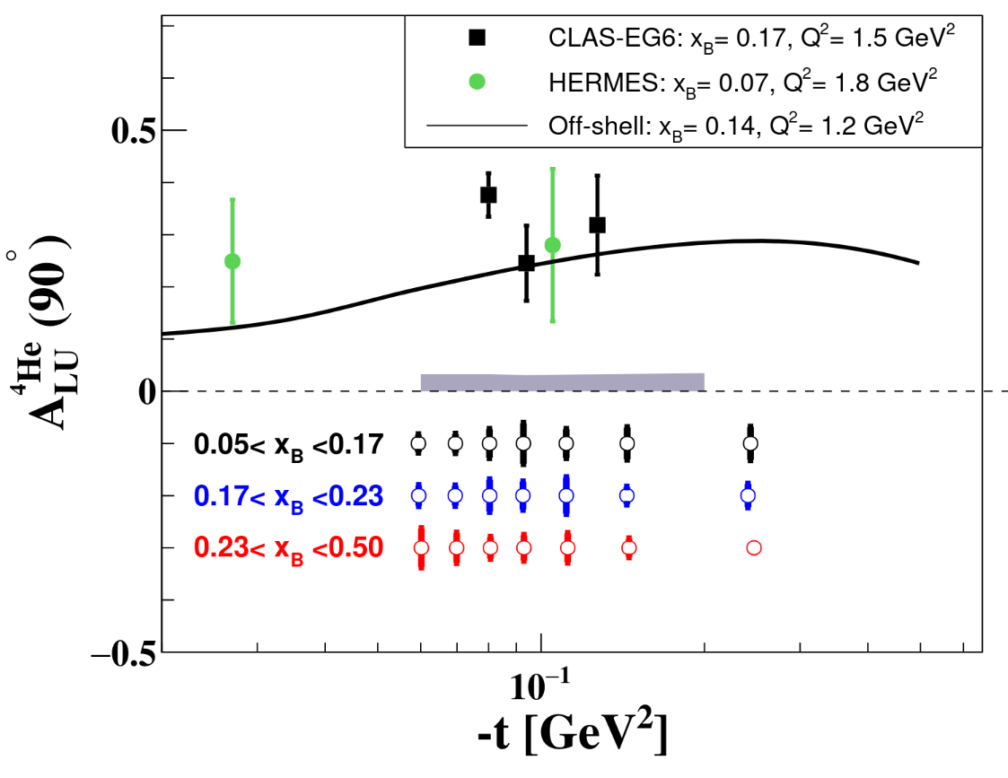
Coherent DVCS with CLAS12 ALERT
Get an estimation of projected precision for A_{LU}(90°)
Extract real and imaginary part of the Compton Form Factor, H_{A}

Slide 9
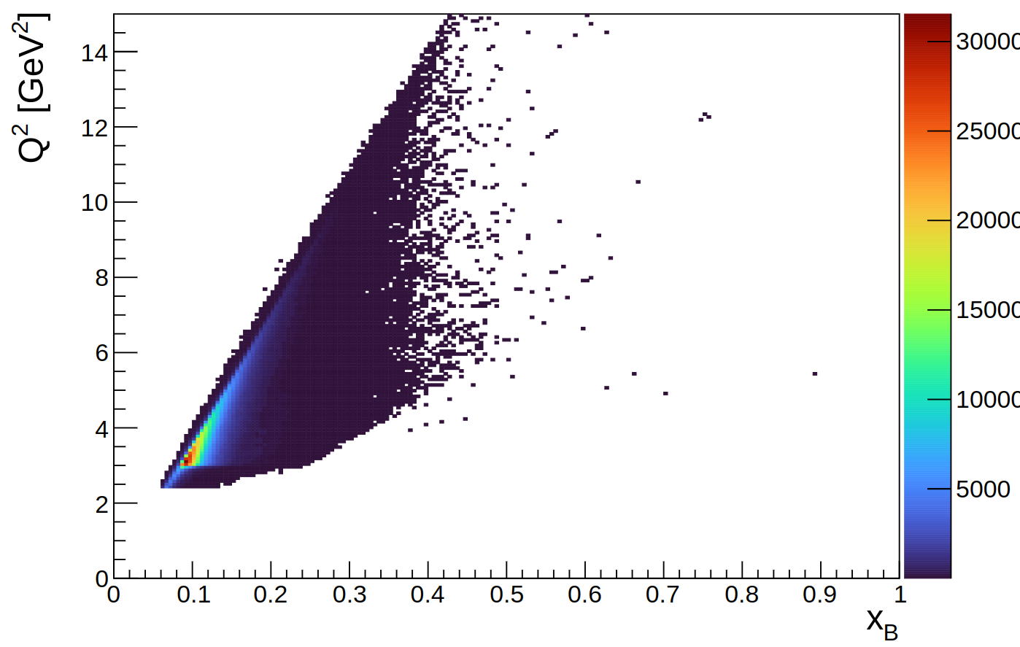
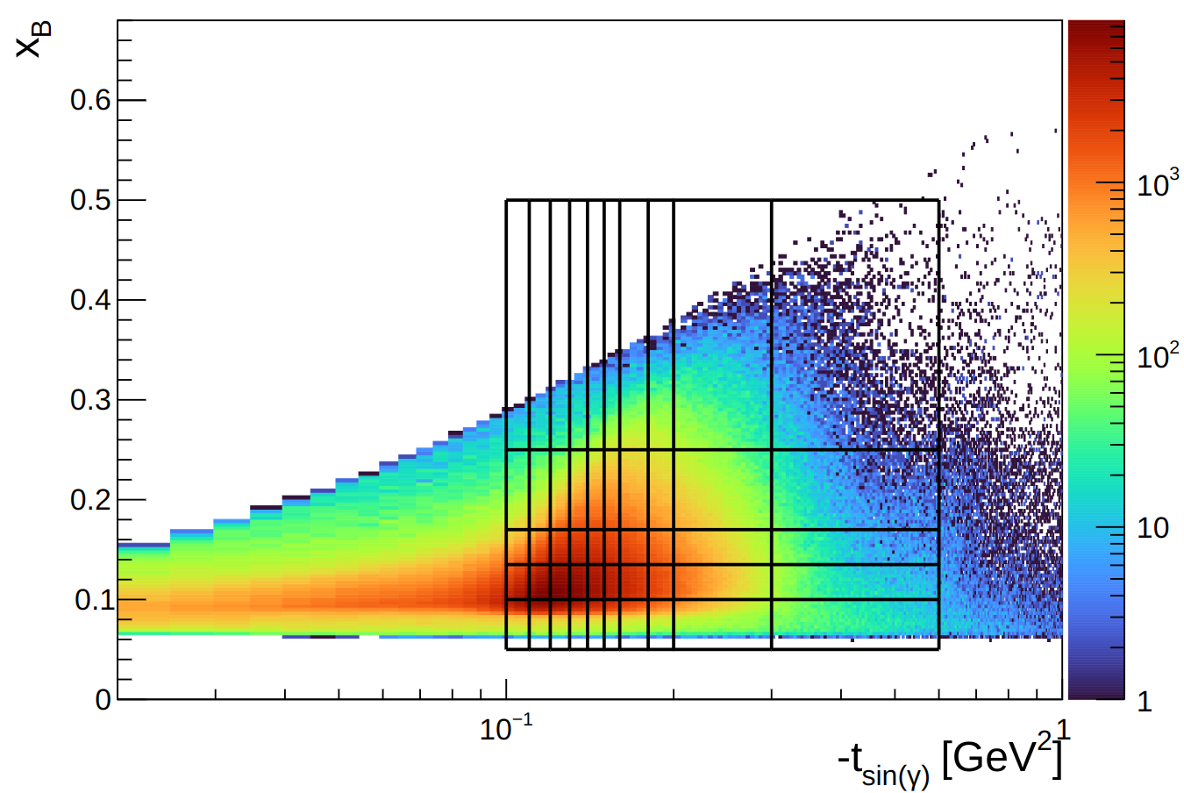
Coherent DVCS with ALERT @ 22 GeV
Performed the 22 GeV simulation of coherent DVCS on ⁴He using
TOPEG, The Orsay-Perugia Event Generator,
CLAS12 and ALERT GEant4 Monte-Carlo packages as well as their up-to-date event reconstruction chains
10 bins in -t, 5 bins in x_{B}, and 12 bins in ɸ_{h}

Slide 10
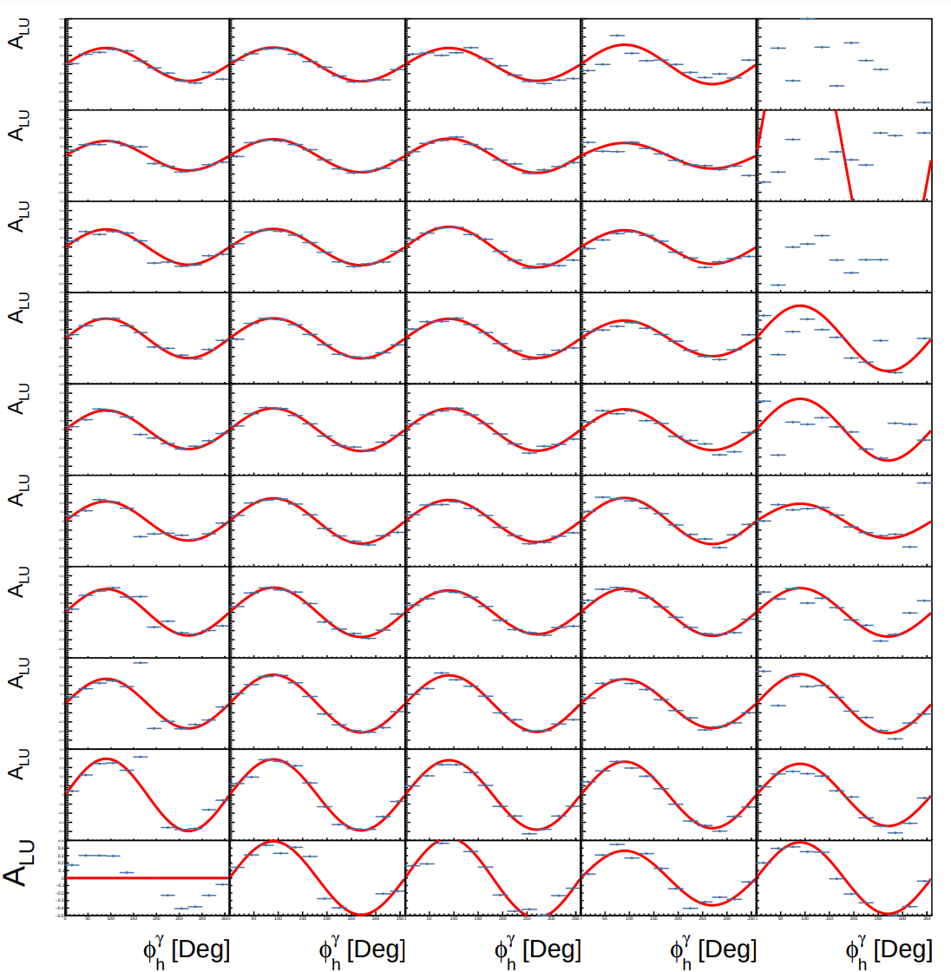
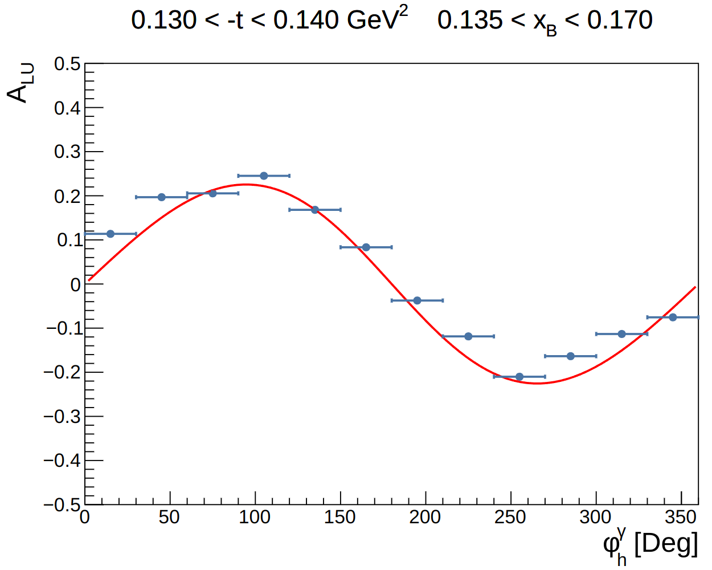
Coherent DVCS with ALERT @ 22 GeV
x_{B}
Projections for the ALERT BSA @ 22 GeV:
Beam time: 20 PAC days
Luminosity: 2·10³⁵ cm² s⁻¹, but just 1·10³⁵ cm² s⁻¹ is considered in this extraction since only half of the target is contained within the ALERT detector
Beam polarization: 80%
-t [GeV²]

Slide 11
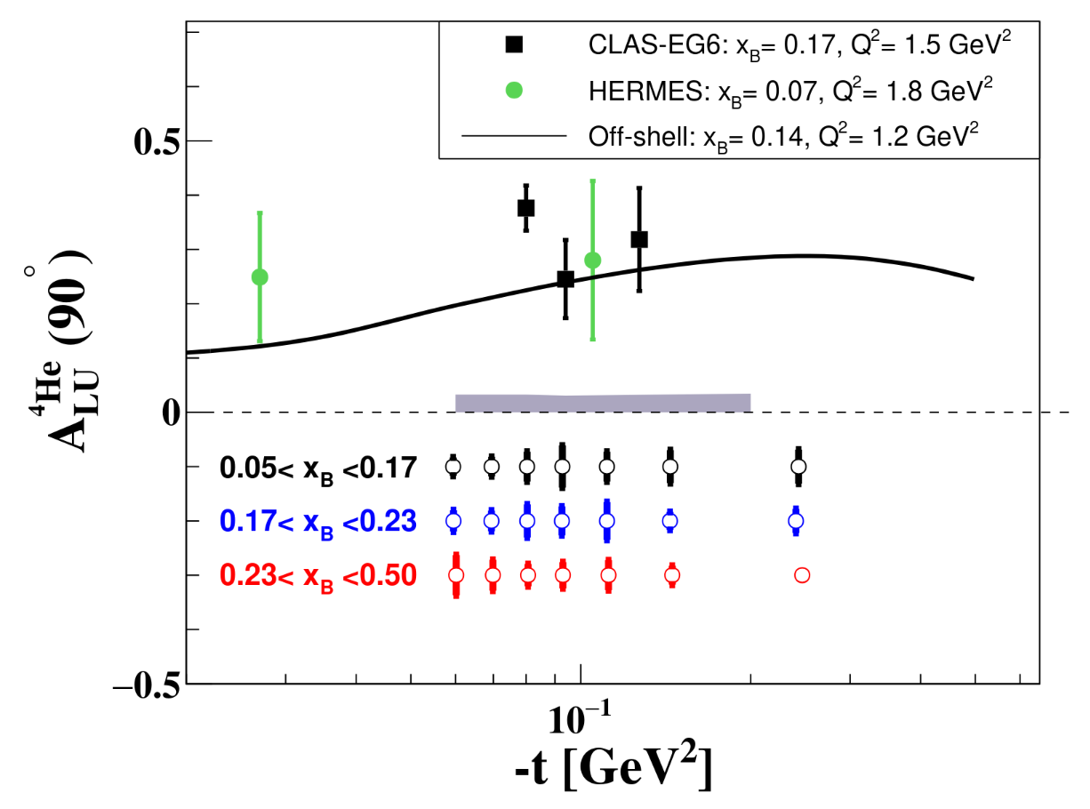
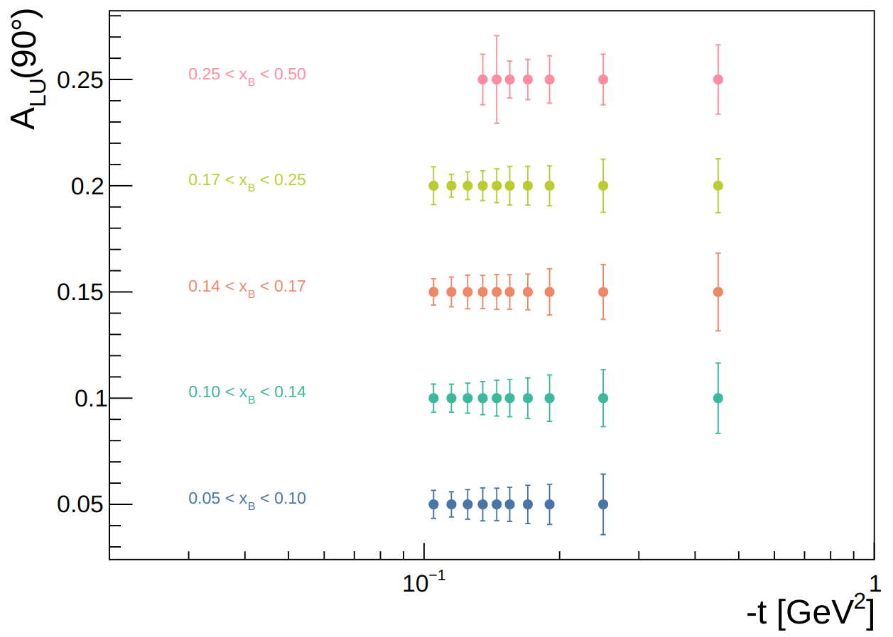
Coherent DVCS with ALERT @ 22 GeV
Projections for the ALERT BSA @ 90◦, A_{LU}(90◦)
ALERT at 12 GeV
ALERT at 22 GeV

Slide 12
Summary and Outlook
Study coherent DVCS on ⁴He to explore the partonic structure of nuclei
The performed 22 GeV studies deployed the up-to-date CLAS12 and ALERT simulation and reconstruction chains
Extract BSA for the entire angular coverage as well as at 90°
The 22 GeV upgrade will allow
access to smaller x_{B}, larger Q², and finer kinematical binning in both -t and x_{B}
extract CFF and GPDs for a broader kinematical coverage compared to forthcoming CLAS12 ALERT measurements
Could explore other tagged processes such as incoherent DVCS

Slide 13
Summary and Outlook
Study coherent DVCS on ⁴He to explore the partonic structure of nuclei
The performed 22 GeV studies deployed the up-to-date CLAS12 and ALERT simulation and reconstruction chains
Extract BSA for the entire angular coverage as well as at 90°
The 22 GeV upgrade will allow
access to smaller x_{B}, larger Q², and finer kinematical binning in both -t and x_{B}
extract CFF and GPDs for a broader kinematical coverage compared to forthcoming CLAS12 ALERT measurements
Could explore other tagged processes such as incoherent DVCS
Thank you; Questions?
This work is supported in part by the U.S. DOE award #: DE-FG02-07ER41528

