Slide 1
Group meeting
Mathieu Ouillon (Mississippi State University)
01/27/26

Slide 2
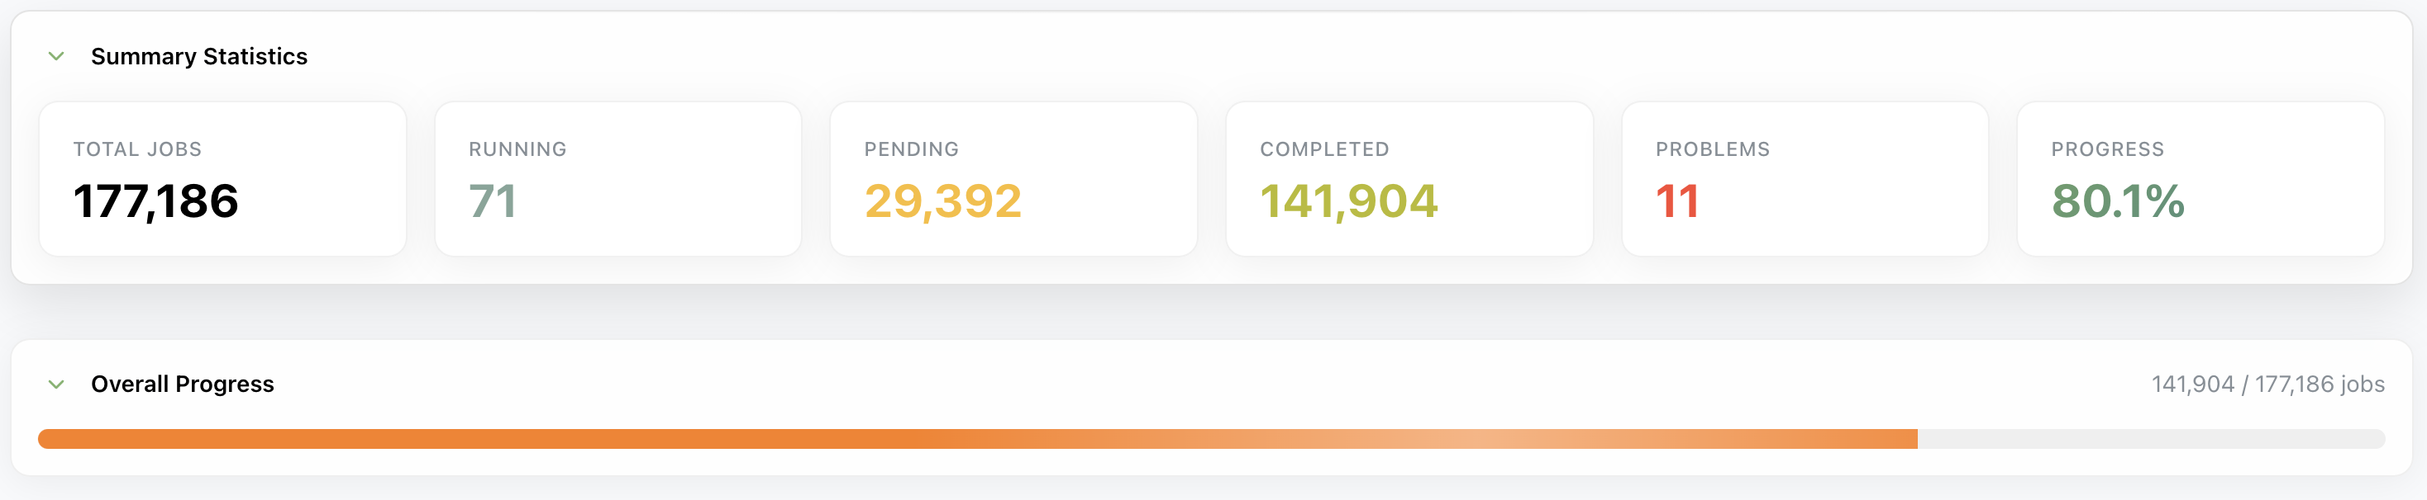
RG-D cooking
Few issues with the CxC_2 cooking workflows:
Decoding of the file: clas_018401.evio.00546
Reconstruction of the file clas_018345.evio.00610-00610.hipo
Missing J/Psi trains

Slide 3
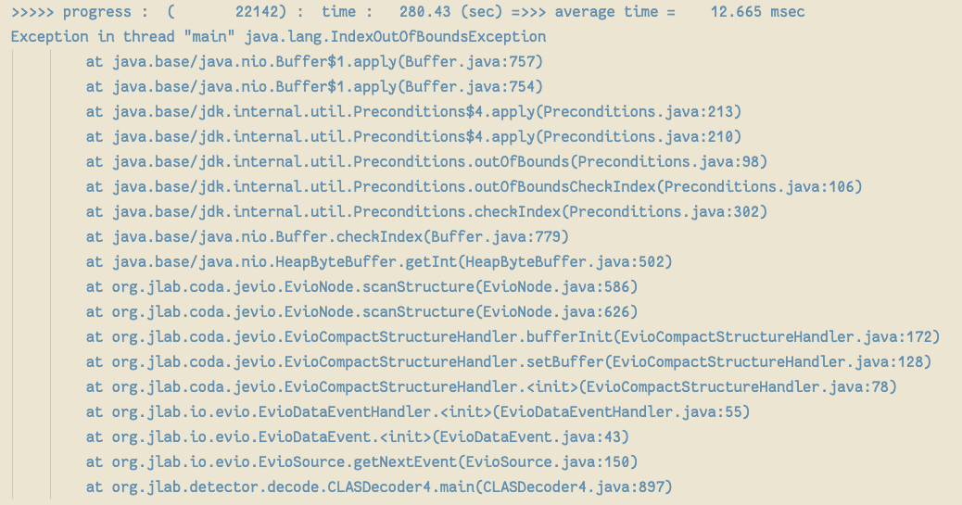
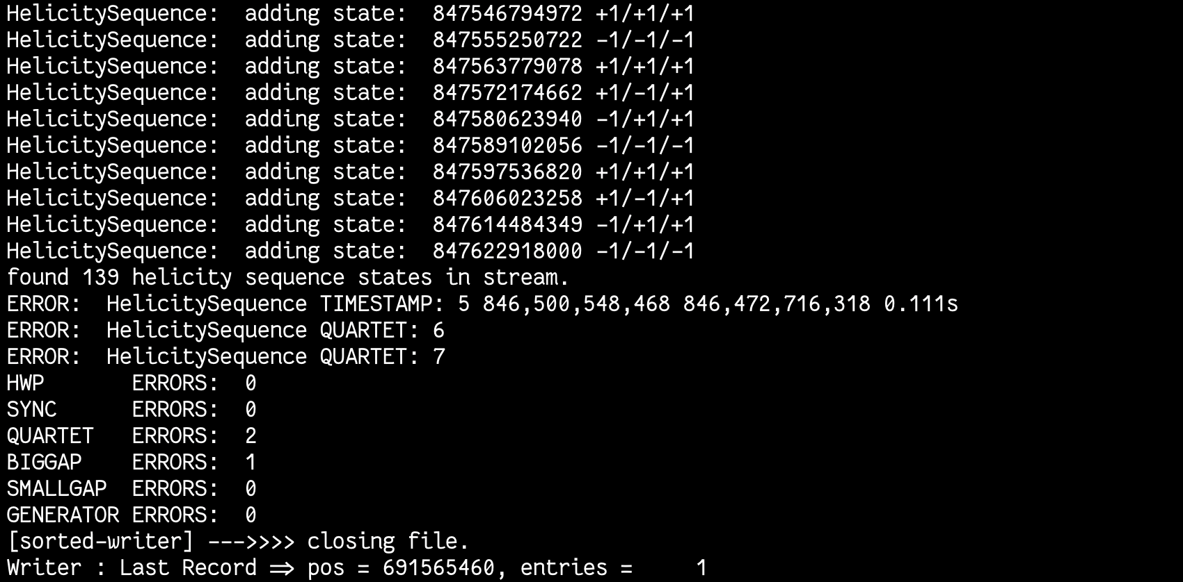
RG-D cooking: Decoding of the file: clas_018401.evio.00546
Error during the decoding of the file.
I asked Nathan, and he told me that it can’t be solve. It is a random error.
Make decoding of clas_018401.evio.0054{5,7,8,9} failed since they are in the same job and then reconstruction of these 4 files never start
Solution: Nathan fix the decoder for us, now I just have do to the reconstruction and then copy all the files to /cache

Slide 4
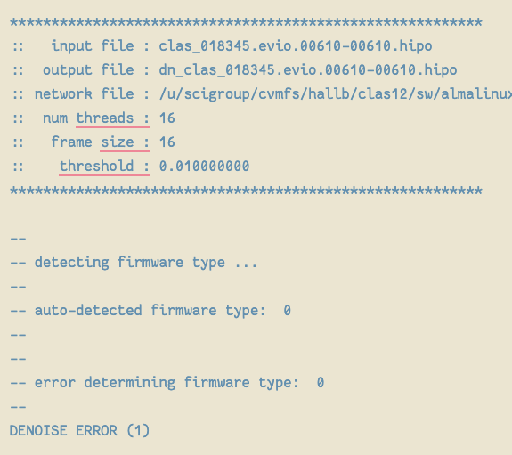
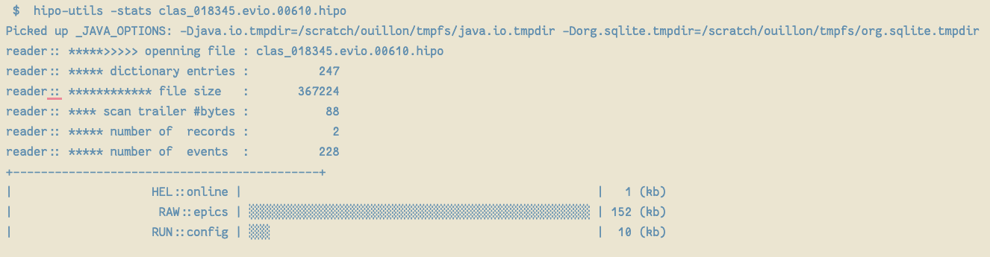
RG-D cooking: Reconstruction of the file: clas_018345.evio.00610-00610.hipo
Error during the reconstruction (denoising) of the file.
It is the last file of the run 18345
And it empty, only RAW::epics, RUN::config and HEL::online bank
Solution: do nothing

Slide 5
RG-D cooking: Missing J/Psi trains
Missing trains for these runs: '018345', '018401', '018445', '018446', '018451', '018452', '018453', '018454', '018459', '018460', '018461', '018463', '018464', '018465', '018468', '018821', '018822', '018823', '018824', '018827', '018828', '018831', '018832', '018833', '018835', '018836', '018837', '018838', '018839', '018840', '018844', '018847', '018849', '018850’
Total: 34 runs
Solution: run the train tool by hand. It quite easy to run. And then copy them to /cache.

Slide 6
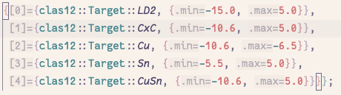
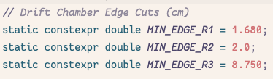
RG-D: Nuclear transparency
I continue the work on the nuclear transparency study:
Look at the old code to get the nuclear transparency that I have
Improve the code and use the improve electron and pion cuts
Extract again the nuclear transparency as a function of Q² and l_{c}
Use pass1 data: 10%, only Outbending
Electron selection:
pid = 11, -4000 < status <= -2000, |chi2pid| < 5
p > 0.8 GeV/c, Vz target dependant,
Fiducial cuts: SF vs p, lv > 9 cm, lw > 9 cm and DC edge

Slide 7
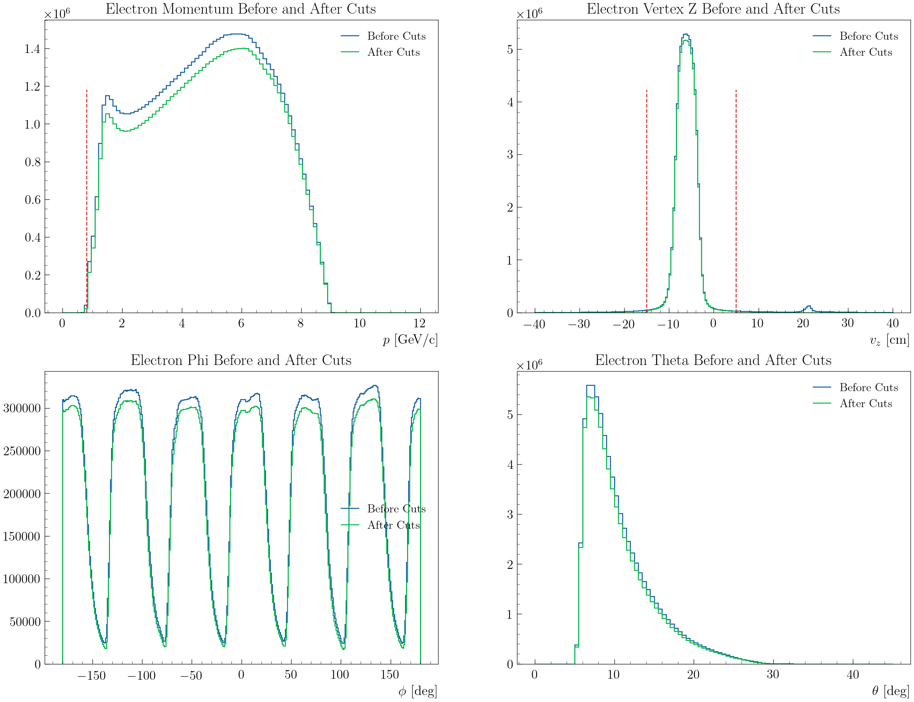
RG-D: Nuclear transparency
Electron kinematics:
For LD2 outbending

Slide 8
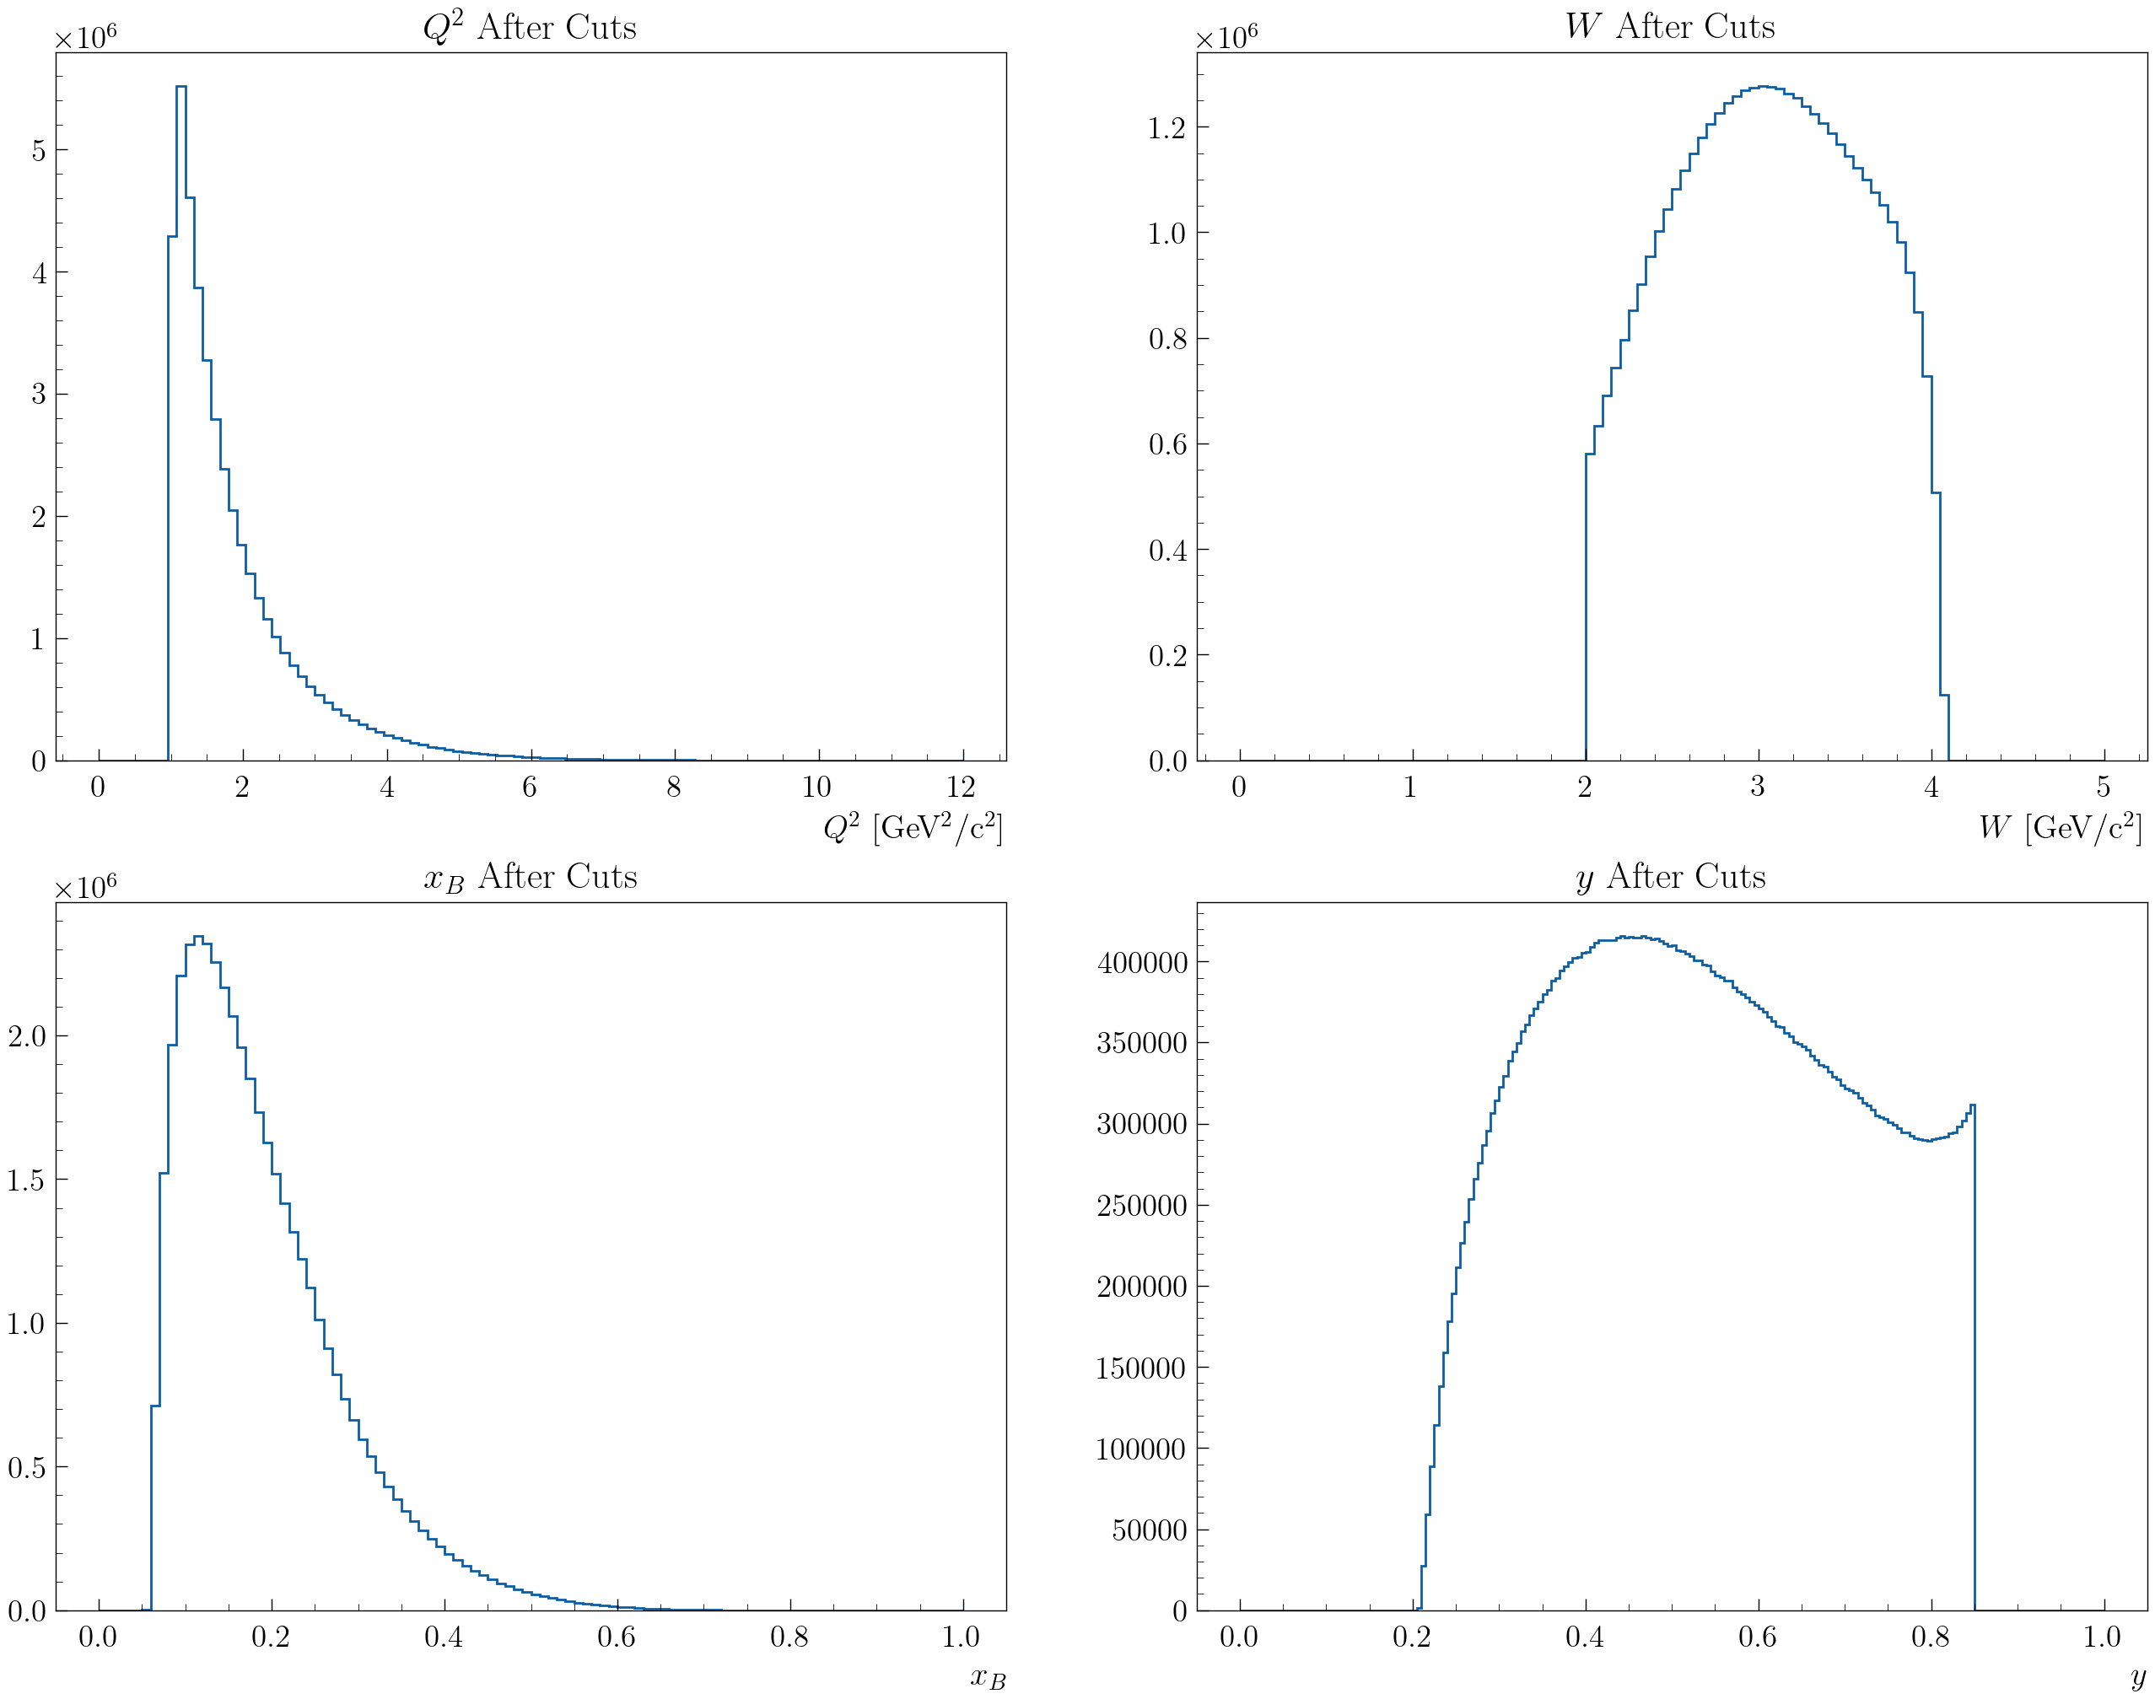
RG-D: Nuclear transparency
DIS kinematics:
Q² > 1 GeV², W > 2 GeV and y < 0.85

Slide 9
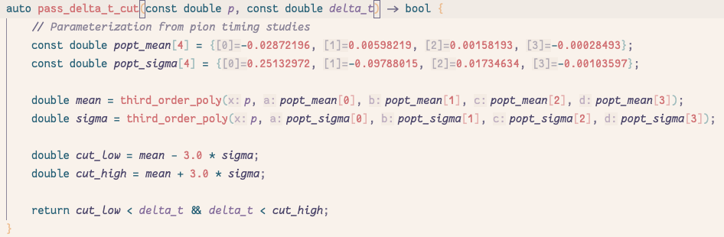
RG-D: Nuclear transparency
Pions:
Forward detector: 2000 <= status < 4000
|Chi2pid| < 10, 0.3 < p, Δt cuts

Slide 10
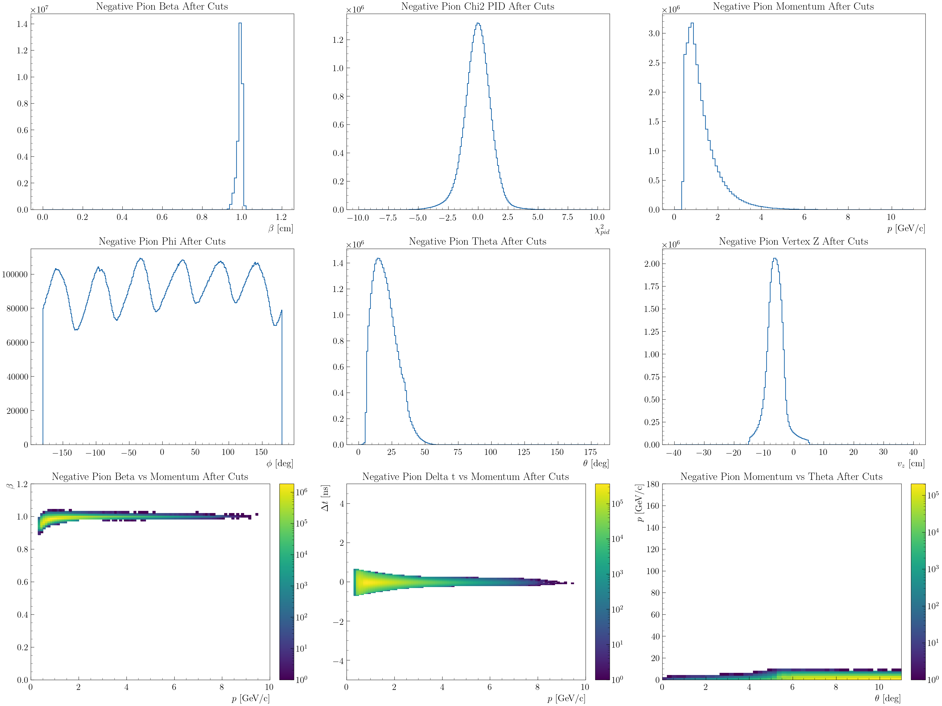
RG-D: Nuclear transparency

Slide 11
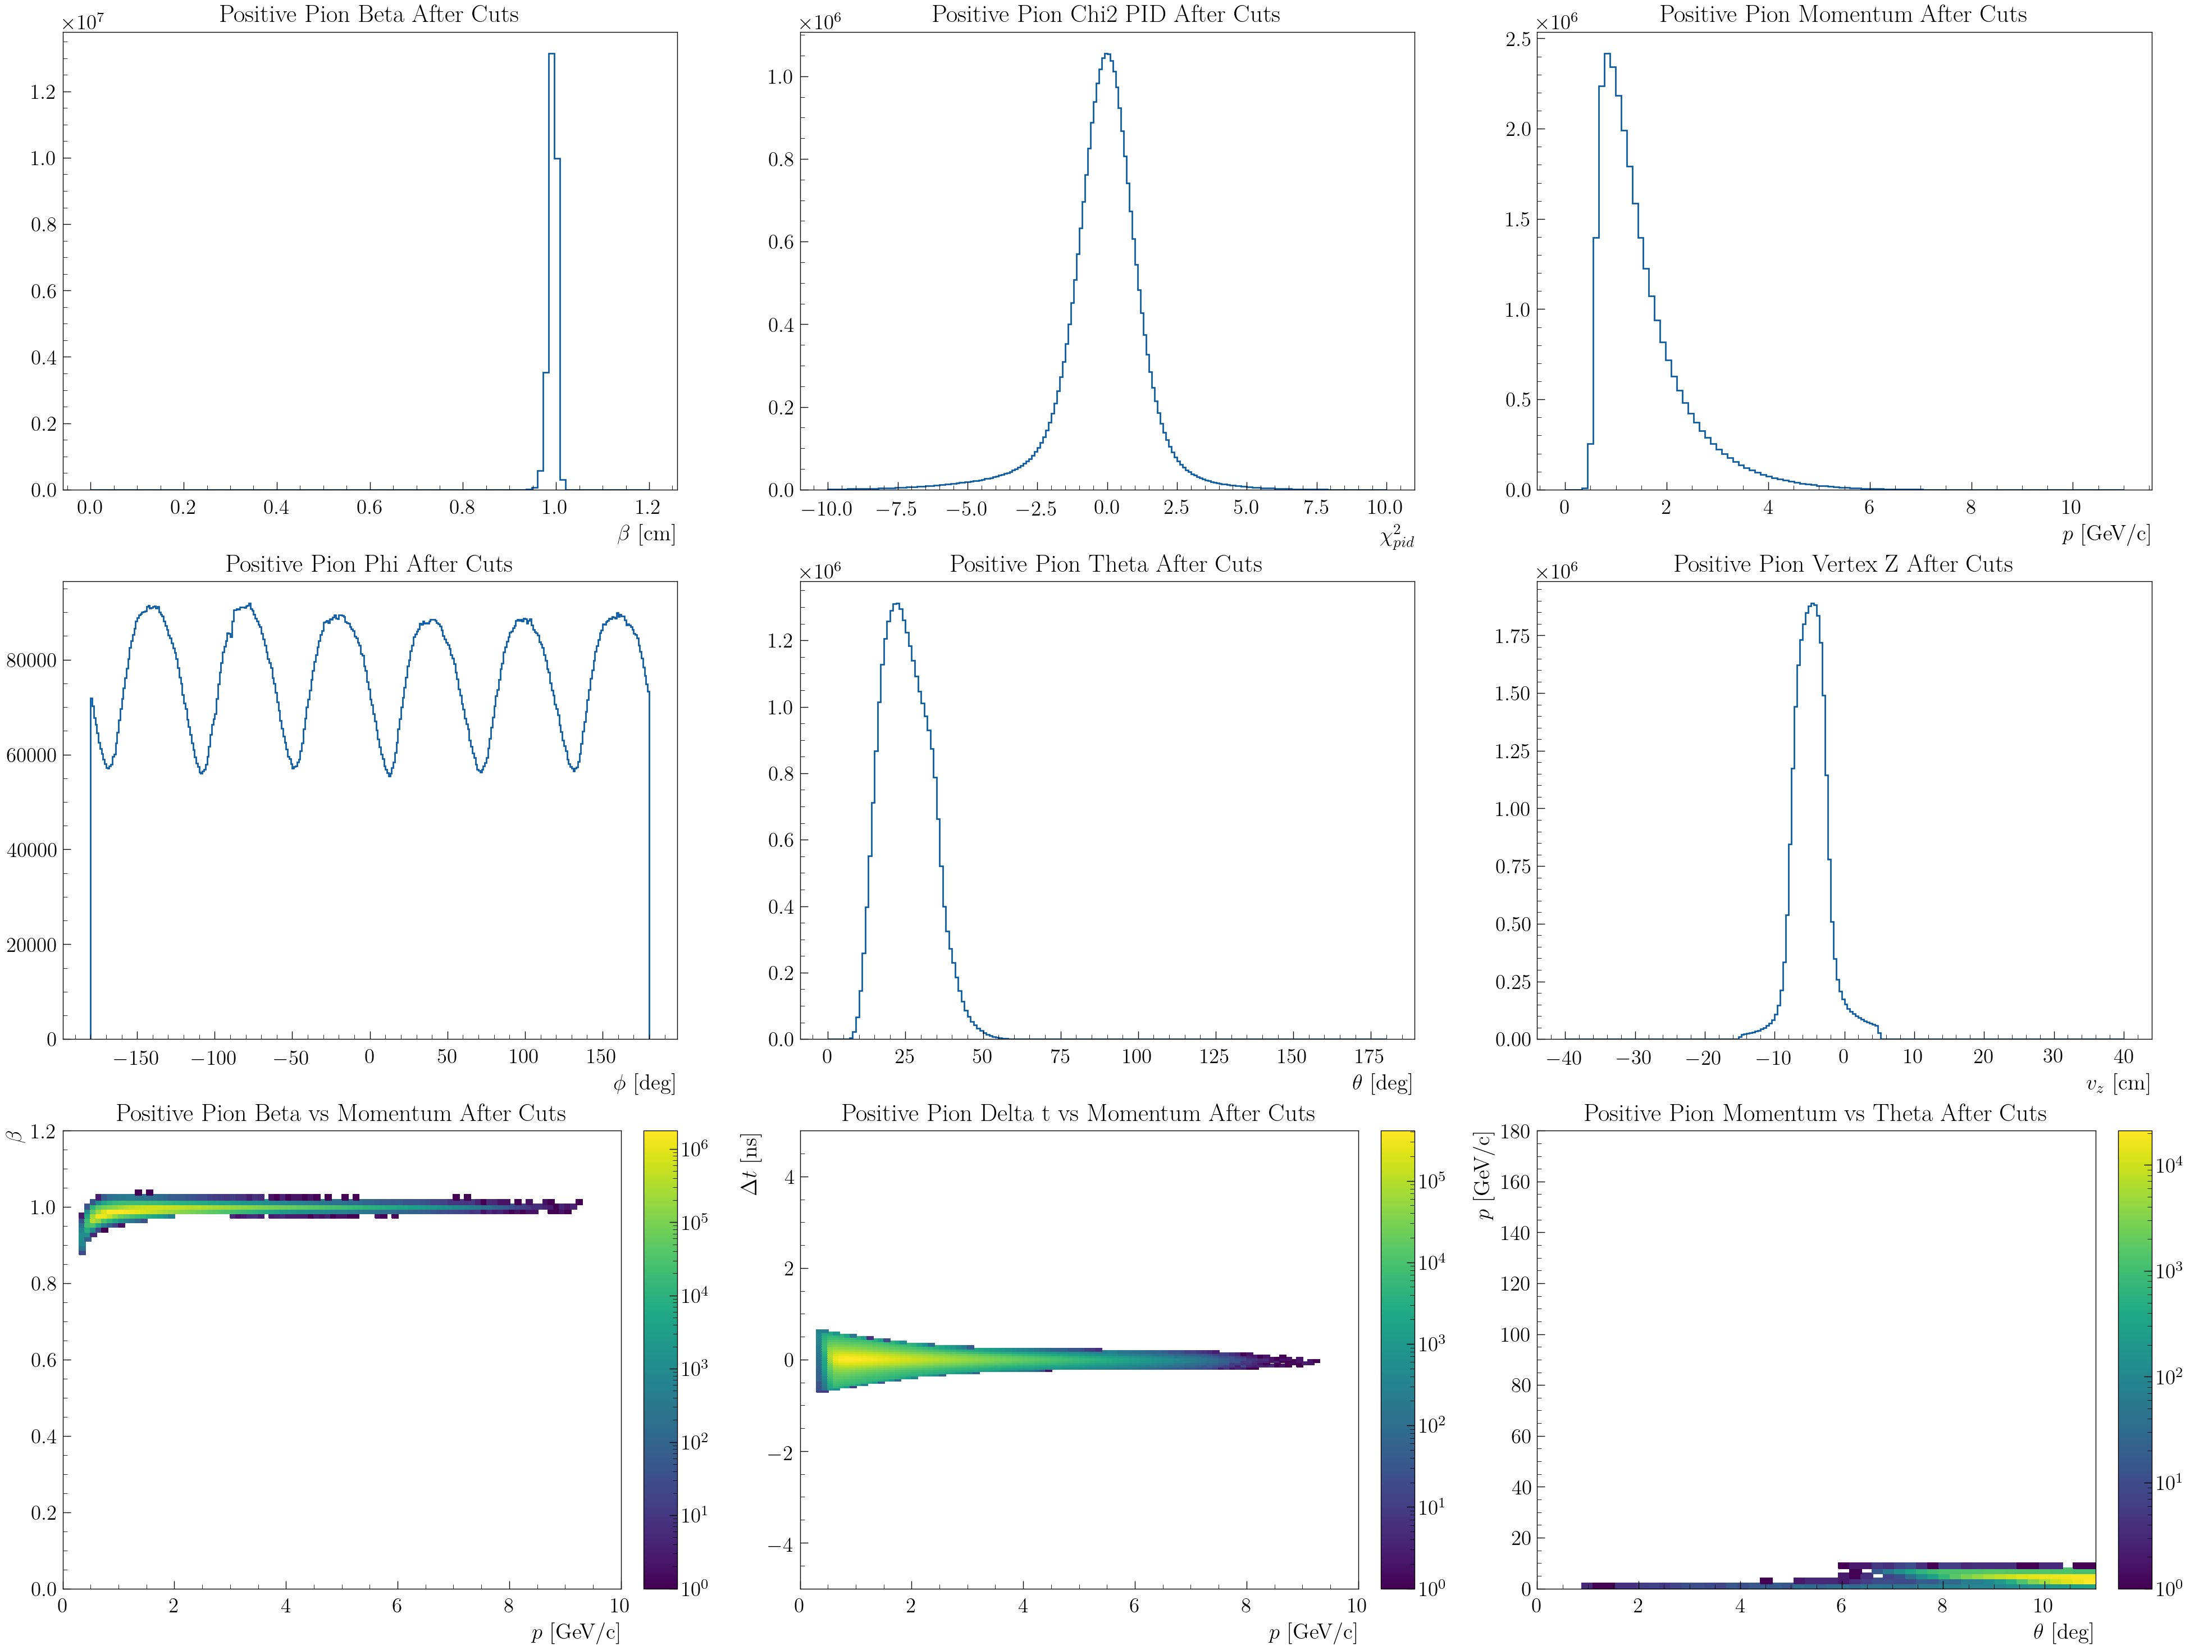
RG-D: Nuclear transparency

Slide 12
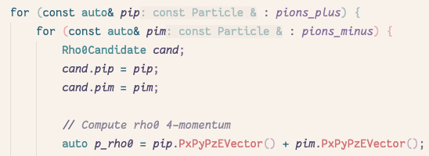
RG-D: Nuclear transparency
ρ⁰ reconstruction:
Event with a good DIS electron, at least on good π⁻ and π⁺
ΔVz cut: |Vz_{e}-Vz_{π+/-}| < 5 cm: to have the electron and pion from the same target
z_{h} > 0.9, l_{c} < 1 fm and 0.1 < -t < 0.5
Generate all ρ⁰ candidates:

Slide 13
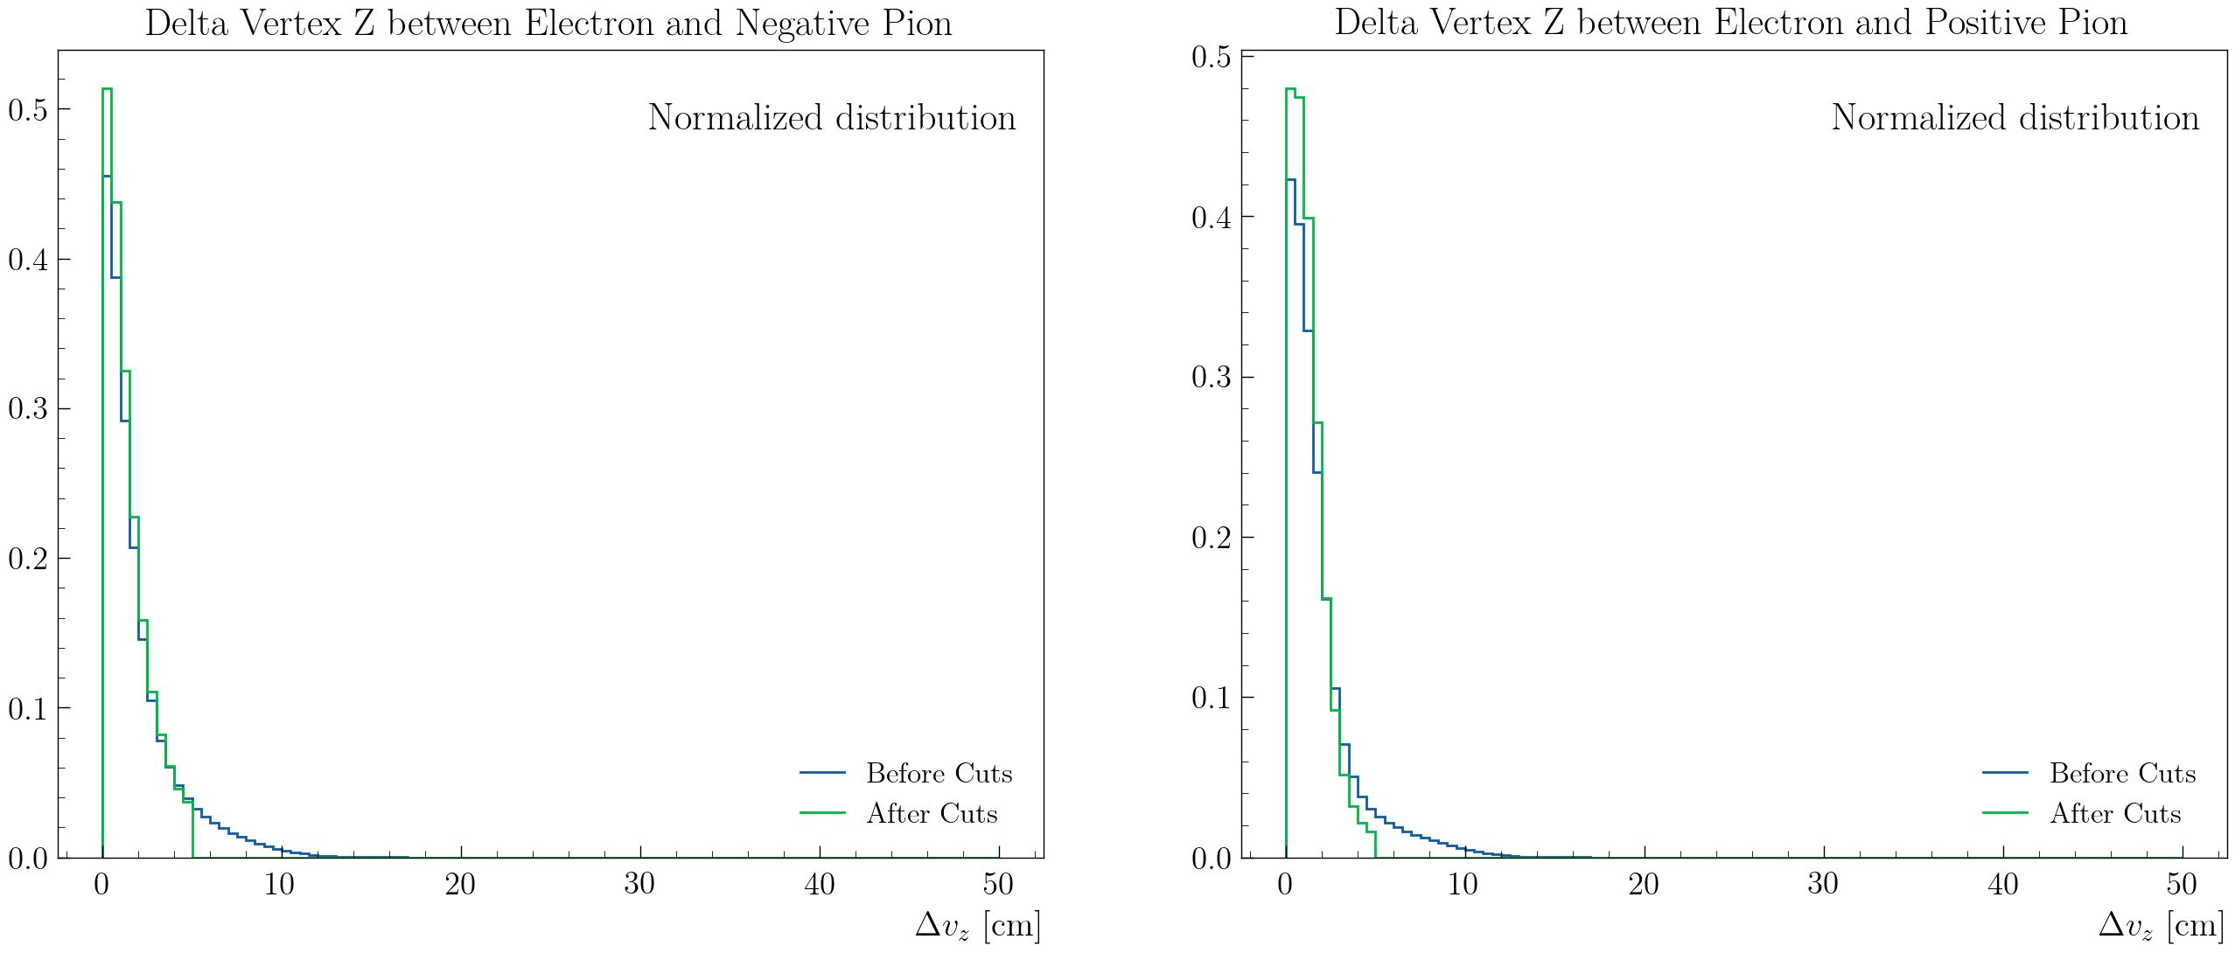
RG-D: Nuclear transparency
ΔVz cut: |Vz_{e}-Vz_{π+/-}| < 5 cm

Slide 14
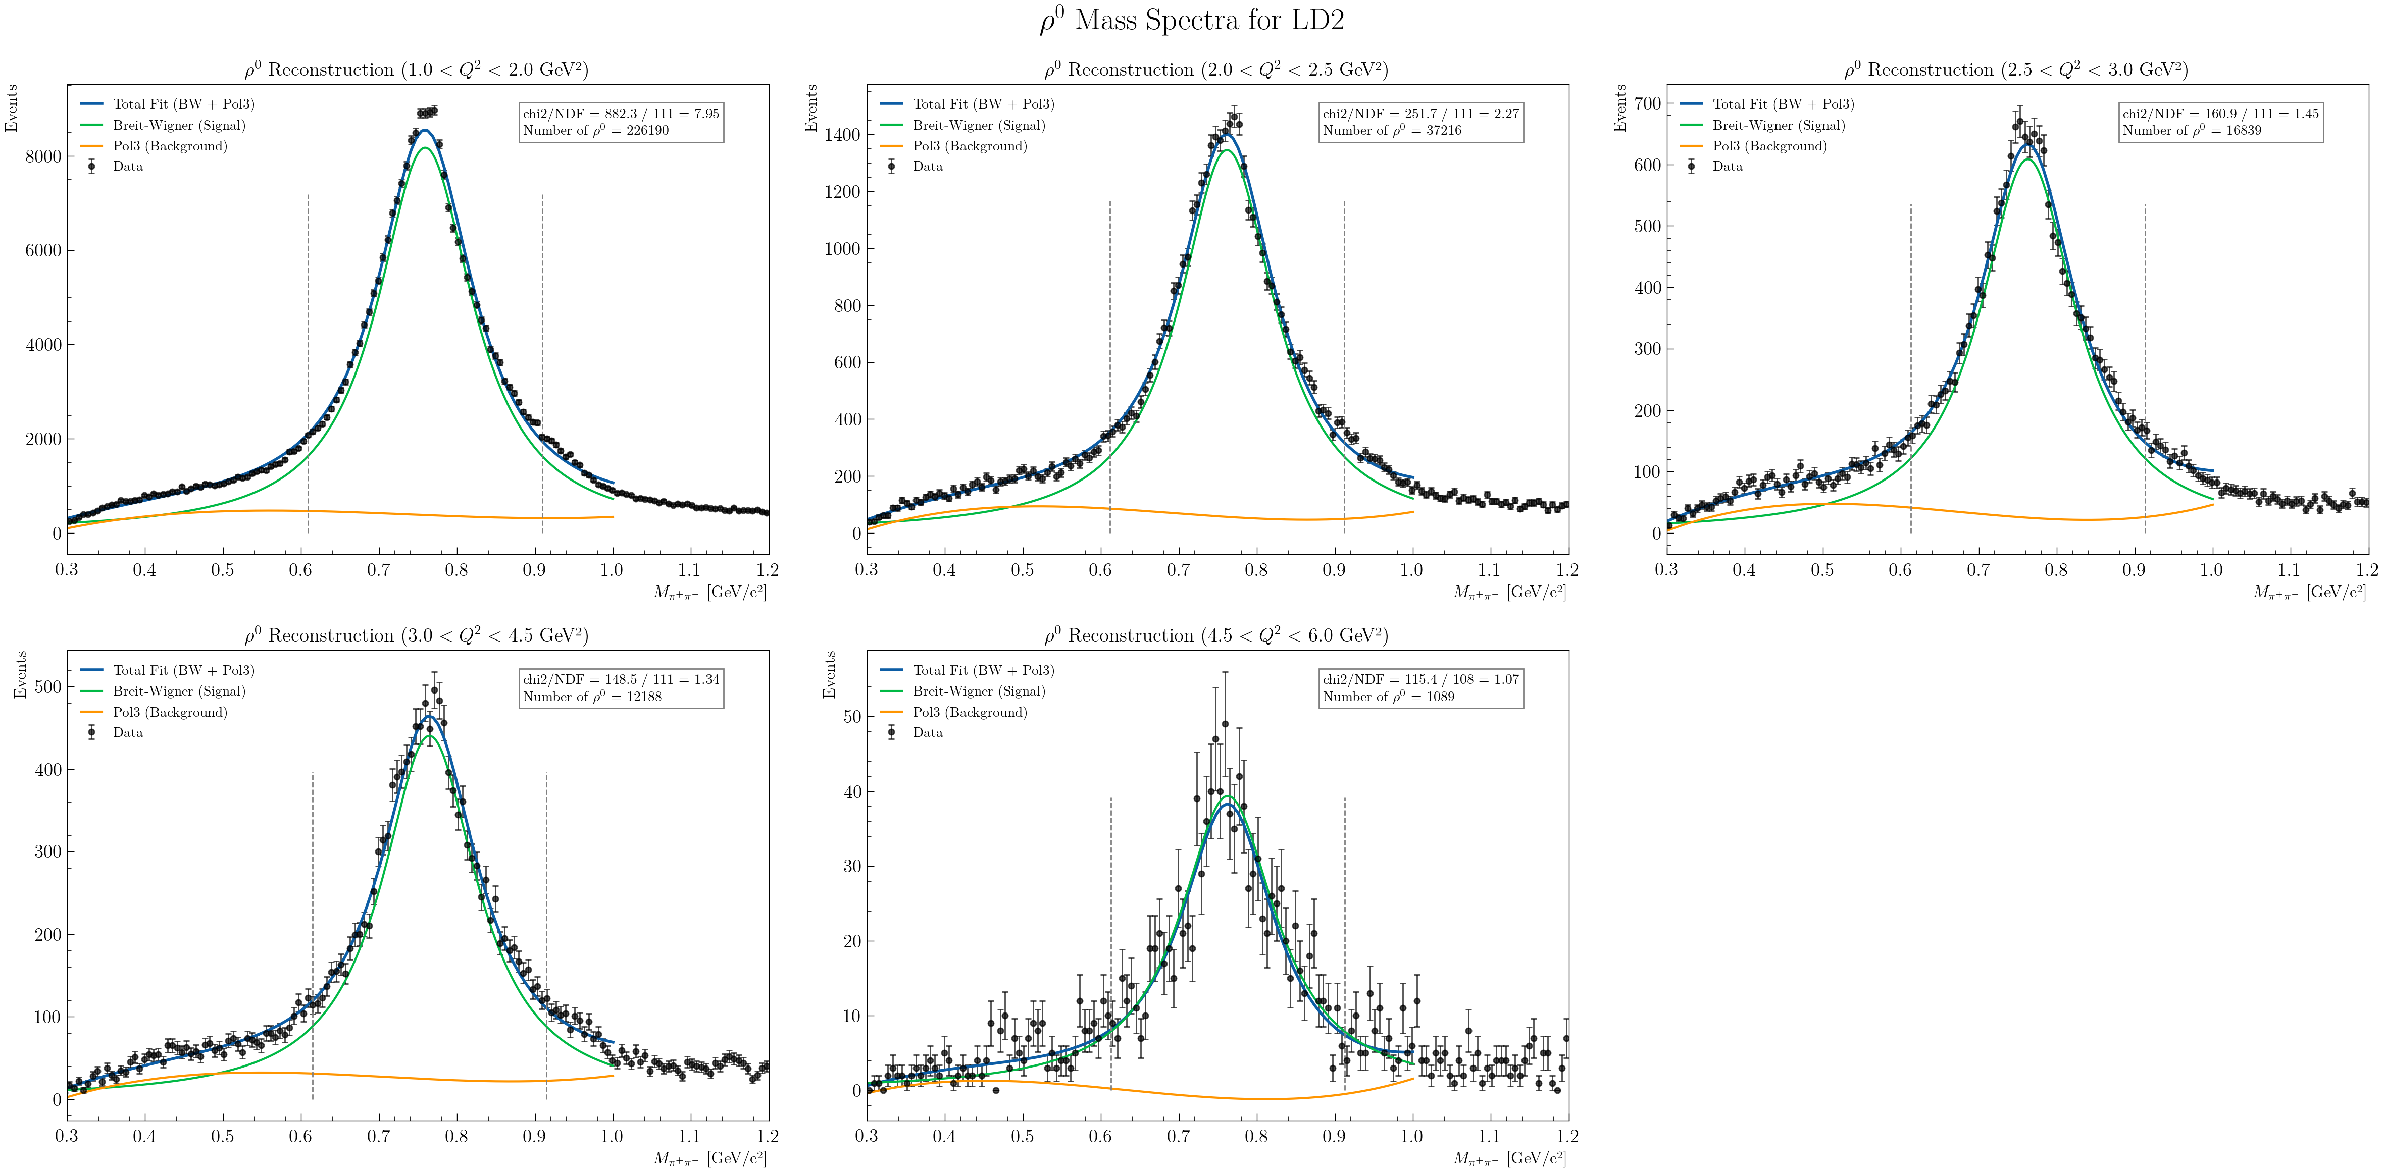
RG-D: Nuclear transparency
Invariant mass of the two pions for LD2:

Slide 15
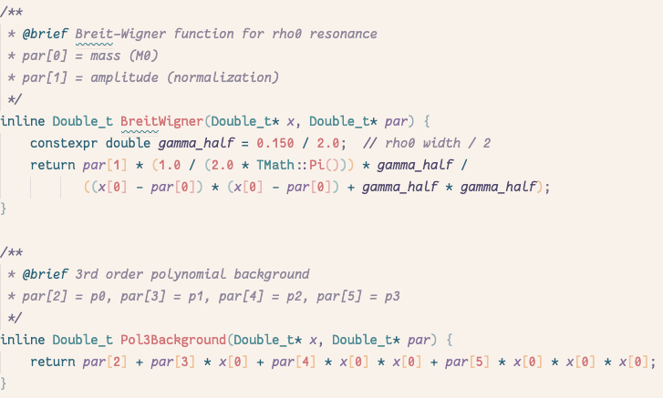
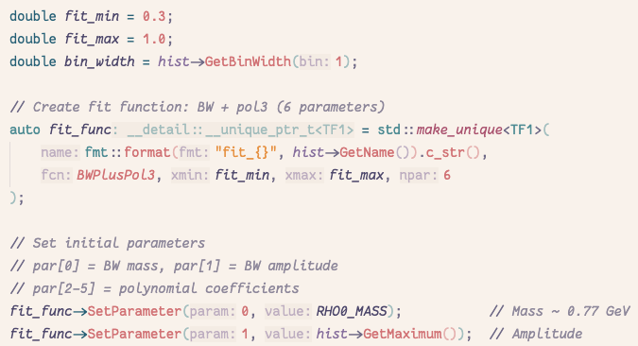
RG-D: Nuclear transparency
Invariant mass of the two pions for LD2:

Slide 16
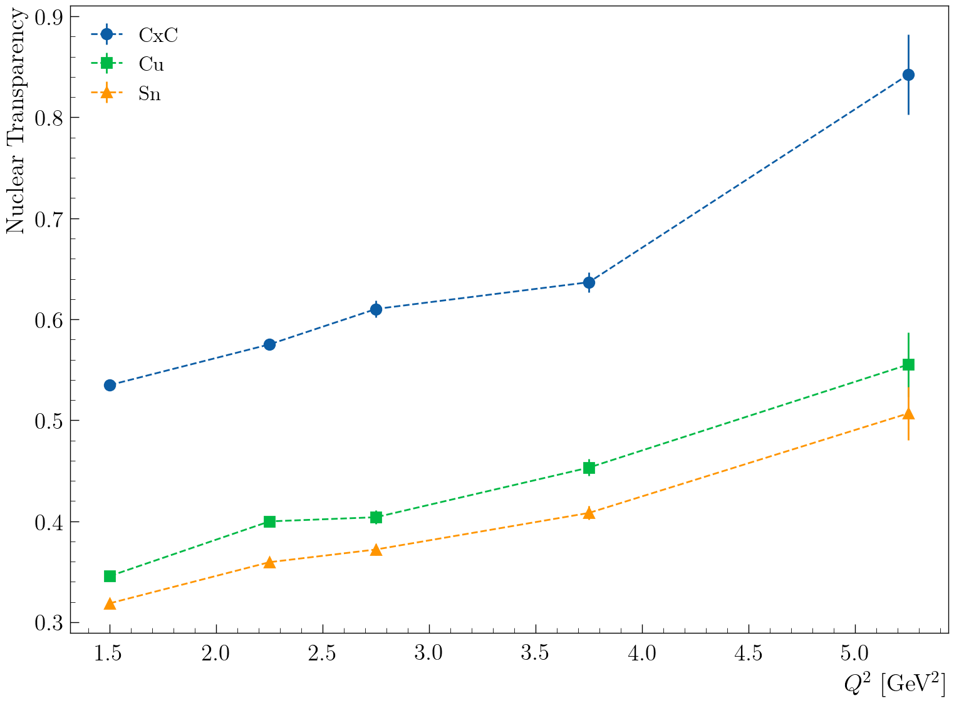
RG-D: Nuclear transparency
Extract nuclear transparency

Slide 17
RG-D: Nuclear transparency
Extract nuclear transparency

Slide 18
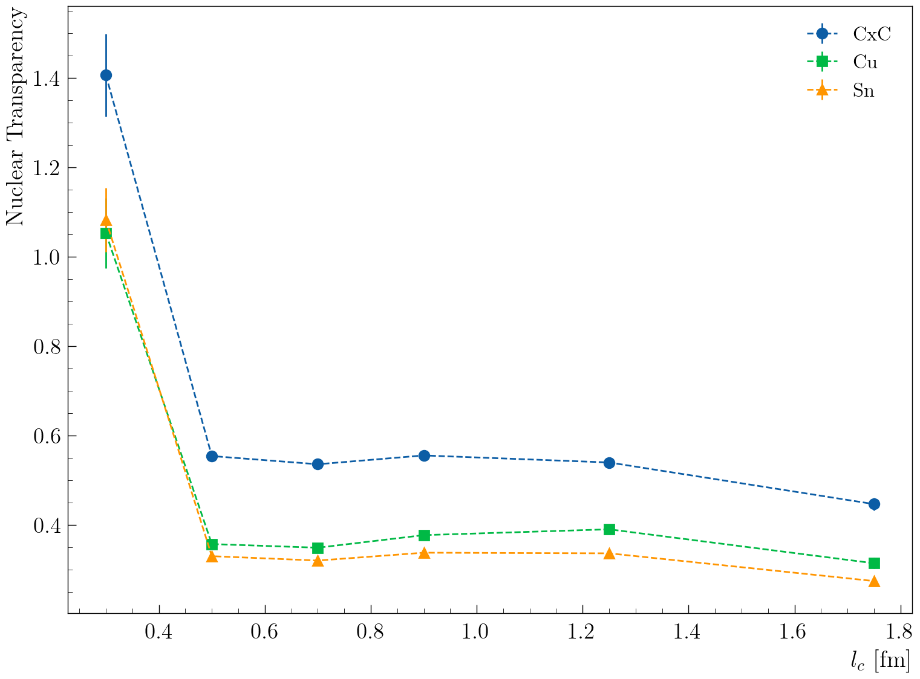
RG-D: Nuclear transparency
Extract nuclear transparency

Slide 19
RG-D: Nuclear transparency
Next steps (in not particular order):
Invariant Mass Background Subtraction using simulation
Acceptance and Efficiency Correction
Radiative Corrections
Target density measurement
Momentum correction for the electron? (like RG-A)
Implement fiducial cuts for pions
Systematic uncertainty
CuSn contamination

Slide 20
Other work
Work report from March 2025 to March 2026:
In a good shape: https://www.overleaf.com/8989239232wsdvbmfctgts#0b7b74
RG-D simulation is available on OSG
I have launch 5M events for CuSn setup, I will use that to estimate the CU contamination in Sn and the opposite.

