Slide 1
Group meeting
Mathieu Ouillon (Mississippi State University)
02/02/26

Slide 2
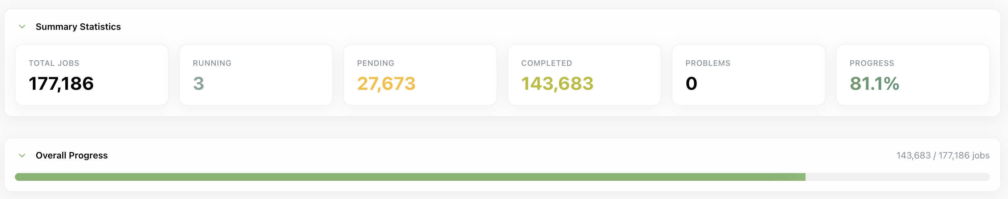
RG-D cooking
Fix the issue for the decoding of the file: clas_018401.evio.00546
Did the reconstruction for the file clas_018401.evio.00545-00549.hipo
Create all the trains for the CxC runs
Copy all of that on the tape

Slide 3
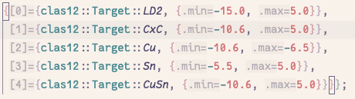
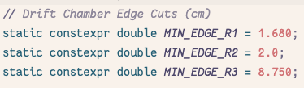
RG-D: Nuclear transparency
I continue the work on the nuclear transparency study:
Use pass1 data: 10%, only Outbending
Electron selection:
pid = 11, -4000 < status <= -2000, |chi2pid| < 5
p > 0.8 GeV/c, Vz target dependant, SF vs p
Fiducial cuts: lv > 9 cm, lw > 9 cm and DC edge
Q² > 1 GeV² and W > 2 GeV

Slide 4
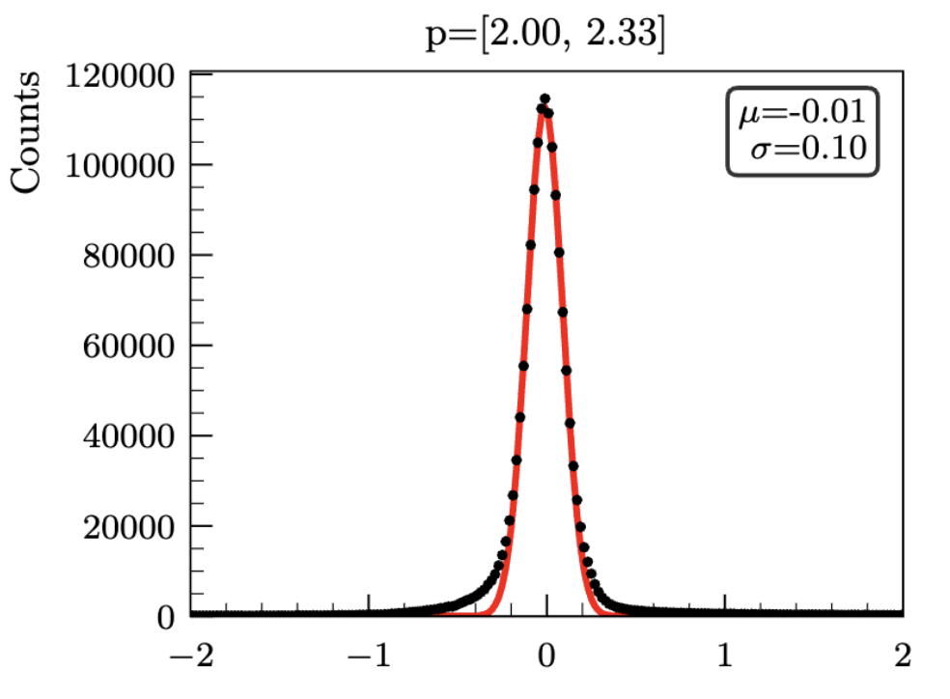
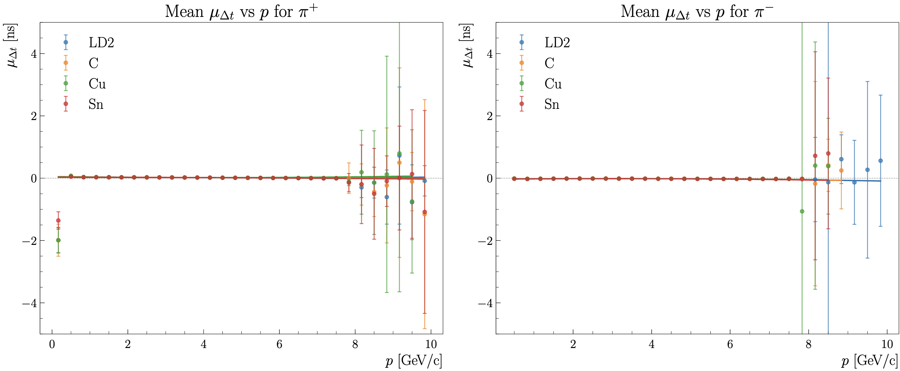

RG-D: Nuclear transparency
Pions:
Forward detector: 2000 <= status < 4000
|Chi2pid| < 10, 0.3 GeV < p, Δt cuts, Vz cuts
Slice the Δt distribution for p bins. Fit with Gaussian
Fit the mean and sigma using second order polynomial function

Slide 5
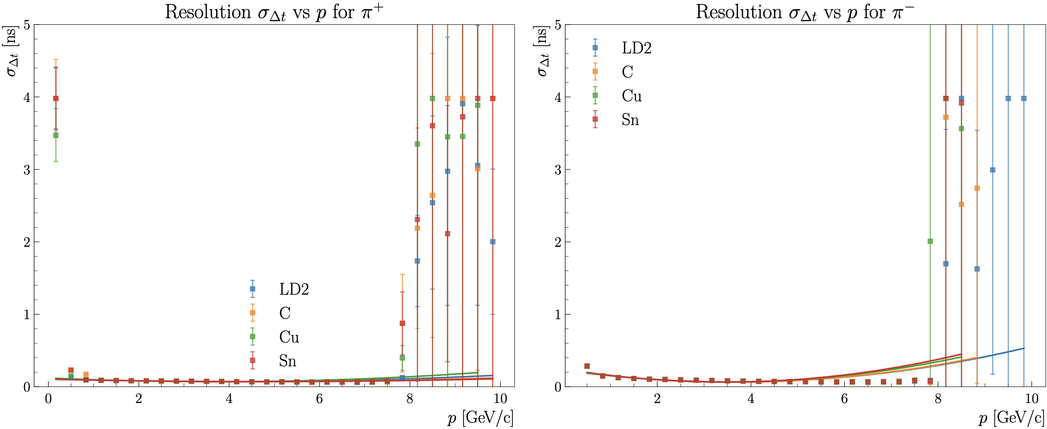
RG-D: Nuclear transparency
Pions:
Forward detector: 2000 <= status < 4000
|Chi2pid| < 10, 0.3 GeV < p, Δt cuts, Vz cuts
Fit the mean and sigma using second order polynomial function

Slide 6
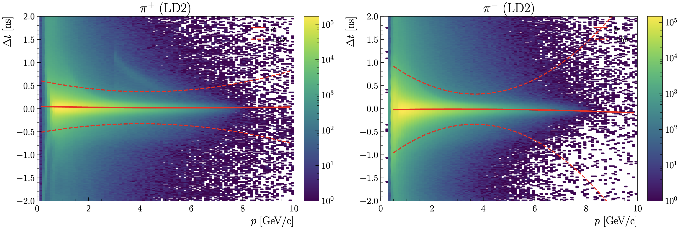
RG-D: Nuclear transparency
Pions:
Forward detector: 2000 <= status < 4000
|Chi2pid| < 10, 0.3 < p, Δt cuts: μ ± 3σ, Vz cuts

Slide 7
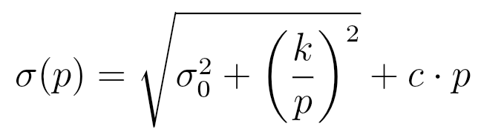
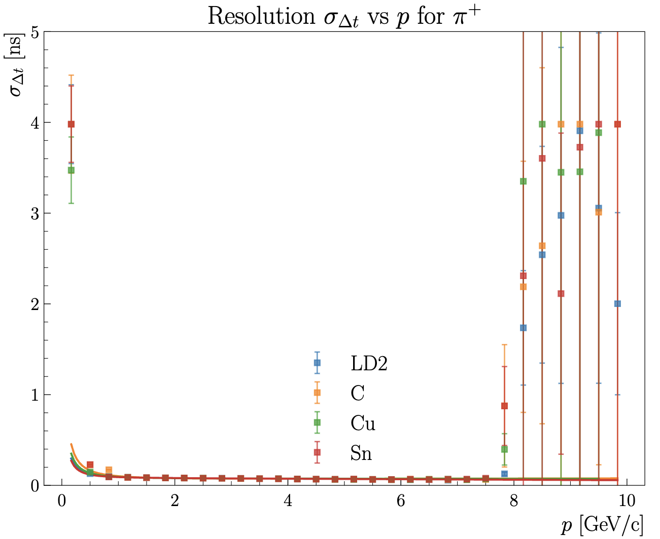
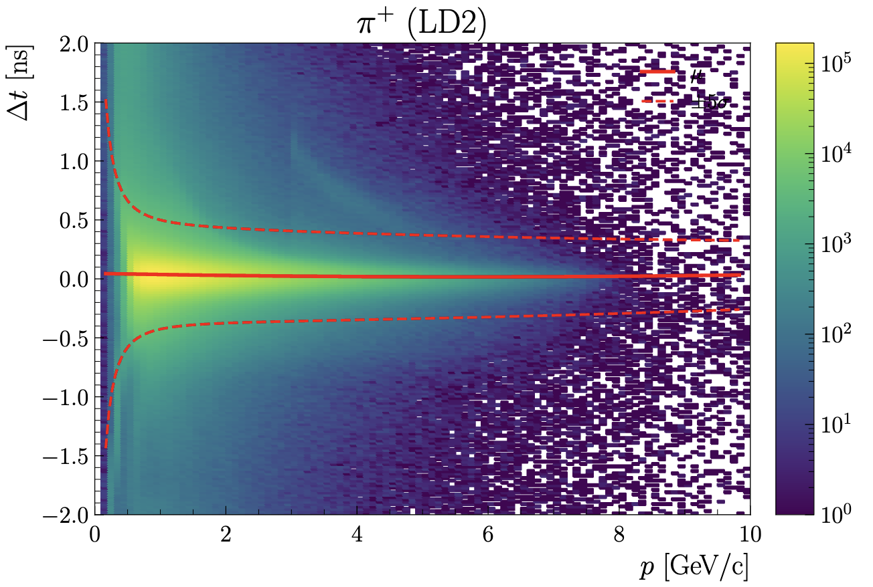
RG-D: Nuclear transparency
Can also try for sigma with:

Slide 8
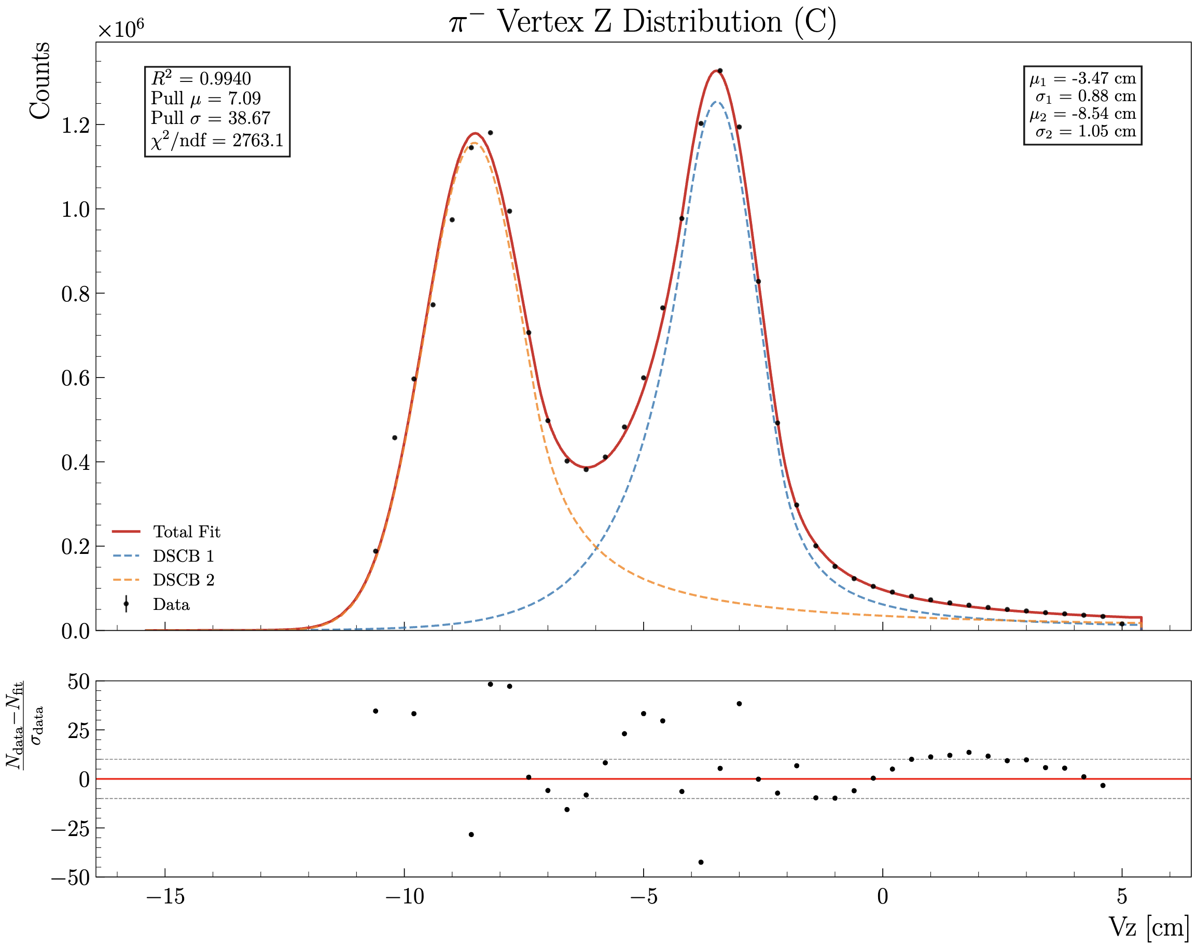
RG-D: Nuclear transparency
Pions:
Forward detector: 2000 <= status < 4000
|Chi2pid| < 10, 0.3 < p, Δt cuts, Vz cuts
Vz cuts:
Fit the Vz distribution with two double sided crystal ball functions for CxC, Single DSCB for Cu and Sn.

Slide 9
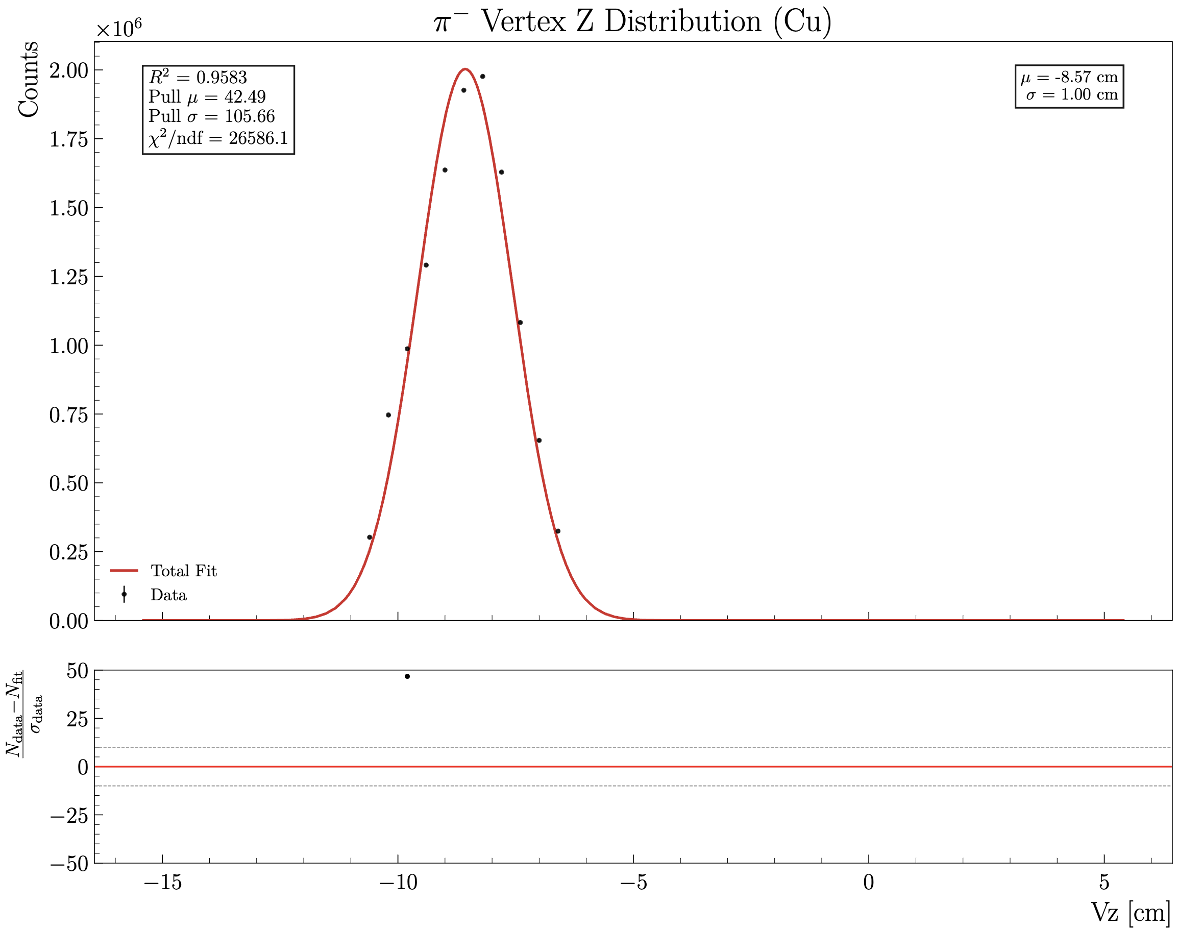
RG-D: Nuclear transparency
Pions:
Forward detector: 2000 <= status < 4000
|Chi2pid| < 10, 0.3 < p, Δt cuts, Vz cuts
Vz cuts:
Fit the Vz distribution with two double sided crystal ball functions for CxC, Single DSCB for Cu and Sn.

Slide 10
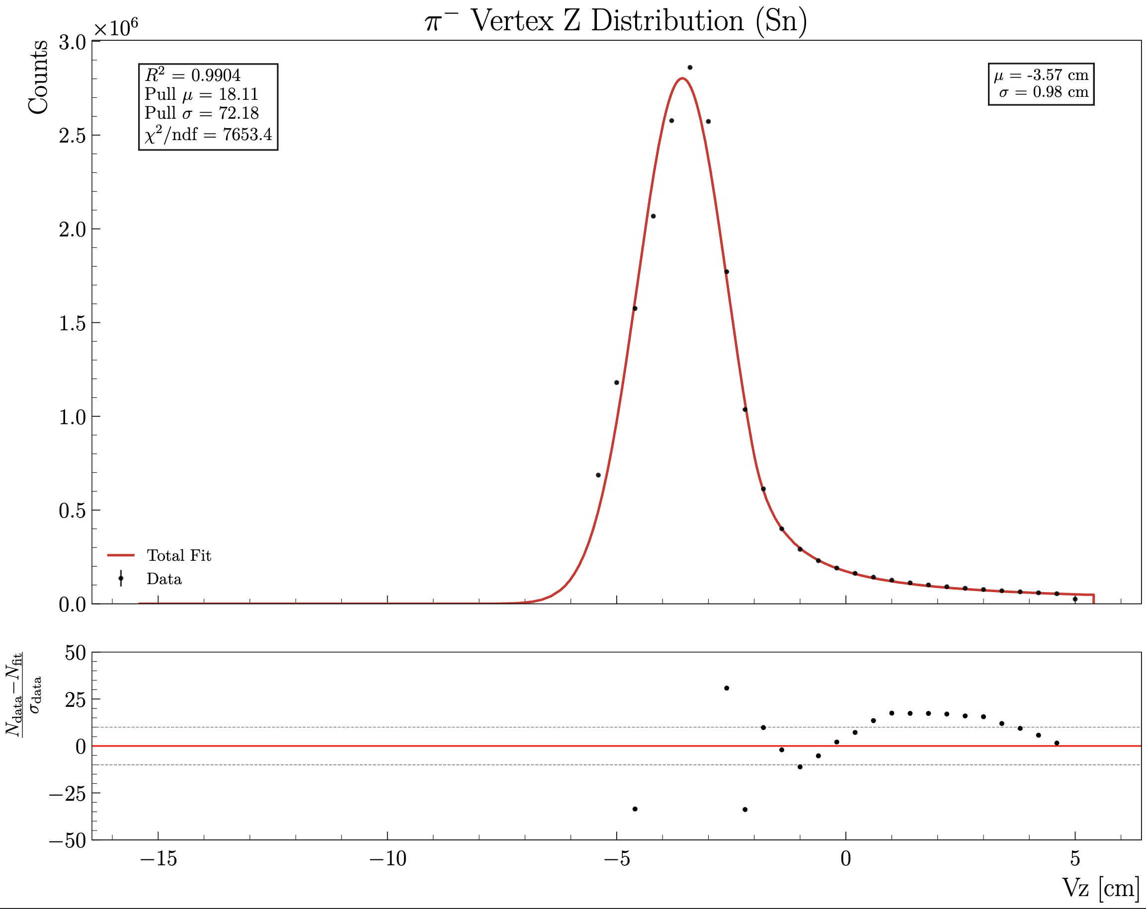
RG-D: Nuclear transparency
Pions:
Forward detector: 2000 <= status < 4000
|Chi2pid| < 10, 0.3 < p, Δt cuts, Vz cuts
Vz cuts:
Fit the Vz distribution with two double sided crystal ball functions for CxC, Single DSCB for Cu and Sn.

Slide 11
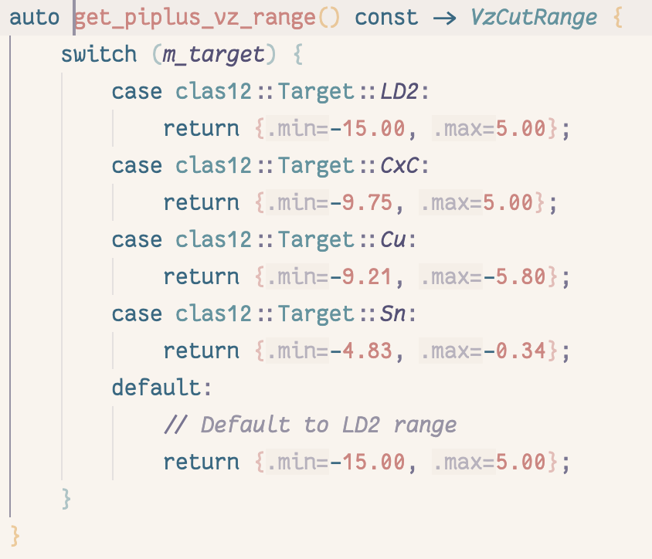
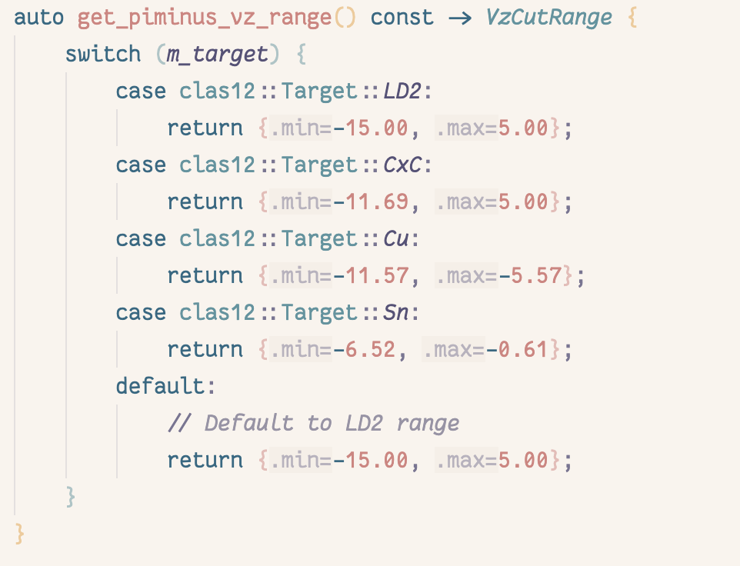
RG-D: Nuclear transparency
Vz cuts:
Fit the Vz distribution with two double sided crystal ball functions for CxC, Single DSCB for Cu and Sn.

Slide 12
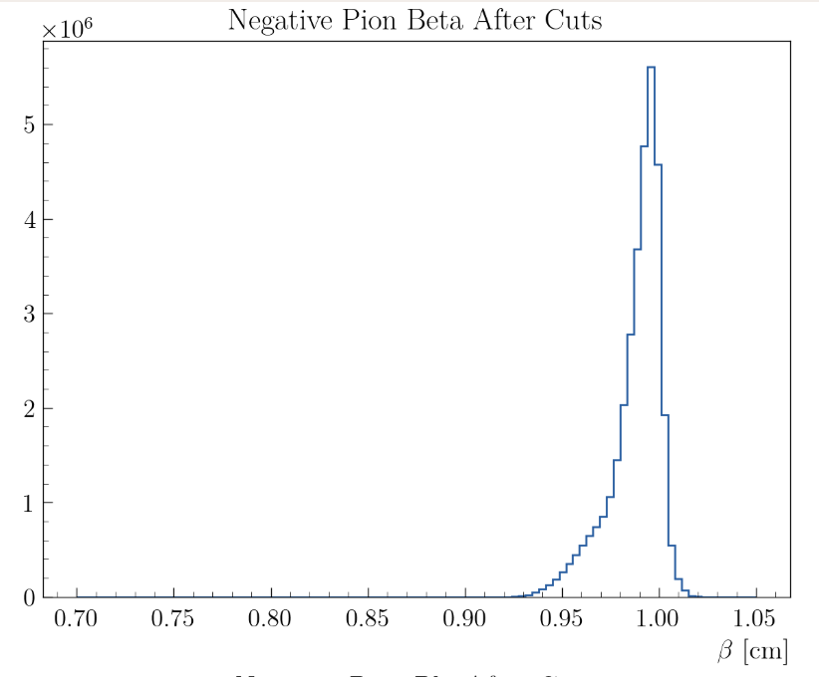
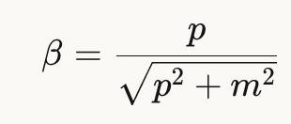
RG-D: Nuclear transparency
Pion β:
For a 0.3 GeV/c pion: β=0.909
For a 1 GeV/c pion: β=0.9907

Slide 13
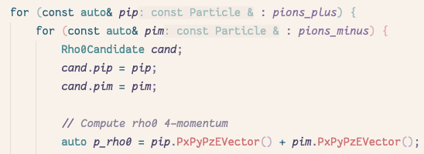
RG-D: Nuclear transparency
ρ⁰ reconstruction:
Event with a good electron, at least on good π⁻ and π⁺
ΔVz cut: to have the electron and pion from the same target
z_{h} > 0.9, l_{c} < 1 fm and 0.1 < -t < 0.5
Generate all ρ⁰ candidates:

Slide 14
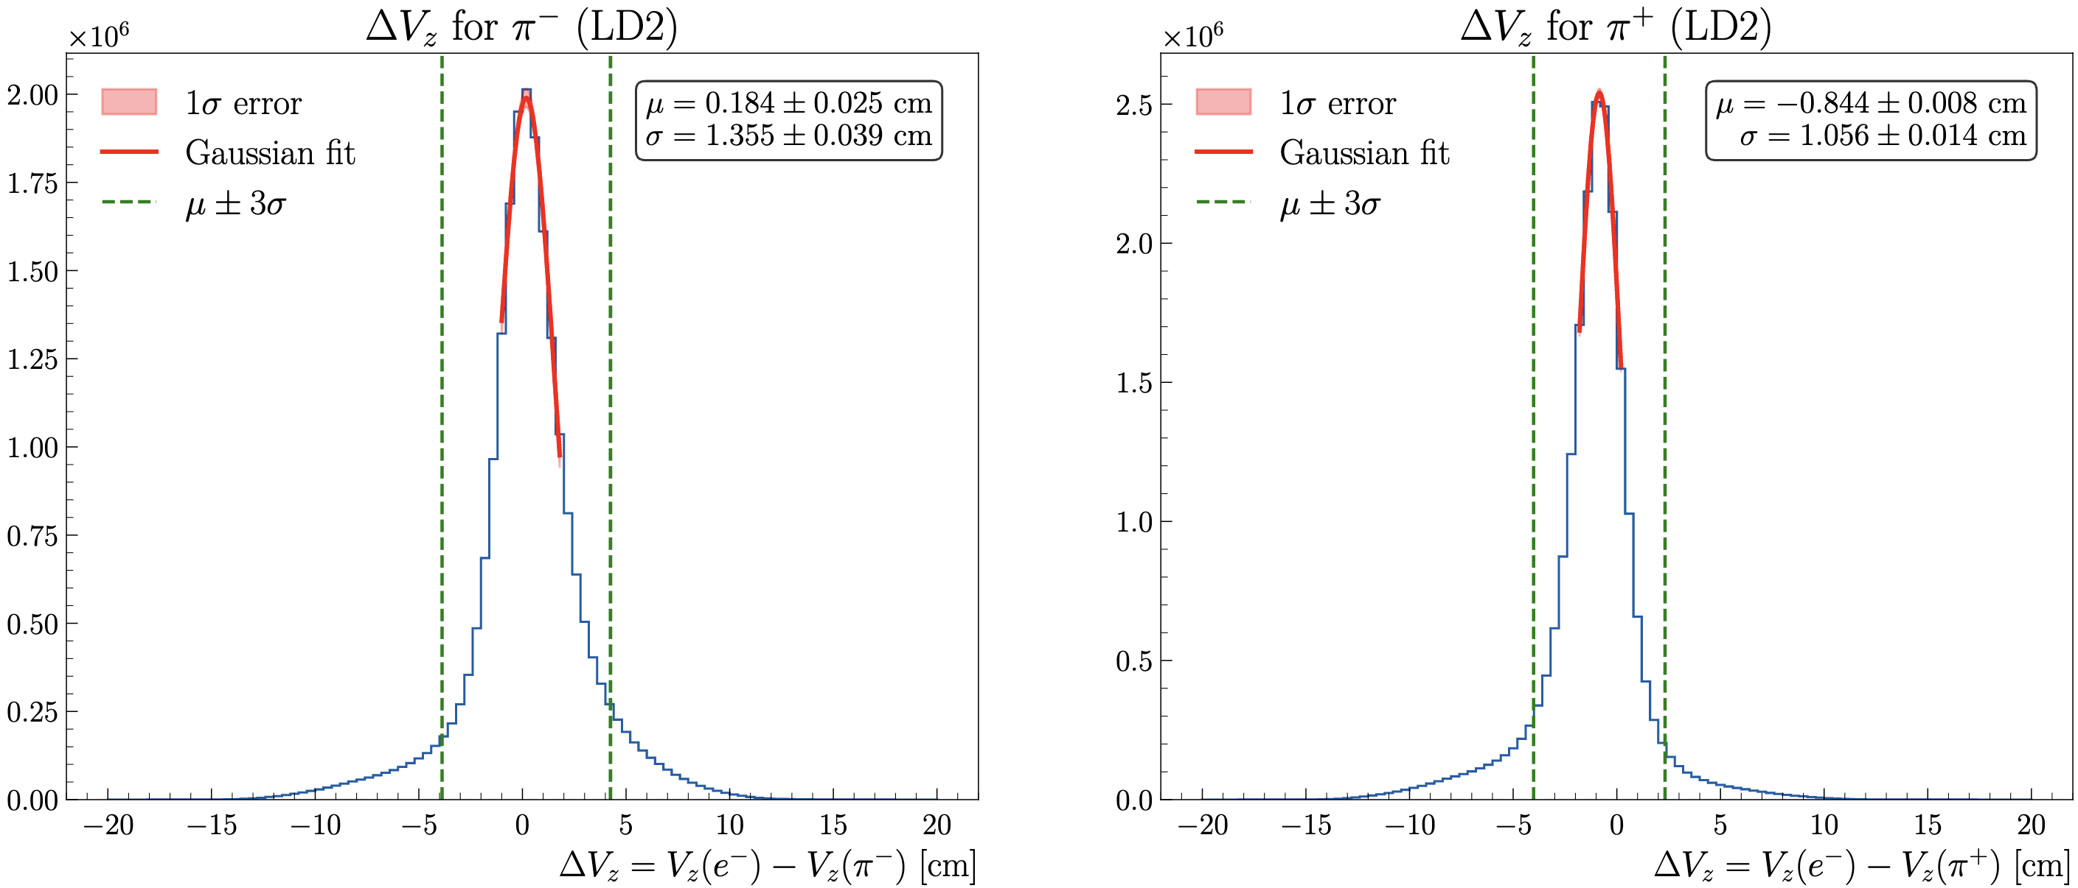
RG-D: Nuclear transparency
ΔVz is fitted with a Gaussian, cut is μ ± 3σ

Slide 15
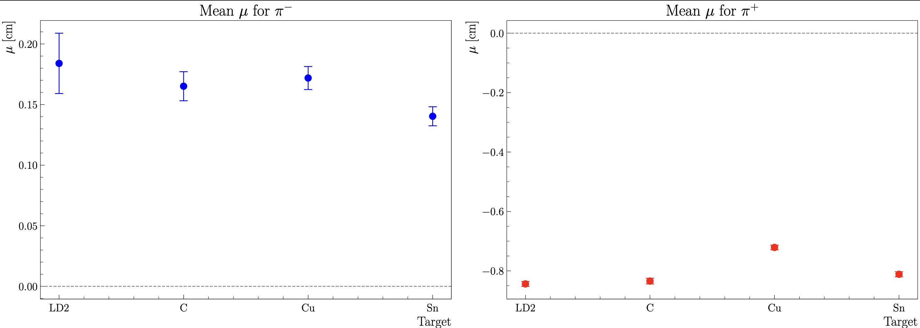
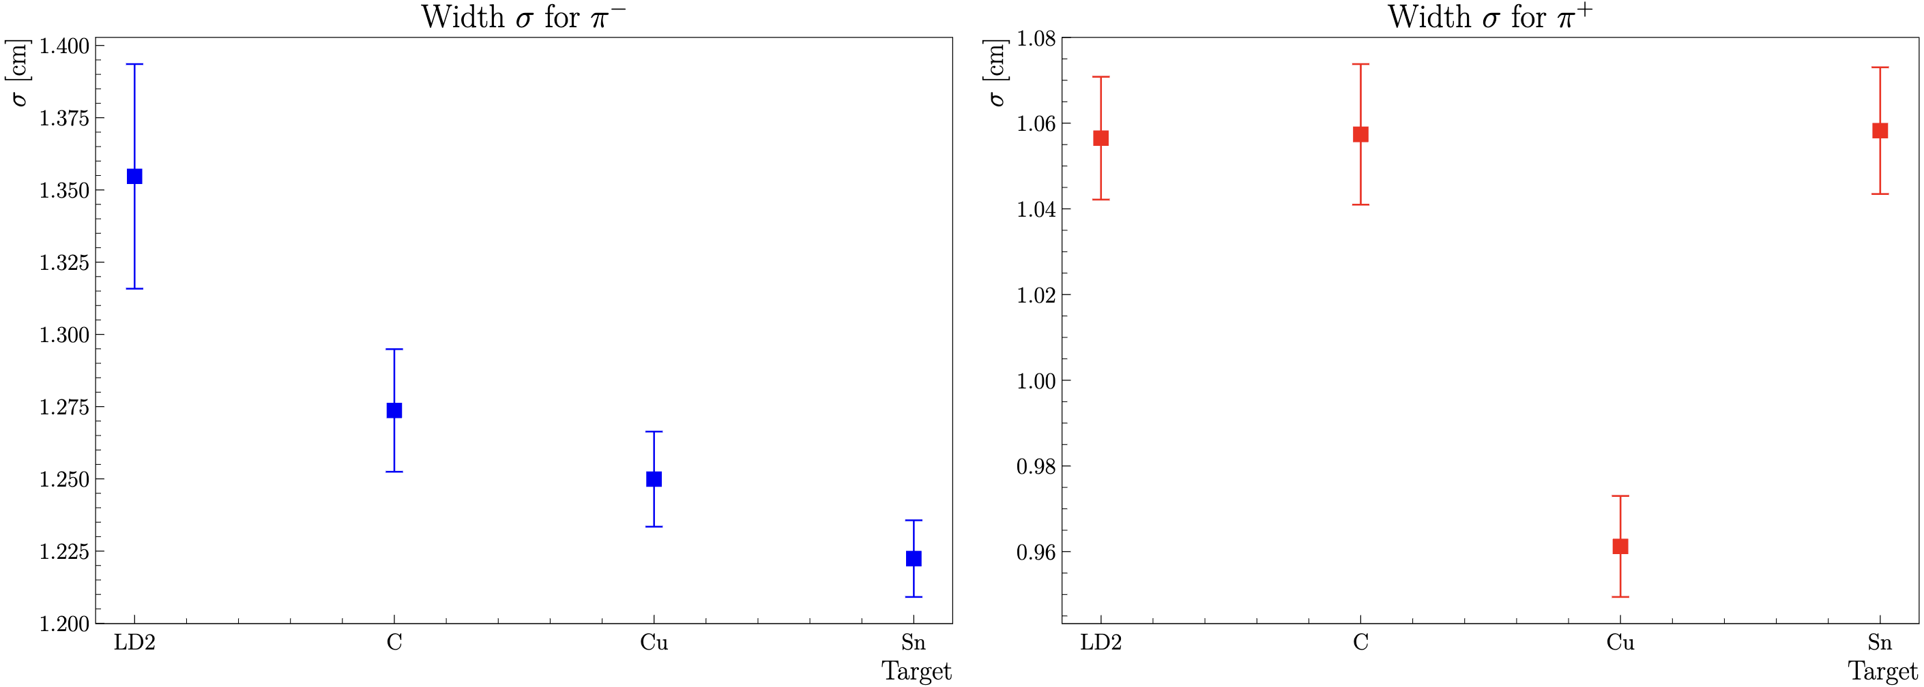
RG-D: Nuclear transparency
ΔVz is fitted with a Gaussian, cut is μ ± 3σ, target comparison

Slide 16
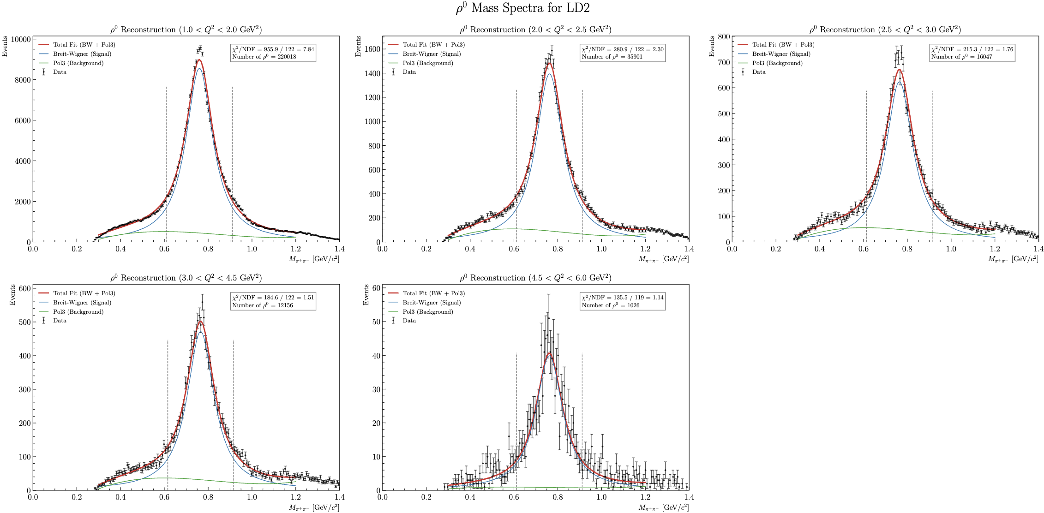
RG-D: Nuclear transparency
Invariant mass of the two pions for LD2, fit range 0.3–1.2:

Slide 17
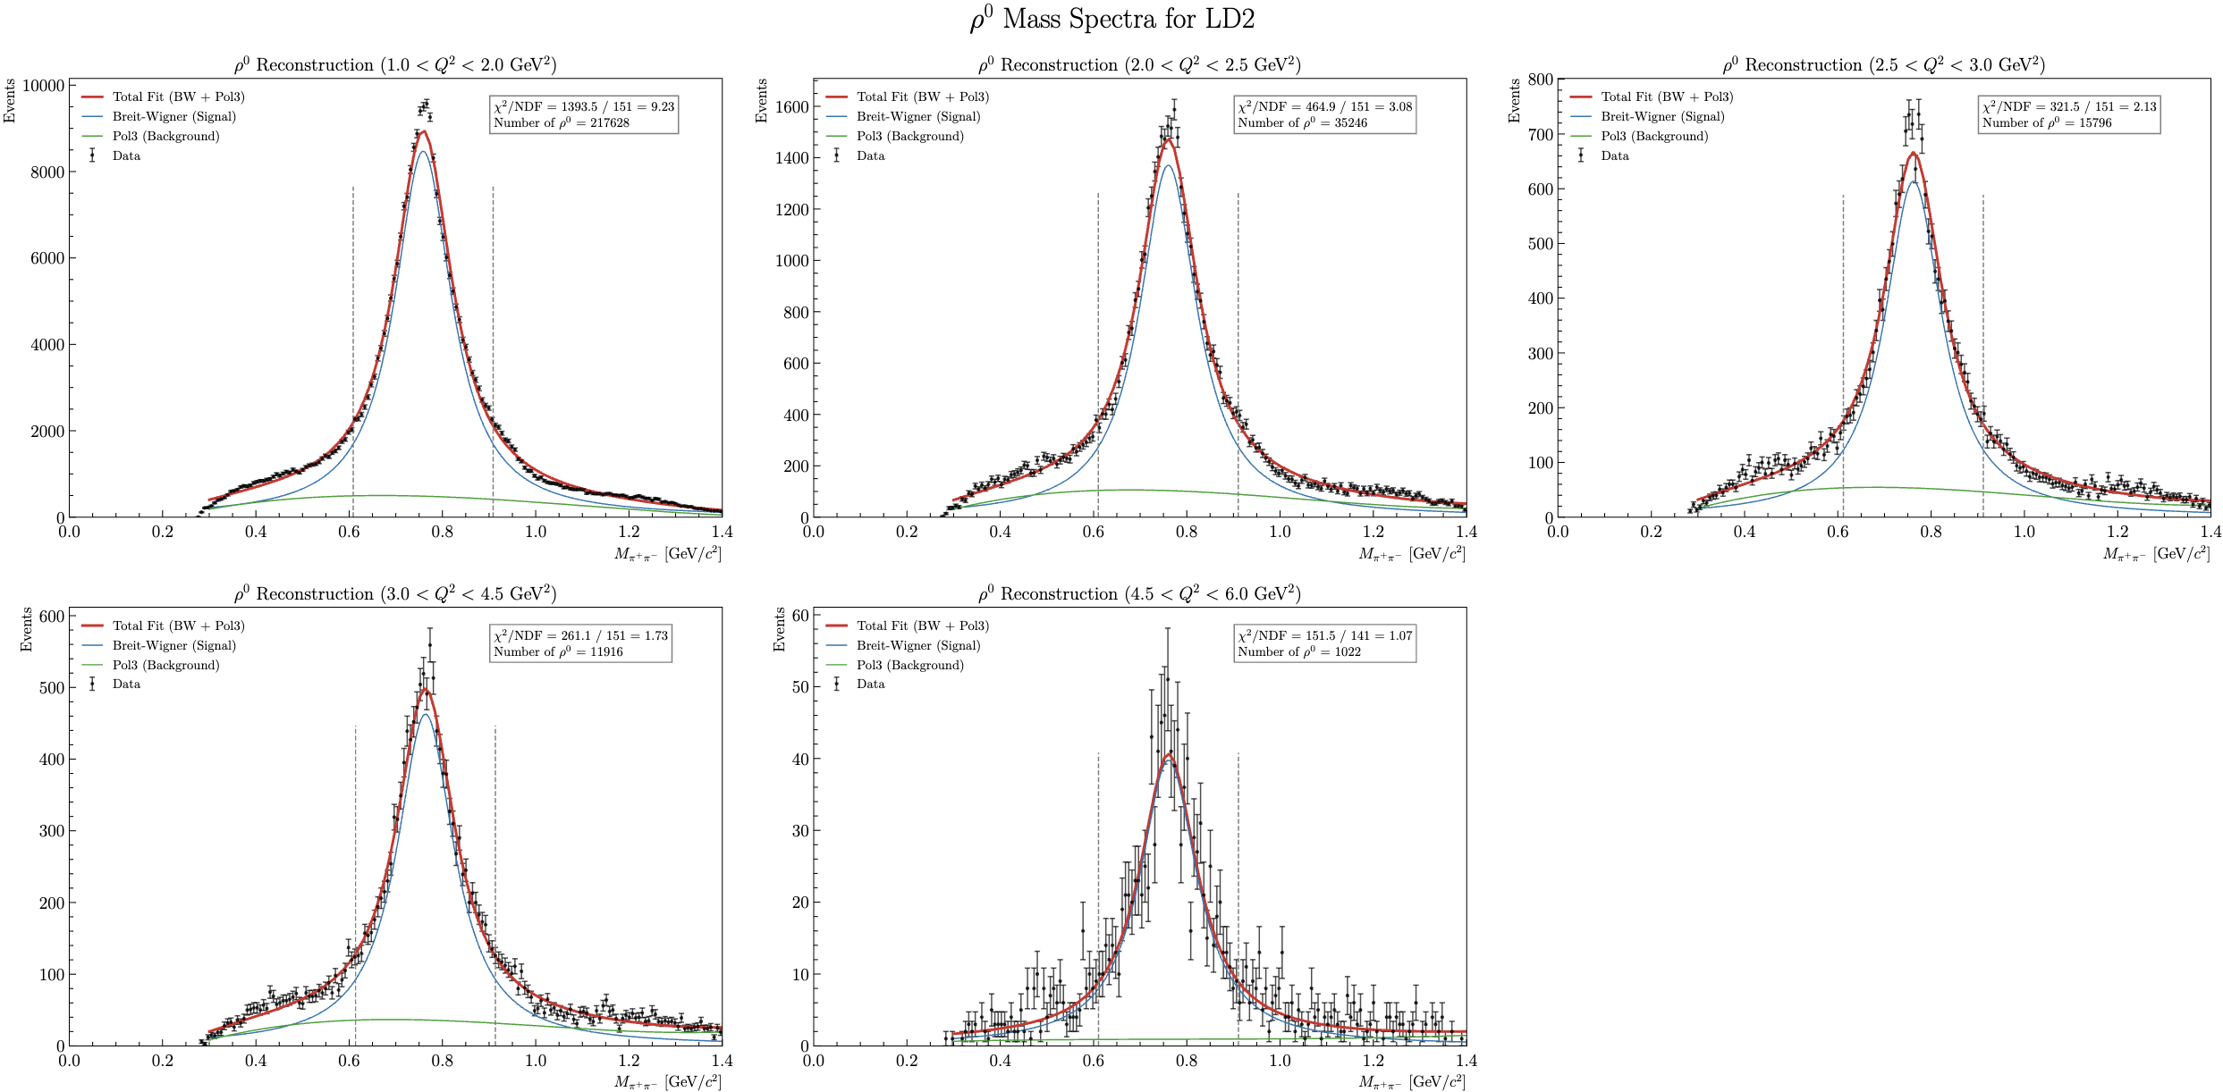
RG-D: Nuclear transparency
Invariant mass of the two pions for LD2, fit range 0.3–1.4:

Slide 18
RG-D: Nuclear transparency
Invariant mass of the two pions for LD2:
fit range 0.3–1.2
fit range 0.3–1.4

Slide 19
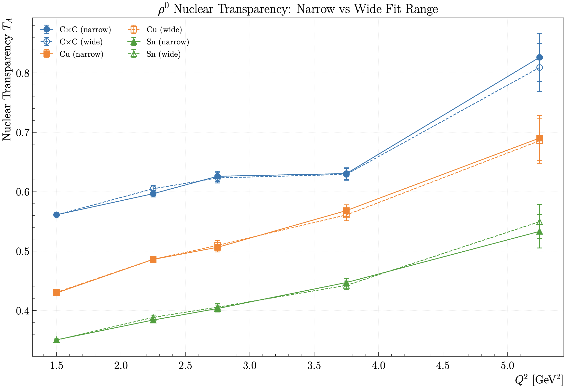
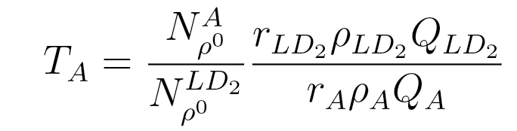
RG-D: Nuclear transparency
Extract nuclear transparency:
r_{LD2}= 5 cm: LD2 thickness
r_{CxC} = 0.4 cm: CxC thickness
r_{Cu}= 93 μm: Copper thickness
r_{Sn} = 171 μm: Tin thickness
ρ_{LD2}= 0.164 g/cm³: LD2 density
ρ_{C}= 2.2g/cm³ : Carbon density
ρ_{Cu}= 8.96 g/cm³: Copper density
ρ_{Sn}= 7.31g/cm³ : Tin density

Slide 20
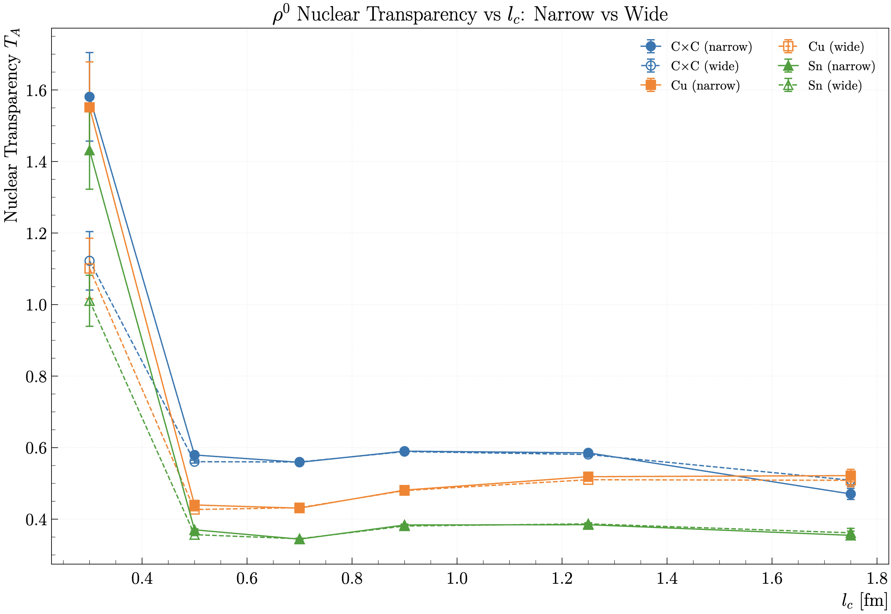
RG-D: Nuclear transparency

Slide 21
RG-D: Nuclear transparency
Next steps (in not particular order):
CuSn contamination
Invariant Mass Background Subtraction using simulation
Acceptance and Efficiency Correction
Radiative Corrections
Target density measurement
Momentum correction for the electron? (like RG-A)
Implement fiducial cuts for pions
Systematic uncertainty

Slide 22
RG-D: Hadron identification with AI
The goal is to have a model that use information only from the REC banks.
So, it can be use in the analysis step (on DST files).
Use information from the calorimeters, Cherenkov counters, TOF and higher-level variables (px, py, pz, charge, …)
Use all variable found in the DST banks: 96 features.
Try many different architectures: Gradient Boosting Decision Trees:
XGBoost, LightGBM and CatBoost
Also, other architecture MLP, MLP + GBDT.
The best results are for CatBoost (Categorical Boosting).

Slide 23
RG-D: Hadron identification with AI

Slide 24
RG-D: Hadron identification with AI

Slide 25
RG-D: Hadron identification with AI

Slide 26
RG-D: Hadron identification with AI

Slide 27
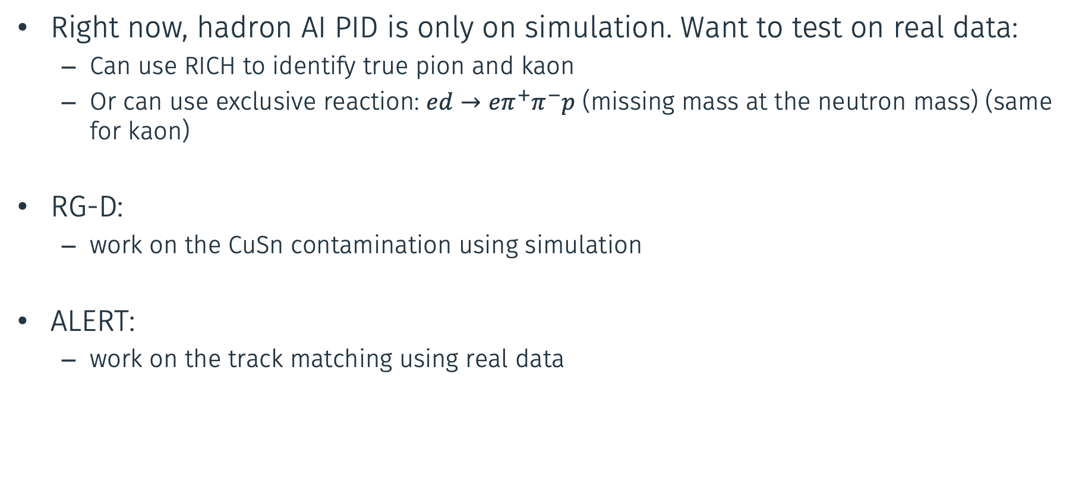
Work plan
Right now, hadron AI PID is only on simulation. Want to test on real data:
Can use RICH to identify true pion and kaon
Or can use exclusive reaction: $ed→eπ^{+}π^{−}p$ (missing mass at the neutron mass) (same for kaon)
RG-D:
work on the CuSn contamination using simulation
ALERT:
work on the track matching using real data

