Slide 1
Group meeting
Mathieu Ouillon (Mississippi State University)
02/10/26

Slide 2
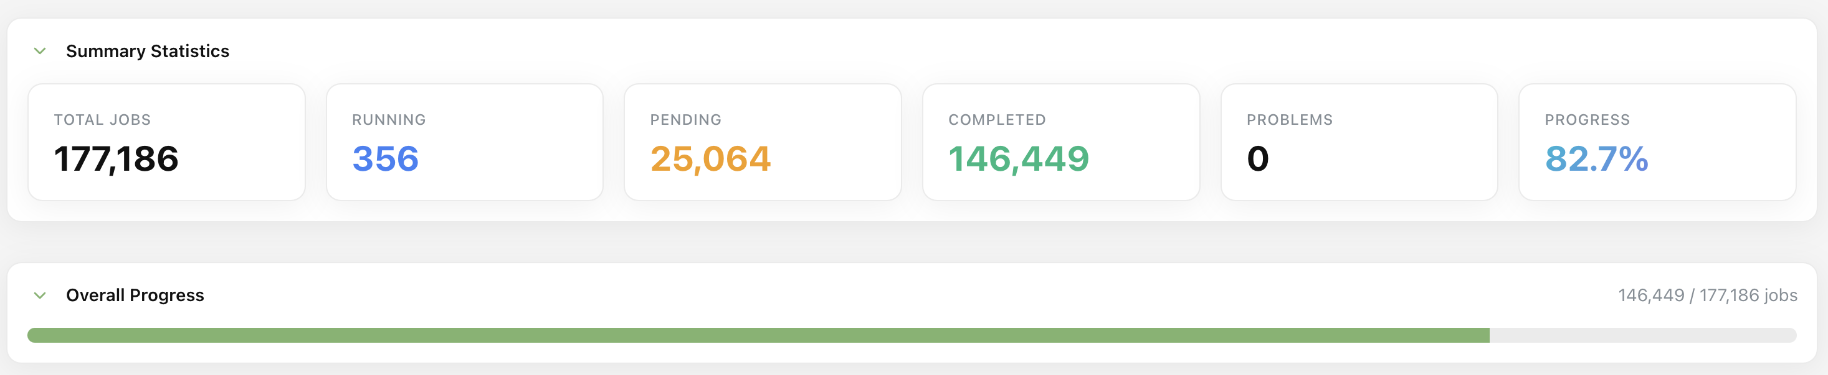
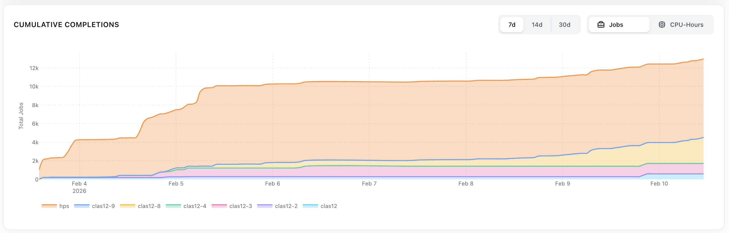
RG-D cooking

Slide 3
RG-D: Hadron identification with AI
Goal: Improve PID using machine-learning techniques.
Input features: Exploit all available variables from the DST banks (REC::Particle, REC::Calorimeter, REC::Cherenkov, REC::Scintillator, REC::ScintExtras, and REC::CaloExtras) for a total of 96 features.
Model: CatBoost (Categorical Boosting) architecture.
On simulation achieve an overall:
π⁻: efficiency=0.669, purity=0.554
π⁺: efficiency=0.619, purity=0.625
K⁻: efficiency=0.527, purity=0.684
K⁺: efficiency=0.513, purity=0.678
anti-p: efficiency=0.857, purity=0.771
p: efficiency=0.790, purity=0.816

Slide 4
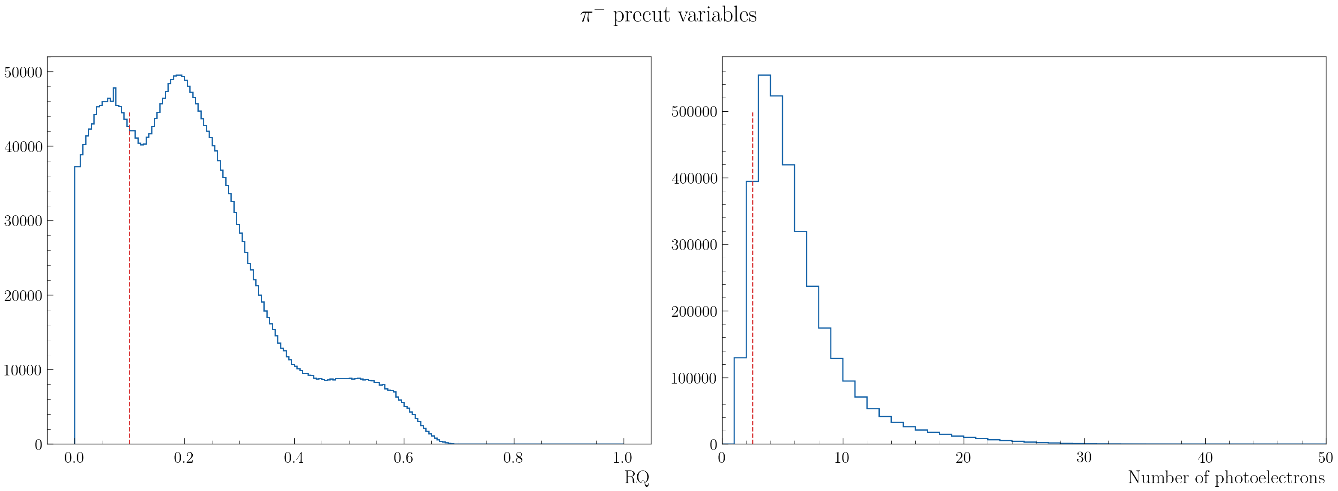
RG-D: Hadron identification with AI
Wanted to test it on real data:
Use the RICH as the truth (like MC is the truth in the simulation)
Apply cut on the RICH variables to have a (as) pure (as possible) sample of pion and kaon:
RQ (goodness of hadron choice parameter (1=anambiguos, 0=random)) > 0.1 and ntot (Number of photon used for likelihood)> 2.5

Slide 5
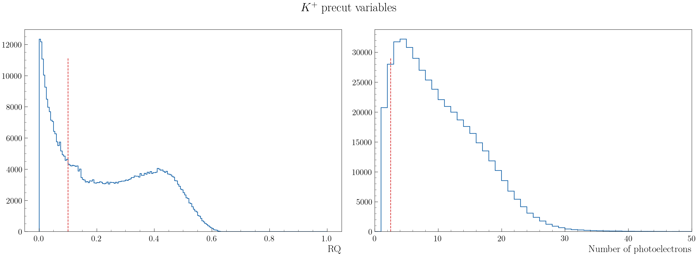
RG-D: Hadron identification with AI
Wanted to test it on real data:
Use the RICH as the truth (like MC is the truth in the simulation)
Apply cut on the RICH variables to have a (as) pure (as possible) sample of pion and kaon:
RQ (goodness of hadron choice parameter (1=anambiguos, 0=random)) > 0.1 and ntot (Number of photon used for likelihood)> 2.5

Slide 6
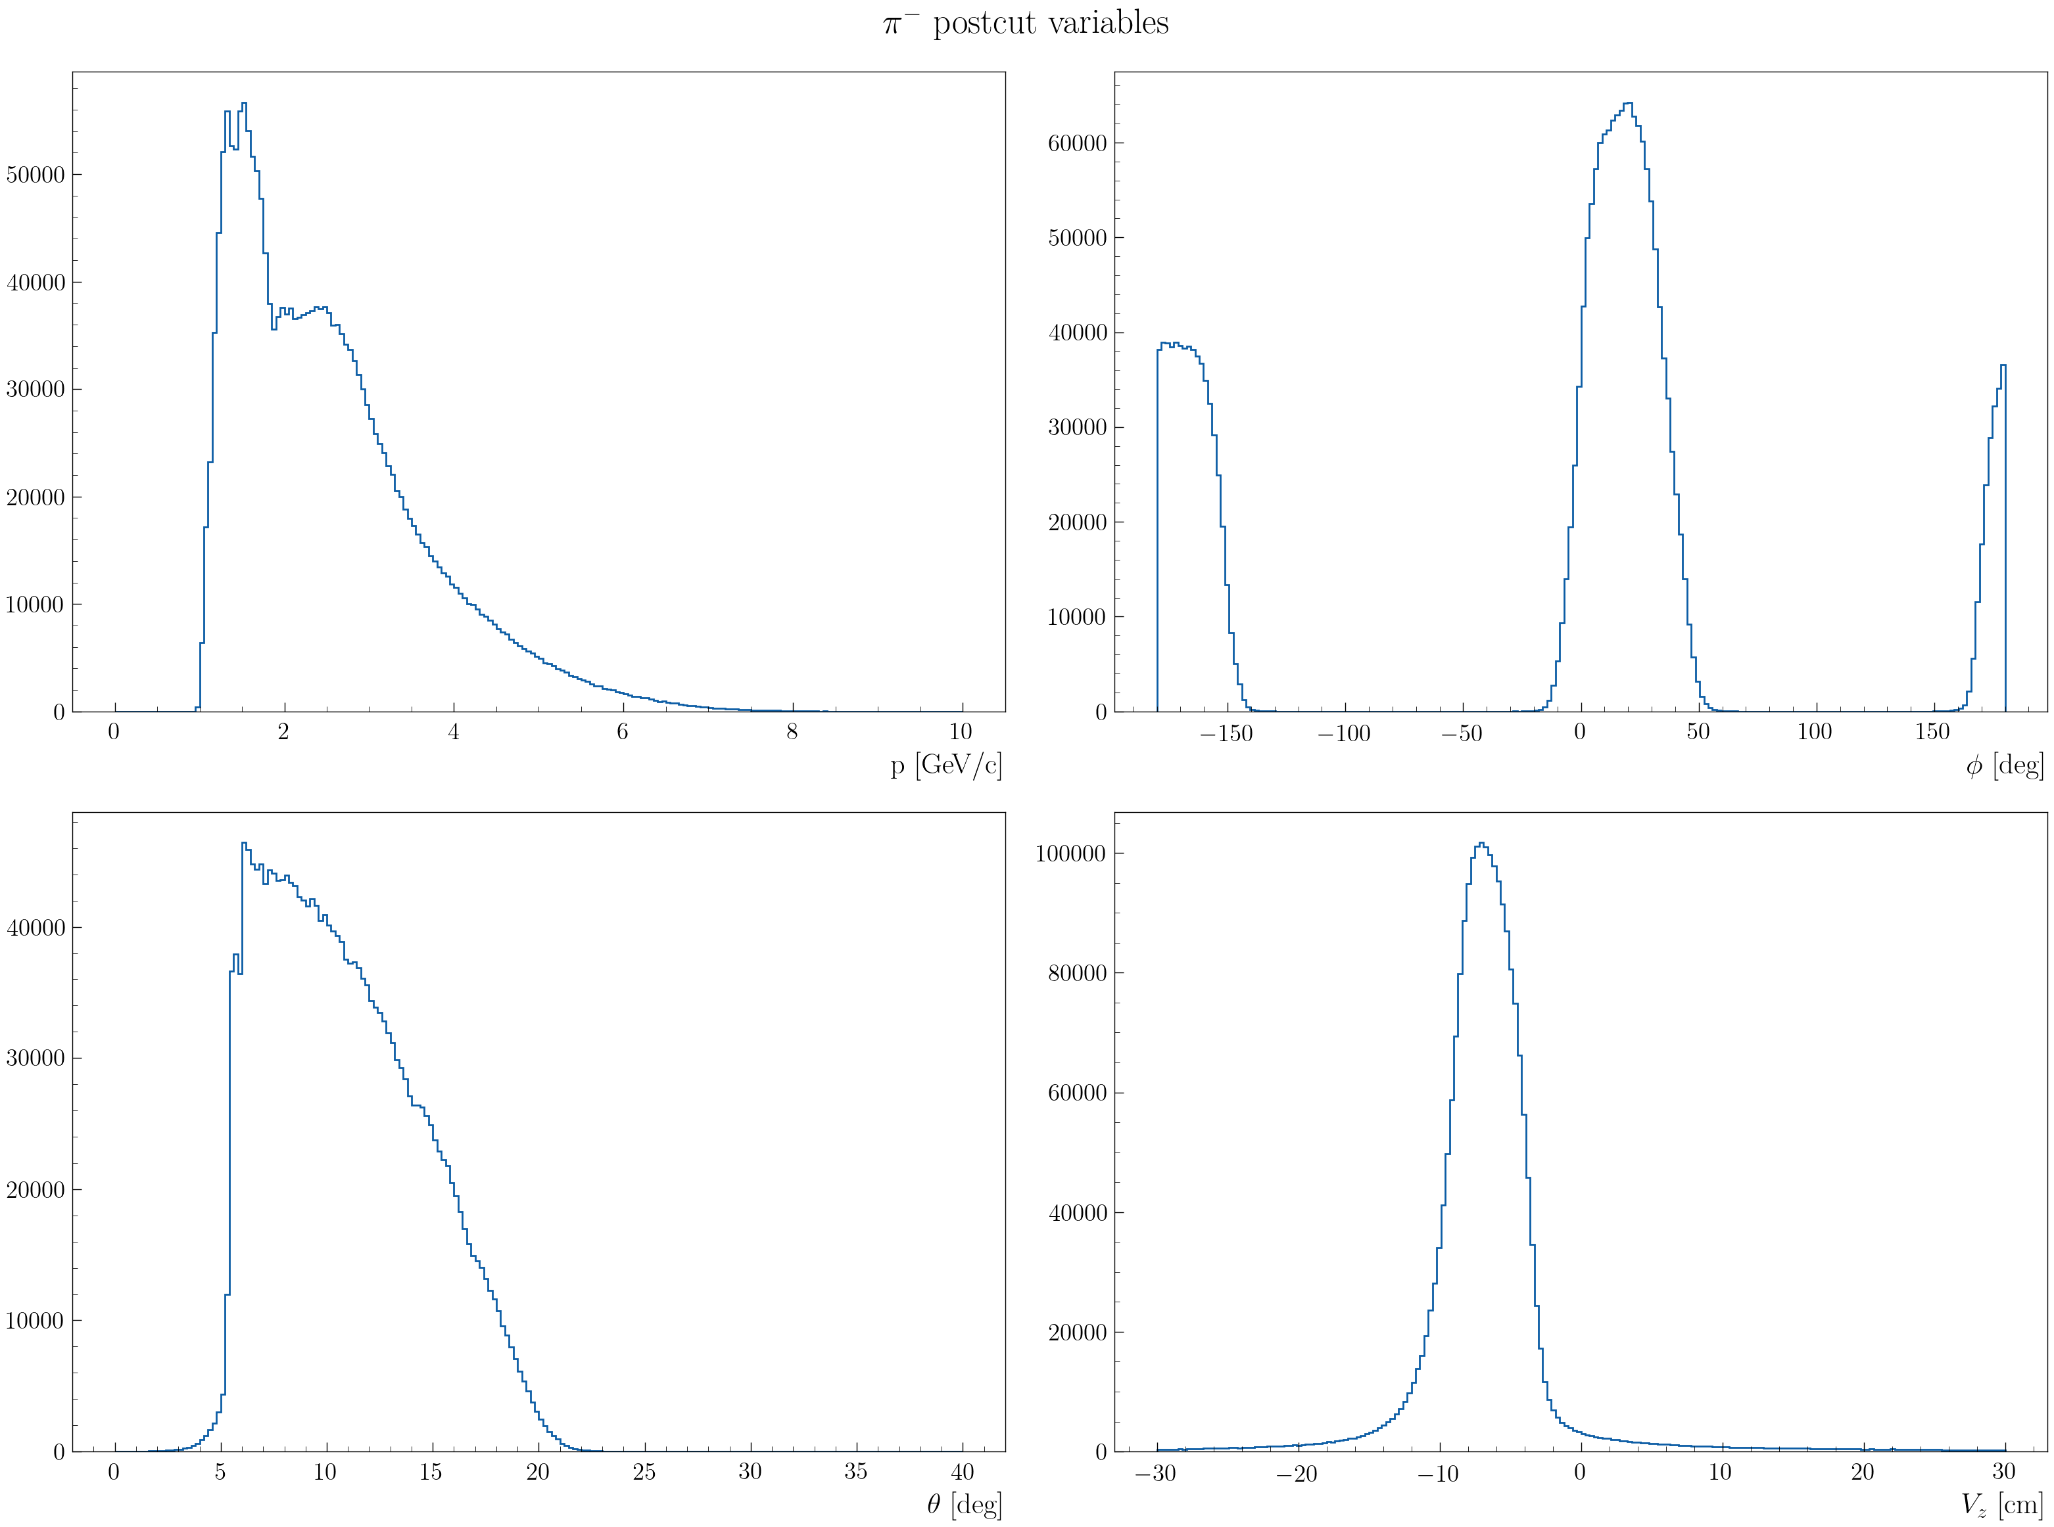
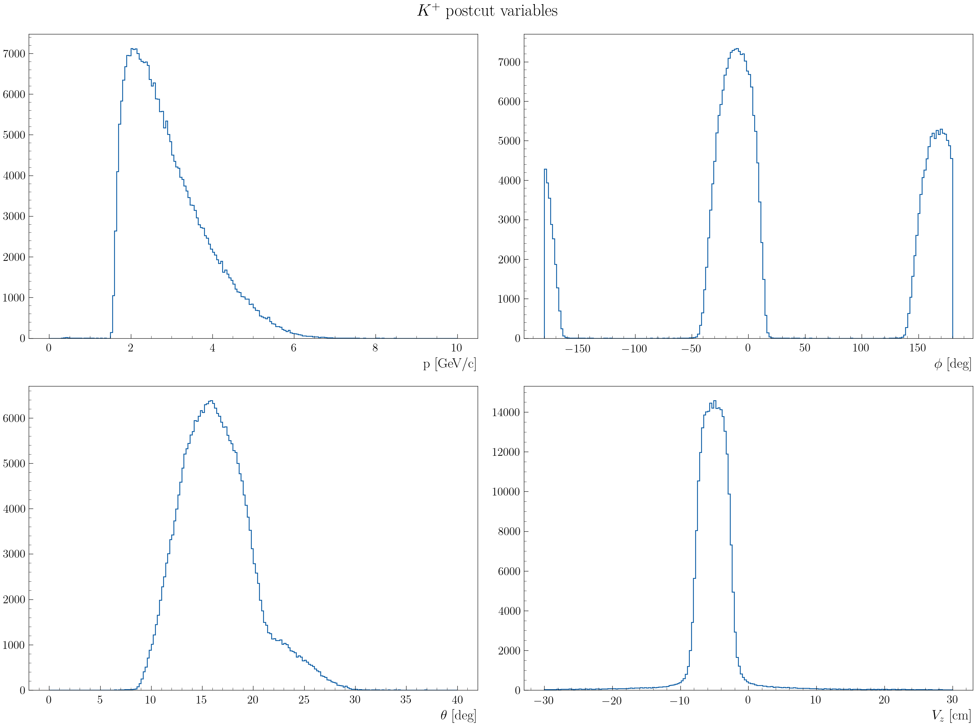
RG-D: Hadron identification with AI
After the cuts:

Slide 7
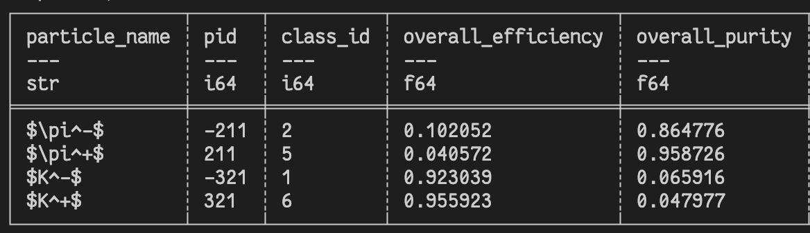
RG-D: Hadron identification with AI
I have tested the AI on real data:
Very bad: low efficiency on the pion and low purity on the kaon:
Mean that the AI assign a kaon PID to all particles.

Slide 8

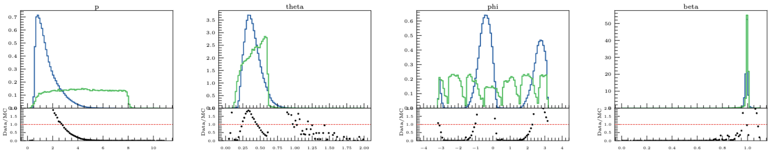
RG-D: Hadron identification with AI
So, there is an issue with either the AI or the inputs. First look at the inputs variables, in simulation and data
Some difference in the momentum and angles distribution but it should be fine, as long as the phase space is well cover.

Slide 9
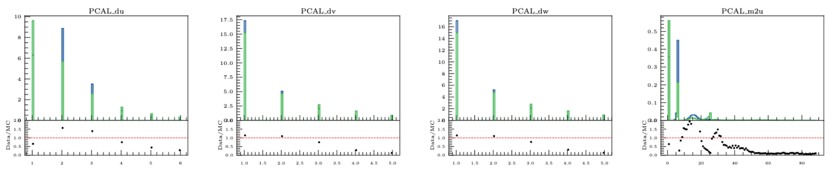
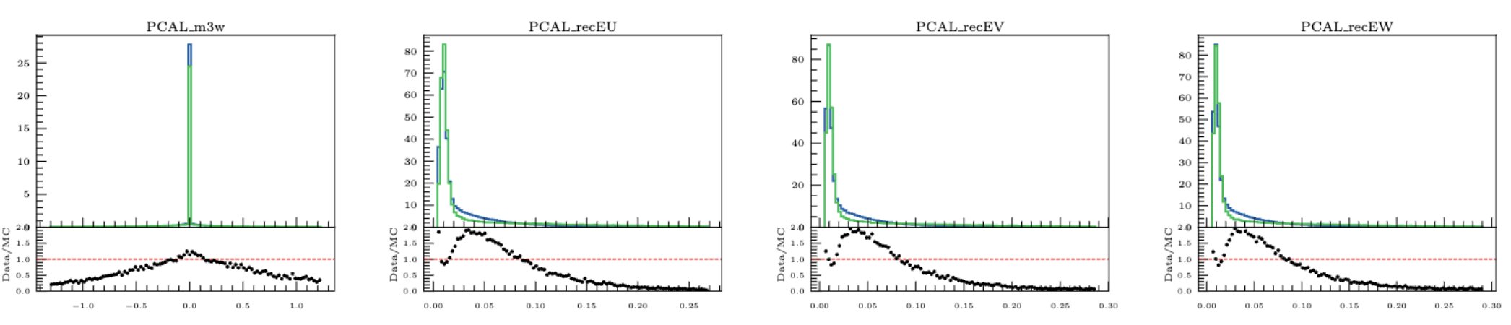
RG-D: Hadron identification with AI
So, there is an issue with either the AI or the inputs. First look at the inputs variables, in simulation and data
Look to energy distribution in the calorimeter

Slide 10
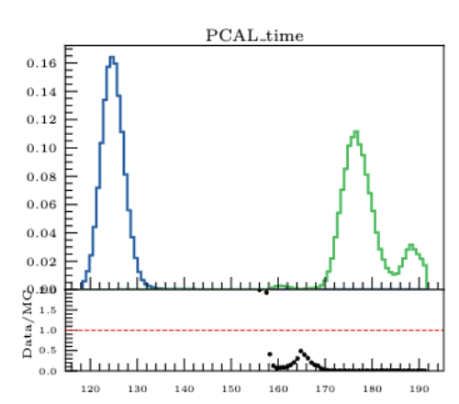
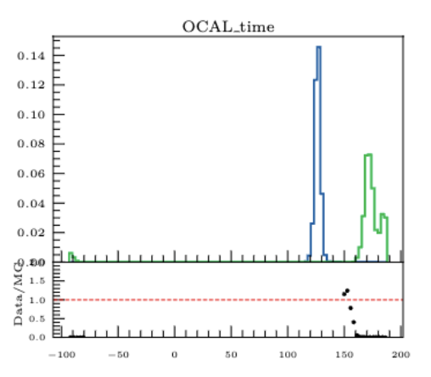
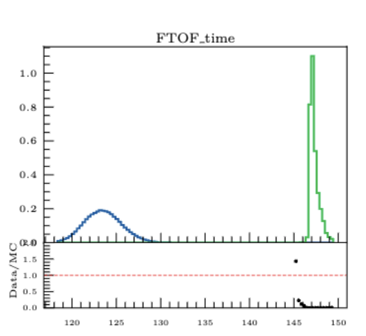
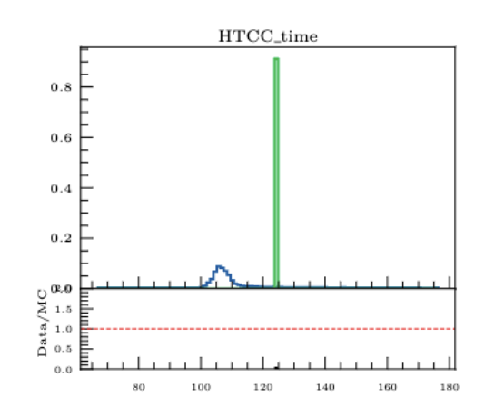
RG-D: Hadron identification with AI
So, there is an issue with either the AI or the inputs. First look at the inputs variables, in simulation and data
Look into time distribution
A ~30 ns shift in most of the distribution, I asked Raffaella and she told me it is expected, it will be fix with the real run number simulation.

Slide 11
RG-D: Hadron identification with AI
So, there is an issue with either the AI or the inputs. First look at the inputs variables, in simulation and data
Look into time distribution
A ~30 ns shift in most of the distribution, I asked Raffaella and she told me it is expected, it will be fix with the real run number simulation.
If all the particle are shifted by ~30ns all the pions will be identify as kaons.
Right now, I should always use time – start_time instead of just the time in the REC banks.

Slide 12
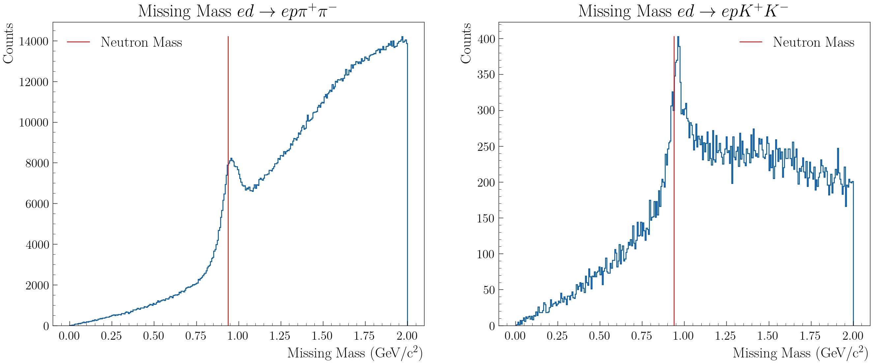

RG-D: Hadron identification with AI
Also, I have discussed with Raffaella and Bhawani about the exclusive process to test the AI.
Should be possible to have another way to have a good sample of pion and kaon
Reaction would be: $ed→eπ^{+}π^{−}p\left(n\right)$ and $ed→eK^{+}K^{−}p\left(n\right)$
Electron: standard RG-D cut + fiducials
DIS cuts: Q²>1GeV², W>2 GeV and y < 0.85
Pions and kaon are selected with pid only.

Slide 13
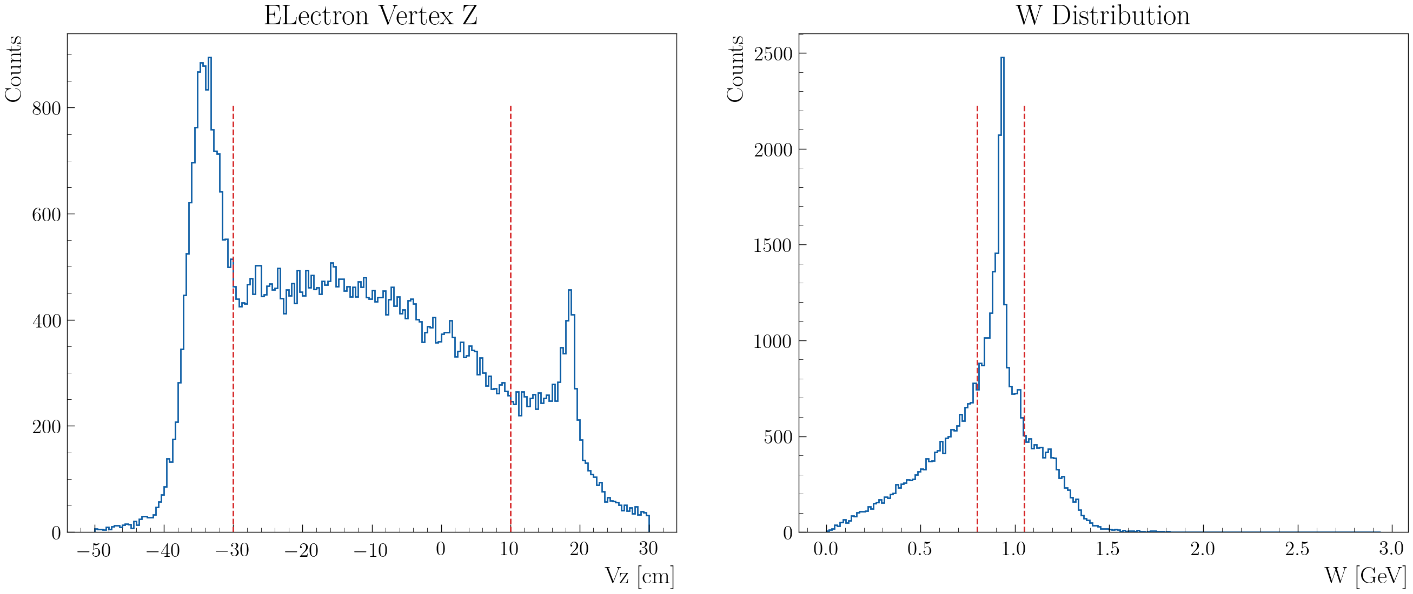
ALERT: Track matching with AI
Inputs: 5 of 2-D points (intercluster: x, y) (in total 10 numbers)
Output: sector, layer, wedge
Test it on real data (elastic proton/deuterium) selected with with Vz and W cut

Slide 14
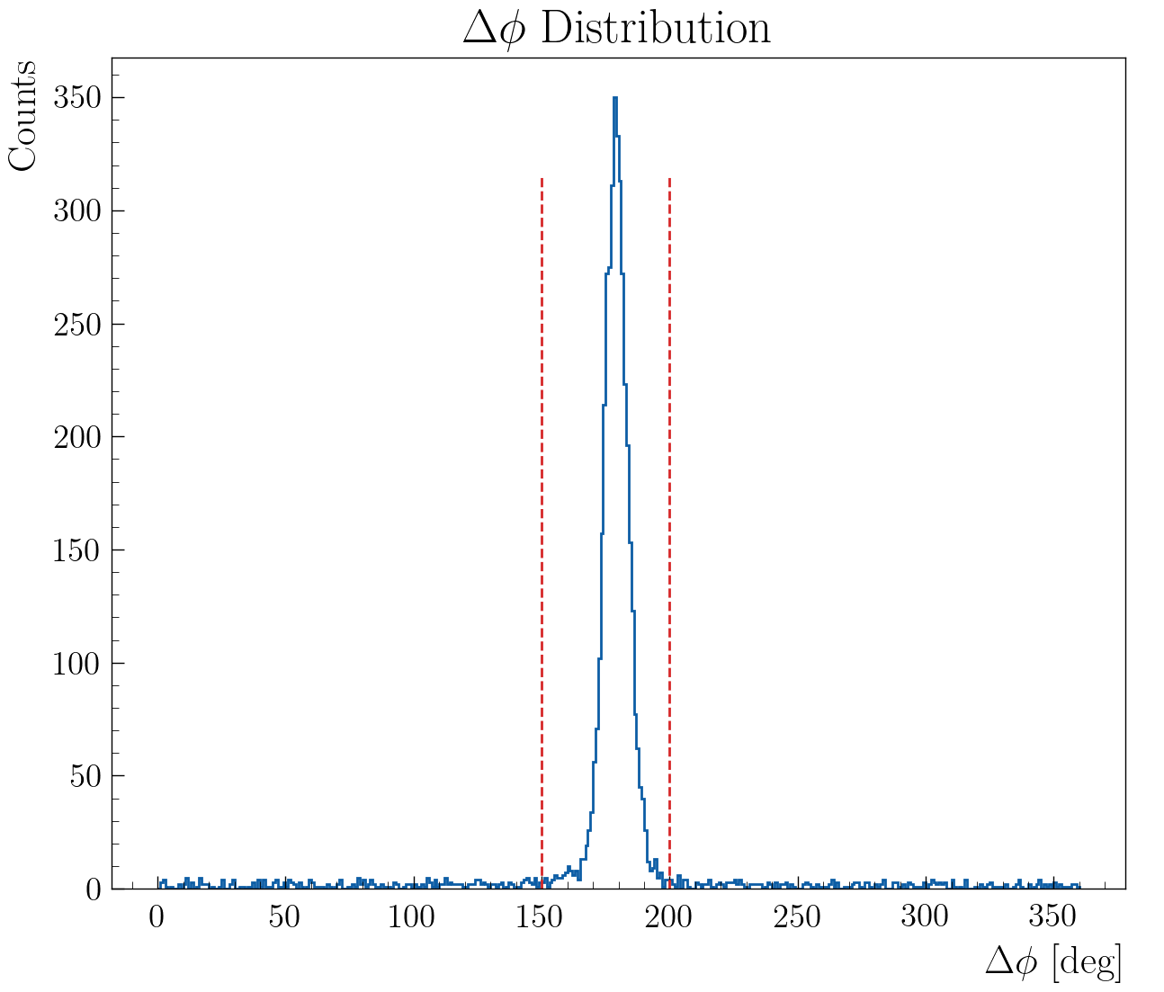
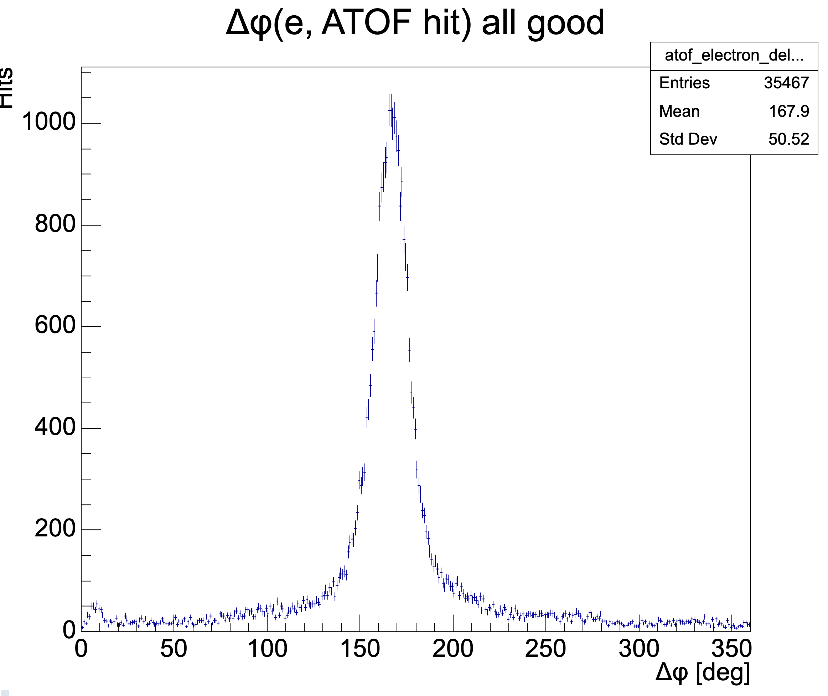
ALERT: Track matching with AI
Tracks matched to electron (by ɸ):
AHDC tracks with Δɸ between 150-200° from the elastic electron
Good ATOF hits match to electron (by ɸ):
ATOF hits that pass the cut given by Zhiwan/Noémie (Δɸ between 150-200°)

Slide 15
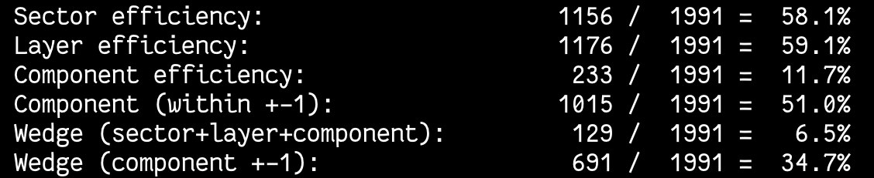
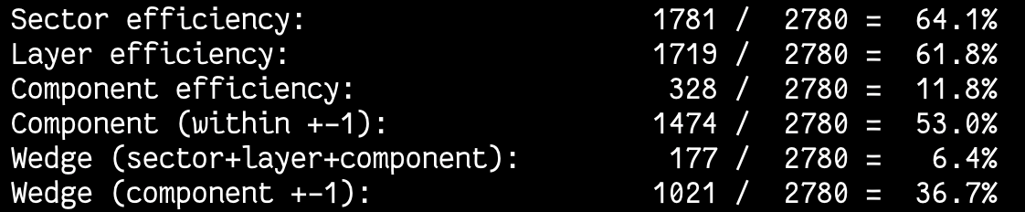
ALERT: Track matching with AI
Efficiencies for the proton:
Efficiencies for the deuterium:
Efficiencies are too low compared to simulation (92% for the Wedge (component +-1)).

Slide 16
ALERT: Track matching with AI
Raphael say that the geometry have change, maybe I have use the new geometry for the real data but not for the simulation/training.
I think I also have an issue in the code to extract the efficiency on real data.

Slide 17
Work plan
RG-D:
Study the CuSn contamination using simulations.
Retrain the AI-based PID using (time − start_time); aim to reduce the input feature set to only the most relevant variables.
Add the inbending configuration to the OSG portal.
For OSG, there is an option to merge background events. This requires extracting background from the decoded files. I know how to do this, and we now have enough files to extract a good background sample. Would you like me to proceed with extracting the background events?
ALERT:
work on the track matching using real data (retrain the model using the new geometry)
Fix the code if there is an issue (likely needed).
Extract correct efficiency
Shift PRad2

