Slide 1
Group meeting
Mathieu Ouillon (Mississippi State University)
02/17/26

Slide 2
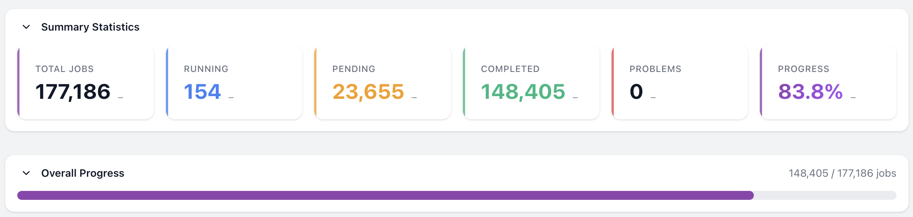
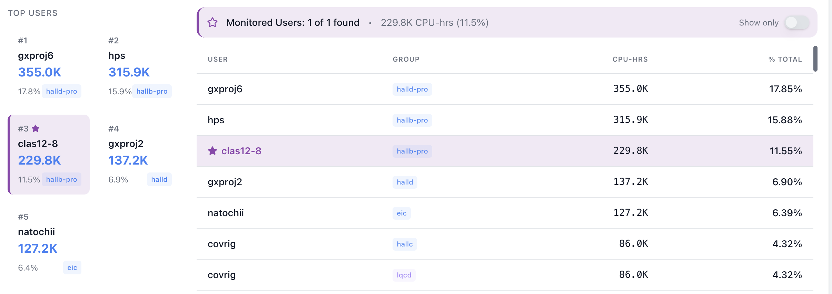
RG-D cooking

Slide 3
RG-D: Background merging
The Problem:
Pure Monte Carlo simulations (generated events → GEMC → reconstruction) produce clean events that don't reflect the real experimental environment.
In practice, the CLAS12 detector sees significant backgrounds from beam-target electromagnetic interactions, Møller scattering, accidental hits, and general detector noise.
These affect detector occupancy, tracking efficiency, and particle identification.
In the latest version of CoatJava used for pass1 processing of the RG-A, RG-B, and RG-K data, the drop of the charged particle reconstruction efficiency was ∼0.3% per nA.
The workflow is roughly:
Random-trigger data collection: During actual beam operations, events are recorded on a random (clock) trigger, capturing a snapshot of the real detector background at that moment — with no physics-event bias.
The simulated hit banks are merged with the hits from randomly selected real background events. This is typically done at the raw/digitized hit level.

Slide 4
RG-D: Background merging
We want a bit more than 2M events each configuration split in 100 files:
From 1 runs with 72M events → 1M background events
18354 (302 decoded and merged files): 1000301 background events (around 1.4%)
Target | Torus | Beam Current (nA) | Event Count
CuSn | −1 | 130 | 158,973,653
 | −1 | 150 | 294,294,862
 | +1 | 100 | 3,733,072,722
 | +1 | 86 | 100,062,529
 | +1 | 90 | 2,586,697,573
 | +1 | 95 | 7,807,749,486
 | +1 | 90 | 181,383,559
CxC | −1 | 50 | 198,427,732
 | +1 | 50 | 7,728,760,584
LD2 | −1 | 35 | 145,554,024
 | −1 | 50 | 200,238,342
 | +1 | 35 | 153,366,607
 | +1 | 45 | 167,660,546
 | +1 | 50 | 2,318,123,816
 | +1 | 60 | 5,664,535,047

Slide 5
RG-D: Background merging
We want a bit more than 2M events each configuration split in 100 files:
From 1 runs with 72M events → 1M background events
18354 (302 decoded and merged files): 1000301 background events (around 1.4%)
Other possibility: consider only the target and torus for the configuration and extract background with a similar event ratio
work only if we use all the data (all the outbending or all inbending)
For CuSn: only -1 and +1 for the torus:
For torus -1: 2 currents: 130 and 150 with 35.07% and 64.93%
Extract: 0.7M and 1.3M background events
For torus +1: 4 currents: 86, 90, 95 and 100 with 0.7%, 18.18%, 54.88% and 26.24%
Extract: 0.14M, 0.36M, 1.08M and 0.52M background events

Slide 6
RG-D: Background merging
Example for RG-A: fall2018 torus: +1, solenoid: -1, current: 50nA

Slide 7
RG-D: Compare the RICH and REC PID
Want to compare the PID of the RICH and the standard reconstruction (REC)
Use LD2 outbending data, sector 1

Slide 8
RG-D: Compare the RICH and REC PID
Want to compare the PID of the RICH and the standard reconstruction (REC)
Use LD2 outbending data, sector 1

Slide 9
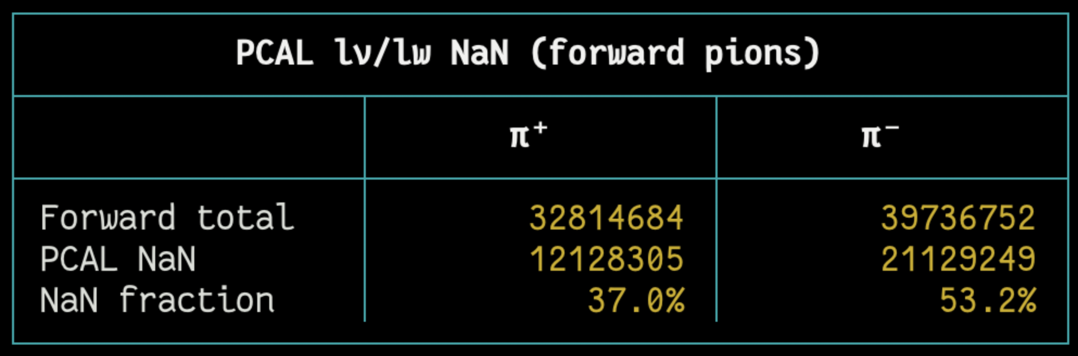
RG-D: Fiducial cuts for pions
For the fiducial cuts on pions, I was thinking of using the similar cuts as for the electrons
Cuts on the calorimeter: lv and lw
And on the DC
But for the calorimeter, the lv and lw are not define for many pions:
Raffaella told me that the calorimeter is not use for hadron PID, so no fiducial cuts on the calorimeter for hadron.

Slide 10
RG-D: Fiducial cuts for pions
For the fiducial cuts on pions, I was thinking of using the similar cuts as for the electrons
Cuts on the calorimeter: lv and lw
And on the DC
For the DC, use similar method as for the electron and end with these cuts:
For π−, the cut positions are 2.125 cm, 3.625 cm, and 9.625 cm for regions 1, 2, and 3, respectively.
For π+, the cut positions are 3.875 cm, 4.375 cm, and 2.625 cm for regions 1, 2, and 3, respectively

Slide 11
RG-D: Fiducial cuts for pions
Impact on the invariant mass plots (LD2, outbending, 10%):

Slide 12
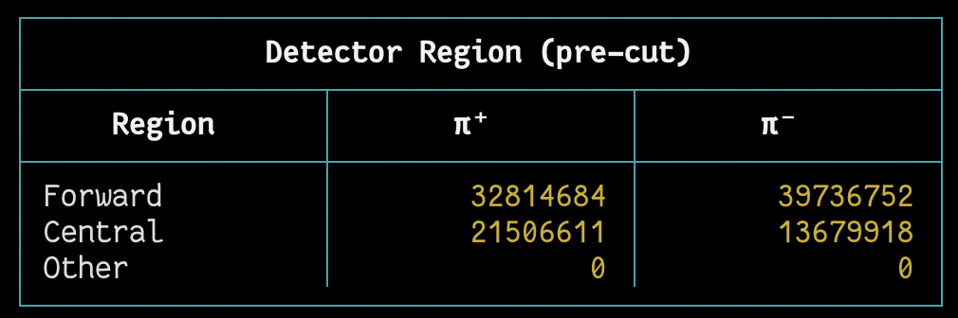
RG-D: Central pions
Wanted to look at the pions detected in the central detector:
Between a third and half of the statistic is in the central

Slide 13
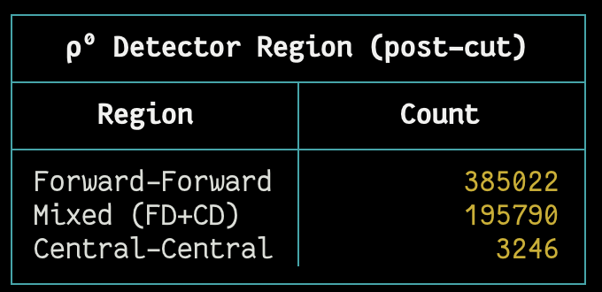
RG-D: Central pions
Wanted to look at the pions detected in the central detector:
Between a third and half of the statistic is in the central
For the ρ⁰: can be forward-forward pions, mixed pions, or central-central pions

Slide 14
RG-D: Central pions
Impact on the invariant mass: FD-FD vs CD-CD pions

Slide 15
RG-D: Central pions
Impact on the invariant mass: FD-FD vs Mixed pions
So, using the forward pions will increase the statistic for the low Q² bins only
But need to develop Δt vs p cuts + fiducials (CVT)

Slide 16
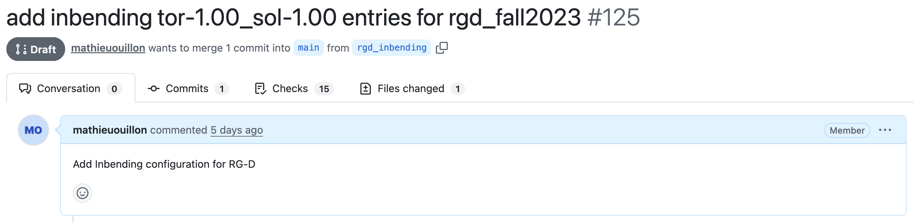
Other things
I have started to work on adding the inbending configuration to the OSG portal.
Work on the work report: new plots and rewrite part of the text + invariant mass plots.
For the CLAS Collaboration meeting:
I suppose I will give the RG-D update talk?
For ALERT, I can give a talk about the track matching, since I have result on simulation and data.

Slide 17
Work plan
RG-D:
Retrain the AI-based PID using (time − start_time); aim to reduce the input feature set to only the most relevant variables.
Study the CuSn contamination using simulations.
Add the inbending configuration to the OSG portal.
ALERT:
Retrain the track finding and track matching with the new geometry.

