Slide 1
Group meeting
Mathieu Ouillon (Mississippi State University)
02/24/26

Slide 2
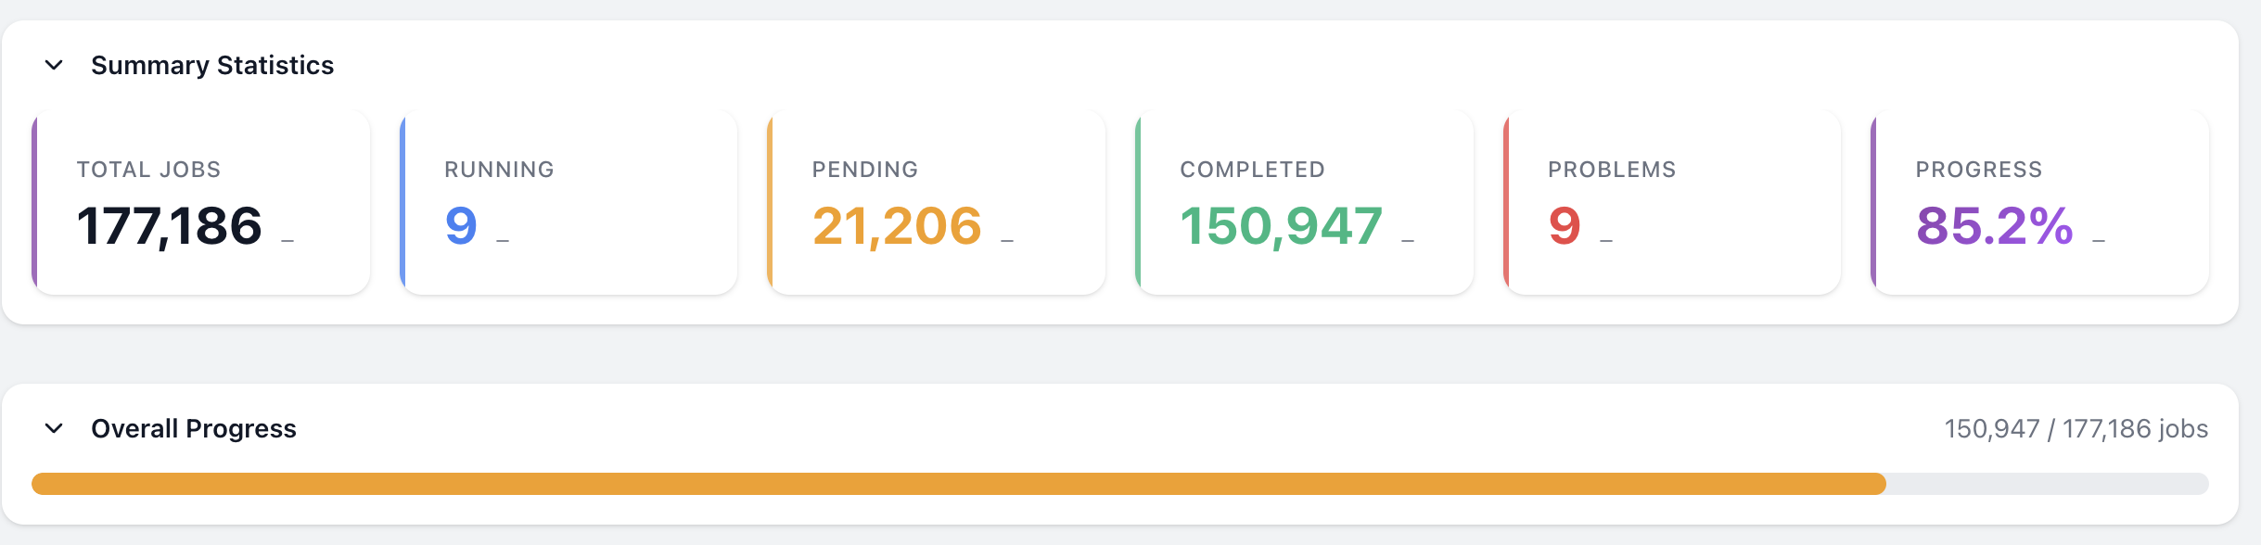
RG-D cooking

Slide 3
RG-D: Background merging
Target | Torus | Beam Current | Num Runs | Event Count | Percentage
CuSn | -1 | 100na | 2 | 16164206 | 1.4
 |  | 110na | 2 | 53434219 | 4.6
 |  | 130na | 25 | 551602073 | 47.3
 |  | 135na | 1 | 22294711 | 1.9
 |  | 150na | 12 | 496106028 | 42.6
 |  | 175na | 1 | 26278056 | 2.3
 | 1 | 100na | 67 | 4476544824 | 24.5
 |  | 20na | 2 | 31510627 | 0.2
 |  | 30na | 3 | 39319399 | 0.2
 |  | 50na | 3 | 39458848 | 0.2
 |  | 86na | 8 | 231383125 | 1.3
 |  | 90na | 70 | 3612079659 | 19.7
 |  | 95na | 179 | 9861877767 | 53.9
CxC | -1 | 10na | 3 | 6254024 | 1.4
 |  | 20na | 1 | 10242961 | 2.4
 |  | 45na | 1 | 15138153 | 3.5
 |  | 50na | 9 | 373558009 | 86.5
 |  | 75na | 1 | 26532001 | 6.1
 | 1 | 10na | 1 | 10164252 | 0.1
 |  | 30na | 1 | 25505024 | 0.3
 |  | 50na | 127 | 8900163297 | 99.3
 |  | 75na | 2 | 24654459 | 0.3
LD2 | -1 | 100na | 1 | 50548605 | 4.1
 |  | 20na | 2 | 10002720 | 0.8
 |  | 35na | 11 | 706491728 | 57.9
 |  | 45na | 2 | 100197071 | 8.2
 |  | 50na | 9 | 295112978 | 24.2
 |  | 5na | 1 | 6966837 | 0.6
 |  | 75na | 1 | 51857208 | 4.2
 | 1 | 20na | 1 | 11130358 | 0.1
 |  | 35na | 7 | 327477900 | 3.3
 |  | 45na | 3 | 234171970 | 2.3
 |  | 50na | 42 | 2798586689 | 27.9
 |  | 60na | 97 | 6622227758 | 65.9
 |  | 75na | 1 | 50464210 | 0.5
We want a bit more than 2M events each configuration split in 100 files:
From 1 runs with 72M events → 1M background events
18354 (302 decoded and merged files): 1000301 background events (around 1.4%)

Slide 4
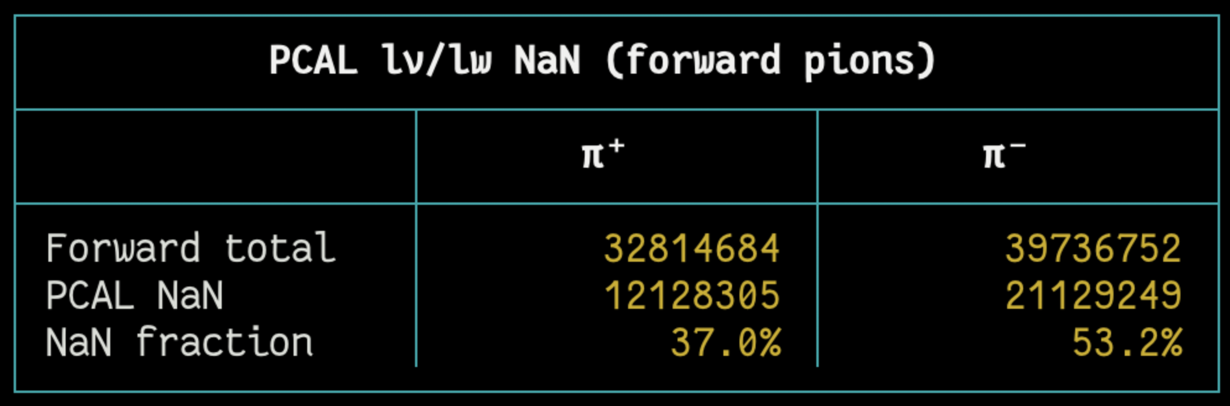
RG-D: Cuts for pions
For the fiducial cuts on pions, I was thinking of using the similar cuts as for the electrons
Cuts on the calorimeter: lv and lw
And on the DC
But for the calorimeter, the lv and lw are not define for many pions:
Raffaella told me that the calorimeter is not use for hadron PID, so no fiducial cuts on the calorimeter for hadron.

Slide 5
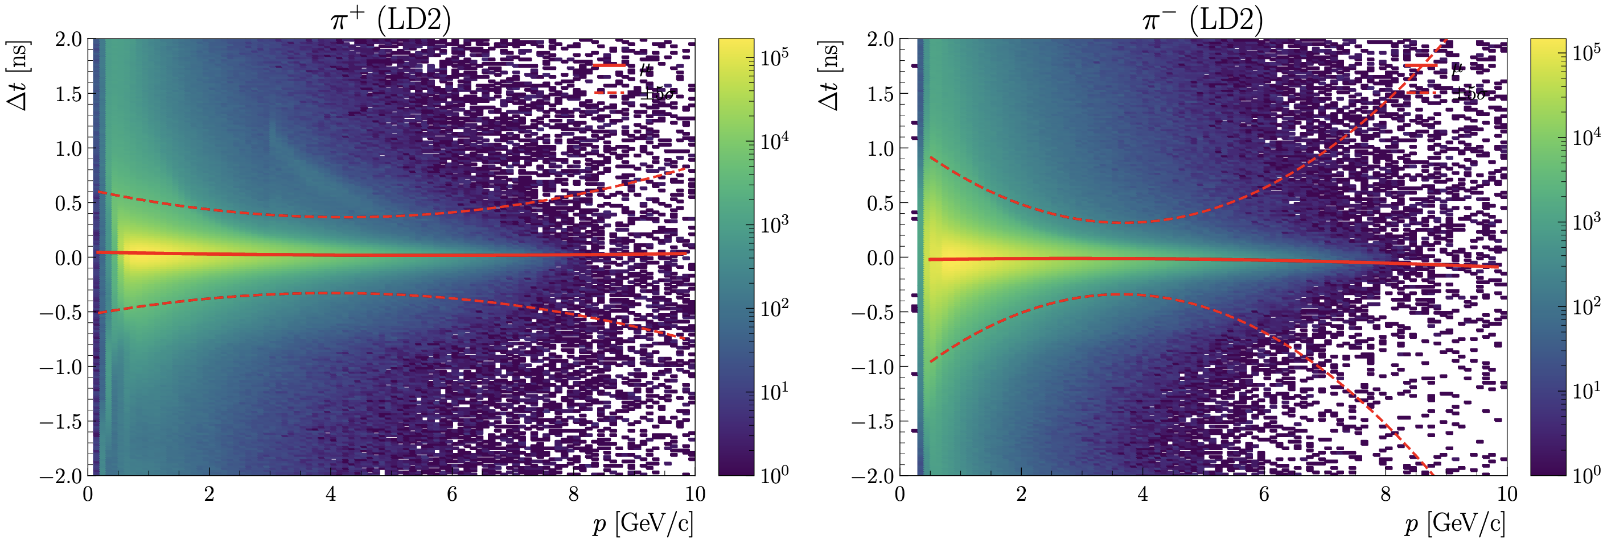
RG-D: Cuts for pions
For the Δt vs p cut:
Forward detector: 2000 <= status < 4000
|Chi2pid| < 10, 0.3 < p, Δt cuts: μ ± 3σ, Vz cuts

Slide 6
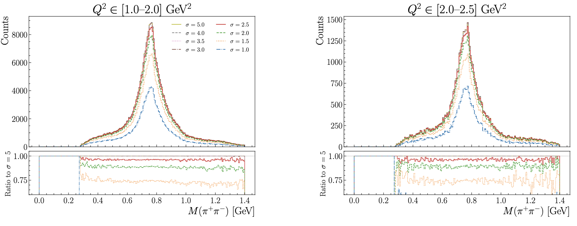
RG-D: Cuts for pions
I wanted to study the impact of the Δt vs p cut on the invariant mass of the two pions:

Slide 7
RG-D: Cuts for pions
I wanted to study the impact of the Δt vs p cut on the invariant mass of the two pions:
Almost not difference for σ > 3

Slide 8
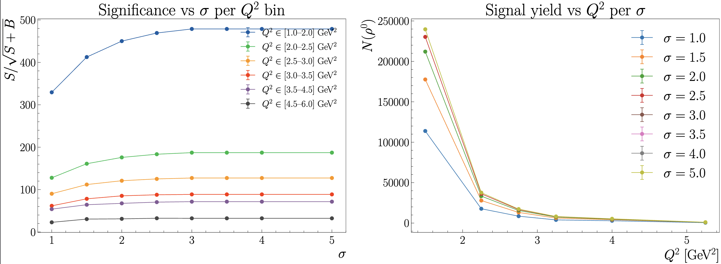
RG-D: Cuts for pions
Look at the significance:
S: total counts under the Breit-Wigner curve over the entire fitted region
B: total background counts under the polynomial in the rho0 peak window only

Slide 9
RG-D: Cuts for pions

Slide 10
RG-D: Cuts for pions

Slide 11
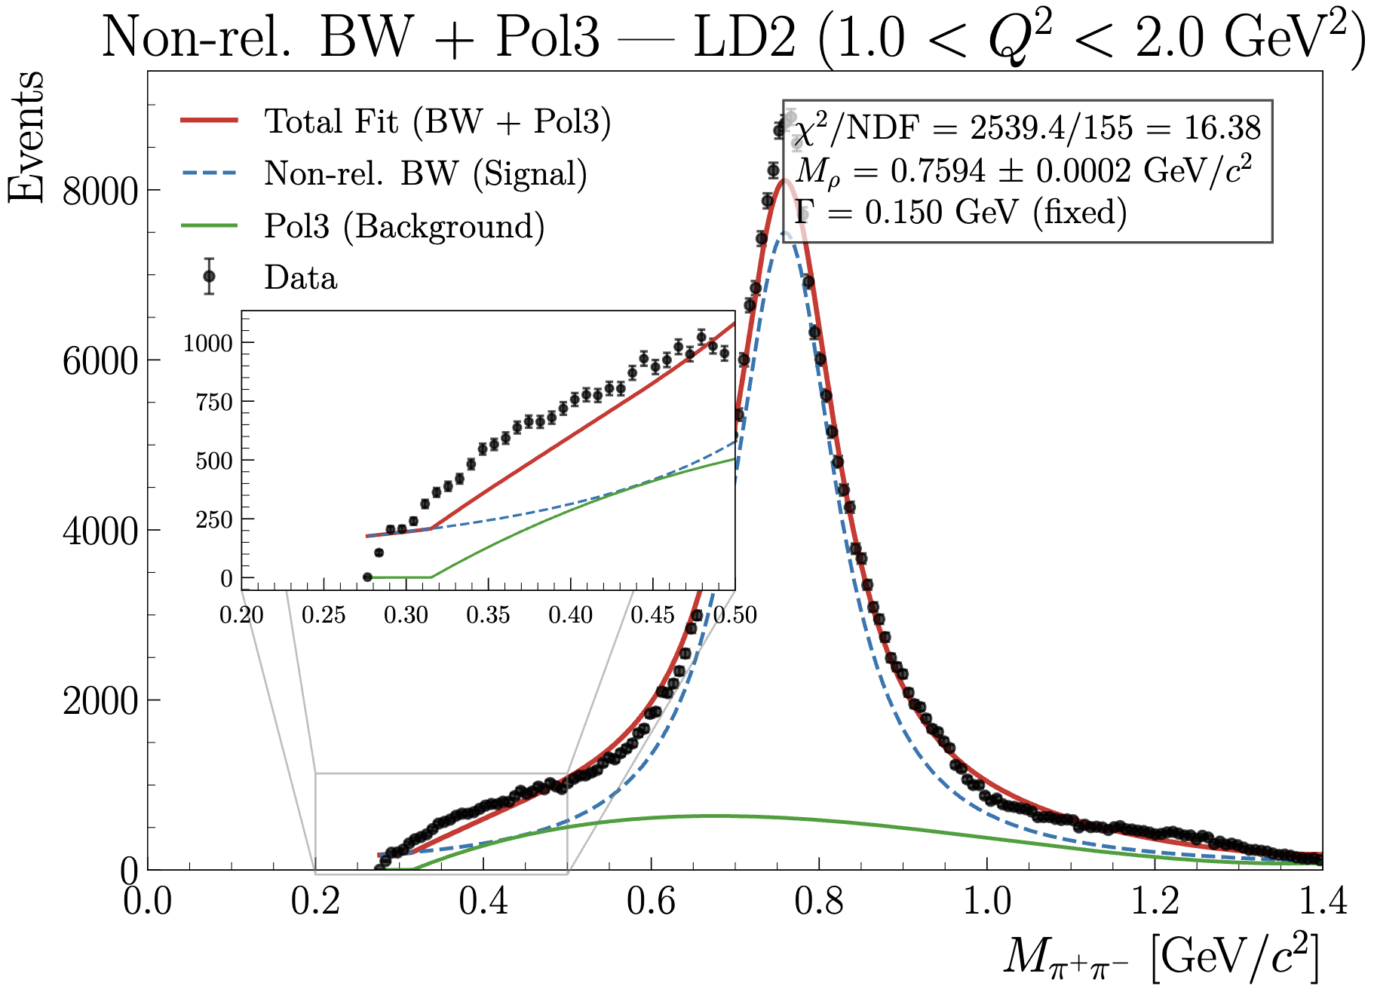
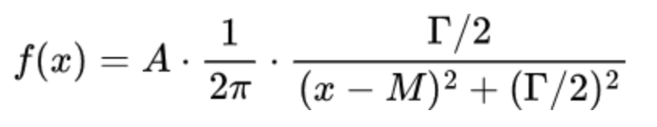
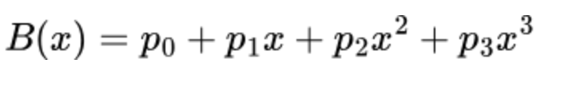
RG-D: Fit for the invariant mass
I realize what is the issue with the fit for the invariant mass of the two pions

Slide 12
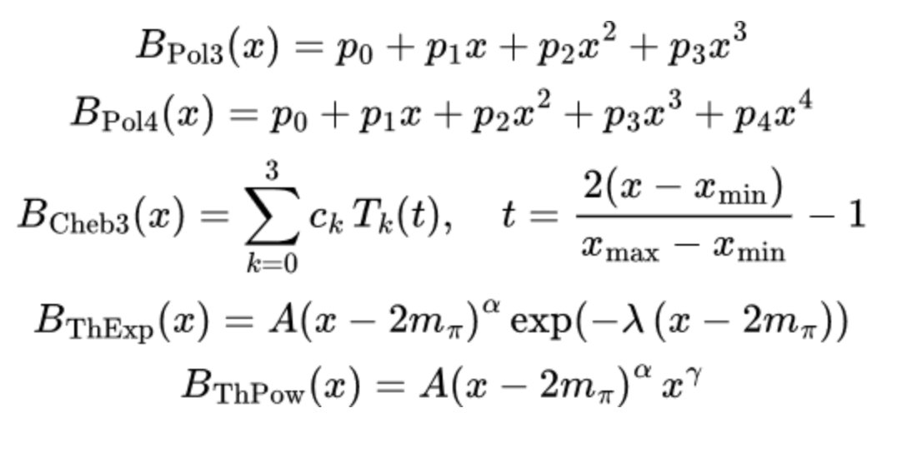
RG-D: Fit for the invariant mass
Try different background functions:

Slide 13
RG-D: Fit for the invariant mass
Try different model functions:
Non-relativistic Breit-Wigner
Relativistic Breit-Wigner
Ross-Stodolsky
Söding
Drell-Söding
Sill distribution

Slide 14
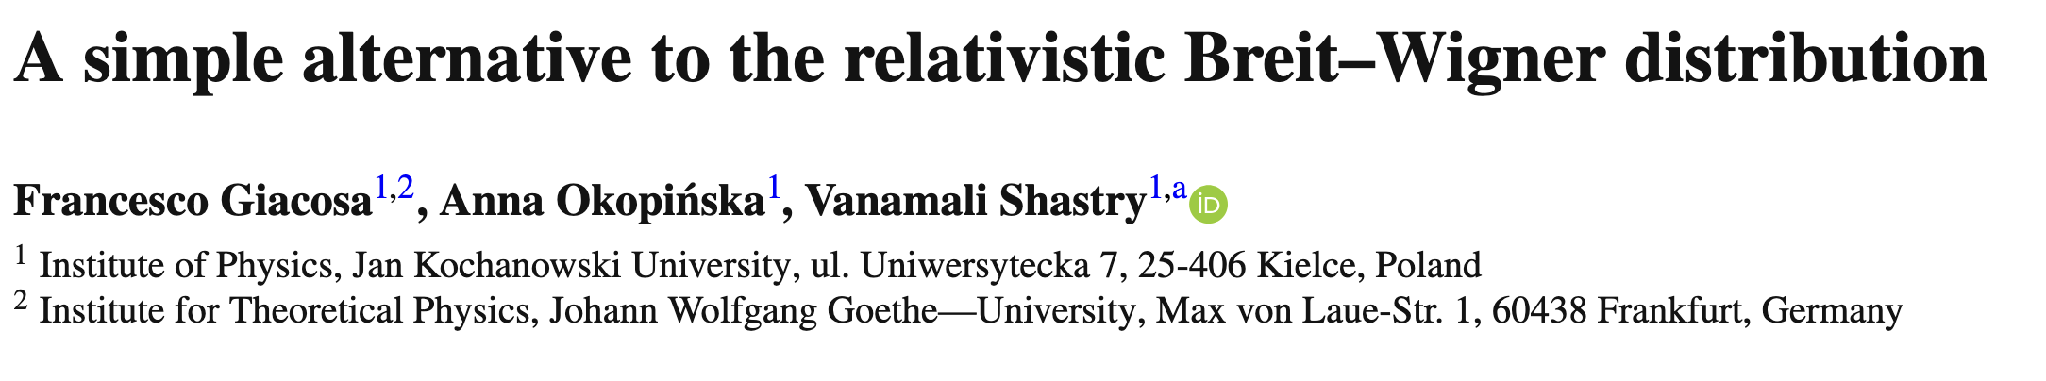
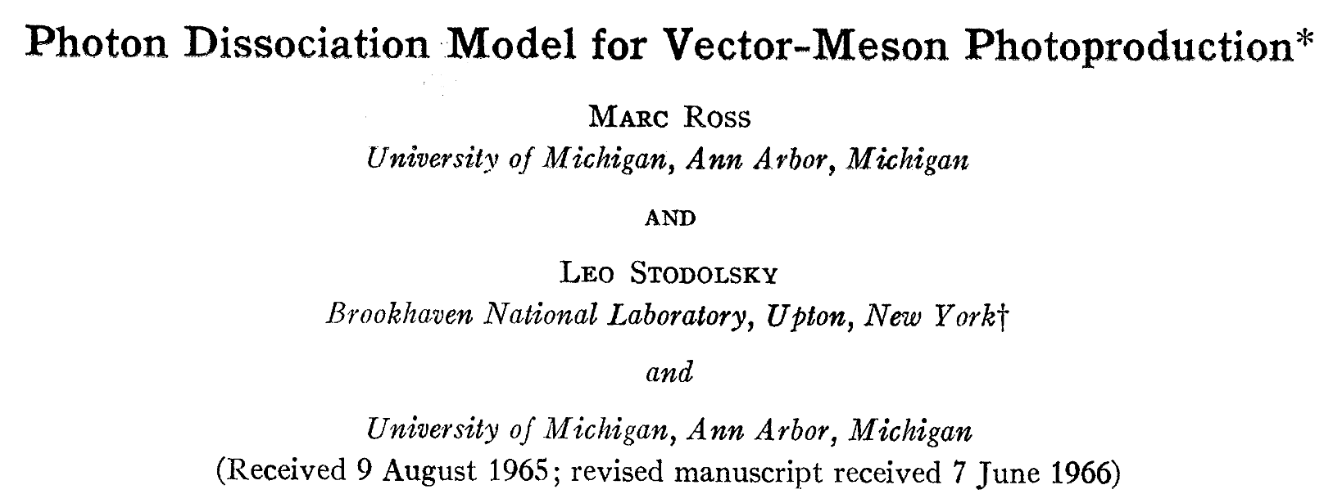

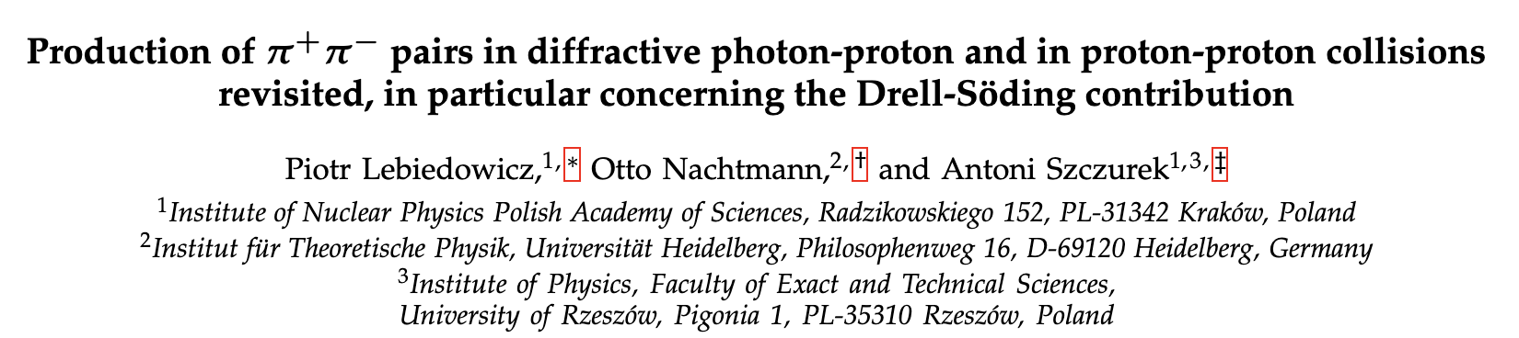
RG-D: Fit for the invariant mass
Try different model functions:
Non-relativistic Breit-Wigner
Relativistic Breit-Wigner
Ross-Stodolsky
Söding
Drell-Söding
Sill
Sill
Ross-Stodolsky
Drell-Söding
Söding

Slide 15
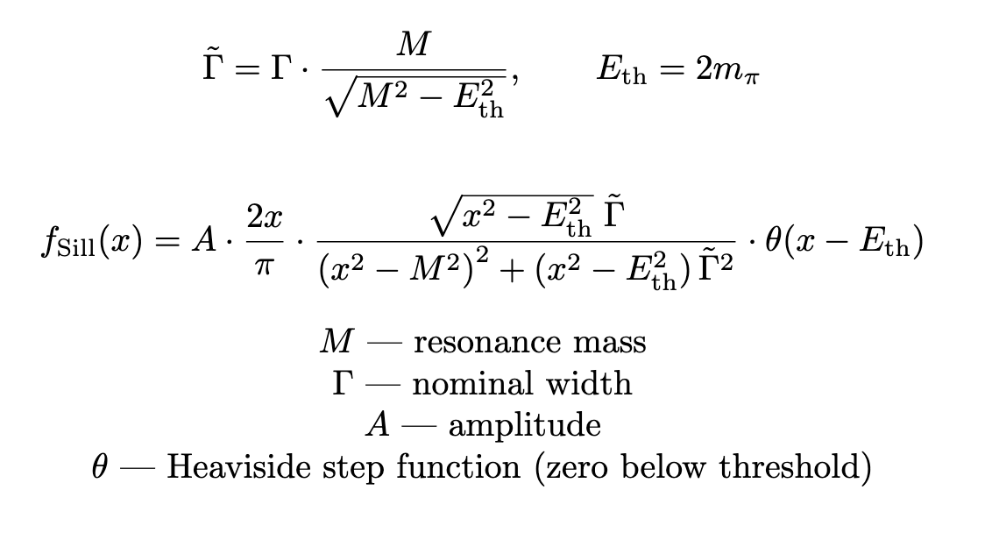
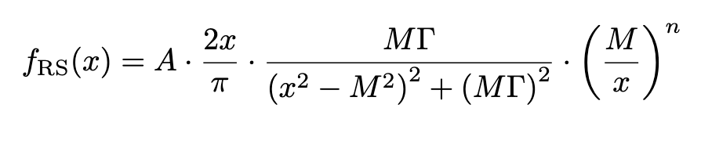
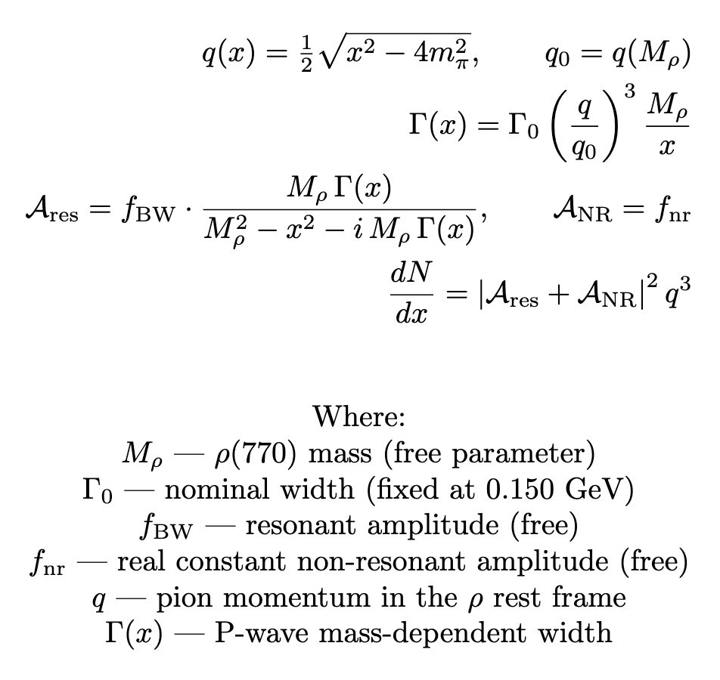
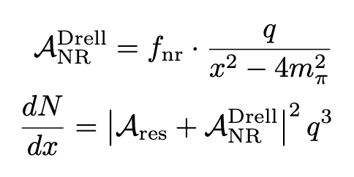
RG-D: Fit for the invariant mass
Sill
Try different model functions:
Non-relativistic Breit-Wigner
Relativistic Breit-Wigner
Ross-Stodolsky
Söding
Drell-Söding
Sill
Ross-Stodolsky
Söding
Drell-Söding

Slide 16
RG-D: Fit for the invariant mass

Slide 17
RG-D: Nuclear transparency
Use the previous binning: 1-2, 2-2.5, 2.5-3, 3-3.5, 3.5-4.5, and 4.5-6

Slide 18
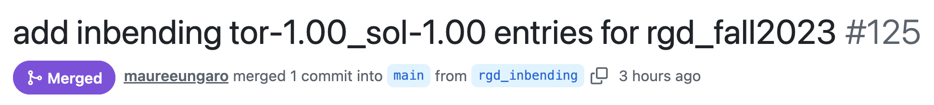
Other work
Pull request for inbending configuration on OSG:

Slide 19
Other work
CLAS Collaboration Meeting plan:
1: title slides
2-5: intro slides
6: cooking
hadron cuts (fiducial + delta t) + (contamination?, central?)
The effect of the hadron cuts on the invariant mass
nuclear transparency fits
RG-D nTMDs Studies: π0 analysis multi-dimensional bins
new extraction of the nuclear transparency
path forward?
nTMDs Studies: π+ analysis, Daniel's analysis?
Suman's analysis?
Summary?
For ALERT, talk about the track matching, since I have result on simulation and data.

Slide 20
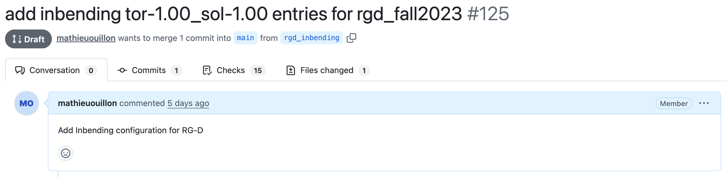
Other things
I have started to work on adding the inbending configuration to the OSG portal.
Work on the work report: new plots and rewrite part of the text + invariant mass plots.
For the CLAS Collaboration meeting:
I suppose I will give the RG-D update talk?
For ALERT, I can give a talk about the track matching, since I have result on simulation and data.

Slide 21
Work plan
RG-D:
Retrain the AI-based PID using (time − start_time); aim to reduce the input feature set to only the most relevant variables.
Study the CuSn contamination using simulations.
Add the inbending configuration to the OSG portal.
ALERT:
Retrain the track finding and track matching with the new geometry.

