Slide 1
Group meeting
Mathieu Ouillon (Mississippi State University)
03/03/26

Slide 2
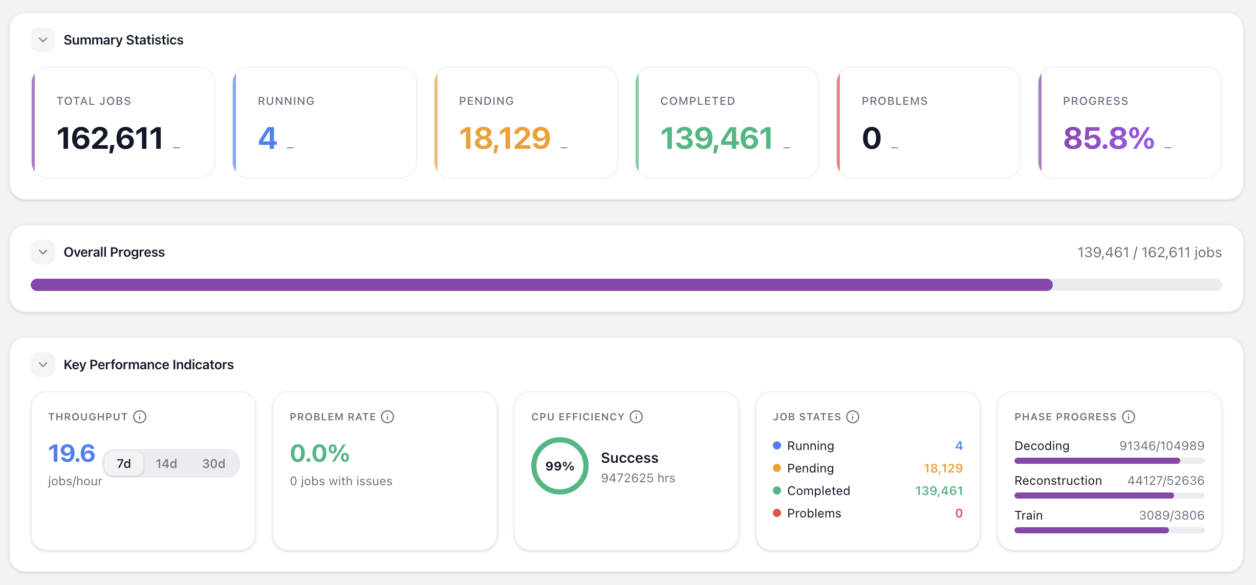
RG-D cooking

Slide 3
RG-D: AI for pions identification
Wanted to study the gain in number of pions of the AI:
AI PID yields slightly fewer pions overall but achieves higher purity
Purity gain may be absorbed by delta-t vs p cuts, requires verification
AI benefit may be limited unless targeting high-momentum pions or kaons at any momentum

Slide 4
RG-D: Fit for the invariant mass
Tested different lower limit for the fit using Breit-Wigner and Pol3
From 0.28 to 0.4
Best is 0.4

Slide 5
RG-D: Fit for the invariant mass
Tested different lower limit for the fit using Breit-Wigner and Pol4
From 0.28 to 0.4
Best is 0.36

Slide 6
RG-D: Fit for the invariant mass
Quick summary:
Use pol4 and lower limit of 0.36 seems the best

Slide 7
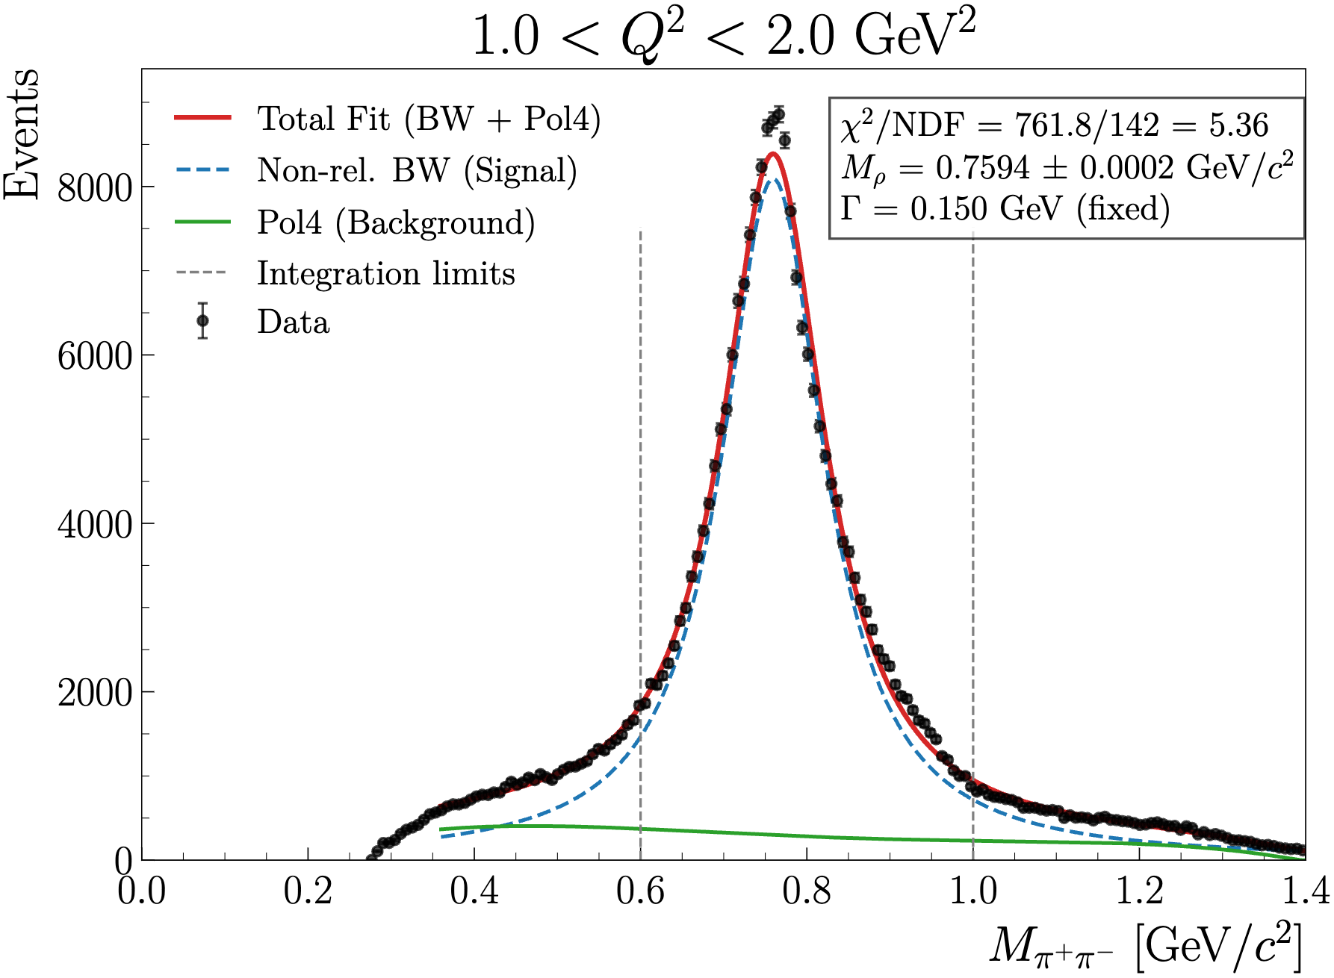
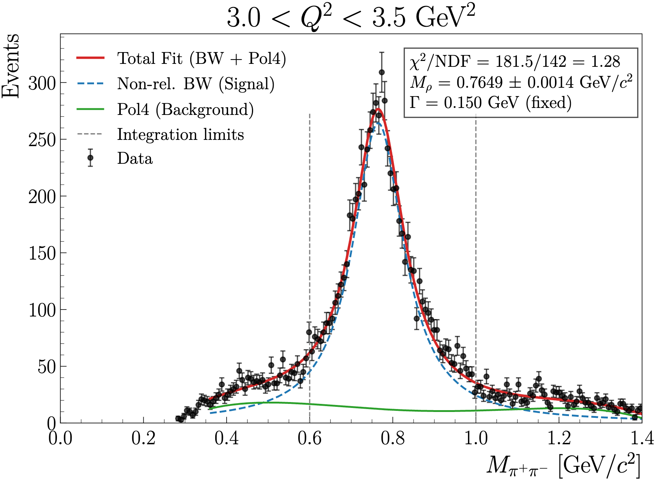
RG-D: Fit for the invariant mass
Quick summary:
Use pol4 and lower limit of 0.36 seems the best

Slide 8
RG-D: Nuclear transparency cut effect
Want to study the effect of the cuts on the invariants mass:
The effect of z_{h} ,l_{c}, and t
The default cut are: z_{h} > 0.9, l_{c} < 1 fm, 0.1 < -t < 0.5

Slide 9
RG-D: Nuclear transparency cut effect
Effect of -t cut:
Goal is to select diffractive process and exclude coherent production
Cut above 0.5 have small effect on the S/√(S+B)
But increase a bit the yield
N-1 distribution mean all the other cuts but the one on the variable show

Slide 10
RG-D: Nuclear transparency cut effect
Effect of z_{h} cut:
Goal is to select elastic process
A cut too high on zh will increase the background faster than the signal
The best is around 0.85

Slide 11
RG-D: Nuclear transparency cut effect
Effect of l_{c} cut:
Goal is to disentangle color transparency effects from coherence length effects
The S/√(S+B) is maximal around 1.2

Slide 12
RG-D: Nuclear transparency cut effect
Effect of l_{c} cut:
Goal is to disentangle color transparency effects from coherence length effects
The S/√(S+B) is maximal around 1.2
The nuclear transparency is flat from 0.4 to 1.2

Slide 13
Other work
This week, I mostly worked on the presentation for the Collaboration meeting, both for. RG-D and RG-L

Slide 14
Work plan
RG-D:
Study the CuSn contamination using simulations (Now I can submit OSG jobs with 5.13)
Test the purity of the hadron PID AI with a Δt vs p cut
Work on the slides for the Collaboration metting
ALERT:
Retrain the track finding and track matching with the new geometry
Work on the slides for the Collaboration metting

