Slide 1
Group meeting
Mathieu Ouillon (Mississippi State University)
03/17/26

Slide 2
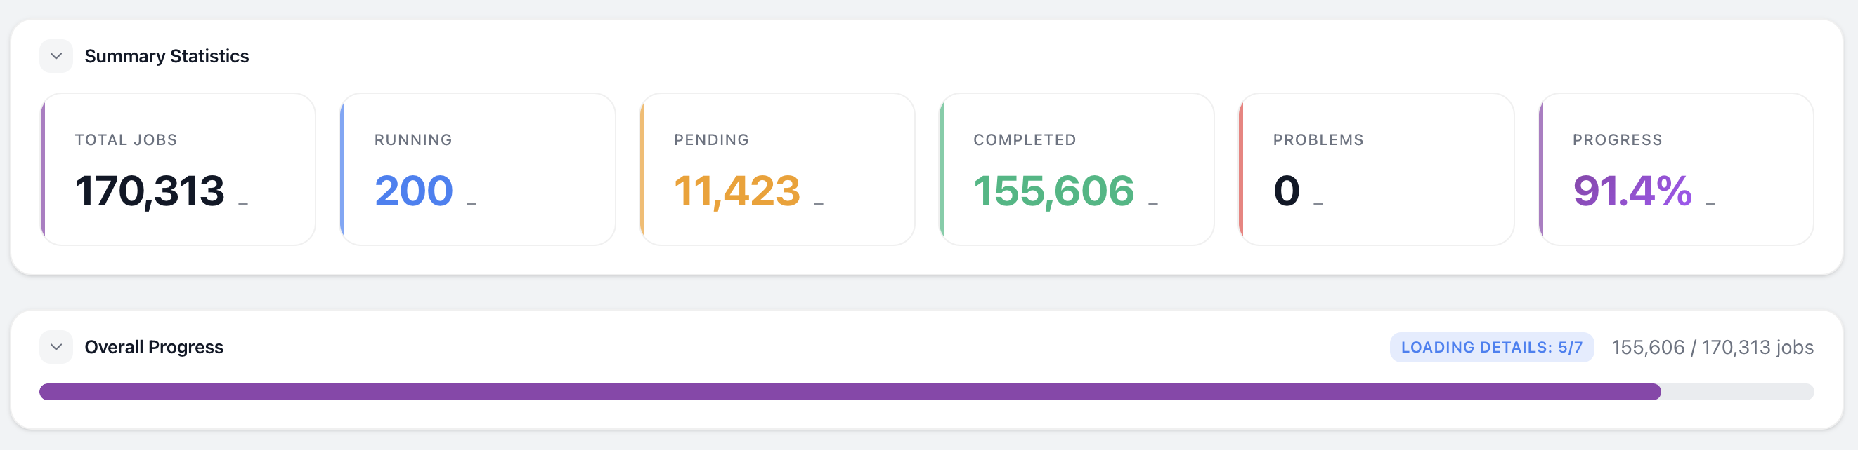
RG-D cooking
I have an error with some reconstruction jobs: corrupted input files
I have discussed with Nathan about that
The files on cache/mss are good it is an issue with the swif2 job only
Nathan told me to refresh the input files and retry the jobs

Slide 3
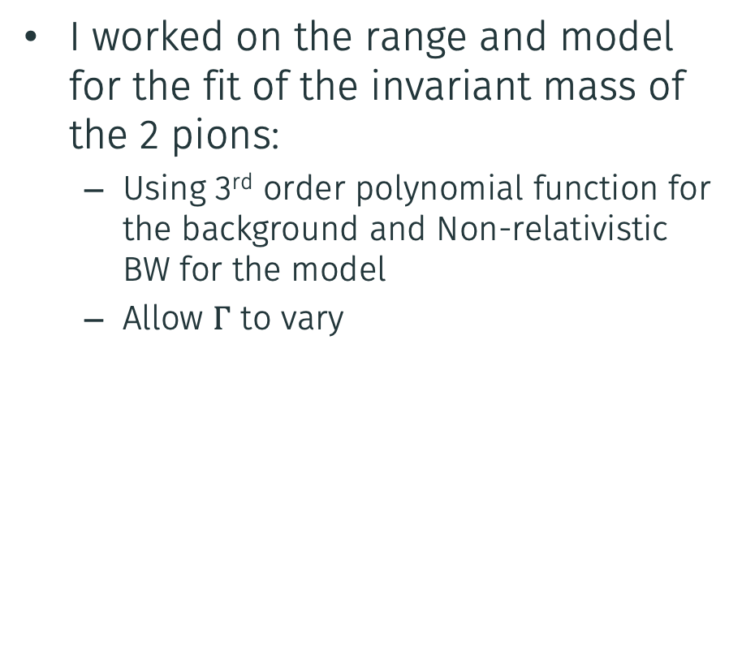
RG-D: Invariant mass fit
I worked on the range and model for the fit of the invariant mass of the 2 pions:
Using 3rd order polynomial function for the background and Non-relativistic BW for the model
Allow $Γ$ to vary

Slide 4
RG-D: Invariant mass fit
Vary both the upper and lower limit of the fit from:
x_{min}: 0.28, 0.46 increment of 0.01 and x_{max}: 0.95, 1.50 increment of 0.025

Slide 5
RG-D: Invariant mass fit
Vary both the upper and lower limit of the fit from:
x_{min}: 0.28, 0.46 increment of 0.01 and x_{max}: 0.95, 1.50 increment of 0.025

Slide 6
RG-D: Invariant mass fit
Try other background functions:

Slide 7
RG-D: Invariant mass fit
Try other background functions:

Slide 8

RG-D: Invariant mass fit
$$B\left(M\right)=A{\left(M−2m_{π}\right)}^{α},e^{−λ,\left(M−2m_{π}\right)}$$
Try other background functions:

Slide 9
RG-D: Invariant mass fit
Try other model functions (I have tried every background functions):

Slide 10
RG-D: Invariant mass fit
Try other model functions (I have tried every background functions):

Slide 11
RG-D: Cu-Sn contamination
Try to estimate the contamination using the vertex fit
Each foil region is defined as mean ± 3σ around its peak (e.g., First foil: [-5.48, -1.50], Second foil: [-10.49, -6.41])
Each of the components (fnc_i) is numerically integrated over each region
For a given region, the contamination from another peak is its integral divided by the total integral of all components in that region. E.g., Second foil contamination in First foil region = ∫(fnc2) / ∫(total) over [-5.48, -1.50]

Slide 12
ALERT: Track finding
Model: MultiLayer Perceptron, 10 inputs, 1 output (size and number of layer have been optimized)
Inputs: x and y values of the five inter-clusters
For the training ⇒ Need good and bad tracks:
Good tracks: GEANT4 simulation (particle with p ∈ [0.07, 1.5] GeV/c, φ ∈ [0, 360]°, θ ∈ [30, 150]° , and Vz ∈ [-20, 20] cm)
False tracks: Interchanging randomly up to two inter-clusters with another event
Generate 5M events composed of all light nuclei (flat distribution for all variables)
Output: Number between 0 and 1, with 0/1 means bad/good track

Slide 13
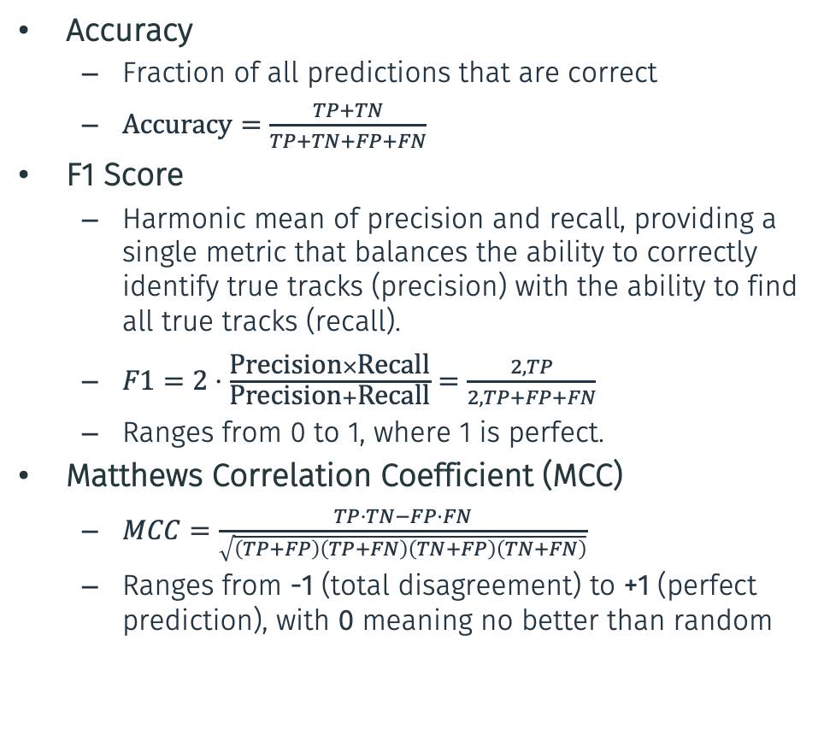
ALERT: Track finding
Accuracy
Fraction of all predictions that are correct
$\text{Accuracy}=\frac{TP+TN}{TP+TN+FP+FN}$
F1 Score
Harmonic mean of precision and recall, providing a single metric that balances the ability to correctly identify true tracks (precision) with the ability to find all true tracks (recall).
$F1=2⋅\frac{\text{Precision}×\text{Recall}}{\text{Precision}+\text{Recall}}=\frac{2,TP}{2,TP+FP+FN}$
Ranges from 0 to 1, where 1 is perfect.
Matthews Correlation Coefficient (MCC)
$MCC=\frac{TP⋅TN−FP⋅FN}{\sqrt{\left(TP+FP\right)\left(TP+FN\right)\left(TN+FP\right)\left(TN+FN\right)}}$
Ranges from -1 (total disagreement) to +1 (perfect prediction), with 0 meaning no better than random

Slide 14
ALERT Track finding: Optimization
Optuna framework with MedianPruner — prunes unpromising trials early
Tunes: learning rate, weight decay, batch size, network depth, hidden dimensions

Slide 15
ALERT Track finding: Evaluation on simulation
Per-momentum bin evaluation (60–240 MeV)
Multi-track and particle-ID evaluation
Threshold sweep
Noise: injects 0–20 random hits to measure degradation

Slide 16
ALERT Track finding: Small test on data
Just to see that we are not losing too much tracks
Use 2.2 GeV proton run and check how many track are found by the two models
========================================
Event-by-event comparison (50000 events)
========================================
Events where new finds MORE tracks: 1132
Events where new finds FEWER tracks: 836
Events where new finds SAME tracks: 48032
Old total tracks: 10907 | New total tracks: 11365

Slide 17
ALERT: Other
The new model is in the networks repository:
https://code.jlab.org/hallb/clas12/coatjava/networks
Not available in COATJAVA yet need a pull request
Code to train and evaluated the network is available on GitLab:
https://gitlab.com/MathieuOuillon/alert-track-finding
Next step: same things for track matching
Produced mini timeline after Florian calibration of the t00
Published the timeline

Slide 18
To do list
RG-D:
Study the effect of the \Delta t cut on the purity of the hadron PID AI
Background merging: produces background files from decoded files
Background for \rho^0 with simulation
Radiative correction
Acceptance and efficiency correction
Study the CuSn contamination using simulations
Maybe simulation will not work (use vertex fit, maybe the sPlot technique)
ALERT:
Retrain track matching with the new geometry (Add it to the GitLab)
I found that I lose some hits between the helix fitter and the track matching

