Slide 1
Group meeting
Mathieu Ouillon (Mississippi State University)
03/17/26

Slide 2
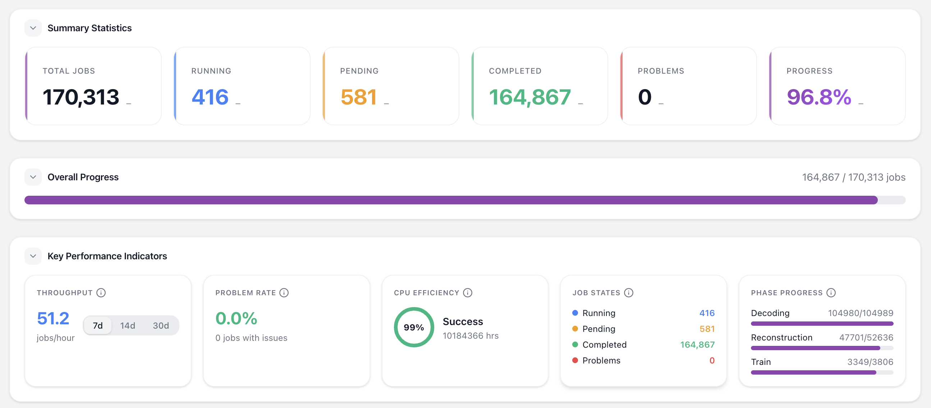
RG-D cooking

Slide 3
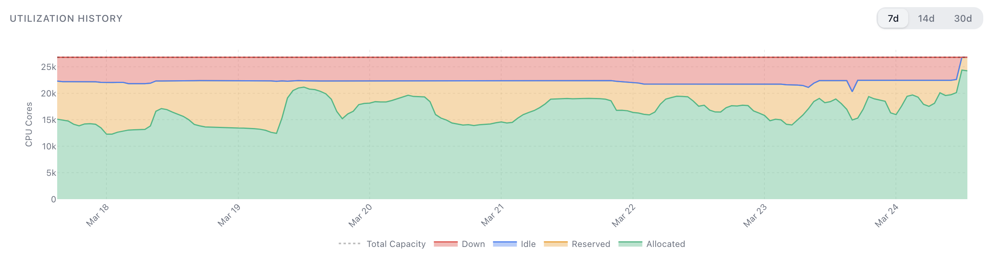
RG-D cooking

Slide 4
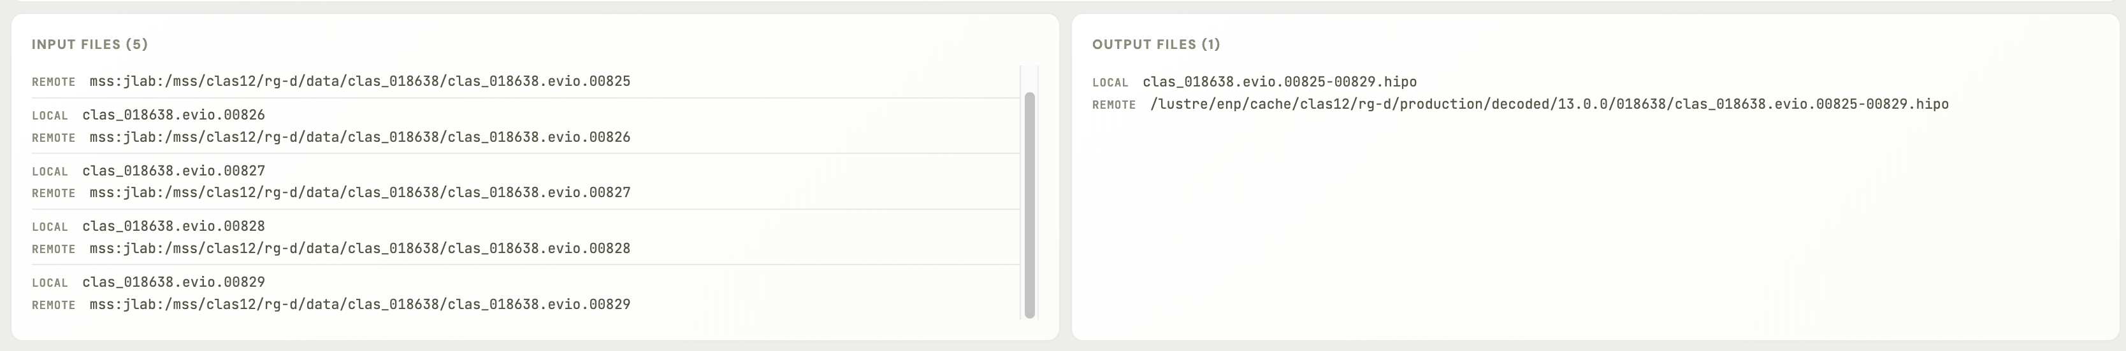
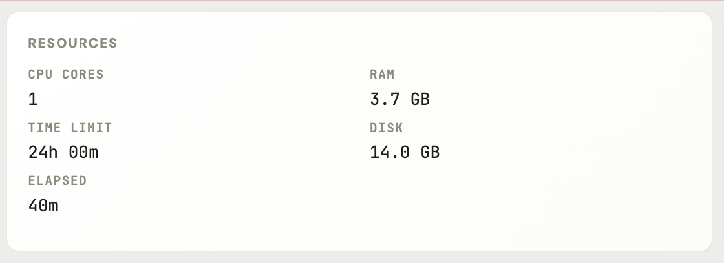
RG-D cooking
I wanted to give more detail about the last week issue and how I solved it:
Last week some reconstruction jobs failed, and few week before some decoding jobs that failed
The issue was the disk requirement for these jobs
When you submit a job, you need to specify the disk usage with: -disk
If the disk usage is larger than than the jobs will crash (sometimes without a proper error message)
That disk requirement was not enforced in the past, but since January/February(?) scicomp start to enforce it
For the decoding jobs the workflow tools use 15 GB (and it cannot be change without modifying the code)
For RG-D we decode 5 files in the same jobs, meaning we need 10GB for the input, 5GB to store the intermediate files, and we merge all of them in 1 decoded files (~5GB)
So, we need in total ~20GB, more than the disk requirement (20GB is probably a bit too much)

Slide 5
RG-D cooking
For the reconstruction jobs, the workflow tool request 13GB of disk space
But the inputs are 2×5GB files, and we have 2×5GB intermediate files and 2 output files (3GB each?), in total ~23GB
So, the jobs will crash
The solution for that is to modify the disk requirement of these jobs (for the decoding add 10GB and for the reconstruction add 20GB)
To do that I use the swif2 modify-jobs command:
swif2 modify-jobs -workflow rgd-dmra-pass1_LD2_2-18305x144 -disk add 10gb -names rgd-dmra-pass1_LD2_2-18305x144-p0-dm-08854
To get the jobs name I use :
swif2 status --user clas12-8 -workflow rgd-dmra-pass1_LD2_2-18305x144 -problems --display json

Slide 6
RG-D cooking: Skimming
Those numbers look very small, I need to check again
I check the size of different skims for the color transparency
Use the run 018777: LD2 run with 100,953,988 events
DST size: 396GB
With:
Electron: all usual cuts (fiducial + other), Q² > 1 GeV² and W > 2 GeV cuts
Pion: -10 < chi2pid < 10, Δt, p > 0.3 GeV/c, Vz and fiducials
ρ⁰: 0.1 < t < 0.5 GeV², lc < 1 fm and zh > 0.9
Size of the full run: 135MB → 0.03%
With:
Electron: all usual cuts (fiducial + other), Q² > 1 GeV² and W > 2 GeV cuts
Pion: -10 < chi2pid < 10, Δt, p > 0.3 GeV/c, Vz and fiducials
Size of the full run: 1.1GB → 0.2%
Size of full DST files: 172 TB

Slide 7
RG-D: Background merging for simulation
beam_current_request | target | n_runs | total_events | torus_scale | pct_events
100.0 | CuSn | 2 | 16,164,206 | -1.0 | 1.39
110.0 | CuSn | 2 | 53,434,219 | -1.0 | 4.59
130.0 | CuSn | 21 | 550,916,728 | -1.0 | 47.28
135.0 | CuSn | 1 | 22,294,711 | -1.0 | 1.91
150.0 | CuSn | 10 | 496,105,782 | -1.0 | 42.58
175.0 | CuSn | 1 | 26,278,056 | -1.0 | 2.26
10.0 | CxC | 1 | 5,069,529 | -1.0 | 1.18
20.0 | CxC | 1 | 10,242,961 | -1.0 | 2.38
45.0 | CxC | 1 | 15,138,153 | -1.0 | 3.52
50.0 | CxC | 9 | 373,558,009 | -1.0 | 86.76
75.0 | CxC | 1 | 26,532,001 | -1.0 | 6.16
5.0 | LD2 | 1 | 6,966,837 | -1.0 | 0.57
20.0 | LD2 | 1 | 10,002,718 | -1.0 | 0.82
35.0 | LD2 | 11 | 706,491,728 | -1.0 | 57.86
45.0 | LD2 | 2 | 100,197,071 | -1.0 | 8.21
50.0 | LD2 | 7 | 294,980,214 | -1.0 | 24.16
75.0 | LD2 | 1 | 51,857,208 | -1.0 | 4.25
100.0 | LD2 | 1 | 50,548,605 | -1.0 | 4.14
20.0 | CuSn | 2 | 31,510,627 | 1.0 | 0.17
30.0 | CuSn | 2 | 39,255,714 | 1.0 | 0.21
50.0 | CuSn | 1 | 299,782 | 1.0 | 0.00
85.0 | CuSn | 1 | 11,277,806 | 1.0 | 0.06
86.0 | CuSn | 6 | 231,303,974 | 1.0 | 1.27
90.0 | CuSn | 58 | 3,636,858,354 | 1.0 | 19.89
95.0 | CuSn | 162 | 9,856,091,334 | 1.0 | 53.91
100.0 | CuSn | 61 | 4,475,796,456 | 1.0 | 24.48
10.0 | CxC | 1 | 10,164,252 | 1.0 | 0.11
30.0 | CxC | 1 | 25,505,024 | 1.0 | 0.29
50.0 | CxC | 113 | 8,797,963,851 | 1.0 | 99.32
75.0 | CxC | 2 | 24,654,459 | 1.0 | 0.28
20.0 | LD2 | 1 | 11,130,358 | 1.0 | 0.11
30.0 | LD2 | 2 | 54,374,188 | 1.0 | 0.54
35.0 | LD2 | 4 | 273,098,136 | 1.0 | 2.72
45.0 | LD2 | 3 | 234,171,970 | 1.0 | 2.33
50.0 | LD2 | 39 | 2,798,555,356 | 1.0 | 27.87
60.0 | LD2 | 86 | 6,618,079,189 | 1.0 | 65.92
75.0 | LD2 | 1 | 50,464,210 | 1.0 | 0.50
Background merging:
Pure Monte Carlo simulations (generated events → GEMC → reconstruction) produce clean events that don't reflect the real experimental environment.
In practice, the CLAS12 detector sees significant backgrounds from beam-target electromagnetic interactions, Møller scattering, accidental hits, and general detector noise.
We want a bit more than 2M events each configuration split in 100 files:
From 1 runs with 72M events → 1M background events
18354 (302 decoded and merged files): 1000301 background events (around 1.4%)
We want background event from each target and torus polarity configuration, I chose to focus on current with at least 10% of the data for a specific configuration

Slide 8
RG-D cooking
The final table, with final percentage
beam_current_request | target | n_runs | total_events | torus_scale | pct_events | pct_filtered | pct_diff
130.0 | CuSn | 21 | 550,916,728 | -1.0 | 47.28 | 52.62 | 5.34
150.0 | CuSn | 10 | 496,105,782 | -1.0 | 42.58 | 47.38 | 4.80
50.0 | CxC | 9 | 373,558,009 | -1.0 | 86.76 | 100.00 | 13.24
35.0 | LD2 | 11 | 706,491,728 | -1.0 | 57.86 | 70.55 | 12.69
50.0 | LD2 | 7 | 294,980,214 | -1.0 | 24.16 | 29.45 | 5.29
90.0 | CuSn | 58 | 3,636,858,354 | 1.0 | 19.89 | 20.24 | 0.35
95.0 | CuSn | 162 | 9,856,091,334 | 1.0 | 53.91 | 54.85 | 0.94
100.0 | CuSn | 61 | 4,475,796,456 | 1.0 | 24.48 | 24.91 | 0.43
50.0 | CxC | 113 | 8,797,963,851 | 1.0 | 99.32 | 100.00 | 0.68
50.0 | LD2 | 39 | 2,798,555,356 | 1.0 | 27.87 | 29.72 | 1.85
60.0 | LD2 | 86 | 6,618,079,189 | 1.0 | 65.92 | 70.28 | 4.36

Slide 9
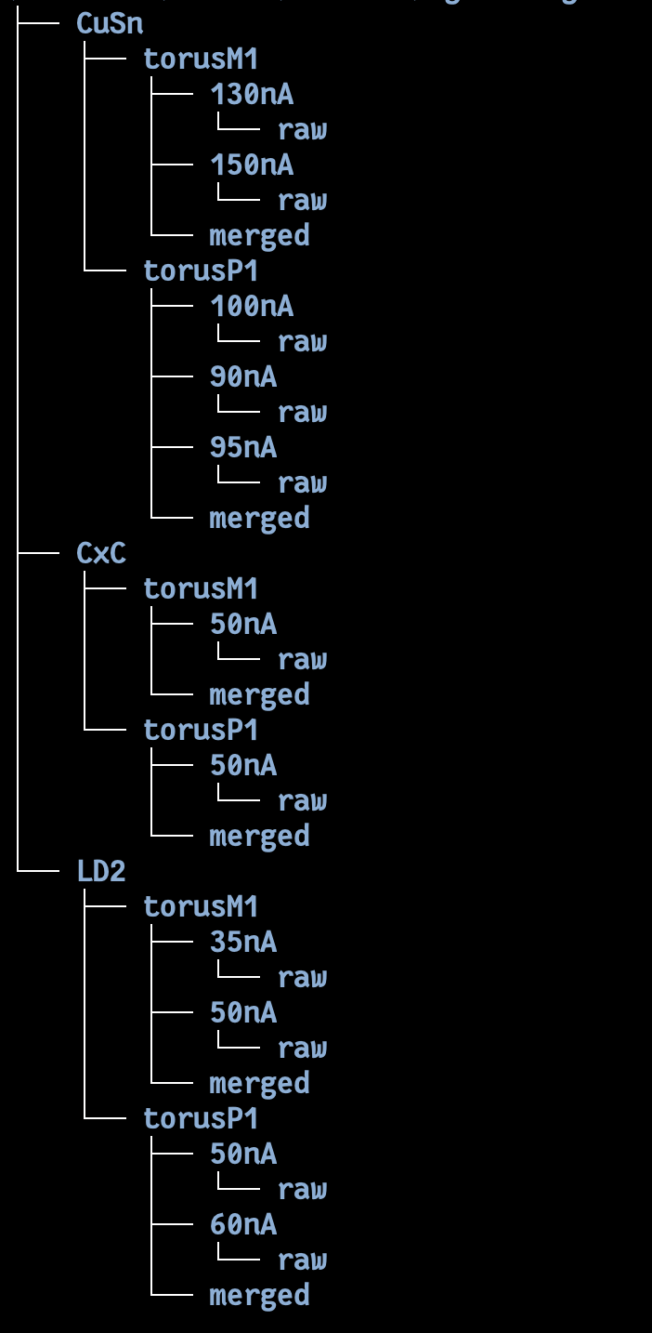
RG-D cooking
I made a python script to extract the background event for at runs with the correct percentage of each current based on the number of event
But it failed, got only 7540 background event for the LD2/torusP1 configuration
Need to debug the script

Slide 10
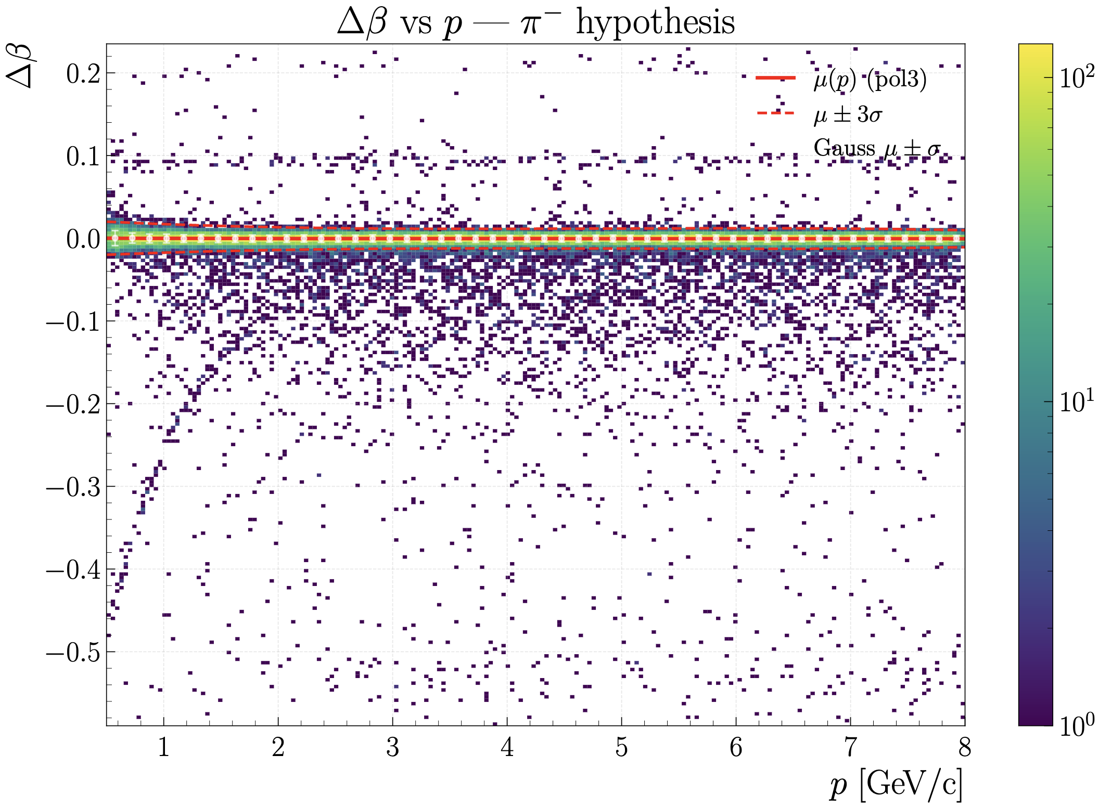
RG-D: AI for pion identification
I check the effect of the Δβ cut (the start time was not available in these data) on the purity on simulation
Make 50 momentum slices, fit the Δβ distribution with gaussian
Extract mean and sigma, fit them with 2nd order polynomial function
Use mean ± 3 sigma to cut

Slide 11
RG-D: AI for pion identification
Look on the efficiency and purity as a function of the momentum with and without the Δβ cut

Slide 12
RG-D: AI for pion identification
Look on the efficiency and purity as a function of the momentum with and without the Δβ cut

Slide 13
RG-D: AI for pion identification
The purity of the AI stay much better than the Event Builder after the Δβ cut
But the Δβ cut don’t look realistic: the distribution is too clean
So, I don’t know if it will remain on real data
The question is: Should I continue working on an AI to improve the pion identification:
At best, it will improve the purity of the pion sample and the efficiency at high momentum (but there is no statistic here)
Next step would be to test the AI on real data and test a Δt/Δβ cut on real data: Need to recreate the data set for the training and retrain the AI, evaluate which variable use for the training are well reproduce and use only these variables

Slide 14
ALERT: Track matching
Train a new model for the track matching, use Optuna to find the hyperparameters for the model
Push the new model in the networks repository: https://code.jlab.org/hallb/clas12/coatjava/networks
The merge request have been accepted by Nathan
A pull request have been automatically open on COATJAVA to use the new model
And have been merged

Slide 15
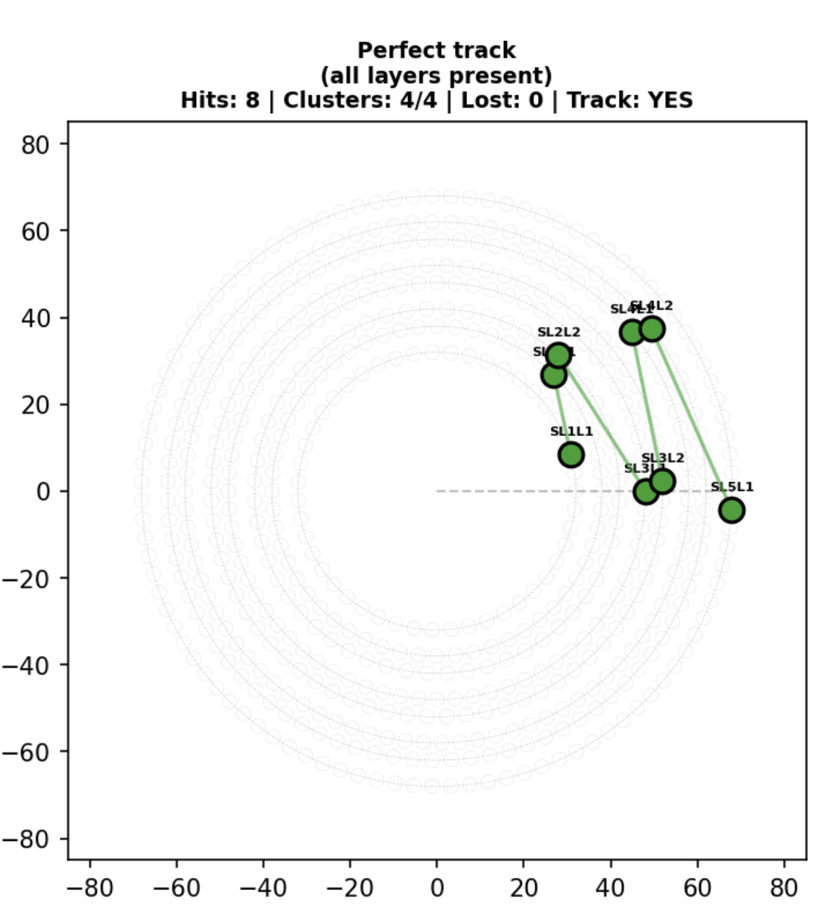
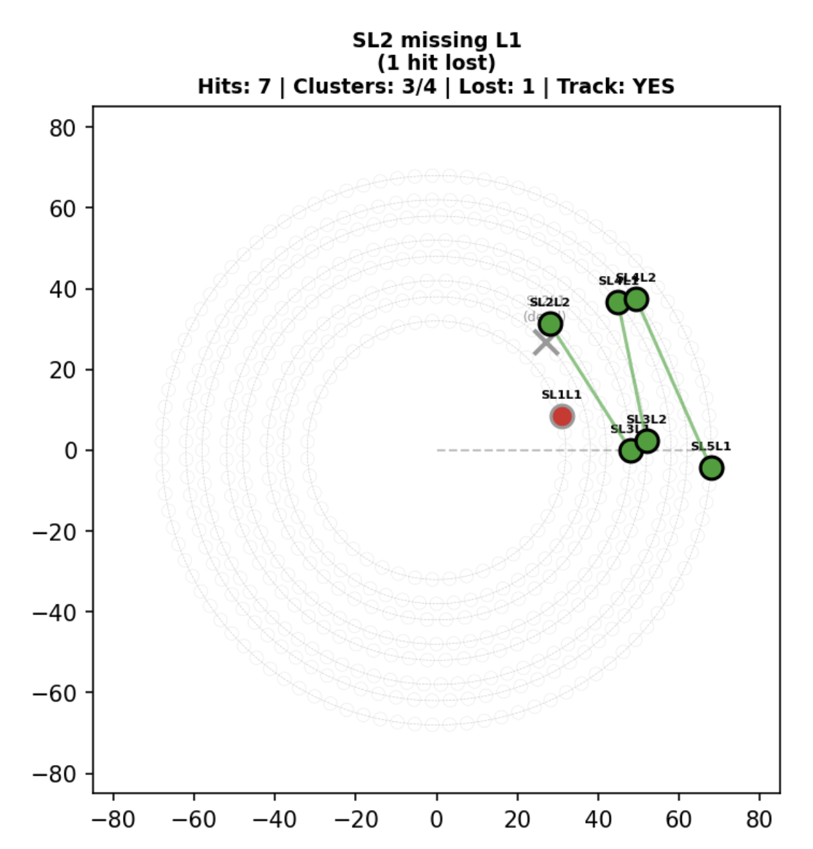
ALERT: hit loss
Last week I said that we lose some hits in the reconstruction between the track finding and the Kalman Filter/track matching
I trace that back to the clustering algorithm
The track are construct using the clusters at the helix fitter level and then pass to the Kalman filter and the track matching
If a track don’t have a hit on the SL2L1, the track finding AI will still find the track, but the clustering algorithm will only find 3 clusters and the hit on SL1L1 will be lost.

Slide 16
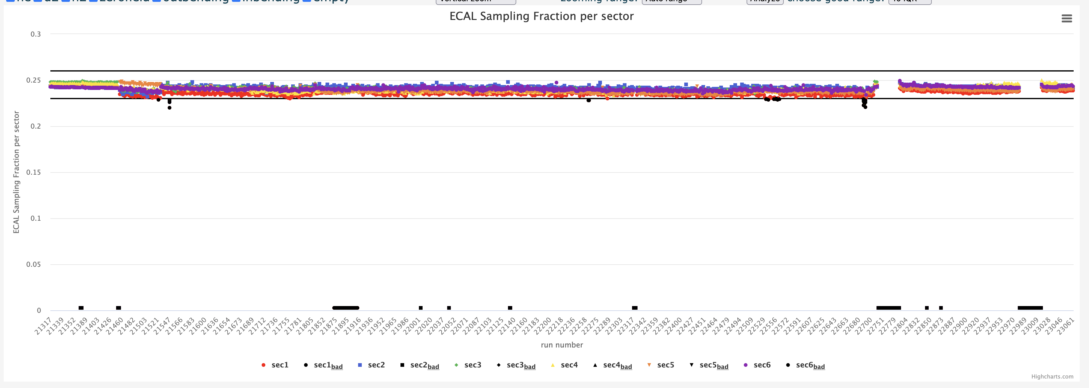
ALERT: Timelines
During the last CalCom meeting Cole point at an issue in the timelines for the EC Sampling fraction timelines. The values in the timelines for some runs has 0.
It is an long standing issue. Same issue in Pass0 v3. Only for the last 2.2 GeV runs

Slide 17
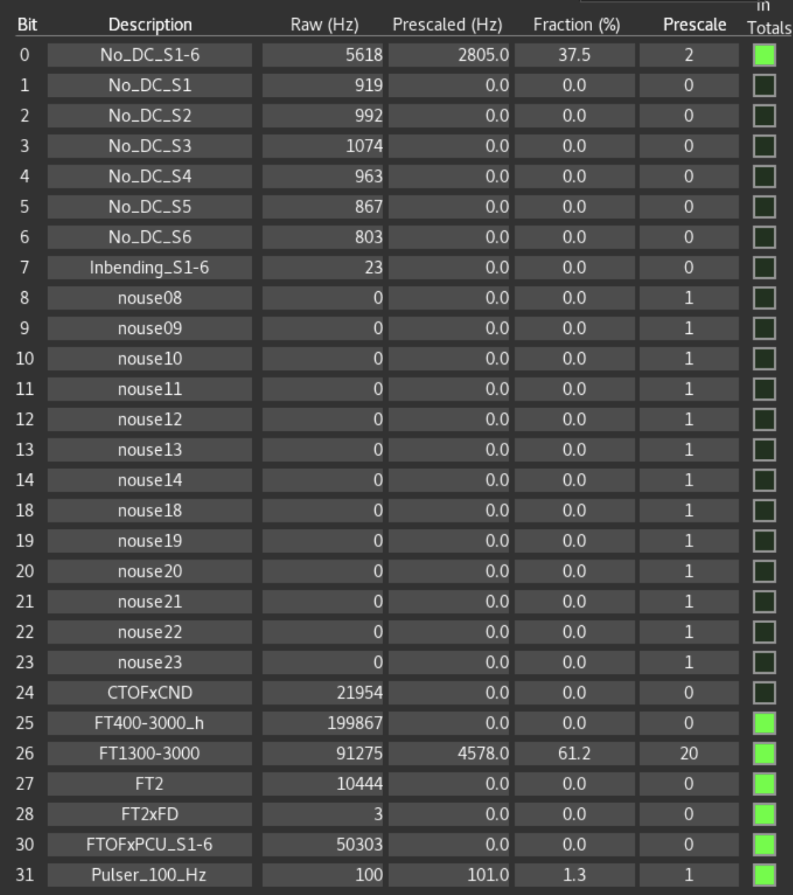
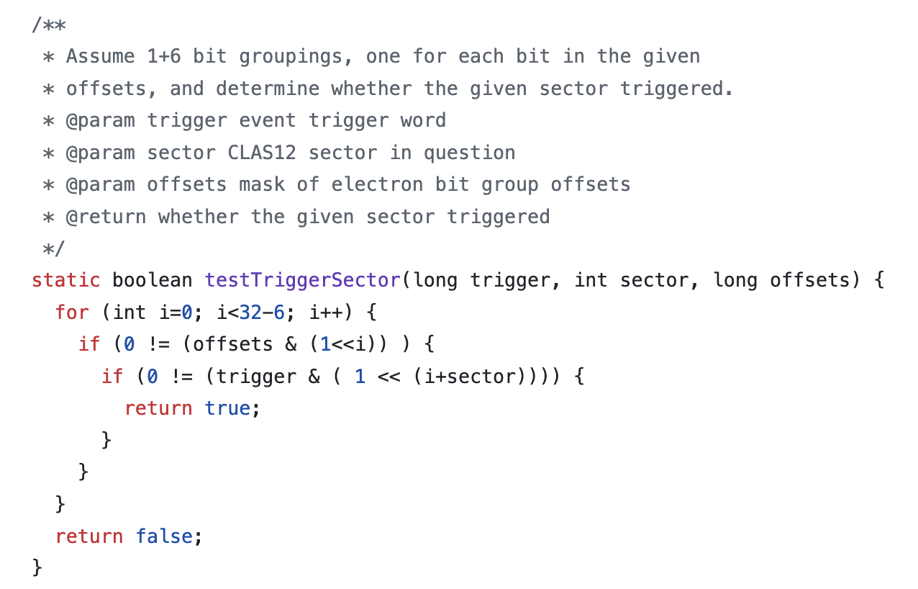
ALERT: Timelines
During the last CalCom meeting Cole point at an issue in the timelines for the EC Sampling fraction timelines. The values in the timelines for some runs has 0.
The issue is related to the trigger bit use in these runs
So run sector specific trigger, and the timelines code check these bit between 1 and 6 to ensure that a sector have been hit

Slide 18
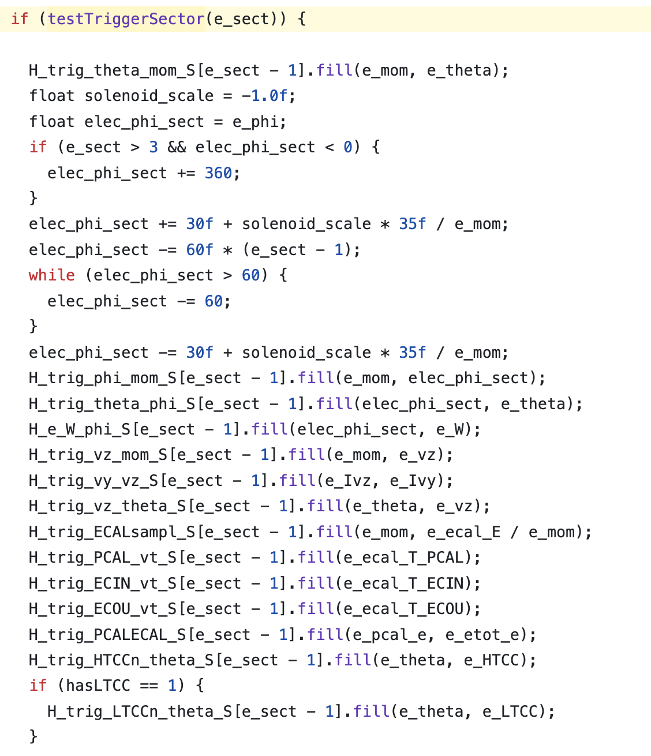
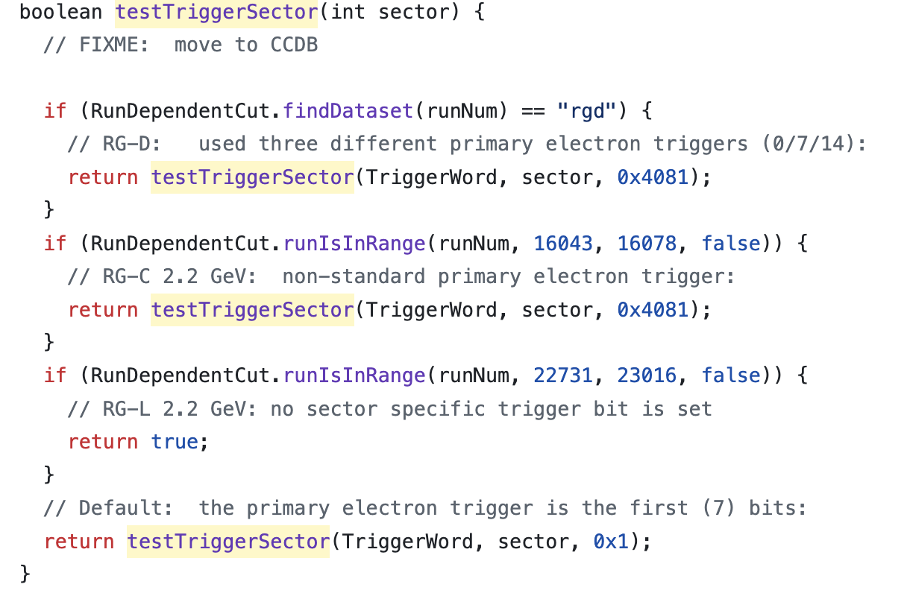
ALERT: Timelines
During the last CalCom meeting Cole point at an issue in the timelines for the EC Sampling fraction timelines. The values in the timelines for some runs has 0.
And if no sector specific bit are set the code will not fill some histograms
The fix is to bypass the function that check the trigger bit:

Slide 19
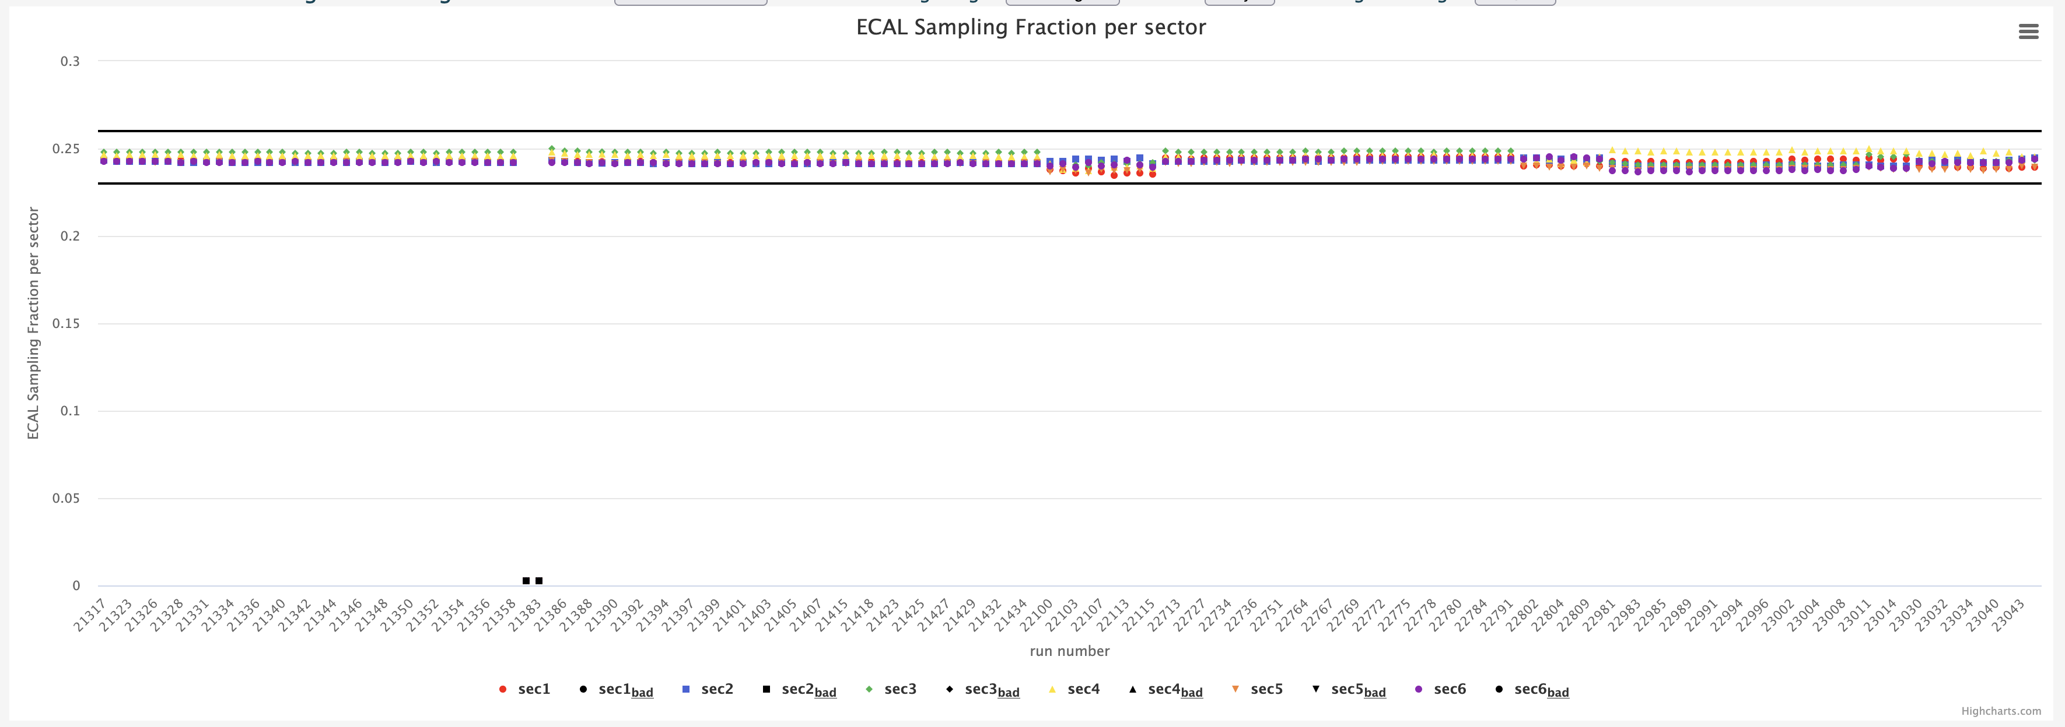
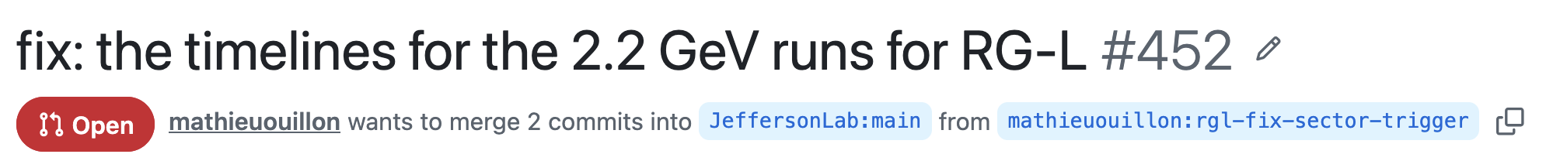
ALERT: Timelines
Work well:

Slide 20
To do list
RG-D:
Fix the bug for the background merging and produces background files from decoded files
Background for ρ⁰ with simulation
Study the CuSn contamination using simulations
Maybe simulation will not work (use vertex fit, maybe the sPlot technique)
Start to work again on the π⁰ analysis: implement the mixing event technique for the multidimensional binning
ALERT:
In the past, I discuss about using another architecture than MLP for the track finding and track matching: Graph Neural Network
Have huge advantages: can to both at the same time, work on the hits for both detectors, no need for a clustering, can be faster(?)
I would like to start working on that if it is ok?

