Slide 1
Group meeting
Mathieu Ouillon (Mississippi State University)
03/31/26

Slide 2
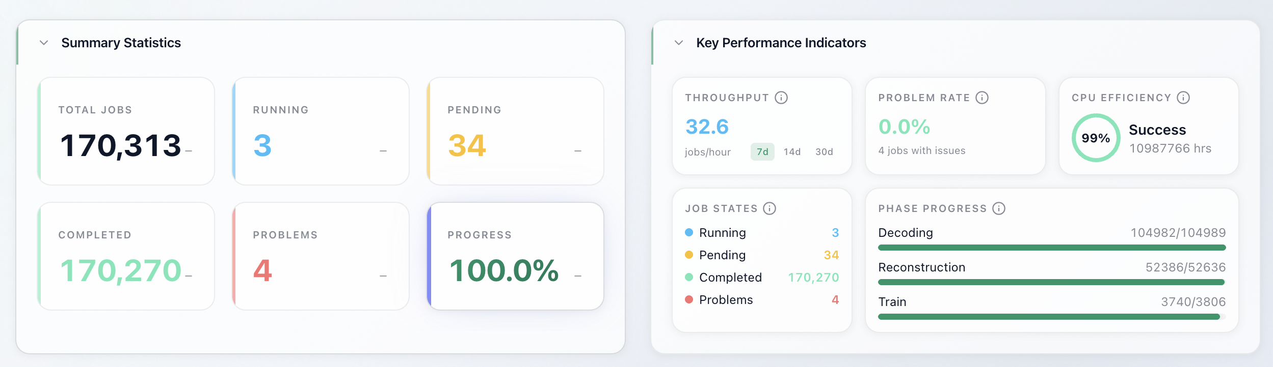
RG-D: cooking

Slide 3
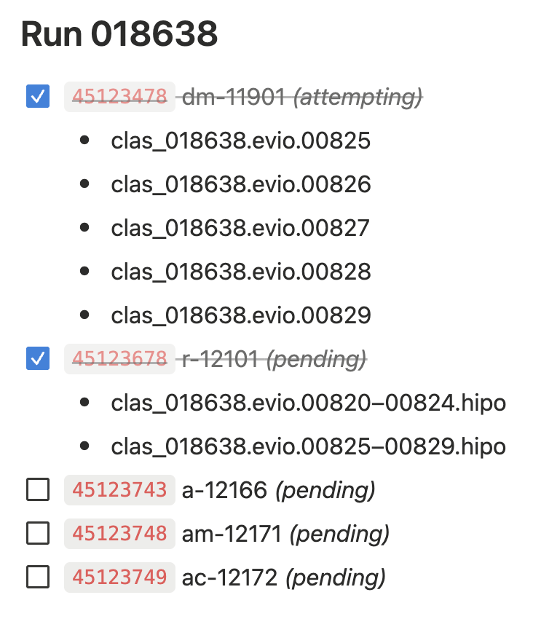
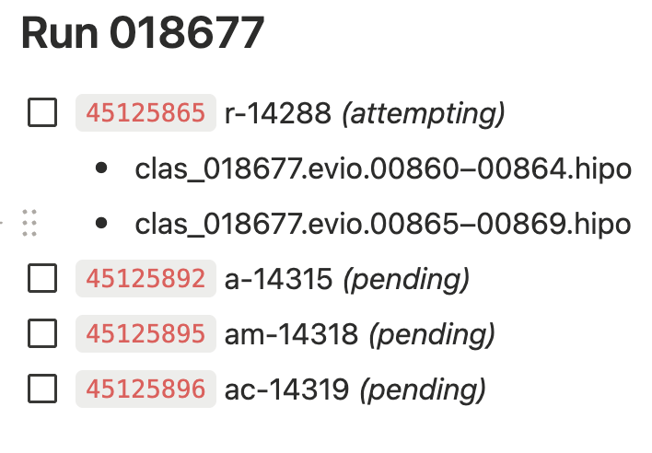
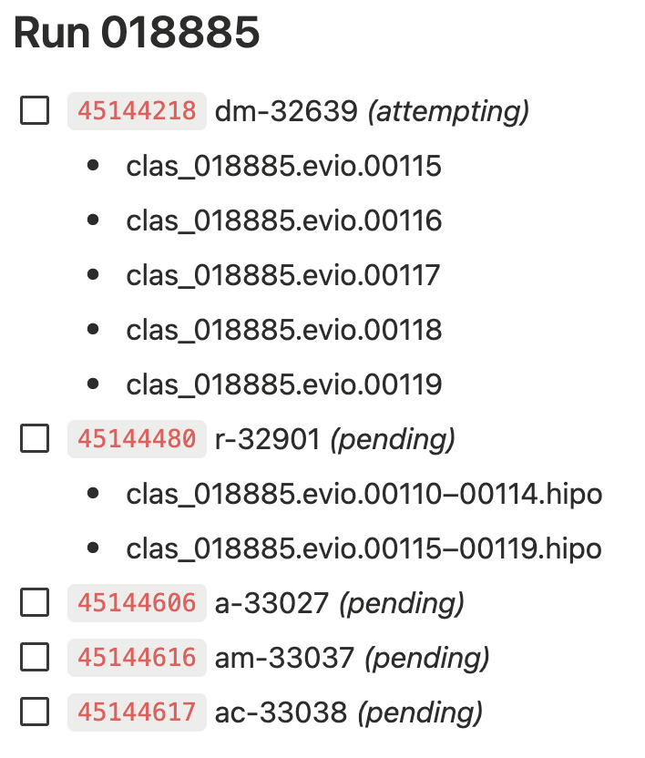
RG-D: cooking
Still 34 jobs in to run, they can’t run on the farm
I need to run them manually: the decoding failed for these files.
Nathan fix the decoder for these files.

Slide 4
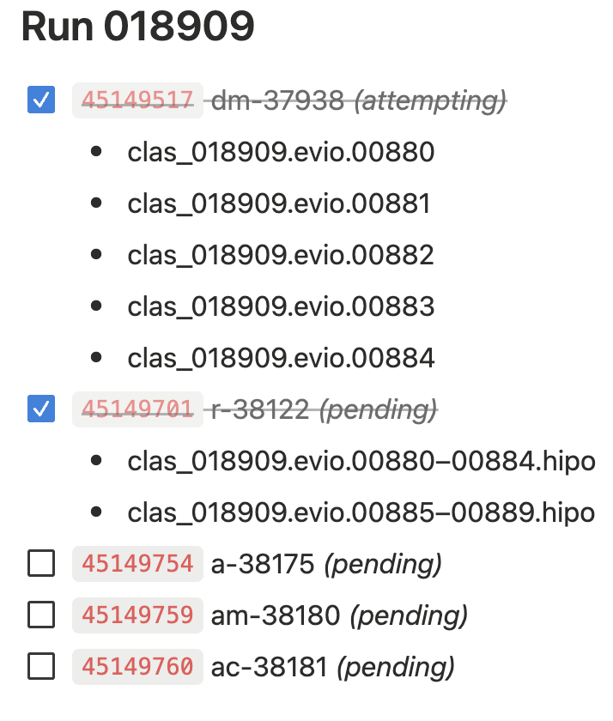
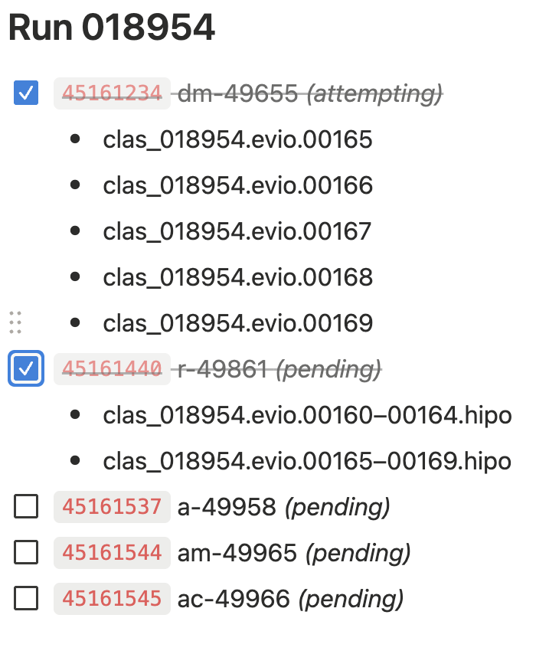
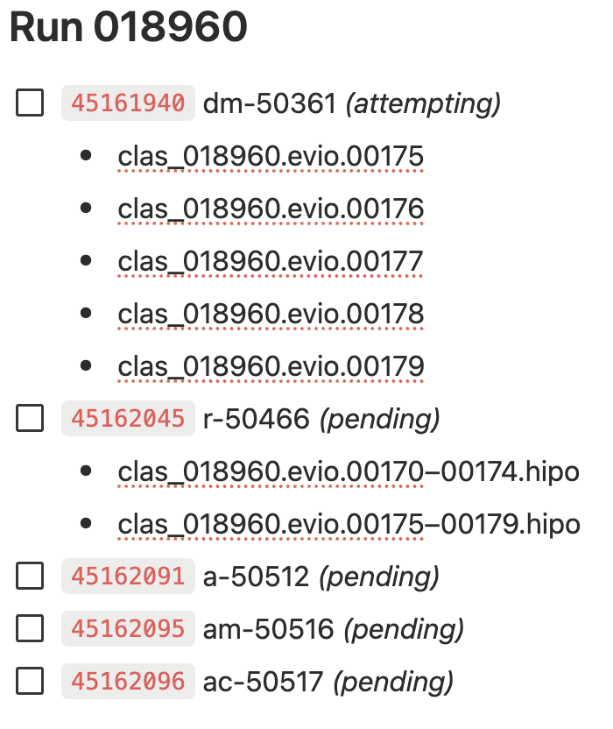
RG-D: cooking
Still 34 jobs in to run, they can’t run on the farm
I need to run them manually: the decoding failed for these files.
Nathan fix the decoder for these files.

Slide 5
RG-D: Pion cuts
I added to the DOE report the pion vertex cut, ΔVz and the Δt vs p cut

Slide 6
RG-D: Pion cuts

Slide 7
RG-D: Pion cuts

Slide 8
RG-D: Pion cuts

Slide 9
RG-D: Pion cuts

Slide 10
RG-D: Pion cuts
I want to check the impact of sector depend cuts on ρ⁰ yields

Slide 11
RG-D: Pion cuts

Slide 12
RG-D: Pion cuts

Slide 13
RG-D: Pion cuts

Slide 14
RG-D: Background merging
I get the background event for all the 6 configurations (target, and torus polarity)
I fix the bug from last week: it was a issue this the jcache command to get the decoded files, the command sometimes fail when use *.hipo to get all hipo files in a folder.
beam_current_request | target | n_runs | total_events | torus_scale | pct_events | pct_filtered | pct_diff
130.0 | CuSn | 21 | 550,916,728 | -1.0 | 47.28 | 52.62 | 5.34
150.0 | CuSn | 10 | 496,105,782 | -1.0 | 42.58 | 47.38 | 4.80
50.0 | CxC | 9 | 373,558,009 | -1.0 | 86.76 | 100.00 | 13.24
35.0 | LD2 | 11 | 706,491,728 | -1.0 | 57.86 | 70.55 | 12.69
50.0 | LD2 | 7 | 294,980,214 | -1.0 | 24.16 | 29.45 | 5.29
90.0 | CuSn | 58 | 3,636,858,354 | 1.0 | 19.89 | 20.24 | 0.35
95.0 | CuSn | 162 | 9,856,091,334 | 1.0 | 53.91 | 54.85 | 0.94
100.0 | CuSn | 61 | 4,475,796,456 | 1.0 | 24.48 | 24.91 | 0.43
50.0 | CxC | 113 | 8,797,963,851 | 1.0 | 99.32 | 100.00 | 0.68
50.0 | LD2 | 39 | 2,798,555,356 | 1.0 | 27.87 | 29.72 | 1.85
60.0 | LD2 | 86 | 6,618,079,189 | 1.0 | 65.92 | 70.28 | 4.36

Slide 15
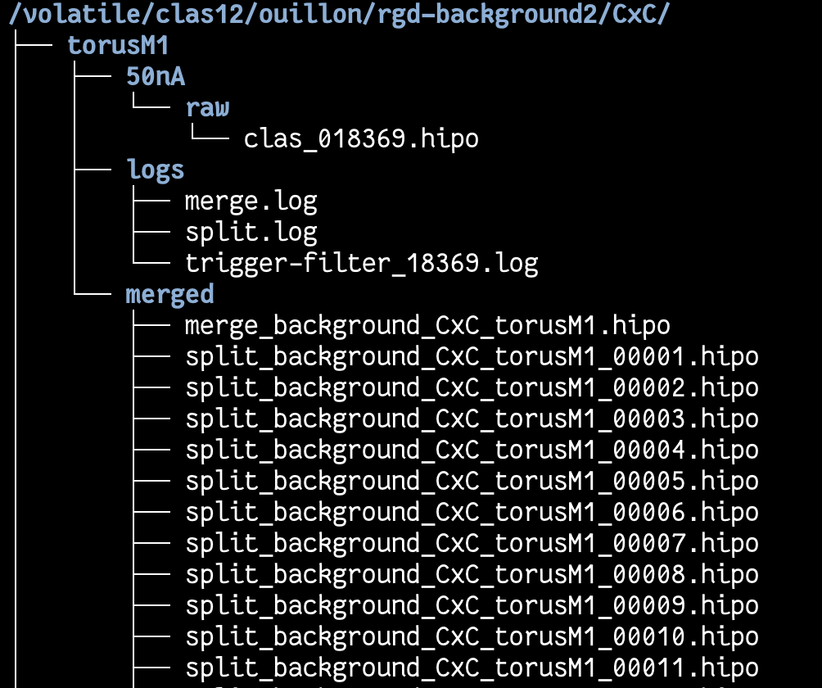
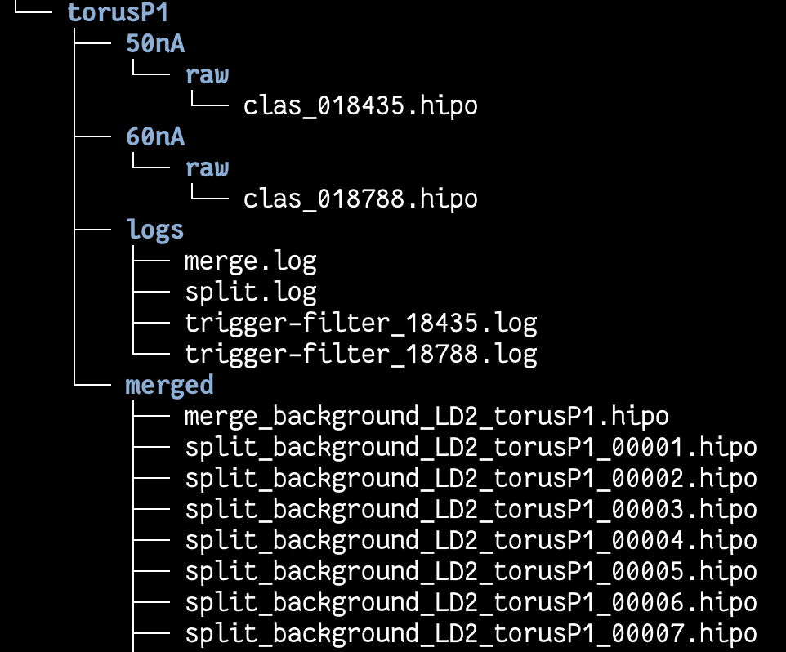
RG-D: Background merging
I get the background event for all the 6 configurations (target, and torus polarity)

Slide 16
RG-D: Background merging
I get the background event for all the 6 configurations (target, and torus polarity)
I asked Raffaella about that why 2M events, and she said they use this value after some test for RG-A/B to have enough events for background merging and not reusing events to much and not using too much disk space on work.
Discussed with Mauri about moving them to work/osgpull
The files are now in /work/osgpull/…
I need to do a pull request to clas12-config to make them available in OSG

Slide 17
RG-D: π⁰ analysis
Implement the mixing event technique for the multidimensional binning
Photons from different events in the same DIS kinematic bin are paired to build a background shape, which is then subtracted from the same-event distribution
Pooling & Binning:
Photons are pooled per DIS bin defined by (Q², x_{B}): events in the same bin are kinematically similar
Mix 50 photons
Q² edges: [1.0, 1.5, 2.0, 2.5, 3.0, 4.0, 5.0, 7.0, 11.0] (8 bins)
x_{B} edges: [0.1, 0.15, 0.2, 0.25, 0.3, 0.4, 0.5, 0.7] (7 bins)
Total DIS bins: 8 × 7 = 56
4D binning: Q²×x_{B}×z×p_{T} (8×7×8×3 = 1344 bins)
z edges: [0.0, 0.15, 0.25, 0.35, 0.45, 0.55, 0.65, 0.8, 1.0]
pT edges: [0.0, 0.15, 0.30, 0.50]

Slide 18
RG-D: π⁰ analysis
LD2 Target
1% of the data
50 photons for the mixing

Slide 19
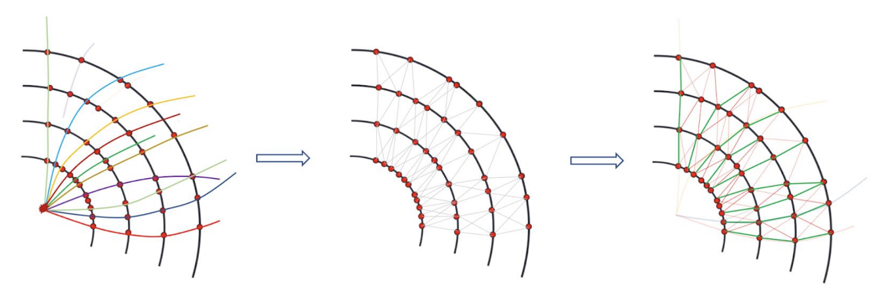
ALERT: Graph Neural Network
Ferenc Sikler CTD 2017 CTD 2019
The goal of track reconstruction:
Given set of hits in a detector from particles, assign label(s) to each hit.
Perfect classification: All hits from a particle (and only those hits) share the same label
What does it mean to represent an event with a graph?
Treat each hit as a node
A node can have features (e.g. position, charge deposit, etc.)
Nodes can be connected by edges, that represent the possibility of belonging to the same track
Goal: classify edges as "same track" or "different track" to reconstruct particle trajectories

Slide 20
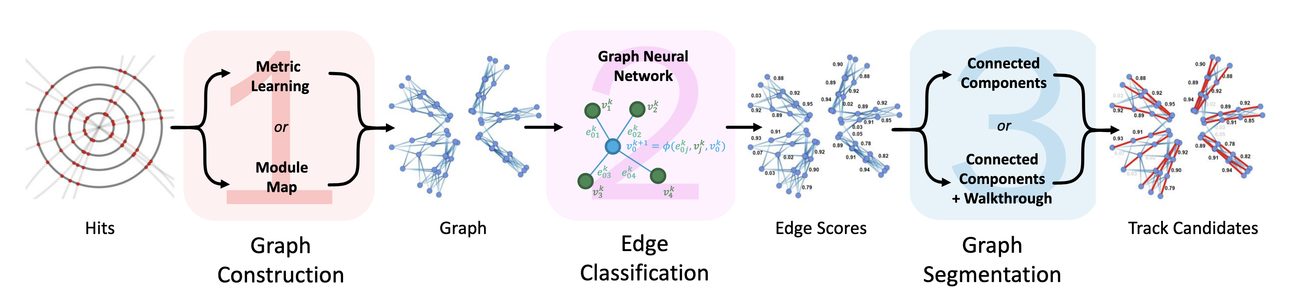
ALERT: Graph Neural Network

Slide 21
ALERT: Graph Neural Network
1 Graph Construction
Nodes = detector hits (AHDC wires, ATOF bars and wedge)
Features: layer position, azimuthal angle, stereo angle and radius for AHDC hits
Wedge x, y and z
Bar x and y
Edges = candidate connections between hits in adjacent layers
Constraints: layer gap of 1–2, Euclidean proximity in (x, y)
Features: delta-phi, delta-layer
Directed graph: inner layers → outer layers (follows particle trajectory)

Slide 22
ALERT: Graph Neural Network
2 Edge Classification
Use the information from edge and neighbor nodes to predicts if an edge belongs to a true track segment with a score from 0 to 1
Score ≈ 1 means these two hits very likely belong to the same track
Score ≈ 0 means likely different tracks or noise
3 Graph Segmentation: From Scores to Tracks
A threshold (e.g., 0.5) is applied to edge scores, removing low-confidence edges
The remaining high-score edges form connected subgraphs: each connected graph is a track candidate
Ambiguities (nodes connected to multiple candidate tracks) are resolved by higher threshold

Slide 23
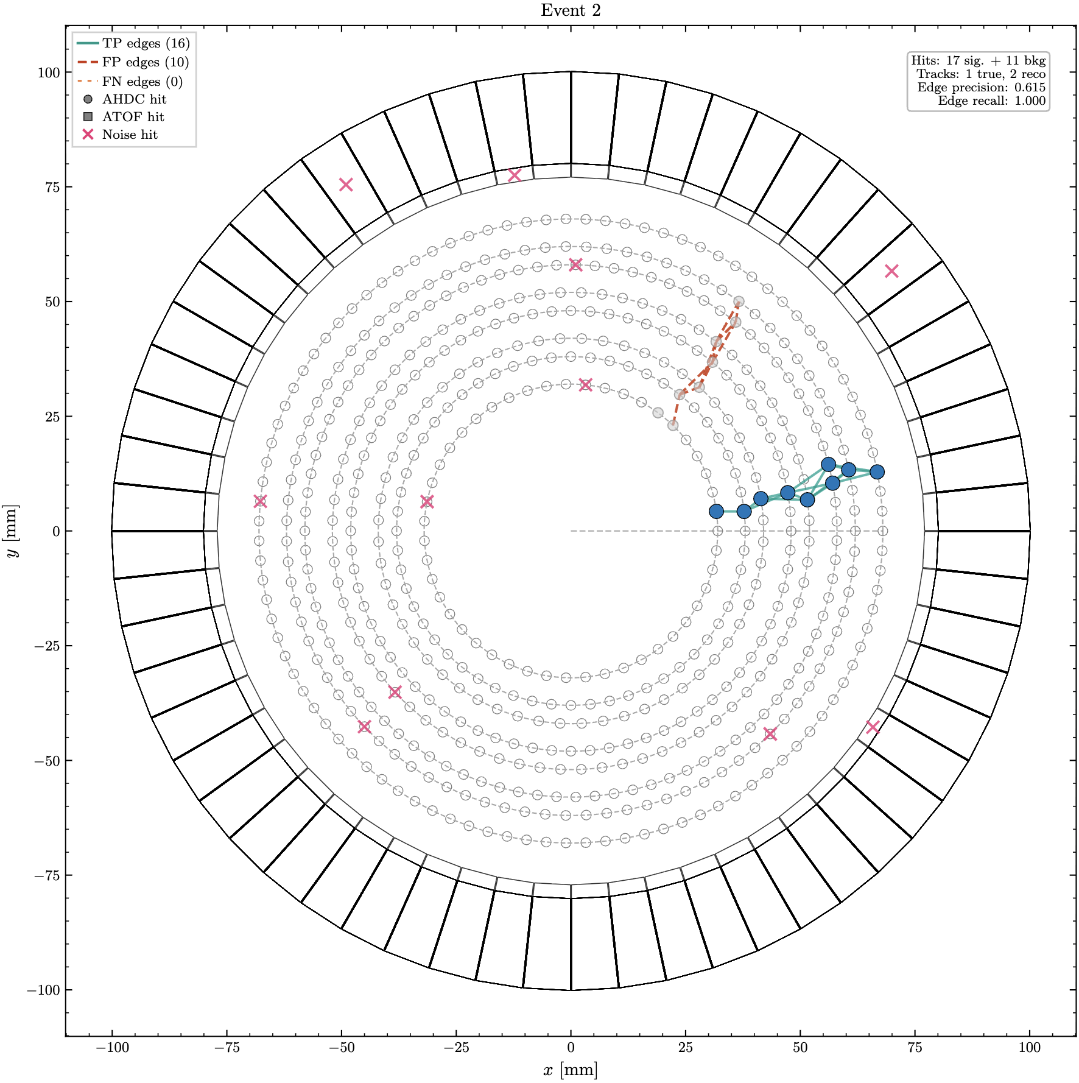
ALERT: Graph Neural Network

Slide 24
To do list
RG-D:
Background for ρ⁰ with simulation
Study the CuSn contamination using simulation
Maybe simulation will not work (maybe the sPlot technique)
Continue to work on the π⁰ analysis:
The difference in invariant mass at high value between same event and mixed
Extraction of the azimuthal sin and cos phi modulation
Work on the binning
Radiative and acceptance correction
Work on the RG-D Common analysis note to add pion cuts
ALERT:
Continue the work on Graph Neural Network

