Slide 1
Group meeting
Mathieu Ouillon (Mississippi State University)
04/07/26

Slide 2
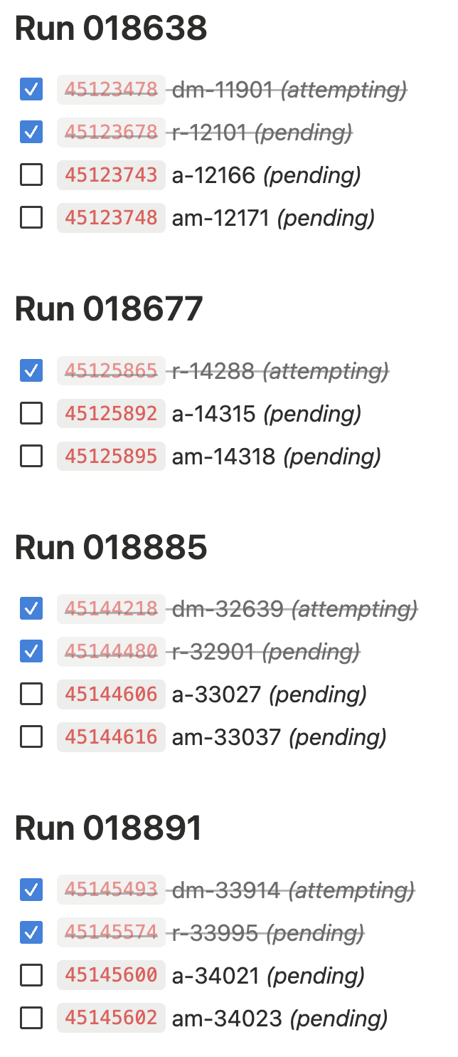
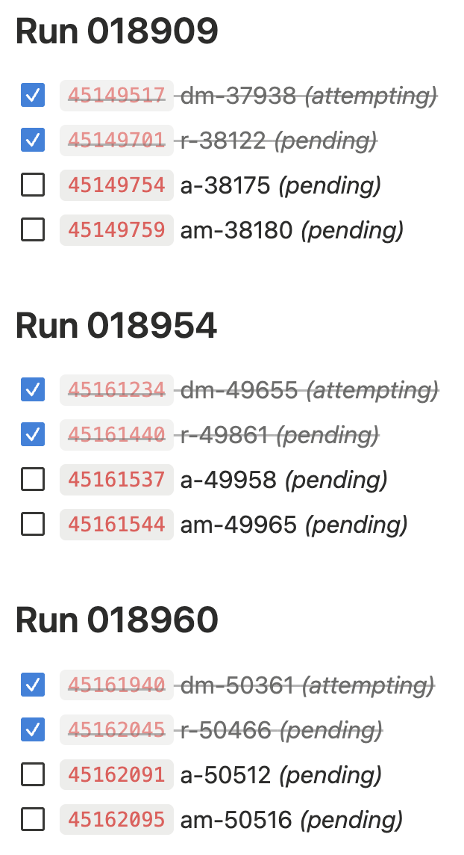
RG-D: cooking
Finish all the decoding and reconstruction
Work on the trains
Should be done this week

Slide 3

RG-D: Background merging
The background merging is do between the GEMC simulation and the reconstruction:
Use the tool: bg-merger –i <input_simulation>.hipo –o <output_simulation>.hipo <background_file>.hipo
Path for the background files: /work/osgpool/hallb/clas12/backgroundfiles/
The pull request to make the background files for RG-D available to OSG have been accepted
Now people can run simulation on OSG with backgroung merging

Slide 4
RG-D: CuSn Contamination
Work on the Cu and Sn contamination using simulation:
Simulated 1M events for the Cu using Raphael/Daniel event generator at -8.5 cm
1M events for the Sn target at -3.5 cm
Reconstructed them with CJ 13.0.0
No background merging (it will be the next step)
Simulation to reproduce the data
Scale the Sn peak in simulation to match data

Slide 5
RG-D: CuSn Contamination

Slide 6
RG-D: CuSn Contamination
I can try to estimate the contamination in the simulation
Regions: Cu region [-10.6, -6.5] cm, Sn region [-5.5, 5.0] cm
Look into Cu leakage into the Sn region and Sn leakage into the Cu region
Contamination fractions computed as the ratio of wrong-target counts to total counts in each cut window

Slide 7
RG-D: CuSn Contamination
I can smear the simulation distribution to try to mimic the data
MC truth Cu/Sn shapes used as templates, fitted to inclusive data vertex distribution
Templates are shifted to account for data-MC peak position offsets (dz_Cu = +0.260 cm, dz_Sn = +0.130 cm)
Gaussian smearing applied to templates to match data resolution — smearing widths determined from top 50% of each peak independently

Slide 8
RG-D: CuSn Contamination
At this point, I discussed with Raffaella about the difference between simulation and MC.
She told me that the Vz distribution is θ dependent (and momentum dependent too)
We already discussed that right before the pass1 review, but I never look to much into it
The Vz distribution is shifted, and larger at low θ
That modification is also charge dependent

Slide 9
RG-D: CuSn Contamination
We can look at slices in θ
Clear shift between 5 and 10 deg, small shift between 10 and 15, and stable after that
Most of the event are between 5 and 20 deg
Above 20 deg, the peaks are symmetric and more gaussian like.

Slide 10
RG-D: CuSn Contamination

Slide 11
RG-D: CuSn Contamination
So, in high momentum high θ bins the Vz distribution is more symmetric and gaussian like.
I can compare simulation with data when θ is between 20 and 40 deg
Already much better, the proportion of Cu and Sn is not exactly 50-50%, but more 40-60%
The peaks are scaled independently for the dashed lines

Slide 12
RG-D: CuSn Contamination
Can add a be of smearing (gaussian) to the simulation to be closer to the data.
The middle part is still larger in data than in simulation
Maybe background merging can help?
I need to develop a θ and momentum correction for Vz
The high momentum high θ Vz distribution is correct, I need to correct the low region to match

Slide 13
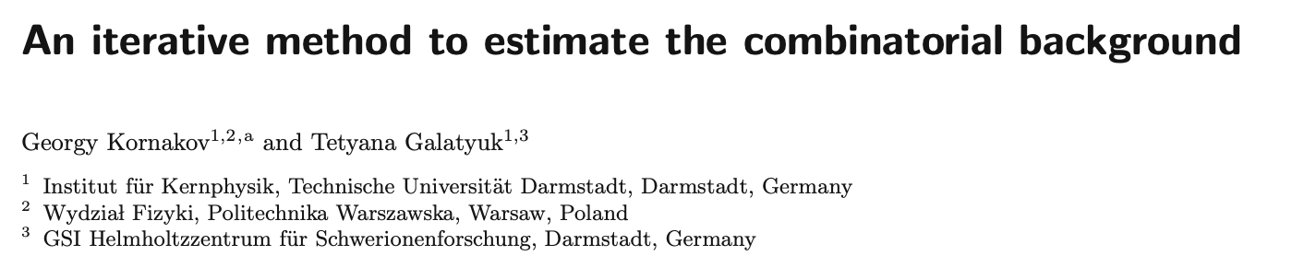
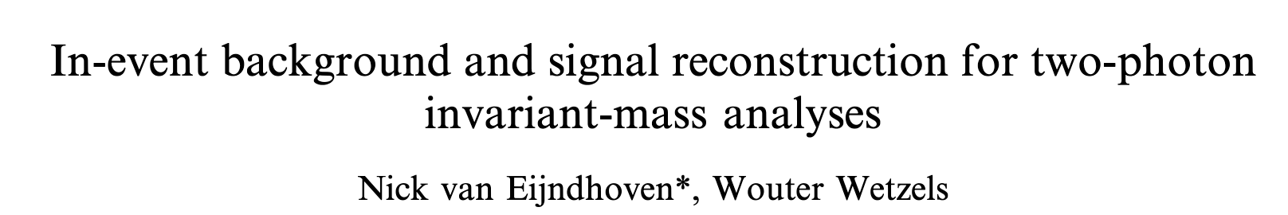
RG-D: π⁰ analysis
Implement the mixing event technique for the multidimensional binning
Photons are pooled per DIS bin defined by (Q², x_{B}): events in the same bin are kinematically similar
Mix photons from 100 events
I try different things to get ride of the difference at high invariant mass:
Add a bin in ν, to have photon with similar energy, doesn’t change
Add a bin in W, to have similar hadron mass
Try to rotate the photon from the same event to keep the same kinematics

Slide 14
RG-D: π⁰ analysis
To estimate the quality of the mixed distribution:
Compute chi2/ndf in the sideband of the M(gamma gamma) distribution, 0.17 < M(gg) < 0.28 GeV
a bin fails if chi2/ndf > 5.0

Slide 15
RG-D: π⁰ analysis
Where is the bins that fail the chi2/ndf test
Still not too bad

Slide 16
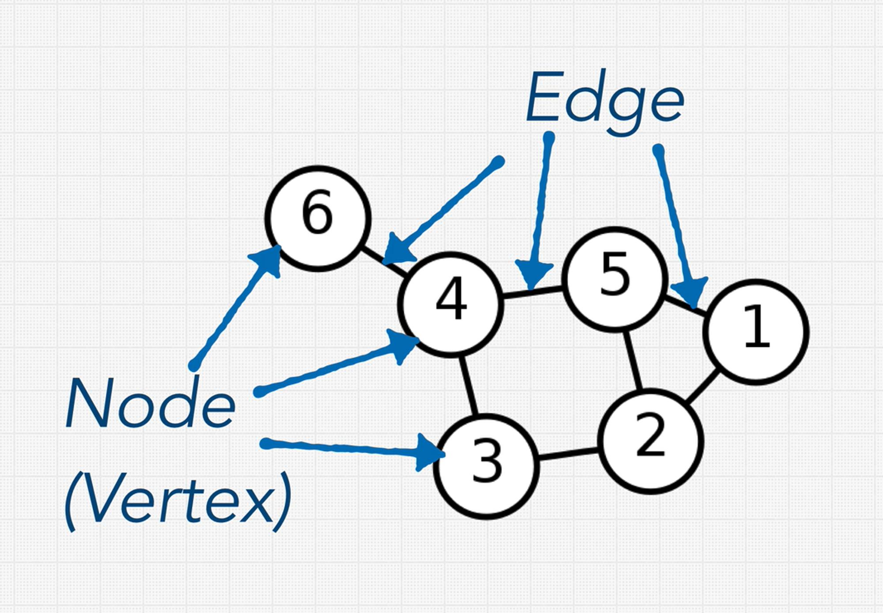
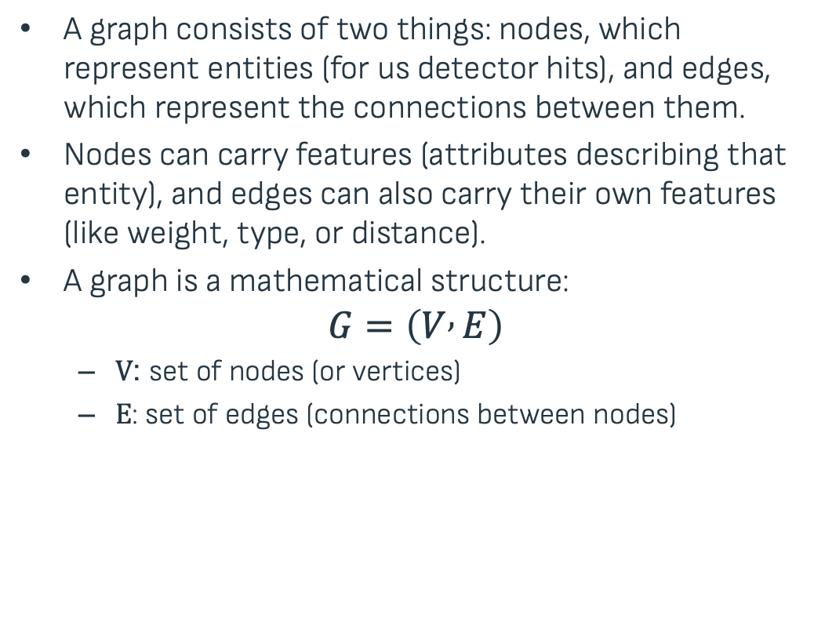
Introduction to Graph and Graph Neural Networks
A graph consists of two things: nodes, which represent entities (for us detector hits), and edges, which represent the connections between them.
Nodes can carry features (attributes describing that entity), and edges can also carry their own features (like weight, type, or distance).
A graph is a mathematical structure:
$$G=\left(V , E\right)$$
$V$: set of nodes (or vertices)
$E$: set of edges (connections between nodes)

Slide 17
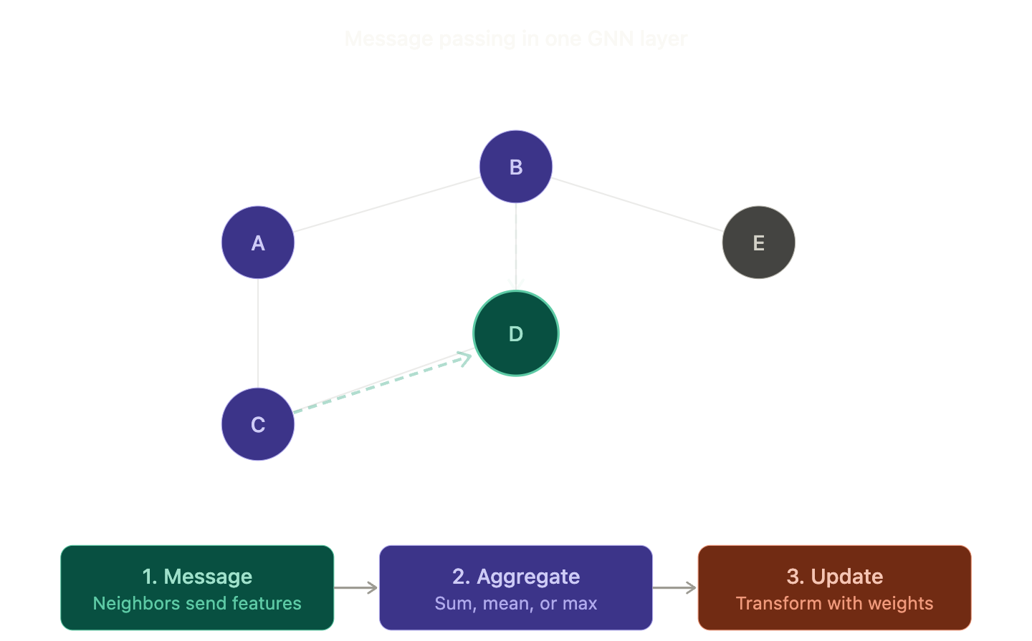
Why Graph Neural Networks for Track Finding?
Track finding = connecting detector hits into particle trajectories
Variable number of hits per event
No fixed ordering or regular grid structure
Relationships between hits are naturally graph-like
Traditional approaches struggle with this:
CNNs expect grid inputs (images)
MLPs expect fixed-size inputs
GNNs operate directly on graph structure via message passing
Each node gathers information from its neighbors
Learns both local hit correlations and global track structure

Slide 18
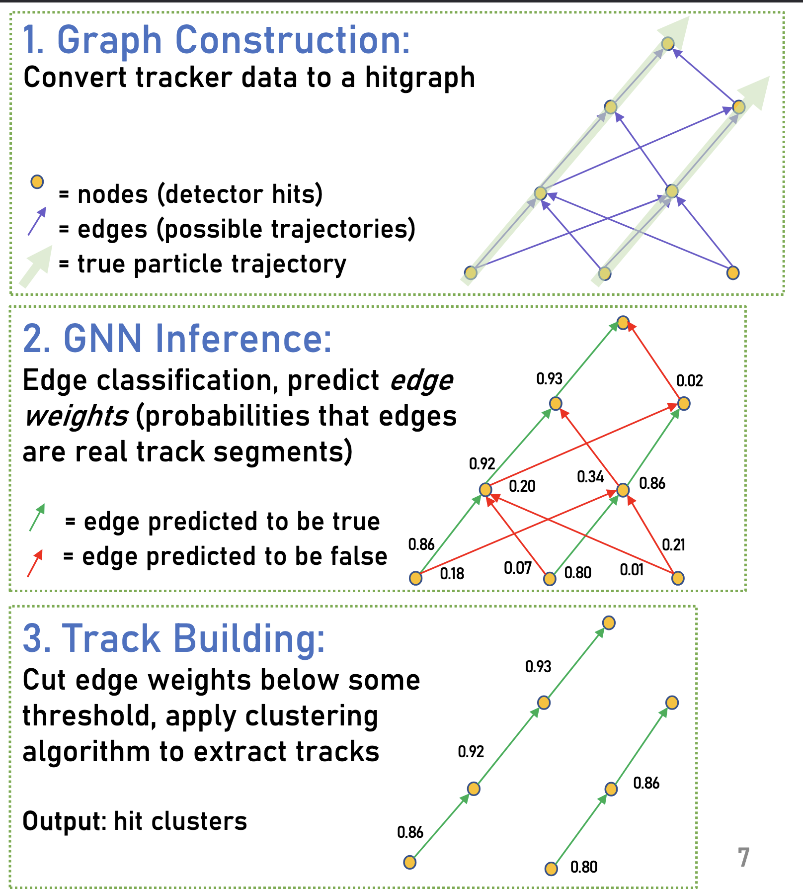
Track Finding with Graph Neural Networks (GNNs)
Edge Classification: Predict whether two hits belong to the same track
Pipeline:
Construct graph from hits using geometric constraints
Apply GNN
Threshold edges → reconstruct tracks
Optionally, perform post-processing to merge/split tracks
Advantages of GNNs
Learn both local hit correlations and global track structure
Can handle noise, missing hits, and variable hit densities

Slide 19
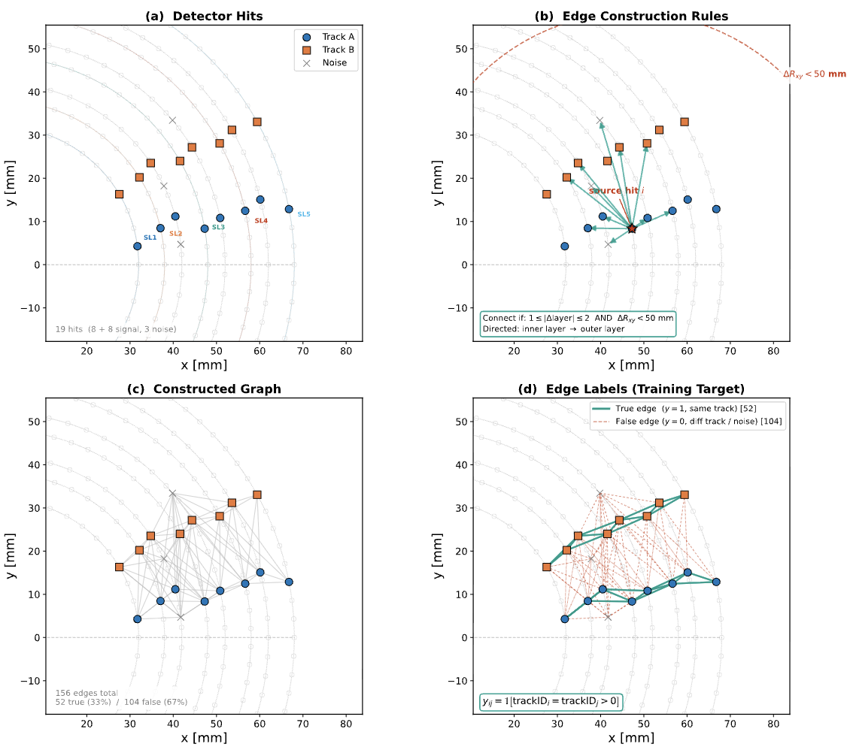
Track Finding as a Graph Problem
Idea: Represent hits and their relationships as a graph
Nodes = detector hits (AHDC + ATOF)
Edges = candidate connections between hits
Layer gap: 1-2 layers apart
Euclidean distance < 50 mm
Directed: inner layer to outer layer
Task: Classify each edge as same-track (1) or different-track (0)

Slide 20
Training setup
MC Sample used to build the same-track edge and add noise hits and multi-track events for the different-track edge
Use all light ions, flat distribution in momentum (0.05 to 1.5 GeV), φ, θ and Vz
1-5 tracks merged per event + 5-30 noise hits
Node features:
Position, stereo-angle
Edge features:
Δφ_{ij}, Δl_{ij}

Slide 21

Evaluation on simulation
Track Efficiency (how many true tracks did we find?):
$\text{Efficiency}=\frac{N_{\text{matched} \text{tracks}}}{N_{\text{true} \text{tracks}}}$
A true track is considered "matched" to a reconstructed track if they share at least 80% of their hits
Efficiency of 84.28%
Efficiency of reconstructable tracks (tracks with at least 7 AHDC hits and at least 1 ATOF hit): 99.99%

Slide 22
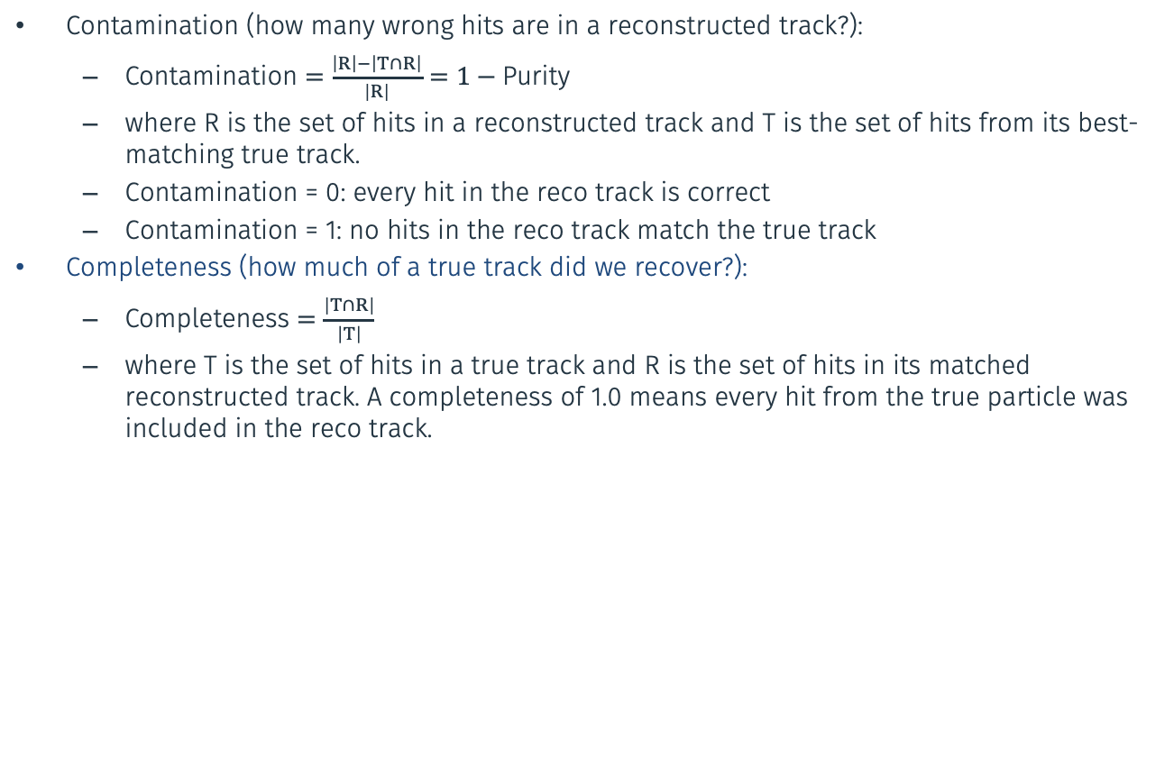
Evaluation on simulation
Contamination (how many wrong hits are in a reconstructed track?):
$\text{Contamination}=\frac{\left|R\right|−\left|T∩R\right|}{\left|R\right|}=1−\text{Purity}$
where R is the set of hits in a reconstructed track and T is the set of hits from its best-matching true track.
Contamination = 0: every hit in the reco track is correct
Contamination = 1: no hits in the reco track match the true track
Completeness (how much of a true track did we recover?):
$\text{Completeness}=\frac{\left|T∩R\right|}{\left|T\right|}$
where T is the set of hits in a true track and R is the set of hits in its matched reconstructed track. A completeness of 1.0 means every hit from the true particle was included in the reco track.

Slide 23
Other things
I updated the RG-D Common analysis note with all the new cuts for electron and pions cuts
I have shifts starting this Saturday to Tuesday (swing shift)
It should not impact this meeting next week
Also, my Tuesday shit is likely to be cancel (accelerator will be done)
I have nothing to show for that, but I also worked on extracting pT broadening and azimuthal modulation sin phih and cos phih for the π⁰

Slide 24
To do list
RG-D:
Continue to work on CuSn contamination, develop correction for Vz distribution
Get multiplicity ratio for π⁰ after the event mixing substraction
Continue the work on pT broadening and cos and sin phih extraction
Work on the binning
Radiative and acceptance correction
Background for ρ⁰ with simulation for CT analysis
ALERT:
Continue the work on Graph Neural Network: optimization and implementation in coatjava

