Slide 1
Group meeting
Mathieu Ouillon (Mississippi State University)
04/14/26

Slide 2
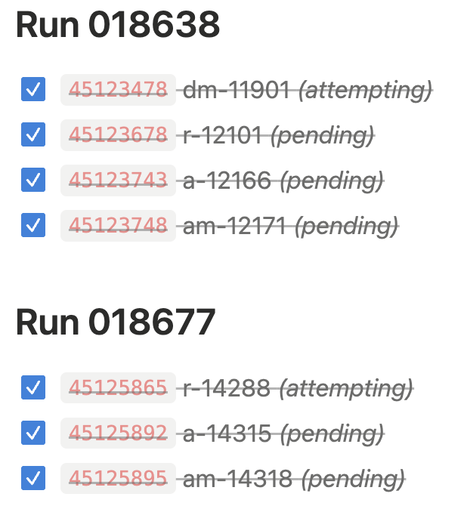
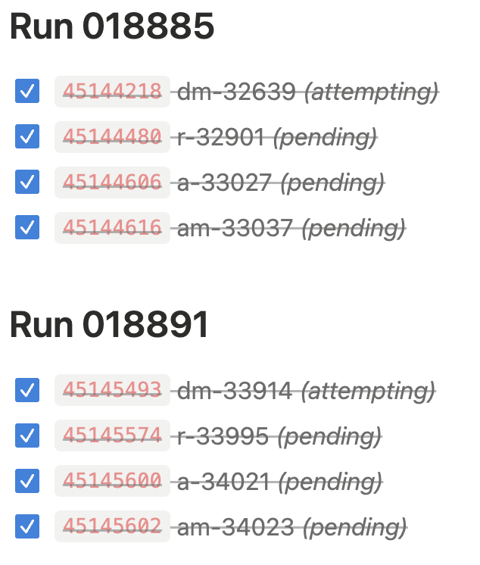
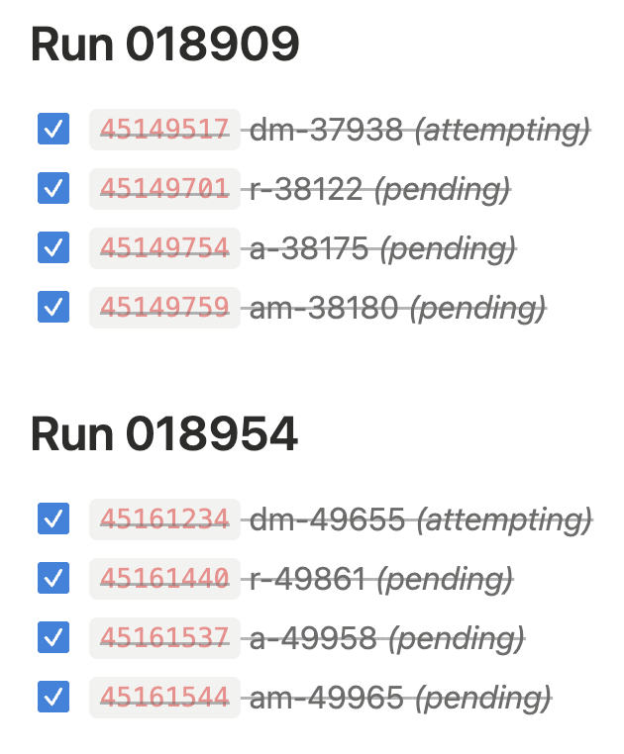
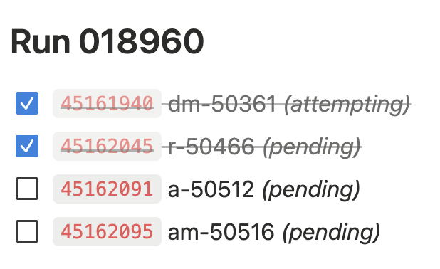
RG-D: cooking
Sadly, not done yet. Still remain the train for one run: 018960
Then, I need to copy all the decoded, reconstructed and train files to /cache and /mss

Slide 3
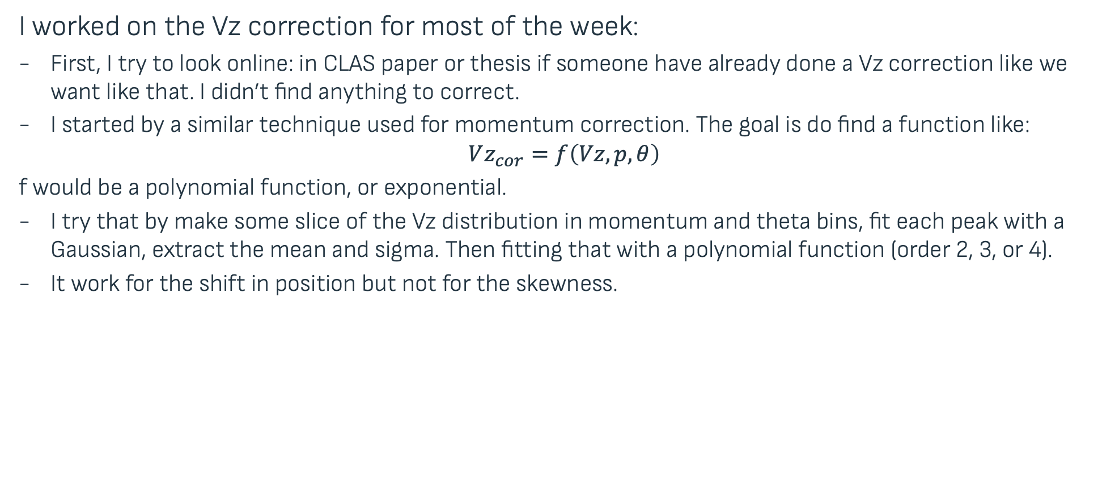
RG-D: CuSn Contamination / Vz correction
I worked on the Vz correction for most of the week:
First, I try to look online: in CLAS paper or thesis if someone have already done a Vz correction like we want like that. I didn’t find anything to correct.
I started by a similar technique used for momentum correction. The goal is do find a function like:
$$Vz_{cor}=f\left(Vz,p,θ\right)$$ f would be a polynomial function, or exponential.
I try that by make some slice of the Vz distribution in momentum and theta bins, fit each peak with a Gaussian, extract the mean and sigma. Then fitting that with a polynomial function (order 2, 3, or 4).
It work for the shift in position but not for the skewness.

Slide 4
RG-D: CuSn Contamination / Vz correction
I want to show the problem first:
Data: 10% of the CuSn dataset, only outbending.
Electron with the standard cuts and fiducial cuts
Between 0.8 and 1, we don’t see any peaks. Between 1 and 1.5, a peak starts to emerge for 8<θ<9 deg.

Slide 5
RG-D: CuSn Contamination / Vz correction

Slide 6
RG-D: CuSn Contamination / Vz correction

Slide 7
RG-D: CuSn Contamination / Vz correction
So, for high momenta and high θ bins, the Vz distribution shows two nicely separated Gaussian peaks. The issue is with the low-momentum and low-θ bins.
One easy solution would be to cut that region:
Cut θ > 10 deg and p > 2 GeV
The momentum cut doesn’t impact the statistic significantly
But the θ cut removes most of the stats
So we can't use that technique

Slide 8
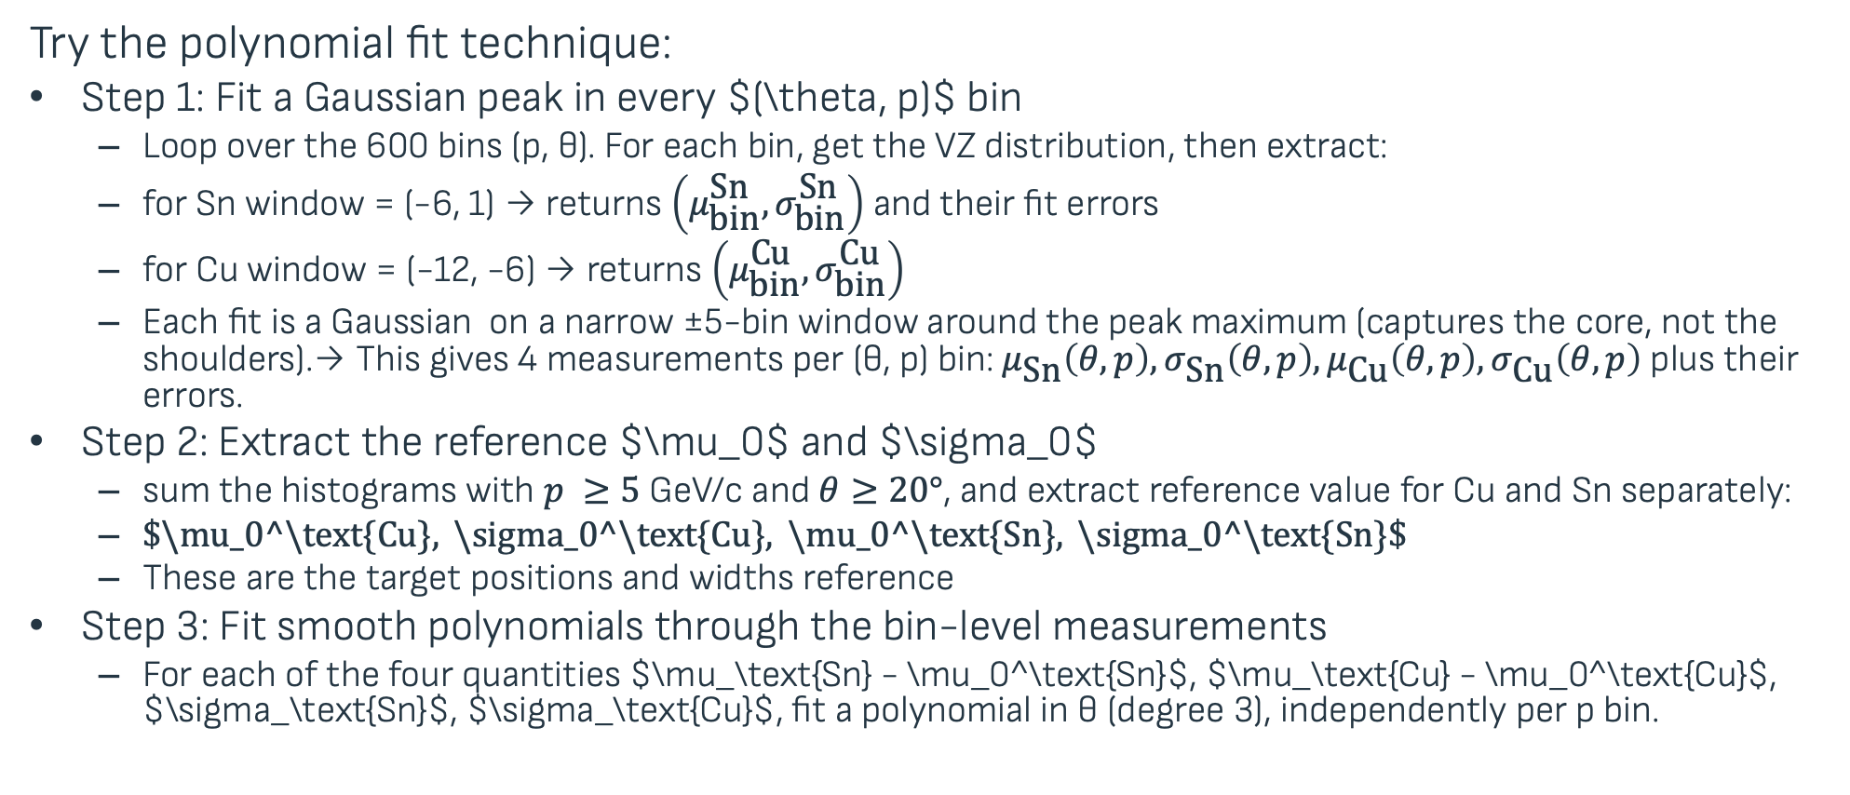
RG-D: CuSn Contamination / Vz correction
Try the polynomial fit technique:
Step 1: Fit a Gaussian peak in every $(\theta, p)$ bin
Loop over the 600 bins (p, θ). For each bin, get the VZ distribution, then extract:
for Sn window = (-6, 1) → returns $\left(μ_{\text{bin}}^{\text{Sn}},σ_{\text{bin}}^{\text{Sn}}\right)$ and their fit errors
for Cu window = (-12, -6) → returns $\left(μ_{\text{bin}}^{\text{Cu}},σ_{\text{bin}}^{\text{Cu}}\right)$
Each fit is a Gaussian on a narrow ±5-bin window around the peak maximum (captures the core, not the shoulders).→ This gives 4 measurements per (θ, p) bin: $μ_{\text{Sn}}\left(θ,p\right),σ_{\text{Sn}}\left(θ,p\right),μ_{\text{Cu}}\left(θ,p\right),σ_{\text{Cu}}\left(θ,p\right)$ plus their errors.
Step 2: Extract the reference $\mu_0$ and $\sigma_0$
sum the histograms with $p ≥5$ GeV/c and $θ≥20°$, and extract reference value for Cu and Sn separately:
$\$\backslash mu_0^\backslash text\{Cu\}, \backslash sigma_0^\backslash text\{Cu\}, \backslash mu_0^\backslash text\{Sn\}, \backslash sigma_0^\backslash text\{Sn\}\$$
These are the target positions and widths reference
Step 3: Fit smooth polynomials through the bin-level measurements
For each of the four quantities $\mu_\text{Sn} - \mu_0^\text{Sn}$, $\mu_\text{Cu} - \mu_0^\text{Cu}$, $\sigma_\text{Sn}$, $\sigma_\text{Cu}$, fit a polynomial in θ (degree 3), independently per p bin.

Slide 9
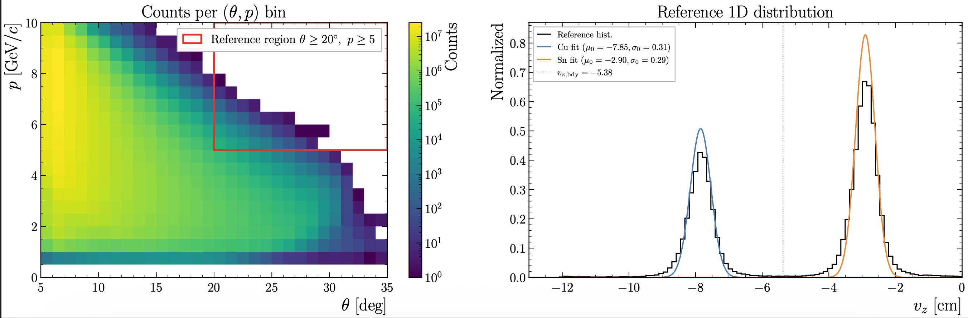
RG-D: CuSn Contamination / Vz correction

Slide 10
RG-D: CuSn Contamination / Vz correction

Slide 11
RG-D: CuSn Contamination / Vz correction
def correct_vz_event(vz, theta, p):
if vz < VZ_BOUNDARY:
dz = eval_poly(poly_cu_dz, theta, p)
σ = eval_poly(poly_cu_sig, theta, p)
return mu0_cu + (vz - dz - mu0_cu)
else:
dz = eval_poly(poly_sn_dz, theta, p)
σ = eval_poly(poly_sn_sig, theta, p)
return mu0_sn + (vz - dz - mu0_sn)

Slide 12
RG-D: CuSn Contamination / Vz correction

Slide 13
RG-D: CuSn Contamination / Vz correction
Raffaella told me this morning that we should not use trigger electron with p < 2 GeV (due to the Ecal trigger threshold) and θ < 6 deg (due to the FT material)

Slide 14
RG-D: CuSn Contamination / Vz correction

Slide 15
Other stuff this week
All my shifts so far have been canceled, we may receive beam today during the swif shift (mine).
Work on ALERT/RG-L to fix the cooking for pass0v10 and the GNN:
Noemie has not been able to reproduce the bug in ifarm, and so wasn’t able to fix it
GNN showed very good efficiency, purity, and completeness compared to MLP
Next step: work on COATJAVA implementation

Slide 16
To do list
RG-D:
Continue to work on CuSn contamination, develop a correction for Vz distribution
Idea from Raffaella:
Check the Vz distribution with the FMT for different p, θ bins
Remove θ < 6 deg and p < 2 GeV badly reconstructed electron (remove 3.3% of the statistics)
Look at sector dependence and add a φ dependence in the fit/CDF
Check the same things for pions
Get the multiplicity ratio for π⁰ after the event mixing subtraction
Continue the work on pT broadening and cos and sin phi_h extraction
Work on the binning
Radiative and acceptance correction
Background for ρ⁰ with simulation for CT analysis
ALERT:
Continue the work on Graph Neural Network: optimization and implementation in coatjava

