Slide 1
Group meeting
Mathieu Ouillon (Mississippi State University)
04/21/26

Slide 2
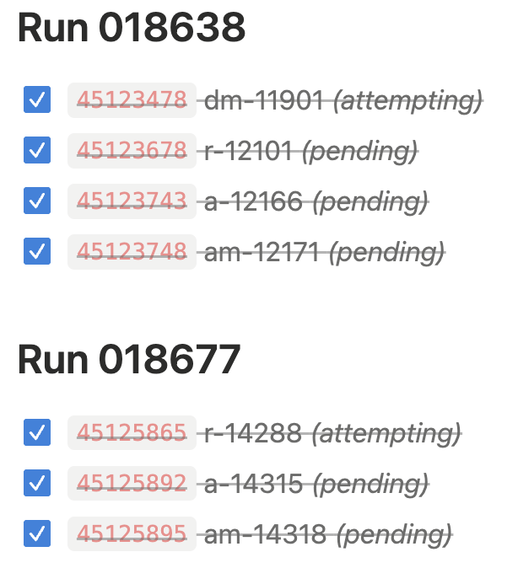
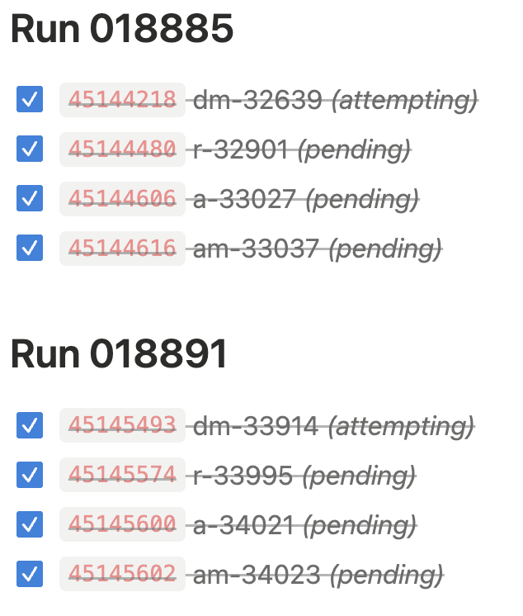
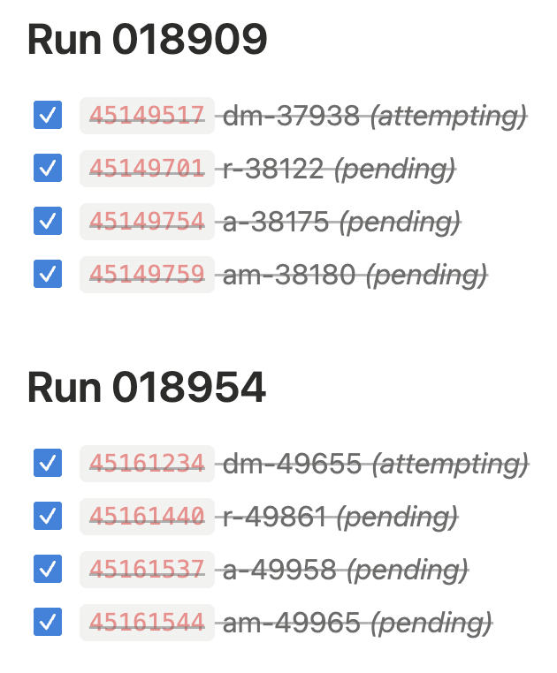
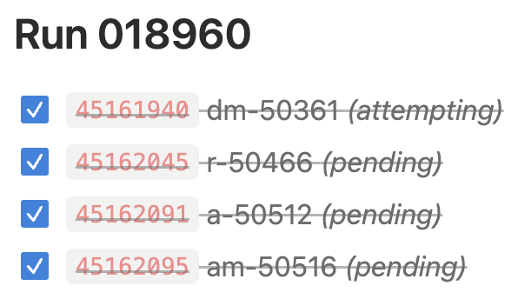
RG-D: cooking
All the files have been reconstructed, and all the trains have been produced.
I have copied all the files to their correct location in /cache and /mss

Slide 3
RG-D: Vz correction
Reconstructed Vz peak positions drift and distributions deviate from Gaussian as a function of kinematics (p, θ, φ).
Data: 10% of the CuSn dataset, only outbending.
Focus on electron with the standard cuts and fiducial cuts first
Select electron with p > 2GeV, θ > 6 deg
Without correction: O(2 cm) shift, Non-Gaussian distribution, hard to estimate the contamination, and hard to compare with simulation

Slide 4
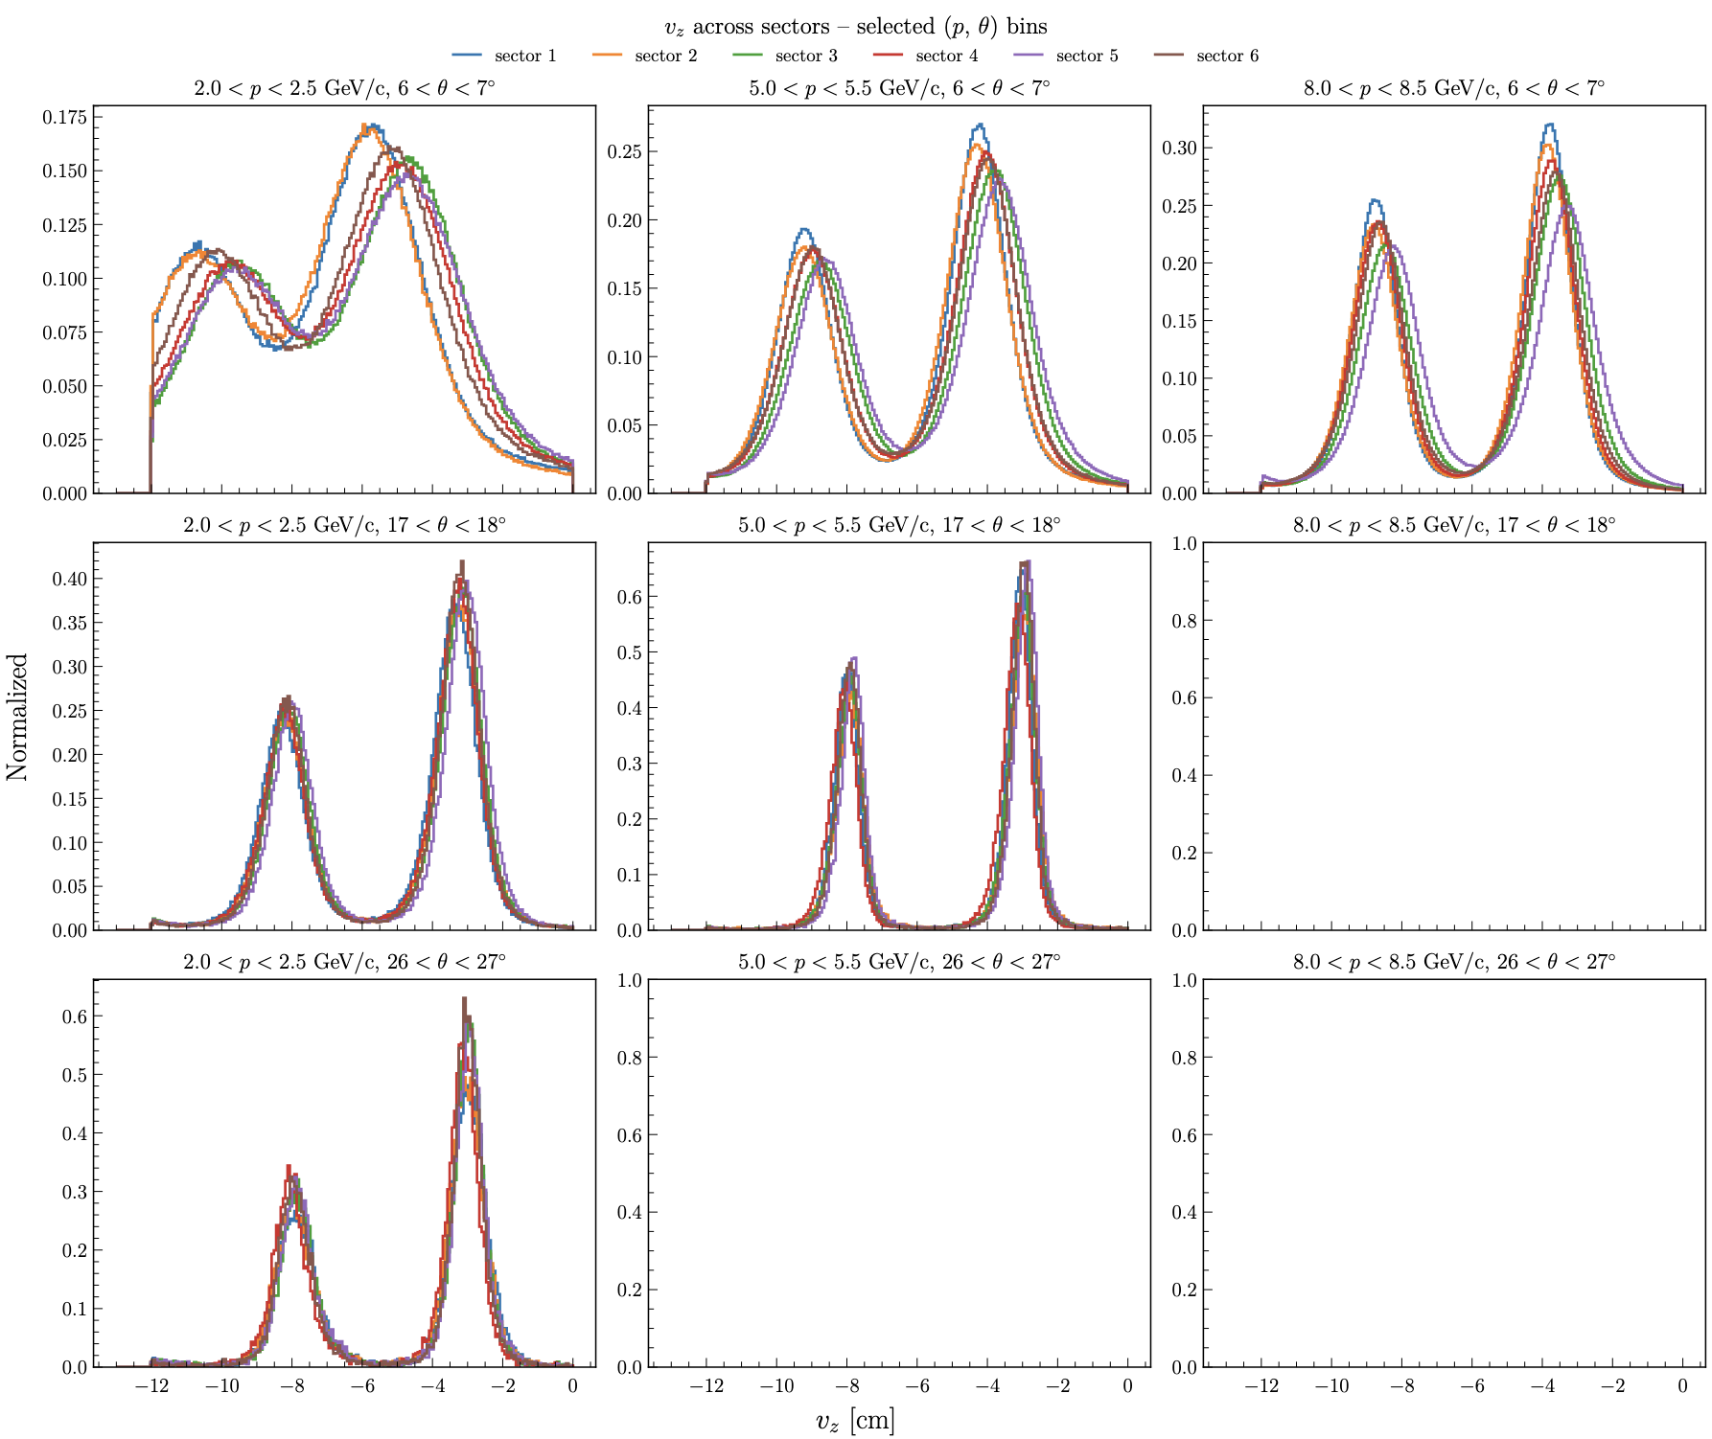
RG-D: Vz correction
Sector dependence:
Just for selected kinematics bin (p, θ), Overlay: same (p, θ) bin, 6 sectors.
Clear sector dependence, not large.
Peak positions drift by ~0.5–1 cm across sectors at low θ.
Convergence toward θ ≈ 17– 27
Motivates a per-sector correction.

Slide 5
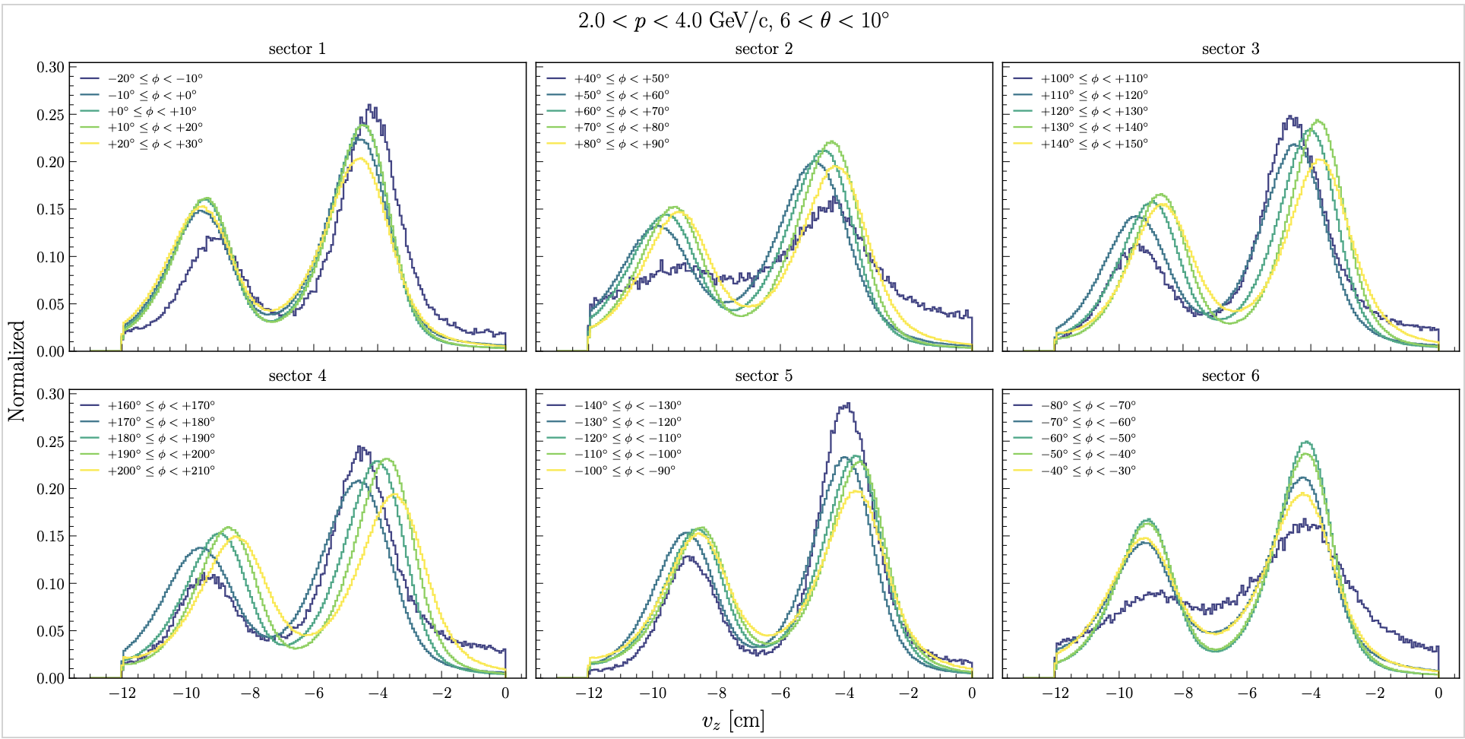
RG-D: Vz correction
Local-𝜙 dependence:
Within each sector, Vz peak shifts with local φ (10° bins).
Shown for 2 < p < 4 GeV/c, 6° < θ < 10° (largest effect).
Motivates a per-φ-bin correction on top of the per-sector one.

Slide 6
RG-D: Vz correction
Binning
• p: 16 bins of 0.5 GeV/c in [2, 10]
• θ : 24 bins of 1° in [6°, 30°]
• 6 sectors × 6 local-φ bins (10°)
⇒ 13,824 (s, p, θ, φ) bins
Reference region for μ₀, σ₀:
θ ≥ 20° and p ≥ 5 GeV/c
Where I consider the Vz distribution to be correct (simulation and data are very similar)

Slide 7
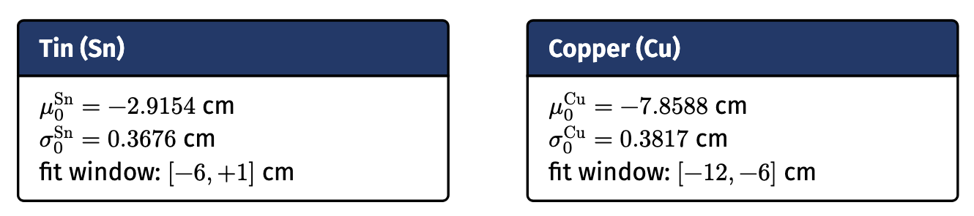
RG-D: Vz correction
Gaussian fit on the high-stats, clean region (θ ≥ 20°, p ≥ 5 GeV/c) fixes the targets everything is corrected to.

Slide 8
RG-D: Vz correction
In every (s, p, φ, θ) cell: fit two Gaussians (Sn and Cu).
Acceptance cuts: ≥ 200 events; σ ∈ [0.3, 2.5] cm
Give μ(θ), σ(θ) with error bars for
both targets, per (s, p, φ).

Slide 9
RG-D: Vz correction
θ-parametrization:
poly3 fit to the 24 θ-points of: μ_{Sn}(θ), σ_{Sn}(θ), μ_{Cu}(θ), σ_{Cu}(θ).
Stored (shape 6×16×6×4):
- poly_mu_sn_th
- poly_sig_sn_th
- poly_mu_cu_th
- poly_sig_cu_th

Slide 10
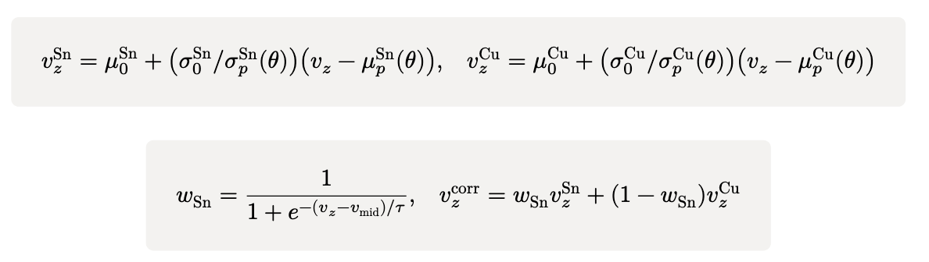
RG-D: Vz correction: Correction formula
A bit more complicated that last time but the only way I found to fix that weird second small peak: Two affine transforms (one per target) blended by a logistic in
v_{mid}= (μ^{Sn}_{p} + μ^{Cu}_{p} )/2.
Each event shifts toward its nearest target; smooth handover near v_{mid}.
μ_{p}, σ_{p} come from the poly3 evaluated at the event’s (s, p, φ, θ)
This correction can probably be simplified

Slide 11
RG-D: Vz correction

Slide 12
RG-D: Vz correction

Slide 13
RG-D: Vz correction
10 origin-buckets split pre-correction Vz. Colors track where each lands after.

Slide 14
RG-E: Vz correction
Wanted to test the same thing with FMT.
FMT banks are not available in DST for RG-D (only in calib schema)
So, test on RG-E data (since they have FMT banks and I know where the data are. And they have inbending and outbending data)
Process 4 inbending runs and plot the VZ distributions for different (p, θ bins).
Compare Vz from DC and from FMT

Slide 15
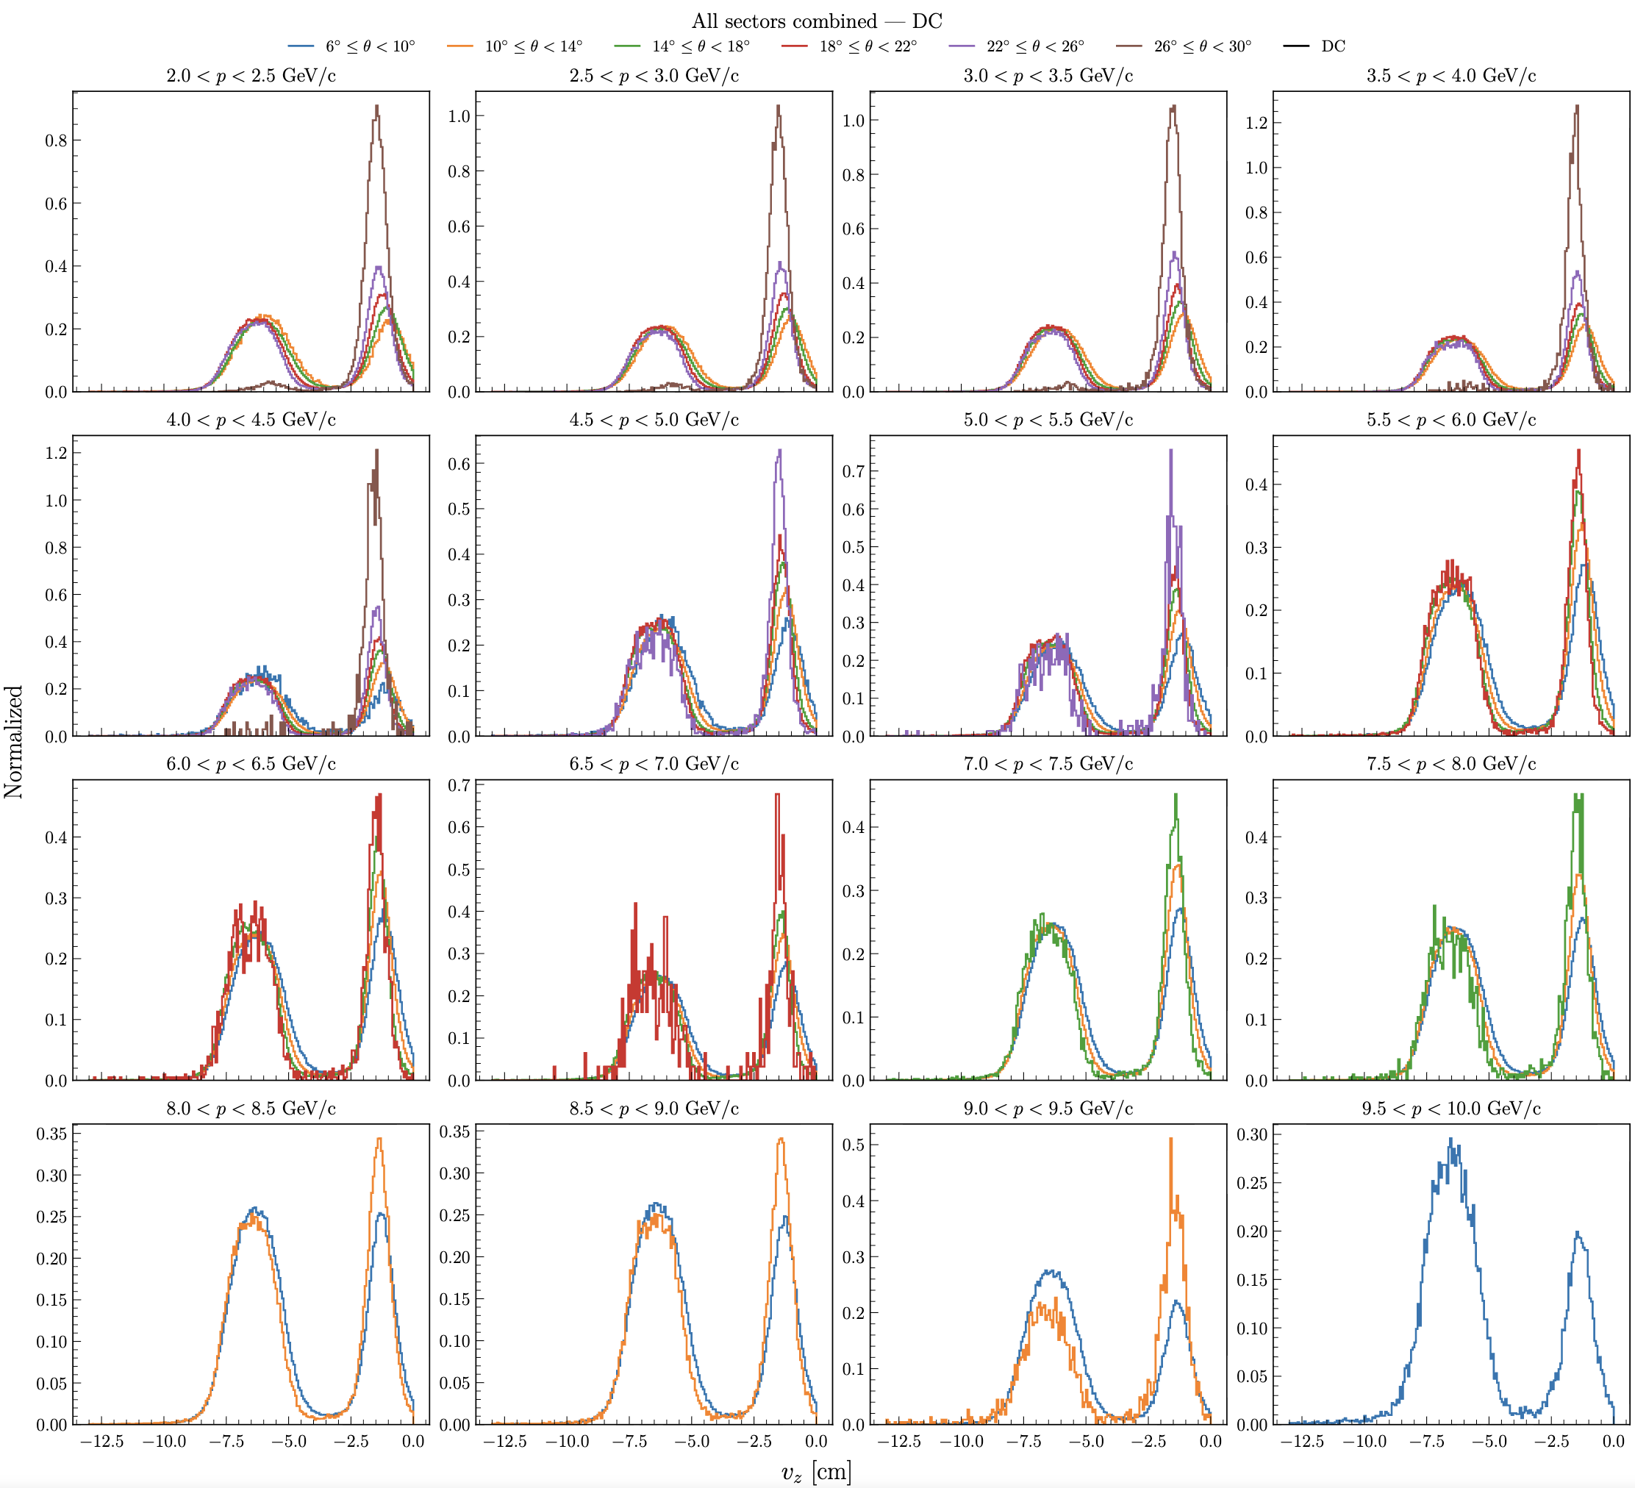
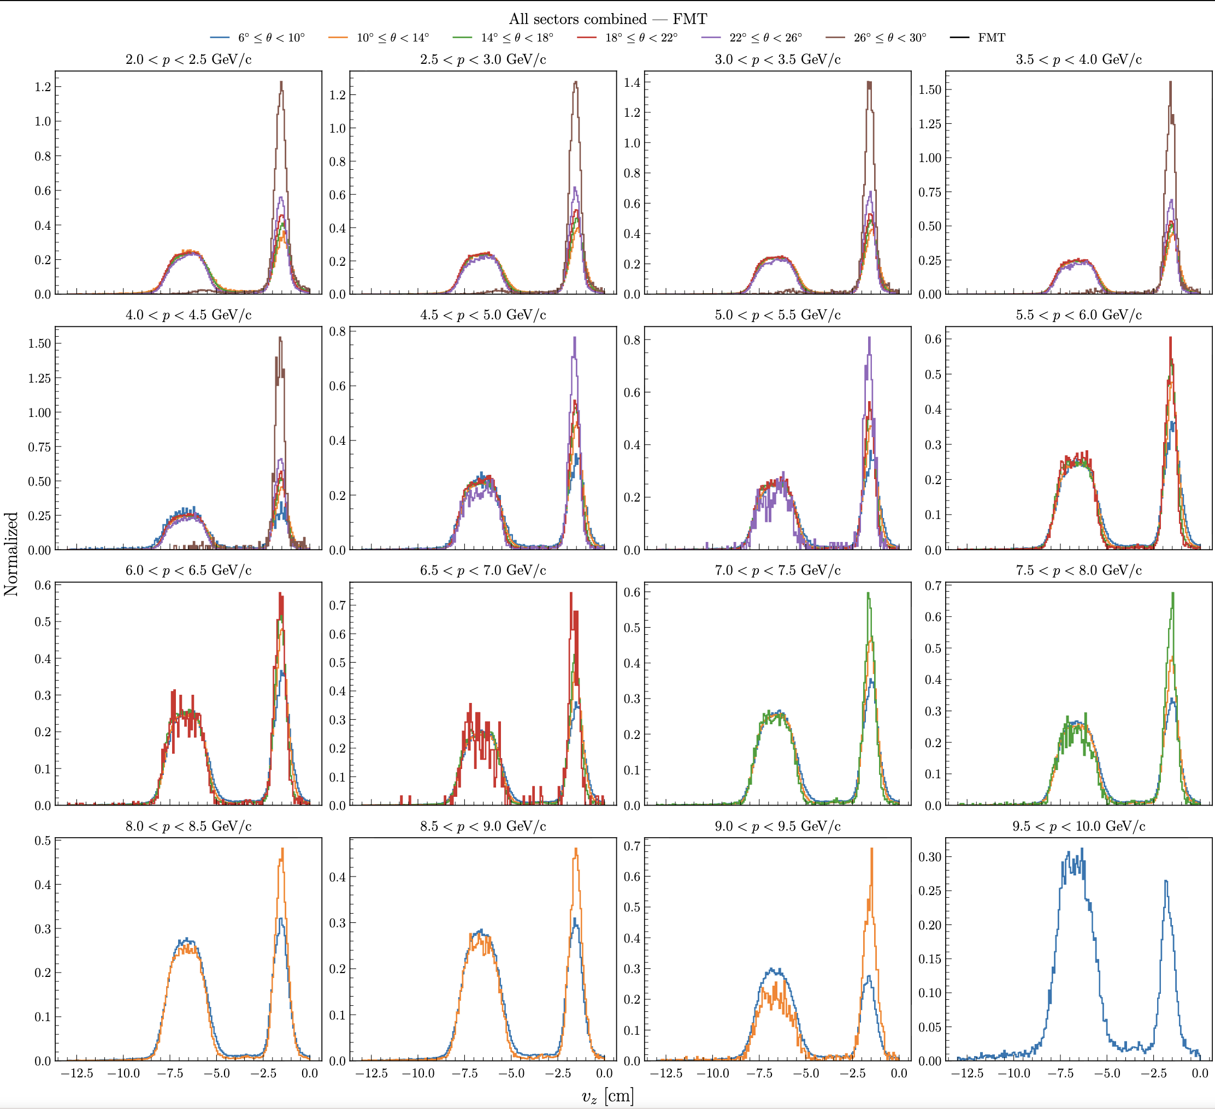
RG-E: Vz correction

Slide 16
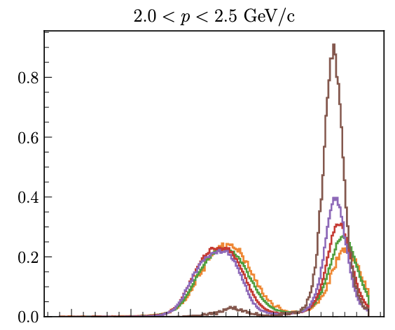
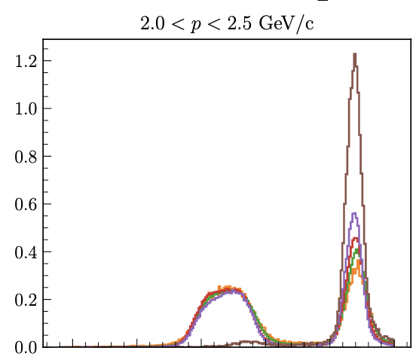
RG-E: Vz correction
With the FMT the shift and distortion are smaller
DC
FMT

Slide 17
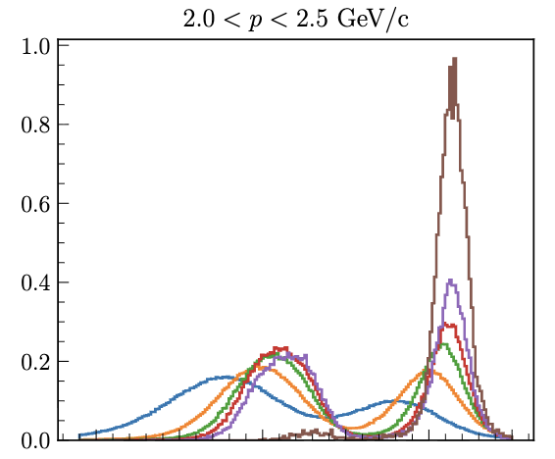
RG-E: Vz correction
In inbending the shift and distortion are also smaller
DC IB
DC OB

Slide 18
ALERT: GNN Implementation
Work to implement my new model in COATJAVA:
First thing: save the model in a PyTorch script
Then we can work in COATJAVA
First need to move the track finding and track fitting (helix fitter) to the ALERT Engine:
AHDCEngine should only read the hits and use CCDB to select and correct the hits
ATOFEngine only read the hits apply CCDB correction and do clustering (?)
ALERTEngine will do the track finding, helix fitter and Kalman filter
It is because I need both AHDC and ATOF hits for the new model

Slide 19
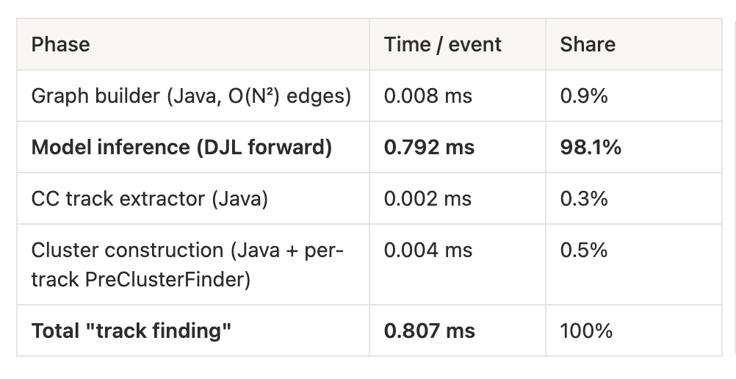
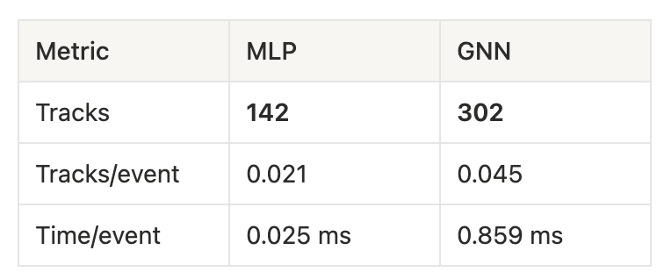
ALERT: GNN Implementation
Work to implement my new model in COATJAVA:
Now, I can implement the new model (GNN):
First, I need to create the graph in CJ (in the same way it was done in Python)
Next, the model will do the inference (prediction) with Deep Java Library
Next, generate the tracks in CJ
Tested on clas_021903.evio.00000 with 10k events. (325 nA 10676.6 4He )
GNN is much slower, mainly because the model is much larger
All the time spent is in the inference of the model

Slide 20
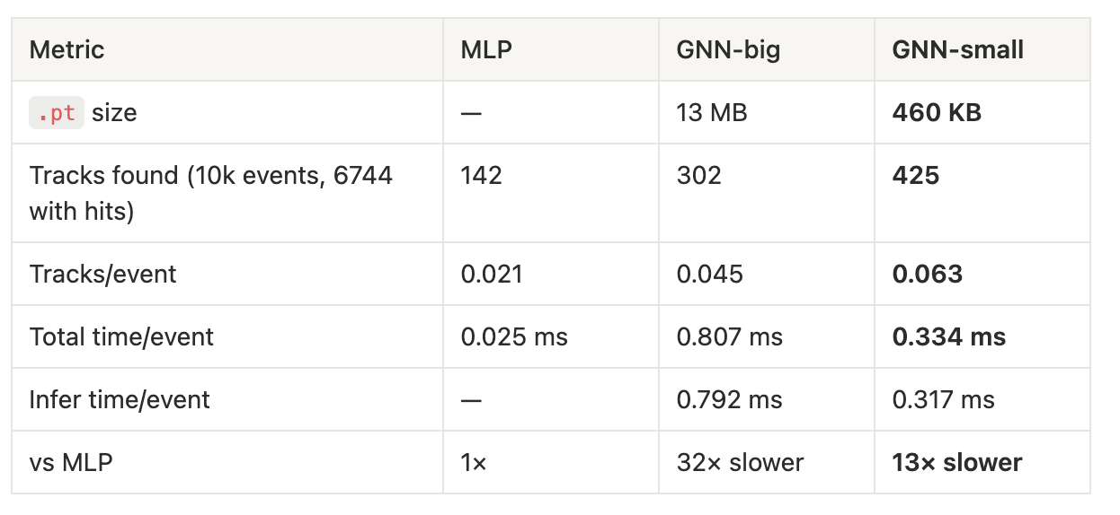
ALERT: GNN Implementation
Work to implement my new model in COATJAVA:
Try a smaller network:
Tested on clas_021903.evio.00000 with 10k events. (325 nA 10676.6 4He )
Smaller GNN is faster but the efficiency of the smaller is 97% (big model efficiency is 99.9%)
Maybe with optimization, the efficiency of the smaller can be improve

Slide 21
To do list
RG-D:
Continue to work on CuSn contamination, develop a correction for Vz distribution
Check the same things for pions
Raffaella ideas: use phi from region 1 hits not from px, py at the vertex
Develop correction of Carbon
Get the multiplicity ratio for π⁰ after the event mixing subtraction
Continue the work on p_{T} broadening and cos and sin φ_{h} extraction
Work on the binning
Radiative and acceptance correction
Background for ρ⁰ with simulation for CT analysis
ALERT:
Continue the work on Graph Neural Network: optimization and implementation in coatjava
Try to develop a smaller/faster network with similar efficiency

