Slide 1
Group meeting
Mathieu Ouillon (Mississippi State University)
04/21/26

Slide 2
RG-D: Vz correction
Goal:
Develop an correction for Inbending CuSn
Compare correction between polarity
Look at CxC correction for Outbending
Look into correction for π in CuSn (Inbending and Outbending)

Slide 3
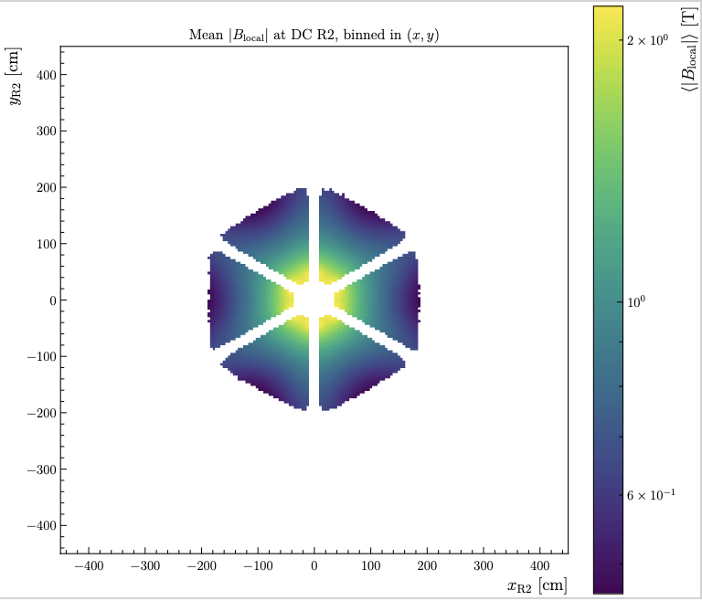
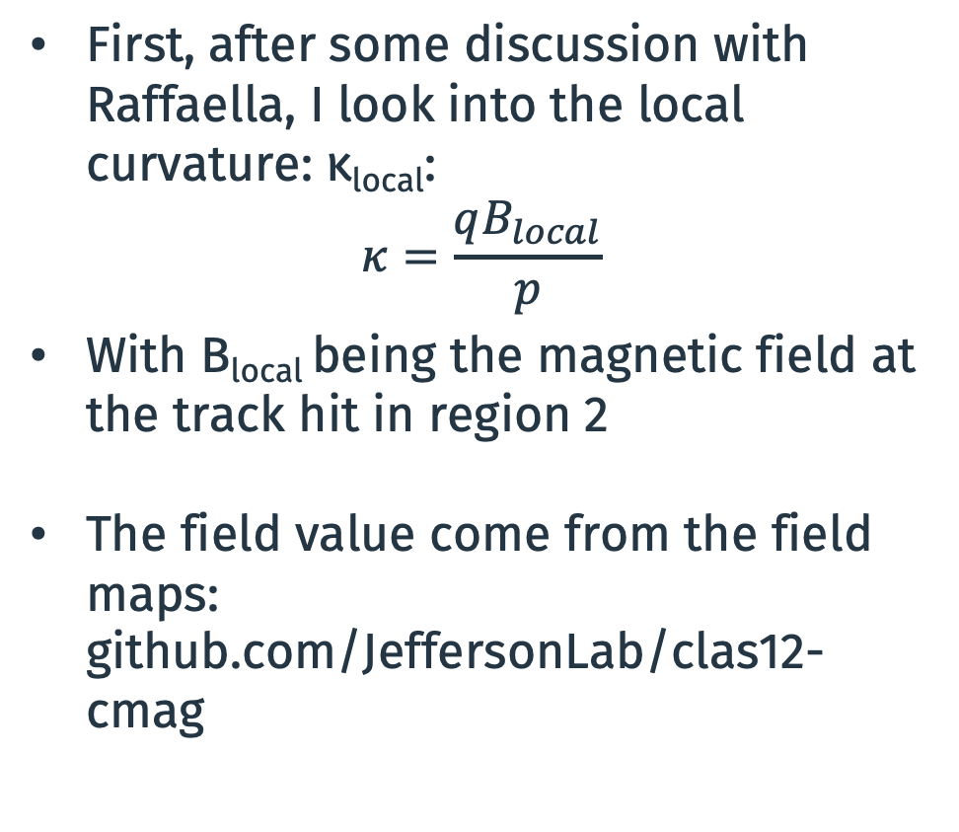
RG-D: Vz correction
First, after some discussion with Raffaella, I look into the local curvature: κ_{local}:
$$κ=\frac{qB_{local}}{p}$$
With B_{local} being the magnetic field at the track hit in region 2
The field value come from the field maps: github.com/JeffersonLab/clas12-cmag

Slide 4
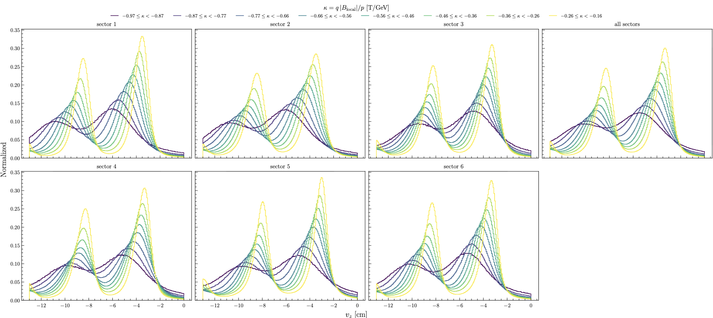
RG-D: Vz correction
Plot Vz distribution as function of κ: Much more linear for the shit in μ

Slide 5
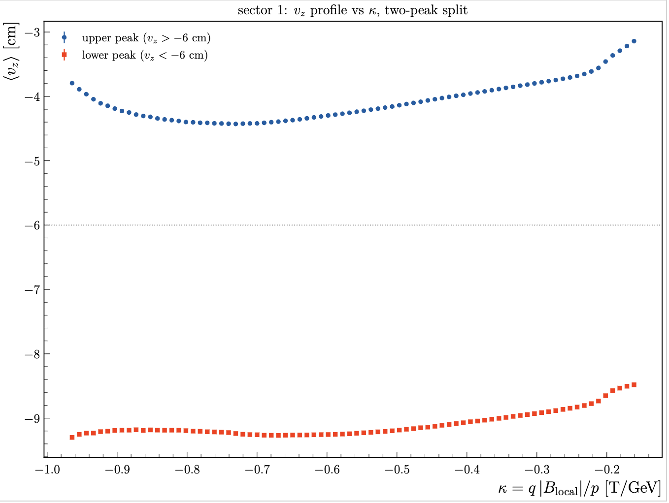
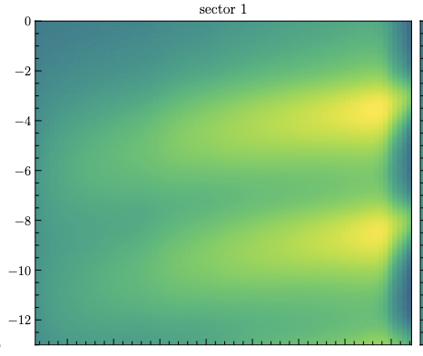
RG-D: Vz correction
Vz [cm]
K [T/GeV]

Slide 6
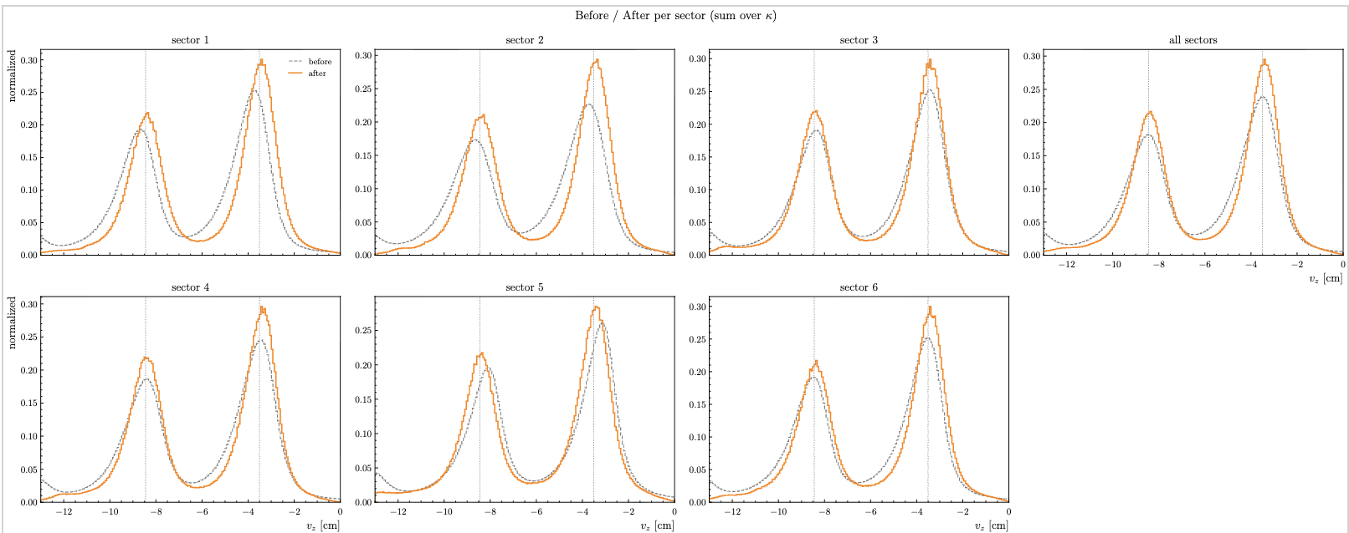
RG-D: Vz correction
I have tried to develop a correction based on κ and sector instead of momentum, theta, phi, and sector. Don’t work as well:

Slide 7
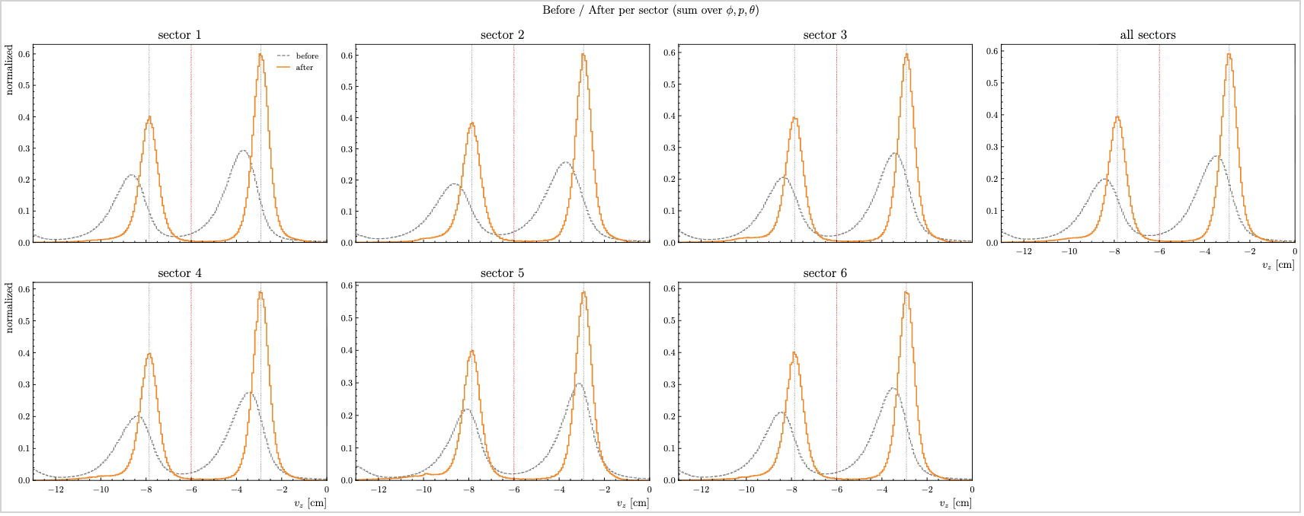
RG-D: Vz correction
Compare to:

Slide 8
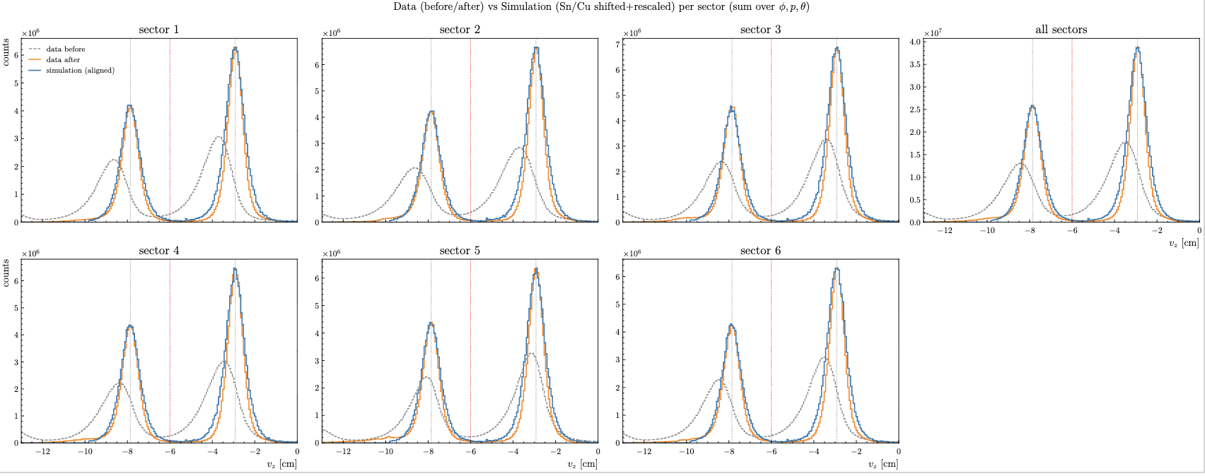
RG-D: Vz correction
I also compare Outbending CuSn data and simulation: Very similar after correction

Slide 9
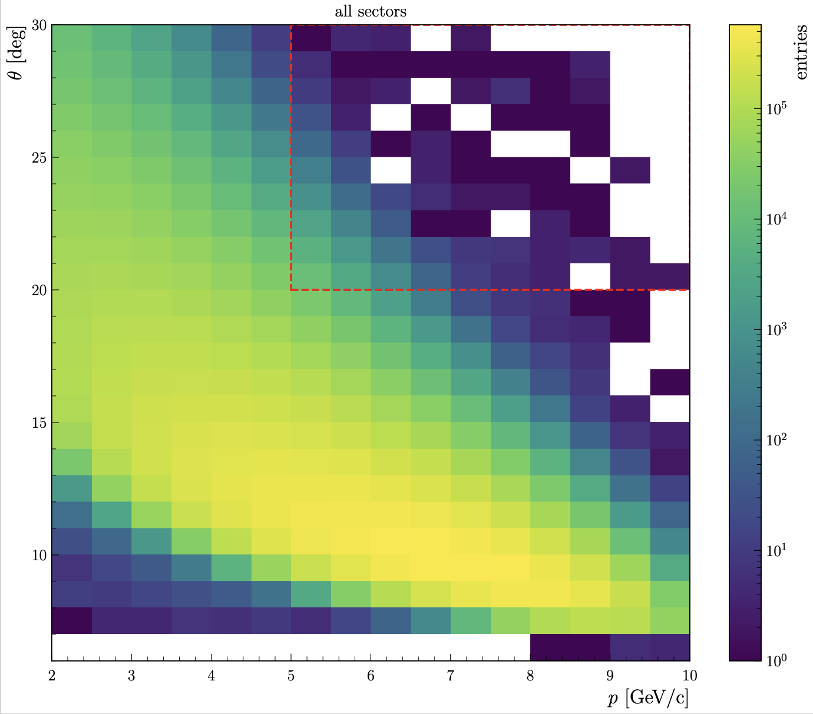
RG-D: Vz correction
Develop a similar correction for Inbending CuSn:
Select reference region (can be changed)

Slide 10
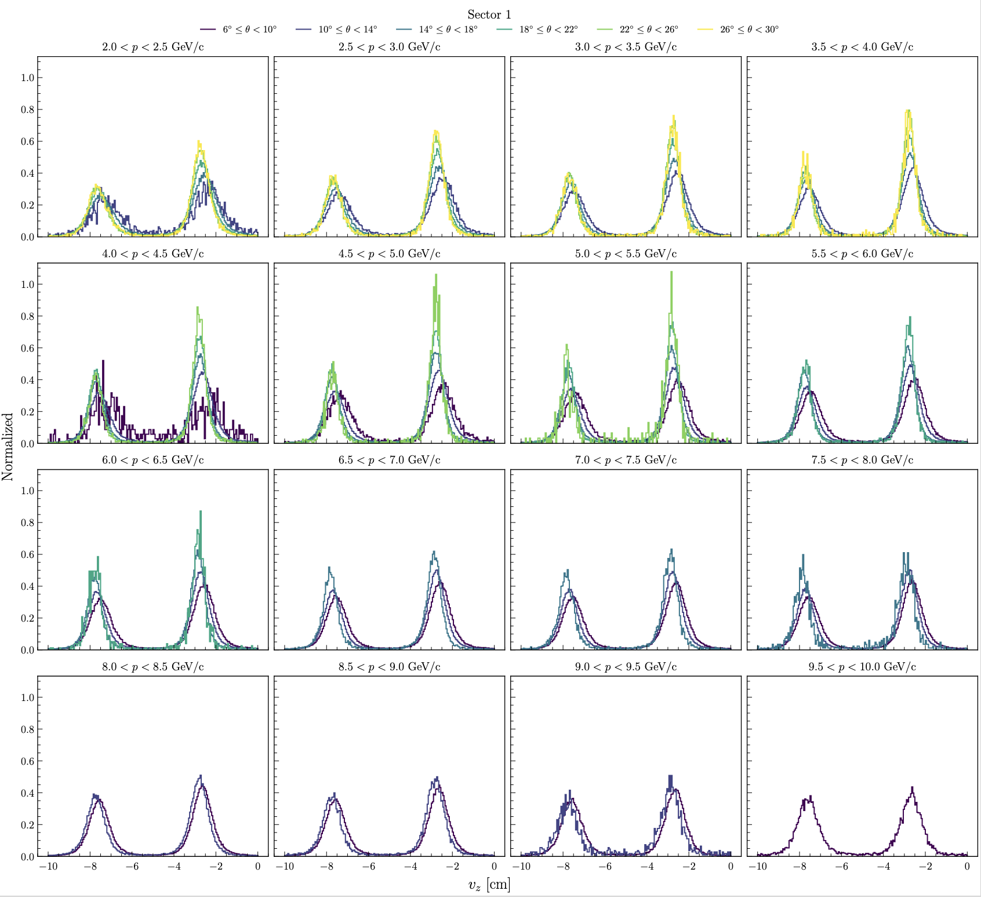
RG-D: Vz correction
Develop a similar correction for Inbending CuSn:
Look at the Vz distribution for different momentum and theta bin
Smaller shit for the mean compare to Outbending
Less distortion of the distribution also.

Slide 11
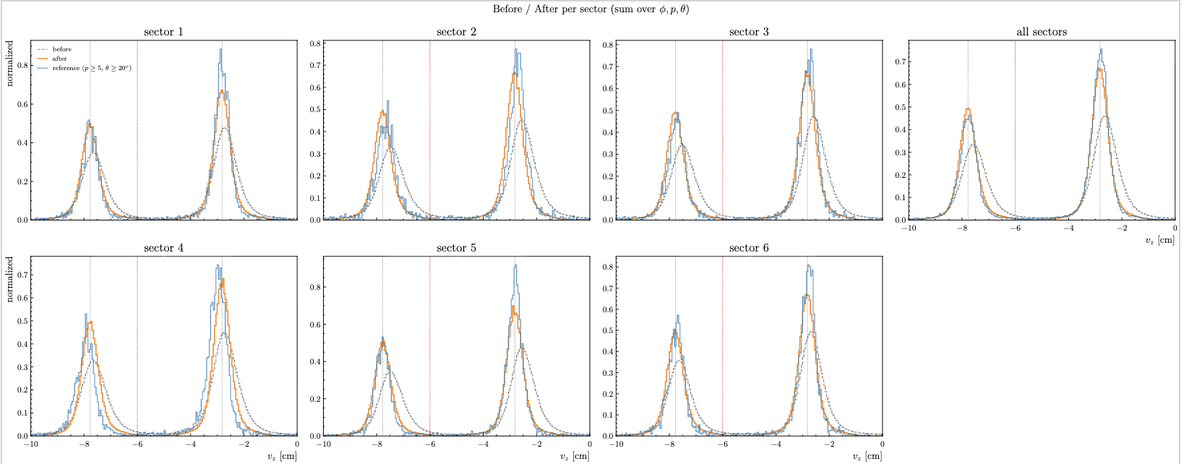
RG-D: Vz correction
Develop a similar correction for Inbending CuSn:
Before/After correction + reference distribution: smaller correction than Outbending

Slide 12
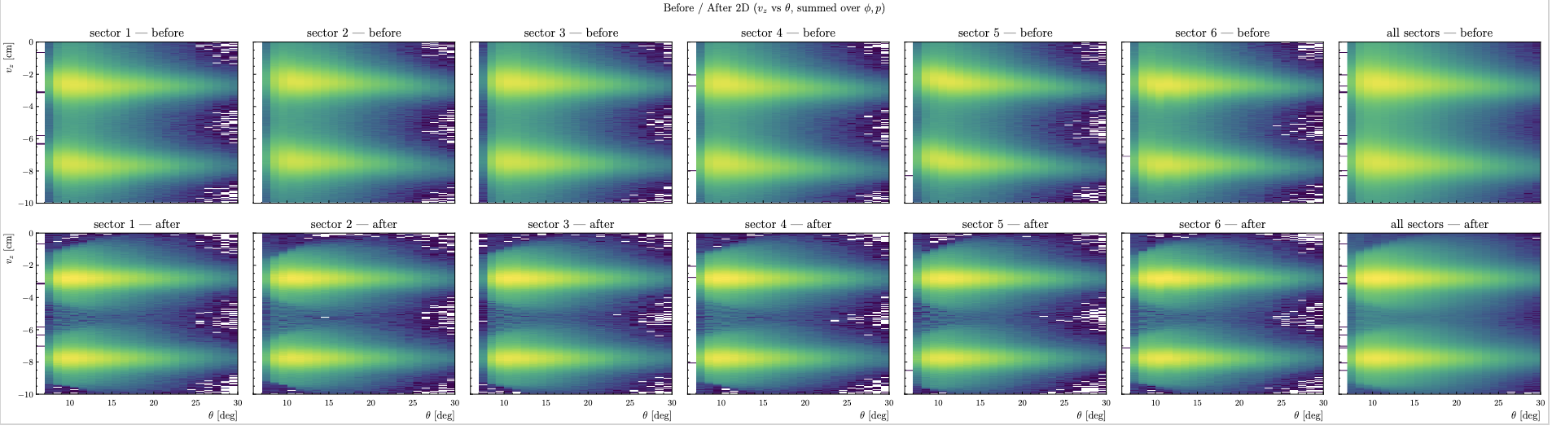
RG-D: Vz correction
Develop a similar correction for Inbending CuSn:
Before/After correction + reference distribution: smaller correction than Outbending

Slide 13
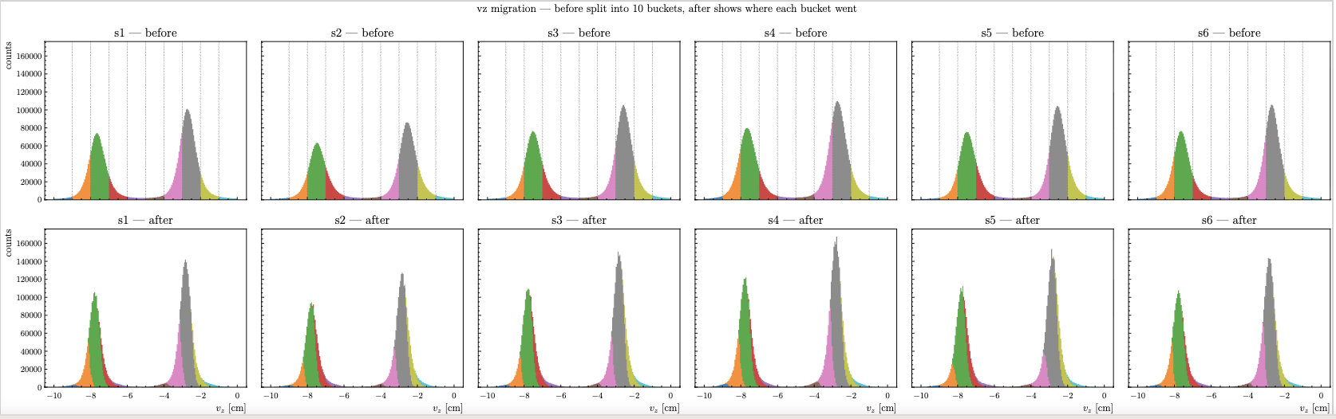
RG-D: Vz correction
Develop a similar correction for Inbending CuSn:
Before/After correction + reference distribution: smaller correction than Outbending

Slide 14
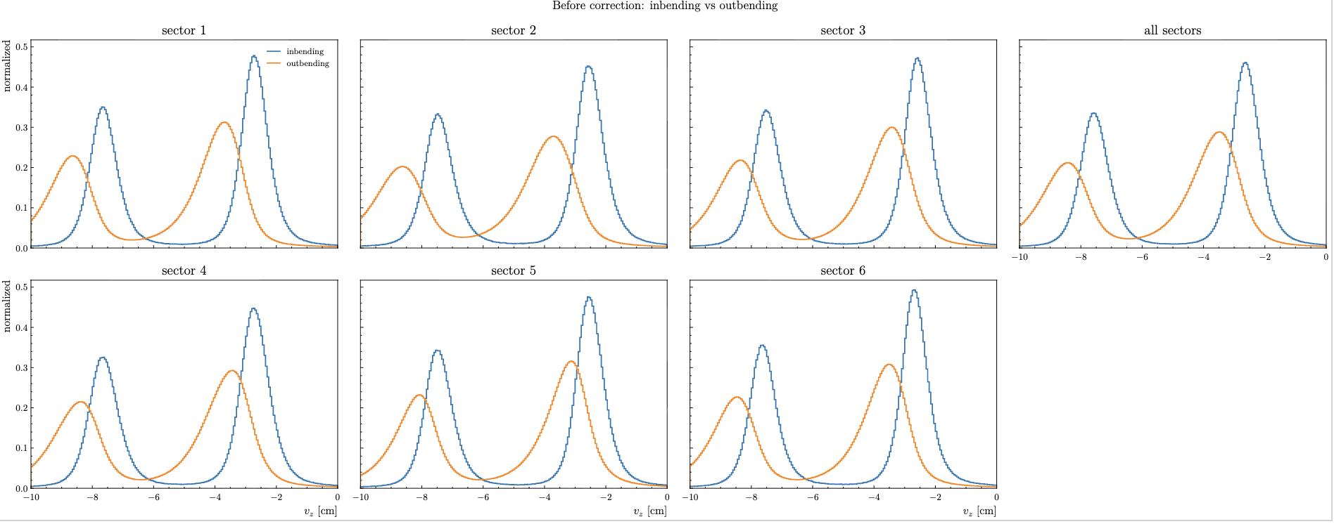
RG-D: Vz correction
Compare Inbending/Outbending CuSn correction
Before correction:

Slide 15
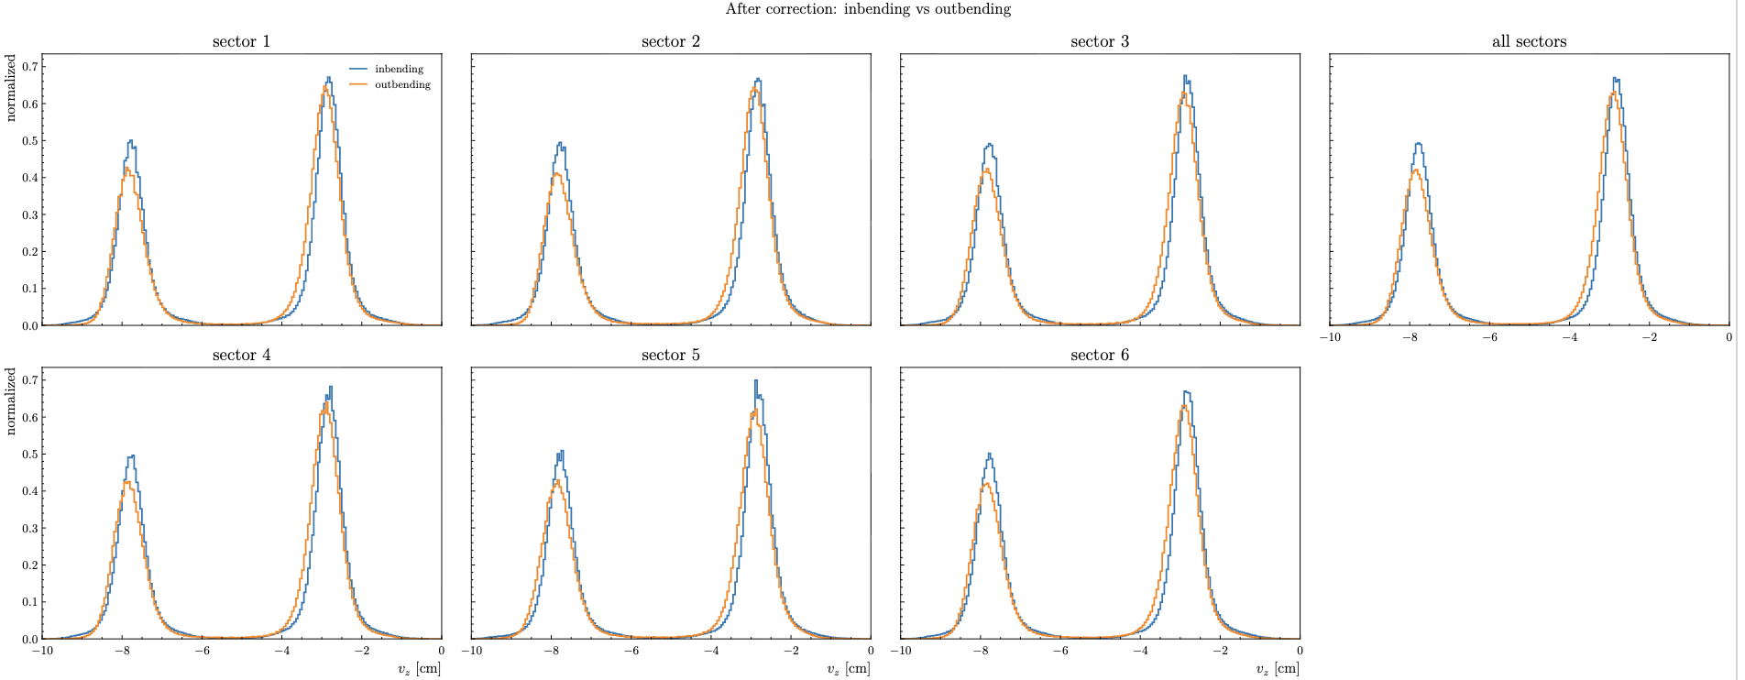
RG-D: Vz correction
Compare Inbending/Outbending CuSn correction
After correction: Very similar after correction

Slide 16
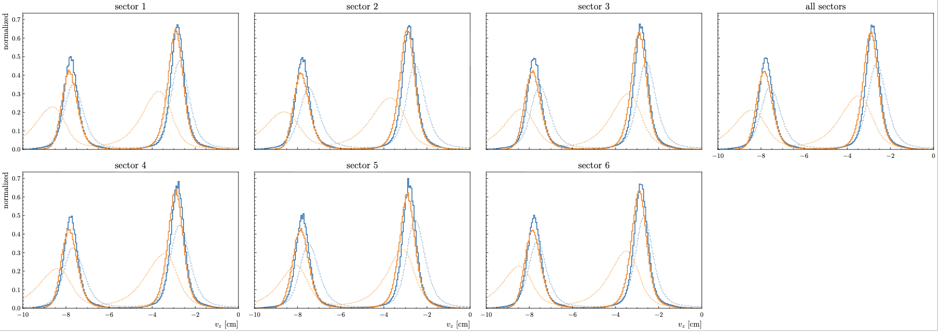
RG-D: Vz correction
Compare Inbending/Outbending CuSn correction
After correction: Very similar after correction

Slide 17
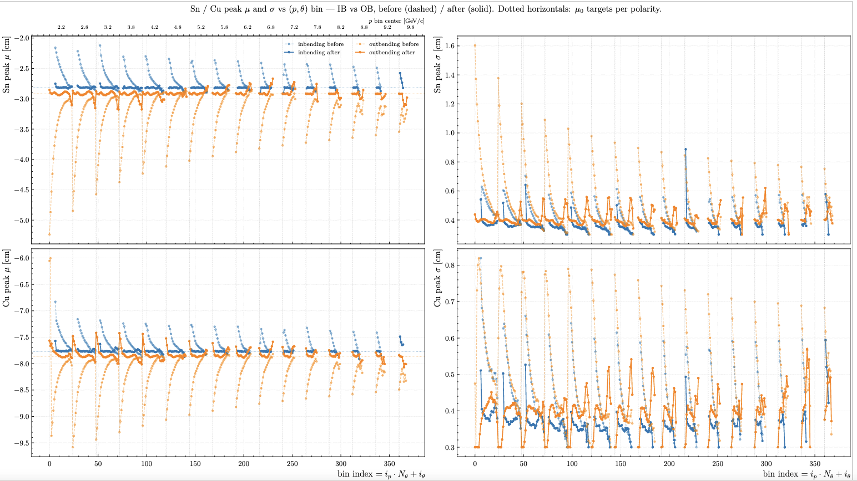
RG-D: Vz correction
Compare Inbending/Outbending:
After correcting the mean and sigma of each peak are much more constant across all momentum and theta bins.
Inbending blue
Outbending orange

Slide 18
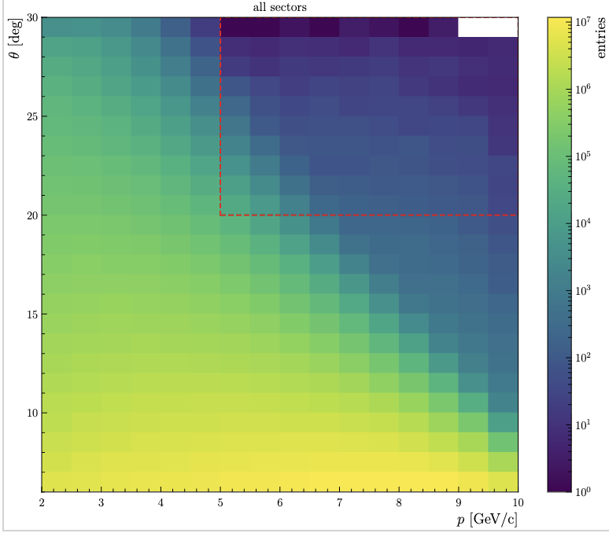
RG-D: Vz correction
Develop a correction for CxC Outbending:
Select reference region p>5GeV and theta > 20 deg:

Slide 19
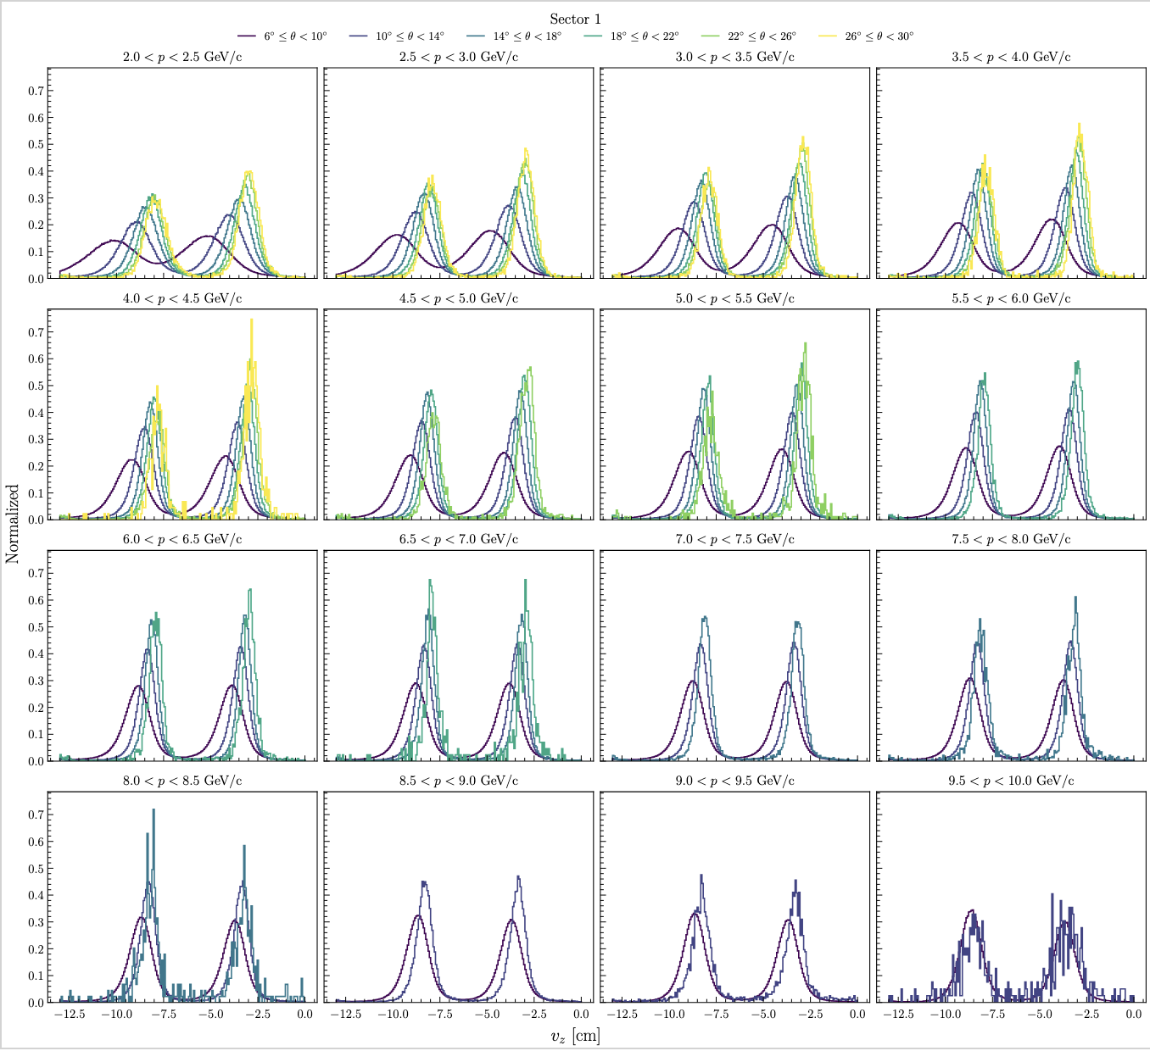
RG-D: Vz correction
Develop a correction for CxC Outbending:
Similar shifts and distortions as CuSn Outbending.

Slide 20
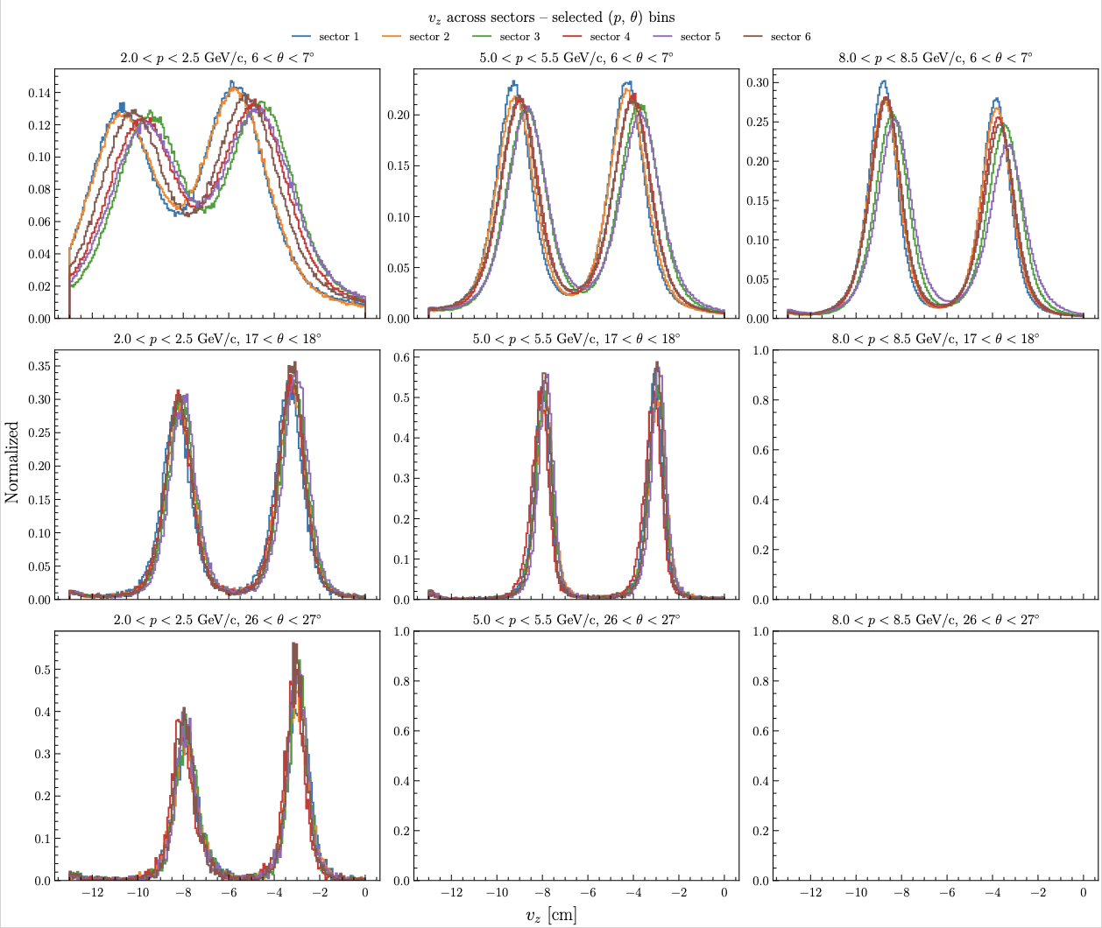
RG-D: Vz correction
Develop a correction for CxC Outbending:
Sector differences

Slide 21
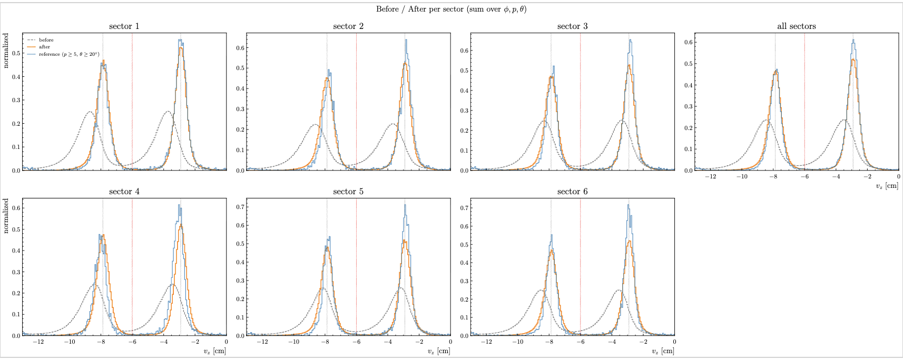
RG-D: Vz correction
Develop a correction for CxC Outbending:

Slide 22
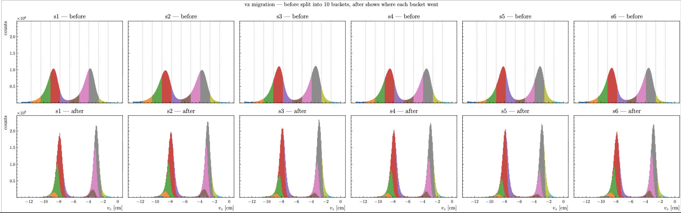
RG-D: Vz correction
Develop a correction for CxC Outbending:

Slide 23
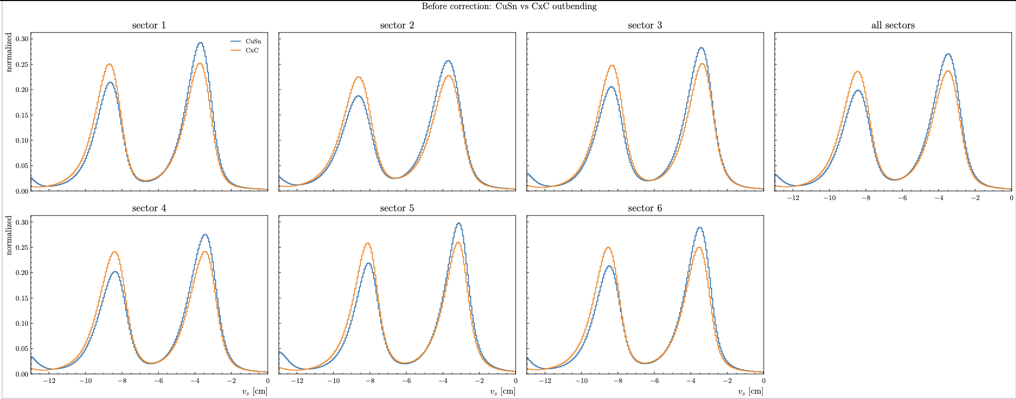
RG-D: Vz correction
Compare CxC and CuSn Outbending correction:
Similar distributions

Slide 24
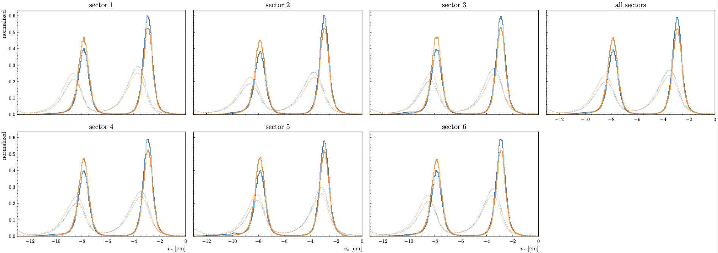
RG-D: Vz correction
Compare CxC and CuSn Outbending correction:
Very close sigma and mu

Slide 25
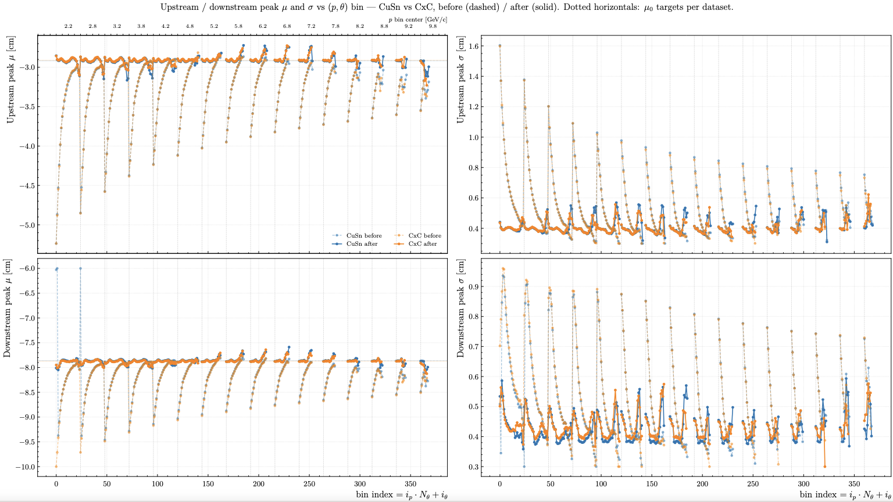
RG-D: Vz correction
Compare CxC and CuSn Outbending correction:

Slide 26
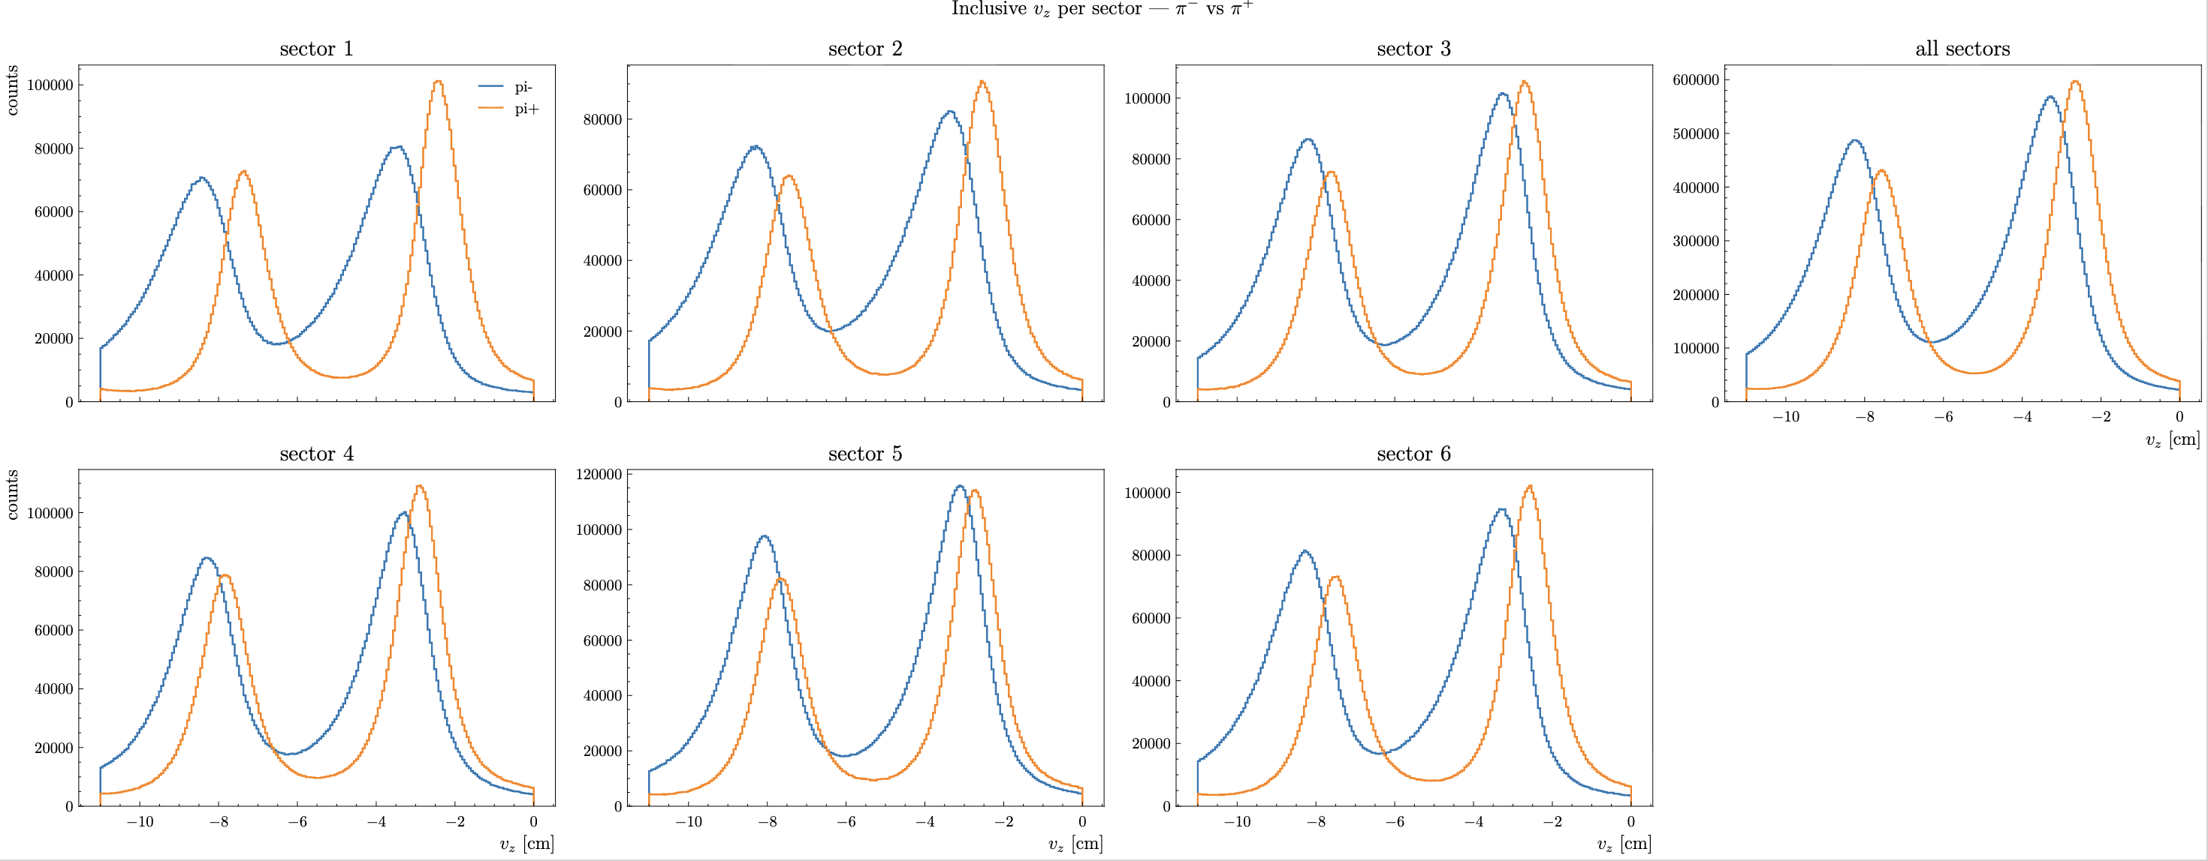
RG-D: Vz correction
Look into the pion Vz distribution (CuSn, no Vz cut apply, event with good electron)
Pion selected with PID, |chi2pid| < 10

Slide 27
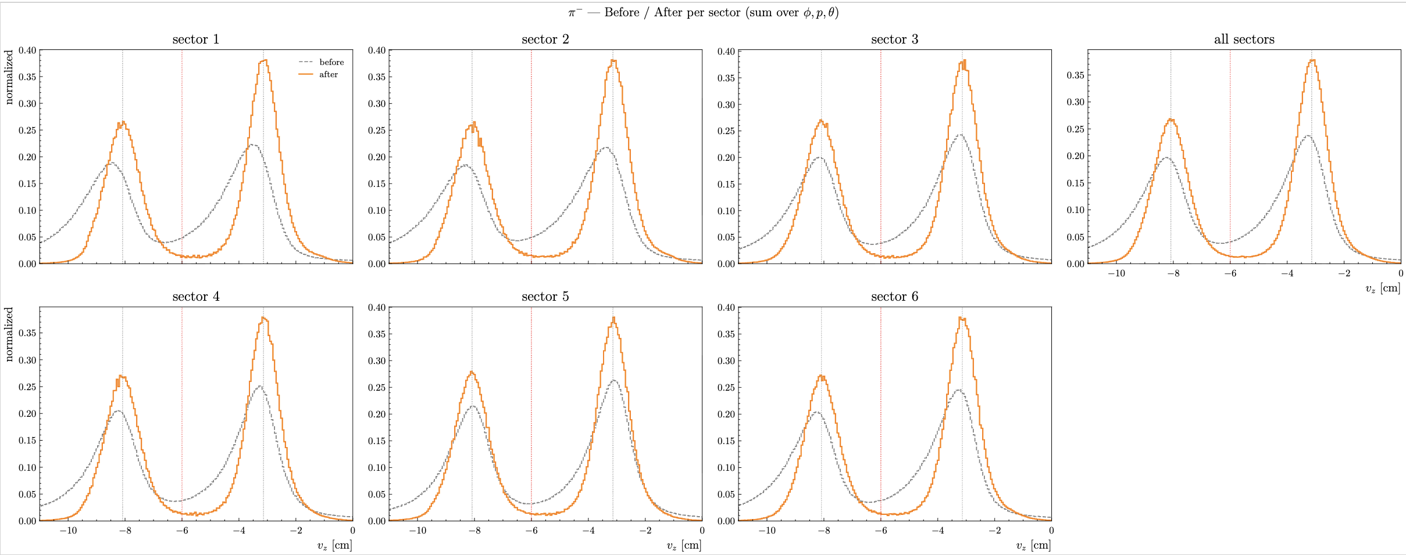
RG-D: Vz correction
Look into the pion Vz distribution (CuSn, no Vz cut apply, event with good electron)
Pion selected with PID, |chi2pid| < 10, p > 0.3 GeV
Reference region: theta > 15.0 deg, and p > 2.0 GeV

Slide 28
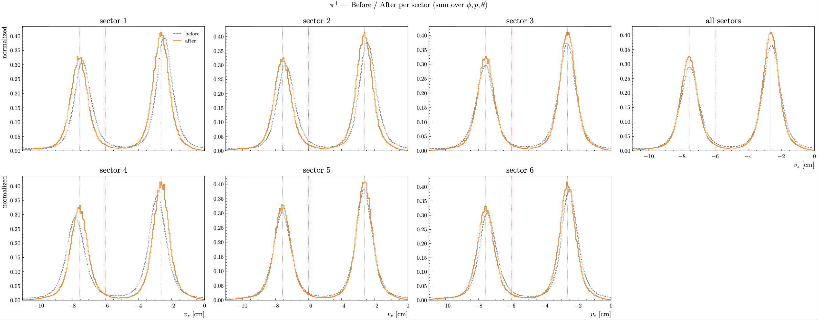
RG-D: Vz correction
Look into the pion Vz distribution (CuSn, no Vz cut apply, event with good electron)
Pion selected with PID, |chi2pid| < 10, p > 0.3 GeV
Reference region: theta > 15.0 deg, and p > 2.0 GeV

Slide 29
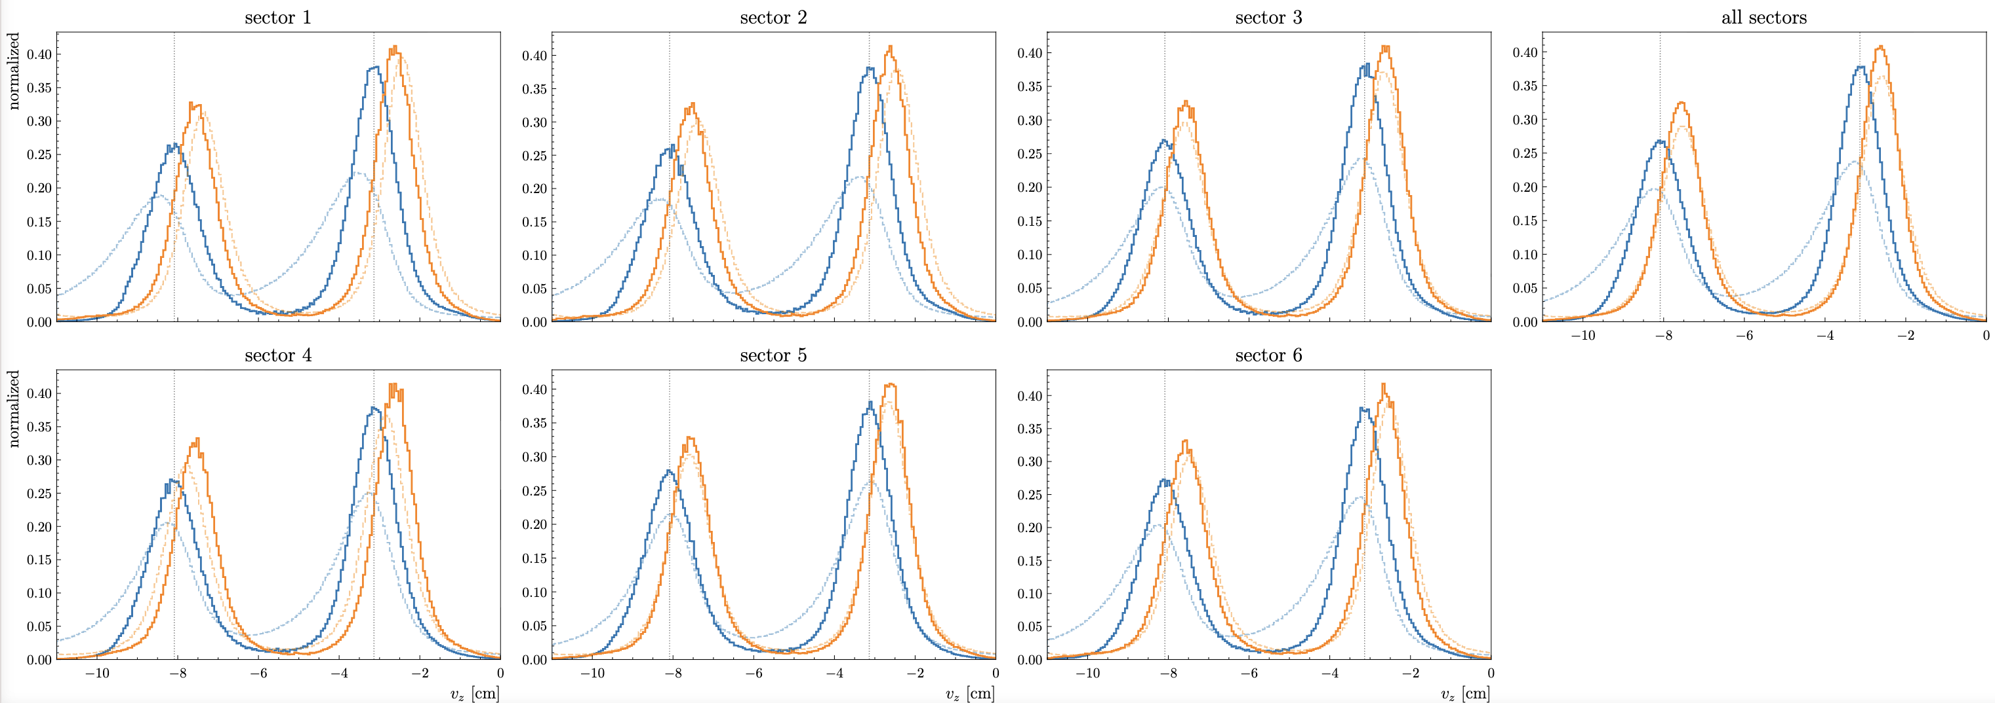
RG-D: Vz correction
Comparison of pi+ and pi-: The corrected distributions are different (mean)
Maybe the issue is with the reference region

Slide 30
To do list
RG-D:
Continue to work on CuSn contamination, develop a correction for Vz distribution
Check the same things for pions
Develop a correction of Carbon
Get the multiplicity ratio for π⁰ after the event mixing subtraction
Continue the work on p_{T} broadening and cos and sin φ_{h} extraction
Work on the binning
Radiative and acceptance correction
Background for ρ⁰ with simulation for CT analysis
ALERT:
Continue the work on Graph Neural Network: implementation in coatjava, make a pull request
Redo the efficiency study on elastic data but use the polar angle of the electron instead of the momentum for calculation of the predicted deuterium

