Slide 1
Group meeting
Mathieu Ouillon (Mississippi State University)
05/05/26

Slide 2
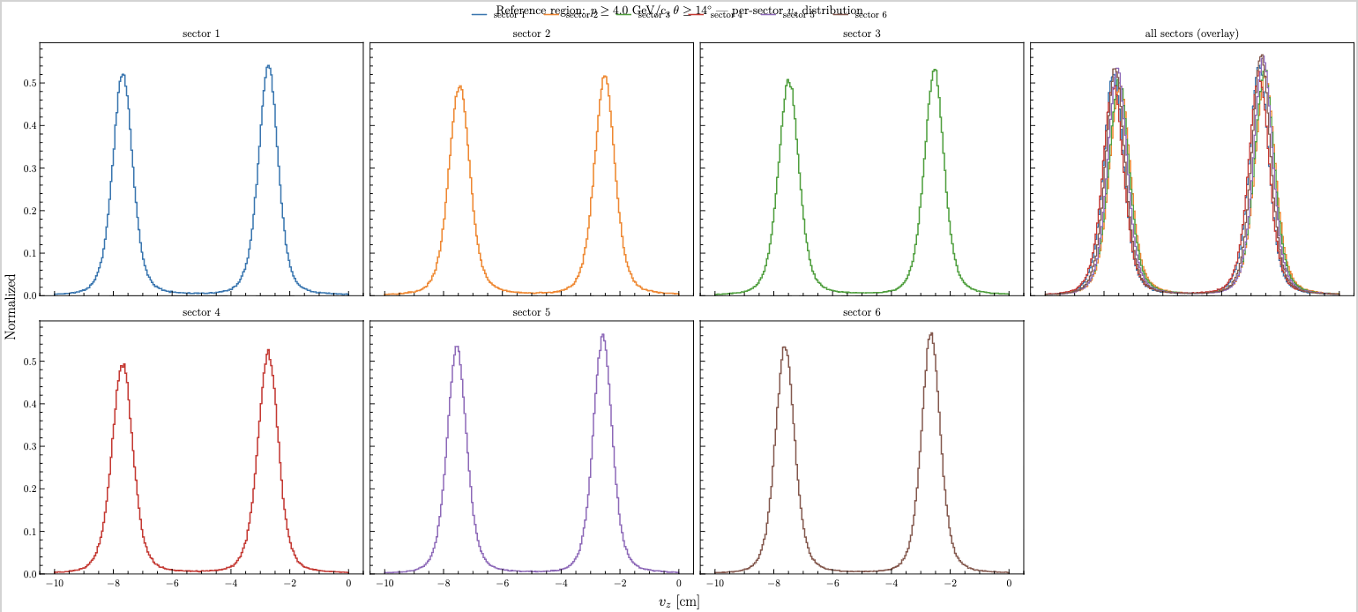
RG-D: Vz correction
Develop Vz correction for CxC inbending:
Use same reference region as CuSn/CxC Outbending and CuSn Inbending

Slide 3
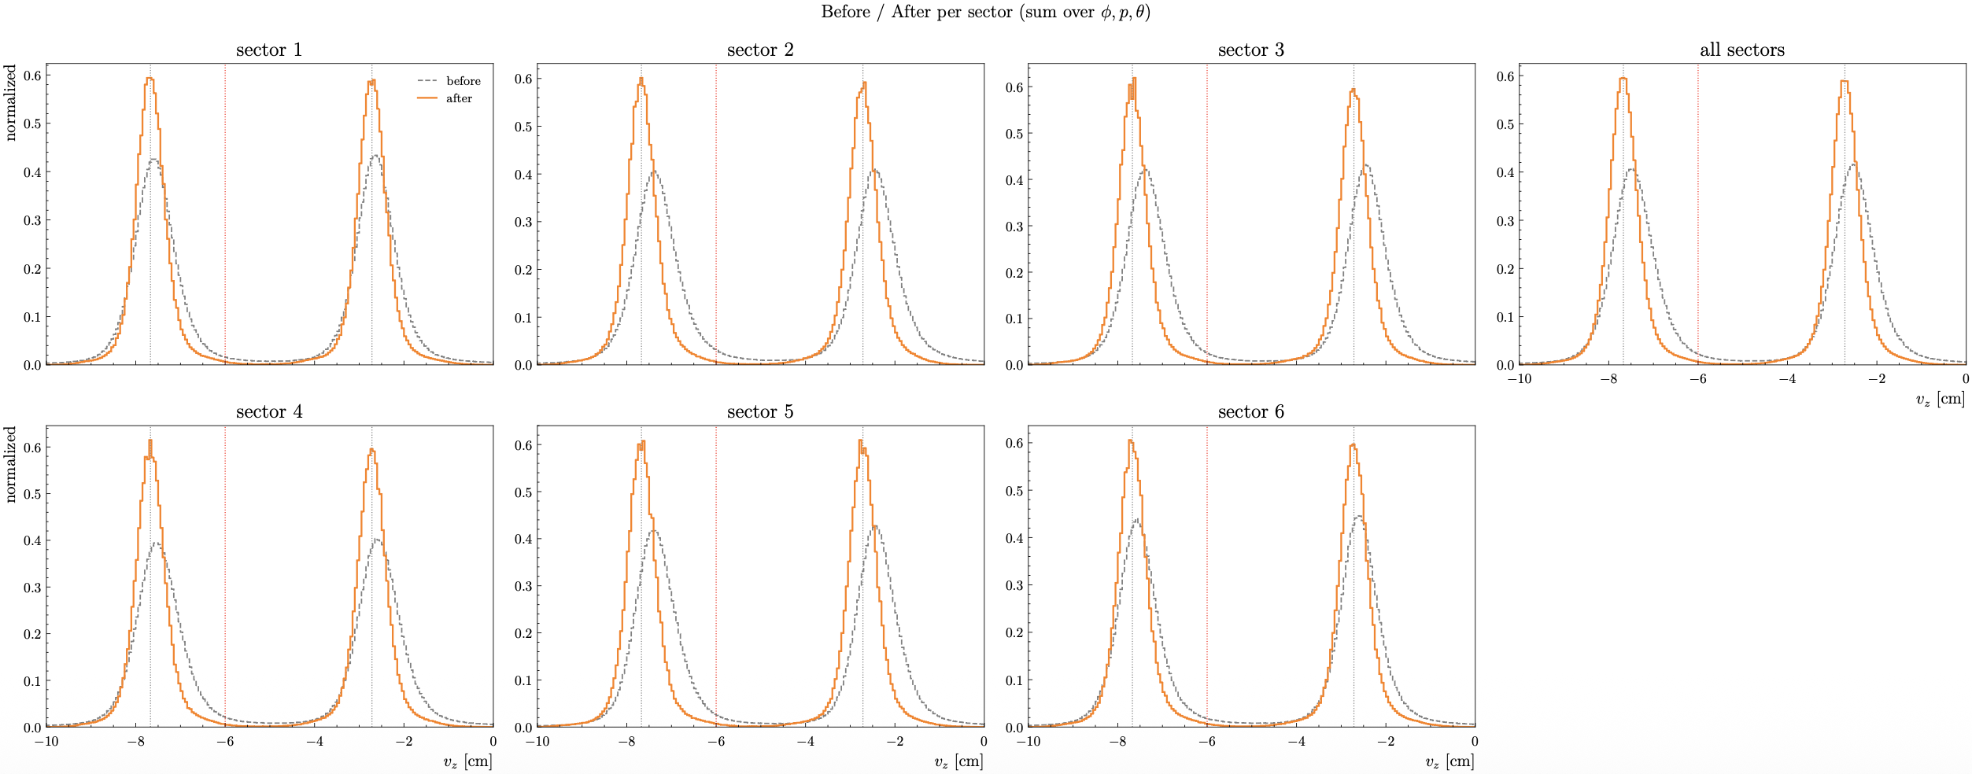
RG-D: Vz correction
Develop Vz correction for CxC inbending:

Slide 4
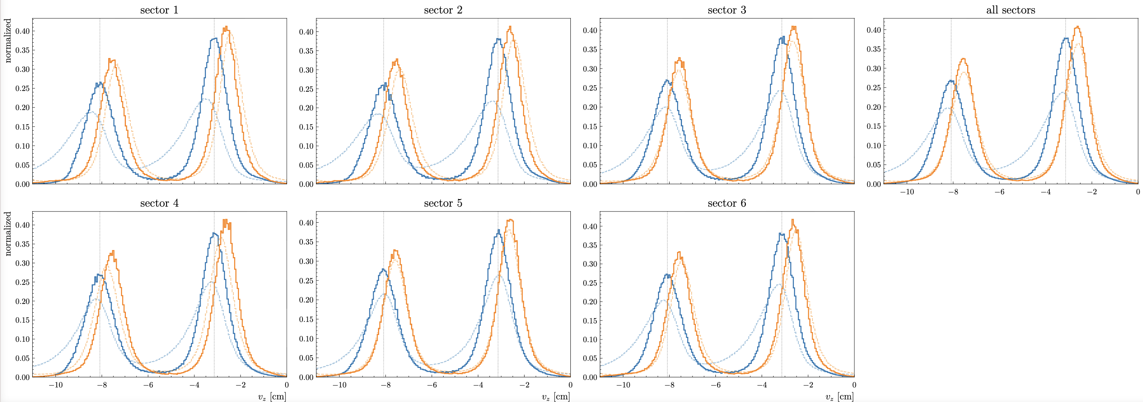
RG-D: Vz correction
Look into the pion correction, last week the π⁺ and π⁻ have a different mean; to fix it I need to look into the reference region. (CuSn Outbending)

Slide 5
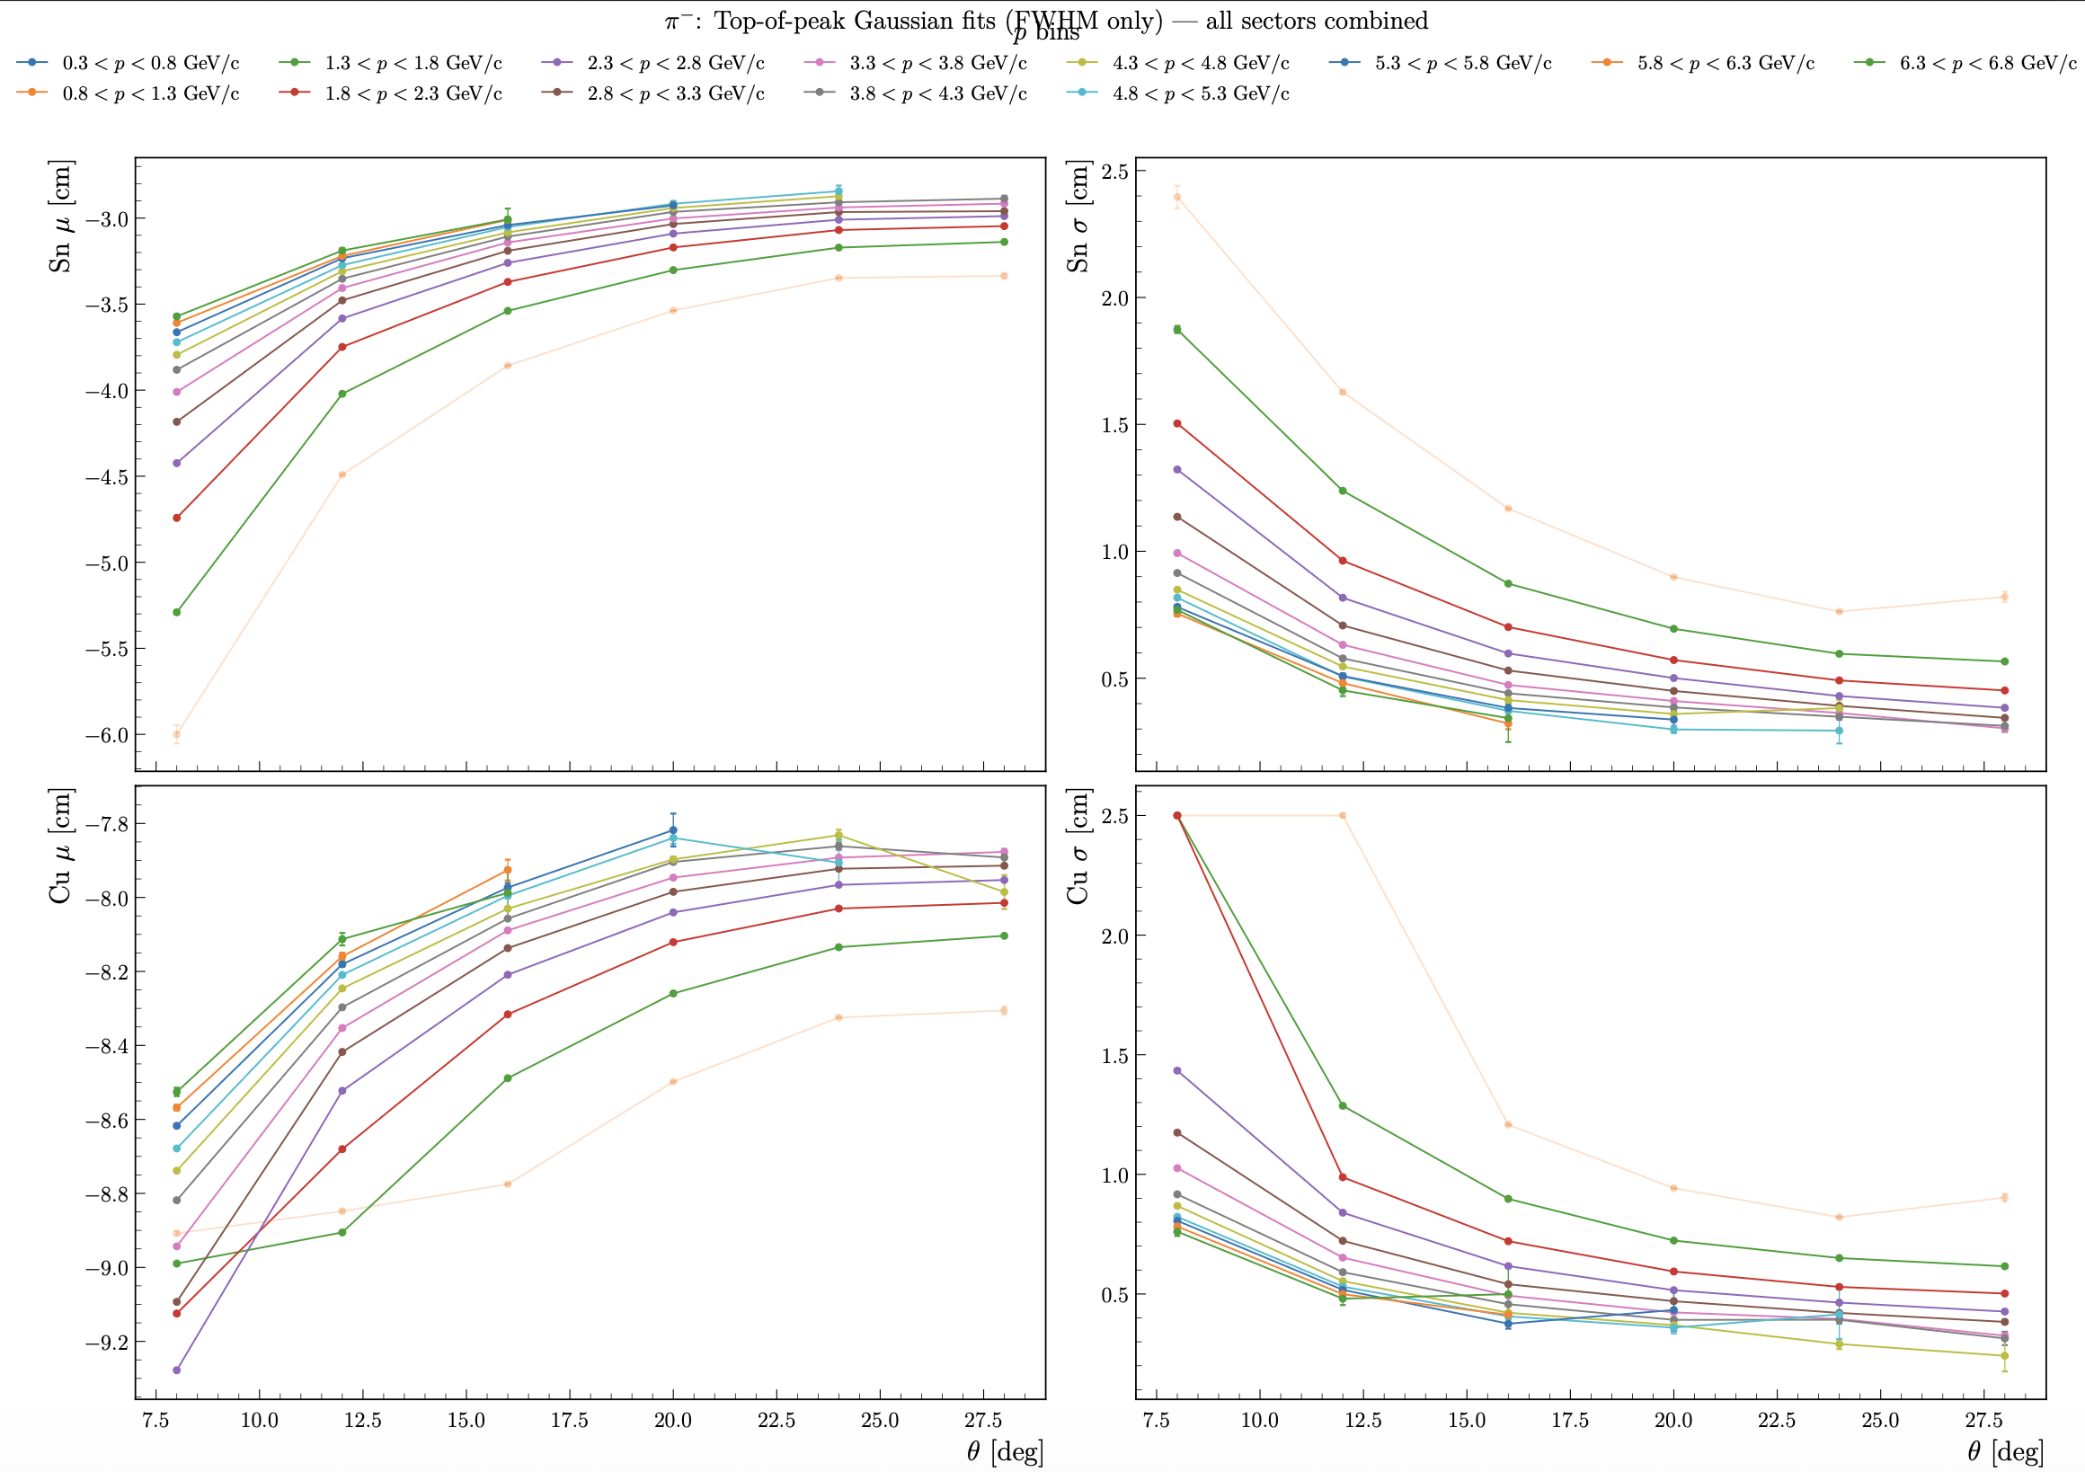
RG-D: Vz correction
Look into the pion correction to find the reference region (CuSn Outbending):
Reference region: Region where the mean and sigma of the peaks is constant across p and θ bins
Reference region: p > 3 GeV/c and θ > 15 deg

Slide 6
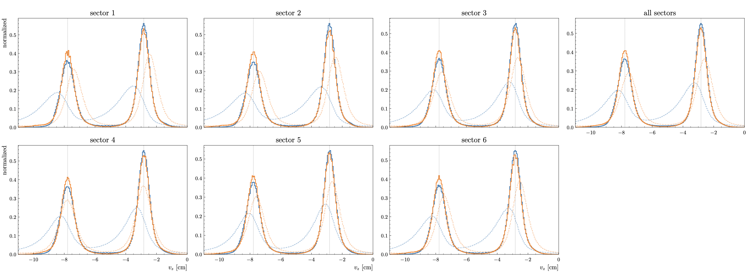
RG-D: Vz correction
With the new reference region (CuSn Outbending):

Slide 7
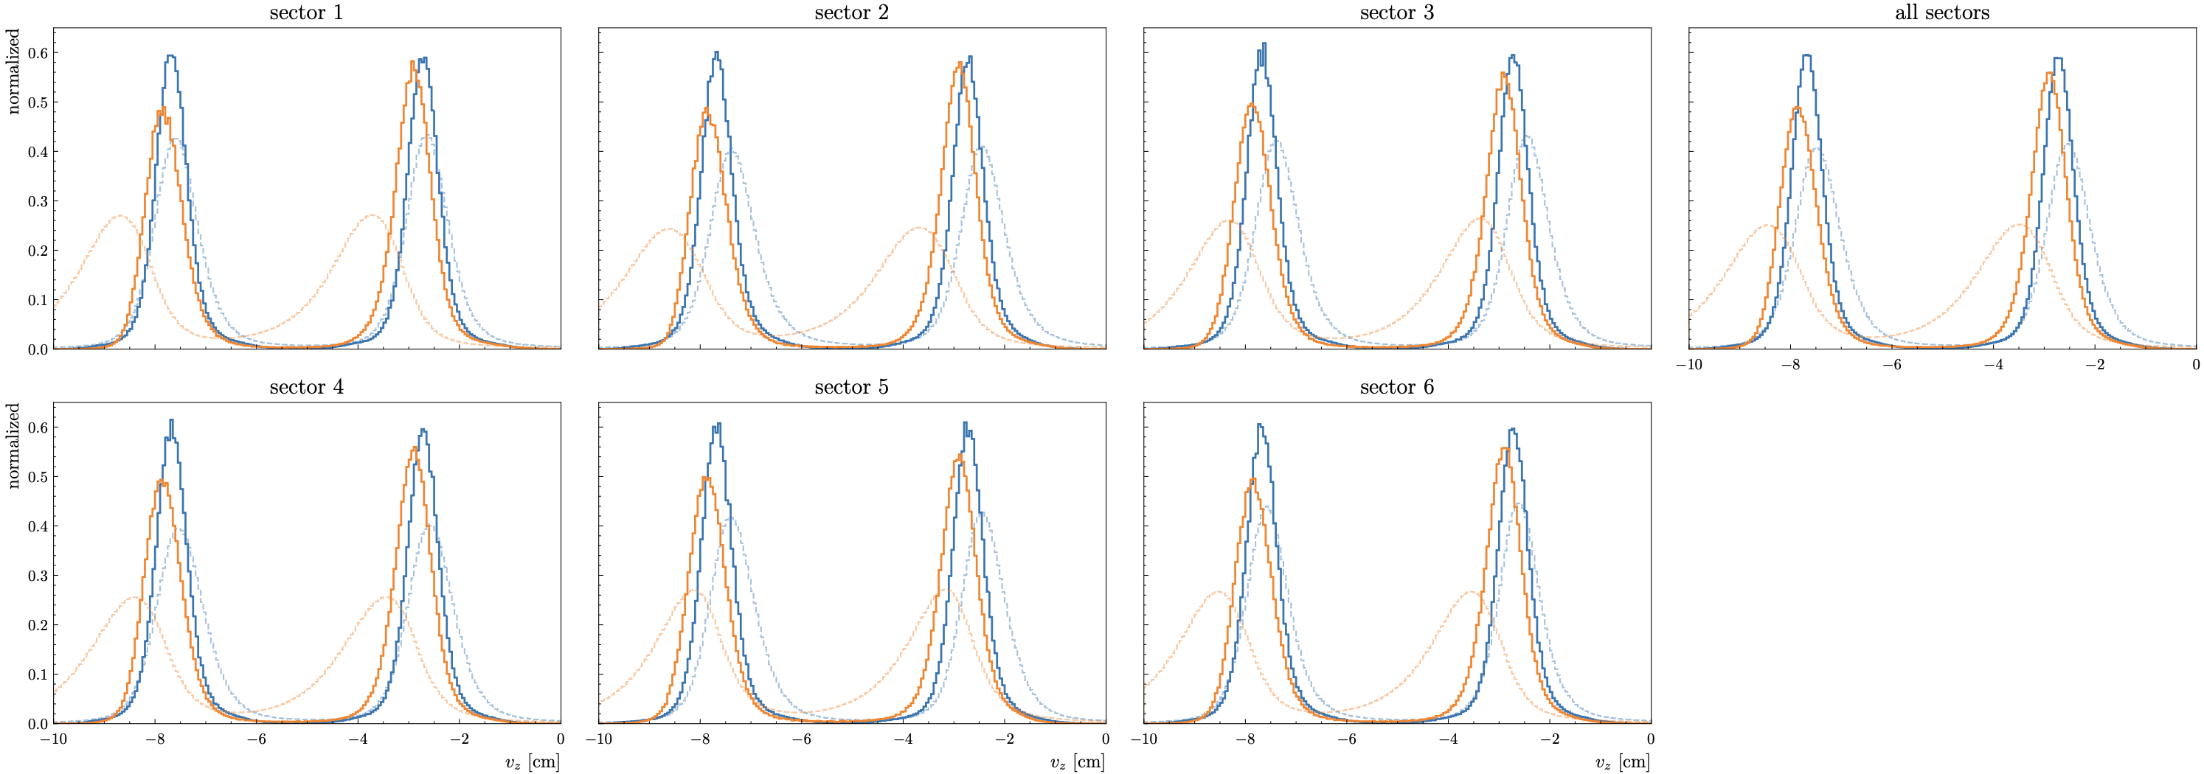
RG-D: Vz correction
Compare Inbending and Outbending for CxC electron

Slide 8
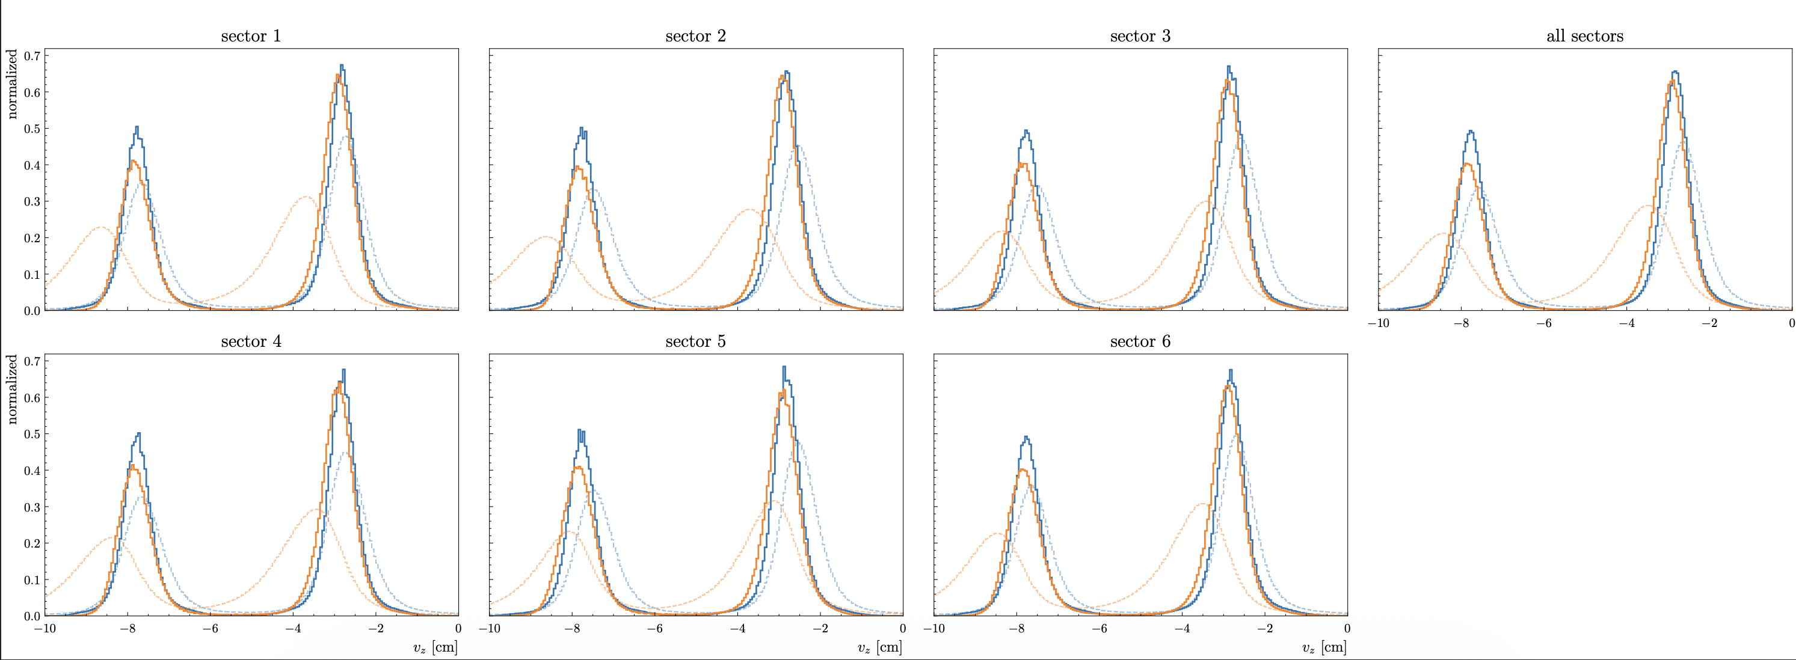
RG-D: Vz correction
Compare Inbending and Outbending for CuSn electron

Slide 9
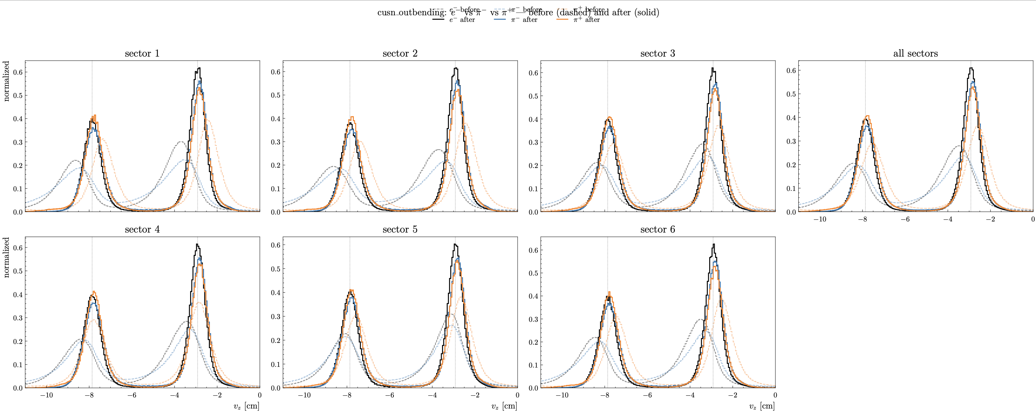
RG-D: Vz correction
Compare electron and pions (CuSn Outbending):

Slide 10
RG-D: Vz correction
Compare electron and pions (CxC Inbending):

Slide 11
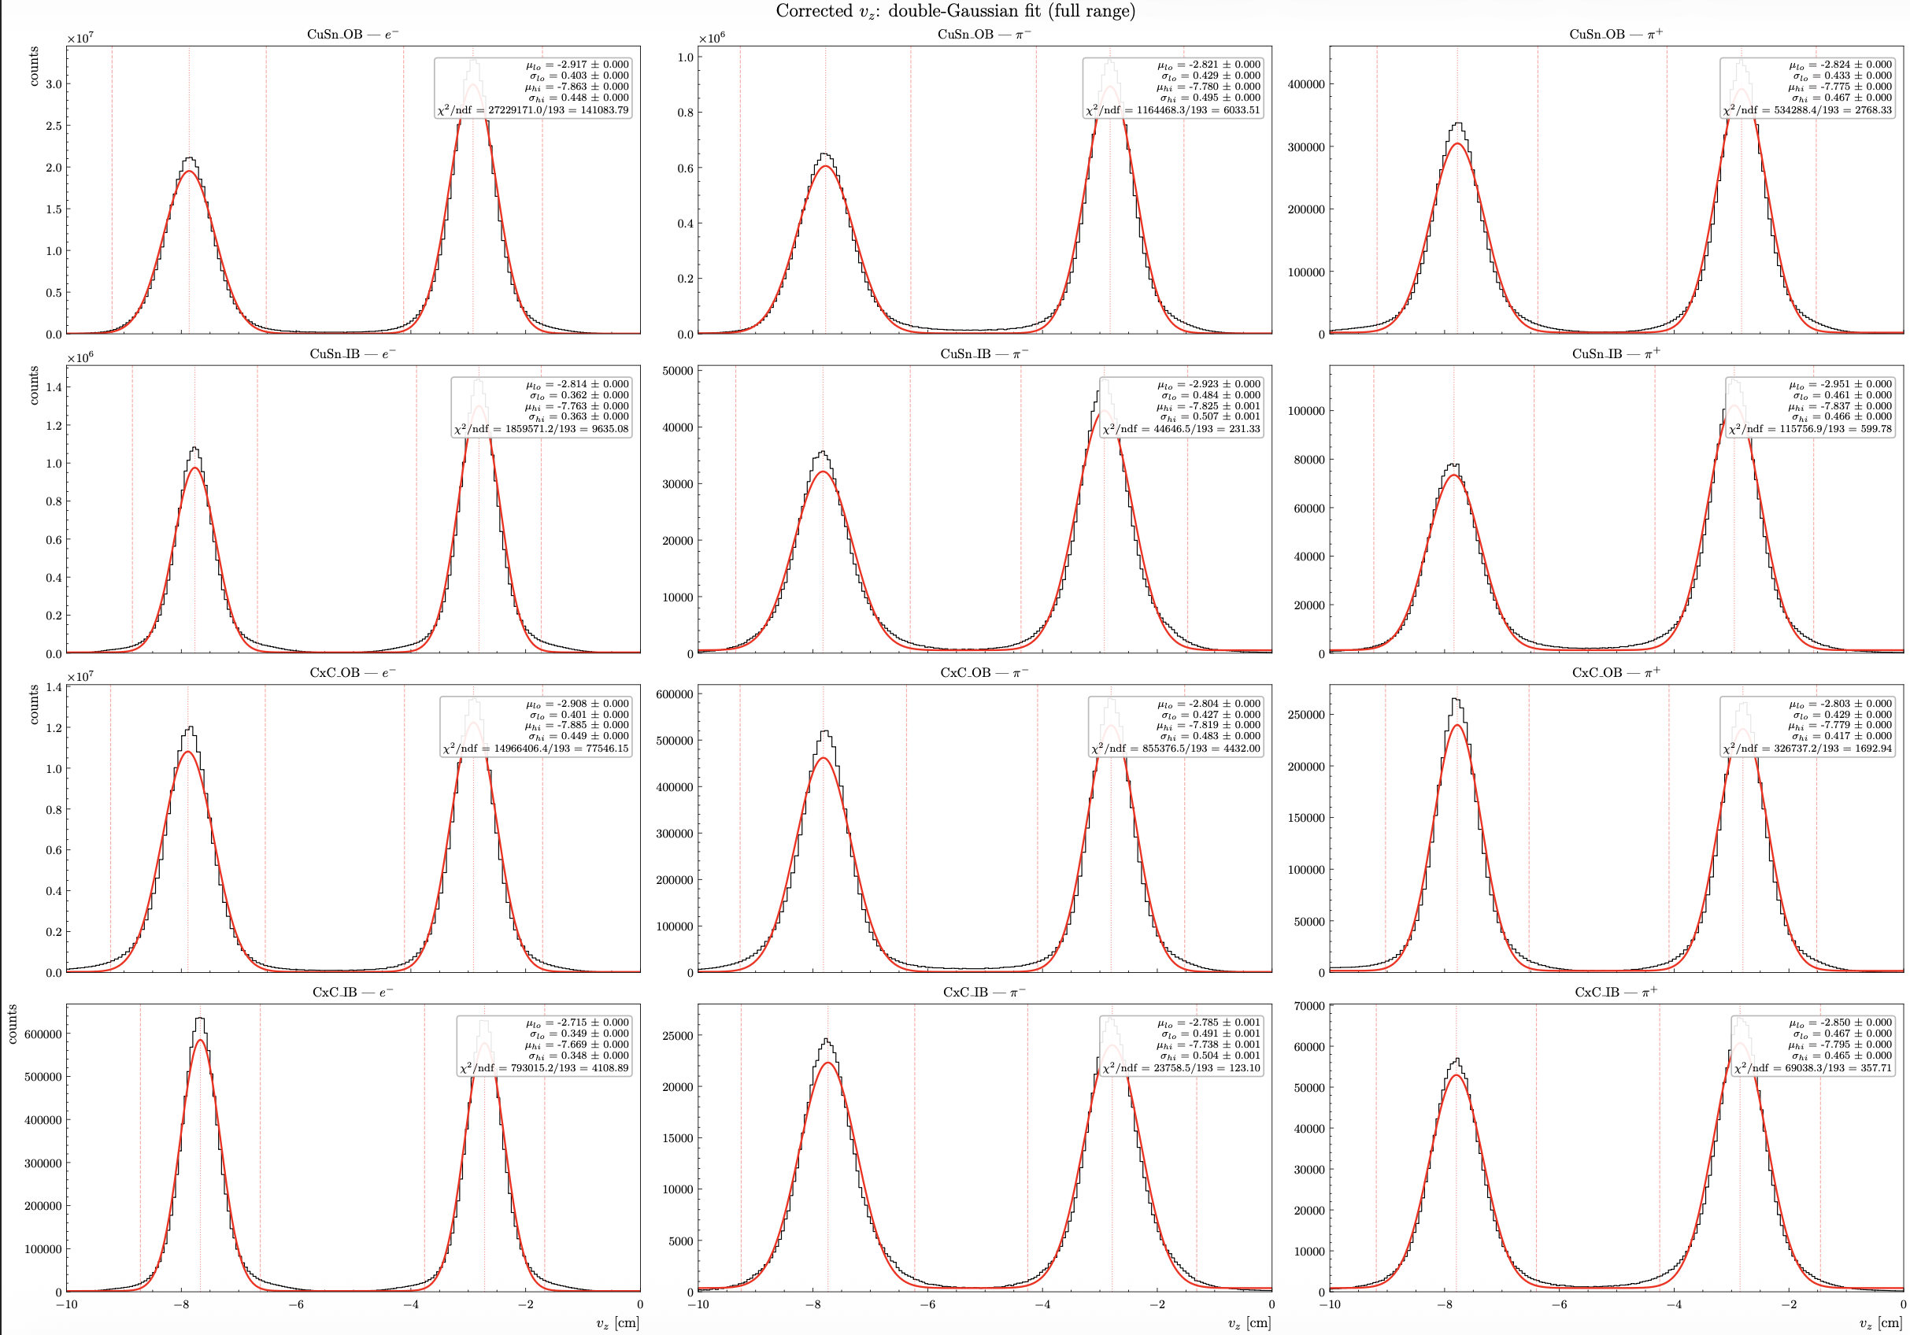
RG-D: Vz correction
Now we can try to fit the corrected distributions:

Slide 12
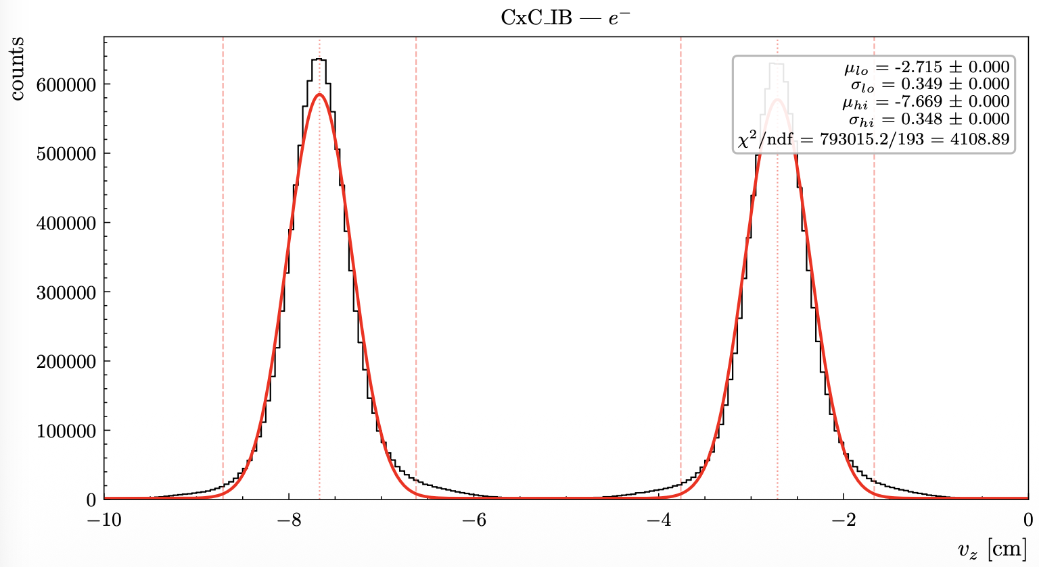
RG-D: Vz correction
Now we can try to fit the corrected distributions:
Fit with two gaussian distribution
The dotted lines are ±3σ for each peak
The double gaussians have some issue fit the top of the peaks

Slide 13
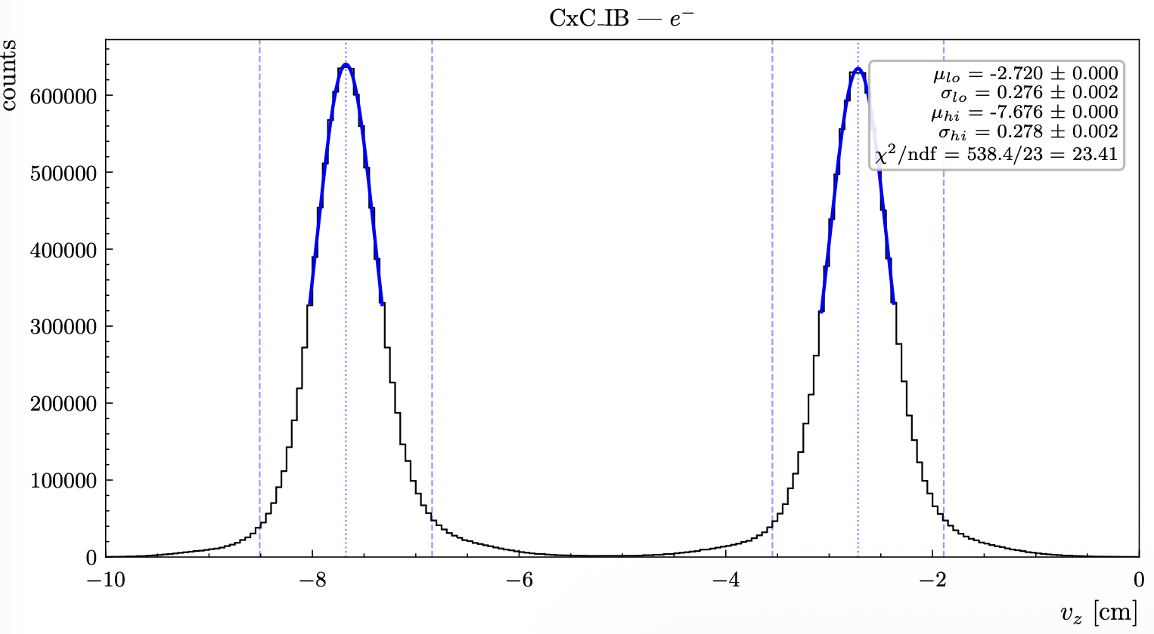
RG-D: Vz correction
Now we can try to fit the corrected distributions:
Can try fitting jus the top of the peaks and check for any difference

Slide 14
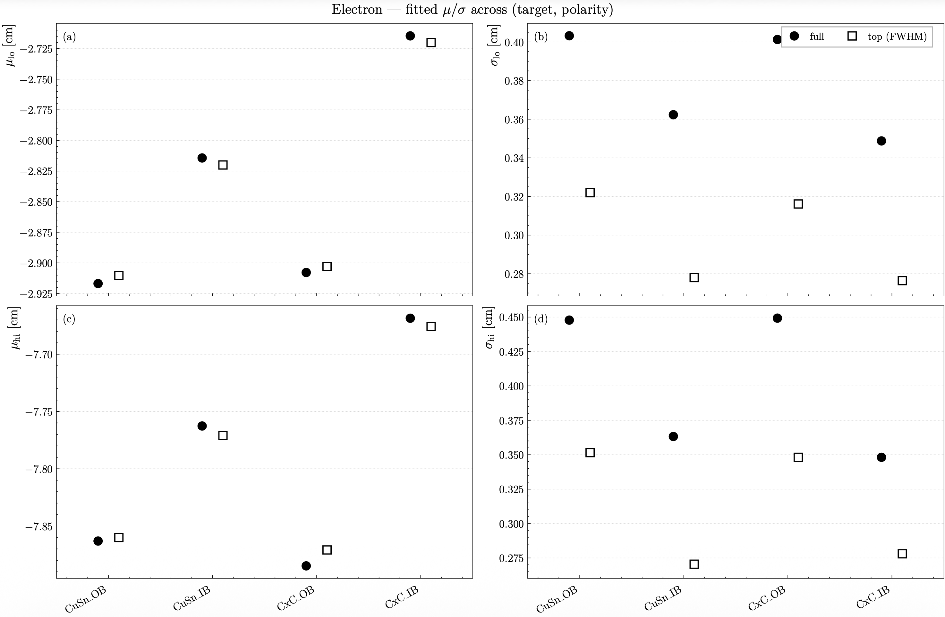
RG-D: Vz correction
Now we can try to fit the corrected distributions:
Can try fitting jus the top of the peaks and check for any difference
Only for electron
Mean of the peaks is consistent but as expected the sigma change a lot

Slide 15
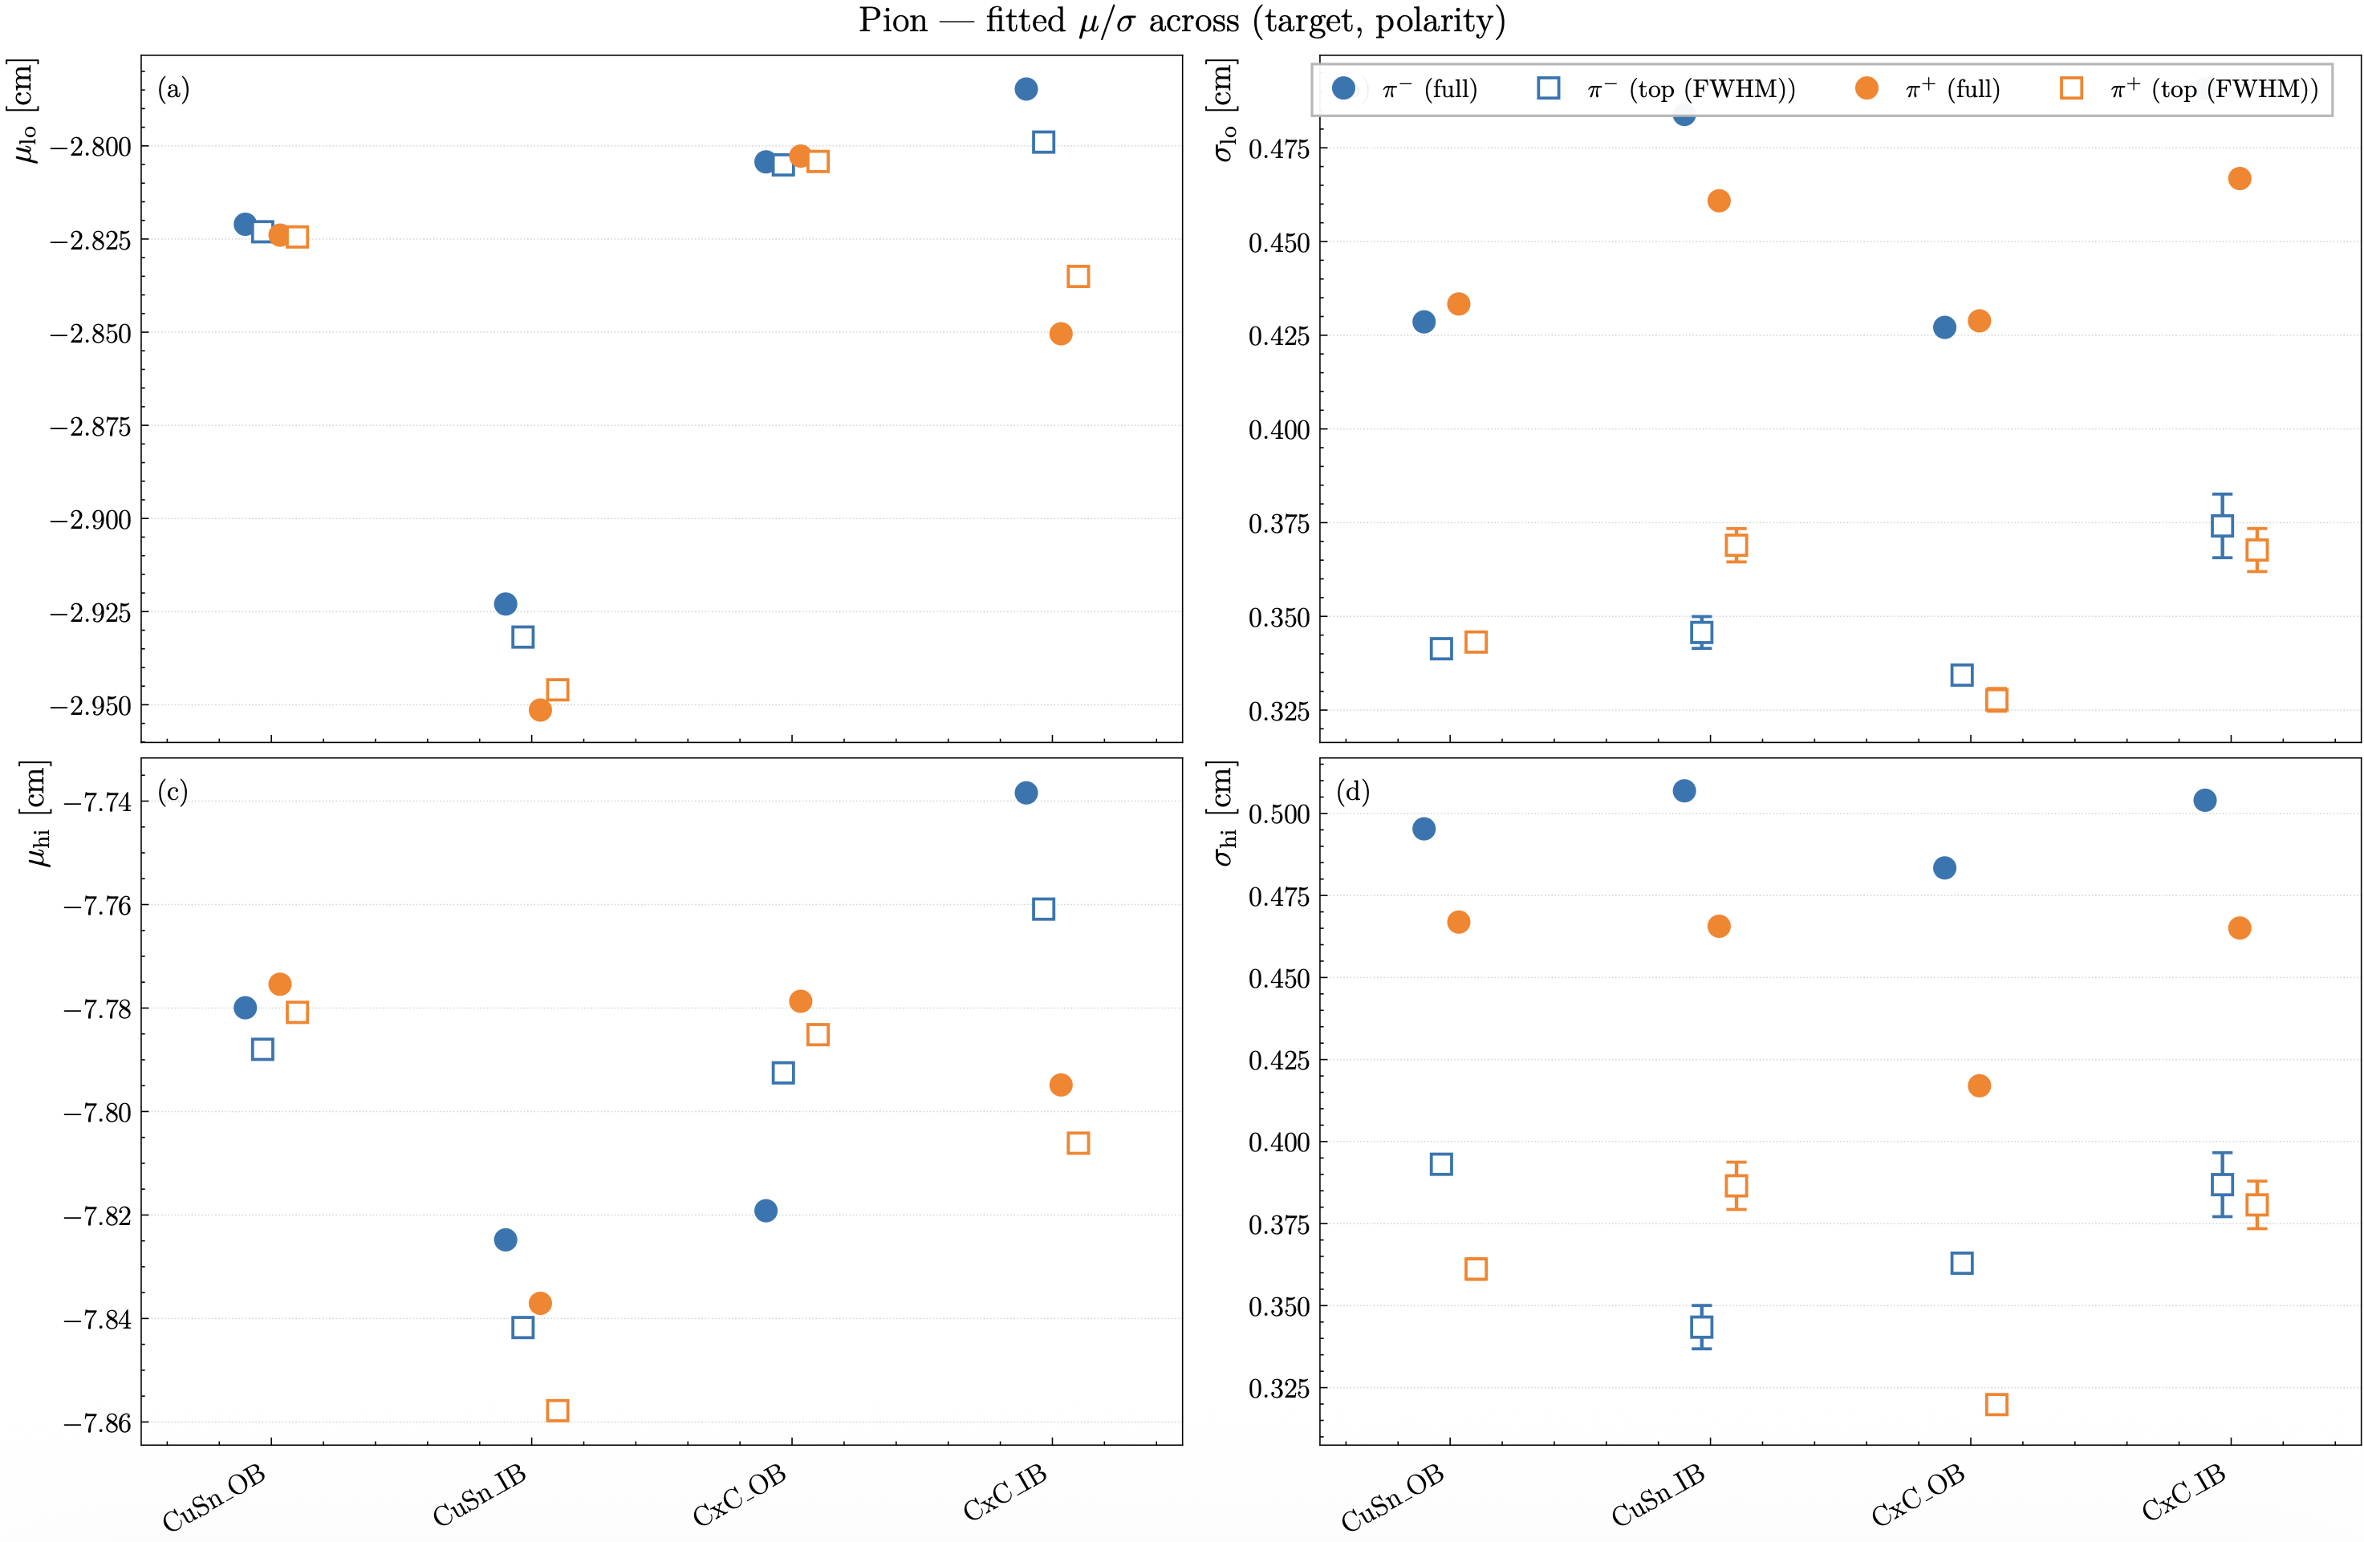
RG-D: Vz correction
Now we can try to fit the corrected distributions:
Can try fitting jus the top of the peaks and check for any difference
Now pions
Mean of the peaks is consistent but as expected the sigma change a lot

Slide 16
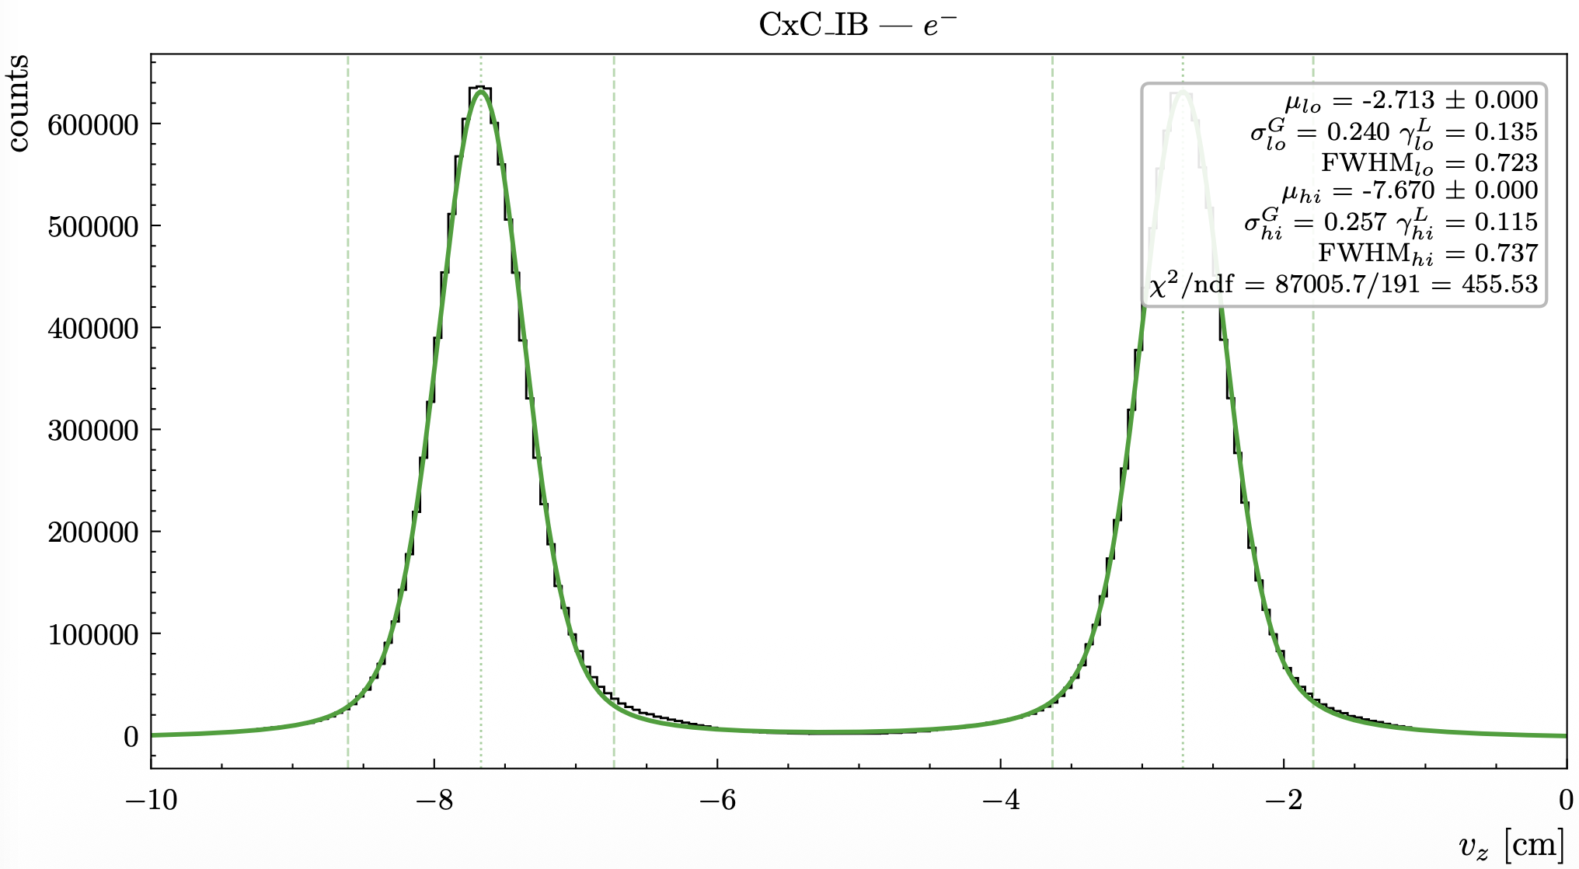
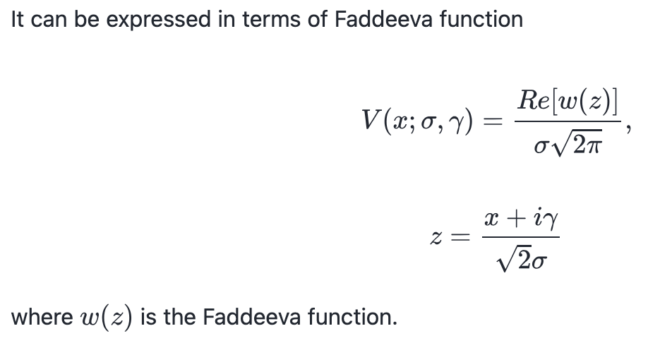
RG-D: Vz correction
Now we can try to fit the corrected distributions:
Can try fitting with Voigt distribution:
It is the convolution of a Gaussian and a Lorentzian distribution
Much better

Slide 17
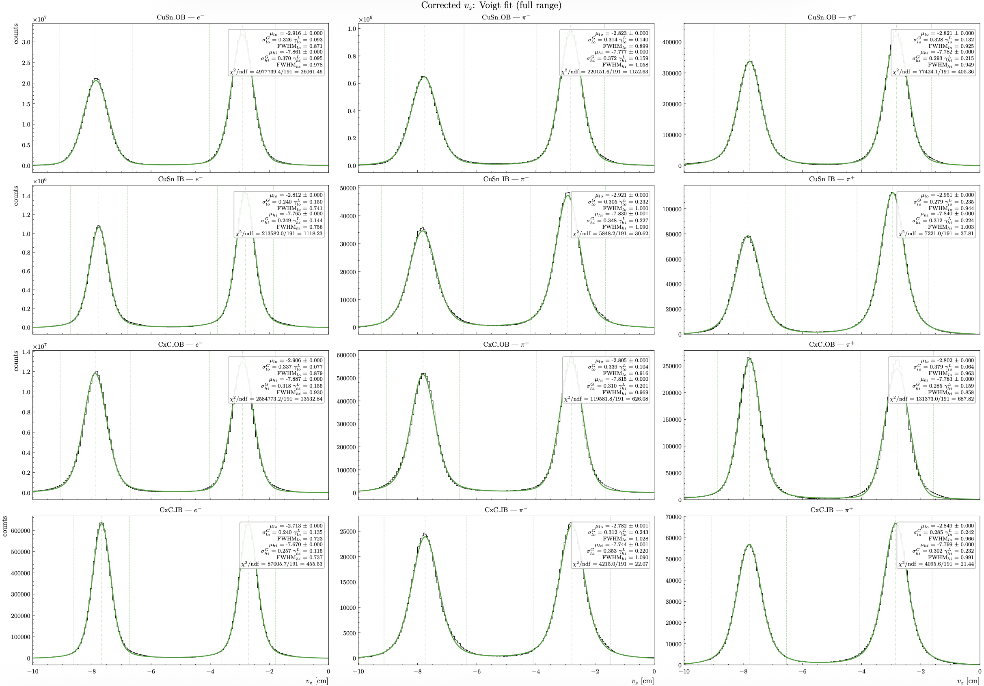
RG-D: Vz correction
Now we can try to fit the corrected distributions:
Can try fitting with Voigt distribution
Better for all

Slide 18
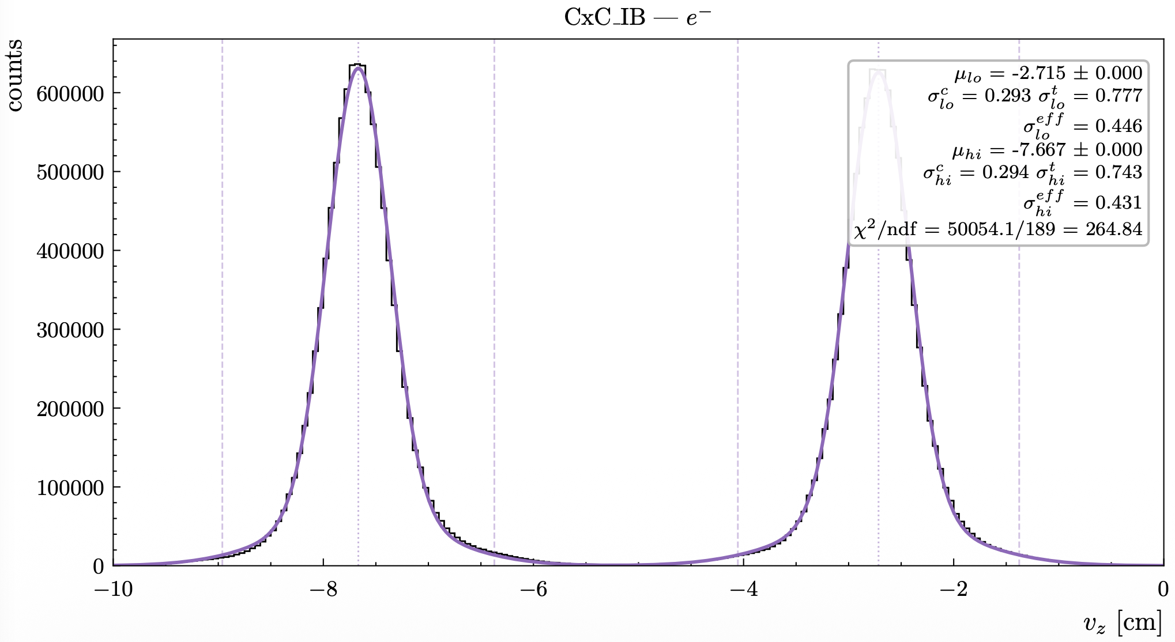
RG-D: Vz correction
Now we can try to fit the corrected distributions:
Can try fitting with double Gaussians (core+tail):
Sum of two gaussians
Much better

Slide 19
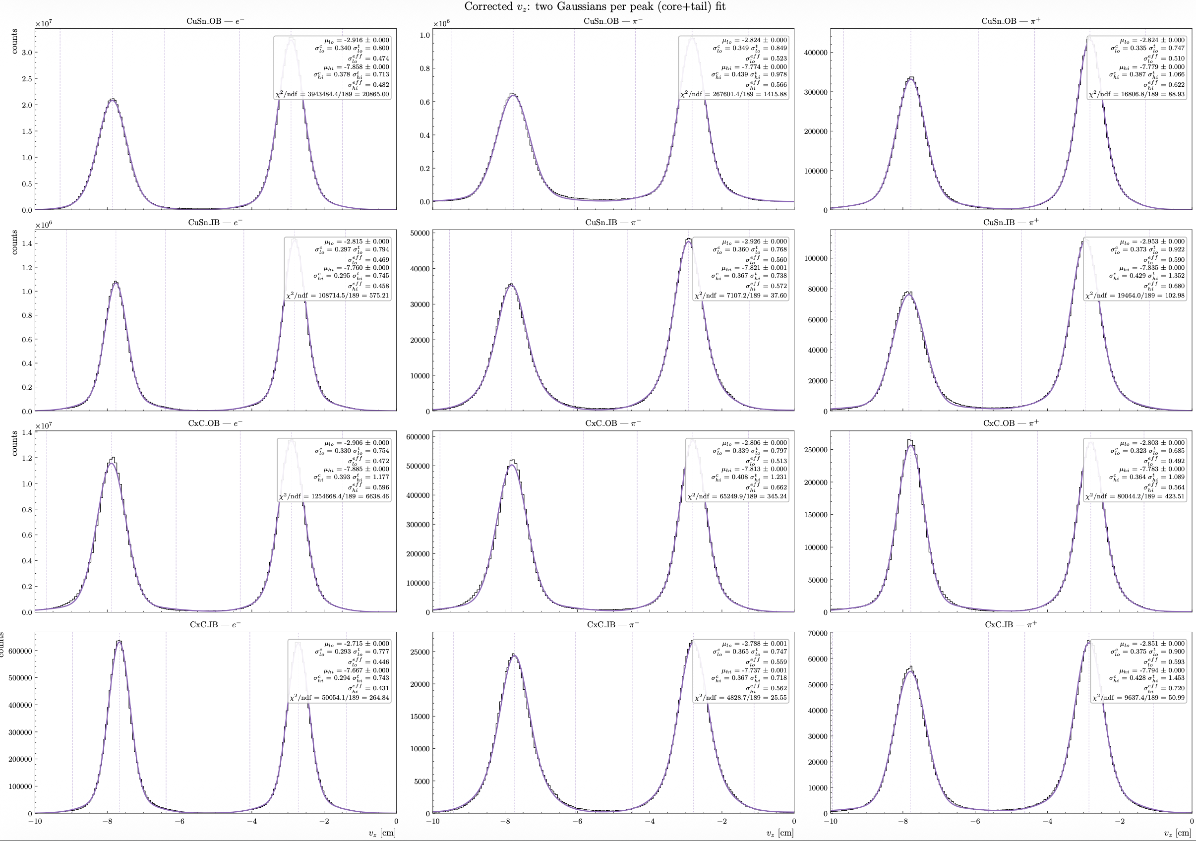
RG-D: Vz correction
Now we can try to fit the corrected distributions:
Can try fitting with double Gaussians (core+tail):
Sum of two gaussians
Much better

Slide 20
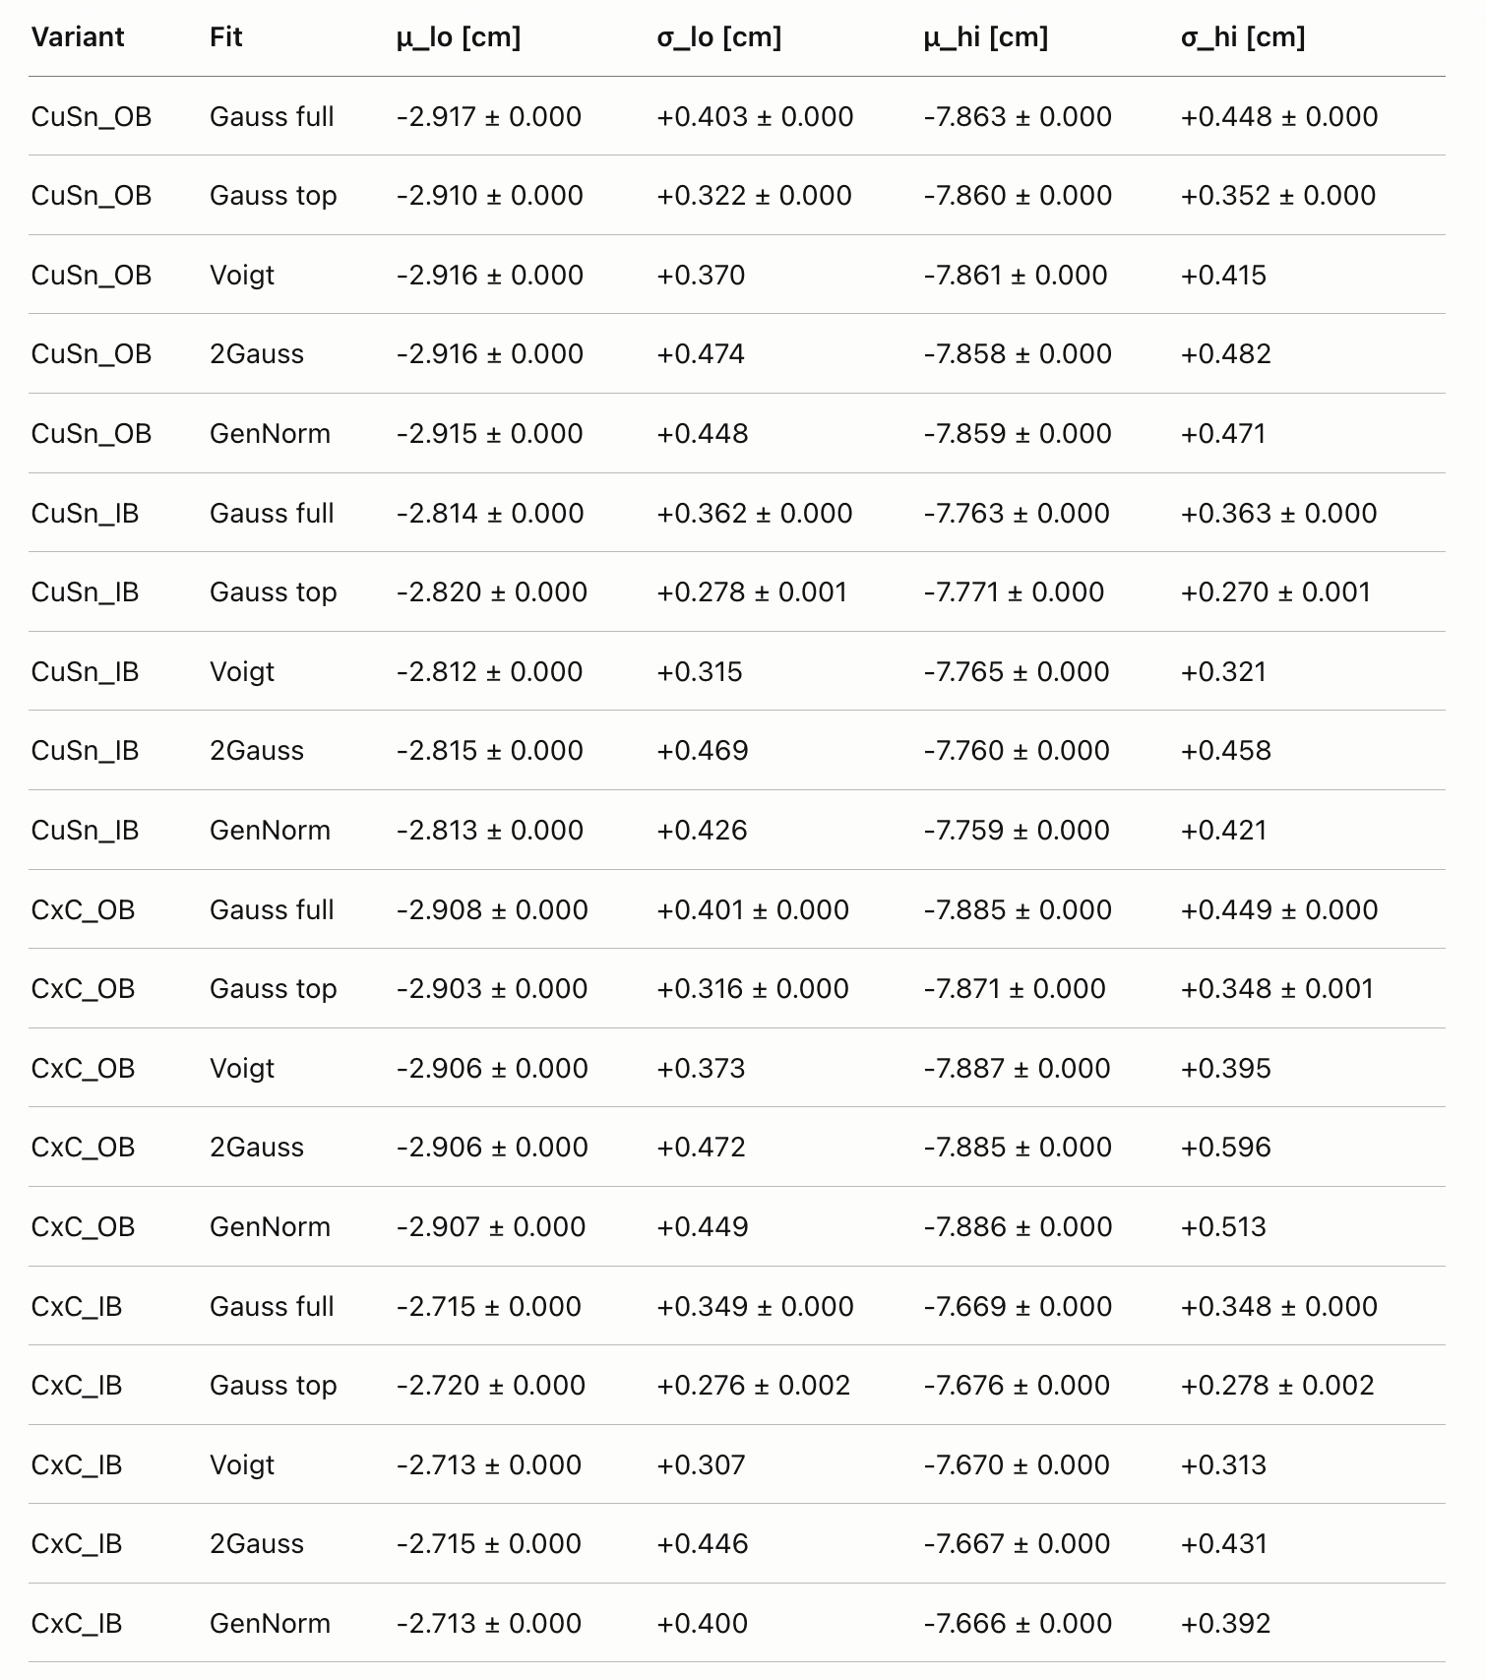
RG-D: Vz correction
Very similar between Voigt and double Gaussian:
But Voigt have less free parameters (5) compared to double Gaussians (6)
So, I would choose Voigt for the fitting

Slide 21
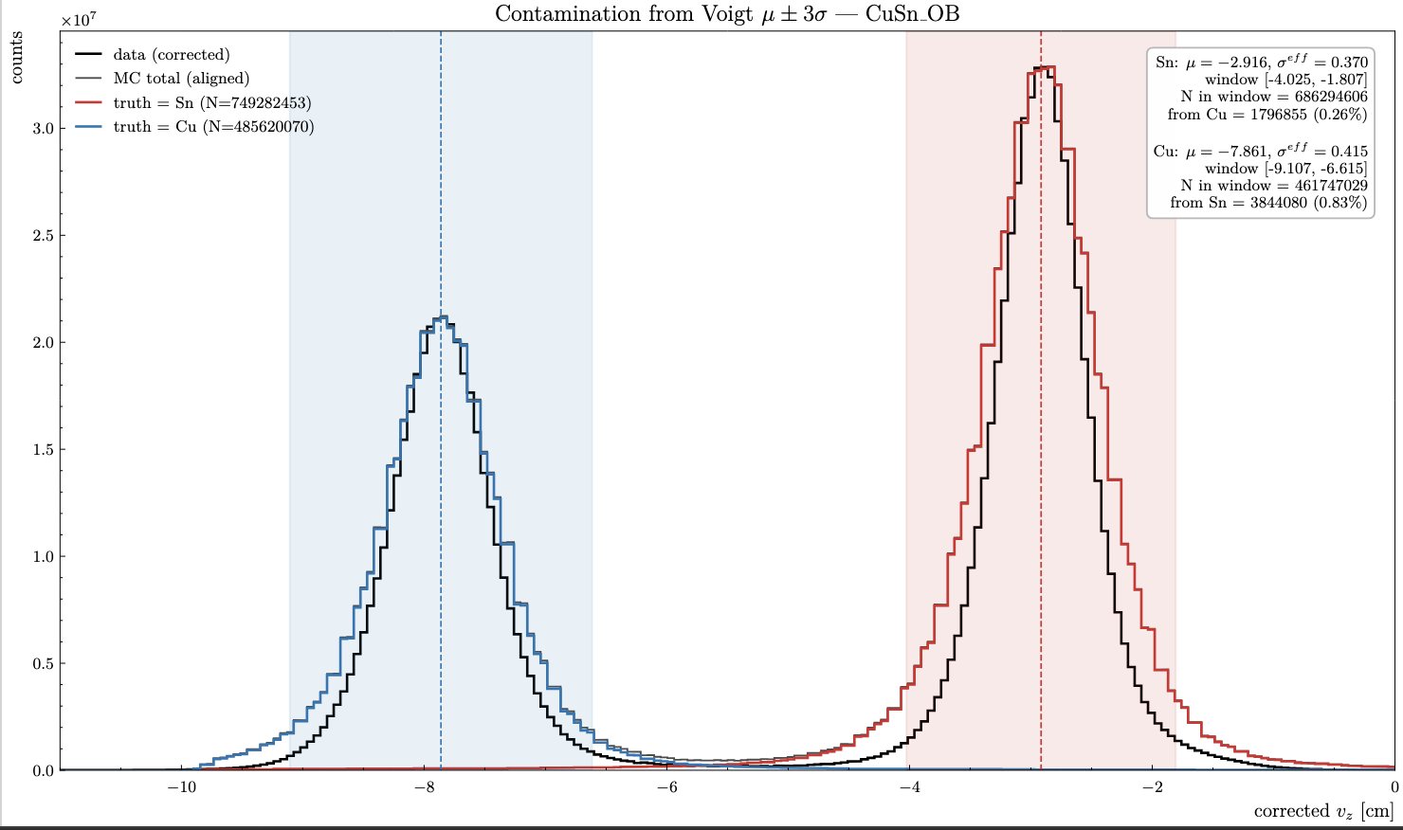
RG-D: Vz Contamination
After the correction simulation and data are much closer:
We can use simulation to estimate the Cu contamination in the Sn target and Sn contamination in Cu target:
Cu contamination in the Sn target: 0.26%
Sn contamination in the Cu target: 0.83%
If use ±3σ from the Voigt fit

Slide 22
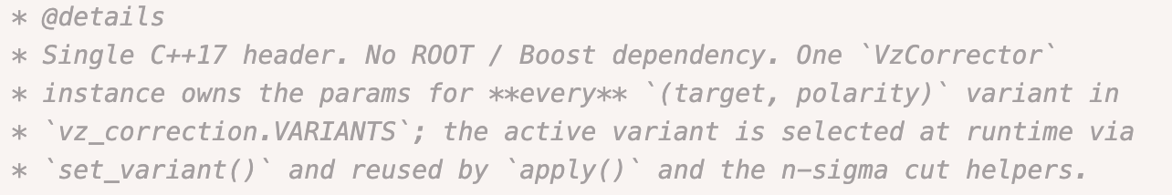
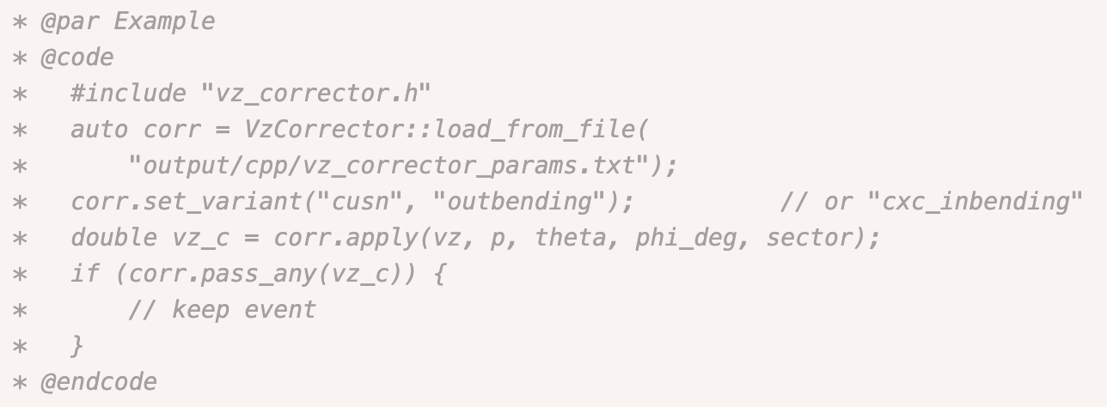
RG-D: Vz correction
Develop C++ code to apply correction and a ±3σ:
Use a txt file with the value of the third order polynomial function for each (p,θ,φ,sector)
And create C++ code to use it: (600 lines with comments)

Slide 23

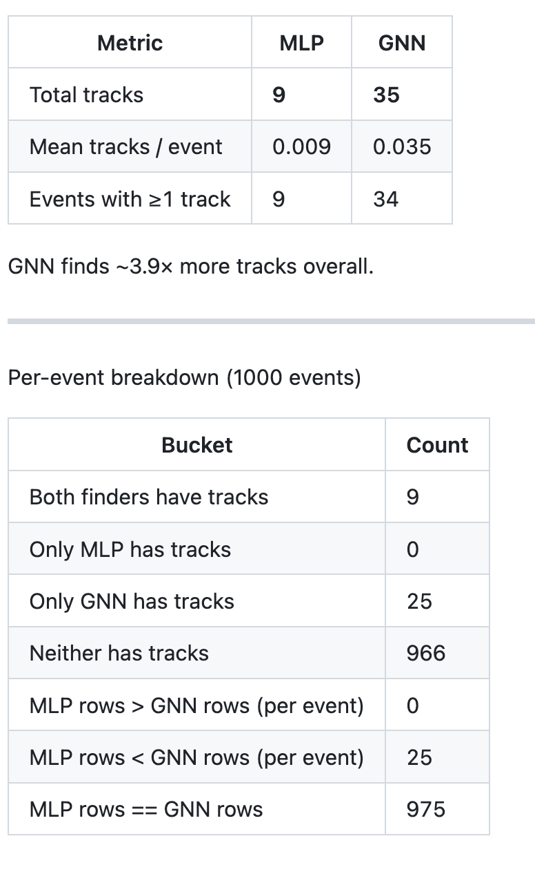
RG-L/ALERT: GNN Implementation
Work on the pull request of the GNN in COATJAVA:

Slide 24
Other things
I will be on shift: today, tomorrow and Thursday
Nathan and Chris asked me to give a presentation during the next software metting (Thursday in two week 05/14) about my multithreading class in HIPO

Slide 25
To do list
RG-D:
Write the correction in the common analysis note
Will simulate CuSn inbending and compare to data (use it for contamination study too), same for CxC and for pions
Get the multiplicity ratio for π⁰ after the event mixing subtraction
Continue the work on p_{T} broadening and cos and sin φ_{h} extraction
Work on the binning
Radiative and acceptance correction
Background for ρ⁰ with simulation for CT analysis
ALERT:
Continue the work on Graph Neural Network: implementation in coatjava, make a pull request
Redo the efficiency study on elastic data but use the polar angle of the electron instead of the momentum for calculation of the predicted deuterium

