Slide 1
Group meeting
Mathieu Ouillon (Mississippi State University)
05/12/26

Slide 2
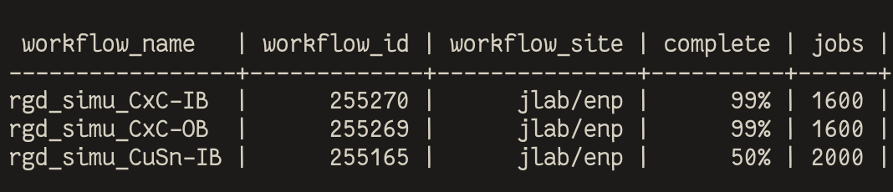
RG-D: Vz correction
Launched new simulation to compare data and MC, and estimate contamination
CuSn IB, CxC OB/IB
I will be able to analyse them this week, both electron and pion 4/5 M events per configuration

Slide 3
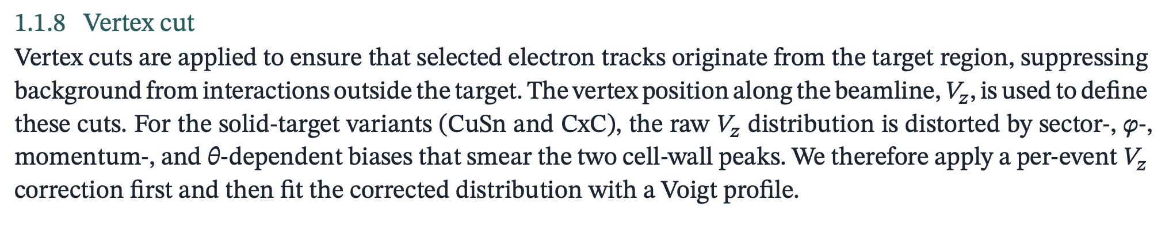
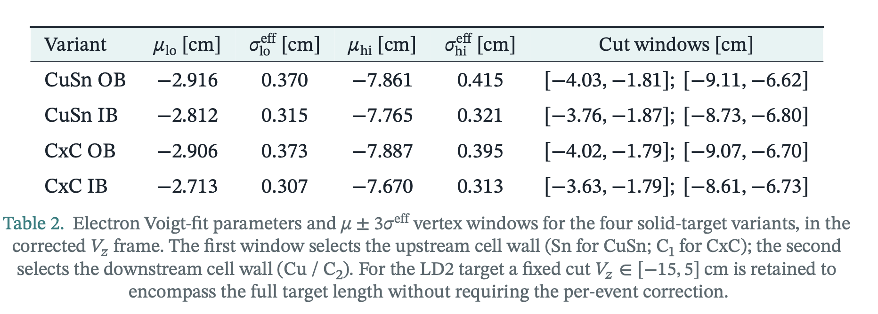
RG-D: Vz correction
Worked on the common analysis note to write about the new correction and cuts

Slide 4
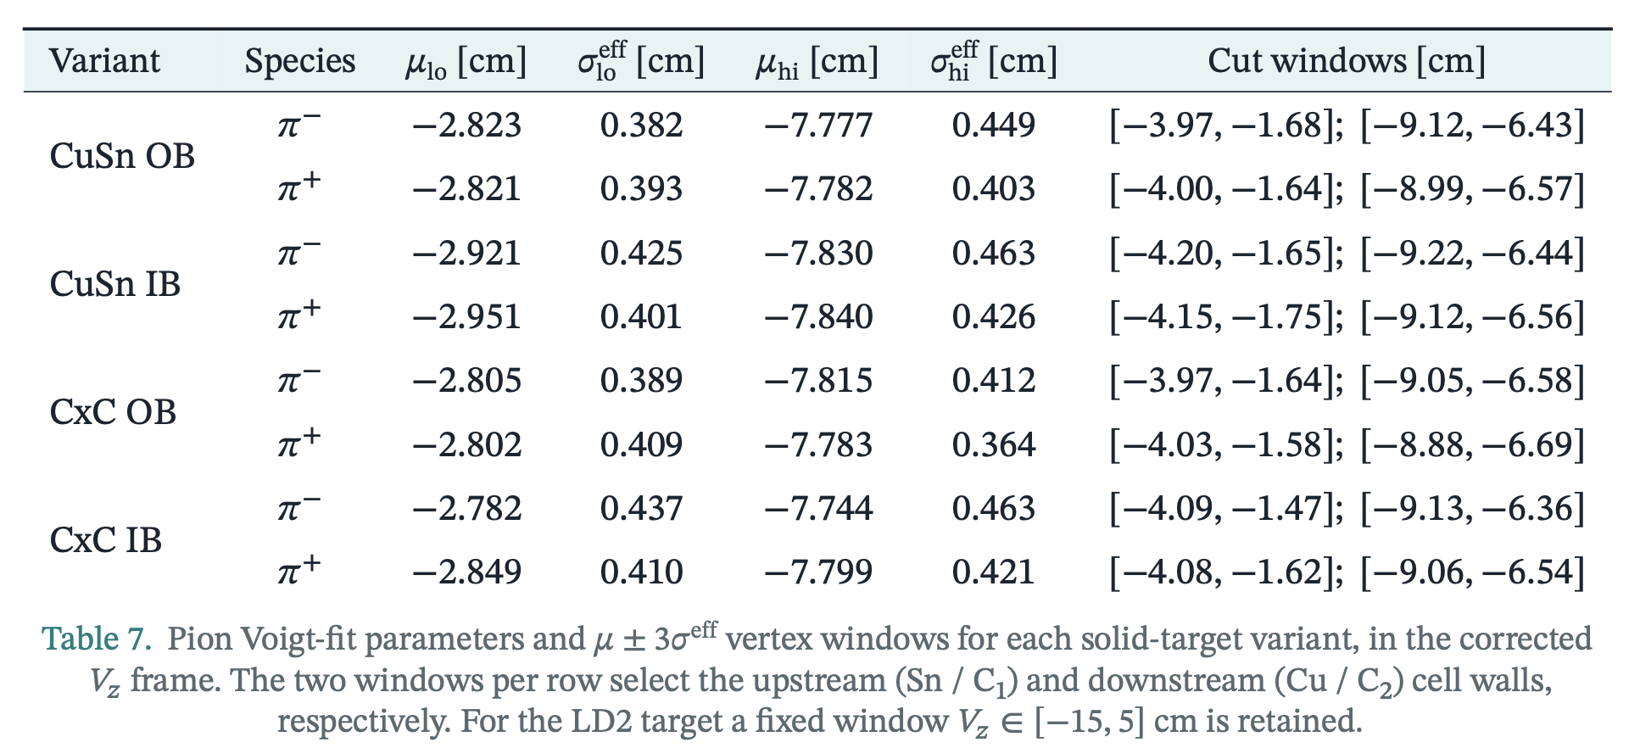
RG-D: Vz correction
Same for pions

Slide 5
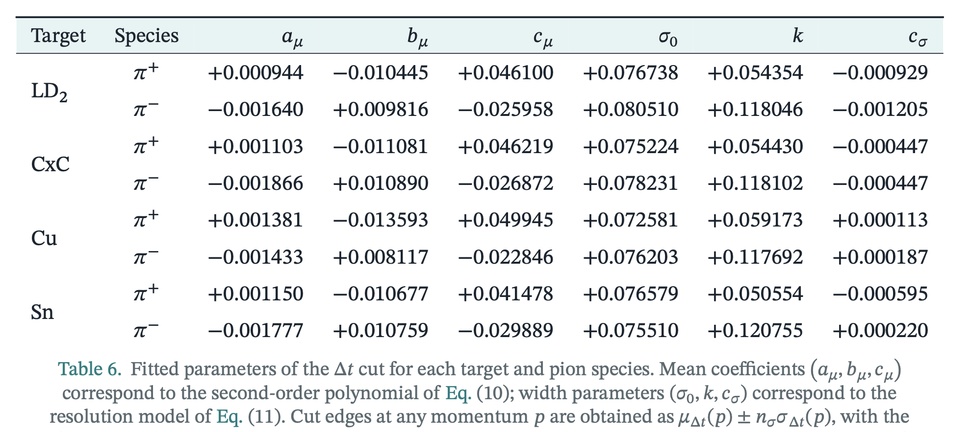
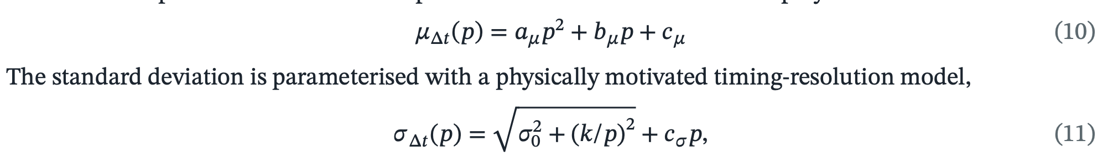
RG-D: Vz correction
I have also added the Δt vs p cut for pions:

Slide 6
RG-D: π⁰ multiplicity and p_{T} broadening
I started to work again on my π⁰ analysis, extracting the multiplicity ratio after background subtraction, extracting p_{T} broadening
Very preliminary, I need to check the code again I may have some bug
Select electron with the standard cuts + new Vz correction
Select photon with PID, AI + beta cut

Slide 7
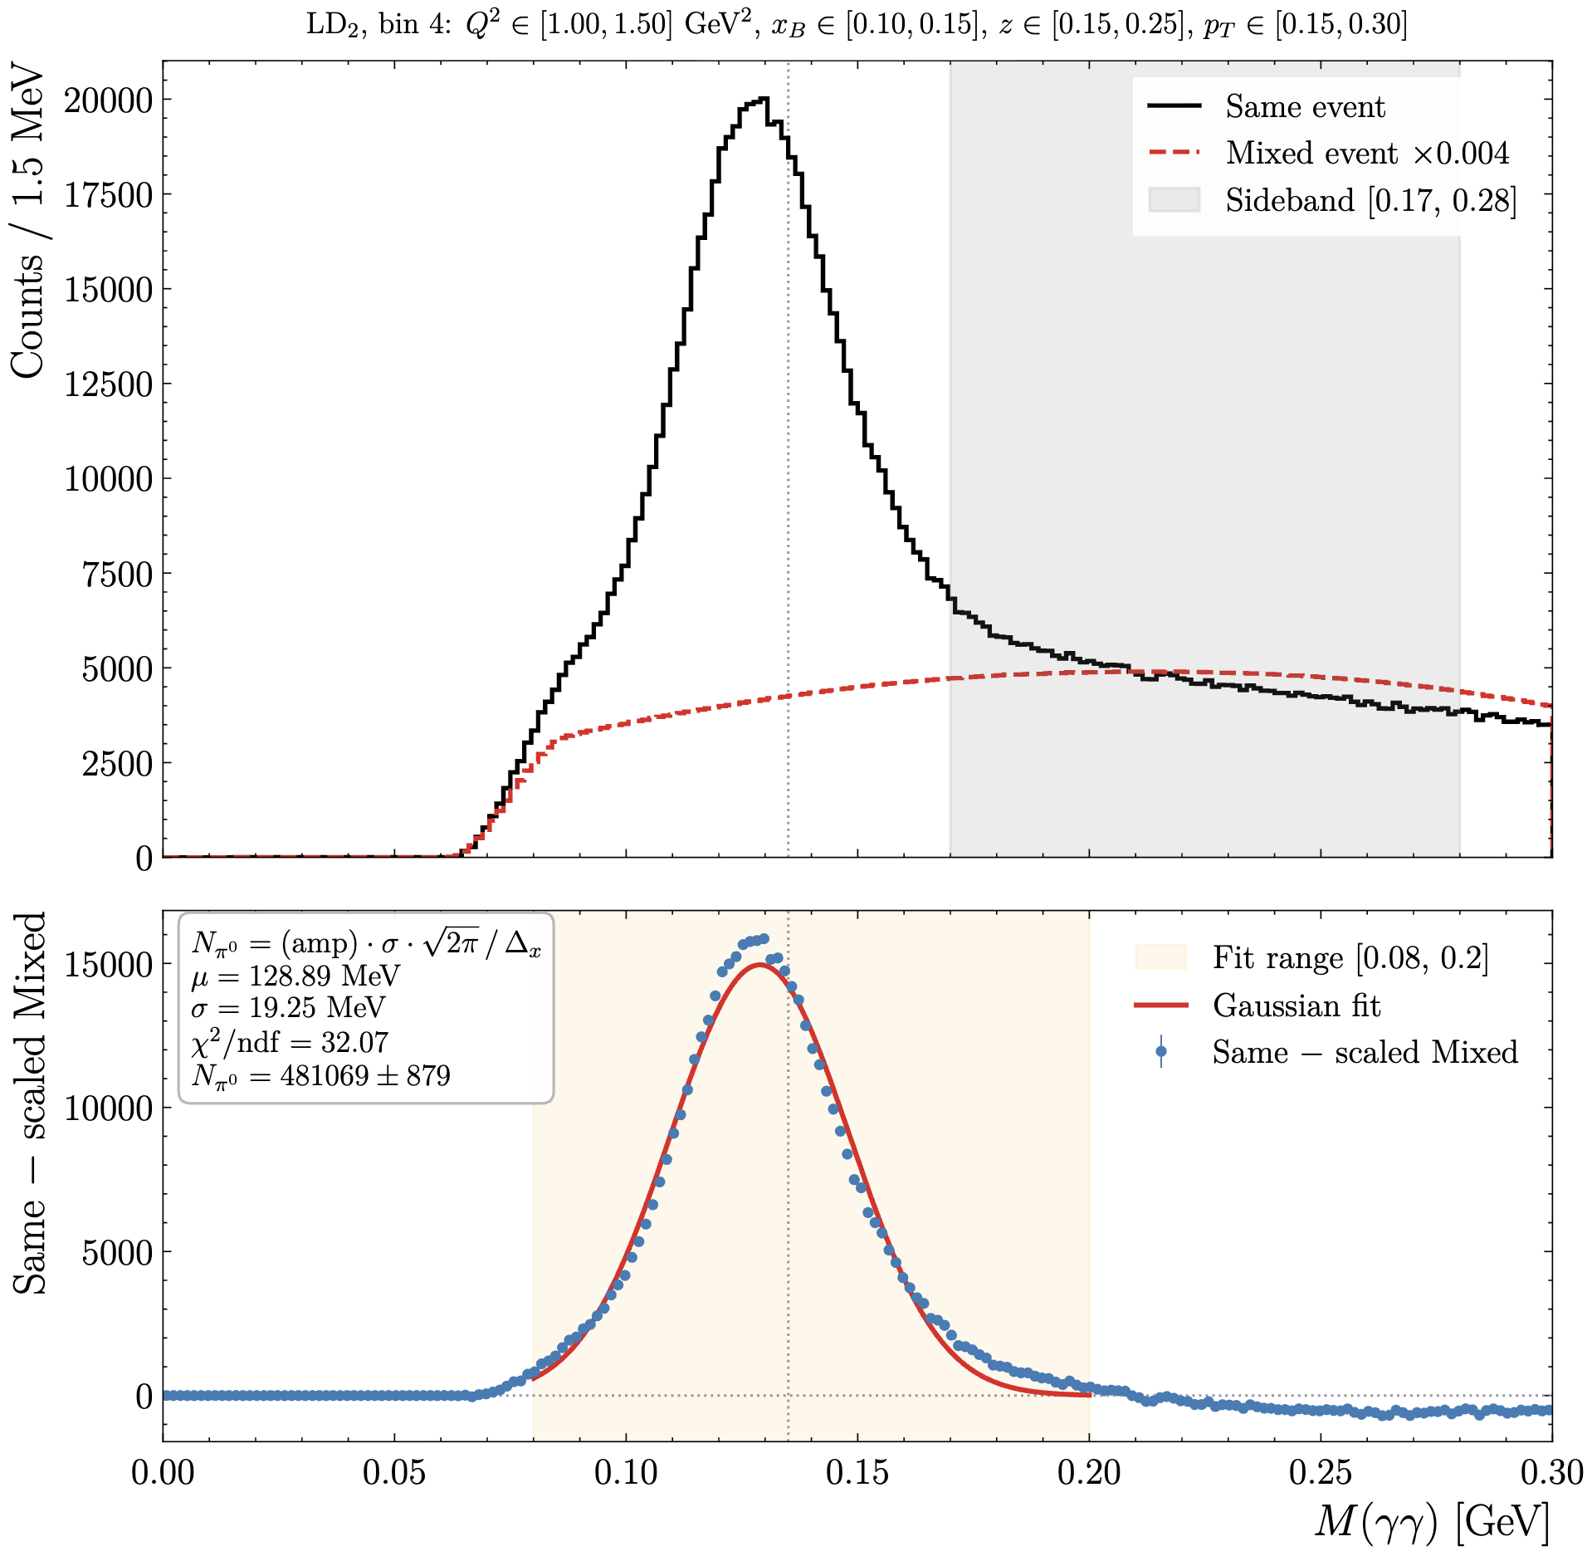
RG-D: π⁰ multiplicity and p_{T} broadening
First step:
Extract the number of π⁰ in each targets (LD2, CxC, Cu and Sn)

Slide 8
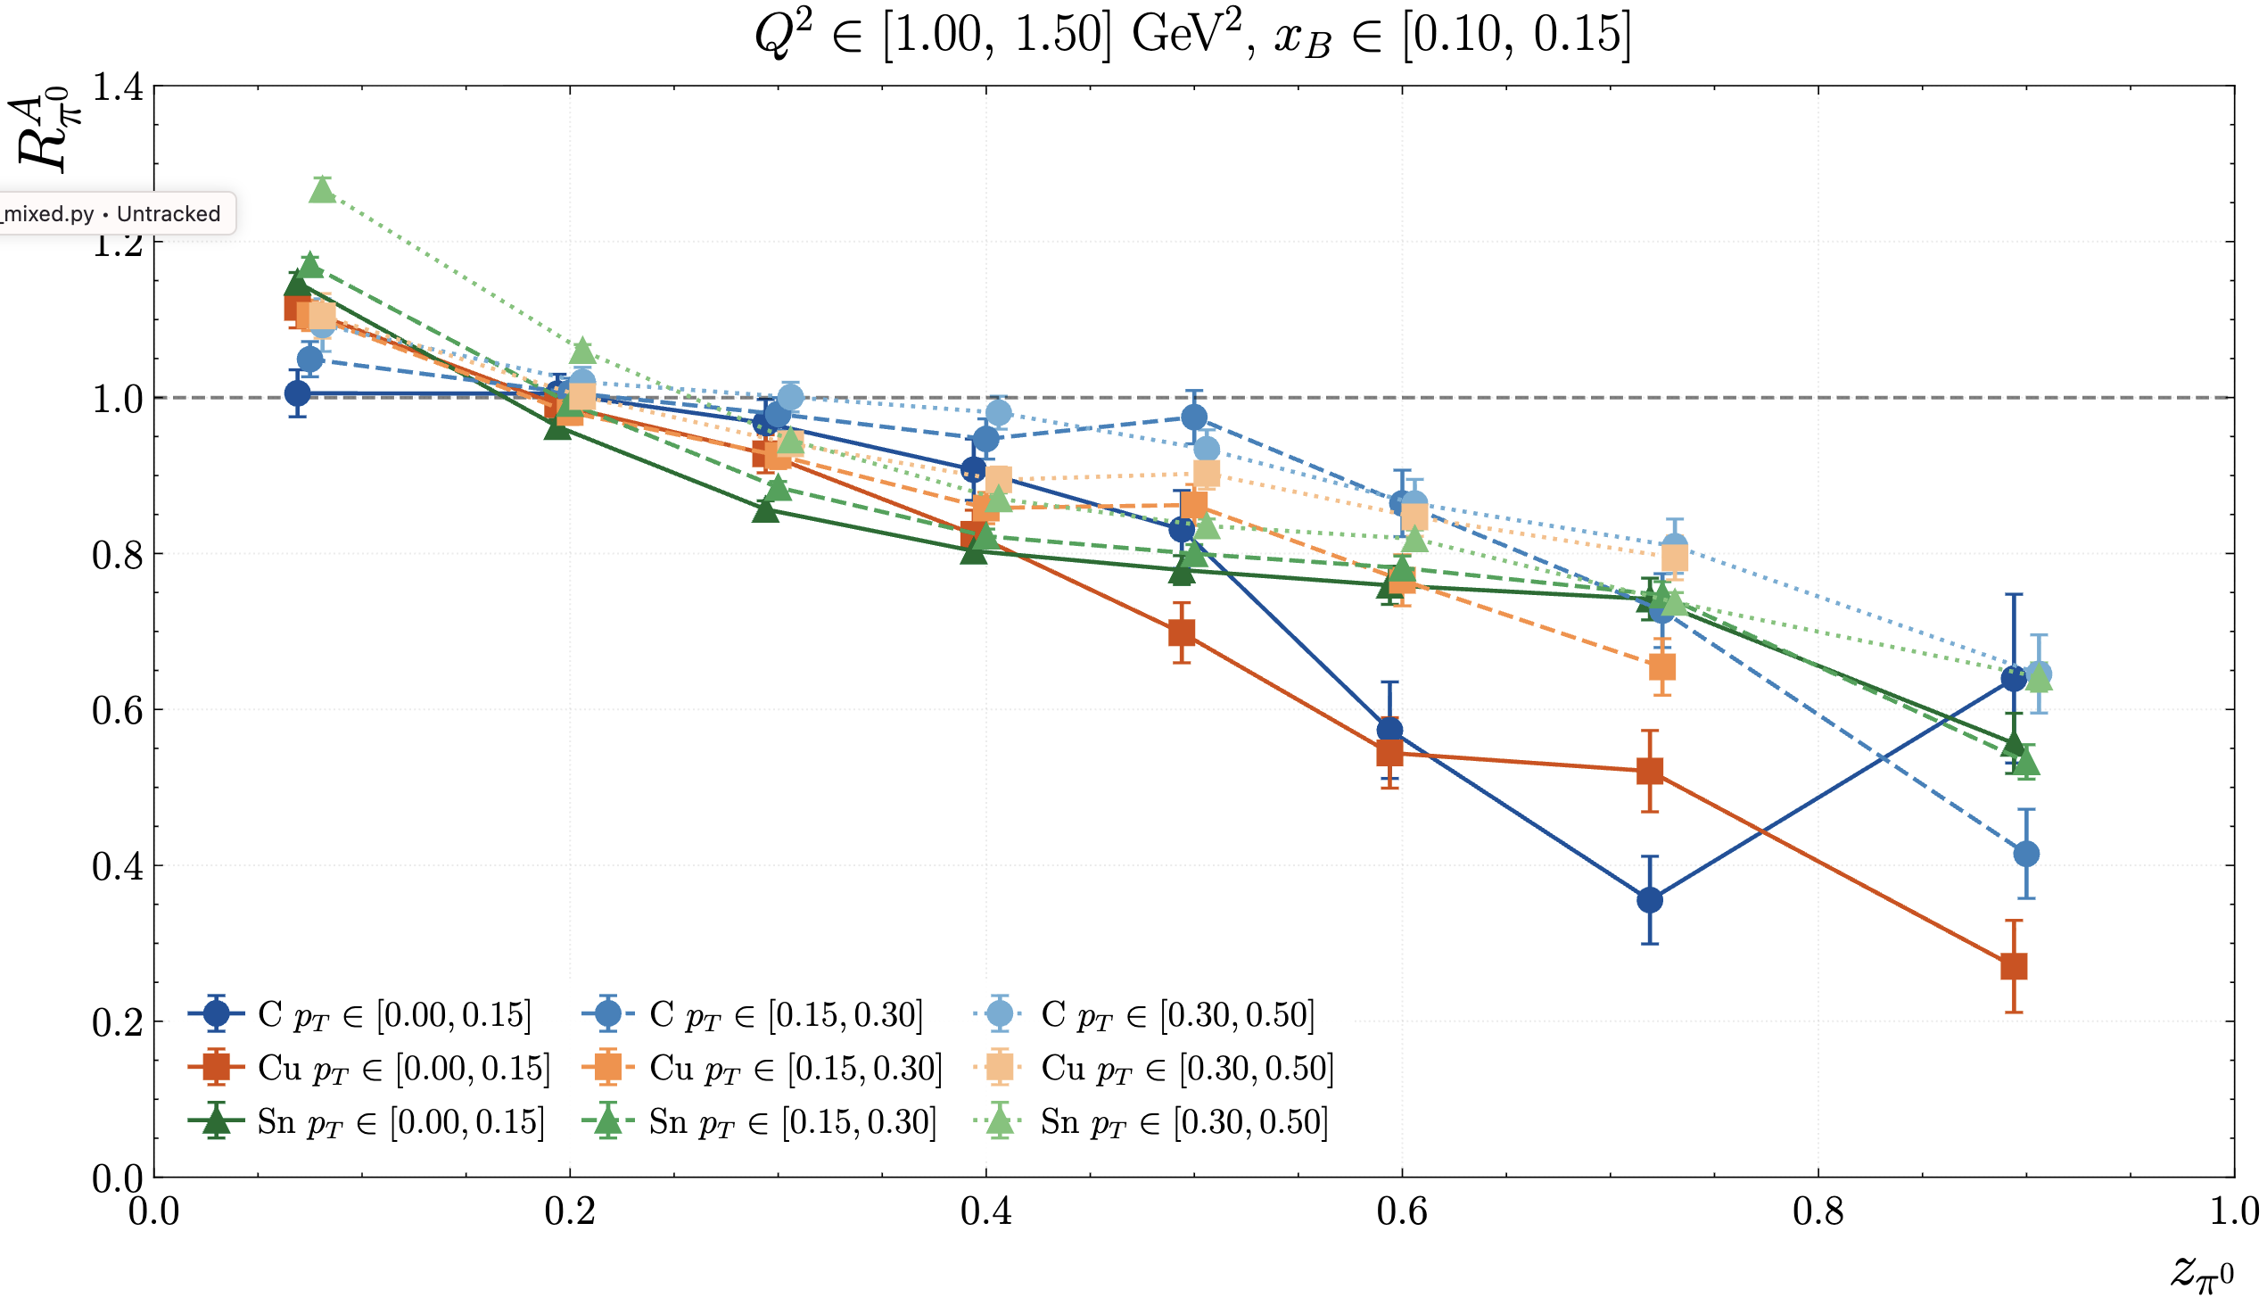

RG-D: π⁰ multiplicity and p_{T} broadening
First step:
Extract the number of π⁰ in each targets (LD2, CxC, Cu and Sn)
Extract multiplicity ratio:

Slide 9
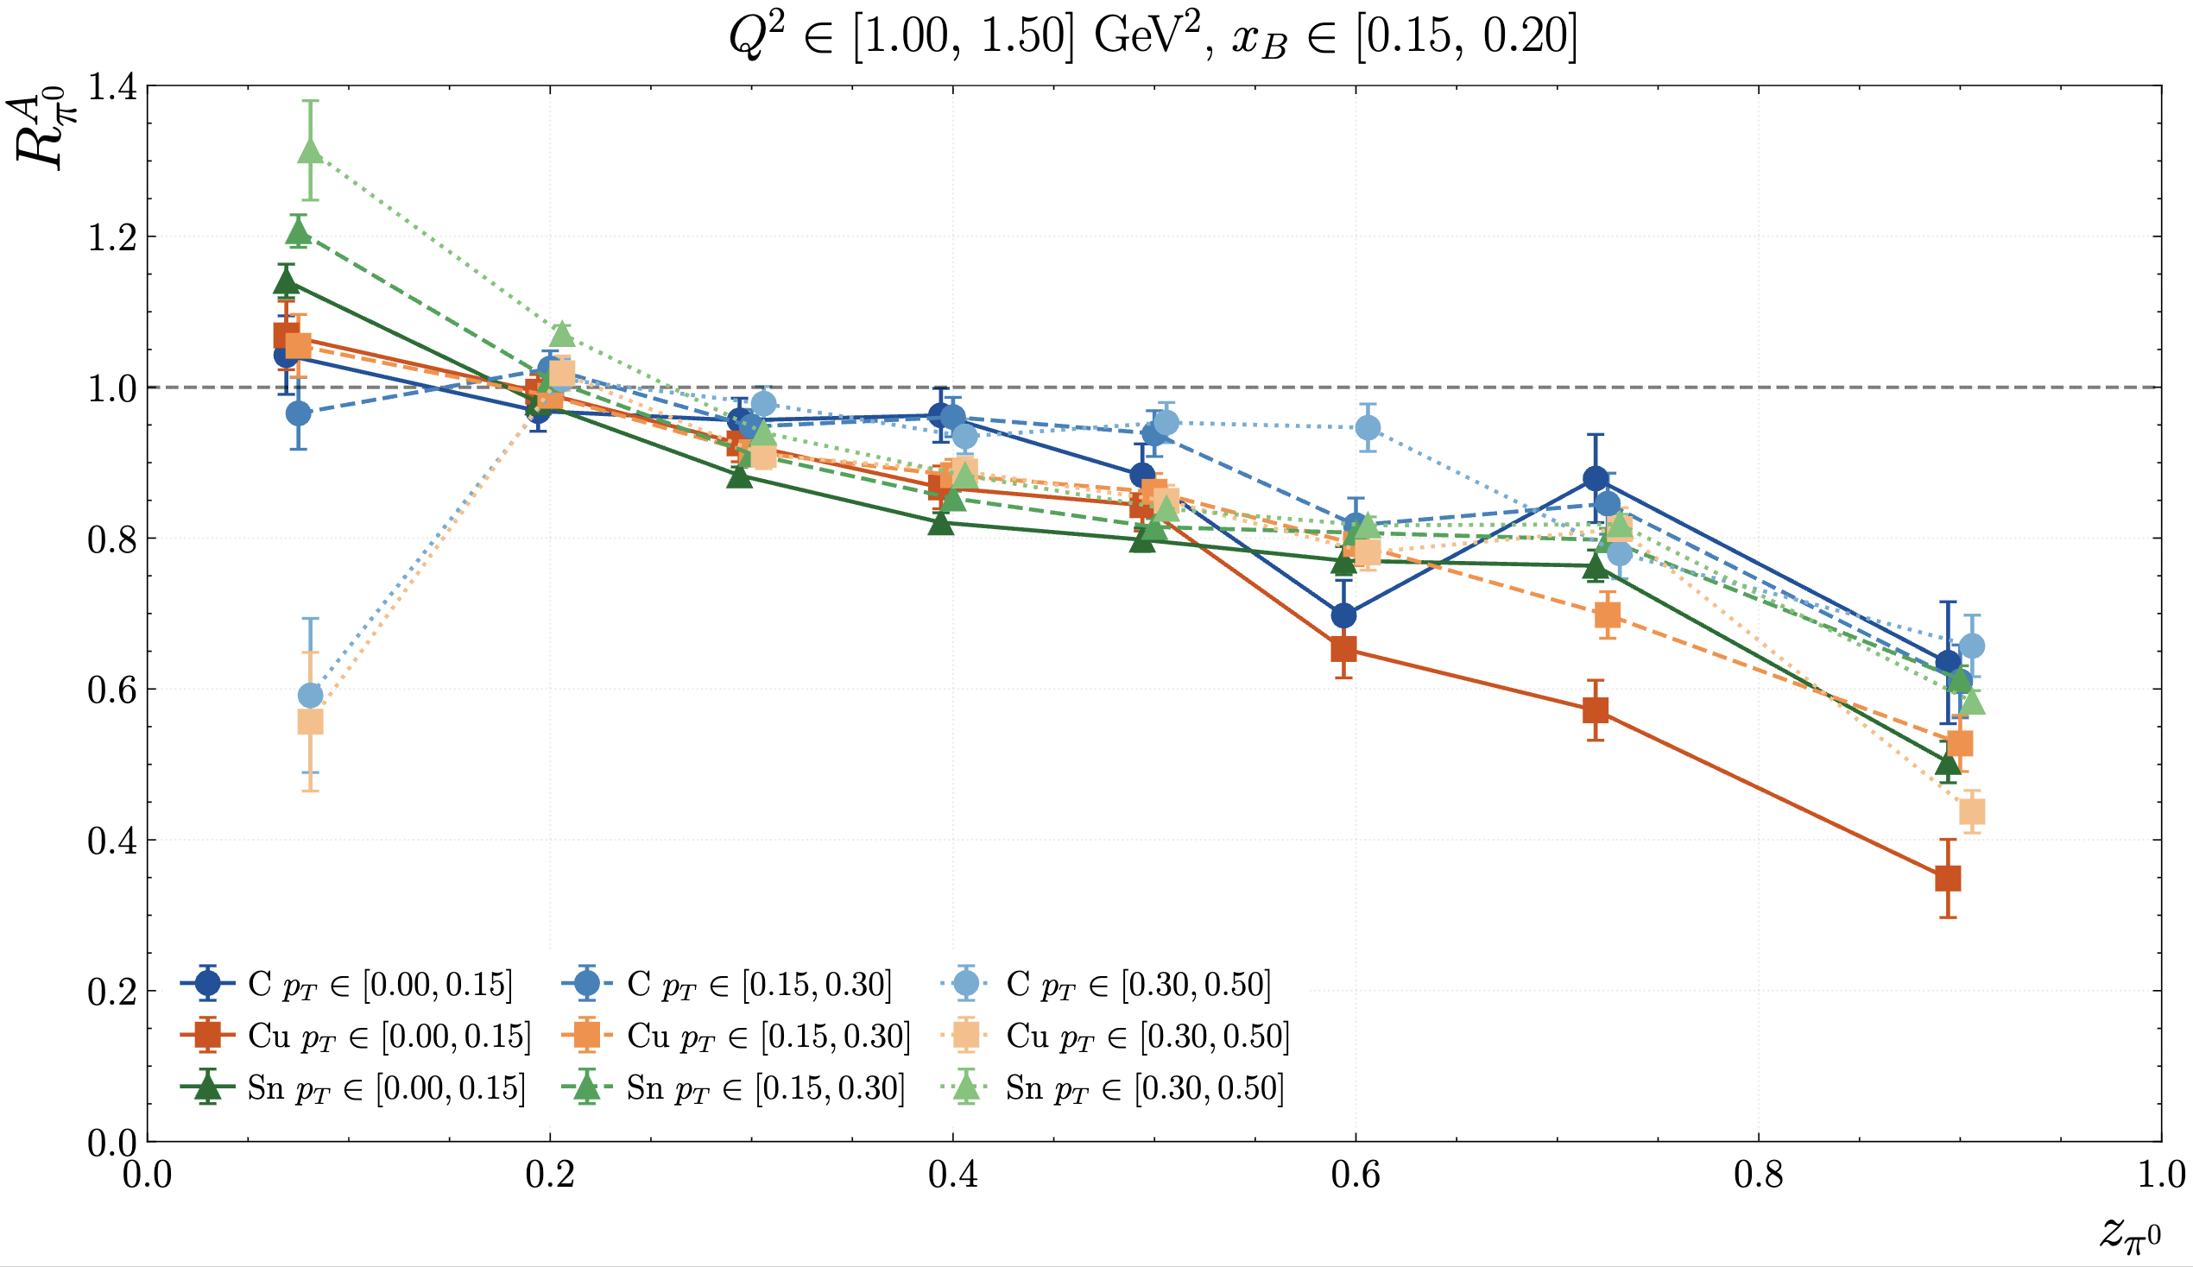
RG-D: π⁰ multiplicity and p_{T} broadening
First step:
Extract the number of π⁰ in each targets (LD2, CxC, Cu and Sn)
Extract multiplicity ratio:

Slide 10
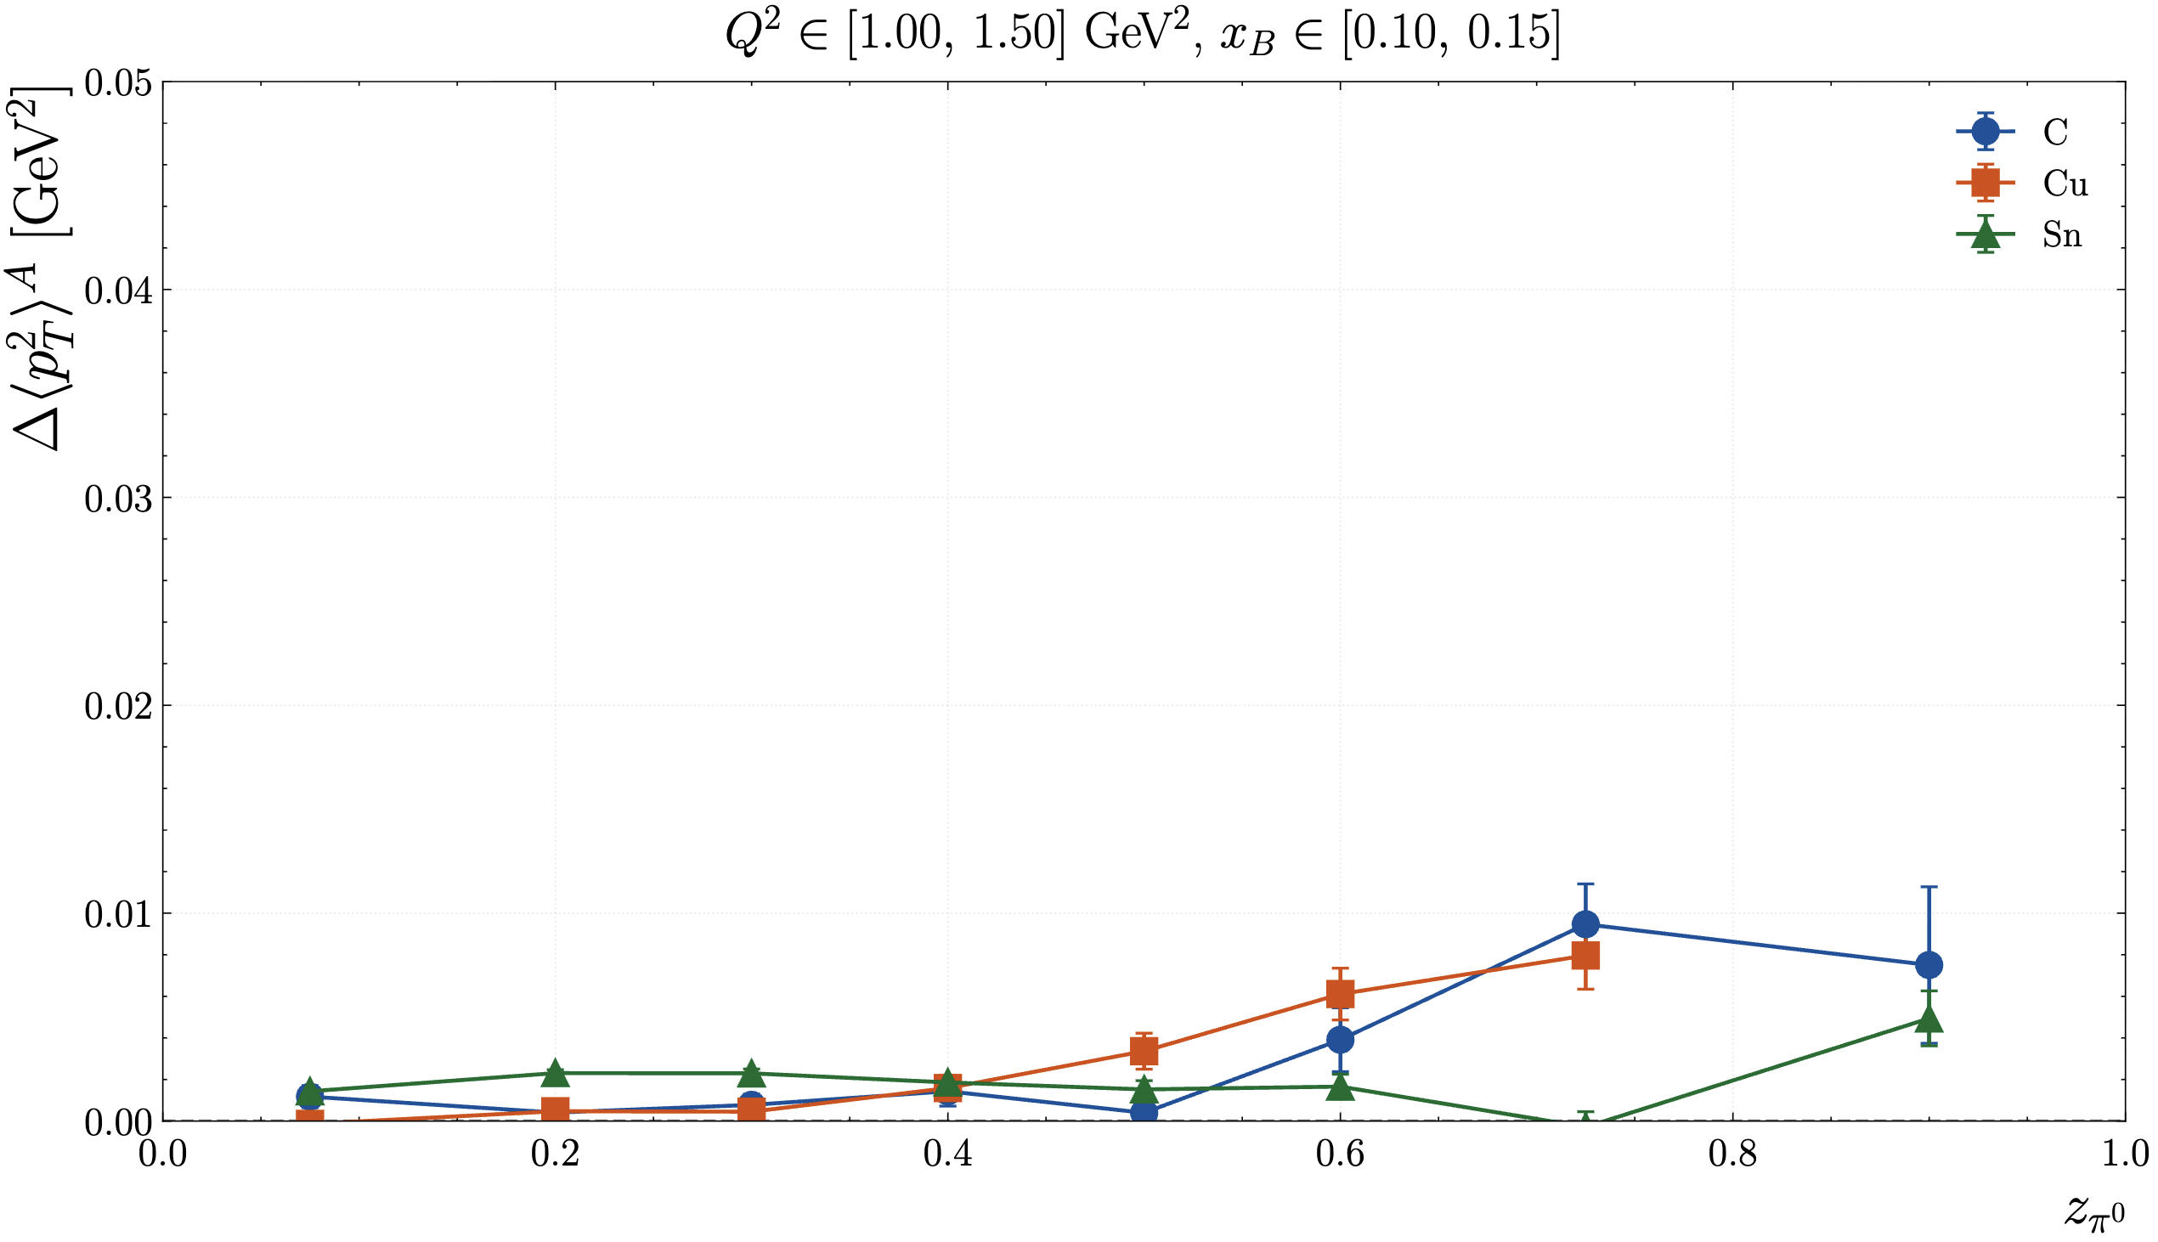
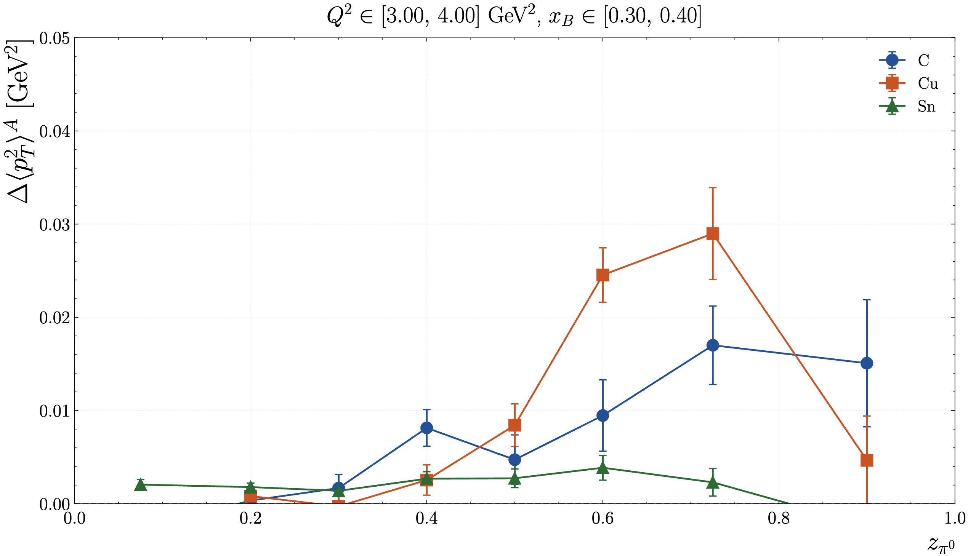
RG-D: π⁰ multiplicity and p_{T} broadening
pT broadening:
Bins in Q², x_{B} and z
Probably wrong

Slide 11
Other stuff
I have worked on my presentation for Thursday software meeting

Slide 12
To do list
RG-D:
Compare simulation to data (use it for contamination study too), same for CxC and for pions
Get the multiplicity ratio for π⁰ after the event mixing subtraction
Continue the work on p_{T} broadening and cos and sin φ_{h} extraction
Work on the binning
Radiative and acceptance correction
Background for ρ⁰ with simulation for CT analysis
ALERT:
Finishing the pull request for the GNN (reply to comments)

