Slide 1
Group meeting
Mathieu Ouillon (Mississippi State University)
05/12/26

Slide 2
RG-D: Vz correction
Got my new simulation to compare data and MC, and estimate contamination
CuSn IB, CxC OB/IB
Between 4 and 5 M events, use Raphael event generator: SIDIS + some nuclear effects:
Modified version of Pythia 6, adapted for studies involving parton energy loss and transverse momentum broadening in cold nuclear matter
Use the framework PyQM to incorporate initial state Fermi motion and partonic energy loss
Bound nucleon momentum is sampled from andel–Vary–Garpman (SVG) mean-field or the Ciofi–Simula (CS) spectral-function

Slide 3
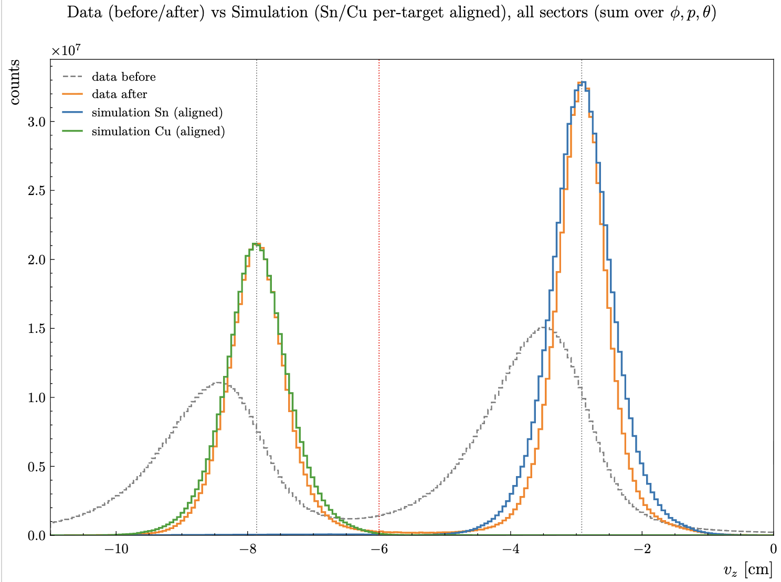
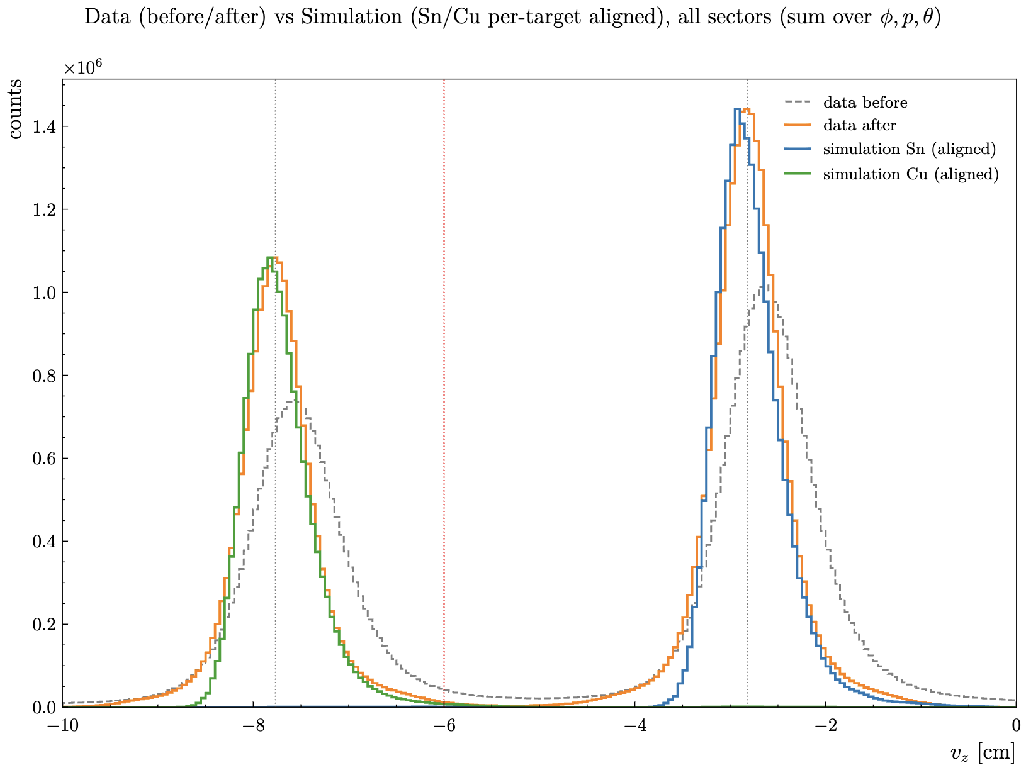
RG-D: Vz correction
Compare: Electron CuSn Data vs MC Outbending and Inbending
Outbending
Inbending

Slide 4
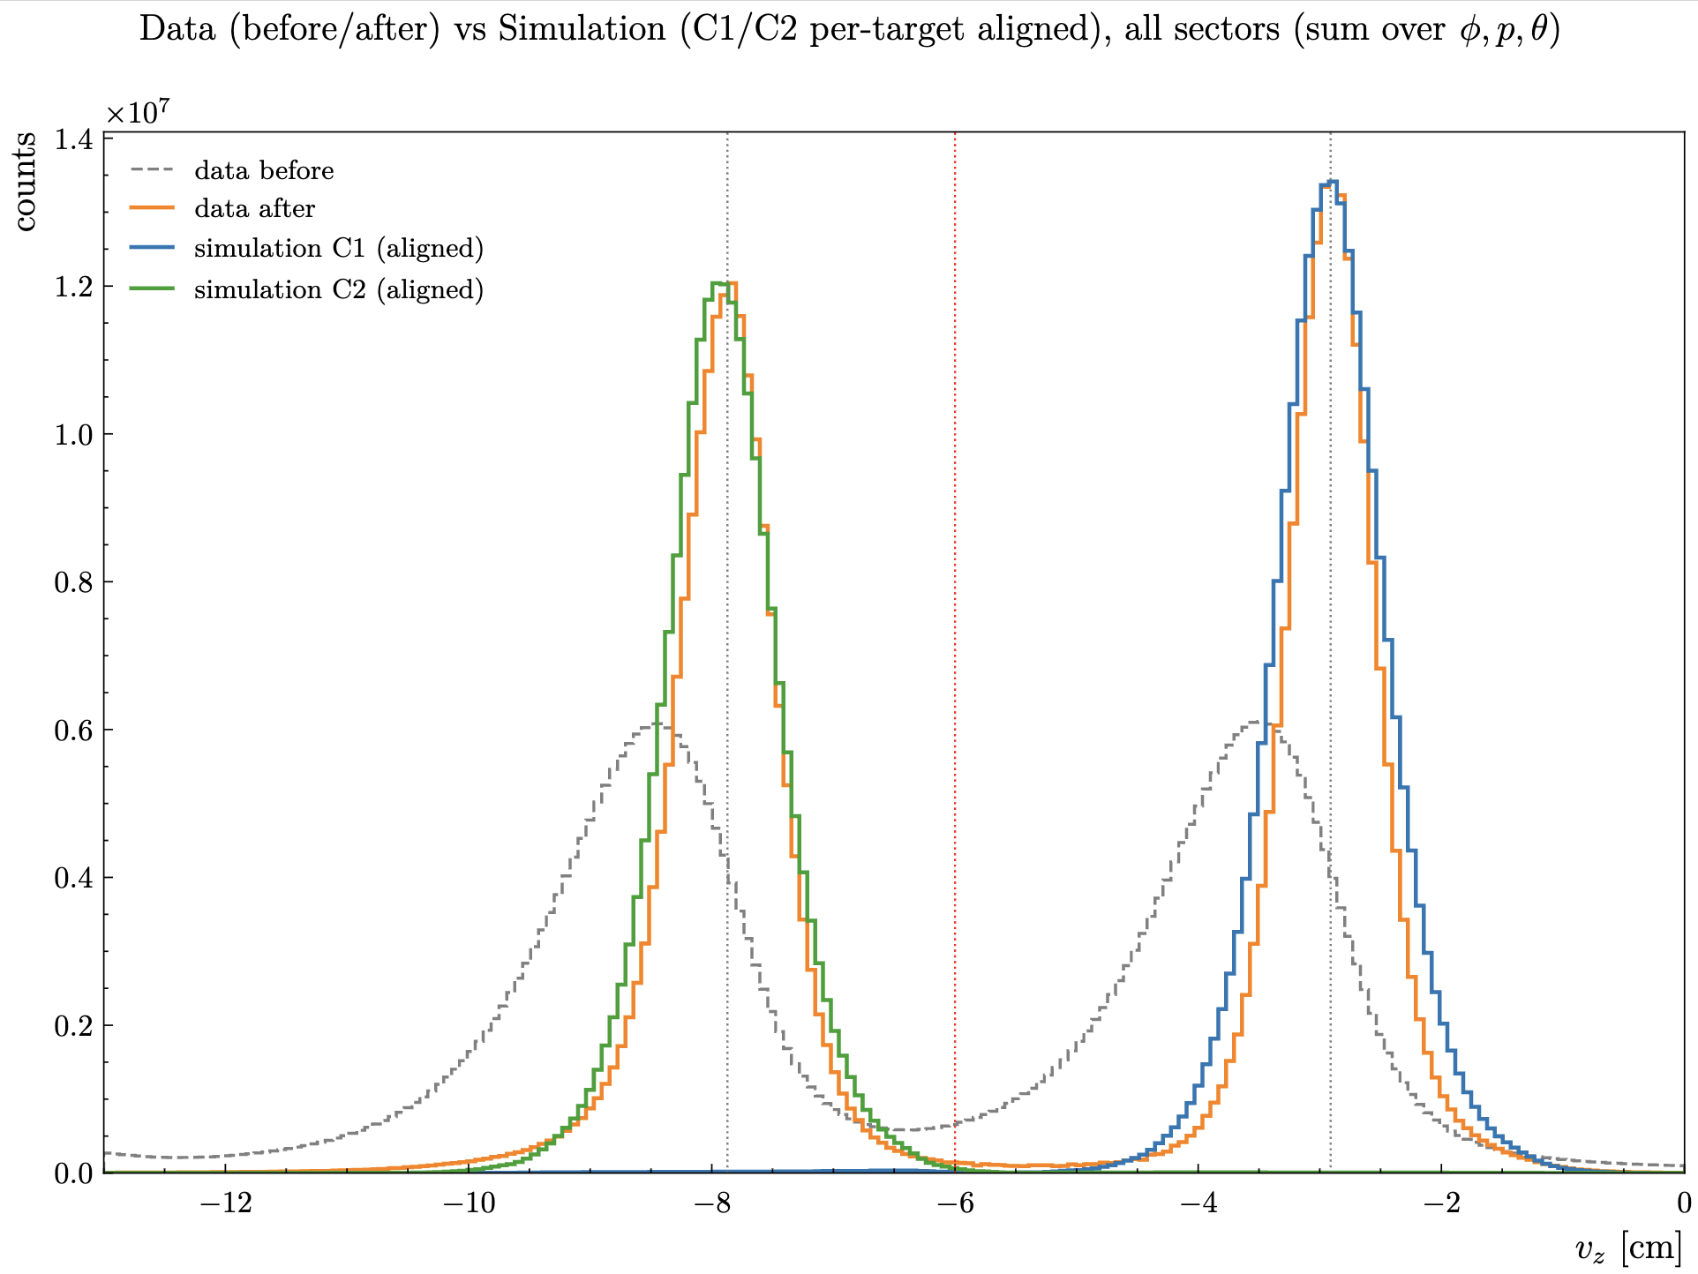
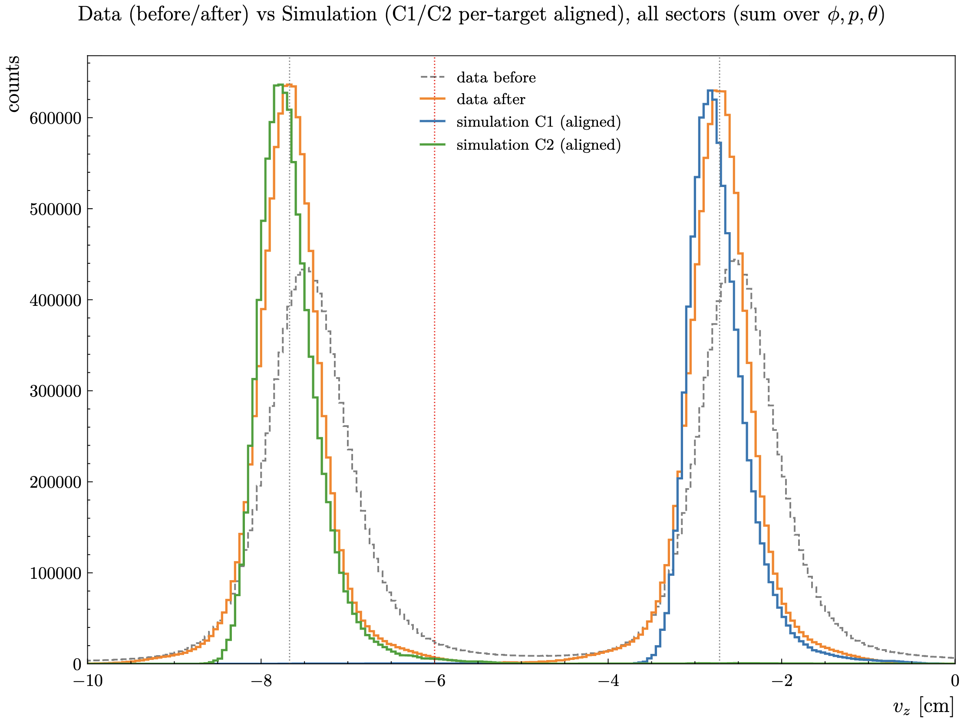
RG-D: Vz correction
Compare: Electron CxC Data vs MC Outbending and Inbending
Outbending
Inbending

Slide 5
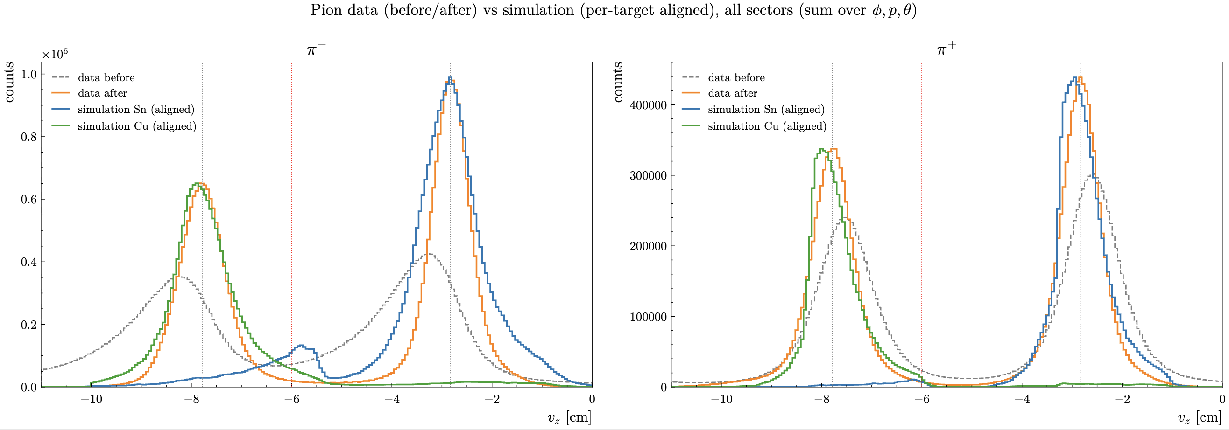
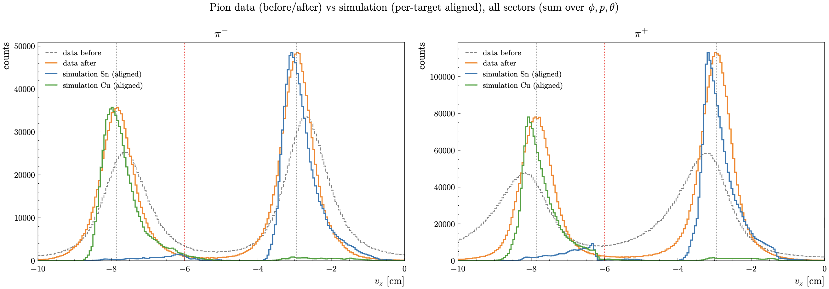
RG-D: Vz correction
Compare: Pion CuSn Data vs MC Outbending and Inbending
Outbending
Inbending

Slide 6
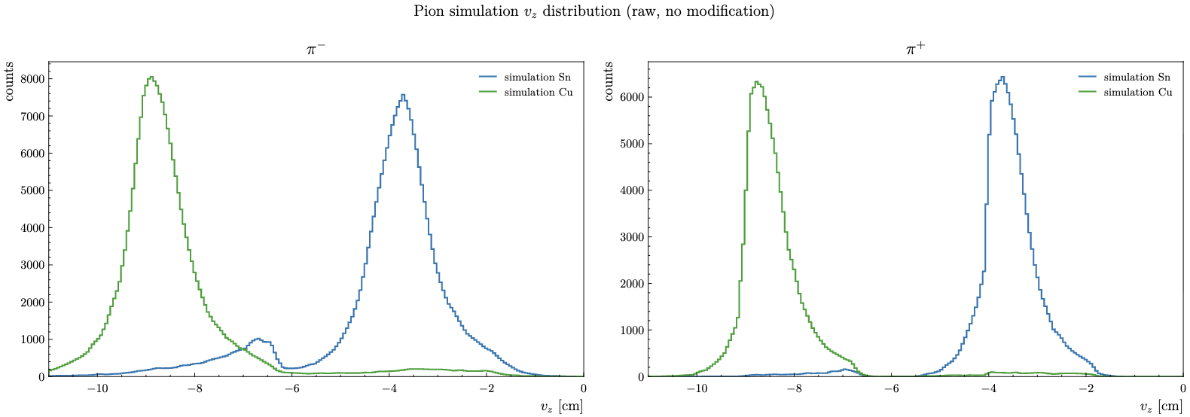
RG-D: Vz correction
Reconstructed Vz distribution for pions in CuSn outbending
We have that feature around -6 cm
I need to understand if it is a real thing or a bug in my code

Slide 7
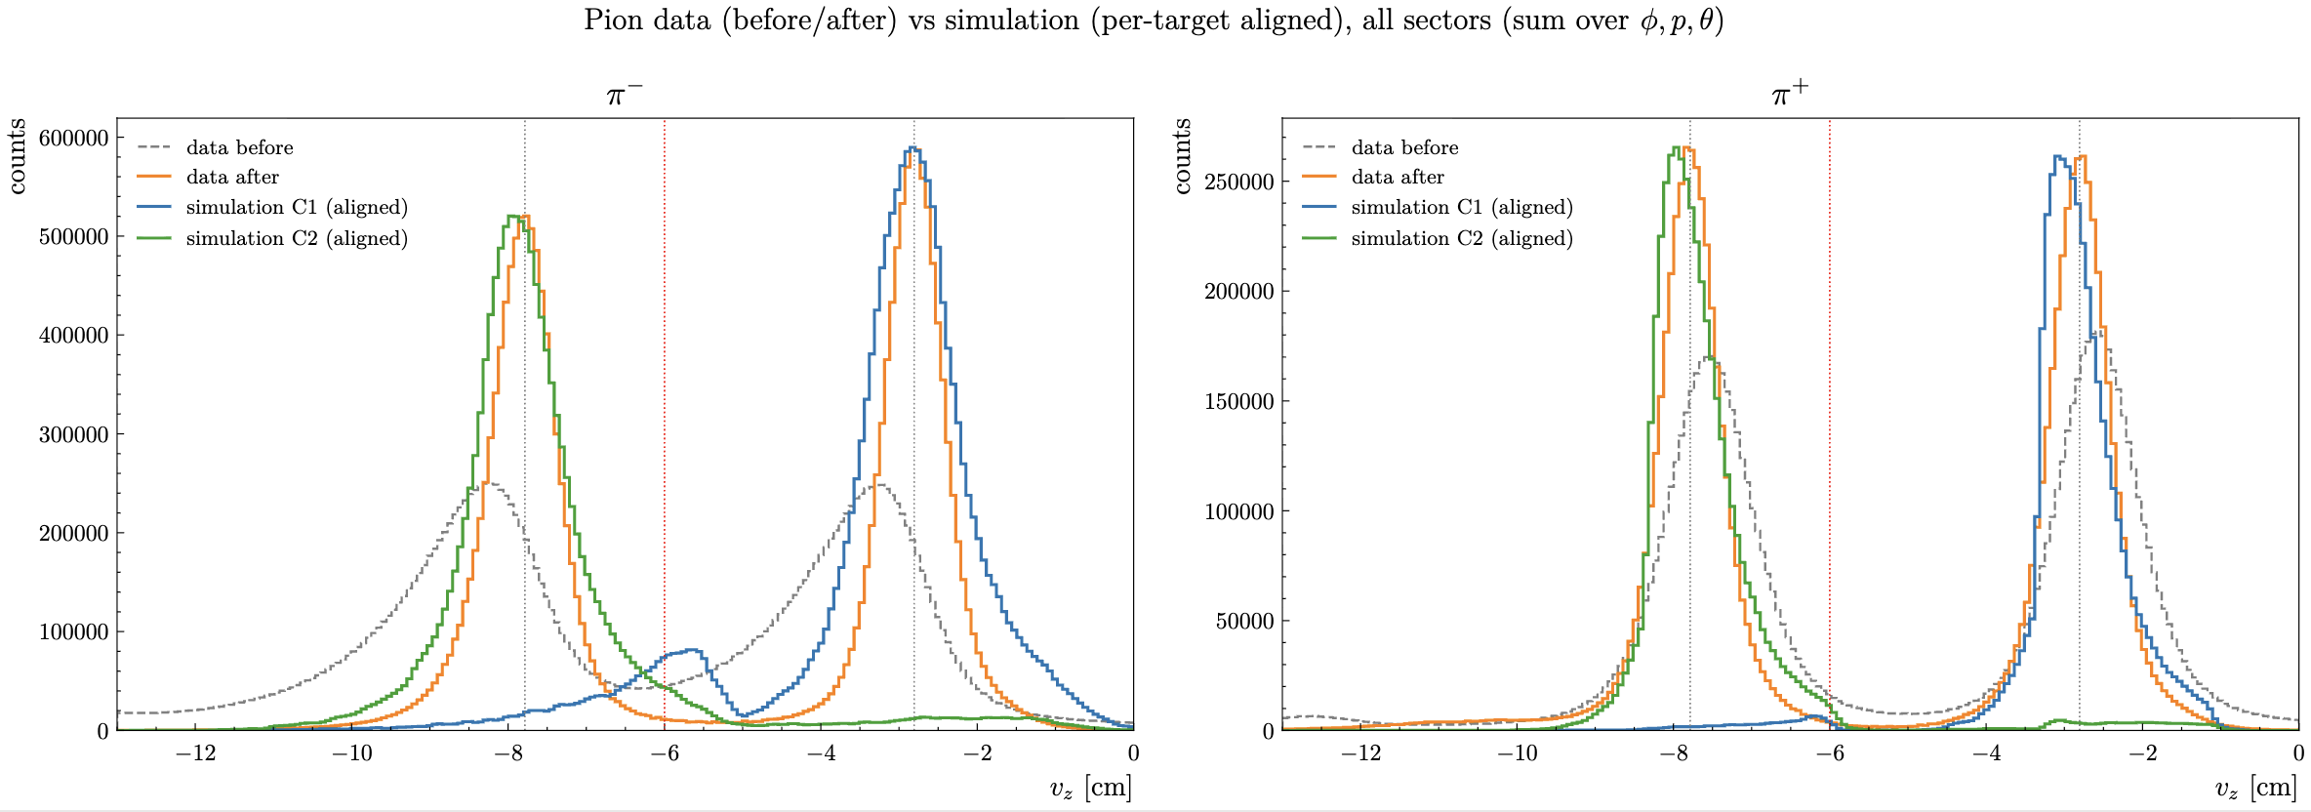
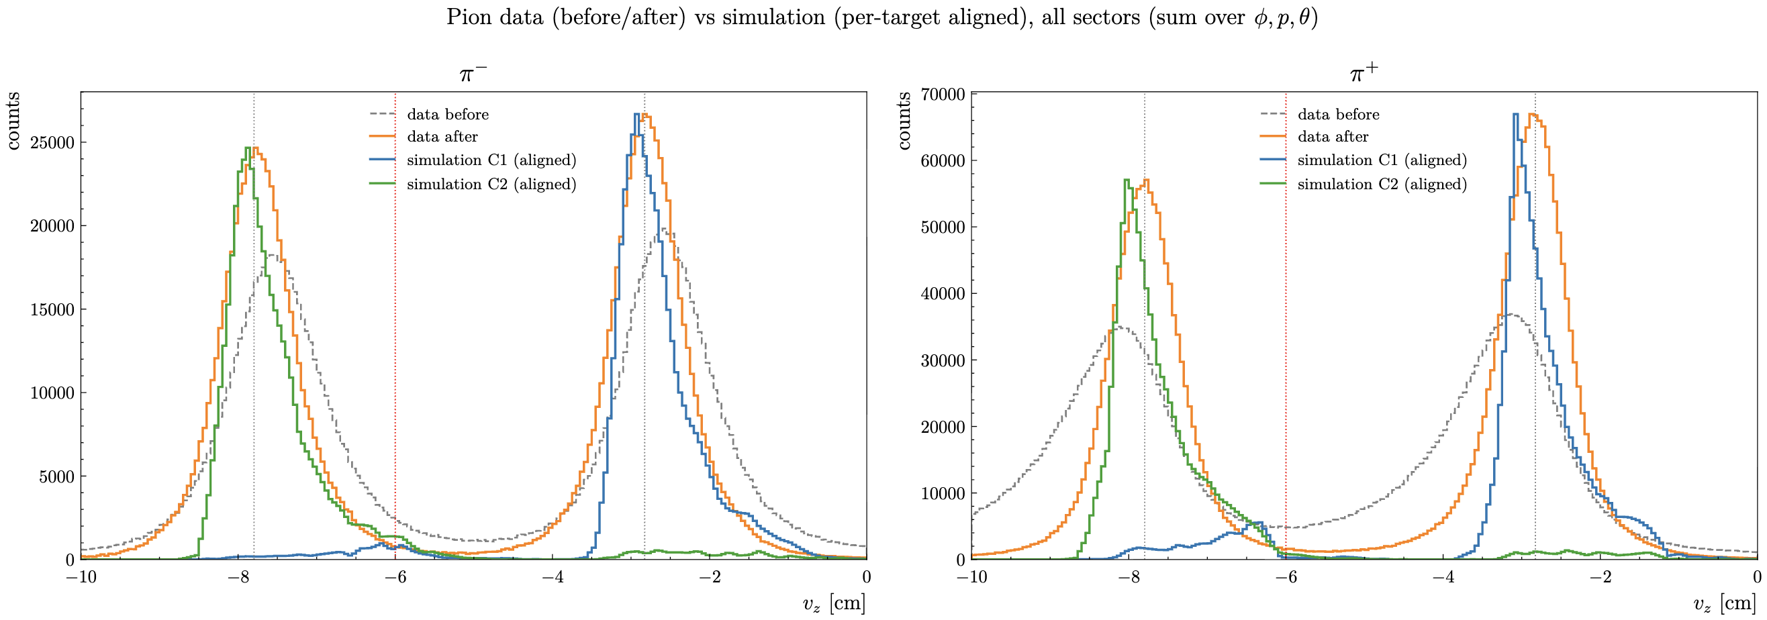
RG-D: Vz correction
Compare: Pion CxC Data vs MC Outbending and Inbending
Outbending
Inbending

Slide 8
RG-D: Vz Contamination
Estimate the contamination for CuSn OB and IB using simulation:
For each target peak we have the simulated Vz distribution: the total, the Sn-only (true Sn tracks), and the Cu-only (true Cu tracks).
The MC Vz peaks are shifted so they sit exactly where the corrected data peaks are.
Define a selection window per target: Around each peak we draw a window of μ ± 3σ, taken from the Voigt fit of the corrected data peak (the actual cut one would use to select that target).
Count the wrong-target events inside the window: Within the Sn window we integrate the Cu-truth MC distribution. Those are Cu events that leak into the Sn selection (and vice versa).
Contamination = (wrong-target events in the window) / (all events in the window)

Slide 9
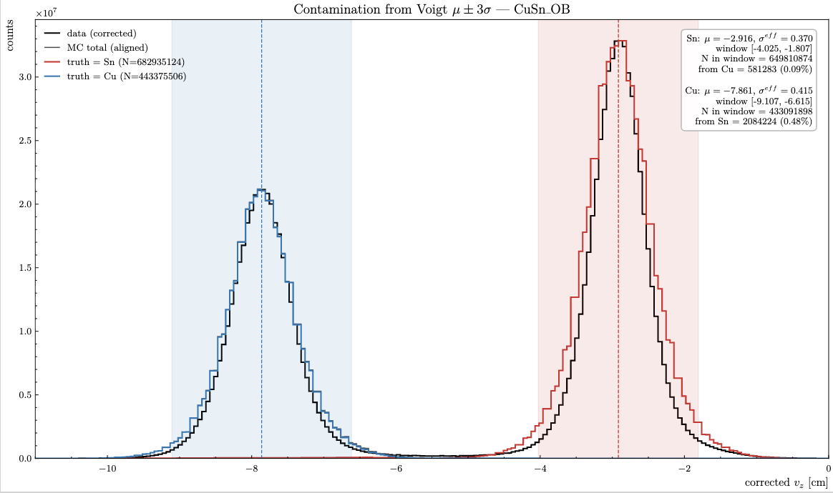
RG-D: Vz Contamination
Estimate the contamination for CuSn OB and IB using simulation:

Slide 10
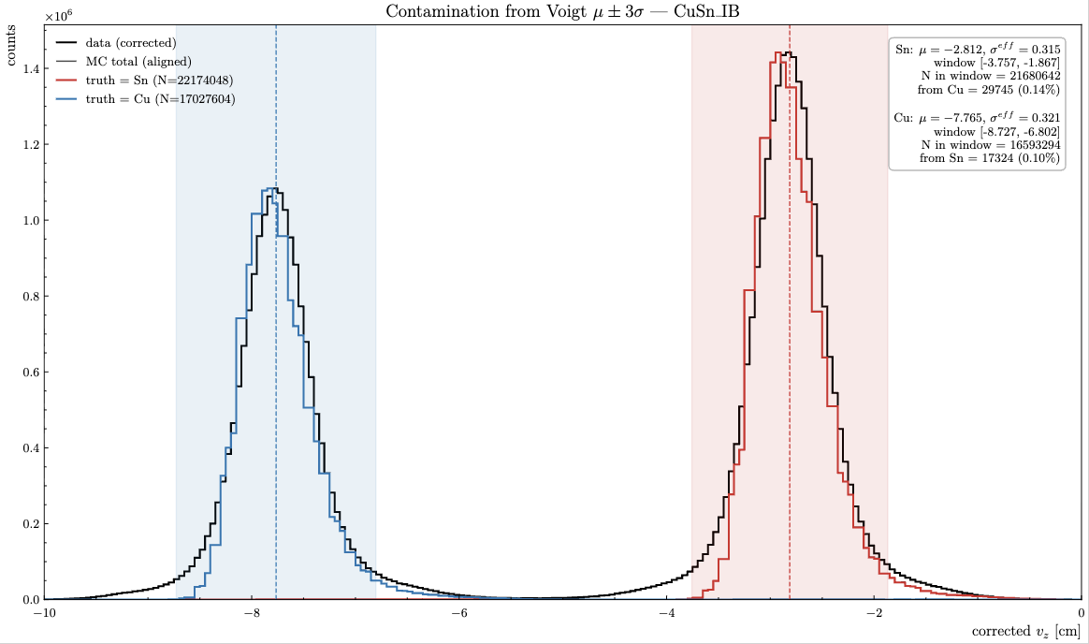
RG-D: Vz Contamination
Estimate the contamination for CuSn OB and IB using simulation:

Slide 11
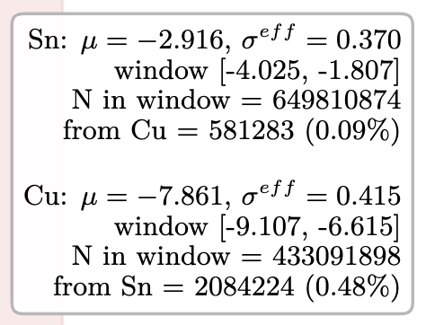
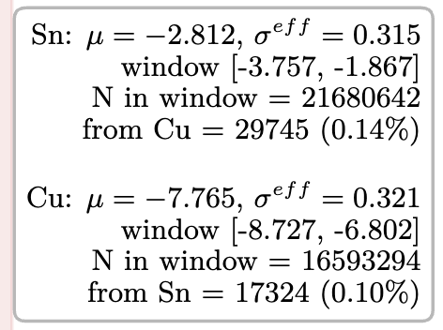
RG-D: Vz correction
Conclusion:
MC and data are quite similar
We can use MC to estimate the contamination of Cu in Sn target and the Sn in Cu target for electron and pions
Contamination:
OB IB

Slide 12
RG-D: π⁰ study
Want to extract multiplicity ratio, p_{T} broadening and azithumal modulation for π⁰
Work with 10% of the dataset
First step: electron selection:
Cut | Value
Momentum | p > 2 GeV
Status | status < 0 and 2000 < |status| < 4000
Chi2 PID | −5.0 < χ²pid < 5.0
Sampling fraction | mean ± 3.5σ
Vertex z (target-dependent) | mean ± 3σ on corrected Vz
PCAL fiducial | lv > 9.0 cm and lw > 9.0 cm
DC edge fiducial | R1 > 1.68, R2 > 2.0, R3 > 8.75 cm

Slide 13
RG-D: π⁰ study
Want to extract multiplicity ratio, p_{T} broadening and azithumal modulation for π⁰
Work with 10% of the dataset
Then select DIS events + y cut:
Then photon selection:
Cut | Value
Q² | > 1.0
W | > 2.0
y | < 0.85
Cut | Value
Min photon energy | E ≥ 0.2 GeV
Beta | 0.9 < β < 1.1
PCAL fiducial | lv > 14.0 cm and lw > 14.0 cm
FD theta | 5.0° – 35.0°
AI photon classifier | sigmoid output > 0.78

Slide 14

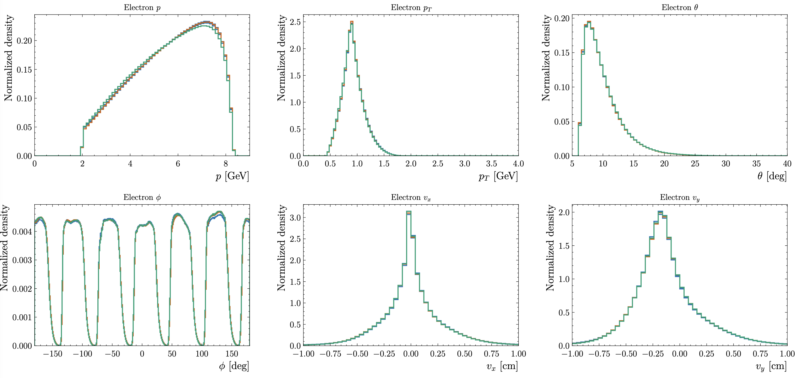
RG-D: π⁰ study
Electron kinematics after all these cuts:

Slide 15
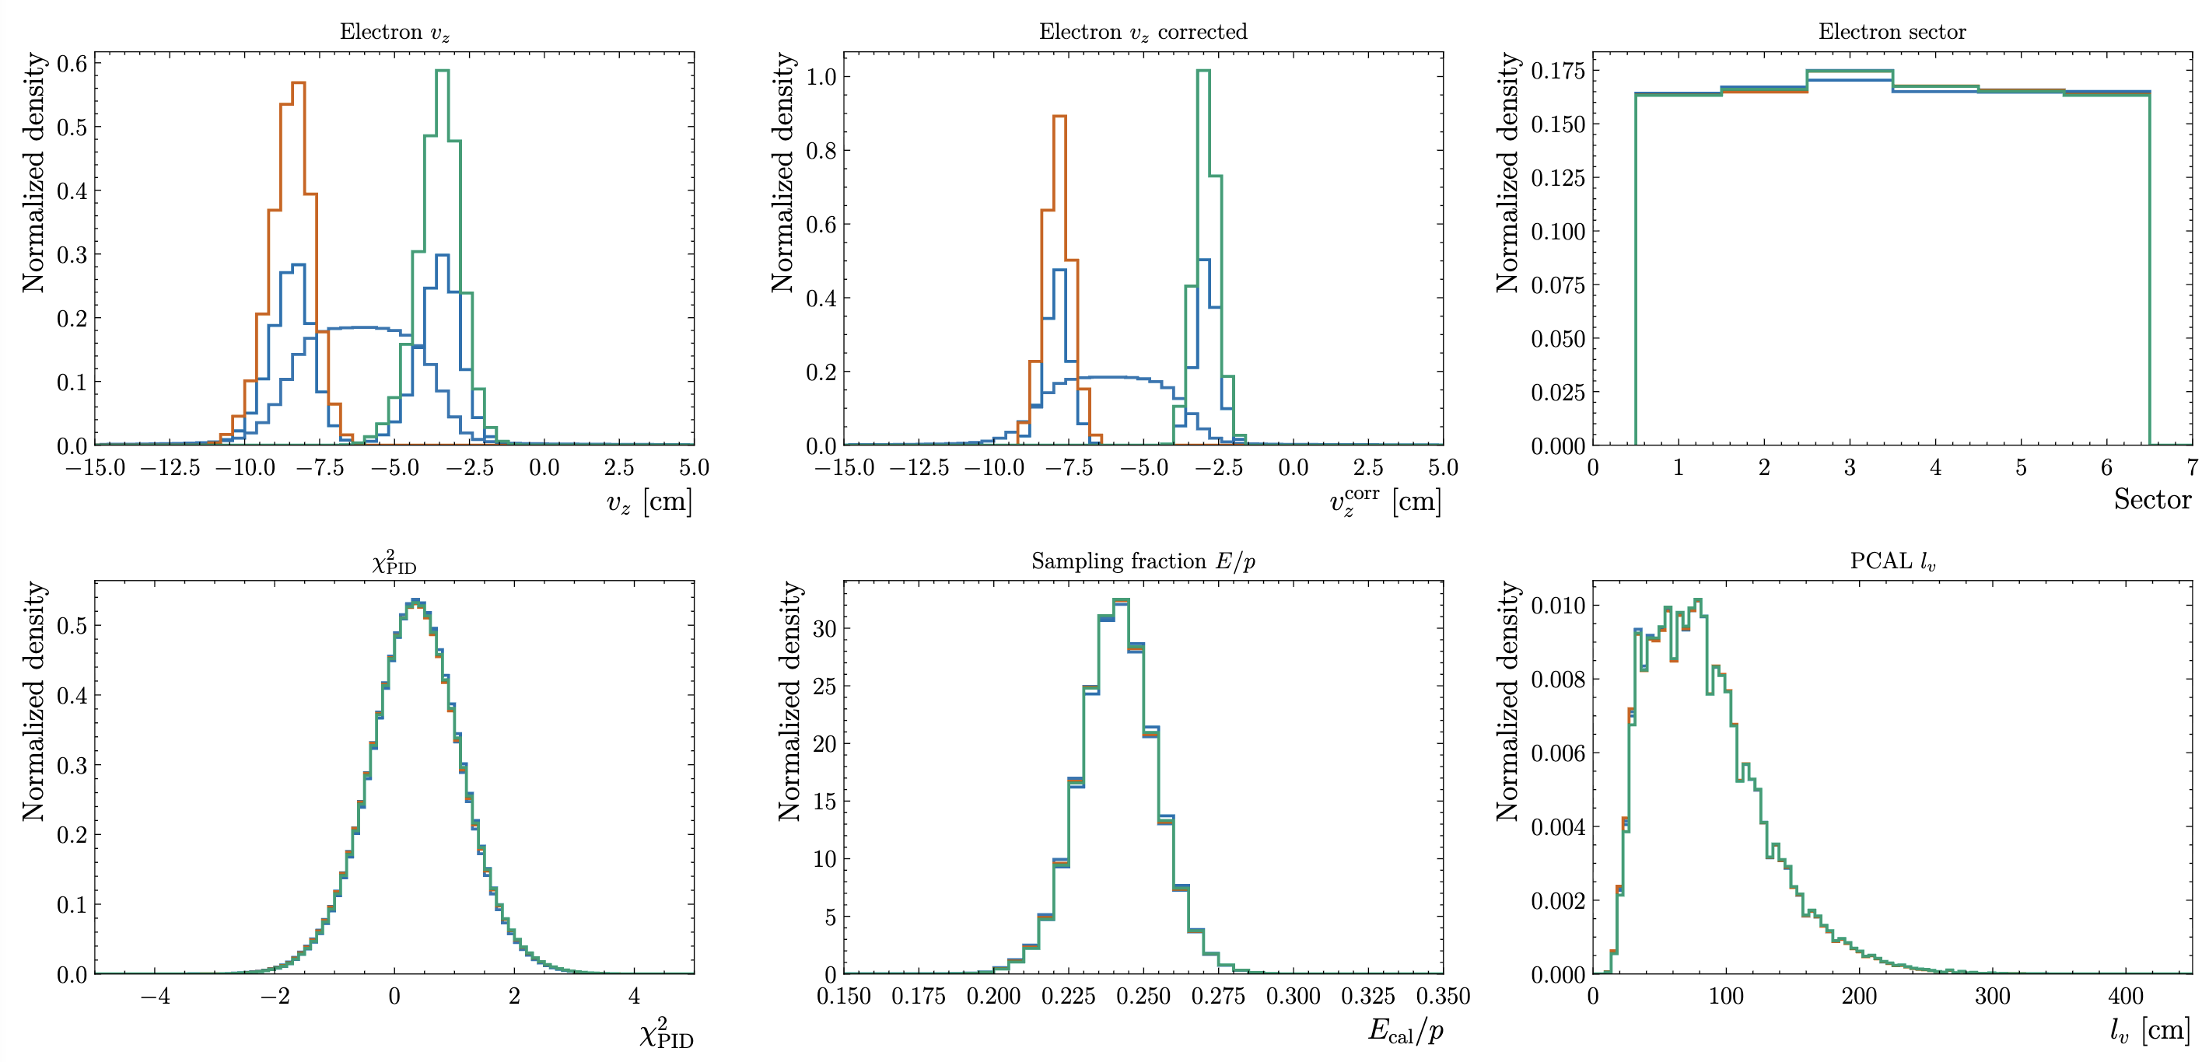
RG-D: π⁰ study
Electron kinematics after all these cuts:
Mostly sanity check

Slide 16
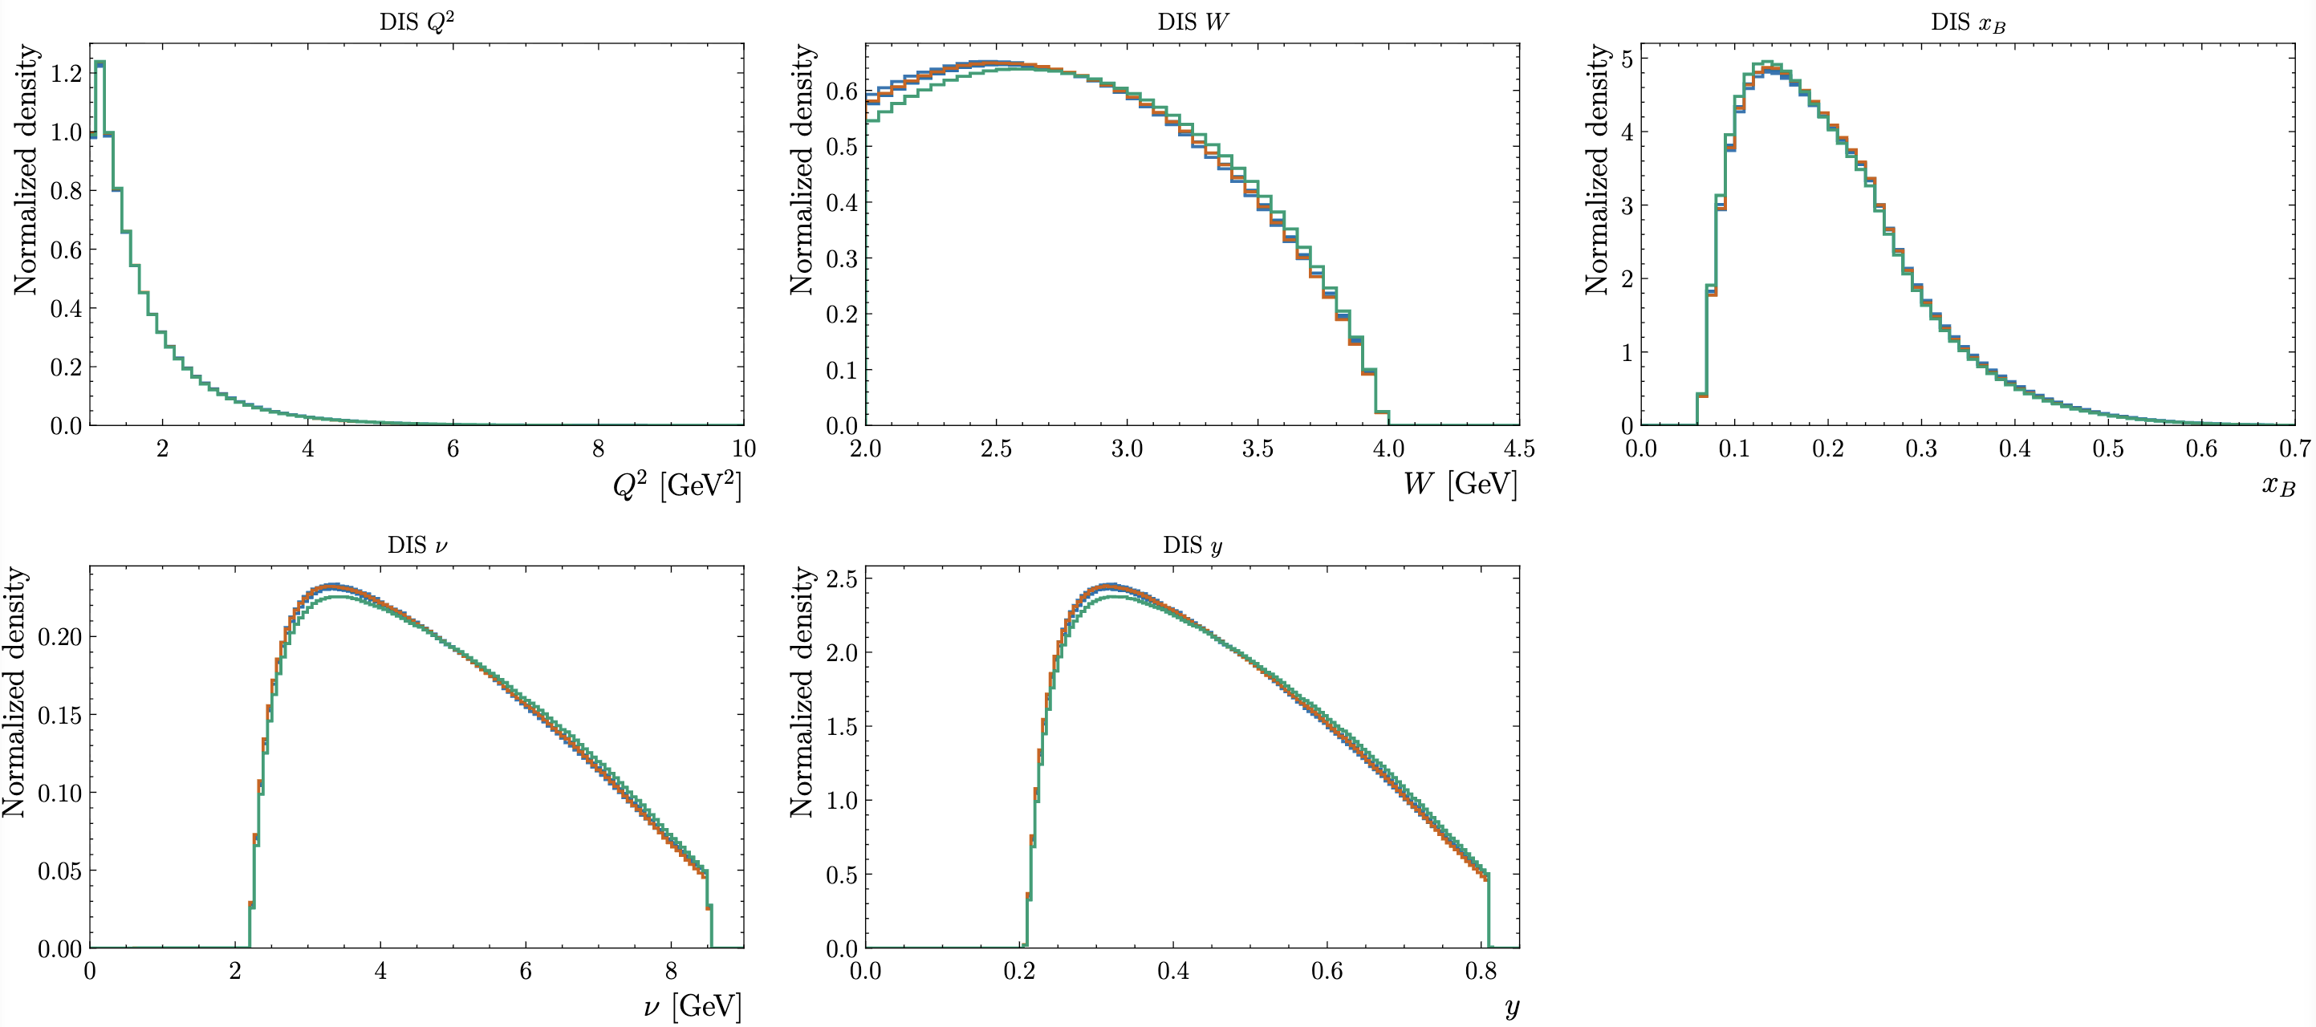
RG-D: π⁰ study
DIS variable after all these cuts:

Slide 17
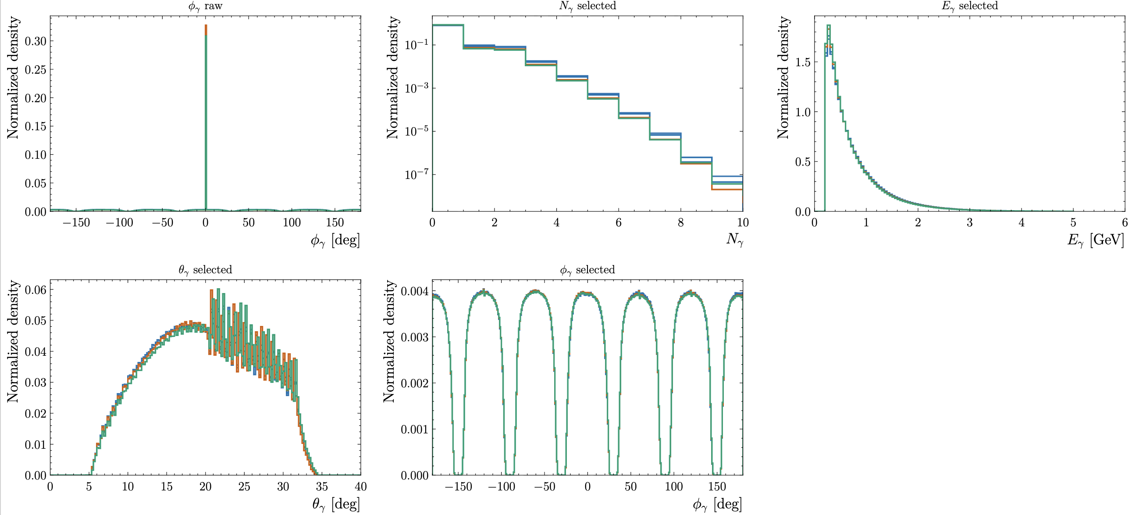
RG-D: π⁰ study
photon kinematics after all these cuts:

Slide 18
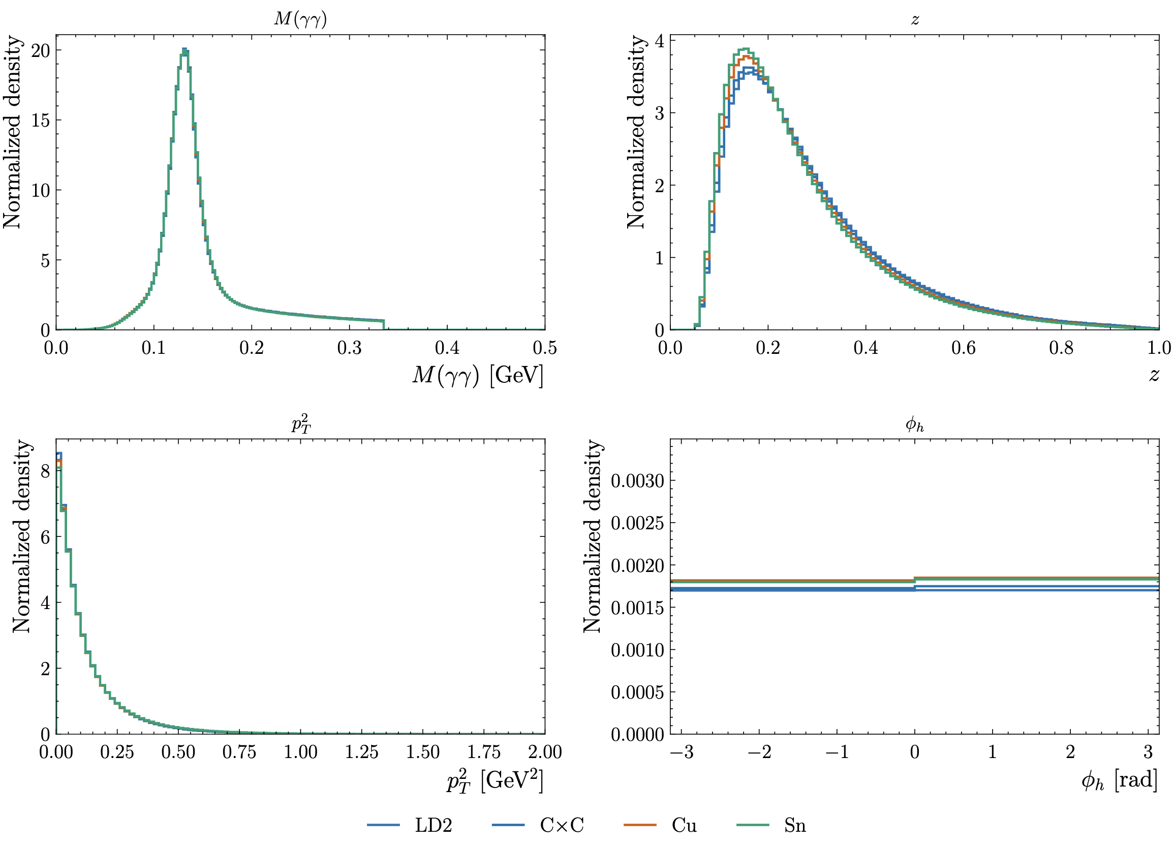
RG-D: π⁰ study
Then select π⁰ candidate:
Cut | Value
Electron–photon angle | > 8.0°
Min γγ invariant mass | > 0.001 GeV
z range | 0.0 < z < 1.0

Slide 19
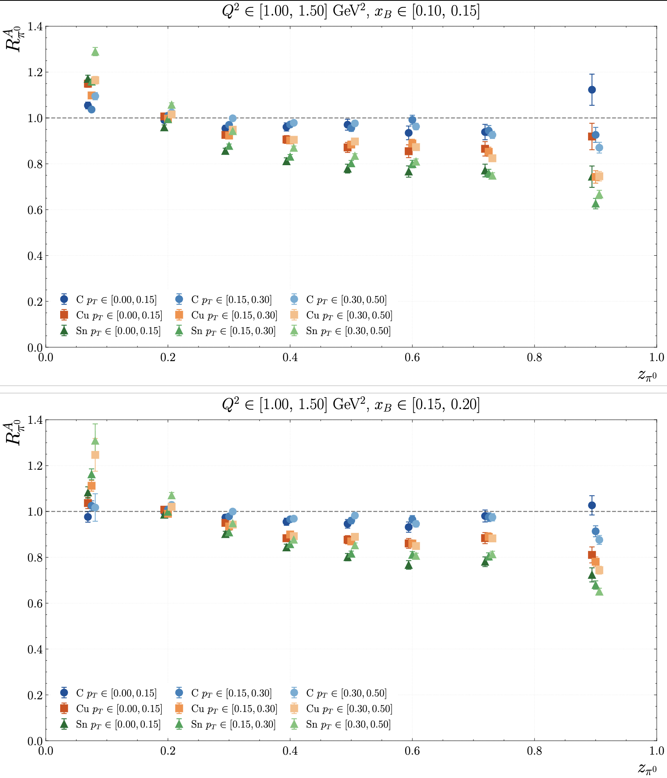
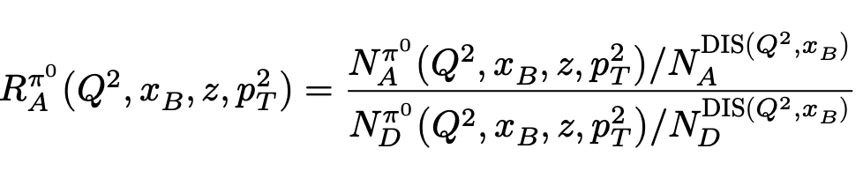
RG-D: π⁰ study
Then extract multiplicity ratio:
where the π⁰ yields N_{π}⁰ are obtained after background subtraction

Slide 20
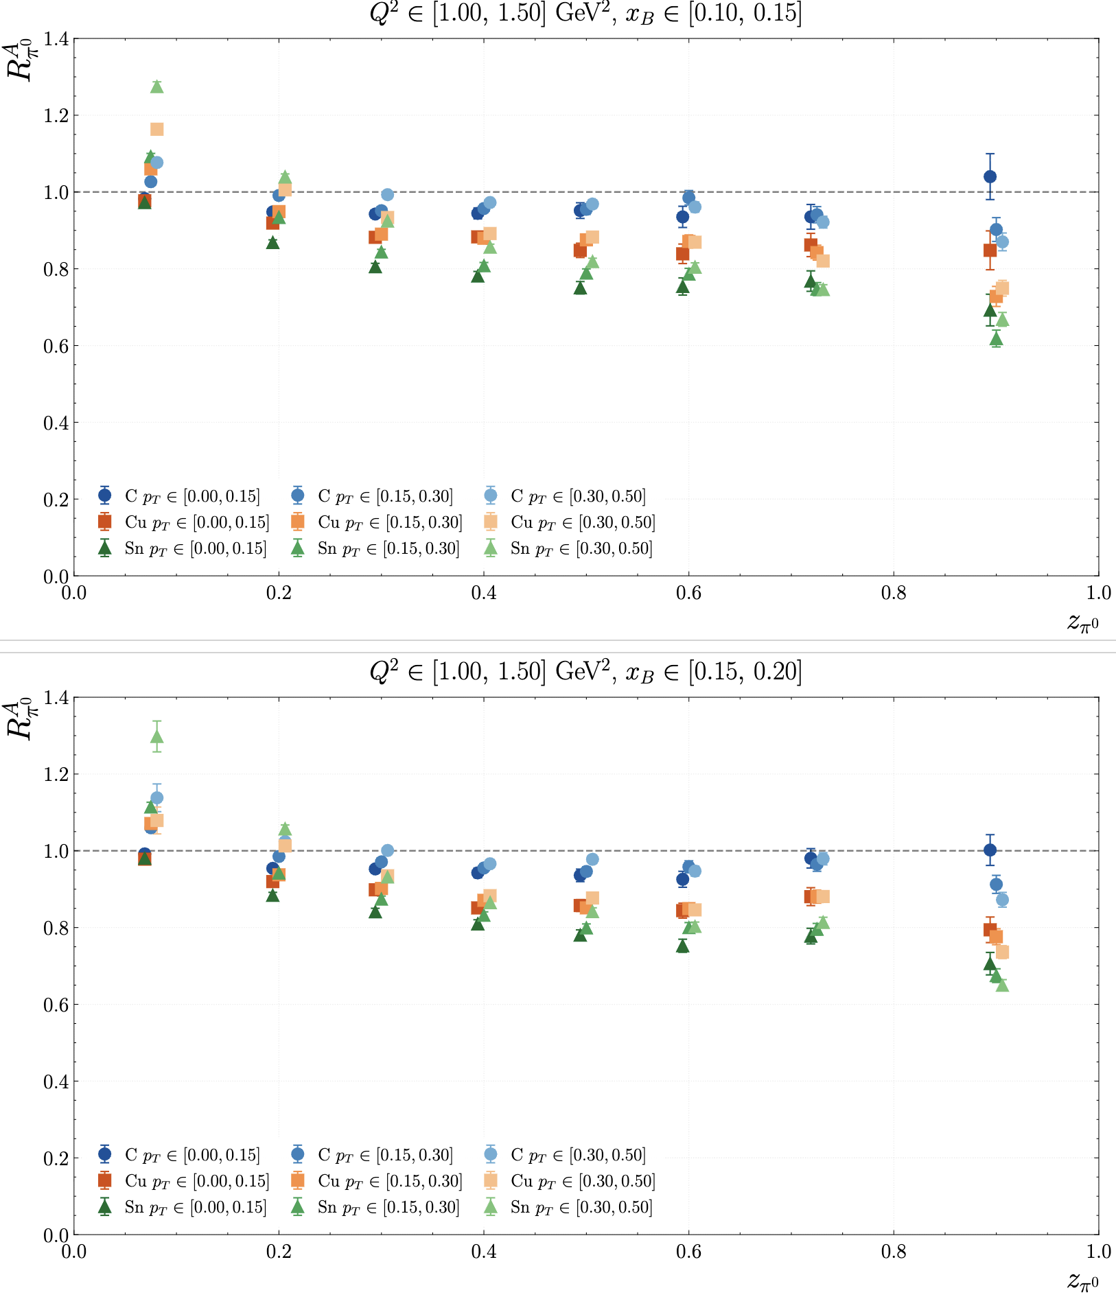
RG-D: π⁰ study
Then extract multiplicity ratio (without background subtraction):

Slide 21
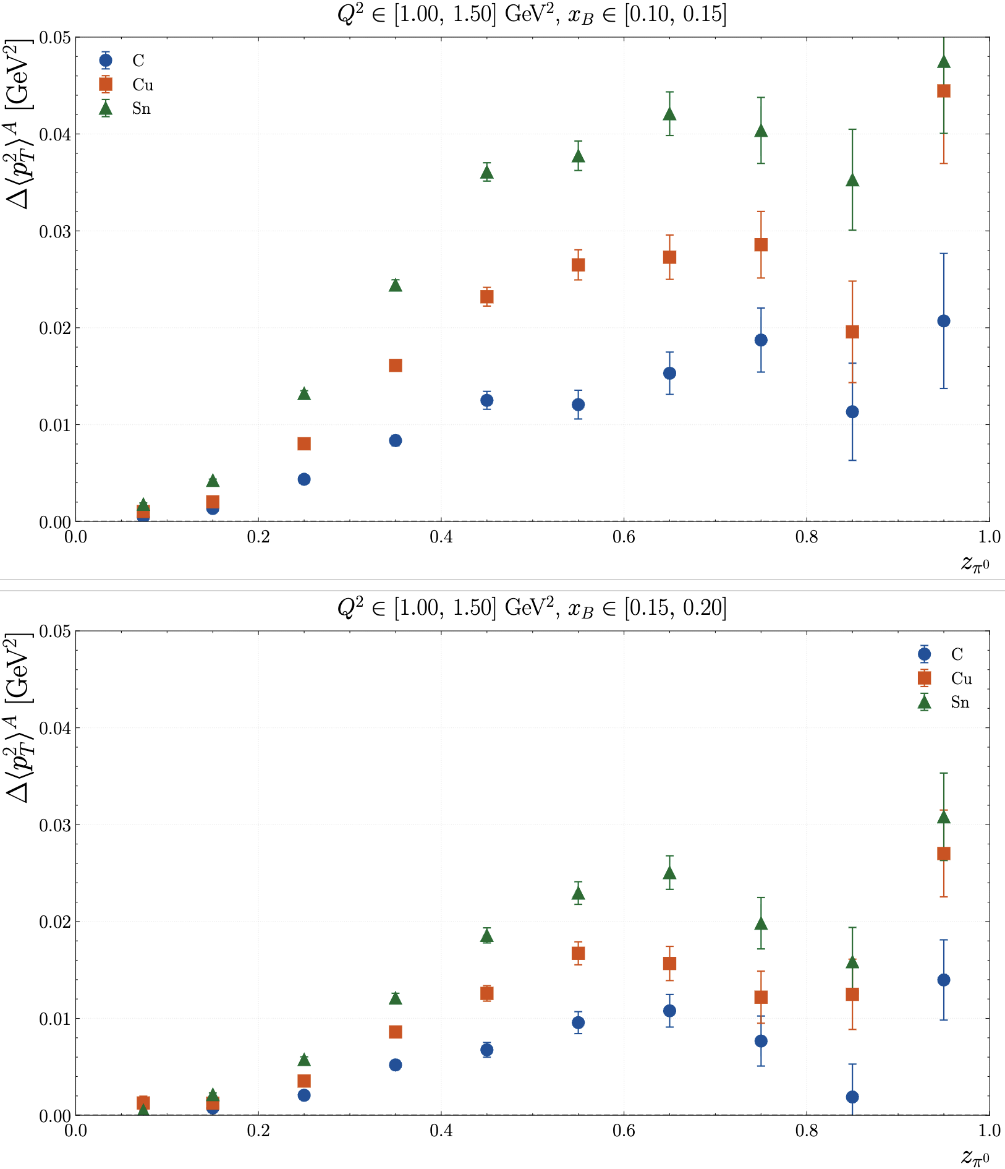
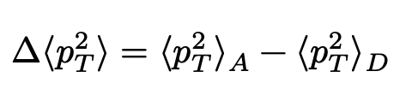
RG-D: π⁰ study
Then extract p_{T} broadening:
where ⟨𝑝²_{𝑇}⟩ is the mean transverse momentum squared in a given kinematic bin

Slide 22
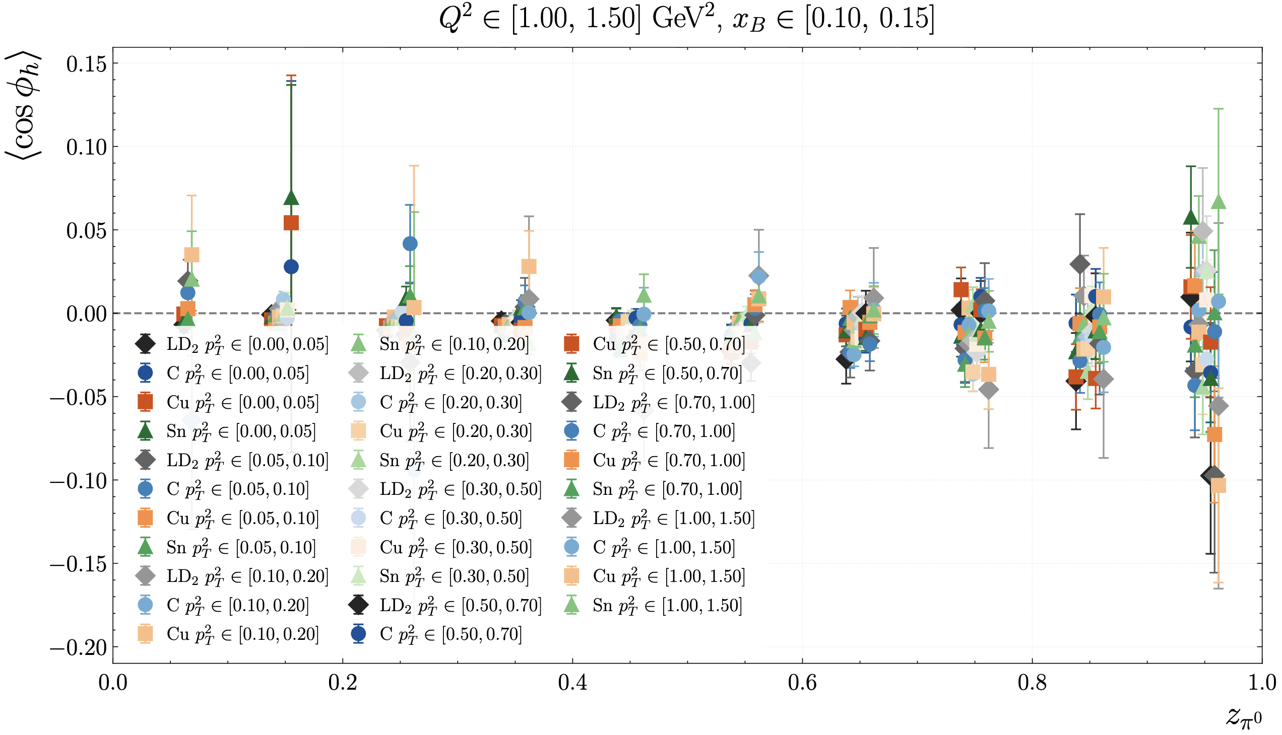
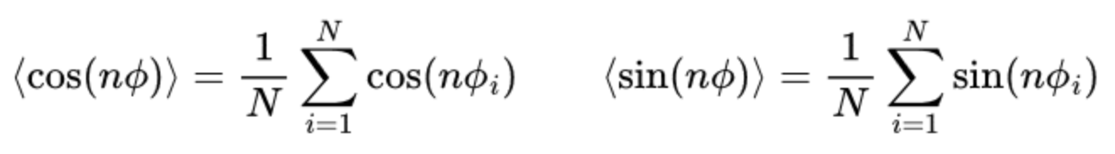
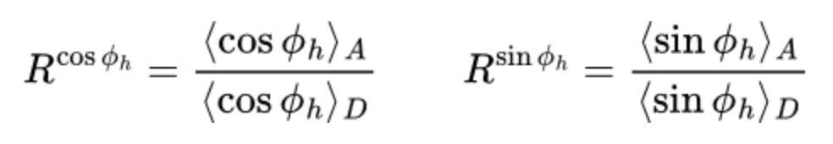
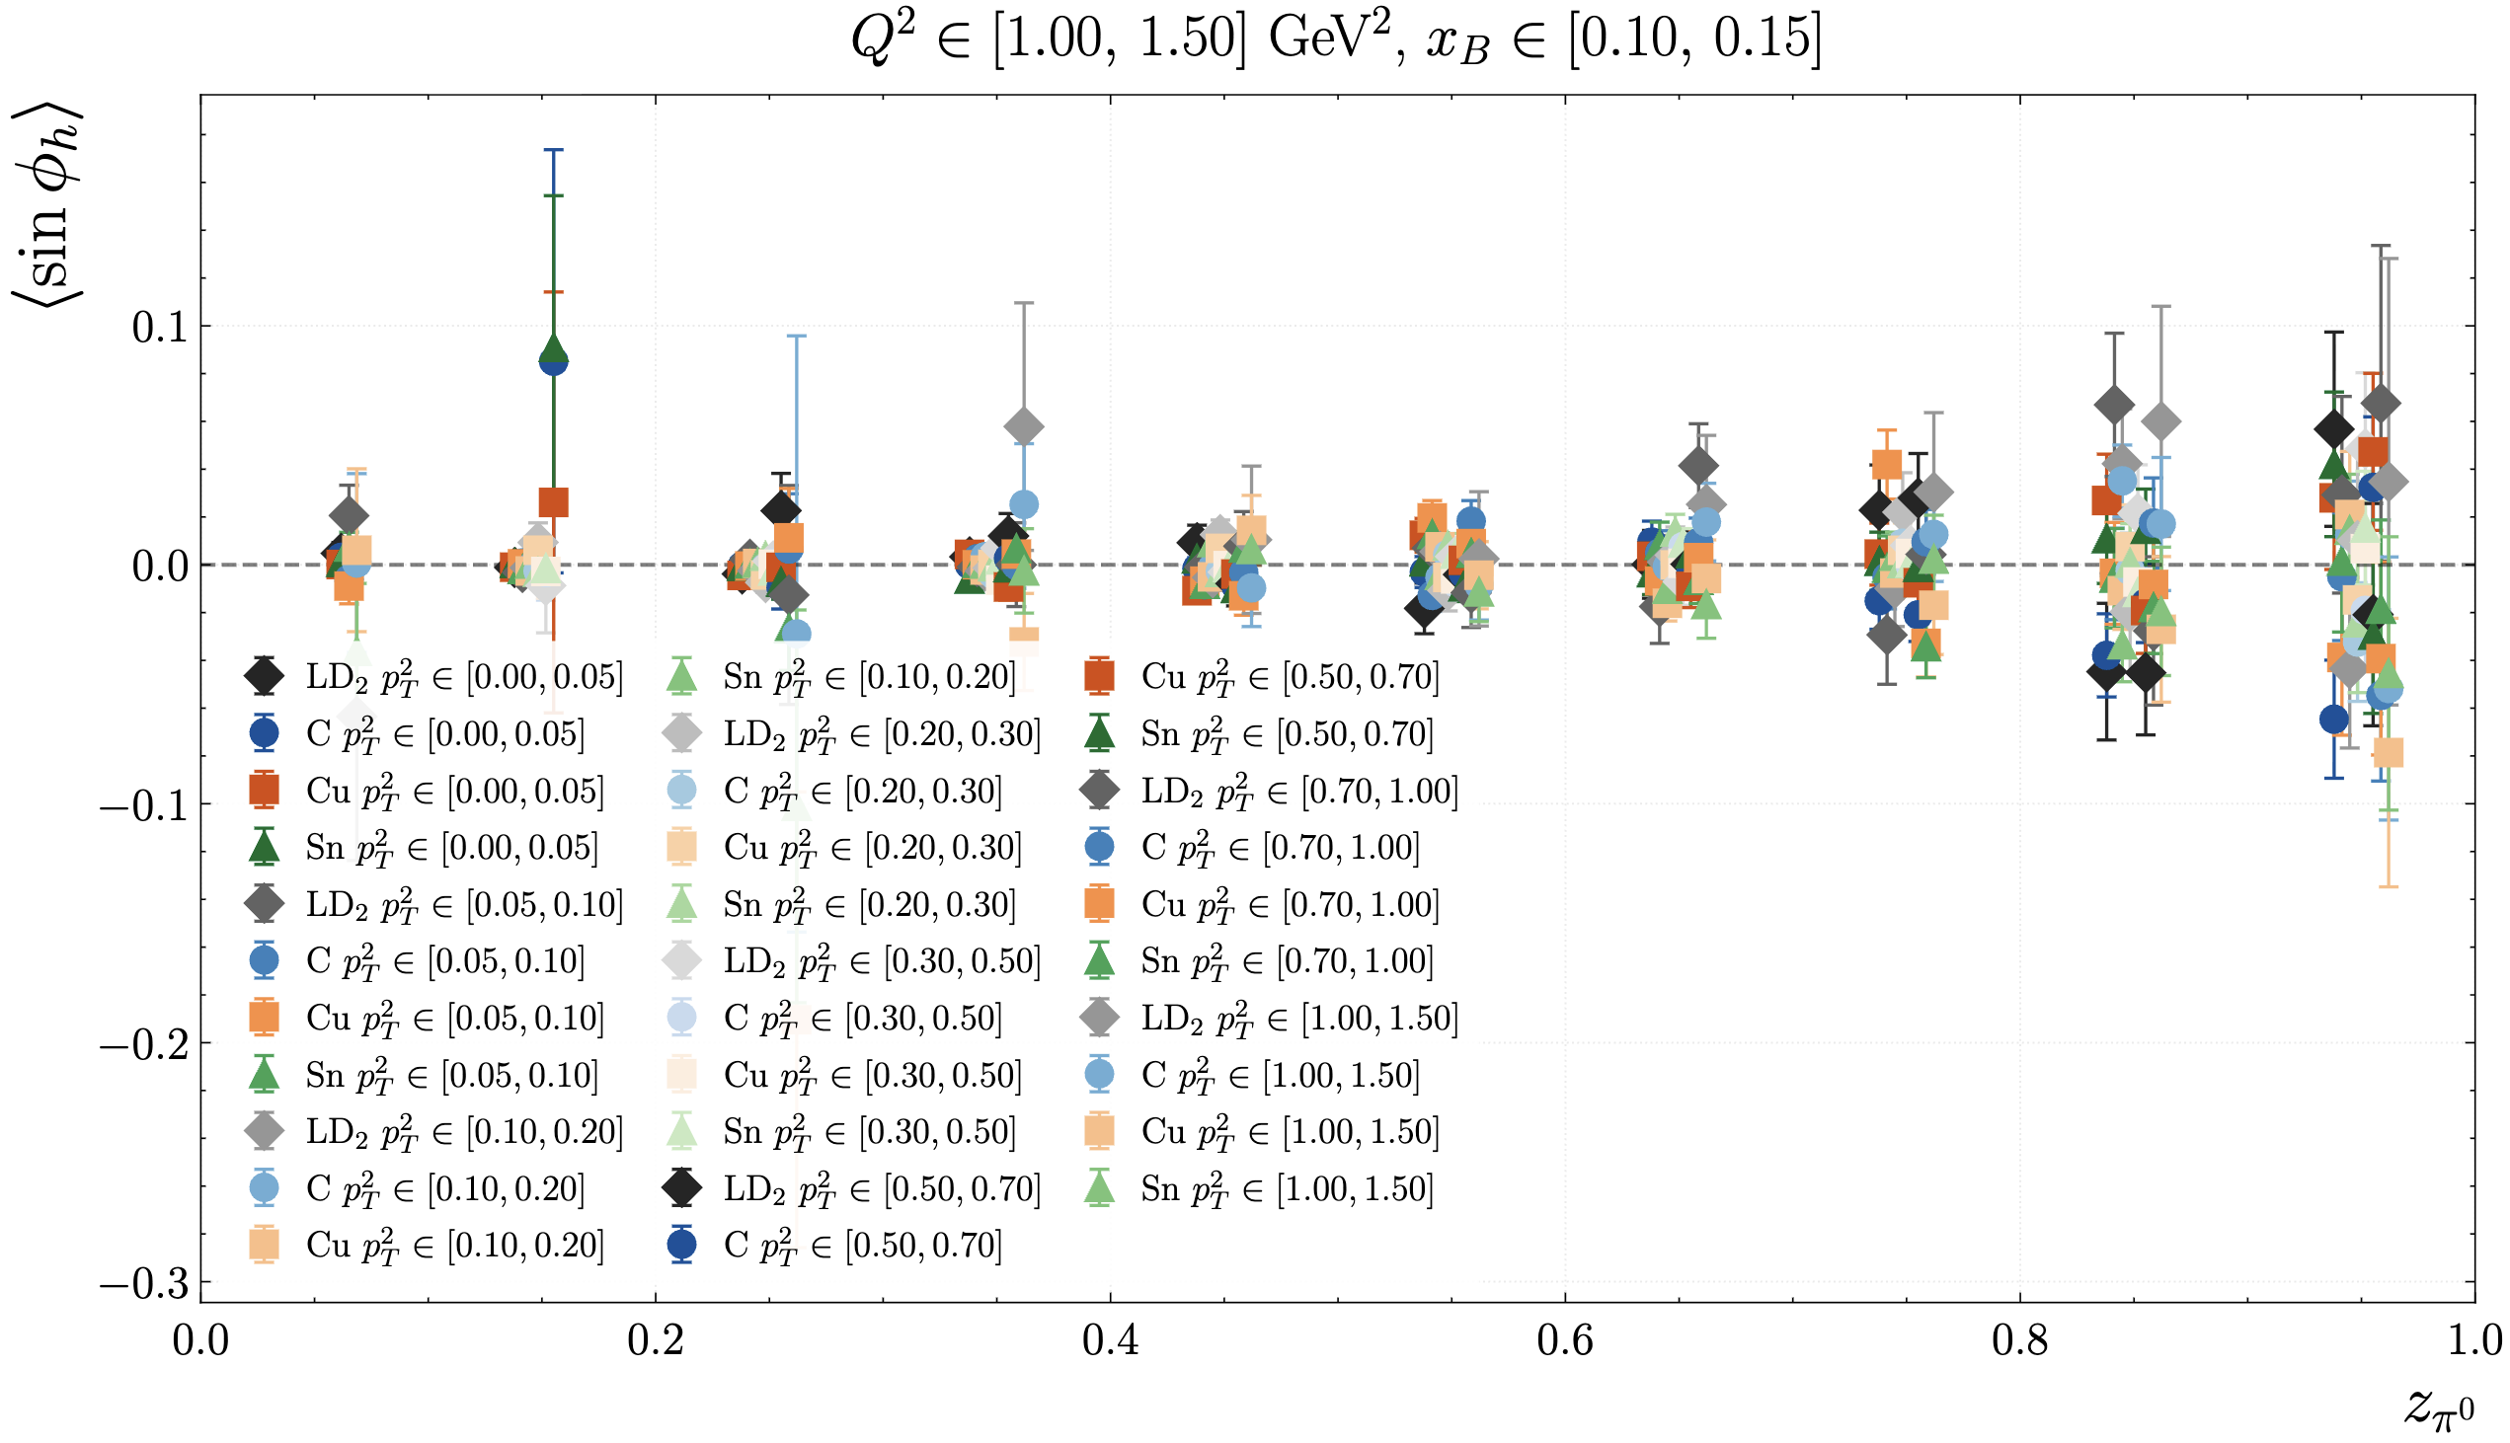
RG-D: π⁰ study
Then extract azithumal modulation:

Slide 23
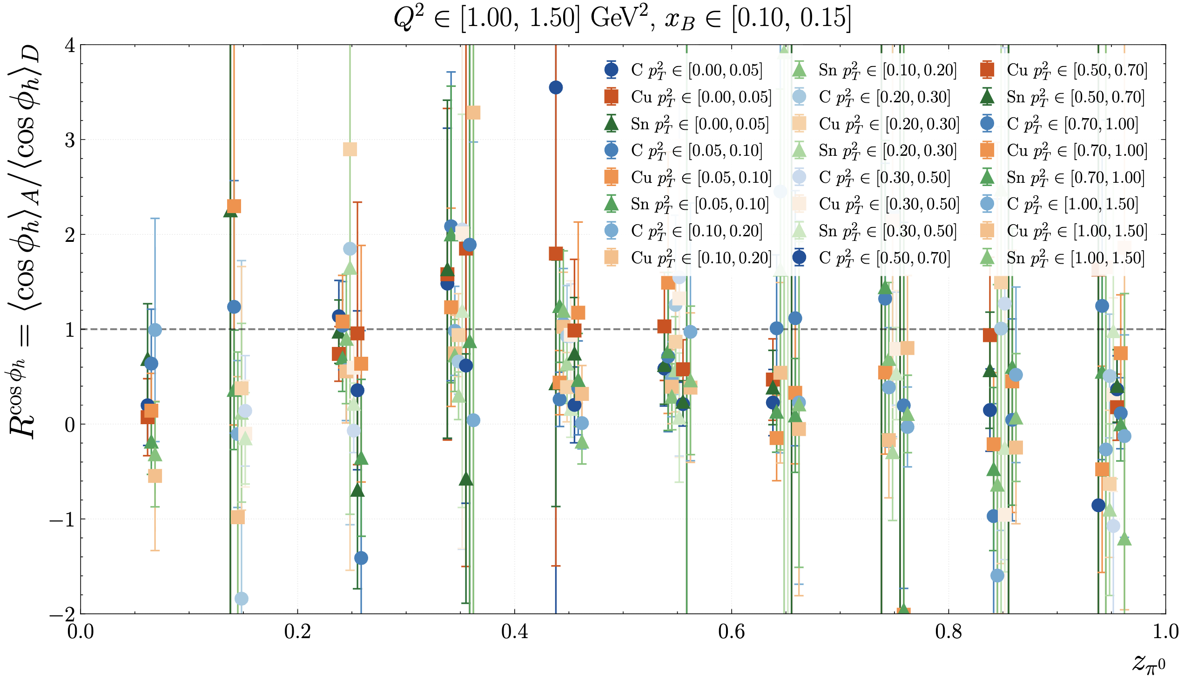
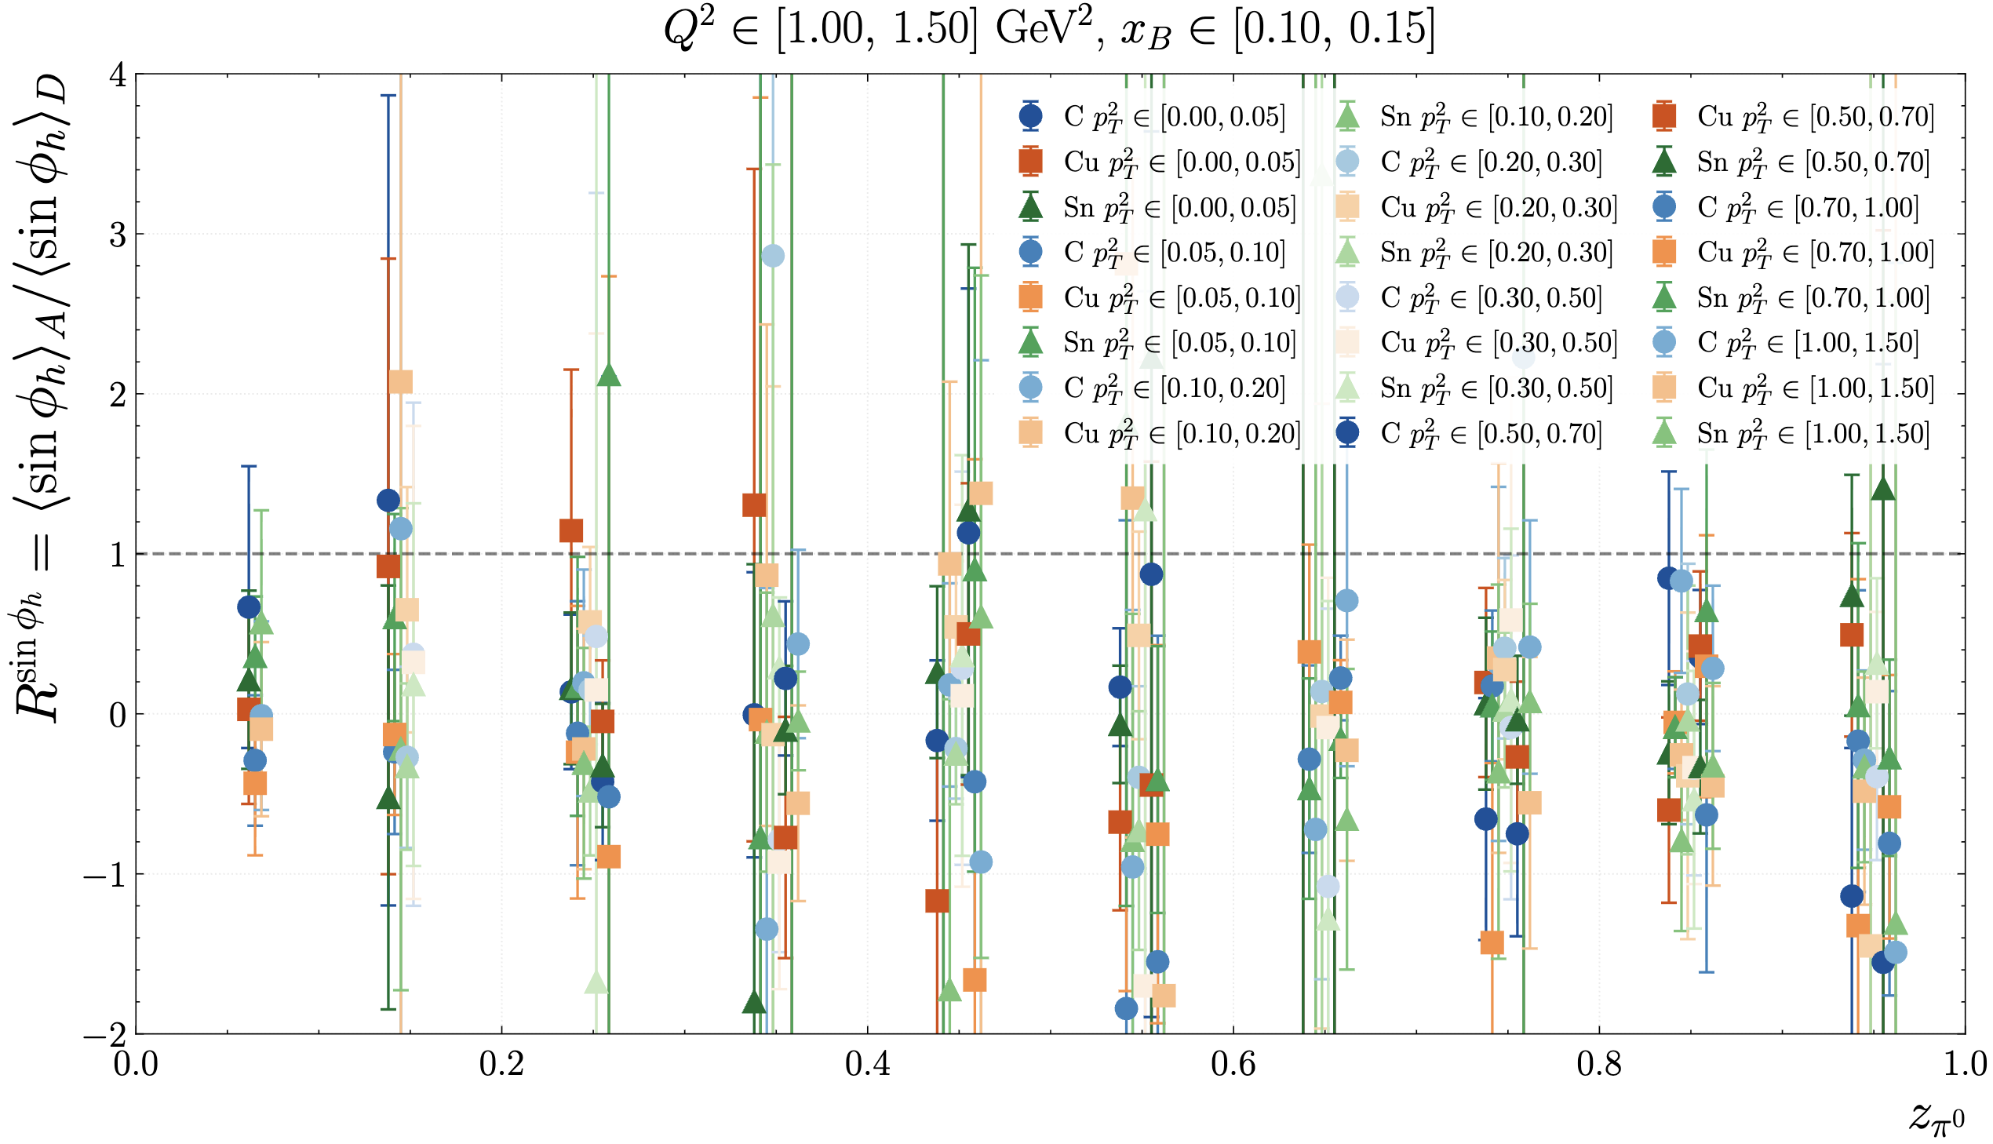
RG-D: π⁰ study
Then extract azithumal modulation:
I need to find how to plot that variable

Slide 24
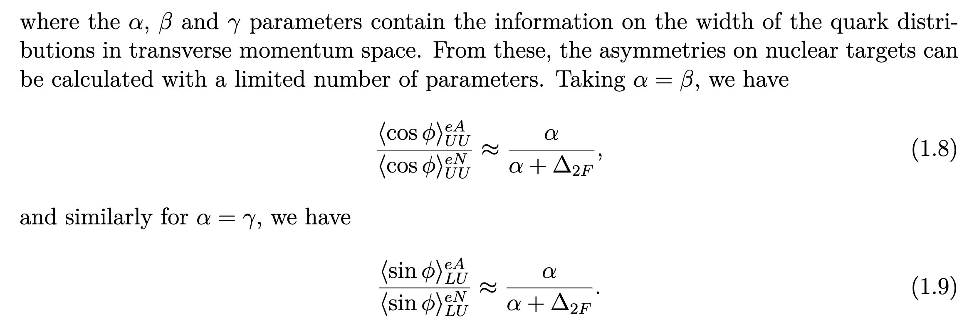
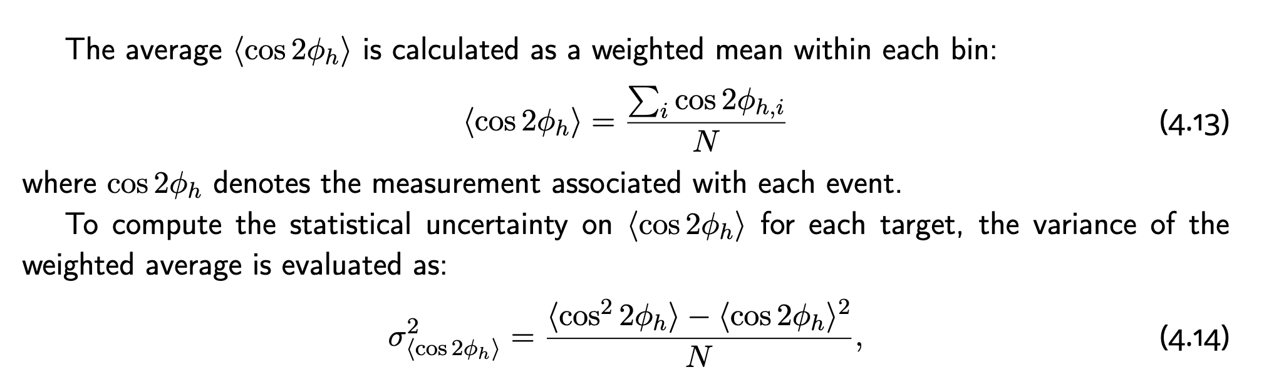
RG-D: π⁰ study
In the NTMDs proposal the observables are:
And from Daniel thesis:
I am not sure how to compute the
sin_{LU}: I think I need to compute
beam spin asymmetry, fit and
extract the sin moment

Slide 25
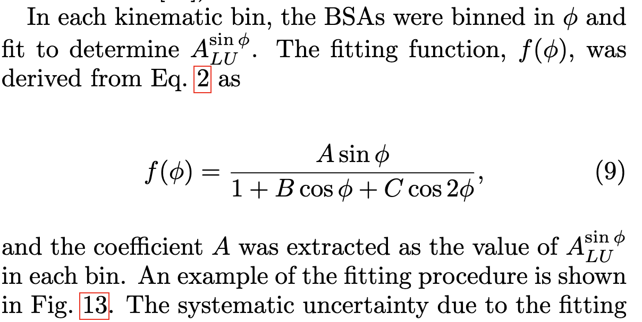
RG-D: π⁰ study
Because we can also extract A_{LU}^{sin}:

Slide 26
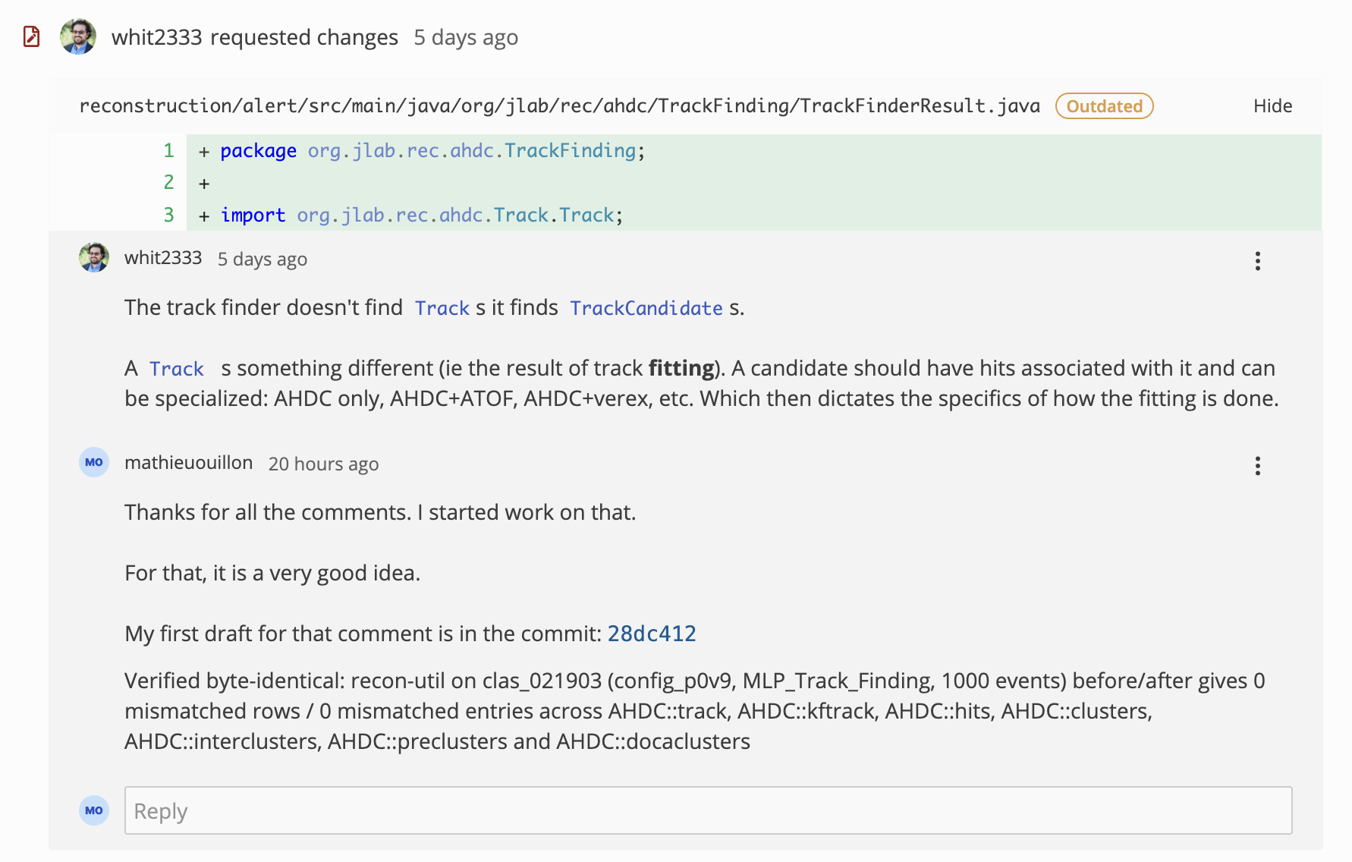
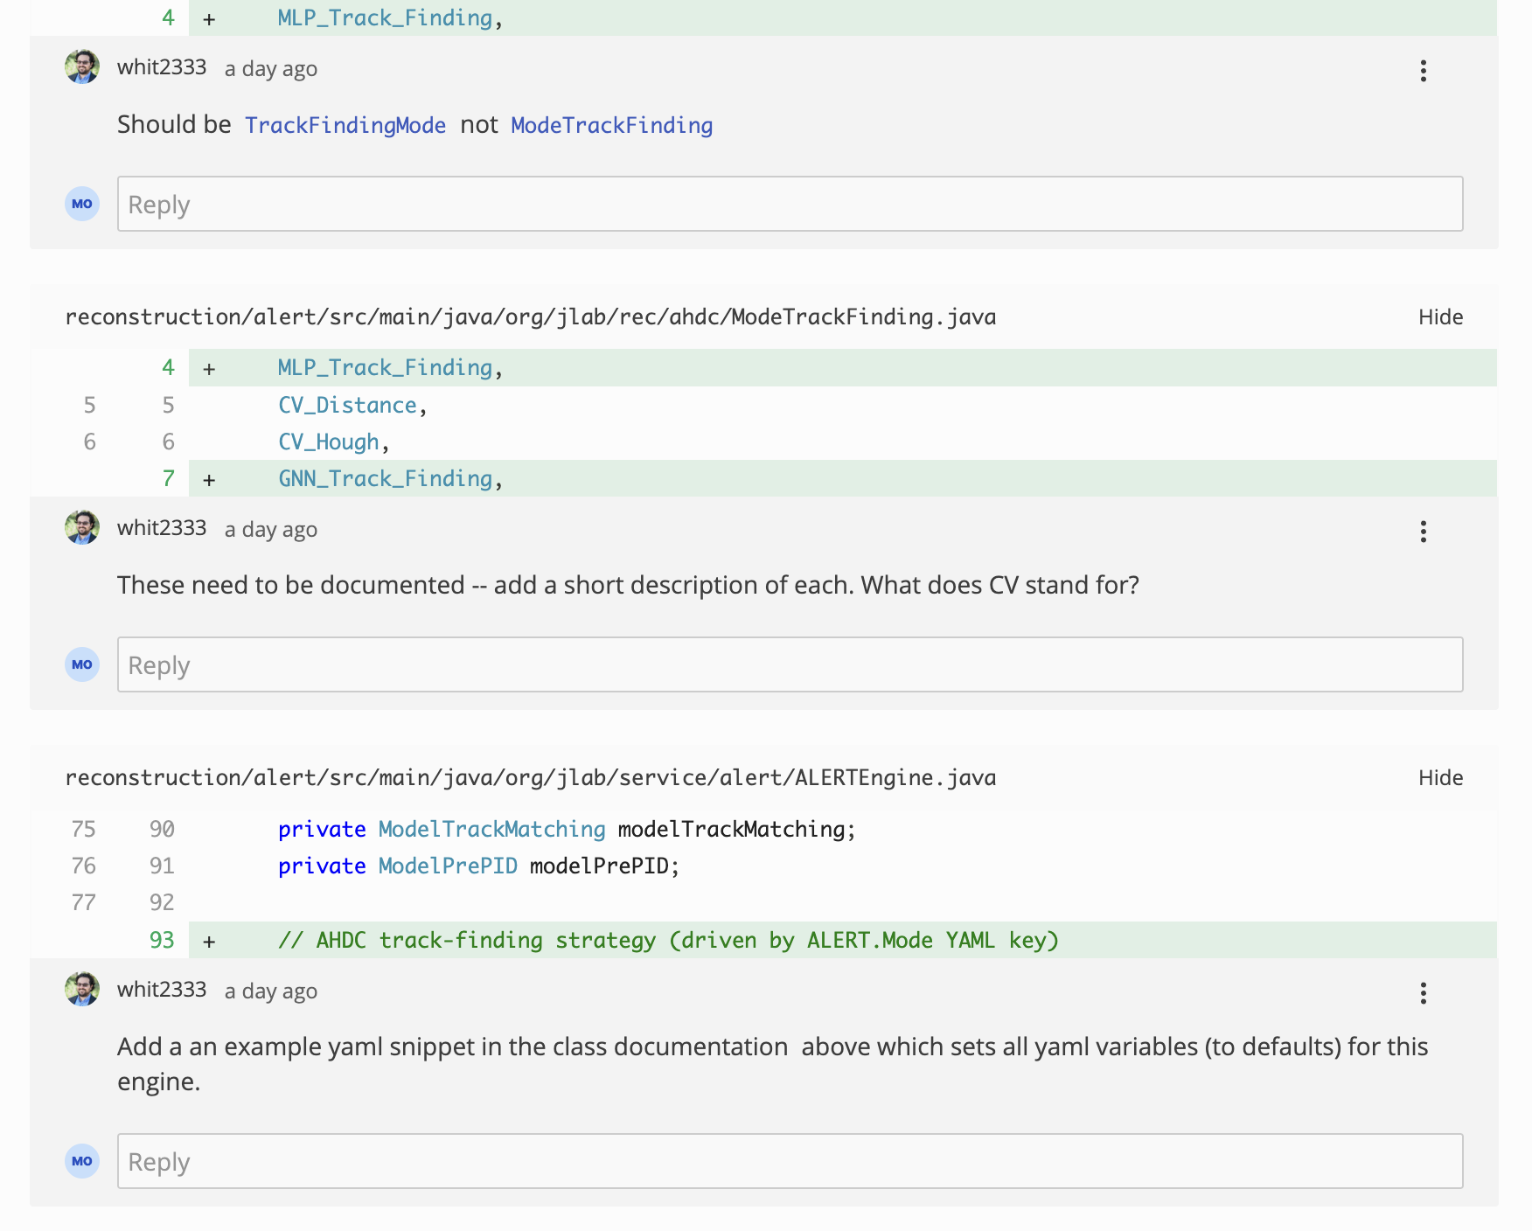
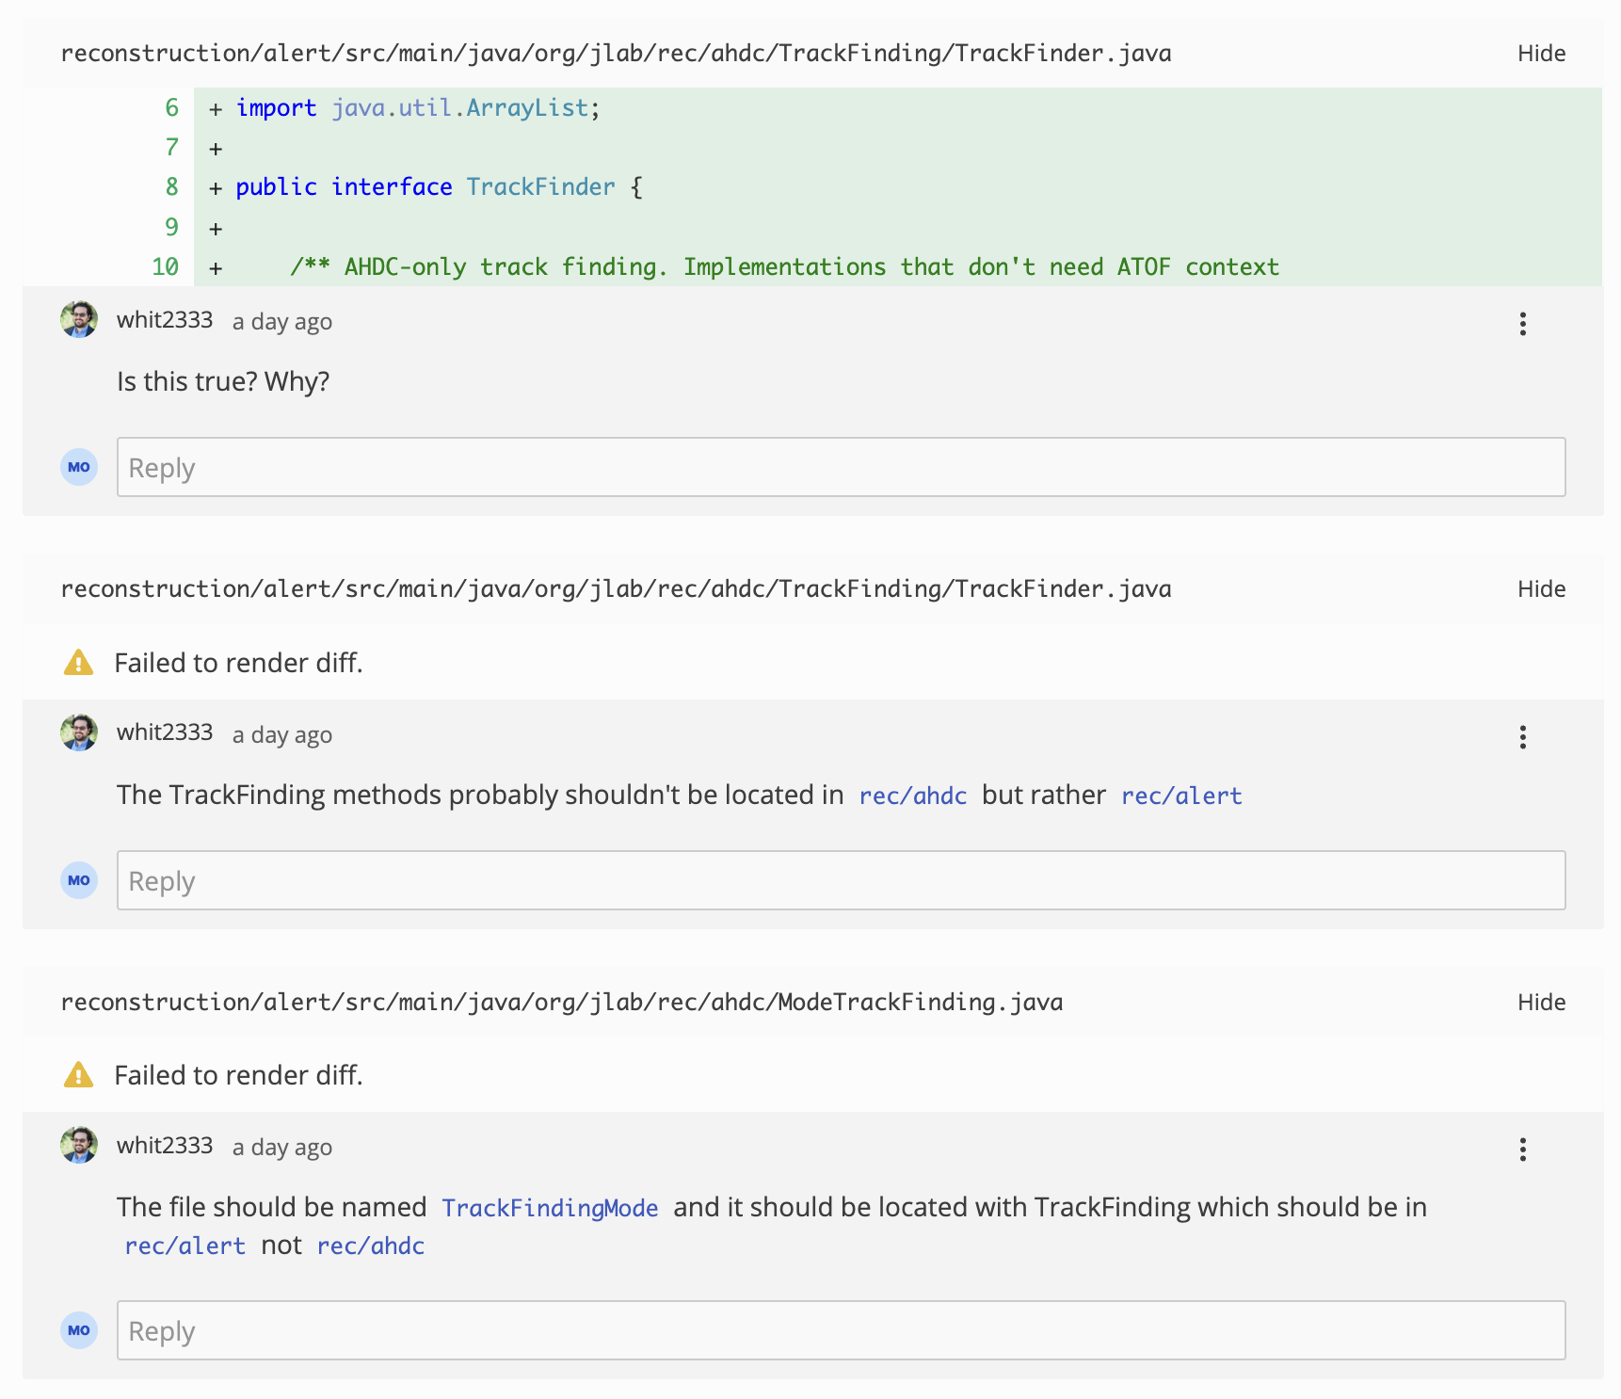
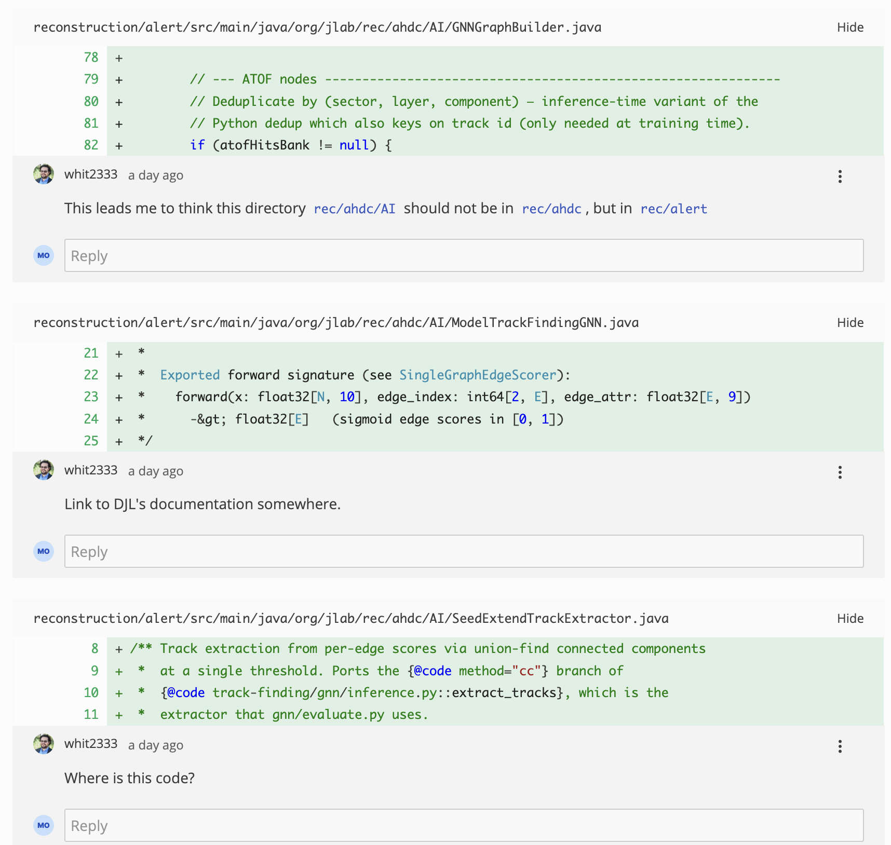
RG-L/ALERT: Pull Request
Whitney give me a lot of comments for the pull request. I started to work on them:

Slide 27
To do list
RG-D:
Contamination study for pions
Continue the work on cos and sin φ_{h} extraction (find which variables to plot and how)
Read more paper/thesis/analysis note about azimuthal moment extraction
Work on the binning
Radiative and acceptance correction
Background for ρ⁰ with simulation for CT analysis
ALERT:
Finishing the pull request for the GNN (reply to comments: Whitney send me some comments)

