Slide 1
Group meeting
Mathieu Ouillon (Mississippi State University)
05/26/26

Slide 2
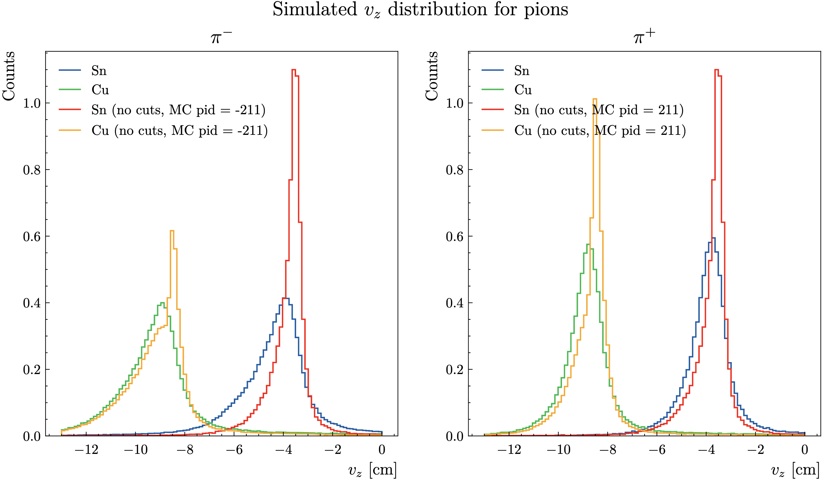
RG-D: Vz correction MC vs Data
Fix an issue in my code: I was applying the VZ correction on MC
For CuSn OB, reconstructed Vz with Δt vs p, chi2pid, momentum, and DC fiducial cuts

Slide 3
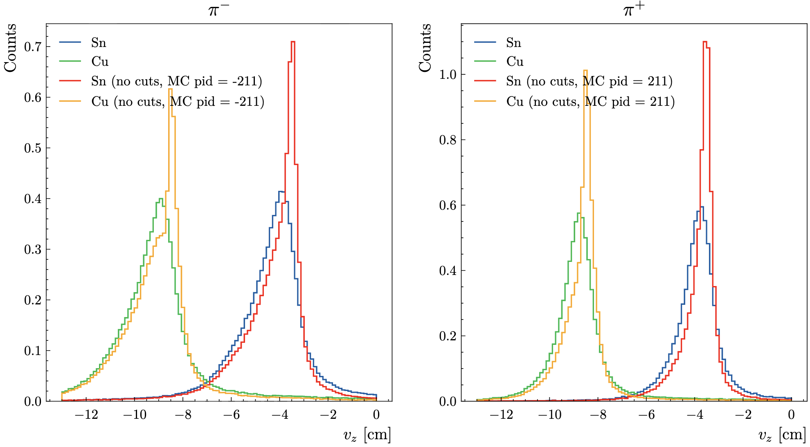
RG-D: Vz correction MC vs Data
Strange Vz distributions, I was expecting a Gaussian distribution
For CuSn OB, reconstructed Vz with Δt vs p, chi2pid, momentum, PCal and DC fiducial cuts

Slide 4
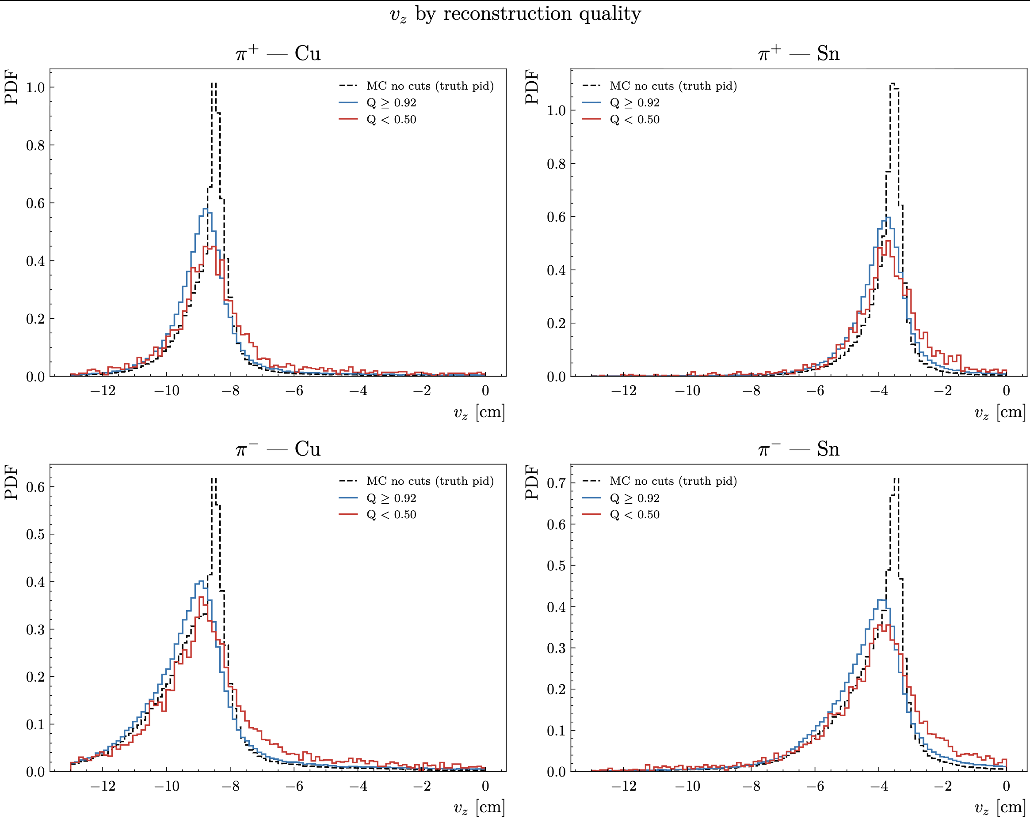
RG-D: Vz correction MC vs Data
Look at the MC no cuts (reconstructed pions that are a pion without any cuts) vs Q > 0.92 (reconstructed pions that are in MC pions) and Q < 0.5 (reconstructed pions that are not a associate to a MC particle)

Slide 5
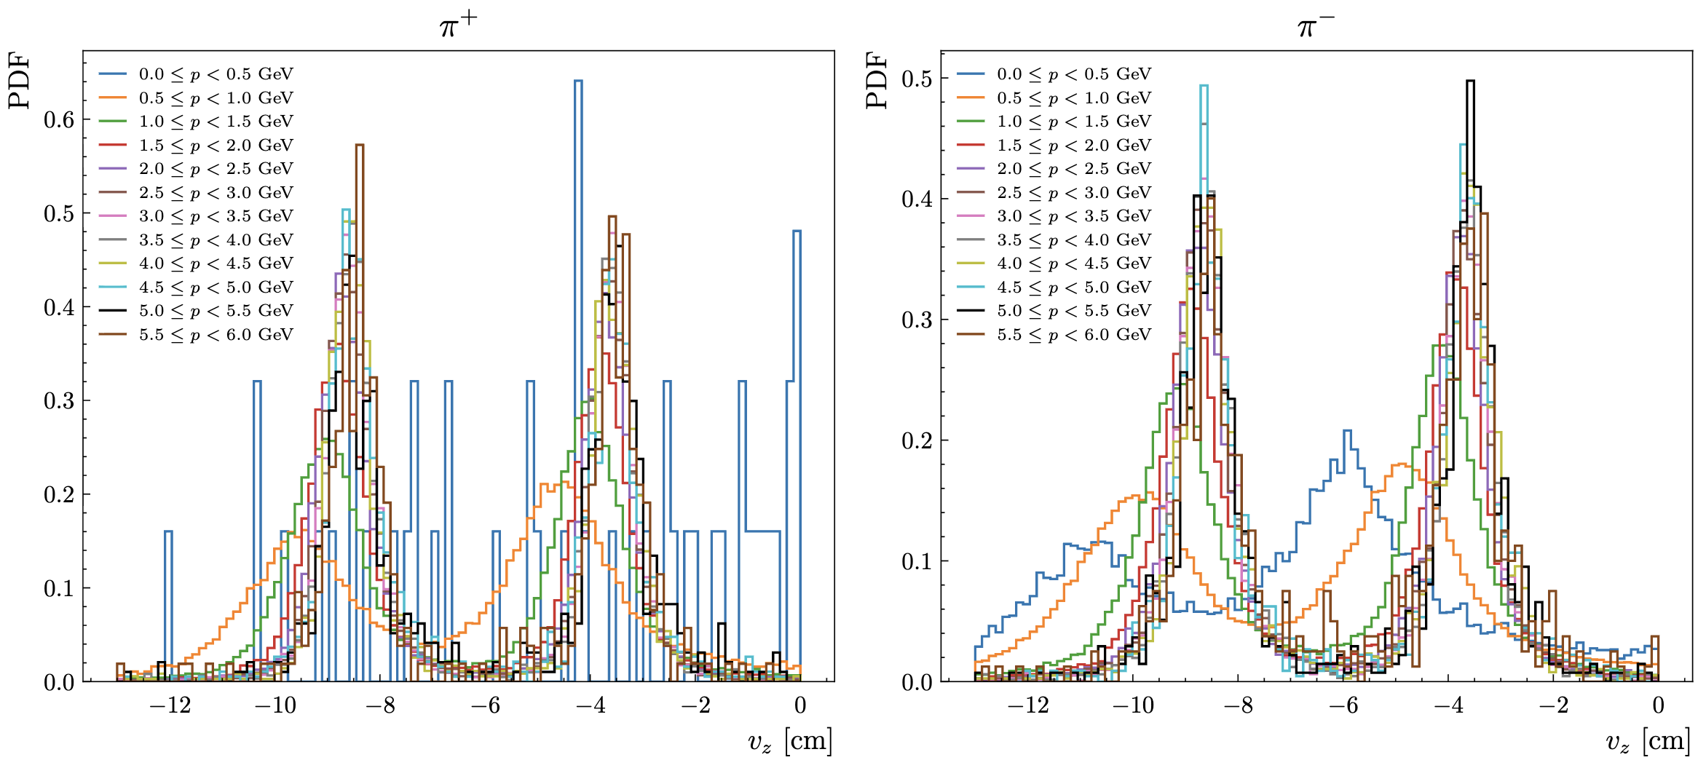
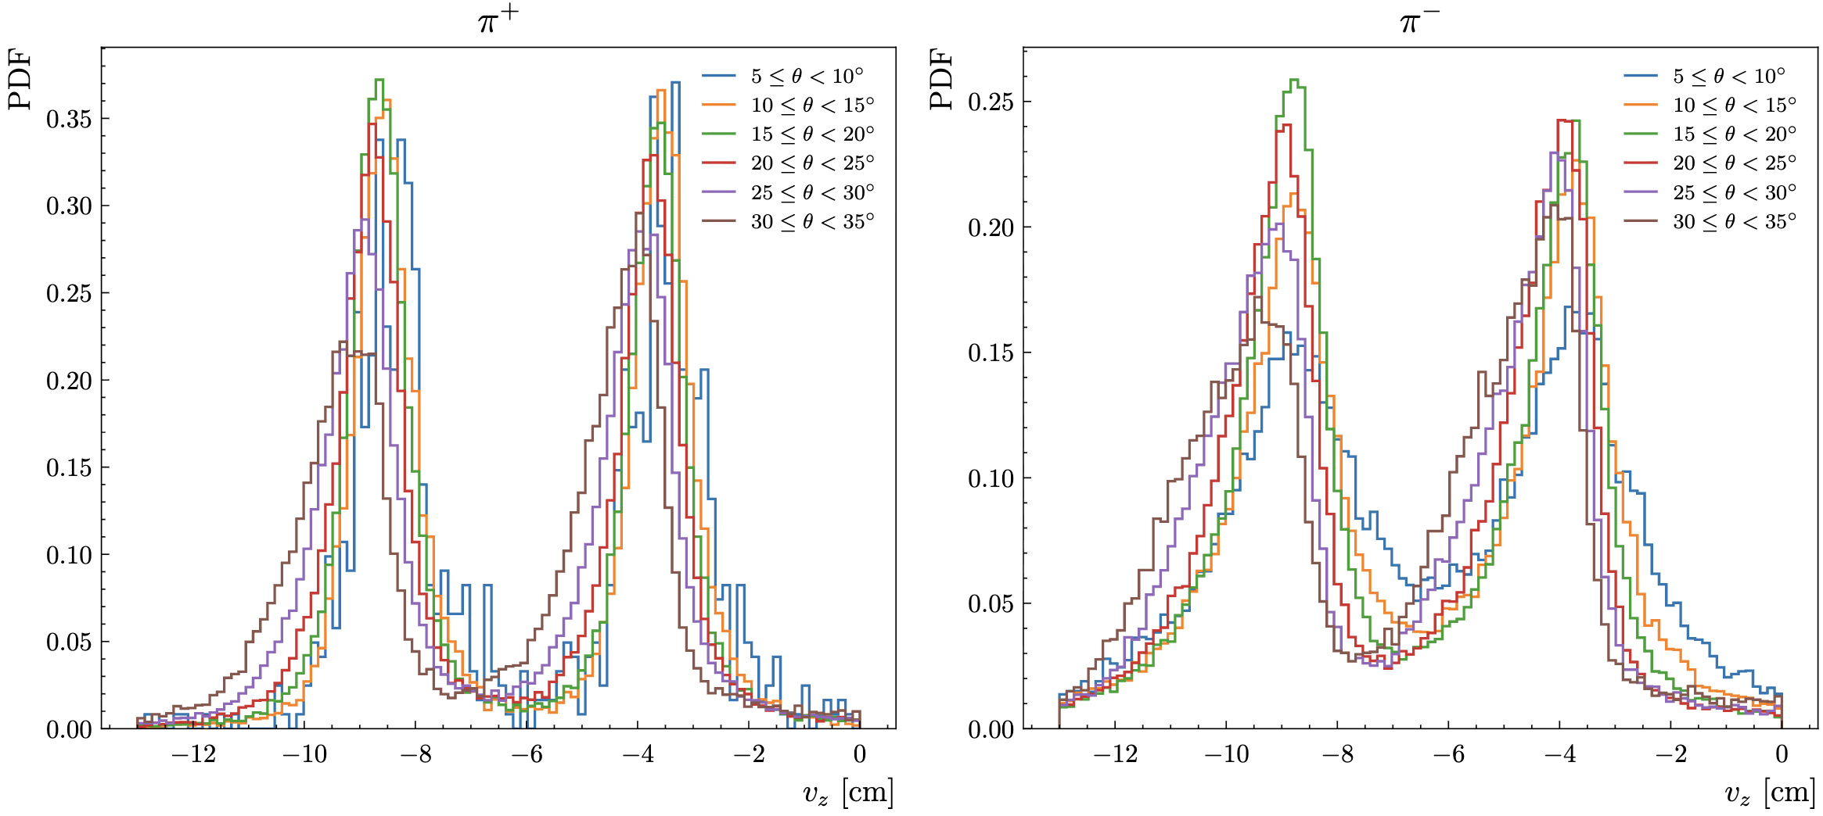
RG-D: Vz correction MC vs Data
All reconstructed pions that pass the usual cuts expect Vz
Pions with a momentum below 1 have a very bad Vz distribution
Same with θ < 10 deg
Even on simulation, interesting

Slide 6
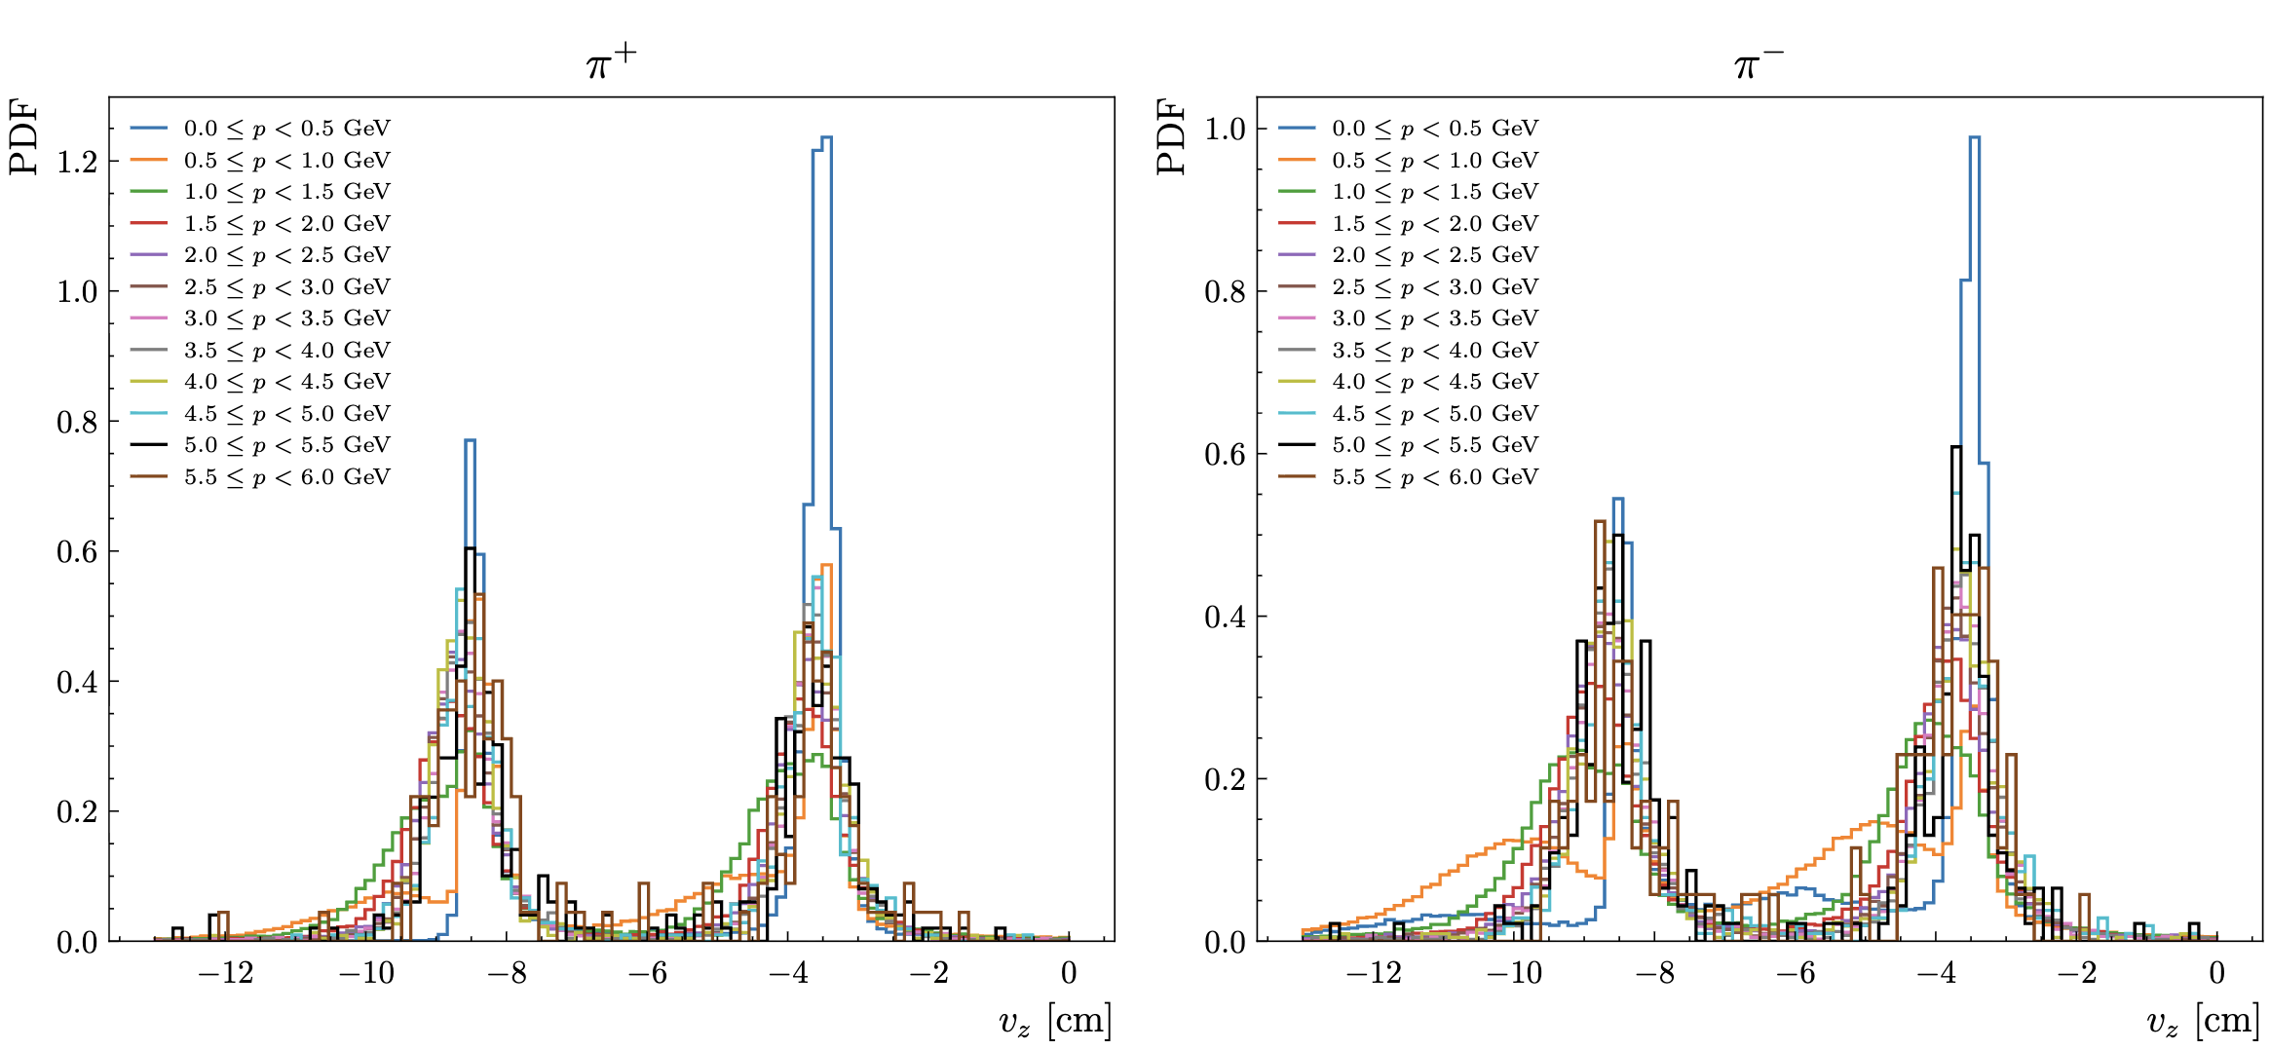
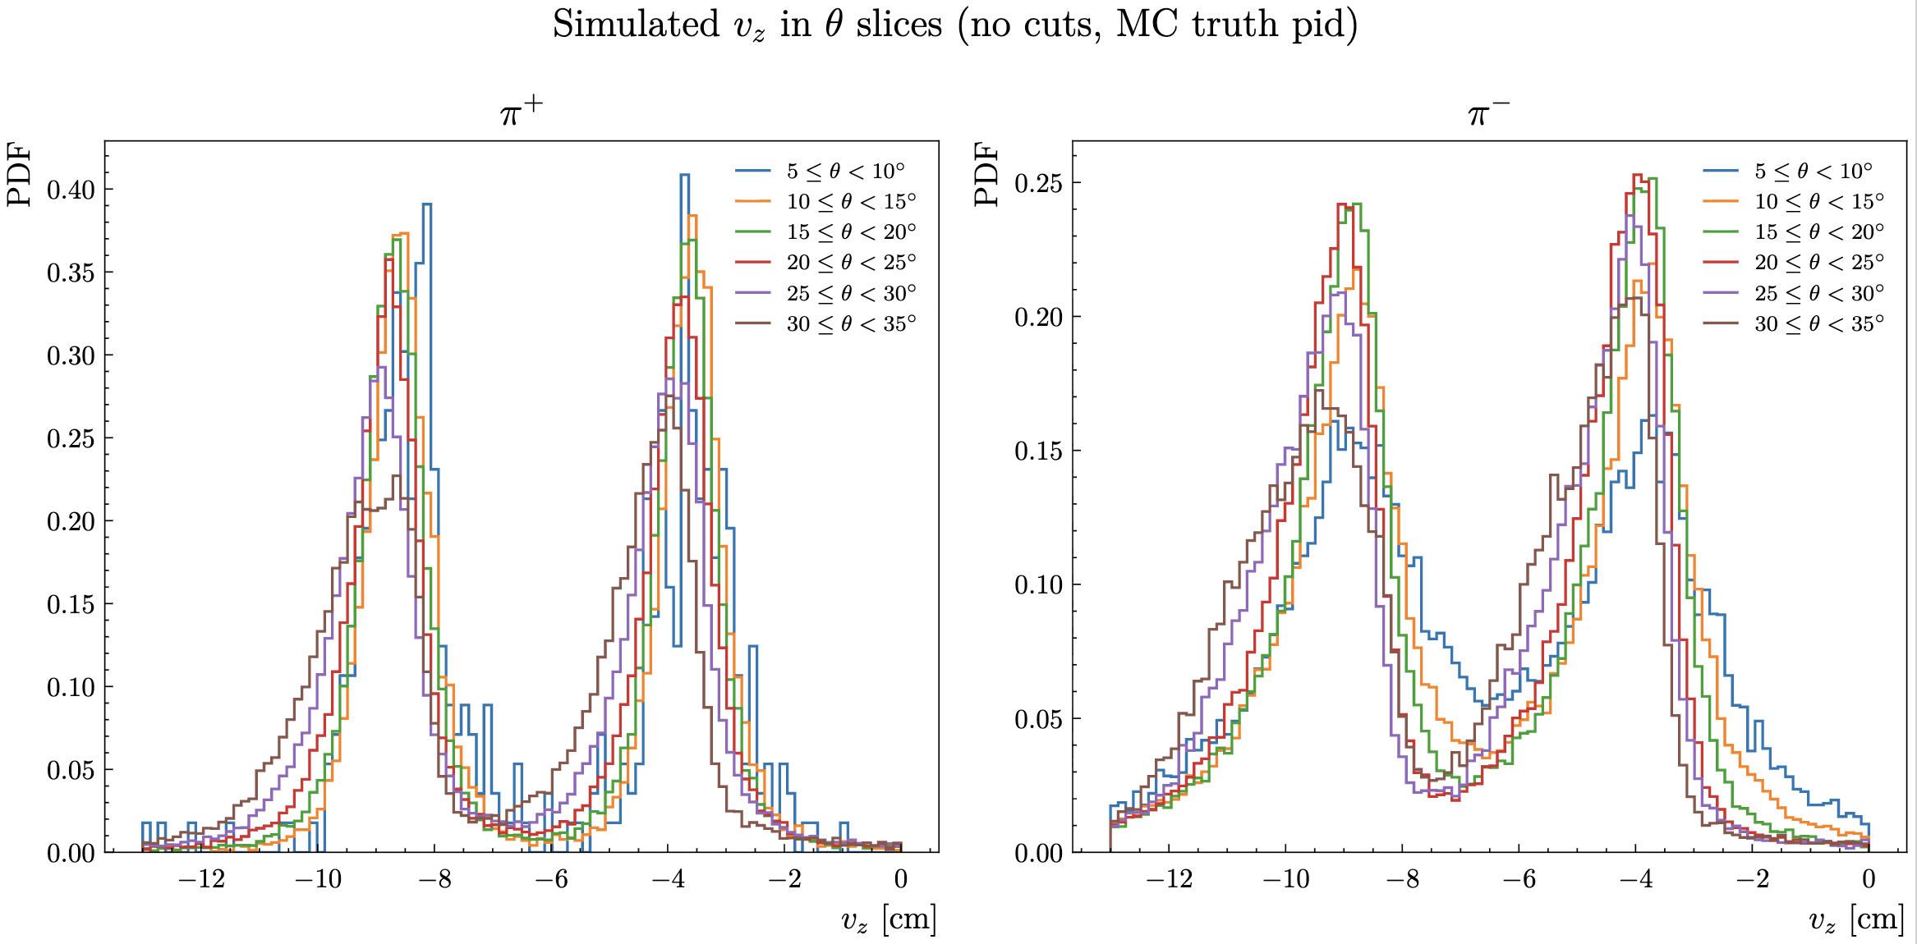
RG-D: Vz correction MC vs Data
Reconstructed pions (|pid|=211) no other cuts + Truth matching, they are real pions (MC)
Pions with a momentum below 1 have a very bad Vz distribution
Same with θ < 10 deg
Even on simulation, interesting

Slide 7
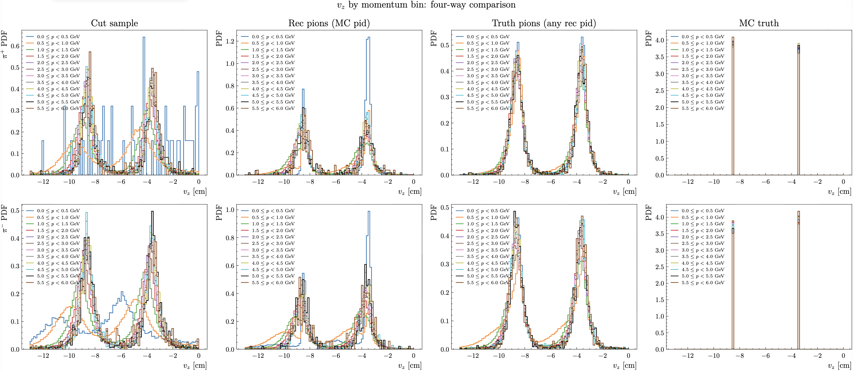
RG-D: Vz correction MC vs Data
After Raffaella comment to try smaller bin and check the generated Vz

Slide 8
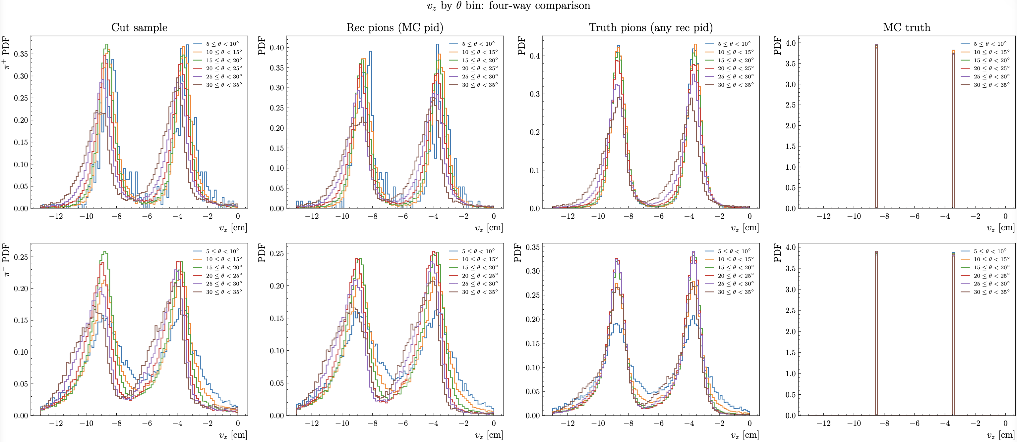
RG-D: Vz correction MC vs Data
After Raffaella comment to try smaller bin and check the generated Vz

Slide 9
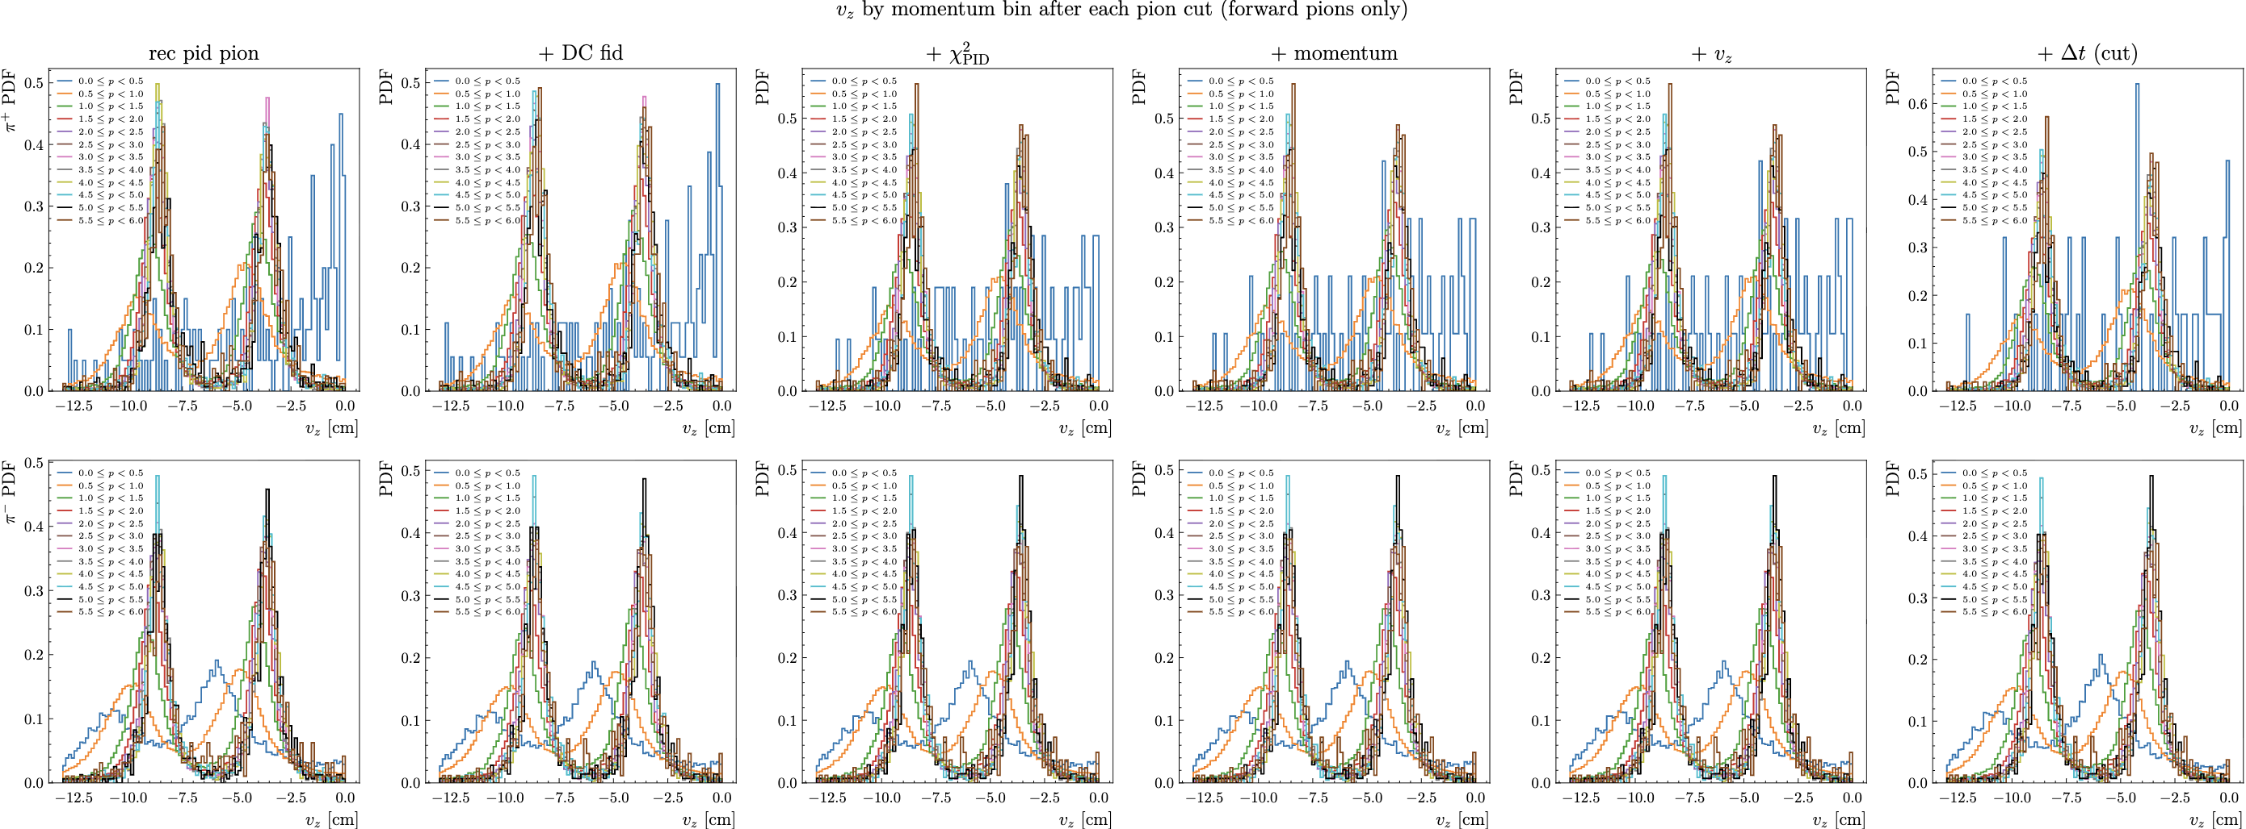
RG-D: Vz correction MC vs Data
After Raffaella comment to try smaller bin and check the generated Vz

Slide 10
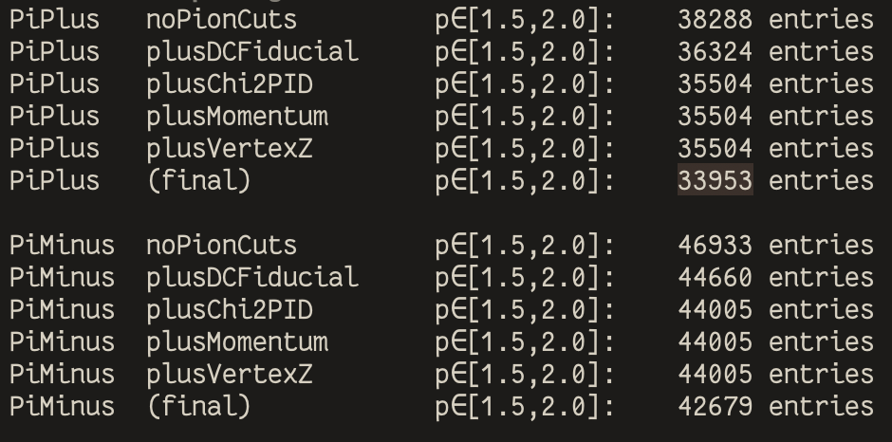
RG-D: Vz correction MC vs Data
After Raffaella comment to try smaller bin and check the generated Vz

Slide 11
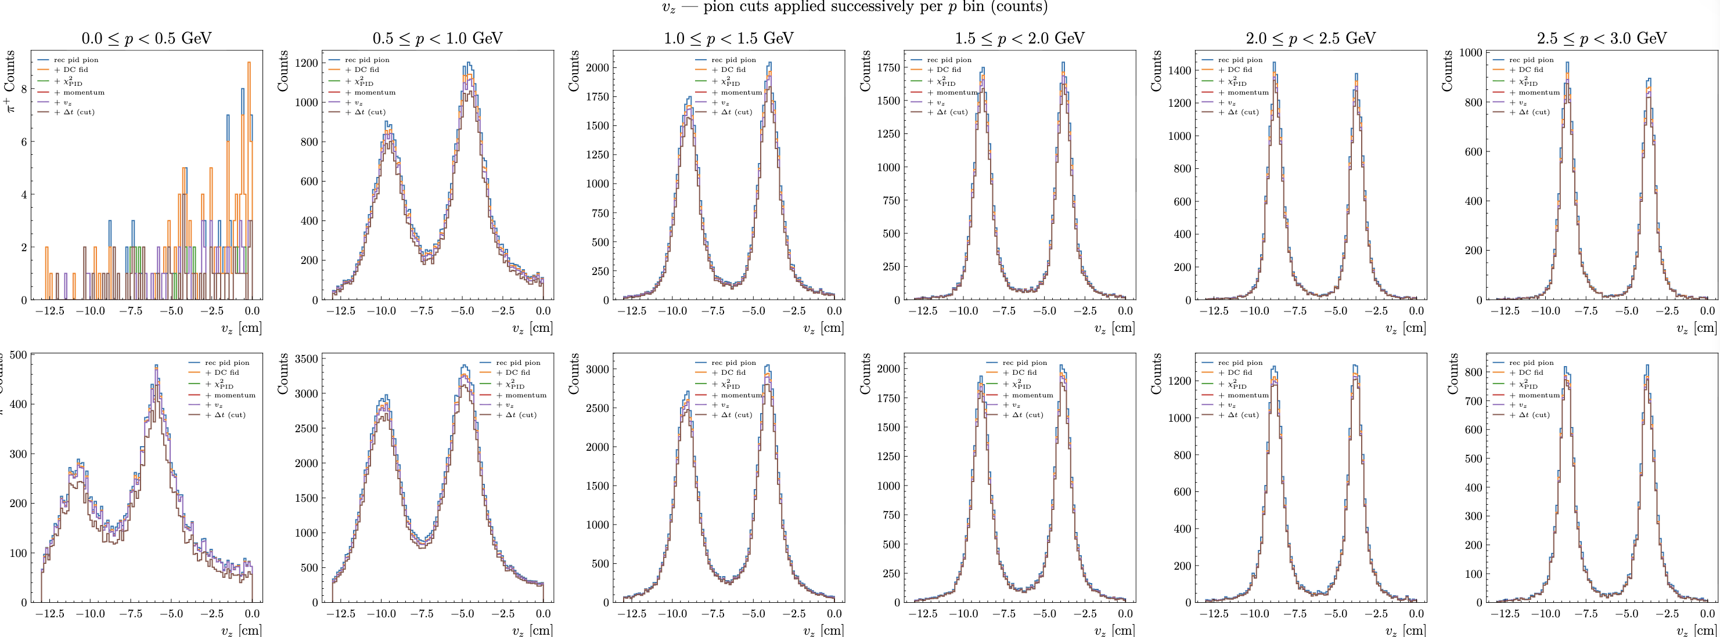
RG-D: Vz correction MC vs Data
After Raffaella comment to try smaller bin and check the generated Vz

Slide 12
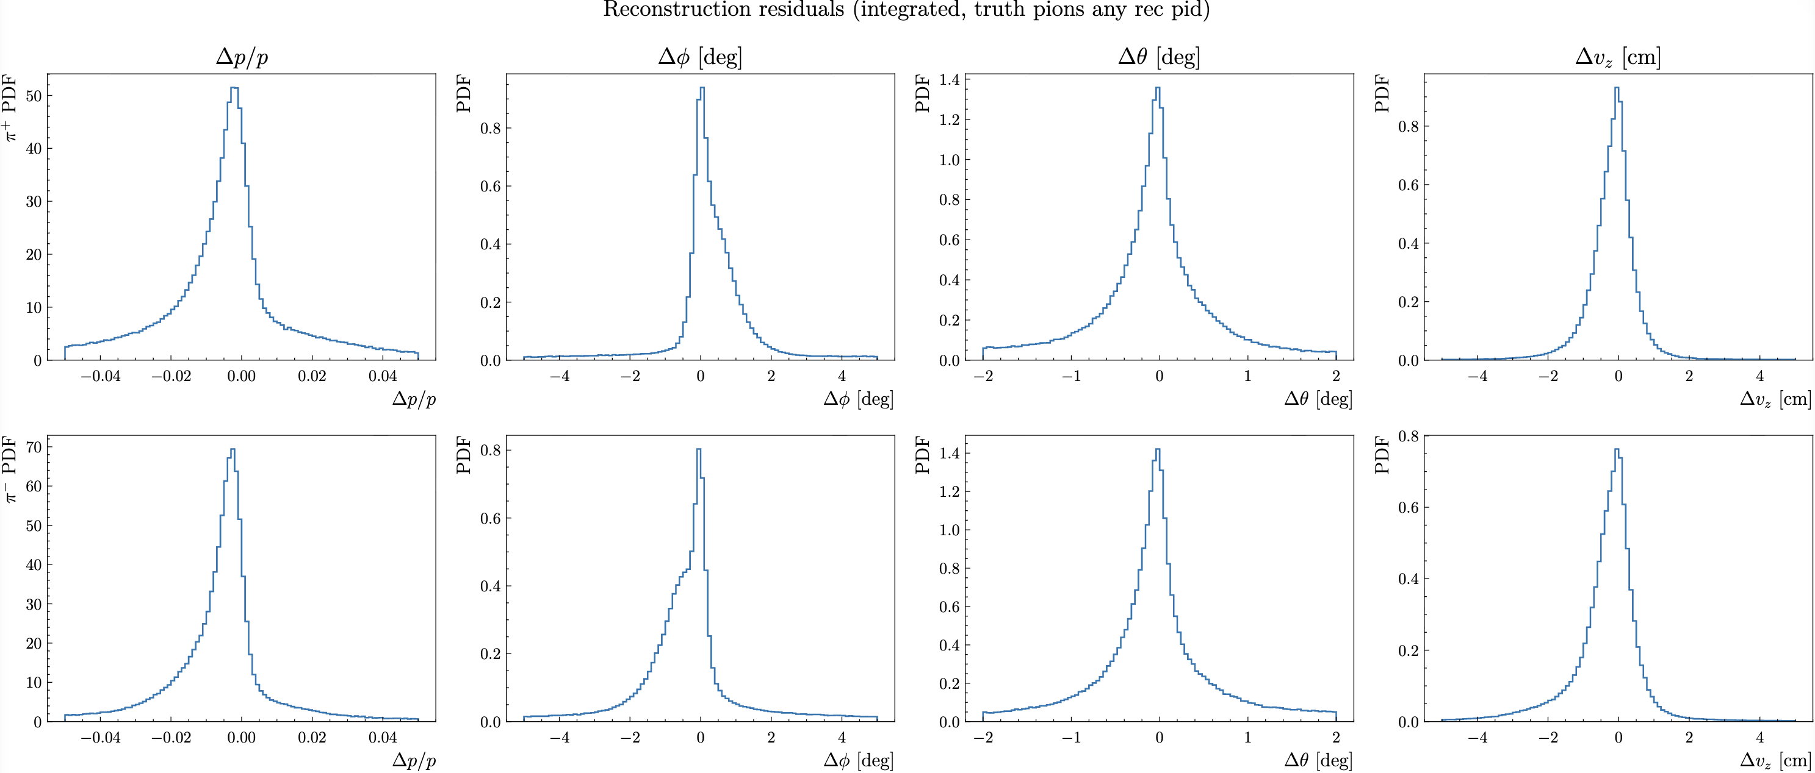
RG-D: Vz correction MC vs Data
Some comparison between Truth and Reconstructed pions in MC for all particle that are pions

Slide 13
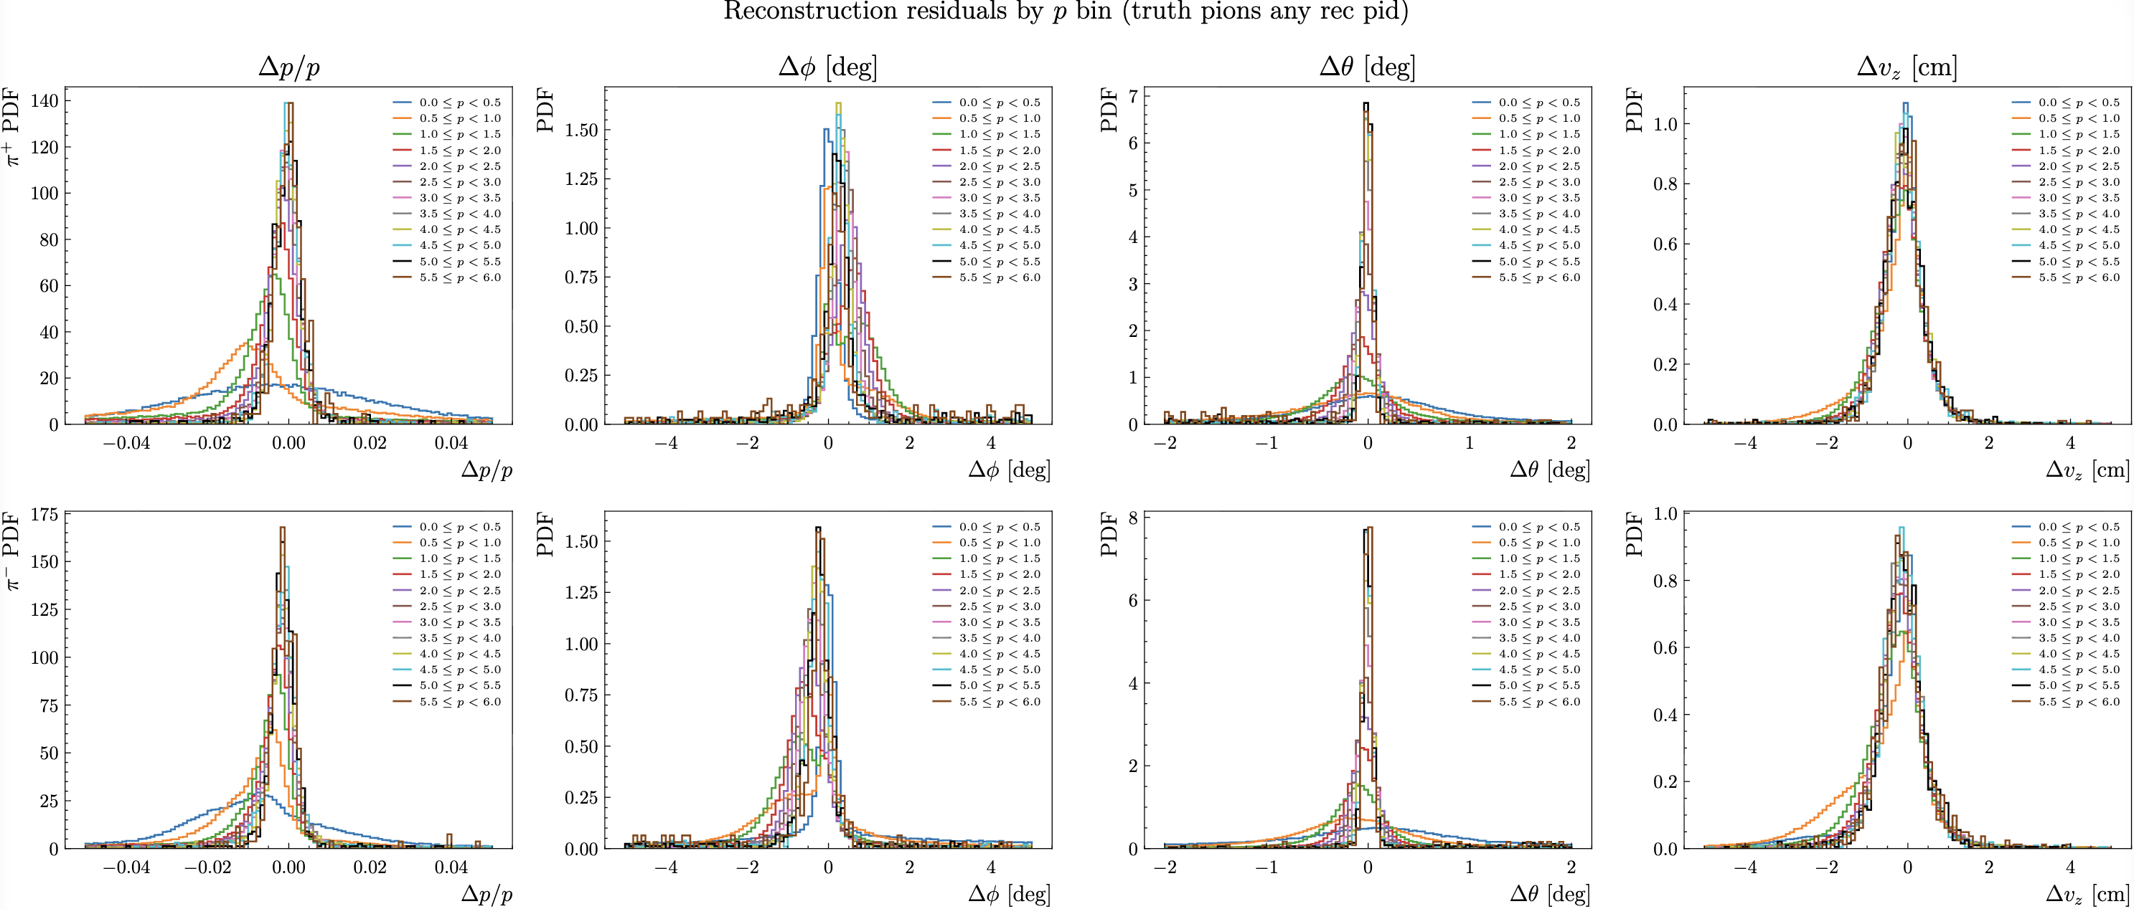
RG-D: Vz correction MC vs Data
Some comparison between Truth and Reconstructed pions in MC for all particle that are pions

Slide 14
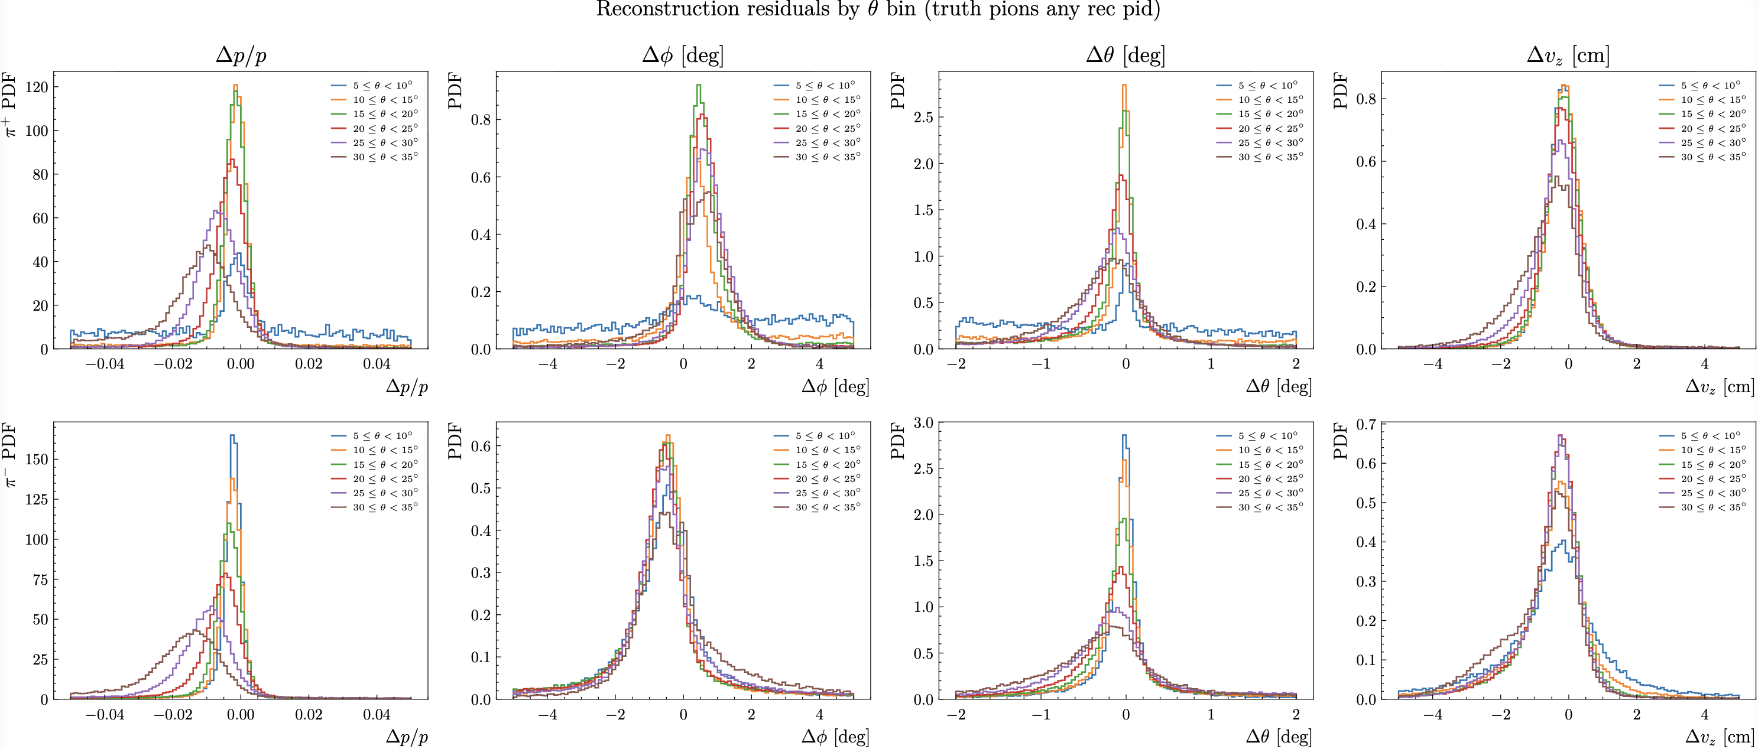
RG-D: Vz correction MC vs Data
Some comparison between Truth and Reconstructed pions in MC for all particle that are pions

Slide 15
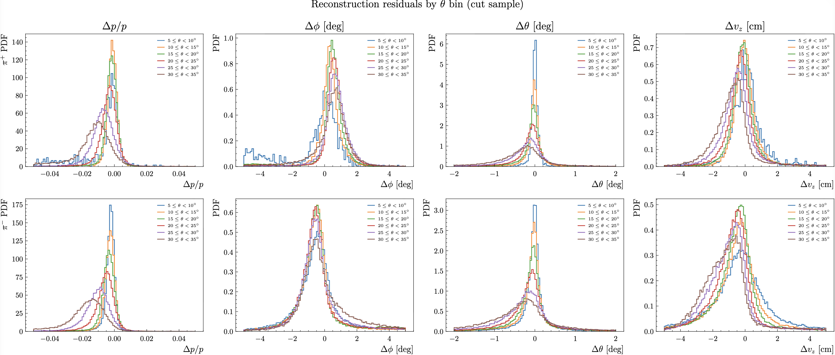
RG-D: Vz correction MC vs Data
Some comparison between Truth and Reconstructed pions in MC for REC pions that pass cuts

Slide 16
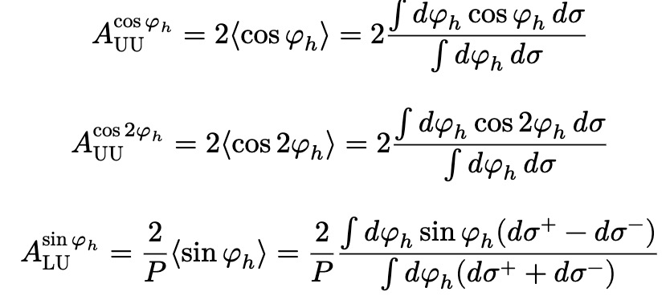
RG-D: ᴨ⁰ Analysis
I have extracted multiplicity ratio and p_{T} broadening, the next step is azimuthal modulation:
First, it took me some time to understand A_{LU} and <cosφ_{h}> are the same things

Slide 17
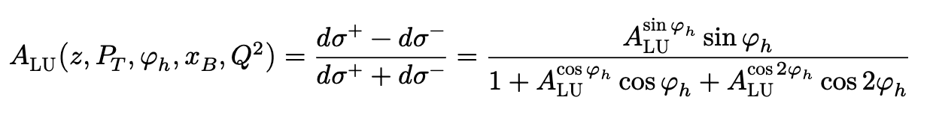
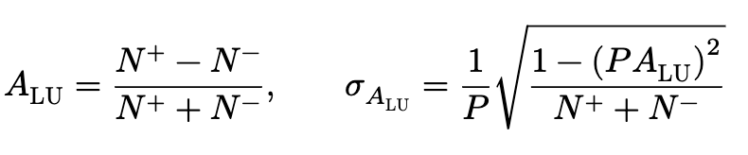
RG-D: ᴨ⁰ Analysis
I have extracted multiplicity ratio and p_{T} broadening, the next step is azimuthal modulation:
First, it took me some time to understand A_{LU} and <cosφ_{h}> are the same things
Two techniques to extract these observables: BSA fitting and Unbinning Maximum Likelihood
Then it was much easier, BSA are defined thus:
where 𝑑𝜎+ and 𝑑𝜎− are the differential cross sections for each beam helicity state (+/-)
BSA can be extracted from the number of counts with positive and negative helicity (𝑁±_{𝑖} ) in a specific bin 𝑖 as:

Slide 18
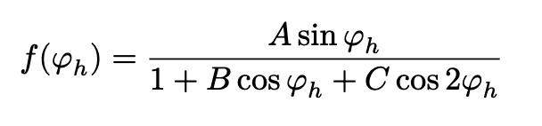
RG-D: ᴨ⁰ Analysis
I have extracted multiplicity ratio and p_{T} broadening, the next step is azimuthal modulation:
In each kinematic bin, the BSAs were binned in 𝜑ℎ and fit to determine 𝐴^{sin 𝜑ℎ}_{LU} , 𝐴^{cos𝜑ℎ}_{UU} , and 𝐴^{cos 2𝜑ℎ} _{UU} .
The fitting function 𝑓(𝜑ℎ) was derived from the expression for 𝐴_{LU}:
Come mostly from: Beam-spin Asymmetries from Semi-inclusive Pion Electroproduction https://arxiv.org/pdf/1402.4097

Slide 19
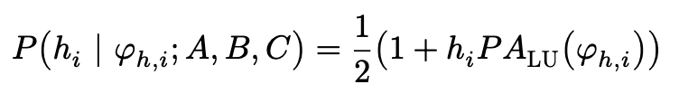
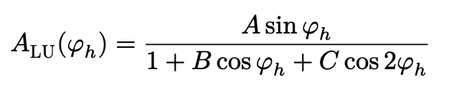
RG-D: ᴨ⁰ Analysis
I have extracted multiplicity ratio and p_{T} broadening, the next step is azimuthal modulation:
Other method to extract these asymmetry amplitudes: unbinned maximum likelihood
This avoids any dependence on the choice of binning in 𝜑_{ℎ} and makes optimal use of the available statistics, which is especially advantageous in sparsely populated multidimensional kinematic bins.
For a longitudinally polarized beam and an unpolarized target, the probability for a single event 𝑖 with measured azimuthal angle 𝜑_{ℎ,𝑖} and helicity state ℎ_{𝑖} = ±1 is
where 𝑃 is the average magnitude of the beam polarization and 𝐴LU(𝜑ℎ) carries the same functional form used for the binned fit,

Slide 20
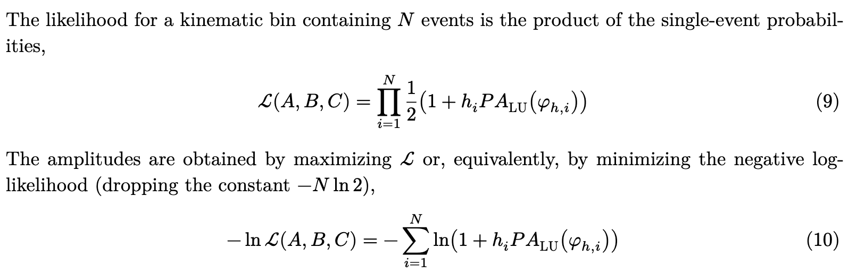
RG-D: ᴨ⁰ Analysis
I have extracted multiplicity ratio and p_{T} broadening, the next step is azimuthal modulation:
Other method to extract these asymmetry amplitudes: unbinned maximum likelihood
References (2 CLAS note/analysis note from Timothy B. Hayward):
https://www.jlab.org/Hall-B/shifts/admin/paper_reviews/2020/Note_CLAS_Dihadron_BSA_
PRL_from_RGA-6137329-2020-08-31-v1.pdf
https://clas12-docdb.jlab.org/DocDB/0011/001176/001/CLAS_MLM_Analysis_Note.pdf

Slide 21
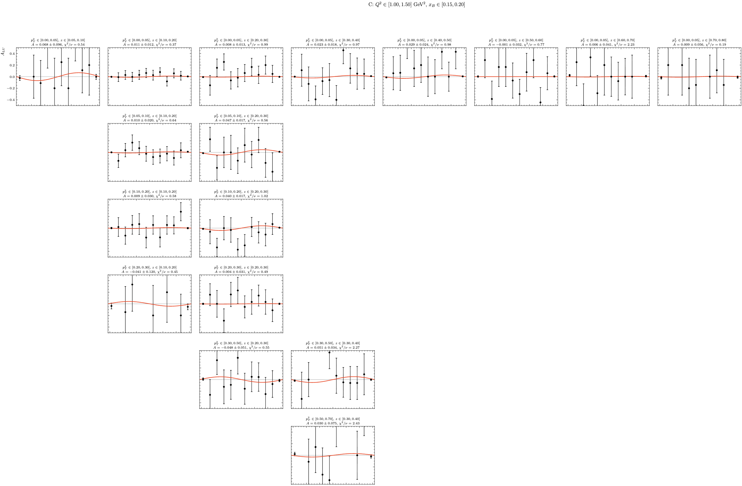
RG-D: ᴨ⁰ Analysis
Started working on BSA extraction with bin and chi2 fit:
Started with an easier fit function: 𝑓(𝜑_{ℎ}) = Asin(𝜑_{ℎ})
Lot of empty bin and low statistics:
1344 bins in Q2,xB,pT and z * 12 bin in 𝜑_{ℎ}
Too many bins need to reduce that

Slide 22
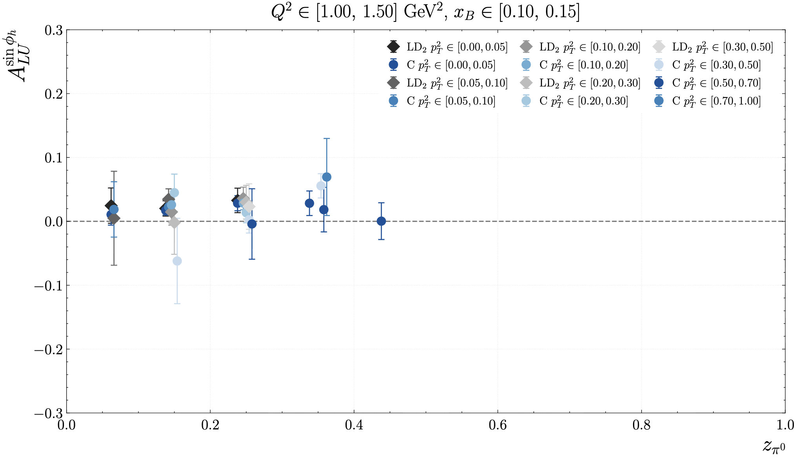
RG-D: ᴨ⁰ Analysis
Started working on BSA extraction with bin and chi2 fit:
Started with an easier fit function: 𝑓(𝜑_{ℎ}) = Asin(𝜑_{ℎ})
But can extract something at least
My plan would be to use UML as systematic error

Slide 23
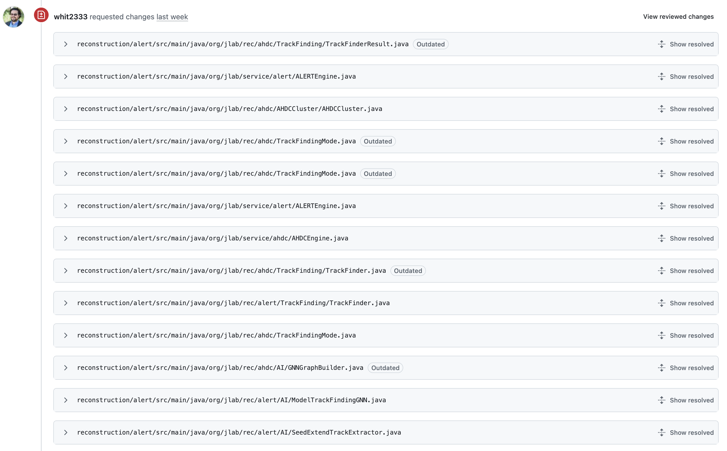
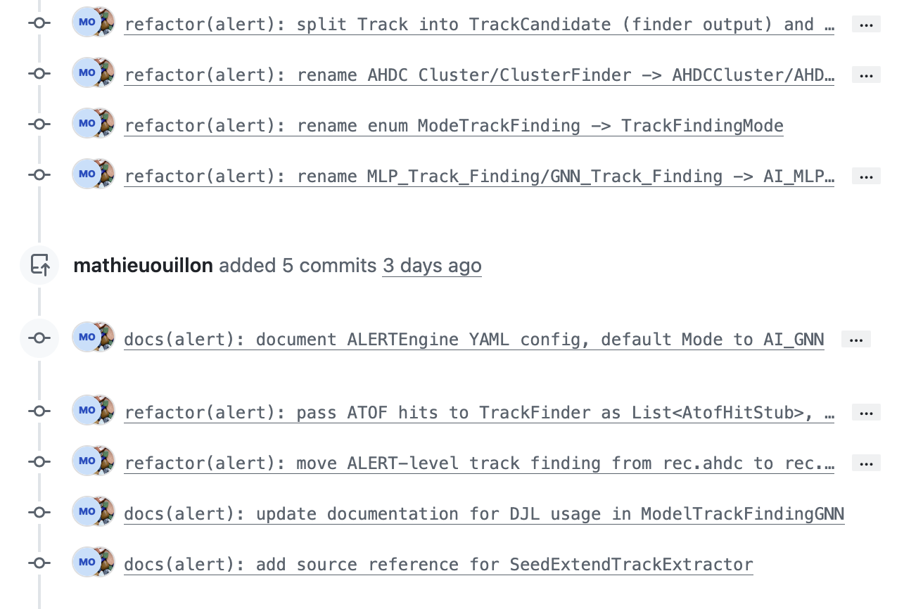
RG-L: GNN Pull Request
I also worked on the comment left by Whitney about the GNN. I respond to all of them. And Nathan merge it today
Now I am waiting for him to reply.

Slide 24
To do list
RG-D:
Contamination study for pions/Understanding Vz for pion in simulation
Work on the binning
Continue the work on cos and sin φ_{h} extraction
Radiative and acceptance correction
Background for ρ⁰ with simulation for CT analysis
Write README and analysis details about the code

