Slide 1
Group meeting
Mathieu Ouillon (Mississippi State University)
06/02/26

Slide 2
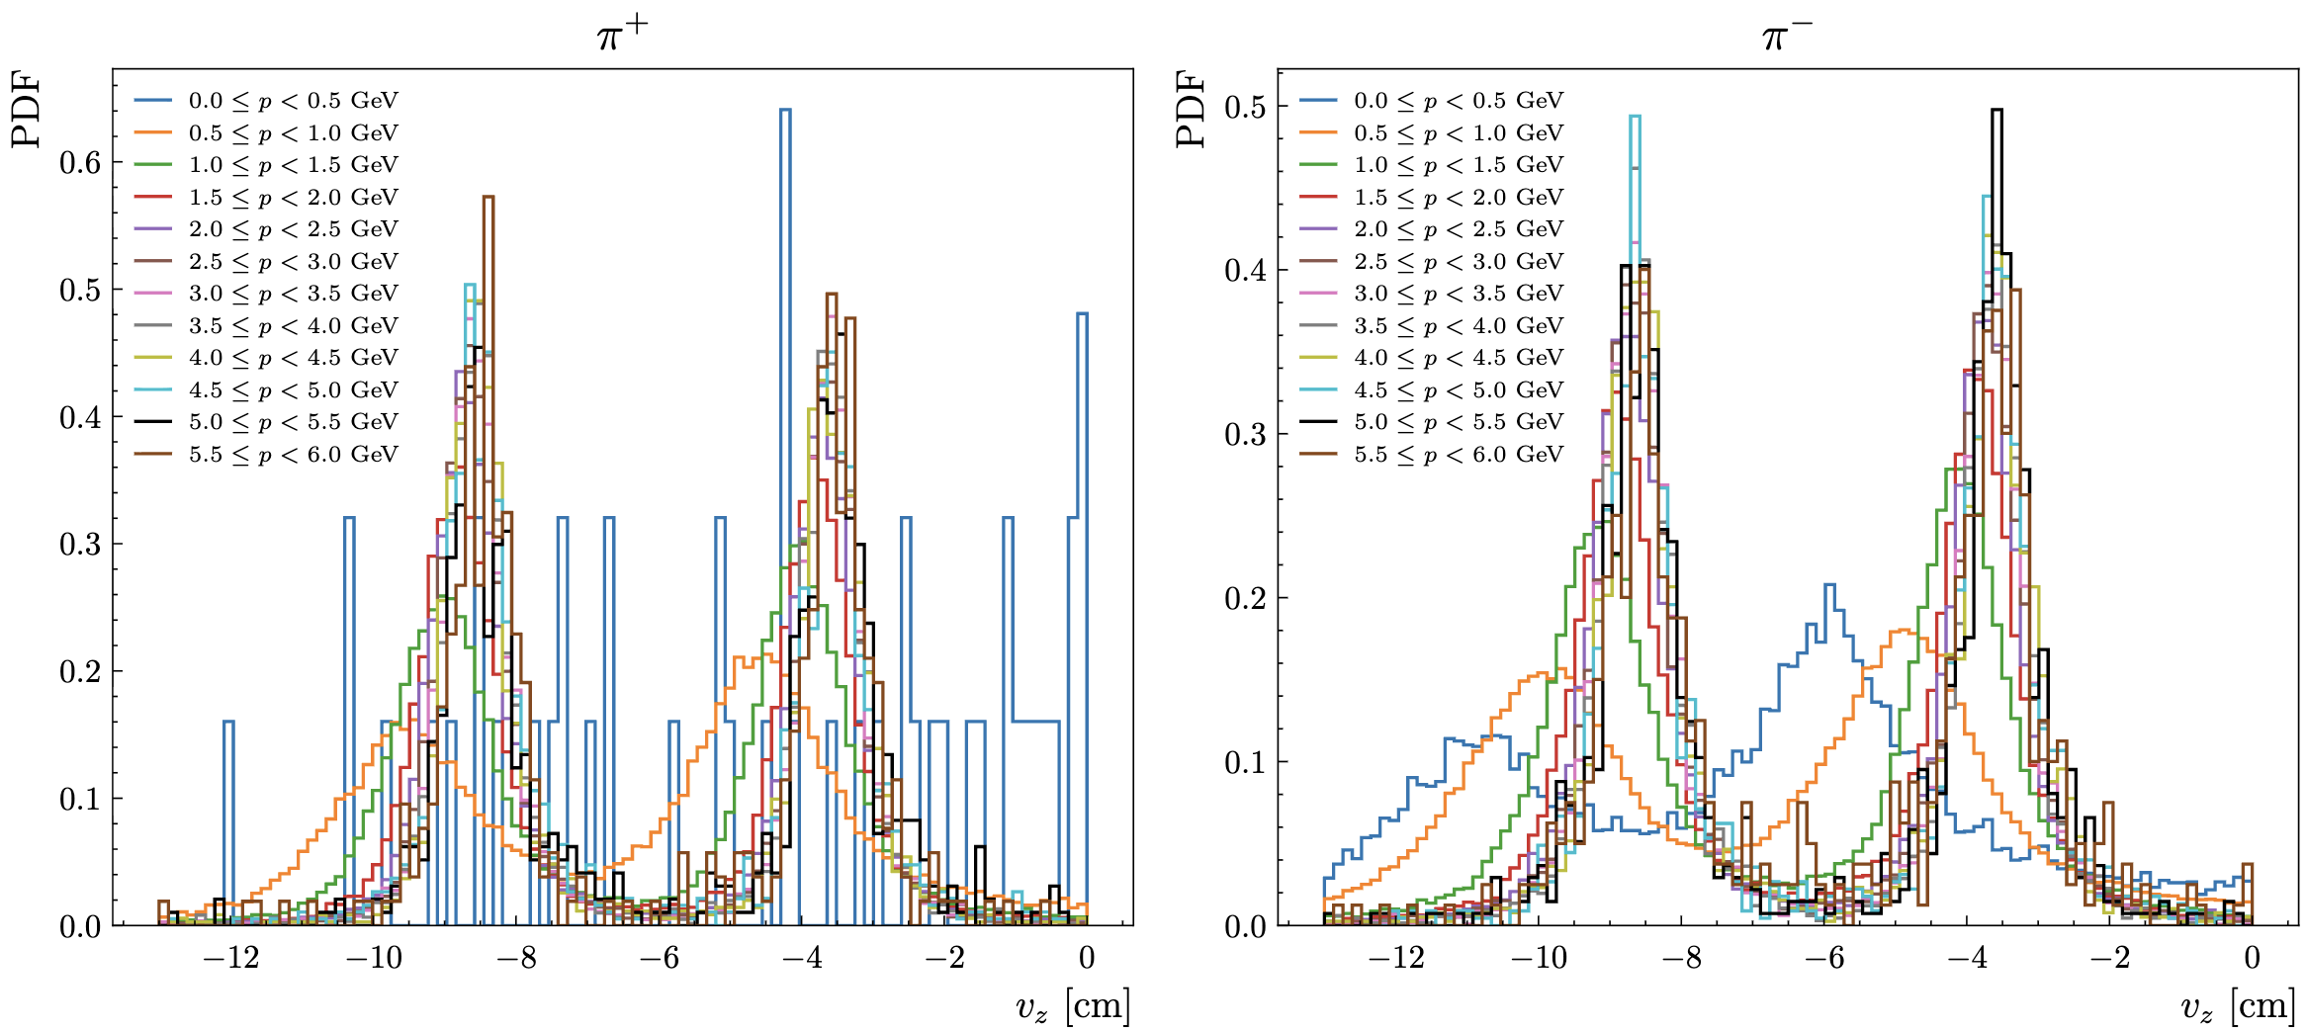
RG-D: MC Pion
Try to understand the shift in the Vz distribution for pion that I see in simulation:

Slide 3
RG-D: MC Pion
I discuss with Raffaella, and her first idea was: the shift could come from pion decay into muon:
A muon would be reconstructed as pion by COATJAVA
That would shift in one direction the Vz of the reconstructed pion (that is a muon in reality)
To check that I have generated single pion and single muon event (using particle gun from GEMC)
And we can compare Vz distribution for low momentum reconstructed pion for truth pion and truth muon, if the shift come from the pion decay into muon then the shift should be visible only for truth pions

Slide 4
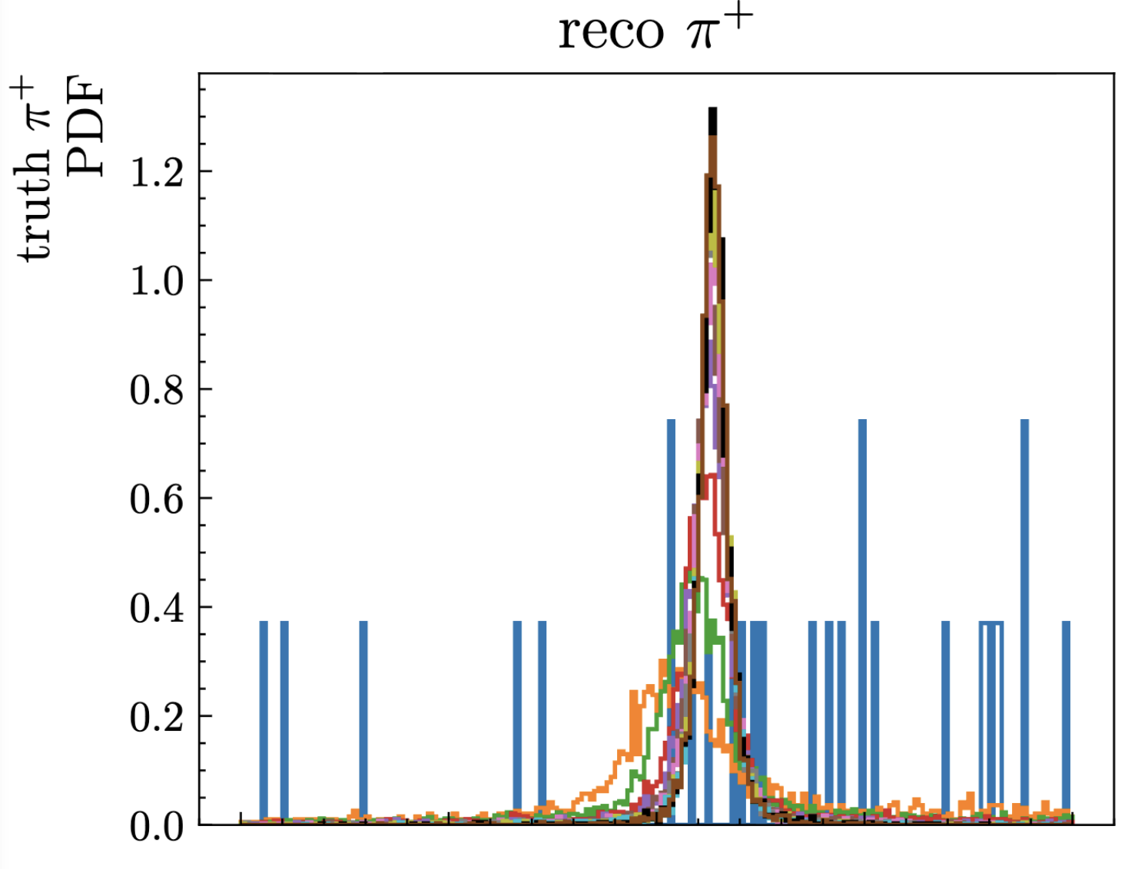
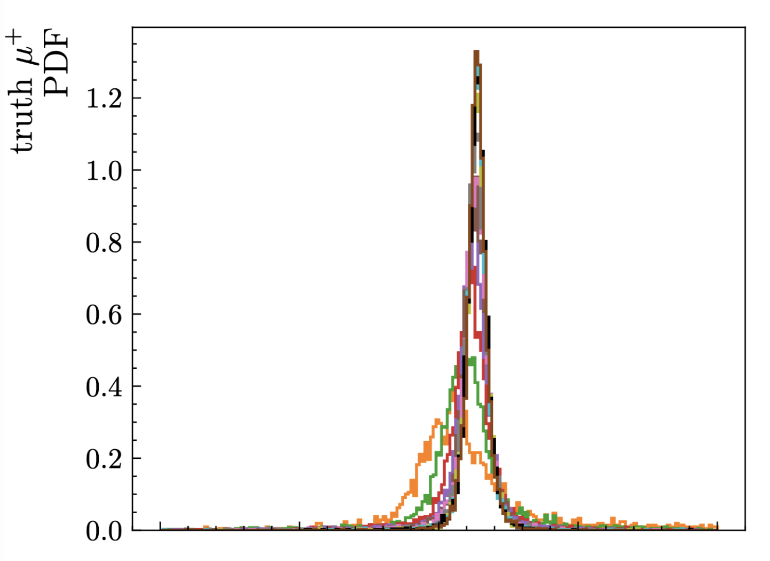
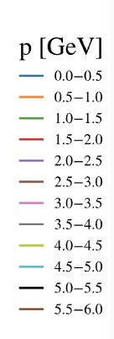
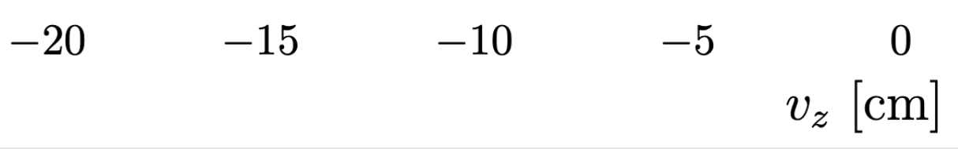
RG-D: MC Pion
I discuss with Raffaella, and her first idea was: the shift could come from pion decay into muon:
- So, the shift is here for both muon and pion: so the pion decay is not the reason for that

Slide 5
RG-D: MC Pion
I discuss with Raffaella, and her first idea was: the shift could come from pion decay into muon:
- So, the shift is here for both muon and pion: so the pion decay is not the reason for that

Slide 6

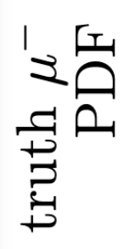
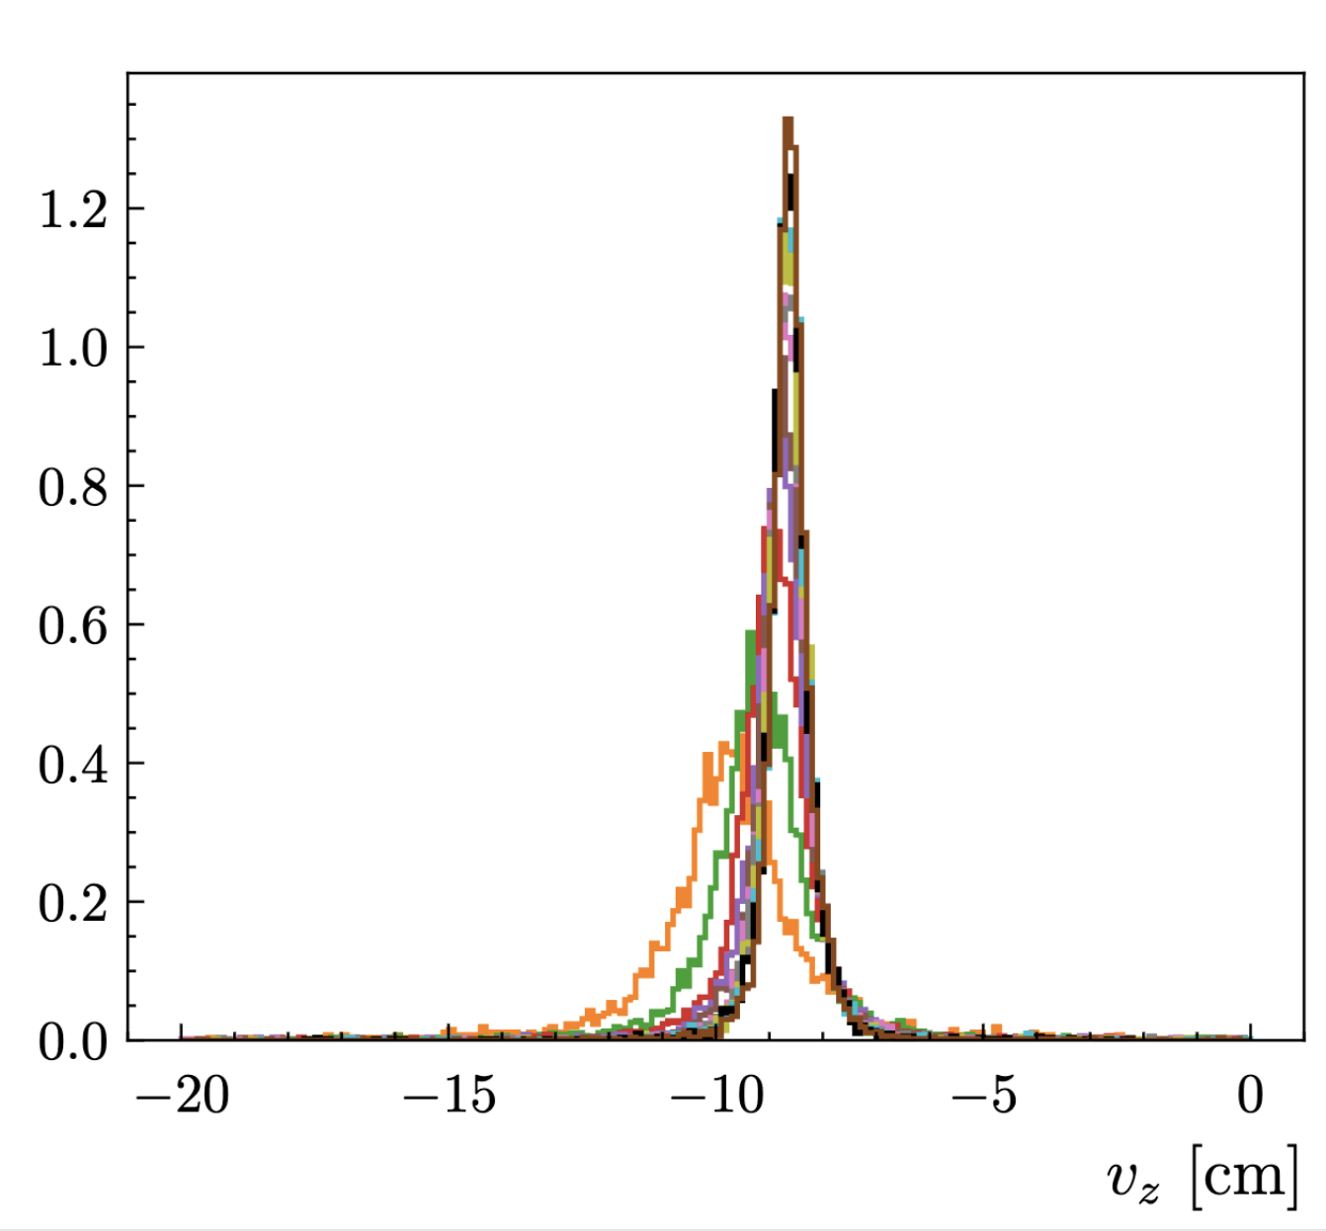
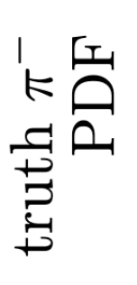
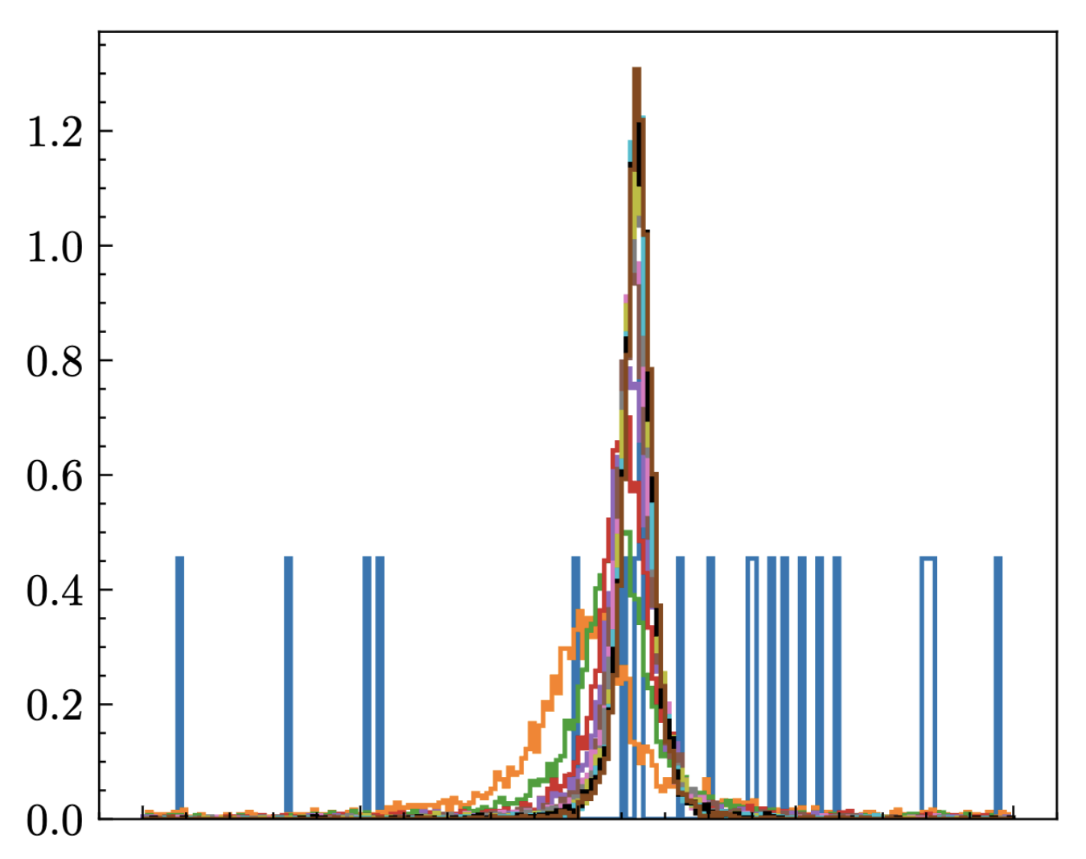
RG-D: MC Pion
I discuss with Raffaella, and her first idea was: the shift could come from pion decay into muon:
- So, the shift is here for both muon and pion: so the pion decay is not the reason for that

Slide 7
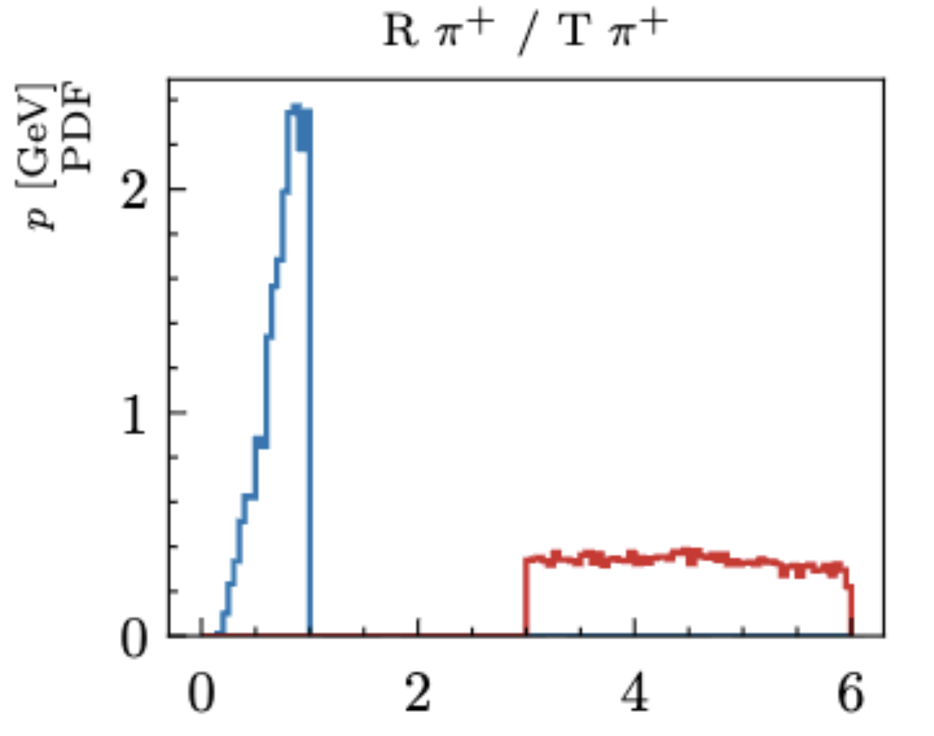
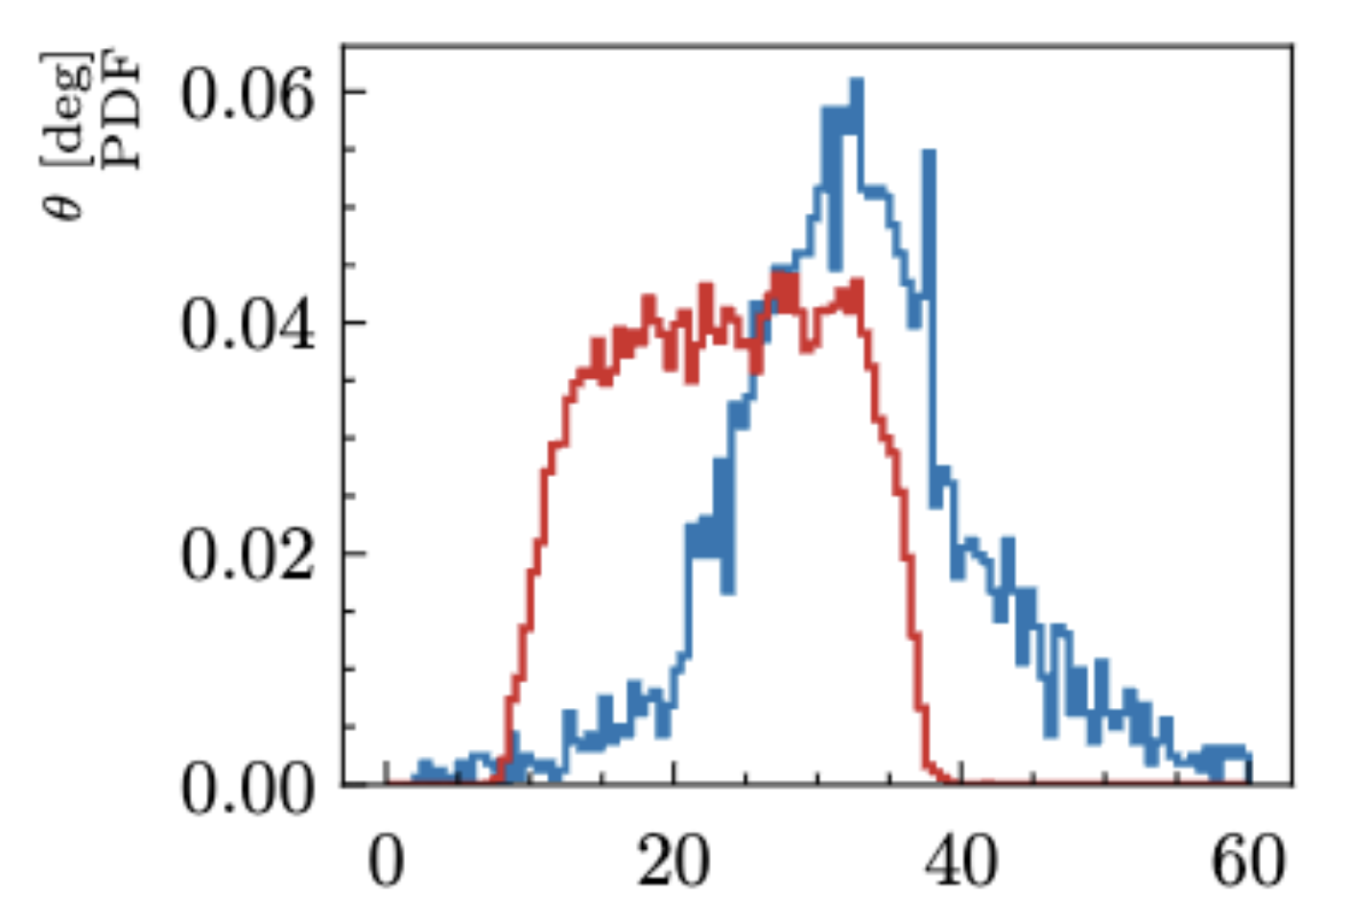
RG-D: MC Pion
After that, I check the track quality variables:
For low momentum pions (blue)
For high momentum pions (red)

Slide 8
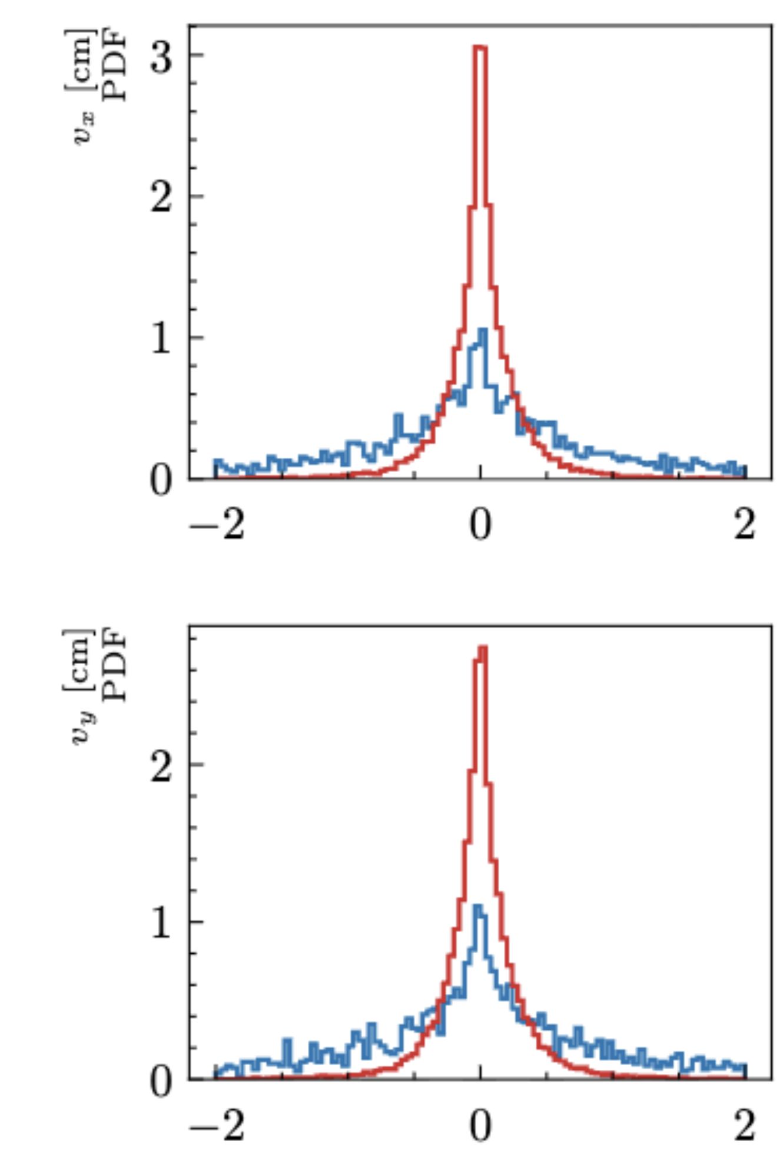
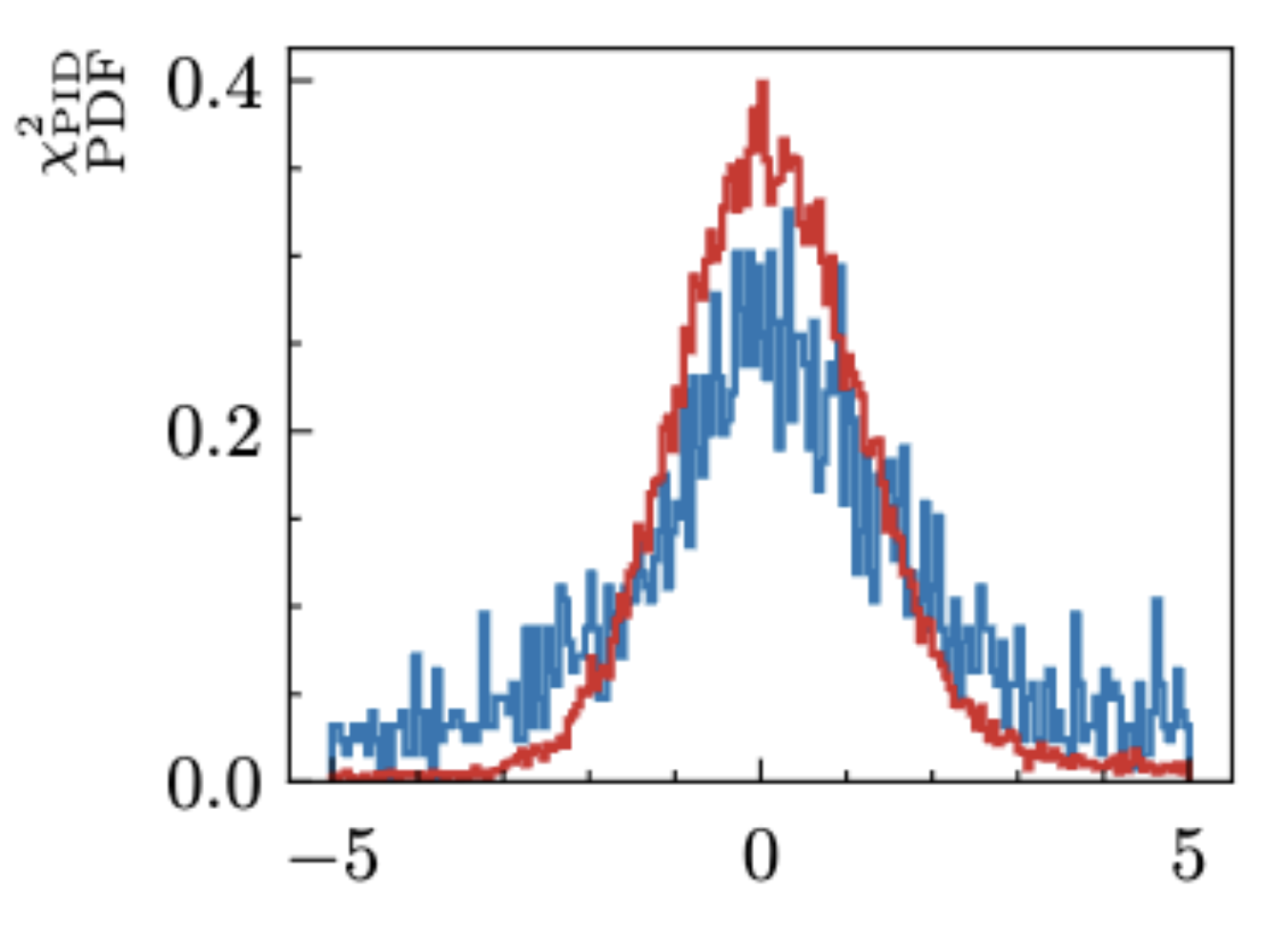
RG-D: MC Pion
After that, I check the track quality variables:
For low momentum pions (blue)
For high momentum pions (red)

Slide 9
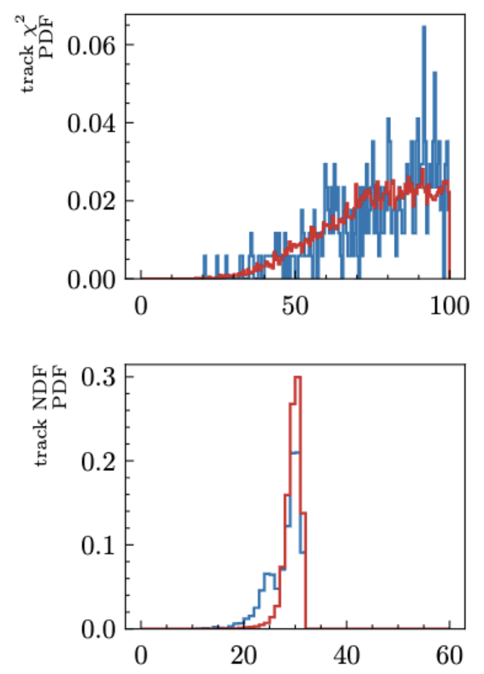
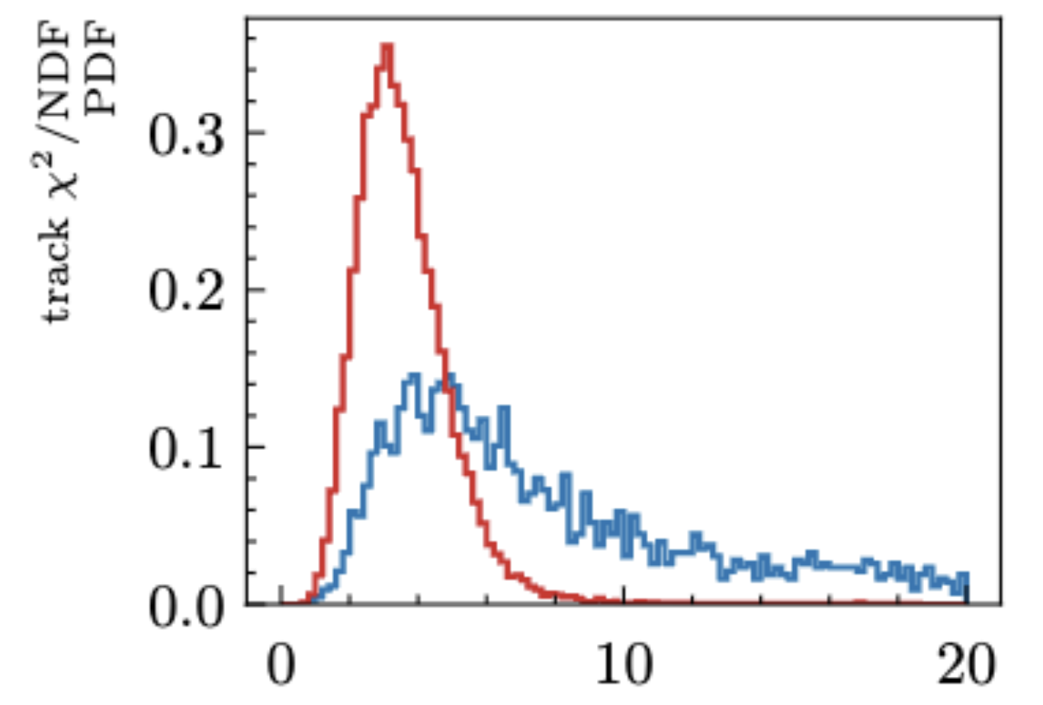
RG-D: MC Pion
After that, I check the track quality variables:
For low momentum pions (blue)
For high momentum pions (red)

Slide 10
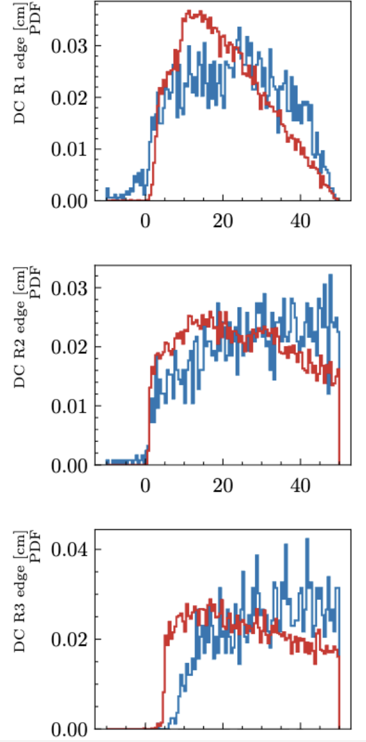
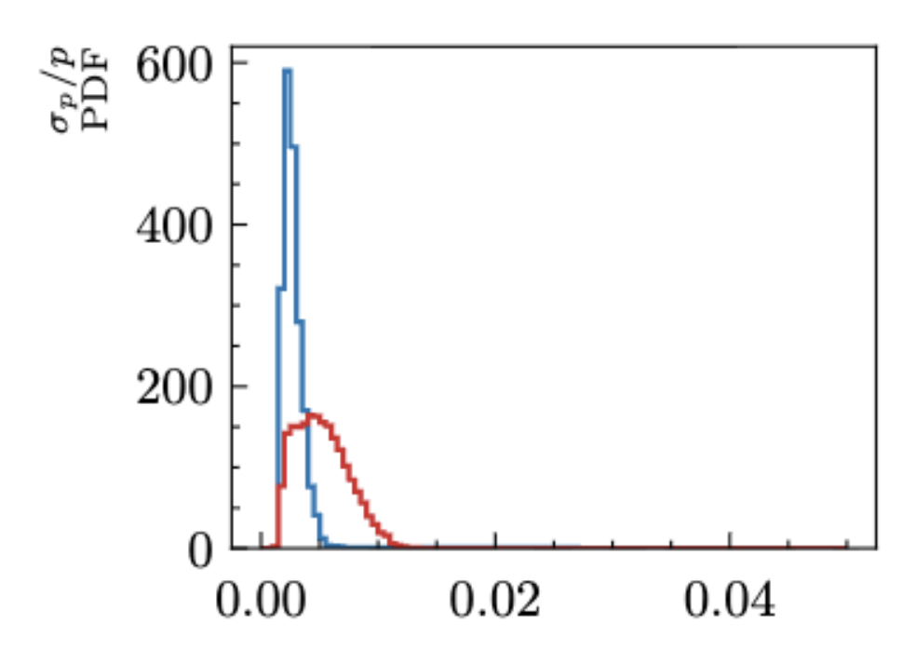
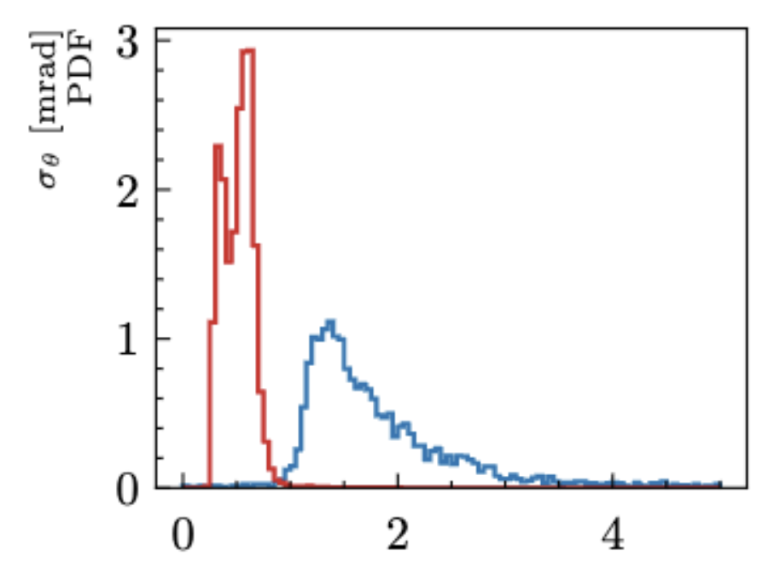
RG-D: MC Pion
After that, I check the track quality variables:
For low momentum pions (blue)
For high momentum pions (red)
Can also look at the covariance matrix generated by the Kalman Filter

Slide 11
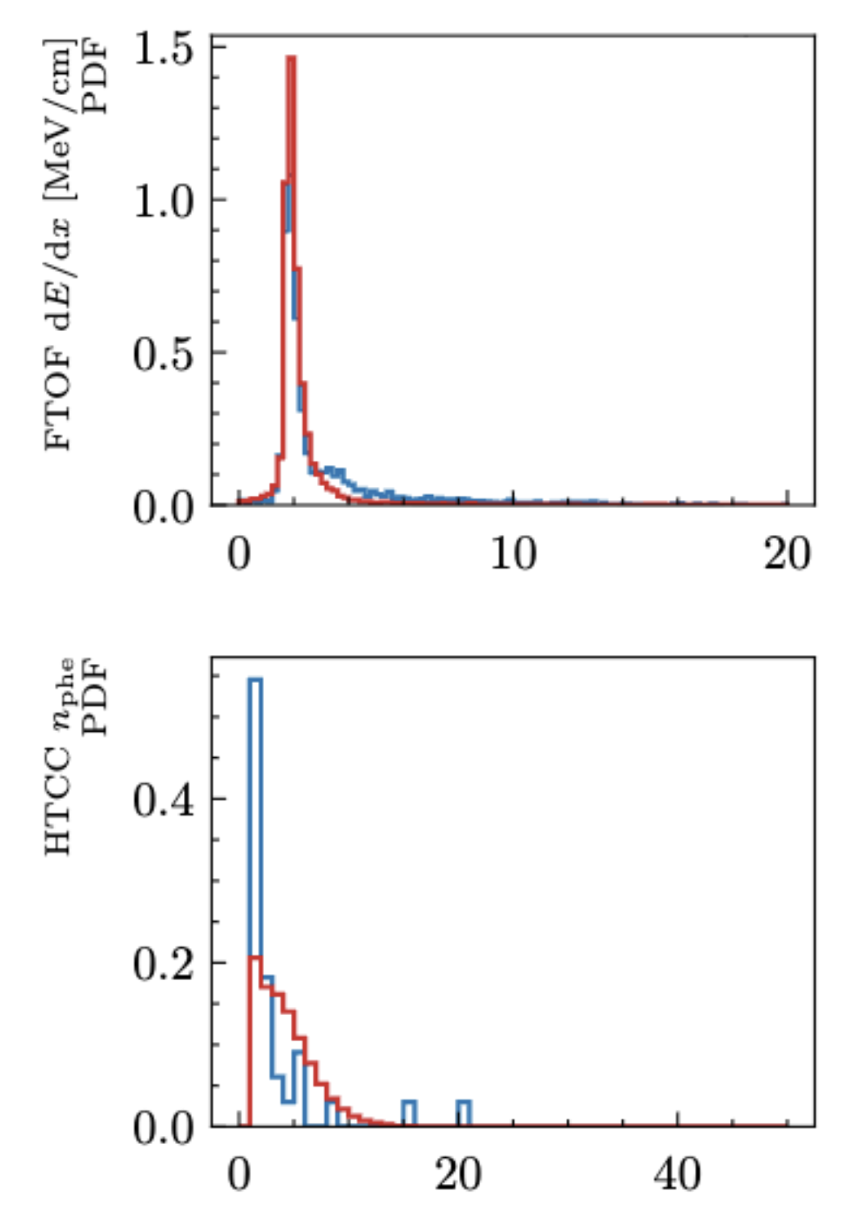
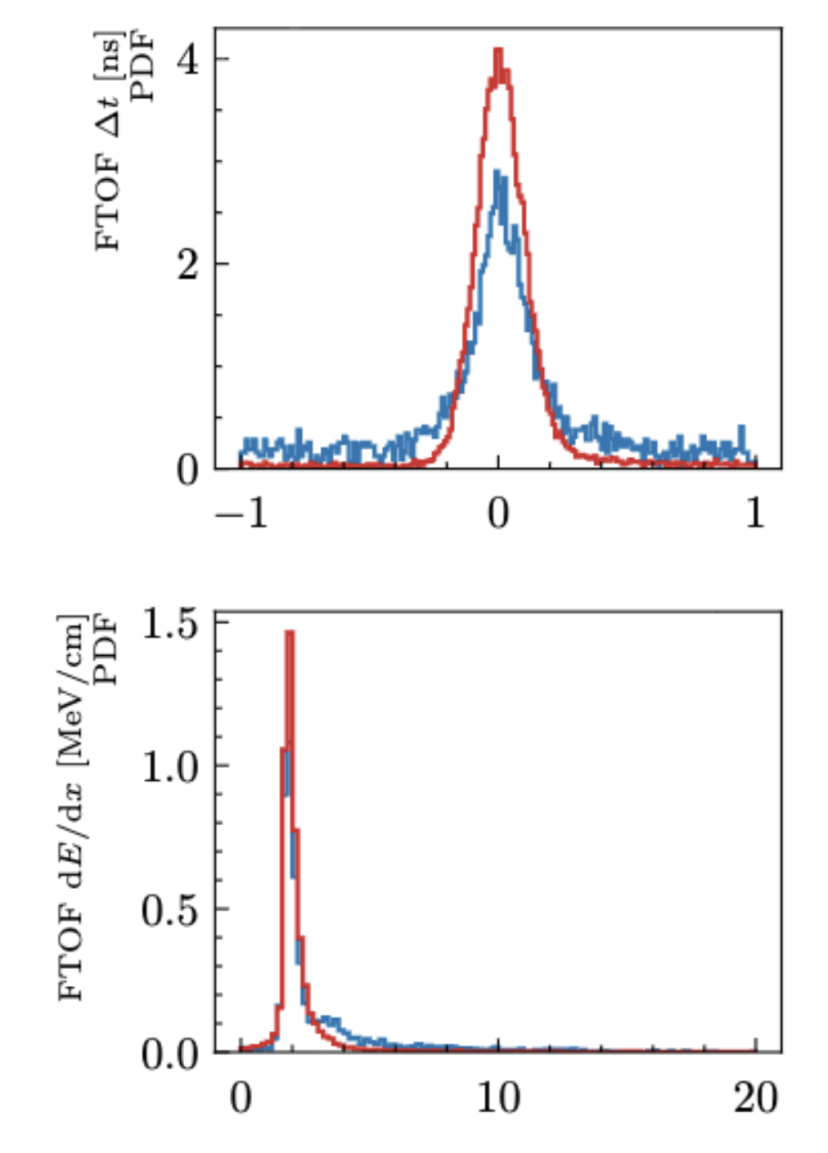
RG-D: MC Pion
After that, I check the track quality variables:
For low momentum pions (blue)
For high momentum pions (red)

Slide 12
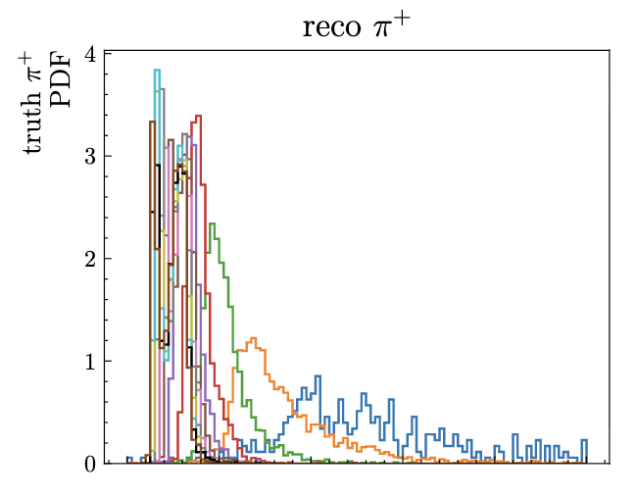
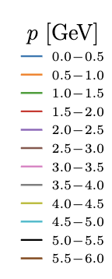

RG-D: MC Pion
After that, I check the track quality variables:
For low momentum pions (blue)
For high momentum pions (red)
So, the only difference between low and high momentum pions that could explain the shift in Vz is the worse resolution in σ_{θ}

Slide 13

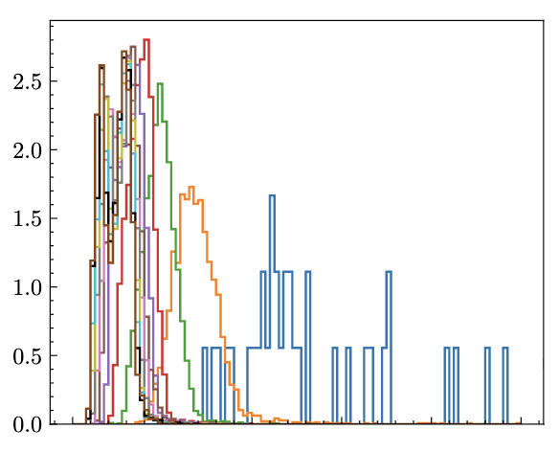

RG-D: MC Pion
After that, I check the track quality variables:
For low momentum pions (blue)
For high momentum pions (red)
So, the only difference between low and high momentum pions that could explain the shift in Vz is the worse resolution in σ_{θ}

Slide 14
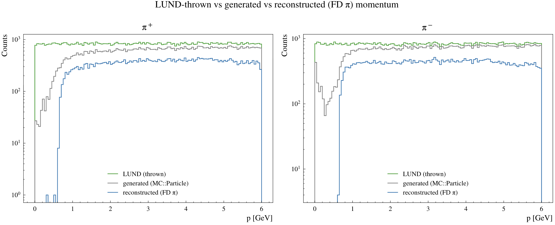
RG-D: MC Pion
After that, I discuss again with Raffaella: she ruled out the pion decay
The other possibility to explain the shift would be:
issue in the reconstruction
or energy loss high enough to significantly shift the Vz
True MC momentum

Slide 15
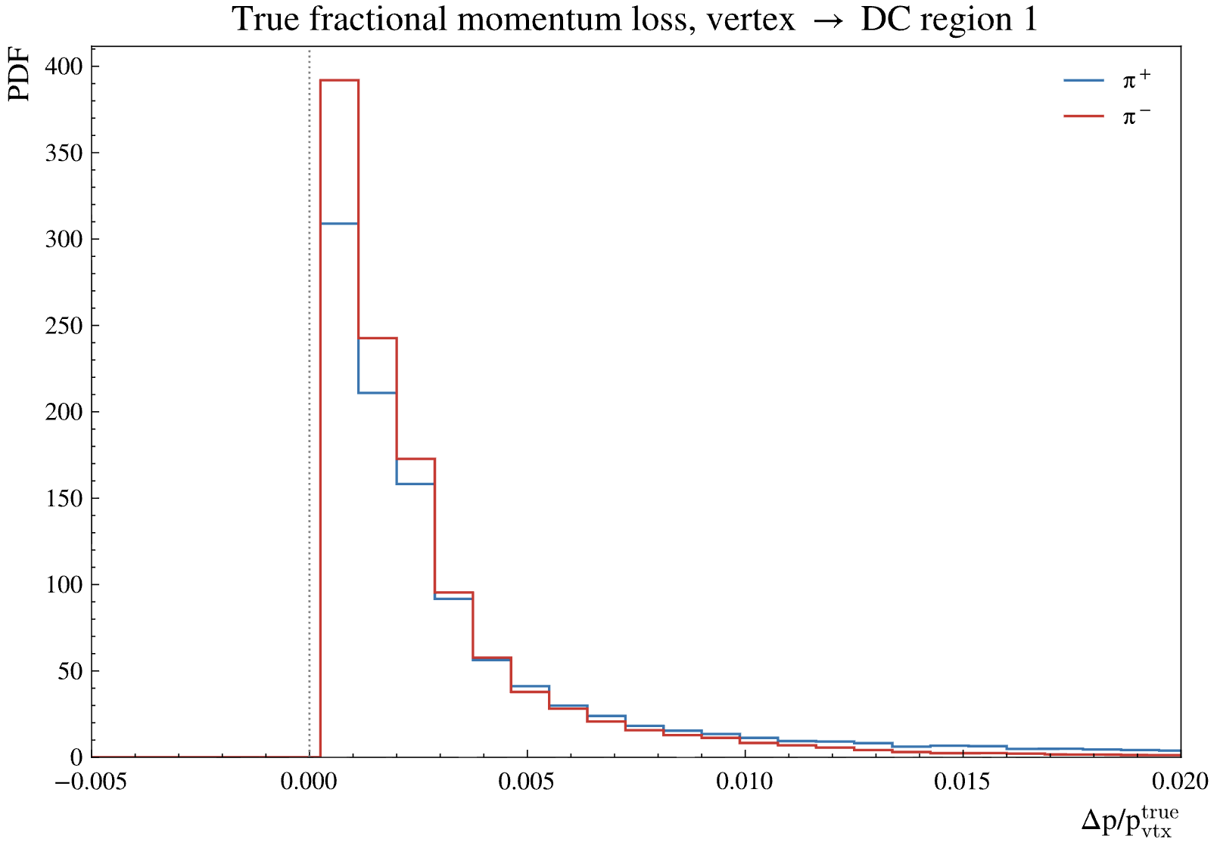
RG-D: MC Pion
To see if it is energy loss, plot the truth momentum at the vertex and truth momentum at DC R1:

Slide 16
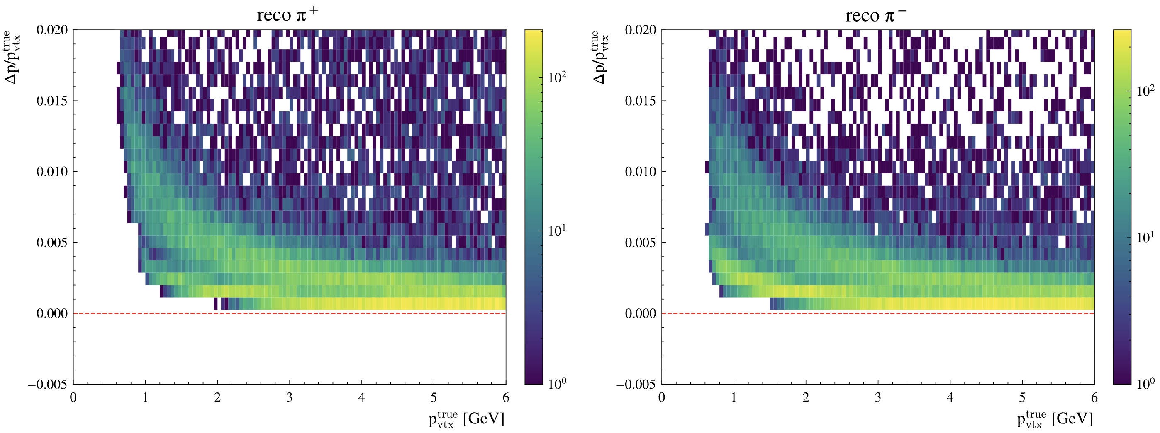
RG-D: MC Pion
To see if it is energy loss, plot the truth momentum at the vertex and truth momentum at DC R1:
Loss up to 1.5% of the momentum due to energy loss

Slide 17
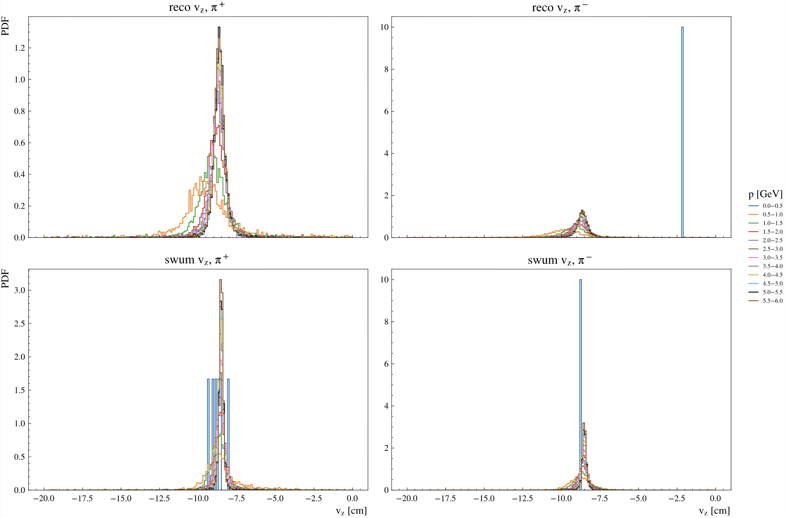
RG-D: MC Pion
If I swim the pions from DC R1 using the truth momentum and position:
Shift is much smaller if I use the truth momentum even with energy loss
So, I don’t think energy loss is the main reason for the shift
So, either the momentum reconstructed in region 1 is wrong, or the swimming is wrong

Slide 18
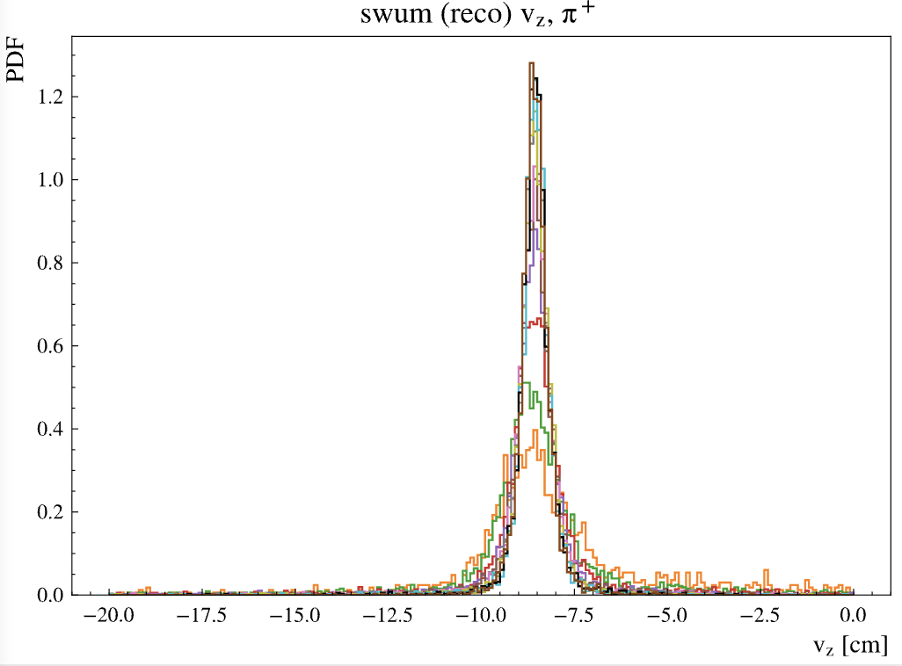
RG-D: MC Pion
If I swim the pions from DC R1 using the truth momentum and position:
Shift is much smaller if I use the truth momentum even with energy loss
So, I don’t think energy loss is the main reason for the shift
So, either the momentum reconstructed in region 1 is wrong, or the swimming is wrong

Slide 19
RG-D: MC Pion
Using LD2 data:
- π⁺ momentum-cut impact (forward-detector pions = 541937):
p < 0.3 GeV -> lost 8024 (1.48%), kept 533913
p < 0.5 GeV -> lost 39972 (7.38%), kept 501965
p < 0.7 GeV -> lost 115204 (21.26%), kept 426733
p < 1.0 GeV -> lost 242743 (44.79%), kept 299194
- π⁻ momentum-cut impact (forward-detector pions = 751348):
p < 0.3 GeV -> lost 1 (0.00%), kept 751347
p < 0.5 GeV -> lost 54885 (7.30%), kept 696463
p < 0.7 GeV -> lost 190114 (25.30%), kept 561234
p < 1.0 GeV -> lost 368621 (49.06%), kept 382727
We can not cut at 1 GeV, 0.5 would be possible

Slide 20
RG-D: MC Pion
So, all this analysis is to estimate the contamination in the CuSn target
I am not sure how to do that, if the simulation and data are too different
The correction I have develop on data correct for the effect we see in simulation too.
My idea would be to find a way to get the contamination from data and not rely on simulation at all. The main issue is I have not idea how to do that.
Maybe find a process that is really different between Cu and Sn?
For the contamination: is getting the contamination from electron enough? it will tell us the number of event that come from the wrong target.
One thing that we learn from that study on simulation is that pion below 0.7 GeV can’t be reconstruct in the forward detector. If there is some low momentum pion (0.3 to 0.5), then the momentum is wrong by 0.2 to 0.4 GeV at least.

Slide 21
RG-D: ᴨ⁰ analysis
Work on the binning:
binning in 4 kinematic variables: Q², x_{B}, z, p_{T}²:
Q² 8 bins, xB 7 bins, z 10 bins and p_{T}² 8 bins. These values have been arbitrary choose.
Instead of a fixed grid, it partitions 4D space into ~equal-occupancy boxes by greedily splitting the fullest region using KD-Tree (using ROOT https://root.cern.ch/doc/v640/classTKDTree.html)
Strategy:
Start with one leaf (the root) containing all points.
Repeatedly: pick the most-populated leaf, find its widest dimension, split it at the median of the points along that dimension → two leaves with half the points each.
Stop when you reach target_bins leaves.
Result is irregular boxes: for 2 differents Q², x_{B} bins the z, p_{T}² will be differents

Slide 22
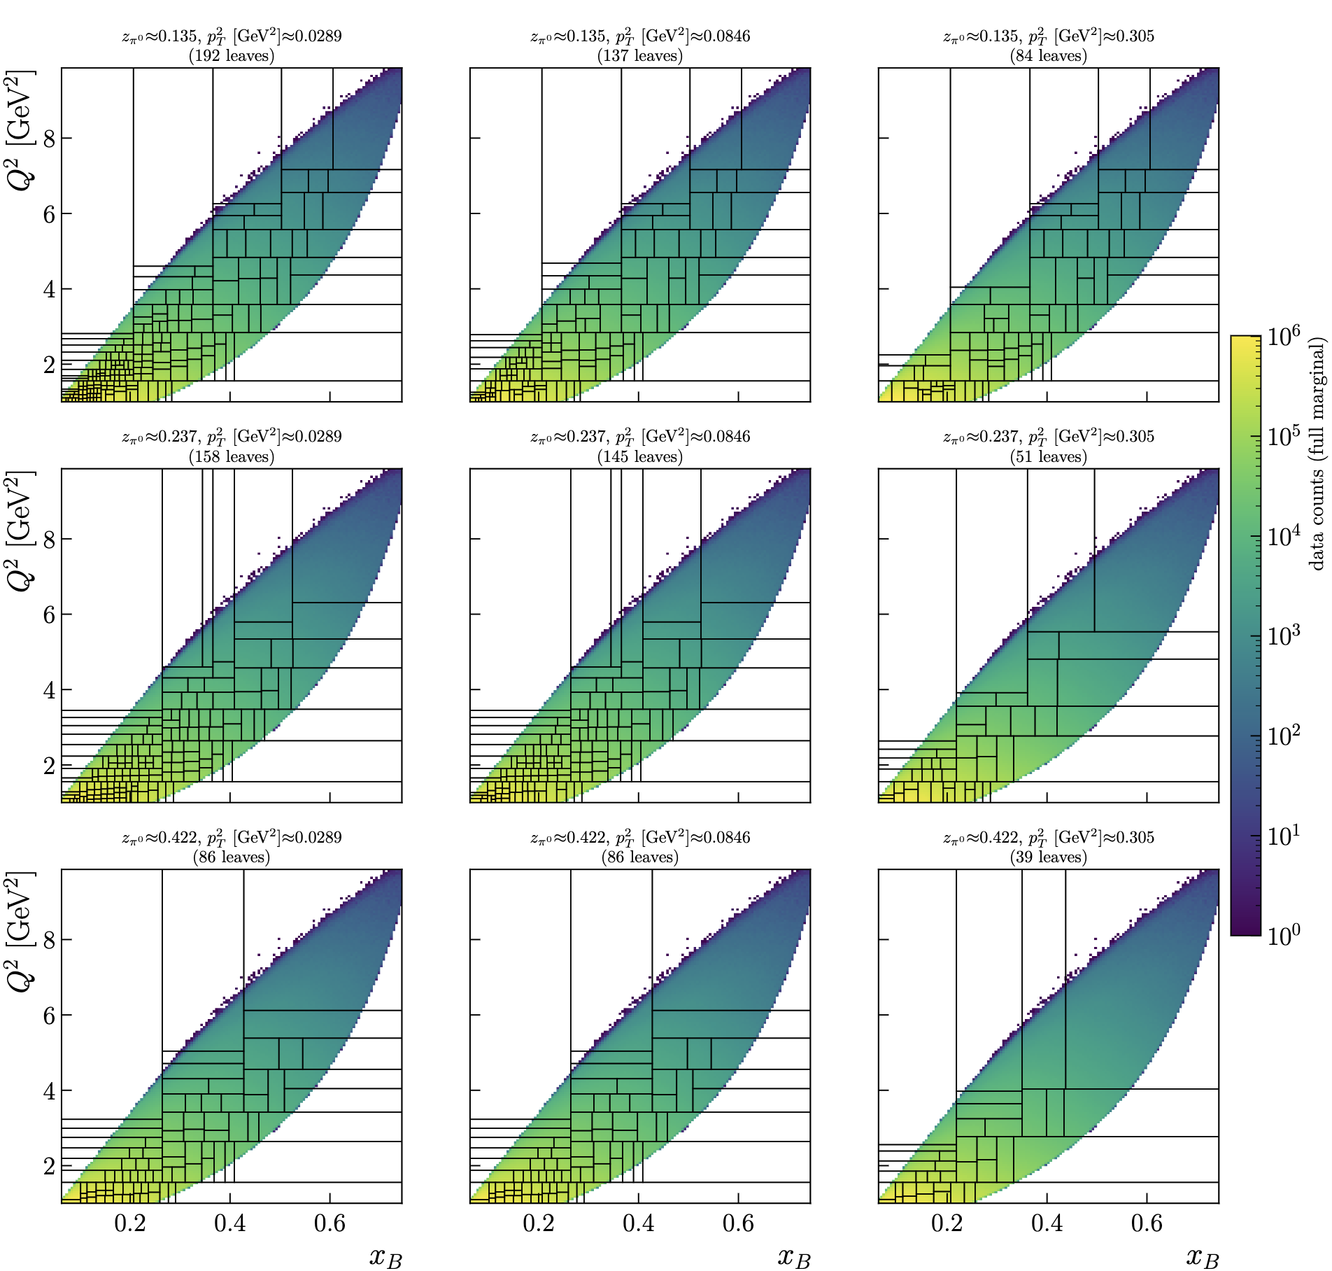
RG-D: ᴨ⁰ analysis
Work on the binning:

Slide 23
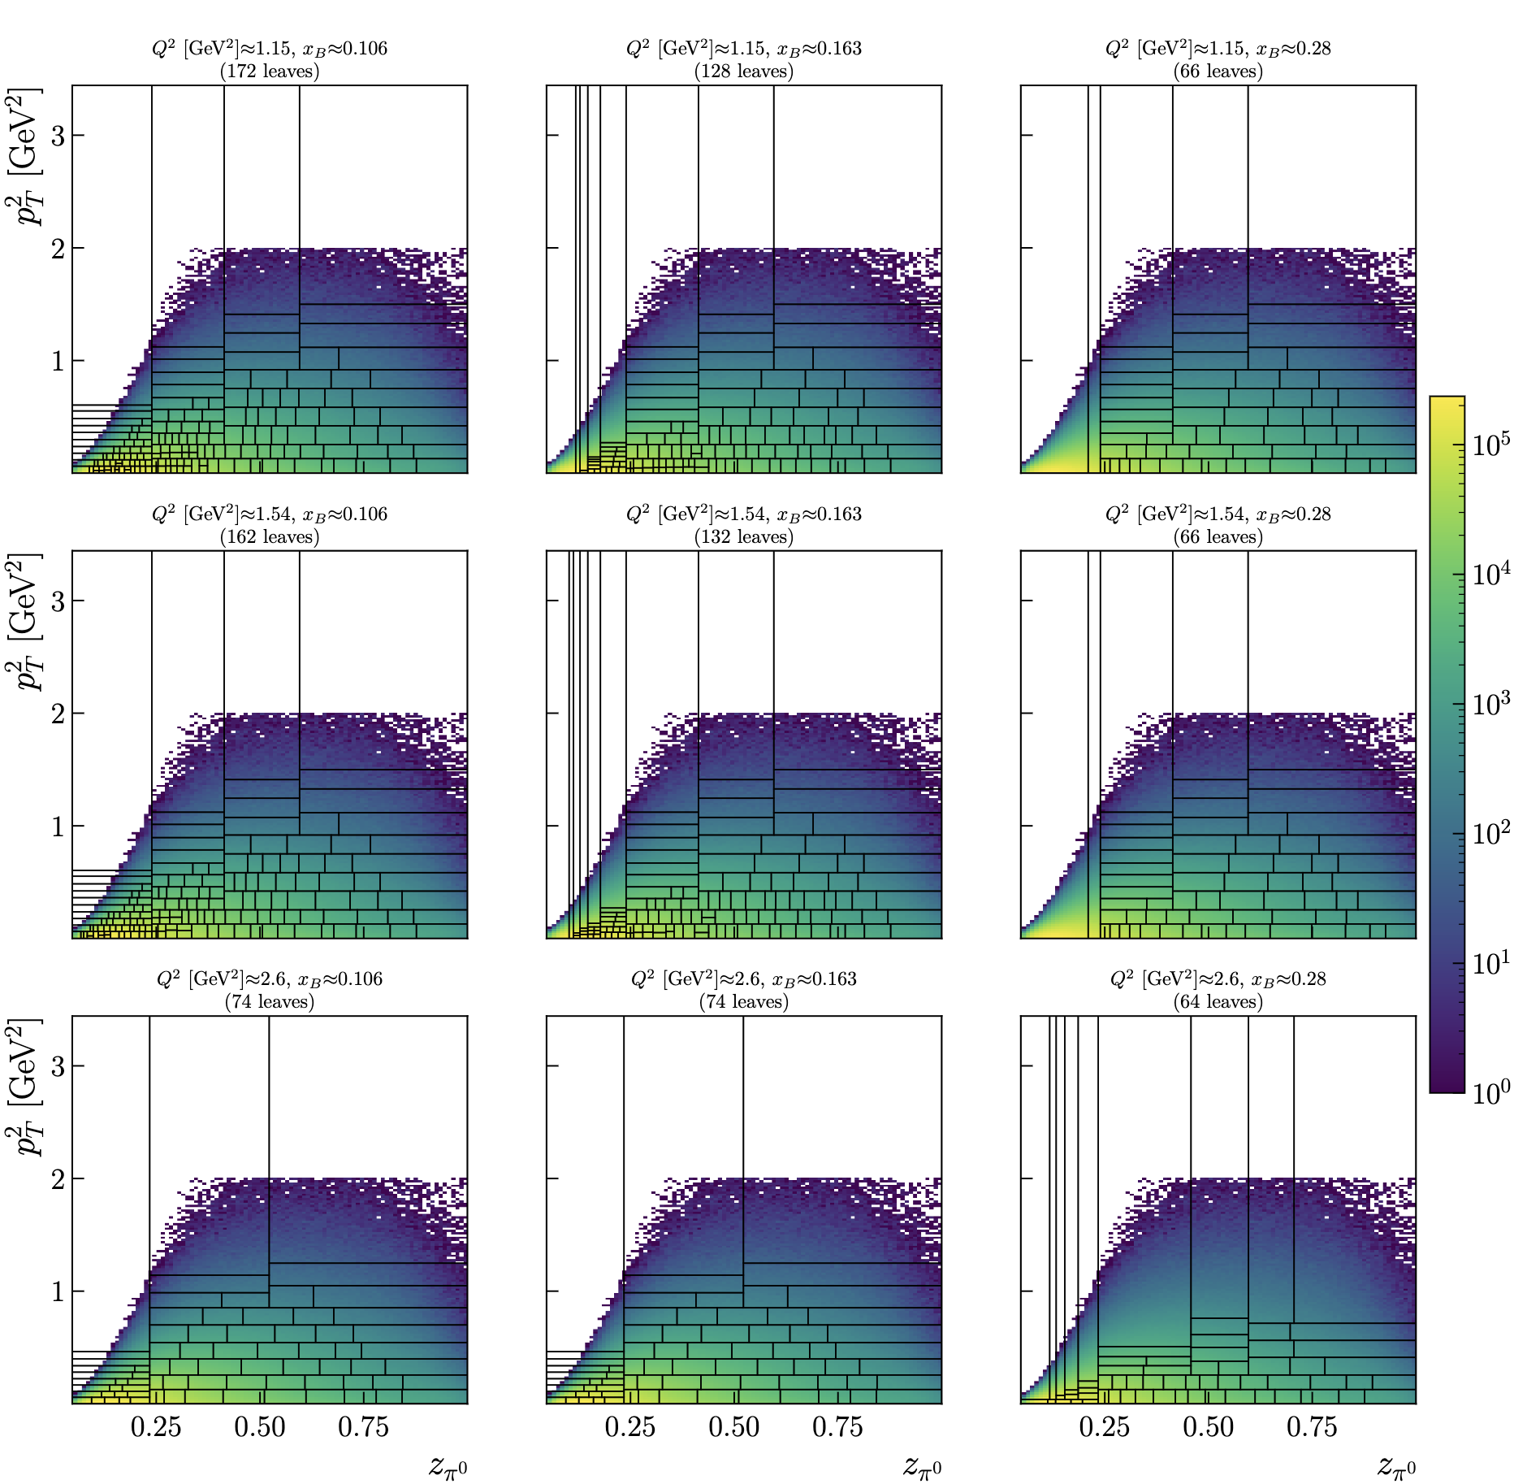
RG-D: ᴨ⁰ analysis
Work on the binning:
In total, I have 4480 bins, maybe too much

Slide 24
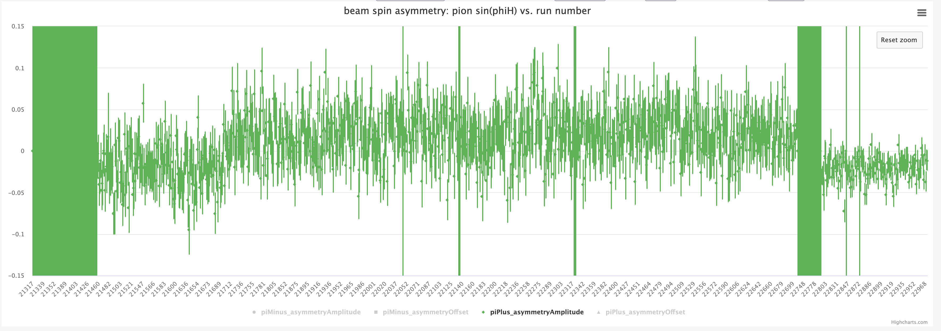
RG-L/ALERT: Physics Timelines
Last week I produce physics timelines for RG-L, to check the polarization

Slide 25
RG-L/ALERT: Physics Timelines
Last week I produce physics timelines for RG-L, to check the polarization
Two problematic regions:

Slide 26
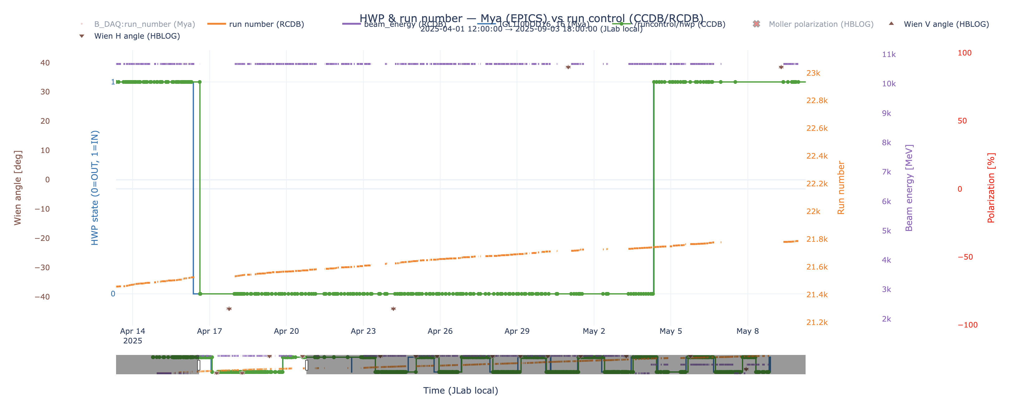
RG-L/ALERT: Physics Timelines
Last week I produce physics timelines for RG-L, to check the polarization
Look at the HWP status in CCDB vs Mya database: Almost no difference, can’t explain the issue

Slide 27
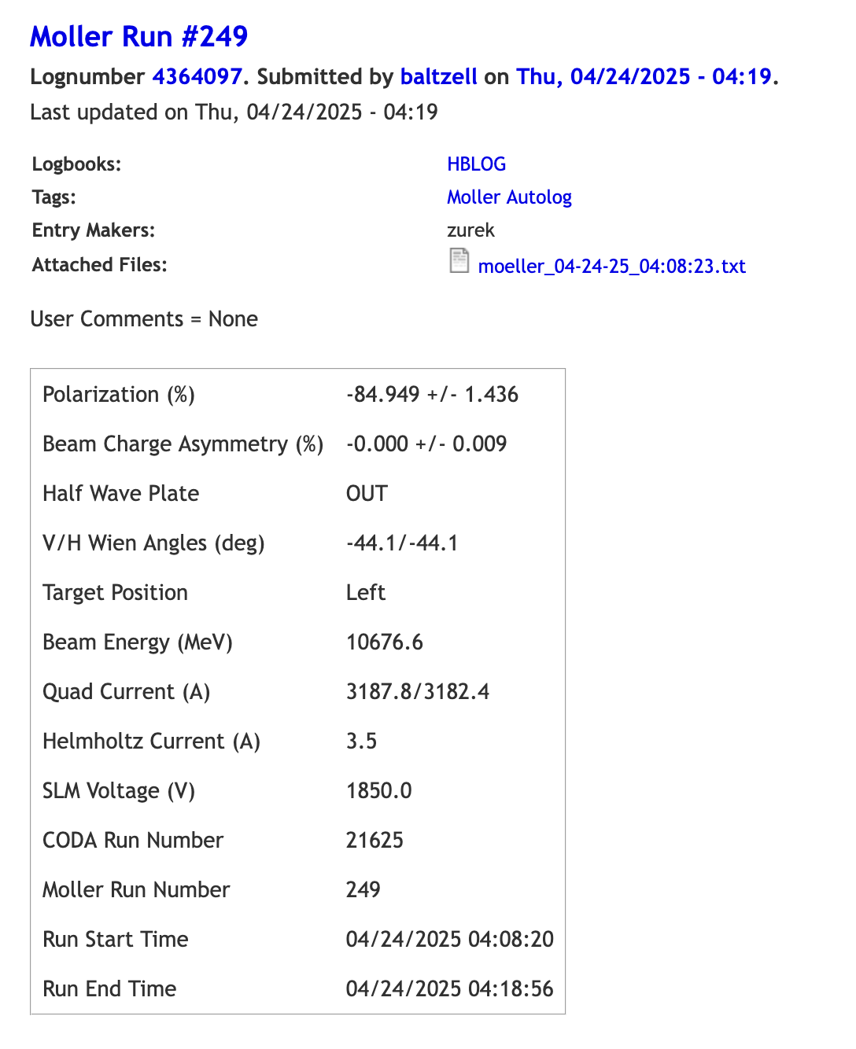
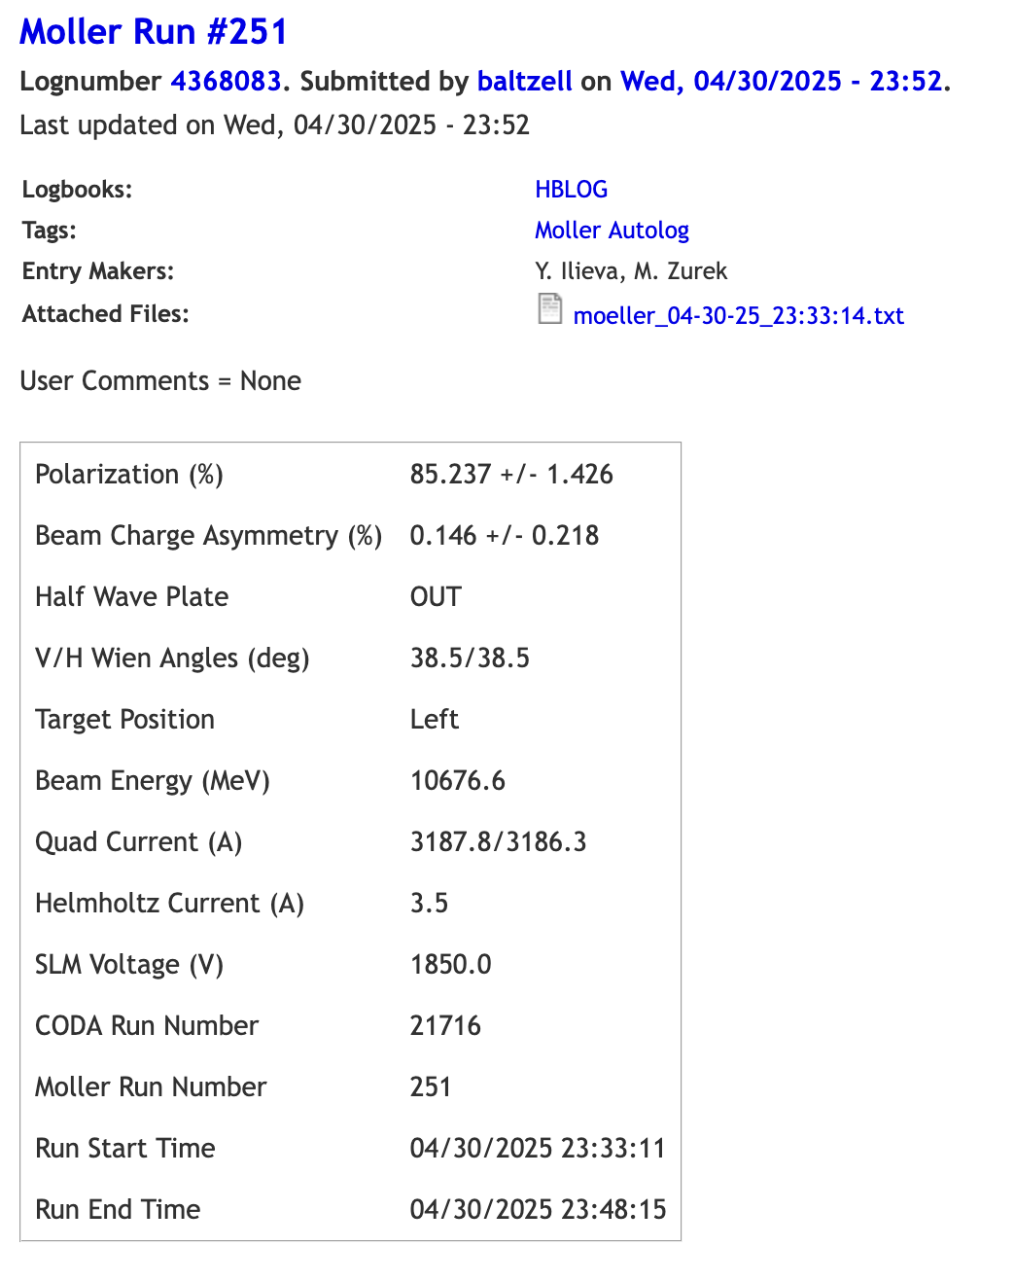
RG-L/ALERT: Physics Timelines
Last week I produce physics timelines for RG-L, to check the polarization
Same issue with the polarization with the Moller run

Slide 28
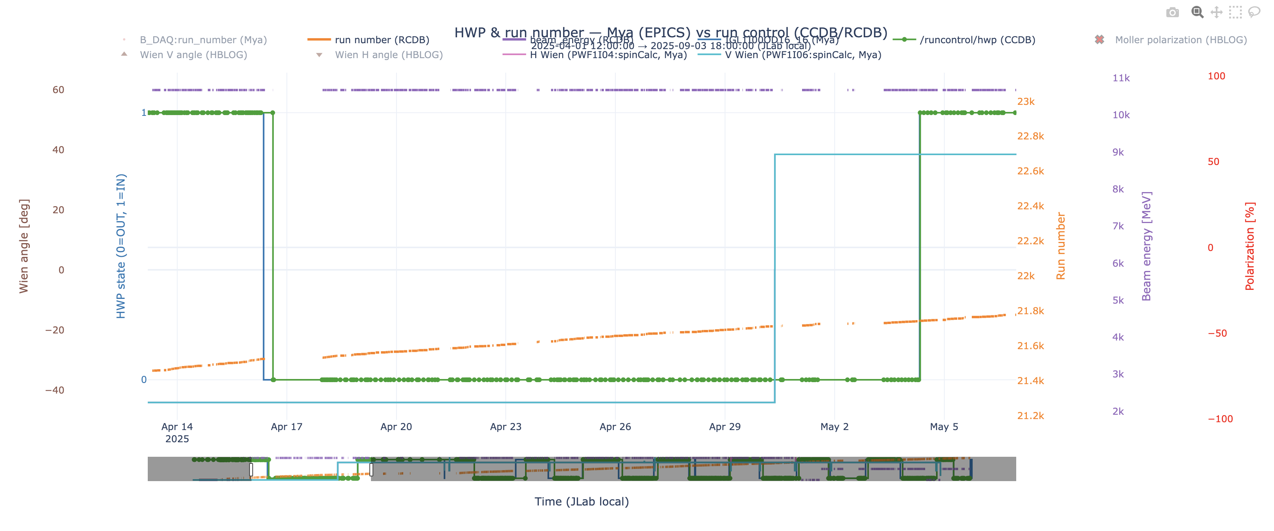
RG-L/ALERT: Physics Timelines
Last week I produce physics timelines for RG-L, to check the polarization
Look at the HWP status in CCDB vs Mya database: Almost no difference, can’t explain the issue

Slide 29
RG-L/ALERT: Physics Timelines
Last week I produce physics timelines for RG-L, to check the polarization
Look at the HWP status in CCDB vs Mya database: Almost no difference, can’t explain the issue
I also discuss that with Stepan, and he don’t think the modification of the Wien angle modification can explain the issue.
So, he told me that the best thing to do would be to send an email to expert: Riad Suleiman to ask more details. I send the email yesterday, I hope I will have the answer today or tomorrow.

Slide 30
Other works
CLAS Collaboration meeting in 3 weeks
I guess I will give the RG-D update?
Should I also give a software talk about the GNN development/implementation?
I also need to work a bit on the Student and Post doc meeting

Slide 31
To do list
RG-D:
Contamination study for pions/Understanding Vz for pion in simulation
Work on the binning
Continue the work on cos and sin φ_{h} extraction
Radiative and acceptance correction
Background for ρ⁰ with simulation for CT analysis
Write README and analysis details about the code
ALERT:
Understand the reason for the wrong polarization in the timlines

