Slide 1
Group meeting
Mathieu Ouillon (Mississippi State University)
06/09/26

Slide 2
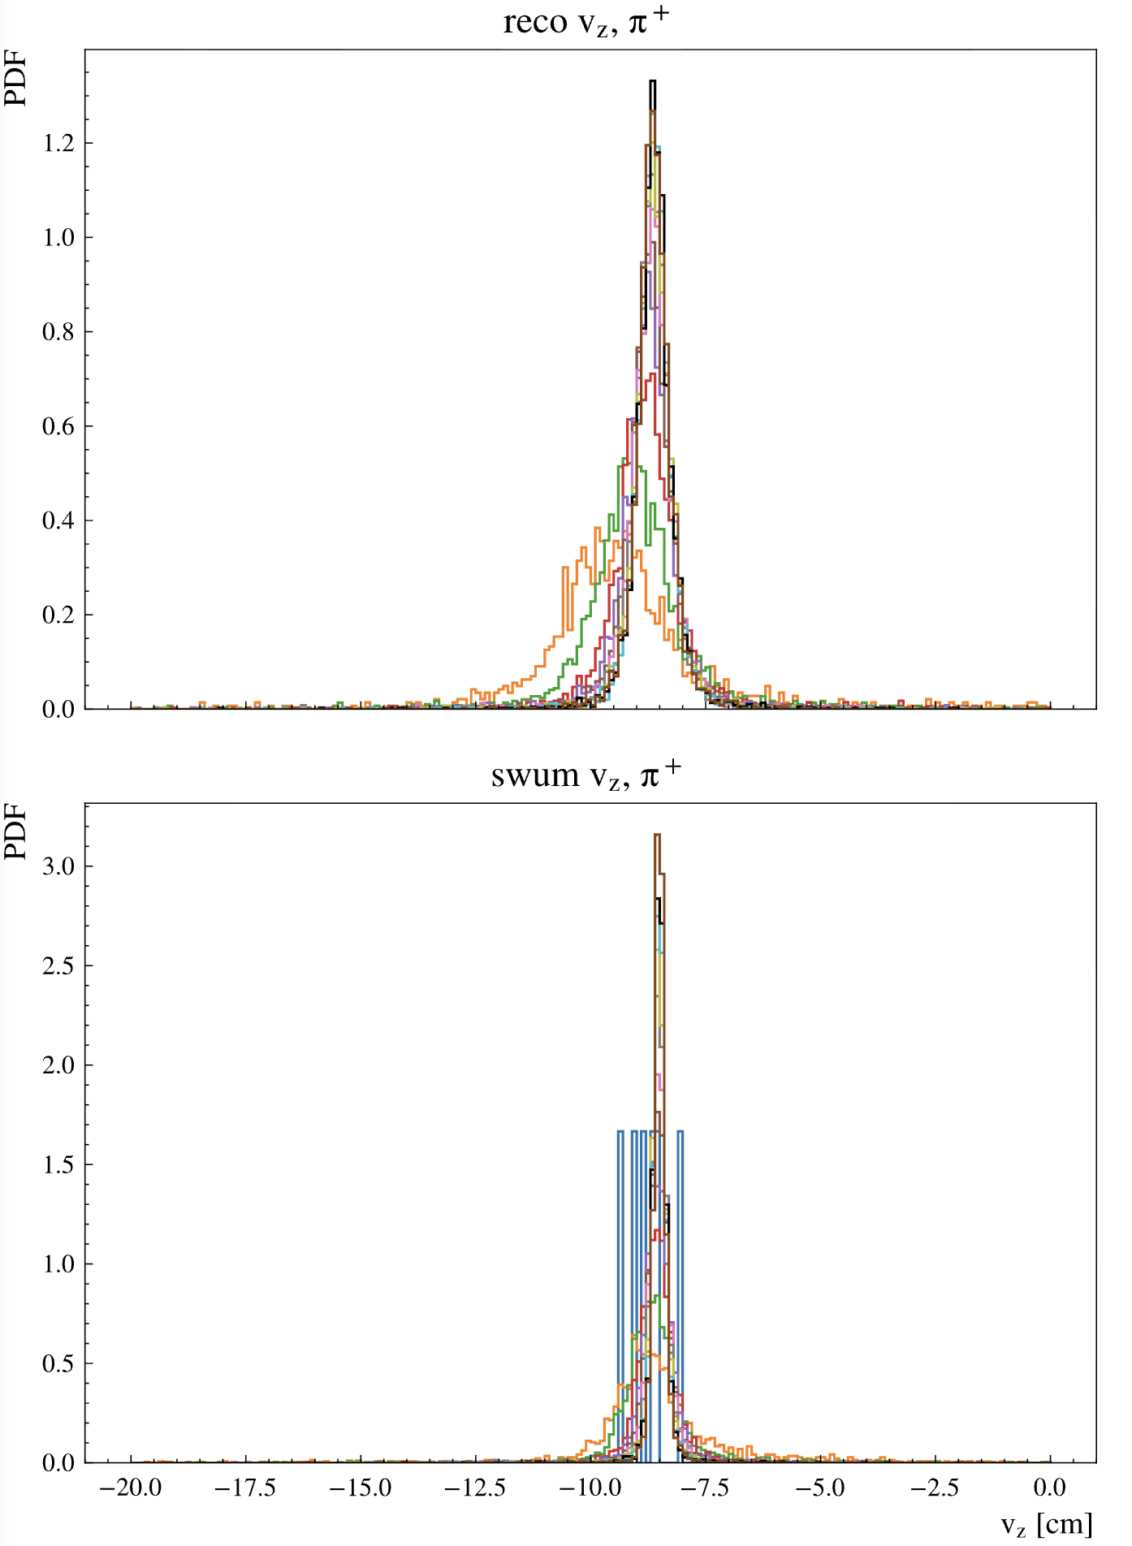
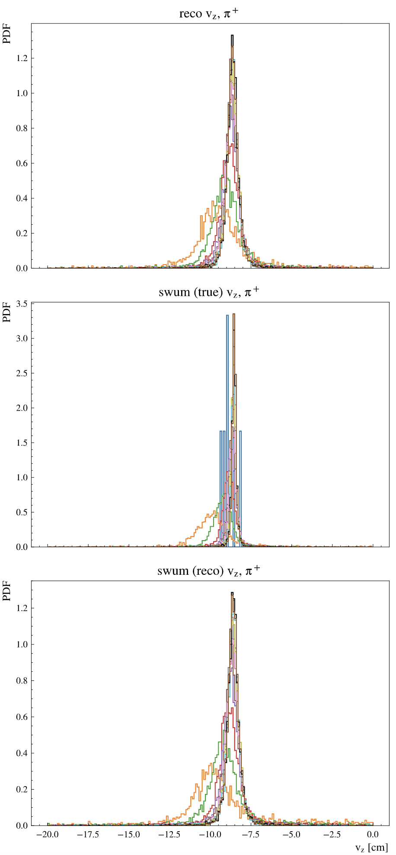
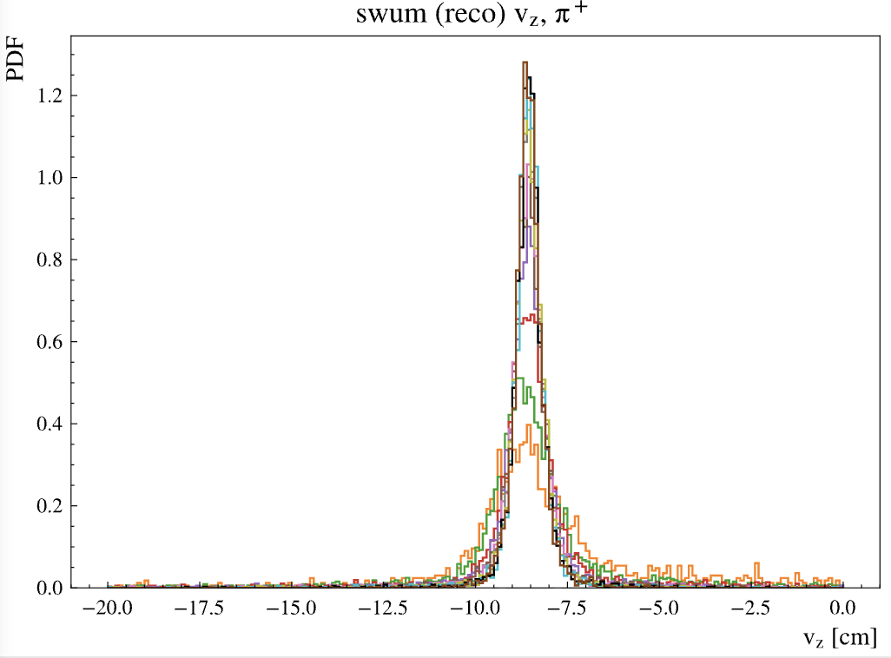
RG-D: MC Pion
Last week
This week
Ok I found an issue in the code for the propagation of the pion in the magnetic field:
I forgot to shift the solenoid map by -3cm
With the shift the reconstructed Vz from the EB and my reconstructed VZ by swimming the particle is similar
That indicates to me that the issue may be in the shift of the solenoid map, not in the reconstruction.

Slide 3
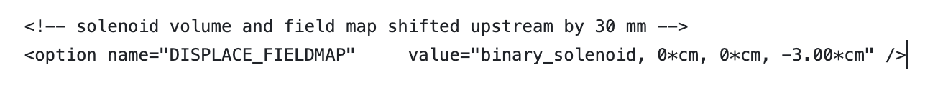
RG-D: MC Pion
So I look into the GCARD that I use and compare it to other GCARD in clas12-config:
In most of the GCARDs (RG-A fall 2018/spring 2019, RG-C, RG-E, RG-K and RG-M):
But it is not in the RG-D ones
RG-A spring 2018 is the only one with:

Slide 4
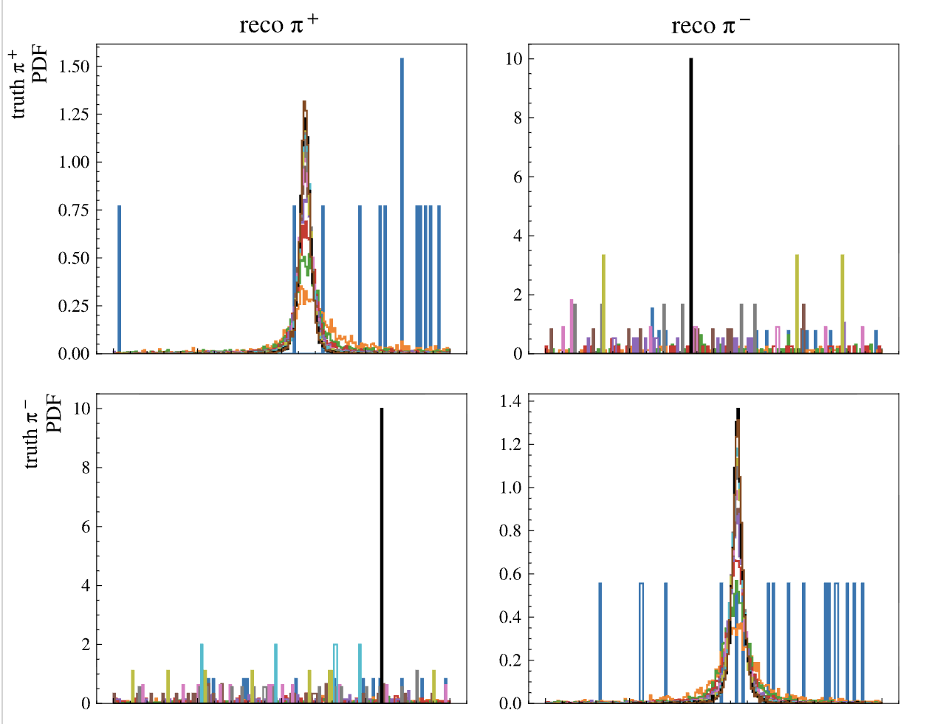
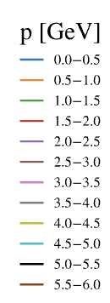
RG-D: MC Pion
So, if I add these lines in the RG-D GCARD:
No more shift for low momentum pions
I need to simulated again my sample of pions and electrons, with the new GCARDs
I also need to modify the RG-D GCARDs
in clas12-config

Slide 5
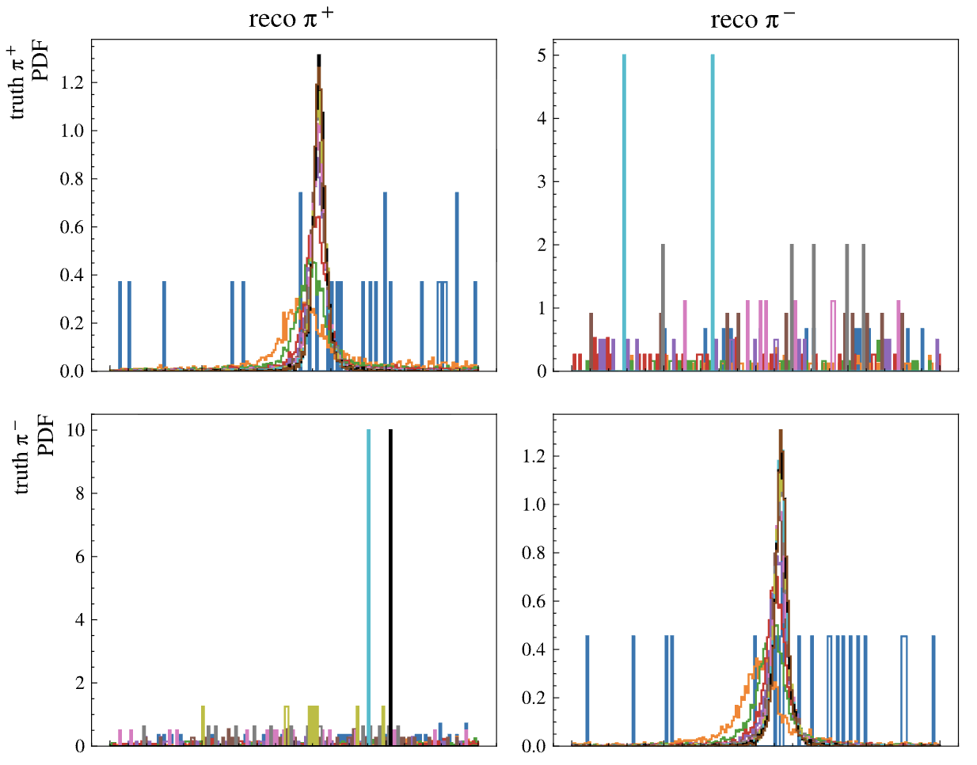
RG-D: MC Pion
Last week no solenoid shift
So, if I add these lines in the RG-D GCARD:
No more shift for low momentum pions
I need to simulated again my sample of pions and electrons, with the new GCARDs
I also need to modify the RG-D GCARDs
in clas12-config
I also hope with that the data and simulation for pions would be closer

Slide 6
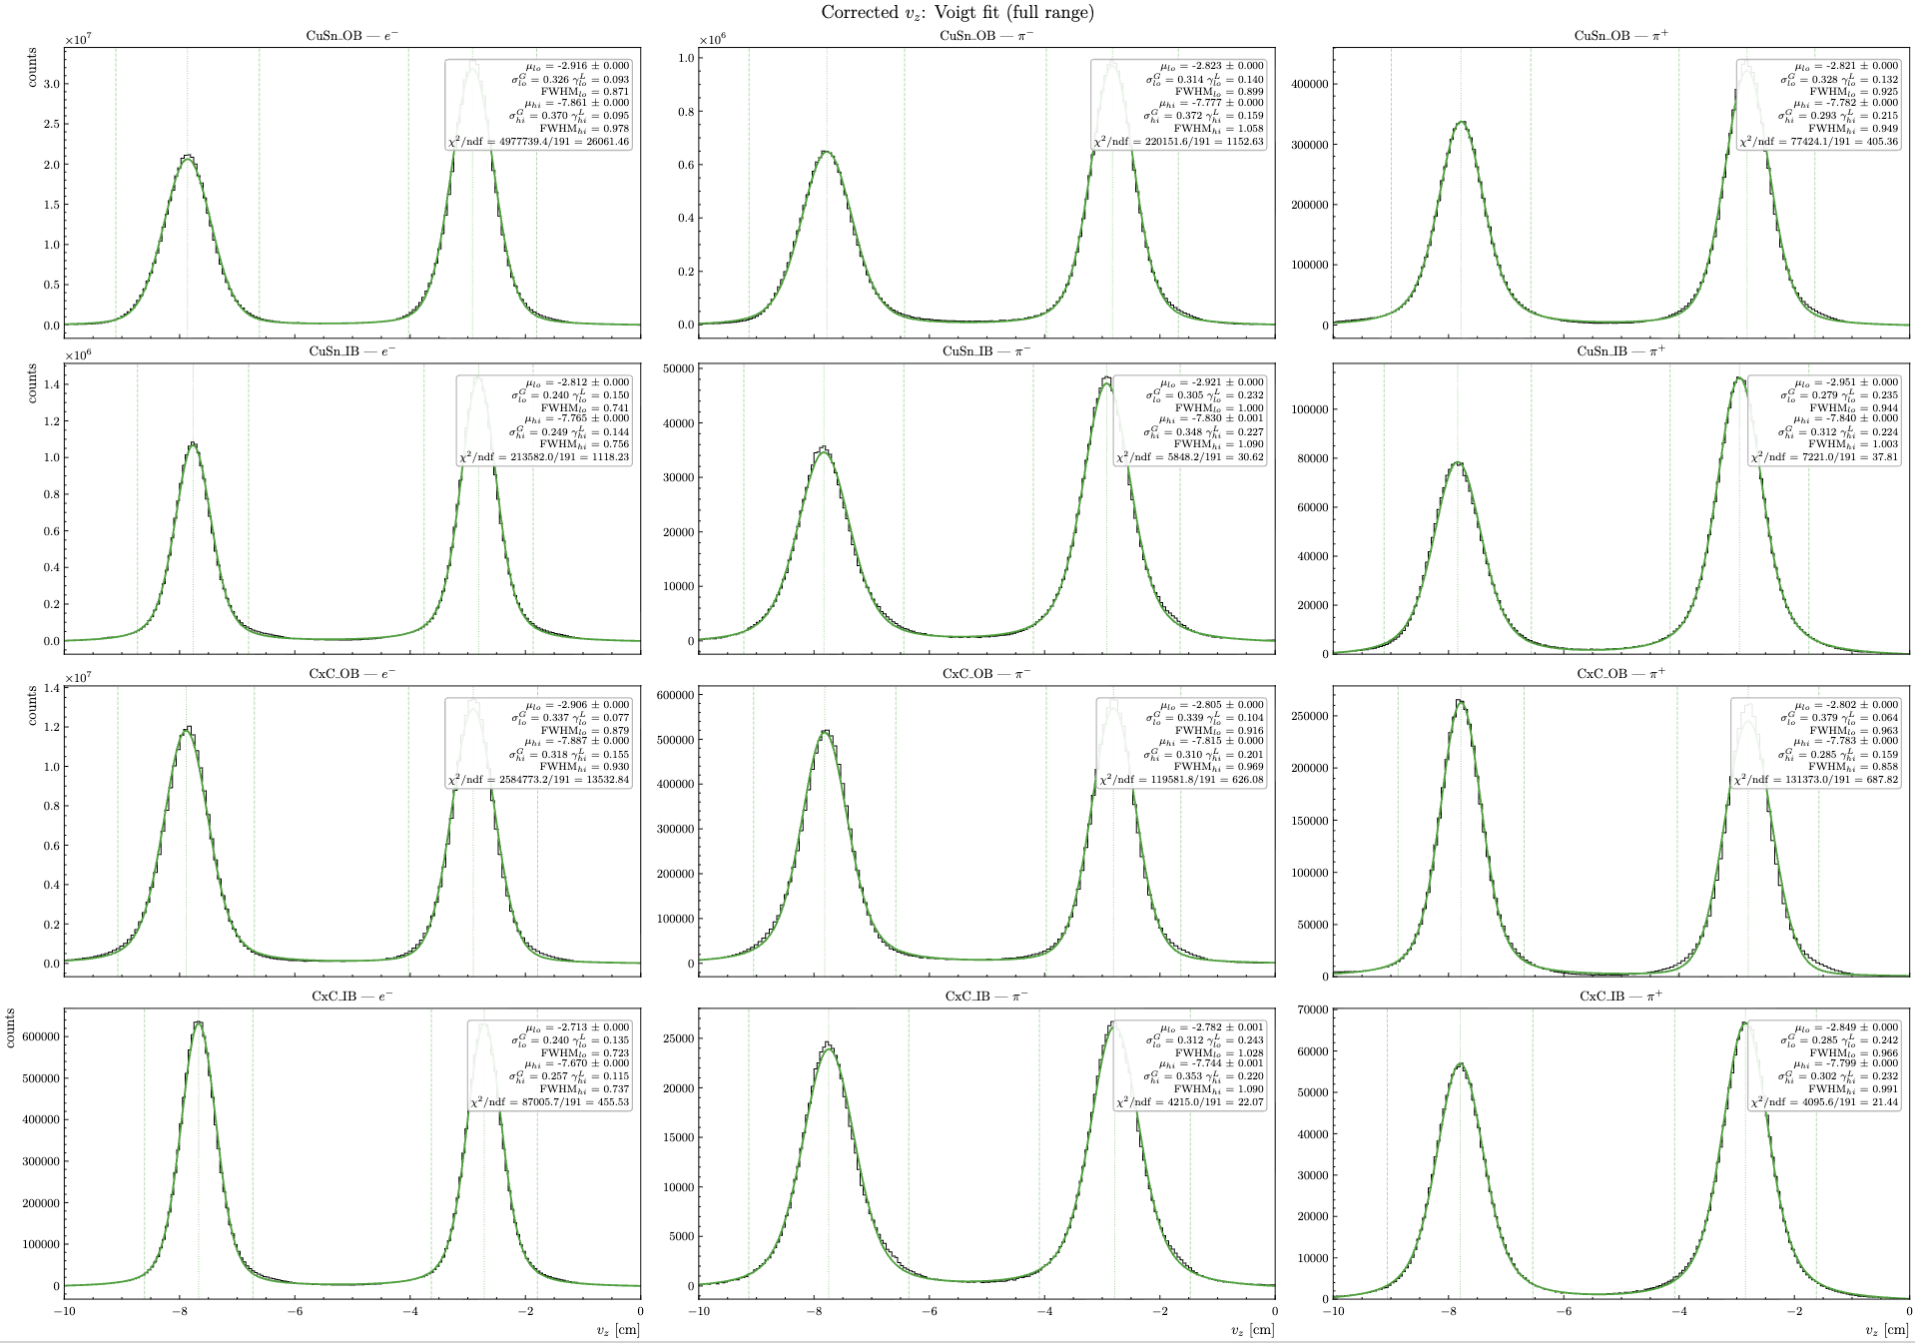
RG-D: CuSn contamination for pion
Two or three weeks ago I have fitted the Vz distribution for data after correction with two Voigt distributions:

Slide 7
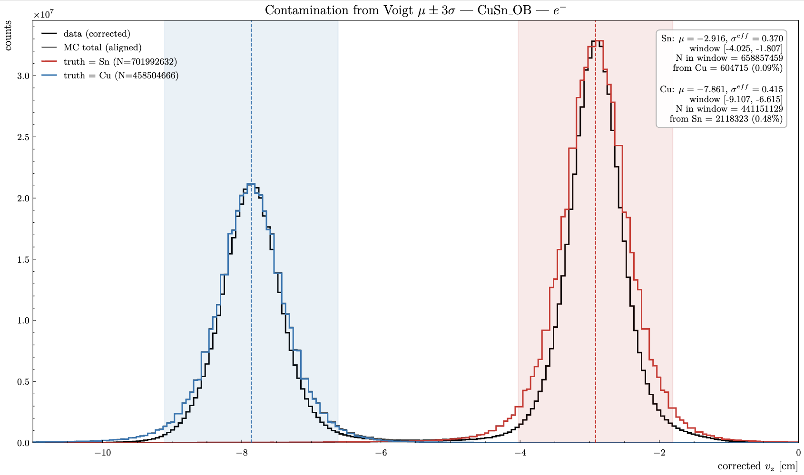
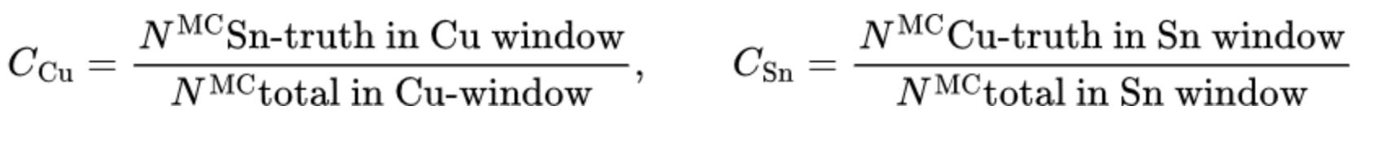
RG-D: CuSn contamination for pion
Add using the mean and sigma for that fit, I have extracted the CuSn contamination for electrons:
For each target peak we define a ±3σ window from its Voigt fit. Contamination is the fraction of counts in that window coming from the other target, estimated from truth-labelled MC integrated in the same window.

Slide 8
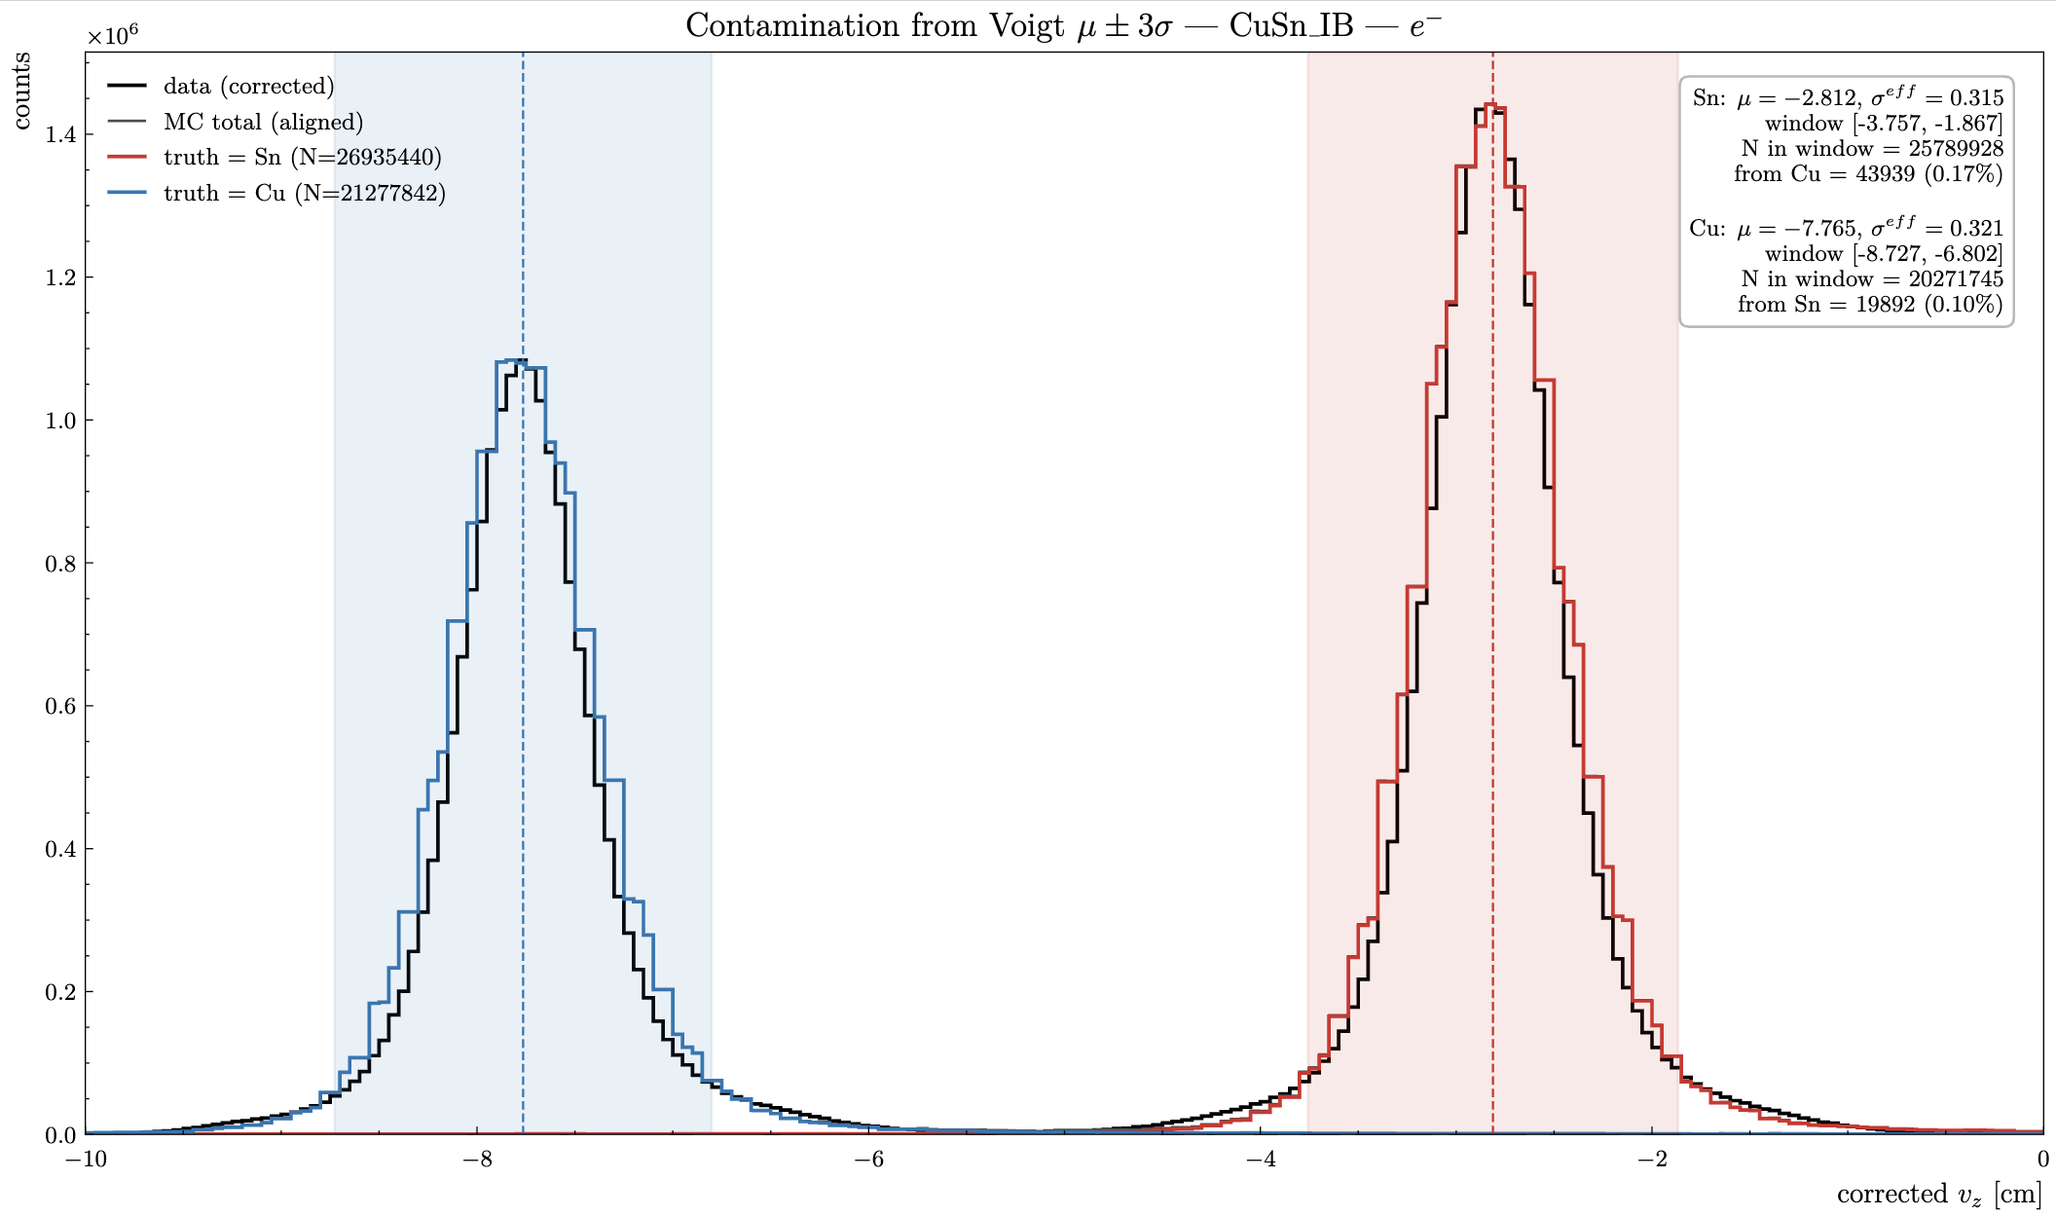
RG-D: CuSn contamination for pion
Add using the mean and sigma for that fit, I have extracted the CuSn contamination for electrons:
For each target peak we define a ±3σ window from its Voigt fit. Contamination is the fraction of counts in that window coming from the other target, estimated from truth-labelled MC integrated in the same window.

Slide 9


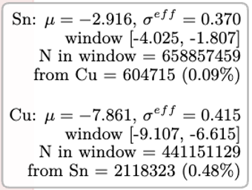
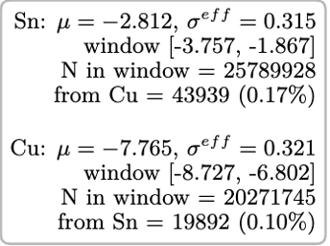
RG-D: CuSn contamination for pion
Add using the mean and sigma for that fit, I have extracted the CuSn contamination for electrons:

Slide 10
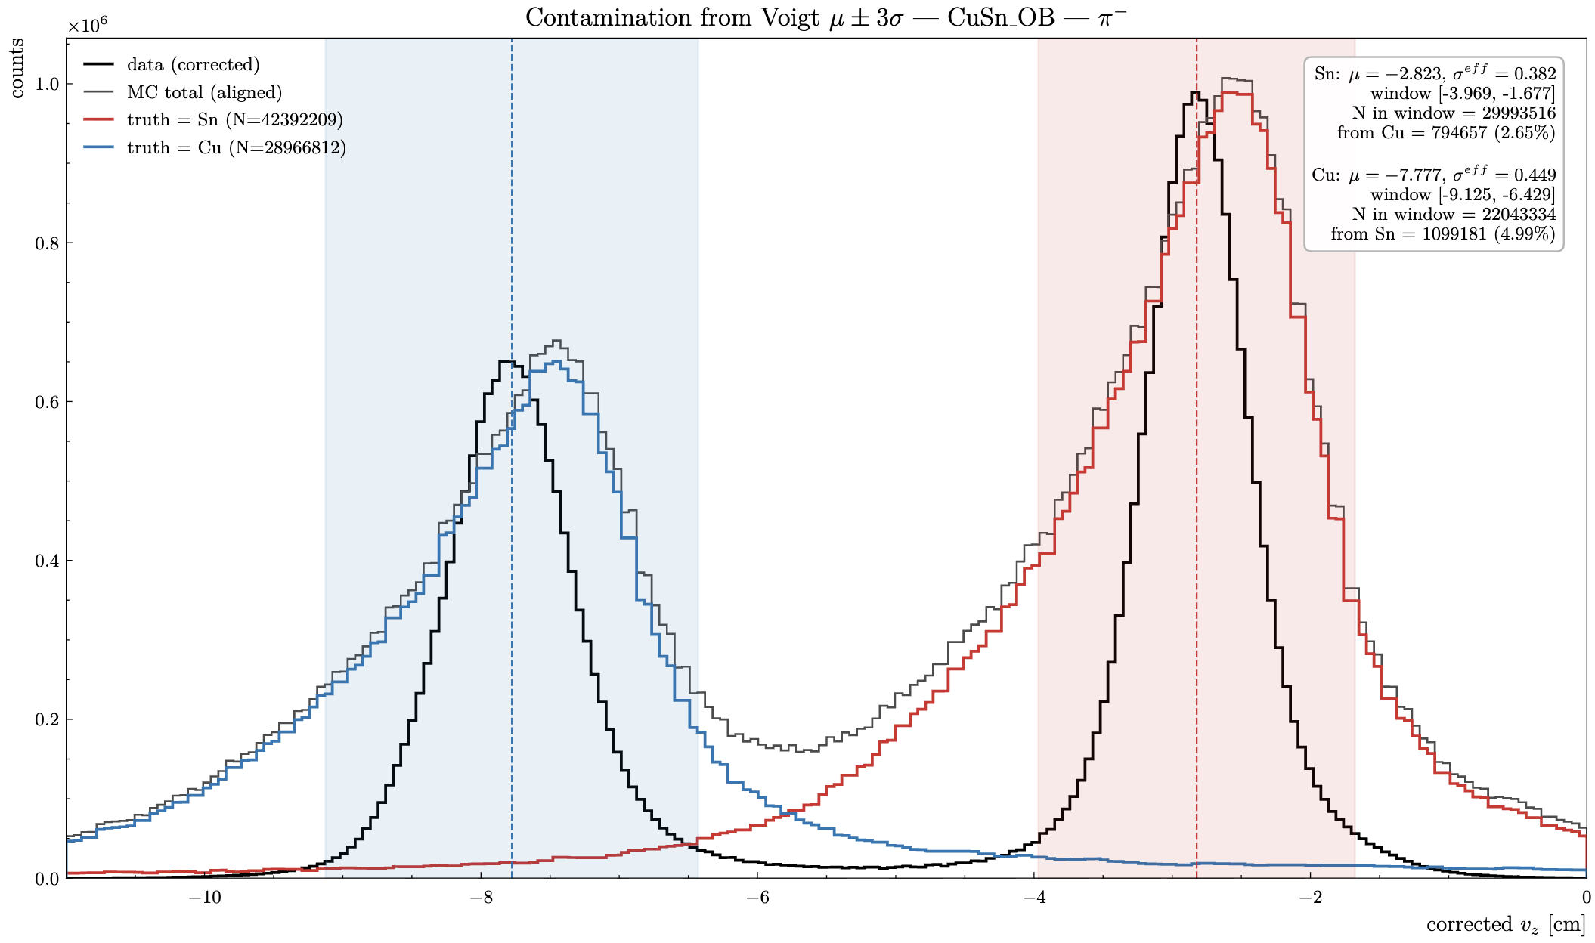
RG-D: CuSn contamination for pion
Can try to do the same for pions:
To different but can still extract something

Slide 11
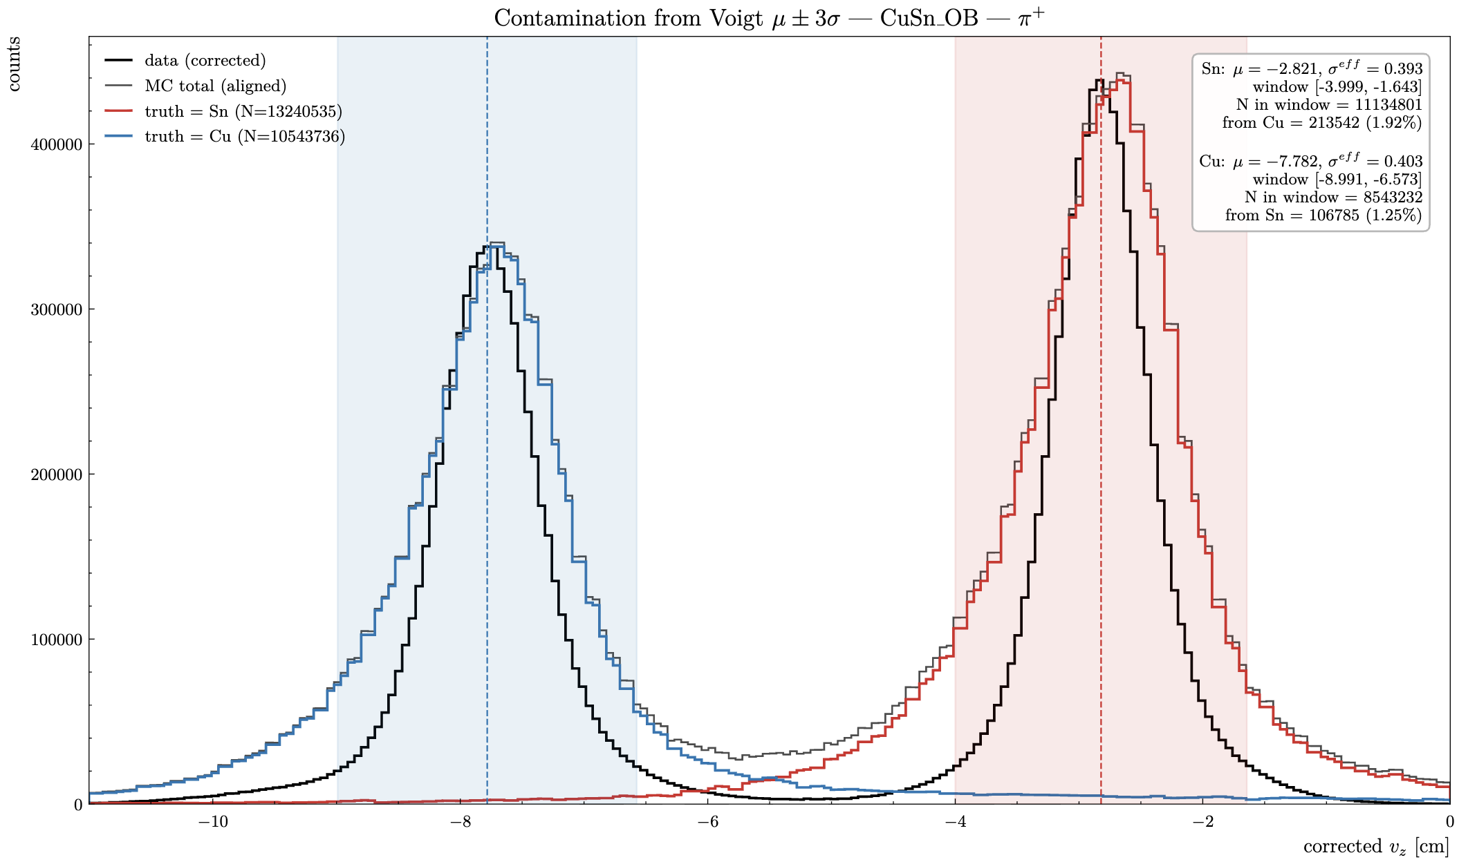
RG-D: CuSn contamination for pion
Can try to do the same for pions:
To different but can still extract something
I need to regenerate the reconstruction files with the -3 cm solenoid shift

Slide 12
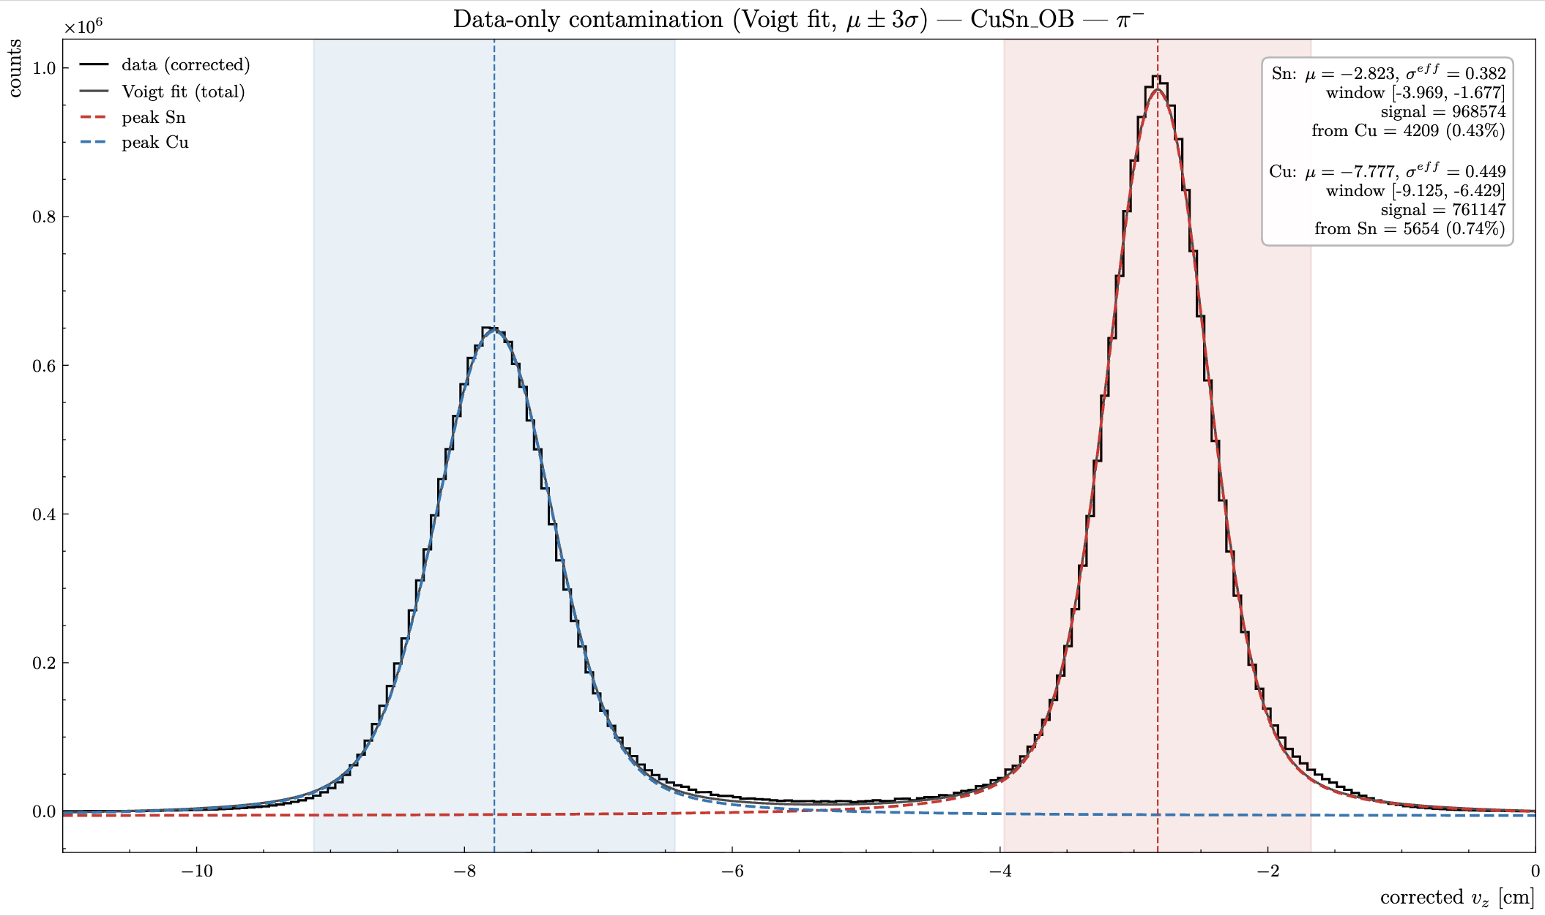
RG-D: CuSn contamination for pion
Can use just data and the fit:
For each target peak we define a ±3σ window from its Voigt fit. Contamination is the fraction of counts in that window coming from the other target, estimated from the fitted Voigt of the wrong peak in the data

Slide 13
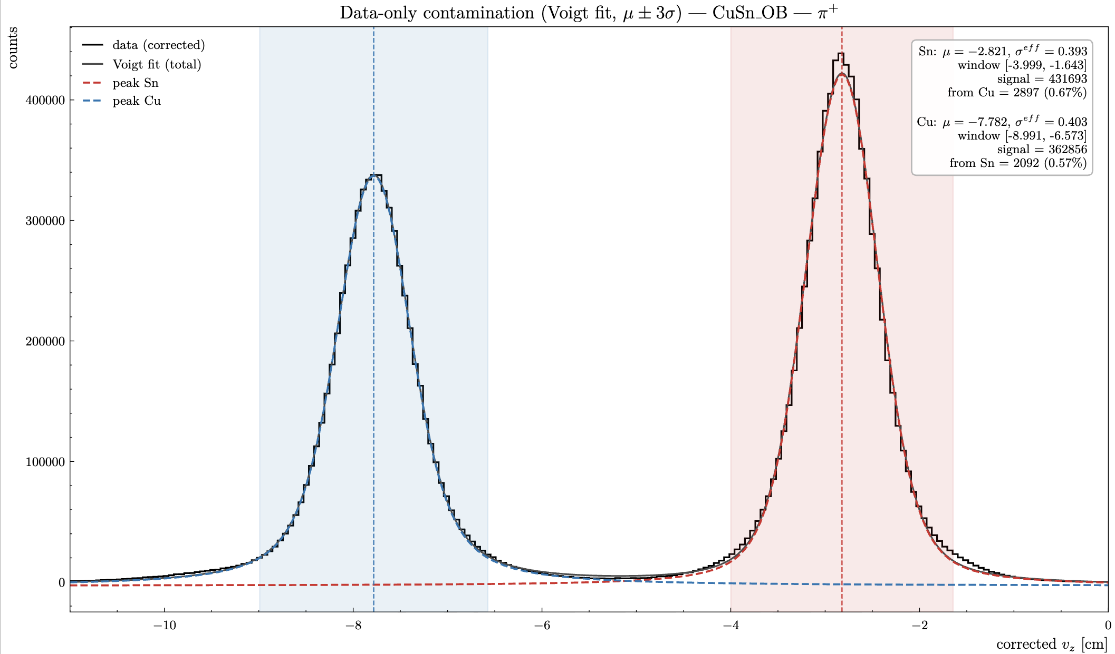
RG-D: CuSn contamination for pion
Can use just data and the fit:
For each target peak we define a ±3σ window from its Voigt fit. Contamination is the fraction of counts in that window coming from the other target, estimated from the fitted Voigt of the wrong peak in the data

Slide 14
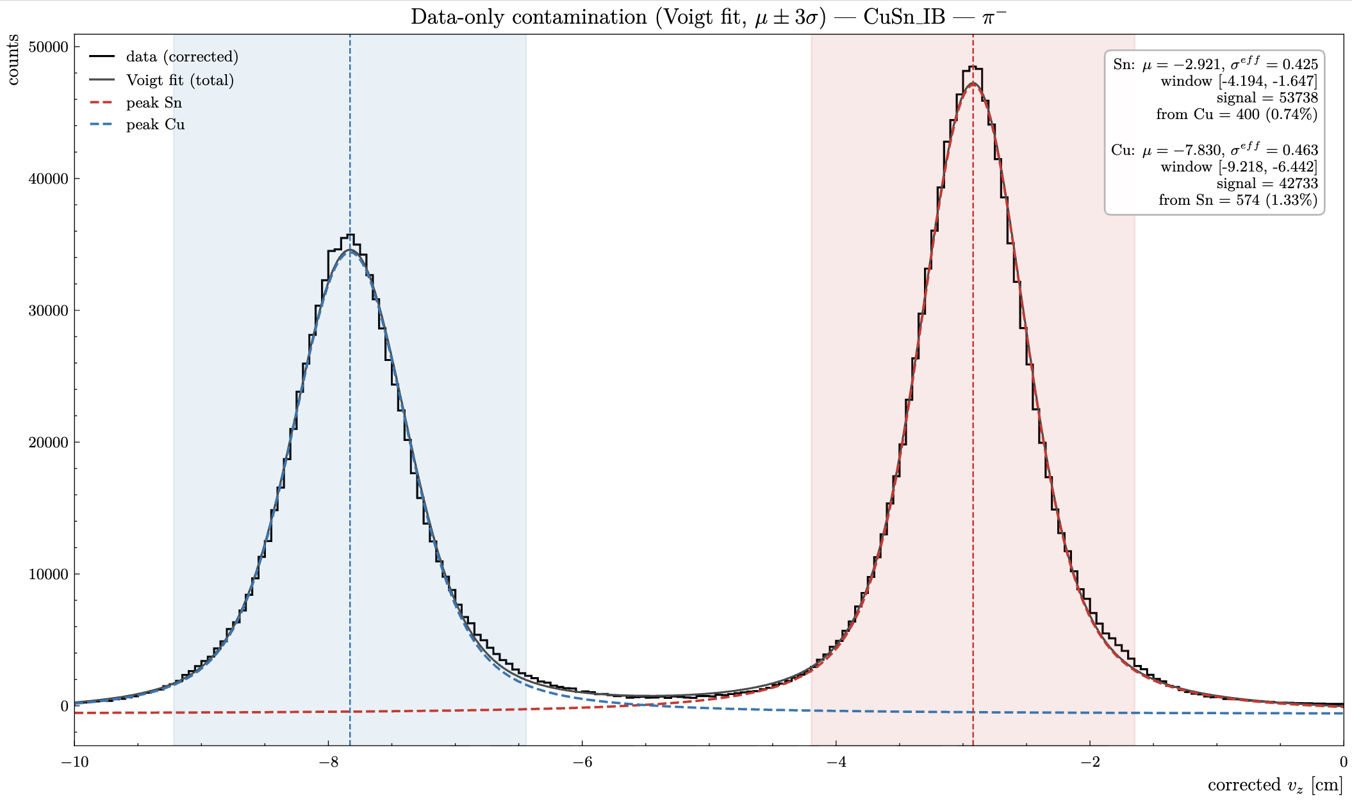
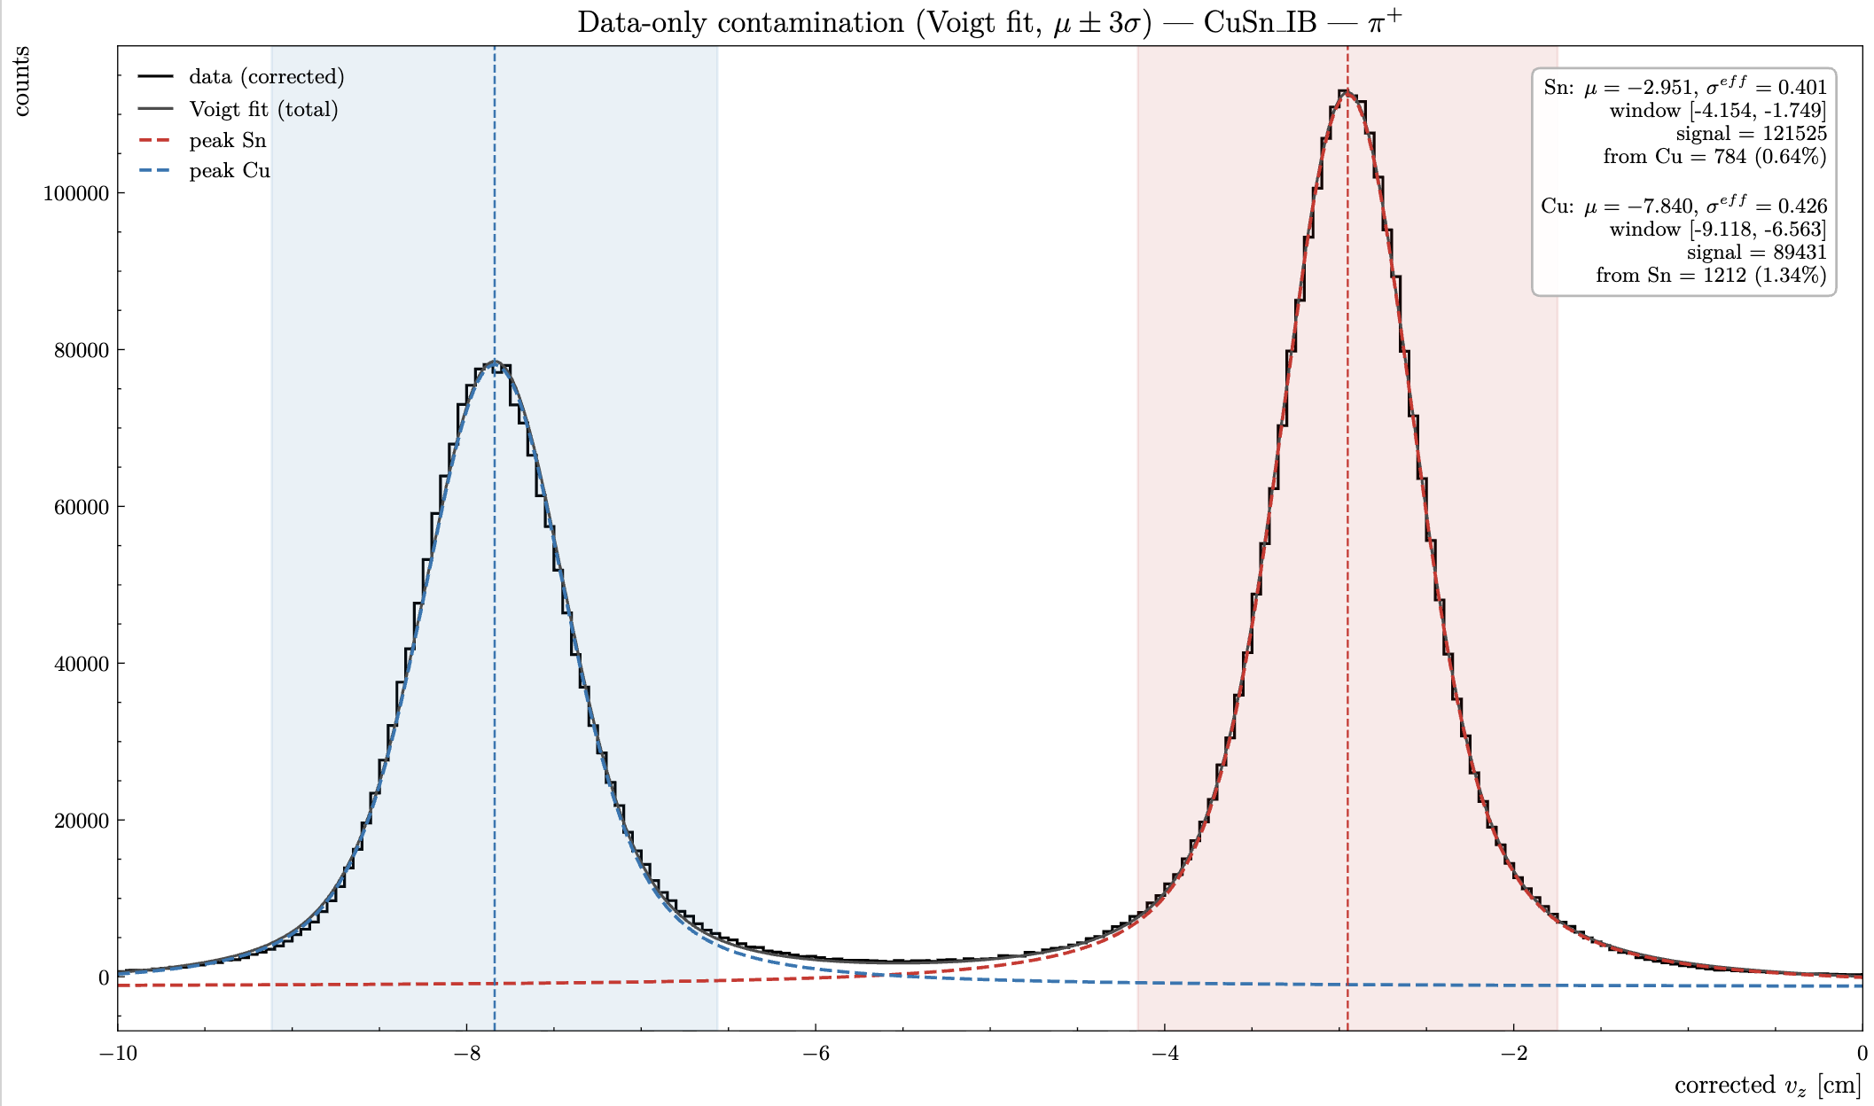
RG-D: CuSn contamination for pion
Can use just data and the fit:
For each target peak we define a ±3σ window from its Voigt fit. Contamination is the fraction of counts in that window coming from the other target, estimated from the fitted Voigt of the wrong peak in the data

Slide 15




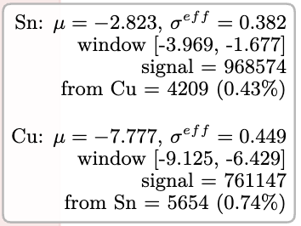
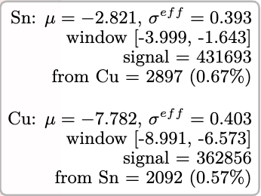
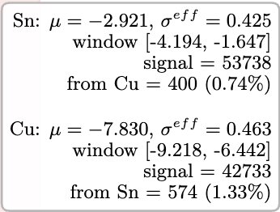
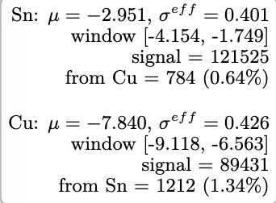
RG-D: CuSn contamination for pion
Can use just data and the fit:
For each target peak we define a ±3σ window from its Voigt fit. Contamination is the fraction of counts in that window coming from the other target, estimated from the fitted Voigt of the wrong peak in the data

Slide 16
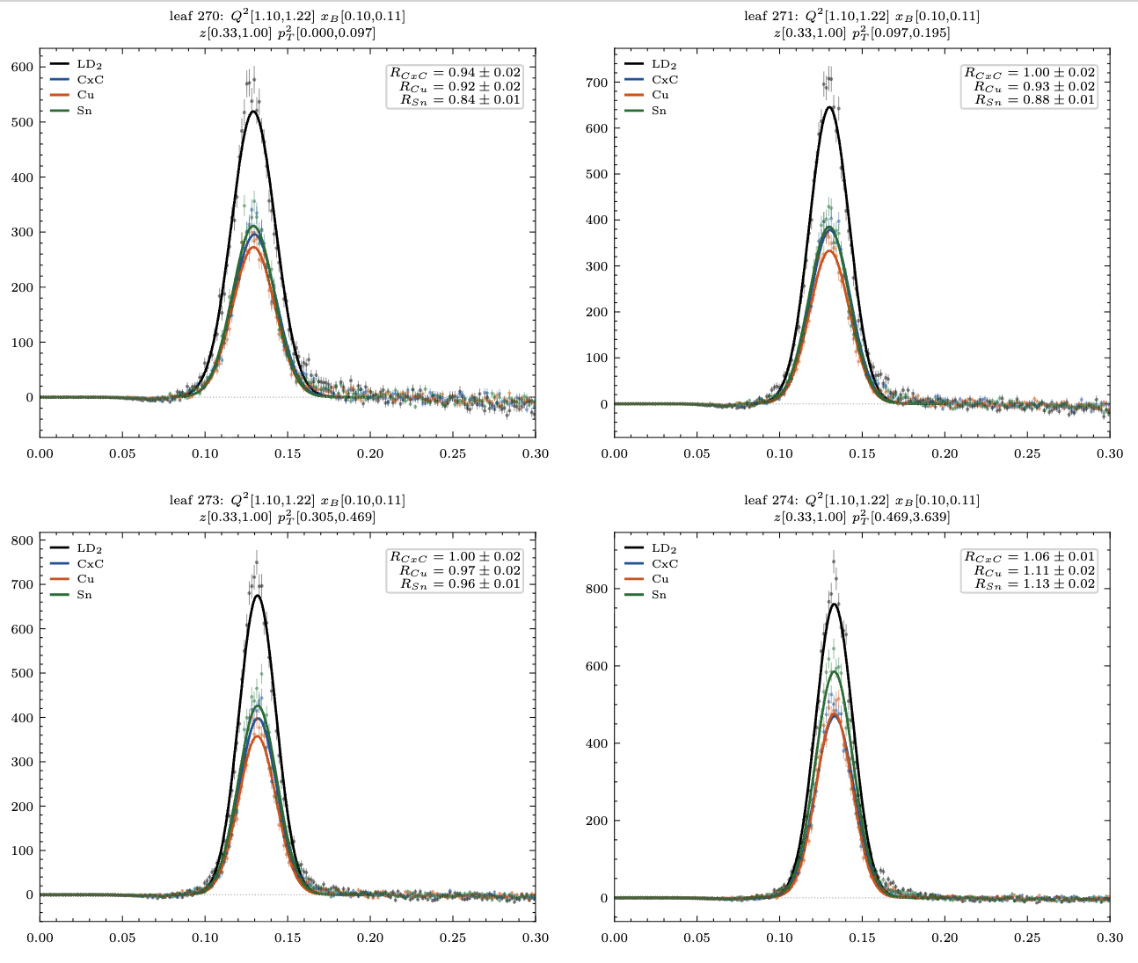
RG-D: ᴨ⁰ analysis
Ok with the new binning I can extract the multiplicity ratio:
I have 1600 bins in Q², x_{B}, z_{h} and p_{T}², for each I can plot the invariants mass of the two photons after the background subtraction:

Slide 17
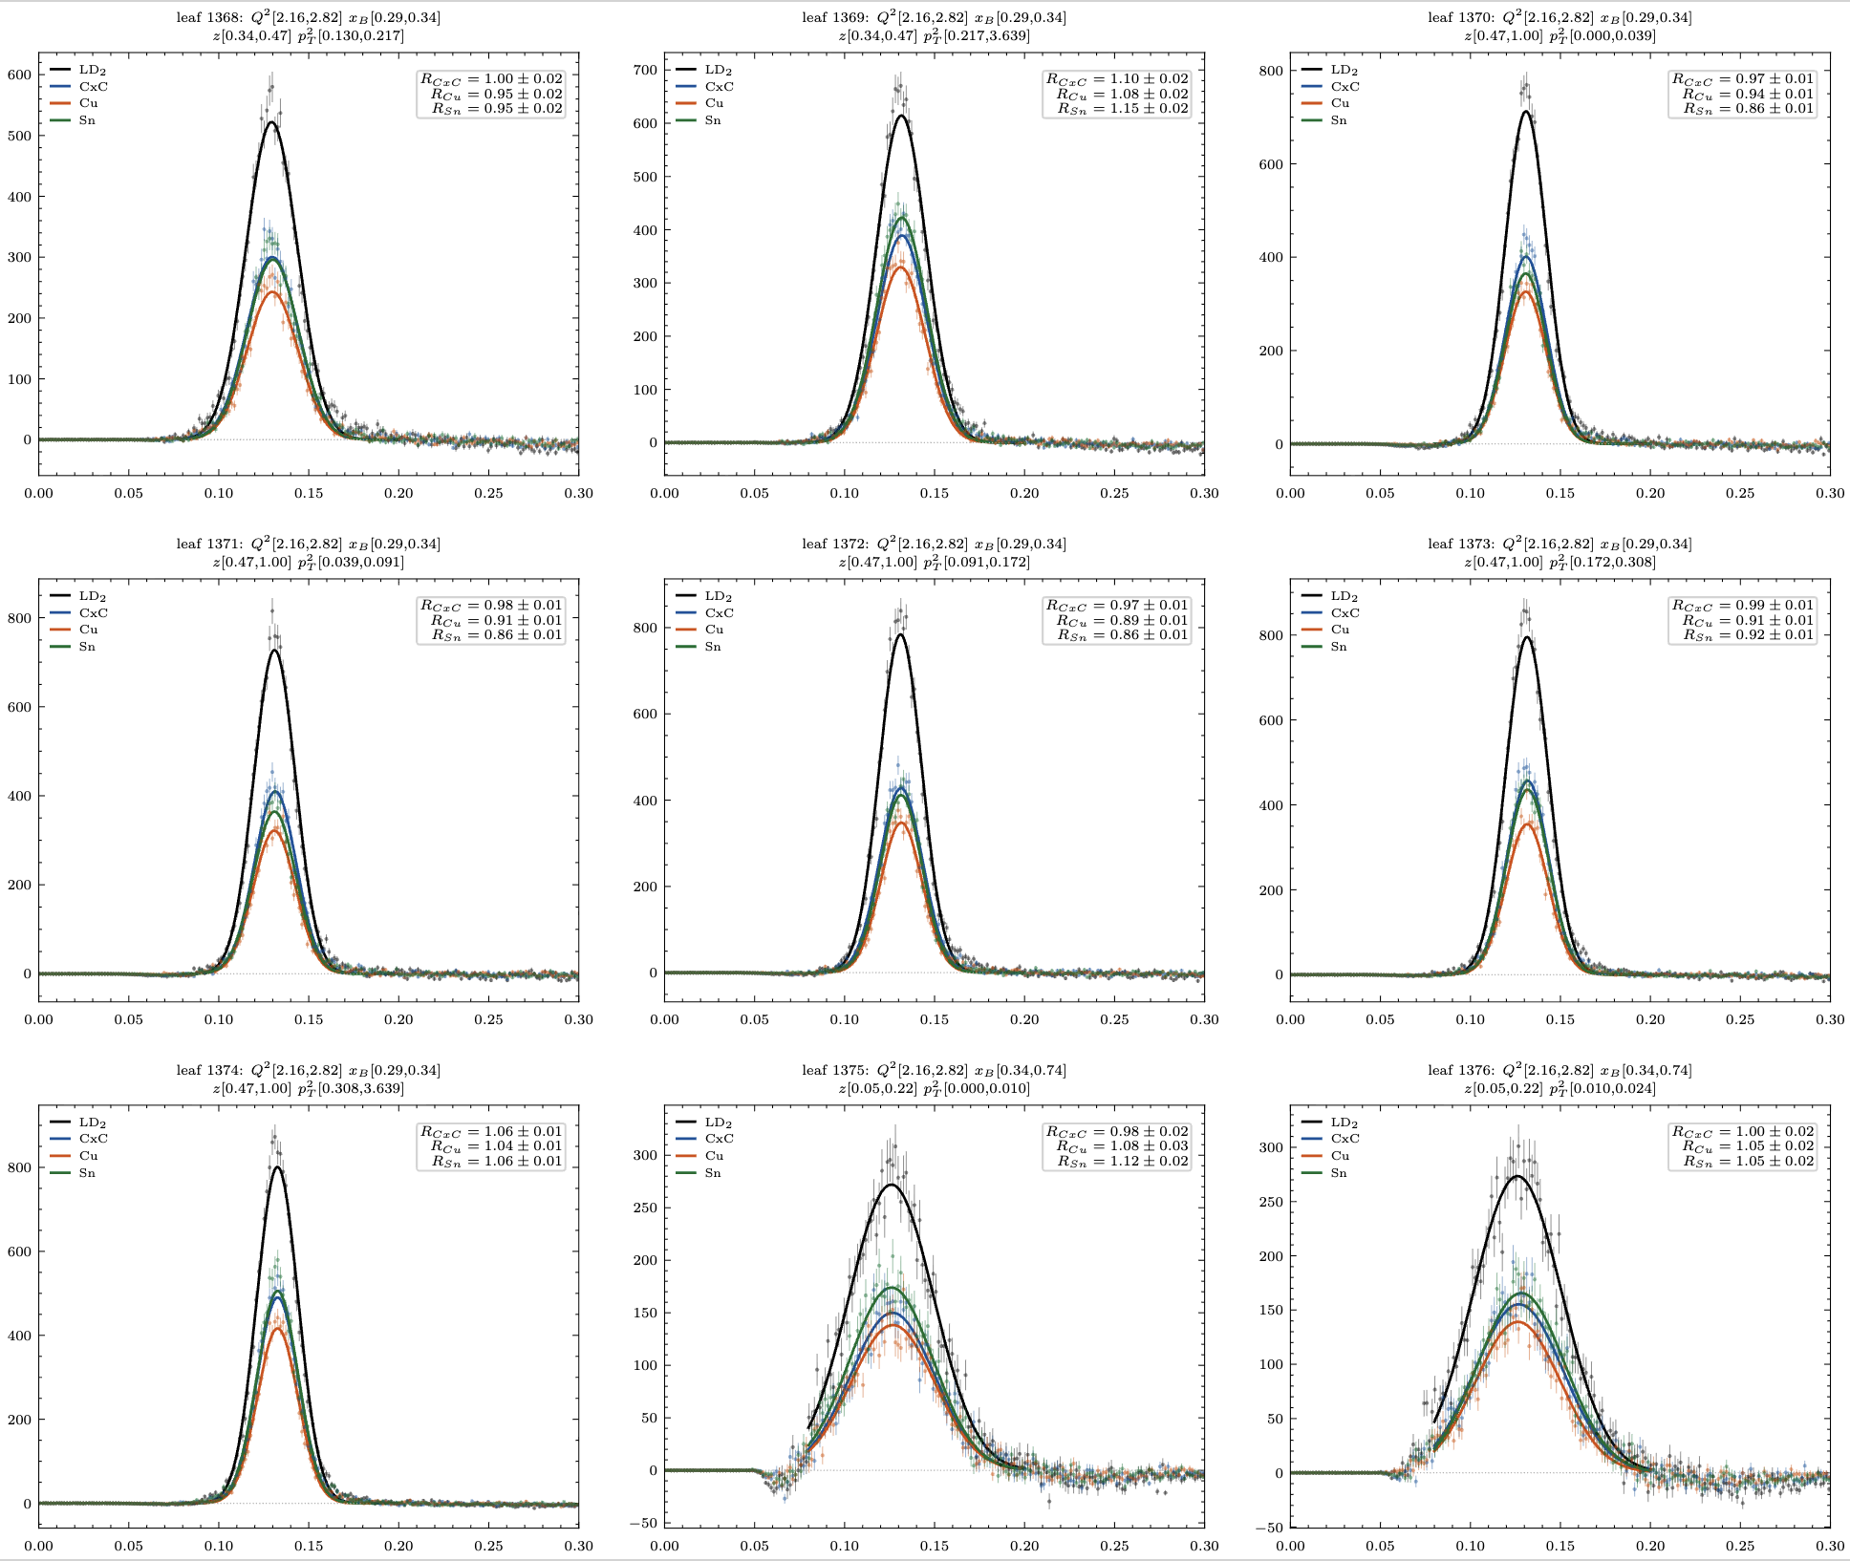
RG-D: ᴨ⁰ analysis
Ok with the new binning I can extract the multiplicity ratio:
I have 1600 bins in Q², x_{B}, z_{h} and p_{T}², for each I can plot the invariants mass of the two photons after the background subtraction:

Slide 18
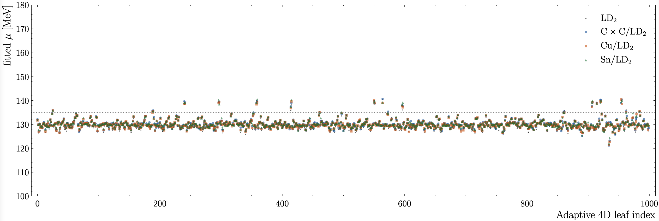
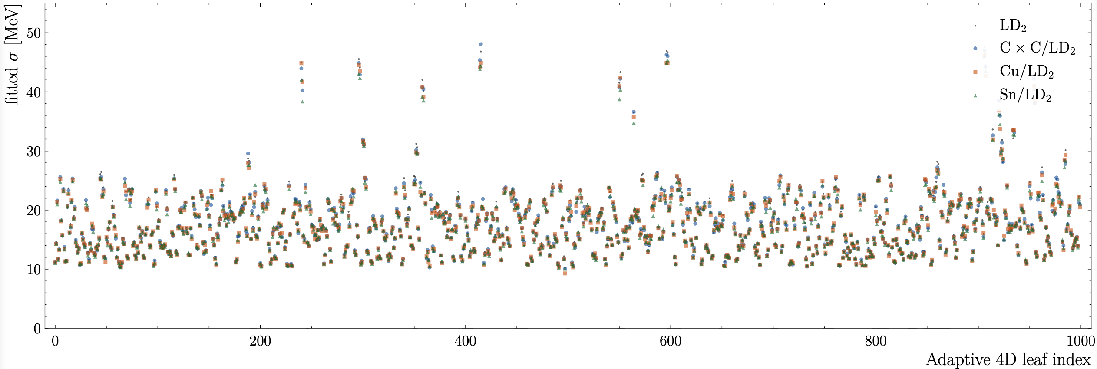
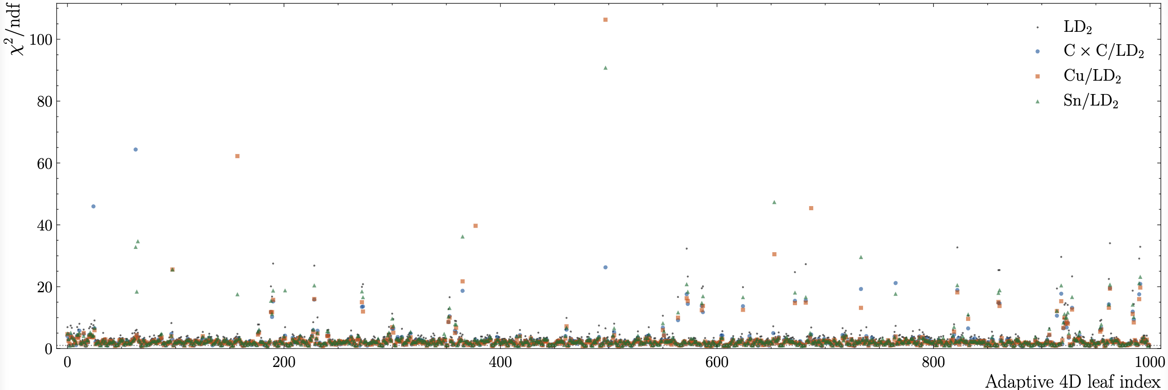
RG-D: ᴨ⁰ analysis
Ok with the new binning I can extract the multiplicity ratio:
I have 1600 bins in Q², x_{B}, z_{h} and p_{T}², for each I can plot the invariants mass of the two photons after the background subtraction.
Looking at 1000 plots is a bit too much so I plotted the mean, sigma and chi2/ndf for each bin
Couple of bad fits

Slide 19
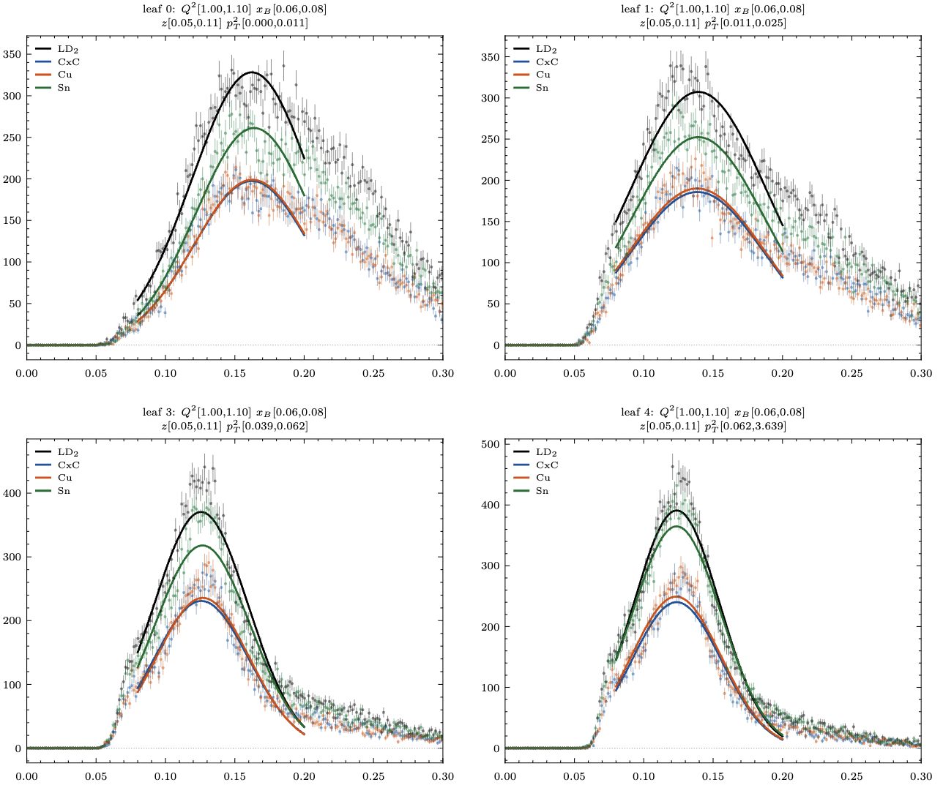
RG-D: ᴨ⁰ analysis
Ok with the new binning I can extract the multiplicity ratio:
I have 1600 (8*8*5*5) bins in Q², x_{B}, z_{h} and p_{T}², for each I can plot the invariants mass of the two photons after the background subtraction.
Looking at 1000 plots is a bit too much so I plotted the mean, sigma and chi2/ndf for each bin
Couple of bad fits, I need to work on the fit range, initial parameters and maybe add constant term. Also it is probably an issue with the event mixing

Slide 20
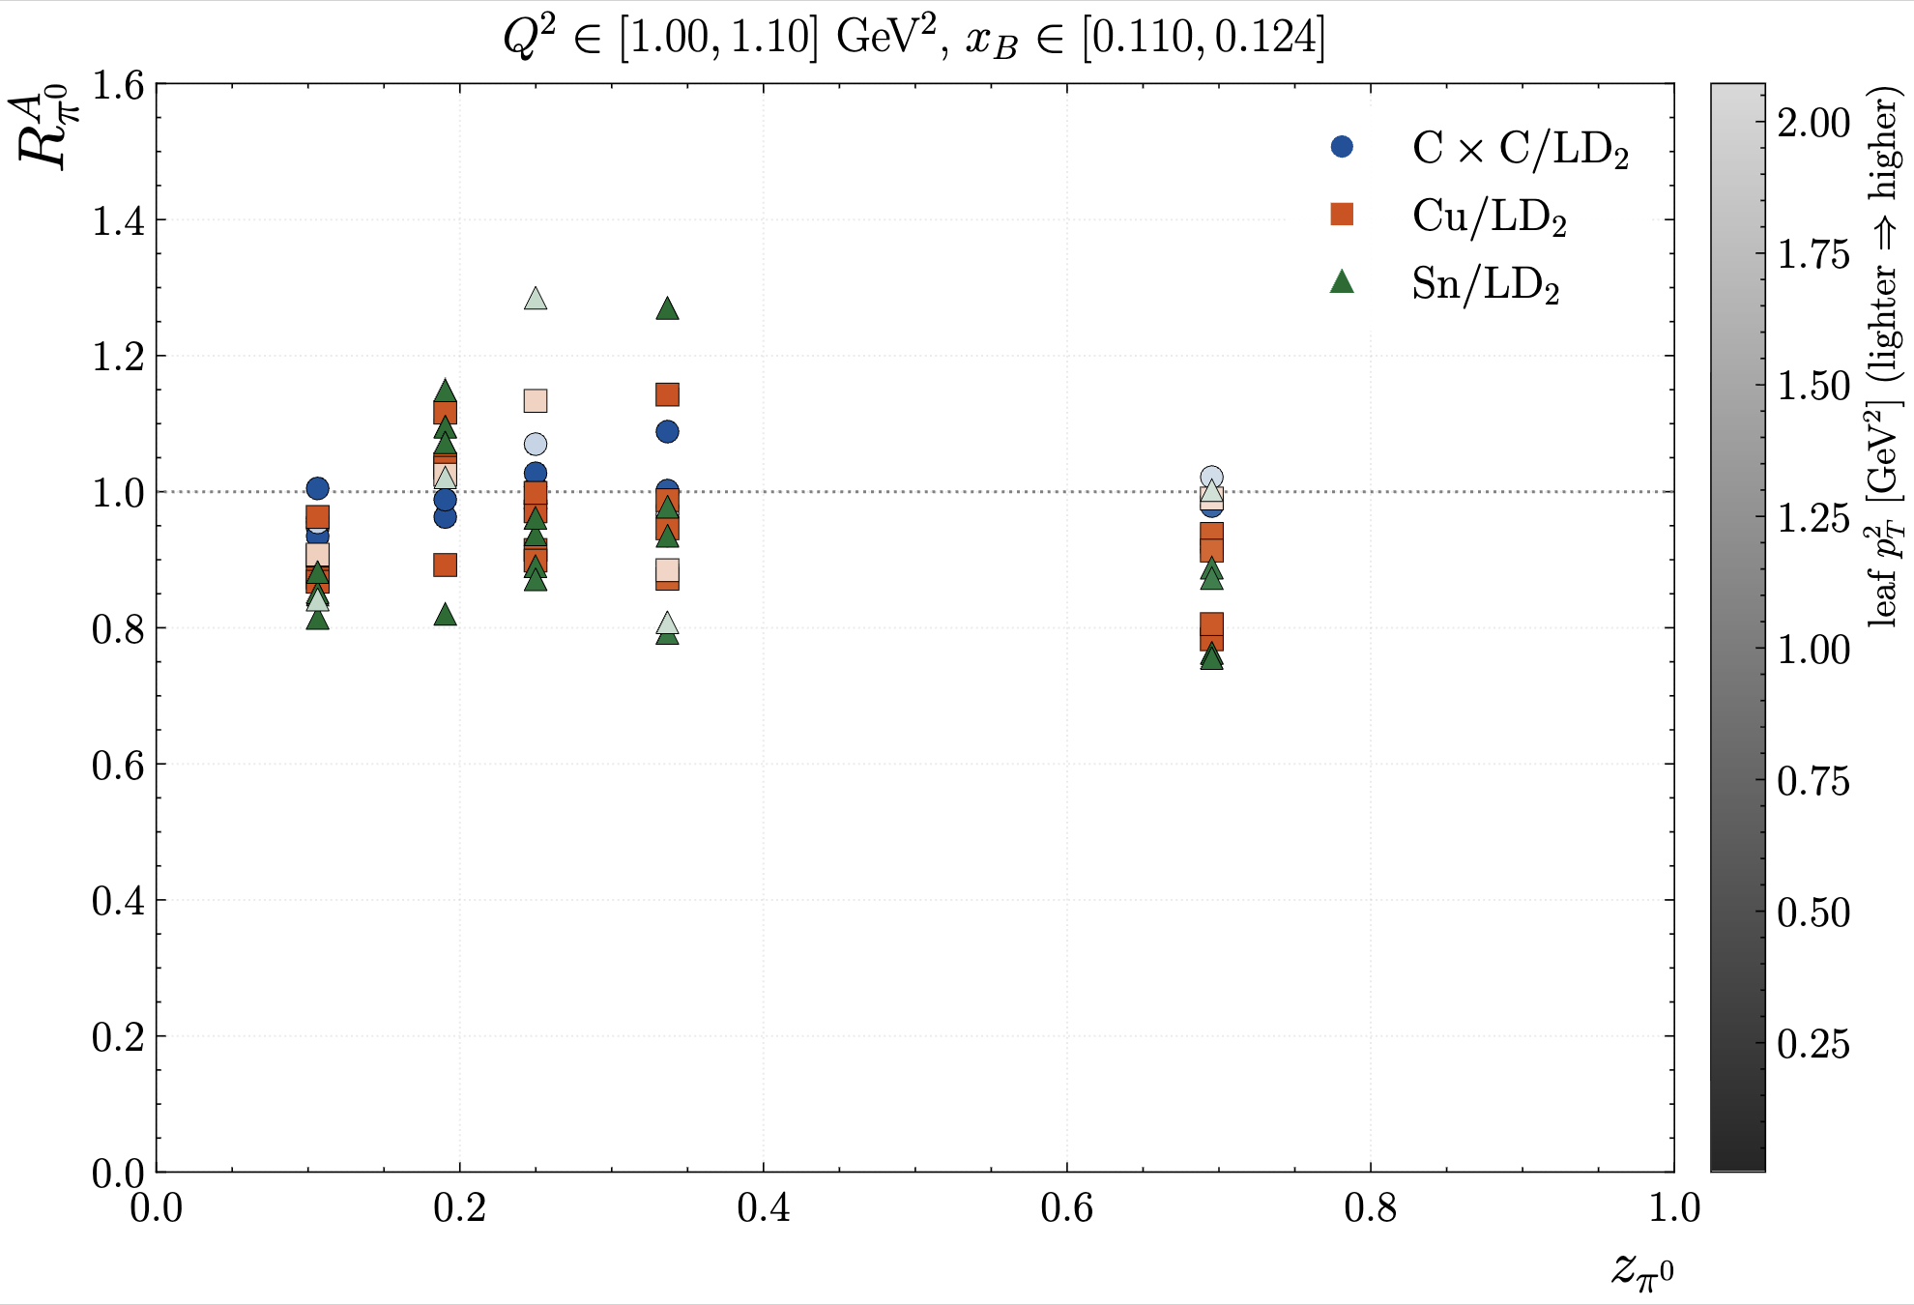
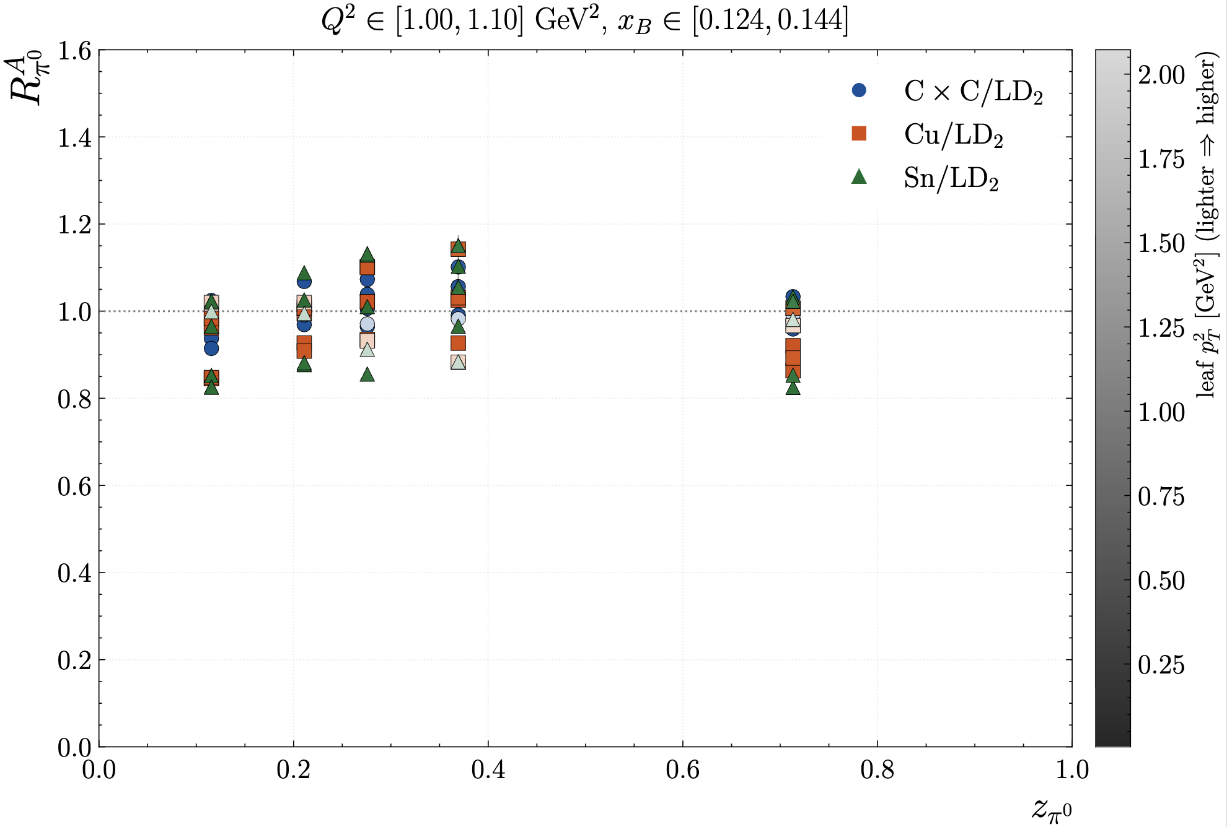
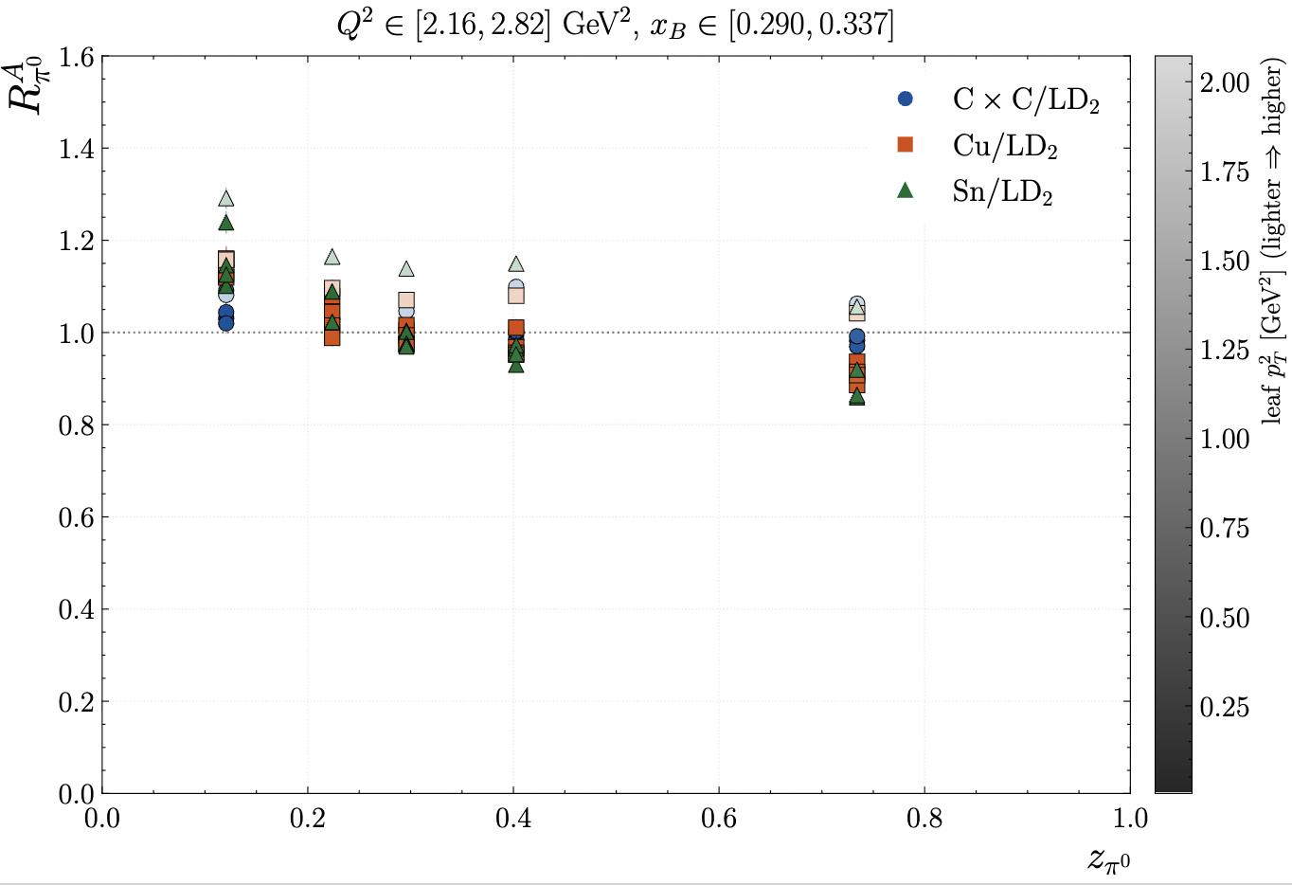
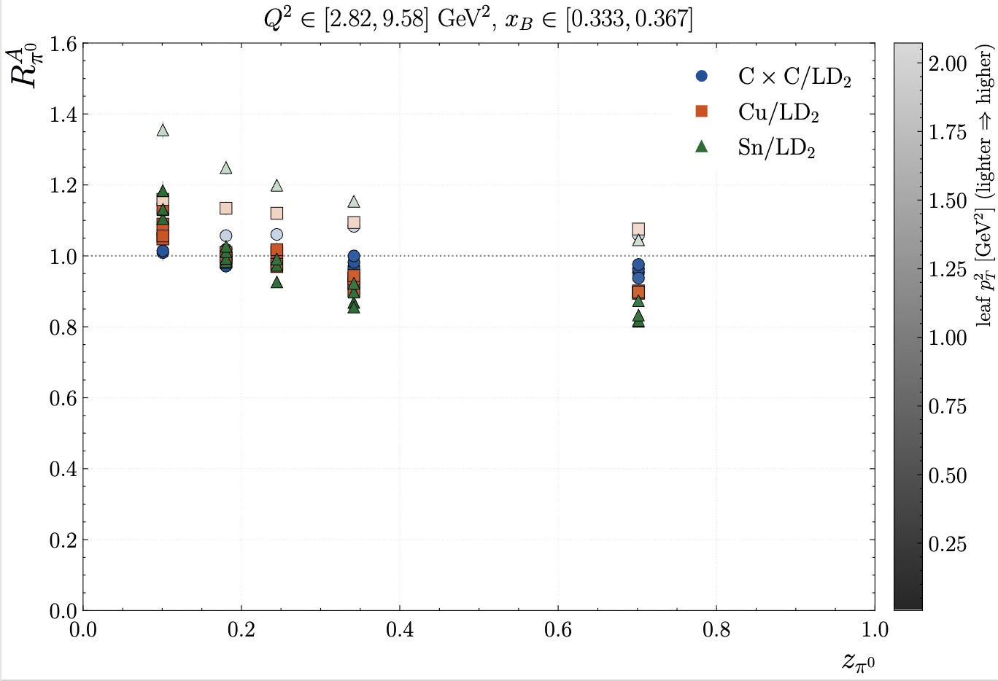
RG-D: ᴨ⁰ analysis
Ok with the new binning I can extract the multiplicity ratio:

Slide 21
RG-D: Clas Collaboration meeting plan
Introduction:
Run Group D
CT Experiment
Nuclear TMDs
Run Configuration
Cooking Summary: some stats
Particle Identification:
Vertex correction
Problem for electrons and pions (maybe 2 slides): low momentum + low theta
Explanation for the correction
Show correction electron (3 slides)
Show correction on pions
Comparison of the electron with the simulation
CuSn contamination using simulation
pi0 analysis:
Binning using a KD-tree
π0 event mixing background-subtraction
4D multiplicity ratio
pT broadening
azimuthal modulation
Pion analysis from Suman?
Study the hadron/electron contamination
Color transparency analysis
rho invariant mass
color transparency

Slide 22
RG-L/Alert
I have discussed with Raphael about some work I can do for RG-L/ALERT
He want me to work on beam position calibration
Some NMSU student work on that but he want me to integrate that in the timeline.
Add also we didn’t ear from them in months.
For that, I will be using the clas12-beamspot software: https://github.com/JeffersonLab/clas12-beamspot
Is it ok for you, if I work?

Slide 23
To do list
RG-D:
Regenerate simulation with the -3 cm solenoid shift.
Correct the RG-D GCARDs in clas12-config
Continue the work on cos and sin φ_{h} extraction
Radiative and acceptance correction
Background for ρ⁰ with simulation for CT analysis
Write README and analysis details about the code
ALERT:
Work on the beam position calibration:
Understand how the software work

