Slide 1
Group meeting
Mathieu Ouillon (Mississippi State University)
06/15/26

Slide 2
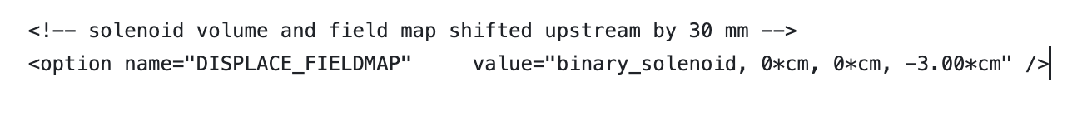
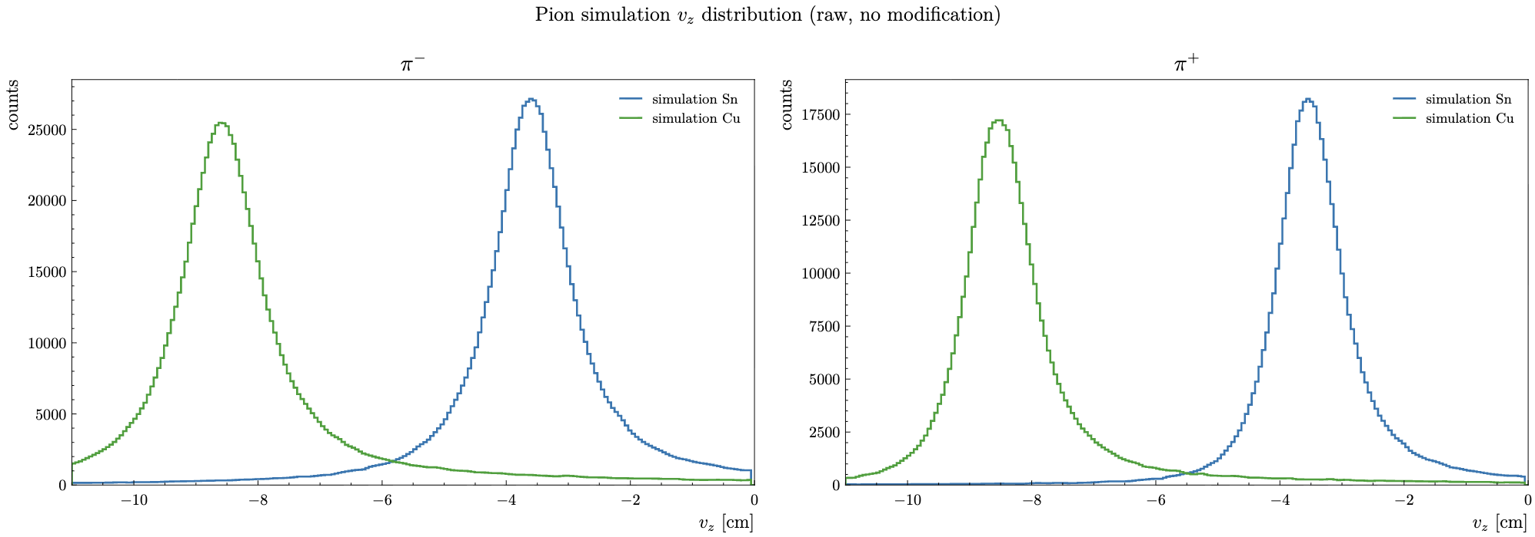
RG-D: MC Pion
Simulate SIDIS events using Raphael event generator and:
Now I get a much better Vz distribution

Slide 3
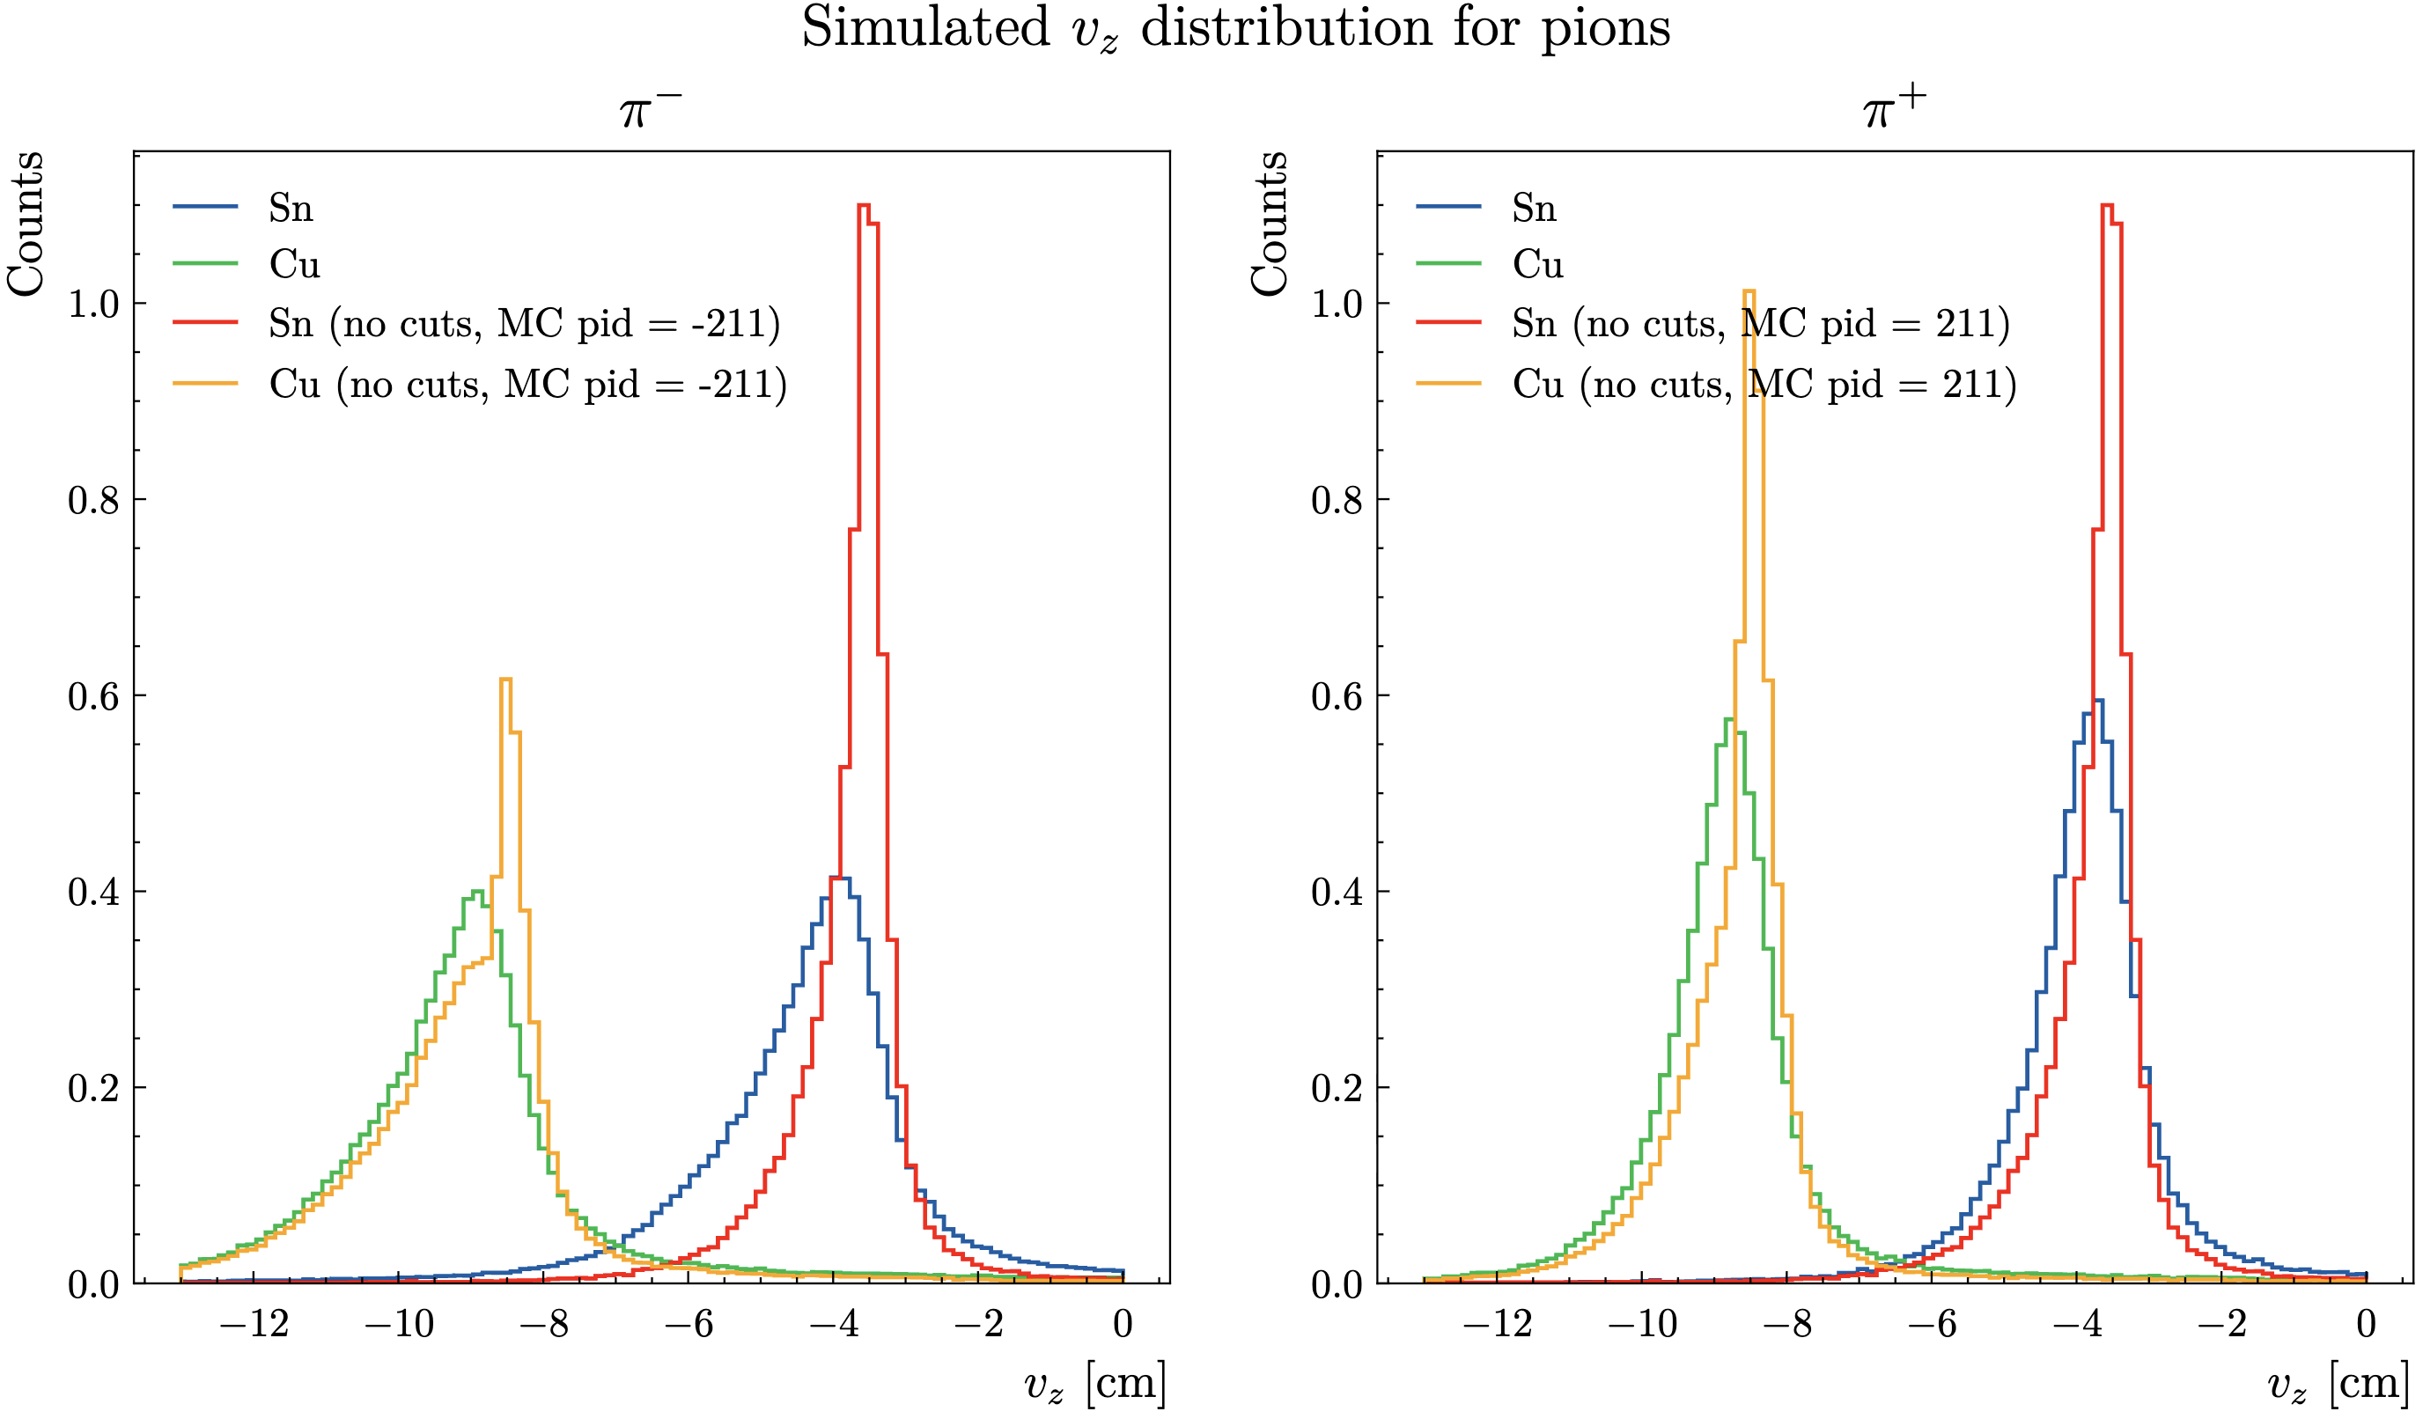
RG-D: MC Pion
Simulate SIDIS events using Raphael event generator and:
Now I get a much better Vz distribution

Slide 4
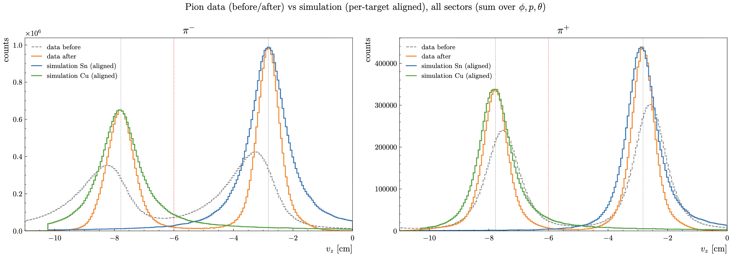
RG-D: MC Pion
Now I can compare MC and data:
Still not perfect but much better. It seems that the correction does too much

Slide 5
RG-D: MC Pion
Now I can compare MC and data:
Still not perfect but much better. It seems that the correction does too much
Question about the correction:
The correction accounts for three things at the same time: the shift of the vertex (caused by an unknown source in the reconstruction), the vertex resolution that becomes worse at low θ (a purely geometric effect), and multiple scattering (low momentum means larger deviation), maybe also a bit of energy loss (but very small for electron and pion).
The question then becomes: which effect should the correction address, and how?
One possibly would be to correct for the shift of the vertex, for each bin in θ and momentum the Vz distribution would become a gaussian, and develop a 3-D cut (similar to Δt vs p cut but would be Vz vs (θ,p))

Slide 6
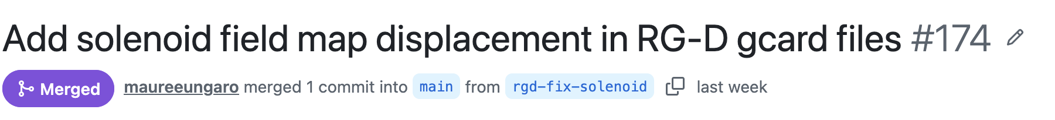
RG-D: MC Pion
So, I made a pull request to clas12-config to add these lines in all 4 RG-D GCARDs:
The pull request have been merged by Maurizio, and I have told Suman that

Slide 7
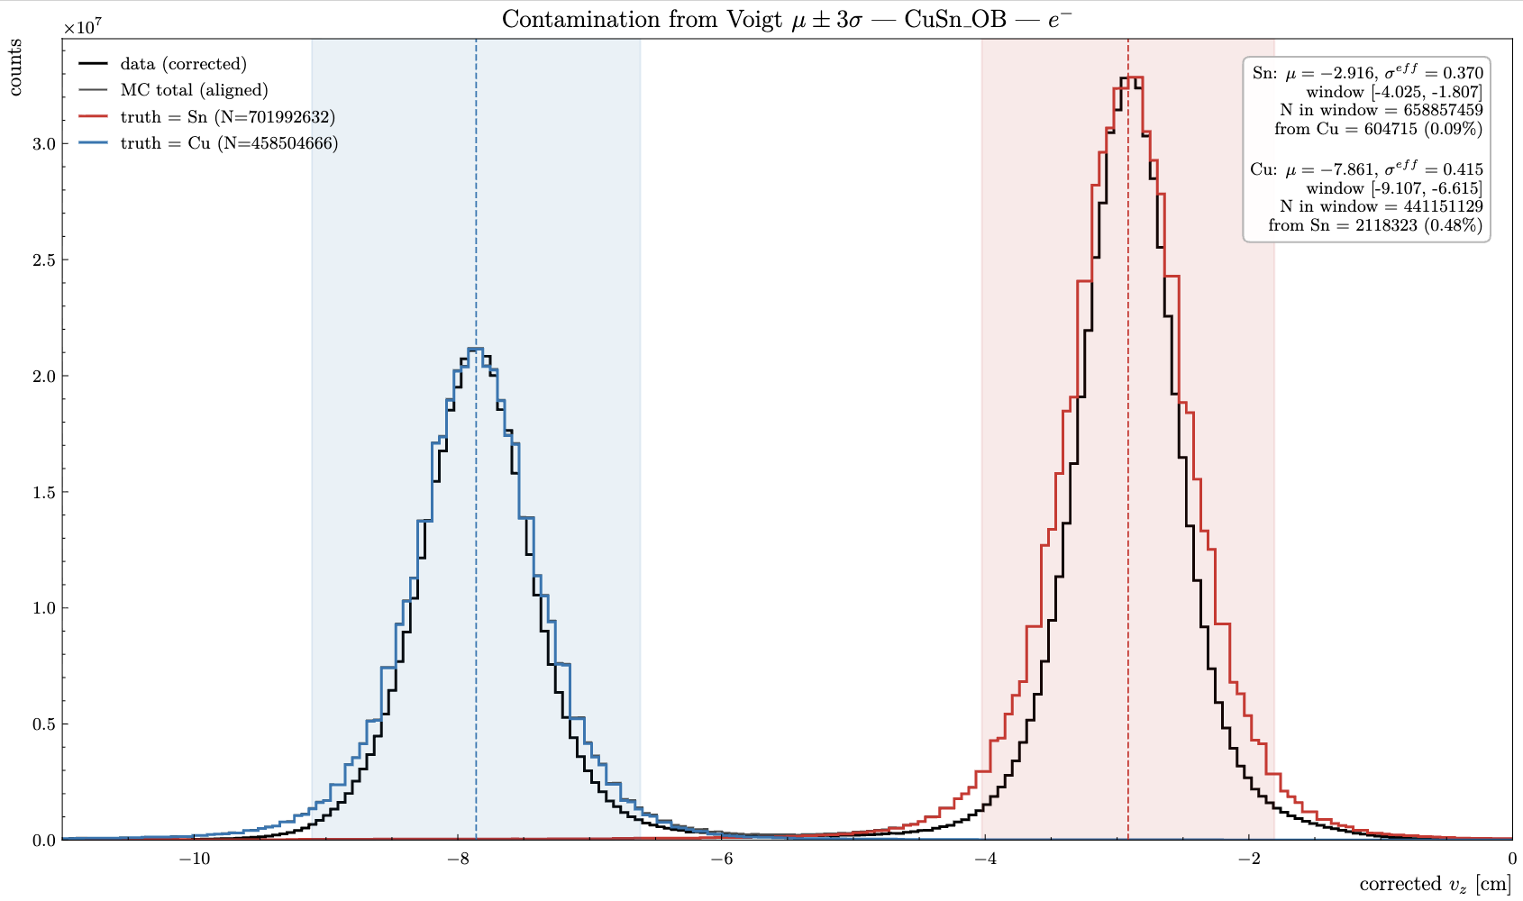
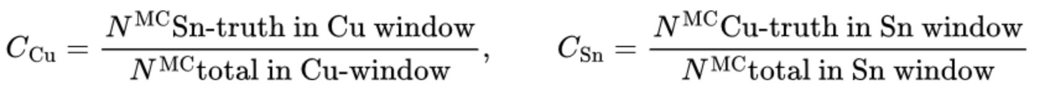
RG-D: CuSn contamination for pion
Add using the mean and sigma for that fit, I have extracted the CuSn contamination for electrons:
For each target peak we define a ±3σ window from its Voigt fit. Contamination is the fraction of counts in that window coming from the other target, estimated from truth-labelled MC integrated in the same window.

Slide 8
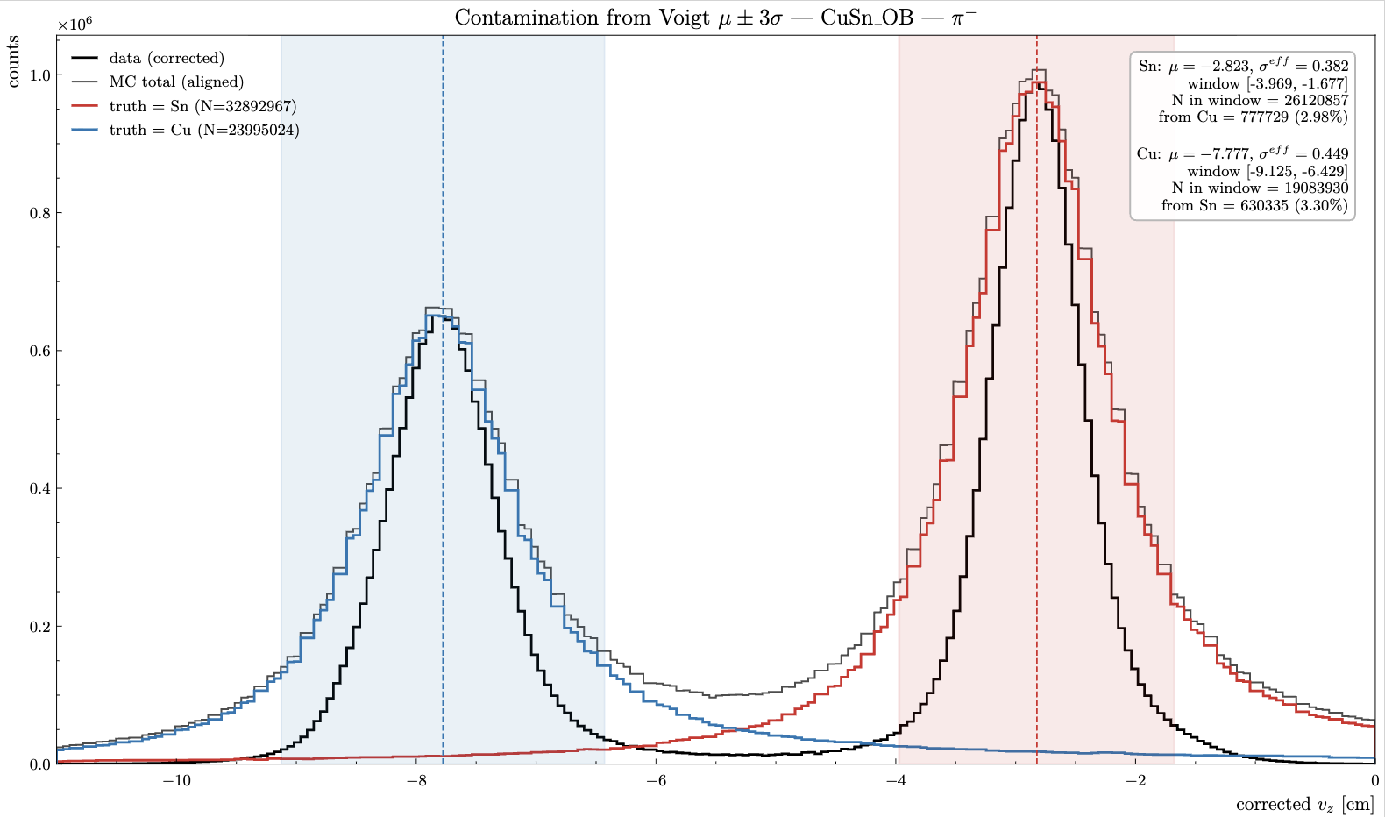
RG-D: CuSn contamination for pion
Do the same thing for pions (only for CuSn outbending, I don’t have yet new similuation for inbending)

Slide 9
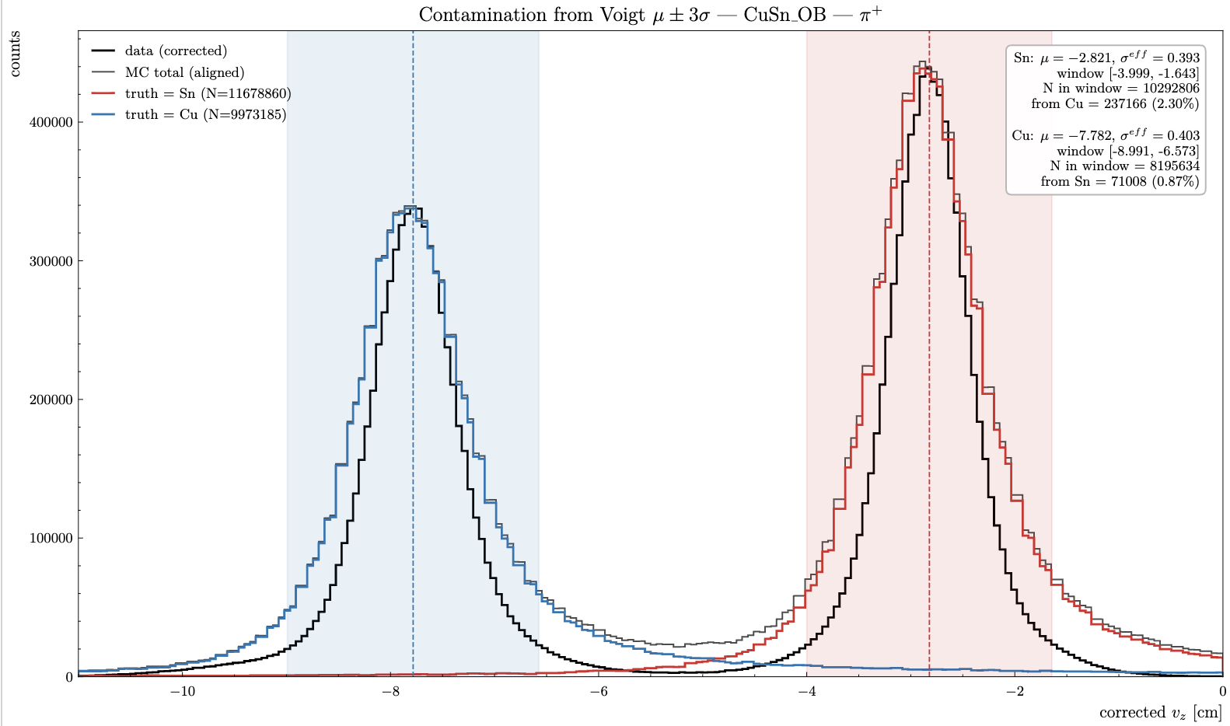
RG-D: CuSn contamination for pion
Do the same thing for pions (only for CuSn outbending, I don’t have yet new similuation for inbending)

Slide 10
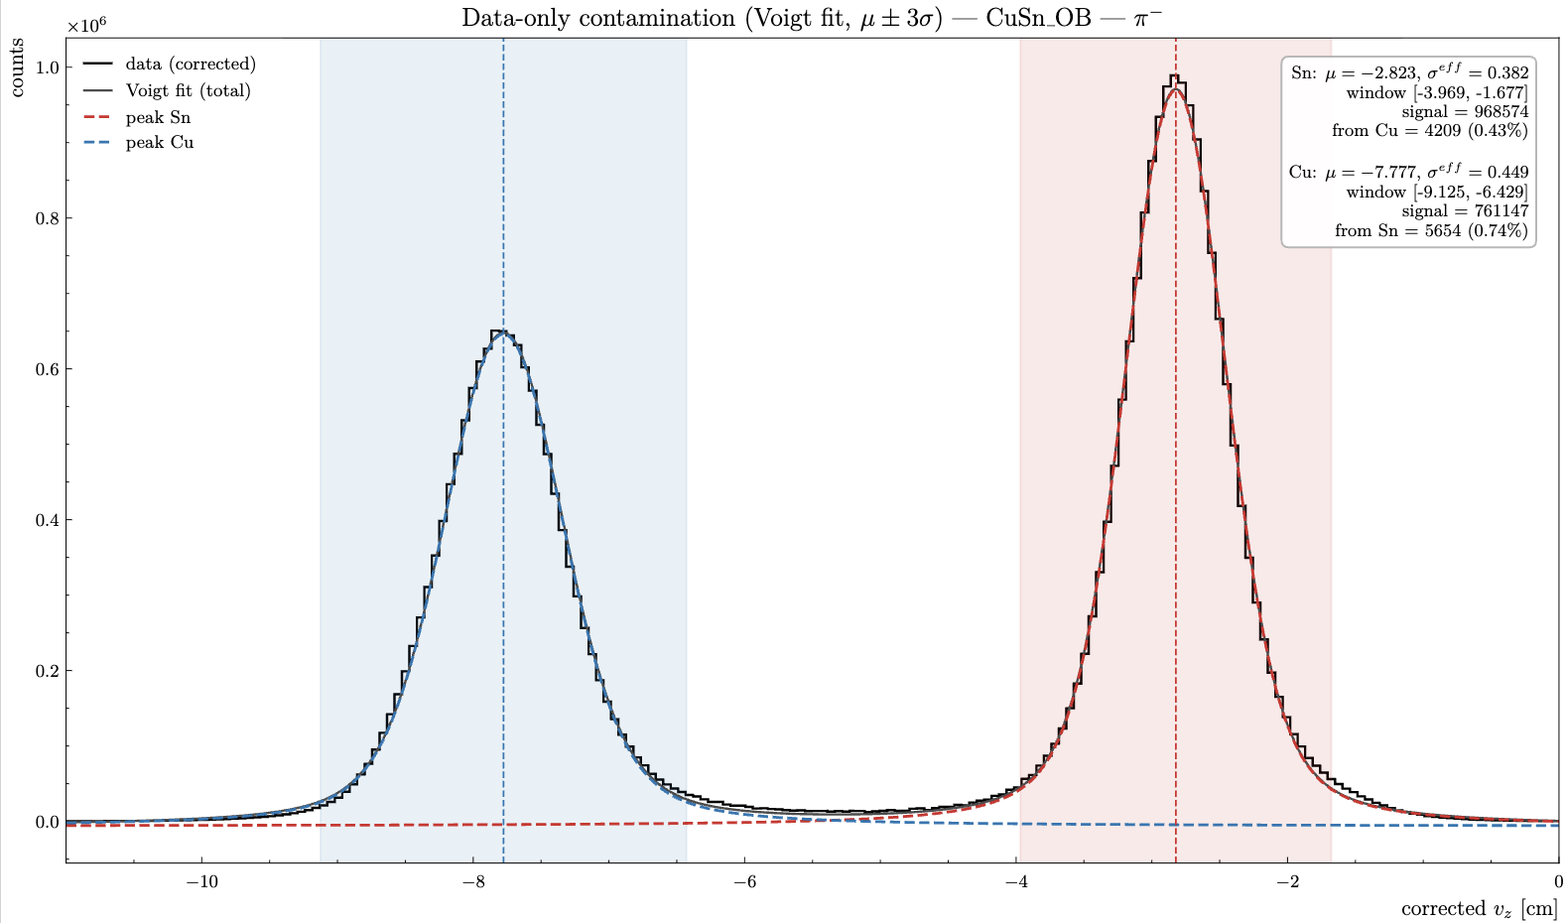
RG-D: CuSn contamination for pion
I can also extract the contamination using the Voigt fit and only the data

Slide 11
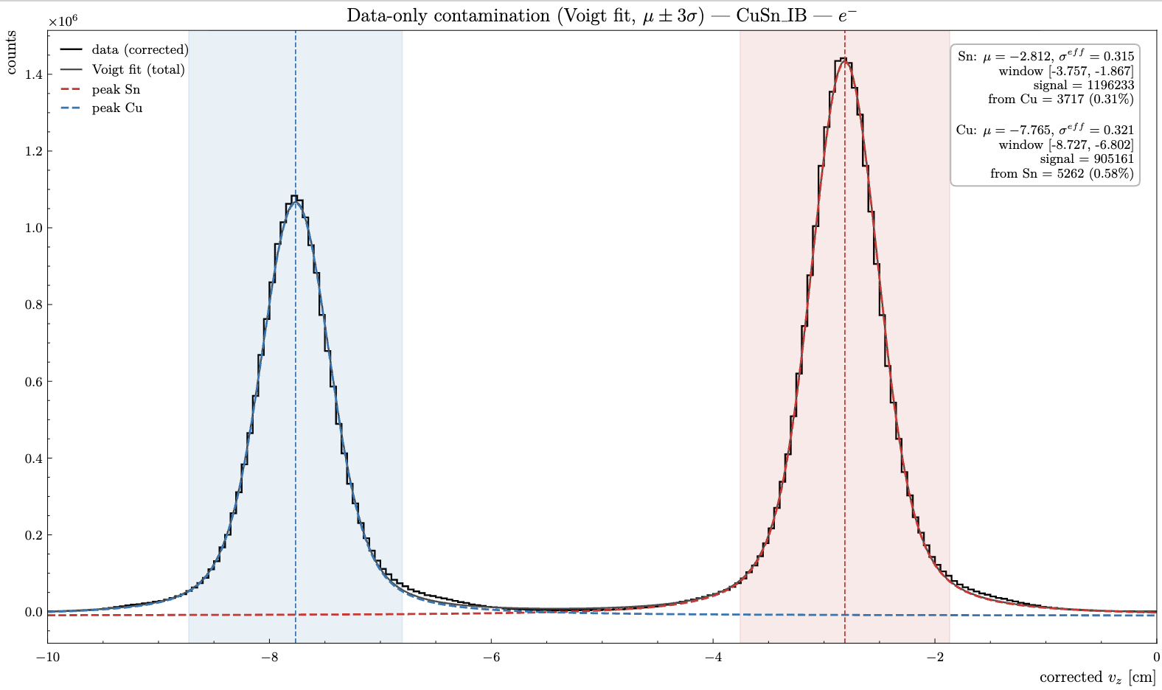
RG-D: CuSn contamination for pion
I can also extract the contamination using the Voigt fit and only the data

Slide 12
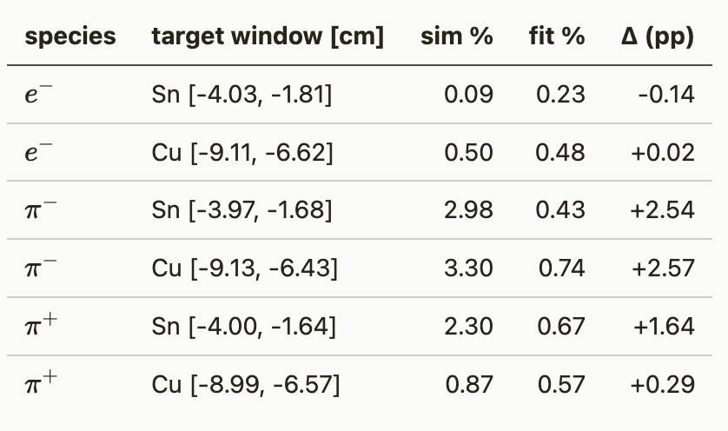
RG-D: CuSn contamination for pion
Now, we can compare the two method for electron, π⁺ and π⁻ only for CuSn outbending
Some difference for the pions, as expected due to the different between data and MC

Slide 13
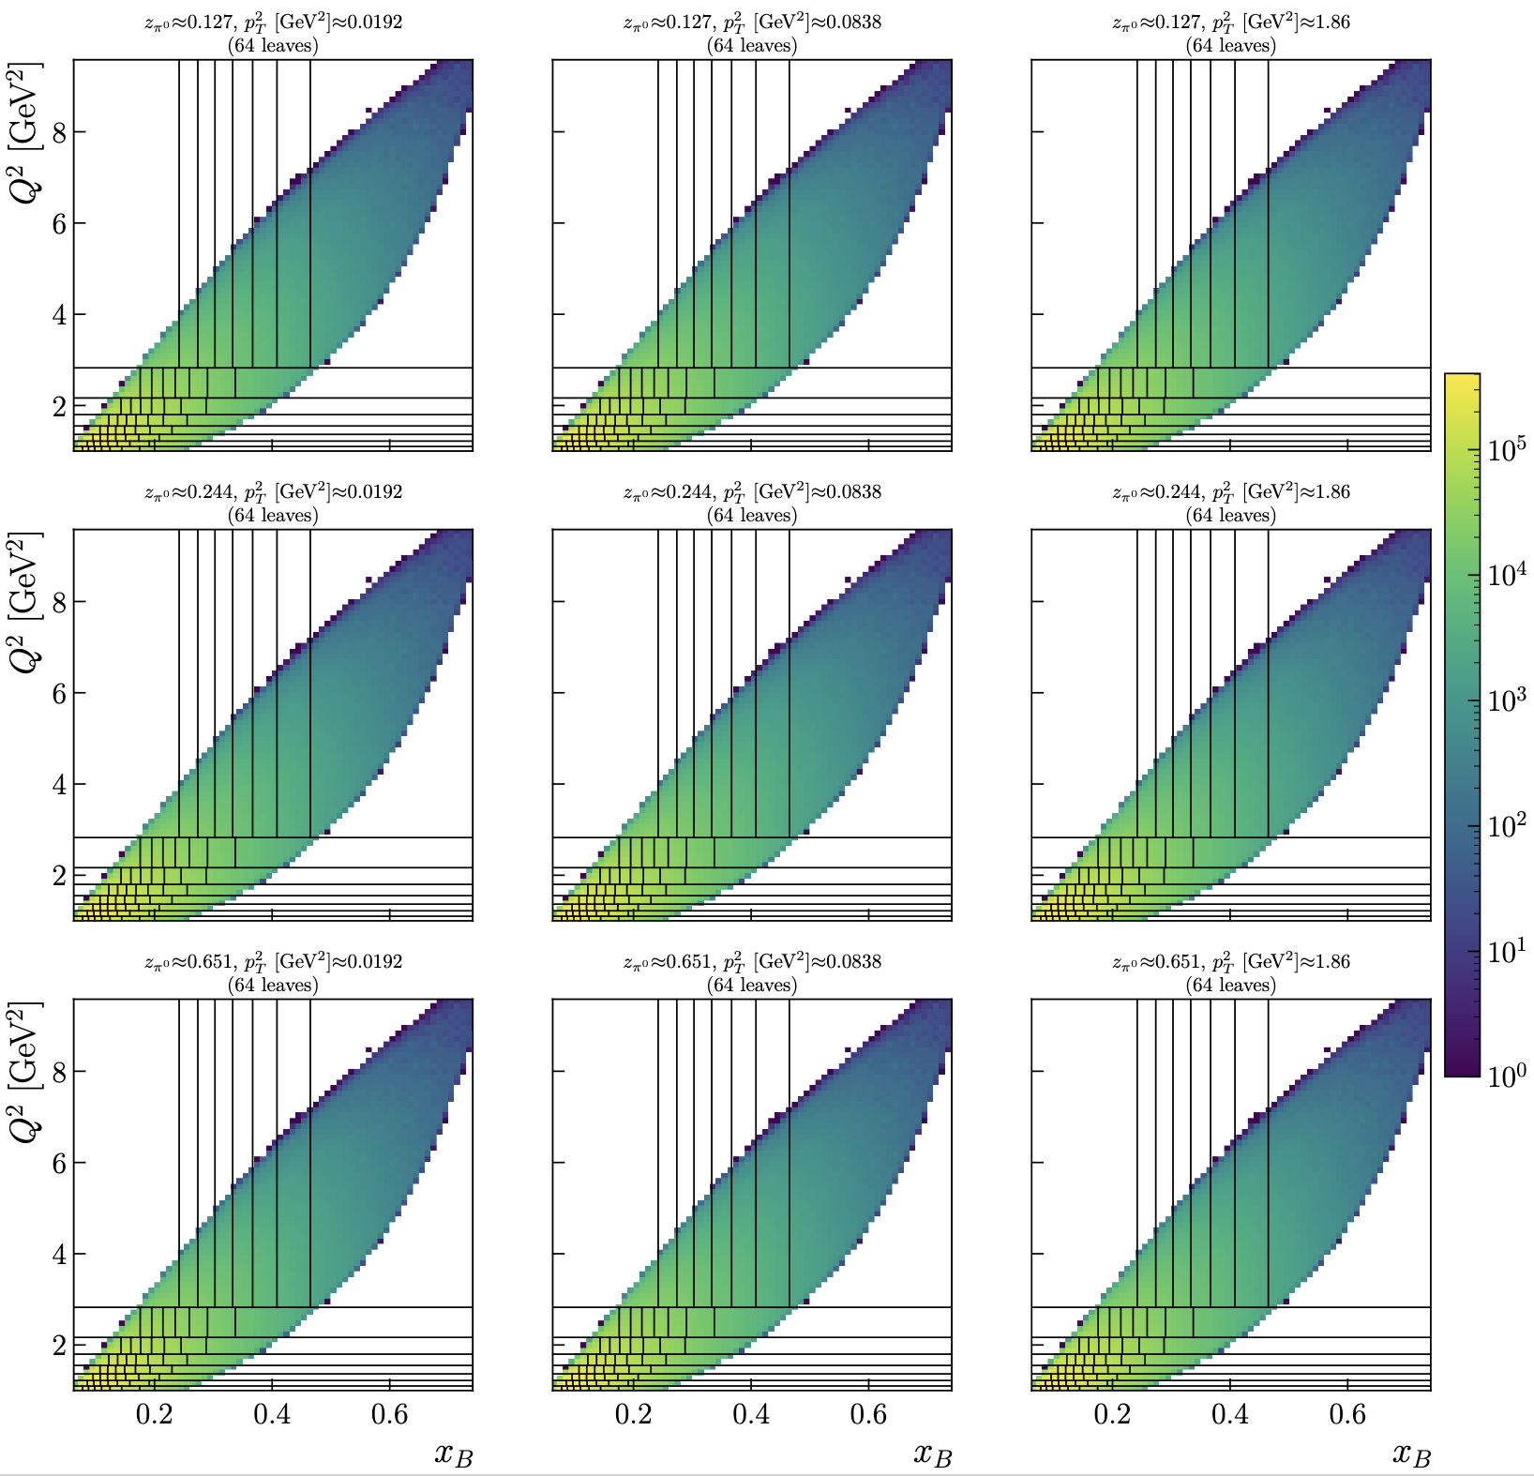
RG-D: ᴨ⁰ analysis
I have 1600 bins in Q², x_{B}, z_{h} and p_{T}² Here is the new binning

Slide 14
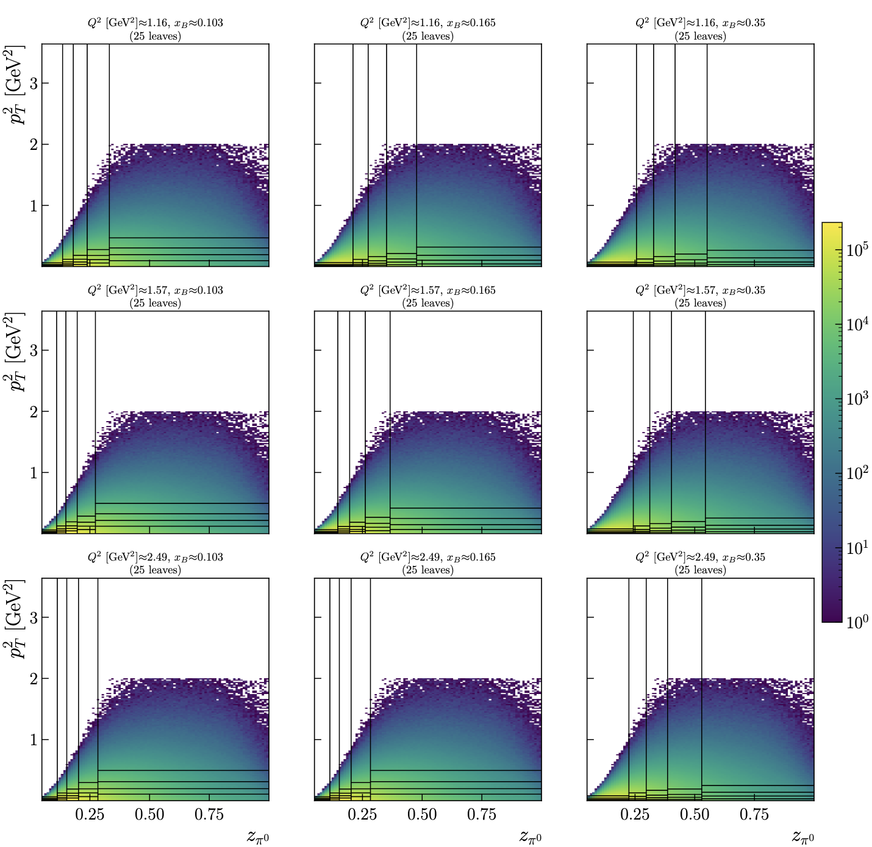
RG-D: ᴨ⁰ analysis
I have 1600 bins in Q², x_{B}, z_{h} and p_{T}² Here is the new binning

Slide 15
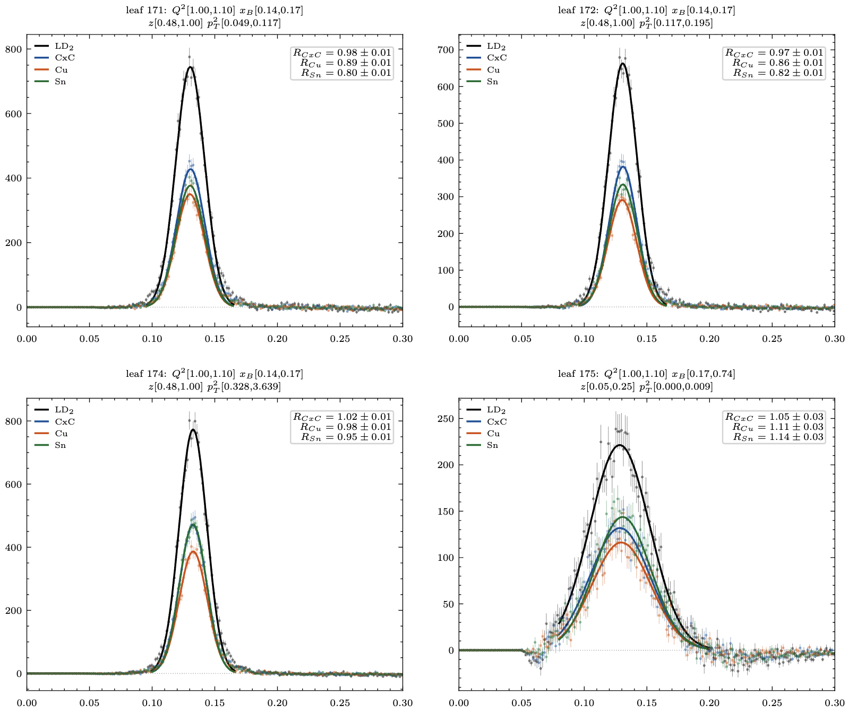
RG-D: ᴨ⁰ analysis
Ok with the new binning I can extract the multiplicity ratio:
I have 1600 bins in Q², x_{B}, z_{h} and p_{T}², for each I can plot the invariants mass of the two photons after the background subtraction:

Slide 16
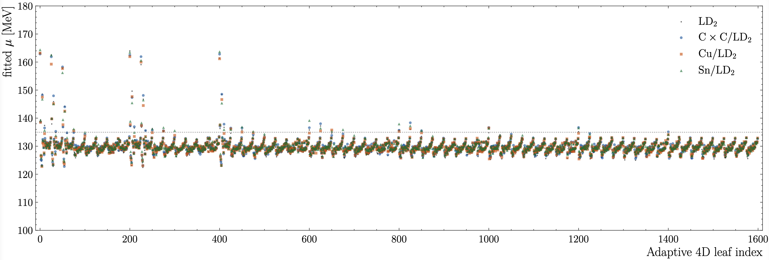
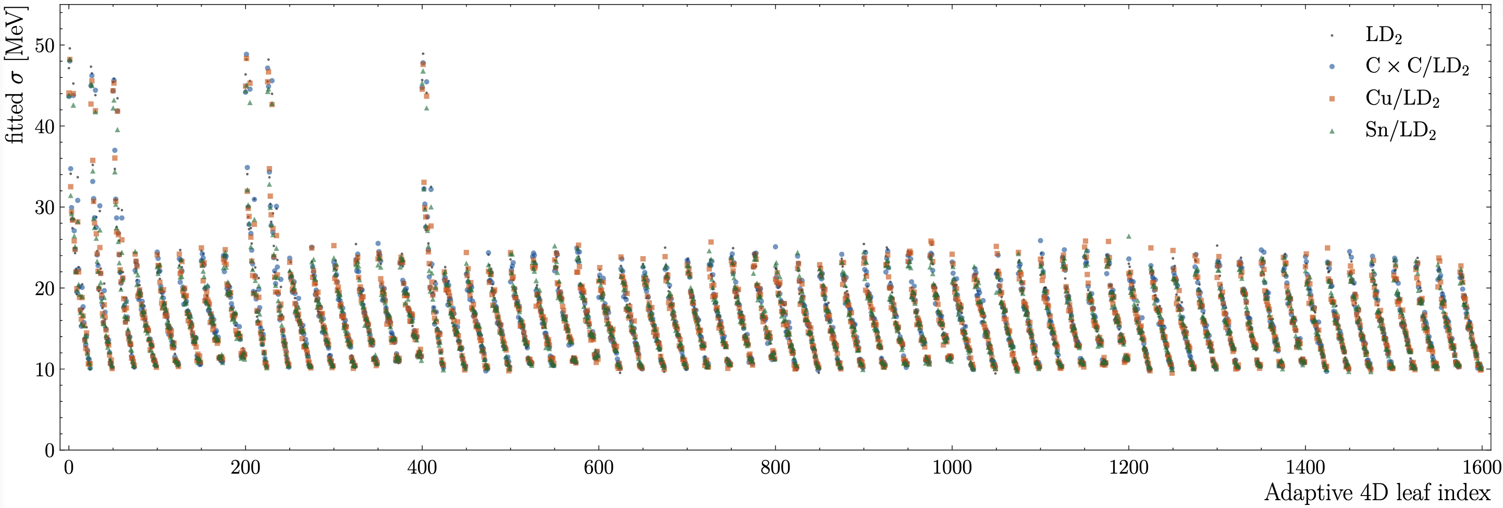
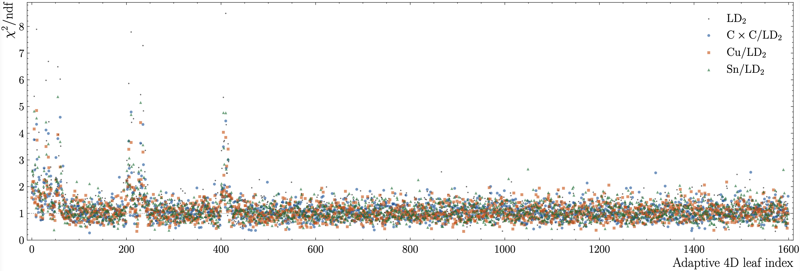
RG-D: ᴨ⁰ analysis
Ok with the new binning I can extract the multiplicity ratio:
I have 1600 bins in Q², x_{B}, z_{h} and p_{T}², for each I can plot the invariants mass of the two photons after the background subtraction.
Looking at 1600 plots is a bit too much so I plotted the mean, sigma and chi2/ndf for each bin

Slide 17
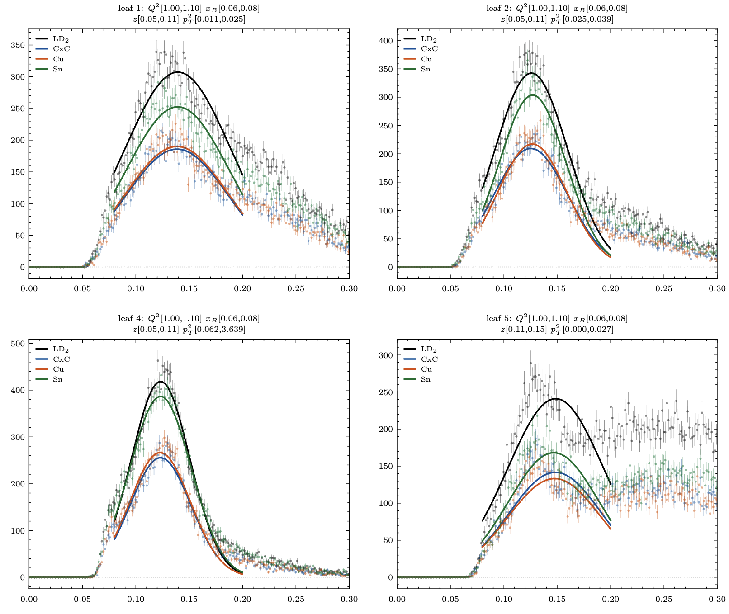
RG-D: ᴨ⁰ analysis
Ok with the new binning I can extract the multiplicity ratio:
I have 1600 (8*8*5*5) bins in Q², x_{B}, z_{h} and p_{T}², for each I can plot the invariants mass of the two photons after the background subtraction.
Looking at 1000 plots is a bit too much so I plotted the mean, sigma and chi2/ndf for each bin
Couple of bad fits, I need to work on the the event mixing for some specific bins

Slide 18
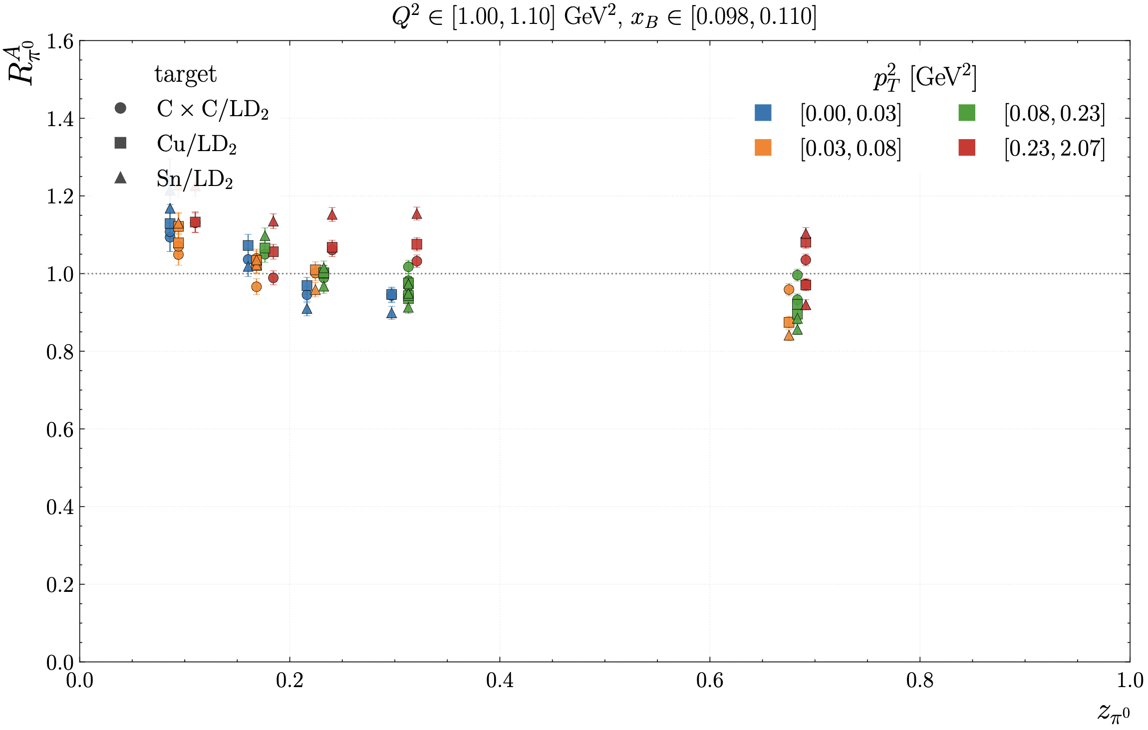
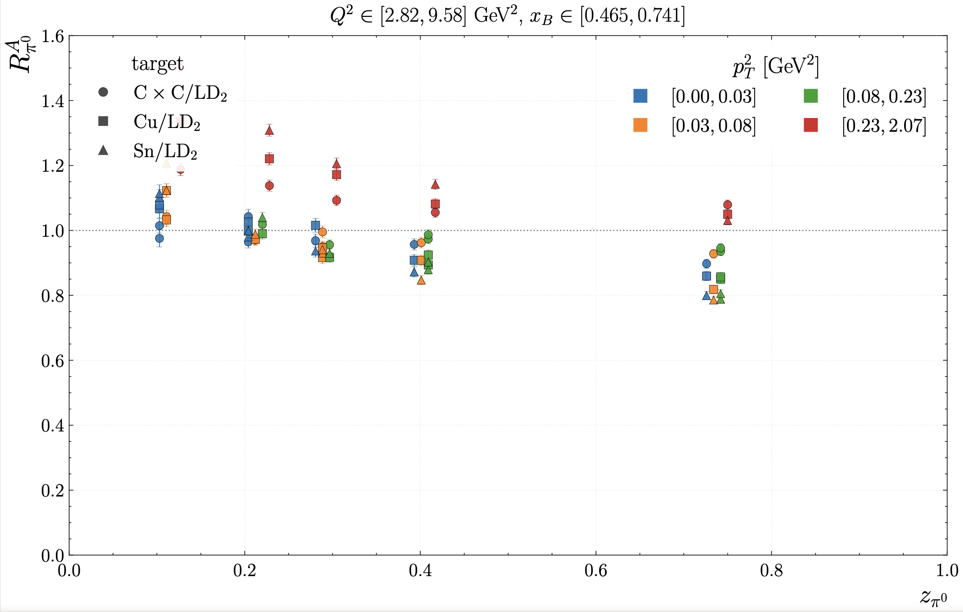
RG-D: ᴨ⁰ analysis
Ok with the new binning I can extract the multiplicity ratio:

Slide 19
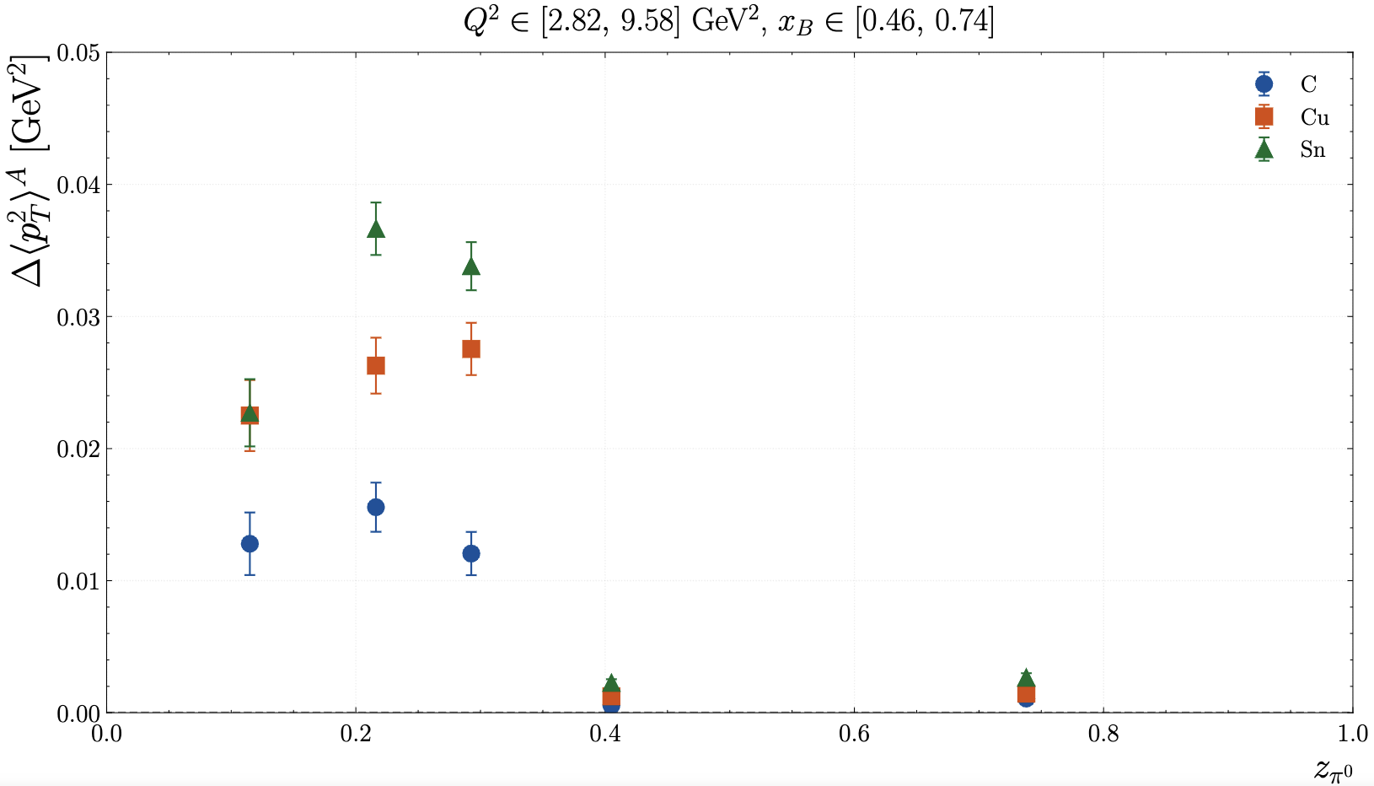
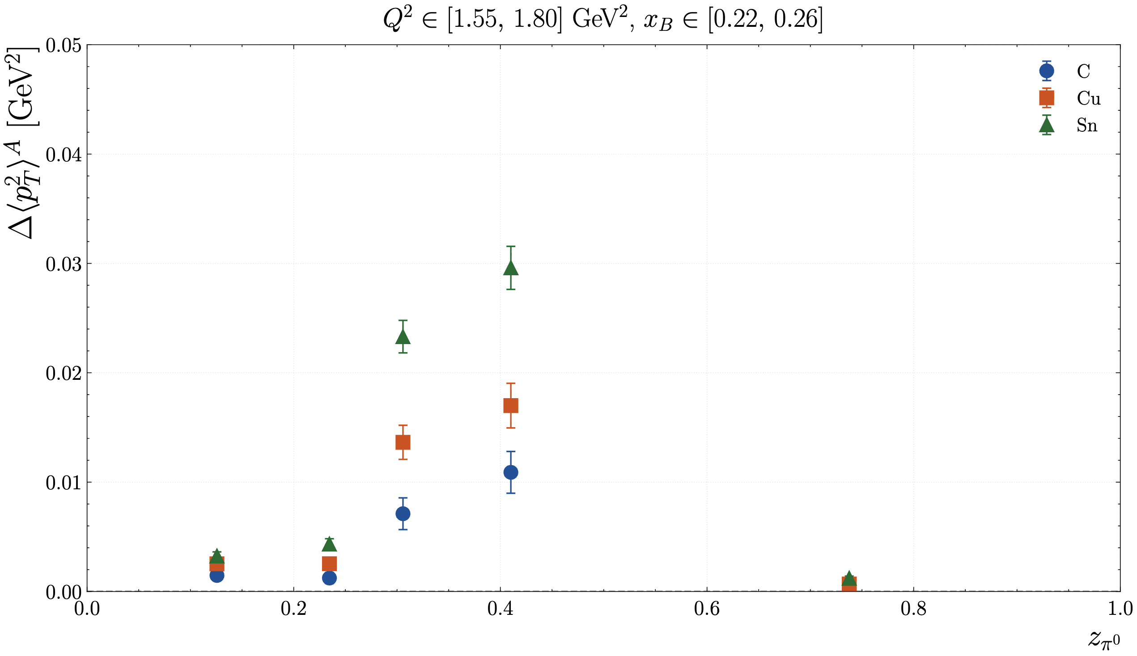
RG-D: ᴨ⁰ analysis
Ok with the new binning I can extract the pT broadening:

Slide 20
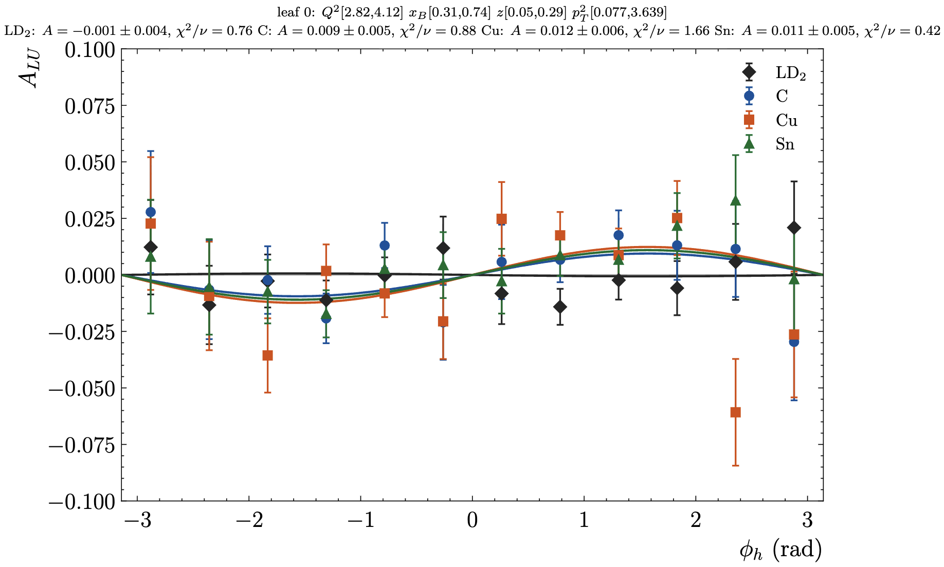
RG-D: ᴨ⁰ analysis
Ok with the new binning I can extract the Beam Spin Asymmetry (BSA):
First extract asymmetry for each bin using f(φ_{h}) = Asin(φ_{h})

Slide 21
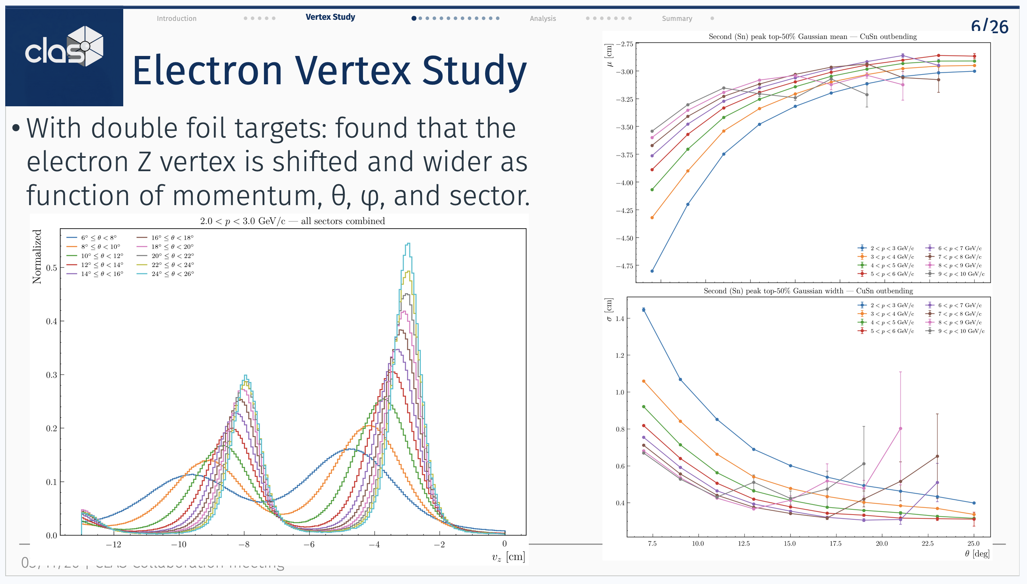
RG-D: Clas Collaboration meeting plan
I started working on my presentation for RG-D in the CLAS Collaboration metting
Also, the registration fee should open soon (maybe already open), I suppose I will pay the fee with the pro-card?

Slide 22
RG-L/Alert
I have discussed with Raphael about the beam spot/position calibration
The beam position have been calibrated for CLAS12 forward detector using electron
The goal is to redo similar analysis but for the AHDC

Slide 23
To do list
RG-D:
Regenerate simulation with the -3 cm solenoid shift for inbending CuSn.
Continue the work on cos and sin φ_{h} extraction
Radiative and acceptance correction
Background for ρ⁰ with simulation for CT analysis
Write README and analysis details about the code
Write contamination study in common analysis note
Write analysis note for pi0
ALERT:
Work on the beam position calibration for AHDC

