Slide 1
Group meeting
Mathieu Ouillon (Mississippi State University)
07/14/26

Slide 2
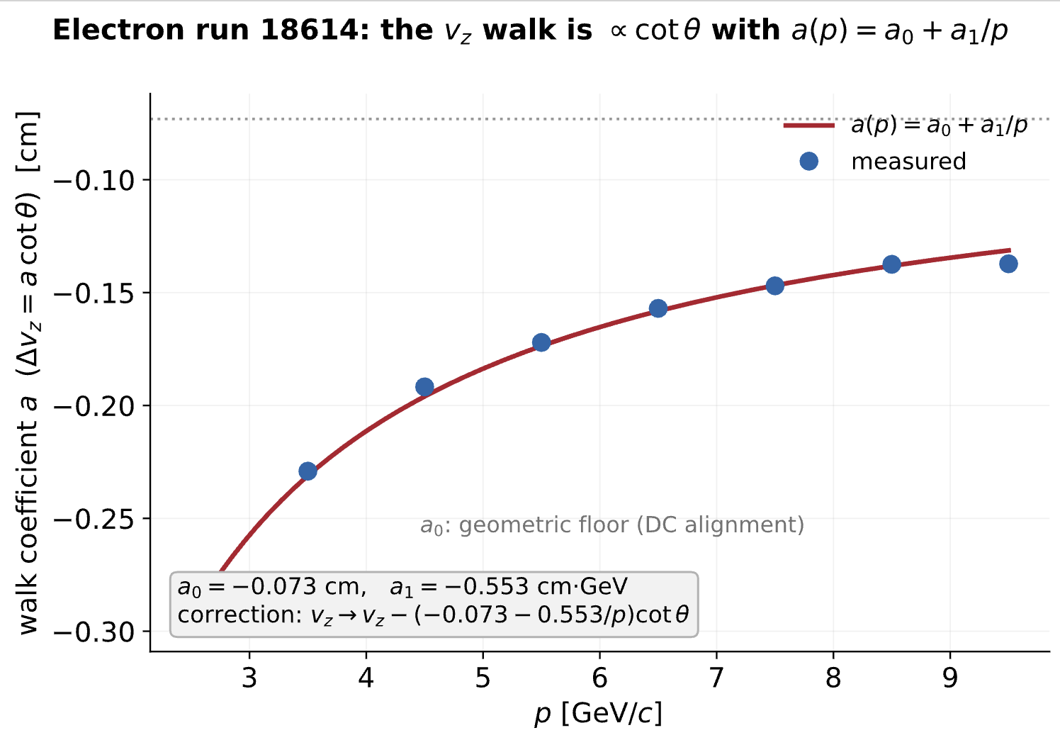
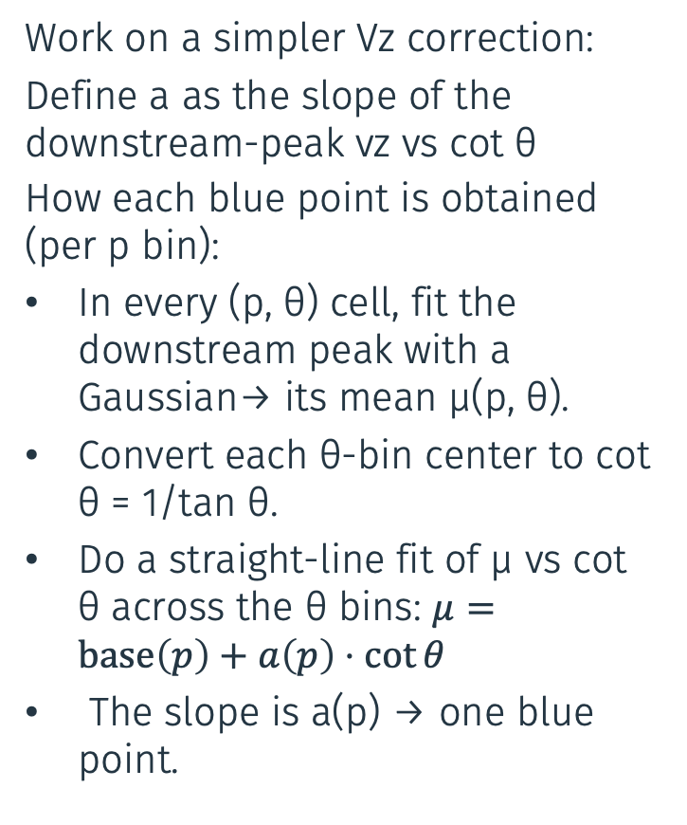
RG-D: Vz Correction
Work on a simpler Vz correction:
Define a as the slope of the downstream-peak vz vs cot θ
How each blue point is obtained (per p bin):
In every (p, θ) cell, fit the downstream peak with a Gaussian→ its mean μ(p, θ).
Convert each θ-bin center to cot θ = 1/tan θ.
Do a straight-line fit of μ vs cot θ across the θ bins: $μ=\text{base}\left(p\right)+a\left(p\right)⋅\cot{θ}$
The slope is a(p) → one blue point.

Slide 3
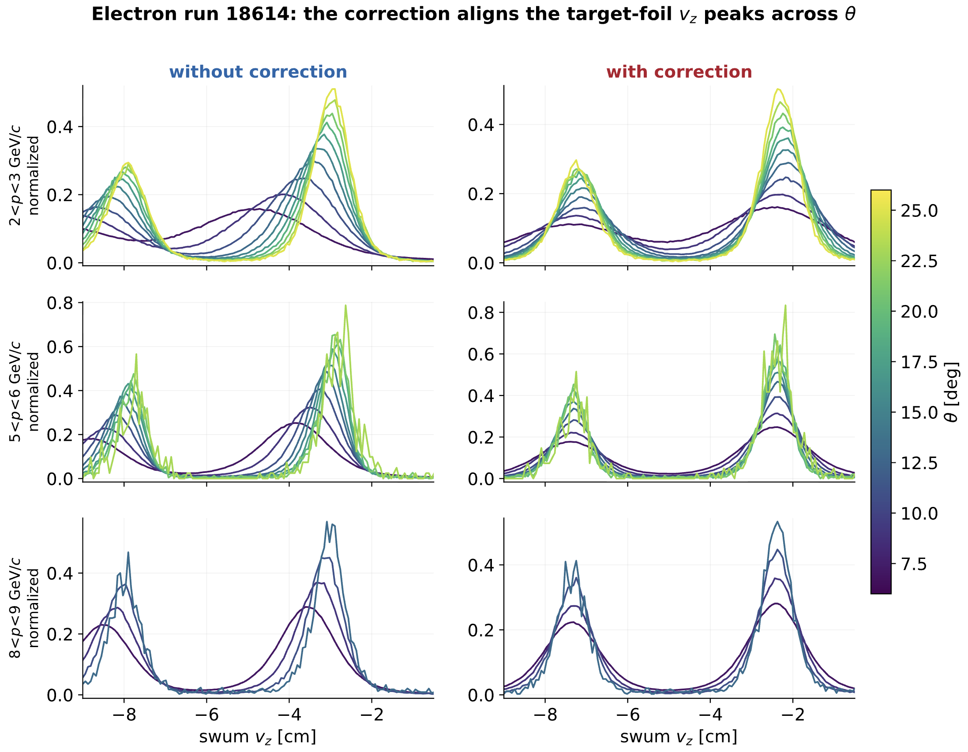
RG-D: Vz Correction
Work on a simpler Vz correction:
Define a as the slope of the downstream-peak vz vs cot θ
How each blue point is obtained (per p bin):
In every (p, θ) cell, fit the downstream peak with a Gaussian→ its mean μ(p, θ).
Convert each θ-bin center to cot θ = 1/tan θ.
Do a straight-line fit of μ vs cot θ across the θ bins: $μ=\text{base}\left(p\right)+a\left(p\right)⋅\cot{θ}$
The slope is a(p) → one blue point.

Slide 4
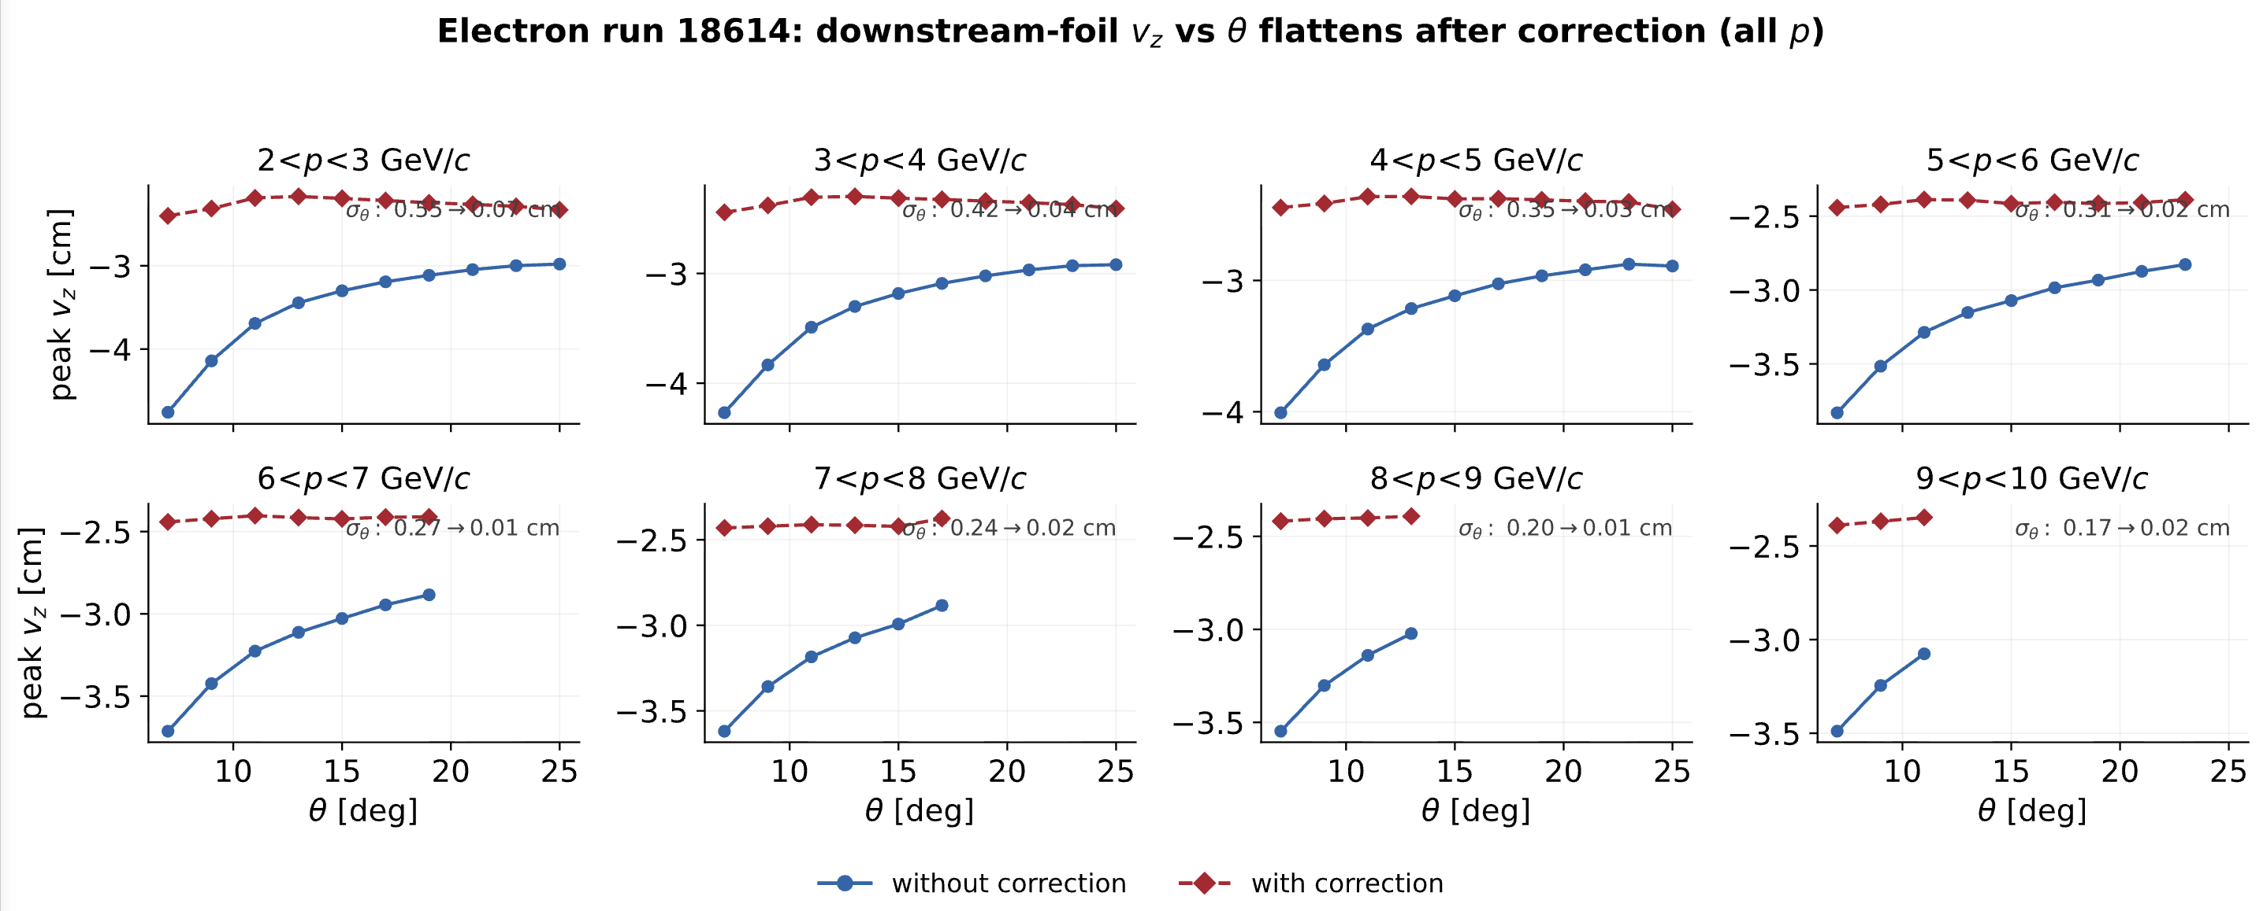
RG-D: Vz Correction

Slide 5
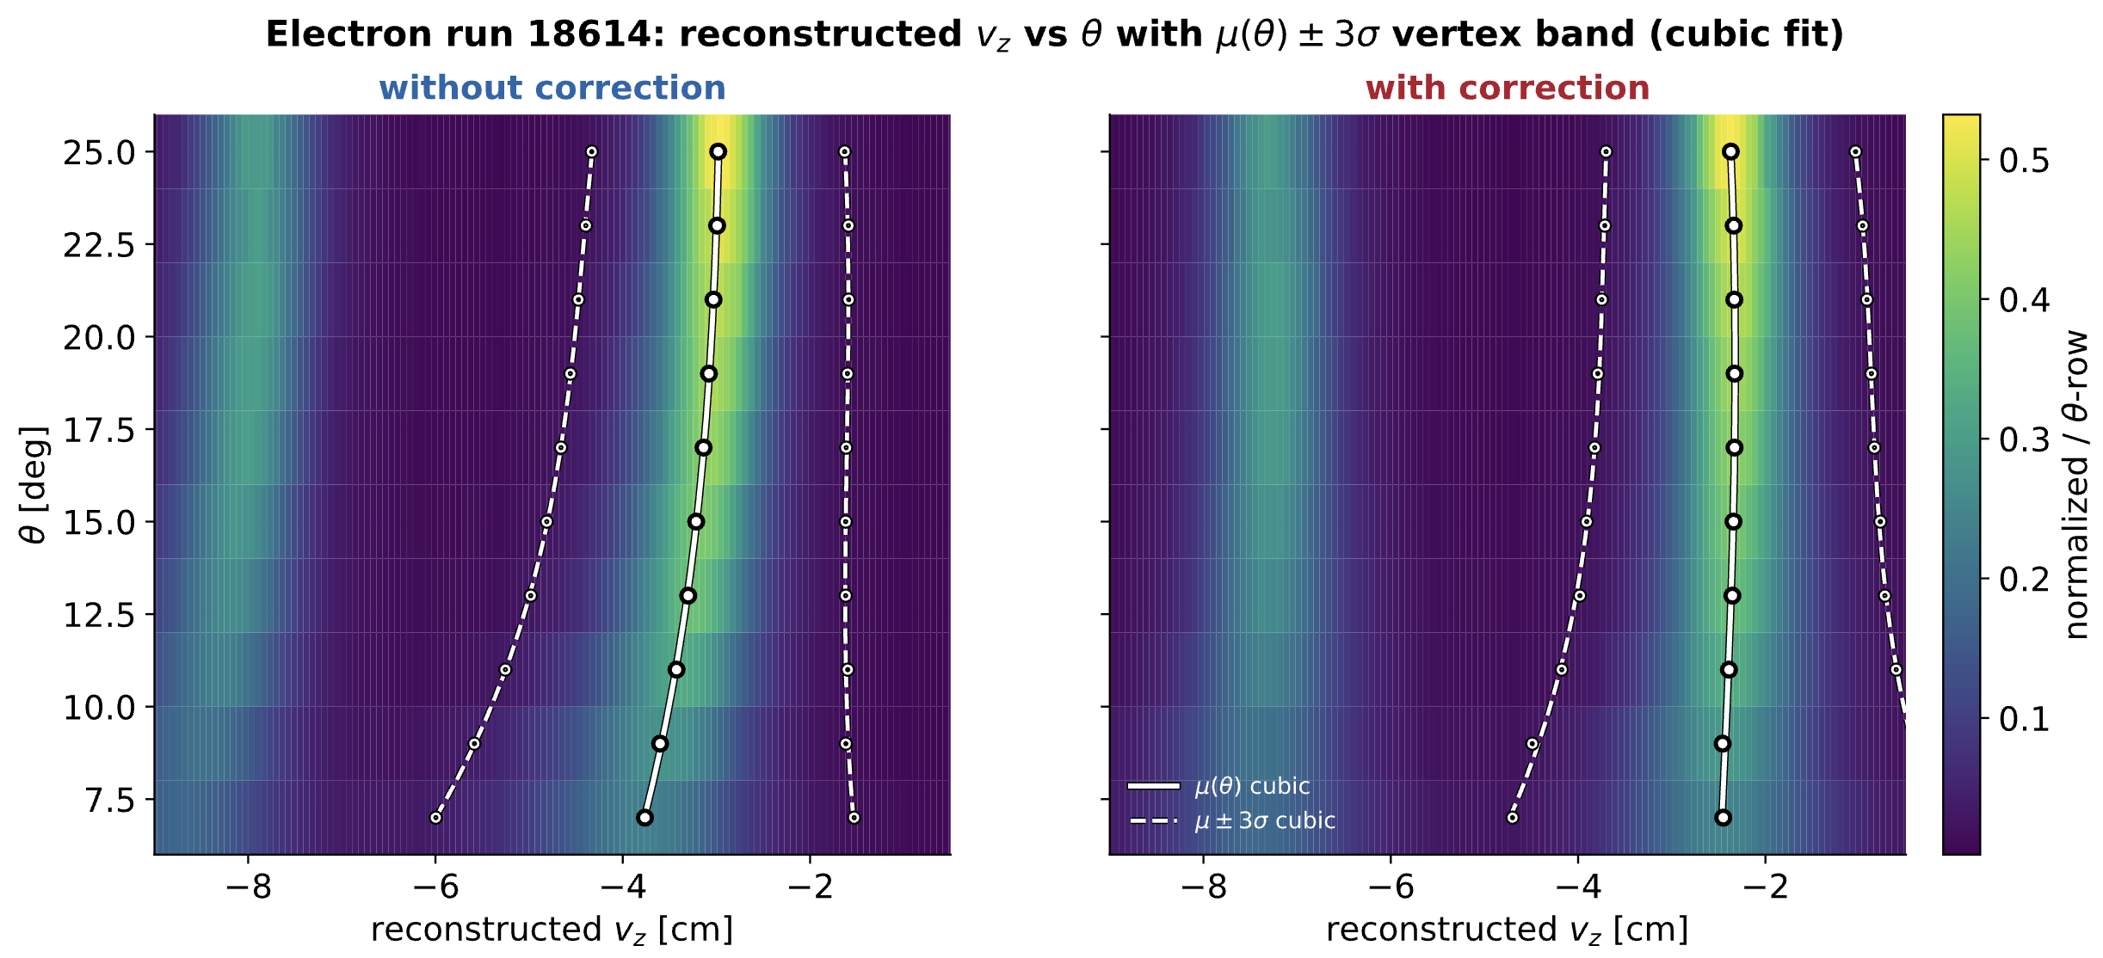
RG-D: Vz Correction

Slide 6
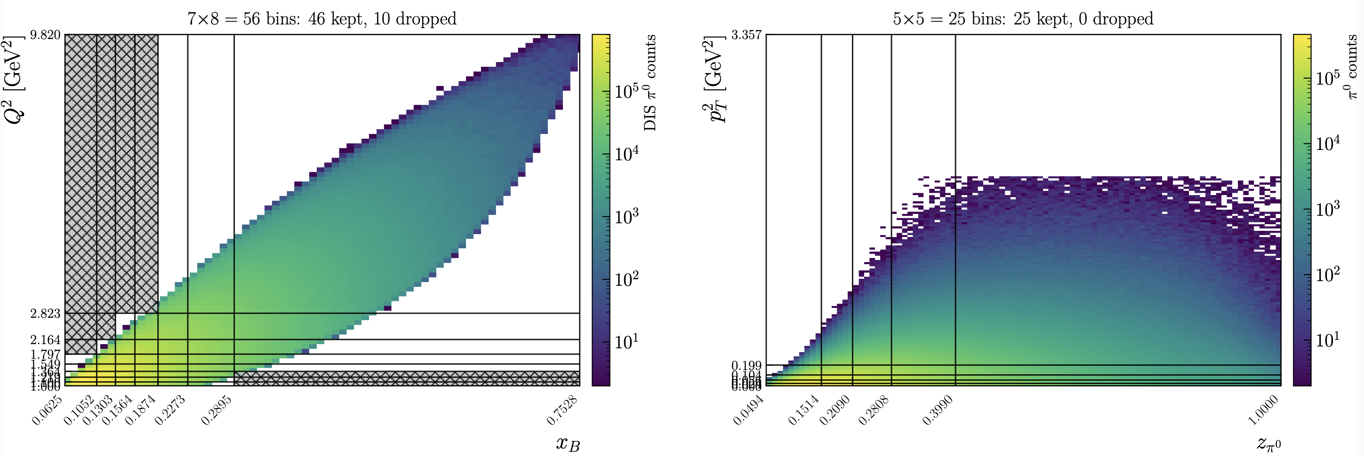
RG-D: Pi0 Binning

Slide 7
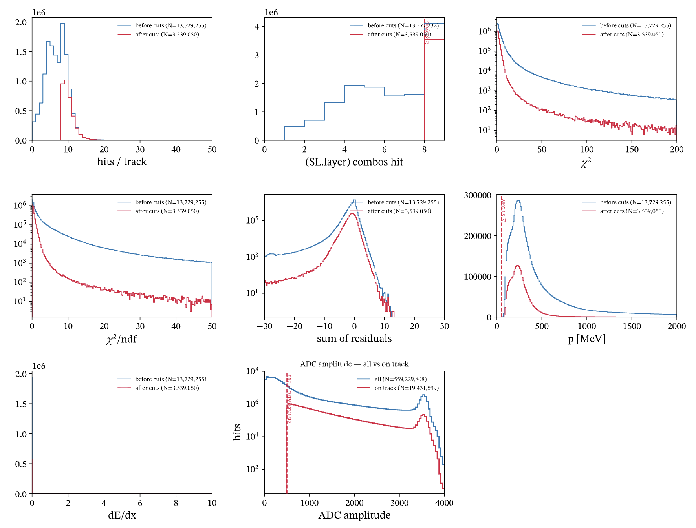
ALERT: T0 Calibration
Extraction of T0 for the AHDC
First on elastic D2 run: 22990
It is simpler, almost no noise/bad hits
Need to select hits on track:
At least one hits per layer/superlayer
p > 50MeV
ADC > 500

Slide 8
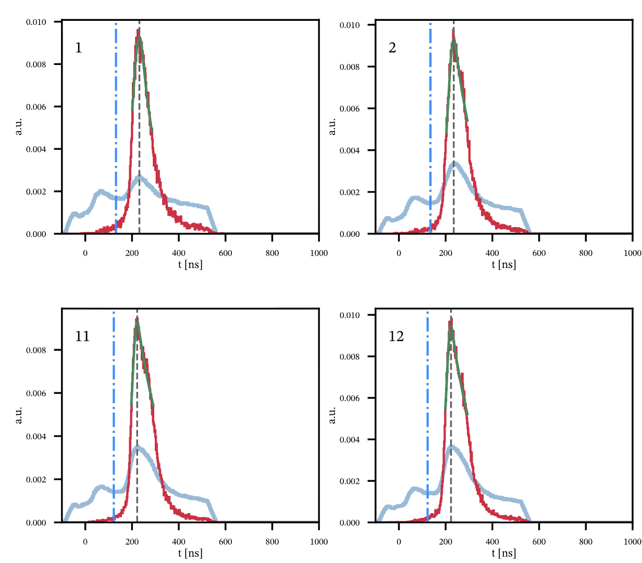
ALERT: T0 Calibration
Extraction of T0 for the AHDC
First on elastic D2 run: 22990
Need to select hits on track:
At least one hits per layer/superlayer
p > 50MeV
ADC > 500

Slide 9
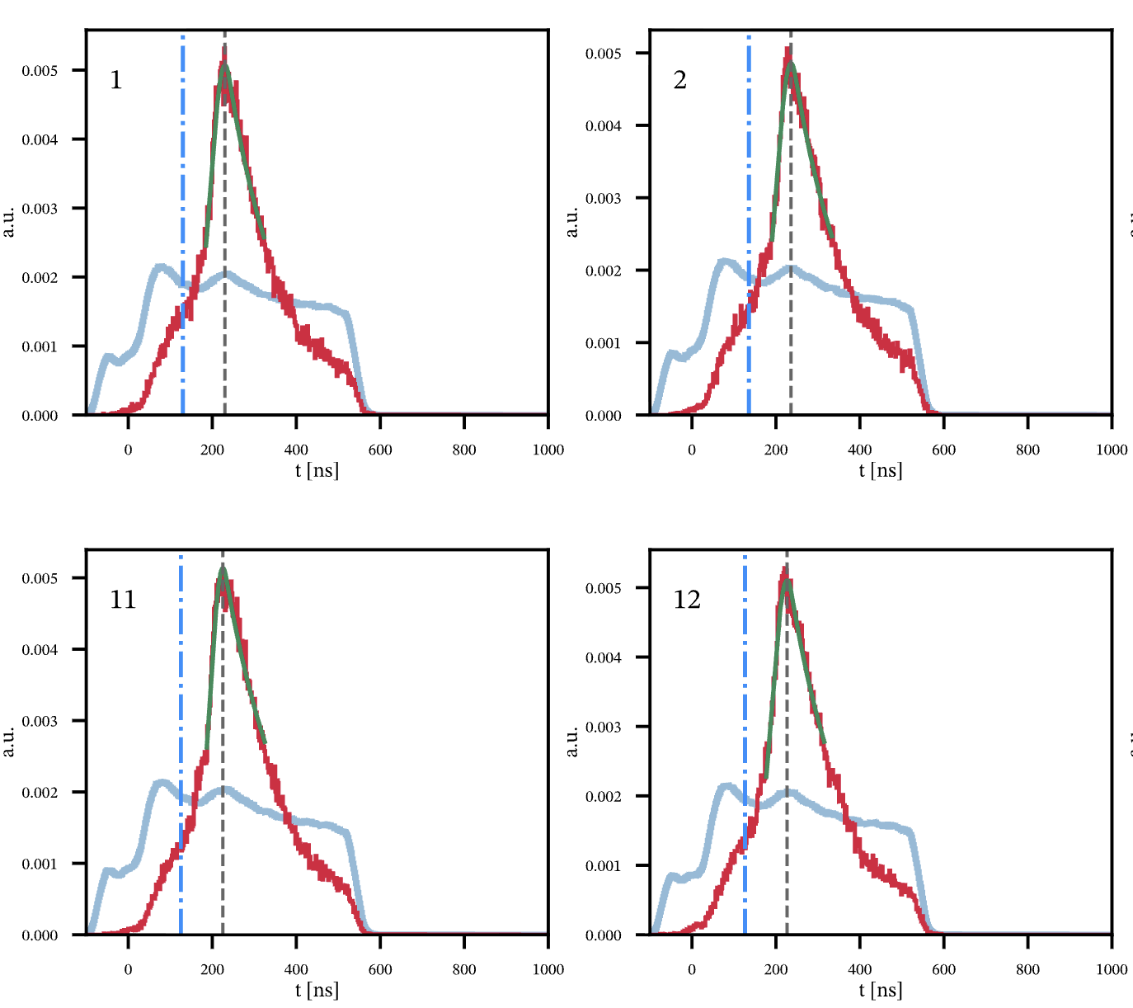
ALERT: T0 Calibration
Extraction of T0 for the AHDC
Then on ⁴He 10.6 GeV run (22083)
Need to select hits on track:
At least one hits per layer/superlayer
p > 50MeV
ADC > 500

Slide 10
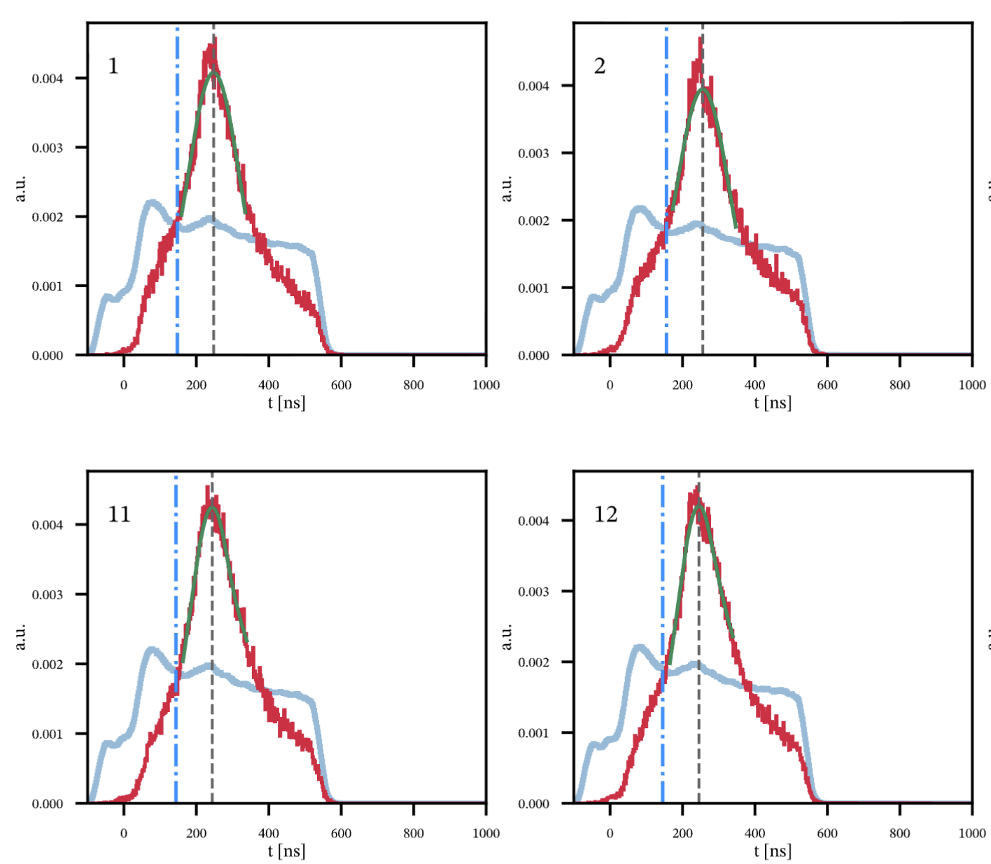
ALERT: T0 Calibration
Extraction of T0 for the AHDC
Then on D2 10.6 GeV run (22598)
Need to select hits on track:
At least one hits per layer/superlayer
p > 50MeV
ADC > 500

Slide 11
ALERT: T0 Calibration
To find T0:
Find the peak (5-bin method):
Smooth the spectrum with a 5-bin moving sum (each bin replaced by the sum of itself ±2 neighbours) to suppress bin-to-bin noise.
Take the max bin of the smoothed spectrum as the coarse peak.
Define t0: t0 = peak − 100 ns.
Fill every wire (all 576 from geometry):
a wire with a good peak → its measured peak − 100.
a wire with too few counts / no usable peak → the per-(SL,layer) median t0 as a fallback (no wire left blank).

Slide 12
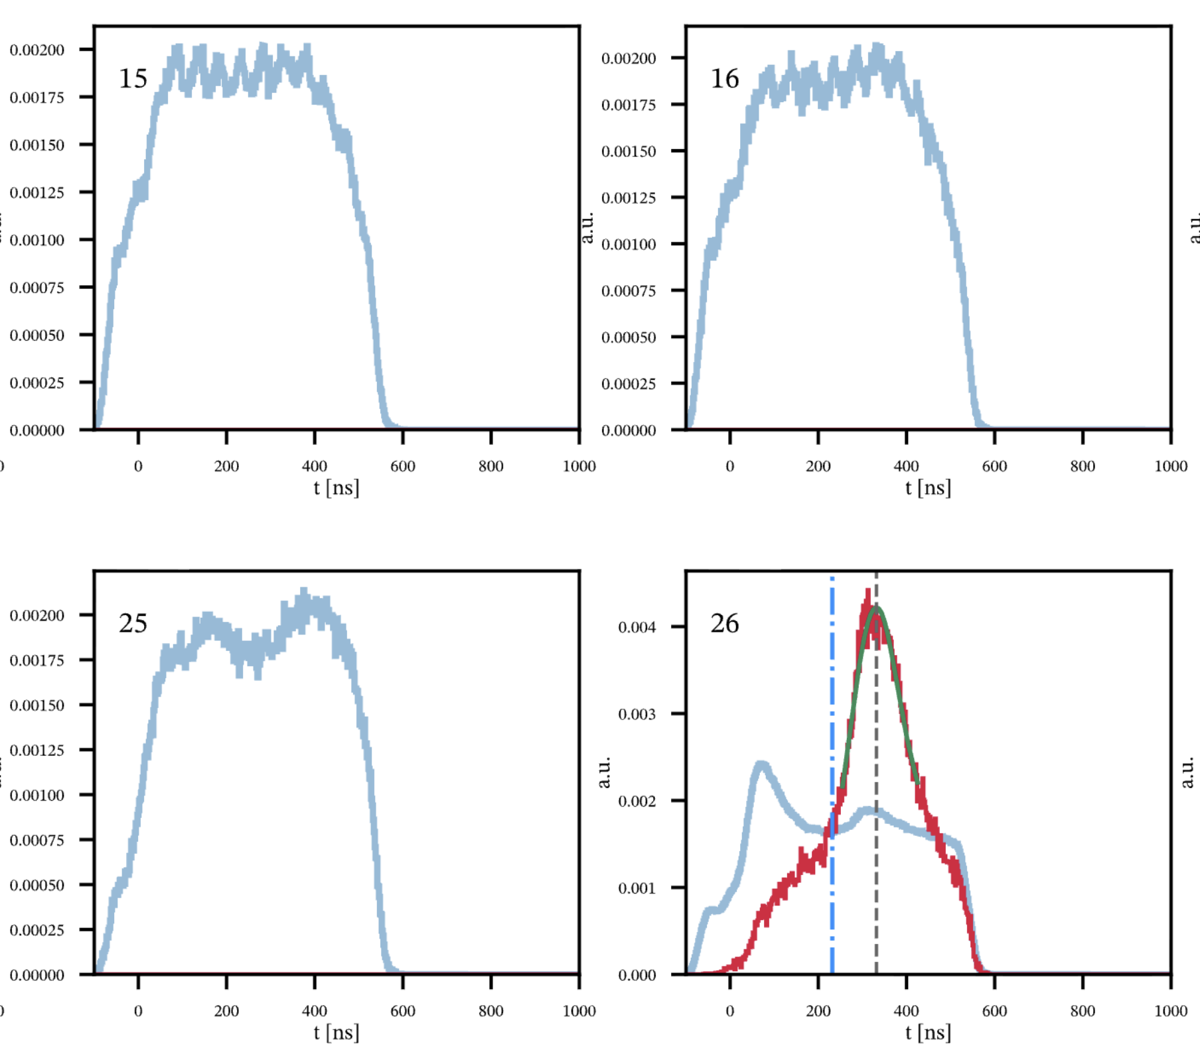
ALERT: T0 Calibration

Slide 13
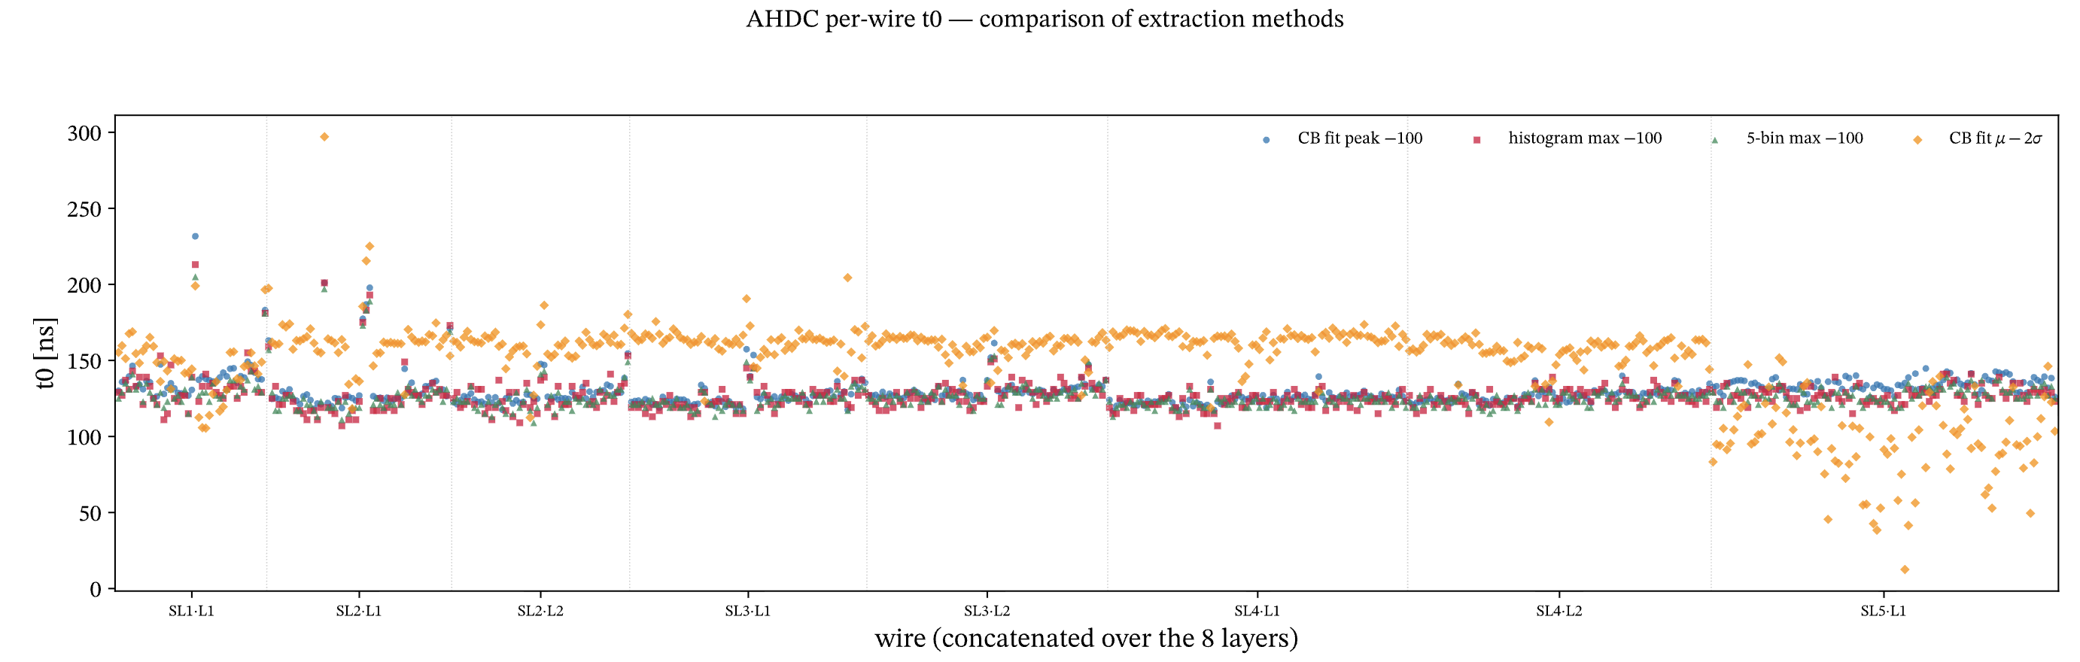
T0 Calibration
All T0s for 1 run (22083):

Slide 14
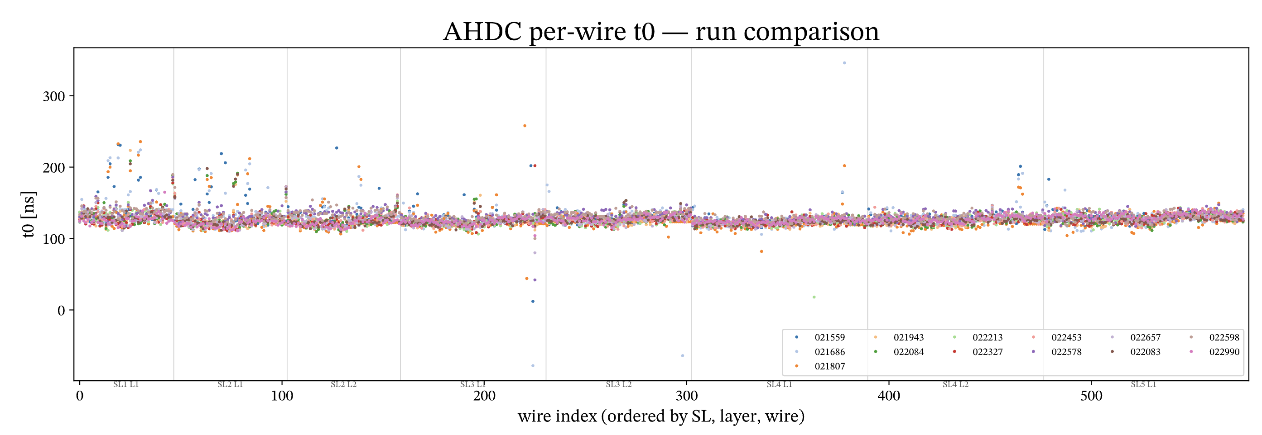
T0 Calibration
Compare T0s for different runs:

Slide 15
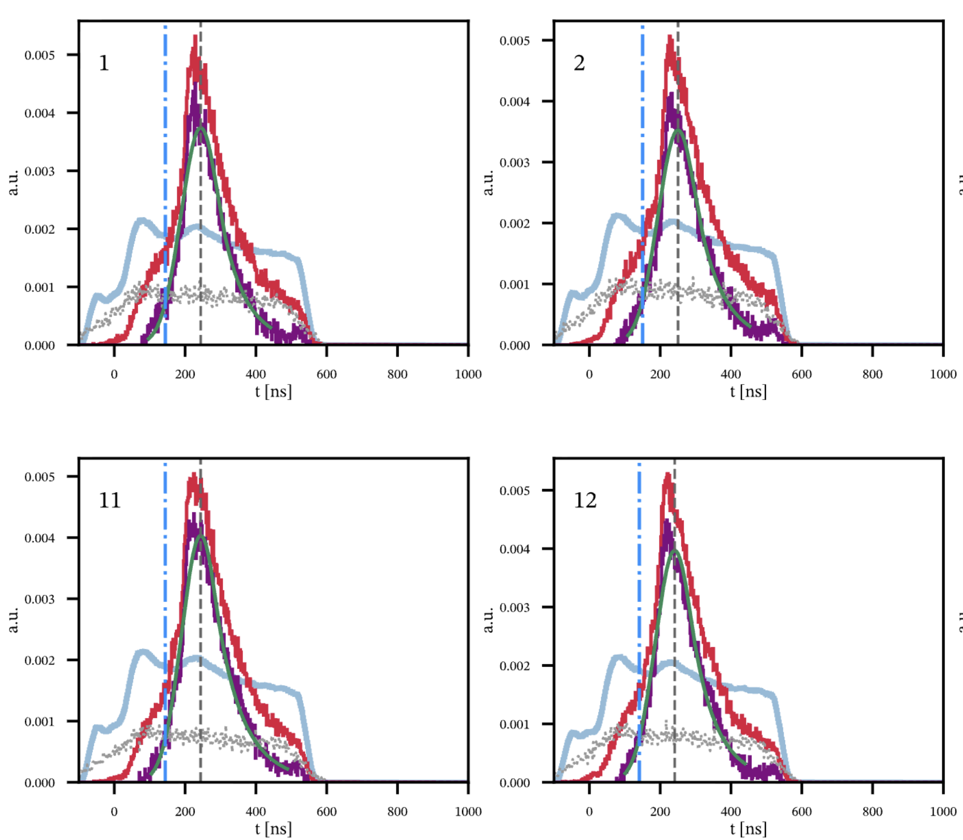
T0 Calibration
Extraction of T0 for the AHDC
On 4He 10.6 GeV run (22083)
For all hits coming from random trigger
Can be use to subtract the background below the peak
Purple is after the background substraction

Slide 16
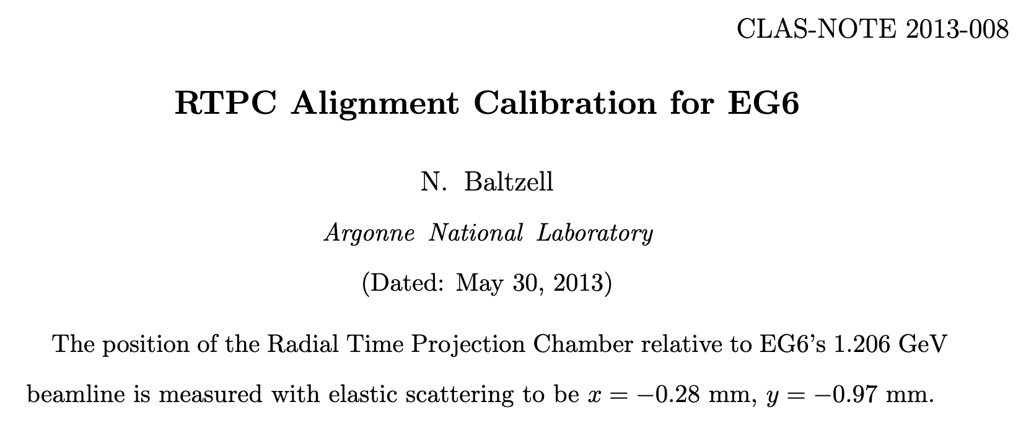

ALERT Beamspot position
Measure the transverse (𝑥, 𝑦) offset between the ALERT recoil detector and the forward- CLAS / beamline frame using coherent elastic 𝑒 + 𝑑 → 𝑒′ + 𝑑′ events.
The electron is reconstructed in forward CLAS (defining the CLAS frame); the recoil deuteron is seen in ALERT/AHDC.
For elastic kinematic: the two are coplanar, so a transverse misalignment appears as a sinusoidal modulation of the azimuthal coplanarity Δ𝜑 versus the electron azimuth 𝜑𝑒.

Slide 17
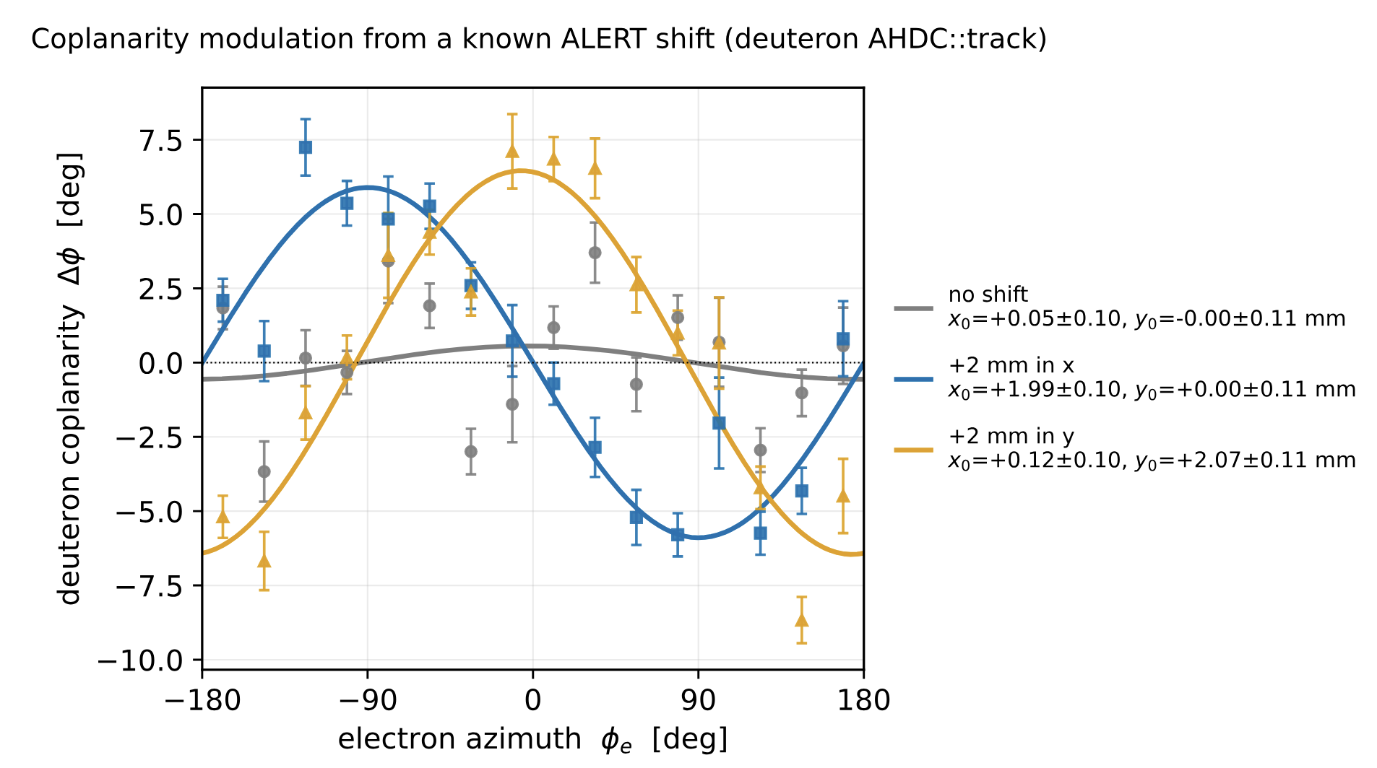
ALERT Beamspot position
First test it on simulation:

Slide 18
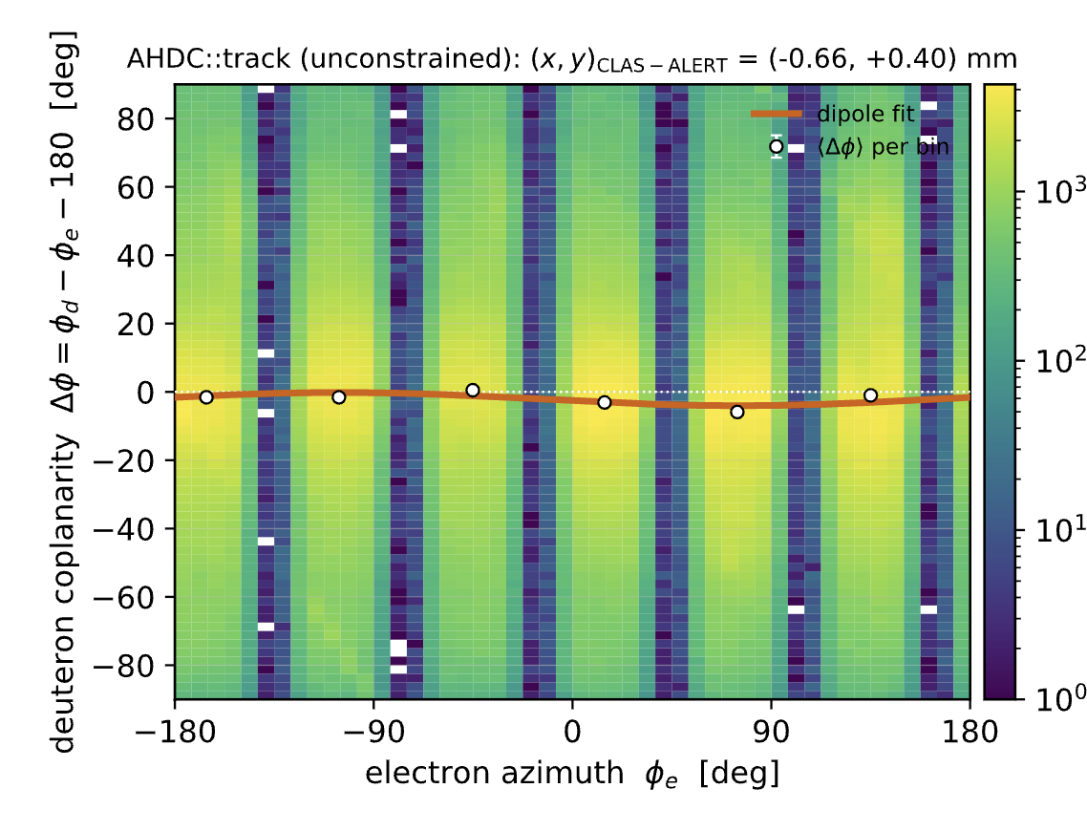
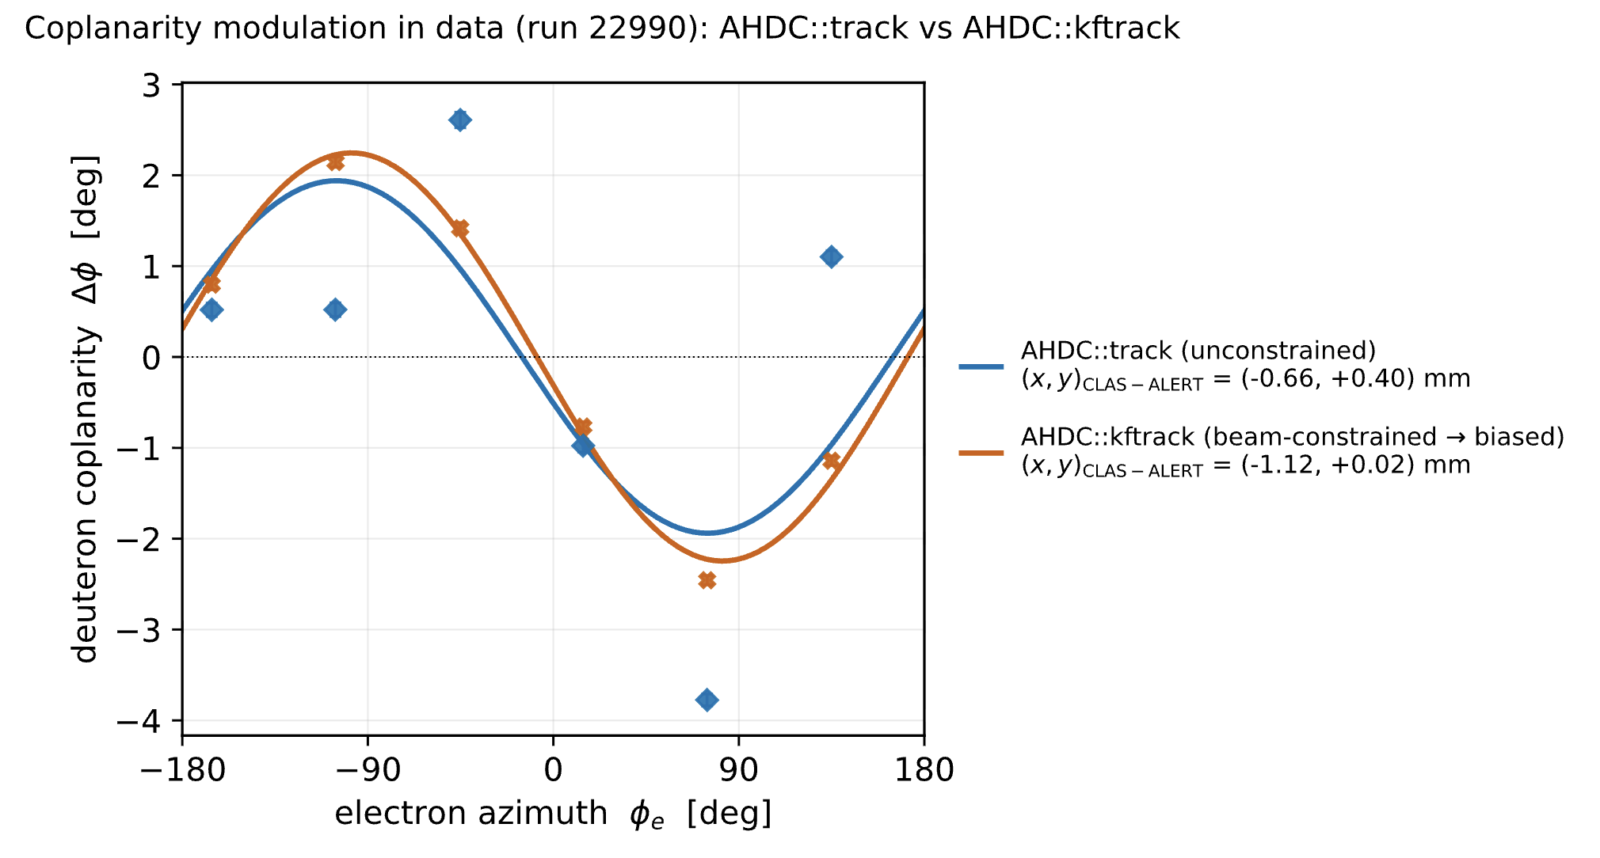
ALERT Beamspot position
Then on real data

Slide 19
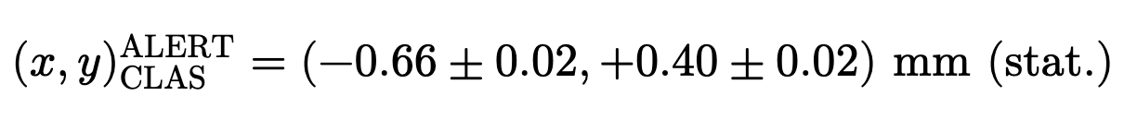
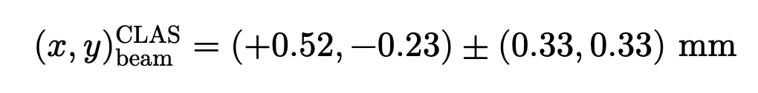
ALERT Beamspot position
And on data found:
It is the difference between CLAS and ALERT beamspot NOT the absolute beamspot position of ALERT
For the run 22990, CLAS absolute position is
So, the absolute ALERT beamspot position is

Slide 20
To do list
RG-D:
Write README and analysis details about the all my codes
Write documentation and organize my codes
Write analysis note for pi0
Continue the work on cos and sin φ_{h} extraction
Radiative and acceptance correction
Background for ρ⁰ with simulation for CT analysis
ALERT:
Work on the beam position calibration for AHDC and T0 extraction

