Slide 1
Group meeting
Mathieu Ouillon (Mississippi State University)
07/21/26

Slide 2
Overview: what is in the workspace
Last week I work on organizing and documenting all the code/work on ifarm and GitHub:
Main folder in ifarm: /work/clas12/ouillon

Slide 3
Overview: what is in the workspace
RGD/ : Run Group D, nuclear targets LD2 / CxC / Cu / Sn (12 projects)
RGF/ : Run Group F, neutron DVCS with the BONuS12 RTPC (3 projects)
RGL/ : Run Group L, the ALERT recoil detector and AHDC (3 projects)
other/ : shared tooling: farm job monitoring, beam charge and run database (4)
Typst/ and Presentation/ : analysis notes and slide decks
archive/ : about 43 retired projects, kept for reference
Organised by run group, plus shared tooling that is not tied to one
Every folder has a README: top level, then a per-run-group index, then the project
Python with uv; C++ with meson or CMake; some Fortran

Slide 4
RG-D: twelve projects
Simulation
sidis_mc — SIDIS event generator, PYTHIA6 plus nuclear effects
background_merging — GEMC and coatjava reconstruction workflows
Machine learning
ai_hadron — CatBoost hadron particle identification
RGD-AINet — AI drift chamber track finding and denoising, trains the .network models coatjava loads
Physics analyses
nuclear_transparency_python (still need some work), rgd-pi0, rgd_hadron_contamination, toy-contamination
Tools and quality checks
skim_for_RGD, check_timelines, swim-cpp, pion_vs_mu_analysis
Each stage is its own project with its own README, so the chain can be joined at any point

Slide 5
RG-F: neutron DVCS
Neutron DVCS on a deuterium target; the BONuS12 RTPC tags the spectator proton
Bonus12simu: GEMC and BONuS12 detector simulation: gcards, LUND inputs, farm jobs
my_topeg: the TOPEG exclusive-process generator, C++ and Fortran, Argonne-v18 wavefunction
nDVCSAnalysis: the analysis in C++ and CMake: cut configs, elastic calibration, 2020 data

Slide 6
RG-L: ALERT and the AHDC
rgl-t0-analysis (t0rch): per-wire t0 calibration for the AHDC; a Rust extractor fills the drift-time spectra, Python fits the prompt peak and writes the CCDB table
rgl_beamspot_sim: transverse alignment between ALERT and forward CLAS, from elastic e d coplanarity, validated on simulation
alert-track-finding: AI track finding: an MLP over candidates and a GravNet graph network over hits

Slide 7
Shared tooling
py-swif2: command line and TUI over swif2 and Slurm: failures, CPU efficiency, fair share, disk usage
rcdb_run_charge: run metadata and beam current or charge from RCDB and the Mya archiver
study_charge: accumulated charge per run, Moller polarization and half-wave-plate state

Slide 8
Notes, talks and the archive
Typst/ — sources for the write-ups: the RG-D common analysis note, contamination, gnn
Presentation/ — the dated slide decks from group and collaboration talks
archive/ — about 43 retired projects: earlier RG-D analyses, RG-L and ALERT iterations, generators and one-off studies
Kept for reference only, and not documented individually

Slide 9
On GitHub: 13 public repositories
https://github.com/mathieuouillon/
Analysis and simulation (9)
sidis_mc, swim-cpp, rgd-pi0, toy-contamination, alert-track-finding, RGD-AINet, cpp-beamspot, toy-model-generator, rgd-yaml
Writing and talks (2)
RGD_CommonNote2, Presentation

Slide 10
Where to start
1. Open the top-level README: it maps every folder and states the conventions
2. Pick an area and read its index: RGD/, RGL/ and other/ each list their projects
3. Drop into the project: every README covers what it does, how to build and how to run it

Slide 11
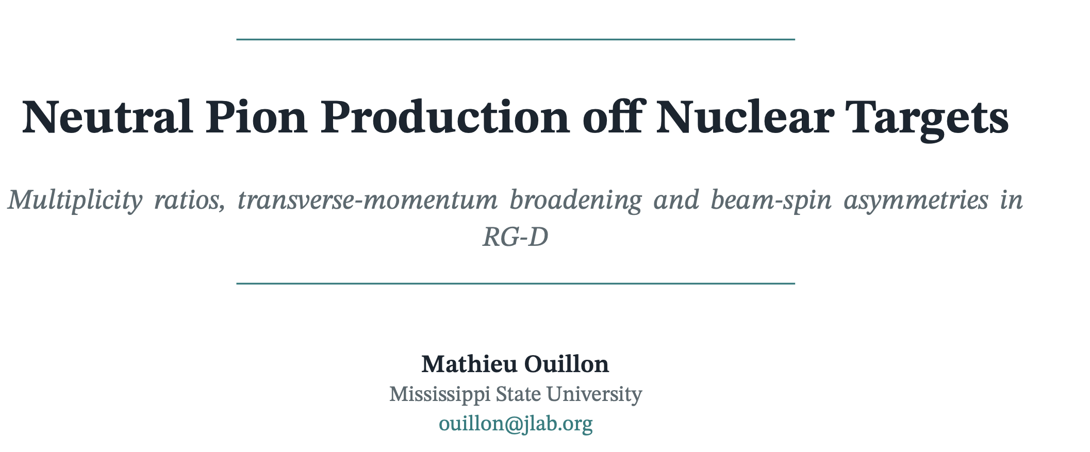
Pi0 Analysis Note and Code
The code for pi0 analysis is in RGD folder and on GitHub.
I wrote an analysis note about that:
To know how to run the code (3 steps), that the code does, and the next steps

Slide 12
To do list
RG-D:
Write documentation and organize my codes (the remaining parts python_nuclear_transparency)
Continue the work on cos and sin φ_{h} extraction
Radiative and acceptance correction
Background for ρ⁰ with simulation for CT analysis
ALERT:
Work on the beam position calibration for AHDC and T0 extraction

