Slide 1
Group meeting
Mathieu Ouillon (Mississippi State University)
07/28/26

Slide 2
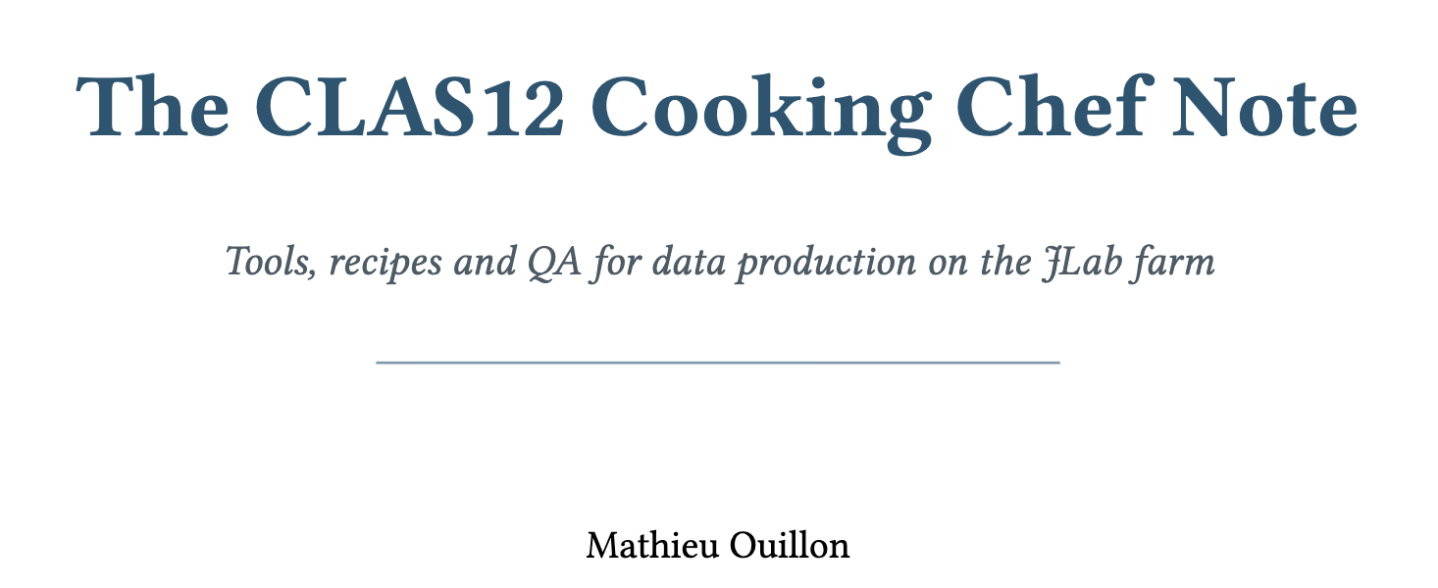
Cleaning Up
Physics analyses: finish cleaning up the nuclear_transparency_python
Typst: add a new note on Chef Cooking:
/work/clas12/ouillon/Typst/CookingChefNote

Slide 3
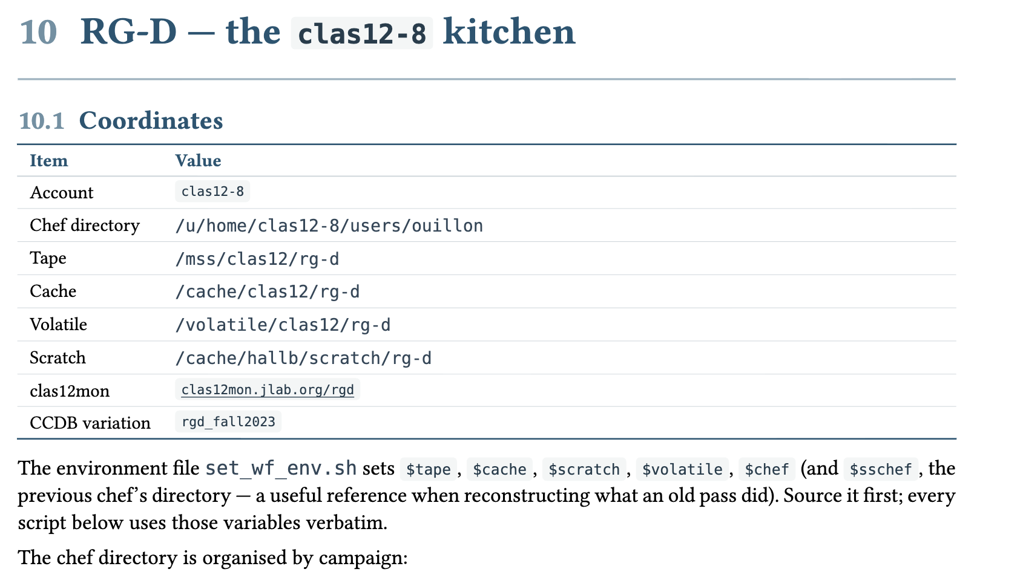
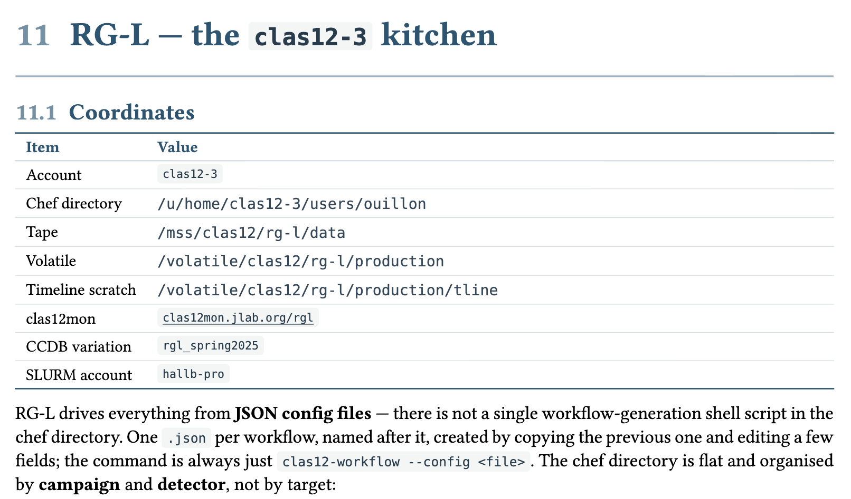
Cleaning Up
Typst: add a new note on Chef Cooking:
/work/clas12/ouillon/Typst/CookingChefNote
With some RG-D/L specific sections:

Slide 4
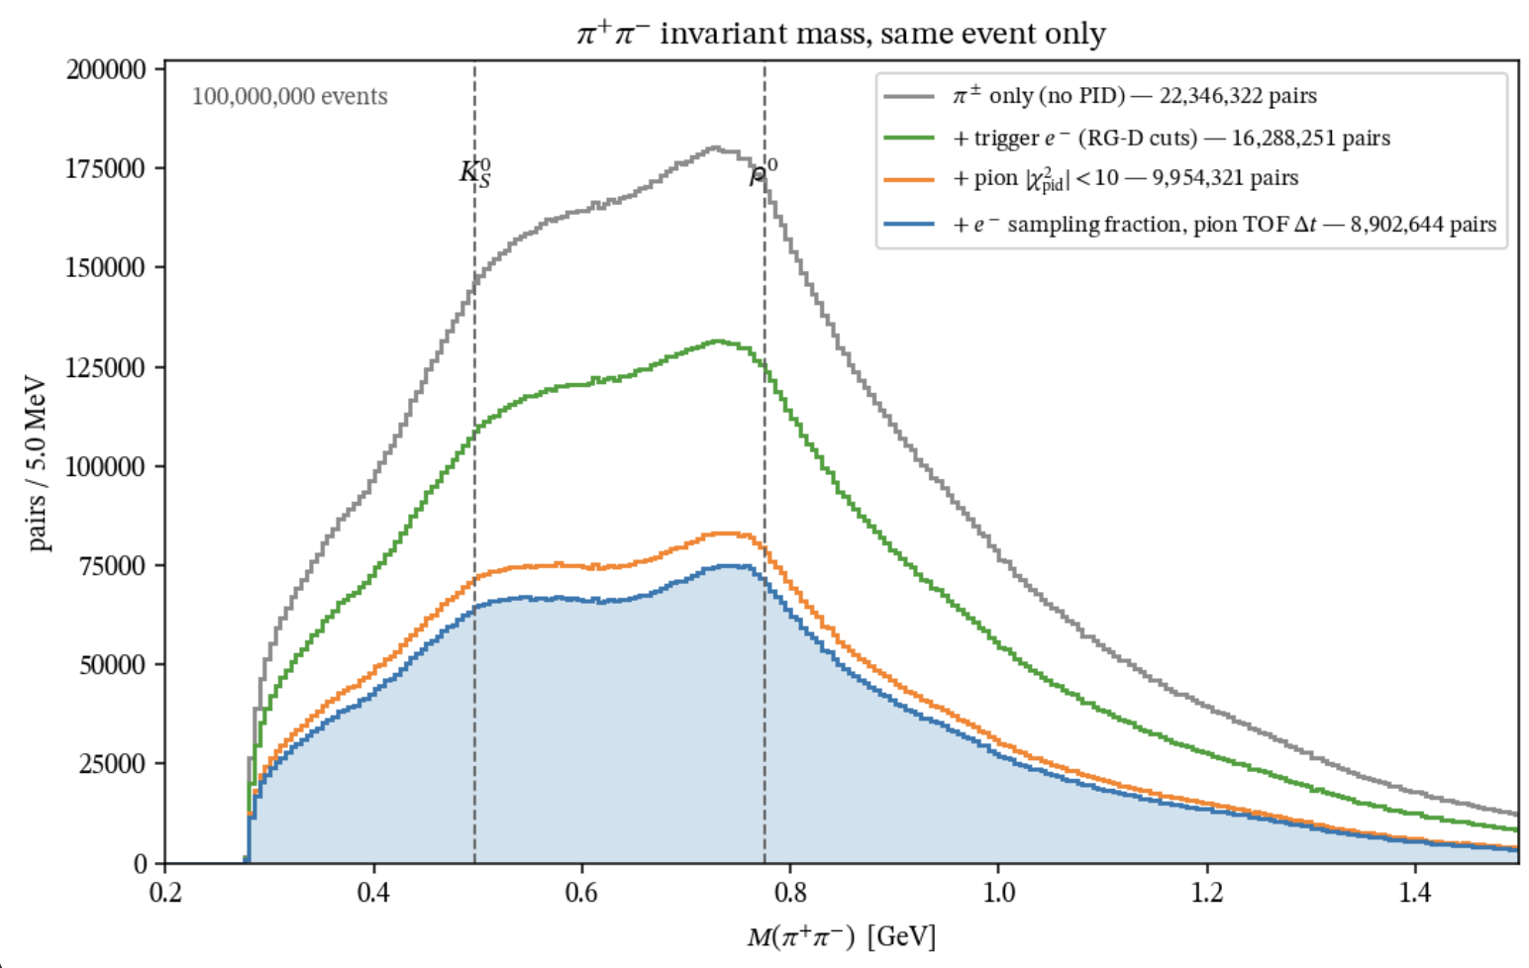
RG-D: Rho0
I wanted to check the the invariant mass of the oppositely charged pions:

Slide 5
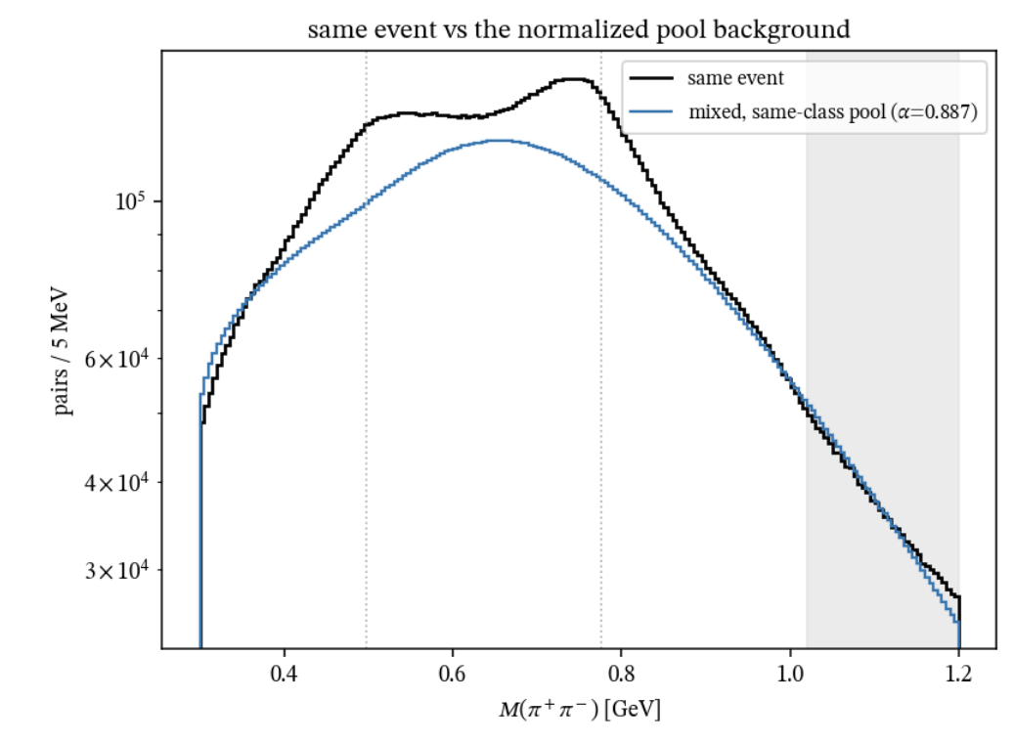
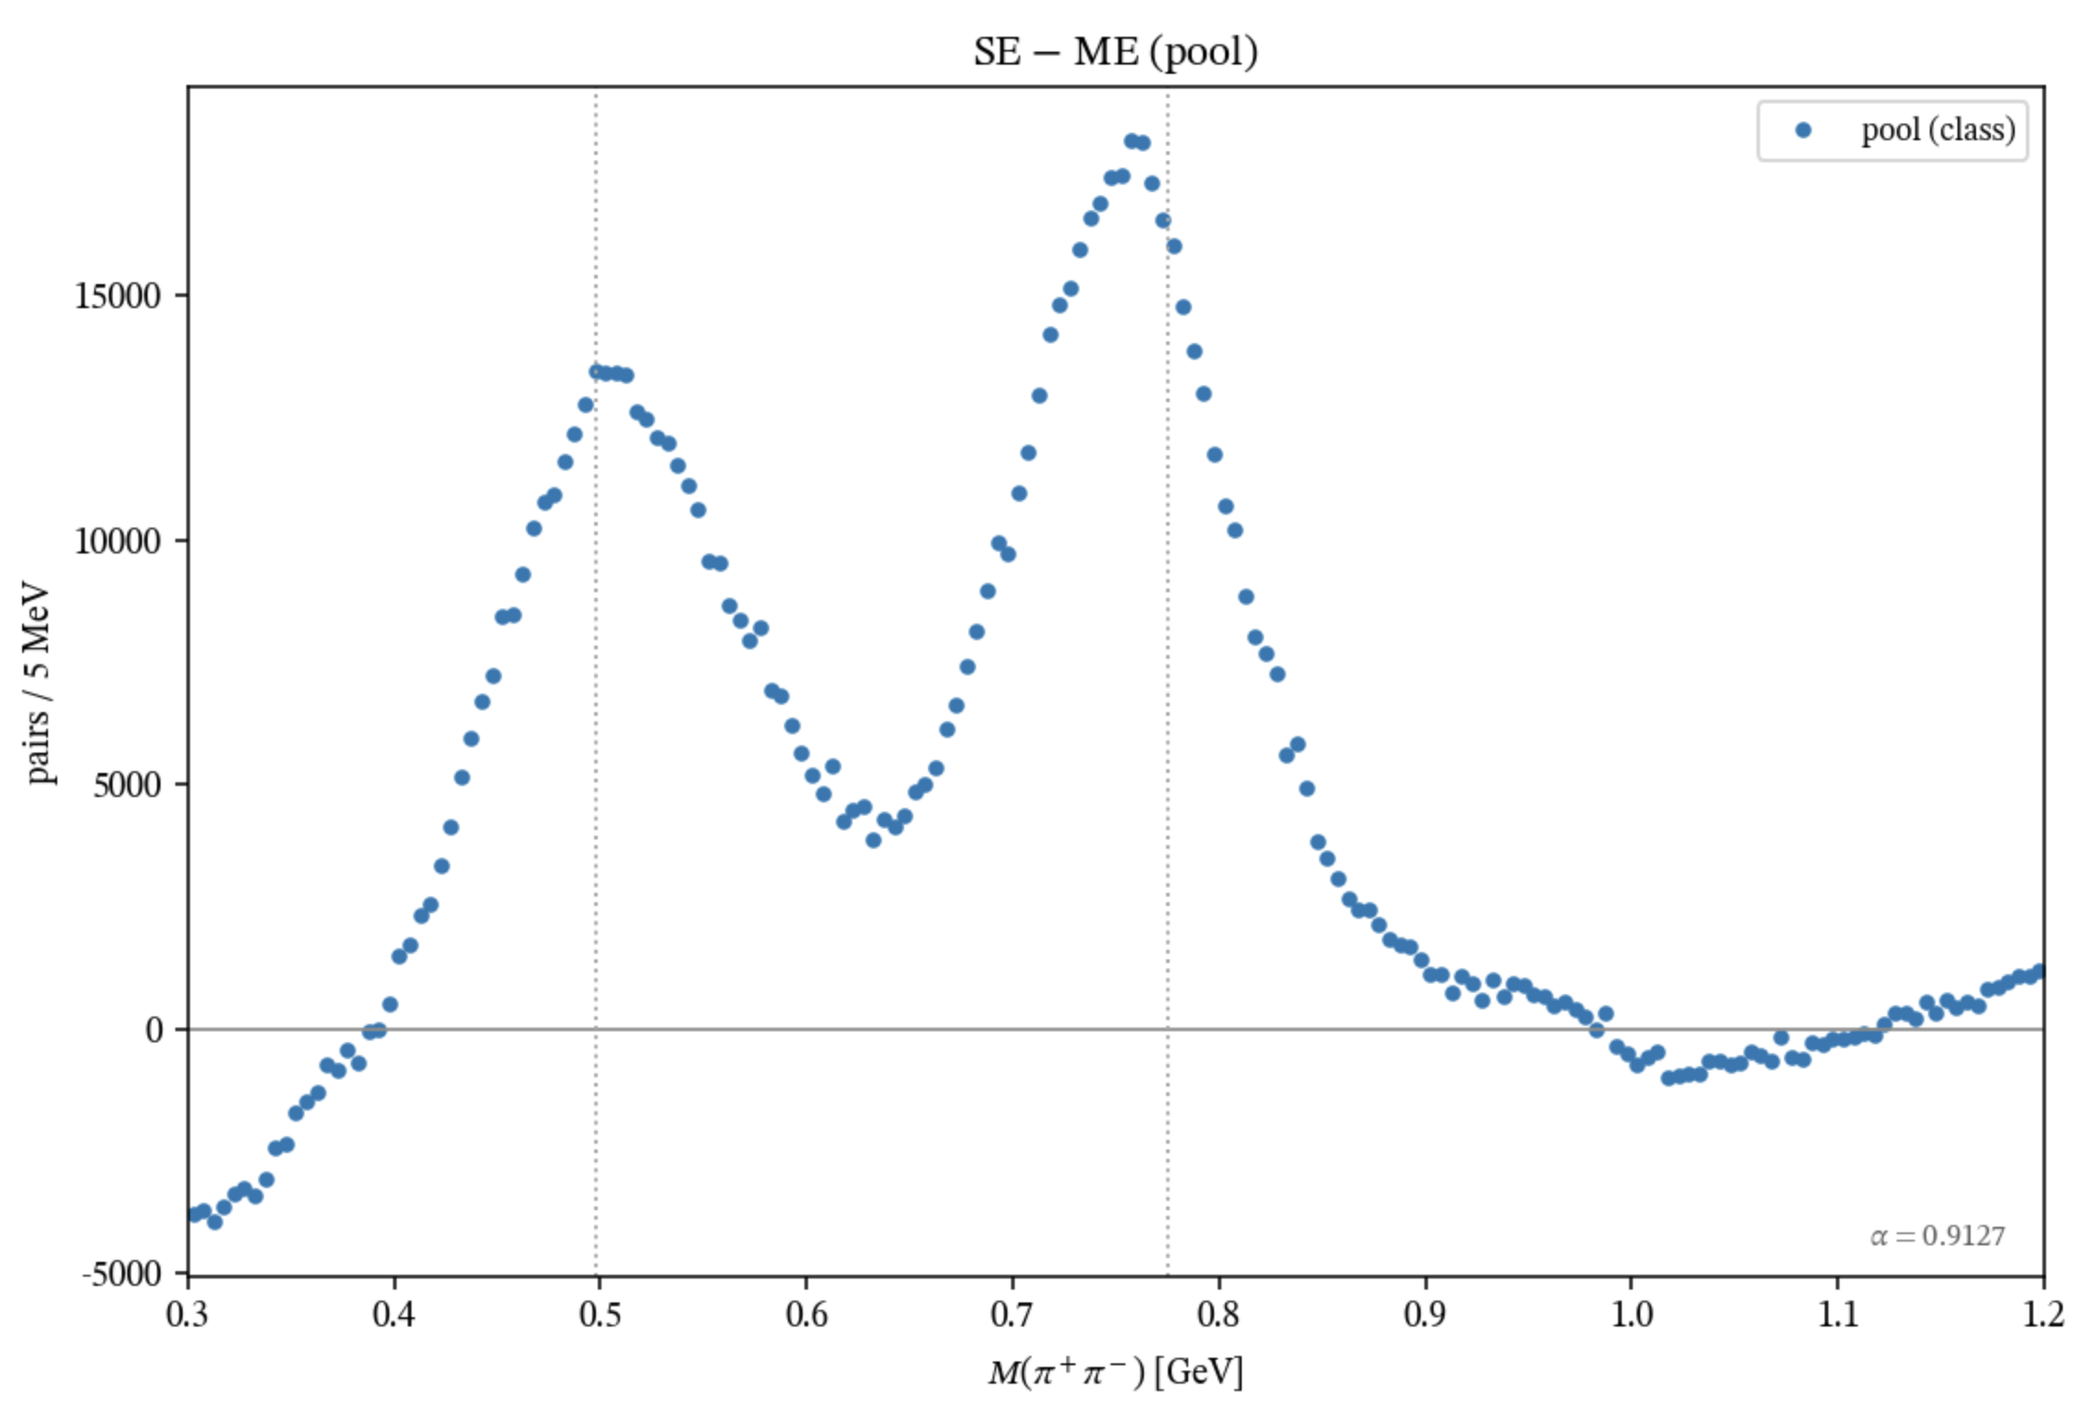
RG-D: Rho0
I have tested a very simple event mixing
Very clear peaks for the K0s but much larger than expected

Slide 6
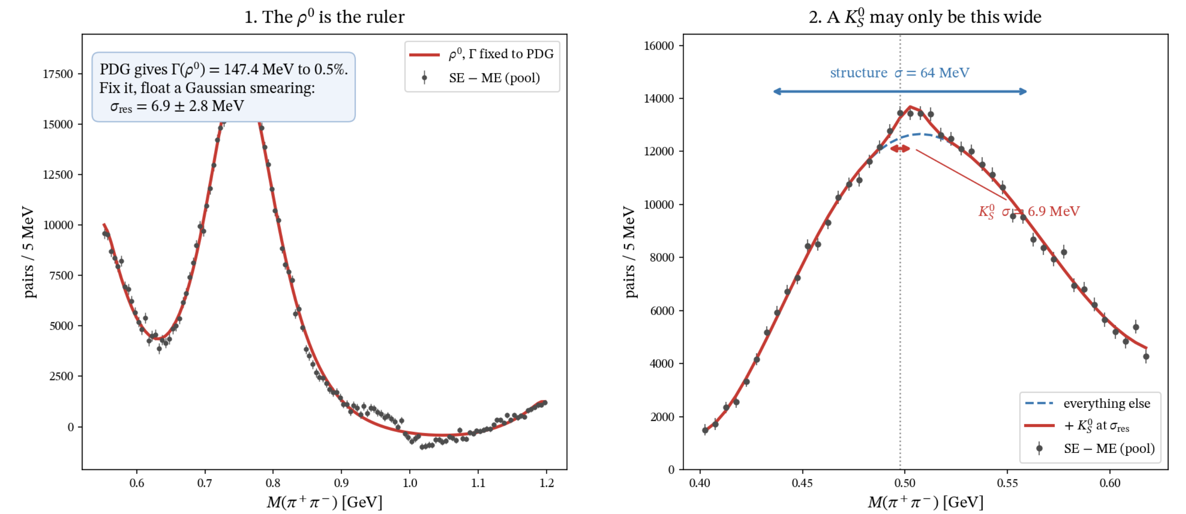
RG-D: Rho0
Fit ρ0 peak with Γ fixed to the PDG value and let a Gaussian smearing float. Whatever the smearing absorbs is the detector mass resolution: σ_res = 6.9 ± 2.8 MeV.
The K⁰S has almost no width, so it can be no wider than the resolution. The two arrows are drawn to the same scale: the structure spans σ = 64 MeV, the K⁰S σ = 6.9 MeV.

Slide 7
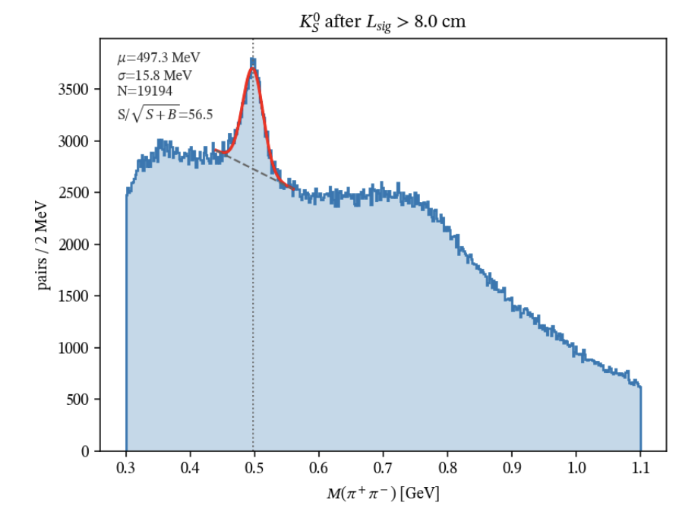
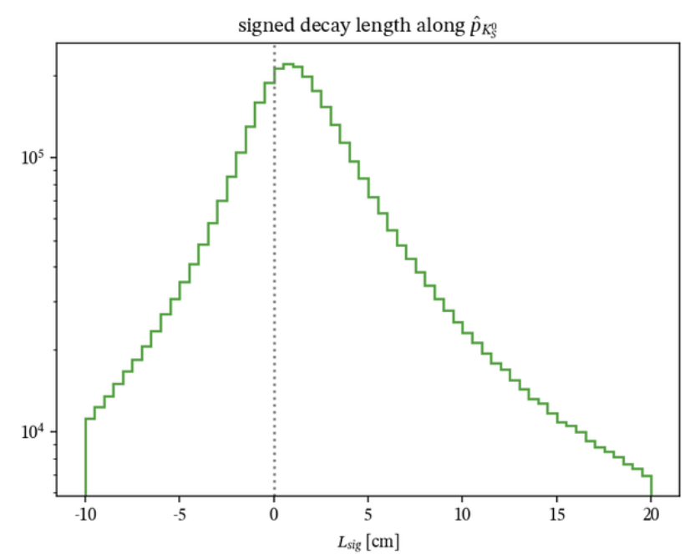
RG-D: Rho0
Try detach vertex like analysis

Slide 8
Service Work 2026
Service work 2026
Category | Description | Contributor | FTE | Percentage Done | Information | Calculation
Cooking | Cooking Chef duties for RG-L | Mathieu Ouillon | 0.125 | 100% | 8 months of Cooking Chef duties | Chef from december 2025 to End of july 2026
Software | Work on track matching with AI MLP + working on GNN for track finding | Mathieu Ouillon | 0.1 | 100% | Informations can be found in the meeting minutes under the Weekly Meetings of the ALERT Collaboration wiki page: https://clasweb.jlab.org/wiki/index.php/ALERT_Meeting_2026 and CLAS Collaboration meeting: https://indico.jlab.org/event/1077/contributions/18914/attachments/14300/23116/Presentation_CLASCollaboration_GNN_260629.pdf, https://indico.jlab.org/event/1017/contributions/18352/attachments/13823/22362/Presentation_CLASCollaboration_ALERT_260310.pdf
Software | Work on the t0 calibration for ALERT | Mathieu Ouillon | 0.0125 | 100% | Informations can be found in the meeting minutes under the Weekly Meetings of the ALERT Collaboration wiki page: https://clasweb.jlab.org/wiki/index.php/ALERT_Meeting_2026 and https://code.jlab.org/ouillon/t0rch
Software | Work on ALERT-CLAS transverse beamspot position | Mathieu Ouillon | 0.0062 | 100% | Informations can be found in the meeting minutes under the Weekly Meetings of the ALERT Collaboration wiki page: https://clasweb.jlab.org/wiki/index.php/ALERT_Meeting_2026 and https://code.jlab.org/ouillon/alert-clas-alignment#
Software | Documentation hipo-cpp library | Mathieu Ouillon | 0.1 | 100% | https://pages.jlab.org/hallb/clas12/hipo-cpp/
 |  | Total | 0.3437

Slide 9
Thanks
Thank you all for these two years
It was a great experience, I learned a lot
Stay in touch: ouillon@jlab.org or mathieu.ouillon1@gmail.com

