Slide 1
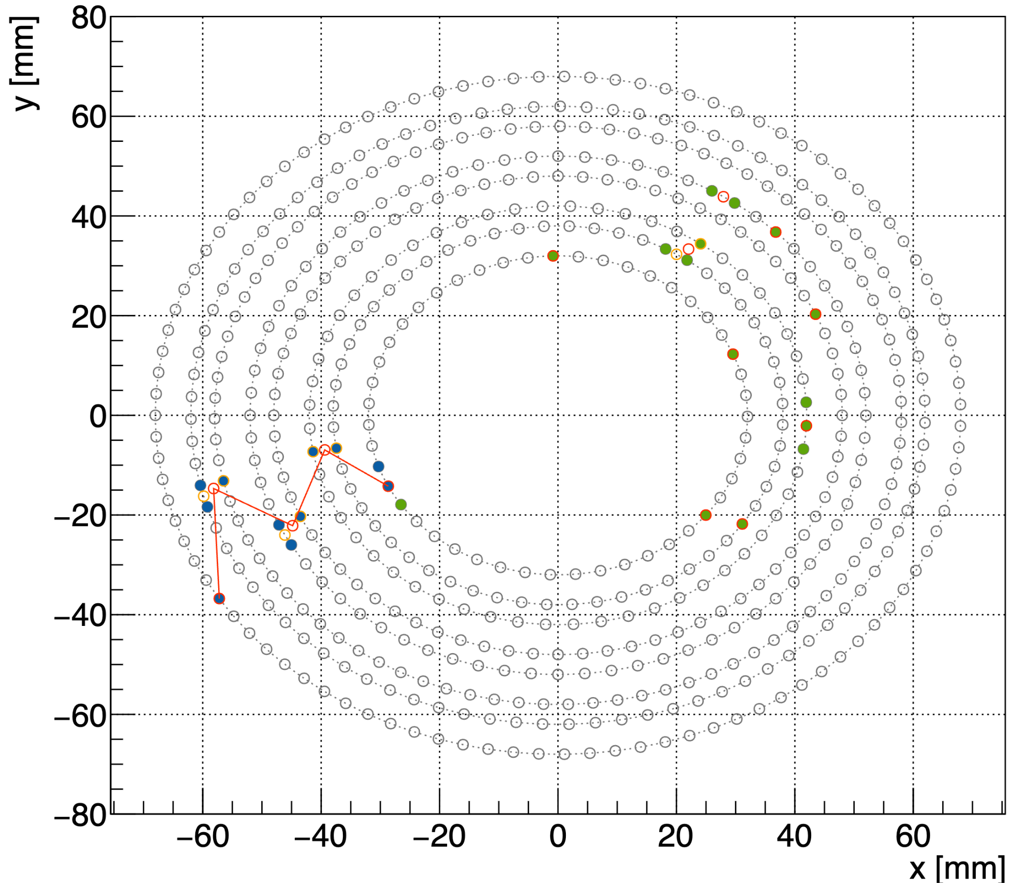
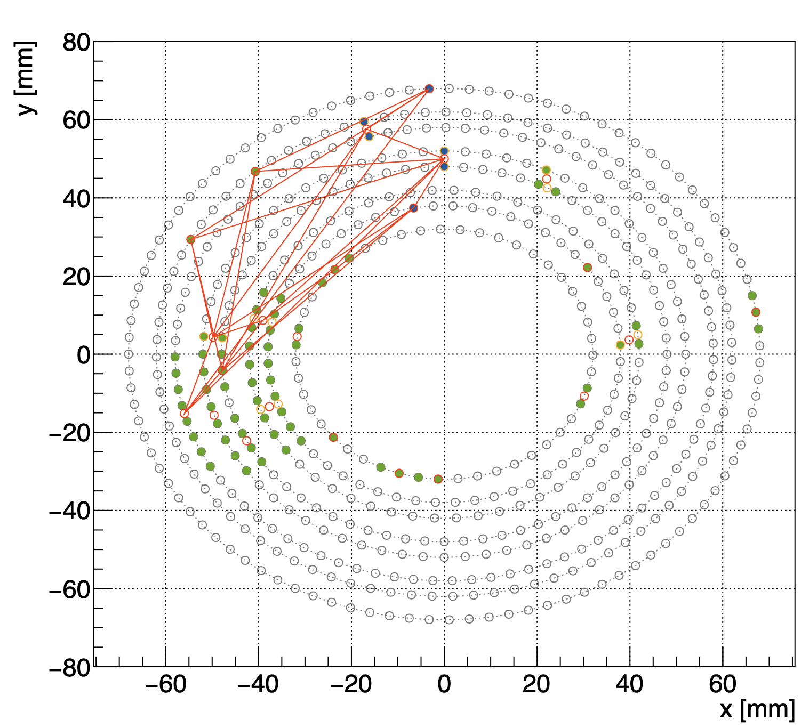
AI for ALERT
Goal: use luminosity simulation as background. 2 events from the same HIPO file.

Slide 2
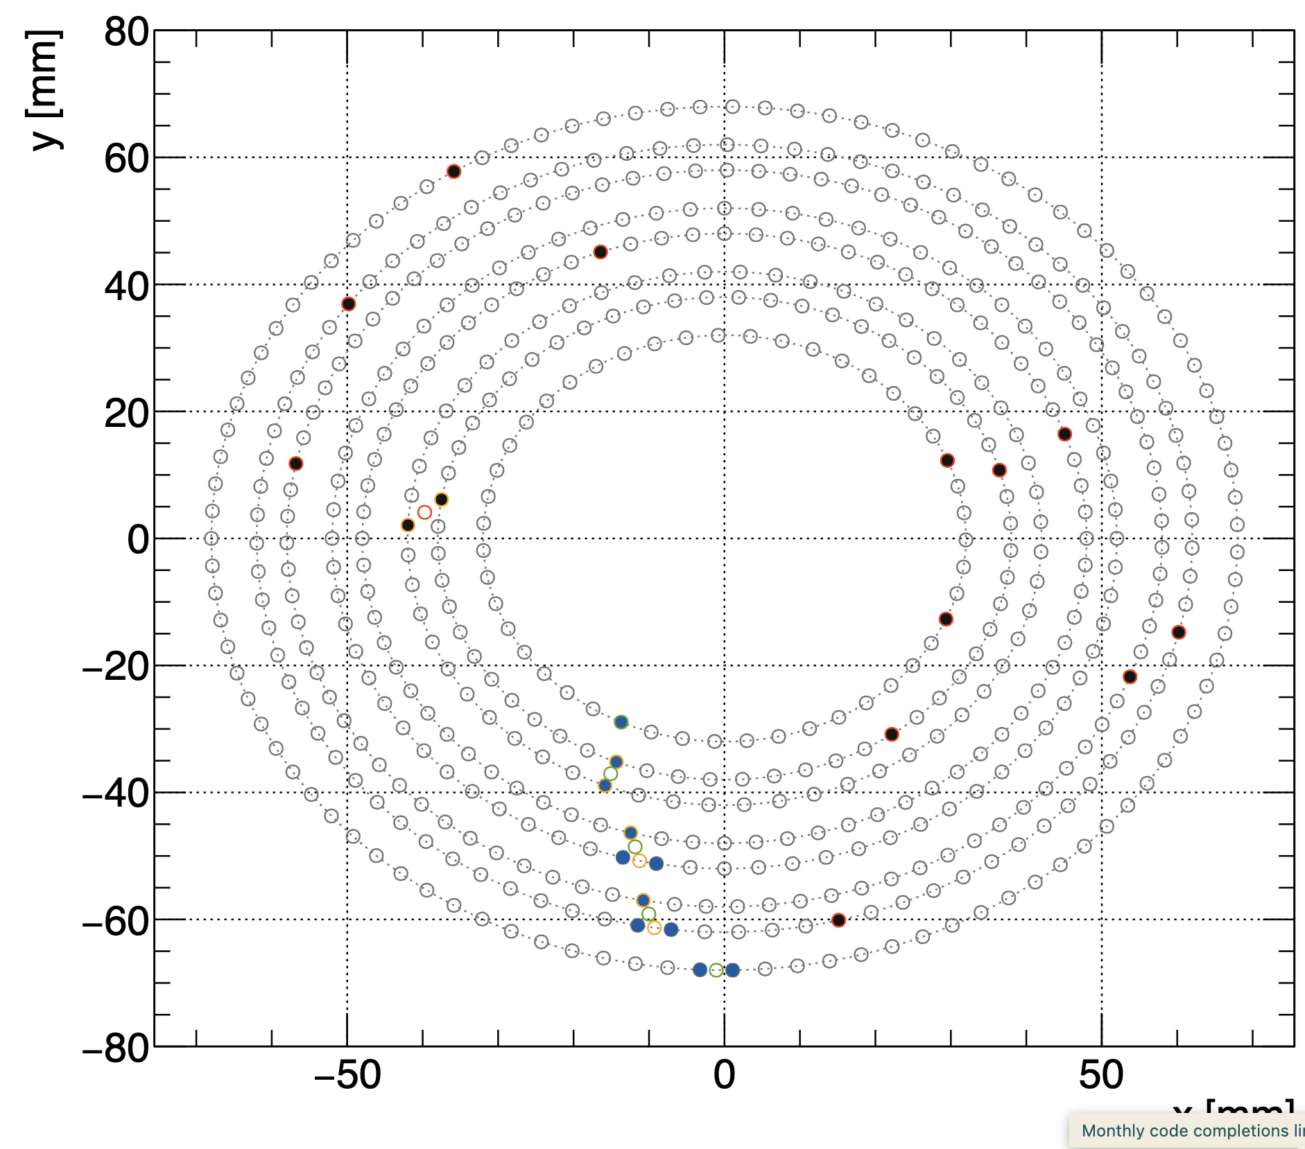
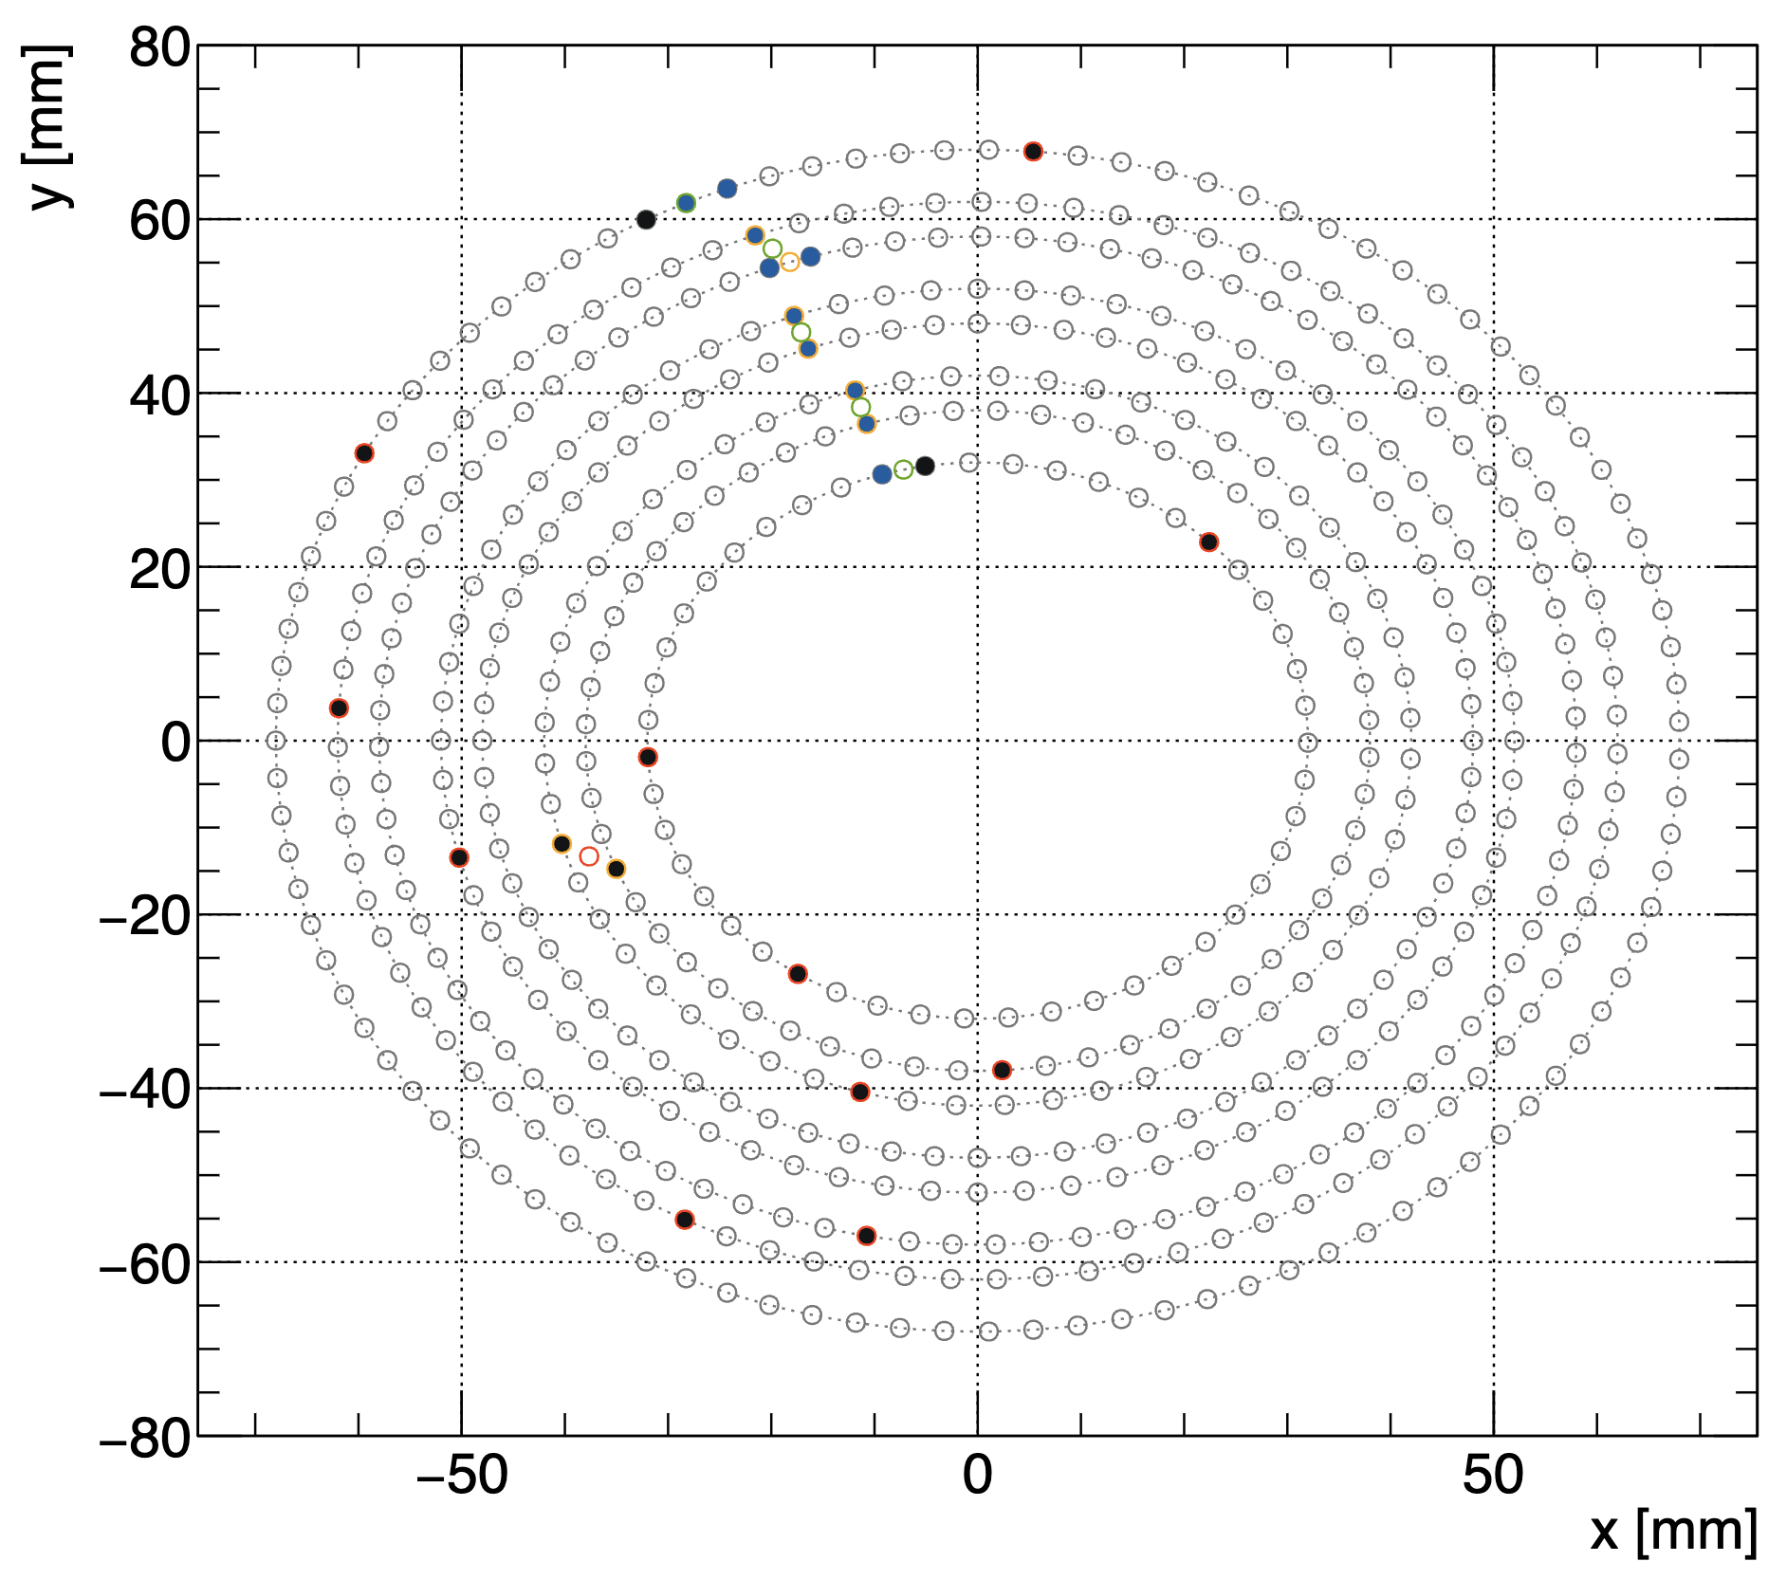
Using the previous method: randomly choose a wire.

Slide 3
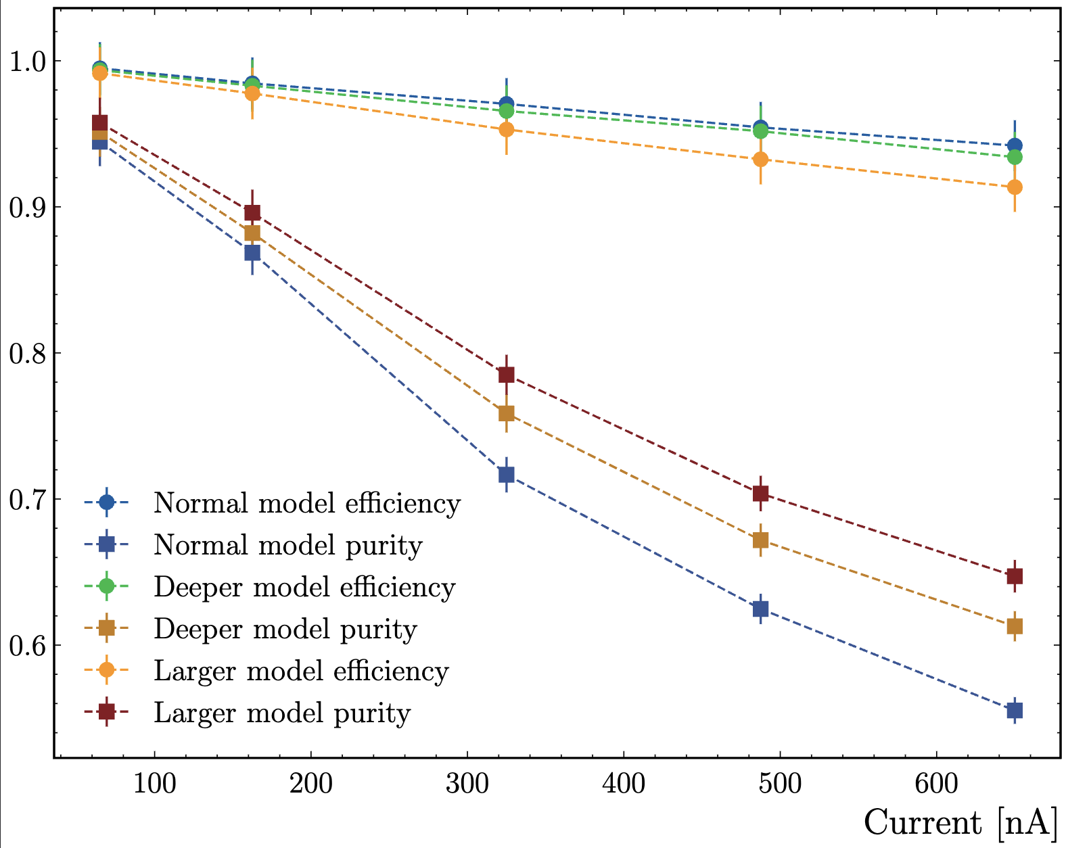
AI for ALERT
Use simulated background (mostly electron-electron collision)
Add proton track.
Compute efficiency and purity:
Efficiency: Number of good tracks classified as good / number of event which have a track.
Purity: Number of good tracks classified as good / number of tracks (good or bad) classified as good.
Blue line/dot: model with 20 neurons in the 3 hidden layers
Red line/dot: model with 100 neurons in the 3 hidden layers
Orange line/dot: model with 20 neurons in the 5 hidden layers

Slide 4
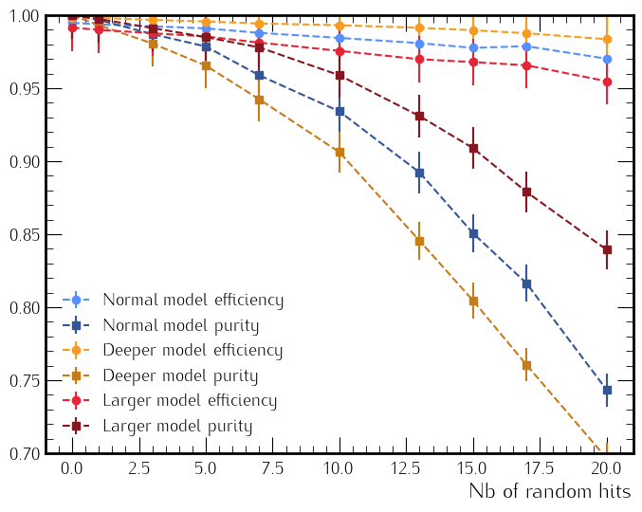
Efficiency and purity as a function of occupancy
Old method:

Slide 5
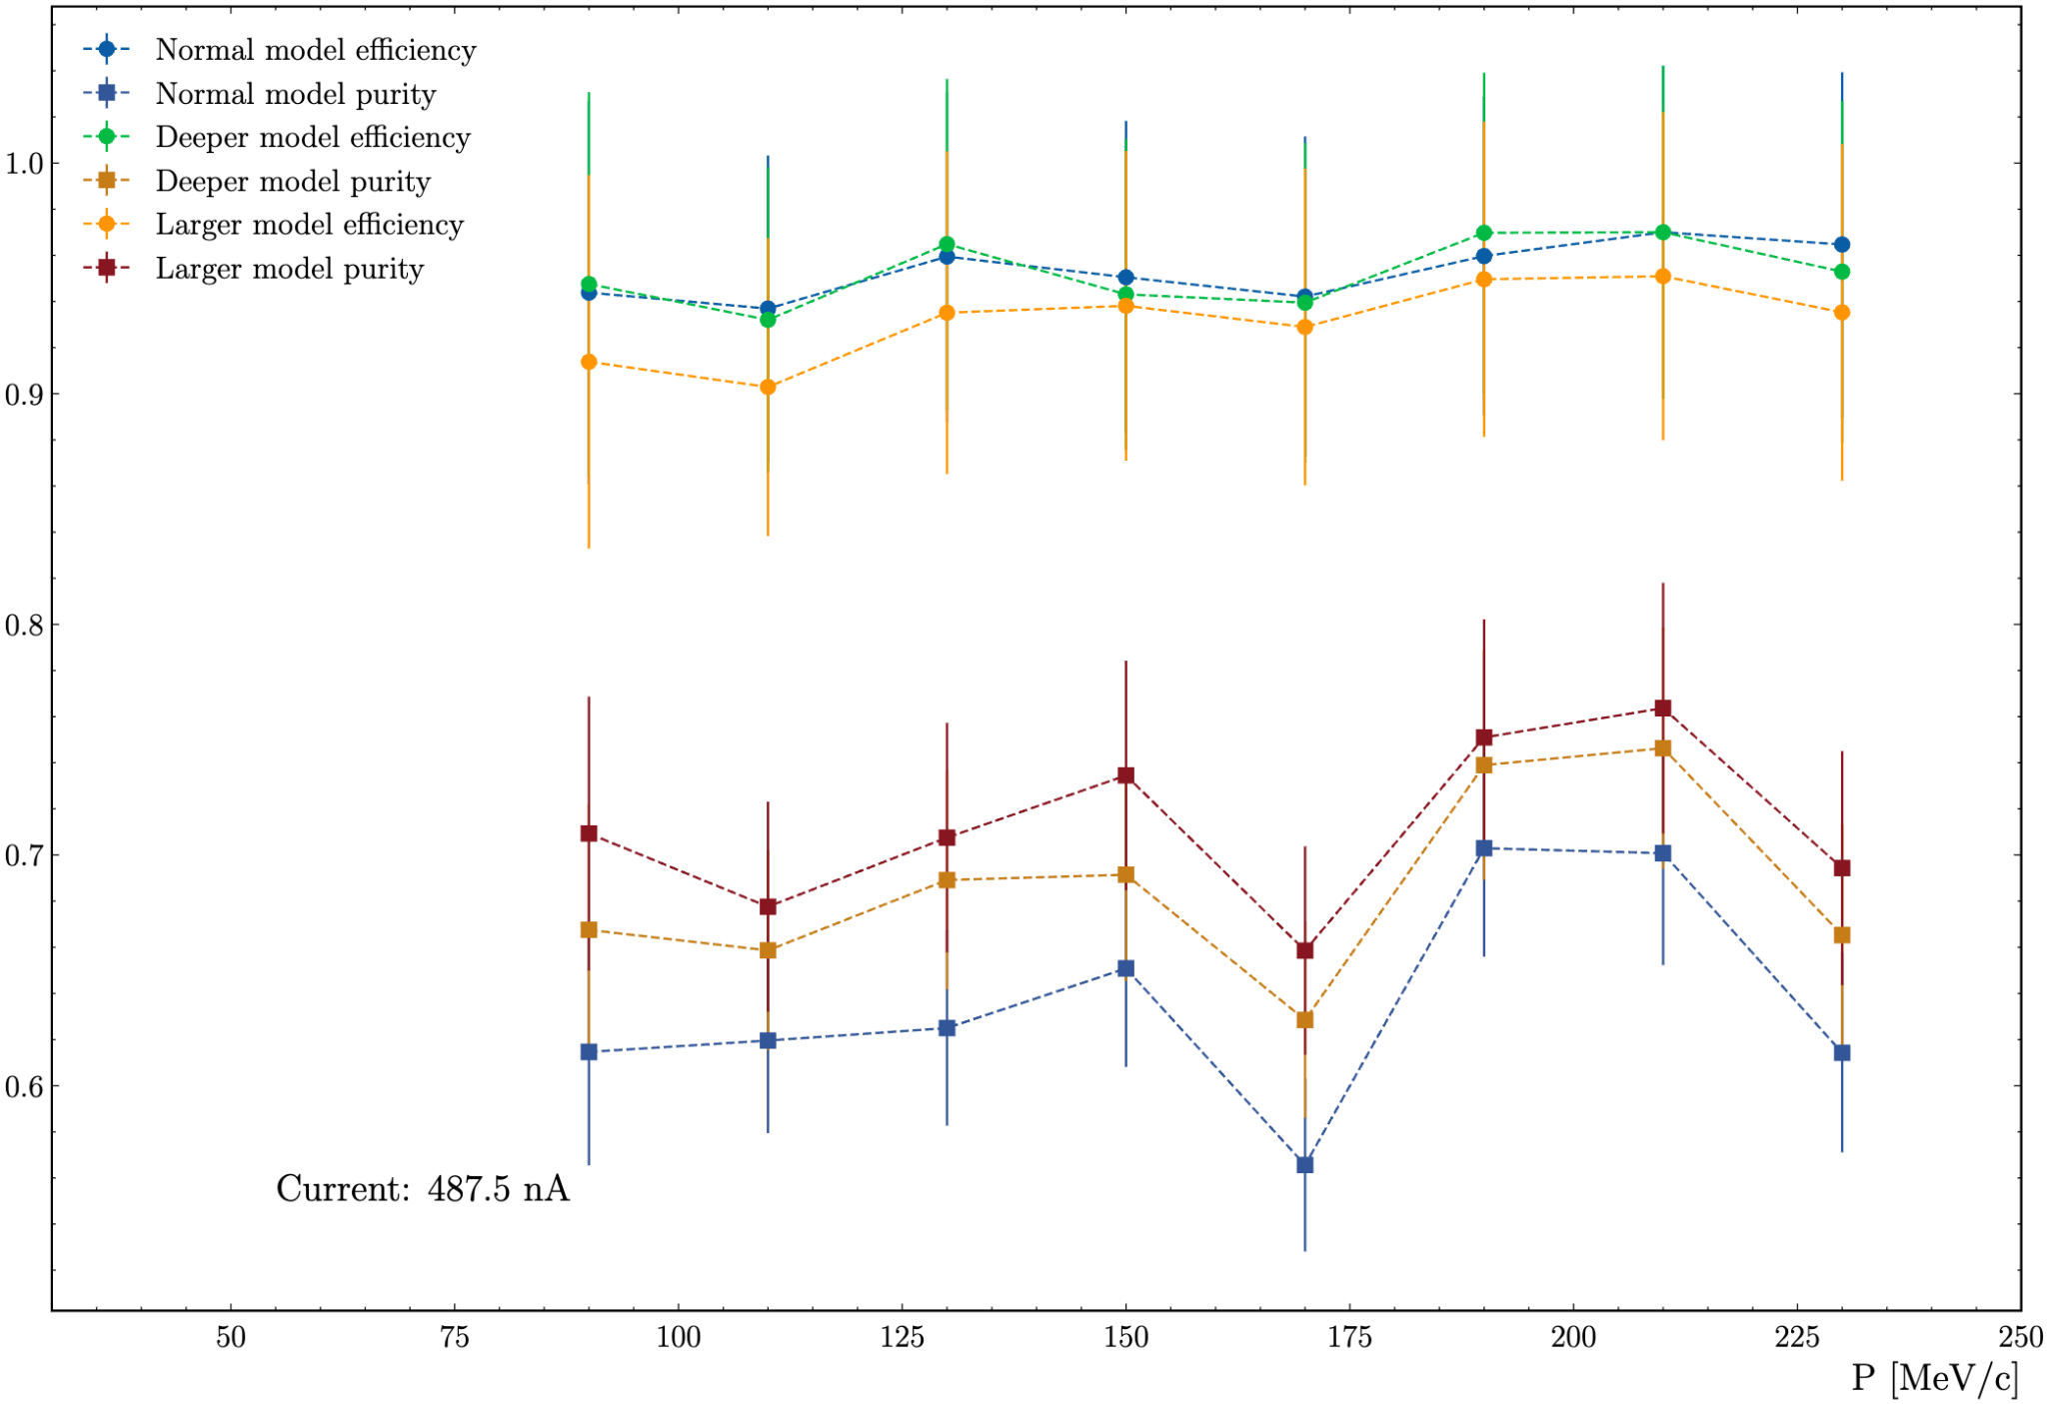
AI for ALERT
Use simulated background (mostly electron-electron collision)
Add proton track.
Can also compute the efficiency as function of the proton momentum

Slide 6
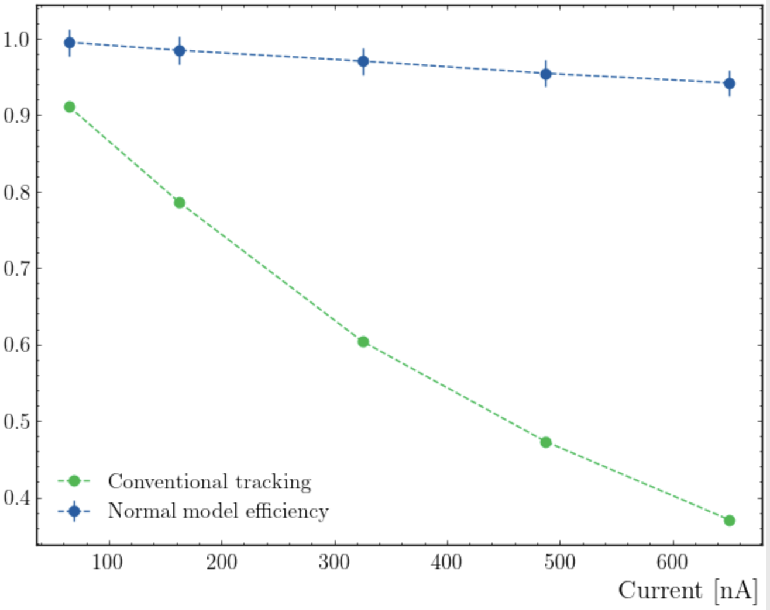
AI for ALERT
We can also compare the efficiency for the conventional track finding and the AI.

