Slide 1
Hadron PID with AI
Mathieu Ouillon (Mississippi State University)

Slide 2
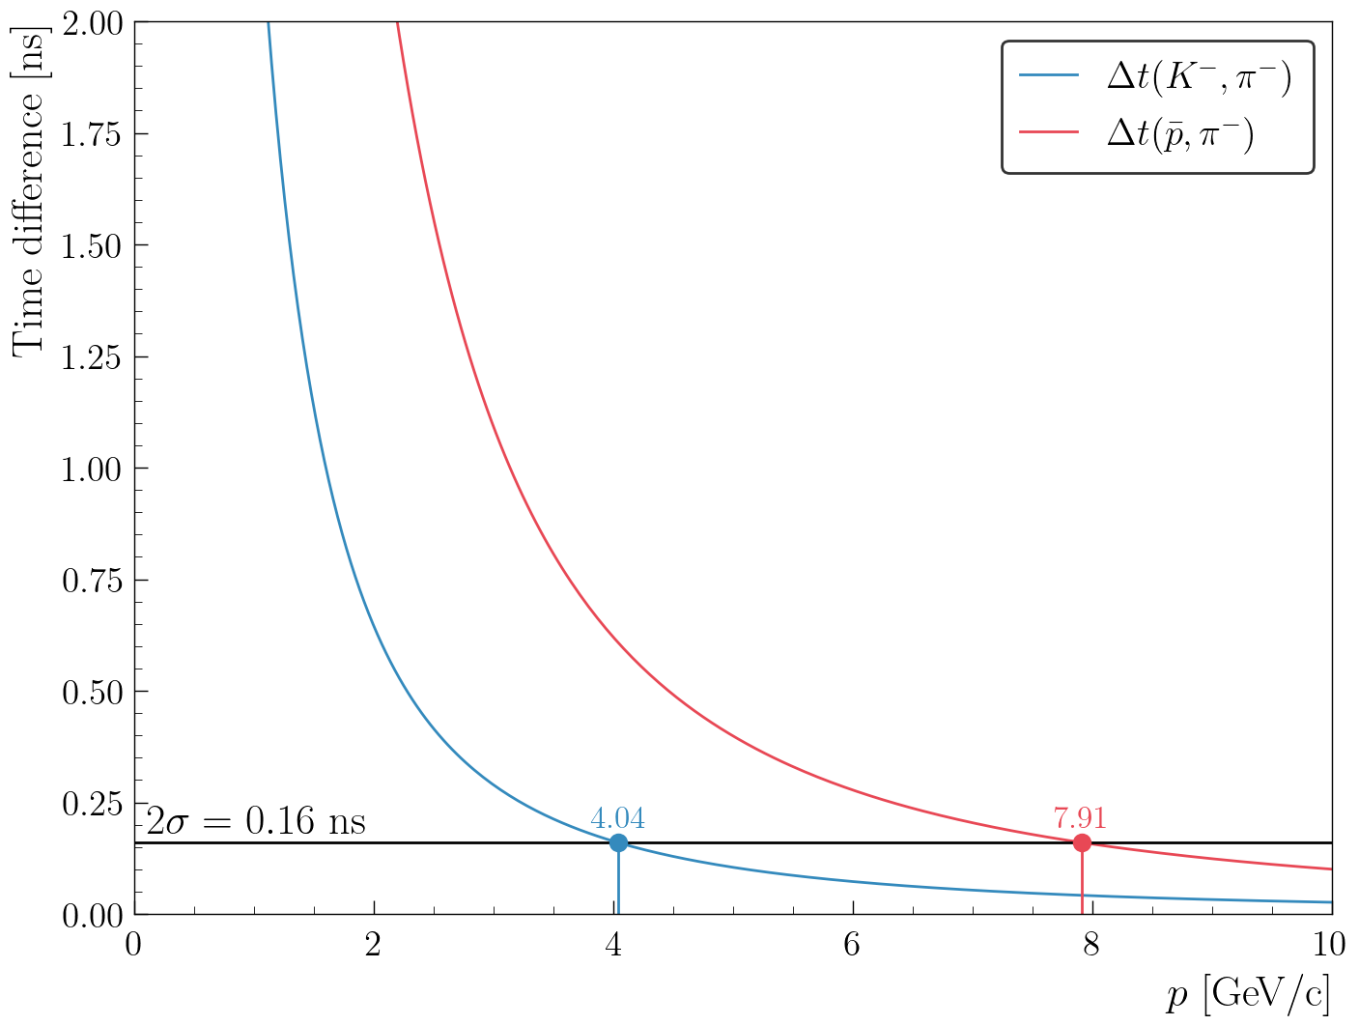
Hadron identification
The hadron identification is done after the identification of the trigger electron and use the start time define by the trigger electron.
It use mostly the FTOF and rely on β (or Δt):
FTOF can separate kaon and pion up to
4 GeV with a 2σ resolution of the FTOF
(5.7 GeV for 1σ), and proton and pion up
to 8 GeV.
Above that, the FTOF is not enough
We can try to use other detectors:
Such as calorimeters and Cherenkov counters

Slide 3
Hadron identification
To use the information of all these detectors (Calorimeters, HTCC, …) in the most efficient way, we can use AI. More specifically the Boosted decision tree architecture are well suited for that problem.
The goal is to have a model that use information only from the REC banks.
So, it can be use in the analysis step (on DST files).
Use information from the calorimeters, Cherenkov counters, TOF and higher-level variables (px, py, pz, charge, …)
Use all variable found in the DST banks: 96 features.
Data for the training and validation: ONLY simulation, simulate events with an electron and a hadron (ONLY in the forward).
Training and validation are done in Python.
Need to use real data for validation with either the RICH and exclusive reaction
The goal is to implement that algorithm in Iguana

Slide 4
Hadron identification
Try many different architectures: Gradient Boosting Decision Trees (GBDT), XGBoost, LightGBM and CatBoost (same family), MLP, MLP + GBDT.
The best results are for CatBoost (Categorical Boosting).

Slide 5
Hadron identification

Slide 6
Hadron identification

Slide 7
Hadron identification

Slide 8
Hadron identification
With the CatBoost model, we can improve the hadron identification, especially for π and K at high momentum.
It also enhances low-momentum hadrons.
Not much improvement for the proton/anti-proton.
Name | Overall efficiency | Overall purity
 | 0.843879 | 0.873114
 | 0.838079 | 0.859936
 | 0.78045 | 0.75665
 | 0.761896 | 0.75869
 | 0.85905 | 0.848871
 | 0.851671 | 0.833633

Slide 9
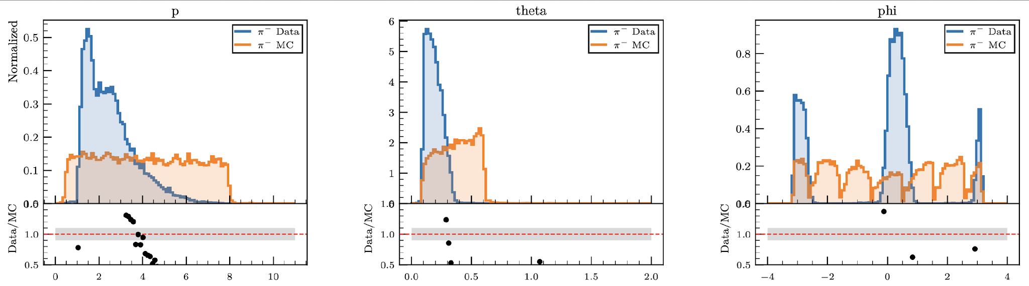
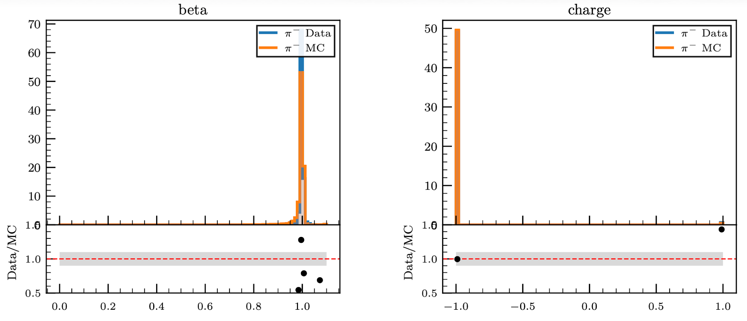
Hadron identification: Data vs MC features
Before testing the AI on real data, we can compare the inputs features between MC and data for π⁻:
Phase space is flat in simulation but not in data: should not be an issue we cover the same space.

Slide 10
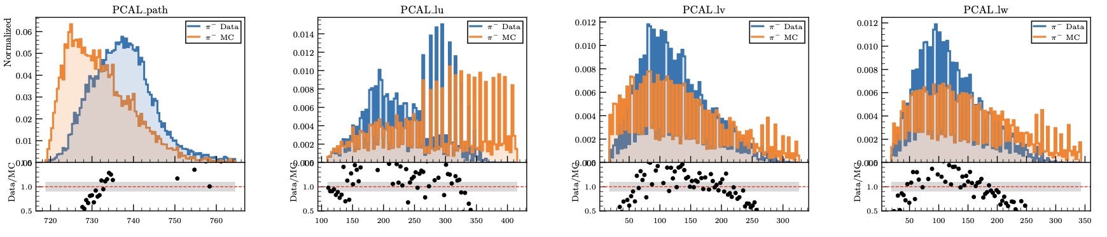
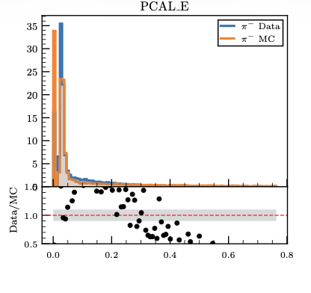
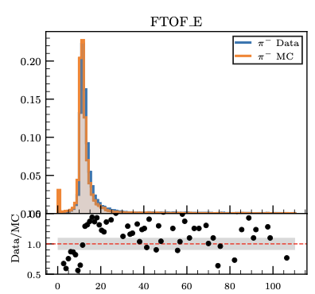
Hadron identification: Data vs MC features
Before testing the AI on real data, we can compare the inputs features between MC and data for π⁻:
Energy (both in CAL and FTOF) are well reproduce in simulation, same for calorimeter shower width and 2nd moment of the shower are also well reproduce.

Slide 11
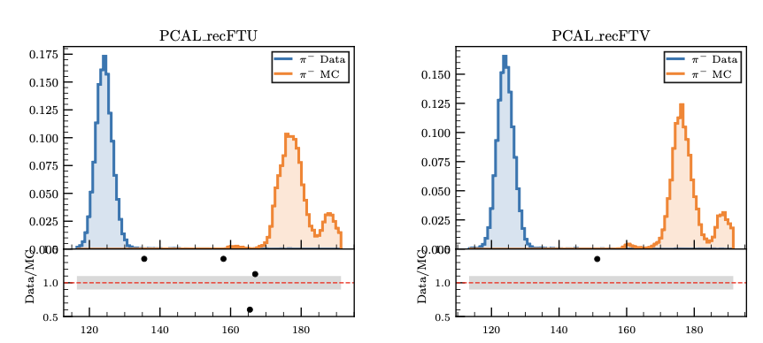
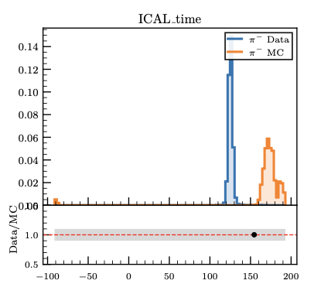
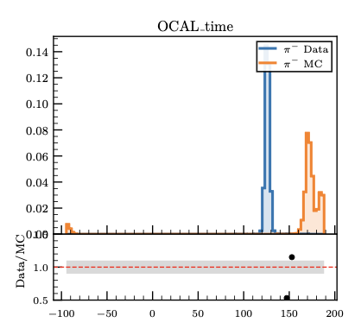
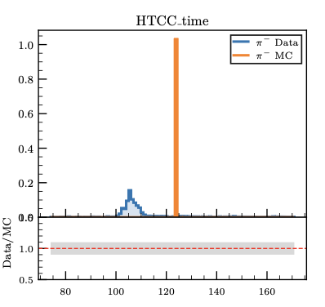
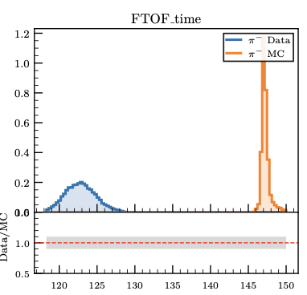
Hadron identification: Data vs MC features
Before testing the AI on real data, we can compare the inputs features between MC and data for π⁻:
I have a ~30ns shift for the timing in all detector between MC and Data.
I should use the time – start time not the raw time.

Slide 12
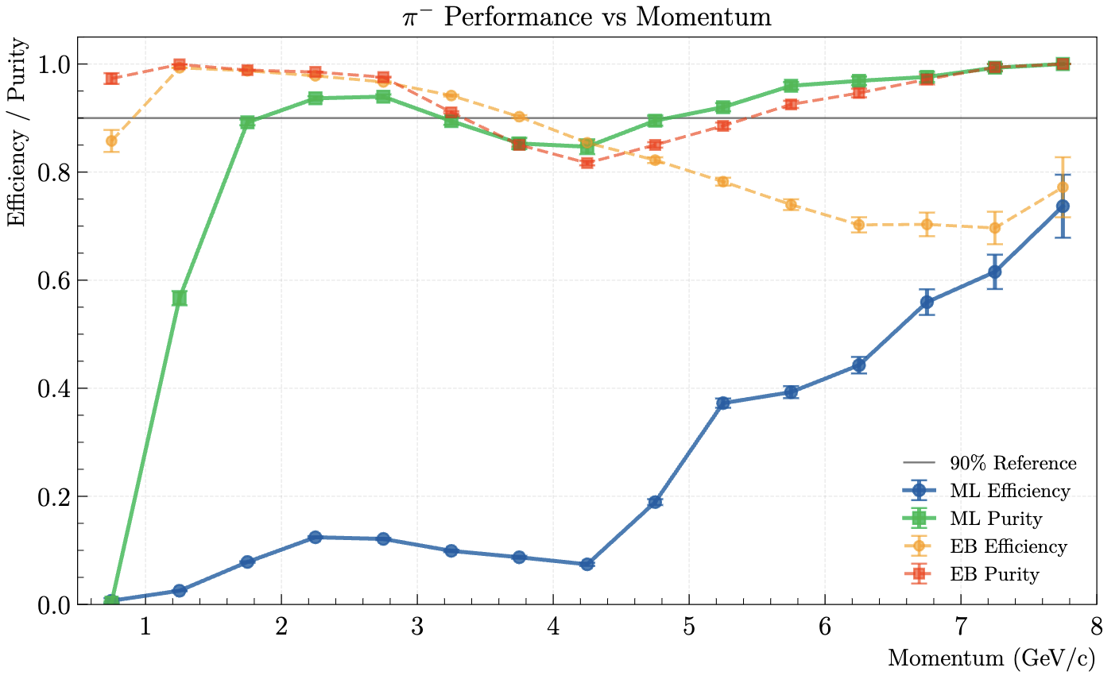
Hadron identification: Data vs MC features
Due to the timing difference between the MC and Data, I can’t test the AI on real data, I need to retrain using the time - start time

Slide 13
Hadron identification: Limitation
The AI requires calorimeter variables as input, involving more detectors than conventional PID — this reduces the number of detected pions.
Solution: Allow the AI to handle NaN values, so calorimeter information is no longer strictly required. This is already implemented, but there is room for further improvement.
Improvements in purity may be of limited impact, as Δt or χ²PID cuts are already applied in analyses. Gains in efficiency are therefore more valuable.

Slide 14


Hadron identification: Limitation
Improvements in purity may be of limited impact, as Δt or χ²PID cuts are already applied in analyses. Gains in efficiency are therefore more valuable.
The impact of the purity improvement need to be study

Slide 15
Hadron identification: Limitation
Improvements in purity may be of limited impact, as Δt or χ²PID cuts are already applied in analyses. Gains in efficiency are therefore more valuable.
The impact of Δt on the purity need to be study

Slide 16
Summary
Model: CatBoost selected as best architecture (vs. XGBoost, LightGBM, MLP) — uses 96 features from REC banks
Performance: Improved π and K identification at high momentum, and low-momentum K — limited gain for protons
Data vs. MC: ~30 ns timing shift identified between data and simulation — retraining required using time − start time
Limitation: Calorimeter variables reduce pion count — NaN handling already implemented, further improvement ongoing
Priority: Efficiency gains are more valuable than purity, as Δt and χ²PID cuts are already applied in analyses
Next steps: Retrain with corrected timing, validate on real data (RICH + exclusive reactions), implement in Iguana
Available: Code available on GitLab

