Slide 1
Track matching with AI
Mathieu Ouillon (Mississippi State University)

Slide 2
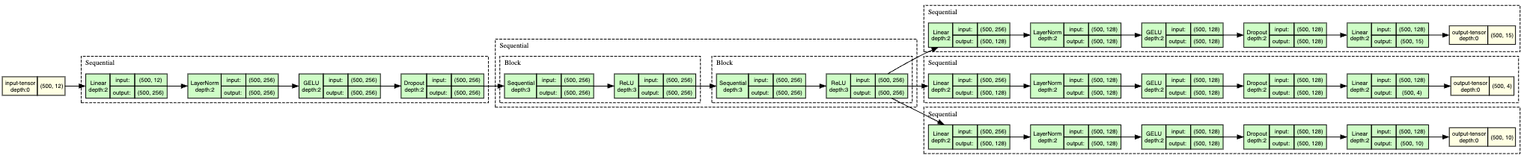
Track matching: model
Inputs: 5 of 2-D points (intercluster: x, y) (in total 10 numbers)
Output: sector, layer, wedge
For the training, 5M events, and select them with a good track (pred > 0.2), and only one bar and wedge hit.
Network architecture:
Input: 10 numbers
Initial layers
Feature extraction: 2 blocks of 2*256 neurons = total numbers of neurons = 2*2*256
3 specific heads

Slide 3
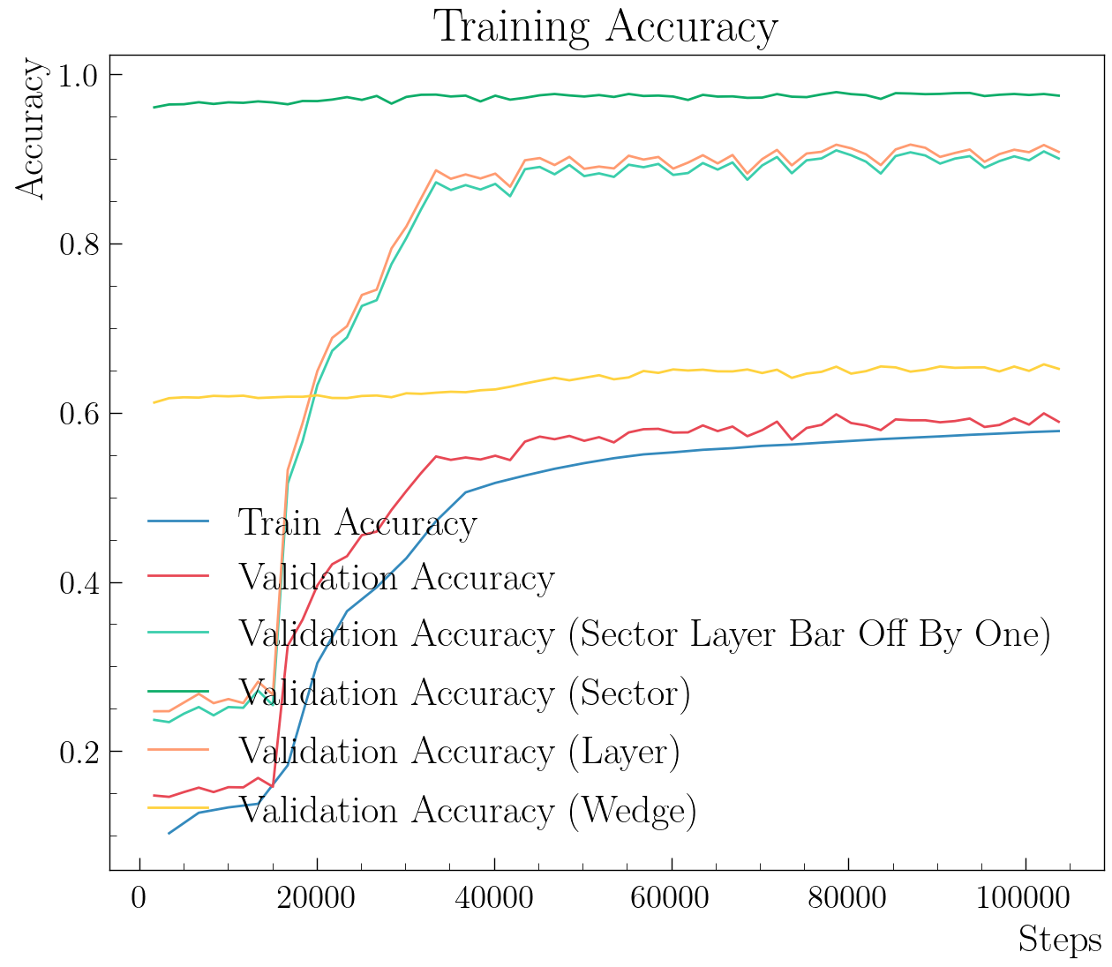
Track matching: efficiency on simulation
Efficiency on simulation: 92% of finding the good layer, sector and by off by one for the wedge.

Slide 4
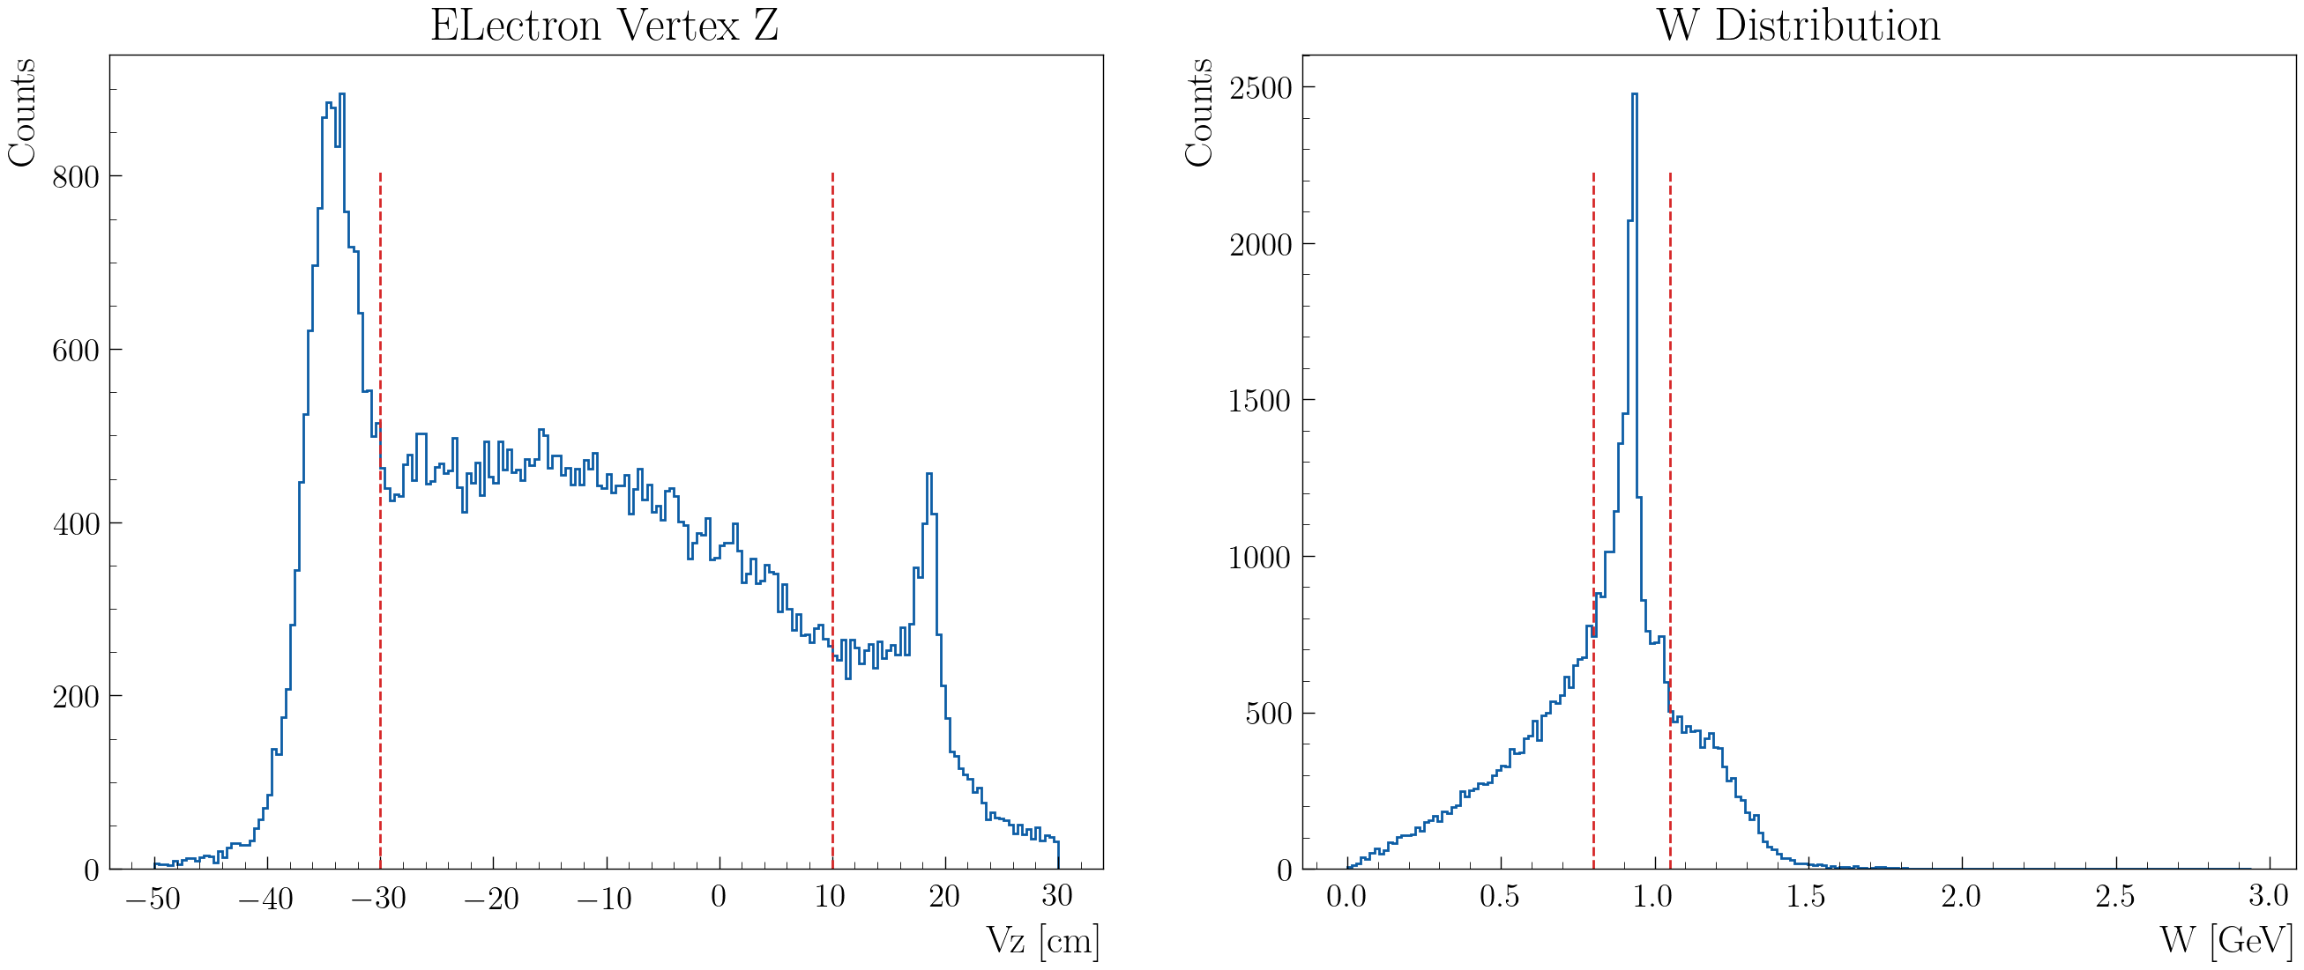
Track matching with AI: test on data
Test the AI track matching on real data: elastic electron-proton (23012)
Select the elastic electron with Vz and W cut

Slide 5
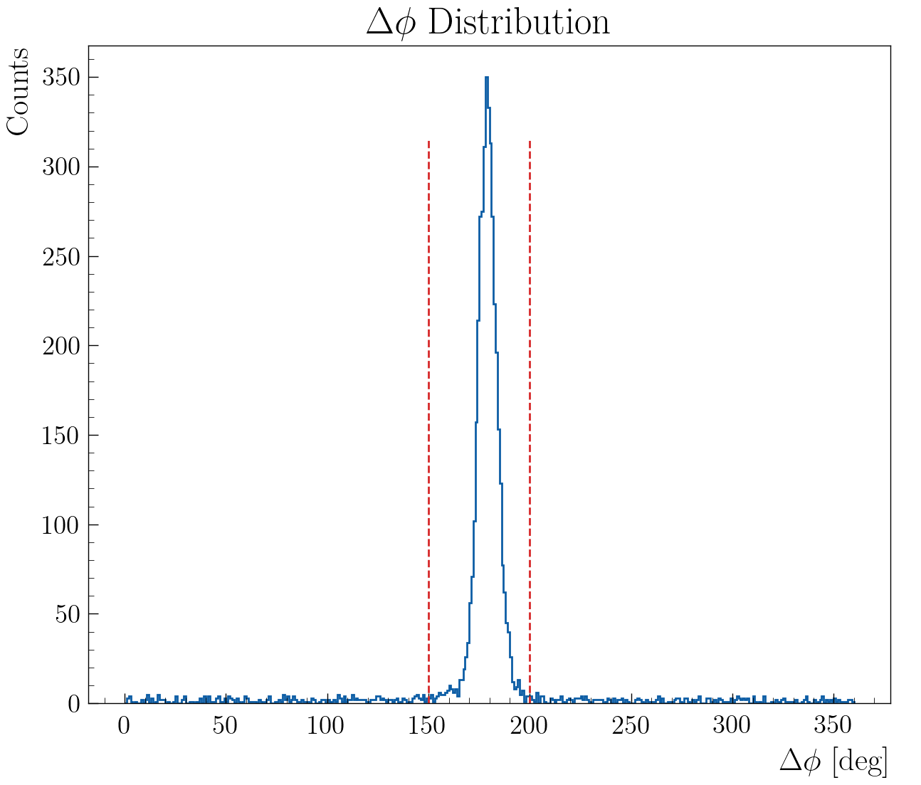
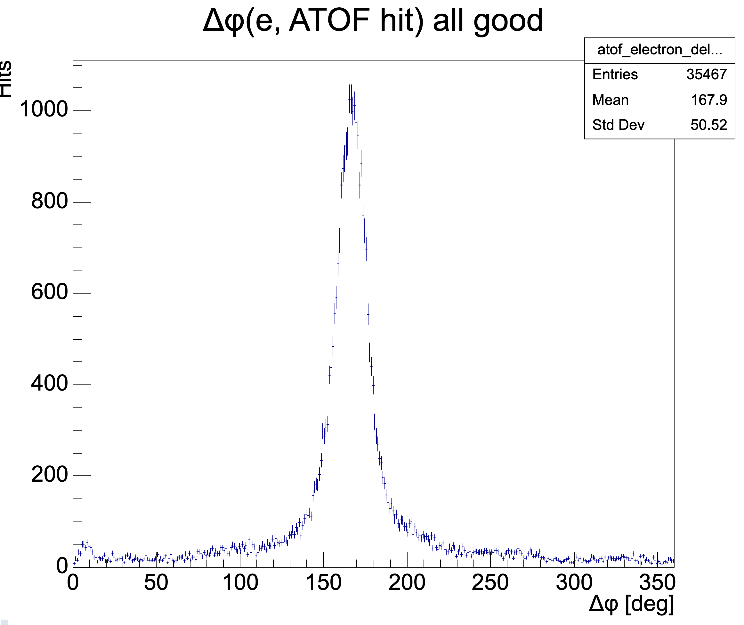
Track matching with AI: test on data
Use the ATOF cut to select good hits: ±3σ (cut given by Zhiwan/Noémie)

Slide 6
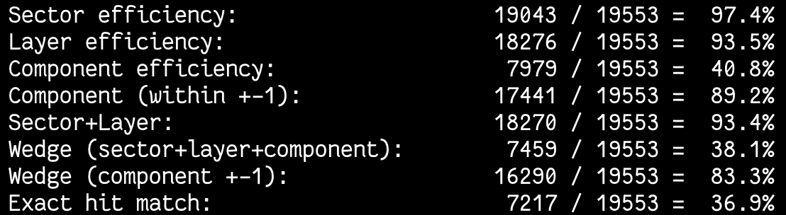
Track matching with AI: test on data
Tracks matched to electron (by ɸ):
AHDC tracks with Δɸ between 150-200° from the elastic electron
Good ATOF hits match to electron (by ɸ):
ATOF hits that pass the cut given by Zhiwan/Noémie (Δɸ between 150-200°)
Efficiencies for the proton:
Fix an off by one error in my code, need to check the track matching code in CJ

Slide 7
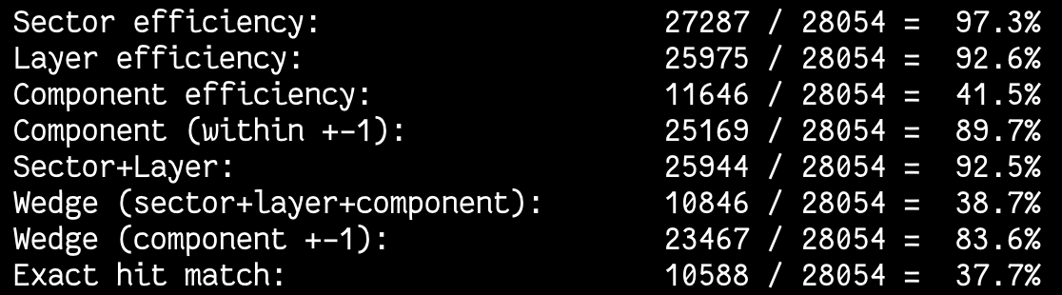
Track matching with AI: test on data
Efficiencies for the deuterium:

