Slide 1
Graph Neural Network for ALERT
Mathieu Ouillon (Mississippi State University)
04/06/26

Slide 2
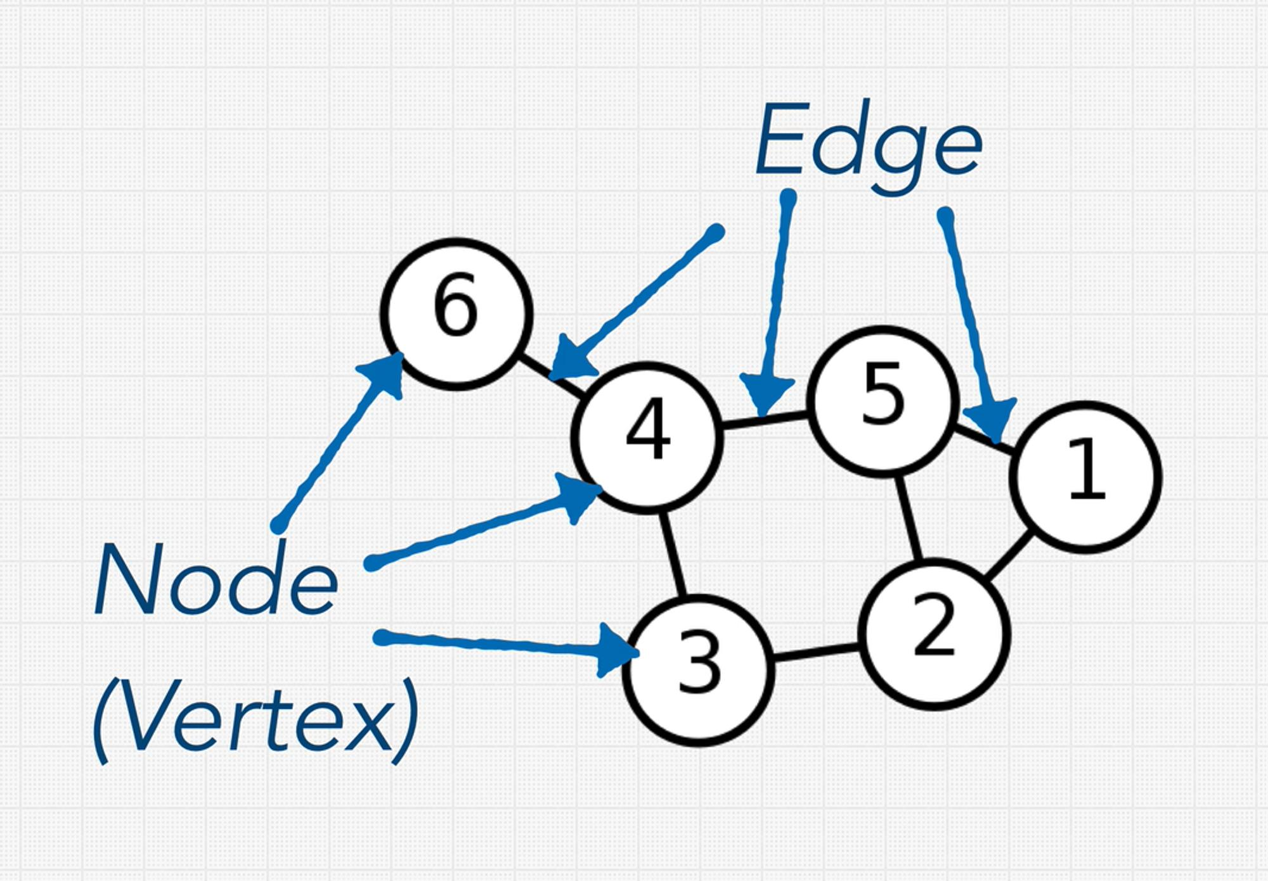
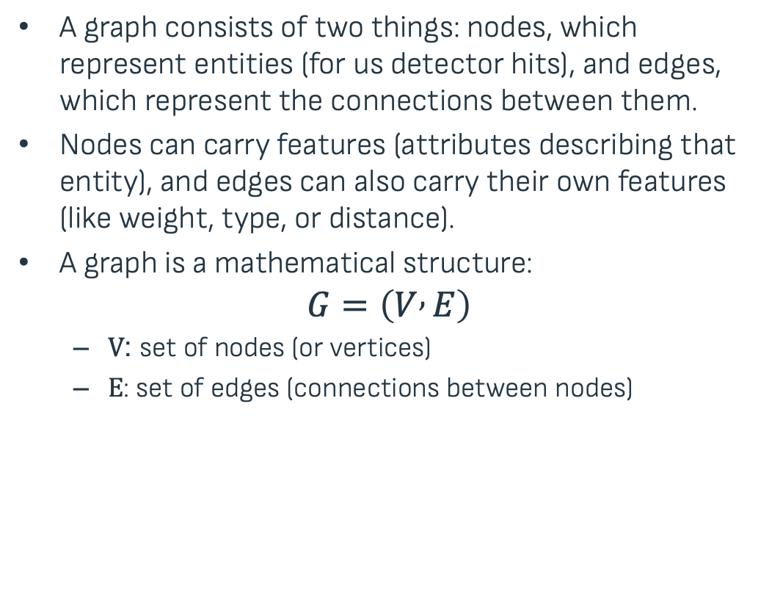
Introduction to Graph and Graph Neural Networks
A graph consists of two things: nodes, which represent entities (for us detector hits), and edges, which represent the connections between them.
Nodes can carry features (attributes describing that entity), and edges can also carry their own features (like weight, type, or distance).
A graph is a mathematical structure:
$$G=\left(V , E\right)$$
$V$: set of nodes (or vertices)
$E$: set of edges (connections between nodes)

Slide 3
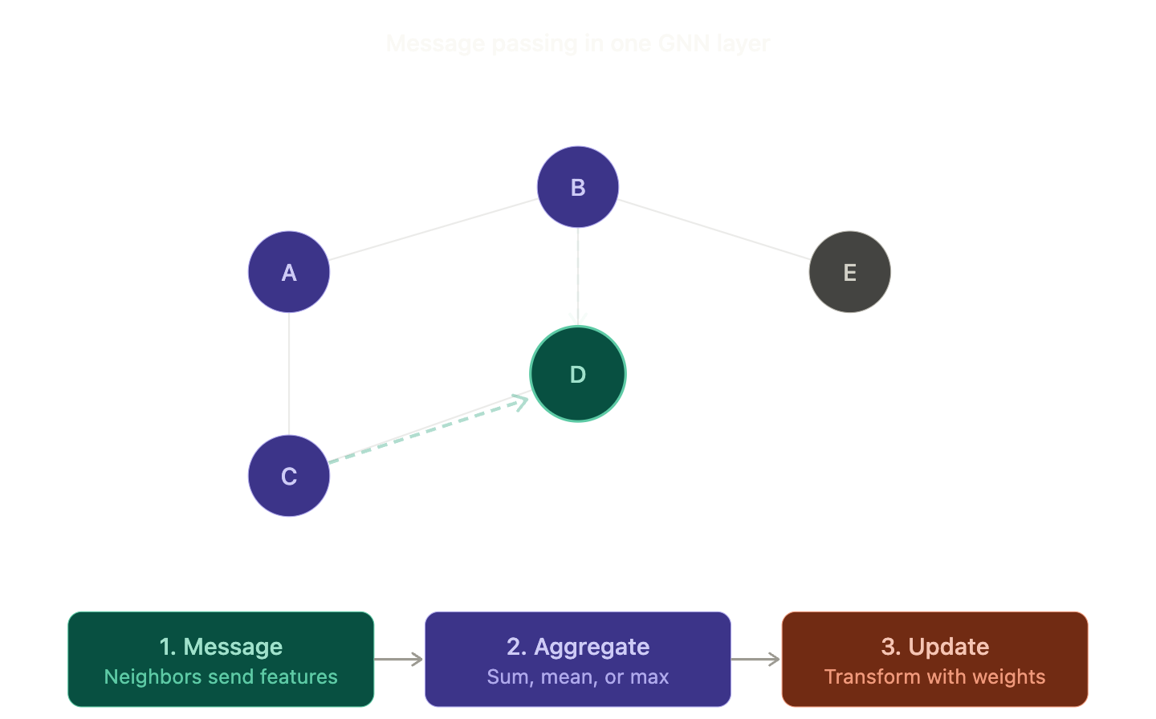
Why Graph Neural Networks for Track Finding?
Track finding = connecting detector hits into particle trajectories
Variable number of hits per event
No fixed ordering or regular grid structure
Relationships between hits are naturally graph-like
Traditional approaches struggle with this:
CNNs expect grid inputs (images)
MLPs expect fixed-size inputs
GNNs operate directly on graph structure via message passing
Each node gathers information from its neighbors
Learns both local hit correlations and global track structure

Slide 4
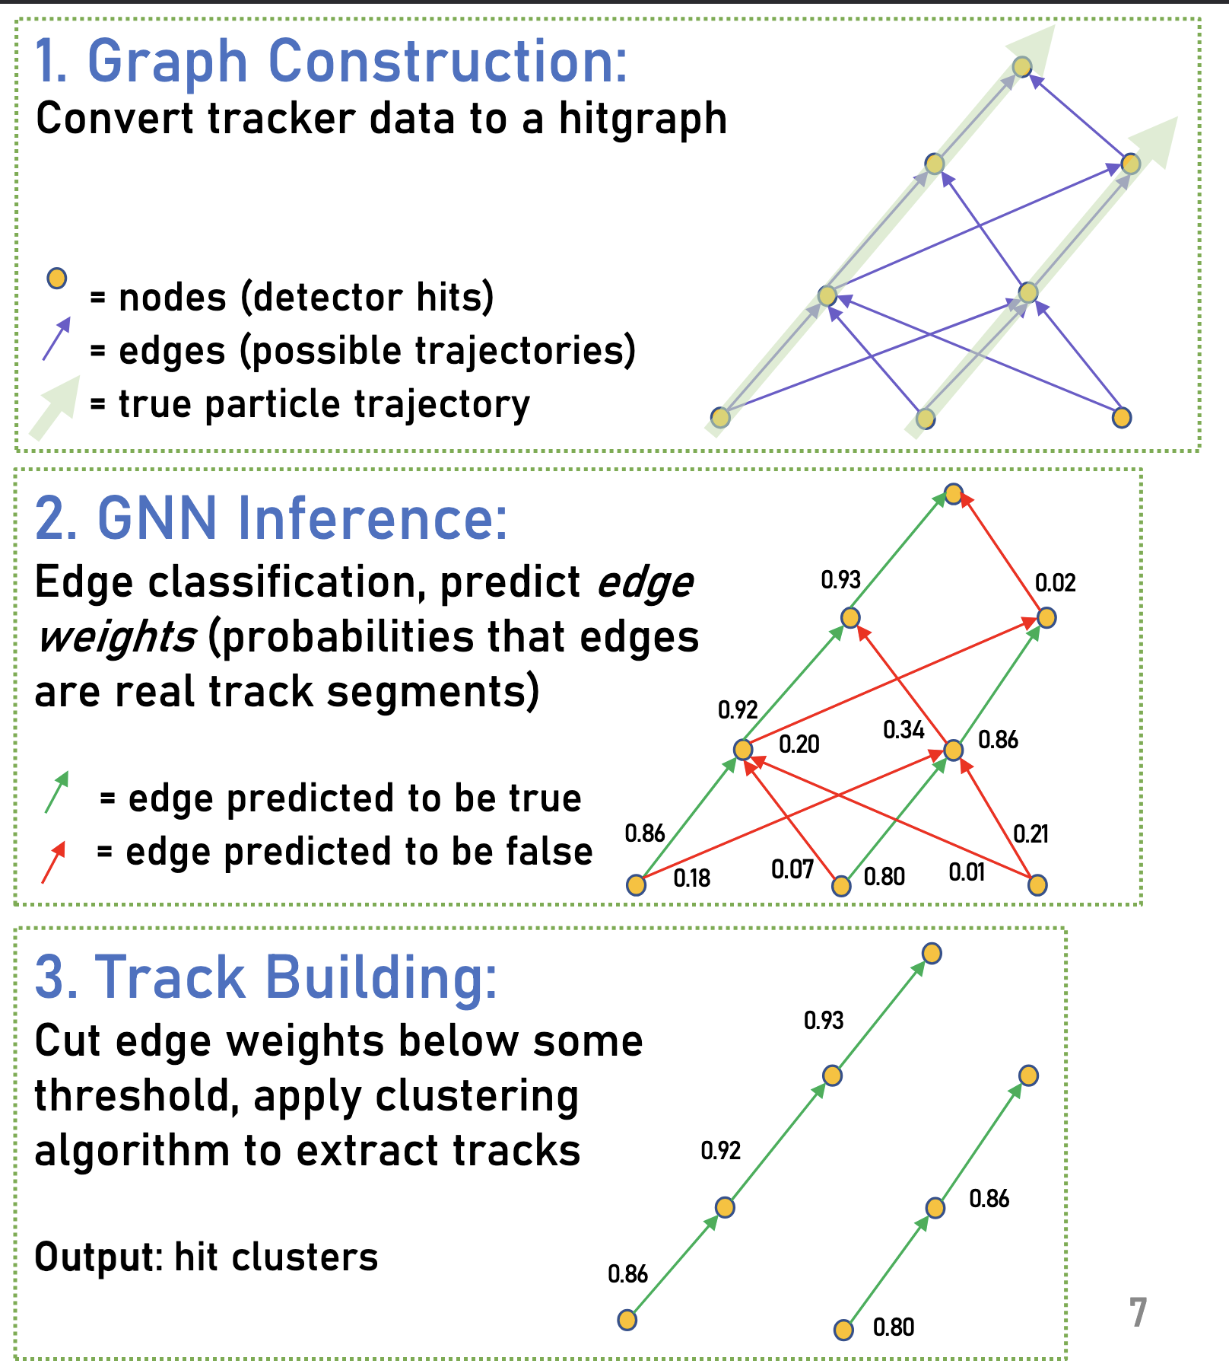
Track Finding with Graph Neural Networks (GNNs)
Edge Classification: Predict whether two hits belong to the same track
Pipeline:
Construct graph from hits using geometric constraints
Apply GNN
Threshold edges → reconstruct tracks
Optionally, perform post-processing to merge/split tracks
Advantages of GNNs
Learn both local hit correlations and global track structure
Can handle noise, missing hits, and variable hit densities

Slide 5
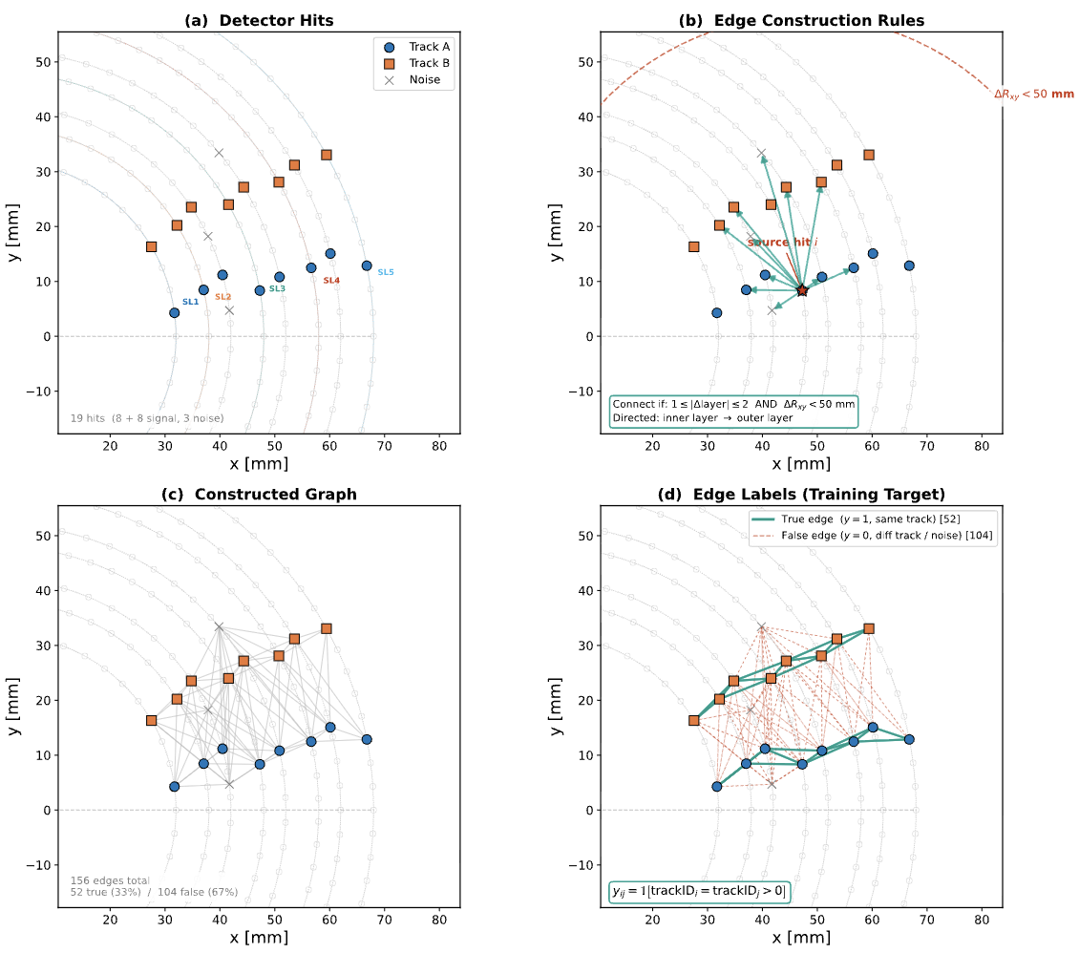
Track Finding as a Graph Problem
Idea: Represent hits and their relationships as a graph
Nodes = detector hits (AHDC + ATOF)
Edges = candidate connections between hits
Layer gap: 1-2 layers apart
Euclidean distance < 50 mm
Directed: inner layer to outer layer
Task: Classify each edge as same-track (1) or different-track (0)

Slide 6
Training setup
MC Sample used to build the same-track edge and add noise hits and multi-track events for the different-track edge
Use all light ions, flat distribution in momentum (0.05 to 1.5 GeV), φ, θ and Vz
1-5 tracks merged per event + 5-30 noise hits
Node features:
Position, stereo-angle
Edge features:
Δφ_{ij}, Δl_{ij}

Slide 7
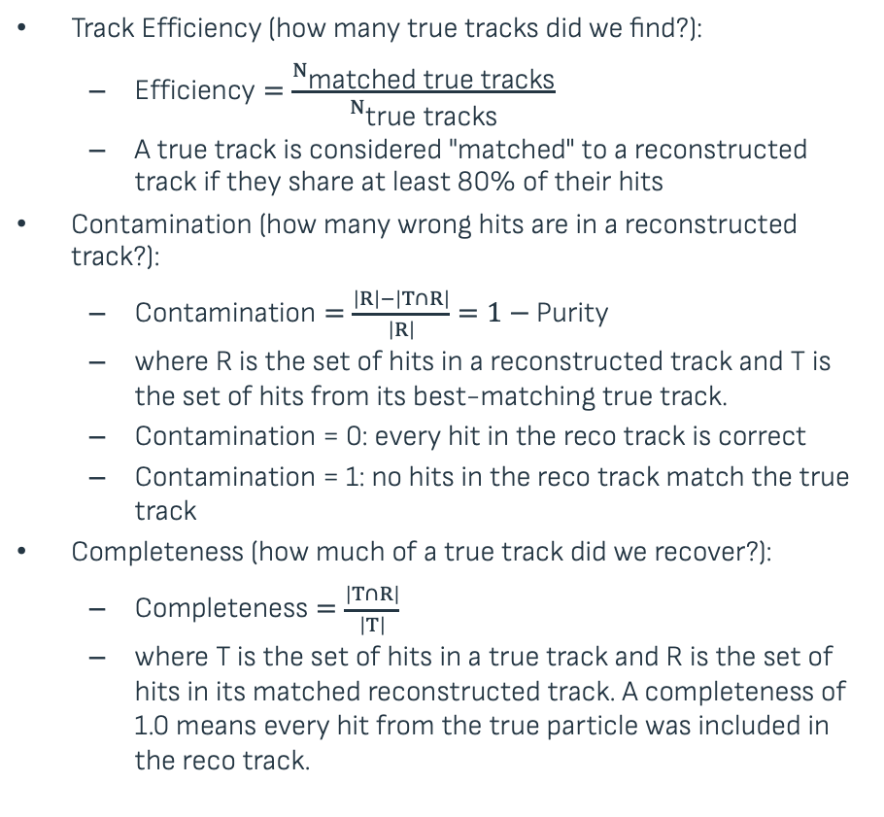
Evaluation on simulation
Track Efficiency (how many true tracks did we find?):
$\text{Efficiency}=\frac{N_{\text{matched} \text{true} \text{tracks}}}{N_{\text{true} \text{tracks}}}$
A true track is considered "matched" to a reconstructed track if they share at least 80% of their hits
Contamination (how many wrong hits are in a reconstructed track?):
$\text{Contamination}=\frac{\left|R\right|−\left|T∩R\right|}{\left|R\right|}=1−\text{Purity}$
where R is the set of hits in a reconstructed track and T is the set of hits from its best-matching true track.
Contamination = 0: every hit in the reco track is correct
Contamination = 1: no hits in the reco track match the true track
Completeness (how much of a true track did we recover?):
$\text{Completeness}=\frac{\left|T∩R\right|}{\left|T\right|}$
where T is the set of hits in a true track and R is the set of hits in its matched reconstructed track. A completeness of 1.0 means every hit from the true particle was included in the reco track.

Slide 8
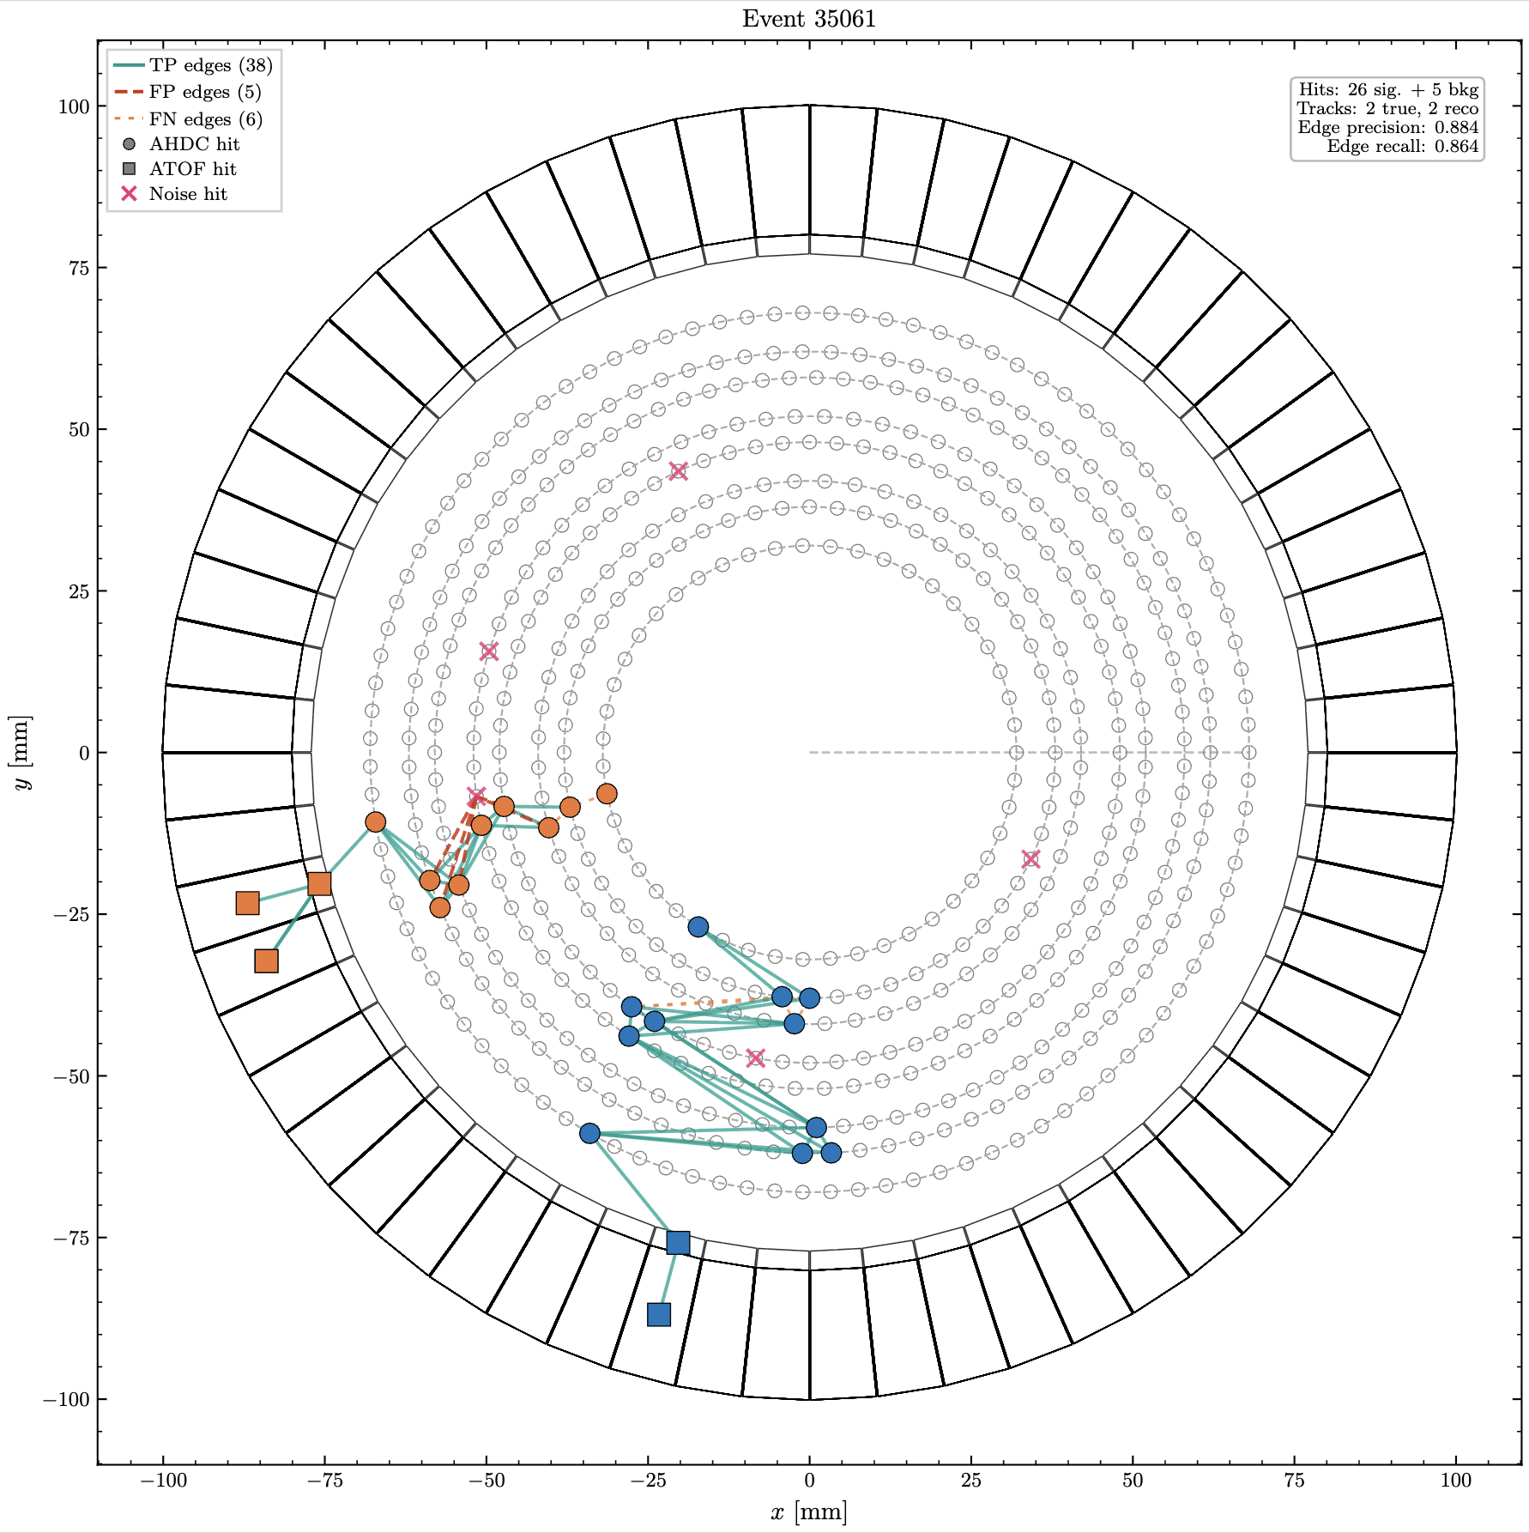
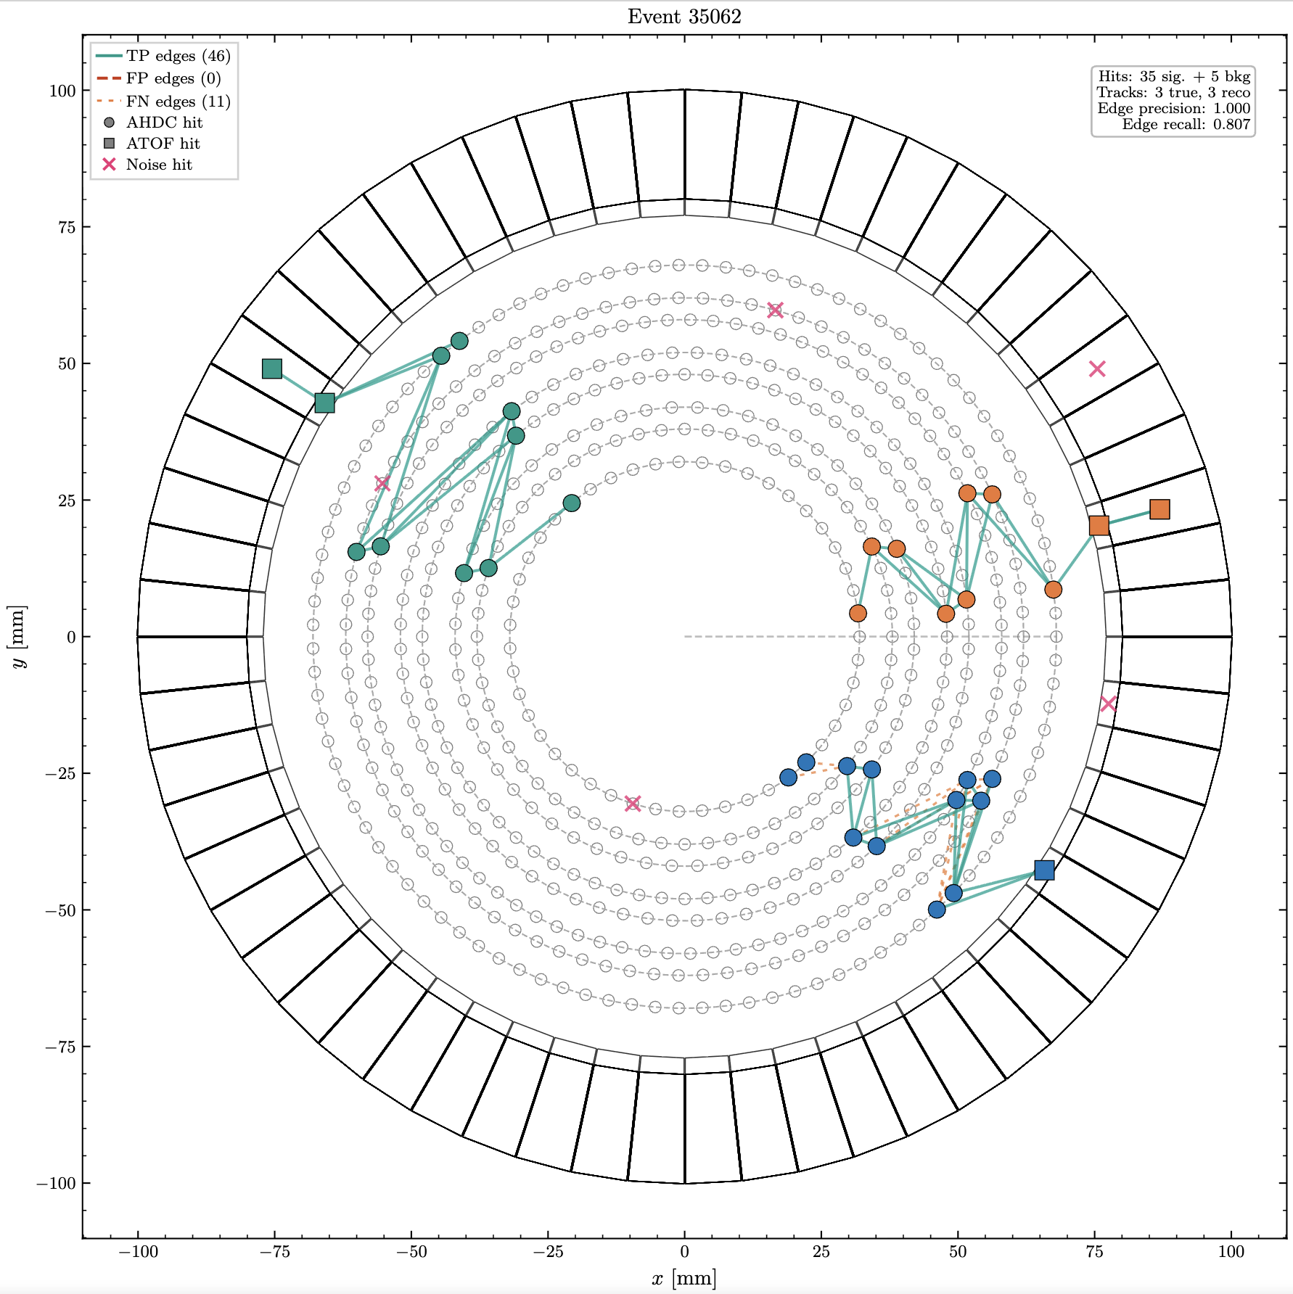
Event display

