Slide 1
Errors in the last cooking: Pass0 v10
During the last cooking (Pass0v10, first try) we got two errors:
java.lang.NullPointerException: Cannot load from double array because "timeOffsets" is null
at org.jlab.rec.atof.hit.ATOFHit.convertTdcToTime(ATOFHit.java:204)
at org.jlab.rec.atof.hit.ATOFHit.<init>(ATOFHit.java:417)
at org.jlab.rec.atof.hit.HitFinder.findHits(HitFinder.java:92)
at org.jlab.service.atof.ATOFEngine.processDataEvent(ATOFEngine.java:106)
at org.jlab.clas.reco.ReconstructionEngine.filterEvent(ReconstructionEngine.java:368)
at org.jlab.clas.reco.ReconstructionEngine.execute(ReconstructionEngine.java:407)
java.lang.IndexOutOfBoundsException: Index 0 out of bounds for length 0
at java.base/jdk.internal.util.Preconditions.outOfBounds(Preconditions.java:100)
at java.base/jdk.internal.util.Preconditions.outOfBoundsCheckIndex(Preconditions.java:106)
at java.base/jdk.internal.util.Preconditions.checkIndex(Preconditions.java:302)
at java.base/java.util.Objects.checkIndex(Objects.java:385)
at java.base/java.util.ArrayList.get(ArrayList.java:427)
at org.jlab.rec.ahdc.Track.Track.<init>(Track.java:61)
at org.jlab.service.alert.ALERTEngine.processDataEvent(ALERTEngine.java:349)

Slide 2
Errors in the last cooking: Pass0 v10
It was related to how the CCDB table were loaded:
Some tables needs 3 indexes, some needs 4
All the tables (for the ATOF and AHDC) were loaded in both the engines, with different number of indexes
Found other issues:
CSTLOADED flag prevented constants from reloading. All runs after the first silently used stale calibration data.
After loading constants, ATOFEngine never updated its Run field, causing incorrect calibration lookups.
Static HashMap fields were shared across engine instances without synchronization, a race condition problem.
The fix:
Remove CalibrationConstantsLoader and its static table. Engines now fetch IndexedTable references directly from ConstantsManager and pass them to consumer code.
Simplify calibration access: consumer code (HitReader, ATOFHit, BarHit) queries IndexedTable directly via getDoubleValue("column", sector, layer, component). No manual key encoding, no intermediate maps
Separate AHDC/ATOF table requirements: each engine's init() now only registers its own detector's CCDB tables
Fix in the already merged PR: 1200

Slide 3
Graph Neural Network for ALERT
Mathieu Ouillon (Mississippi State University)
04/13/26

Slide 4
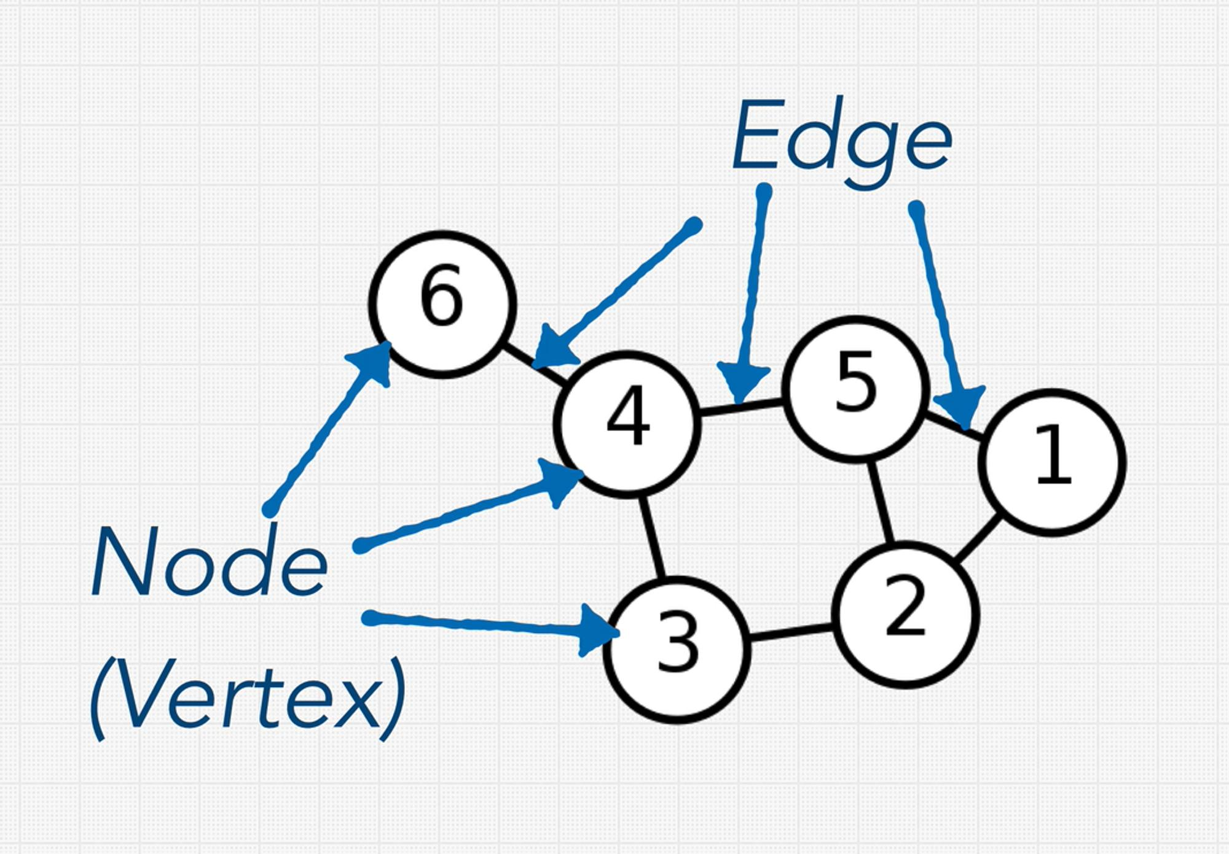
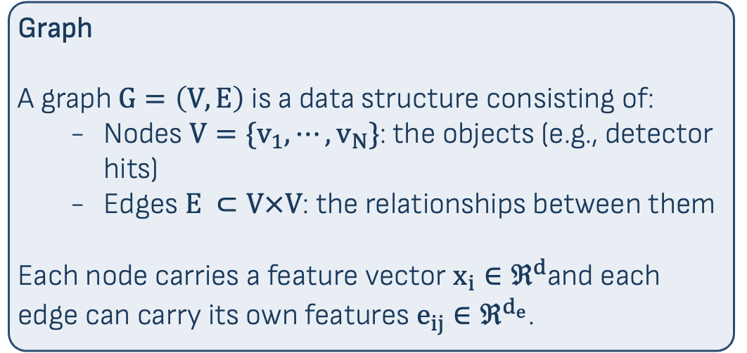
Introduction to Graph and Graph Neural Networks
Graph
A graph $G=\left(V,E\right)$ is a data structure consisting of:
Nodes $V={\{v}_{1},⋯,v_{N}\}$: the objects (e.g., detector hits)
Edges $E ⊂V×V$: the relationships between them
Each node carries a feature vector $x_{i}∈ℜ^{d}$and each edge can carry its own features $e_{ij}∈ℜ^{d_{e}}$.
Why graphs for detectors?
- Hits are an unstructured point cloud. Not a grid (CNN) nor a sequence (RNN)

Slide 5
What Is a Graph Neural Network?
Graph Neural Network (GNN)
A neural network that operates on graph-structured data, learning node representations by aggregating information from neighboring nodes in a permutation-invariant way.
Why not a regular MLP/CNN/RNN?
Expects a fixed-length input vector
Needs an external candidate generator: bringing combinatorial explosion
CNN needs fixed size image (grids)
RNN assume the data has a sequential structure. Hits within a single event have no natural ordering: any permutation of the hit list describes the same physics
What does a GNN output?
Node level: a vector per hit (node classification, regression)
Edge level: a score per pair (our task: same track or not)
Graph level: one vector for the entire event (jet tagging, event classification)
Every GNN is built from one fundamental operation: message passing

Slide 6
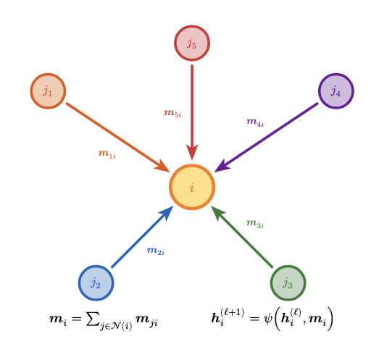
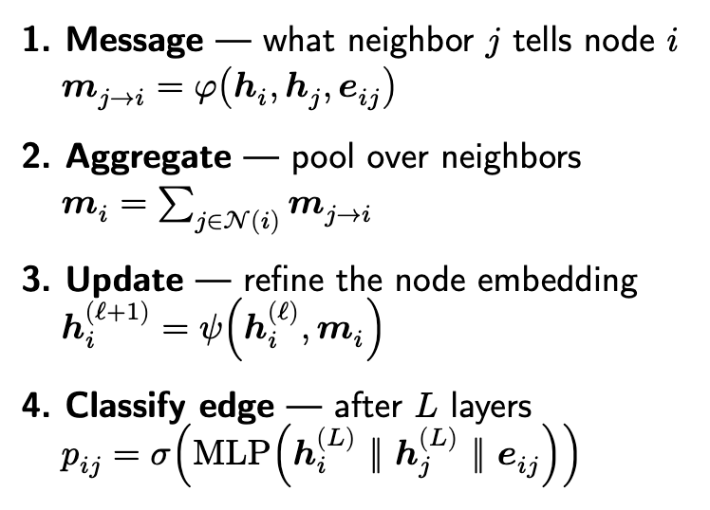
Message Passing: The Core of GNNs
Message Passing
At each GNN layer ℓ, every node collects information
from its neighbors, aggregates it, and updates its own
representation. After 𝐿 layers, each node encodes
information from its 𝐿-hop neighborhood.

Slide 7
GNN Architectures for Physics
Architecture | Key Idea | Use Case
GCN | Symmetric neighbor averaging D̃⁻½ Ã D̃⁻½ | Node classification
GAT | Learned attention coefficients αᵢⱼ per neighbor | Adaptive weighting
Interaction Net | Separate edge MLP φₑ + node MLP φᵥ, iterated | Track finding (Exa.TrkX)
EdgeConv | Dynamic kNN rebuilt in feature space each layer | Jet tagging (ParticleNet)
GravNet | Learned kNN in coordinate space + Gaussian weights | ← This work
All architectures share the same message-passing skeleton. They differ in how messages are computed
and which neighbors participate.

Slide 8
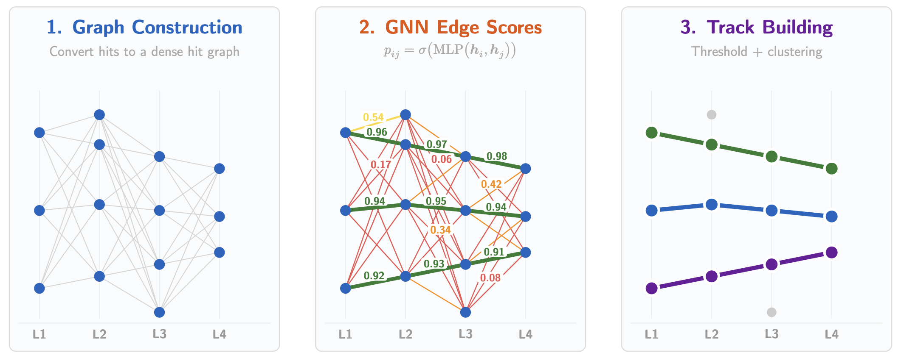
Edge Classification for Track Finding
The GNN assigns a score e_{𝑖𝑗} ∈ [0, 1] to every edge, indicating the probability that hits 𝑖 and 𝑗 belong to the same particle track. High-scoring edges are kept; connected components in the surviving graph become track candidates.
The GNN transforms a dense candidate graph (left) into clean track candidates (right) by scoring each edge and keeping only the survivors.

Slide 9
Graph Construction
Node Features (10D)
Each detector hit becomes a node with:
layer index, 𝜑, 𝑟 (normalized), stereo angle, wire
midpoint (𝑥, 𝑦, 𝑧), wire direction (𝑢_{𝑥}, 𝑢_{𝑦}, 𝑢_{𝑧})
Training Data
To simulate multi-track events:
– Merge 1–5 single-track events into one event
– Inject 5–30 noise hits
– 1M events: 75% train / 12.5% val / 12.5% test
Edge Features (8D)
Δ𝜑, layer gap, 𝑧₁, 𝑧₂, 𝑟₁, 𝑟₂, Δstereo, same-detector flag
Edge Labels
An edge is positive (𝑦 = 1) if both hits share the same
MC particle track ID.
Noise hits (track_id = −1) produce only negative
edges.
Edge Construction
Two hits are connected if:
1. Destination is 1–2 layers outward (directed)
2. Euclidean distance < 35 mm in (𝑥, 𝑦) plane

Slide 10
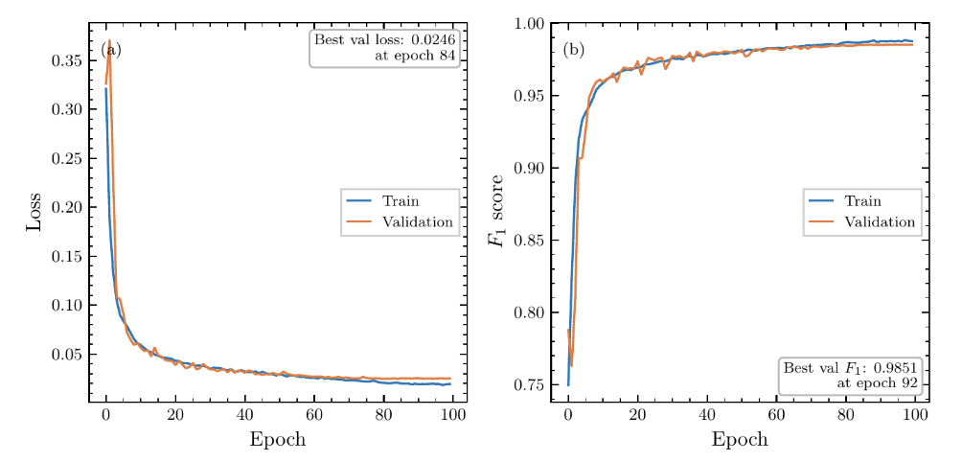
Training
Focal Loss
Down-weights easy examples, focuses on hard edges:
ℒ︀ = −(1 − 𝑝∗)𝛾 log(𝑝∗) with 𝛾 = 1
Hard-Negative Mining
Geometrically close false edges (the hardest to reject) receive exponentially higher loss weights: For each false edge (𝑖, 𝑗), compute a closeness score 𝑐_{𝑖𝑗} from its raw geometry, then scale its loss contribution by 𝑤𝑖𝑗 = exp(𝛼 ⋅ 𝑐𝑖𝑗)
- Close (hard) fakes → large 𝑤, big gradient
- Far (easy) fakes → small 𝑤, tiny gradient
This focuses the model on the decision boundary.
Best validation F1 = 0.985 at epoch 92. Train and validation curves track closely: no overfitting.
– AdamW, lr = 5 × 10−4, weight decay 10−4
– 5-epoch warmup → cosine annealing
– 100 epochs, batch 64, fp16 mixed precision

Slide 11
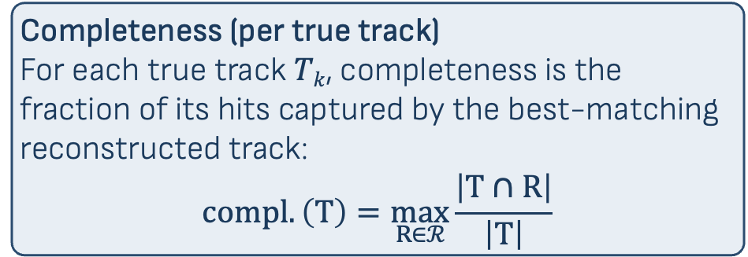
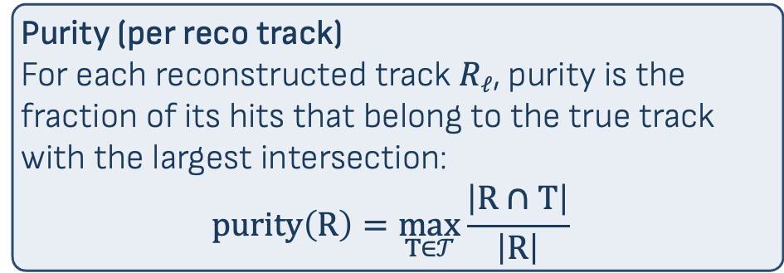
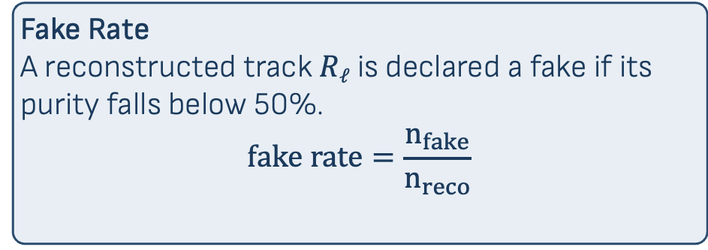
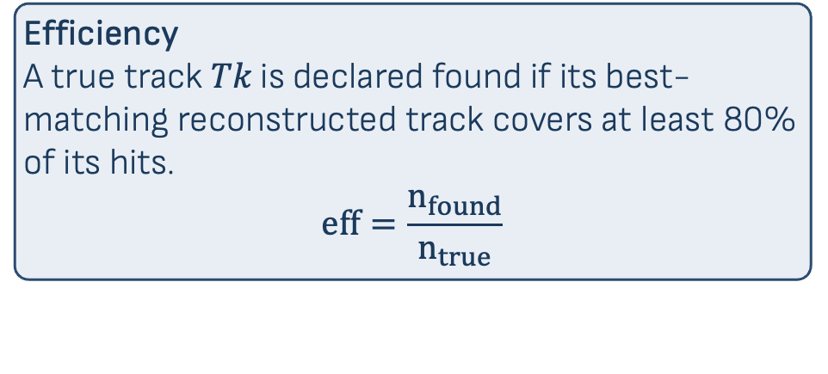
Track-Level Metric Definitions
Let 𝒯 = {T₁, ..., T_{ntrue}} be the set of true tracks (MC truth hit sets) and ℛ︀ = {R₁, ..., R_{nreco}} be the set of reconstructed tracks (connected components from thresholded edge scores). All metrics are defined in terms of hit-set overlaps |R ∩ T|.
Purity (per reco track)
For each reconstructed track 𝑅_{ℓ}, purity is the fraction of its hits that belong to the true track with the largest intersection:
$$\operatorname{purity}\left(R\right)=\max_{T∈𝒯}{\frac{\left|R∩T\right|}{\left|R\right|} }$$
Efficiency
A true track 𝑇𝑘 is declared found if its best-matching reconstructed track covers at least 80% of its hits.
$$eff=\frac{n_{found}}{n_{true}}$$
Completeness (per true track)
For each true track 𝑇_{𝑘}, completeness is the fraction of its hits captured by the best-matching
reconstructed track:
$$\operatorname{compl}{.\left(T\right)}=\max_{R∈ℛ}{\frac{\left|T∩R\right|}{\left|T\right|}}$$
Fake Rate
A reconstructed track 𝑅_{ℓ} is declared a fake if its purity falls below 50%.
$$fake rate=\frac{n_{fake}}{n_{reco}}$$

Slide 12
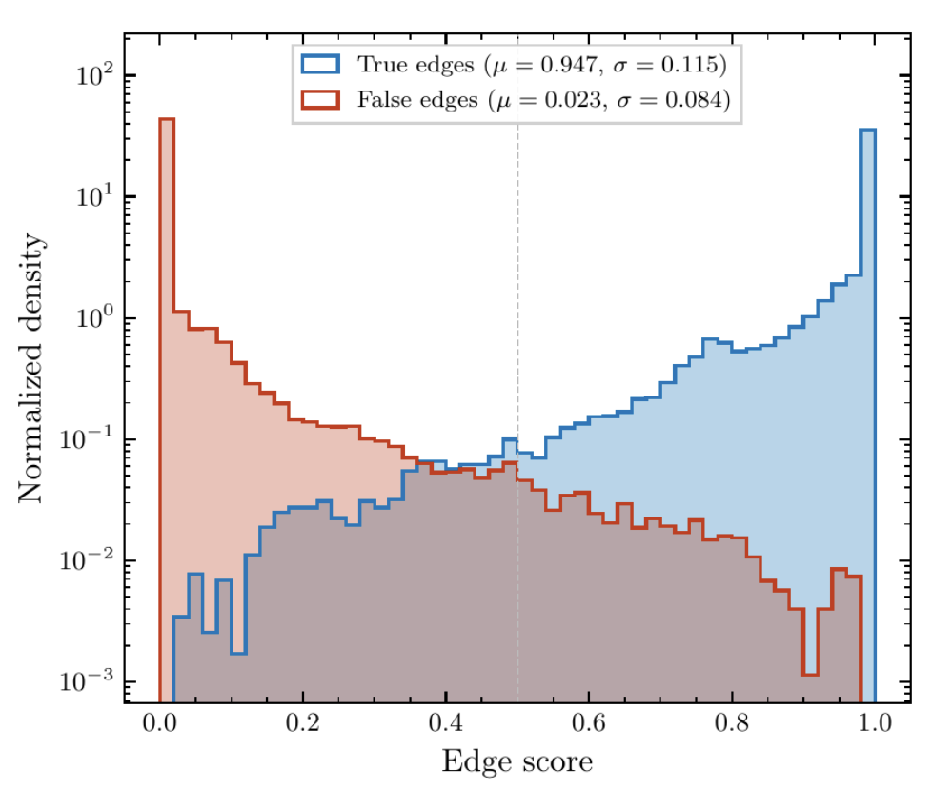
Edge Score Separation
Clean Separation
– True edges: 𝜇 = 0.947, 𝜎 = 0.115
– False edges: 𝜇 = 0.023, 𝜎 = 0.084
– 4 orders of magnitude density contrast in the tails
The small central overlap at scores ∼ 0.3–0.5 is where the classifier is genuinely uncertain: this is what drives the residual fake rate/contamination.

Slide 13
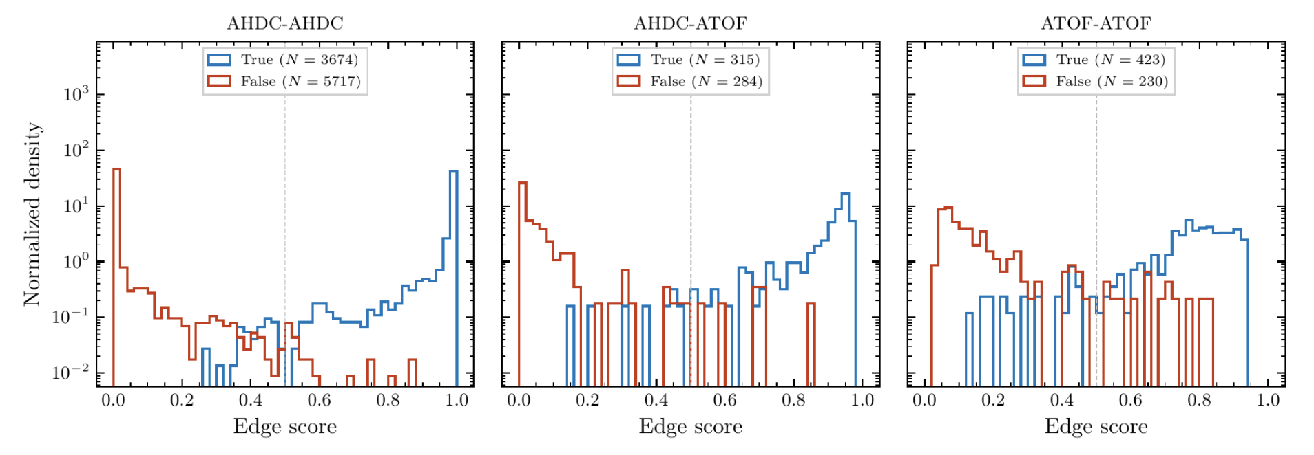
Edge Scores by Detector Region
AHDC–AHDC (𝑁 ≈ 9400): cleanest separation, dominates training signal.
AHDC–ATOF and ATOF–ATOF: rarer (𝑁 ≈ 600 each), noisier

Slide 14
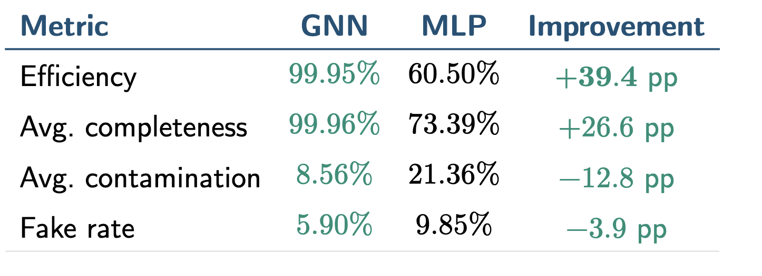
GNN vs MLP: Track-Level Performance
N_{events} = 2823, N_{true} = 5704 true tracks.
GNN threshold = 0.1, MLP threshold = 0.2.
The GNN finds nearly every true track while producing fewer fake candidates than the MLP.

Slide 15
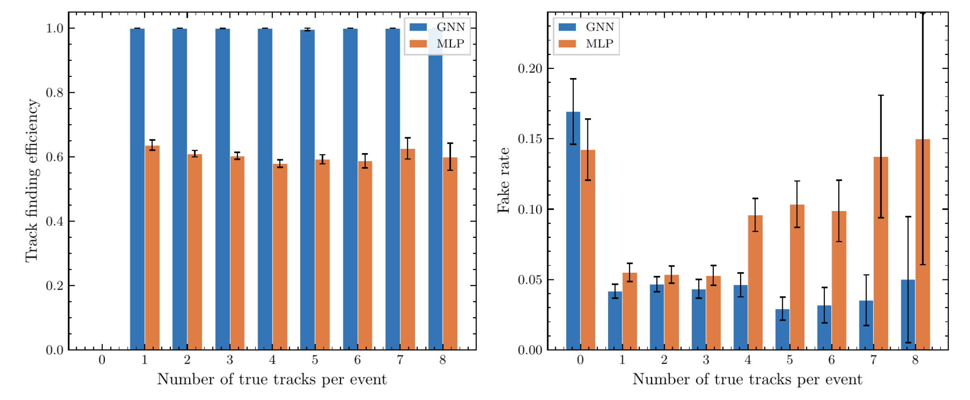
Robustness: Efficiency & Fake Rate vs Multiplicity
GNN: flat at 100% efficiency from 1 to 8 tracks/event. MLP: stuck at ∼ 60% regardless.
GNN fake rate stays 3–5% while MLP climbs to 10–15% at high multiplicity.

Slide 16
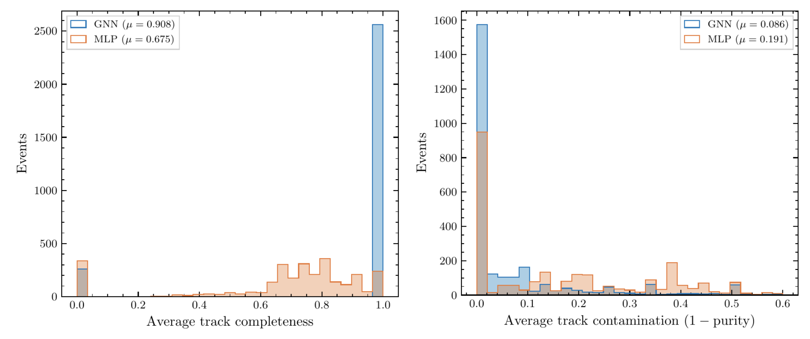
Robustness: Efficiency & Fake Rate vs Multiplicity
GNN: sharp spike at completeness = 1 (𝜇 = 0.908) and contamination ≈ 0 (𝜇 = 0.086).
MLP: broad distributions, many partially reconstructed or contaminated tracks.

Slide 17
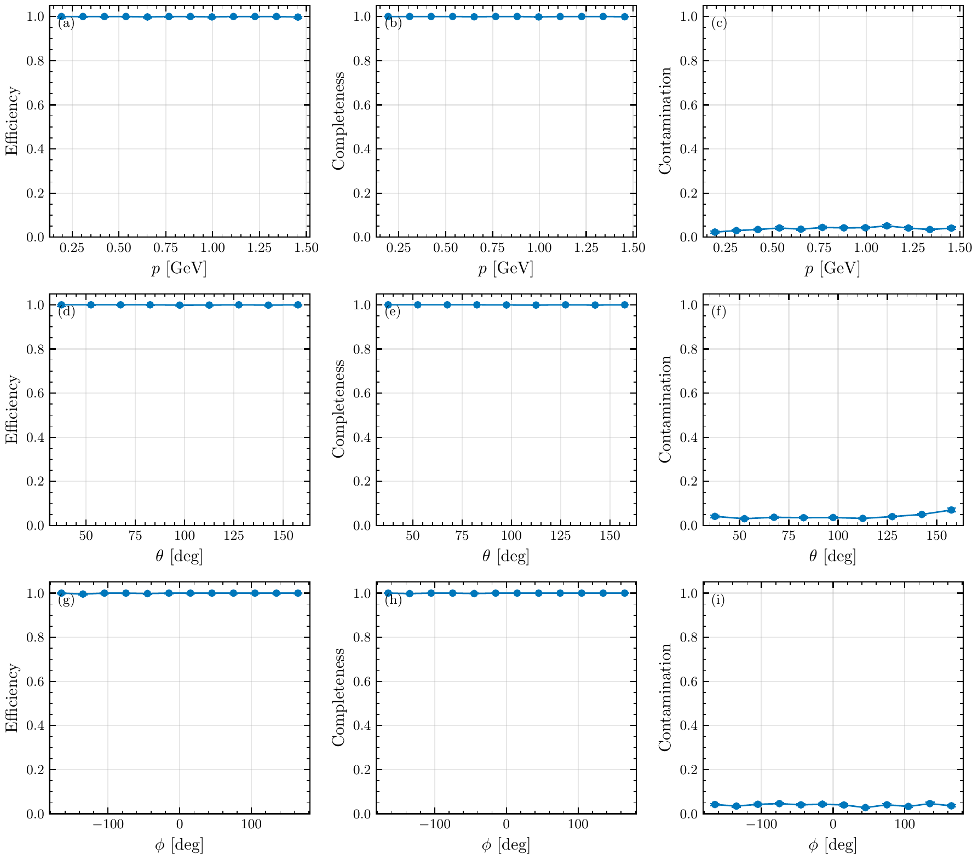
Kinematic Uniformity
Efficiency, completeness, and contamination are flat across momentum 𝑝, polar angle 𝜃, and azimuth 𝜑

Slide 18
Outlook & Next Steps
I have tested a new method for track finding and track matching:
Can replace both networks with only one
Work at the hit level not clusters
99.95% efficiency with 5.9% fake rate
Performance is uniformly flat across multiplicity (1-8 tracks), noise level, and kinematics (𝑝, 𝜃, 𝜑)
Next steps:
Integration with coatjava
Validation on real CLAS12 data
Hyperparameter optimization (Optuna)
Measure inference time and compare to MLP

