Slide 1
Graph Neural Network for ALERT
Mathieu Ouillon (Mississippi State University)
04/27/26

Slide 2
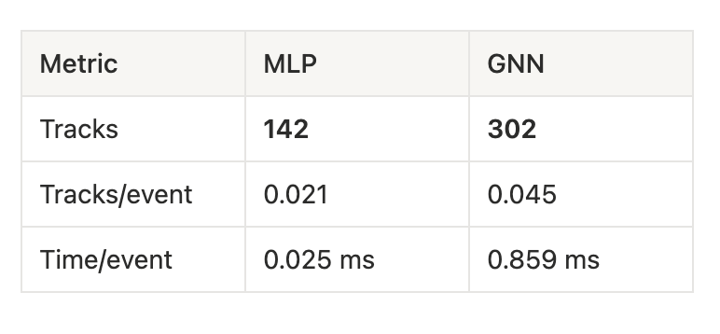
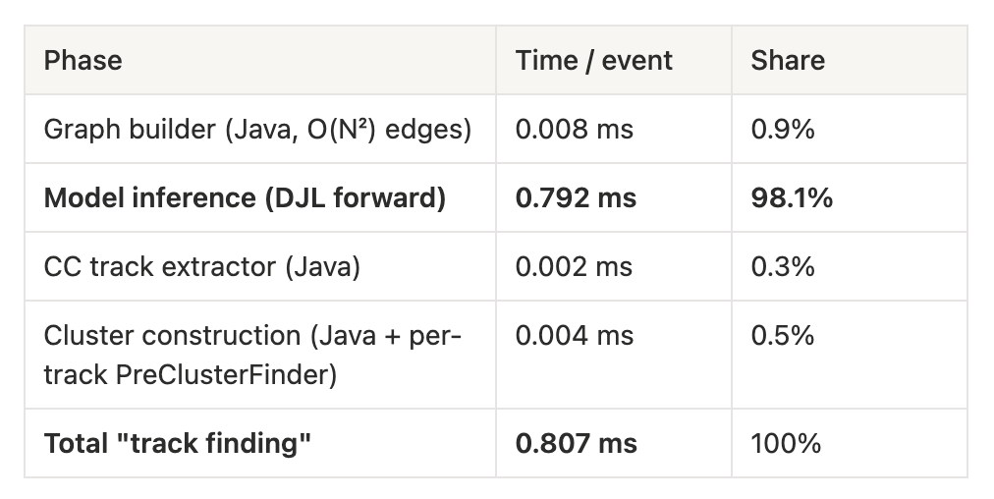
GNN vs MLP: Inference speed
Compare the inference speed of GNN vs MLP in COATJAVA:
Tested on clas_021903.evio.00000 with 10k events. (325 nA 10676.6 4He )
MLP is faster on small event, but GNN is still fast.
A full event take around ~500ms so GNN is 0.16%
Most of the time for the GNN is the model inference. I try smaller models but the efficiency on simulation was lower.

Slide 3
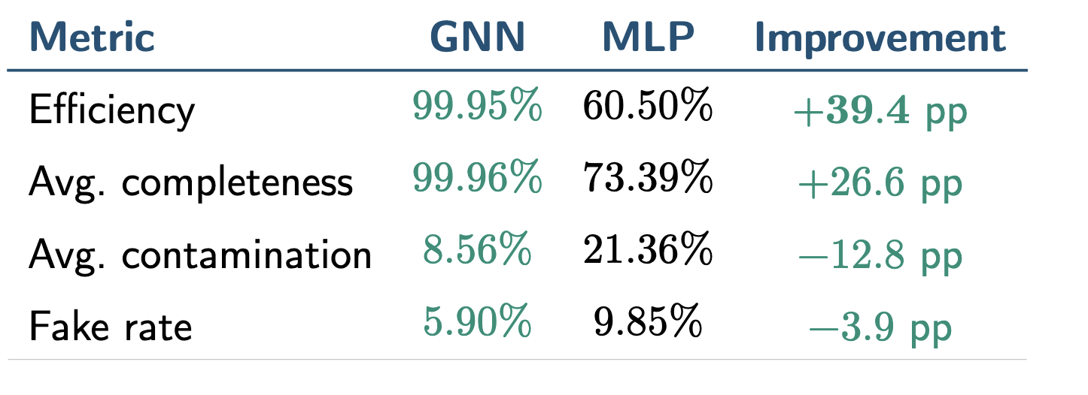
GNN vs MLP: Performance on simulation
N_{events} = 2823, N_{true} = 5704 true tracks.
GNN threshold = 0.1, MLP threshold = 0.2.
The GNN finds nearly every true track while producing fewer fake candidates than the MLP.

Slide 4
GNN vs MLP: Performance on elastic data
The goal is to test GNN and MLP on elastic data: use D2 data (full run) at 2.23 GeV
Select elastic electron with cut on Vz and W:

Slide 5
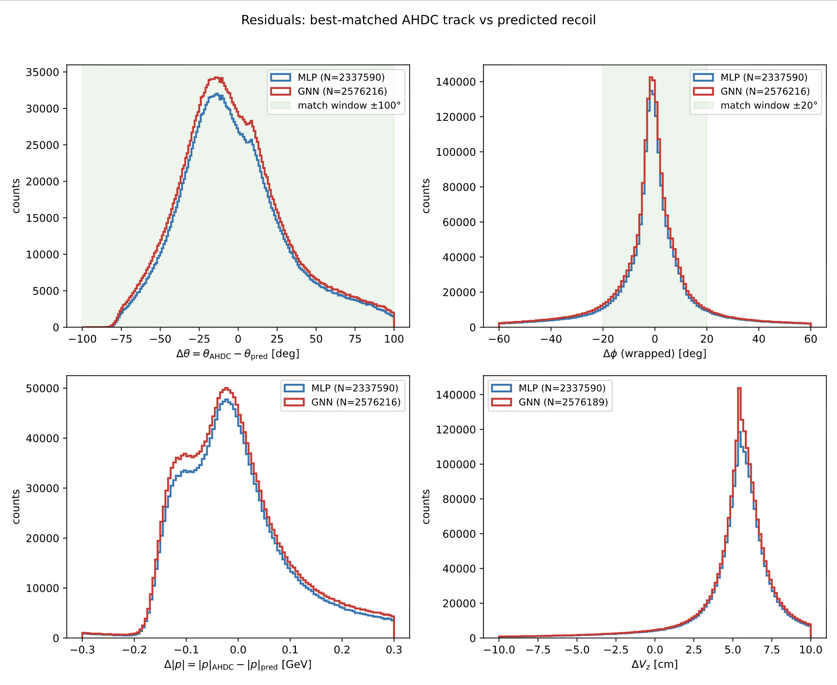
GNN vs MLP: Performance on elastic data
Look at the kinematics of the track found by MLP and GNN:
- A track is match when both angular residuals are inside the matching windows
- GNN found more tracks that pass the Helix fitter than MLP
- With no specific phase space

Slide 6
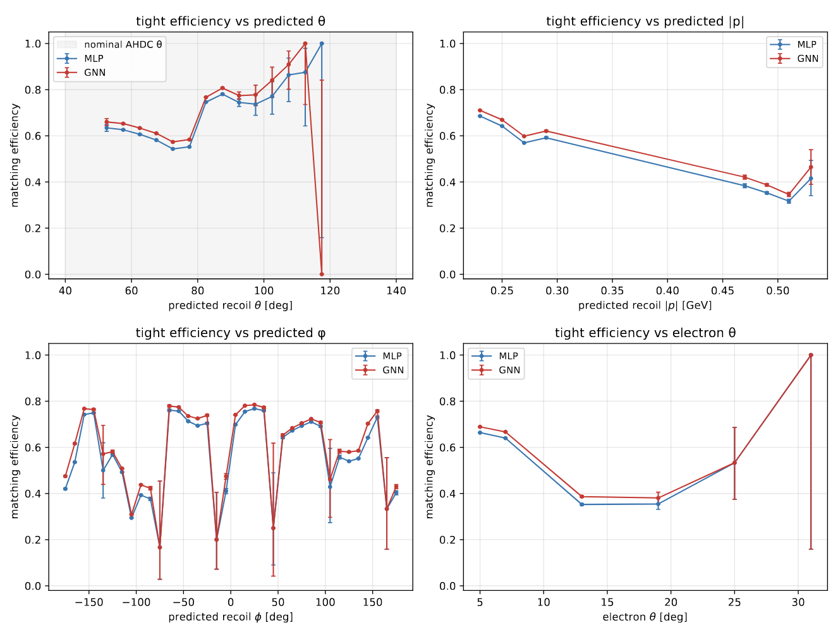
GNN vs MLP: Performance on elastic data
Can compute the efficiency: - Tight track-finding efficiency (denom: elastic & in fiducial & 7 hits in 7 layers within ±30° of predicted)

Slide 7
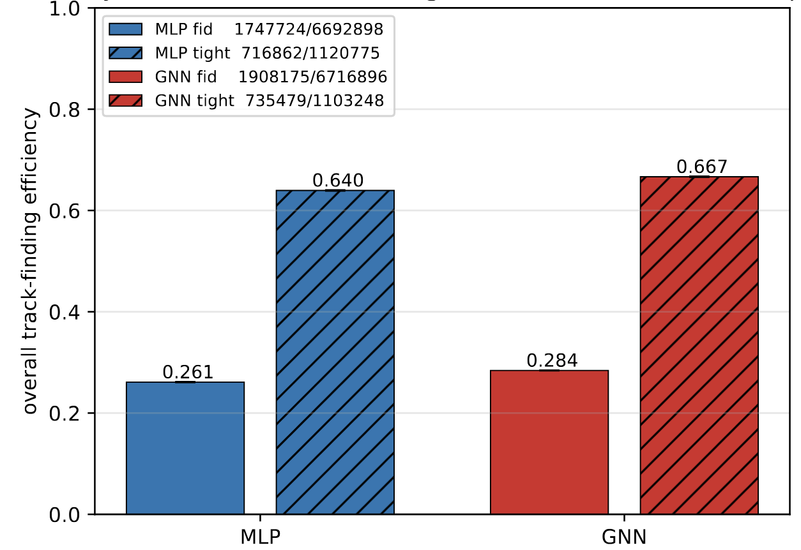
GNN vs MLP: Performance on elastic data
Can compute the efficiency:
- Tight track-finding efficiency (denom: elastic & in fiducial & 7 hits in 7 layers within ±30° of predicted )

Slide 8
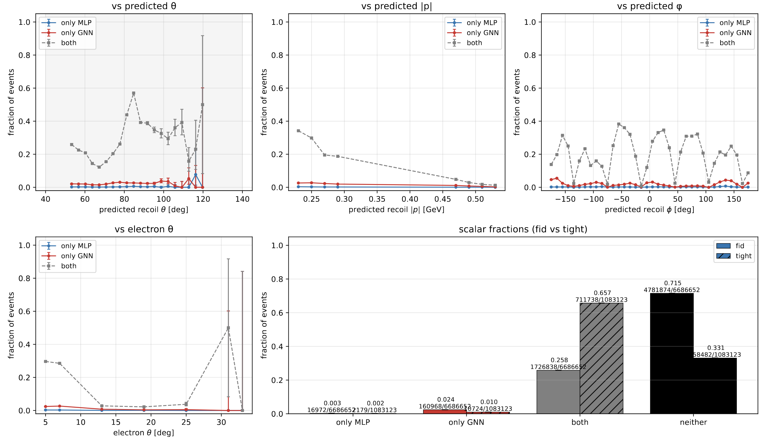
GNN vs MLP: Performance on elastic data
Look at disagreement plot:
Most of the tracks are found by both
No kinematics dependence
In the neither, it is probably mostly detector efficiency

Slide 9
Summary
Still preliminary work:
Efficiency: track finding efficiency ⨉ detector efficiency ⨉ helix fitter efficiency
GNN find more tracks
GNN is a bit slower, but no significantly (0.16% of a standard reconstruction time)
GNN have advantages:
Work at the hit level, so no clustering
Find tracks compose of AHDC and ATOF hits
Find more tracks (the difference in efficiency is probably higher in event with higher multiplicity, see simulation)

